Slide 1
Functional data methods for Accelerometer data
Jeff Goldsmith, PhD
Columbia Biostatistics

Slide 2
Disclaimer
Plan is to cover a lot of ground
  Give an overview of thought process, not technical details
  Close on what I’d like to work on

Slide 3
Acknowledgements
Xinyue Liu, Judith S. Jacobson, Andrew Rundle
Joseph E. Schwartz
Daniel Backenroth, Taki Shinohara
Julia Wrobel, Vadim Zipunnikov, Jennifer Schrack
R21EB018917, R01NS097423-01, R01HL123407, R01NS085211, R21NS93349, R01NS060910, R01MH112847, others …
Columbia Center for Children’s Environmental Health
Masked Hypertension Study
The Baltimore Longitudinal Study of Aging, an Intramural Study of the National Institute on Aging.

Slide 4
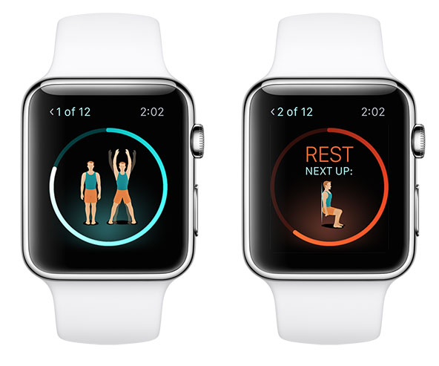
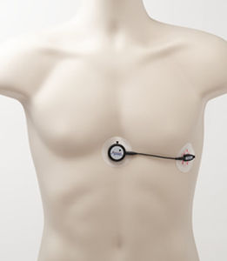
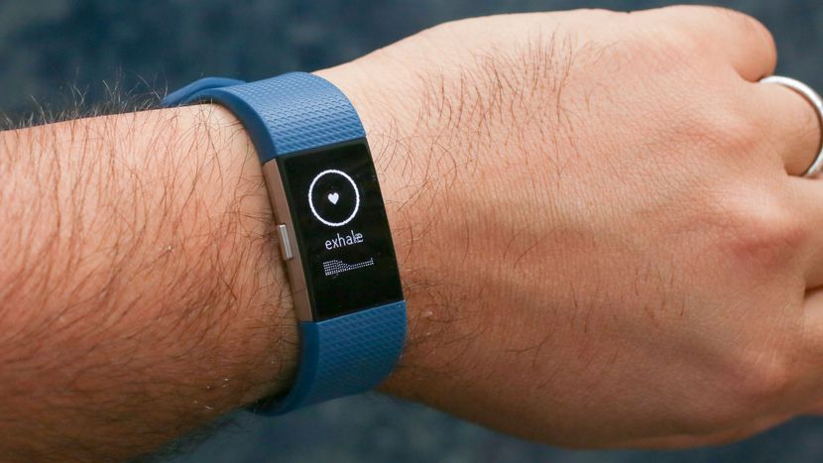

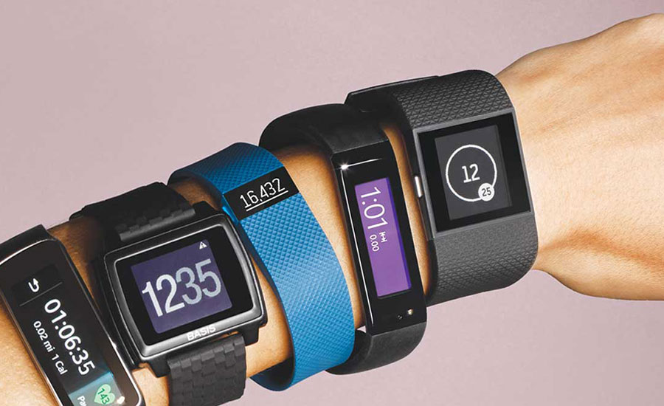

Wearable devices

Slide 5
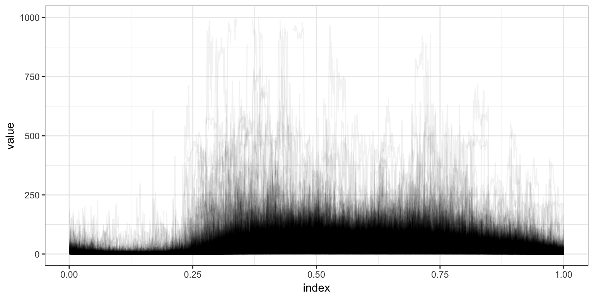
Data produced

Slide 6
Functional data analysis
My preference
Tentative definition for functional data:
Observations on subjects that you can imagine
as X_{i}(t_{i}), where t_{i} is continuous
Functional notation is conceptual; observations are made on a finite discrete grid (“intensely longitudinal data”)
Domain is shared across subjects, e.g. 0 < t < 1
Works for wearable device data

Slide 7
Functional data analysis
Given this framework, we want to “do statistics”
  Define mean and covariance, for example
For this talk, I’ll focus on two major problems:
  Function-on-scalar regression
  Dimension reduction

Slide 8
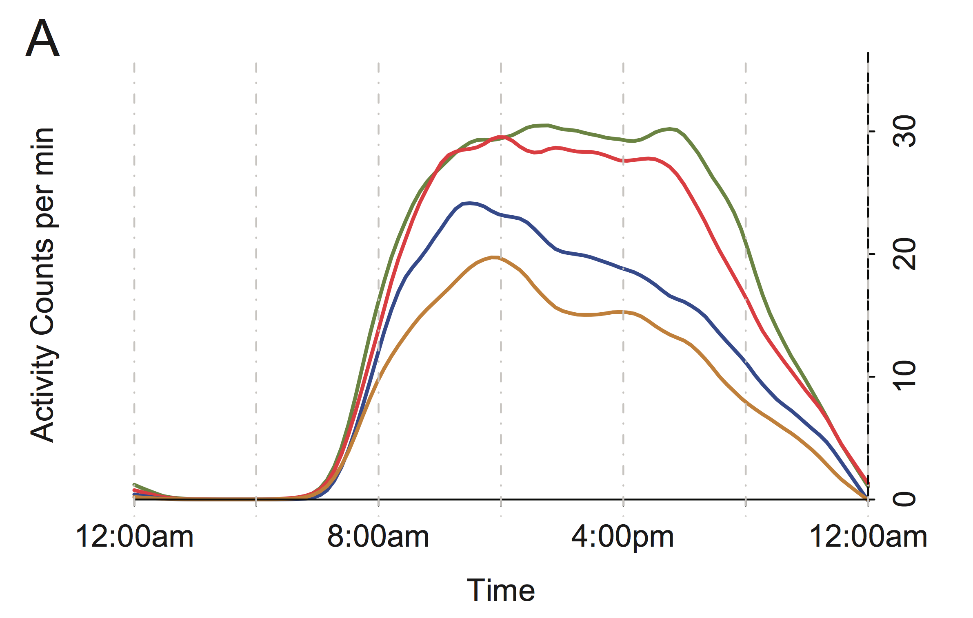
Function-on-scalar regression: motivation
J. A. Schrack, V. Zipunnikov, J. Goldsmith, J. Bai, E. M. Simonsick, C. M. Crainiceanu, L. Ferrucci (2014). Assessing the “Physical Cliff”: Detailed Quantification of Aging and Physical Activity. Journal of Gerontology: Medical Sciences, 69 973-979.

Slide 9
Questions to address
Association?
Confounding?
Significance?

Slide 10
Data for FoSR
420 kids recruited from HeadStart centers
Accelerometer worn on the non-dominant hand
Attached with a hospital band
Worn for five days, although we average across days
Covariates include child demographics (age, sex, BMI), behaviors (TV, video games), mother demographics, and season

Slide 11
Initial analyses
Reduced to minute-level data to single number summaries
Analyzed using MLR
Found several associations of interest

Slide 12
Issue with initial analyses
Reduced to minute-level data to single number summaries

Slide 13
Our goal
Model covariate effects on diurnal activity patterns

Slide 14
How do we deal with that?
Outcome is a curve
Everything else should be too
Interpretations stay the same
becomes

Slide 15
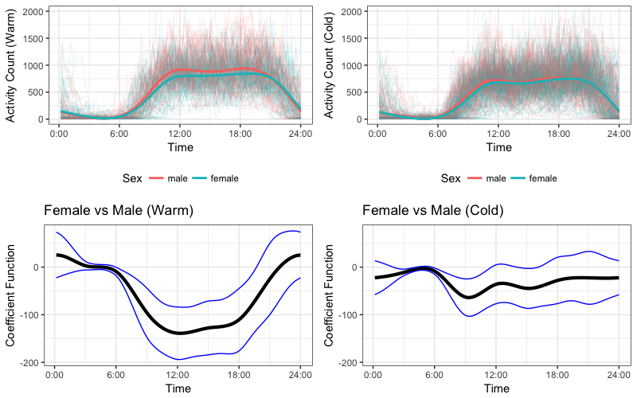
Results

Slide 16
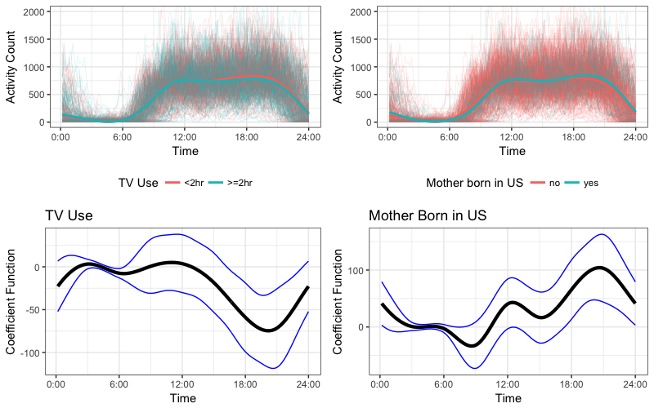
Results

Slide 17
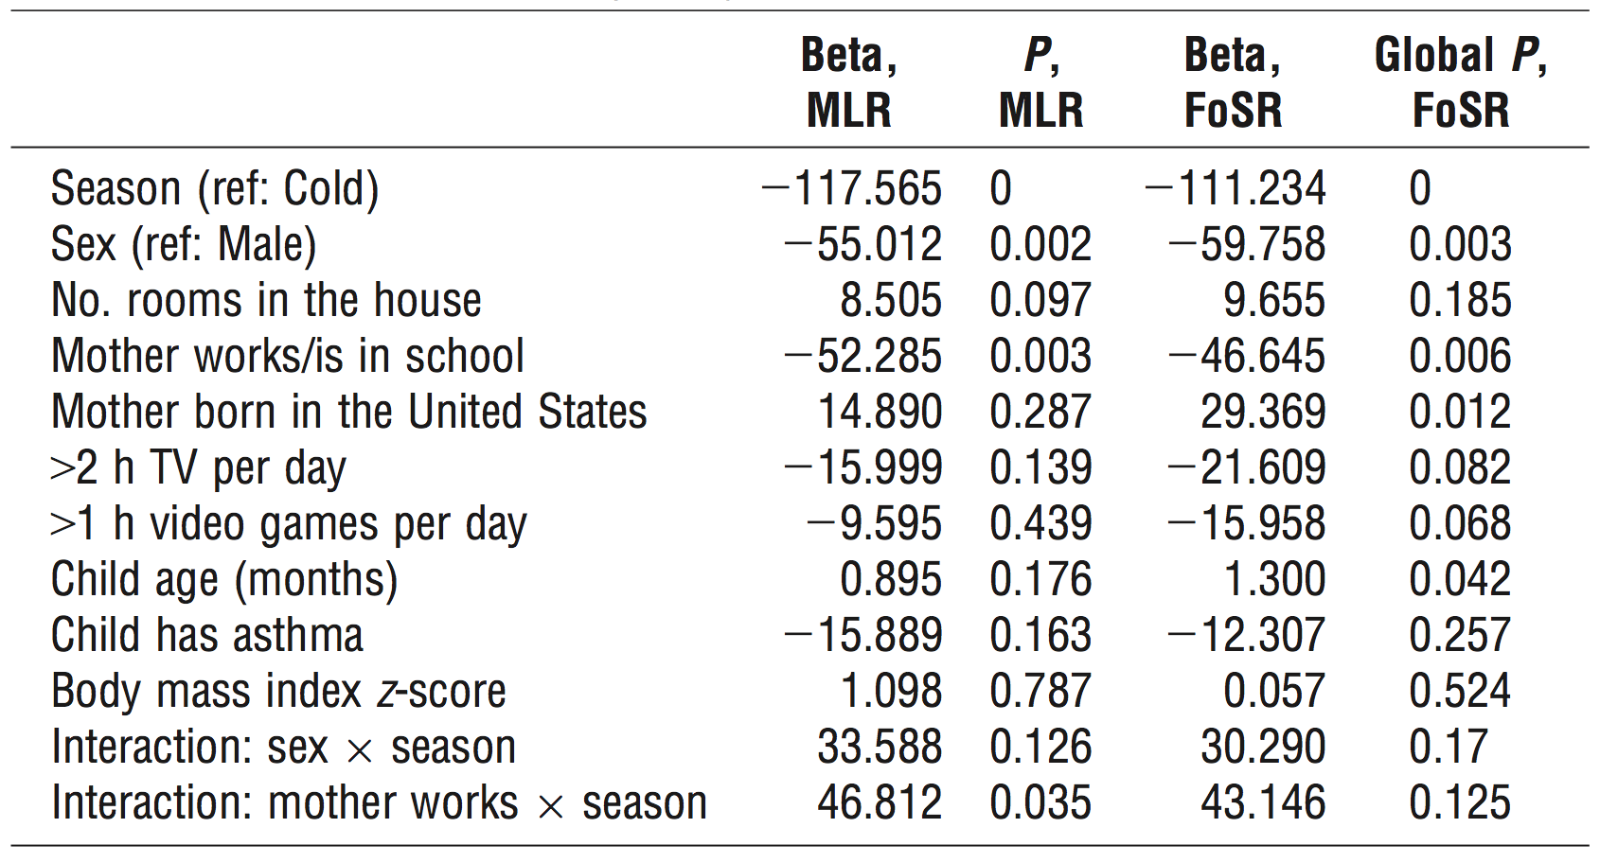
MLR vs FoSR

Slide 18
Dimension reduction
Accelerometer data (and other wearable device data) is complex and high-dimensional
It’d be great to extract some interpretable, low-dimensional structure from these data
Usual approaches (e.g. PCA) won’t naturally account for temporal structure
Two One idea
  NARFD
  GFPCA

Slide 19
Data (you’ve seen this before)

Slide 20
NARFD
Non-negative and Regularized Functional Decomposition (NARFD)
Borrow from non-negative matrix factorization:
  Decompose curves into non-negative prototypes, non-negative scores
  Reconstruct curves through addition
  Makes a lot of sense for count data from accelerometers
Incorporate smoothness / functional approach into the NMF framework

Slide 21
Model
Generative model for Poisson data:
Note:
  No population mean
  Functional prototypes and scores are non-negative
  Subject-level mean is constructed through addition

Slide 22
Data for Dimension Reduction
BLSA data:
  592 subjects; five days of observation, averaged across days
  10-minute epochs (for computational reasons)
  Prototypes / FPCs estimated using periodic B-splines with 25 basis functions

Slide 23
BLSA: Estimated Prototypes
Five estimated prototypes / FPCs

Slide 24
What do I want to work on?
More of this, if there’s reason to
Maybe also scalar outcomes and predictors from accelerometer data?
Always software

Slide 25


Software
refund
refund.shiny
tidyfun
(cheer::cheer)

Slide 26
Thanks!
jeff.goldsmith@columbia.edu
jeffgoldsmith.com
github.com/jeff-goldsmith/

