Slide 1

Districting Problems:
Models, Algorithms, and Research Trends
Roger Z. Ríos
Graduate Program in Systems Engineering
Universidad Autónoma de Nuevo León
http://pisis.fime.uanl.mx/
CMO – BIRS Workshop
Modern Techniques in Discrete Optimization:
Mathematics, Algorithms and Applications
Oaxaca, Mexico 04 November 2015

Slide 2
Agenda
Territory design/districting background
Example:
  Commercial territory design
Modeling framework
Solution algorithms
  Exact
  Heuristics
Research trends

Slide 3
Background: Territory design/districting
Data
Node → Basic unit (BU)
BU location (coordinates)
BU activity
p territories
Generic problem specification
The objective is to find a p-partition of a given set of basic units (BUs) that optimizes a performance measure subject to specified planning criteria.

Slide 4
Background: Territory design/districting
Districting problems vs. Clustering problems
Districting problems vs. Location problems
Application-Oriented

Slide 5
Background: Applications
Political districting
  Hess et al. (1965)
  Garfinkel and Nemhauser (1970)
  Hojati (1988)
  Ricca and Simeone (1997)
  Mehrotra et al. (1998)
  Bozkaya, Erkut, and Laporte (2003)
Sales territory design
  Hess and Samuels (1971)
  Shanker et al. (1975)
  Zoltners (1979)
  Zoltners and Sinha (1983)
  Fleischmann and Paraschis (1983)
  Drexl and Hasse (1999)
Service territory design
  Easingwood (1973)
  Marlin (1981)
  Blais et al. (2003)
School districting
  Palermo et al. (1977)
  Ferland and Guénette (1990)
Waste recollection
  Muyldermans et al. (2002)
  Hanafi et al. (1999)
  Fernández et al. (2010)
Commercial territory design
  Ríos-Mercado and Fernández (2009)
  Salazar-Aguilar et al. (2011,2012)

Slide 6
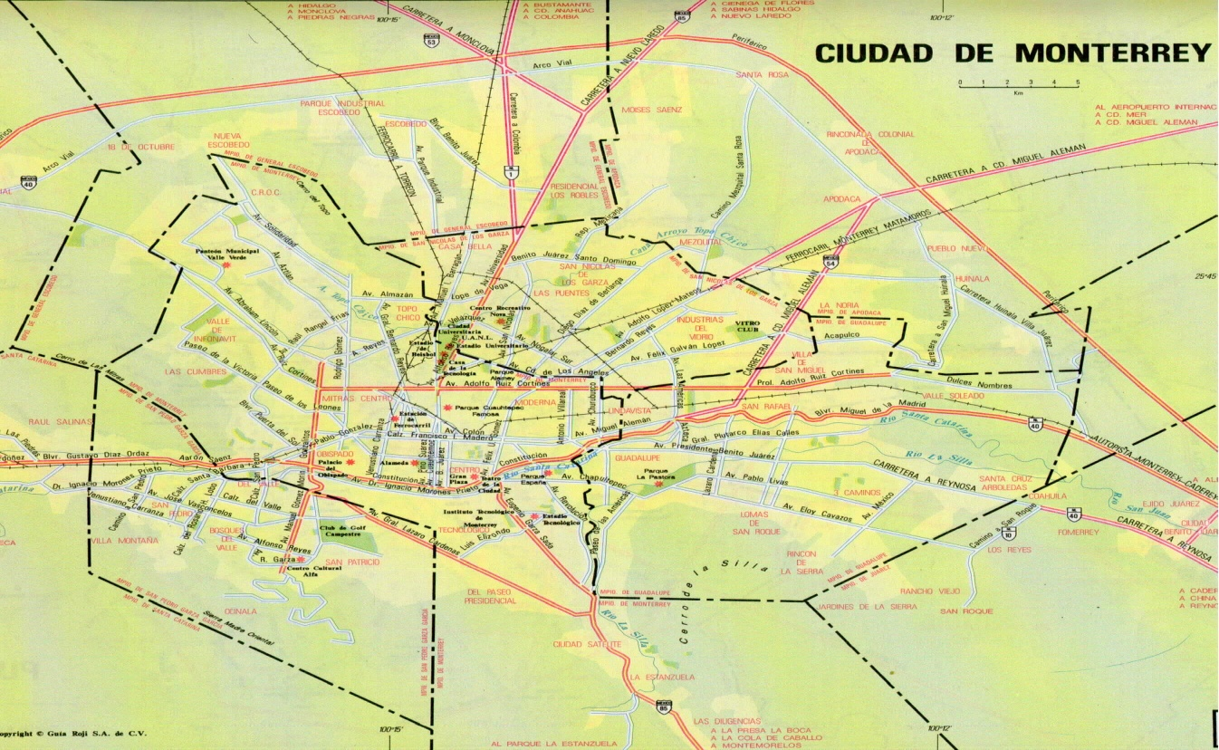
Example B: Commercial territory design
Ríos-Mercado & Fernández (2009)
w(j,a) = weight of activity a in unit j
d(i,j) = Euclidean distance between units i and j

Slide 7
Example B: Commercial territory design (cont’d)
Objective: Partition territory into commercial districts
Fixed number of districts (p)
Territory balance (multiple node activities)
  Demand
  Number of customers
  Workload
Connectivity
Compactness

Slide 8
Example B: Illustrating connectivity
9
12
V₂
5
11
7
8
2
5
6
2
14
7
V₁
11
9
13
8
11
10
V₃
Unconnected
territories

Slide 9
Example B: Modeling balancing
9
12
V₂
Modeling balance
Goal for average demand
:= ( ∑ w_{j} ) / p
:= 150 / 3 = 50
where
w_{j} := demand at node j
p := number of territories (= 3)
τ := Tolerance parameter (= 0.10)
5
11
7
8
2
5
6
2
14
Territory size w(V)
Territory is balanced if
(1- τ)μ ≤ w(V_{j}) ≤ (1+ τ)μ
45 ≤ w(V_{j}) ≤ 55
7
11
9
13
8
11
V₁
10
In this example:
w(V₁) = 37 [Unbalanced]
w(V₂) = 38 [Unbalanced]
w(V₃) = 75 [Unbalanced]
V₃

Slide 10
Example B: Modeling balancing
9
12
V₂
Modeling balance
Goal for average demand
:= ( ∑ w_{j} ) / p
:= 150 / 3 = 50
where
w_{j} := demand at node j
p := number of territories (p = 3)
τ := Tolerance parameter (= 0.10)
5
11
7
8
2
5
6
2
14
Territory size w(V)
Territory is balanced if
(1- τ)μ ≤ w(V_{j}) ≤ (1+ τ)μ
45 ≤ w(V_{j}) ≤ 55
7
11
9
13
8
11
V₁
10
In this example:
w(V₁) = 48 [Balanced]
w(V₂) = 51 [Balanced]
w(V₃) = 51 [Balanced]
V₃

Slide 11
Example B: Illustrating Compactness
V₁
9
12
V₂
Modeling compacity
d_{ij} := Distance from node i to j
5
11
7
8
Territory centers
c(k) := center of territory k
d(V_{k}) := dispersion function
d(V_{k}) = sum { d_{c(k),j} : j in V_{k} }
d(V_{k}) = max { d_{c(k),j} : j in V_{k} }
2
5
6
2
14
7
11
9
13
8
11
Objective (dispersion)
Minimize
Minimize max d(V_{k} )
10
V₂ is “more compact” than V₁

Slide 12
Basic model: Description
Constraints
Each BU (node) must belong to a unique territory
For each territory, the activity value is the sum of the activity value of its BUs
Territories must be “balanced” with respect to the activity measure
Territories must be connected
Number of territories is p.
Objective
Minimize territory dispersion (maximize compactness)

Slide 13
Basic model: Parameters
G = (V,E) Problem graph
V = { 1, 2, ..., n } Set of BUs (nodes)
E := Set of edges; (i, j) exists if i and j are adjacent blocks
p := Number of territories
w_{j}:= Demand in node j; j∈V
μ := Target of node activity given by ( ∑ w_{j} ) / p
τ := Tolerance parameter regarding μ
d_{ij}:= Euclidean distance between nodes i, j ∈ V
j ∈V

Slide 14
Basic model: p-Median Model
V_{k}
i(k)

Slide 15
Basic model: p-Center Model
Mixed-integer piece-wise
linear model
MILP model

Slide 16
Basic model: Additional Requirements
Joint assignment
Disjoint assignment
Similarity with existing plan (re-design)

Slide 17
Basic model: Remarks
Problems are NP-hard
Real-world instances are typically very large
Binary variables is O(n ²)
“Small” models can be solved by B&B methods

Slide 18
Solving Territory Design Problems
Exact Methods (Enumerative Algorithms)
  Branch and bound for small problems
  Branch-and-price for political districting
  B&B-and-cut for commercial districting
  No polyhedral results
Approximate Methods (Heuristics)
  Location-allocation heuristics
  Metaheuristics (GRASP, Tabu Search)
Lower bounds
  Practically nothing

Slide 19
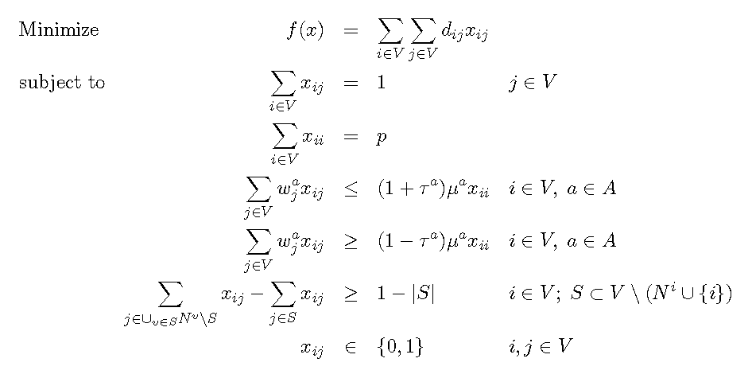
Exact Optimization Approach

Slide 20
Exact Optimization: Connectivity Constraints
i

Slide 21
Exact Optimization: Connectivity Constraints
i

Slide 22
Exact Optimization: Connectivity Constraints
i

Slide 23
Exact Optimization: Connectivity Constraints
i

Slide 24
Exact Optimization: Connectivity Constraints
i

Slide 25
Exact Optimization: Relaxation RTDP
Relax

Slide 26
Exact Optimization: Algorithm
BB&cut_TDP( )
Input: An instance of the TDP
Output: X=(X₁, …, X_{p}) := An optimal p-partition
1 RTDP ← RelaxModel( )
2 do {
3 X ← SolveMILP( RTDP )
4 Cuts ← SolveSeparationProblem( X )
5 AddCuts( Cuts )
6 } while ( Cuts ≠  )
7 return X

Slide 27
Exact Optimization: Separation Problem
SolveSeparationProblem( X )
Input: X=(X₁, …, X_{p}) := a p-partition of V
Output: Cuts := Set of violated constraints
1 Cuts ← 
2 for (k = 1, …, p) {
3 (S₁, …, S_{t}) ← ConnectedComponents( G(X_{k}, E(X_{k}) )
4 for (q=2, …, t) {
5 cut ← GenerateCut( S_{k} )
6 Cuts ← Cuts U { Cut }
7 }
8 }
9 return Cuts
Note Step 3: c(k) in S₁

Slide 28
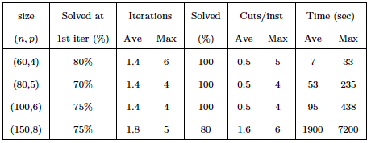
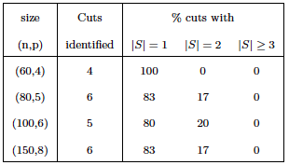
Exact Optimization: Computational Results

Slide 29
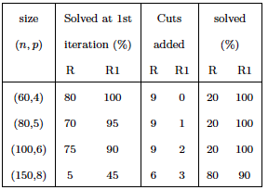
Exact Optimization: Model Strengthening
New idea: Add connectivity constraints for sets of size 1
(it is a polynomial number, bounded by n(n – 1))
Relaxation R1: Previous relaxation RTDP plus these new constraints

Slide 30
Location-Allocation Method: Model
V_{k}
i(k)

Slide 31
Location-Allocation Method
Hess and Samuels (1971)
Separate decision into 2 phases
  Location: Locate territory centers
  Allocation: Assign basic units to centers

Slide 32
Location-Allocation Algorithm
START
LOCATION
ALLOCATION
Stopping Criteria
no
yes
END

Slide 33
Location-Allocation Method
Step 1: Locate centers
9
12
5
11
7
8
2
5
6
2
14
7
11
9
13
8
11
10

Slide 34
Location-Allocation Method
Step 1: Locate centers
p-Dispersion Problem:
Given: V={1, …, n}, d_{ij}, i,j ∈ V
Find S ⊆ V with |S|=p such that
min {d_{ij} : i,j in S } is maximized
9
12
5
11
7
8
2
5
6
2
14
7
11
9
13
8
11
10

Slide 35
Location-Allocation Method
Step 2: Solve Allocation model
Original model (P)
Allocation model (P1)
Binary variables: n² → np
Constraints: 2n + 1 → n + 2p

Slide 36
Location-Allocation Method
Step 2: Solve Allocation model
Allocation model (P1)
Relaxed allocation model (P1R)

Slide 37
Location-Allocation Method: Allocation Phase
Problem P₁R can be solved efficiently using a network method (or even the Simplex)
In an optimal solution to P₁R, territories are perfectly balanced
However, unique assignment constraints may not be satisfied (split unit := unit “partially” assigned to two or more territories)
Theoretical result: No. of split units is at most p - 1

Slide 38
L-A Method: Allocation Phase
Theoretical result: Number of split units is at most p - 1
Lemma 1. The solution of the transportation technique will have at most p - l split population units.
Proof. Because there are at most p+n- 1 basic cells in this solution, at most p-1 demand points (population units) can have two or more cells in their associated columns, leaving at least n-p+ 1 columns having exactly one basic cell. This is because 2(p - 1)+(n- p+ 1)=n+p - 1. If a population unit is split among more than two districts, then the number of split population units will be less than p - 1.

Slide 39
Location-Allocation Method
Step 2: Allocation
9
12
5
11
7
8
2
5
6
2
14
7
11
9
13
8
11
10

Slide 40
Location-Allocation Method
Step 2: Allocation
9
12
5
11
7
8
2
5
6
2
14
7
11
9
13
8
11
10

Slide 41
L-A Method: Allocation Phase
The unique assignment constraint may not be satisfied
A basic unit j for which more than one variable x_{ij} has positive values is called a split area or just a split.
Problem: Decide where to assign each split j
Split Resolution Problem
j
splits

Slide 42
L-A Method: Allocation Phase
Split Resolution Heuristic
For each unassigned split j do:
  Compute ϕ( j, k ), a merit function of assigning j to k as:
  ϕ( j, k ) = λ F(j, k) + (1 – λ) G(j, k)
  Let k’ = argmin { ϕ( j, k ) : k =1,…, p }
  Assign j to k’
F(j, k) dispersion function cost when assigning j to k
G(j, k) violation of balance constraints when assigning j to k

Slide 43
Location-Allocation Method
Step 2: Allocation
9
12
5
11
7
8
2
5
6
2
14
7
11
9
13
8
11
10

Slide 44
Location-Allocation Method
Step 2: Allocation
9
12
5
11
7
8
2
5
6
2
14
7
11
9
13
8
11
10

Slide 45
Location-Allocation Method
Step 2: Allocation
9
12
5
11
7
8
2
5
6
2
14
7
11
9
13
8
11
10

Slide 46
Location-Allocation Method
Step 1 (It 2): Relocate centers
9
12
5
11
7
8
2
5
6
2
14
7
11
9
13
8
11
10

Slide 47
Location-Allocation Method
Step 1 (It 2): Relocate centers
9
12
5
11
7
8
2
5
6
2
14
7
11
9
13
8
11
10

Slide 48
Location-Allocation Algorithm
START
LOCATION
ALLOCATION
Stopping Criteria
no
yes
END

Slide 49
Wrap-up
Research Trends
  Polyhedral theory
  Lower bounds
  Reformulation
  Joint/Disjoint assignment
  Similarity with existing plan / re-design
  Other dispersion measures
  Multi-objective approaches
  Incorporating routing decisions
  Stochastic optimization models
  Edge/arc districting

Slide 50



Thank you …
http://yalma.fime.uanl.mx/~roger
roger@yalma.fime.uanl.mx
Acknowledgements:
Mexican Council for Science and Technology (CONACYT grant CB11-01-166397)
U A N L (PAICYT grant CA1478-07)

Slide 51
References
B. Bozkaya, E. Erkut, and G. Laporte (2003). A tabu search heuristic and adaptive memory procedure for political districting. European Journal of Operational Research,144(3):12–26.
S. W. Hess and S. A. Samuels (1971). Experiences with a sales districting model: Criteria and implementation. Management Science, 18:41-54.
E. Fernández, J. Kalcsics, S. Nickel, and R. Z. Ríos-Mercado. A novel maximum dispersion territory design model arising in the implementation of the WEEE-directive. Journal of the Operational Research Society, 61(3):503-514.
J. Kalcsics, S. Nickel, and M. Schröder (2005). Towards a unified territorial design approach - Applications, algorithms and GIS integration. TOP, 13(1):1–56.
R. Z. Ríos-Mercado and E. A. Fernández (2009). A reactive GRASP for a commercial territory design problem with multiple balancing requirements. Computers & Operations Research,36(3):755–776.

Slide 52
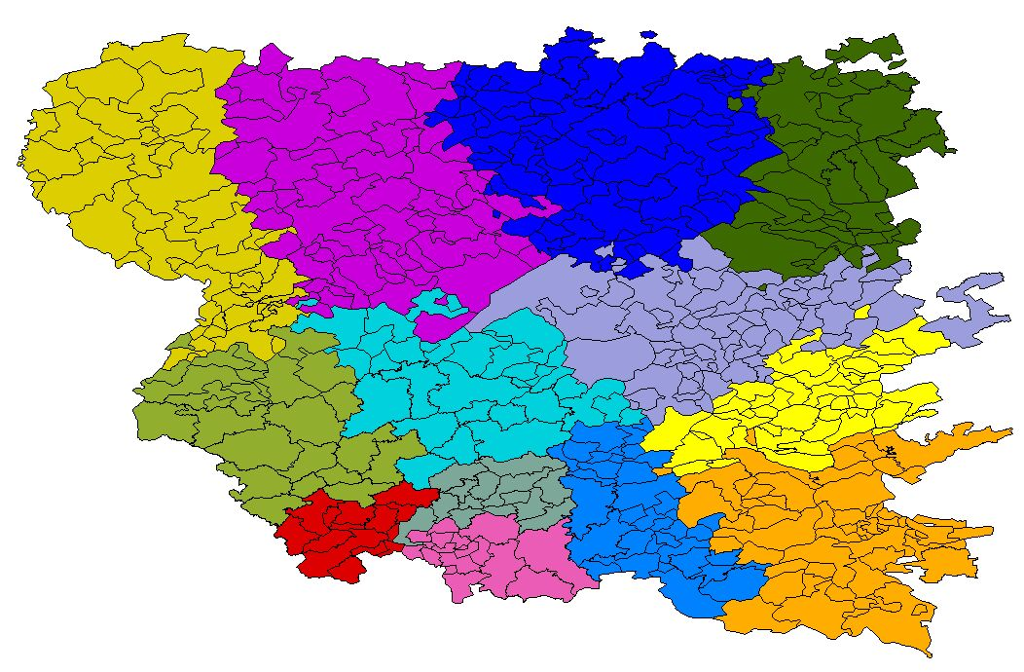
Example A: Political districting
p(j) = population of unit j
s(j) = average income of unit j

Slide 53
Example A: Political districting (cont’d)
Objective: Partition territory into electoral districts
Fixed number of districts (p)
Population equality (balancing)
Contiguity
Compactness
Socio-economic homogeneity

Slide 54
Example A: Political districting (cont’d)
Compactness
R₁(x)=12
R₂(x)=12
R₁(x)=8
R₂(x)=10

Slide 55
Example A: Political districting (cont’d)
Bozkaya, Erkut, Laporte (2003)
Socio-economic homogeneity

Slide 56
L-A Method: An Advanced Approach

Slide 57
Proposed Approach: Location-Allocation-LS
Separate decision into 3 phases
  Location: Locate territory centers
  Allocation: Assign basic units to centers
  Local Search: Improve solution
Novelty
  Handle multiple balancing constraints
  Handle contiguity constraints
  Improving through local search

Slide 58
Location-Allocation-Local Search Algorithm
START
LOCATION
ALLOCATION
LOCAL SEARCH
Stopping Criteria
no
yes
END

Slide 59
L-A-LS Method: Allocation Phase
Input: Set V_{c} ⊂ V of p territory centers (from the Location Phase)
Job: To assign each BU to a center to form the territories (satisfying model constraints)

Slide 60
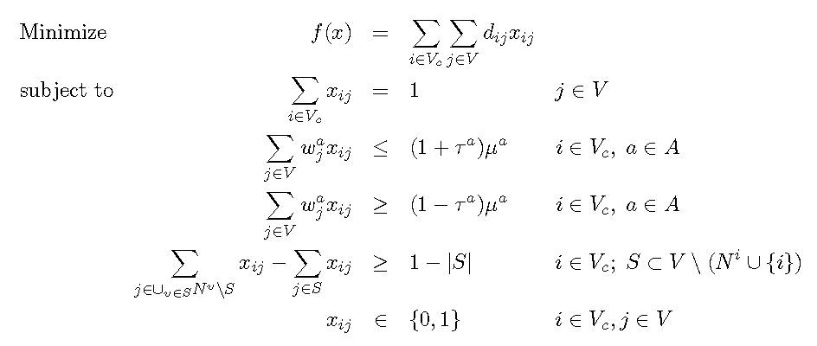
L-A-LS: Allocation Phase
Allocation Model (AM)
No. of binary variables: n² → np

Slide 61
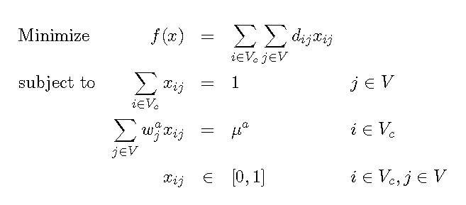
L-A-LS Method: Allocation Phase
Allocation Subproblem (perfect balance for a)
RM(a)
Relaxation of AM (connectivity constraints and integrality requirements)

Slide 62
L-A-LS Method: Allocation Phase Remarks
Problem RM(a) can be solved efficiently using a network method (or even the Simplex)
In an optimal solution to RM(a), territories are perfectly balanced
However, unique assignment constraints may not be satisfied (split unit := unit “partially” assigned to two or more territories)
Theoretical result: No. of split units is at most p - 1 for RM(a)
ISSUE: No longer holds for both simultaneously
Connectivity constraints may not be satisfied

Slide 63
L-A-LS: Allocation Phase
The unique assignment constraint may not be satisfied
A basic unit j for which more than one variable x_{ij} has positive values is called a split area or just a split.
Problem: Decide where to assign each split j
Issue: 2 subproblems!!!
Need to recover feasibility
(connectivity & balancing)
Split Resolution Problem
j
splits

Slide 64
L-A-LS: Allocation Phase
Split Resolution Heuristic
Step 1: Attempt to repair connectivity (j → territory k if this repairs connectivity of k)
Step 2: For each unassigned split j do:
  Forbid “disconnecting” moves
  Compute ϕ( j, k ), a merit function of assigning j to k as:
  ϕ( j, k ) = λ F(j, k) + (1 – λ) G(j, k)
  Let k’ = argmin { ϕ( j, k ) : k =1,…, p }
  Assign j to k’
F(j, k) dispersion function cost when assigning j to k
G(j, k) violation of balance constraints when assigning j to k

Slide 65
Location-Allocation-LS Algorithm
START
LOCATION
ALLOCATION
LOCAL SEARCH
Stopping Criteria
no
yes
END

Slide 66
L-A-LS Method: Local Search Phase
Solution from Allocation Phase may not satisfy balance constraints
Merit function change
V_{k}
Δ(v,k,k’) < 0
V_{k’}
N( X ): Set of solutions reachable from X = ( X₁, …, X_{p} ) by reassigning a node from X_{k} to a different territory
Move( i, k ): Move node i (from t(i)) to territory k ( with k ≠ t(i) )
Weighted merit function

Slide 67
L-A-LS Method: Empirical Work
Instance Generation
Instances randomly generated with data provided by industrial partner (30 for each combination)
Planar maps with |V| = 500, 1000, and 2000 in [0, 500] x [0,500] and p = 20, 40, 60
Node activities randomly generated from ranges provided by industrial partner
Tolerance levels: 5% (DS05) and 10% (DS10)

Slide 68
L-A-LS Method: Results
CPU time distribution

Slide 69
L-A-LS Method: Results
Split node average

Slide 70
L-A-LS Method: Results
Local Search improvement

Slide 71
L-A-LS Method: Results
Performance of Algorithm
Size | Balance Tolerance | LS Improvement (%) | CPU Time Average (sec) | Iteration Average | Connectivity Proportion
500 | 10% | 46.45 % | 192.76 | 47.4 | 97.5 %
500 | 5% | 47.34 % | 201.23 | 48.0 | 94.4 %
1000 | 10% | 51.23 % | 289.48 | 63.3 | 93.1 %
1000 | 5% | 50.67 % | 291.53 | 65.3 | 91.2 %

Slide 72
L-A-LS Method: Results
Connectivity per iteration
p\n | T500 | T1000 | T2000
20 | 94.81% | 91.66% | 89.33%
40 | 94.93% | 91.67% | 89.28%
60 | 95.38% | 91.67% | 89.27%
Final connectivity
p\n | T500 | T1000 | T2000
20 | 100% | 100% | 100%
40 | 100% | 100% | 100%
60 | 100% | 100% | 100%

Slide 73
L-A-LS Method: Results
Satisfaction of balancing constraints

