Slide 1
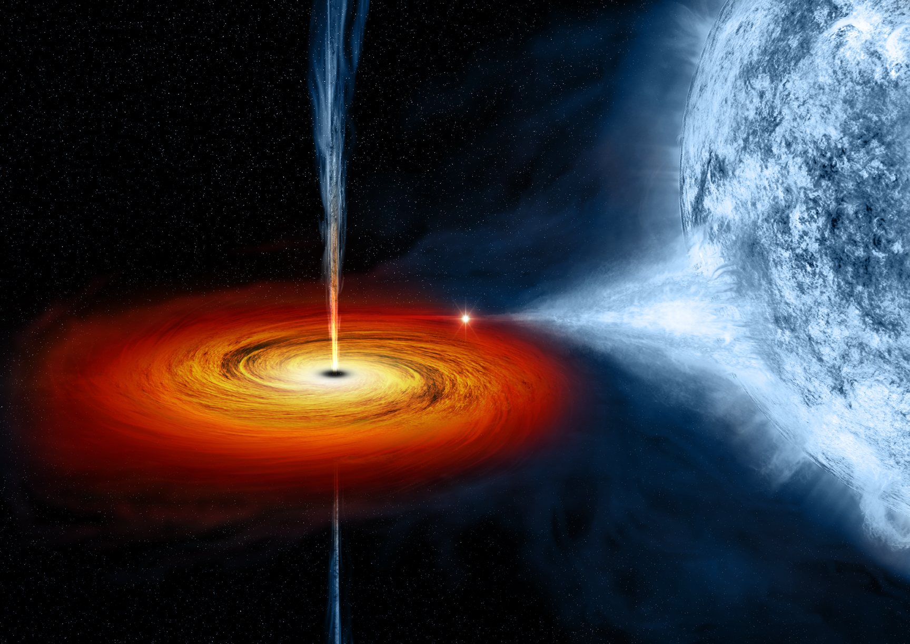
Lively Accreting Black Holes in X-ray Binaries
Jeff McClintock
Harvard-Smithsonian Center for Astrophysics
Outline
Introduction
Spin via continuum-fitting
Applications of spin data
X-ray “reflection” spectroscopy
Conclusions
Black Holes’ New Horizons
Oaxaca, May 2016

Slide 2
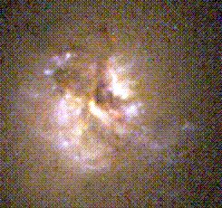
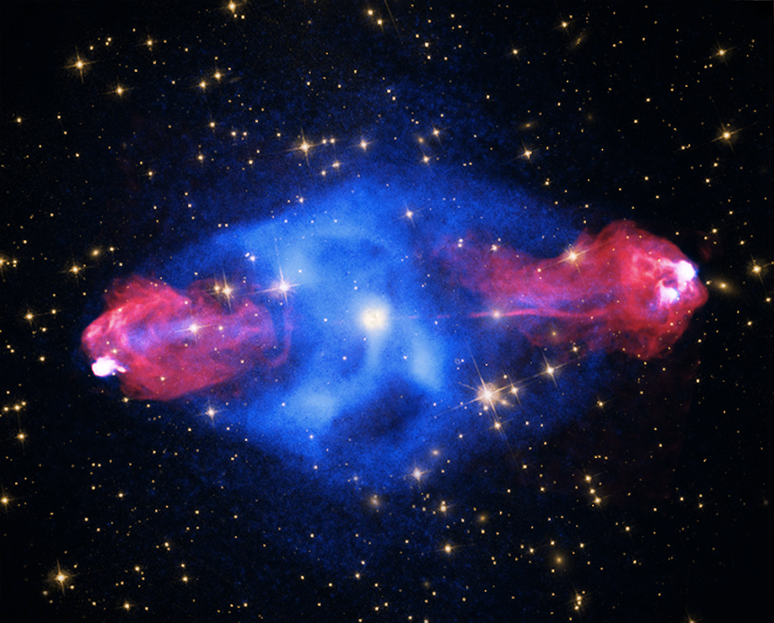

The two kinds of black holes in action
X-ray binary Cygnus X-1
Black hole mass = 16 suns
Quasar Cygnus A
Black hole mass = 3,000,000,000 suns
Radio + X-ray
Optical
300 km
3,000,000 km
0.000001 light years
100,000 light years

Slide 3
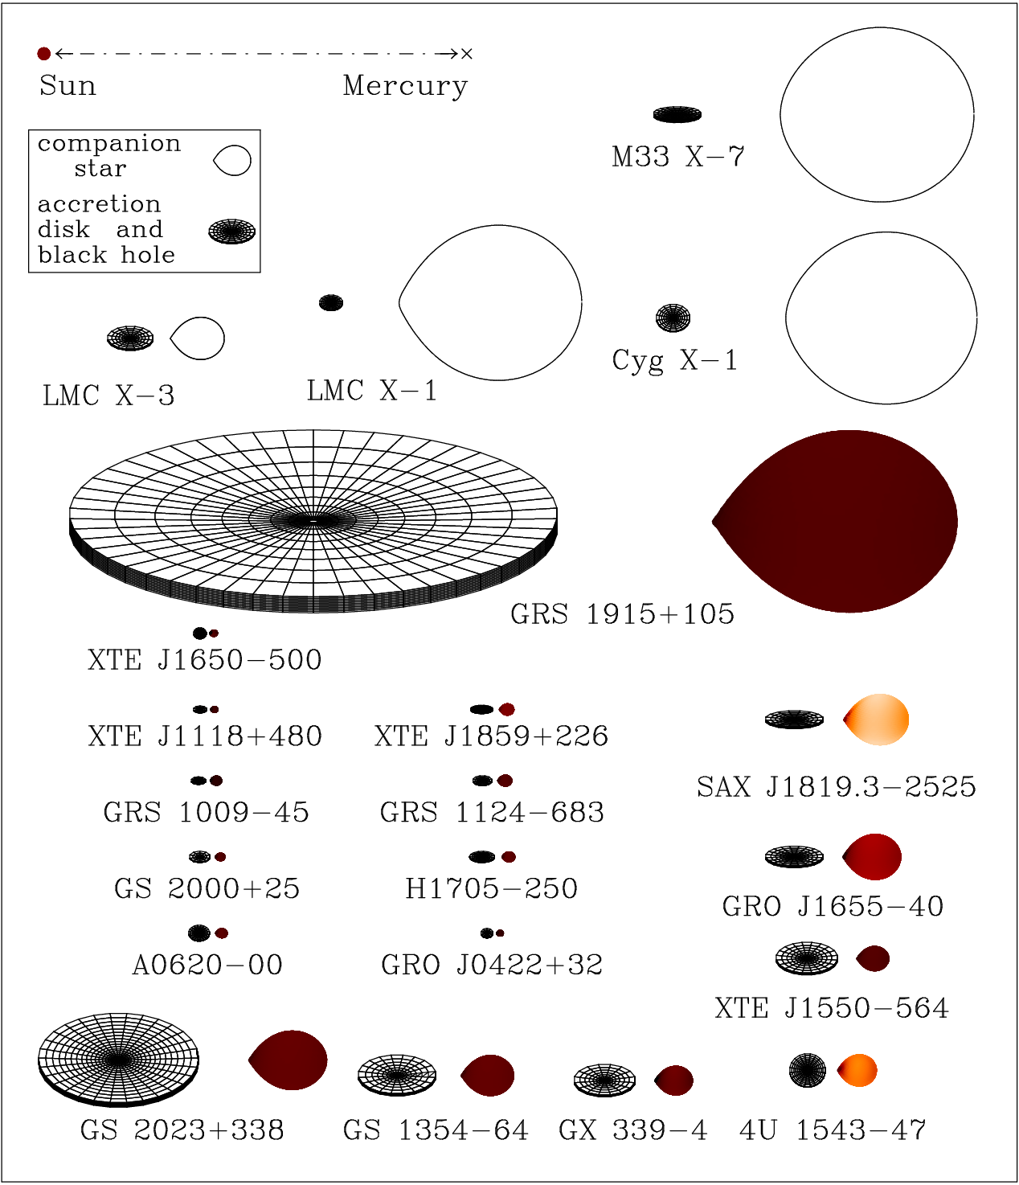
Black hole binaries
Persistent systems
x
Sun
Mercury
M33 X-7
LMC X-1
Cygnus X-1
LMC X-3
GRS 1915+105
XTE J1650-500
Transient systems
XTE J1118+480
XTE J1859+226
SAX J1819.3-2525
GRS 1009-45
GRS 1124-683
GS 2000+25
H1705-250
GRO J1655-40
A0620-00
GRO J0422+32
XTE J1550-564
V404 Cyg
GS 1354-64
GX 339-4
4U 1543-47
Courtesy: J. Orosz
Notes:
Tens of millions…. a few dozen
Describe Orosz plot
2 distinct classes of systems

Slide 4
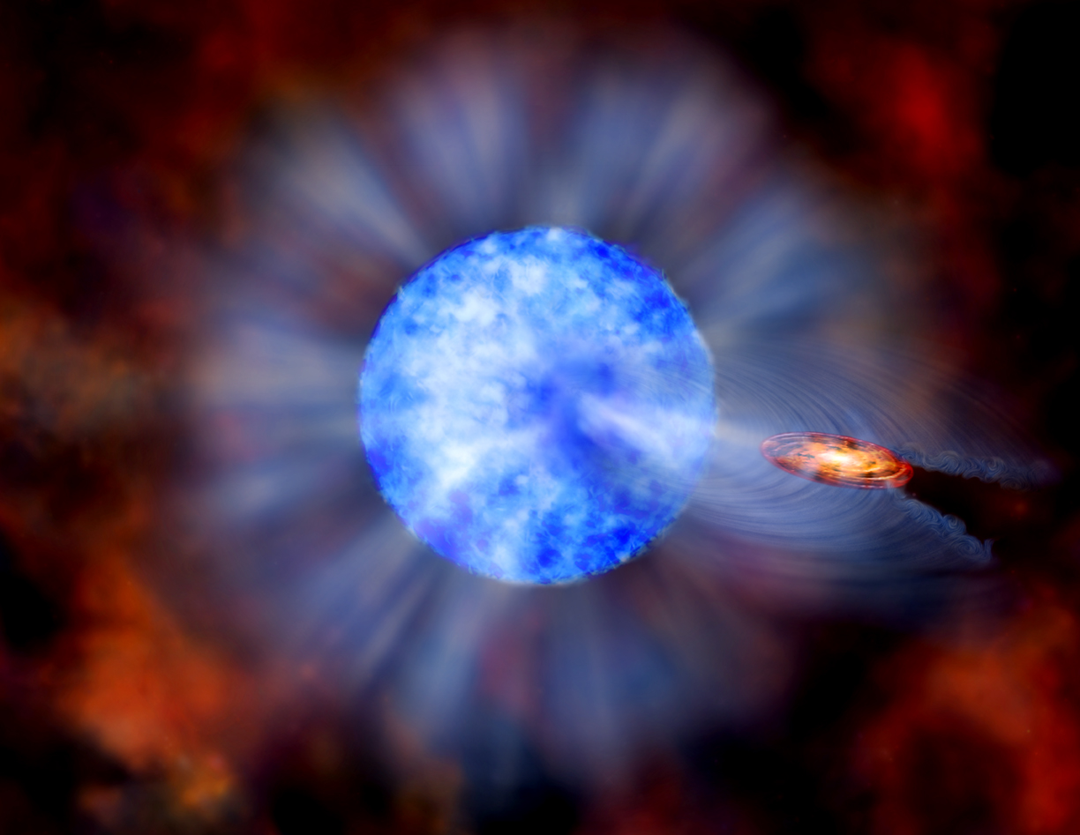
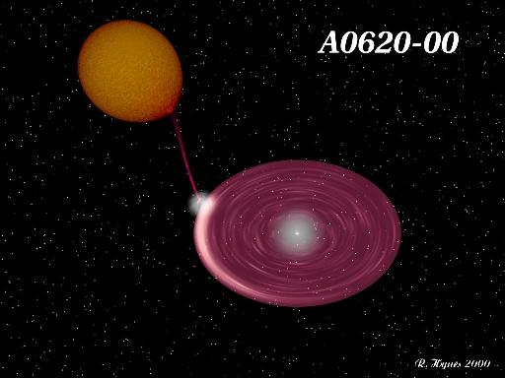
The two kinds of black-hole X-ray binaries:
Persistent and Transient
Cygnus X-1 LMC X-1 M33 X-7
e.g., A0620-00
Credit: CXC
Credit: R. Hynes
Notes:
2 classes distinguished by mode of mass xfer
Also distinguished by mass and age
Also, distinguished by mass and spin distributions
A0620: Tiny inner-disk region… 10^5 Lsun… 10^7K

Slide 5
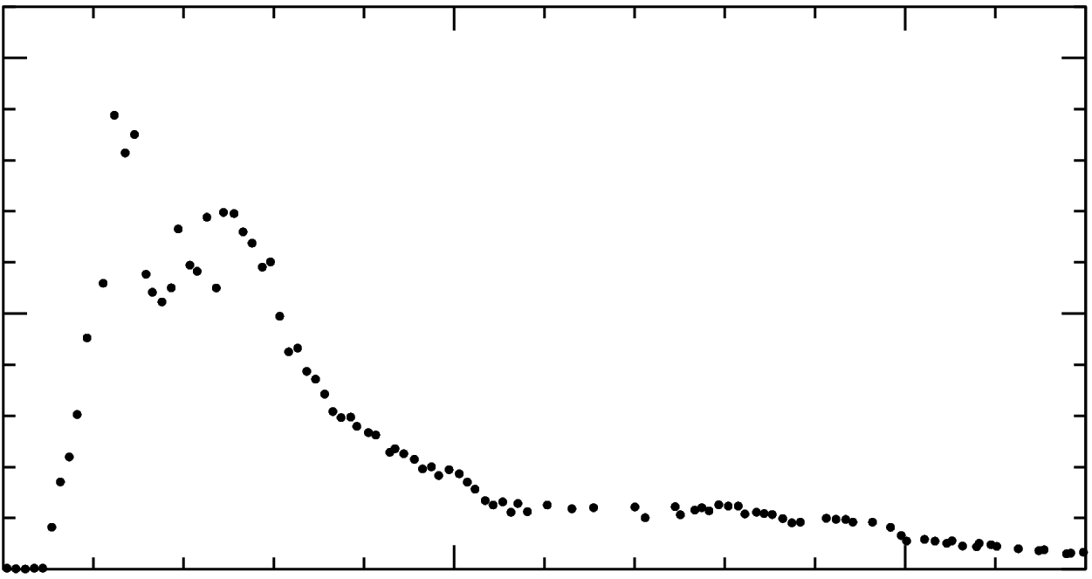
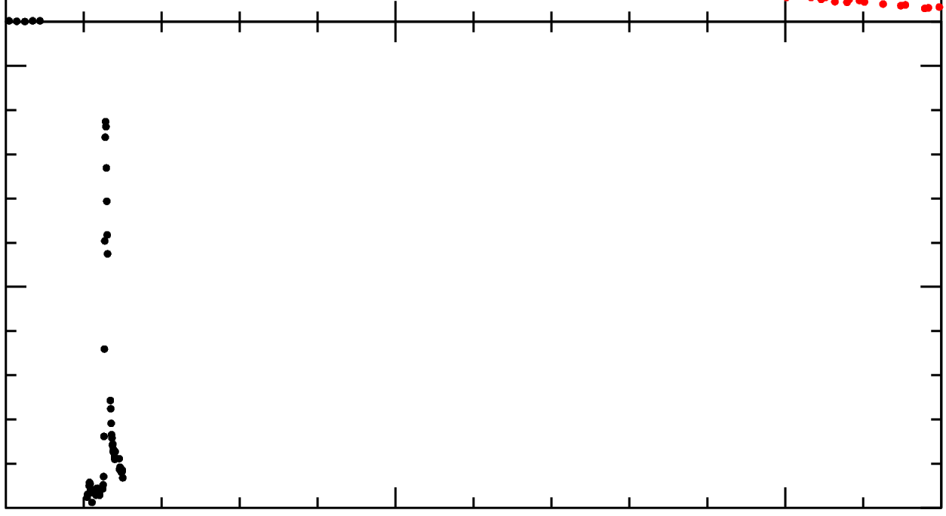

Ballistic jet launched at L_{x} ~ L_{Eddington}
100
Transient
Jet launched
50
Intensity
X-ray (2-12 keV)
0
100
0
50
100
Time (days)
50
Intensity
Credit: F. Mirabel
Radio (5 GHz)
0
0
100
200
Time (days)

Slide 6
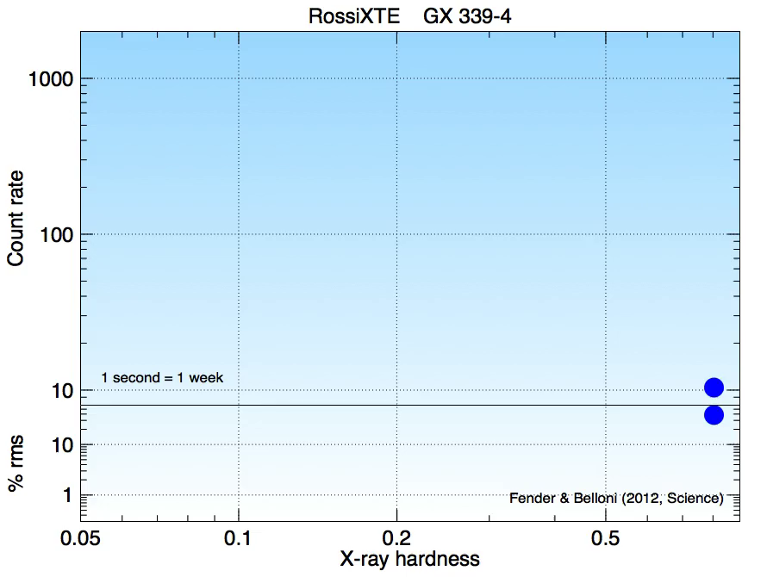
Six months in the life of GX 339-4
X-ray hardness: Counts (10-40 keV) / Counts (3-10 keV)

Slide 7
Spin via the Continuum-Fitting Method
McClintock, Narayan & Steiner 2014 (Space Sci. Rev. 183, 295)

Slide 8
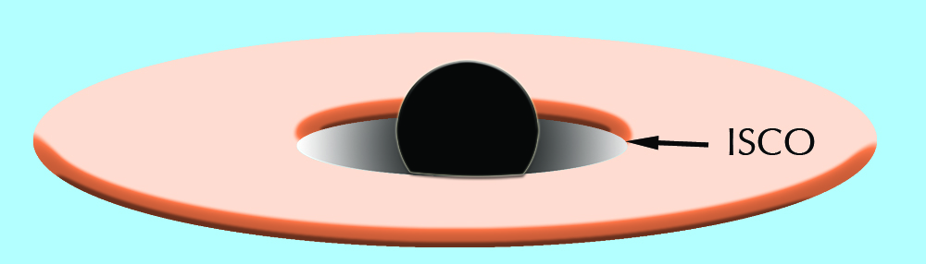
Continuum-Fitting: Measuring R_{ISCO} & inferring a*
kT ≈ 1 keV
10
8
6
R_{ISCO} / M
4
2
0
-1
0
+1
Spin a* = J/M²
c = G = 1
Notes:
ISCO foundation for *both* methods
Describe ISCO -- plunge time – dark region
Simple problem: Measuring R_isco like R* (flux, T, D)
R_isco to a*… J is ang. Mom… a* <1
Virtue: simple/elegant… 1970s…NT73

Slide 9
Measuring R_{ISCO} is Analogous to Measuring the Radius of a Star of known distance D
R*
R_{ISCO}
R_{ISCO}
(R*/D)² = F / σT⁴
Required for spin a*:
Distance D
Inclination i
Mass M
Model of disk flux F(R)

Slide 10
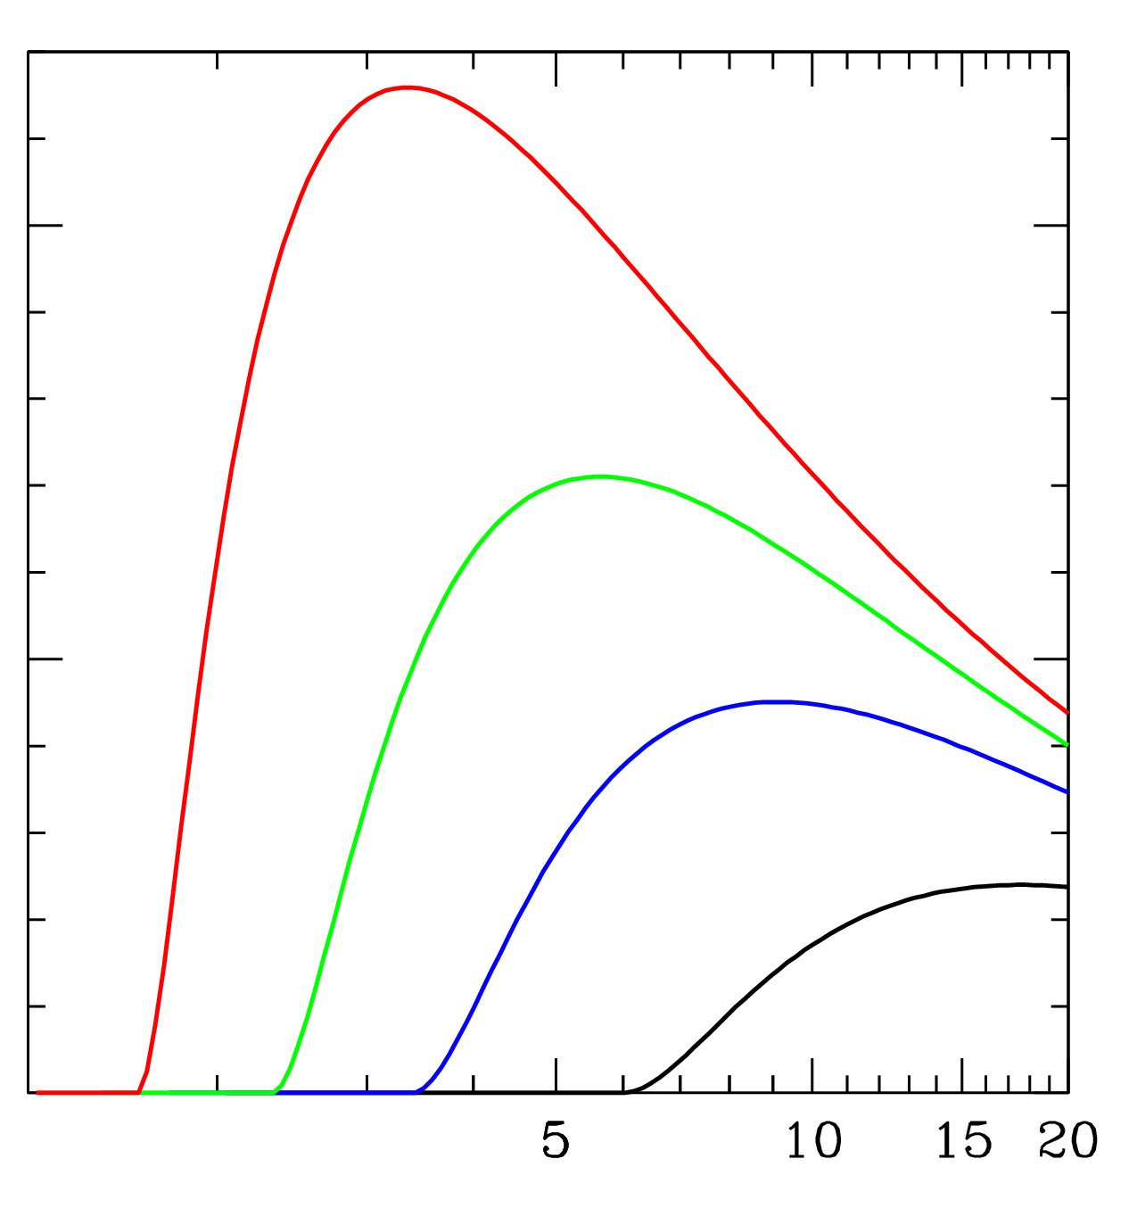
Novikov & Thorne Thin-Disk Model: F(R)
a* = 0.98
0.10
dF/d(lnR)
a* = 0.9
0.05
a* = 0.7
a* = 0
0
1
5
10
15
20
R / M
Novikov & Thorne 1973

Slide 11
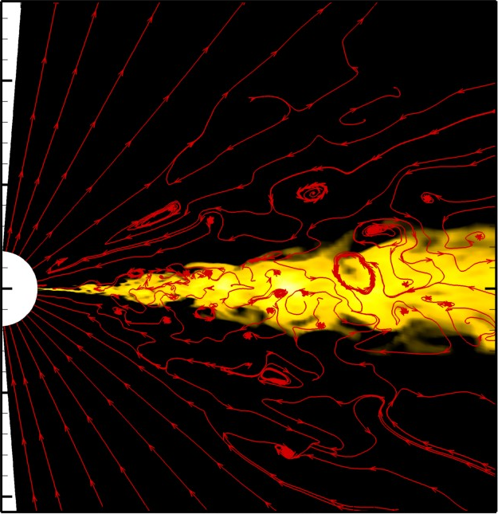
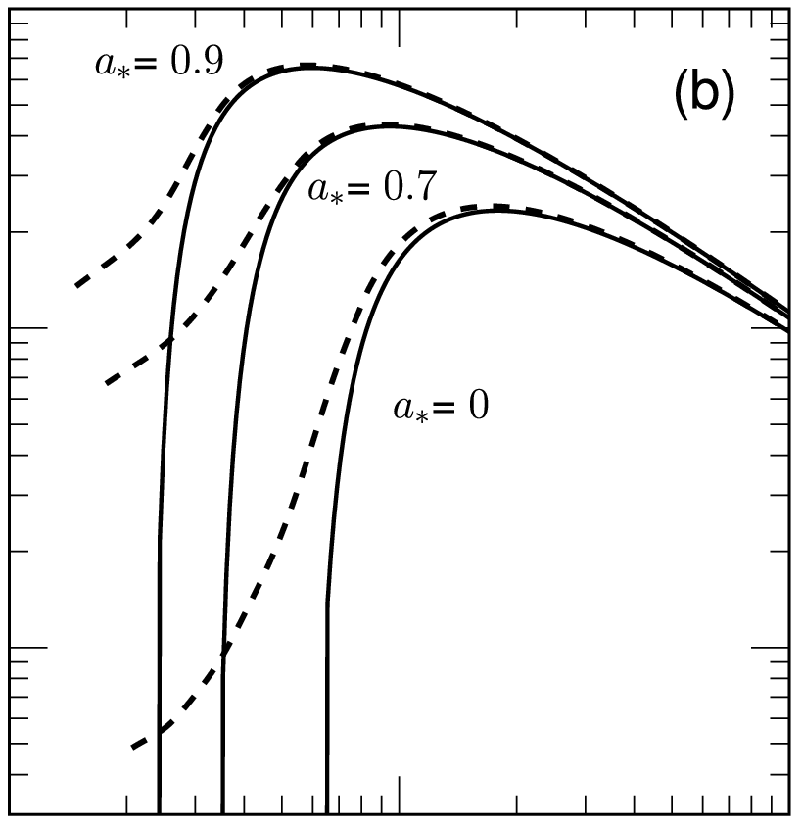
Theoretical foundation for CF method
10⁻¹
a* = 0.9
10
a* = 0.7
GRMHD
a* = 0
10⁻²
Z
Flux
0
Novikov-Thorne
10⁻³
-10
0
10
20
1
10
100
R / M
R / M
Shafee et al. 2008; Penna et al. 2010; Kulkarni et al. 2011; Zhu et al. 2012
Also: Reynolds & Fabian (2008); Noble, Krolik & Hawley (2009, 2010, 2011)

Slide 12
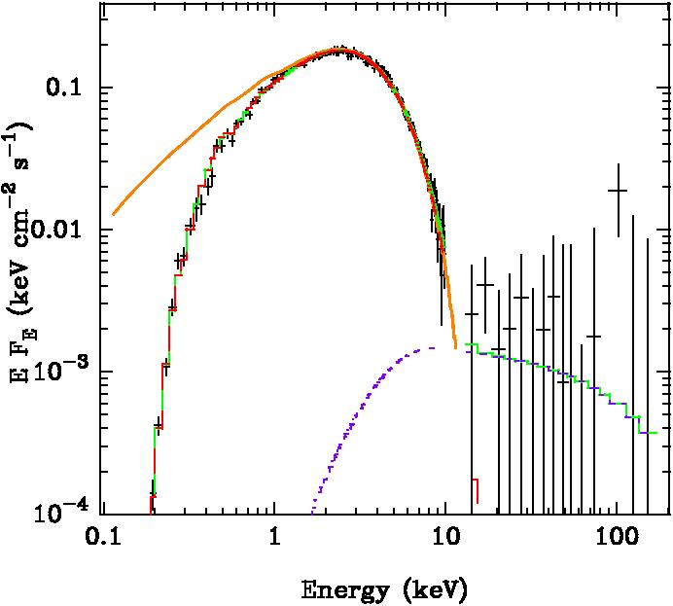
Continuum fitting in practice
LMC X-3
Beppo-SAX
EF_{E}
Energy (keV)
Davis, Done & Blaes 2006
Notes:
Dominant disk is crucial
1% Compton comp. unimportant… up to 25%
For most BHs, we have spectra of this quality
Fit NT model & get R_isco & Mdot with M,i,D

Slide 13
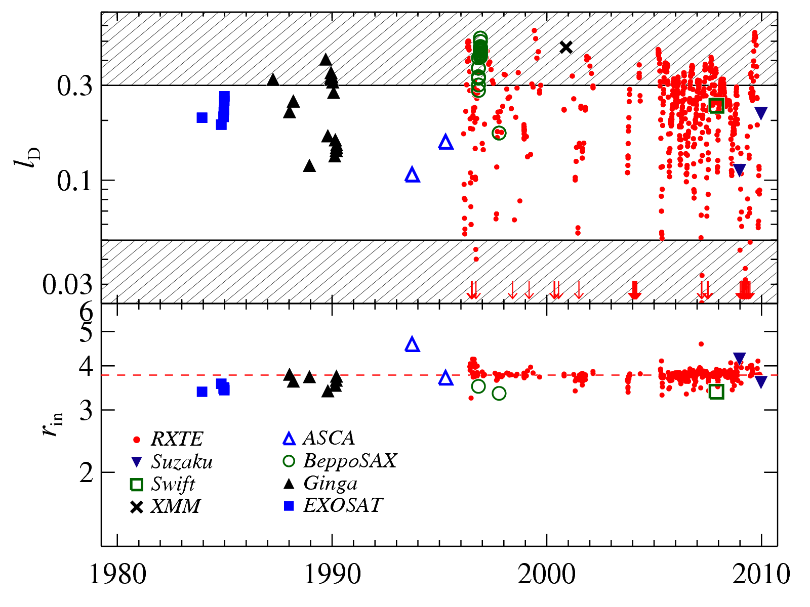
Observational foundation for CF method
Steiner et al. 2010
Slim Disk
L_{D} / L_{Edd}
LMC X-3
ADAF
1980
1990
2000
2010
R_{in} / M
R_{in} stable to ≈ 2%
Notes:
Standard spiel on Jack’s LMC X-3 plot…
766 observations, 8 X-ray missions…
Luminosity in Edd-scaled units…
Stable inner-disk radius, 27 yrs…
Constancy to ~2%... Strong foundation…

Slide 14
Complete descriptions of 11 black holes
System | Spin a* | M/M | References
Persistent
Cygnus X-1 | > 0.98 | 15.8 ± 1.0 | Gou+ 2011; Orosz+ 2011
LMC X-1 | 0.92 ± 0.06 | 10.9 ± 1.4 | Gou+2009; Orosz+ 2009
M33 X-7 | 0.84 ± 0.05 | 15.7 ± 1.5 | Liu+ 2008; Orosz+2007
Transient
GRS 1915+105 | > 0.95 | 12.4 ± 1.9 | McClintock+ 2006; Steegths+ 2013
4U 1543-47 | 0.8 ± 0.1 | 9.4 ± 1.0 | Shafee+ 2006; Orosz+ 2003
GRO J1655-40 | 0.7 ± 0.1 | 6.3 ± 0.5 | Shafee+ 2006; Greene+ 2001
Nova Mus 1991 | 0.66 ± 0.17 | 11.0 ± 1.8 | Wu+ 2016; Gou+ 2016
XTE J1550-564 | 0.34 ± 0.24 | 9.1 ± 0.6 | Steiner+ 2011; Orosz+ 2011
LMC X-3 | 0.25 ± 0.15 | 7.0 ± 0.5 | Steiner+ 2013; Orosz+ 2013
H1743-322 | 0.2 ± 0.3 | 8 ± 2 | Steiner+ 2012; Ozel+ 2010
A0620-00 | 0.12 ± 0.19 | 6.3 ± 0.3 | Gou+ 2010; Cantrell+ 2010

Slide 15
Applications of Spin and Mass Data

Slide 16
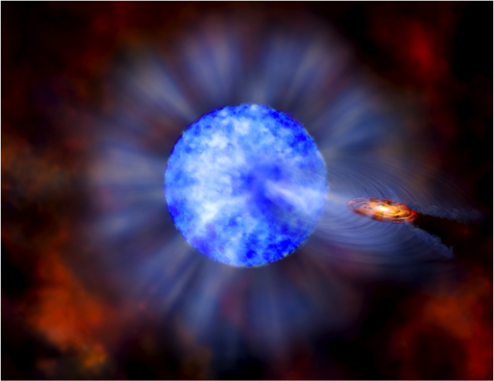
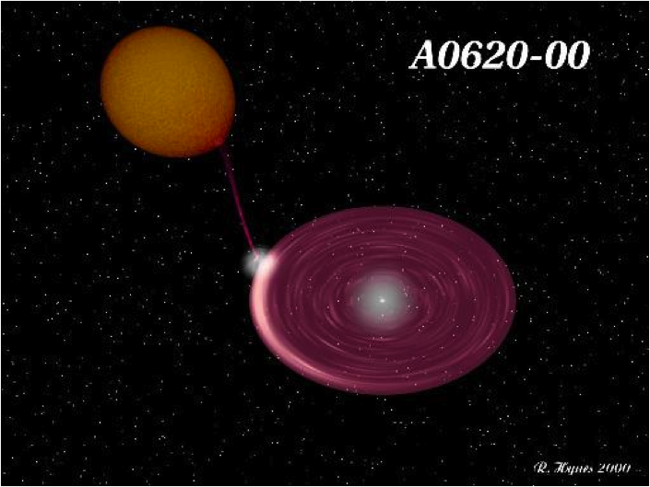
Persistent BHs vs. transient BHs
System | Spin a* | M/M | References
Persistent | > 0.8 | 11 - 16
Cygnus X-1 | > 0.98 | 15.8 ± 1.0 | Gou+ 2011; Orosz+ 2011
LMC X-1 | 0.92 ± 0.06 | 10.9 ± 1.4 | Gou+2009; Orosz+ 2009
M33 X-7 | 0.84 ± 0.05 | 15.7 ± 1.5 | Liu+ 2008; Orosz+2007
Transient | 0 ⬅➔ 1 | 7.8 ± 1.2
GRS 1915+105 | > 0.95 | 12.4 ± 1.9 | McClintock+ 2006; Steegths+ 2013
4U 1543-47 | 0.8 ± 0.1 | 9.4 ± 1.0 | Shafee+ 2006; Orosz+ 2003
GRO J1655-40 | 0.7 ± 0.1 | 6.3 ± 0.5 | Shafee+ 2006; Greene+ 2001
Nova Mus 1991 | 0.66 ± 0.17 | 11.0 ± 1.8 | Wu+ 2016; Gou+ 2016
XTE J1550-564 | 0.34 ± 0.24 | 9.1 ± 0.6 | Steiner+ 2011; Orosz+ 2011
LMC X-3 | 0.25 ± 0.15 | 7.0 ± 0.5 | Steiner+ 2013; Orosz+ 2013
H1743-322 | 0.2 ± 0.3 | 8 ± 2 | Steiner+ 2012; Ozel+ 2010
A0620-00 | 0.12 ± 0.19 | 6.3 ± 0.3 | Gou+ 2010; Cantrell+ 2010
Persistent
Transient

Slide 17
Origin of spin: persistent sources vs. transient
Fragos & JM 2014
System | Spin a* | M/M | References
Persistent | > 0.8 | 11 - 16
Cygnus X-1 | > 0.98 | 15.8 ± 1.0 | Gou+ 2011; Orosz+ 2011
LMC X-1 | 0.92 ± 0.06 | 10.9 ± 1.4 | Gou+2009; Orosz+ 2009
M33 X-7 | 0.84 ± 0.05 | 15.7 ± 1.5 | Liu+ 2008; Orosz+2007
Transient | 0 ⬅➔ 1 | 7.8 ± 1.2
GRS 1915+105 | > 0.95 | 12.4 ± 1.9 | McClintock+ 2006; Steegths+ 2013
4U 1543-47 | 0.8 ± 0.1 | 9.4 ± 1.0 | Shafee+ 2006; Orosz+ 2003
GRO J1655-40 | 0.7 ± 0.1 | 6.3 ± 0.5 | Shafee+ 2006; Greene+ 2001
Nova Mus 1991 | 0.66 ± 0.17 | 11.0 ± 1.8 | Wu+ 2016; Gou+ 2016
XTE J1550-564 | 0.34 ± 0.24 | 9.1 ± 0.6 | Steiner+ 2011; Orosz+ 2011
LMC X-3 | 0.25 ± 0.15 | 7.0 ± 0.5 | Steiner+ 2013; Orosz+ 2013
H1743-322 | 0.2 ± 0.3 | 8 ± 2 | Steiner+ 2012; Ozel+ 2010
A0620-00 | 0.12 ± 0.19 | 6.3 ± 0.3 | Gou+ 2010; Cantrell+ 2010
Persistent
Natal
Transient
Accretion
torques

Slide 18
Ballistic jet launched at L_{x} ~ L_{Eddington}
100
Transient
Jet launched
50
Intensity
X-ray (2-12 keV)
0
100
0
50
100
Time (days)
50
Intensity
Radio (5 GHz)
0
0
100
200
Time (days)

Slide 19
Jet Power vs. R_{ISCO}/M
Jet power ~ Ω_{H}²
a*
Blandford-Znajek 1977
Chen et al. 2016
Narayan & McClintock 2012
Steiner, McClintock & Narayan 2013
(but see Russell et al. 2013)

Slide 20
X-ray Reflection Spectroscopy a.k.a. The Fe-line method of measuring spin

Slide 21
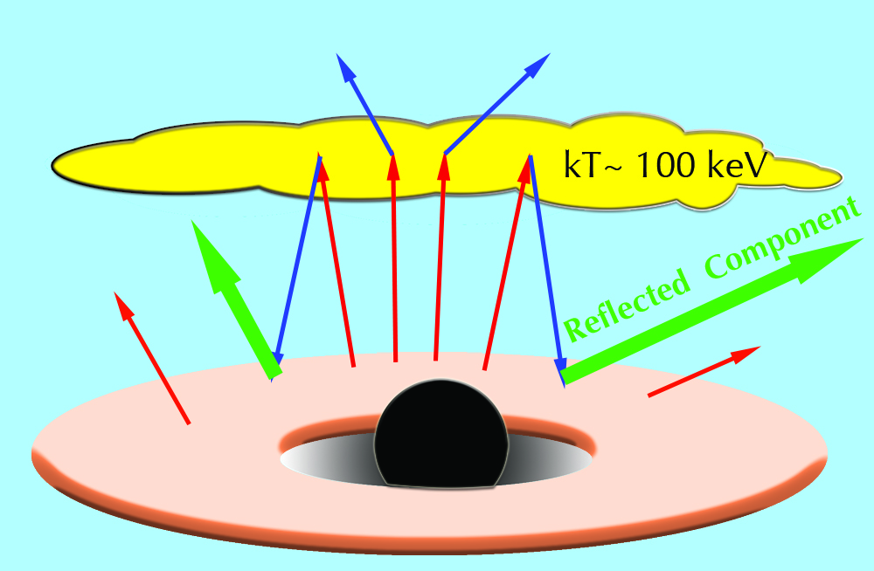
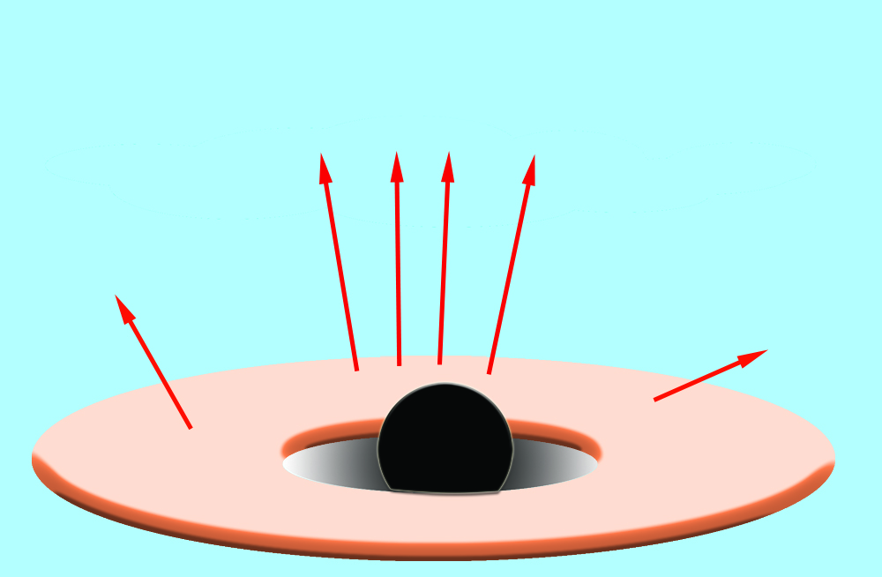
Fe-line method (a.k.a. reflection spectroscopy)
kT ~ 1 keV
10⁸
Garcia & Kallman 2010
Dauser, Garcia, et al 2013
Garcia et al. 2011, 2013
Garcia & Kallman 2010
Dauser, Garcia, et al 2013
Garcia et al. 2011, 2013
Flux
10⁴
10⁰
0.1
1
10
100
Energy (keV)
Notes:
[Describe how Fe K line is formed…]
Strong Compt / Coronal geometry?
Typically, low/hard-state spectra used
Doubtful that R_in is at ISCO… truncated / Juri
Complex model of reflected spect….

Slide 22
Effect of spin on relativistically-blurred Fe K line
6
i = 40 deg
Flux
4
a* = 1
6.4 keV
2
a* = 0
4
5
6
7
8
Energy (keV)
Garcia & Kallman 2010
Dauser, Garcia, et al 2013
Garcia et al. 2011, 2013

Slide 23
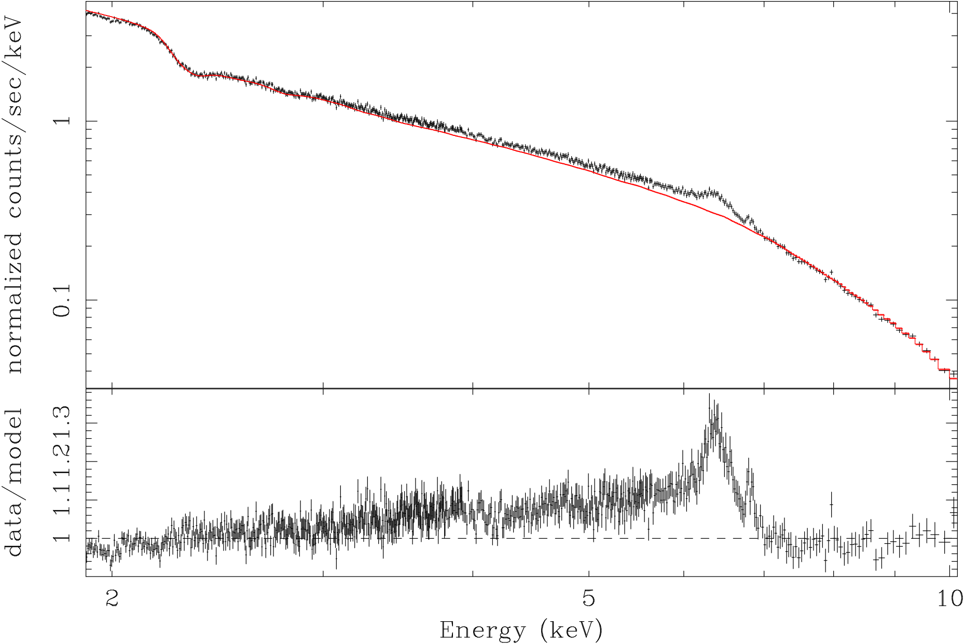
The Seyfert galaxy MCG-6-30-15
Fe K_{α}
1
Data
Counts / sec / keV
Model
0.1
1.4
The “tender” red wing
1.2
Data / Model
1
2 5 10
Energy (keV)
Brenneman & Reynolds 2006

Slide 24
Continuum-fitting and Fe-line spin results
System | a* (CF) | a* (Fe line) |  | References
Cygnus X-1 | > 0.98 | 0.97 ± 0.02 |  | Gou+ 2011, 2014 Fabian+ 2012
LMC X-1 | 0.92 ± 0.06 | 0.72 – 0.99 |  | Gou+ 2009 Steiner+ 2012
GRS 1915+105 | > 0.95 | 0.98 ± 0.01 |  | McClintock +2006 Miller +2013
XTE J1550-564 | 0.34 ± 0.24 | 0.55 ± 0.20 |  | Steiner, Reis+ 2011
GRO J1655-40 | 0.8 ± 0.1 | > 0.9 |  | Shafee+ 2006 Reis+ 2009
4U 1543-47 | 0.7 ± 0.1 | 0.3 ± 0.1 |  | Shafee+ 2006 Miller+ 2009
☑
☑
☑
☑
✕
✕
Notes:
Comparison: Blue / red for CF & Fe-line
Fe-line results for only 1 or 2 spectra, not 30
Agreement good for 1st 5, poor for last 2
[click, click…] ** GRS1915 MILLER QUOTE **

Slide 25
Fe-line: Unaddressed sources of systematic error
✕ Gross uncertainty in the properties of the corona
✕ Constant density model of disk atmosphere
✕ Use of a single ionization parameter
Completeness and accuracy of atomic physics
✕ Disk truncated at R > R_{ISCO}?

Slide 26
New Initiative in
X-ray Reflection Spectroscopy

Slide 27
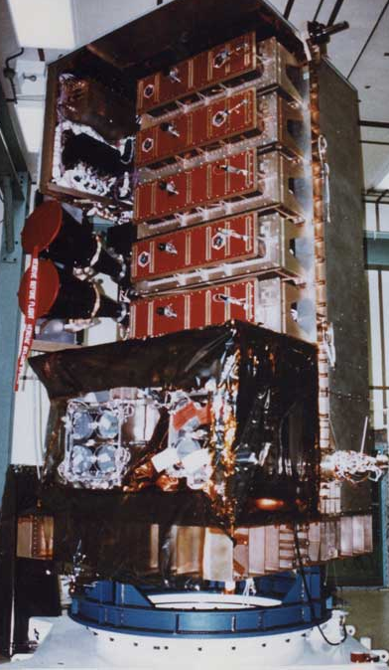
The Rossi X-ray Timing Explorer: 1996 - 2012
Order-of-magnitude increase in sensitivity: Garcia, Steiner, JM 2014
Premier Black Hole Archive
29 black holes
500 observations each
30 Msec of data
The PCA: 6500 cm²
Notes:
Thank organizers
ontinum-fitting + applications (+Fe-line at end)
As you can see, trying to get close
For details, see our review

Slide 28
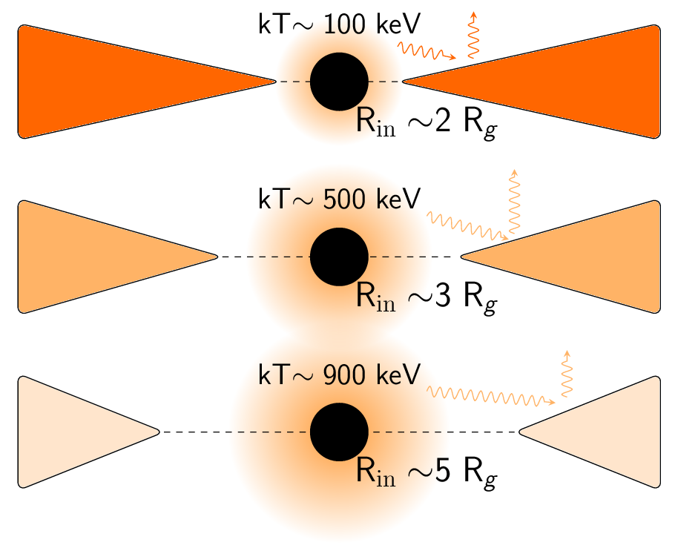
Reflection spectroscopy of GX 339-4 with unprecedented precison
Garcia, Steiner, JM et al. 2016
L_{x} / L_{Edd}
17%
8%
2%

Slide 29
Conclusions

Slide 30
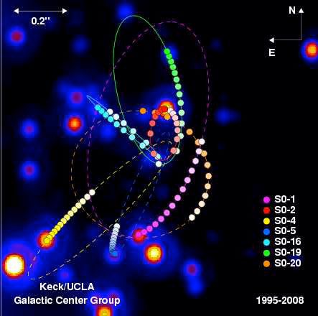
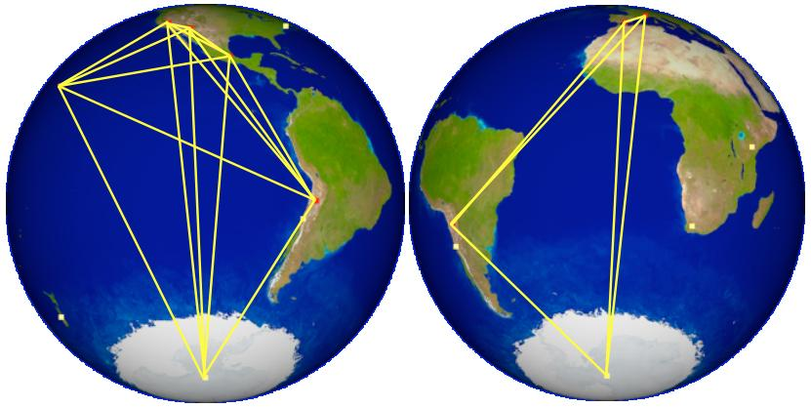
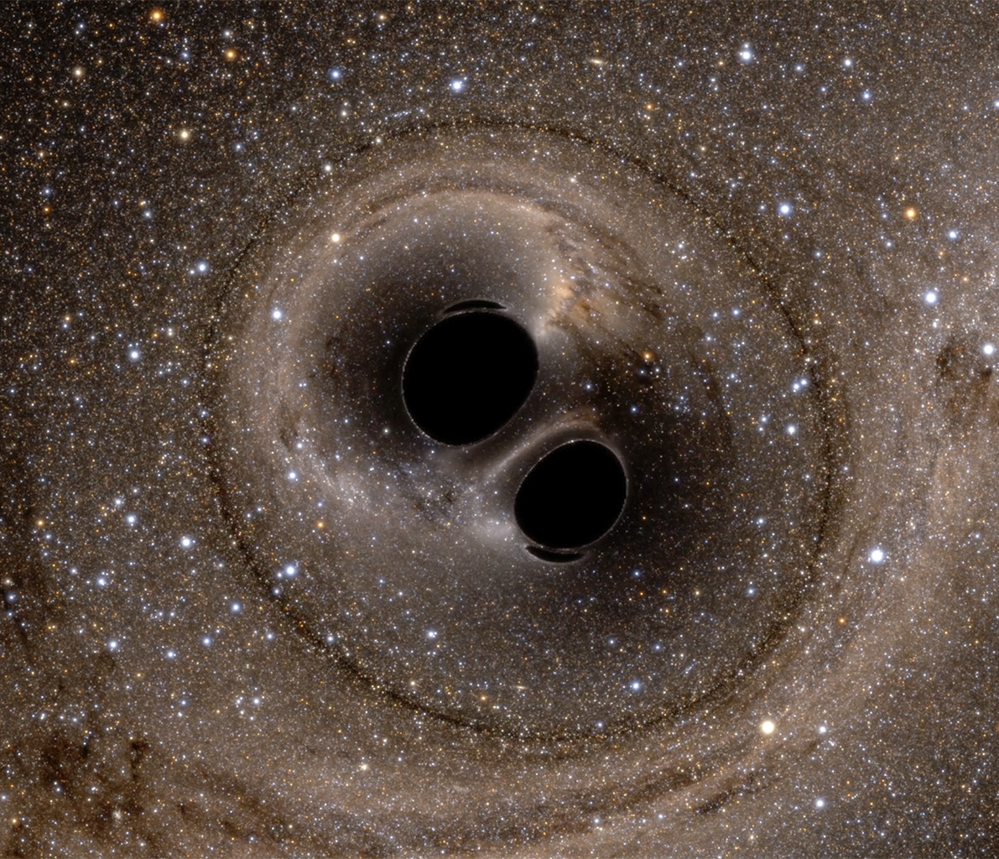
GR at 100 years: Landmark black hole science
Sgr A*: Stellar dynamics
Sgr A* & M87 images
EHT
Keck / VLT
Merging stellar black holes
Quasar Cygnus A
LIGO
Chandra / VLA

Slide 31
Summary
Lively stellar BHs show their full repertoire in months!
Three applications of 11 spin estimates:
Distinguish persistent and transient BHs
Indicate two origins of spin of stellar BHs
Provides first evidence that some jets powered by BH spin energy
The promise of X-ray reflection spectroscopy:
Estimate the spins of hundreds of supermassive BHs
Learn how accreting BHs shape the universe

