Slide 1



Complex polymer interactions in azobenzene-based photoresponsive polymers
William S. Oates
Department of Mechanical Engineering
Florida A&M-Florida State University
Tallahassee, FL 32308
Acknowledgements: NSF CAREER, AFOSR, Tim White (AFRL), Yousuff Hussaini, Jonghoon Bin, Somayeh Mashayekhi, Sabah Chowdhury, Paul Miles
CMO-BIRS Mathematical Problems of Orientationally Ordered Soft Solids
Oaxaca, Mexico

Slide 2
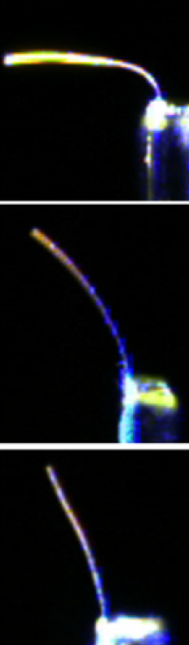

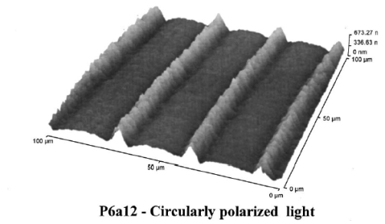
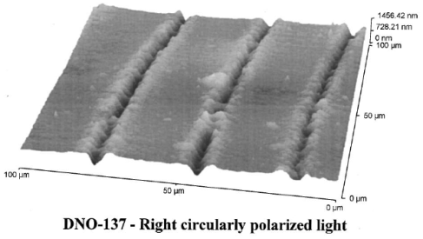
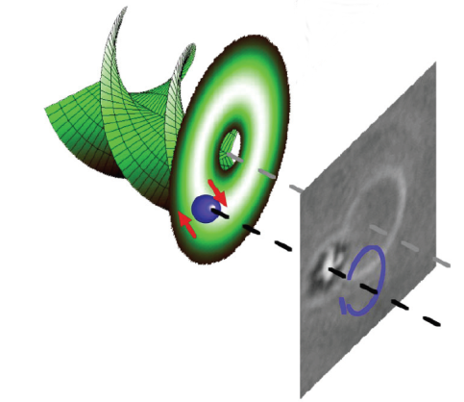
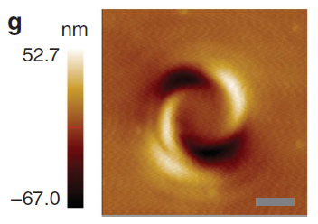
Motivation
Light activated adaptable structures
  Remote temporal and spatial shape control
  Shape memory actuation
Multi-physics coupling
  Influence of molecular scale photoisomerization & polymer network evolution on macroscale
  Unusual photostriction
Performance & efficiency
  Role of heat and polymer network on shape change
hν
hν
hν
Increasing cross-link density
Opposite photostriction in SRGs
Cheng, L., et al., J. Appl. Phys. v. 112, p. 013513, 2012.
Oates, W., Bin, J., “Unifying Relations in Polymer Photomechanics,” SPIE Smart Structures and Materials, v. 943202, doi: 10.1117/12.2084344, 2015.
W. Oates and J. Bin, in Shape Memory Polymers for Aerospace Applications: Novel Synthesis, Modeling, Characterization and Design, eds. G. P. Tandon, A. McClung, and J. Baur, 2015.
Complex deformation from optical vortex beams

Slide 3
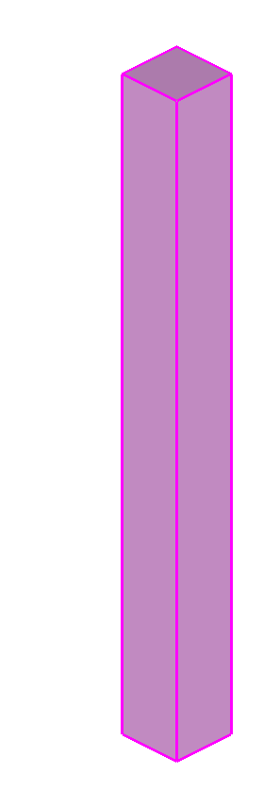
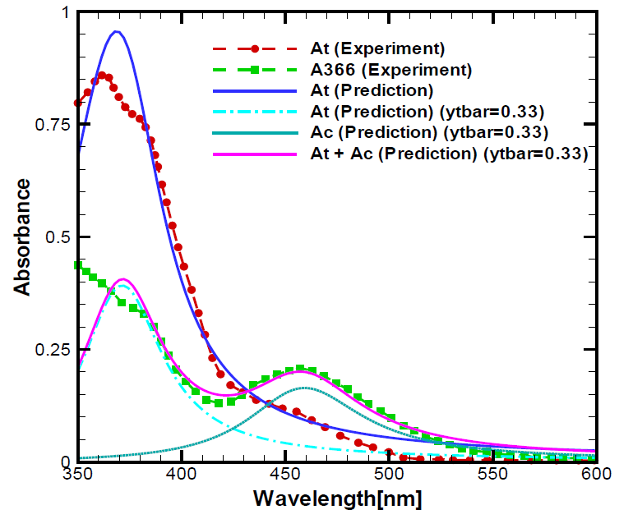

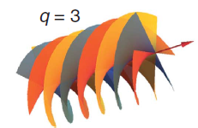
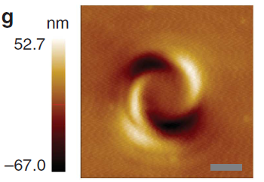
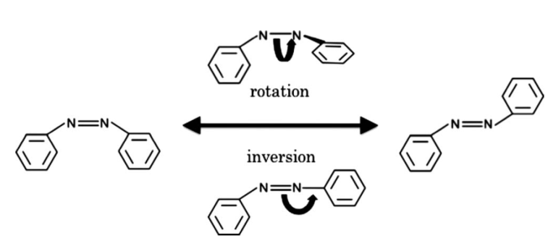
Light-Matter Controlled Adaptive Structures
Excitation wavelengths
Microstructure induced shape change
Polarized light control
A. Ambrosio, et al., Nat. Comm., 3:989, 2012.
Molecular evolution

Slide 4
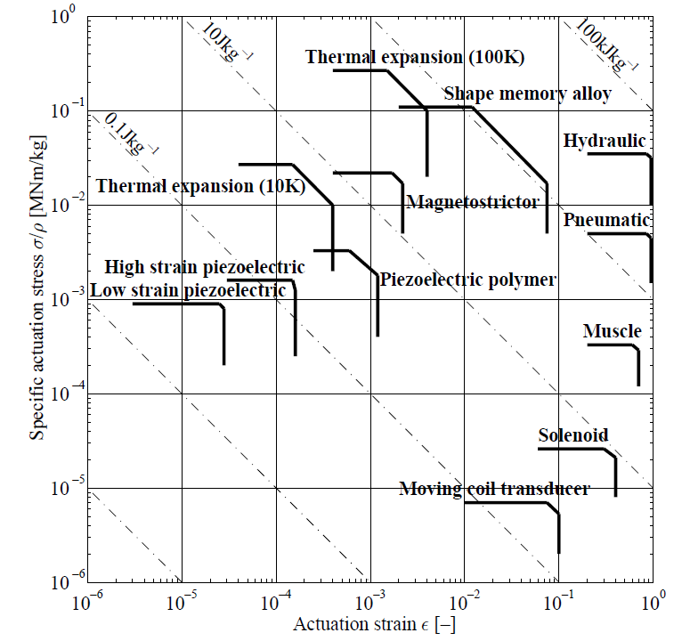
Azo-polymers

Slide 5
Outline
Light-matter modeling
  Multiaxial photomechanical predictions
Model validation
  Experimental characterization of heat and photopolymer viscoelasticity/plasticity
  Bayesian uncertainty analysis
Fractional derivatives (time permitting)
Concluding remarks

Slide 6
Modeling Framework
Unifying Concepts in Photomechanics

Slide 7
Lattice vibrations at long wavelength limit
--- D. F. Nelson, Phys. Rev. A, v. 44(6), p. 3985, 1991
M
m
Optic mode
Acoustic mode
Optic mode
Local motion
Acoustic mode
Macroscopic deformation

Slide 8
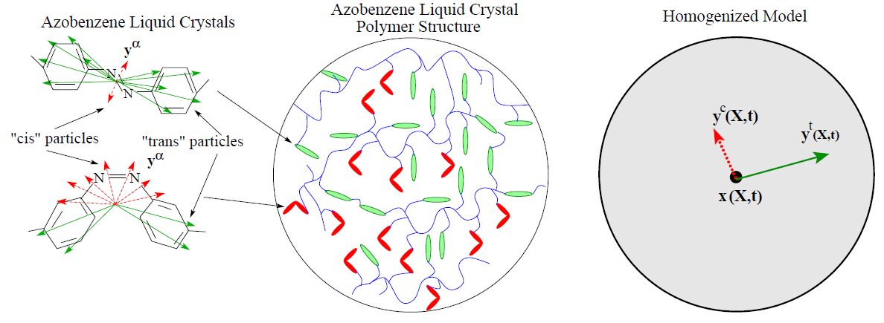
Molecular Energy Transfer→ Continuum deformation
Azobenzene electronic structure
light
Total photomechanical strain
heat
Non-affine polymer deformation

Slide 9
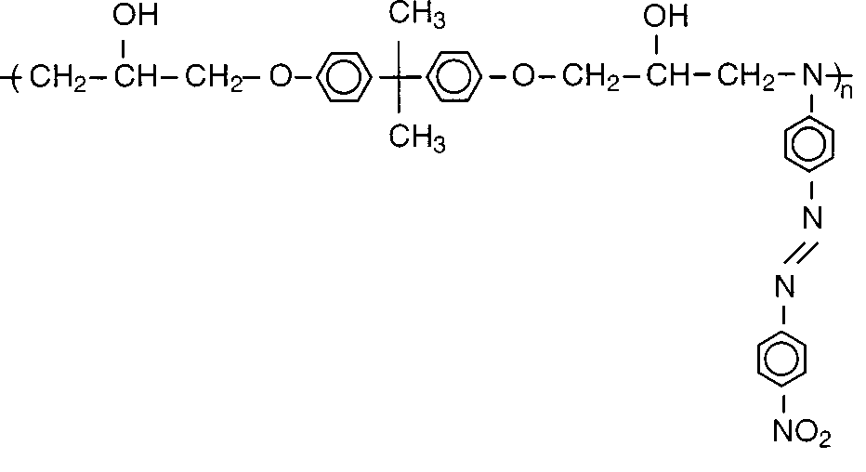
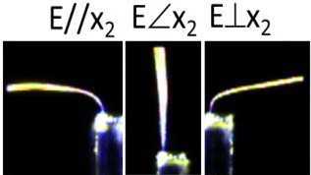
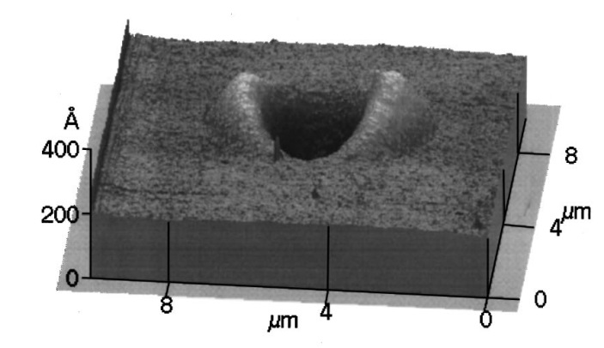
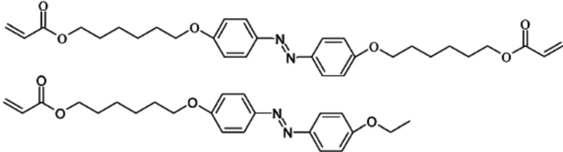
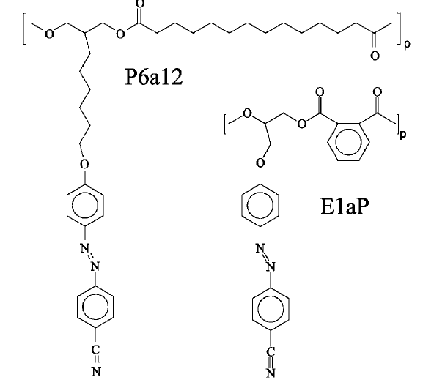
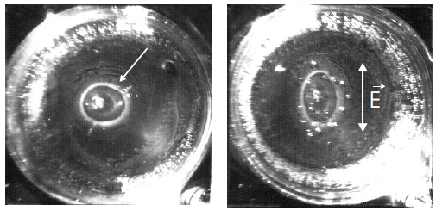
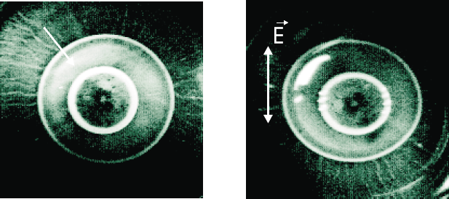
Polymer Chemistry
Bian, S., et al., J. Appl. Phys. v. 86(8), p. 4498, 1999.
Cheng, L., et al., J. Appl. Phys. v. 112, p. 013513, 2012.
E1aP
P6a12
D. Bublitz et al., Appl. Phys. B, 70, 863-865, 2000.

Slide 10
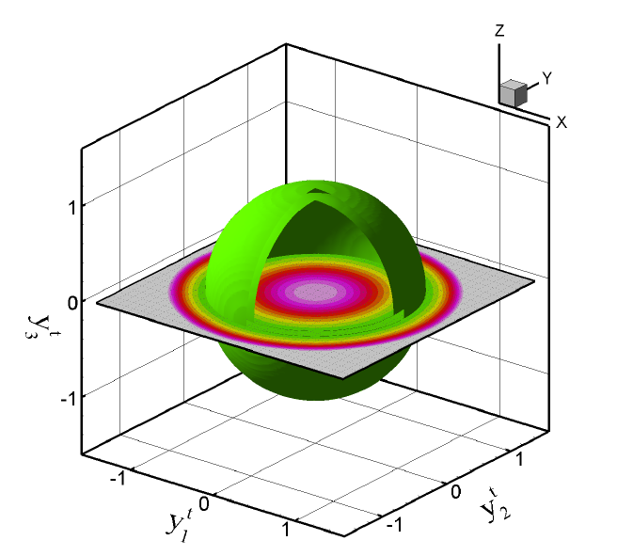
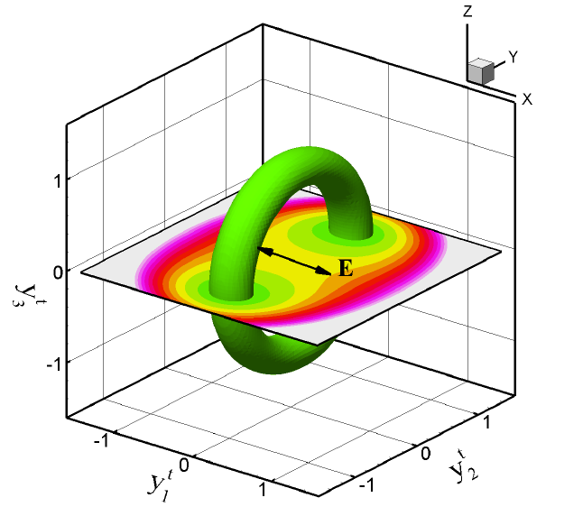
Lagrangian Density Relations
Acoustic and optic mode decomposition
Light-matter interactions
Losses via entropy generation
10

Slide 11
Balance Equations
Maxwell’s equations
Linear momentum
Electronic (optical mode) force balance
Photostrictive azo-polymer coupling
Dipole energy
Quadrupole energy

Slide 12
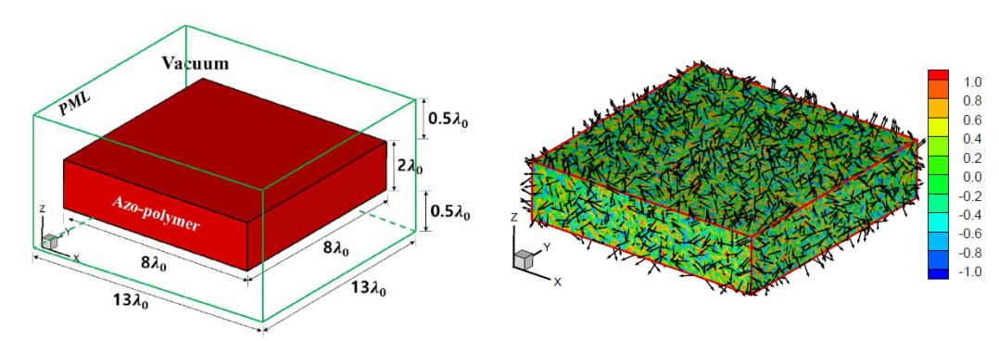
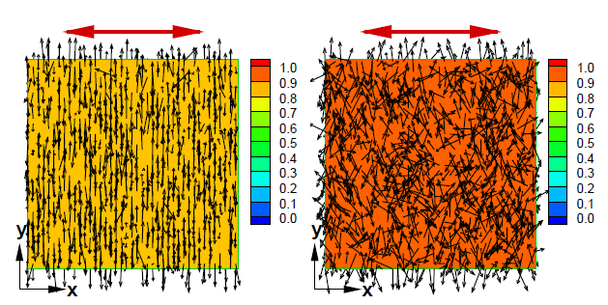
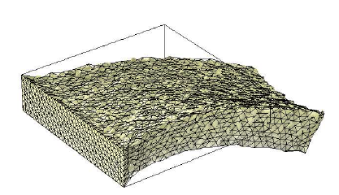
Stationary Bending and Twisting
hν
Finite element/finite difference simulations
Uniform, polarized light exposure
Qualitative correlation with data
Numerical domain—material & surrounding vacuum
Initial polydomain azobenzene microstructure
Polarization direction
Microstructure evolution—exposed side
Microstructure evolution—bottom side
Bending from gradient of microstructure through thickness

Slide 13
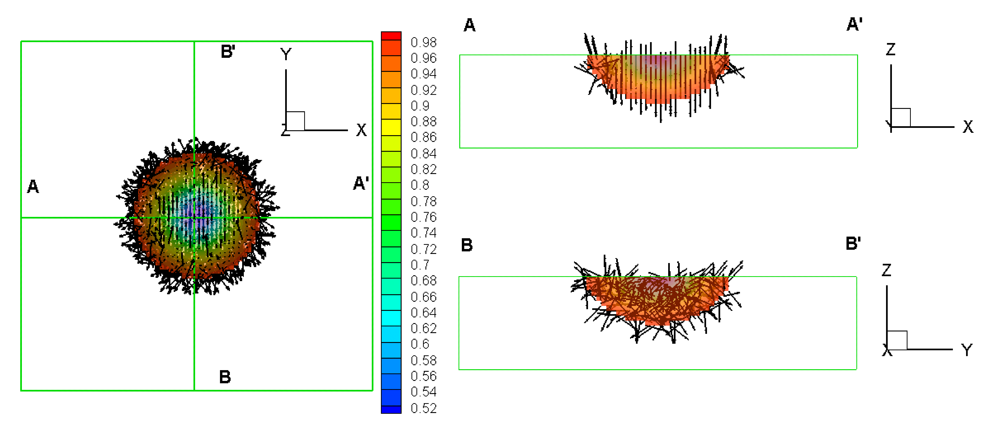
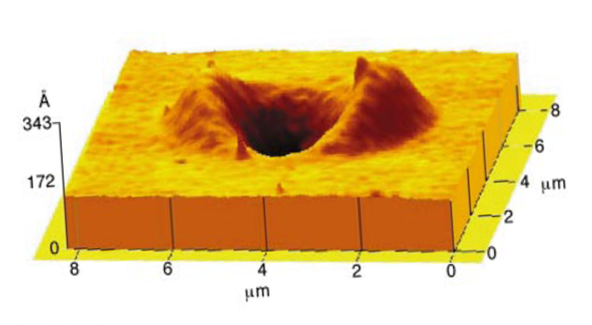
Surface Deformation
Comparisons made with complex surface deformation
  Linear polarized light
  Circularly polarized light
  Vortex beams with different topological charge
trans state
Linearly polarized light
Viswanathan, et. al, J. Mater. Chem., 9:1941, 1999.
A. Ambrosio, et al., Nat. Comm., 3:989, 2012.
W. Oates and J. Bin, “Non-equilibrium thermodynamics and electromagnetics of azobenzene liquid crystal polymer networks” Shape Memory Polymers for Aerospace Applications: Novel Synthesis, Modeling, Characterization and Design, eds. G. P. Tandon, A. McClung, and J. Baur, DEStech Publications, Inc. pg. 183-225, 2016.
Bin, J., Oates, W., "A Unified Material Description for Light Induced Deformation in Azobenzene Polymers," Scientific Reports, v. 5(14654), pp. 1-12, 2015.

Slide 14
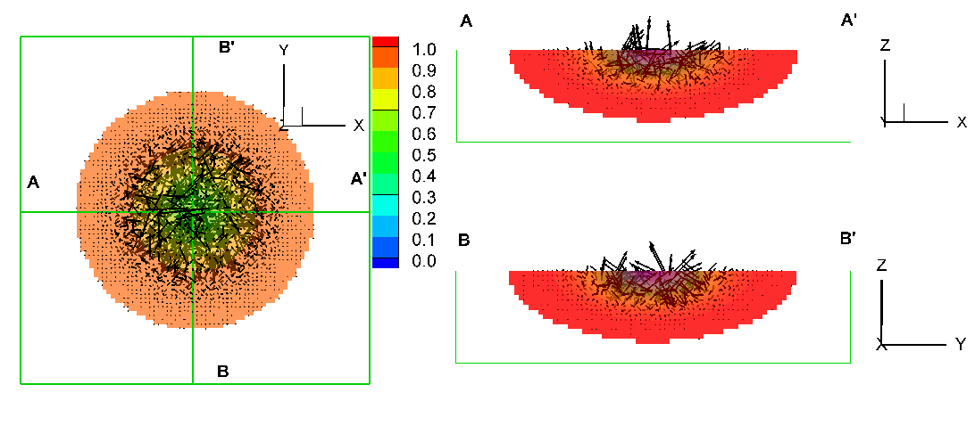
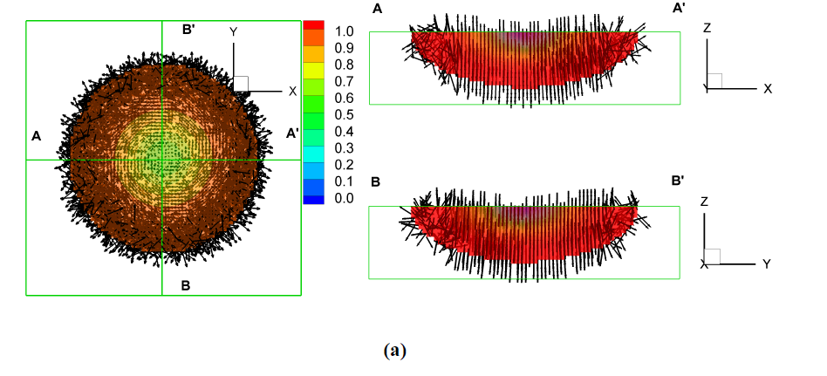
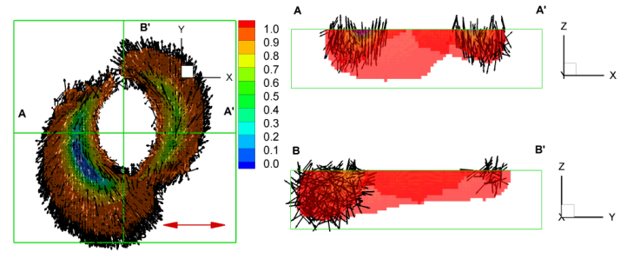
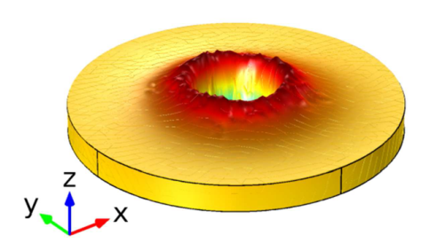
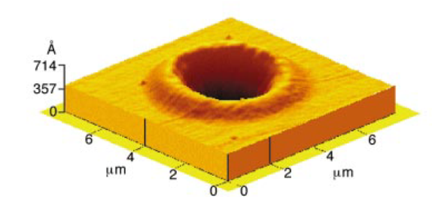

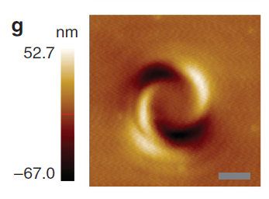
Stationary Surface Deformation
Circularly polarized light
Vortex beams with different topological charge
trans state
cis state
trans state
Circularly polarized light

Slide 15
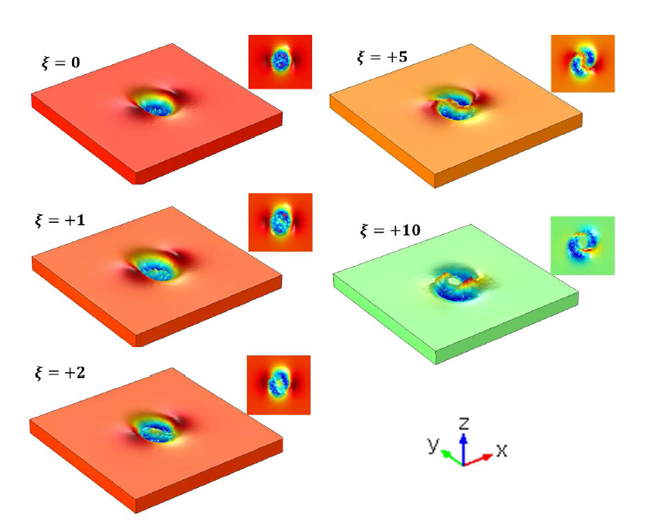
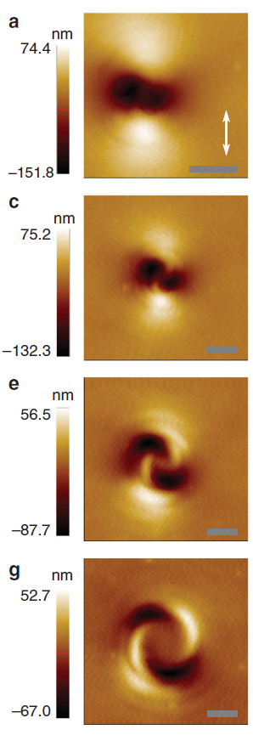
Topological Charge Analysis
Model Predictions
Validation
ξ=1
ξ=5
ξ=2
ξ=10

Slide 16

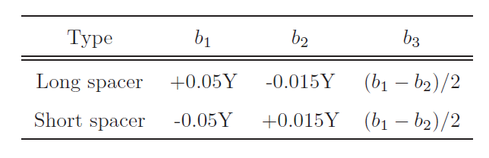
Modeling Summary
Chemical structure influence on photostriction
  Long azo-spacers—prolate deformation
  Short azo-spacers—oblate deformation
Photostrictive parameters

Slide 17
Experimental Characterization
Thermal, viscoelasticity, liquid crystal microstructure evolution

Slide 18
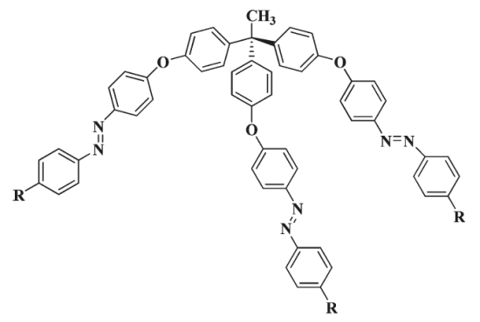
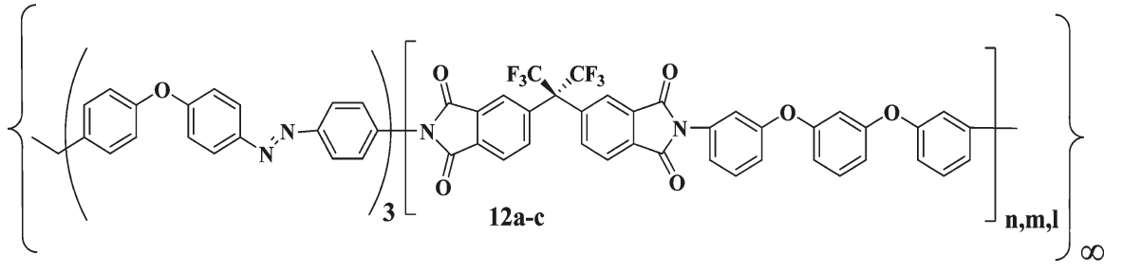
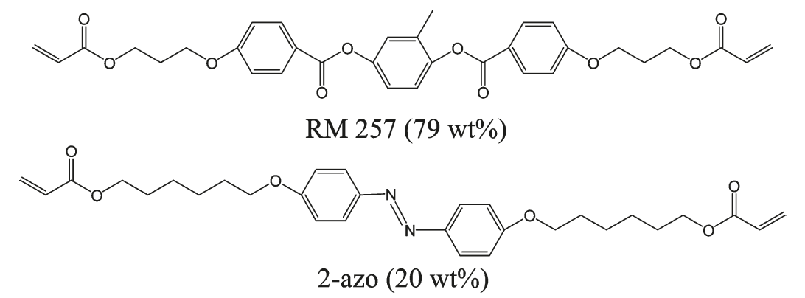
Material Compositions
Azobenzene 35% weight polyimide composition
Azobenzene 20% weight polyacrylate composition

Slide 19
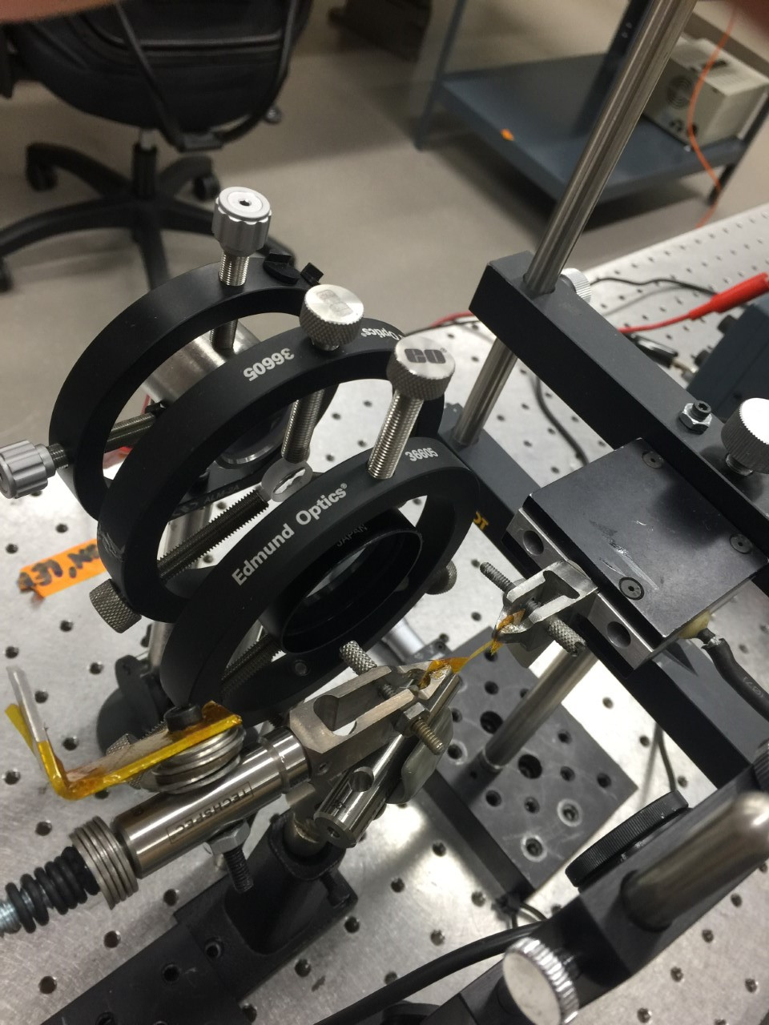
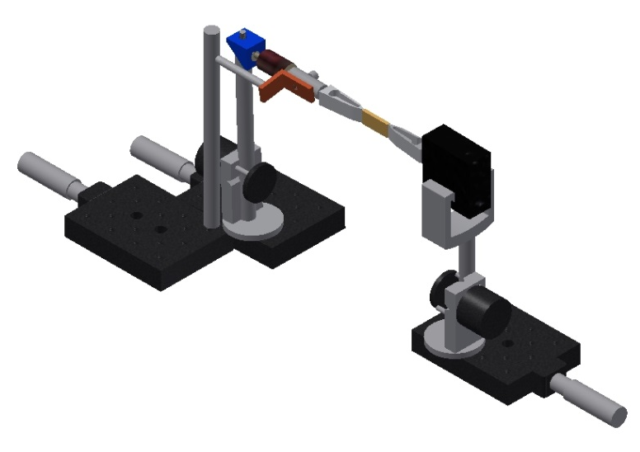
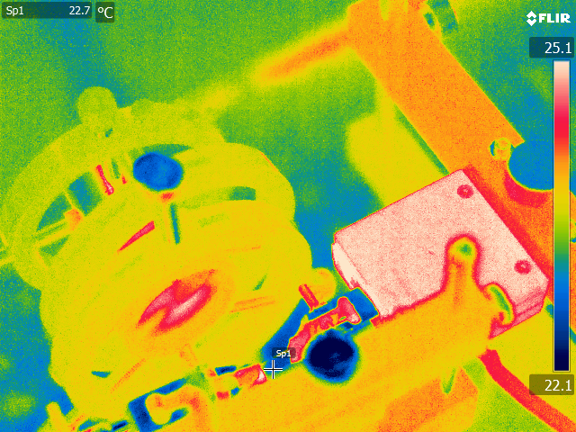
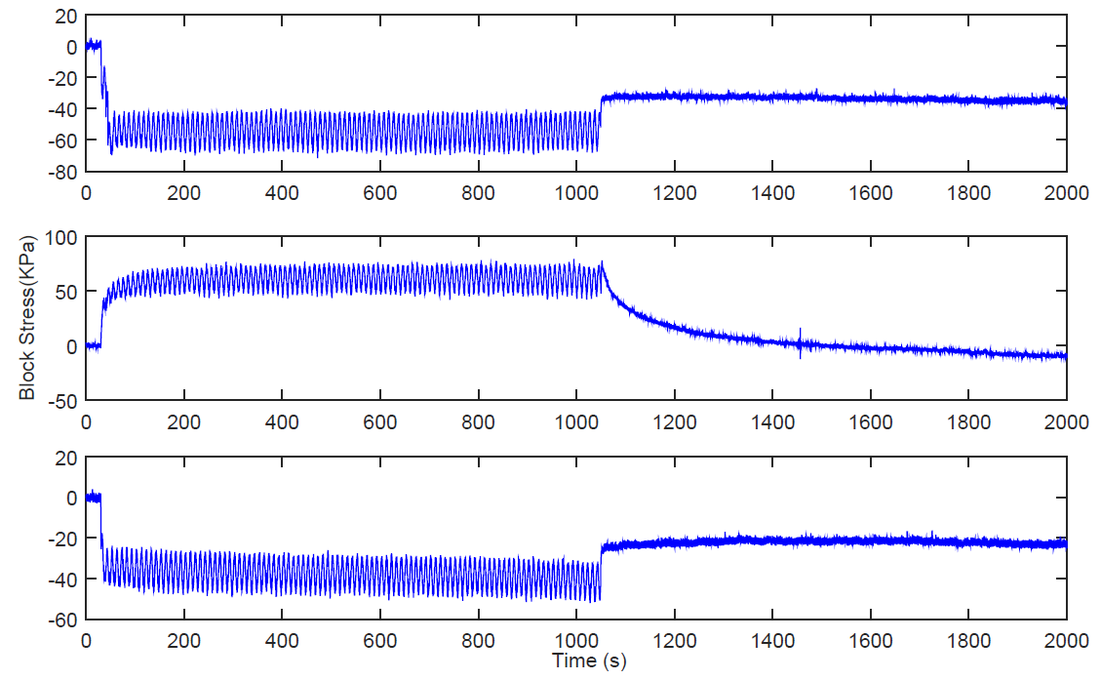
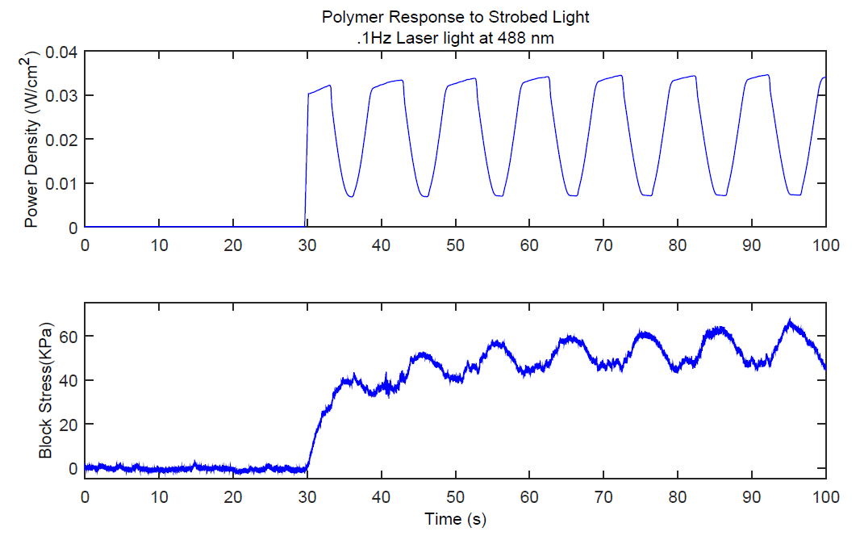
Rate Dependence/Shape Memory
Photochemical and photomechanical measurements
Light induced blocked stress
Compositions
  Azo-polyimide (below)
  Azo-polyacrylate (next slide)
Piezo actuator
Servo control
Light source
Specimen
Laser (488nm) excitation (E x)
Laser (488nm) excitation (E x)
Laser (488nm) excitation (E x)

Slide 20
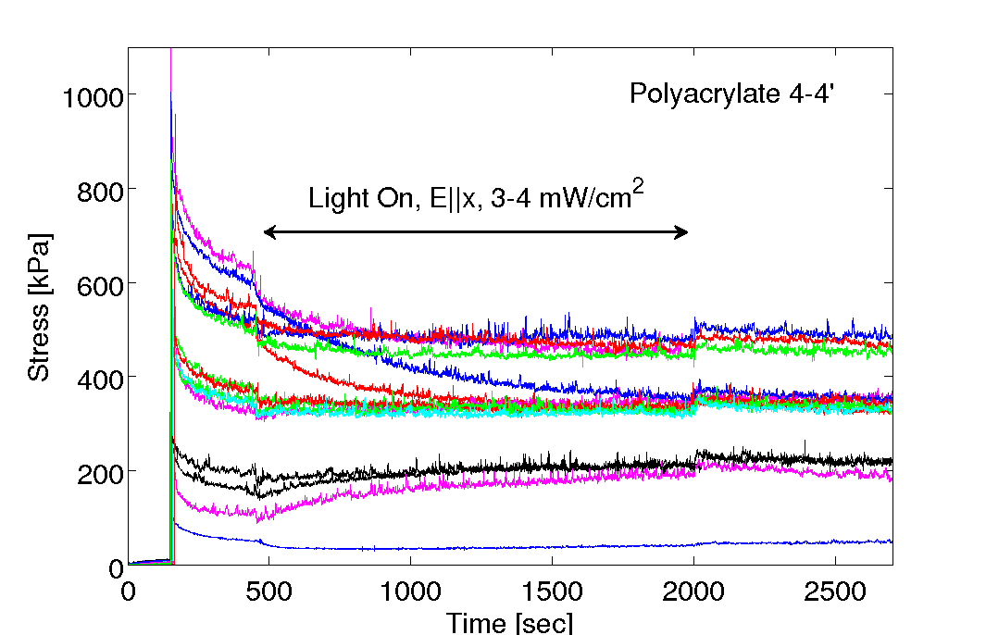
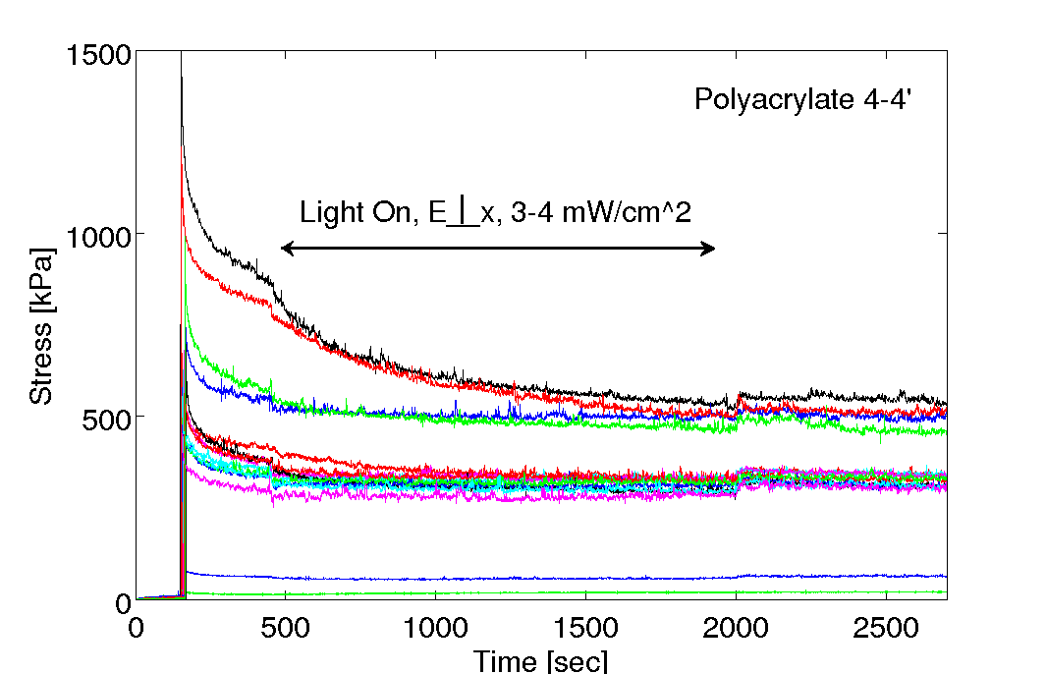
Pre-stress and Photostriction
E
E

Slide 21
Constitutive Parameter Analysis
Gibbs energy function
Multi-physics coupling
  Thermomechanics
  Electronic structure (azo)
  Photostriction
  Thermal energy
  Viscoelasticity
Entropy generation
Mobility dependence on free volume via trace of internal stress

Slide 22
Polymer Mobility
Viscoelasticity ∝ energy barrier
  Viscosity of internal network (inverse mobility)
Free volume effects on energy barrier
Hypothesis:
Arrhenius relation
Internal hydrostatic stress

Slide 23
Bayesian Parameter Estimation
Thermal, viscoelasticity, liquid crystal microstructure evolution

Slide 24
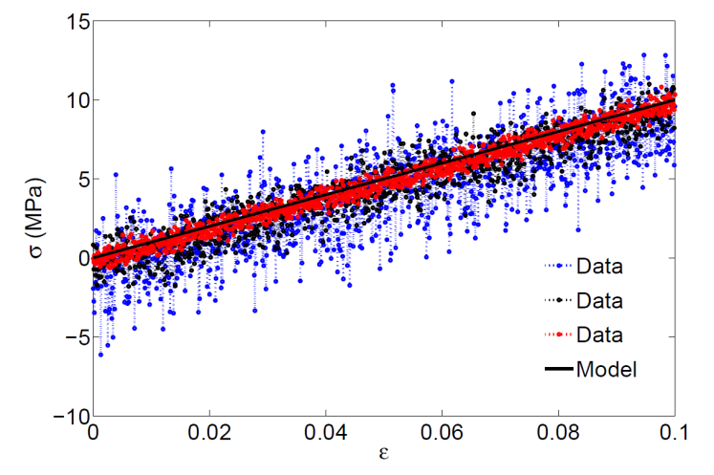
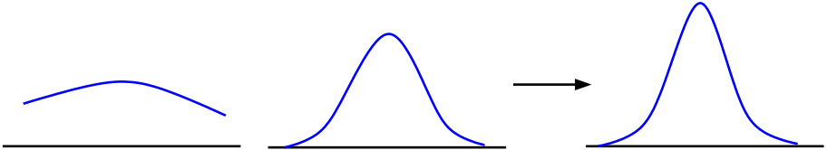
Bayesian Uncertainty Analysis
Quotes:
  It’s tough to make predictions, especially about the future, Neils Bohr.
  What is not surrounded by uncertainty cannot be the truth, Richard Feynman.
Information processing
  Lack of information→uncertainty
  Bayes’ rule is the machinery used to process information from prior knowledge into a new belief (posterior probability distribution)
Information Provided by Model and Data
Updated Information
Prior Information
e

Slide 25
Parameter Estimation & UQ
Bayesian uncertainty quantification
  Estimation of light-induced heat generation
  Photomechanics coupled to thermo-viscoelastic/plastic behavior
    Numerical implementation
      Bayes’ equation
      MCMC/DRAM* sampling method
Likelihood
Prior Distribution
Posterior Distribution
Normalization factor
    *Markov Chain Monte Carlo/Delayed Rejection Adaptive Metropolis

Slide 26
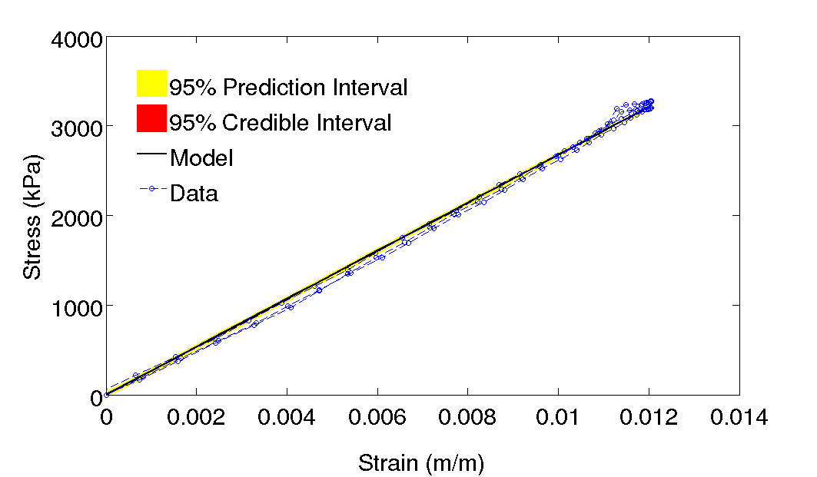
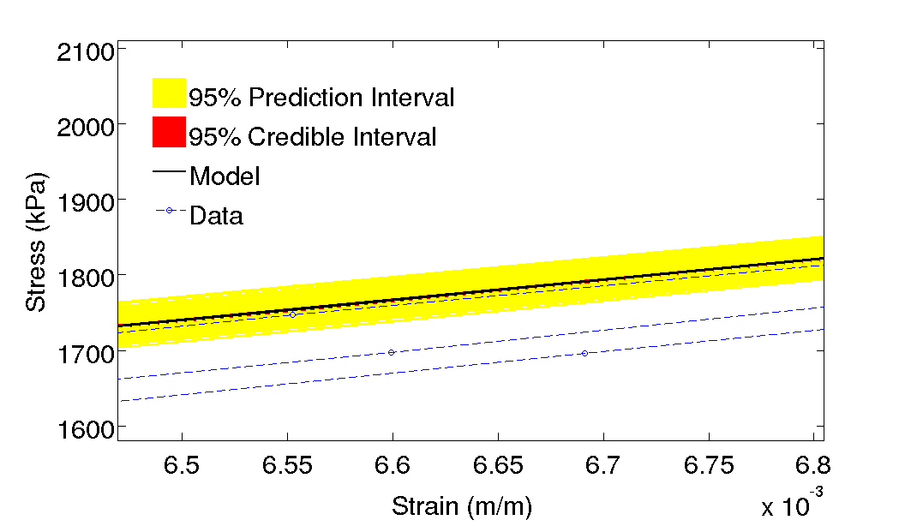
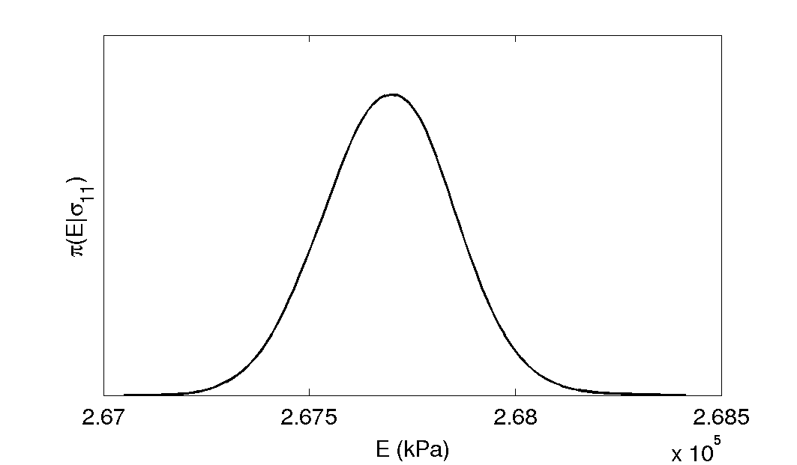
Elastic Modulus Uncertainty
Conduct cyclic loading on polyimide films
Quasi-static loading rate, 65 mHz
Parameter estimation of elastic modulus

Slide 27




Thermal Effects
Light energy converted to heat determined
Energy balance
Simplified form
Thermal time constant
Light→heat energy conversion

Slide 28




Rate Dependent Stress
Propagation of error in stress predictions
  Parameter uncertainty propagated through posterior densities
Broad parameter space sampled over
  Thermoelastic, viscoelastic, photostriction parameter estimation

Slide 29


Perpendicular Light Excitation

Slide 30




Parameter Comparisons
Laser excitation (E x)
Laser excitation (E x)
 | Mean | Standard Deviation
α (ppm/°C) | 116 | 28.7
E^{Q} (kPa) | 1281 | 128.3
γ₀^{Q} | 56.9 | 59.7
γ_{y} | 2.04E+07 | 7.47E+05
d₃₃ | 4.39 | 0.42
d₃₁ | -0.027 | 0.025
A | -- | --
 | Mean | Standard Deviation
α (ppm/°C) | -- | --
E^{Q} (kPa) | 431 | 33.4
γ₀^{Q} | 9.43E-07 | 3.09E-07
γ_{y} | 2.23E+05 | 1.75E04
d₃₃ | 1.77 | 0.16
d₃₁ | -4.45 | 0.56
A | 138.8 | 5.36

Slide 31
Fractional Derivatives
Dielectric Elastomers

Slide 32



Fractional Derivatives
Caputo derivative of fractional order α
  Applicable to linear viscoelasticity
Grunwald-Letnikov of fractional order α
  Applicable to nonlinear viscoelasticity
1
0
Memory

Slide 33

Fractional Derivative Theory
Second law dependent upon polymer network evolution
Entropy generation function, $F\left(\dot{Г},λ\right)$ is
Fractional derivative takes the form
Internal fractional stress dependence becomes
Notes:
λ--polymer stretch ratio, Γ--internal degrees of freedom of polymer network motion

Slide 34

Parameter Analysis
Fixed set of hyperelastic parameters
Effect of fractional derivative order α

Slide 35




Statistical Analysis
Model validated on 3M VHB elastomer
Parameter Sampling
  ${10}^{4}$ simulations
  Converged posterior densities
Figure 1: Parameter posterior densities – sampled values for fractional order, $α$, and coefficient, $η$.
Table 1: Mean parameter values from sampling of fractional order viscoelastic model.
$$Rate [1/s]$$ | $η$ $[kPa]$ | $α$ $[−]$
$$6.7\text{x}{10}^{−5}$$ | $$35.0$$ | $$0.12$$
$$0.0472$$ | $$26.8$$ | $$0.11$$
$$0.10$$ | 25.5 | $$0.12$$
$$0.335$$ | 40.6 | $$0.12$$
$$0.50$$ | 40.0 | $$0.12$$
$$0.67$$ | 38.9 | $$0.15$$
Figure 2: Parameter chain – sampled values for fractional order, $α$, and coefficient, $η$.

Slide 36










Predictions—Integer Order
Predict stress at stretch rates not used for model calibration.
  Integer order
  Nonlinear viscoelastic
  Calibrated at $6.7\text{x}{10}^{−5} Hz$
Optimal fit requires 10⁴ change in time constant
$${dλ}/{dt}=6.7\text{x}{10}^{−5} Hz$$
$${dλ}/{dt}=0.0472 Hz$$
$${dλ}/{dt}=0.335 Hz$$
$${dλ}/{dt}=0.67 Hz$$

Slide 37










Predictions—Fractional Order
Predict stress at stretch rates not used for model calibration.
  Fractional order
  Nonlinear viscoelastic
  Calibrated at $6.7\text{x}{10}^{−5} Hz$
Optimal fit requires small change in fractional order
$${dλ}/{dt}=6.7\text{x}{10}^{−5} Hz$$
$${dλ}/{dt}=0.0472 Hz$$
$$Rate [1/s]$$ | $η$ $[kPa]$ | $α$ $[−]$
$$6.7\text{x}{10}^{−5}$$ | $$35.0$$ | $$0.12$$
$$0.0472$$ | $$26.8$$ | $$0.11$$
$$0.10$$ | 25.5 | $$0.12$$
$$0.335$$ | 40.6 | $$0.12$$
$$0.50$$ | 40.0 | $$0.12$$
$$0.67$$ | 38.9 | $$0.15$$
$${dλ}/{dt}=0.335 Hz$$
$${dλ}/{dt}=0.67 Hz$$

Slide 38
Summary
Polarized light control of polymer deformation
  Advantageous in temporal and spatially controlled adaptive structures
Key developments
  Identified differences in dipole (electric field) and quadrupole (electric field gradient) forces on photostriction
  Rate dependent viscoelastic and shape memory effects quantified using uncertainty analysis
  Superior prediction of viscoelasticity using fractional derivatives
On-going research
  Materials synthesis of several mesogens and polymer systems with up-conversion
  Material repeatability
    Cyclic loading and viscoelastic/plastic effects in presence/absence of light
  Technology transfer to flow control

Slide 39
Thank You

Slide 40
Balance Equations
Maxwell’s equations
Linear momentum
Electronic (optical mode) force balance
Non-affine polymer deformation
Photostrictive azo-polymer coupling
Non-affine polymer network coupling
Dipole energy
Quadrupole energy

