Slide 1
Deterministic Objects: Life Beyond Consensus
Yehuda Afek, Faith Ellen, and ElI GafNi
PODC 2016

Slide 2
Herlihy’s Consensus Hierarchy
consensus-number(O) = maximum number n such that wait-free consensus among n processes can be solved using only copies of object O and (read/write) registers
consensus, LL/SC, compare&swap,…
∞
⋮
2-consensus, fetch&add, test&set, swap, queue,…
2
register, 2-set-consensus, 3-set-consensus,…
1

Slide 3

2-consensus object
supports: propose(v) for v $∈ℕ$

Slide 4

2-consensus object
supports: propose(v) for v $∈ℕ$
propose(v₁) a⟵ v₁; return a

Slide 5

2-consensus object
supports: propose(v) for v $∈ℕ$
propose(v₁) a⟵ v₁; return a
propose(v₂) return a

Slide 6

2-consensus object
supports: propose(v) for v $∈ℕ$
propose(v₁) a⟵ v₁; return a
propose(v₂) return a
propose(v₃) return⊥

Slide 7
Universality of n-consensus
There is a wait-free implementation of any object using only n-consensus objects and registers in a system of at most n processes.

Slide 8
Universality of n-consensus
There is a wait-free implementation of any object using only n-consensus objects and registers in a system of at most n processes.
What about in systems with more than n processes?

Slide 9
Universality of n-consensus
There is a wait-free implementation of any object using only n-consensus objects and registers in a system of at most n processes.
What about in systems of more than n processes?
Within level 1, there are an infinite number of incomparable objects.

Slide 10
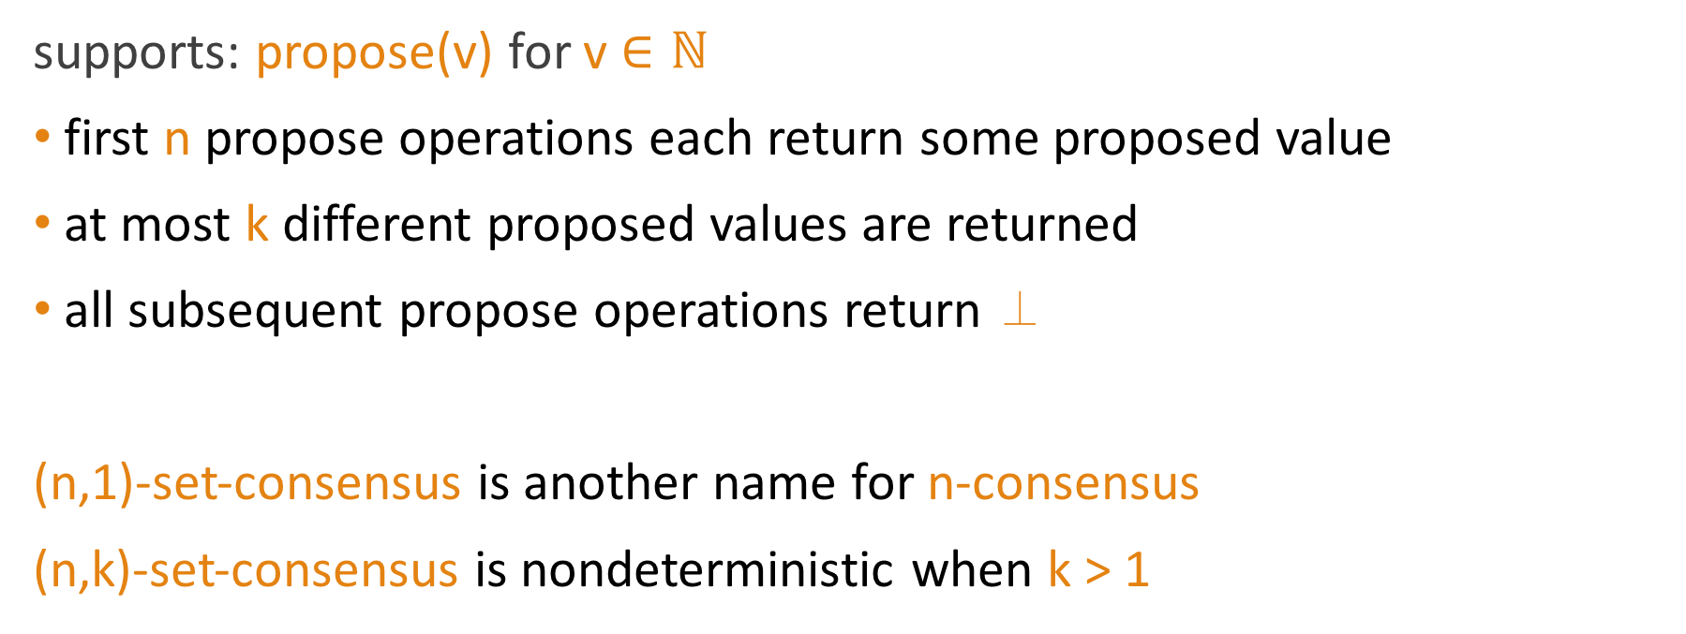
(n,k)-set-consensus for n > k ≥ 1
supports: propose(v) for v $∈ℕ$
first n propose operations each return some proposed value
at most k different proposed values are returned
all subsequent propose operations return ⊥
(n,1)-set-consensus is another name for n-consensus
(n,k)-set-consensus is nondeterministic when k > 1

Slide 11
Theorem [Borowsky & Gafni 1993, Chaudhuri & Reiners 1996]
In a system of n or more processes, an (n,k)-set-consensus object can be implemented from (m,j)-set-consensus objects and registers if and only if
k ≥ j,
n/k ≤ m/j, and
either k ≥ j ⎡n/m⎤ or k ≥ j ⎣n/m⎦ + n – m ⎣n/m⎦ .
For example, a (2k,k)-set-consensus object can be implemented from 2-consensus objects and registers but a (2k+1,k)-set-consensus object cannot.

Slide 12
(4,2)-set-consensus can be implemented from 2-consensus objects
PROPOSE(v):
f ⟵ fetch&inc(F)
if f ≥ 5 then return ⊥
g ⟵ ⎡f/2⎤
c ⟵ propose(v) to C_{g}
return c
⊥
1
C₁
F
⊥
C₂

Slide 13
(4,2)-set-consensus can be implemented from 2-consensus objects
PROPOSE(v):
f ⟵ fetch&inc(F)
if f ≥ 5 then return ⊥
g ⟵ ⎡f/2⎤
c ⟵ propose(v) to C_{g}
return c
PROPOSE(v₁): returns v₁
v₁
2
C₁
F
⊥
C₂

Slide 14
(4,2)-set-consensus can be implemented from 2-consensus objects
PROPOSE(v):
f ⟵ fetch&inc(F)
if f ≥ 5 then return ⊥
g ⟵ ⎡f/2⎤
c ⟵ propose(v) to C_{g}
return c
PROPOSE(v₁): returns v₁ PROPOSE (v₂):
v₁
3
C₁
F
⊥
C₂

Slide 15
(4,2)-set-consensus can be implemented from 2-consensus objects
PROPOSE(v):
f ⟵ fetch&inc(F)
if f ≥ 5 then return ⊥
g ⟵ ⎡f/2⎤
c ⟵ propose(v) to C_{g}
return c
PROPOSE(v₁): returns v₁ PROPOSE (v₂):
PROPOSE(v₃):
v₁
4
C₁
F
⊥
C₂

Slide 16
(4,2)-set-consensus can be implemented from 2-consensus objects
PROPOSE(v):
f ⟵ fetch&inc(F)
if f ≥ 5 then return ⊥
g ⟵ ⎡f/2⎤
c ⟵ propose(v) to C_{g}
return c
PROPOSE(v₁): returns v₁ PROPOSE (v₂):
PROPOSE(v₃): PROPOSE (v₄): returns v₄
v₁
5
C₁
F
v₄
C₂

Slide 17
(4,2)-set-consensus can be implemented from 2-consensus objects
PROPOSE(v):
f ⟵ fetch&inc(F)
if f ≥ 5 then return ⊥
g ⟵ ⎡f/2⎤
c ⟵ propose(v) to C_{g}
return c
PROPOSE(v₁): returns v₁ PROPOSE (v₂):
PROPOSE(v₃): returns v₄
PROPOSE(v₄): returns v₄
v₁
5
C₁
F
v₄
C₂

Slide 18
(4,2)-set-consensus can be implemented from 2-consensus objects
PROPOSE(v):
f ⟵ fetch&inc(F)
if f ≥ 5 then return ⊥
g ⟵ ⎡f/2⎤
c ⟵ propose(v) to C_{g}
return c
PROPOSE(v₁): returns v₁ PROPOSE (v₂): returns v₁
PROPOSE(v₃): returns v₄
PROPOSE(v₄): returns v₄
v₁
5
C₁
F
v₄
C₂

Slide 19
Theorem [Rachman 1994]
For all m ≥ 2, there is a non-deterministic object of consensus number m that cannot be implemented from n-consensus objects and registers in a system of 2n + 1 processes, for all n ≥ 2.

Slide 20
Theorem [Gafni & Kuznetsov, 2007]
Any algorithm using only deterministic objects of consensus numbers at most n can be simulated using n-consensus objects and registers in a system of n+1 processes.

Slide 21
Common2 Conjecture [Afek, Weisberger, & Weisman, 1993]
Any deterministic object of consensus number 2 can be implemented from 2-consensus objects and registers in a system with any finite number of processes.

Slide 22
Common2 Conjecture [Afek, Weisberger, & Weisman]
Any deterministic object of consensus number 2 can be implemented from 2-consensus objects and registers in a system with any finite number of processes.
test&set objects, fetch&add objects, swap objects, and stacks can be implemented from 2-consensus objects and registers in a system with any finite number of processes.

Slide 23
Consensus Hierarchy Conjecture
For all m ≥ 2, any deterministic object of consensus number m can be implemented from m-consensus objects and registers in a system with any finite number of processes.

Slide 24
Consensus Hierarchy Conjecture
FALSE
For all m ≥ 2 any deterministic object of consensus number m can be implemented from m-consensus objects and registers in a system with any finite number of processes.

Slide 25
Theorem
For all m ≥ 2, there is a deterministic object O_{m,2} with consensus number m that cannot be implemented from m-consensus objects and registers in a system of 2m + 1 processes.

Slide 26
Theorem
For all m ≥ 2 and k ≥ 2, there are deterministic objects O_{m,k} with consensus number m such that:
O_{m,2} cannot be implemented from m-consensus objects and registers in a system of 2m + 1 processes,
O_{m,k+1} cannot be implemented from O_{m,k} objects and registers in a system of km + m + k processes, and
O_{m,k} can be implemented from an O_{m,k+1} object in a system with any finite number of processes.

Slide 27
Theorem
⋮
3-consensus < O_{3,2} < O_{3,3}< O_{3,4} < O_{3,5} < ⋯
2-consensus < O_{2,2} < O_{2,3}< O_{2,4} < O_{2,5} < ⋯

Slide 28
Theorem
⋮
3-consensus
⋮
O_{2,3}
v
O_{2,2}
v
2-consensus

Slide 29

O_{2,2} object A₁A₁A₂A₂A₁
supports: suggest(v) for v $∈ℕ$

Slide 30
O_{2,2} object A₁A₁A₂A₂A₁
supports: suggest(v) for v ∊ N
suggest(v₁) a₁⟵ v₁; return a₁

Slide 31
O_{2,2} object A₁A₁A₂A₂A₁
supports: suggest(v) for v ∊ N
suggest(v₁) a₁⟵ v₁; return a₁
suggest(v₂) return a₁

Slide 32
O_{2,2} object A₁A₁A₂A₂A₁
supports: suggest(v) for v ∊ N
suggest(v₁) a₁⟵ v₁; return a₁
suggest(v₂) return a₁
suggest(v₃) a₂⟵ v₃; return a₂

Slide 33
O_{2,2} object A₁A₁A₂A₂A₁
supports: suggest(v) for v ∊ N
suggest(v₁) a₁⟵ v₁; return a₁
suggest(v₂) return a₁
suggest(v₃) a₂⟵ v₃; return a₂
suggest(v₄) return a₂

Slide 34
O_{2,2} object A₁A₁A₂A₂A₁
supports: suggest(v) for v ∊ N
suggest(v₁) a₁⟵ v₁; return a₁
suggest(v₂) return a₁
suggest(v₃) a₂⟵ v₃; return a₂
suggest(v₄) return a₂
suggest(v₅) return a₁

Slide 35
O_{2,2} object A₁A₁A₂A₂A₁
supports: suggest(v) for v ∊ N
suggest(v₁) a₁⟵ v₁; return a₁
suggest(v₂) return a₁
suggest(v₃) a₂⟵ v₃; return a₂
suggest(v₄) return a₂
suggest(v₅) return a₁
suggest(v₆) return⊥

Slide 36
O_{m,k} object A₁^{m} A₂^{m} … A_{k-1}^{m} A_{k}^{m} A_{k-1} …A₂ A₁
supports: suggest(v) for v ∊ N
sequential specifications:
increment cnt
if cnt = (j-1)m+1 for j ∊ {1,…,k} then a_{j} ⟵ v; return a_{j}
if (j-1)m + 2 ≤ cnt ≤ jm for j ∊ {1,…,k} then return a_{j}
if cnt = km+k-j for j ∊ {1,…,k-1} then return a_{j}
else return ⊥ % cnt ≥ km+k

Slide 37
O_{m,k} object A₁^{m} A₂^{m} … A_{k-1}^{m} A_{k}^{m} A_{k-1} …A₂ A₁
supports: suggest(v) for v ∊ N
sequential specifications:
increment cnt
if cnt = (j-1)m+1 for j ∊ {1,…,k} then a_{j} ⟵ v; return a_{j}
if (j-1)m + 2 ≤ cnt ≤ jm for j ∊ {1,…,k} then return a_{j}
if cnt = km+k-j for j ∊ {1,…,k-1} then return a_{j}
else return ⊥ % cnt ≥ km+k

Slide 38
O_{m,k} object A₁^{m} A₂^{m} … A_{k-1}^{m} A_{k}^{m} A_{k-1} …A₂ A₁
supports: suggest(v) for v ∊ N
sequential specifications:
increment cnt
if cnt = (j-1)m+1 for j ∊ {1,…,k} then a_{j} ⟵ v; return a_{j}
if (j-1)m + 2 ≤ cnt ≤ jm for j ∊ {1,…,k} then return a_{j}
if cnt = km+k-j for j ∊ {1,…,k-1} then return a_{j}
else return ⊥ % cnt ≥ km+k

Slide 39
O_{m,k} object A₁^{m} A₂^{m} … A_{k-1}^{m} A_{k}^{m} A_{k-1} …A₂ A₁
supports: suggest(v) for v ∊ N
sequential specifications:
increment cnt
if cnt = (j-1)m+1 for j ∊ {1,…,k} then a_{j} ⟵ v; return a_{j}
if (j-1)m + 2 ≤ cnt ≤ jm for j ∊ {1,…,k} then return a_{j}
if cnt = km+k-j for j ∊ {1,…,k-1} then return a_{j}
else return ⊥ % cnt ≥ km+k

Slide 40
O_{m,k} object A₁^{m} A₂^{m} … A_{k-1}^{m} A_{k}^{m} A_{k-1} …A₂ A₁
supports: suggest(v) for v ∊ N
sequential specifications:
increment cnt
if cnt = (j-1)m+1 for j ∊ {1,…,k} then a_{j} ⟵ v; return a_{j}
if (j-1)m + 2 ≤ cnt ≤ jm for j ∊ {1,…,k} then return a_{j}
if cnt = km+k-j for j ∊ {1,…,k-1} then return a_{j}
else return ⊥ % cnt ≥ km+k

Slide 41
Solving m-consensus using an O_{m,k} object
A₁^{m} A₂^{m} … A_{k-1}^{m} A_{k}^{m} A_{k-1} … A₂A₁
If m processes each perform suggest once, then they all output a₁, the input of the process that performs suggest first.

Slide 42
(m+1)-consensus cannot be solved using only O_{m,k} objects and registers
proved using a valency argument

Slide 43
B
initial bivalent configuration
C
critical configuration
s₀
s₁
s₂
C₀
C₂
C₁
univalent configurations
0
0
1
1

Slide 44
s₀ and s₁ must access the same object.
They cannot both be reads.
B
initial bivalent configuration
C
critical configuration
s₀
s₁
C₀
C₁
univalent configurations
s₁
s₀
0
0
1
1
?

Slide 45
s₀ cannot be a write.
B
initial bivalent configuration
C
critical configuration
s₀
s₁
C₀
C₁
univalent configurations
s₀
0
0
C₁₀
1
1

Slide 46
s₀, s₁ and s₂ must all be suggest operations accessing the same O_{2,2} object.
B
initial bivalent configuration
C
critical configuration
s₀
s₁
s₂
C₀
C₂
C₁
univalent configurations
0
0
1
1

Slide 47
s₀ = suggest(v₀) on O s₁ = suggest(v₁) on O s₂ = suggest(v₂) on O
O.cnt ∊ {1,3} in C
C
critical configuration
s₀
s₁
s₂
C₀
C₂
C₁
univalent configurations
0
0
1
1
A₁A₁A₂A₂A₁

Slide 48
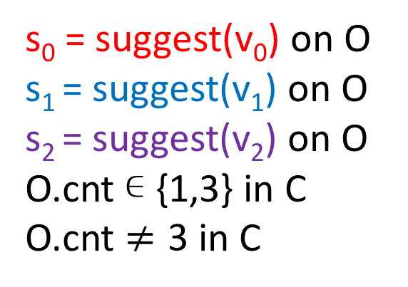
s₀ = suggest(v₀) on O s₁ = suggest(v₁) on O s₂ = suggest(v₂) on O
O.cnt ∊ {1,3} in C
O.cnt $≠\text{3}$ in C
C
critical configuration
s₀
s₁
s₂
C₀
C₂
C₁
univalent configurations
s₁
s₀
0
1
C₀₁
C₁₀
A₁A₁A₂A₂A₁

Slide 49
s₀ = suggest(v₀) on O s₁ = suggest(v₁) on O s₂ = suggest(v₂) on O
O.cnt = 1 in C
C
critical configuration
s₀
s₁
s₂
O.a₁ = v₀
O.cnt = 2
univalent configurations
C₀
C₂
C₁
s₂
0
C₁₂
1
s₀
O.a₁ = v₁
O.a₂ = v₀
O.cnt = 4
C₁₂₀
A₁A₁A₂A₂A₁

Slide 50
s₀ = suggest(v₀) on O s₁ = suggest(v₁) on O s₂ = suggest(v₂) on O
O.cnt = 1 in C
C
critical configuration
s₀
s₁
s₂
C₀
C₂
C₁
univalent configurations
σ
s₂
σs₀’ is a solo execution by p₀ starting from C₀
σ contains 1 suggest on O
s₀’ is a suggest on O
0
C₁₂
1
s₀’
s₁
s₀
C₁₂₀
s₂
σ
O.a₁ = v₀
O.a₂ = v₁
O.cnt = 5
O.a₁ = v₁
O.a₂ = v₀
O.cnt = 5
A₁A₁A₂A₂A₁
s₀’
s₀’

Slide 51
(m+1)-consensus cannot be solved using only O_{m,k} objects and registers
proved using a valency argument
O_{m,k} has consensus number m

Slide 52
Solving (mk + k -1,k)-set-consensus using an O_{m,k} object
A₁^{m} A₂^{m} … A_{k-1}^{m} A_{k}^{m} A_{k-1} … A₂A₁
If mk + k -1 processes each perform suggest once, then they each output one of a₁,…, a_{k}.

Slide 53
Solving (mk + k -1,k)-set-consensus using an O_{m,k} object
A₁^{m} A₂^{m} … A_{k-1}^{m} A_{k}^{m} A_{k-1} … A₂A₁
If mk + k -1 processes perform suggest once each, then they each output one of a₁,…, a_{k}.
A (5,2)-set-consensus object can be implemented from an O_{2,2} object.

Slide 54
An O_{2,2} object cannot be implemented from 2-consensus objects and registers
Proof:
A (5,2)-set-consensus object can be implemented from an O_{2,2} object.
A (5,2)-set-consensus object cannot be implemented from 2-consensus objects and registers.

Slide 55
An O_{2,2} object cannot be implemented from 2-consensus objects and registers
The Common2 Conjecture is false.

Slide 56
An O_{m,2} object cannot be implemented from m-consensus objects and registers
The Consensus Hierarchy Conjecture is false.

Slide 57
An O_{m,k} object can be implemented from an O_{m,k+1} object

Slide 58
An O_{m,k} object can be implemented from an O_{m,k+1} object
A₁^{m} A₂^{m} … A_{k}^{m} A_{k+1}^{m} A_{k} … A₂A₁

Slide 59
An O_{2,2} object can be implemented from an O_{2,3} object
O_{2,3}
+ 1
if v’ = 0 or ⊥ then v” =⊥
else
v’- 1
a₁ = 0
v+1
v’
v
v”
cnt = 2

Slide 60
An O_{2,2} object can be implemented from an O_{2,3} object
O_{2,3}
+ 1
if v’ = 0 or ⊥ then v” =⊥
else
v’- 1
a₁ = 0
v₁+1
a₂ ⟵ v₁+1
a₂
v₁
a₂-1
cnt = 3

Slide 61
An O_{2,2} object can be implemented from an O_{2,3} object
O_{2,3}
+ 1
if v’ = 0 or ⊥ then v” =⊥
else
v’- 1
a₁ = 0
v₂+1
a₂ = v₁+1
a₂
v₂
a₂-1
cnt = 4

Slide 62
An O_{2,2} object can be implemented from an O_{2,3} object
O_{2,3}
+ 1
if v’ = 0 or ⊥ then v” =⊥
else
v’- 1
a₁ = 0
v₃+1
a₂ = v₁+1
a₃
v₃
a₃ ⟵ v₃+1
a₃-1
cnt = 5

Slide 63
An O_{2,2} object can be implemented from an O_{2,3} object
O_{2,3}
+ 1
if v’ = 0 or ⊥ then v” =⊥
else
v’- 1
a₁ = 0
v₄+1
a₂ = v₁+1
a₃
v₄
a₃ = v₃+1
a₃-1
cnt = 6

Slide 64
An O_{2,2} object can be implemented from an O_{2,3} object
O_{2,3}
+ 1
if v’ = 0 or ⊥ then v” =⊥
else
v’- 1
a₁ = 0
v₅+1
a₂ = v₁+1
a₂
v₅
a₃ = v₃+1
a₂-1
cnt = 7

Slide 65
An O_{2,2} object can be implemented from an O_{2,3} object
O_{2,3}
+ 1
if v’ = 0 or ⊥ then v” =⊥
else
v’- 1
a₁ = 0
v₆+1
a₂ = v₁+1
a₁
v₆
a₃ = v₃+1
⊥
cnt = 8

Slide 66
An O_{2,2} object can be implemented from an O_{2,3} object
O_{2,3}
+ 1
if v’ = 0 or ⊥ then v” =⊥
else
v’- 1
a₁ = 0
v₇+1
a₂ = v₁+1
⊥
v₇
a₃ = v₃+1
⊥
cnt = 9

Slide 67
Theorem
For all m ≥ 2 and k ≥ 2, there are deterministic objects O_{m,k} with consensus number m such that:
O_{m,k+1} cannot be implemented from O_{m,k} objects and registers in a system of km + m + k processes.

Slide 68
Theorem
For all m ≥ 2 and k ≥ 2, there are deterministic objects O_{m,k} with consensus number m such that:
O_{m,k+1} cannot be implemented from O_{m,k} objects and registers in a system of km + m + k processes.
O_{2,3} cannot be implemented from O_{2,2} objects and registers in a system of 8 processes.

Slide 69
Lemma
Any 3-set-consensus algorithm for 8 threads using O_{2,2} objects and registers can be simulated by 7 processes using 2-consensus objects and registers.
Corollary O_{2,2} < O_{2,3}
O_{2,3} cannot be implemented from O_{2,2} objects and registers in a system of 8 processes.

Slide 70
Lemma
Any 3-set-consensus algorithm for 8 threads using O_{2,2} objects and one single-writer register per thread can be simulated by 7 processes using 2-consensus objects and registers.

Slide 71
A 3-set-consensus algorithm for 8 threads using O_{2,2} objects and one single-writer register per thread can be simulated by 7 processes using 2-consensus objects and registers.
R₁
T₁
0
0
⊥
value state
⋮
R₈
T₈
0
0
⊥
value state
Notes:
The current state of thread j and the value of its single-writer register are stored in the shared register Rj. There is also a test&set object Tj that acts as a lock to ensure that only one process simulates a step of thread j at a time.
It can be implemented from 2-consensus objects. Each of the 7 processes tries to simulate steps of the 8 threads in round robin order. A simulating process p begins by performing test&set on T1

Slide 72
A 3-set-consensus algorithm for 8 threads using O_{2,2} objects and one single-writer register per thread can be simulated by 7 processes using 2-consensus objects and registers.
R₁
T₁
1
0
⊥
value state
⋮
R₈
T₈
0
0
⊥
value state
Notes:
If it wins the test&set and the state of thread 1 is uninitialized, p initializes the state of thread 1 by giving it p’s input value as its own.

Slide 73
A 3-set-consensus algorithm for 8 threads using O_{2,2} objects and one single-writer register per thread can be simulated by 7 processes using 2-consensus objects and registers.
R₁
T₁
1
0
7
value state
⋮
R₈
T₈
0
0
⊥
value state
Notes:
Then it resets T1

Slide 74
A 3-set-consensus algorithm for 8 threads using O_{2,2} objects and one single-writer register per thread can be simulated by 7 processes using 2-consensus objects and registers.
R₁
T₁
0
0
7
value state
⋮
R₈
T₈
0
0
⊥
value state
Notes:
And goes onto the next thread. If it loses the test&set, it just goes onto the next thread.

Slide 75
A 3-set-consensus algorithm for 8 threads using O_{2,2} objects and one single-writer register per thread can be simulated by 7 processes using 2-consensus objects and registers.
R₁
T₁
0
0
7
value state
⋮
R₈
T₈
1
0
1
value state
Notes:
If p wins the test&set of some thread whose state has already been initialized, it performs the next step of its algorithm. For example, if the next step of thread 8 when it is in state 1 is to read the single writer register of thread 1, then p reads R1 and, in this case, sees that the value is 0, so p updates the state of thread 8 accordingly.

Slide 76
A 3-set-consensus algorithm for 8 threads using O_{2,2} objects and one single-writer register per thread can be simulated by 7 processes using 2-consensus objects and registers.
R₁
T₁
0
0
7
value state
⋮
R₈
T₈
1
0
9
value state
Notes:
Then it resets T8 and goes onto the next thread.

Slide 77
A 3-set-consensus algorithm for 8 threads using O_{2,2} objects and one single-writer register per thread can be simulated by 7 processes using 2-consensus objects and registers.
R₁
T₁
1
0
7
value state
⋮
R₈
T₈
0
0
9
value state
Notes:
Now suppose p wins the test&set of thread 1 and its next step in state 7 is to write 7 into its single writer register.
Then p updates both the value and state fields of R1

Slide 78
A 3-set-consensus algorithm for 8 threads using O_{2,2} objects and one single-writer register per thread can be simulated by 7 processes using 2-consensus objects and registers.
R₁
T₁
1
7
8
value state
⋮
R₈
T₈
0
0
9
value state
Notes:
and then resets T₁

Slide 79
A 3-set-consensus algorithm for 8 threads using O_{2,2} objects and one single-writer register per thread can be simulated by 7 processes using 2-consensus objects and registers.
R₁
T₁
0
7
8
value state
⋮
R₈
T₈
0
0
9
value state
Notes:
and goes on to try to simulate a step of the next thread.

Slide 80
A 3-set-consensus algorithm for 8 threads using O_{2,2} objects and one single-writer register per thread can be simulated by 7 processes using 2-consensus objects and registers.
R₁
T₁
0
7
8
value state
⋮
R₈
T₈
1
0
9
value state
Notes:
If process p wins the test&set of some thread whose next step is to decide v, then p simply resets the test&set

Slide 81
A 3-set-consensus algorithm for 8 threads using O_{2,2} objects and one single-writer register per thread can be simulated by 7 processes using 2-consensus objects and registers.
R₁
T₁
0
7
8
value state
⋮
R₈
T₈
0
0
9
value state
Notes:
decides v, and terminates.

Slide 82
A 3-set-consensus algorithm for 8 threads using O_{2,2} objects and one single-writer register per thread can be simulated by 7 processes using 2-consensus objects and registers.
R₁
T₁
1
7
8
value state
If a process crashes, the simulation of at most one thread is blocked.
⋮
R₈
T₈
0
0
9
value state

Slide 83
A 3-set-consensus algorithm for 8 threads using O_{2,2} objects and one single-writer register per thread can be simulated by 7 processes using 2-consensus objects and registers.
R₁
T₁
0
1
3
0
value state index
⋮
R₈
T₈
0
0
4
0
value state index
Notes:
Now suppose the algorithm to be simulated also uses O2,2 objects. The register Rj for each thread j, has one more field, which is called index. It usually has value 0.

Slide 84
A 3-set-consensus algorithm for 8 threads using O_{2,2} objects and one single-writer register per thread can be simulated by 7 processes using 2-consensus objects and registers.
R₁
T₁
0
1
3
0
⊥
⊥
value state index
1
C₁
G₁
⋮
F
⊥
⊥
R₈
C₂
G₂
T₈
0
0
4
0
value state index
Notes:
For each O2,2 object used by the algorithm, we also have a collection of 5 objects: a fetch&inc object F, 2-consensus objects C1 and C2 , and registers G1 and G2.

Slide 85
A 3-set-consensus algorithm for 8 threads using O_{2,2} objects and one single-writer register per thread can be simulated by 7 processes using 2-consensus objects and registers.
T₁
R₁
A₁A₁A₂A₂A₁
1
1
3
0
T₂
R₂
⊥
suggest(v₁):
0
2
3
0
⊥
T₃
0
4
3
0
R₃
1
C₁
G₁
T₄
0
2
3
0
R₄
F
⊥
⊥
T₅
0
1
3
0
R₅
T₆
0
4
0
R₆
C₂
G₂
0
T₇
0
5
4
0
R₇
T₈
0
6
4
0
R₈
Notes:
To begin the simulation of suggest(v1) by thread 1, process p reads R1 and sees that it is 0, so it performs fetch&inc on F.

Slide 86
A 3-set-consensus algorithm for 8 threads using O_{2,2} objects and one single-writer register per thread can be simulated by 7 processes using 2-consensus objects and registers.
T₁
R₁
A₁A₁A₂A₂A₁
1
1
3
0
T₂
R₂
⊥
suggest(v₁):
0
2
3
0
⊥
T₃
0
4
3
0
R₃
2
C₁
G₁
T₄
0
2
3
0
R₄
F
⊥
⊥
T₅
0
1
3
0
R₅
T₆
0
4
0
R₆
C₂
G₂
0
T₇
0
5
4
0
R₇
T₈
R₈
If F returns 1 or 2, then this operation is in group 1.
0
6
4
0
Notes:
If F returns 1 or 2, then this operation is in group 1. In this case, p proposes v1 to consensus object C1,

Slide 87
A 3-set-consensus algorithm for 8 threads using O_{2,2} objects and one single-writer register per thread can be simulated by 7 processes using 2-consensus objects and registers.
T₁
A₁A₁A₂A₂A₁
T₁
1
1
3
0
R₁
T₂
R₂
v₁
suggest(v₁):
0
2
3
0
⊥
T₃
0
4
3
0
R₃
2
C₁
G₁
T₄
0
2
3
0
R₄
F
⊥
⊥
T₅
0
1
3
0
R₅
T₆
0
4
0
R₆
C₂
G₂
0
T₇
0
5
4
0
R₇
T₈
R₈
If F returns 1 or 2, then this operation is in group 1.
0
6
4
0
Notes:
and writes the result to register G1.

Slide 88
A 3-set-consensus algorithm for 8 threads using O_{2,2} objects and one single-writer register per thread can be simulated by 7 processes using 2-consensus objects and registers.
T₁
R₁
A₁A₁A₂A₂A₁
1
1
3
0
T₂
R₂
v₁
v₁
suggest(v₁):
0
2
3
0
T₃
0
4
3
0
R₃
2
C₁
G₁
T₄
0
2
3
0
R₄
F
⊥
⊥
T₅
0
1
3
0
R₅
T₆
0
4
0
R₆
C₂
G₂
0
T₇
0
5
4
0
R₇
T₈
R₈
If F returns 1 or 2, then this operation is in group 1.
0
6
4
0
Notes:
Then p updates the state stored in R1 based on getting the result written to G1 as its response from the O2,2 object,
and resets T1 to complete the suggest step.

Slide 89
A 3-set-consensus algorithm for 8 threads using O_{2,2} objects and one single-writer register per thread can be simulated by 7 processes using 2-consensus objects and registers.
T₁
R₁
A₁A₁A₂A₂A₁
0
1
6
0
T₂
R₂
v₁
v₁
suggest(v₁): returns v₁
0
2
3
0
T₃
0
4
3
0
R₃
2
C₁
G₁
T₄
0
2
3
0
R₄
F
⊥
⊥
T₅
0
1
3
0
R₅
T₆
0
4
0
R₆
C₂
G₂
0
T₇
0
5
4
0
R₇
T₈
R₈
If F returns 1 or 2, then this operation is in group 1.
0
6
4
0

Slide 90
A 3-set-consensus algorithm for 8 threads using O_{2,2} objects and one single-writer register per thread can be simulated by 7 processes using 2-consensus objects and registers.
T₁
R₁
A₁A₁A₂A₂A₁
0
1
6
0
T₂
R₂
v₁
v₁
suggest(v₁): returns v₁
suggest(v₂): returns v₁
1
2
3
0
T₃
0
4
3
0
R₃
3
C₁
G₁
T₄
0
2
3
0
R₄
F
⊥
⊥
T₅
0
1
3
0
R₅
T₆
0
4
0
R₆
C₂
G₂
0
T₇
0
5
4
0
R₇
T₈
R₈
If F returns 1 or 2, then this operation is in group 1.
0
6
4
0
Notes:
When a process simulates a second suggest operation, say by thread 2, the process gets 2 from the fetch&increment object, so is also in group 1. It gets the same result from the consensus object C1, writes it to G1, updates the state of thread 2 accordingly, and resets test&set T2.

Slide 91
A 3-set-consensus algorithm for 8 threads using O_{2,2} objects and one single-writer register per thread can be simulated by 7 processes using 2-consensus objects and registers.
T₁
R₁
A₁A₁A₂A₂A₁
0
1
6
0
T₂
R₂
v₁
v₁
suggest(v₁): returns v₁ suggest(v₂): returns v₁
suggest(v₃): returns v₄
suggest(v₄): returns v₄
0
2
6
0
T₃
0
4
6
0
R₃
5
C₁
G₁
T₄
0
2
6
0
R₄
F
v₄
v₄
T₅
0
1
3
0
R₅
T₆
0
4
0
R₆
C₂
G₂
0
T₇
0
5
4
0
R₇
T₈
R₈
If F returns 3 or 4, then this operation is in group 2.
0
6
4
0
Notes:
Similarly, the next two suggest operations are in group 2. They propose their input values to consensus object C2, write the result to G2, and return this value.

Slide 92
A 3-set-consensus algorithm for 8 threads using O_{2,2} objects and one single-writer register per thread can be simulated by 7 processes using 2-consensus objects and registers.
T₁
R₁
A₁A₁A₂A₂A₁
0
1
6
0
T₂
R₂
v₁
v₁
suggest(v₁): returns v₁ suggest(v₂): returns v₁
suggest(v₃): returns v₄
suggest(v₄): returns v₄
suggest(v₅):
0
2
6
0
T₃
0
4
6
0
R₃
6
C₁
G₁
T₄
0
2
6
0
R₄
F
v₄
v₄
T₅
1
1
3
0
R₅
T₆
0
4
0
R₆
C₂
G₂
0
T₇
0
5
4
0
R₇
T₈
R₈
If F returns 5, then this operation is a suffix step.
0
6
4
0
Notes:
The 5th time F is accessed, it returns 5 and we call the suggest operation being simulated a suffix step.

Slide 93
A 3-set-consensus algorithm for 8 threads using O_{2,2} objects and one single-writer register per thread can be simulated by 7 processes using 2-consensus objects and registers.
T₁
R₁
A₁A₁A₂A₂A₁
0
1
6
0
T₂
R₂
v₁
v₁
suggest(v₁): returns v₁ suggest(v₂): returns v₁
suggest(v₃): returns v₄
suggest(v₄): returns v₄
suggest(v₅): returns v₁
0
2
6
0
T₃
0
4
6
0
R₃
6
C₁
G₁
T₄
0
2
6
0
R₄
F
v₄
v₄
T₅
0
1
5
0
R₅
T₆
0
4
0
R₆
C₂
G₂
0
T₇
0
5
4
0
R₇
T₈
R₈
If F returns 5, then this operation is a suffix step.
0
6
4
0
Notes:
In this execution, the suffix step should return v1, which it can read from G1.
But what happens if G1 still contains bottom, because the processes simulating the first two threads are slow?

Slide 94
A 3-set-consensus algorithm for 8 threads using O_{2,2} objects and one single-writer register per thread can be simulated by 7 processes using 2-consensus objects and registers.
T₁
R₁
A₁A₁A₂A₂A₁
1
1
3
0
T₂
R₂
⊥
⊥
suggest(v₁): suggest(v₂):
suggest(v₃): returns v₄
suggest(v₄):
suggest(v₅): returns v₄
1
2
3
0
T₃
0
4
6
0
R₃
6
C₁
G₁
T₄
1
2
3
0
R₄
F
v₄
v₄
T₅
0
1
7
0
R₅
T₆
0
4
0
R₆
C₂
G₂
0
T₇
0
5
4
0
R₇
T₈
R₈
If F returns 5, then this operation is a suffix step.
0
6
4
0
Notes:
In this execution, the suffix step can return v4, which it reads from G2. This is because all of the operations in groups 1 and 2 are concurrent, so group 2 can be considered to be A1’s and group 1 can be considered to be A2’s.

Slide 95
A 3-set-consensus algorithm for 8 threads using O_{2,2} objects and one single-writer register per thread can be simulated by 7 processes using 2-consensus objects and registers.
T₁
R₁
A₁A₁A₂A₂A₁
1
1
3
0
T₂
R₂
⊥
⊥
suggest(v₁): suggest(v₂):
suggest(v₃): suggest(v₄):
suggest(v₅): ?
1
2
3
0
T₃
1
4
3
0
R₃
6
C₁
G₁
T₄
1
2
3
0
R₄
F
v₄
⊥
T₅
1
1
3
0
R₅
T₆
0
4
0
R₆
C₂
G₂
0
T₇
0
5
4
0
R₇
T₈
R₈
If F returns 5, then this operation is a suffix step.
0
6
4
0
Notes:
In this third execution, the suffix step doesn’t have anything it can return, because G1 and G2 both contain bottom.
The process p performing the suffix step can’t simply wait for a value to be written, since the processes simulating the threads in groups 1 and 2 might all crash. p can’t start another simulating another thread, because p might crash and block 2 threads.

Slide 96
A 3-set-consensus algorithm for 8 threads using O_{2,2} objects and one single-writer register per thread can be simulated by 7 processes using 2-consensus objects and registers.
1 process crashes can block 2 threads
4 process crashes can block 8 threads
Remaining 3 processes have no threads left to simulate

Slide 97
A 3-set-consensus algorithm for 8 threads using O_{2,2} objects and one single-writer register per thread can be simulated by 7 processes using 2-consensus objects and registers.
T₁
R₁
A₁A₁A₂A₂A₁
1
1
3
0
T₂
R₂
⊥
⊥
suggest(v₁): suggest(v₂):
suggest(v₃): suggest(v₄):
suggest(v₅):
1
2
3
0
T₃
1
4
3
0
R₃
6
C₁
G₁
T₄
1
2
3
0
R₄
F
v₄
⊥
T₅
1
1
3
0
R₅
T₆
0
4
0
R₆
C₂
G₂
0
T₇
0
5
4
0
R₇
T₈
R₈
If F returns 5, then this operation is a suffix step.
0
6
4
0
Notes:
To solve this problem, the idea is to divide suffix steps into 2 parts. After a process sees that it is simulating a suffix step, it writes 1 to the index field of the register associated with the thread it is currently simulating (in this example, thread 5), resets its test&set, and continues with the next thread.

Slide 98
A 3-set-consensus algorithm for 8 threads using O_{2,2} objects and one single-writer register per thread can be simulated by 7 processes using 2-consensus objects and registers.
T₁
R₁
A₁A₁A₂A₂A₁
1
1
3
0
T₂
R₂
⊥
⊥
suggest(v₁): suggest(v₂):
suggest(v₃): suggest(v₄):
suggest(v₅):
1
2
3
0
T₃
1
4
3
0
R₃
6
C₁
G₁
T₄
1
2
3
0
R₄
F
v₄
⊥
T₅
0
1
3
1
R₅
T₆
0
4
0
R₆
C₂
G₂
0
T₇
0
5
4
0
R₇
T₈
R₈
If F returns 5, then this operation is a suffix step.
0
6
4
0

Slide 99
A 3-set-consensus algorithm for 8 threads using O_{2,2} objects and one single-writer register per thread can be simulated by 7 processes using 2-consensus objects and registers.
T₁
R₁
A₁A₁A₂A₂A₁
1
1
3
0
T₂
R₂
⊥
⊥
suggest(v₁): suggest(v₂):
suggest(v₃): suggest(v₄):
suggest(v₅):
1
2
3
0
T₃
1
4
3
0
R₃
6
C₁
G₁
T₄
1
2
3
0
R₄
F
v₄
⊥
T₅
1
1
3
1
R₅
T₆
0
4
0
R₆
C₂
G₂
0
T₇
0
5
4
0
R₇
T₈
R₈
If F returns 5, then this operation is a suffix step.
0
6
4
0
Notes:
The next time a process wins T5 to simulate a step of thread 5, it sees that the index field is not zero.
Then it reads both G1 and G2.
If it sees that both are still bottom, it simply resets T5 and continues with simulating a step of the next thread.

Slide 100
A 3-set-consensus algorithm for 8 threads using O_{2,2} objects and one single-writer register per thread can be simulated by 7 processes using 2-consensus objects and registers.
T₁
R₁
A₁A₁A₂A₂A₁
1
1
3
0
T₂
R₂
⊥
⊥
suggest(v₁): suggest(v₂):
suggest(v₃): suggest(v₄):
suggest(v₅):
1
2
3
0
T₃
1
4
3
0
R₃
6
C₁
G₁
T₄
1
2
3
0
R₄
F
v₄
⊥
T₅
0
1
3
1
R₅
T₆
0
4
0
R₆
C₂
G₂
0
T₇
0
5
4
0
R₇
T₈
R₈
If F returns 5, then this operation is a suffix step.
0
6
4
0

Slide 101
A 3-set-consensus algorithm for 8 threads using O_{2,2} objects and one single-writer register per thread can be simulated by 7 processes using 2-consensus objects and registers.
T₁
R₁
A₁A₁A₂A₂A₁
0
1
6
0
T₂
R₂
v₁
v₁
suggest(v₁): returns v₁ suggest(v₂):
suggest(v₃): suggest(v₄): suggest(v₅):
1
2
3
0
T₃
1
4
3
0
R₃
6
C₁
G₁
T₄
1
2
3
0
R₄
F
v₄
⊥
T₅
1
1
3
1
R₅
T₆
0
4
0
R₆
C₂
G₂
0
T₇
0
5
4
0
R₇
T₈
R₈
If F returns 5, then this operation is a suffix step.
0
6
4
0
Notes:
The next time a process wins T5 to simulate a step of thread 5, it also sees that the index field is not 0.
But now suppose that one of them, say G1, contains a non-bottom value, say v1.

Slide 102
A 3-set-consensus algorithm for 8 threads using O_{2,2} objects and one single-writer register per thread can be simulated by 7 processes using 2-consensus objects and registers.
T₁
R₁
A₁A₁A₂A₂A₁
0
1
6
0
T₂
R₂
v₁
v₁
suggest(v₁): returns v₁ suggest(v₂):
suggest(v₃): suggest(v₄): suggest(v₅): returns v₁
1
2
3
0
T₃
1
4
3
0
R₃
6
C₁
G₁
T₄
1
2
3
0
R₄
F
v₄
⊥
T₅
0
1
6
0
R₅
T₆
0
4
0
R₆
C₂
G₂
0
T₇
0
5
4
0
R₇
T₈
R₈
If F returns 5, then this operation is a suffix step.
0
6
4
0
Notes:
Then the process can use v1 as the return value for this step of thread 5. It updates the state field of thread 5 accordingly, changes the index field back to 0 and resets T5 to complete the step.

Slide 103
A 3-set-consensus algorithm for 8 threads using O_{2,2} objects and one single-writer register per thread can be simulated by 7 processes using 2-consensus objects and registers.
4 process crashes can block 5 threads
2 other process crashes can each block 1 thread remaining process has at least 1 thread left to simulate
Notes:
If the first 4 processes that access the simulated O2,2 object all crash before they write to the G registers, then the suffix step is also blocked. So 4 process crashes can block 5 threads.
Any other process crash blocks 1 thread. Thus, there is always at least 1 thread left for remaining processes to simulate.

Slide 104
A 3-set-consensus algorithm for 8 threads using O_{2,2} objects and one single-writer register per thread can be simulated by 7 processes using 2-consensus objects and registers.
4 process crashes can block 5 threads
2 other process crashes can each block 1 thread remaining process has at least 1 thread left to simulate
wait-free

Slide 105
Lemma
Any 4-set-consensus algorithm for 11 threads using O_{2,3} objects and registers can be simulated by 9 processes using 2-consensus objects and registers.
Corollary O_{2,3} < O_{2,4}
O_{2,4} cannot be implemented from O_{2,3} objects and registers in a system of 11 processes.
Notes:
Likewise, to prove that a O2,4 object more powerful than an O2,3 object, we show how to simulate any 4-set-consensus algorithm for 11 threads that uses O2,3 objects and registers by 9 processes using only 2-consensus objects and registers, which is impossible.
If O2,4 could be implemented from O2,3 objects and registers in a system of 11 processes, then the implementation could be used to solve (11,4)-set consensus. By the lemma, this implementation can be simulated by 9 processes using 2-consensus objects and registers. This implies that a (9,4)-set consensus object can be implemented from 2-consensus objects and registers. But this is impossible, by the Theorem characterizing the ability of set-consensus objects to implement one another, which I mentioned earlier.

Slide 106
A 4-set-consensus algorithm for 11 threads using O_{2,3} objects and one single-writer register per thread can be simulated by 9 processes using 2-consensus objects and registers.
T₁
R₁
A₁A₁A₂A₂A₃A₃A₂A₁
0
0
⊥
0
T₂
0
0
⊥
0
R₂
⊥
⊥
T₃
0
0
⊥
0
R₃
1
C₁
G₁
T₄
0
0
⊥
0
R₄
F
⊥
⊥
T₅
0
0
⊥
0
R₅
⋮
C₂
G₂
⊥
⊥
T₁₁
0
0
⊥
0
R₁₁
C₃
G₃
Notes:
When simulating accesses to an O2,3 object, we have 3 groups, instead of 2, and there are 2 suffix steps, instead of 1.

Slide 107
A 4-set-consensus algorithm for 11 threads using O_{2,3} objects and one single-writer register per thread can be simulated by 9 processes using 2-consensus objects and registers.
T₁
R₁
A₁A₁A₂A₂A₃A₃A₂A₁
0
1
6
0
T₂
0
2
4
0
R₂
v₁
⊥
When F returns 7, the operation is suffix step 2.
T₃
0
4
6
0
R₃
7
C₁
G₁
T₄
0
2
6
0
R₄
F
⊥
⊥
T₅
1
1
4
2
R₅
⋮
C₂
G₂
v₆
v₆
T₁₁
0
0
⊥
0
R₁₁
C₃
G₃
Notes:
When simulating an access to an O2,3 object, if the fetch&add returns 7, we call it suffix step 2, since it will return the value output by the group that will be called A2. In this case, the value 2 is written to the index field of the thread being simulated (in this picture, Thread 5).

Slide 108
A 4-set-consensus algorithm for 11 threads using O_{2,3} objects and one single-writer register per thread can be simulated by 9 processes using 2-consensus objects and registers.
T₁
R₁
A₁A₁A₂A₂A₃A₃A₂A₁
0
1
6
0
T₂
1
2
4
1
R₂
v₁
⊥
When F returns 8, the operation is suffix step 1.
T₃
0
4
6
0
R₃
8
C₁
G₁
T₄
0
2
6
0
R₄
F
⊥
⊥
T₅
1
1
4
2
R₅
⋮
C₂
G₂
⋮
v₆
v₆
T₁₁
0
0
⊥
0
R₁₁
C₃
G₃
Notes:
Similarly, if the fetch&add returns 8, we call it suffix step 1, since it will return the value output by the group that will be called A1 and the value 1 is written to the index field of the thread being simulated (in this picture, Thread 2).
What happens in this execution, when the processes simulating the two suffix steps see only one completed group?

Slide 109
A 4-set-consensus algorithm for 11 threads using O_{2,3} objects and one single-writer register per thread can be simulated by 9 processes using 2-consensus objects and registers.
T₁
R₁
A₁A₁A₂A₂A₃A₃A₂A₁
0
1
6
0
T₂
1
2
4
1
R₂
v₁
⊥
When F returns 8, the operation is suffix step 1.
T₃
0
4
6
0
R₃
8
C₁
G₁
T₄
0
2
6
0
R₄
F
⊥
⊥
T₅
0
1
4
2
R₅
⋮
C₂
G₂
⋮
v₆
v₆
T₁₁
0
0
⊥
0
R₁₁
C₃
G₃
Notes:
The second part of suffix step j is not performed until there are at least j completed groups. So, in this case, if a process tries to simulate thread 5, which is performing suffix step 2, it will simply reset T5 to 0 and go onto the next thread.

Slide 110
A 4-set-consensus algorithm for 11 threads using O_{2,3} objects and one single-writer register per thread can be simulated by 9 processes using 2-consensus objects and registers.
T₁
R₁
A₁A₁A₂A₂A₃A₃A₂A₁
0
1
6
0
T₂
R₂
v₁
⊥
suggest(v₁): suggest(v₂):
suggest(v₃): suggest(v₄): suggest(v₅): suggest(v₆): returns v₆
suggest(v₇): suggest(v₈): returns v₆
0
2
6
0
T₃
0
4
6
0
R₃
8
C₁
G₁
T₄
0
2
6
0
R₄
F
⊥
⊥
T₅
0
1
4
2
R₅
⋮
C₂
G₂
v₆
v₆
T₁₁
0
0
⊥
0
R₁₁
C₃
G₃
Notes:
But when a process tries to simulate thread 2, which is performing suffix step 1, it sees that group 3 is completed, updates the state of thread 2 as a result of v6 being returned, writes 0 to the index field of R2 and resets T2.

Slide 111
A 4-set-consensus algorithm for 11 threads using O_{2,3} objects and one single-writer register per thread can be simulated by 9 processes using 2-consensus objects and registers.
T₁
R₁
A₁A₁A₂A₂A₃A₃A₂A₁
0
1
6
0
T₂
R₂
v₁
v₁
suggest(v₁): returns v₁ suggest(v₂):
suggest(v₃): suggest(v₄): suggest(v₅): suggest(v₆): returns v₆
suggest(v₇): suggest(v₈): returns v₆
0
2
6
0
T₃
0
4
6
0
R₃
8
C₁
G₁
T₄
0
2
6
0
R₄
F
⊥
⊥
T₅
1
1
4
2
R₅
⋮
C₂
G₂
v₆
v₆
T₁₁
0
0
⊥
0
R₁₁
C₃
G₃
Notes:
Now suppose that some other group writes a value to its G register, and then a process tries to simulate suffix step 2.
It should return v1 , since v6 was returned by suffix step 1. But how can it know this?

Slide 112
A 4-set-consensus algorithm for 11 threads using O_{2,3} objects and one single-writer register per thread can be simulated by 9 processes using 2-consensus objects and registers.
T₁
R₁
A₁A₁A₂A₂A₃A₃A₂A₁
0
1
6
0
T₂
R₂
v₁
⊥
0
suggest(v₁): suggest(v₂):
suggest(v₃): suggest(v₄): suggest(v₅): suggest(v₆): returns v₆
suggest(v₇): suggest(v₈):
1
2
4
1
T₃
0
4
6
0
R₃
8
C₁
U₁
G₁
T₄
0
2
6
0
R₄
F
⊥
⊥
0
T₅
1
1
4
2
R₅
⋮
C₂
G₂
U₂
v₆
v₆
0
T₁₁
0
0
⊥
0
R₁₁
C₃
G₃
U₃
Notes:
The solution is to have a test&set object Uj for each group j.

Slide 113
A 4-set-consensus algorithm for 11 threads using O_{2,3} objects and one single-writer register per thread can be simulated by 9 processes using 2-consensus objects and registers.
T₁
R₁
A₁A₁A₂A₂A₃A₃A₂A₁
0
1
6
0
T₂
R₂
v₁
⊥
0
suggest(v₁): suggest(v₂):
suggest(v₃): suggest(v₄): suggest(v₅): suggest(v₆): returns v₆
suggest(v₇): suggest(v₈): returns v₆
0
2
6
0
T₃
0
4
6
0
R₃
8
C₁
U₁
G₁
T₄
0
2
6
0
R₄
F
⊥
⊥
0
T₅
1
1
4
2
R₅
⋮
C₂
G₂
U₂
v₆
v₆
1
T₁₁
0
0
⊥
0
R₁₁
C₃
G₃
U₃
Notes:
Before returning the value from group 3, suffix step 1 must win the test&set U3 for this group.

Slide 114
A 4-set-consensus algorithm for 11 threads using O_{2,3} objects and one single-writer register per thread can be simulated by 9 processes using 2-consensus objects and registers.
T₁
R₁
A₁A₁A₂A₂A₃A₃A₂A₁
0
1
6
0
T₂
R₂
v₁
v₁
0
suggest(v₁): returns v₁ suggest(v₂):
suggest(v₃): suggest(v₄): suggest(v₅): suggest(v₆): returns v₆
suggest(v₇): suggest(v₈): returns v₆
0
2
6
0
T₃
0
4
6
0
R₃
8
C₁
U₁
G₁
T₄
0
2
6
0
R₄
F
⊥
⊥
0
T₅
1
1
4
2
R₅
⋮
C₂
G₂
U₂
v₆
v₆
1
T₁₁
0
0
⊥
0
R₁₁
C₃
G₃
U₃
Notes:
Likewise, suffix step 2 must win the test&set belonging to a group before it can return the value the decided. This ensures that all suffix steps return values decided by different groups.

Slide 115
A 4-set-consensus algorithm for 11 threads using O_{2,3} objects and one single-writer register per thread can be simulated by 9 processes using 2-consensus objects and registers.
T₁
R₁
A₁A₁A₂A₂A₃A₃A₂A₁
0
1
6
0
T₂
R₂
v₁
v₁
1
suggest(v₁): returns v₁ suggest(v₂):
suggest(v₃): suggest(v₄): suggest(v₅): suggest(v₆): returns v₆
suggest(v₇): returns v₁ suggest(v₈): returns v₆
0
2
6
0
T₃
0
4
6
0
R₃
8
C₁
U₁
G₁
T₄
0
2
6
0
R₄
F
⊥
⊥
0
T₅
0
1
5
0
R₅
⋮
C₂
G₂
U₂
v₆
v₆
1
T₁₁
0
0
⊥
0
R₁₁
C₃
G₃
U₃

Slide 116
A 4-set-consensus algorithm for 11 threads using O_{2,3} objects and one single-writer register per thread can be simulated by 9 processes using 2-consensus objects and registers.
4 process crashes can block 5 threads
6 process crashes can block 8 threads
other process crashes can each block 1 thread
remaining process has at least 1 thread left to simulate
wait-free
Notes:
If the first 6 processes that access the simulated O2,3 object all crash before they write to the G registers, then both suffix steps are also blocked. So 6 process crashes can block 8 threads. If 4 processes in two groups all crash before writing to their G registers, then 1 suffix step is also blocked. Other process crashes only block the threads they are simulating. Thus, even if 8 processes crash, at most 10 threads are blocked, to there is one thread remaining for the remaining process to simulate.

Slide 117
A 4-set-consensus algorithm for 11 threads using O_{2,3} objects and one single-writer register per thread can be simulated by 9 processes using 2-consensus objects and registers.
T₁
R₁
A₁A₁A₂A₂A₃A₃A₂A₁
0
1
6
0
T₂
R₂
v₁
v₁
0
suggest(v₁): returns v₁ suggest(v₂):
suggest(v₃): suggest(v₄): suggest(v₅): suggest(v₆): returns v₆
suggest(v₇): suggest(v₈):
1
2
4
1
T₃
0
4
6
0
R₃
8
C₁
U₁
G₁
T₄
0
2
6
0
R₄
F
⊥
⊥
0
T₅
1
1
4
2
R₅
C₂
G₂
U₂
⋮
v₆
v₆
0
T₁₁
0
0
⊥
0
R₁₁
C₃
G₃
U₃
Notes:
There is still one difficulty: In what order should processes simulating suffix steps try the test&set objects of completed groups?
For example, if a process simulating the second part of suffix step 2 sees that groups 1 and 3 have both completed, in which order should it try the test&set objects U1 and U3? If the simulations of the threads in group 1 finished before the simulations of the threads in group 3 began, then U1 should be left for suffix step 1, to ensure linearizability.

Slide 118
Consistent Ordered Partition Object
Supports two operations:
ARRIVE(g), for g ∊ {1,…,k}
GET-PARTITION()
Returns an ordered partition H = H₁,…,H_{r} of {1,…,k}.
Notes:
To ensure linearizability, the processes use a consistent ordered partition object, which supports 2 operations ARRIVE and GET-PARTITION.
For short, we call this a COP object, since it directs the traffic of arrivals in an orderly way.
When a group g has reached a decision (and all of the threads in the group have begun), ARRIVE(g) is performed.
The suffix steps apply GET-PARTITION to get an ordered partition of the groups.

Slide 119
Consistent Ordered Partition Object
Supports two operations:
ARRIVE(g), for g ∊ {1,…,k}
GET-PARTITION()
Returns an ordered partition H = H₁,…,H_{r} of {1,…,k}.
If some ARRIVE(g) finished before any ARRIVE(g’) began, then g is in an earlier part of the partition than g’.
If some ARRIVE(g) began before any ARRIVE(g’) began, then g is in the same or an earlier part of the partition.
Notes:
The partition is ordered in the sense that If some ARRIVE(g) finished before any ARRIVE(g’) began, then g is in an earlier part of the partition than g’ and if some ARRIVE(g) began before any ARRIVE(g’) began, then g is in the same or an earlier part of the partition.

Slide 120
Consistent Ordered Partition Object
Supports two operations:
ARRIVE(g), for g ∊ {1,…,k}
GET-PARTITION()
Returns an ordered partition H = H₁,…,H_{r} of {1,…,k}.
Partitions are consistent:
If H’ is returned after H, then H’ is a refinement of H (or H’ = H).
Notes:
The partitions are consistent in the sense that if the ordered partition H’ is returned after the ordered partition H, then H’ is a refinement of H.

Slide 121
Consistent Ordered Partition Object
Supports two operations:
ARRIVE(g), for g ∊ {1,…,k}
GET-PARTITION()
Returns an ordered partition H = H₁,…,H_{r} of {1,…,k}.
Related to a one-shot immediate snaphot object.
Notes:
one-shot-immediate snapshot is a special case in which processes performs ARRIVE with their process ids as input and each returns an ordered partition of the object.
The difference between a one-shot immediate snapshot and a consistent ordered partition is that, in the latter, Arrive(g) can be performed by multiple processes and GET-PARTITION is decoupled from ARRIVE.

Slide 122
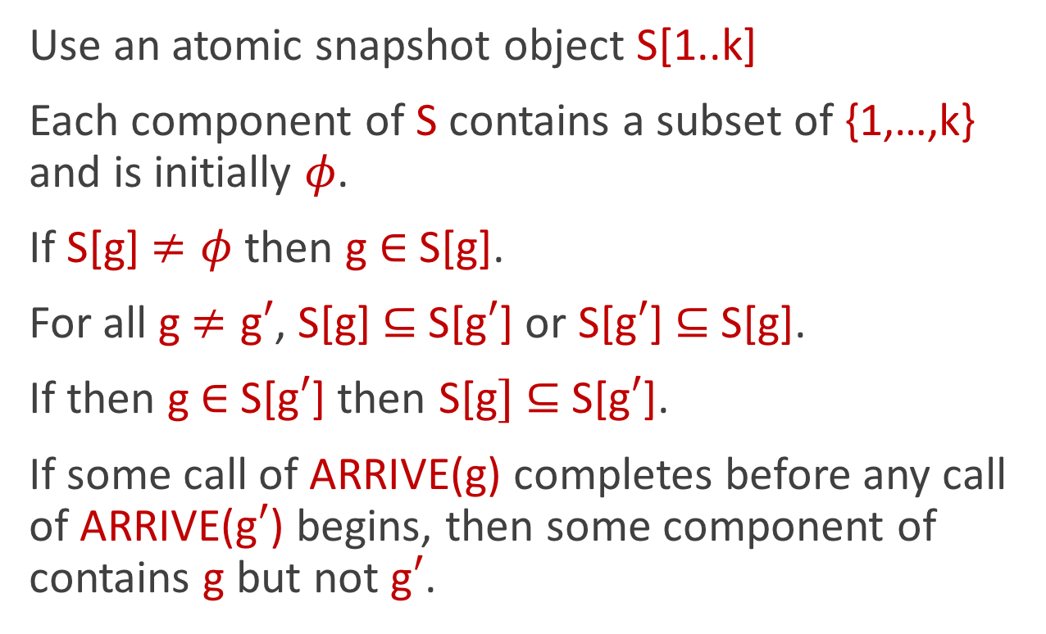
Consistent Ordered Partition Object
Use an atomic snapshot object S[1..k]
Each component of S contains a subset of {1,…,k} and is initially 𝜙.
If S[g] $≠\text{φ}$ then g $∈$ S[$\text{g}$].
For all g$≠\text{g}′$, S[$\text{g}$] $⊆$S[$\text{g}′$] or S[$\text{g}′$] $⊆$ S[$\text{g}$].
If then g$∈$ S[$\text{g}′$] then S[$\text{g}]$ $⊆$S[$\text{g}′$].
If some call of ARRIVE($\text{g}$) completes before any call of ARRIVE($\text{g}′$) begins, then some component of contains g but not g$′$.

Slide 123

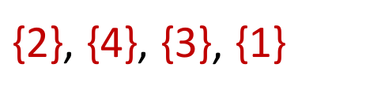
Consistent Ordered Partition Object
If S₀ = 𝜙, S_{r} = {1,…,k} and S₁⊊ … ⊊ S_{r-1} are the nonempty proper subsets of {1,…,k} in S[1..k], then S₁–S₀, S₂–S₁,…, S_{r}–S_{r-1} is the ordered partition induced by S.
$\text{\{2\}}\text{,} \text{\{}\text{4}\text{\}}\text{,} \text{\{}\text{3}\text{\}}$, $\text{\{}\text{1}\text{\}}$
S
$$\text{φ}$$ | $$\text{\{2\}}$$ | $$\text{ \{2,3,4\}}$$ | $$\text{\{2,4\}}$$
Notes:
For example, if S looks like this, then the smallest nonempty set, which contains only 2, is the first part of the ordered partition.
The second smallest nonempty set {2,4} minus the smallest nonempty set {2} is the second part of the partition, which is {4}. The third part of the partition is the third smallest nonempty set minus the second smallest nonempty set, so it is {3}. Finally the remaining element, 1, constitutes the last part of the partition.

Slide 124


Consistent Ordered Partition Object
If S₀ = 𝜙, S_{r} = {1,…,k} and S₁⊊ … ⊊ S_{r-1} are the nonempty proper subsets of {1,…,k} in S[1..k], then S₁–S₀, S₂–S₁,…, S_{r}–S_{r-1} is the ordered partition induced by S.
$$\text{\{2}\text{,}\text{4}\text{\}}\text{,} \text{\{}\text{1,3}\text{\}}$$
S
$$\text{φ}$$ | $$\text{\{2,4\}}$$ | $$\text{φ}$$ | $$\text{\{2,4\}}$$
Notes:
In this case, there are only two parts to the partition, {2,4} followed by {1,3}.

Slide 125
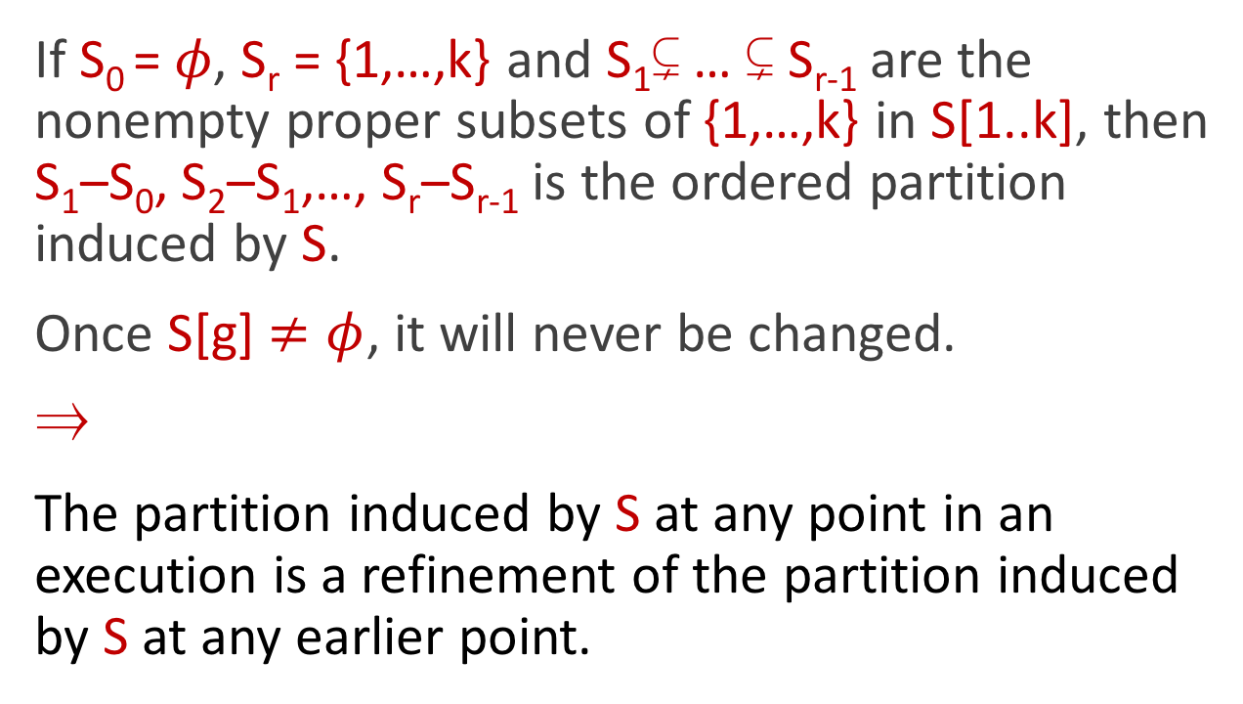
Consistent Ordered Partition Object
If S₀ = 𝜙, S_{r} = {1,…,k} and S₁⊊ … ⊊ S_{r-1} are the nonempty proper subsets of {1,…,k} in S[1..k], then S₁–S₀, S₂–S₁,…, S_{r}–S_{r-1} is the ordered partition induced by S.
Once S[$\text{g}$] $≠\text{φ}$, it will never be changed.
⇒
The partition induced by S at any point in an execution is a refinement of the partition induced by S at any earlier point.

Slide 126
Consistent Ordered Partition Object
Also use an atomic snapshot object M[1..k,1..k]
Each component of M is initially 0 and can only be changed to 1.
Element g is at level L if L is the lowest level in column g that contains 1.
ARRIVE(g) begins by calling UPDATE(M[k,g],1), so g starts at level k.
1
2
3
4
4
0 | 1 | 1 | 1
0 | 1 | 0 | 0
0 | 0 | 0 | 0
0 | 0 | 0 | 0
3
2
1
Notes:
In this example, element g is at level 3 and elements 3 and 4 are at level 4.

Slide 127
MOVEDOWN
Helps elements move down levels, one level at a time.
Element g at level L moves down to level L–1 when UPDATE(M[L-1,g],1) is performed. Can only happen when < L elements are at levels ≤ L.
1
2
3
4
4
0 | 1 | 1 | 1
0 | 1 | 0 | 0
0 | 0 | 0 | 0
0 | 0 | 0 | 0
3
2
1
Notes:
For example, element 4 can move down from level 4 to level 3, since there are only 3 elements at level at most 4. The entry in row 3 column 4 is set to 1.

Slide 128
MOVEDOWN
Helps elements move down levels, one level at a time.
Element g at level L moves down to level L–1 when UPDATE(M[L-1,g],1) is performed. Can only happen when < L elements are at levels ≤ L.
Lemma At most L elements are at levels ≤ L.
1
2
3
4
4
0 | 1 | 1 | 1
0 | 1 | 0 | 1
0 | 0 | 0 | 0
0 | 0 | 0 | 0
3
2
1

Slide 129

MOVEDOWN
Helps elements move down levels, one element and one level at a time.
Element g at level L moves down to level L–1 when UPDATE(M[L-1,g],1) is performed. Can only happen when < L elements are at levels ≤ L.
If element g is at level L and there are L elements at levels ≤ L, then g stops at level L and S[g] is updated with the set of L elements at levels ≤ L.
1
2
3
4
4
0 | 1 | 1 | 1
0 | 1 | 0 | 1
0 | 0 | 0 | 0
0 | 0 | 0 | 0
3
2
1
S
$$\text{φ}$$ | $$\text{φ}$$ | $\text{φ}$ | $$\text{φ}$$

Slide 130
MOVEDOWN
Helps elements move down levels, one element and one level at a time.
Element g at level L moves down to level L–1 when UPDATE(M[L-1,g],1) is performed. Can only happen when < L elements are at levels ≤ L.
If element g is at level L and there are L elements at levels ≤ L, then g stops at level L and S[g] is updated with the set of L elements at levels ≤ L.
1
2
3
4
4
0 | 1 | 1 | 1
0 | 1 | 0 | 1
0 | 1 | 0 | 0
0 | 0 | 0 | 0
3
2
1
S
$$\text{φ}$$ | $$\text{φ}$$ | $\text{φ}$ | $$\text{φ}$$
Notes:
For example, suppose that element 2 moves down to level 2 and

Slide 131

MOVEDOWN
Helps elements move down levels, one element and one level at a time.
Element g at level L moves down to level L–1 when UPDATE(M[L-1,g],1) is performed. Can only happen when < L elements are at levels ≤ L.
If element g is at level L and there are L elements at levels ≤ L, then g stops at level L and S[g] is updated with the set of L elements at levels ≤ L.
1
2
3
4
4
0 | 1 | 1 | 1
0 | 1 | 0 | 1
0 | 1 | 0 | 0
0 | 1 | 0 | 0
3
2
1
S
$$\text{φ}$$ | $$\text{\{2\}}$$ | $\text{φ}$ | $$\text{φ}$$
Notes:
then to level 1. When this happens, the 2nd component of S is updated with the singleton set containing only 2 .

Slide 132

MOVEDOWN
Helps elements move down levels, one element and one level at a time.
Element g at level L moves down to level L–1 when UPDATE(M[L-1,g],1) is performed. Can only happen when < L elements are at levels ≤ L.
If element g is at level L and there are L elements at levels ≤ L, then g stops at level L and S[g] is updated with the set of L elements at levels ≤ L.
1
2
3
4
4
0 | 1 | 1 | 1
0 | 1 | 0 | 1
0 | 1 | 0 | 1
0 | 1 | 0 | 0
3
2
1
S
$$\text{φ}$$ | $$\text{\{2\}}$$ | $\text{φ}$ | $$\text{\{2,4\}}$$
Notes:
If element 4 now moves down to level 2, it stops and component 4 of S is updated with the set {2,4}.

Slide 133
MOVEDOWN
Helps elements move down levels, one element and one level at a time.
Element g at level L moves down to level L–1 when UPDATE(M[L-1,g],1) is performed. Can only happen when < L elements are at levels ≤ L.
If element g is at level L and there are L elements at levels ≤ L, then g stops at level L and S[g] is updated with the set of L elements at levels ≤ L.
1
2
3
4
4
0 | 1 | 1 | 1
0 | 1 | 1 | 1
0 | 1 | 0 | 1
0 | 1 | 0 | 0
3
2
1
S
$$\text{φ}$$ | $$\text{\{2\}}$$ | $$\text{ \{2,3,4\}}$$ | $$\text{\{2,4\}}$$
Notes:
Next, if element 3 moves down to level 3, it stops at level 3 and component 3 is updated with the set {2,3,4}.

Slide 134

MOVEDOWN
Helps elements move down levels, one element and one level at a time.
Element g at level L moves down to level L–1 when UPDATE(M[L-1,g],1) is performed. Can only happen when < L elements are at levels ≤ L.
If element g is at level L and there are L elements at levels ≤ L, then g stops at level L and S[g] is updated with the set of L elements at levels ≤ L.
1
2
3
4
4
0 | 1 | 1 | 1
0 | 1 | 0 | 1
0 | 1 | 0 | 1
0 | 0 | 0 | 0
3
2
1
S
$$\text{φ}$$ | $$\text{\{2,4\}}$$ | $\text{φ}$ | $$\text{\{2,4\}}$$
Notes:
Instead, suppose that after element 2 moves to level 2, element 4 moves to level 2. Then the 4th component of S is updated to contain the set {2,4} as is the 2nd component of S.

Slide 135
MOVEDOWN
repeat
M’ ⟵ SCAN(M)
look from top to bottom for an element to move down
move it down
until there are no elements to move down
for each element g that has stopped
UPDATE S[g]

Slide 136
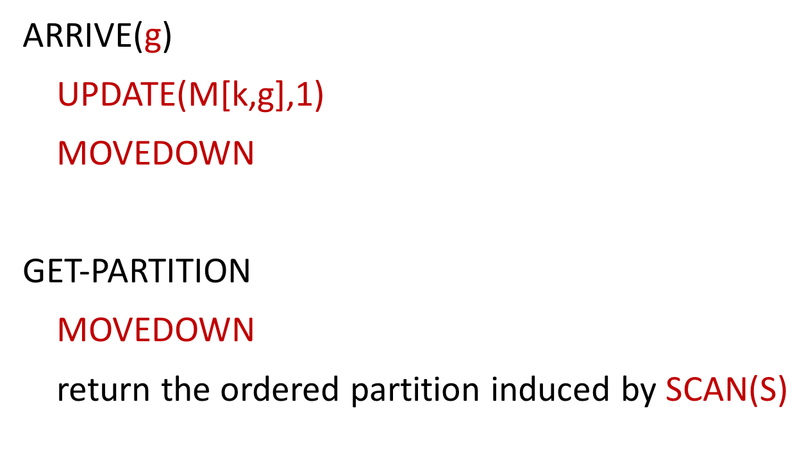
Consistent Ordered Partition Object
ARRIVE($\text{g}$)
UPDATE(M[k,g],1)
MOVEDOWN
GET-PARTITION
MOVEDOWN
return the ordered partition induced by SCAN(S)

Slide 137
MOVEDOWN
Problem:
Process p is helping element 2 to move down to level 1.
In the mean time, another process q helps element 4 to move down to level 2.
1
2
3
4
4
0 | 1 | 1 | 1
0 | 1 | 0 | 1
0 | 1 | 0 | 0
0 | 0 | 0 | 0
3
2
1
S
$$\text{φ}$$ | $$\text{φ}$$ | $\text{φ}$ | $$\text{φ}$$

Slide 138
MOVEDOWN
Problem:
Process p is helping element 2 to move down to level 1.
In the mean time, another process q helps element 4 to move down to level 2. Then process q sees that elements 2 and 4 have stopped and UPDATES S[2] and S[4].
1
2
3
4
4
0 | 1 | 1 | 1
0 | 1 | 0 | 1
0 | 1 | 0 | 1
0 | 0 | 0 | 0
3
2
1
S
$$\text{φ}$$ | $$\text{\{2,4\}}$$ | $\text{φ}$ | $$\text{\{2,4\}}$$

Slide 139

MOVEDOWN
Problem:
Process p is helping element 2 to move down to level 1.
In the mean time, another process q helps element 4 to move down to level 2. Then process q sees that elements 2 and 4 have stopped and UPDATES S[2] and S[4].
Process p finishes helping element 2 to move down to level 1 and then UPDATES S[2].
1
2
3
4
4
0 | 1 | 1 | 1
0 | 1 | 0 | 1
0 | 1 | 0 | 1
0 | 1 | 0 | 0
3
2
1
S
$$\text{φ}$$ | $$\text{\{2\}}$$ | $\text{φ}$ | $$\text{\{2,4\}}$$
Notes:
However, to prove that the partitions are consistent, we used the claim that, once S[$\text{g}$] $≠\text{φ}$, it will never be changed.

Slide 140
MOVEDOWN
Solution:
Have a conflict detector for each entry of M, except for those on level 1.
This prevents an element from stopping at some level and moving down from that level.
A conflict detector can be implemented from registers.
1
2
3
4
4
0 | 1 | 1 | 1
0 | 1 | 0 | 1
0 | 1 | 0 | 1
0 | 1 | 0 | 0
3
2
1
S
$$\text{φ}$$ | $$\text{\{2\}}$$ | $\text{φ}$ | $$\text{\{2,4\}}$$

Slide 141
Conflict Detector
Supports one operation: check(v)
If all check operations that begin before it returns have input v, return false.
If a check operation that begins before it returns has a different input, at least one of them returns true.

Slide 142
Theorem
⋮
3-consensus < O_{3,2} < O_{3,3}< O_{3,4} < O_{3,5} < ⋯
2-consensus < O_{2,2} < O_{2,3}< O_{2,4} < O_{2,5} < ⋯
Notes:
We have shown the following.

Slide 143
Open Questions
Is there a universal object of consensus number m, which can be used to implement any deterministic object of consensus number m, for any finite number of processes?
Is there an infinite family of increasingly strong deterministic readable or read-modify-write objects of consensus number m?
Does the set {(n,k)|k-set consensus for n processes can be solved using copies of O and registers} characterize the computational power of any deterministic object O?

