Slide 1

Byzantine-Resilient Colorless Computation
Companion slides for
Distributed Computing
Through Combinatorial Topology
Maurice Herlihy & Dmitry Kozlov & Sergio Rajsbaum
TexPoint fonts used in EMF.
Read the TexPoint manual before you delete this box.: AAAA
Notes:
1

Slide 2

Crash Failure Model
Byzantine Model

Slide 3
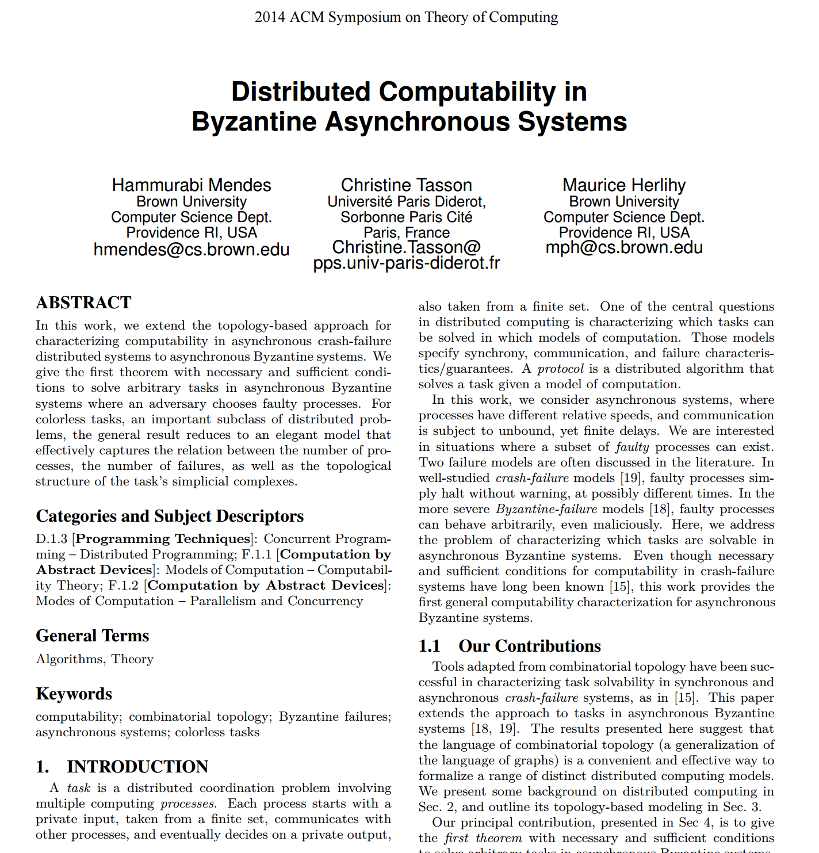
STOC 2014
Can reduce any “colorless” Byzantine task to
to “dual” crash-failure task …
Byzantine processes can lie about initial inputs
but have no other special powers
Here: different proof from our textbook.

Slide 4
Vertex = Process State
Process ID (color)
7
Value (input or output)

Slide 5
Simplex = Global State

Slide 6
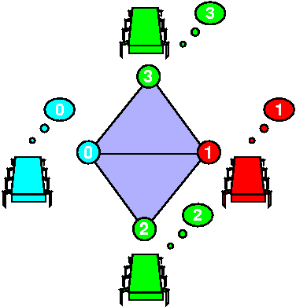
Complex = Global States

Slide 7
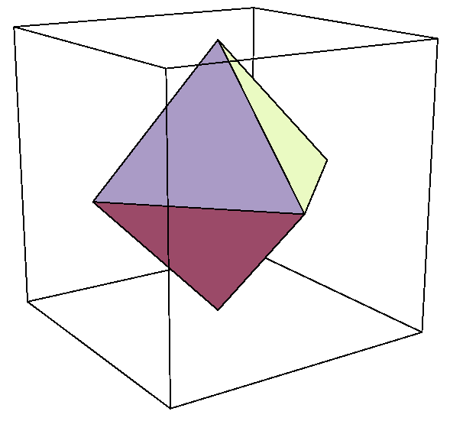
Input Complex for Binary Consensus
0
All possible initial states
0
1
0
Processes: red, green, blue
1
Independently assigned 0 or 1

Slide 8
Output Complex for Binary Consensus
All possible final states
0
0
0
1
Output values all 0 or all 1
1
1
Two disconnected simplexes

Slide 9
Carrier Map for Consensus
All 0 outputs
All 0 inputs

Slide 10
Carrier Map for Consensus
All 1 inputs
All 1 outputs

Slide 11
Carrier Map for Consensus
All 0 outputs
Mixed 0-1 inputs
All 1 outputs

Slide 12
Task Specification
(I, O, ¢)
Input complex
Carrier map
¢: I ! 2^{O}
Output complex

Slide 13
Colorless Tasks
The set of input values …
determines the set of output values.
Number and identities irrelevant…
for both input and output values

Slide 14
Examples
32
32
Consensus
32
OK
k-set agreement
32
7
32
OK
Notes:
Consensus and set agreement are simple examples of colorless tasks where any process can take another’s input or output values.

Slide 15
Crash Model
Fundamental Theorem
Theorem
Colorless (I,O,¢) has a t-crash resilient read-write protocol iff there is a continuous map
f: |skel^{t} I| → |O|...
carried by ¢
Notes:
We will prove a simple theorem that completely characterizes when it is possible to solve a colorless task in wait-free read-write memory.
The theorem states that a colorless task $(\cI^*,\cO^*,\Delta^*)$ has a wait-free read-write protocol if and only if there is a continuous map between their polyhedrons,

Slide 16
Schematic View
¢
(no continuous map)
I
skel^{t} I
O
continuous map
Distributed Computing through Combinatorial Topology
16

Slide 17
Universal Protocol (1 of 2)
t-set agreement protocol
I
skel^{t}(I)
Distributed Computing through Combinatorial Topology
17
17

Slide 18
Universal Protocol (2 of 2)
I
bary(I)
Barycentric agreement protocol
(to approximate continuous map)
Distributed Computing through Combinatorial Topology
Notes:
Informally, the processes start out on vertexes of a single simplex $\sigma$ of $\cI$, and they eventually halt on vertexes of a single simplex of $\Delta(\sigma) \subseteq \cI$.

Slide 19
Fundamental Theorem for colorless Byzantine tasks
Theorem
when n+1 > (dim I + 2) t …
Colorless (I,O,¢) has a t-Byzantine resilient read-write protocol iff there is a continuous map
f: |skel^{t} I| → |O|...
carried by ¢
Notes:
We will prove a simple theorem that completely characterizes when it is possible to solve a colorless task in wait-free read-write memory.
The theorem states that a colorless task $(\cI^*,\cO^*,\Delta^*)$ has a wait-free read-write protocol if and only if there is a continuous map between their polyhedrons,

Slide 20
Fundamental Theorem for colorless Byzantine tasks
Theorem
when n+1 > (dim I + 2) t …
Colorless (I,O,¢) has a t-Byzantine resilient read-write protocol iff there is a continuous map
f: |skel^{t} I| → |O|...
carried by ¢
Notes:
We will prove a simple theorem that completely characterizes when it is possible to solve a colorless task in wait-free read-write memory.
The theorem states that a colorless task $(\cI^*,\cO^*,\Delta^*)$ has a wait-free read-write protocol if and only if there is a continuous map between their polyhedrons,

Slide 21



Message-Passing
Distributed Computing through Combinatorial Topology

Slide 22
Crash Failures
Distributed Computing through Combinatorial Topology

Slide 23
Crash Failures
Distributed Computing through Combinatorial Topology

Slide 24

Byzantine Failures
Distributed Computing through Combinatorial Topology

Slide 25




He said, She said …
???
Distributed Computing through Combinatorial Topology

Slide 26
He said, She said …
???
Distributed Computing through Combinatorial Topology

Slide 27
Identifying Input Values
sorry
t

Slide 28
Identifying Input Values
!
t+1

Slide 29

Nothing Learned
each input reported by only t
t are silent
…
t
t
t
No input learned if
n+1 · (dim I+2) t
(dim I + 1) t

Slide 30
Requirement
requirement that:
n+1 > (dim I + 2) t
means t is “pretty small”
Byzantine is harder!
dim I irrelevant for crash failures

Slide 31
All you need for a protocol …
Byzantine resilient protocols …
t-set agreement
Barycentric agreement

Slide 32
Communication
message-passing
asynchronous layers

Slide 33

Message-Passing Protocols
decide after finite # steps
but protocol
forwards messages …
forever!

Slide 34
Messages
(P, tag, v)
can be forged
cannot be forged
message type
sender
sequence
of values

Slide 35
Reliable Broadcast
RBSend(P, tag, v)
RBReceive(P, tag, v)
Adapted from Bracha 87, Shrikanth & Toueg 87

Slide 36
Non-Faulty Integrity
If non-faulty P never broadcasts (P,tag,v) …
via RBSend(P, tag, v)
Non-faulty Q never receives (P,tag,v)
via RBReceive(P, tag, v)

Slide 37
Non-Faulty Liveness
If non-faulty P does broadcast (P,tag,v) …
via RBSend(P, tag, v)
Every non-faulty Q receives (P,tag,v)
via RBReceive(P, tag, v)

Slide 38
Global Uniqueness
If non-faulty Q,R reliably receive…
(P,tag,v), (P,tag’,v’) respectively …
then tag = tag’ and v = v’
even if P is faulty

Slide 39
Global Liveness
for non-faulty Q,R …
if Q reliably receives (P,tag,v)…
then R reliably receives (P,tag,v)…
even if P is faulty

Slide 40
Summary
The only way ….
a Byzantine process can misbehave ….
is by lying about its input value!

Slide 41
RBSend Phase 1
(P, SEND, v)

Slide 42
RBSend Phase 2
1st time
(P, SEND, v) ?
(Q, P, ECHO, v)
background loop

Slide 43
RBSend Phase 3
1st time received
(*,P, ECHO,v)
from n+1-t?
(Q, P, READY, v)
background loop

Slide 44
RBSend Phase 4
1st time received
(*,P,READY,v)
from t+1?
(Q, P, READY, v)
background loop

Slide 45
RBSend Phase 5
1st time received
(*,P,READY,v)
from n-t+1?
deliver (P, v)

Slide 46
Proofs of Correctness
Mercifully omitted, nothing special, buy the book.

Slide 47
Reading a Value
getQuorum(Tag: tag): Set of Message
M := ;
while |M| < n+1-t or trusted(M) = ; do
upon RBReceive(Q,tag,v) do
M := M [ {(Q,tag,v)}
return M

Slide 48
Reading a Value
getQuorum(Tag: tag): Set of Message
M := ;
while |M| < n+1-t or trusted(M) = ; do
upon RBReceive(Q,tag,v) do
M := M [ {(Q,tag,v)}
return M
returns set of messages (values)

Slide 49
Reading a Value
getQuorum(Tag: tag): Set of Message
M := ;
while |M| < n+1-t or trusted(M) = ; do
upon RBReceive(Q,tag,v) do
M := M [ {(Q,tag,v)}
return M
wait to hear from all but t

Slide 50
Reading a Value
getQuorum(Tag: tag): Set of Message
M := ;
while |M| < n+1-t or trusted(M) = ; do
upon RBReceive(Q,tag,v) do
M := M [ {(Q,tag,v)}
return M
values reported by t+1

Slide 51
Reading a Value
getQuorum(Tag: tag): Set of Message
M := ;
while |M| < n+1-t or trusted(M) = ; do
upon RBReceive(Q,tag,v) do
M := M [ {(Q,tag,v)}
return M
wait until you learn a trusted value

Slide 52
Reading a Value
getQuorum(Tag: tag): Set of Message
M := ;
while |M| < n+1-t or trusted(M) = ; do
upon RBReceive(Q,tag,v) do
M := M [ {(Q,tag,v)}
return M
safe to wait for both (why?)
returns ¸ 1 trusted values

Slide 53
Set Agreement
SetAgree(v): value
RBSend(P,INPUT,v)
M: Set of Message := getQuorum(INPUT)
return min Trusted(M)

Slide 54
Set Agreement
SetAgree(v): value
RBSend(P,INPUT,v)
M: Set of Message := getQuorum(INPUT)
return min Trusted(M)
at most t lower values missing

Slide 55
Barycenrtric Agreement
R_{i}[j] = messages received by P_{i} from P_{j}
R_{i}:= (;,…, ;)
M_{i}:= ;
B_{i}:= ;
M_{i} = messages received by P_{i}
B_{i} = P_{i} ‘s buddies: processes
that reported same set of vertices

Slide 56
Barycentric Agreement (1)
reliably broadcast my input vertex
RBSend(P_{i},INPUT,v)
M_{i} := getQuorum(INPUT)
reliably receive others’ input vertices

Slide 57
Barycentric Agreement (2)
record newly-learned input vertices
background // run forever
upon RBReceive(P_{j},INPUT,u) do
M_{i} := M_{i} [ {u}
RBSend(Pi,REPORT,M_{i})
forward set of vertices with REPORT tag

Slide 58
Barycentric Agreement
until I have n+1-t buddies…
while |B_{i}| < n+1-t do
upon RBReceive(P_{j},REPORT,M_{j}) do
R_{i}[j] := M_{j}
B_{i} := {l : R_{i}[l] = M_{i}, 0 · l · n}
return trusted(M_{i})
accumulate new reports …
return set of trusted input vertices.

Slide 59
Lemma
Non-faulty P_{i} and P_{j} always have
M_{i} µ M_{j} or M_{j} µ M_{i}
Proof
Trust me, I’m a doctor.

Slide 60
Lemma
Non-faulty P_{i} decides in finite steps
Proof
Just go buy the book.

Slide 61
Fundamental Theorem
Theorem
when n+1 > (dim I + 2) t …
Colorless (I,O,¢) has a t-Byzantine resilient read-write protocol iff there is a continuous map
f: |skel^{t} I| → |O|...
carried by ¢
Notes:
We will prove a simple theorem that completely characterizes when it is possible to solve a colorless task in wait-free read-write memory.
The theorem states that a colorless task $(\cI^*,\cO^*,\Delta^*)$ has a wait-free read-write protocol if and only if there is a continuous map between their polyhedrons,

Slide 62
Map Implies Protocol
f: |skel^{t} I| → |O|
carried by ¢.
Á: Bary^{N} skel^{t} I → O
Solve using …
barycentric agreement
t-set agreement
Notes:
Solvability theorems for the other models are pretty much the same, except for the conditions under which we can solve barycentric and t-set agreement

Slide 63
Protocol implies Map
reduction to crash-failure model
Notes:
Solvability theorems for the other models are pretty much the same, except for the conditions under which we can solve barycentric and t-set agreement

Slide 64
Strict Tasks
¢(¾₀) Å ¢(¾₁) = ¢(¾₀ Å ¾₁)
usually require only µ

Slide 65
Lower Bound
A strict colorless task (I,O,¢)
is trivial if there is a simplicial map
Á: I → O
carried by ¢.
(A trivial task can be solved without communication)

Slide 66
Theorem
If a strict colorless task (I,O,¢)
has a t-Byzantine resilient protocol,
where n+1 · (dim I + 2) t
then that task is trivial
False for non-strict tasks!
(thanks Zohir Bouzid and Petr Kuznetsov)

Slide 67

The Takeaway
Relax, combinatorial topology concepts extend naturally to Byzantine models
Colorless Byzantine-resilient tasks reduce to “dual” colorless crash-resilient tasks
Byzantine processes have only one superpower: lying about inputs
Colored tasks?
Non-strict tasks?

Slide 68




Questions?

Slide 69
This work is licensed under a Creative Commons Attribution-ShareAlike 2.5 License.
You are free:
  to Share — to copy, distribute and transmit the work
  to Remix — to adapt the work
Under the following conditions:
  Attribution. You must attribute the work to “Distributed Computing through Combinatorial Topology” (but not in any way that suggests that the authors endorse you or your use of the work).
  Share Alike. If you alter, transform, or build upon this work, you may distribute the resulting work only under the same, similar or a compatible license.
For any reuse or distribution, you must make clear to others the license terms of this work. The best way to do this is with a link to
  http://creativecommons.org/licenses/by-sa/3.0/.
Any of the above conditions can be waived if you get permission from the copyright holder.
Nothing in this license impairs or restricts the author's moral rights.

