Slide 1
Towards Practical Byzantine agreement
Valerie King
University of Victoria

Slide 2
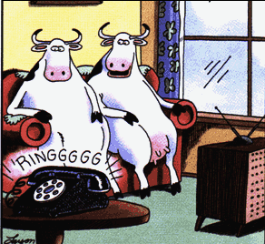
0
0
1
1
1
1978: BA models worst case faults in procs
which communicate via point-to-point links and
worst case delays in message delivery
ID of sender is known?

Slide 3
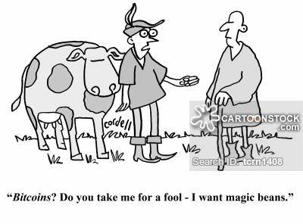
Today: untrusted players possibly controlled by single adversary, need for public ledger, digital currency

Slide 4
Strong adversary
0
0
1
1
1
Sets inputs

Slide 5
Strong adversary
0
0
1
1
1
Sets inputs
Arbitrarily delays messages

Slide 6
Strong adversary
0
0
1
1
1
Sets inputs
Arbitrarily delays messages
Controls t bad procs
➔
NO DETERMINISTIC ALG (FLP)

Slide 7
Randomized algorithms:
Each proc can flip a
private coin

Slide 8
Randomized algorithms →more choices for model
1980’s
Private channels or
crypto assumptions
O(1) expected time
Feldman and Micali 1988
Full information
States of all procs known to adversary

Slide 9
Randomized models
Private channels or
crypto assumptions
→ O(1) expected time
Full information
States of all procs known to adversary
BAD Procs chosen at start (Static)*
Bad procs chosen dynamically
*Easier, elect leader or small group

Slide 10
1983 Ben-Or’s alg t<n/5
v_{p}=input bit of proc p
While not decided proc p does:
Broadcast v_{p} , wait til n-t procs respond,
v ⬅ majority bit if received from >(n+t)/2 proc (else nil)
send out (echo, v ), wait til n-t procs respond
Case analysis:

Slide 11
Every proc in Case A&B or every proc in Case B&C
CASE: #(echo,v), v ≠nil
> (n-t)/2+t decide v
B) > t then v_{p} ←v
C) else v_{p} ← private coinflip
All decide by next round
All decide same value
by next round
If all coinflips agree
and
they agrees with v (“good
direction”)

Slide 12
Essentials of Ben-Or
Repeat until decision
Broadcast
CASE: # (echo,v) messages:
> (n+t)/2 then decide v
>t then v_{p} ← v
sometimes produces a collective coin
else v_{p}← private coinflip
Decision if collective coin agrees with v

Slide 13
We can modify Ben-Or:
Repeat until decision
Broadcast
CASE: # (echo,v) messages:
> (n+t)/2 then decide v
>t then v_{p} ←v
a (sometimes) collective coin alg.
else v_{p} → private coinflip
Decision if collective coin agrees with v

Slide 14
Observe 1:
can be iterated if collective coin is not agreed on or not fair.
Observe 2:
Solves t ≤ √n problem:
W/const prob, variance of coinflips > 2t
→ Adv can’t affect majority value →1/2 prob. of fair coin

Slide 15
Study of coinflipping-1980’s
Byzantine Agreemt Asynchronous Exp time with message passing
(Ben Or, Bracha)
Collective Coinflipping Problem (idealized version)
One time atomic broadcast--
(Linial, Kalai,Ben-Or, Alon, Dodis, Zuckerman, Feige, Saks, …)
Toward multistage asynch version….

Slide 16
Multiround Collective Coin flipping
Collective coin problem
Output F=f_{1,} f_{2,} …
p₁ p_{2 ….}
f₁
→

Slide 17
Add asynchronicity
At each round, F must be robust to up to t (good) coins missing.
→

Slide 18
Generalize Ben-Or’s A –Cast (1-sync) (in Maurice’s talk): m-sync:
p₁ p_{2 ….}
1
2
m
n-t columns complete, known to all procs
The last coin in up to t columns is ambiguous

Slide 19
Generalize Ben-Or’s A –Cast (1-sync) (in Maurice’s talk): m-sync:
p₁ p_{2 ….}
1
f=1 iff
#head ># tails
2
m
n-t columns complete, known to all procs
The last coin in up to t columns is ambiguous

Slide 20
In asynch model with <n/2 crash faults:
p₁ p_{2 ….}
1
2
n
~n² coins→variance ~n > # ambiguous coins.
W/constant prob→Ambiguous coins don’t affect output.
→consensus in O(1) n-syncs= O(n) expected time (Aspnes)

Slide 21
The Byzantine version

Slide 22
BYZANTINE multistage asynch Collective Coin problem
Design F:
Adversary
→
Basic step is n-sync to determine coin

Slide 23
BYZANTINE multistage asynch Collective Coin problem
Design F: Dynamic adversary can take over nt >>var
Adversary
→
Basic step is n-sync to determine coin

Slide 24
How many rounds are needed until
a fair coin is generated?
F=f_{1,} f_{2,} …
Adversary
f₁
→
f_{2,}
f₂
n-sync

Slide 25
We show:
Õ(n^{1.5}) rounds of n-syncs suffice → Õ(n^{2.5}) expected time But we do not know polytime computable F
(STOC 2013 w Jared Saia)
O(n² ) rounds where F is ptime computable
O(n³ ) expected time for Byzantine agreement.
(SODA 2014 with Jared Saia)

Slide 26
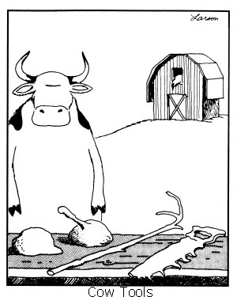
Constructing a polynomial time F

Slide 27
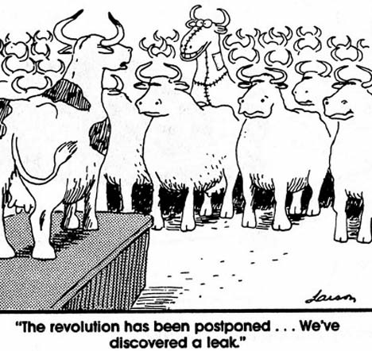
How to design F?
Key Idea: Either majority yields a fair coin sometimes or Bad procs have a
suspicicous pattern of
Biased coinflips over
time because
fewer bad
procs must nearly match
the variance
in the “bad” direction

Slide 28
F=(f_{1,}f₂,…)
Each proc p keeps badness score bad_{p}(j) for each proc
Let |V_{p} |=|V|, initially
For round i,
If bad(j,k) ≥ T remove j from V_{p}
f_{i}=majority of coins in n-sync from procs in V_{p}

Slide 29
F=(f_{1,}f₂,…)*
Each proc p keeps badness score bad_{p}(j,k) for each proc pair measuring their cumulative covariance.
Let |V_{p} |=|V|, initially
For round i,
Correction step: to discover ambiguous coinflips from previous rounds
If bad(j,k) ≥ T remove j,k from V_{p}
f_{i}=majority of coins in n-sync from procs in V_{p}
*New Version, work in progress by Nick Benson, UVic undergrad (Changes in GREEN)

Slide 30
Benson’s new result
Computationally simpler, replaces computation of SingularValueDecomposition of an n x n matrix
Constant overhead additional communication for correction
Brings resilience down to ~n/30 from ~n/(6 billion) for the O(n³ ) time algorithm.

Slide 31
Randomized lower bounds
Full information
States of all procs known to adversary
Symmetric Las Vegas algs with constant # prob choices require 2^{Ω(n)}
A. Lewko (DISC 2011)
Consensus requires Ω(n)
Aspnes, Attiya, Censor-Hillel
BAD Procs chosen at start (Static)
Bad procs chosen dynamically

Slide 32
Further Discussion
Gap of n² or n^{1.5} from consensus lower bound
Sequential computational problem in n^{2.5} round alg “ dense planted clique problem”
Amount of communication and space
Relevance to today’s problems?

Slide 33
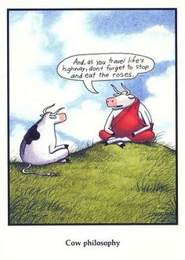
Thank you (and thanks to Gary Larsen) Questions?

Slide 34
Sometimes-collective coinflipping find “planted clique”
Every m n-syncs is an “epoch” e
Find a set of ≤t suspect columns S
Proc
Rounds
“BAD BIAS” > B in each
|heads-tails| for x εS
|S| ≤t

