Slide 1
Real-time Social Internet Data to Guide Forecasting Models
Geoffrey Fairchild, Ph.D.

Slide 2
Two groups, three projects
AIDO (Analytics for the Investigation of Disease Outbreaks)
Wikipedia-based disease modeling
Current project: real-time dengue forecasting by fusing satellite data, climate data, and more

Slide 3
AIDO
Analytics for the Investigation of Disease Outbreaks

Slide 4
Our goal
Aid in decision support by building a tool designed to enhance situational awareness during unfolding disease outbreaks by providing the user with detailed background information on historical outbreaks.
https://aido.bsvgateway.org

Slide 5
AIDO’s data
Disease | Number of Outbreaks
Anthrax | 14
Brucellosis | 10
Campylobacteriosis | 17
Chikungunya | 28
Cholera | 31
Crimean-Congo Hemorrhagic Fever | 10
Dengue | 22
Ebola | 19
Foot And Mouth Disease | 14
Gastroenteritis | 6
Japanese Encephalitis | 13
Lassa Fever | 3
Leishmaniasis | 8
Leptospirosis | 18
Malaria | 25
Marburg | 4
Measles | 35
Meningococcal Disease | 24
Middle East Respiratory Syndrome (MERS-CoV) | 4
Monkeypox | 10
Mumps | 24
Norovirus | 33
Novel Influenza A | 48
Pertussis | 12
Plague | 15
Polio | 21
Porcine Epidemic Diarrhea Virus (PEDV) | 5
Q Fever | 24
Rift Valley Fever | 10
Rubella | 13
Salmonellosis | 31
Severe Acute Respiratory Syndrome (SARS) | 5
Shiga Toxin-Producing E. Coli (STEC) | 19
Shigellosis | 18
Tularemia | 21
West Nile Virus | 17
Yellow Fever | 20
Zika | 14
 | 665
38 diseases
665 representative outbreaks

Slide 6
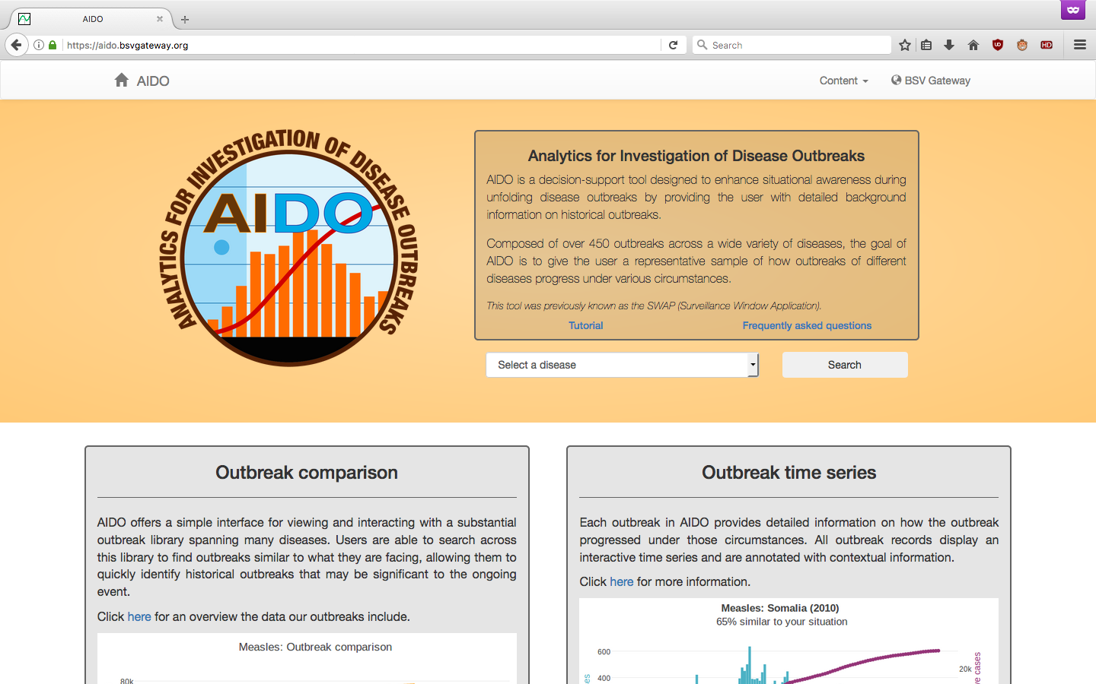
AIDO UI – Homepage

Slide 7
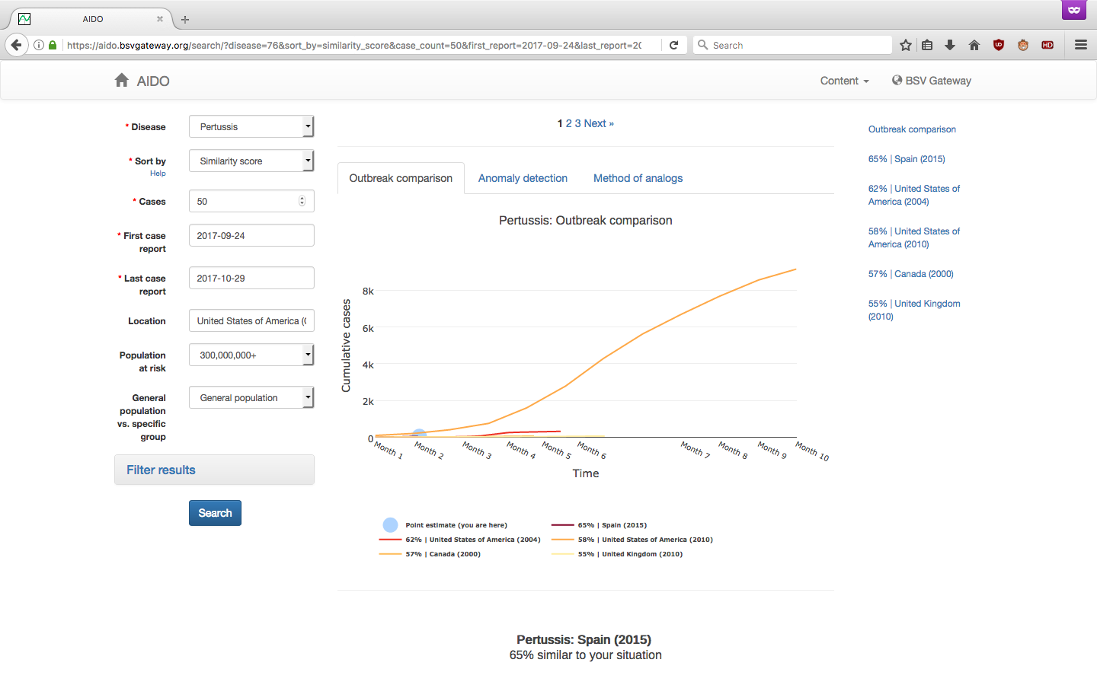
AIDO UI – Search

Slide 8
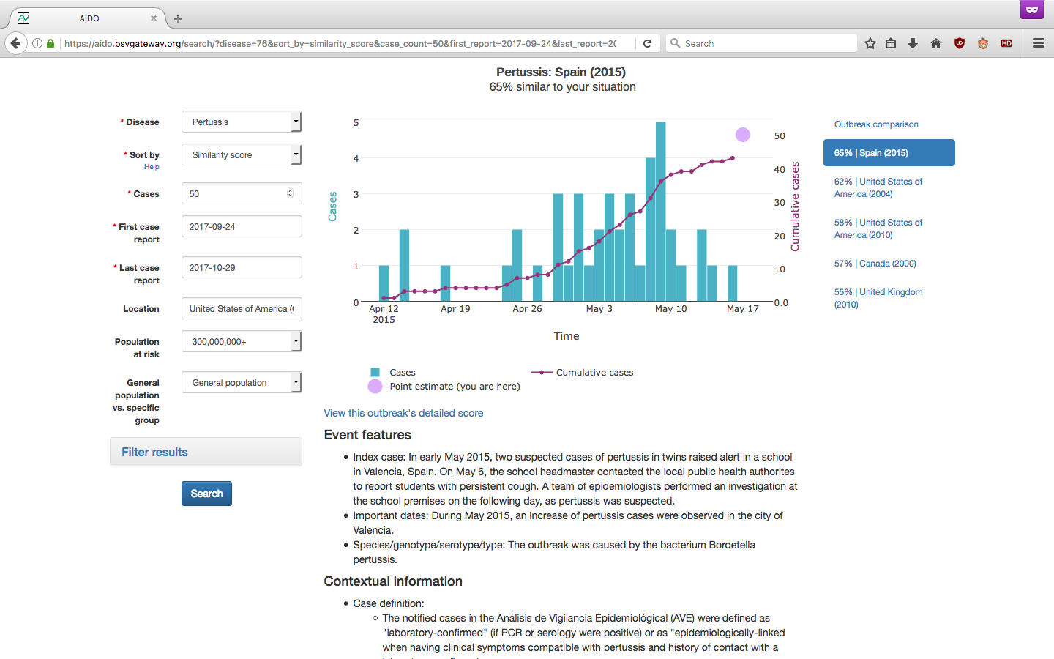
AIDO UI – Search (cont.)

Slide 9
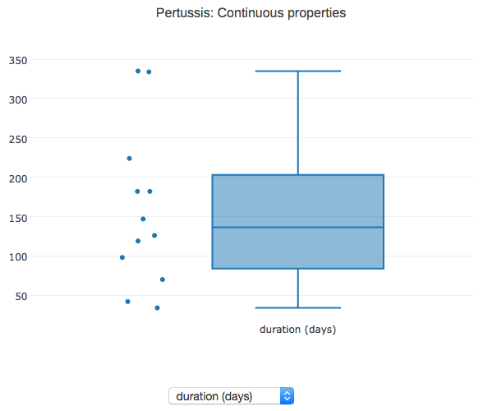
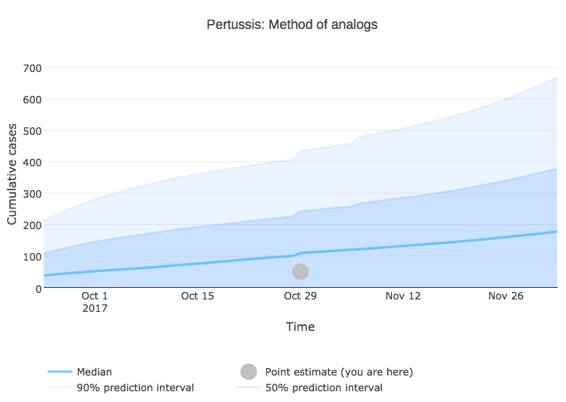
AIDO UI – additional features
Anomaly detection
Method of analogs

Slide 10
Disease modeling with non-traditional data

Slide 11
Our goal
Improve decision support by monitoring and forecasting events using social media, mathematical models, and quantifying model uncertainty.

Slide 12
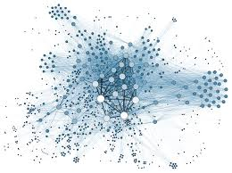
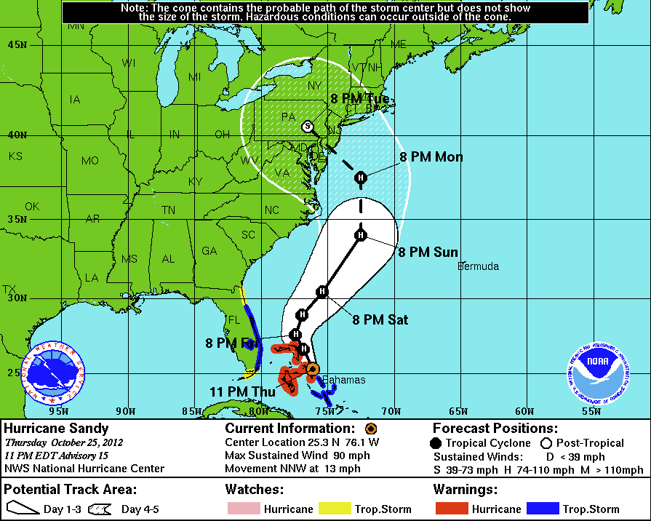


Our approach
Real-time, data-driven approaches: Not just for weather anymore.
+
=
Real-time, voluminous, extremely noisy data
Mathematical & statistical models
Probabilistic
Forecasts
+
=
1
+
1
=
3
1
+
1
=
3
1
1
3
The Whole is Greater than the Sums of its Parts!
The Whole is Greater than the Sums of its Parts!
The Whole is Greater than the Sums of its Parts!
The Whole is Greater than the Sums of its Parts!

Slide 13
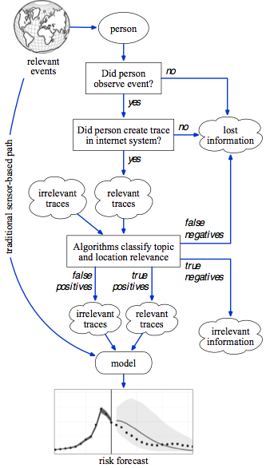
Our approach
Information flow from human observations of events through an Internet system and classification algorithms to produce quantitatively uncertain forecast.

Slide 14

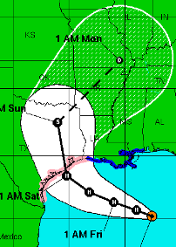

What do we want?
Holy grail
  Predict events before they occur/start
Realistic alternative
  Accurate, quantitatively uncertain forecast
Our proposal
  Social Internet data can help

Slide 15
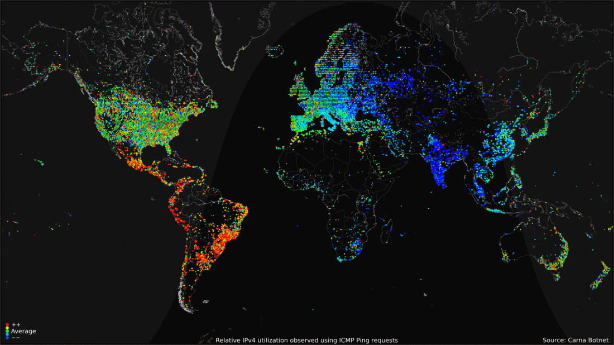
Global internet penetration

Slide 16







Internet data sources
Information sharing
Information seeking

Slide 17
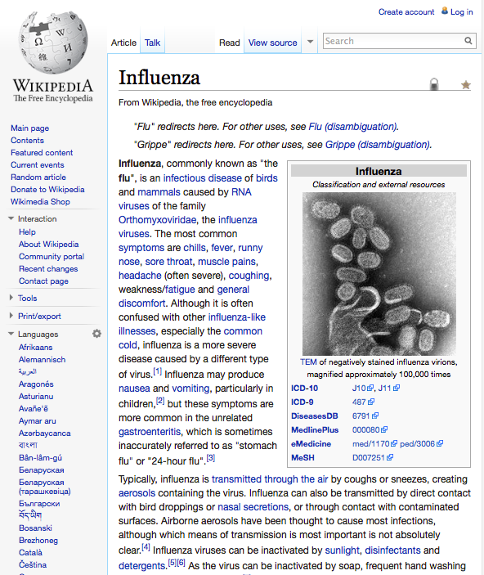

Using Wikipedia to track incidence
30 million articles in 287 languages
6th most popular website
Article access logs available since 2007
All data freely available on an hourly basis

Slide 18
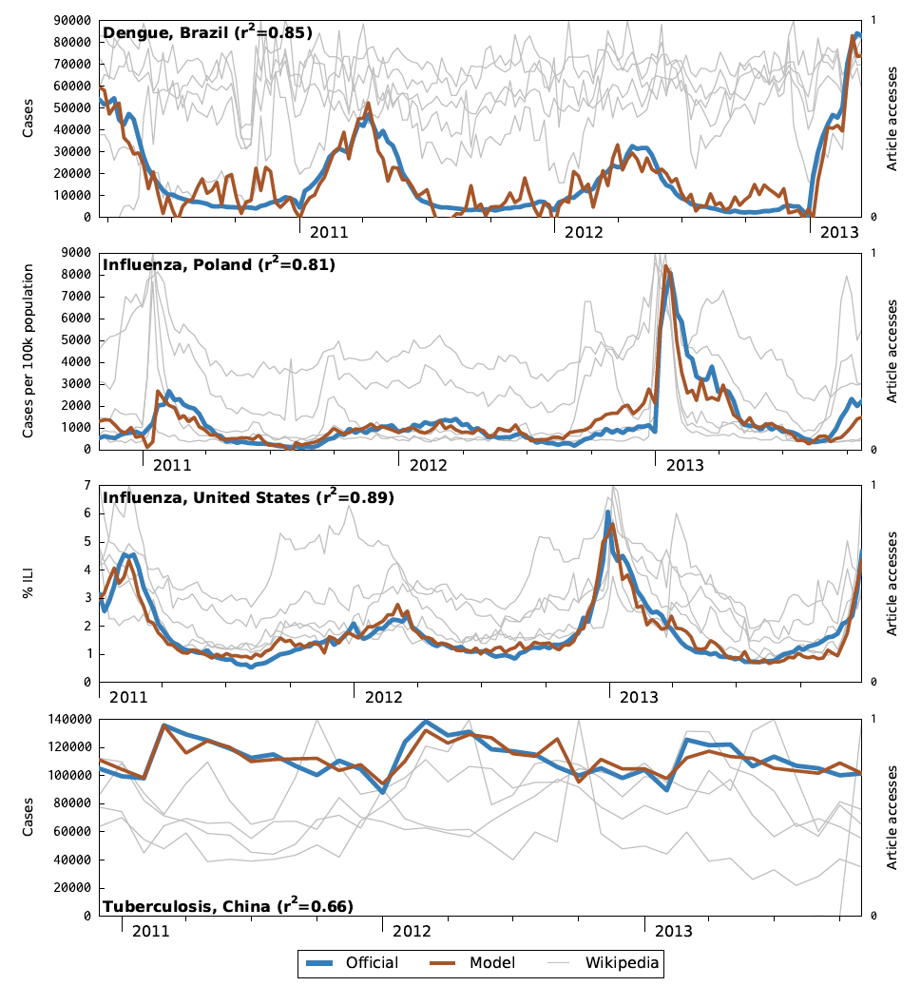
Global disease monitoring
Wikipedia article traffic
Linear models
Monitor disease around the globe
Wikipedia traffic correlates with disease incidence

Slide 19
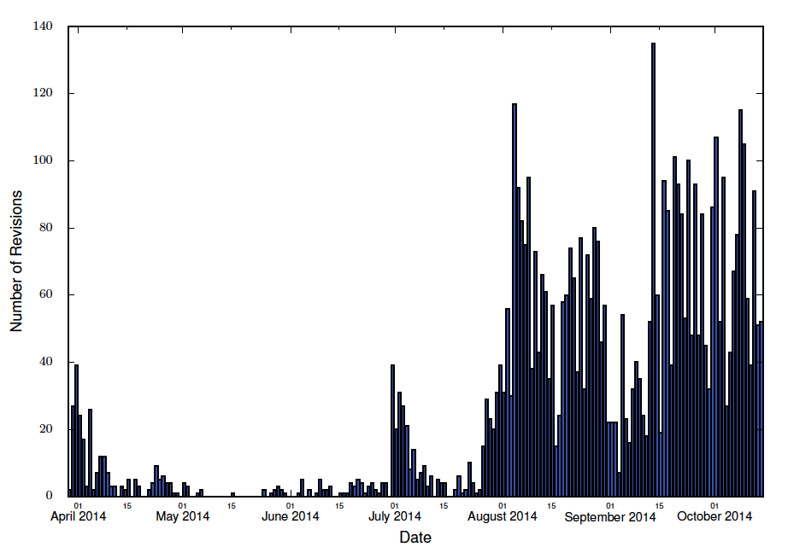
Eliciting data from Wikipedia articles
One stop shop for monitoring an event – Wikipedia article content
Trained named-entity recognizer
Wikipedia information closely align with ground truth data
2014 Ebola Epidemic – cases, deaths, and hospitalizations

Slide 20
Pilot Study: Real-time Heterogeneous Data Fusion Approaches to Predict Dengue in Brazil

Slide 21
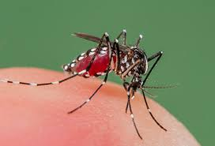
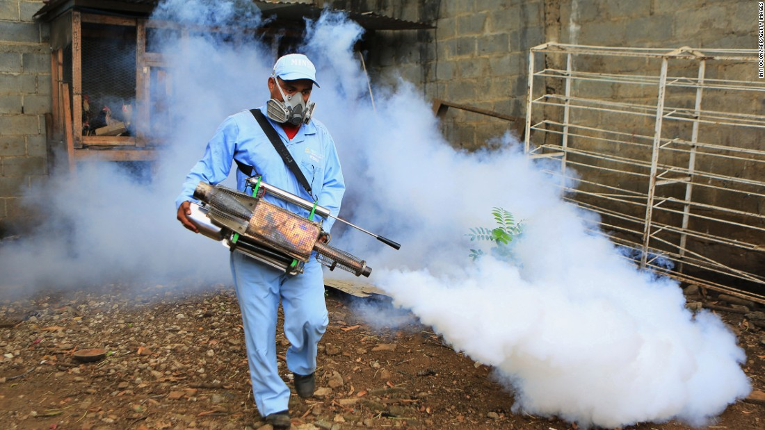
Dengue Fever Overview
Mosquito borne tropical disease
Caused by Dengue Virus
Symptoms include: high fever, headache, vomiting, muscles, joint pain, and skin rash
Small proportion of cases develop dengue hemorrhagic fever
Mortality rates ~<1%
~500 million people infected per year
No vaccine or treatment available
  Only preventative measures such as bed nets and mosquito spraying

Slide 22
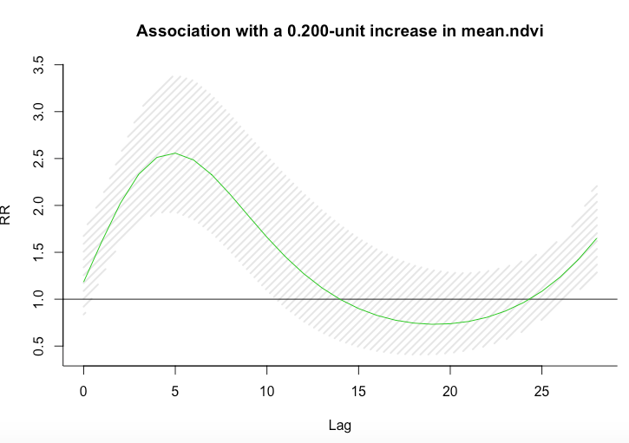
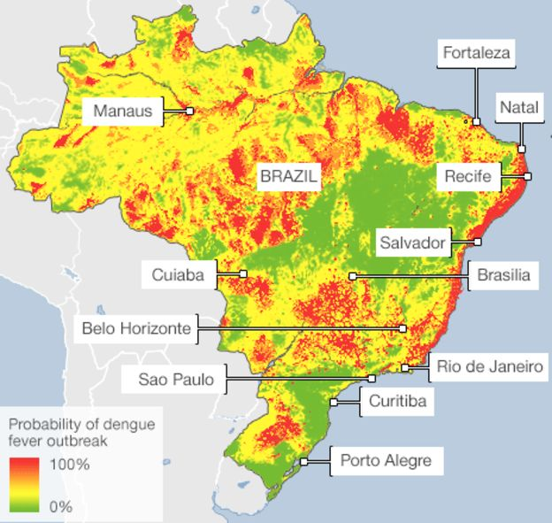
Approach Overview
Satellite Imagery
Climatological Data
Clinical Surveillance Data
Google Search Queries
Demographic Data
+
Predictive Analysis
Dengue Risk Map & Potential Hot Spots

Slide 23
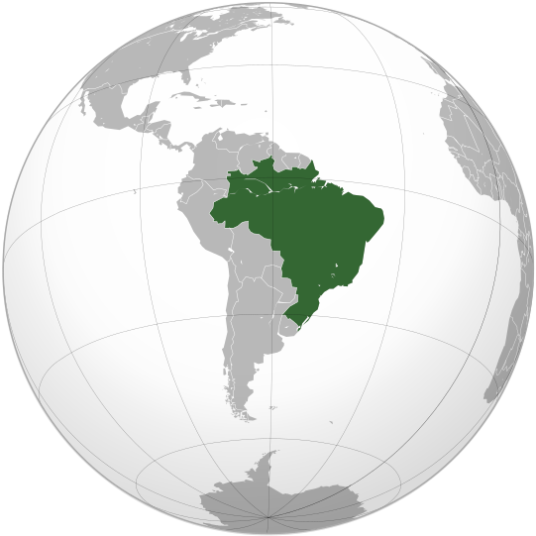
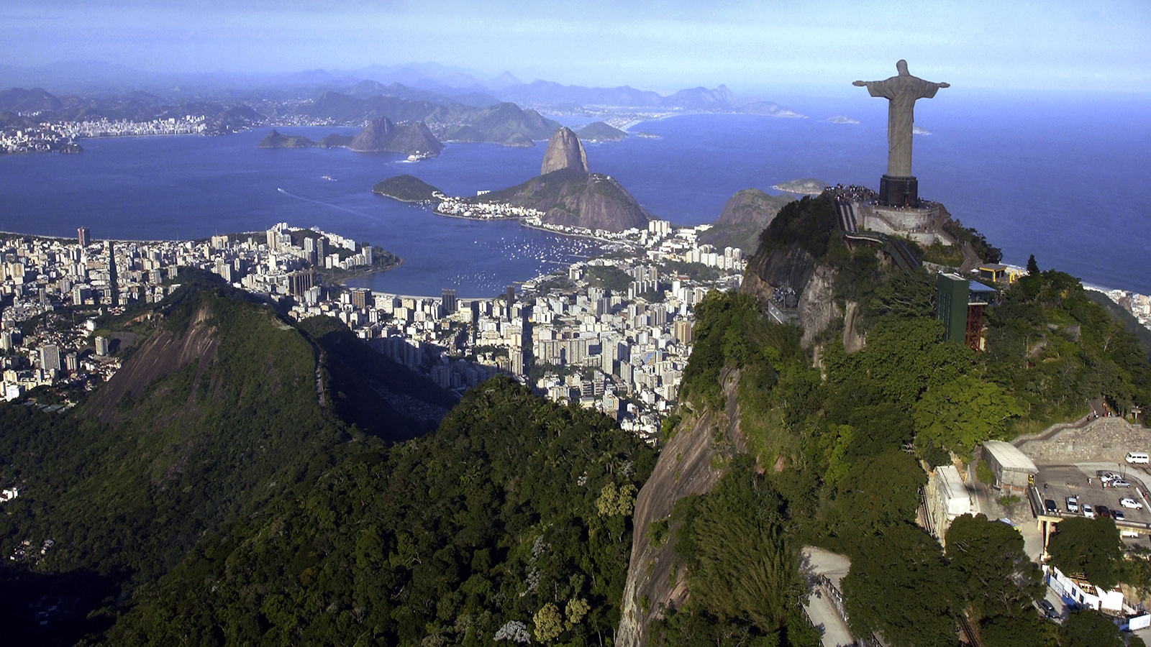
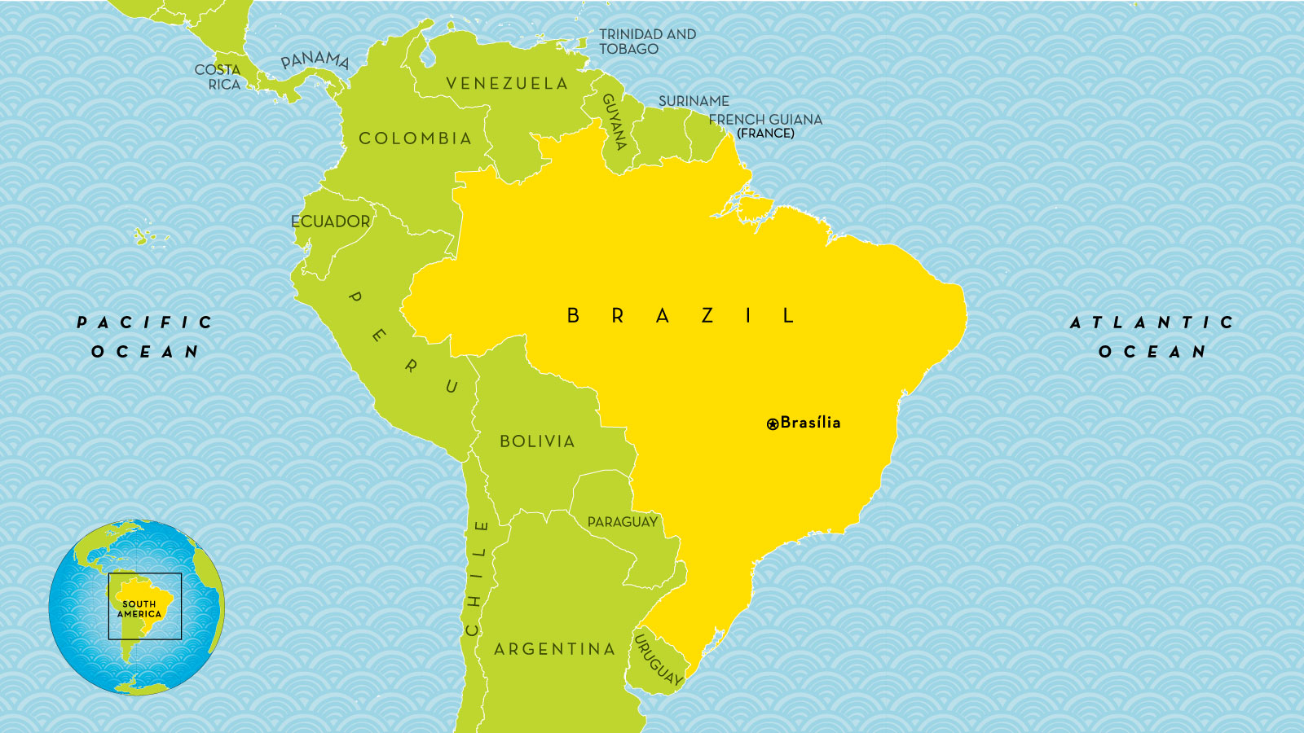
Brazil Overview
~3.3 million miles squared (5th largest country)
~207 million people
5,570 municipalities
  Analogous to US counties
~1.5 million reported cases of Dengue in 2016

Slide 24
Clinical Surveillance Data

Slide 25
Clinical Surveillance Data Overview
Data from Brazilian Ministry of Health
Cases of Dengue from 2010 to 2017 by municipality
Likely reporting bias
“gold standard”
Percent of the total 2015 reported dengue cases in each “meso-region.”

Slide 26
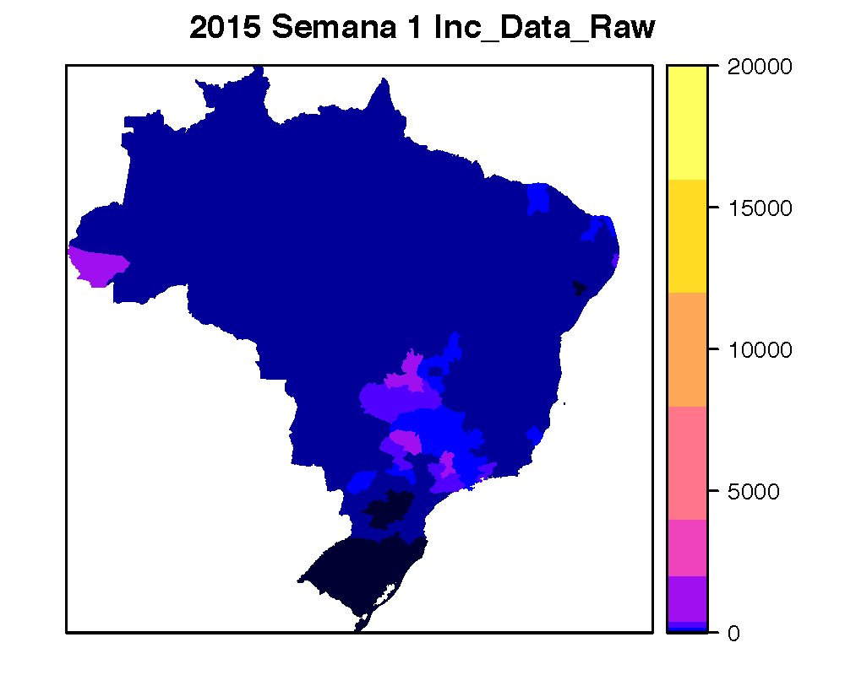
Spatial and Temporal Heterogeneity
Incidence in Minas Girais state by municipality, 2012/2013
Most outbreaks start in the Southeast and spread to the rest of Brazil

Slide 27
Satellite Imagery

Slide 28
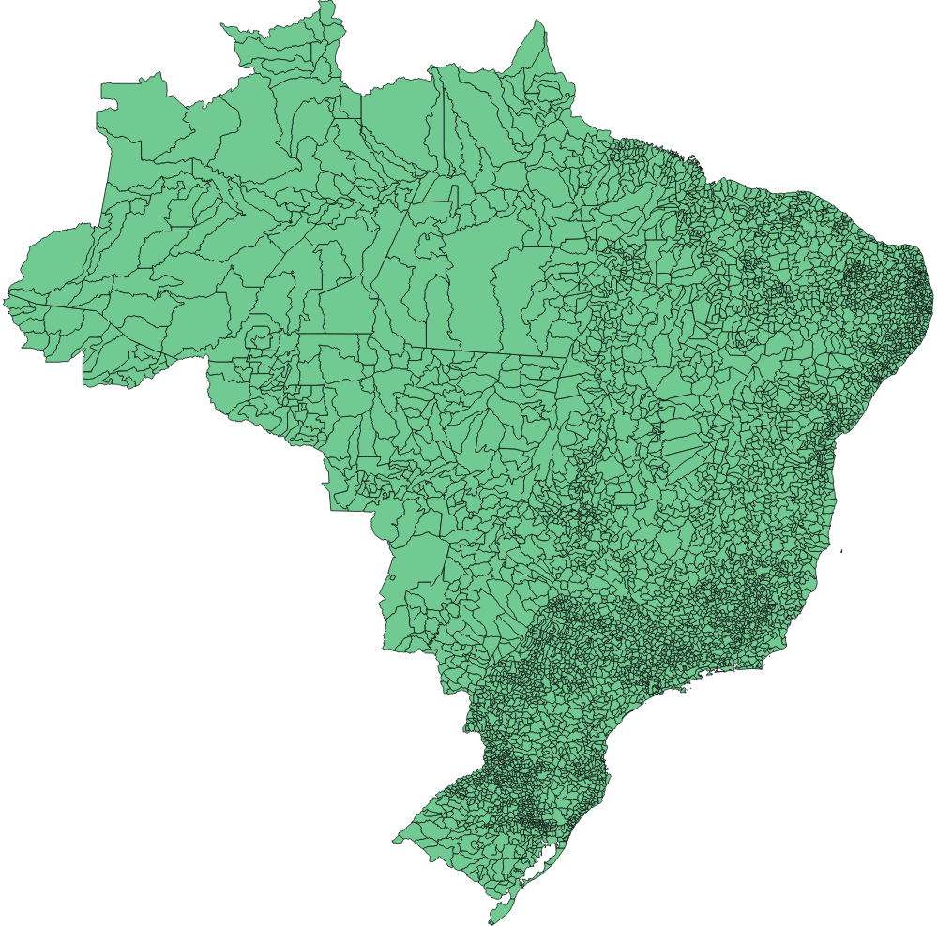
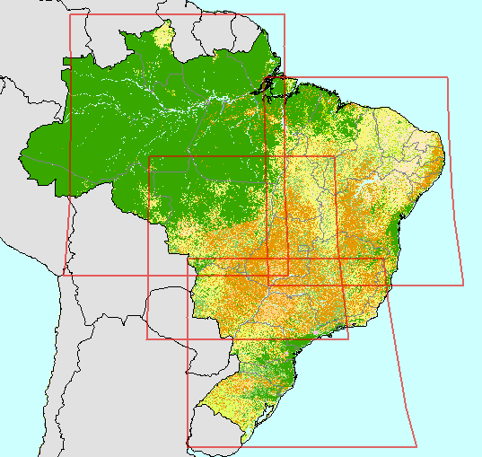
Satellite Imagery Overview
TIME
temporal stack of mean NDVI, etc.
Per each municipality, per week, compute spectral remote sensing derived indicators of vegetation health, water content, and burned areas.

Slide 29
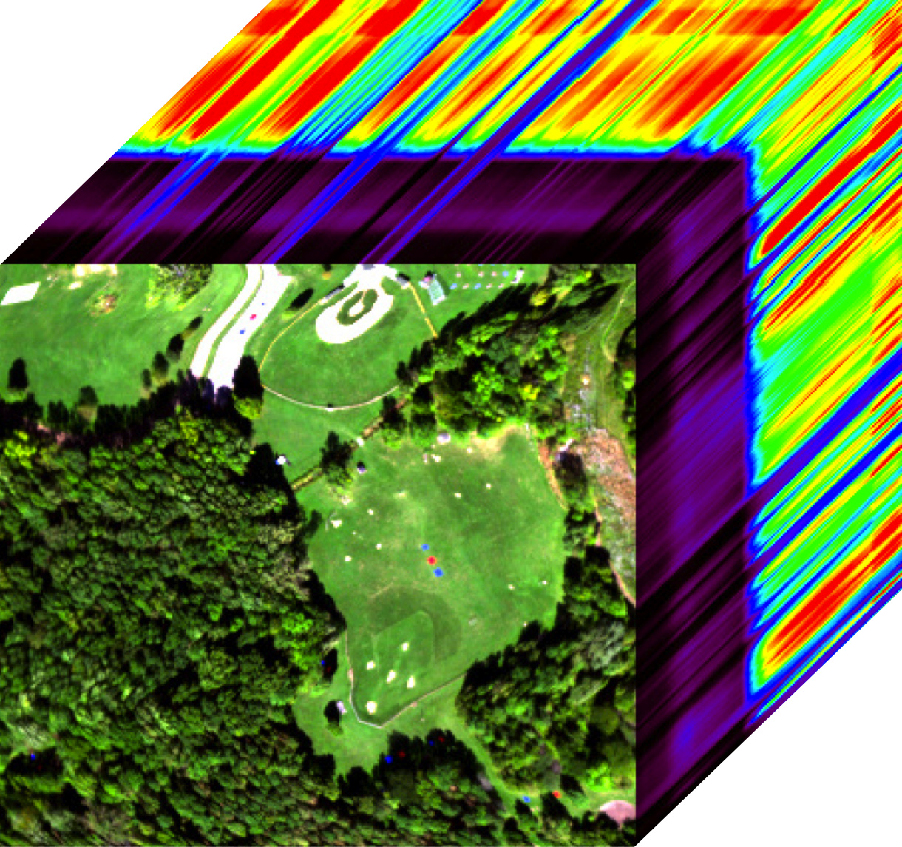
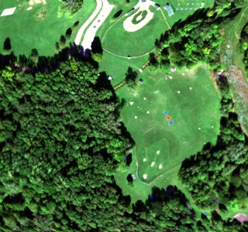

Spectral Remote Sensing
Scalar
Pixel = [7]
3-vector
Pixel = [12,136,71]
n-vector
Pixel = [0.13,0.65,0.71,….,0.23]
digital count
blue
red
radiance / reflectance / emissivity
green
Notes:
Grayscale vs. multispectral vs. hyperspectral

Slide 30
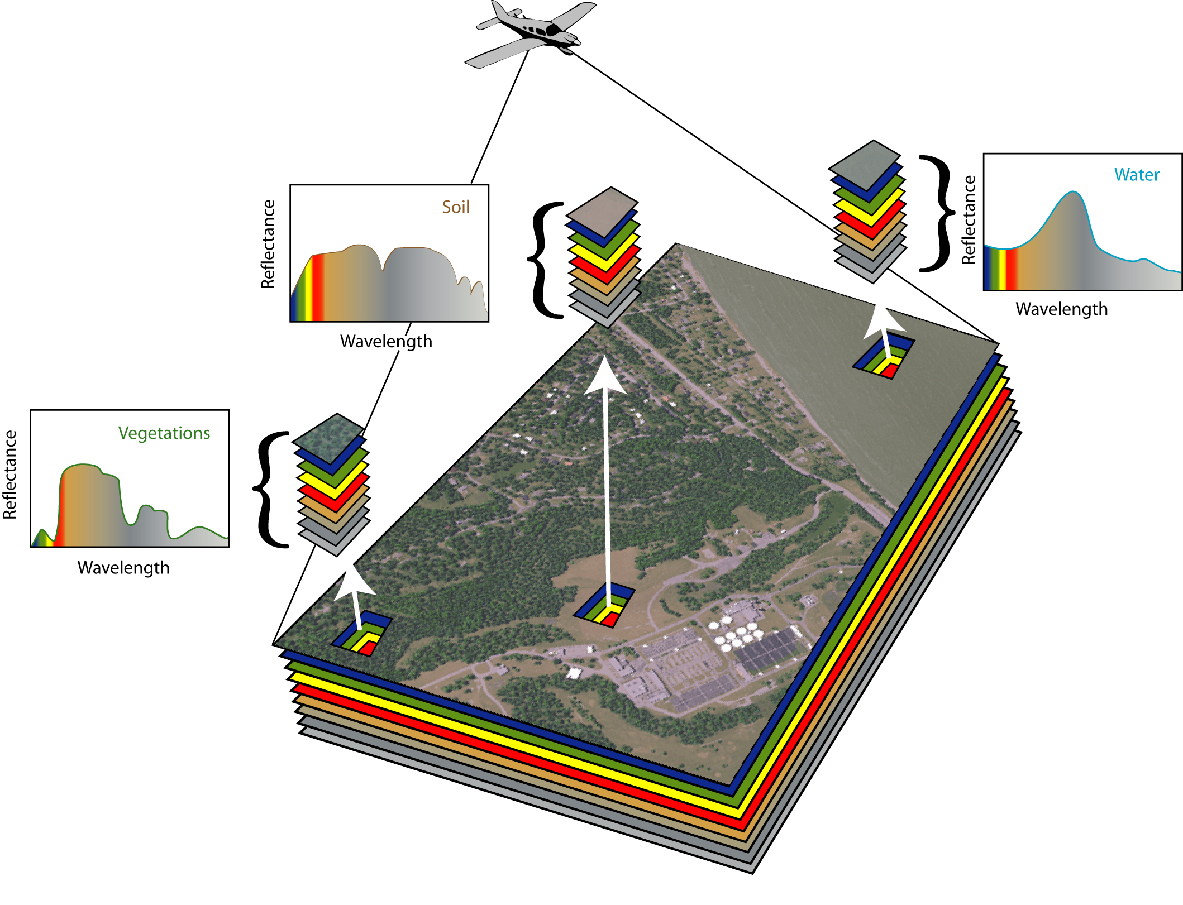
Spectral Remote Sensing
Spectral imagery collected from satellites/airborne platforms provides a tool for remotely analyzing the material content of a scene
Water
Soil
Vegetation
figure courtesy of RIT

Slide 31
Technical Goals: Methods
5570 municipalities
~360 weeks
4 satellites (for this application)
4 indices
For each municipality across a 7 year period:
  For each week:
    See if any satellites (Landsats 5, 7, 8, and Sentinel-2) imaged the full municipality during that week
    If so, mask out the cloudy pixels
    Per satellite, compute the indices on the unmasked pixels
32,083,200 Values!

Slide 32




Technical Goals: Methods
Per pixel, we compute the following:
% cloud coverage
NDVI = Normalized Difference Vegetation Index
NDWI = Normalized Difference Water Index
NBR = Normalized Burn Ratio
1
2

Slide 33
Technical Goals: Methods
Per pixel, we compute the following:
% cloud coverage
NDVI = Normalized Difference Vegetation Index
NDWI = Normalized Difference Water Index
NBR = Normalized Burn Ratio
indicator of healthy, green vegetation
indicator of water content in leaves
indicator of water content in water bodies
indicator of burned areas and fire severity

Slide 34
Technical Goals: Methods
Per municipality, per week, we compute these indices for each pixel in the municipalities. Then, for that set of pixels, we distill them down into single-value indicators by computing:
Each week, each municipality has 17 computed values:
(min, max, mean, std) X (NDVI, NDWI₁, NDWI₂, NBR) + (% cloud coverage)
 | NDVI | NDWI₁ | NDWI₂ | NBR
min | - | - | - | -
max | - | - | - | -
mean | - | - | - | -
std | - | - | - | -

Slide 35
Climatological Data

Slide 36
Weather Stations
Weather stations in Brazil from NOAA’s “Global Surface Summary of the Day” (GSOD) data set
There are 613 weather stations but ~ 5,500 municipalities, covering 8.5million km²
Collected:
  Daily temperature (mean, min, max)
  Daily precipitation
Missing data and errors are common
Available weather stations in Brazil

Slide 37
Kriging: Interpolating Weather Data
Form of Gaussian process regression and Bayesian inference used to interpolate spatial data to give the most likely intermediate values between known points
Red line: true data
Squares: observations
Blue dashed line: Kriging estimate
Grey area: 95% confidence intervals
Kriging determines best estimates for precipitation in a region based on known points (weather stations).
GITTA, Ross Purves
Notes:
Named after South African Danie Krige, who developed the method to estimate most likely distribution of gold based on a few borehole samples

Slide 38
Demographic Data

Slide 39
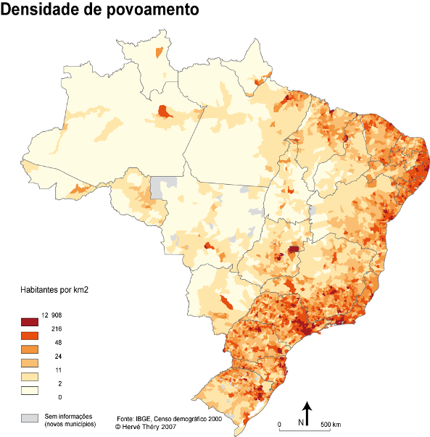
Demographic Information Overview
2010 Census Data (237 characteristics)
  Population density
  Household income
  % of households with inadequate water supply and sewage
  % of urban households with a garbage collection service
  % of households with bathrooms and running water

Slide 40
Demographic Characteristics
Garbage Collection
Sewage
Factors that may contribute to mosquito prevalence

Slide 41
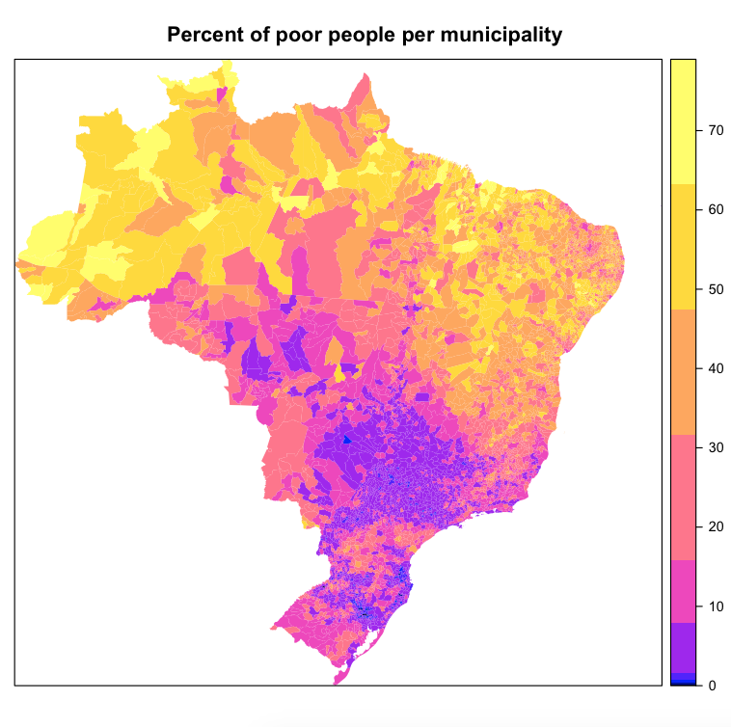
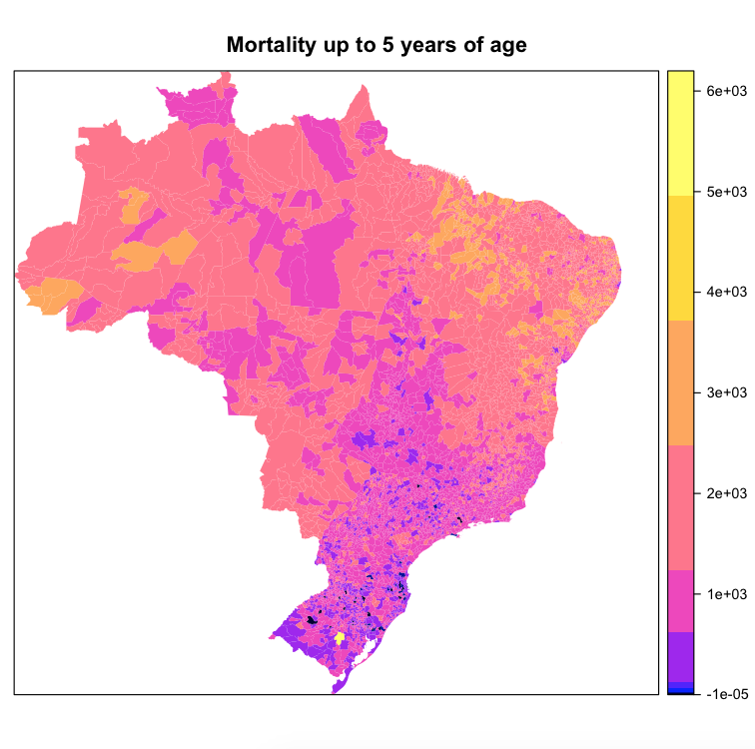
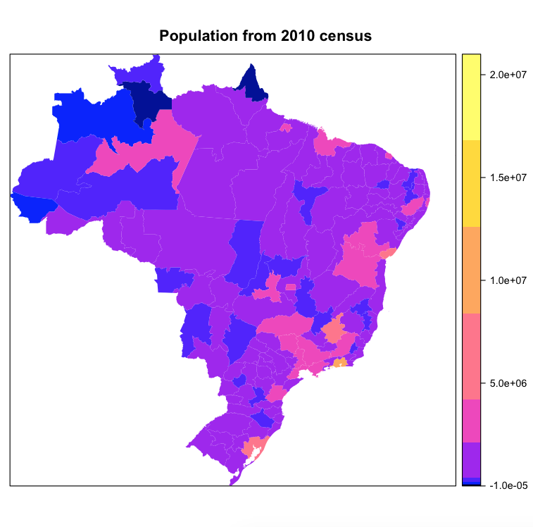
Demographic Characteristics
Geographic differentiation

Slide 42
Google Search Queries

Slide 43
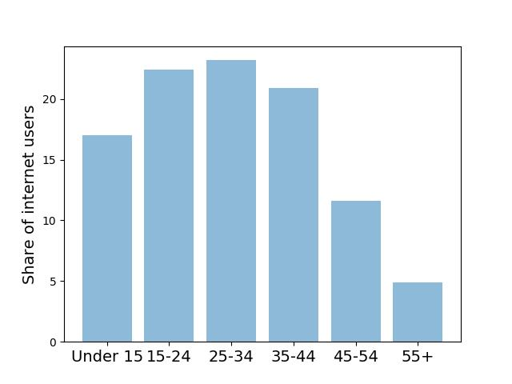
Google Search Data
Advantages:
  A large number of people use internet
    78% of the US and 56.8% of Brazil population
  Google has 97% of the market share for search engines in Brazil
  Real time availability of data
  It is shown to be associated with dengue incidence
Disadvantages:
  Search query vs. search intention
  Data resolution
  Sample population may not be representative
Distribution of internet users in Brazil
Age

Slide 44
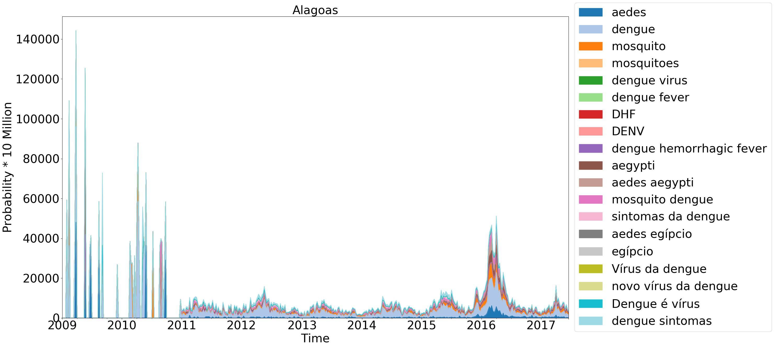
Google Health Trends (GHT) API
Query
  Input: Term, region (country or state), time period, and time resolution
  Output: Time series of search probabilities for the given term in the given region and time period

Slide 45
PREDICTIVE ANALYSIS

Slide 46
Modeling Approach Overview
Delay Response: There is delayed response between environmental conditions and dengue cases
Aedes aegypti is adapted to urban environments so can breed in stored water
rain
transmission
females feed & lay eggs every 2 days
mosquito breeding site fills
eggs develop
adults emerge and mate

Slide 47
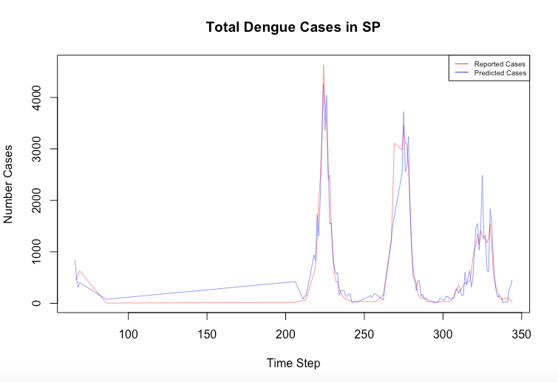
Preliminary Results: São Paulo
Used lags informed by distributed lag nonlinear model to perform a general additive model forecast
São Paulo
We start predicting in 2013 due to sparse data 2010-2012
Our predictions account for ~90% of the variance
Using all data streams to predict
Red: reported
Blue: predicted
Number Reported Cases
Weeks since January 2010

Slide 48
Summary
Build tools to aid in decision support and situational awareness.
Develop new tools to extract useful information from Internet data streams.
Develop new approaches to assimilate real-time information into predictive models.
Validate approaches by forecasting events.
Our ultimate goal: develop an event forecasting system using mathematical approaches and heterogeneous data streams.

Slide 49
Relevant papers
N. Generous, G. Fairchild, A. Deshpande, S. Y. Del Valle, and R. Priedhorsky, “Global Disease Monitoring and Forecasting with Wikipedia,” PLOS Computational Biology, vol. 10, no. 11, p. e1003892, Nov. 2014.
http://dx.plos.org/10.1371/journal.pcbi.1003892
G. Fairchild, L. De Silva, S. Y. Del Valle, and A. M. Segre, “Eliciting Disease Data from Wikipedia Articles,” in Ninth International AAAI Conference on Weblogs and Social Media - Wikipedia Workshop, 2015, pp. 26–33.
http://www.aaai.org/ocs/index.php/ICWSM/ICWSM15/paper/view/10630
K. S. Hickmann, G. Fairchild, R. Priedhorsky, N. Generous, J. M. Hyman, A. Deshpande, and S. Y. Del Valle, “Forecasting the 2013-2014 Influenza Season Using Wikipedia,” PLOS Computational Biology, vol. 11, no. 5, p. e1004239, 2015.
http://dx.plos.org/10.1371/journal.pcbi.1004239
R. Priedhorsky, D. Osthus, A. R. Daughton, K. R. Moran, N. Generous, G. Fairchild, A. Deshpande, and S. Y. Del Valle, “Measuring Global Disease with Wikipedia: Success, Failure, and a Research Agenda,” in Proceedings of the 2017 ACM Conference on Computer Supported Cooperative Work and Social Computing, 2017, pp. 1812–1834.
http://dl.acm.org/citation.cfm?doid=2998181.2998183
D. Osthus, J. Gattiker, R. Priedhorsky, S. Y. Del Valle, “Dynamic Bayesian Influenza Forecasting in the United States with Hierarchical Discrepancy,” under review.
https://arxiv.org/abs/1708.09481

Slide 50
Teams
Alina Deshpande
Forest Altherr
Lauren Castro
Maneesha Chitanvis
Emily Cloyd
Sergio Cordova
Ashlynn Daughton
Nick Generous
Tia Hollander
Leslie Naranjo
Reid Priedhorsky
William Rosenberger
Nileena Velappan
Sara Del Valle
Jessie Conrad
Nick Generous
Kyle Hickmann
Carrie Manore
Kelly Moran
Dave Osthus
Nidhi Parikh
Reid Priedhorsky
Amanda Ziemann
Geoffrey Fairchild
gfairchild@lanl.gov

