Slide 1
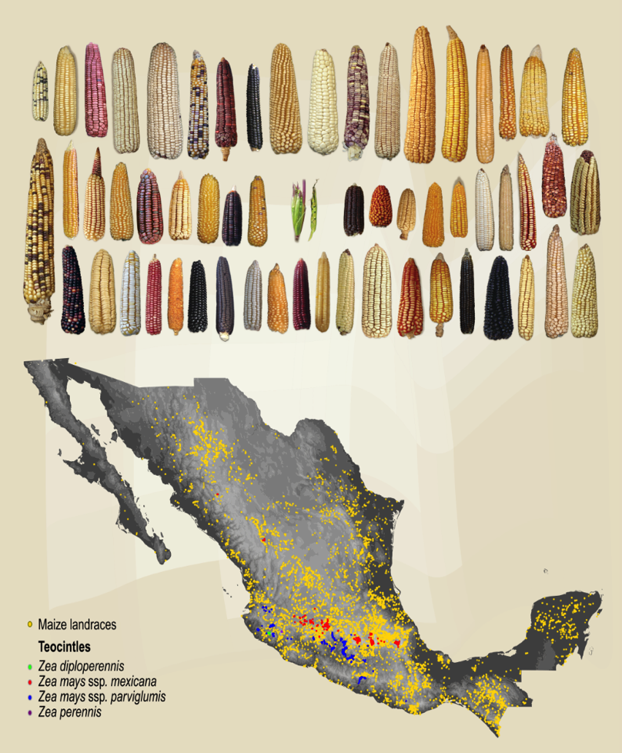
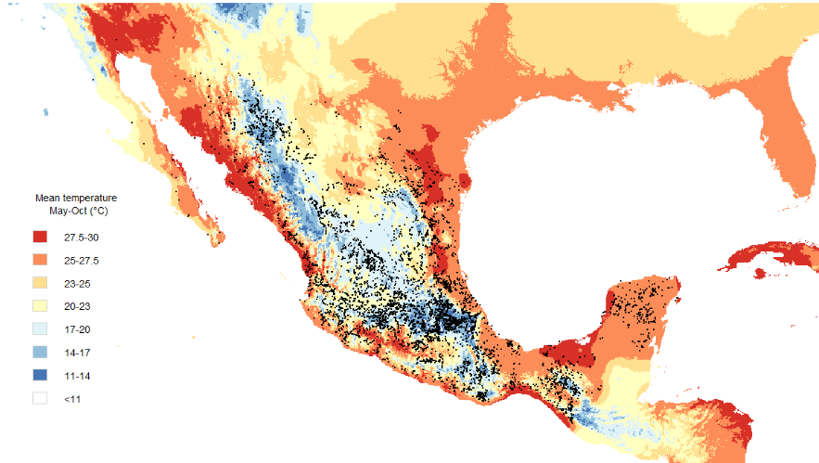


Genetic diversity in space and time, an insurance vs climate change
Mauricio Bellon
Alejandro Ponce
Francisca Acevedo
Daniel Ortíz
Nancy Arizpe
José Sarukhán
Alicia Mastretta-Yanes
@AliciaMstt
amastretta@conabio.gob.mx
01 November 2017

Slide 2
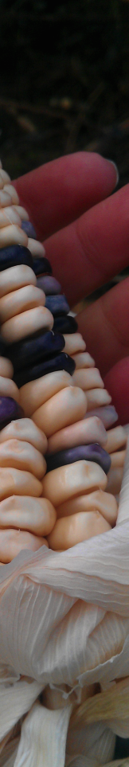
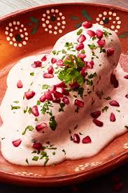
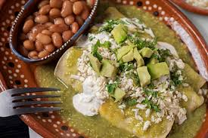
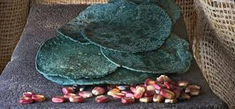
You don’t look Mexican

Slide 3
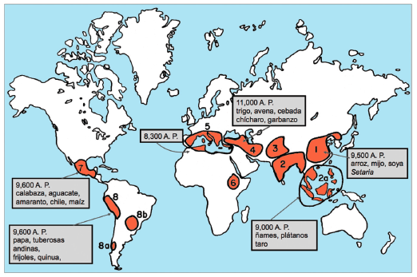
Mexico is one of the places that invented agriculture and (therefore) crops

Slide 4
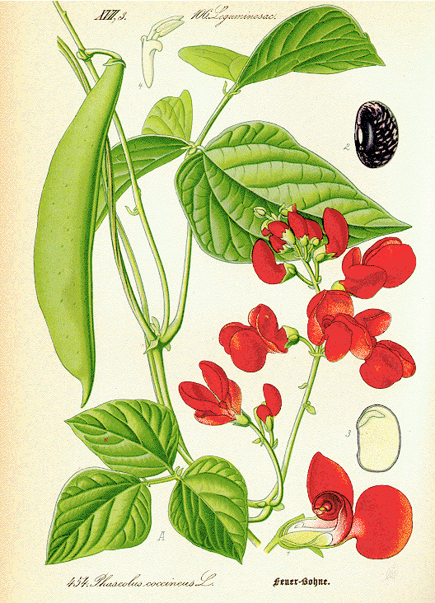
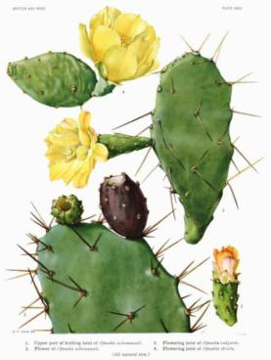
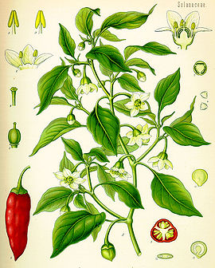
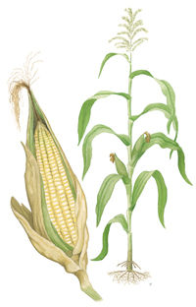
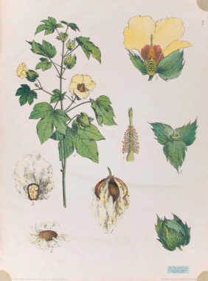
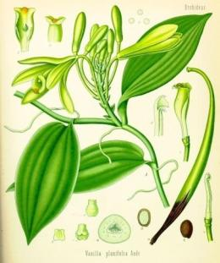
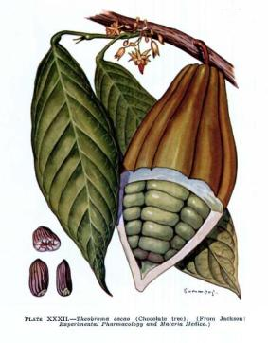
Mexico is center of origin and genetic diversity of many crops
Maize, bean, cotton, squashes/pumpkin, chilis, vainilla, cacao, nopales, chayote, green tomato, agave, avocado, …

Slide 5
This talk
Genetics of domesticated plants
Genomic (Big) data
Statistic and computational tools
Tools that we (biologist) I use and you made
… So maybe something I know more about

Slide 6
This talk
Food
for thought
Crop genetic diversity as an outcome of domestication
Mapping the extent of Mx campesino agriculture
Implications:
  Insurance like things and economics
  Conservation genetics and the math we need for that
  Creative ways to predict and use genetic div.

Slide 7
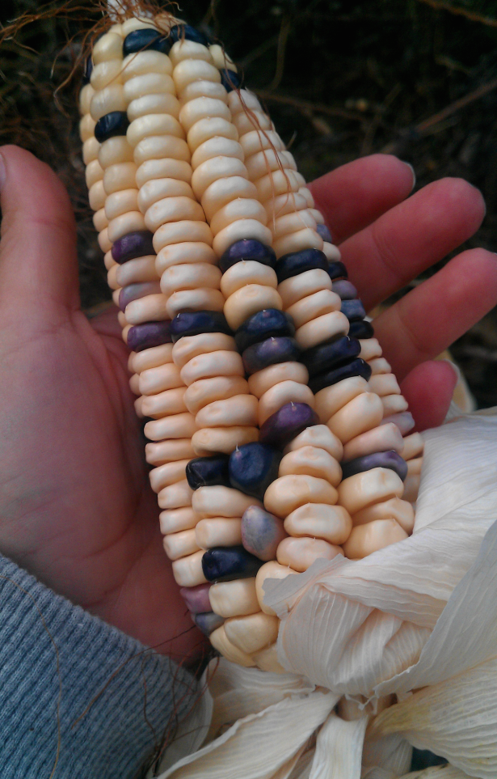
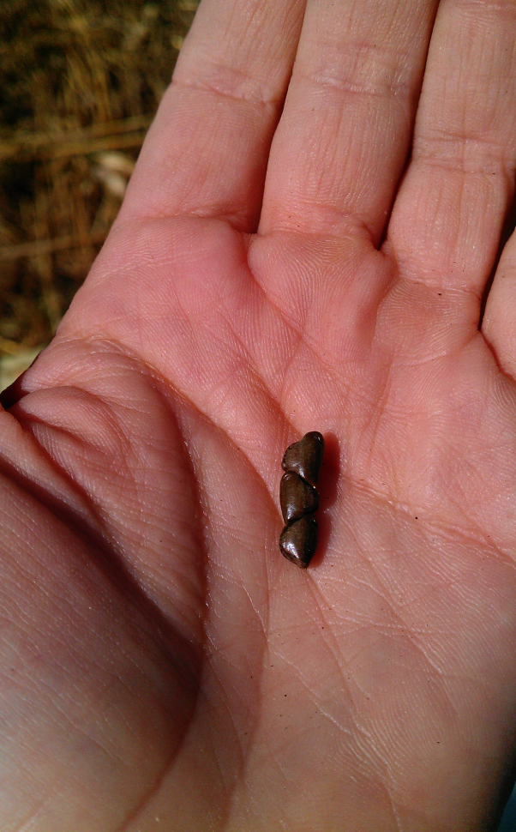



























I. Crop genetic diversity as an outcome of domestication
35 cm

Slide 8
But domestication also exposes crops to new environments where natural selection still occurs

Slide 9
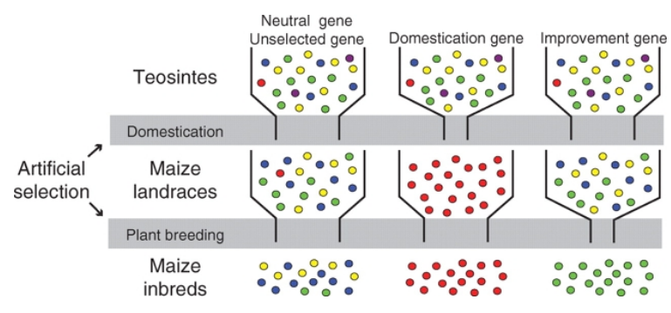
Domestication bottlenecks
Artificial
selection
Genetic drift
Different selected loci
H_{n+1}=(1-1/2Ne)H_{n}
Yamasaki et al (2005) Ann Bot

Slide 10
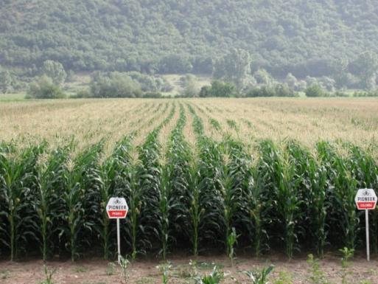
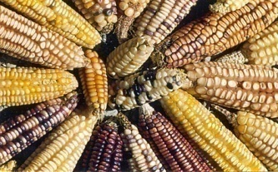
Evolution continues
intensive campesino agriculture
Extensive land owners
Buying seed
Wide adaptation
Selection in few sites
Inputs to make environment suitable
Genetically homogenous fields
Campesino smallholders
Producing seed
Local adaptation
Seleciton in Million of sites
Low inputs, marginal environments
Large genetic diversity within fields

Slide 11
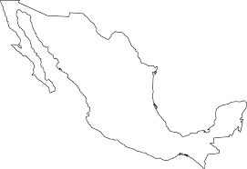
II. Mapping the extent of Mx campesino agriculture
?
Couple different National level data sets
Average yield for rainfed maize by municipality (SIAP, 2003-2015)
Planted area with subsidies (PROCAMPO, 2010)
Landraces sampling lat-long (CONABIO)
Agriculture land use map (INEGI, CONABIO*)
Temp, precipitation, slope, altitude

Slide 12
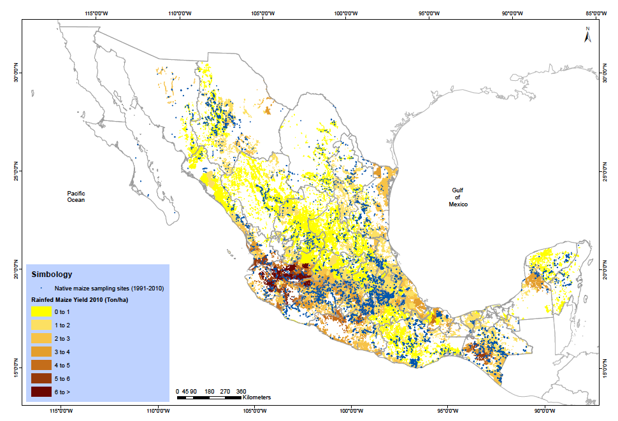
Maize campesino agriculture occurs in
4.68 million ha
Bellon, Mastretta-Yanes et al. (under review)

Slide 13
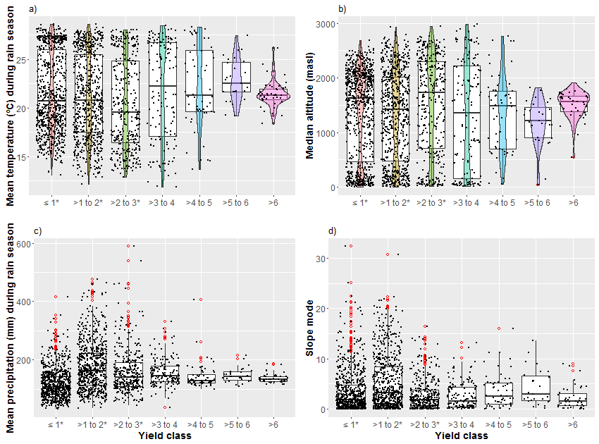
and in a wide range of environmental conditions
Bellon, Mastretta-Yanes et al. (under review)

Slide 14
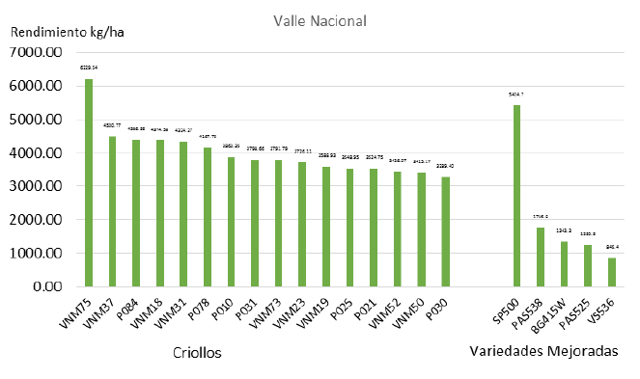
Landraces perform better than hybrids in marginal environments
Aragon (2016) Reporte AccPROMAC CONABIO

Slide 15
III. Implications of the extent and scope of campesino maize production
  Evolutionary services
  Population genetics models to inform conservation genetics
  Predicting where variation is, would be, and where would it be useful
Bellon, Mastretta-Yanes et al. (under review)

Slide 16

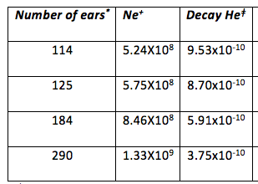
a) Evolutionary services: conservation of genetic diversity
4.68 Millones ha
30,000 genetically different plants per ha
Ne
mother ears
H_{n+1}=(1-1/2Ne)H_{n}
35 cm
Bellon, Mastretta et al. (under review)

Slide 17
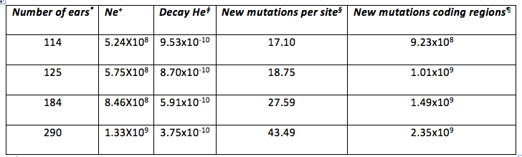
a) Evolutionary services: generation of new diversity
4.68 Millones ha
30,000 genetically different plants per ha
Ne
mother ears
New mutations= ų2Ne
In coding regions = ų2Ne * 0.02 * 2700 Mb
35 cm
each cropping cycle
Bellon, Mastretta et al. (under review)

Slide 18
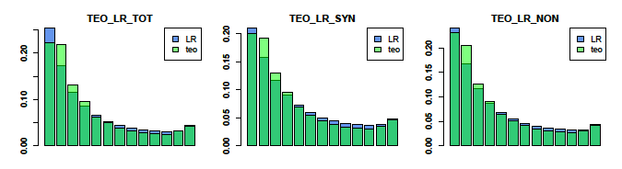
a) Evolutionary services: generation of new diversity
4.68 Millones ha
30,000 genetically different plants per ha
Ne
mother ears
New mutations= ų2N
In coding regions = ų2N * 0.02 * 2700 Mb
Hufford et al. 2012
35 cm
Bellon, Mastretta et al. (under review)

Slide 19
a) Evolutionary services: different enviroments
Differential selection pressures
Different alleles are favored in different environments and social preferences
Higher overall genetic variation
Bellon, Mastretta et al. (under review)

Slide 20
a) Evolutionary services:
Both preserve and generate diversity
THE source for options
An insurance for climate change
Public value
Bellon, Mastretta et al. (under review)

Slide 21
b) Model for in situ conservation
Theory of Island Biogeography R. MacArthur and E. O. Wilson
Predict species richness based on island size (area) and isolation (distance)
A patch of forest doesn’t conserve the forest species: Natural Protected Areas and corridors design
No equivalent for conservation genetics:
  How many ha? What Ne?
  How many farmers?
  Which environments?
  See beyond genes
Bellon, Mastretta et al. (under review)

Slide 22
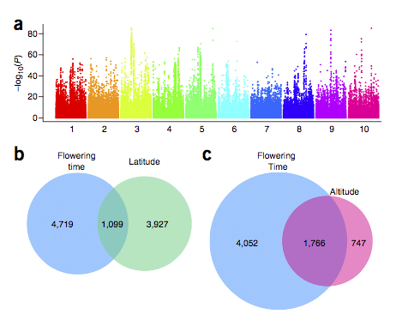
b) Predicting where variation is, would be, and where would it be useful
Genome wide association studies (GWAS) are a lot of trouble
Sequencing
Phenotyping under = conditions
Adaptive variation is related to several genes
Keep doing that, but also:
Couple genetic data with env (present and future) data to inform which genotypes farmers can test.
Romero-Navarro, et al 2017
Significance for flowering time, and overlap between
flowering time and latitude- and altitude-associated SNPs.
Bellon, Mastretta et al. (under review)

Slide 23

Tlazocamati
Gracias
Thanks

Slide 24
Landraces perform better than hybrids in marginal environments
Aragon (2016) Reporte AccPROMAC CONABIO

Slide 25
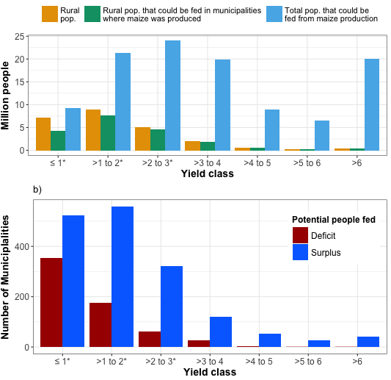
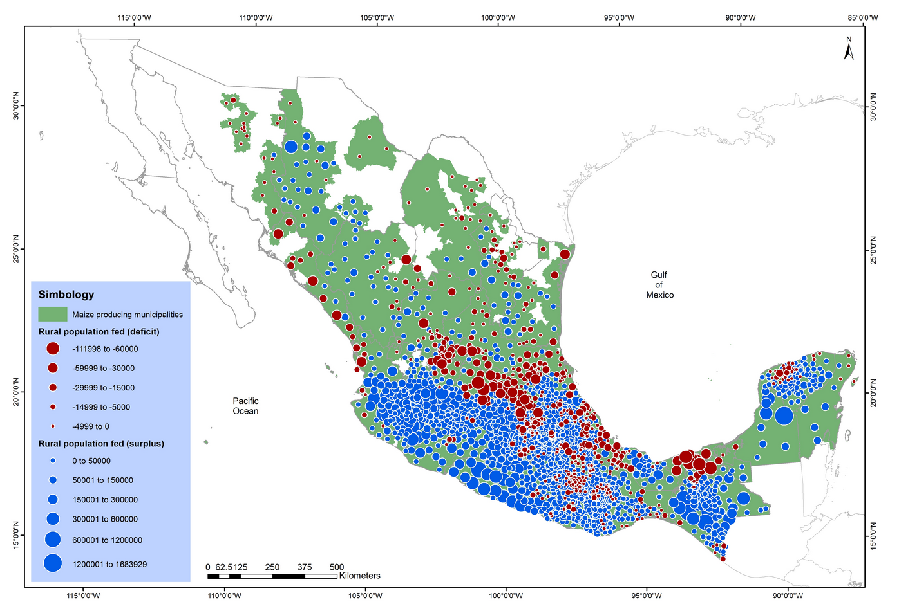

Slide 26
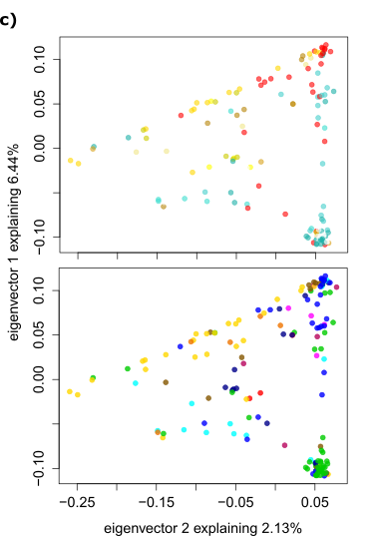
Therefore 1: no genomic clustering by landrace
Arteaga et al. 2016

Slide 27
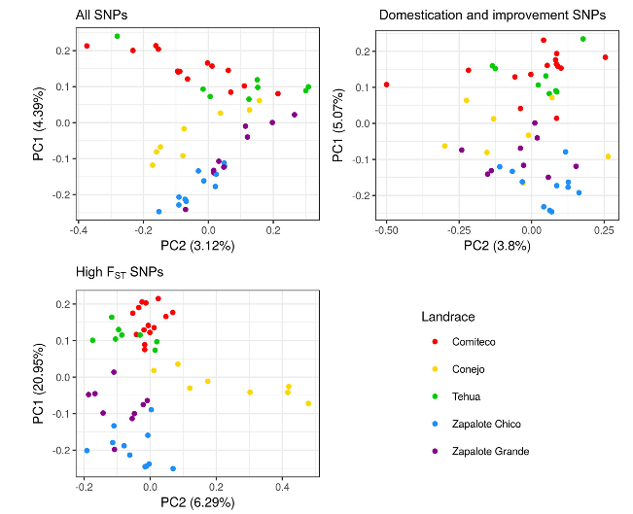
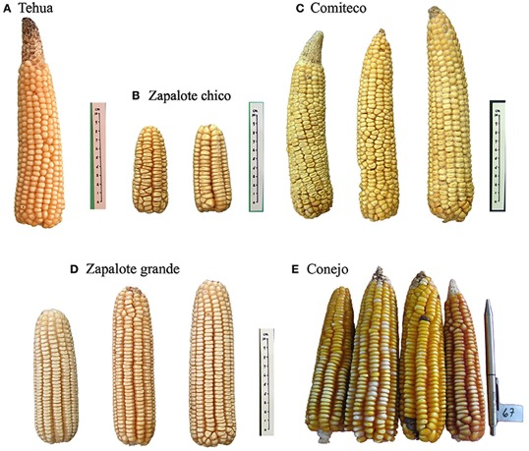
Therefore 2: Landraces can be identified by few SNPs, but the variation at the rest of the genome is high
Caldú-Primo et al. 2017

