Slide 1



Computational Statistics and Molecular Simulation: A Practical Cross-Fertilization
Computational statistical methods applied on conducting scientific literature reviews
Igor Barahona ª
Daría Hernández ^{b}, Hugo Pérez ^{c} María del Pilar Martínes ^{d}
ª Instituto de Matemáticas. UNAM
^{b} Centro Mexicano de Estudios Económicos y Sociales
^{c} Universidad Popular Autónoma del Estado de Puebla
^{d} Universidad Castilla –La Mancha
Oaxaca. 16. November. 2018

Slide 2

OUTLINE
Introduction
The dataset
Methodology
Results
Discussion
2

Slide 3
OUTLINE
Introduction
The dataset
Methodology
Results
Discussion
3

Slide 4
Introduction
The dataset
Methodology
Results
Discussion
In the last 25 years………….…..
On what extent we have changed?
4

Slide 5
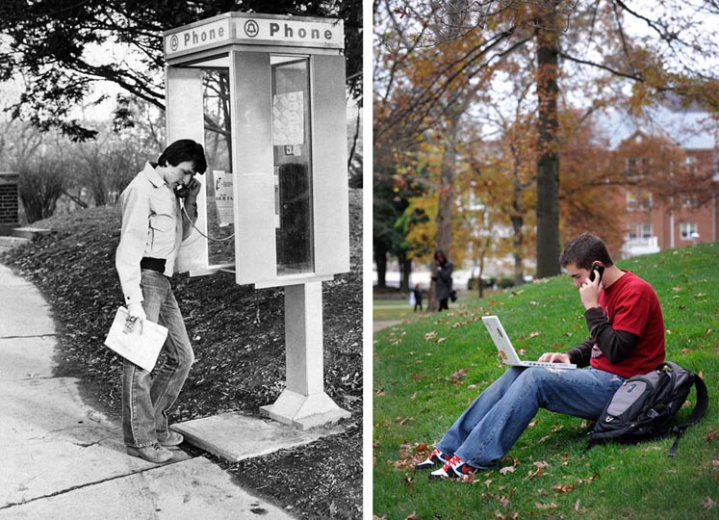
Introduction
The dataset
Methodology
Results
Discussion
Before
Now
5

Slide 6
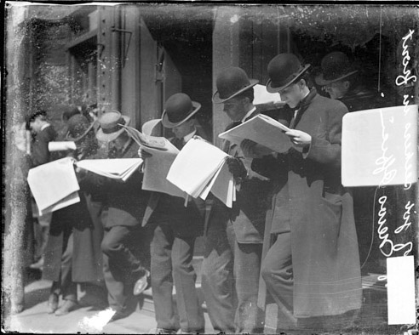
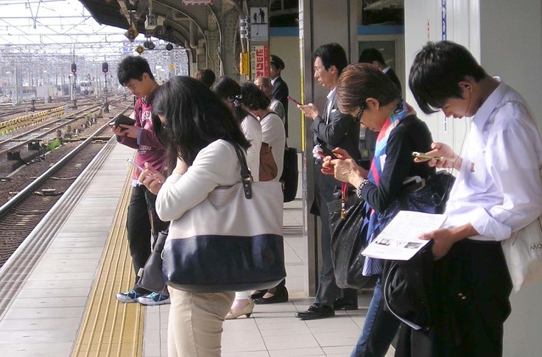
Introduction
The dataset
Methodology
Results
Discussion
Before
Now
6

Slide 7


Introduction
The dataset
Methodology
Results
Discussion
Before
Now
7

Slide 8


Introduction
The dataset
Methodology
Results
Discussion
With regard to literature reviews………….…..
Before
Now

Slide 9
Introduction
The dataset
Methodology
Results
Discussion
Our routines might have changed, but our motivations remain the same
9

Slide 10

Introduction
The dataset
Methodology
Results
Discussion
What is a literature review?
A comprehensive summary of previous research on a topic
It creates a "landscape" for the reader, giving an understanding of the developments in the field
An assessment of the available literature in your given subject or chosen topic area.
It documents the state of the art with respect to the subject or topic you are writing about

Slide 11

Introduction
The dataset
Methodology
Results
Discussion
What is data mining?
Data
Preparing & cleaning
Computational& Statistical models
Insights
Better decision making

Slide 12
Introduction
The dataset
Methodology
Results
Discussion.
Objectives of this research
1. Apply a type of multivariate analysis on data (text) mining
3 specific objectives
2. Find changes on topics and vocabulary. Considering a 10 years period
3. Provide an “easy-to-read” visualizations for a better understanding of how vocabulary is evolving
12

Slide 13
OUTLINE
Introduction
The dataset
Methodology
Results
Discussion
13

Slide 14

Introduction
The dataset
Methodology
Results
Discussion.
The problem isn’t finding data……….
it’s figuring out what to do with it

Slide 15
Introduction
The dataset
Methodology
Results
Discussion.
Journal of Marketing Research (JMR)
Journal of Marketing (JM)
From 2005 to 2014 both journals have published a total of 1169 research articles
29 countries
367 Universities and research centers
They are equal to 120,340 terms
15

Slide 16
Introduction
The dataset
Methodology
Results
Discussion
16

Slide 17
Introduction
The dataset
Methodology
Results
Discussion.
Five step approach.
Summary of descriptive statistics
Simple correspondence analysis
Aggregated tables. CA by adding the variable year
Contributive words
Evolution of vocabulary
Concluding remarks
17

Slide 18
Introduction
The dataset
Methodology
Results
Discussion
18

Slide 19
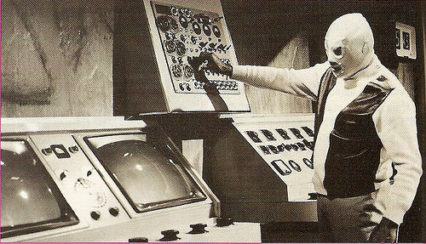

Slide 20
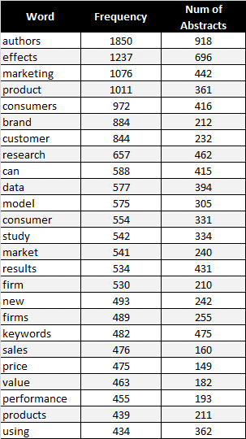
Introduction
The dataset
Methodology
Results
Discussion.
Descriptive statistics
The most frequent words
20

Slide 21

Introduction
The dataset
Methodology
Results
Discussion.
Summary of most frequent terms

Slide 22
Introduction
The dataset
Methodology
Results
Discussion.
Descriptive statistics
Publications per year
The majority of publications are concentrated in USA
22

Slide 23
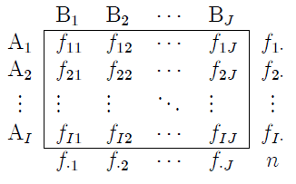
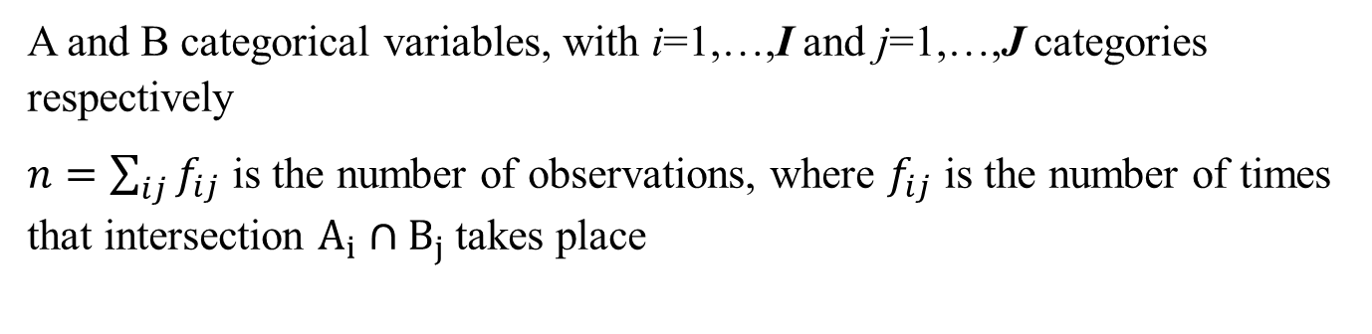
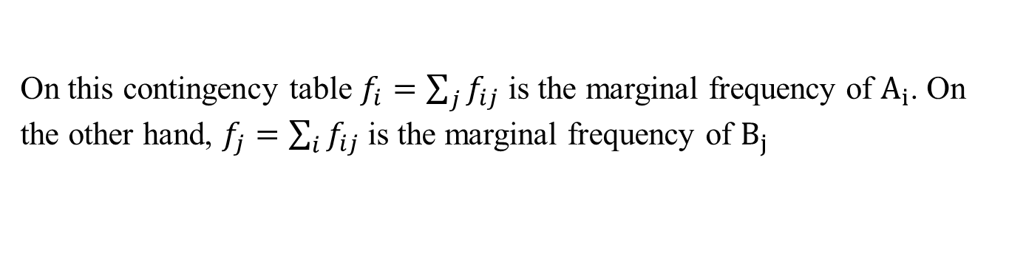
Introduction
The dataset
Methodology
Results
Discussion.
Simple correspondence analysis
A and B categorical variables, with i=1,…,I and j=1,…,J categories respectively
$n=\sum_{ij}{f_{ij}}$ is the number of observations, where $f_{ij}$ is the number of times that intersection $A_{i}∩B_{j}$takes place
On this contingency table $f_{i}=\sum_{j}{f_{ij}}$ is the marginal frequency of $A_{i}$. On the other hand, $f_{j}=\sum_{i}{f_{ij}}$is the marginal frequency of $B_{j}$

Slide 24
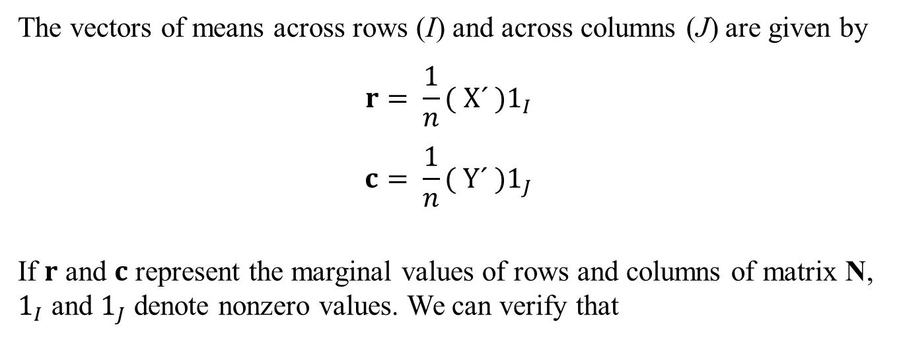
Introduction
The dataset
Methodology
Results
Discussion.
Simple correspondence analysis
The vectors of means across rows (I) and across columns (J) are given by
$$r= \frac{1}{n}( X´ )1_{I}$$
$$c= \frac{1}{n}( Y´ )1_{J}$$
If $r$ and $c$ represent the marginal values of rows and columns of matrix N, $1_{I}$ and $1_{J}$ denote nonzero values. We can verify that
$$XX´=nD_{r} , YY´=nD_{c}, X´Y=nP=N$$
The covariance matrices among rows, columns and row-columns are given by
$$S_{11}=D_{r}−rr´ , S_{22}=D_{c}−cc´, S_{12}=P−rc´$$

Slide 25

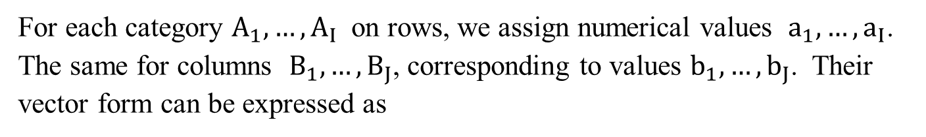
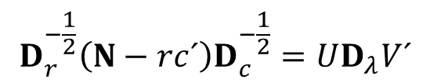
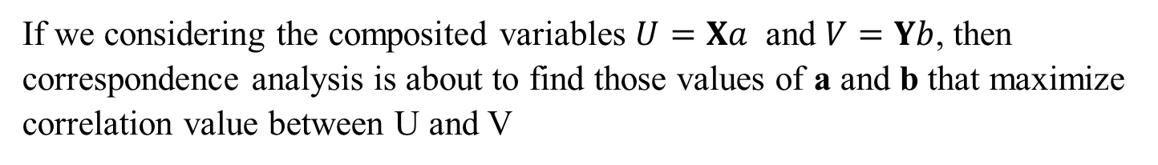
Introduction
The dataset
Methodology
Results
Discussion.
Simple correspondence analysis
For each category $A_{1},…, A_{I}$ on rows, we assign numerical values $a_{1},…, a_{I}$. The same for columns $B_{1},…, B_{J}$, corresponding to values $b_{1},…, b_{J}$. Their vector form can be expressed as
$$a=\left(a_{1},…, a_{I}\right) , b=\left(b_{1},…, b_{J}\right)$$
If we considering the composited variables $U=Xa$ and $V=Yb$, then correspondence analysis is about to find those values of a and b that maximize correlation value between U and V
A singular value decomposition of matrix N, can be expressed as follows
$$D_{r}^{−\frac{1}{2}}\left(N−rc´\right)D_{c}^{−\frac{1}{2}}=UD_{λ}V´$$

Slide 26
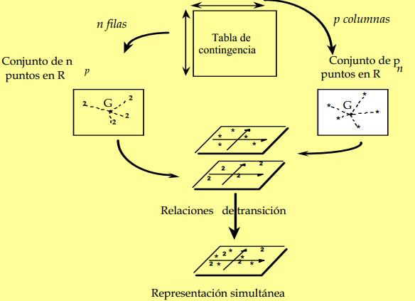
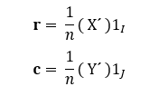
Introduction
The dataset
Methodology
Results
Discussion.
Simple correspondence analysis
r - Rows
C - Columns
Contingency table (N)
SDV of N
Visual representation

Slide 27
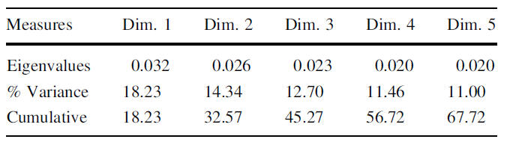
Introduction
The dataset
Methodology
Results
Discussion.
Simple correspondence analysis

Slide 28
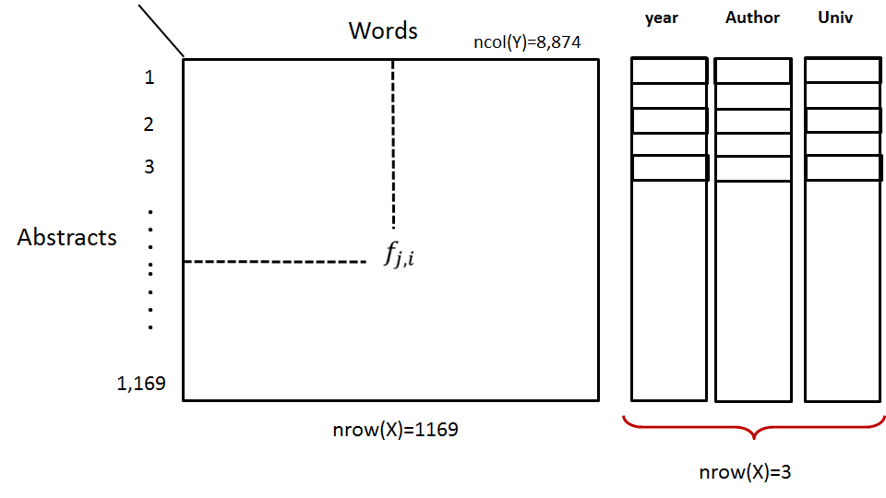
Introduction
The dataset
Methodology
Results
Discussion.
Simple correspondence analysis
28

Slide 29
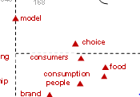
Introduction
The dataset
Methodology
Results
Discussion.
Simple correspondence analysis
It is applied to (abstracts × words) table, also called, lexical table
Table
Visual form
Words
Abstracts
Topics, through association between words
Which papers favour these topics
29

Slide 30
Introduction
The dataset
Methodology
Results
Discussion.
Simple correspondence analysis
30

Slide 31
Introduction
The dataset
Methodology
Results
Discussion.
Aggregated tables. CA integrated with time as factor
Integrating the variable time as factor to the correspondence analysis applied to periods × words table.
Table
Visual form
Words
P1
P4
<<<<<<<<<<<<<<<<<<<<<<
years/
periods
P2
P5
P7
P3
P6
Chronological pattern
31

Slide 32
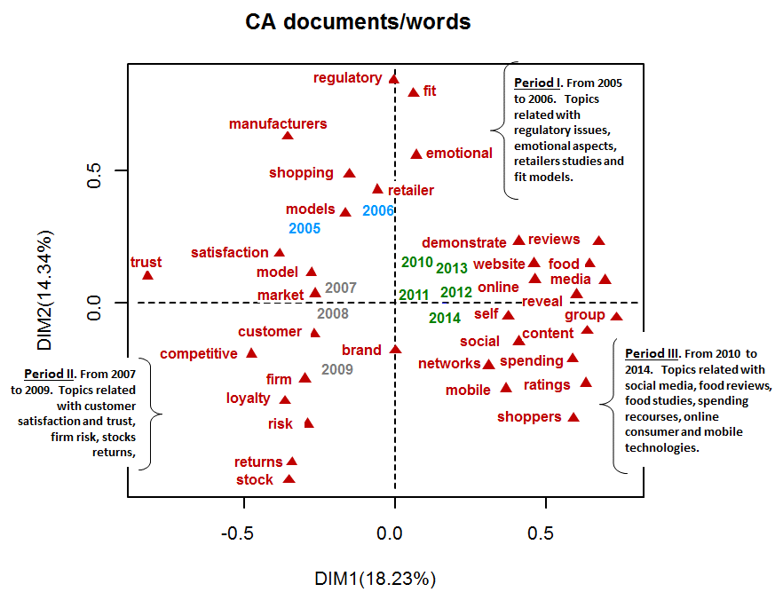
Introduction
The dataset
Methodology
Results
Discussion.
Aggregated tables. CA integrated with time as factor
32

Slide 33
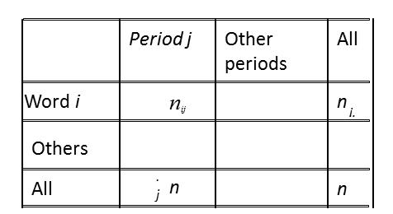
Introduction
The dataset
Methodology
Results
Discussion.
Contributive words
The characteristic words are words significantly overused (underused) in a year/ period as compared to the previous periods
Selection criteria
33

Slide 34
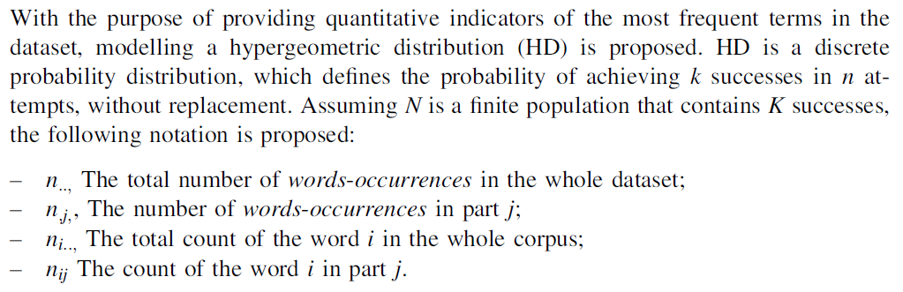
Introduction
The dataset
Methodology
Results
Discussion.
Contributive words
H_{o}: Word is exchangeable across year of publication
H₁: Word is not exchangeable across year of publication

Slide 35
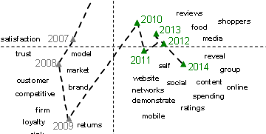
Introduction
The dataset
Methodology
Results
Discussion.
Identifying changes through the time
Year1
Year2
Year3
Year4
j
Lexical Time
Lexical time through MFA-CT
Words
Year
Abstracts
35

Slide 36
Introduction
The dataset
Methodology
Results
Discussion.
Identifying changes through the time
36

Slide 37
Introduction
The dataset
Methodology
Results
Discussion
37

Slide 38
Introduction
The dataset
Methodology
Results
Discussion.
What did we learn here?
This research provides an original methodology for making sense of large textual datasets
On a given bunch of documents, main topics can be effectively identified
It is possible to identify how vocabulary and topics are evolving through the passing of the time
Documents which have done a breakthrough, are quickly identified
Make relevant conclusions by relating words and topics.
38

Slide 39
Introduction
The dataset
Methodology
Results
Discussion.
How it does contribute
This methodology can be easily replicated in other field. (e.g. Chemistry, Medicine, Law, etc)
There are available specialized packages and functions on R, which make possible to perform quick and reliable calculations
These tools are available to any researcher or practitioner, who is interesting on performing literature reviews
39

Slide 40
Introduction
The dataset
Methodology
Results
Discussion.
More details can be found at
Barahona, I., Hernández, D. M., Pérez-Villarreal, H. H., & del Pilar Martínez-Ruíz, M. (2018). Identifying research topics in marketing science along the past decade: a content analysis. Scientometrics, 117(1), 293-312.
Hernandez, D. M., Becue-Bertaut, M., & Barahona, I. (2016). How scientific literature has been evolving over the time? A novel statistical approach using tracking verbal-based methods. arXiv preprint arXiv:1607.07788.
Barahona, I., Hernandez, D. M., & Perez-Villarreal, H. H. (2016). How marketing vocabulary was evolving from 2005 to 2014? An illustrative application of statistical methods on text mining. arXiv preprint arXiv:1606.03963.

Slide 41




Thank you!

Slide 42
OUTLINE
Introduction .
The dataset.
Methodology .
Results .
Discussion.
42

Slide 43
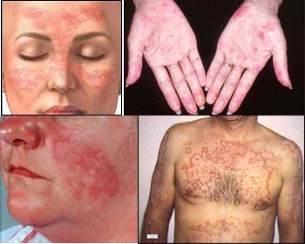
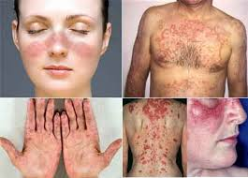
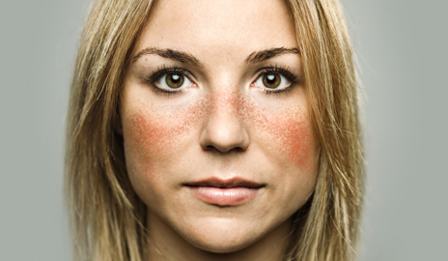
Introduction
The dataset
Methodology
Results
Discussion.
What Systemic Lupus Erythematosus is?
Systemic Lupus Erythematosus (SLE) is a disease on which the immune system attacks cells and tissue of the body.
It results on inflammation and damage of tissues.
There is not cure for the SLE and its course is unpredictable.

Slide 44
Introduction
The dataset
Methodology
Results
Discussion.
Research objectives.
Apply a type of multivariate analysis on text mining.
Find changes on topics and vocabulary on a 20 years period, by analysing 506 abstracts.
Provide an “easy-to-read” visualizations for a better understanding of how vocabulary is evolving.
3 objectives were settled
44

Slide 45
Introduction.
The dataset.
Methodology.
Results .
Discussion.
45

Slide 46
Introduction
The dataset
Methodology
Results
Discussion.
The criteria for selecting the abstracts
The name “SLE” on the tittle must be included.
The manuscript must be referred to “clinical trials”
Observed criteria
It must be published between January 1994 and December 2012.
46

Slide 47
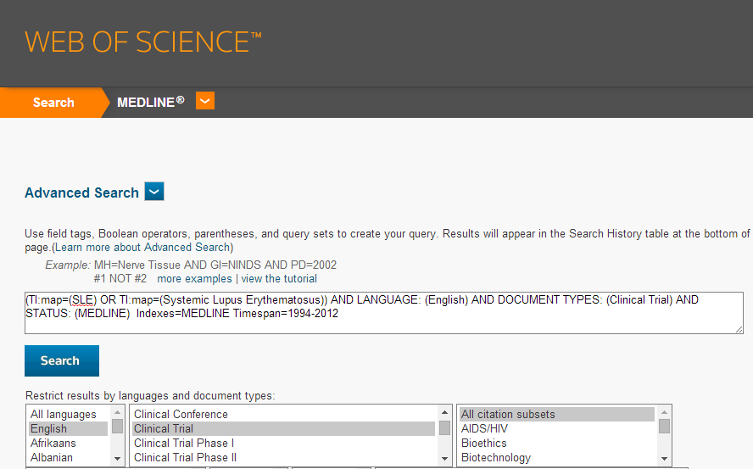
Introduction
The dataset
Methodology
Results
Discussion.
How the search criteria were implemented
SLE on the tittle.
Referred to clinical trials
Has abstract.
English writen
From Jan-94 to Dec-12
47

Slide 48
Introduction
The dataset
Methodology
Results
Discussion.
What did the search criteria throw?
A total of 506 manuscripts.
The final corpus includes 118,094 tokens that correspond to 6,834 different words
The dataset of the order 506 rows and 1120 columns. (Freq>10 and 5=>papers)
48

Slide 49
Introduction
The dataset
Methodology
Results
Discussion.
Structure of the dataset
49

Slide 50
Introduction.
The dataset.
Methodology.
Results .
Discussion.
50

Slide 51
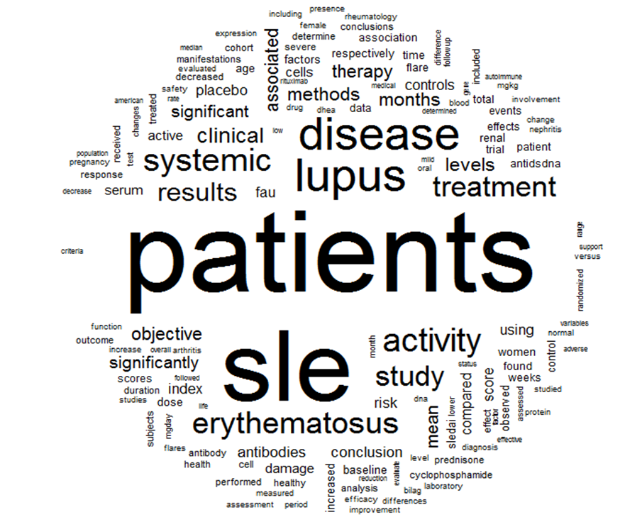
51

Slide 52
Introduction
The dataset
Methodology
Results
Discussion.
Five step approach.
Glossary of frequent terms
Simple correspondence analysis
Aggregated tables. CA by adding the variable time
Contribution of characteristics words.
Identifying changes through the time
Concluding remarks
52

Slide 53
Introduction.
The dataset.
Methodology.
Results.
Discussion.
53

Slide 54
Introduction
The dataset
Methodology
Results
Discussion.
Glossary of frequent terms.
Topic
Most frequent terms
antibody, cell, dna, gene, allele, autoantibody, polymorphism and genotype
Etiology
Epidemiology
women, cohort, age, American, pregnancy, African and ethnic.
renal, damage, manifestation, nephritis, arthritis, rheumatology, depletion, cardiovascular, pulmonary , lymphocyte and fatigue
Symptoms
54

Slide 55
Introduction
The dataset
Methodology
Results
Discussion.
Glossary of frequent terms.
Topic
Most frequent terms
duration, mortality, neuropsychiatric, predictive, social and quality
Prognosis
Diagnostics
infection, serum, sledai, evaluation, biosy, diagnosis and chronic
Treatment
therapy, effect, drug, duration, prednisone, vitamin, dose and risk
55

Slide 56
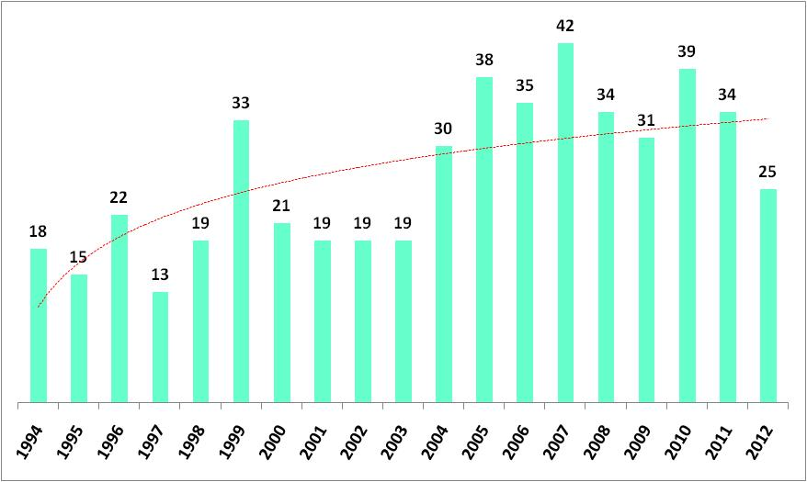
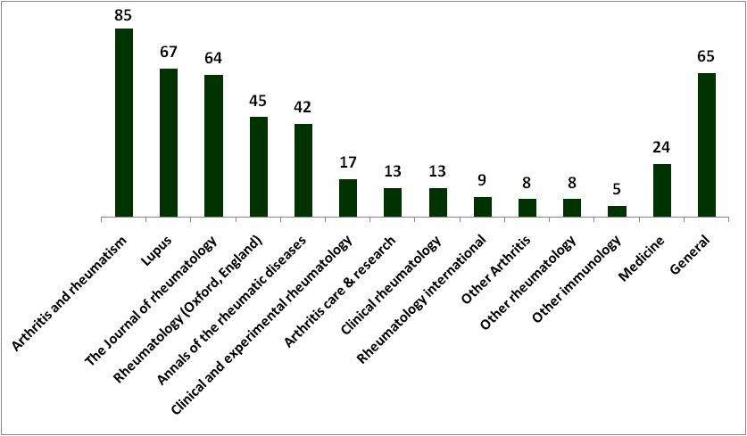
Introduction
The dataset
Methodology
Results
Discussion.
Descriptive statistics
Publications per year have increased on the last periods
The majority of publications are concentrated on 13 journals.
56

Slide 57
Introduction
The dataset
Methodology
Results
Discussion.
Simple correspondence analysis
It is applied to (abstracts × words) table, also called, lexical table
Table
Visual form
Words
gene
manifestation
154
<<<<<<<<<<<<<<<<<<<<<<
belimumab
genetic
patient
Abstracts
pulmonary
142
47
32
8
36
drug
desease
woman
71
85
Topics, through association between words
Which papers favour these topics
57

Slide 58
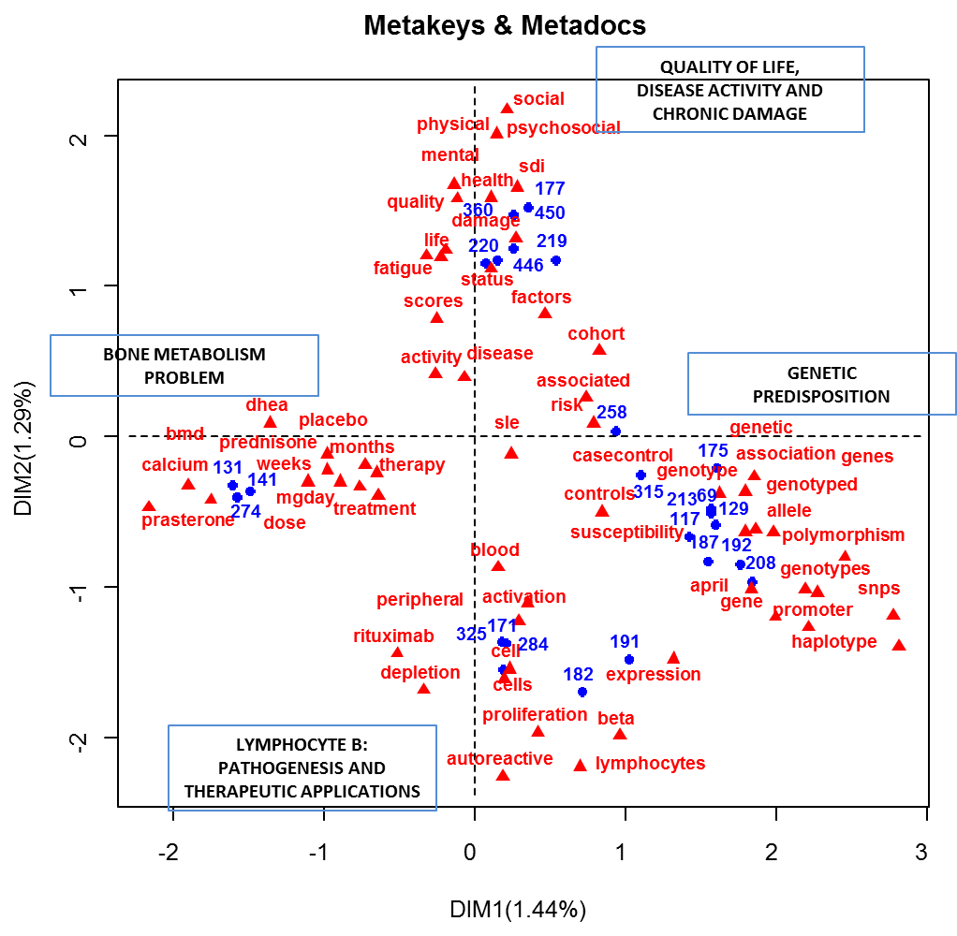
Introduction
The dataset
Methodology
Results
Discussion.
Simple correspondence analysis
58

Slide 59
Introduction
The dataset
Methodology
Results
Discussion.
Aggregated tables. CA integrated with time as factor
Integrating the variable time as factor to the correspondence analysis applied to periods × words table.
Table
Visual form
Words
P1
P4
<<<<<<<<<<<<<<<<<<<<<<
years/
periods
P2
P5
P7
P3
P6
Chronological pattern
59

Slide 60
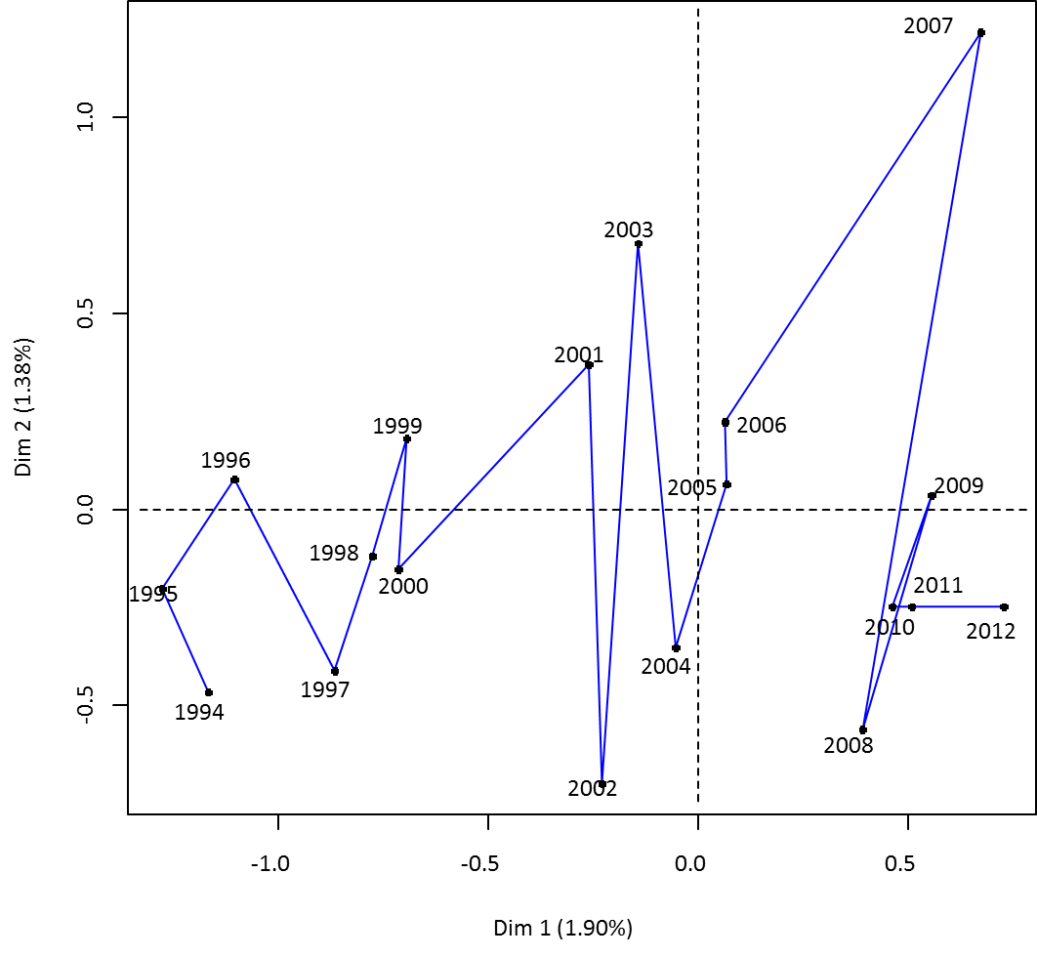
Introduction
The dataset
Methodology
Results
Discussion.
Aggregated tables. CA integrated with time as factor
60

Slide 61
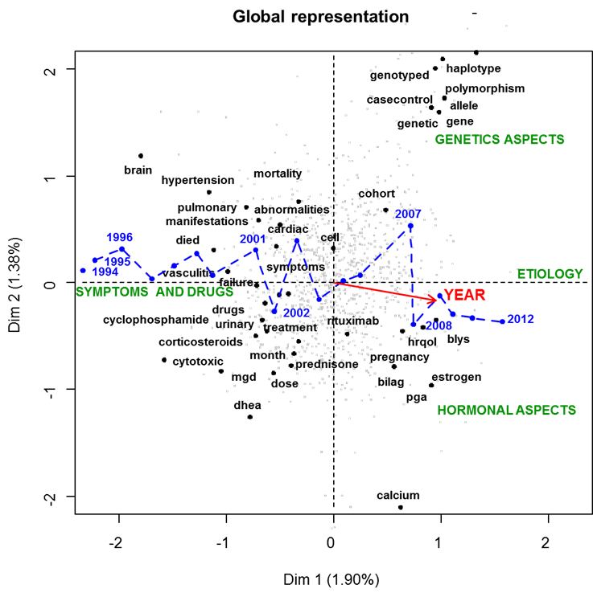
Introduction
The dataset
Methodology
Results
Discussion.
Aggregated tables. CA integrated with time as factor
61

Slide 62
Introduction
The dataset
Methodology
Results
Discussion.
Contribution of characteristics words.
The characteristic words are words significantly overused (underused) in a year/ period as compared to the previous periods
Words overused during Period 1
manifestations, pulmonary,
patients, brain,
dhea, pressure, hypertension,
mortality,
…
psychosocial, cutaneous, lung, vasculitis, urinary, articular, nervous, , drug, urine, mortality,
Selection criteria
62

Slide 63
Introduction
The dataset
Methodology
Results
Discussion.
Contribution of characteristics words.
SYMPTOMATOLOGY
TRANSITION
ETIOLOGY
1994-2000
2001-2006
2007-2011
manifestations
Pulmonary
prednisone
cytotoxic
patients
brain
dhea
pressure
hypertension
mortality
antiphospholipid
cutaneous
discontinued
polymorphism
anaemia
beta
allele
cells
expression
casecontrol
cancer
haplotype
vitamin
lymphocytes
autoimmunity
rituximab
cohort
antibody
Women
Hispanics
Antibodies
Prasterone
Perfusion
Exercise
Fever
chloroquine
cerebrovascular
placebo
cells
63

Slide 64
Introduction
The dataset
Methodology
Results
Discussion.
Identifying changes through the time
Year1
Year2
Year3
Year4
j
Lexical Time
Lexical time through MFA-CT
Words
Year
Abstracts
Pioneer papers
64

Slide 65
Introduction
The dataset
Methodology
Results
Discussion.
Identifying changes through the time
LEXICAL TIME: WORDS AND YEAR ARE ACTIVE.
Year, as categorical variables is projected as supplementary
65

Slide 66
Introduction
The dataset
Methodology
Results
Discussion.
Identifying changes through the time
66

Slide 67
Introduction
The dataset
Methodology
Results
Discussion.
Identifying changes through the time
67

Slide 68
Introduction
The dataset
Methodology
Results
Discussion.
Identifying changes through the time
68

Slide 69
Introduction
The dataset
Methodology
Results
Discussion.
Identifying changes through the time
Example of Pioneer manuscript.
PMID- 19714604
STAT- MEDLINE
VI - 61
IP - 9
DP - 2009 Sep 15
TI - A phase II, randomized, double-blind, placebo-controlled, dose-ranging study of
belimumab in patients with active systemic lupus erythematosus.
PG - 1168-78
AB - OBJECTIVE: To assess the safety, tolerability, biologic activity, and efficacy of
belimumab in combination with standard of care therapy (SOC) in patients with
active systemic lupus erythematosus (SLE). METHODS: Patients with a Safety of
Estrogens in Lupus Erythematosus: National Assessment (SELENA) version of the
Systemic Lupus Erythematosus Disease Activity Index (SLEDAI) score >/=4 (n = 449)
were randomly assigned to belimumab (1, 4, or 10 mg/kg) or placebo in a 52-week
study. Coprimary end points were the percent change in the SELENA-SLEDAI score at
week 24 and the time to first SLE flare. RESULTS: Significant differences between
the treatment and placebo groups were not attained for either primary end point,
and no dose response was observed. Reductions in SELENA-SLEDAI scores from
baseline were 19.5% in the combined belimumab group versus 17.2% in the placebo
group…... CONCLUSION: Belimumab was
biologically active and well tolerated. The effect of belimumab on the reduction
of SLE disease activity or flares was not significant. However, serologically
active SLE patients responded significantly better to belimumab therapy plus SOC
than to SOC alone.
AD - Cedars-Sinai Medical Center, University of California, Los Angeles, USA.
pioneer paper 101
2009: A phase II, randomized, double-blind, placebo-controlled, dose-ranging study of
belimumab in patients with active systemic lupus erythematosus.
69

