Slide 1


Characterizing the effect of genetic variants within promoters with distal enhancer functions
Alejandra Medina Rivera, PhD
Laboratorio Internacional de Investigación en Genoma Humano
Universidad Nacional Autónoma de México
Oaxaca, November 2018

Slide 2
Regulatory Genome

Slide 3
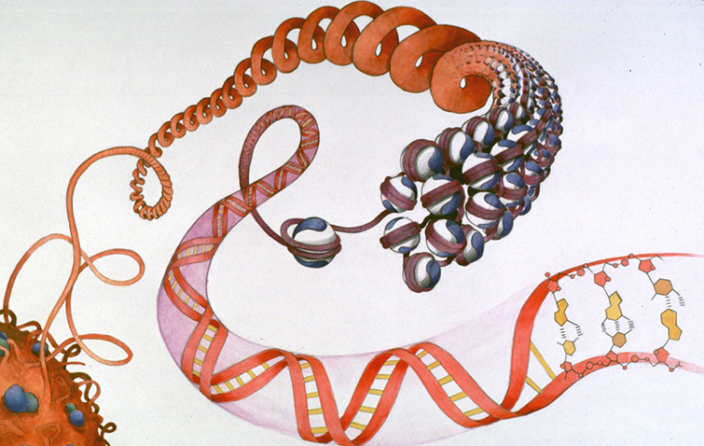
Regulatory Genome
Histones

Slide 4
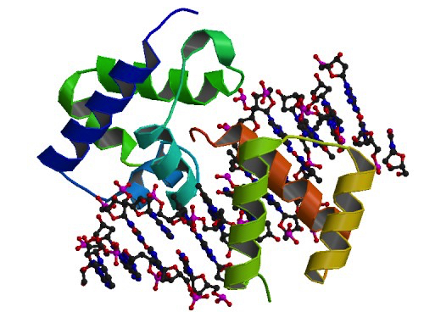
Regulatory Genome
Histones
Transcriptional Factors

Slide 5

Regulatory Genome
Histones
Transcriptional Factors

Slide 6
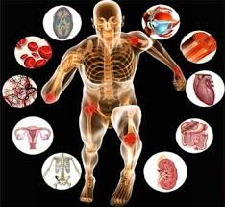
Regulatory Genome
Histones
Transcriptional Factors

Slide 7
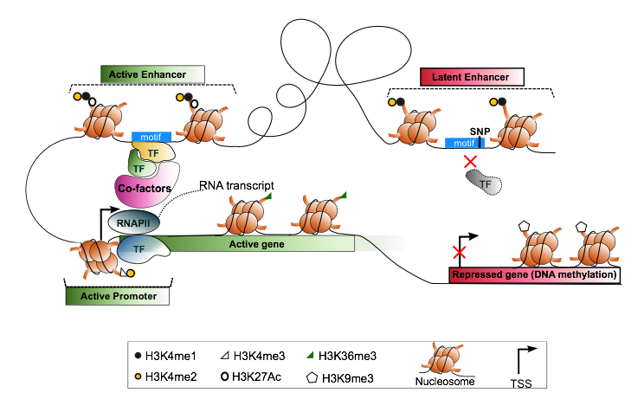
Annotating the Regulatory Genome
Notes:
Non coding DNA: Histones and TFs are proteins that interact with the DNA to regulate gene expression in reponse to the envirioment. SNPs can disrrupt this inteaction causing failure in the regulation system.

Slide 8
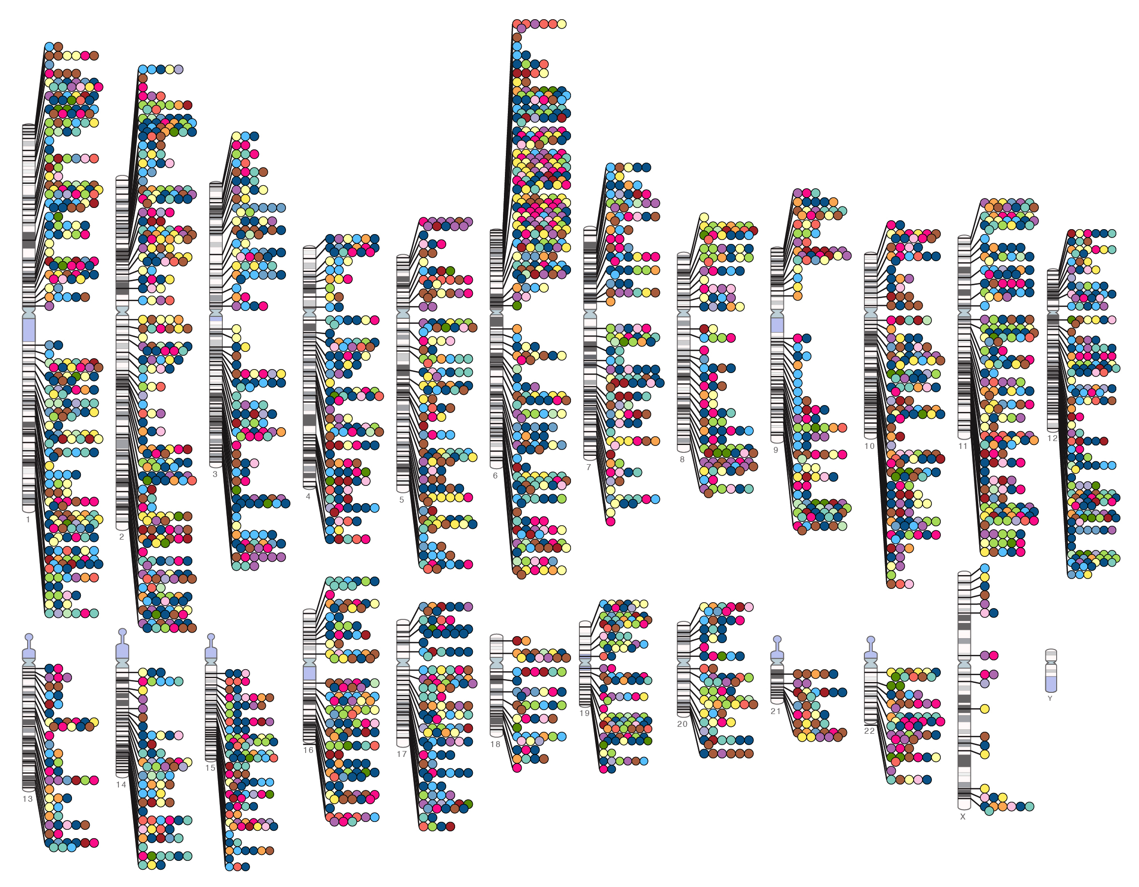
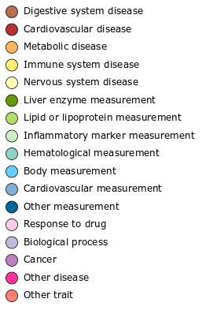


Published Genome-Wide Associations since 12/2012
Published GWA at p≤5X10⁻⁸ for 17 trait categories
More than 17,000 reported associated SNPs
93% in non-coding sequence
NHGRI GWA Catalog
www.genome.gov/GWAStudies
www.ebi.ac.uk/fgpt/gwas/

Slide 9
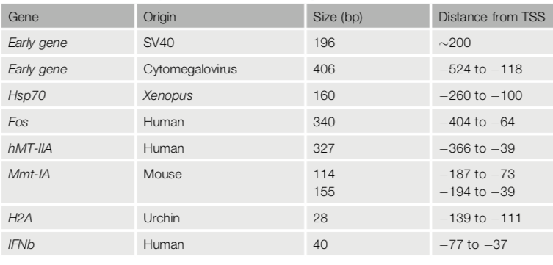
First characterized Enhancers
Banerji, J. et al. (1981); Benoist, C. and Chambon, P. (1981)
Boshart, M. et al. (1985)
Bienz, M. and Pelham, H.R. (1986)
Deschamps, J. et al. (1985)
Enhancer
Promoter
Serfling, E. et al. (1985)
Serfling, E. et al. (1985)
Grosschedl, R. and Birnstiel, M.L. (1982)
Goodbourn, S. et al. (1985)
Medina-Rivera, Trends in Biochemical Sciences, 2018

Slide 10
Regulatory Regions: Enhancers vs Promoters
Banerji, J. et al. (1981); Benoist, C. and Chambon, P. (1981)
Boshart, M. et al. (1985)
Bienz, M. and Pelham, H.R. (1986)
Deschamps, J. et al. (1985)
Enhancer
Promoter
Serfling, E. et al. (1985)
Serfling, E. et al. (1985)
Grosschedl, R. and Birnstiel, M.L. (1982)
Goodbourn, S. et al. (1985)
Medina-Rivera, Trends in Biochemical Sciences, 2018

Slide 11
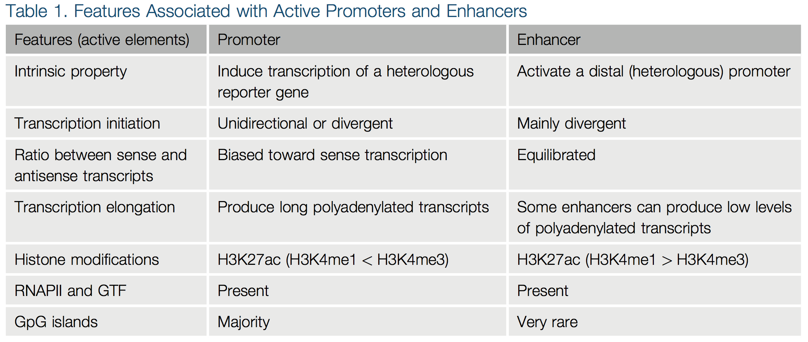
How to classify Regulatory Regions?
Enhancer
Promoter
Medina-Rivera, Trends in Biochemical Sciences, 2018

Slide 12
How to assess the enhancer function of promoters?
Notes:
Given the complexity of the project this a collaborative work
4C, RNA-seq, Starr-seq , the main contribution of my project came in the second half of it.

Slide 13





Major challenge: How to assess the enhancer function of promoters?
Salvatore Spicuglia
Notes:
Given the complexity of the project this a collaborative work
4C, RNA-seq, Starr-seq , the main contribution of my project came in the second half of it.

Slide 14
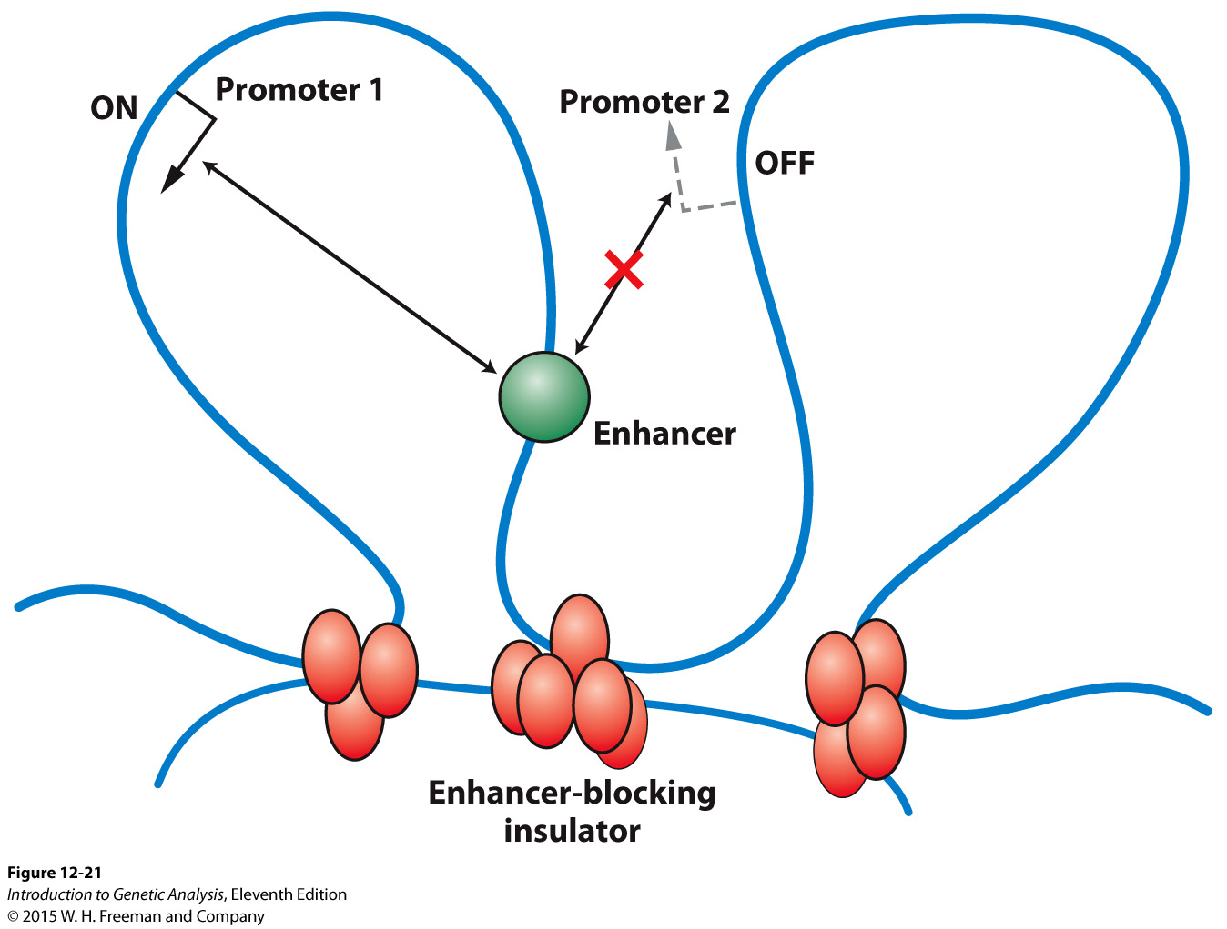
Detection of long-range regulatory regions Enhancers

Slide 15
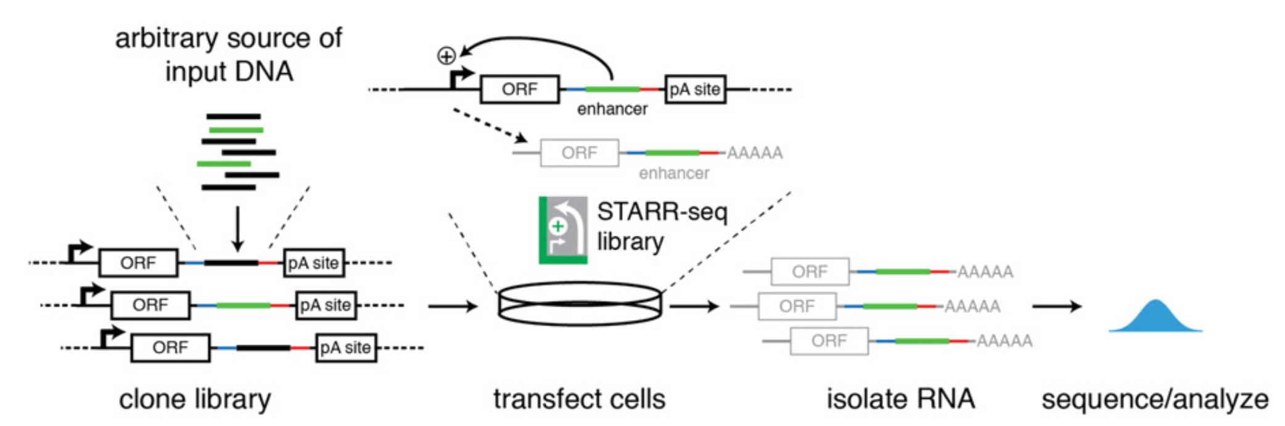
Detection of long-range regulatory regions Enhancers
Starr-seq: High-throughput assessment of sequence enhancer potential
Arnold, C.D. et al. (2013). Science (80-. ).,
Muerdter, F. et al. (2015).106, 145–150

Slide 16
Detection of long-range regulatory regions Enhancers
Starr-seq: High-throughput assessment of sequence enhancer potential
Arnold, C.D. et al. (2013). Science (80-. ).,
Muerdter, F. et al. (2015).106, 145–150

Slide 17
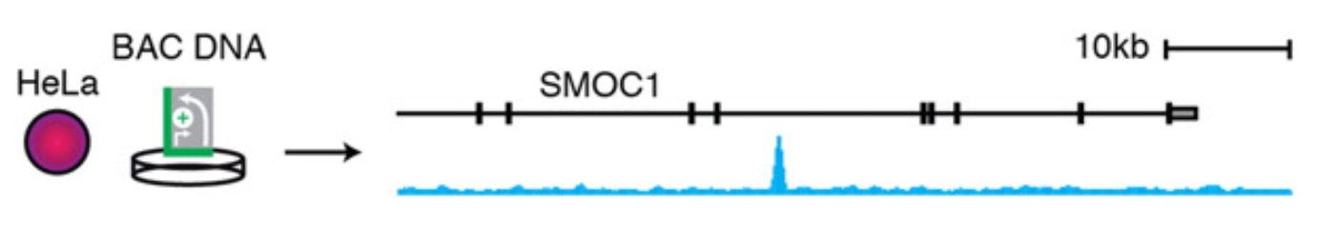
Detection of long-range regulatory regions Enhancers
Starr-seq: High-throughput assessment of sequence enhancer potential
Arnold, C.D. et al. (2013). Science (80-. ).,
Muerdter, F. et al. (2015).106, 145–150
Notes:
Secreted Modular Calcium-Binding Protein 1

Slide 18
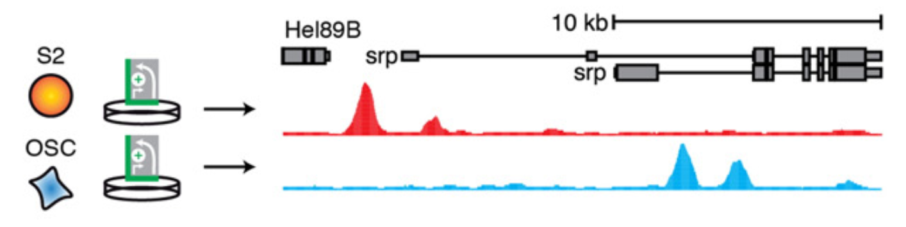
Detection of long-range regulatory regions Enhancers
Starr-seq: High-throughput assessment of sequence enhancer potential
Arnold, C.D. et al. (2013). Science (80-. ).,
Muerdter, F. et al. (2015).106, 145–150
Notes:
Schneider 2 cells, usually abbreviated as S2 cells, are one of the most commonly used Drosophila melanogaster cell lines. S2 cells were derived from a primary culture of late stage (20–24 hours old) Drosophila melanogaster embryos,[1] likely from a macrophage-like lineage.
OSC fly ovary cell line

Slide 19
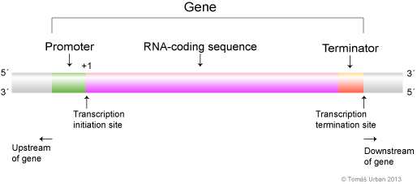
Major challenge: How to assess the enhancer function of promoters?

Slide 20
Major challenge: How to assess the enhancer function of promoters?
Enhancer
Promoter

Slide 21
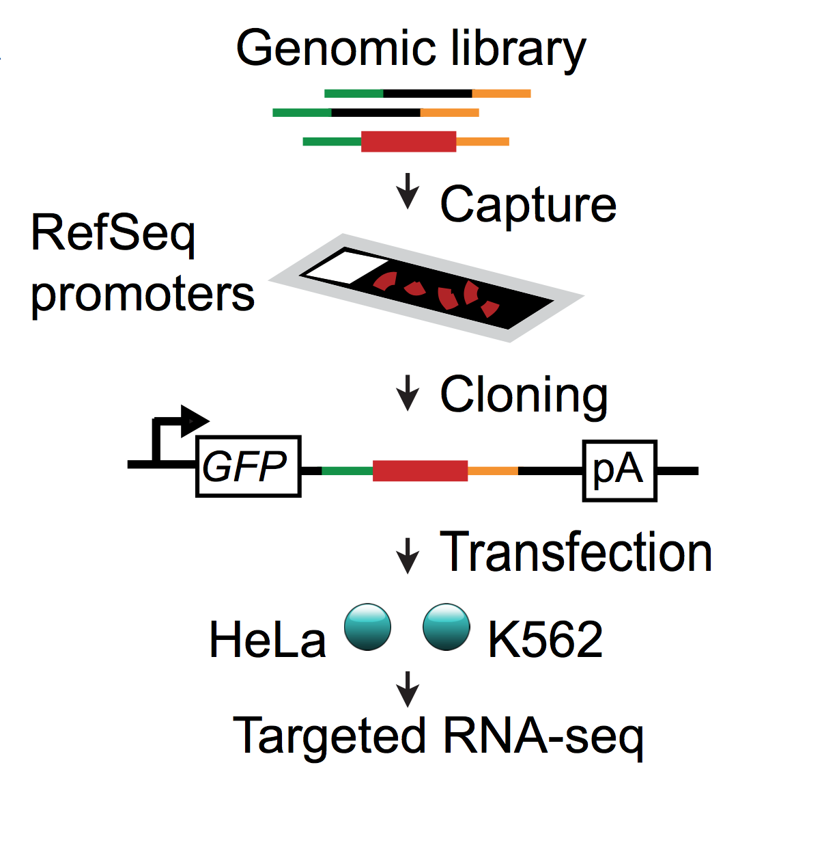
Can promoters work as enhancers?
CapStarr-seq
Salvatore Spicuglia
Lan Dao, et al, Nature Genetics. 2017
Notes:
To characterize Epromoters in an unbiased manner, we performed CapStarr-seq with all promoters of RefSeq-defined human coding genes (−200 to +50 bp with respect to the TSS) in the two ENCODE cell lines K562 and HeLa

Slide 22
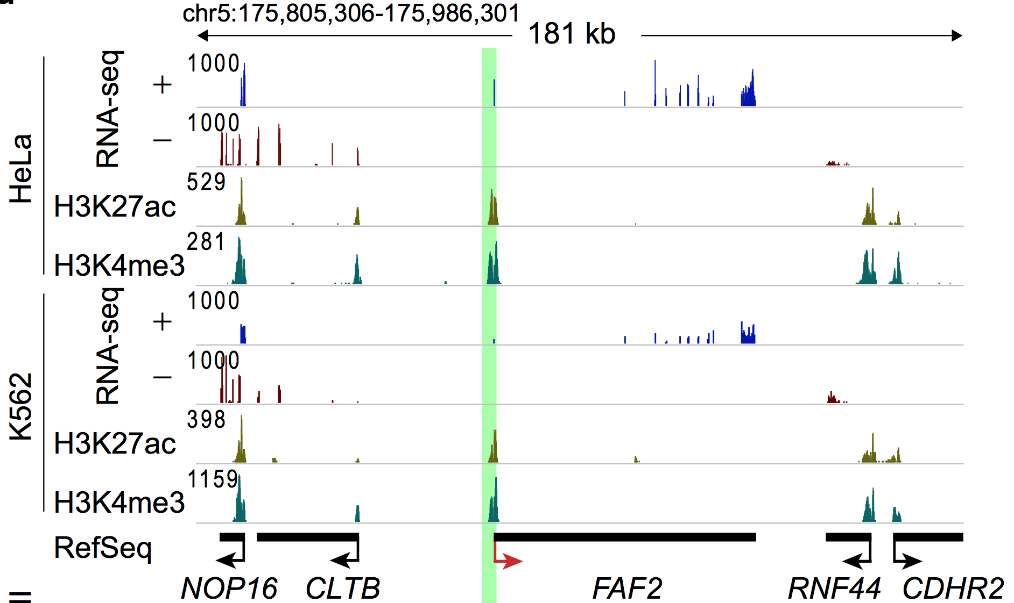
Can promoters work as enhancers?
Lan Dao, et al, Nature Genetics. 2017
Notes:
Fas Associated Factor Family Member 2
It may play a role in regulating the resistance to apoptosis that is observed in T cells and eosinophils of AD patients. [provided by RefSeq, Jul 2008]
The enhancer activity of each captured region was calculated as the fold change of the STARR-seq signal over the input signal. We observed high correlation between replicates in both cell lines (Fig. 2b). Epromoters were defined as promoters for which the fold change in signal for both replicates was beyond the inflexion point of ranked promoters
Input= As controls, we sequenced the cloned libraries obtained before (hereafter, input)

Slide 23
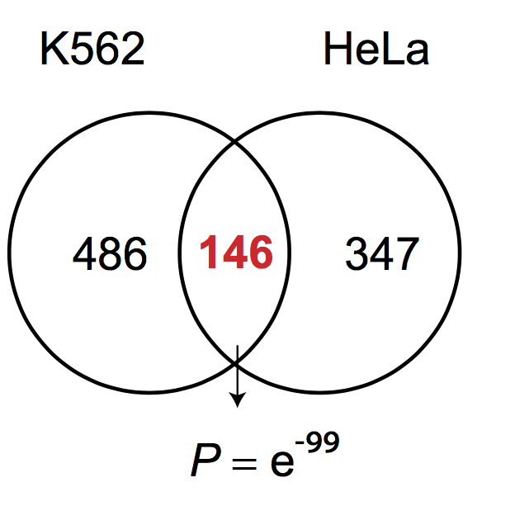
How many promoters work also as enhancers?
Total of ePromoters:
K562= 632 (3%)
HELA= 493 (2.37%)
Total analyzed promoters= 20,719 (100%)
Lan Dao, et al, Nature Genetics. 2017
Notes:
Venn diagram showing the number of Epromoters found in K562 and HeLa cells. The hypergeometric test P value for the overlap between the two sets is shown.

Slide 24
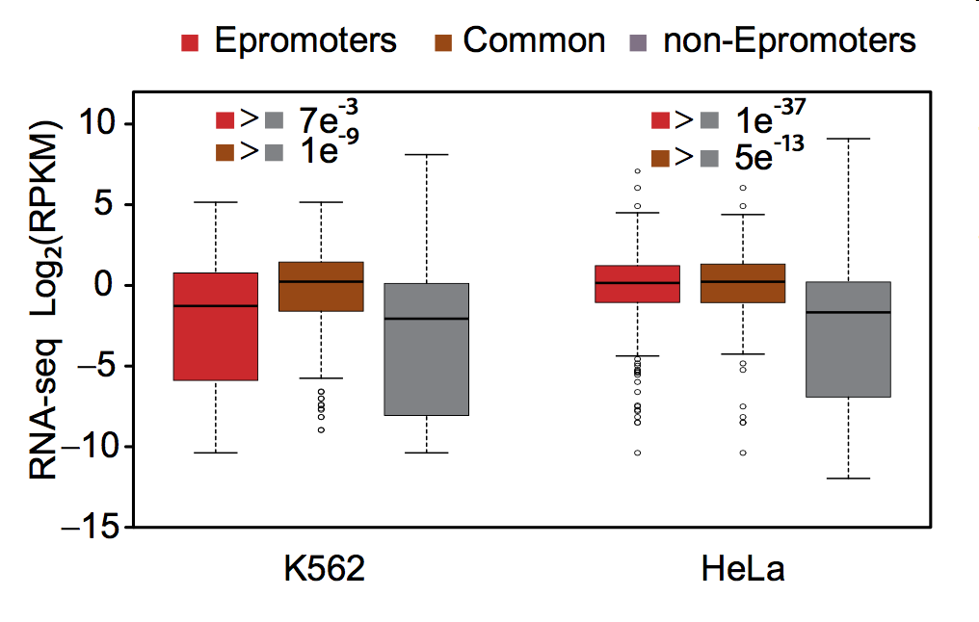
RNA expression of genes downstream promoters
Lan Dao, et al, Nature Genetics. 2017

Slide 25
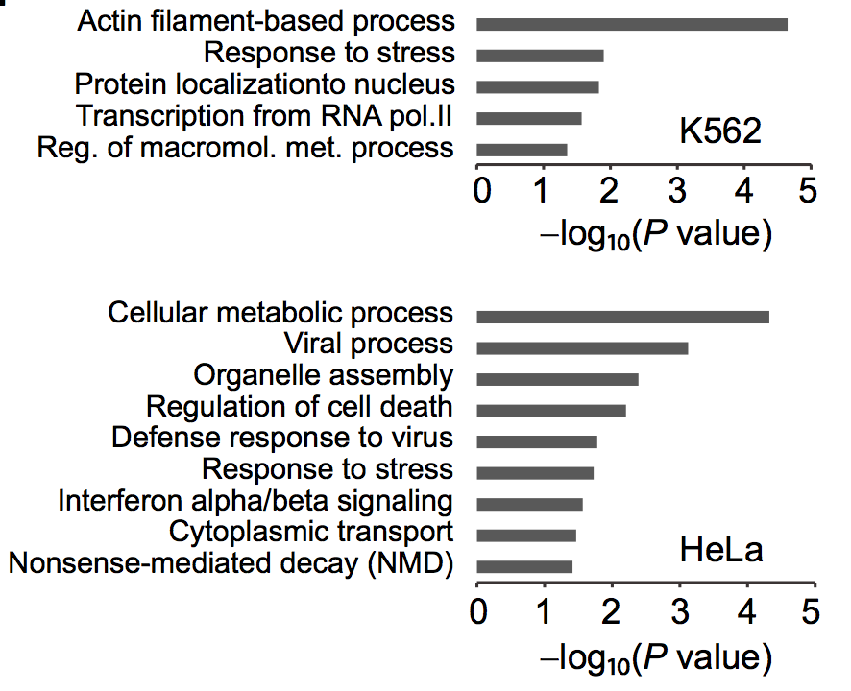
Functional annotation of genes downstream Epromoters
Lan Dao, et al, Nature Genetics. 2017

Slide 26
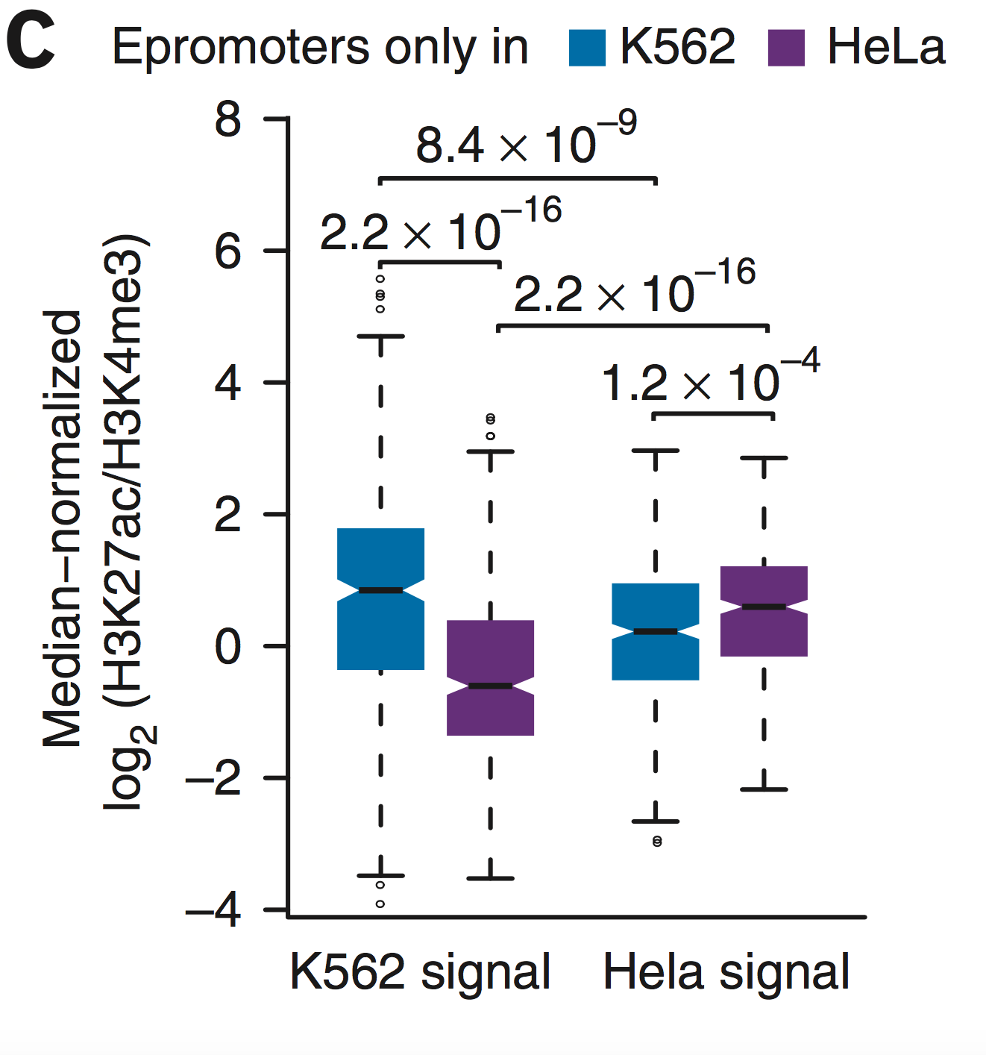
Epromoters had a higher H3K27ac/H3K4me3 ratio in the cell type where they were found to be active
Lan Dao, et al, Nature Genetics. 2017
Notes:
Epromoters had a higher H3K27ac/H3K4me3 ratio in the cell type where they were found to be active
Pointing out cell type specificity

Slide 27
Which are the regulatory mechanisms affecting Epromoters?
Notes:
TFs bind across the genome multiple times to specific binding sites. Our major interest of the reugltory genome are TFs

Slide 28
Transcription factors control gene regulation by binding to specific DNA sequences
Transcription Factors interact with DNA binding to sequence specific sites.
HNF6
Notes:
TFs bind across the genome multiple times to specific binding sites. Our major interest of the reugltory genome are TFs
This is the main contribution of my lab

Slide 29
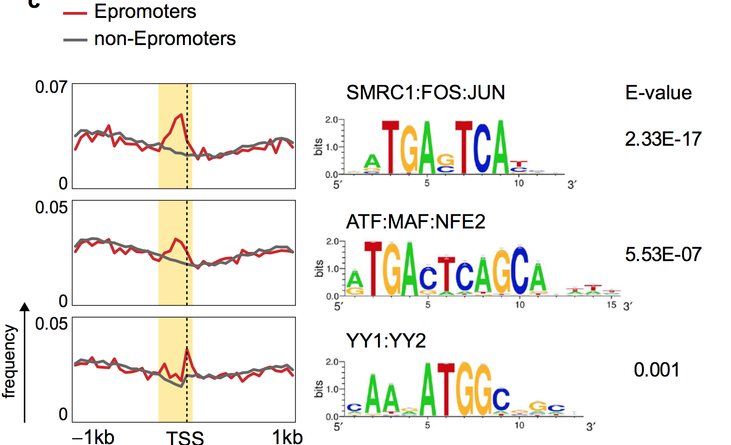

Transcription Factors enriched motifs in Epromoters
K562
position-scan: Motif enrichment in a given position of a set of sequences
Lan Dao, et al, Nature Genetics. 2017

Slide 30
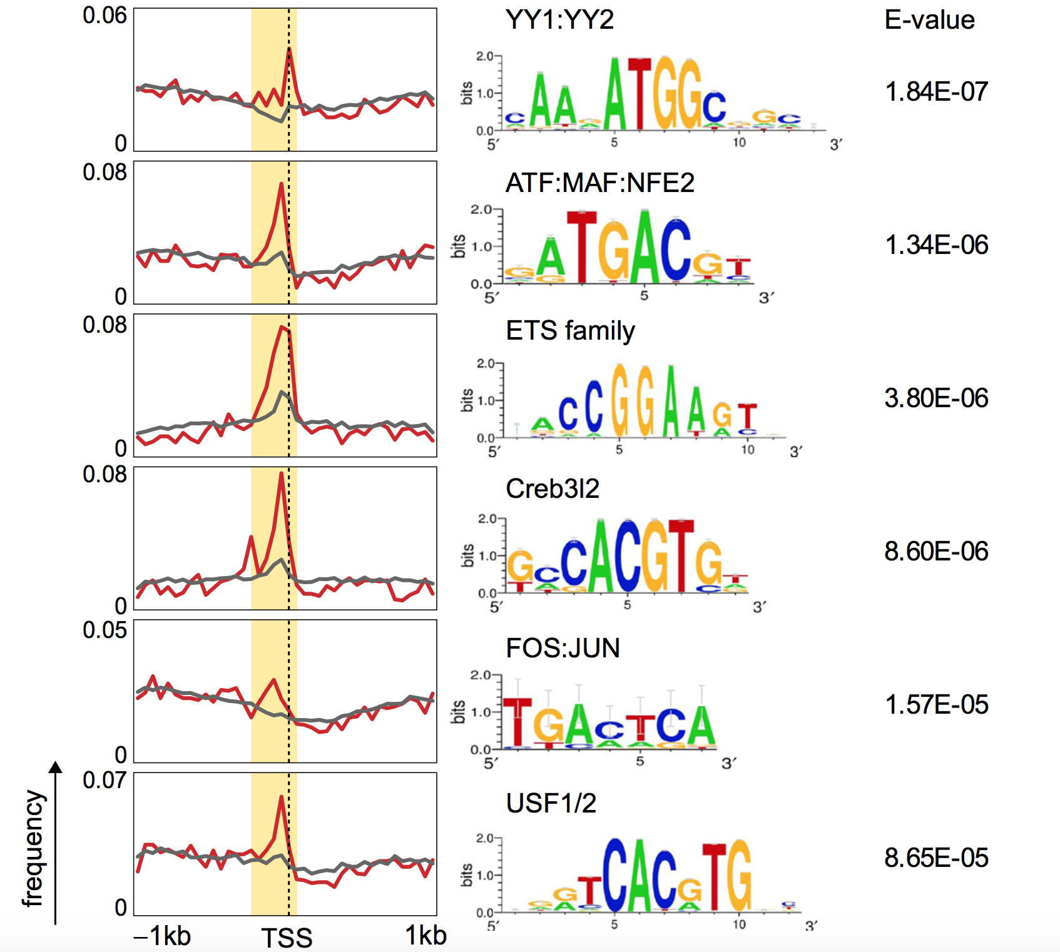
Transcription Factors enriched motifs in Epromoters
HeLA
K562
position-scan: Motif enrichment in a given position of a set of sequences
Lan Dao, et al, Nature Genetics. 2017

Slide 31

Which are the genes regulated by Epromoters?
Lan Dao, et al, Nature Genetics. 2017

Slide 32
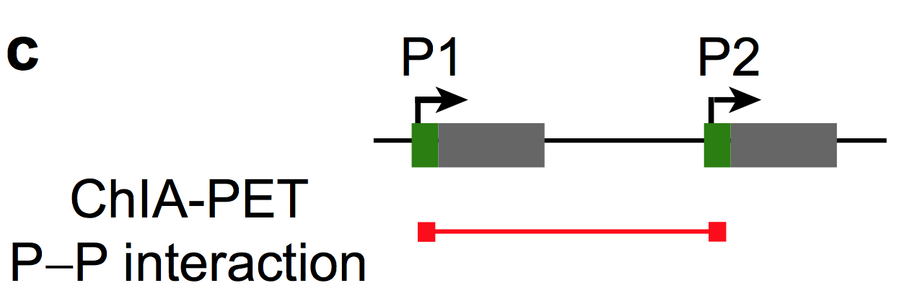
Which are the genes regulated by Epromoters?
Lan Dao, et al, Nature Genetics. 2017

Slide 33
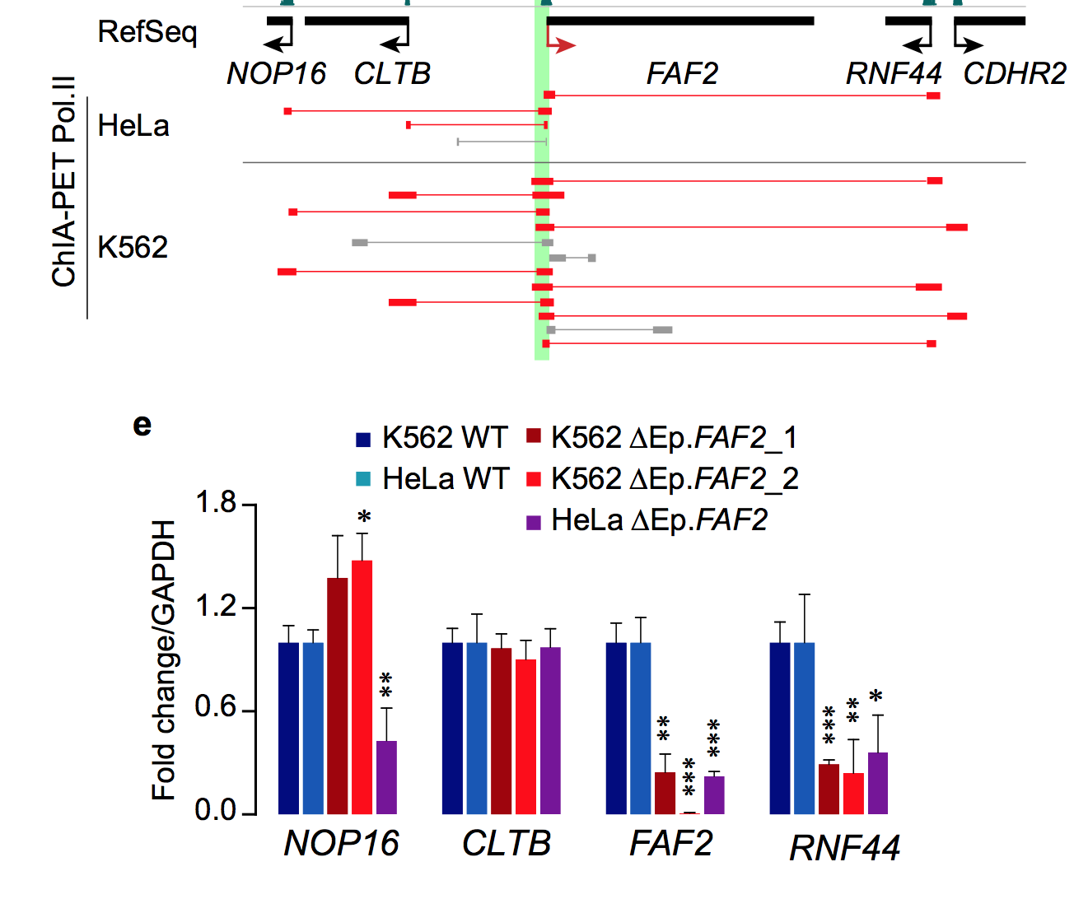
Which are the genes regulated by Epromoters?
Lan Dao, et al, Nature Genetics. 2017

Slide 34
Which are the genes regulated by Epromoters?
Lan, et al, Nature Genetics, 2017.
Notes:
qPCR analysis of gene expression in K562 and HeLa wild-type (WT) cells and knockout FAF2-Epromoters cell clones (∆Ep.FAF2, number following the gene name indicates independent clones)
GAPDH was used as a cDNA loading control glyceraldehyde-3-phosphate dehydrogenase

Slide 35
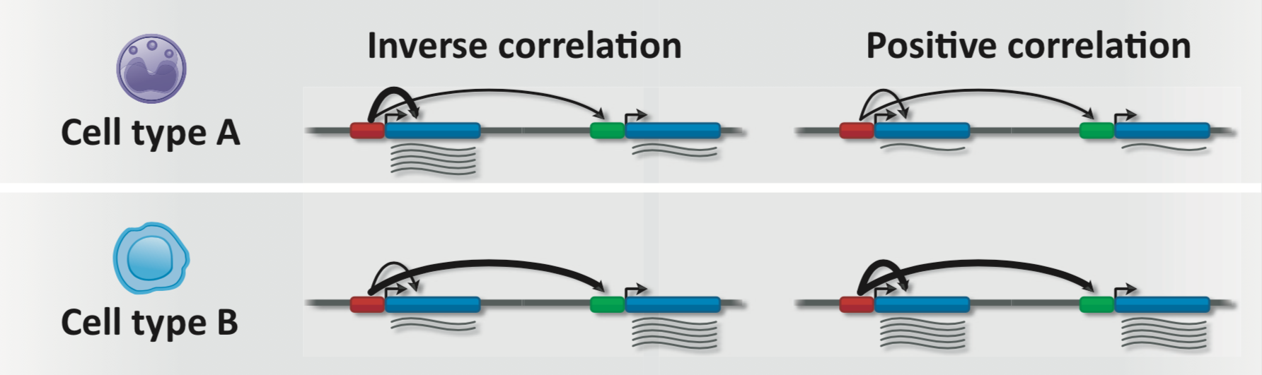
What is the effect of Epromoters on long range regulated genes?
?
?
Medina-Rivera, Trends in Biochemical Sciences, 2018

Slide 36
What is the effect of Epromoters on long range regulated genes?
?
?
Medina-Rivera, Trends in Biochemical Sciences, 2018

Slide 37
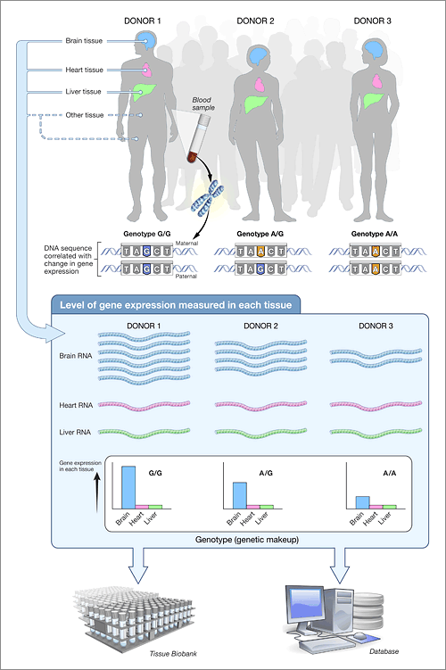

Genotype Tissue Expression Project
https://commonfund.nih.gov/gtex

Slide 38
eQTLs can have negative or positive correlation to gene expression
Beta value is a measure of the effect the variant has on gene expression.
Beta values is bound between -2 and 2.
Gene
Gene
SNP
SNP
eQTL
SNP
Gene
Gene
SNP
SNP
eQTL
SNP
Notes:
A majority of GWAS hits are found outside of coding genes (93%).
GWAS SNPs are used to tag a region which then can be explored
Common variants

Slide 39
Are eQTLs overlapping Epromoters?
Eprom
Gene
Gene
SNP
SNP
eQTL
SNP
prom
Gene
Gene
SNP
SNP
eQTL
SNP
Lan Dao, et al, Nature Genetics. 2017

Slide 40
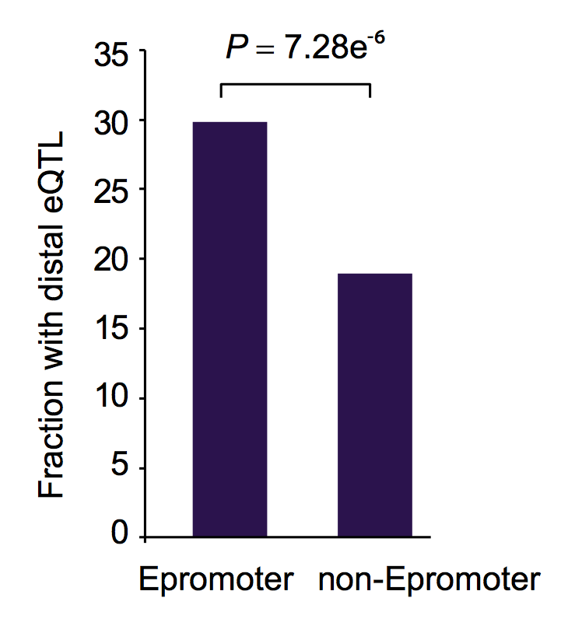
It is more likely to find an eQTL in an Epromoter than in a non-Epromoter
Eprom
Gene
Gene
SNP
SNP
eQTL
SNP
prom
Gene
Gene
SNP
SNP
eQTL
SNP
Lan Dao, et al, Nature Genetics. 2017

Slide 41
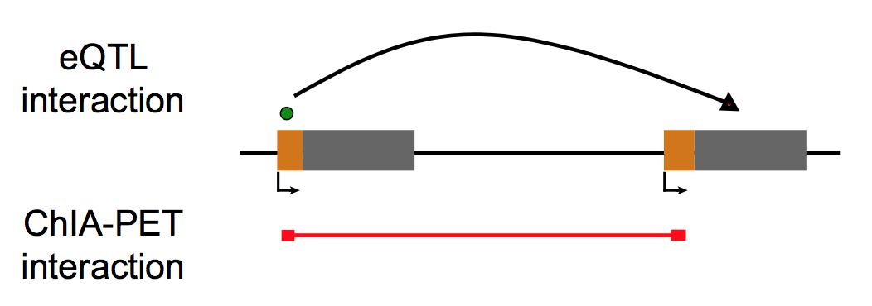
What is the effect of Epromoters on long range regulated genes?
Lan Dao, et al, Nature Genetics. 2017

Slide 42
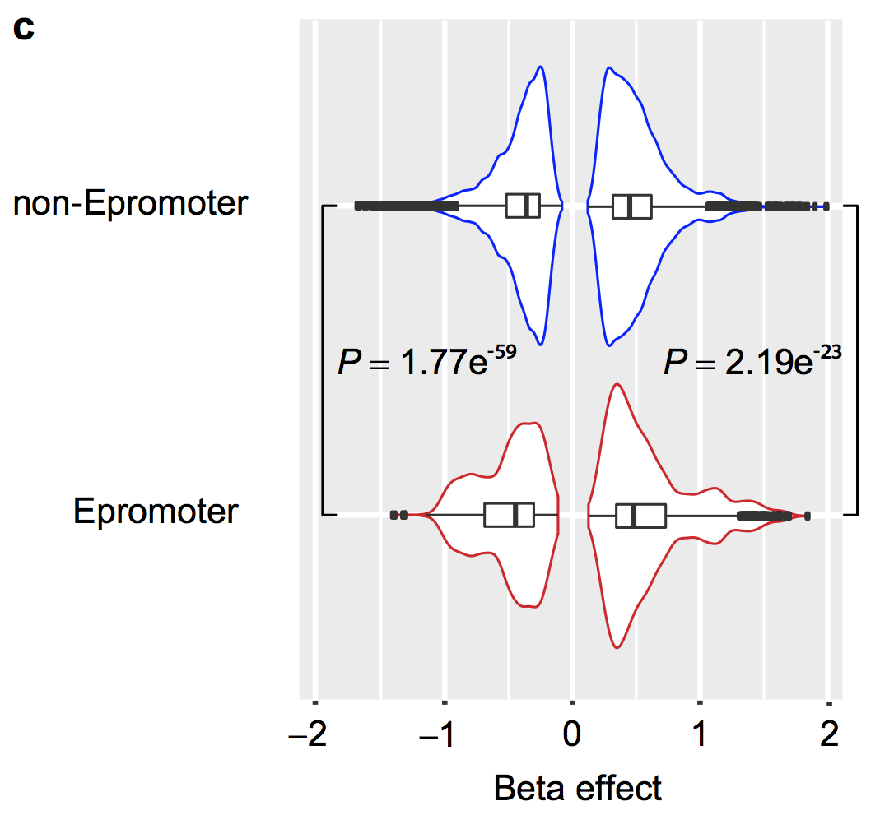
Epromoter eQTLs have a significantly stronger effect on distal gene expression
Lan Dao, et al, Nature Genetics. 2017
Notes:
eQTLs associated with Epromoters had a significantly stronger effect on distal gene expression than the eQTLs associated with non-Epromoters
N= 196,532 interactions
14,052 eQTL

Slide 43
What is the effect of eQTLs that disrupt TF binding?

Slide 44
What is the effect of eQTLs that disrupt TF binding?
Genetic variants in gene regulatory regions are known to cause many diseases
Can be informative of transcription factors and regulatory mechanisms
TF
nnATTGCACAATnn
TF
nnATTGTACAATnn

Slide 45
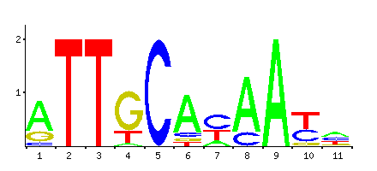

Detecting eQTL effect on TF binding
variation-scan: PSSM based algorithm as part of the RSAT suite
Flexible tool that can be used to scan any variable with any motif.
Multiple organisms are available.
nnATTGCACAATnn
nnATTGTACAATnn
Weight Score
REF: 8.1
MUT: 2.1
DIF: 6.0
Walter Santana

Slide 46
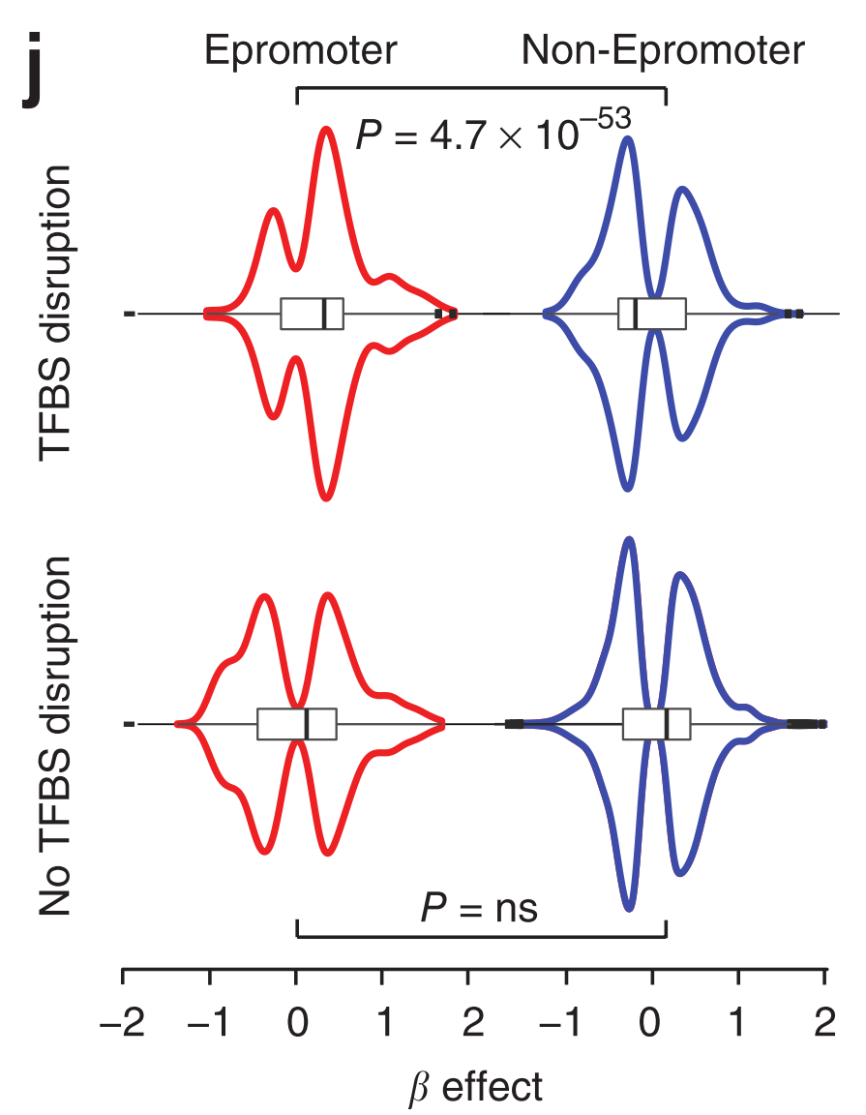
eQTL disrupting TF binding tend to have a positive beta-value
Notes:
N=972 eQTL with efect on TF
594 eQTLs

Slide 47
Summary
High-throughput techniques can be used to identify long range regulatory sequences.
Regulatory sequences can have several functions (Epromoters).
Variation lying within Epromoters might impact distal gene expression beyond their cognate target gene.
eQTLs that might disrupt TF binding tend to have a positive beta value in relation to their linked genes.
Notes:
In the light of evolution important regulatory interactions can be detected.

Slide 48
Future Steps
Identify ePromoters for additional cell lines: Jukart, CEM, RPMI, GM12878
Identify ePromoters under inflammatory conditions (IFN- alpha) in K562.
Leverage public STARR-seq data in HELA with IFN repressors and hESC to recover additional ePromoters.
Further develop position-scan to become user friendly.
Establish a link between ePromoter regulated genes and disease (collaboration with Nancy J Cox’s laboratory).
Identify regulatory variants laying in ePromoters related to diseases that might be disrupting TF binding sites.
Notes:
In the light of evolution important regulatory interactions can be detected.

Slide 49



Acknowledgments:
Regulatory Genomics Lab
Karen Nuñez
Ana Villaseñor
Walter Santana
Monica Padilla
Lucia Ramirez
Diego Terol
Marisol Alvarez
INSERM
Salvatore Spicuglia
Lan Dao
Ariel Galindo
Jacques van Helden
Jaime Castro
Notes:
49

Slide 51
Challenging biological concepts
Notes:
In the light of evolution important regulatory interactions can be detected.

Slide 52
The Non-Coding Genome
Around 80% of the genome has shown to have some biochemical interaction.
Most non-coding region have a regulatory function.
Consortium EP et al. Nature. 489(7414):57. (2012)

Slide 53
How is regulation being affected by genetic variants?

Slide 54
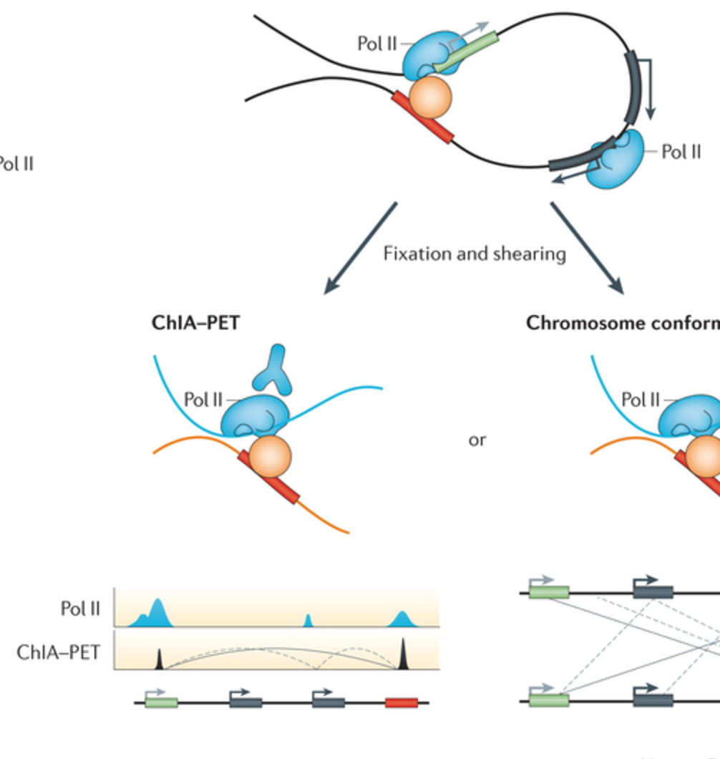
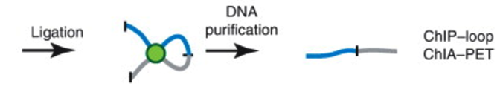
Promoter interactions detected with Pol II ChIA-PET
Shlyueva, et al, Nature Reviews Genetics, 2014

Slide 55
Major challenges to connect the regulatory genome to human pathologies
Detect long-range regulatory regions (enhancers) and connect them to the regulated genes.
Evaluate the effect genetic variants within regulatory sequences have on gene expression.

Slide 56
Transcription factors control gene regulation by binding to specific DNA sequences
Transcription Factors interact with DNA binding to sequence specific sites.
HNF6
Notes:
TFs bind across the genome multiple times to specific binding sites. Our major interest of the reugltory genome are TFs

Slide 57
Scanning a peak sequence with a TF binding motif
Sox2
...AGTGTGGACCATGAAATCTCTAACAGGTTCTGATACTGAGGGA…
Scanning
Sequence position (0 = center of the peak fragment)

Slide 58
Detecting protein disruption of binding at base pair resolution
Genetic variants in gene regulatory regions are known to cause many diseases
Can be informative of transcription factors and regulatory mechanisms

Slide 59
Detecting protein disruption of binding at base pair resolution
Genetic variants in gene regulatory regions are known to cause many diseases
Can be informative of transcription factors and regulatory mechanisms
TF
nnATTGCACAATnn
TF
nnATTGTACAATnn

Slide 60
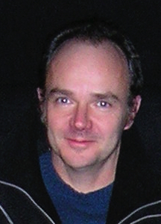
Detecting protein disruption of binding at base pair resolution: variation-scan
variation-scan: PSSM based algorithm as part of the RSAT suite
  Flexibility with species, SNPs, motifs
  High-throughput
nnATTGCACAATnn
nnATTGTACAATnn
Weight Score
REF: 8.1
MUT: 2.1
DIF: 6.0
Jacques van Helden
Walter Santana

Slide 61
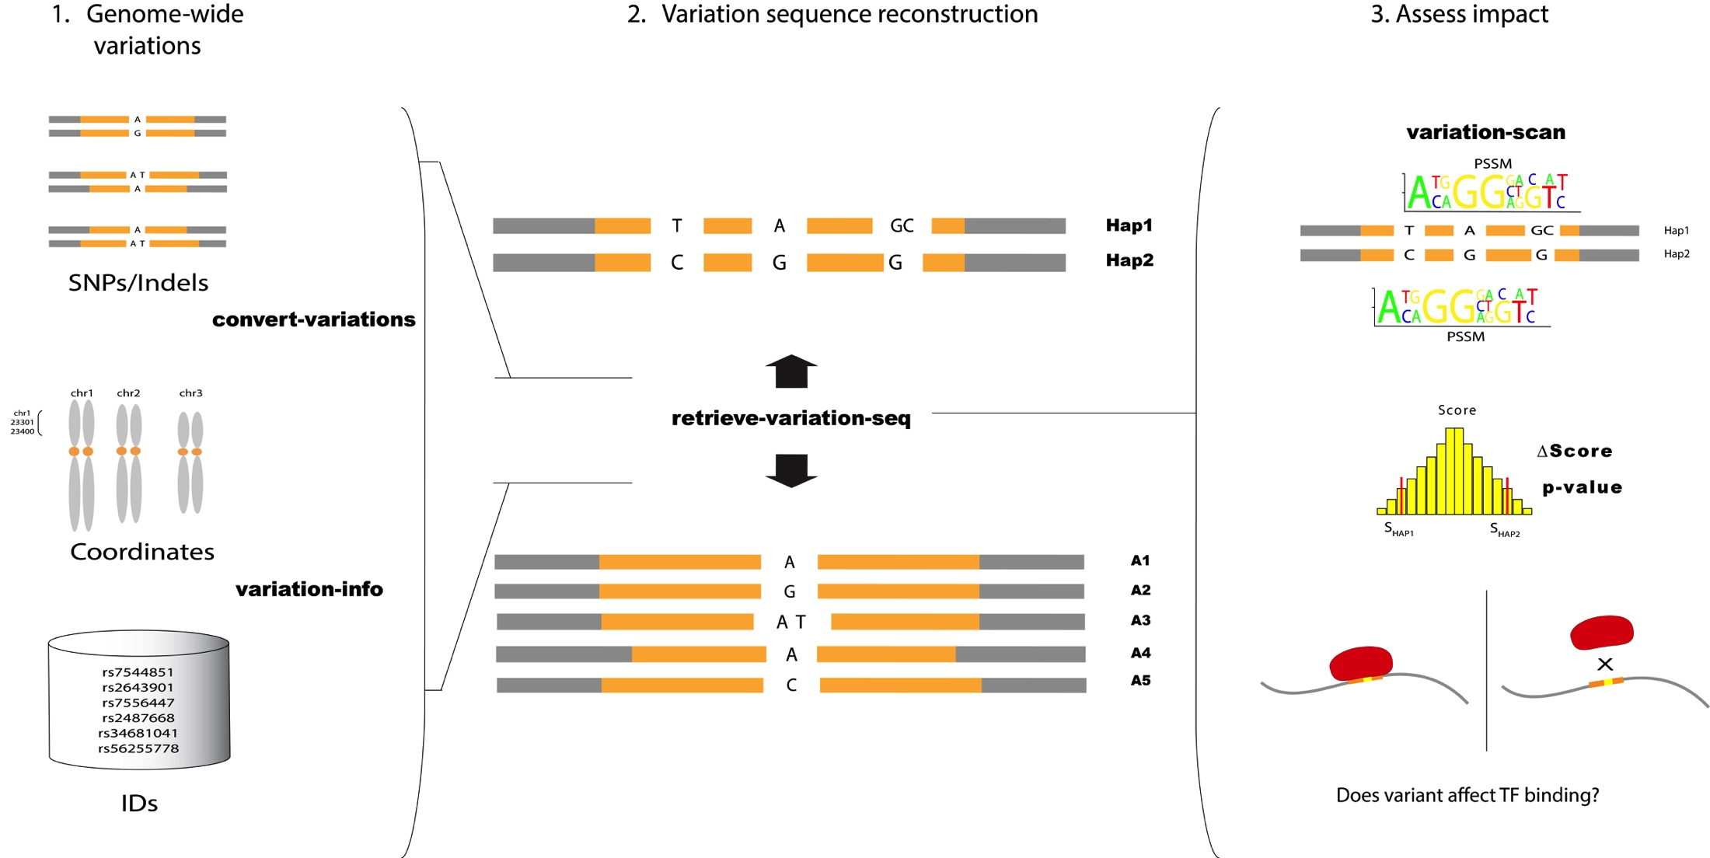
Detecting protein disruption of binding at base pair resolution

Slide 62
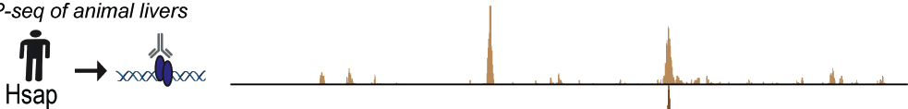
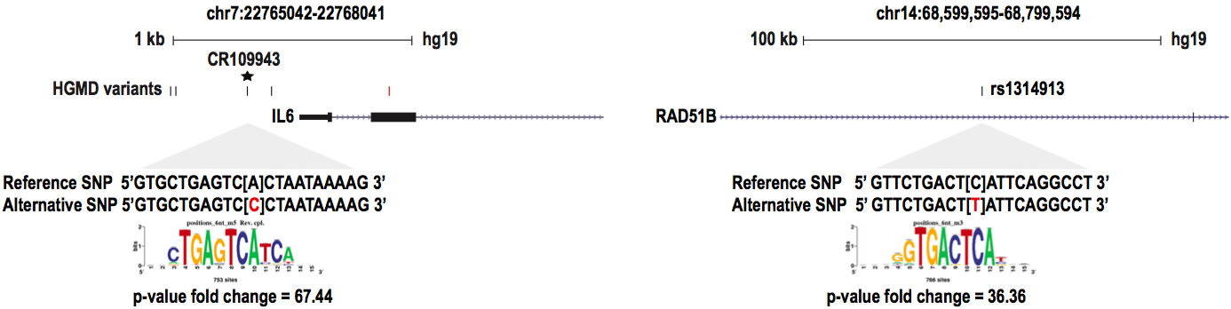

Regulatory mutations alter JUN binding motifs in promoter region of IL6 and intronic region of RAD51B.
Michael Wilson
Notes:
Interleukin 6 (IL-6) is an interleukin that acts as both a pro-inflammatory cytokine and an anti-inflammatory myokine.
The protein encoded by this gene is a member of the RAD51 protein family which assist in repair of DNA double strand breaks.
278A>C is associated with systemic lupus erythematosus in Korean populations and is shown to increase expression of IL6 in vitro [130]. Thus, we predicted a known mechanism that causes misregulation of IL6 through JUN binding motif alteration [131, 132]. Furthermore, we predicted a novel JUN binding motif alteration within an intronic region of RAD51B (Figure 17), a gene that encodes the protein RAD51B that assists in the repair of DNA double strand breaks, and is associated with male breast cancer [133] and cardiovascular disease outcomes

Slide 63
DNA mutations in protein coding genes can explain many human diseases
Mutation Type | HGMD entries
Missense/nonsense | 82176
Small deletions | 22610
Splicing | 13641
Gross deletions | 10968
Small insertions | 9423
Regulatory | 2884
Gross insertions/duplications | 2600
Small indels | 2173
Complex rearrangements | 1504
Repeat variations | 434
Mutation total | 148413
Gene total | 6137
Notes:
Human gene mutation database

Slide 64
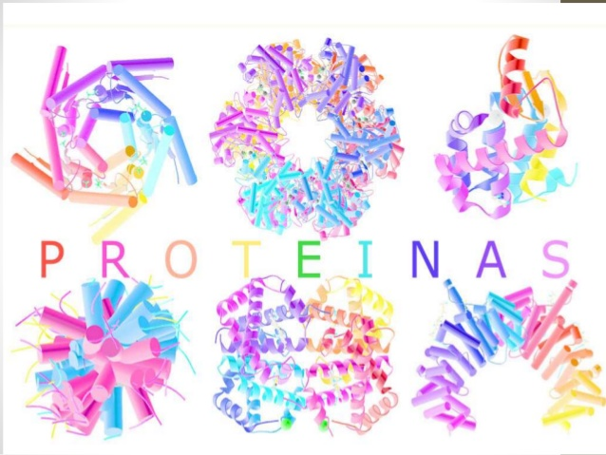
DNA mutations in protein coding genes can explain many human diseases
Mutation Type | HGMD entries
Missense/nonsense | 82176
Small deletions | 22610
Splicing | 13641
Gross deletions | 10968
Small insertions | 9423
Regulatory | 2884
Gross insertions/duplications | 2600
Small indels | 2173
Complex rearrangements | 1504
Repeat variations | 434
Mutation total | 148413
Gene total | 6137

Slide 65
DNA mutations in protein coding genes can explain many human diseases
Mutation Type | HGMD entries
Missense/nonsense | 82176
Small deletions | 22610
Splicing | 13641
Gross deletions | 10968
Small insertions | 9423
Regulatory | 2884
Gross insertions/duplications | 2600
Small indels | 2173
Complex rearrangements | 1504
Repeat variations | 434
Mutation total | 148413
Gene total | 6137

Slide 66
DNA mutations in protein coding genes can explain many human diseases
Mutation Type | HGMD entries
Missense/nonsense | 82176
Small deletions | 22610
Splicing | 13641
Gross deletions | 10968
Small insertions | 9423
Regulatory | 2884
Gross insertions/duplications | 2600
Small indels | 2173
Complex rearrangements | 1504
Repeat variations | 434
Mutation total | 148413
Gene total | 6137

Slide 67
DNA mutations in protein coding genes can explain many human diseases
Mutation Type | HGMD entries
Missense/nonsense | 82176
Small deletions | 22610
Splicing | 13641
Gross deletions | 10968
Small insertions | 9423
Regulatory | 2884
Gross insertions/duplications | 2600
Small indels | 2173
Complex rearrangements | 1504
Repeat variations | 434
Mutation total | 148413
Gene total | 6137

Slide 68
Published Genome-Wide Associations since 12/2012
Published GWA at p≤5X10⁻⁸ for 17 trait categories
More than 17,000 reported associated SNPs
93% in non-coding sequence
NHGRI GWA Catalog
www.genome.gov/GWAStudies
www.ebi.ac.uk/fgpt/gwas/

Slide 69
Weight score difference has proven not to be enough to reliably detect variations affecting TF binding in a genome wide scale
Notes:
2008

Slide 70

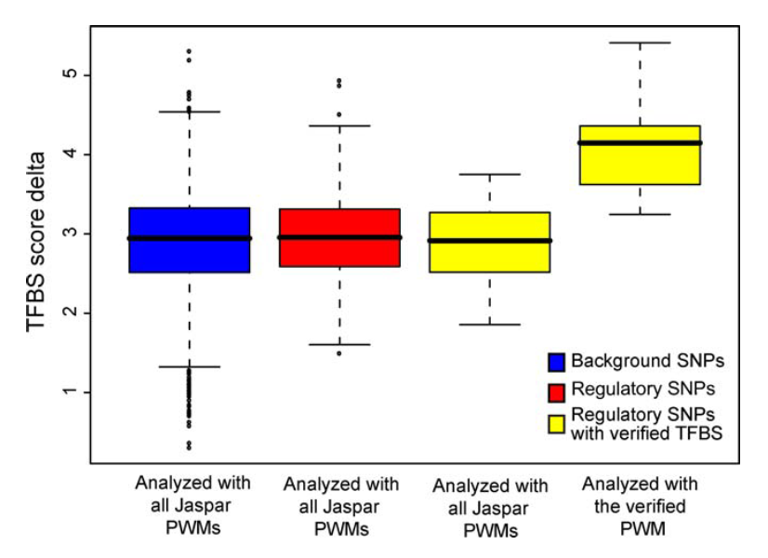
Weight score difference has proven not to be enough to reliably detect variations affecting TF binding in a genome wide scale
Notes:
2008

Slide 71






Detecting protein disruption of binding at base pair resolution: Heterozygous ChIP-seq
F1 mice with inbred parents
All SNP positions known – reduce false positives and search space
Each allele compared within same organism and genomic context
BL6 (Ref)
AJ (Alt)
BL6 (Reference) Genome
5 million SNPs
AJ Parental Genome
Minggao Liang

Slide 72


Detecting protein disruption of binding at base pair resolution: Heterozygous ChIP-seq
HNF6
CEBPA
Processing | Purpose | Remaining mapped reads
mm9 alignment |  | 33.0 million
Filter against Encode Blacklist regions | Remove known sequencing artifact regions | 31.9 million
MACS | Peak calling
WASP | Extract reads overlapping known alleles Remove reads with alignment bias Remove duplicates | 1.68 million 1.50 million 0.97 million
ALEA | Alignment to BL6 Parental genome (REF) Alignment to A/J Parental genome (ALT) | 0.43 million 0.47 million

Slide 73
Detecting protein disruption of binding at base pair resolution: Heterozygous ChIP-seq
C
T
Count Reads:
REF: 9
ALT: 3
RAF: 0.75

Slide 74
Detecting protein disruption of binding at base pair resolution: Heterozygous ChIP-seq
C
T
Count Reads:
REF: 9
ALT: 3
RAF: 0.75
Weight score:
REF: 7.0
ALT: 2.0
DIF: 5.0

Slide 75
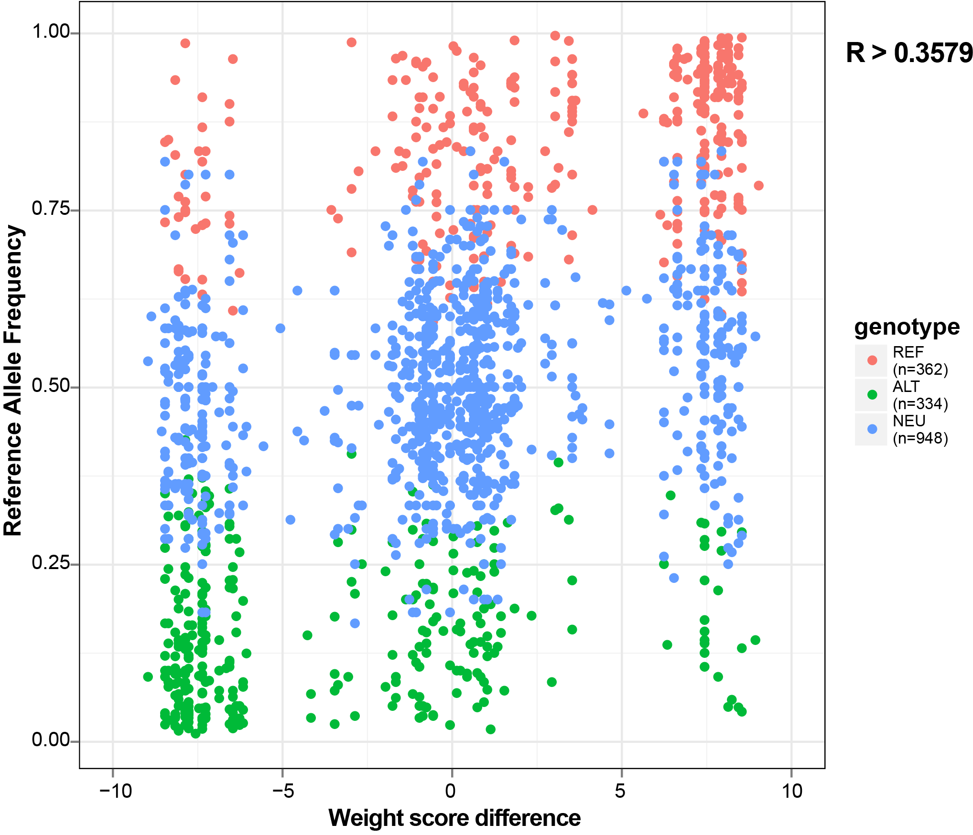
Detecting protein disruption of binding at base pair resolution: Heterozygous ChIP-seq

Slide 76
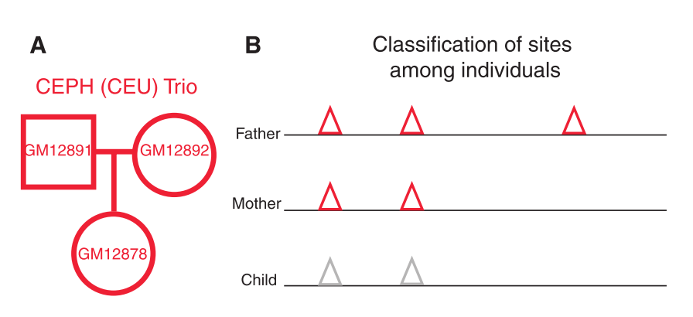
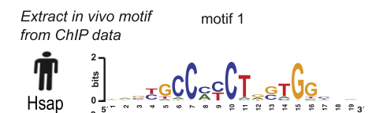
Detecting protein disruption of binding at base pair resolution: Heterozygous ChIP-seq
Human trio families with genotypes
Walter Santana
McDaniell, R.et al (2010). Heritable individual-specific and allele-specific chromatin signatures in humans. Science (New York, N.Y.),

Slide 77
Detecting protein disruption of binding at base pair resolution: Heterozygous ChIP-seq
Human trio families with genotypes

Slide 78
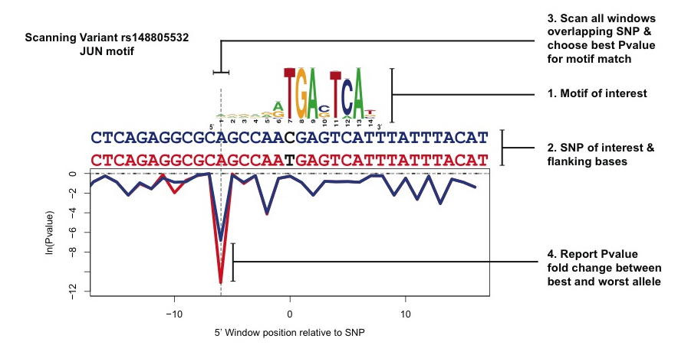
Detecting protein disruption of binding at base pair resolution: variation-scan

Slide 79
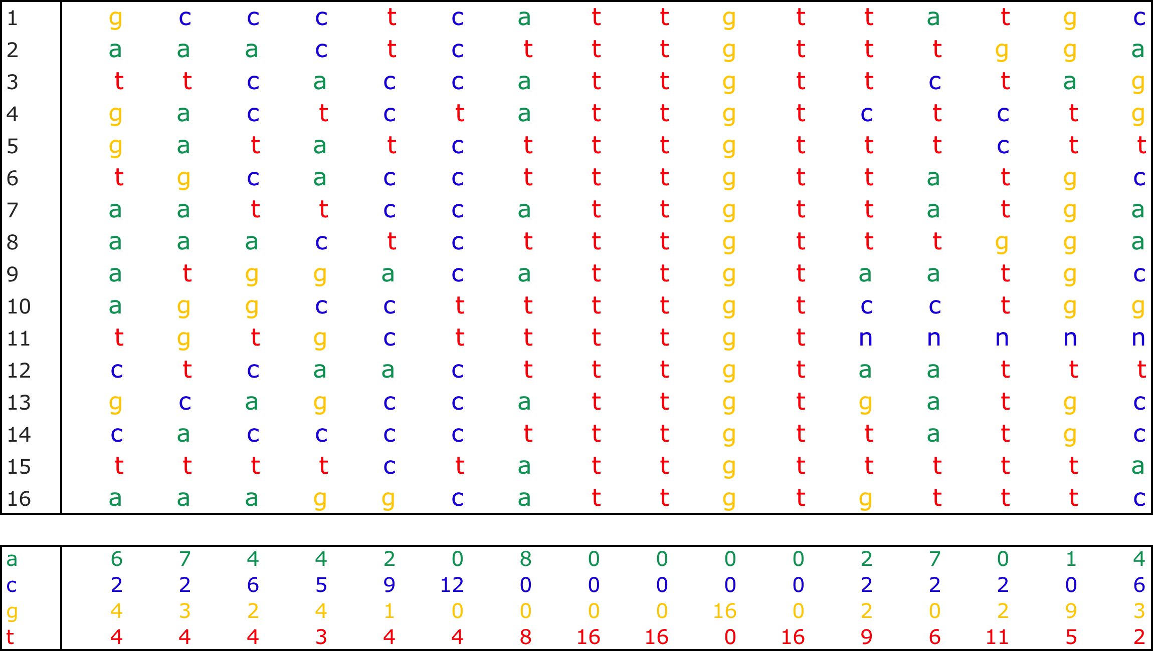
Transcription Factor Sox2
Sox2
-Regulator in neuronal development.
-Required for both the maintenance of neural stem cells and the differentiation of specific neuron sub-types
16 Annotated binding sites in Transfac

Slide 80
Detecting protein disruption of binding at base pair resolution: Variation Scan
CTGTCCCCCTGACTCAGAGGCGCAGCCAACGAGTCATTTATTTACATGTAACTACAAGA
CTGTCCCCCTGACTCAGAGGCGCAGCCAATGAGTCATTTATTTACATGTAACTACAAGA
Collaboration with Dr. van Helden, Université d'Aix-Marseille (AMU).

Slide 81
Detecting protein disruption of binding at base pair resolution: Variation Scan
CTGTCCCCCTGACTCAGAGGCGCAGCCAACGAGTCATTTATTTACATGTAACTACAAGA
CTGTCCCCCTGACTCAGAGGCGCAGCCAATGAGTCATTTATTTACATGTAACTACAAGA

Slide 82
Detecting protein disruption of binding at base pair resolution: Variation Scan
CTGTCCCCCTGACTCAGAGGCGCAGCCAACGAGTCATTTATTTACATGTAACTACAAGA
CTGTCCCCCTGACTCAGAGGCGCAGCCAACGAGTCATTTATTTACATGTAACTACAAGA
CTGTCCCCCTGACTCAGAGGCGCAGCCAACGAGTCATTTATTTACATGTAACTACAAGA
CTGTCCCCCTGACTCAGAGGCGCAGCCAACGAGTCATTTATTTACATGTAACTACAAGA

Slide 83
Detecting protein disruption of binding at base pair resolution: Variation Scan
CTGTCCCCCTGACTCAGAGGCGCAGCCAACGAGTCATTTATTTACATGTAACTACAAGA
CTGTCCCCCTGACTCAGAGGCGCAGCCAATGAGTCATTTATTTACATGTAACTACAAGA

Slide 85
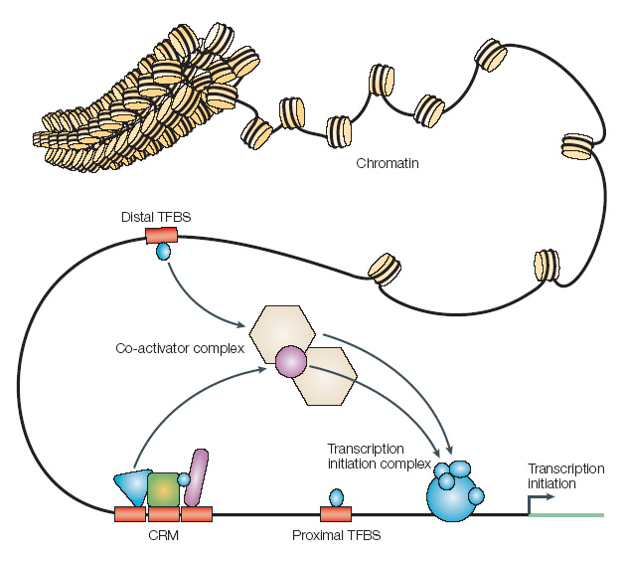
Multiple transcription factors can cooperatively regulate gene regulation
Notes:
Cluster and single Binding TFs collaborate to regulate gene expression

Slide 86
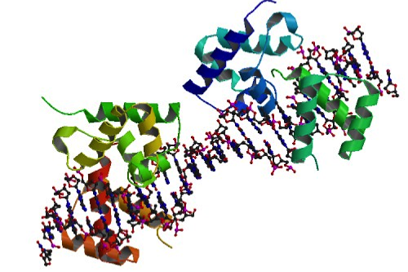
Multiple transcription factors can cooperatively regulate gene regulation
Transcription Factors can bind in cis – Known as Cluster of Regulatory Modules (CRMs)
Notes:
Cluster and single Binding TFs collaborate to regulate gene expression

Slide 87
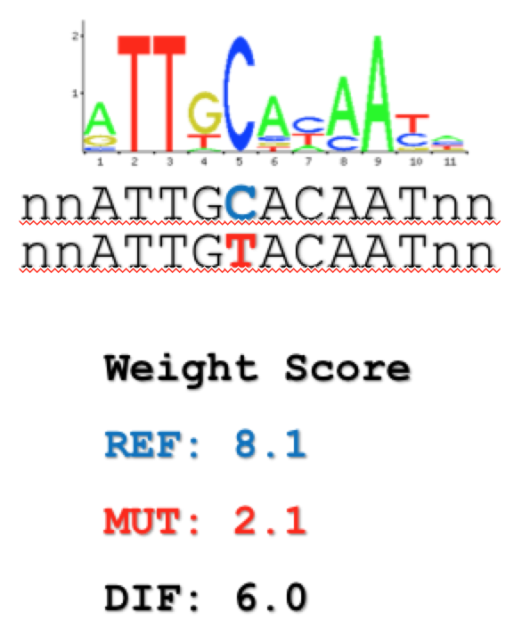
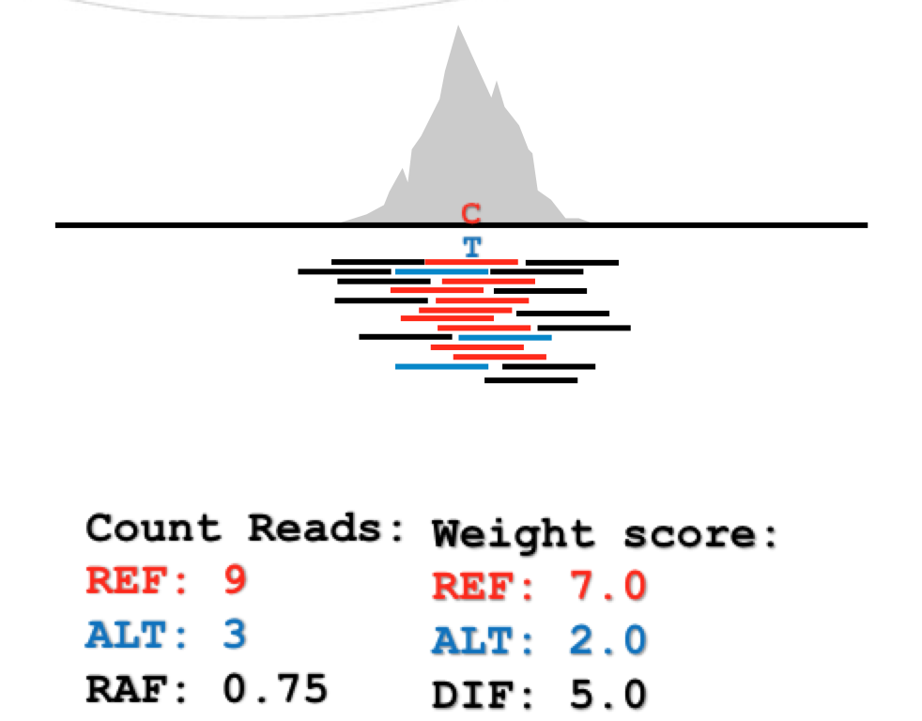
Can we detect when alleles disrupt cofactors?
Why do we expect co-factors?
  TFs in Eukaryotes tend to bind in clusters of regulatory modules.

Slide 88
Can we detect when alleles disrupt cofactors?
Why do we expect co-factors?
  TFs in Eukaryotes tend to bind in clusters of regulatory modules.

Slide 89
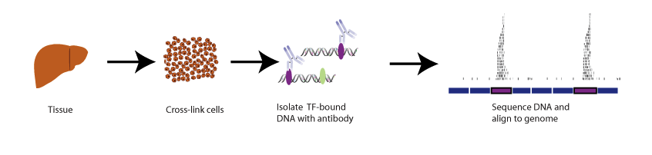



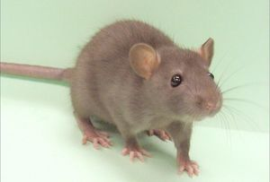
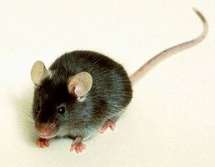
Experimentally determine genome wide binding of 4 TFs relevant for liver from five mammalian species.
Collaboration:
Benoit Ballester (INSERM)
Duncan Odom (Cambridge U)
Paul Flicek (EBI)
80 mya
25 mya
20 mya
Notes:
In order to study conservation of Singletons and CRM binding regions we used liver as our conserved system to characterize binding of four TFs that have been characterized in liver a major regulators and are highly conserved across species. When mutated they show liver phenotype.

Slide 90
Experimentally determine genome wide binding of 4 TFs relevant for liver from five mammalian species.
Collaboration:
Benoit Ballester (INSERM)
Duncan Odom (Cambridge U)
Paul Flicek (EBI)
80 mya
25 mya
20 mya
Notes:
In order to study conservation of Singletons and CRM binding regions we used liver as our conserved system to characterize binding of four TFs that have been characterized in liver a major regulators and are highly conserved across species. When mutated they show liver phenotype.

Slide 91


Transcription factors cluster together to regulate genes
CRMs
Orthologous sequences: Ensembl Compara EPO (Enredo Pecan Ortheus)
multispecies alignment

Slide 92
Transcription factors cluster together to regulate genes
CRMs

Slide 93
Transcription factors cluster together to regulate genes
CRMs

Slide 94

Transcription factors cluster together to regulate genes
CRMs

Slide 95
Heterozygous ChIP-seq: Can we detect co-factor effects?
F1 mice with inbred parents
BL6 (Ref)
AJ (Alt)
HNF6
CEBPA

Slide 96
Transcription factors cluster together to regulate genes
CRMs

Slide 97
Heterozygous ChIP-seq: Can we detect co-factor effects?
HNF6 F1 data set
6458 Peaks with SNPs
2123 sites are novel HNF6 binding.
3433 overlap an zoo-Chip HNF6.
868 are gains at existing binding sites for other TFs.
1253 represent novel binding sites that don't overlap any peak from the Zoo-Chip mouse data.
Notes:
(n=6458), 3433 overlap a crm. 2123 sites are novel HNF6 binding sites not present in the zoochip data. 868 are gains at existing binding sites for other zoochip TFs and 1253 represent novel binding sites that don't overlap any ChIP peak from the zoochip mouse data (see barplot).

Slide 98
Heterozygous ChIP-seq: Can we detect co-factor effects?
Notes:
I subset peaks 1) based on whether or not there is CEBPA binding in zoochip and 2) the allele preference. Then I perform Two Sample Kolmogorov-Smirnov Test for differences in the distribution of weight diffs for CEBPA at the subset of sites versus a reference distribution (ie. all predictions for variants on CEBPA motifs in the HNF6 peaks). What I notice is that the z-value (can be thought of as effect size) is higher in peaks where CEBPA is bound in zooChip (with.peak) and the distribution is shifted more to the extremes. An interpretation here is that variants in CEBPA motifs have a greater effect on HNF6 bind preference at sites where there is actual CEBPA binding.

Slide 99
Heterozygous ChIP-seq: Can we detect co-factor effects?
Notes:
I subset peaks 1) based on whether or not there is CEBPA binding in zoochip and 2) the allele preference. Then I perform a two-sample ks test for differences in the distribution of weight diffs for CEBPA at the subset of sites versus a reference distribution (ie. all predictions for variants on CEBPA motifs in the HNF6 peaks). What I notice is that the z-value (can be thought of as effect size) is higher in peaks where CEBPA is bound in zooChip (with.peak) and the distribution is shifted more to the extremes. An interpretation here is that variants in CEBPA motifs have a greater effect on HNF6 bind preference at sites where there is actual CEBPA binding.

Slide 100
Heterozygous ChIP-seq: Can we detect co-factor effects?
Notes:
The no.peak category here can be thought of as de-novo HNF6 binding in the AJ mouse. In this case the trend is reversed, where the (no.peak) distribution is shifted more towards the extremes of weight diff scores. My interpretation is that these de-novo sites are more sensitive to the motif strength, whereas the other sites are more buffered (perhaps by other factors?). Not sure if this is biologically relevant though...

Slide 101


Heterozygous ChIP-seq: CTCF trio
Can we detect allele effects on secondary motifs?
Schmidt, D., Schwalie, P. C., Wilson, M., Ballester, B., Gonçalves, A.et al (2012). Waves of retrotransposon expansion remodel genome organization and CTCF binding in multiple mammalian lineages. CELL

