Slide 1

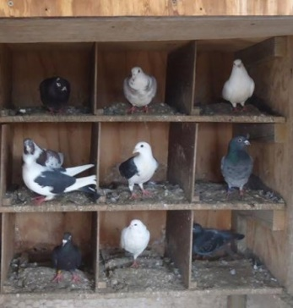
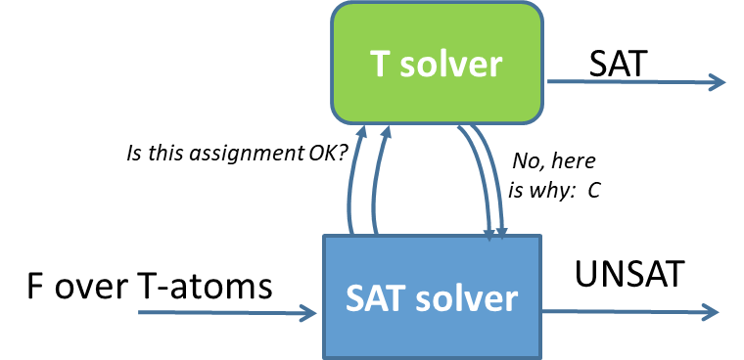

Proof complexity of
Satisfiability Modulo Theories
$$\left(C∨x\right) \left(D∨¬x\right)$$
-----------------------------
$$(C∨D)$$
Robert Robere
Antonina Kolokolova
Vijay Ganesh
Oaxaca, Aug 30, 2018

Slide 2
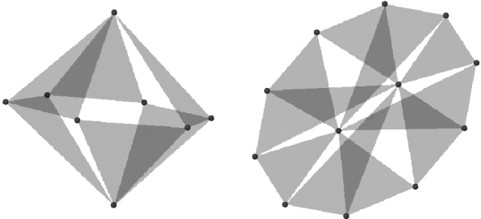
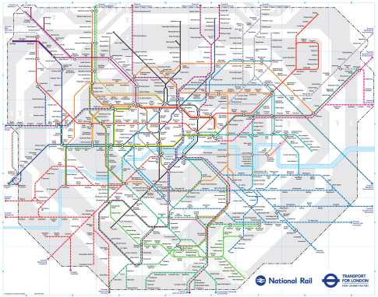
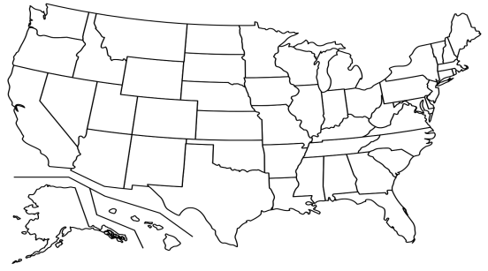

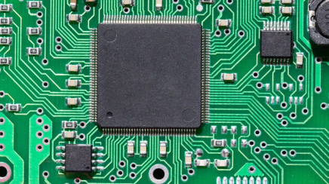

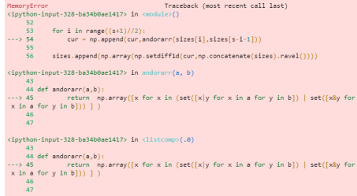
Practical problems rarely start propositional
They talk about programs, circuits, graphs, numbers, strings...
Domains with a lot of inherent structure!

Slide 3
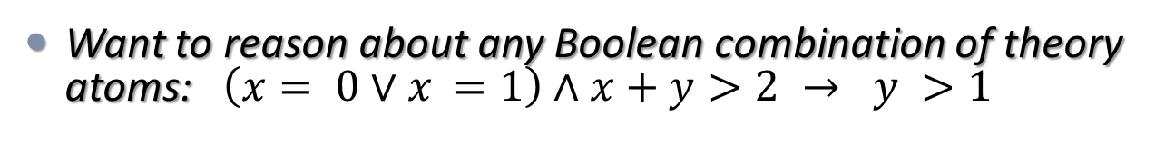
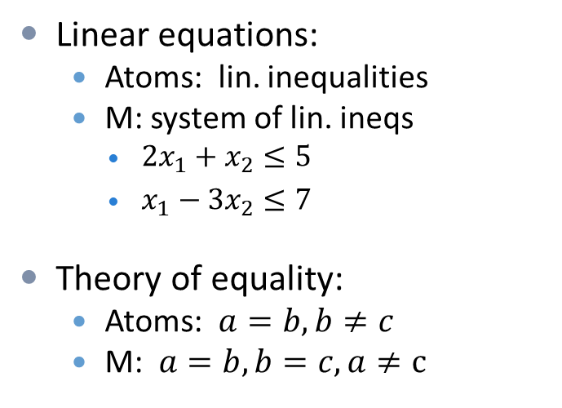
Reasoning within a domain: theories
T is a (first-order) theory over some signature L.
  Focus on quantifier-free fragment of T
  Usually have =
M is a conjunction of atoms of T (and their negations)
Mainly want (efficiently) decidable theories
M
T solver
SAT/UNSAT
Linear equations:
  Atoms: lin. inequalities
  M: system of lin. ineqs
    $2x_{1}+x_{2}≤5$
    $x_{1}−3x_{2}≤7$
Theory of equality:
  Atoms: $a=b, b≠c$
  M: $a=b, b=c, a≠c$
Want to reason about any Boolean combination of theory atoms: $\left(x= 0∨x_{ }=1\right)∧x+y>2 → y >1$

Slide 4


Satisfiability modulo theories (SMT)
Prop. F
SAT solver
SAT/UNSAT
$∧$ of T-atoms M
T solver
SAT/UNSAT
T solver
SAT
Is this assignment OK?
No, here is why: C
F over T-atoms
SAT solver
UNSAT
“Lazy” SMT

Slide 5
SAT solving is to resolution as
SMT solving is to... ?

Slide 6
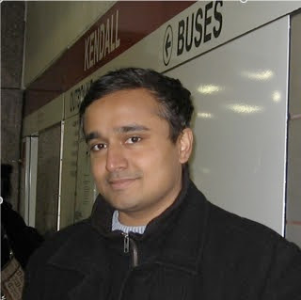
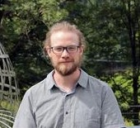
SAT solving is to resolution as
SMT solving is to resolution modulo theories: Res(T)
Joint work with Vijay Ganesh and Robert Robere

Slide 7
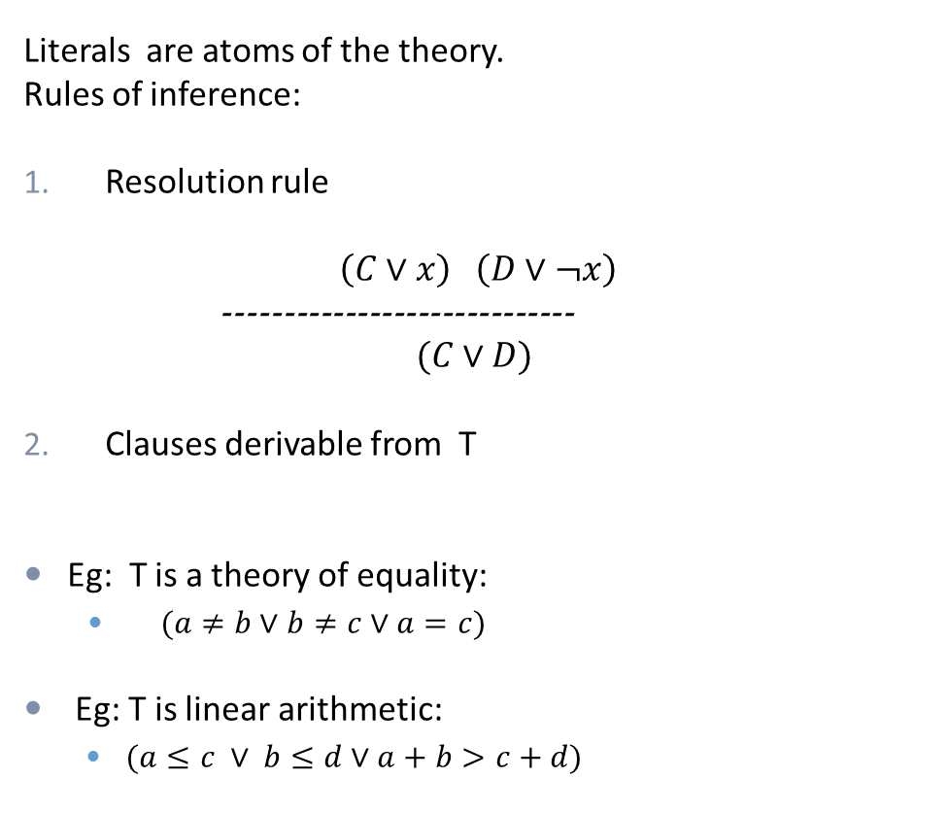
Resolution modulo theories
Literals are atoms of the theory.
Rules of inference:
Resolution rule
$$\left(C∨x\right) \left(D∨¬x\right)$$
-----------------------------
$$(C∨D)$$
Clauses derivable from T
Eg: T is a theory of equality:
  $(a≠b∨b≠c∨a=c)$
Eg: T is linear arithmetic:
  $(a≤c ∨ b≤d∨a+b>c+d)$
CNF
F
SAT solver
SAT/UNSAT
Resolution
T solver
SAT
Is this assignment OK?
No, here is why: C
T-F
SAT solver
UNSAT
Resolution modulo T

Slide 8


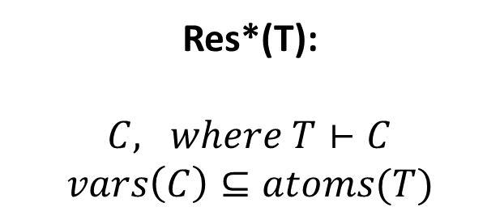
Resolution modulo theories
Literals are atoms of the theory.
Rules of inference:
Resolution rule
$$\left(C∨x\right) \left(D∨¬x\right)$$
-----------------------------
$$(C∨D)$$
Clauses derivable from T
CNF
F
SAT solver
SAT/UNSAT
Resolution
T solver
SAT
Is this assignment OK?
No, here is why: C
SAT solver
UNSAT
Res(T):
$C, where T⊢C$
$$vars\left(C\right)⊆vars(F)$$
Res*(T):
$C, where T⊢C$
$$vars\left(C\right)⊆atoms(T)$$
T-F
Resolution modulo T

Slide 9
Main theorem
Let T be a theory, and F an unsat. formula over atoms of T. Then
an SMT solver produces a Res(T) refutation of F.
an SMT solver with asserting learning scheme and non-deterministic branching can efficiently simulate Res(T).
When theory solvers can introduce new literals, same statements hold for Res*(T) in place of Res(T).

Slide 10
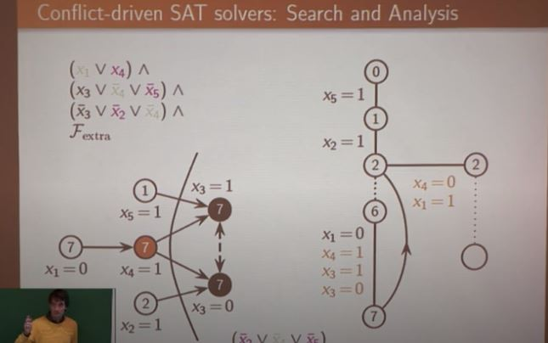
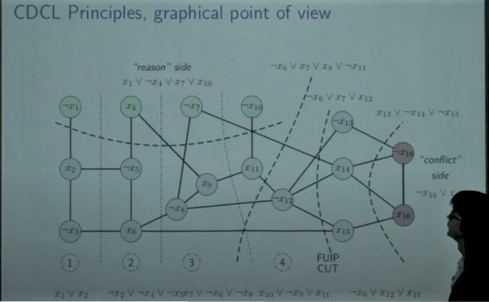
CDCL

Slide 11
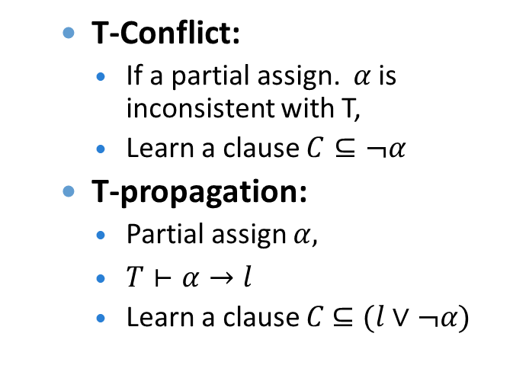
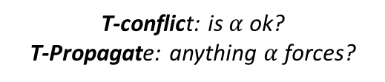
CDCL, CDCL(T) and CDCL*(T)
CDCL:
  Repeat:
    Decision: set a variable
    Propagate unit clauses
    If there is a conflict, analyse it and learn
    Maybe restart
CDCL (T):
  Repeat:
    Decision
    Propagation and T-Propagation
    Conflict analysis and T-conflict
    Maybe restart
  T-Conflict:
    If a partial assign. $α$is inconsistent with T,
    Learn a clause $C⊆¬α$
  T-propagation:
    Partial assign $α,$
    $T⊢α→l$
    Learn a clause $C$ $⊆(l∨¬α)$
T solver
SAT
T-conflict: is $α$ ok?
T-Propagate: anything $α$ forces?
Clause C
F over T-atoms
SAT solver
UNSAT

Slide 12
CDCL, CDCL(T) and CDCL*(T)
CDCL:
  Repeat:
    Decision: set a variable
    Propagate unit clauses
    If there is a conflict, analyse it and learn
    Maybe restart
Resolution captures CDCL
  Pipatsrisawat/Darwiche
  Atserias/Fichte/Thurley.
CDCL (T): CDCL plus
  Repeat:
    Decision
    Propagation and T-Propagation
    Conflict analysis and T-conflict
    Maybe restart
CDCL*(T):
  T-conflict and T-propagation can introduce new literals
Res(T) captures CDCL(T)
Res*(T) captures CDCL*(T)
  Generalizing PD’09, AFT’09

Slide 13
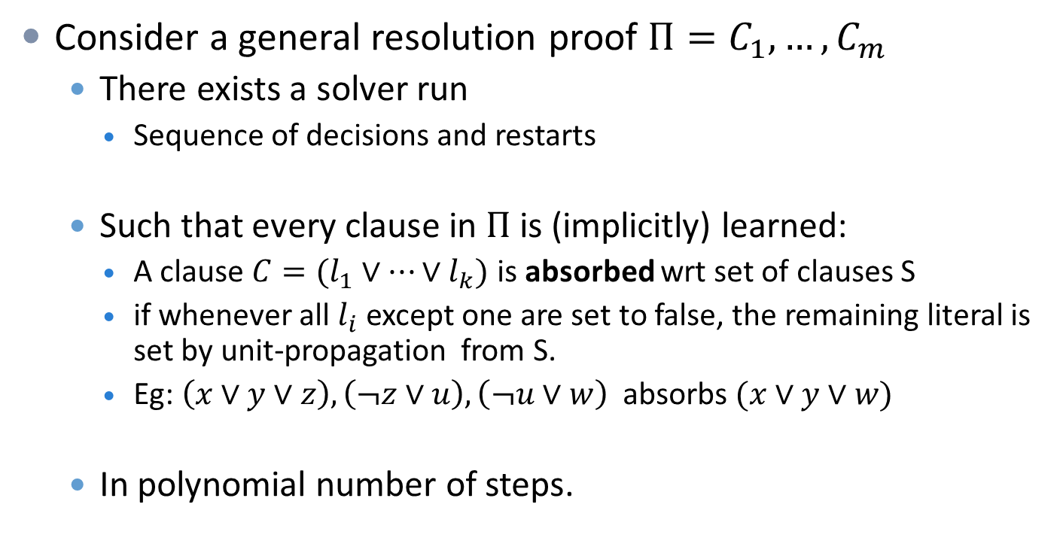
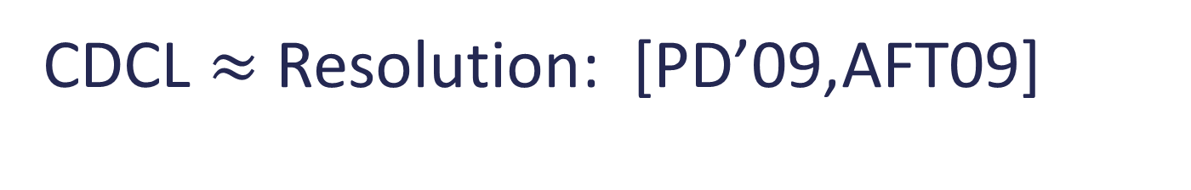
CDCL $≈$ Resolution: [PD’09,AFT09]
Consider a general resolution proof ${Π=C}_{1},…, C_{m}$
  There exists a solver run
    Sequence of decisions and restarts
  Such that every clause in $Π$ is (implicitly) learned:
    A clause $C=(l_{1}∨…{∨l}_{k})$is absorbed wrt set of clauses S
    if whenever all $l_{i}$ except one are set to false, the remaining literal is set by unit-propagation from S.
    Eg: $\left(x∨y∨z\right), \left(¬z∨u\right), \left(¬u∨w\right)$ absorbs $(x∨y∨w)$
  In polynomial number of steps.

Slide 14
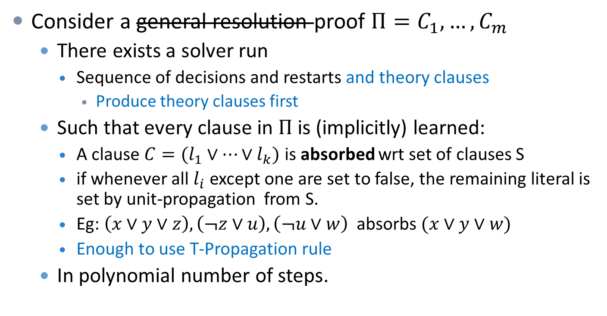
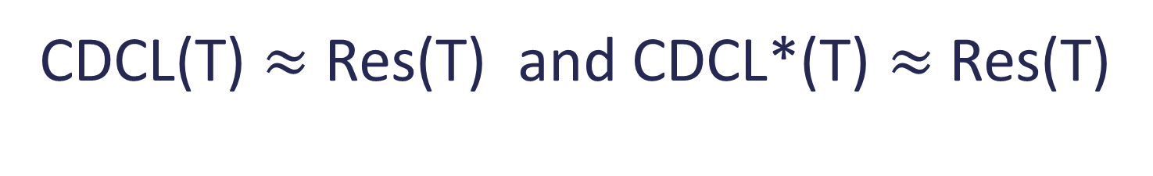
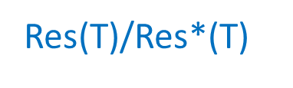
CDCL(T) $≈$ Res(T) and CDCL*(T) $≈$ Res(T)
Res(T)/Res*(T)
Consider a general resolution proof ${Π=C}_{1},…, C_{m}$
  There exists a solver run
    Sequence of decisions and restarts and theory clauses
      Produce theory clauses first
  Such that every clause in $Π$ is (implicitly) learned:
    A clause $C=(l_{1}∨…{∨l}_{k})$is absorbed wrt set of clauses S
    if whenever all $l_{i}$ except one are set to false, the remaining literal is set by unit-propagation from S.
    Eg: $\left(x∨y∨z\right), \left(¬z∨u\right), \left(¬u∨w\right)$ absorbs $(x∨y∨w)$
    Enough to use T-Propagation rule
  In polynomial number of steps.

Slide 15





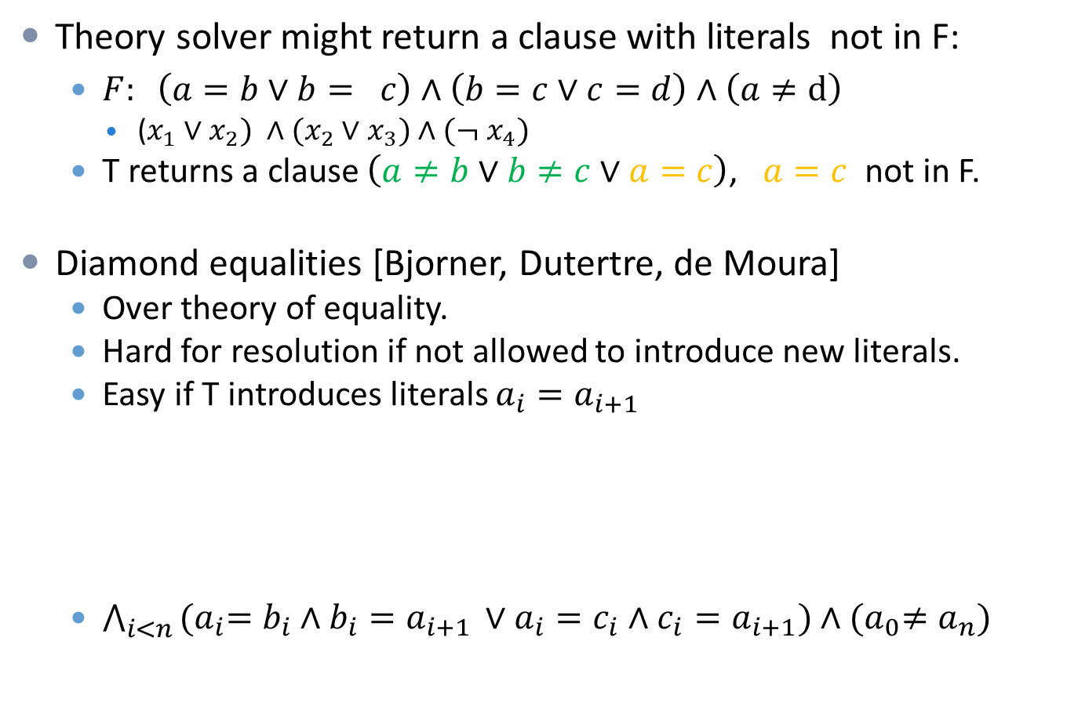







New literals
Theory solver might return a clause with literals not in F:
  $F: \left(a=b∨b= c\right)∧\left(b=c∨c=d\right)∧\left(a≠d\right)$
    ($x_{1}∨x_{2}) ∧(x_{2}∨x_{3})∧(¬ x_{4})$
  T returns a clause $\left(a≠b∨b≠c∨a=c\right)$, $a=c$ not in F.
Diamond equalities [Bjorner, Dutertre, de Moura]
  Over theory of equality.
  Hard for resolution if not allowed to introduce new literals.
  Easy if T introduces literals $a_{i}=a_{i+1}$
  $\bigwedge_{i<n }{{(a}_{i}=b_{i}∧b_{i}=a_{i+1 }∨a_{i}=c_{i}∧c_{i}=a_{i+1})}∧{(a}_{0}≠a_{n})$
$$b_{0}$$
$$b_{1}$$
$$a_{0}≠a_{n}$$
$$b_{n−1}$$
=
=
=
=
=
=
$$a_{0}$$
$$a_{1}$$
$$a_{2}$$
....
$$a_{n−1}$$
$$a_{n}$$
=
=
=
=
=
=
$$c_{0}$$
$$c_{1}$$
$$c_{n−1}$$

Slide 16
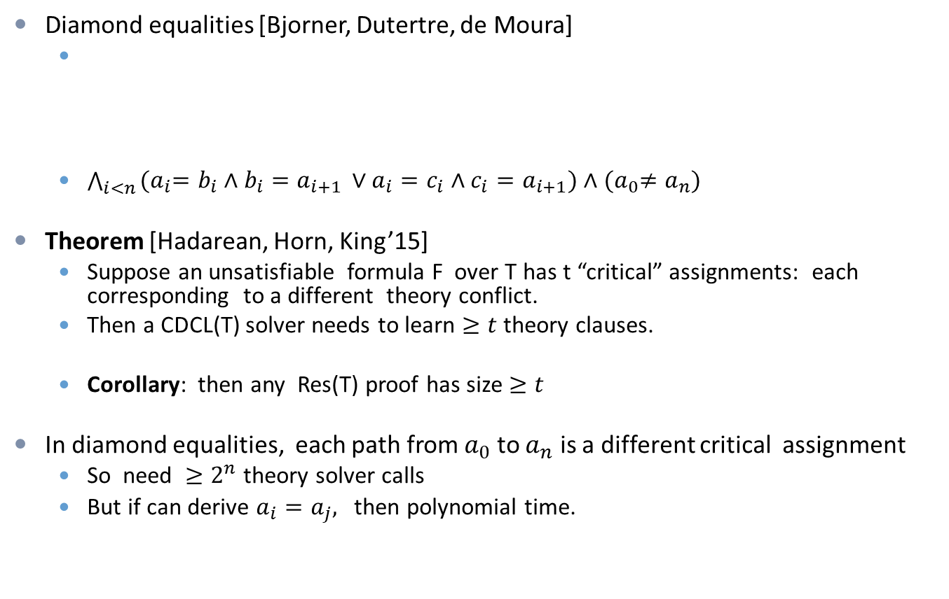
New literals
Diamond equalities [Bjorner, Dutertre, de Moura]
  $\bigwedge_{i<n }{{(a}_{i}=b_{i}∧b_{i}=a_{i+1 }∨a_{i}=c_{i}∧c_{i}=a_{i+1})}∧{(a}_{0}≠a_{n})$
Theorem [Hadarean, Horn, King’15]
  Suppose an unsatisfiable formula F over T has t “critical” assignments: each corresponding to a different theory conflict.
  Then a CDCL(T) solver needs to learn $≥t$ theory clauses.
  Corollary: then any Res(T) proof has size $≥t$
In diamond equalities, each path from $a_{0}$ to $a_{n}$ is a different critical assignment
  So need ${≥2}^{n}$ theory solver calls
  But if can derive $a_{i}=a_{j},$ then polynomial time.
$$b_{0}$$
$$b_{1}$$
$$a_{0}≠a_{n}$$
$$b_{n−1}$$
=
=
=
=
=
=
$$a_{0}$$
$$a_{1}$$
$$a_{2}$$
....
$$a_{n−1}$$
$$a_{n}$$
=
=
=
=
=
=
$$c_{0}$$
$$c_{1}$$
$$c_{n−1}$$

Slide 17
The power of Res*(T)

Slide 18


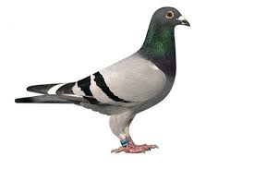
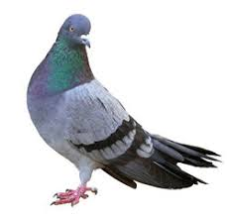


PigeonHolePrinciple
PigeonHole Principle: there is no injective function from [n] to [n-1]
PHP:
$$⋀_{i≤n}(∨_{j<n} p_{i,j})∧\bigwedge_{i≠k, j}{(¬}p_{i,j}∨¬p_{k,j})$$
=-PHP:
$$\bigwedge_{i≤n}{(∨_{j<n}}\left(p_{i}=h_{j}\right)∧\bigwedge_{i<k≤n}{(}p_{i}≠p_{k})$$
EUF-PHP:
$$\bigwedge_{x∈[n]}{(}f\left(x\right)≠0) ∧\bigwedge_{x, y∈[n]}{(}x≠y→f\left(x\right)≠f(y))$$
LA-PHP:
$$\bigwedge_{i≤n}{(Σ_{j<n }x_{i,j}≥1) }∧\bigwedge_{j<n}{(Σ_{i≤n }x_{i,j}≤1) }$$

Slide 19


PigeonHolePrinciple
PigeonHole Principle: there is no injective function from [n] to [n-1]
PHP:
$$⋀_{i≤n}(∨_{j<n} p_{i,j})∧\bigwedge_{i≠k, j}{(¬}p_{i,j}∨¬p_{k,j})$$
=-PHP:
$$\bigwedge_{i≤n}{(∨_{j<n}}\left(p_{i}=h_{j}\right)∧\bigwedge_{i<k≤n}{(}p_{i}≠p_{k})$$
EUF-PHP:
$$\bigwedge_{x∈[n]}{(}f\left(x\right)≠0) ∧\bigwedge_{x, y∈[n]}{(}x≠y→f\left(x\right)≠f(y))$$
LA-PHP:
$$\bigwedge_{i≤n}{(Σ_{j<n }x_{i,j}≥1) }∧\bigwedge_{j<n}{(Σ_{i≤n }x_{i,j}≤1) }$$
Propositional
Theory of equality:
  $\left(a=b∧b=c→a=c\right)$
Equality with uninterpreted functions (EUF)
  equality axioms
  Ackermann axioms: ($a=b→f\left(a\right)=f\left(b\right))$
Linear arithmetic

Slide 20
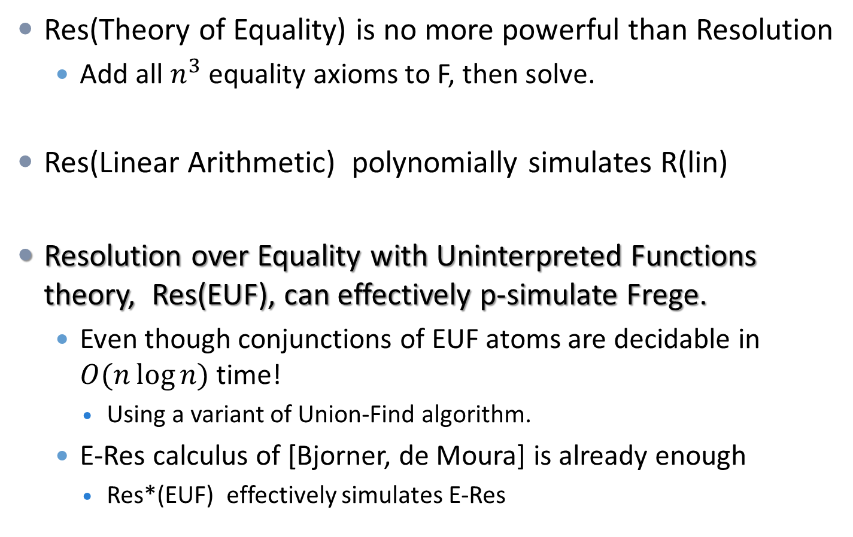
Power of Res(T)
Res(Theory of Equality) is no more powerful than Resolution
  Add all $n^{3}$ equality axioms to F, then solve.
Res(Linear Arithmetic) polynomially simulates R(lin)
Resolution over Equality with Uninterpreted Functions theory, Res(EUF), can effectively p-simulate Frege.
  Even though conjunctions of EUF atoms are decidable in $O(n\log{n) }$time!
    Using a variant of Union-Find algorithm.
  E-Res calculus of [Bjorner, de Moura] is already enough
    Res*(EUF) effectively simulates E-Res

Slide 21
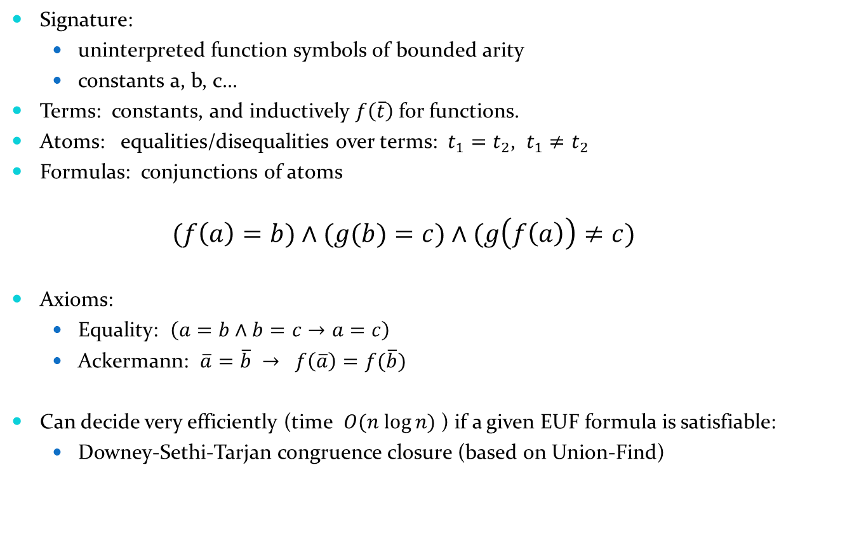





Equality with uninterpreted functions theory (EUF)
Signature:
  uninterpreted function symbols of bounded arity
  constants a, b, c...
Terms: constants, and inductively $f\left(\overline{t}\right)$for functions.
Atoms: equalities/disequalities over terms: $t_{1}=t_{2}$, $t_{1}≠t_{2}$
Formulas: conjunctions of atoms
  $$(f\left(a\right)=b)∧(g(b)=c)∧(g\left(f\left(a\right)\right)≠c)$$
Axioms:
  Equality: $\left(a=b∧b=c→a=c\right)$
  Ackermann: $\overline{a}=\overline{b} → f\left(\overline{a}\right)=f(\overline{b})$
Can decide very efficiently (time $O(n log⁡n)$) if a given EUF formula is satisfiable:
  Downey-Sethi-Tarjan congruence closure (based on Union-Find)
$$b$$
$$c$$
$$f(a)$$
$$g(f\left(a\right))$$
$$g(b)$$

Slide 22
Equality with uninterpreted functions theory (EUF)
Signature:
  uninterpreted function symbols of bounded arity
  constants a, b, c...
Terms: constants, and inductively $f\left(\overline{t}\right)$for functions.
Atoms: equalities/disequalities over terms: $t_{1}=t_{2}$, $t_{1}≠t_{2}$
Formulas: conjunctions of atoms
  $$(f\left(a\right)=b)∧(g(b)=c)∧(g\left(f\left(a\right)\right)≠c)$$
Axioms:
  Equality: $\left(a=b∧b=c→a=c\right)$
  Ackermann: $\overline{a}=\overline{b} → f\left(\overline{a}\right)=f(\overline{b})$
Can decide very efficiently (time $O(n log⁡n)$) if a given EUF formula is satisfiable:
  Downey-Sethi-Tarjan congruence closure (based on Union-Find)
$$b$$
$$c$$
$$f(a)$$
$$g(f\left(a\right))$$
$$g(b)$$

Slide 23





Sequent calculus (LK)
Equivalent to Frege systems.
    Natural deduction
Sequents: $A_{1}, …, A_{n} −→ B_{1},…, B_{m}$
  $A_{1}∧…∧A_{n}→B_{1}∨…∨B_{m}$
  Axioms $A →A,$ $0 →S, S →1$.
  Rules for $∨, ∧,¬$ and cut
Proof size: total number of symbols.
$$F→G, A A, F→G$$
-----------------------------
$$F→G$$
$$F→G, A$$
-------------------
$$¬A, F→G$$
$$F→G, A F→G,B$$
-----------------------------
$$F→G , A∧B$$
$$A, B,F→G$$
-------------------
$$A∧B, F→G$$

Slide 24
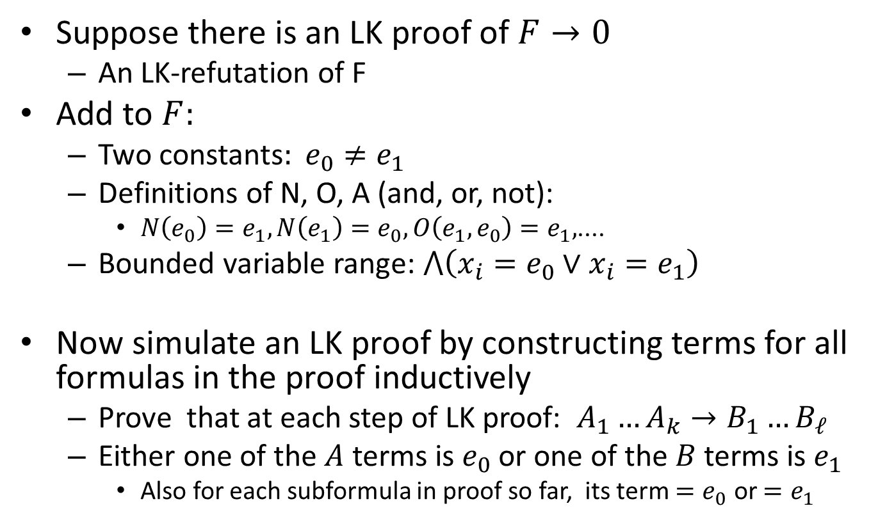
Res(EUF) simulates LK
Suppose there is an LK proof of $F→0$
  An LK-refutation of F
Add to $F:$
  Two constants$: e_{0}≠e_{1}$
  Definitions of N, O, A (and, or, not):
    $N\left(e_{0}\right)=e_{1}, N\left(e_{1}\right)=e_{0}, O\left(e_{1},e_{0}\right)=e_{1},$....
  Bounded variable range: $⋀\left(x_{i}=e_{0}∨x_{i}=e_{1}\right)$
Now simulate an LK proof by constructing terms for all formulas in the proof inductively
  Prove that at each step of LK proof: $A_{1}…A_{k}→B_{1}…B_{ℓ}$
  Either one of the $A$ terms is $e_{0}$ or one of the $B$ terms is $e_{1}$
    Also for each subformula in proof so far, its term ${=e}_{0}$ or $=e_{1}$

Slide 25

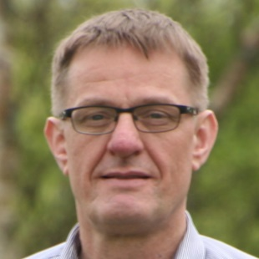
For which theory T would Res*(T) effectively p-simulate Extended Frege?
Didn’t you say EUF instances are usually flattened?
Arnold Beckmann’s observation: just add a flattening rule to Res*(EUF)!
  Flattening: every time a new term is introduced, add a new variable for this term.
    Do not need to decide when to add extension variables!

Slide 26
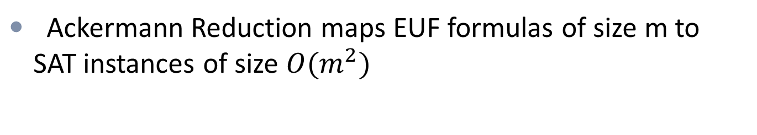
Eager vs. Lazy SMT
Question. Is it better to use a theory solver as an oracle, or just bit-blast all the way to propositional SAT instance?
Ackermann Reduction maps EUF formulas of size m to SAT instances of size $O(m^{2})$
Theorem. Assuming the Exponential Time Hypothesis (SAT requires 2^{Ω(n)} time), any reduction from EUF to SAT requires a blow-up of Ω(m log m).
Remark. This is tight!

Slide 27

Lots of open problems
Upper/lower bounds on Res(T)/ Res*(T) for a variety of theories.
Proof complexity of model checking and first-order provers?
Knowledge compilation:
  How to choose T given a problem and class of instances?
  In particular, when to choose Eager SMT and when Lazy?
  And how to choose T-representation?
How to even compare representations of the same problem in different underlying languages?
  Is Marc’s and Jakob’s PseudoBoolean encoding of PHP the “same PHP” as the classic CNF encoding?
    Work in progress
Given an instance of a problem, what is the best way to state it to make it easier to solve?

Slide 28

PigeonHolePrinciple
PigeonHole Principle: there is no injective function from [n] to [n-1]
PHP:
$$⋀_{i≤n}(∨_{j<n} p_{i,j})∧\bigwedge_{i≠k, j}{(¬}p_{i,j}∨¬p_{k,j})$$
=-PHP:
$$\bigwedge_{i≤n}{(∨_{j<n}}\left(p_{i}=h_{j}\right)∧\bigwedge_{i<k≤n}{(}p_{i}≠p_{k})$$
EUF-PHP:
$$\bigwedge_{x∈[n]}{(}f\left(x\right)≠0) ∧\bigwedge_{x, y∈[n]}{(}x≠y→f\left(x\right)≠f(y))$$
LA-PHP (PB-PHP):
$$\bigwedge_{i≤n}{(Σ_{j<n }x_{i,j}≥1) }∧\bigwedge_{j<n}{(Σ_{i≤n }x_{i,j}≤1) }$$

Slide 29

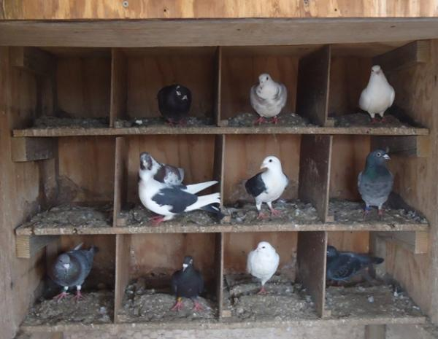








Thank you!
0
T-F
T solver
6
1
SAT
No, here is why: C
5
2
Is this assignment OK?
SAT solver
UNSAT
T-F
4
3
$$b$$
P/poly Frege
$$c$$
$$f(a)$$
$NC^{2}$ depth Frege
$NC^{1}$Frege
$$g(f\left(a\right))$$
$$g(b)$$
Cutting planes
$AC^{0}$ Frege
Resolution

