Slide 1
Logarithmicity, the TC-Generating Function
and
Right-Angled Artin Groups
John Oprea
Cleveland State University
(Joint with Michael Farber)

Slide 2
Obligatory Slide!

Slide 7
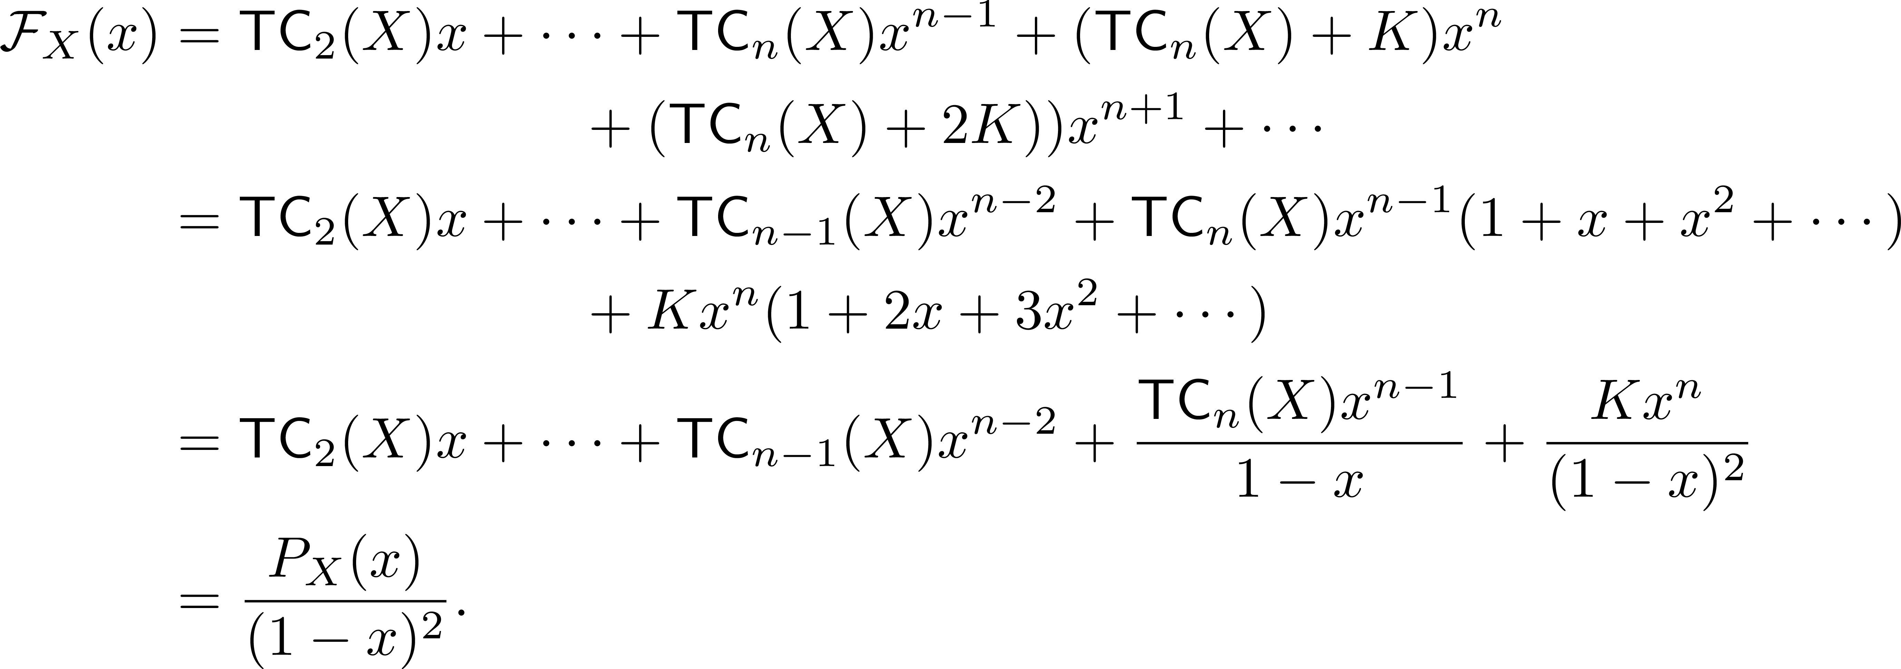

Slide 13
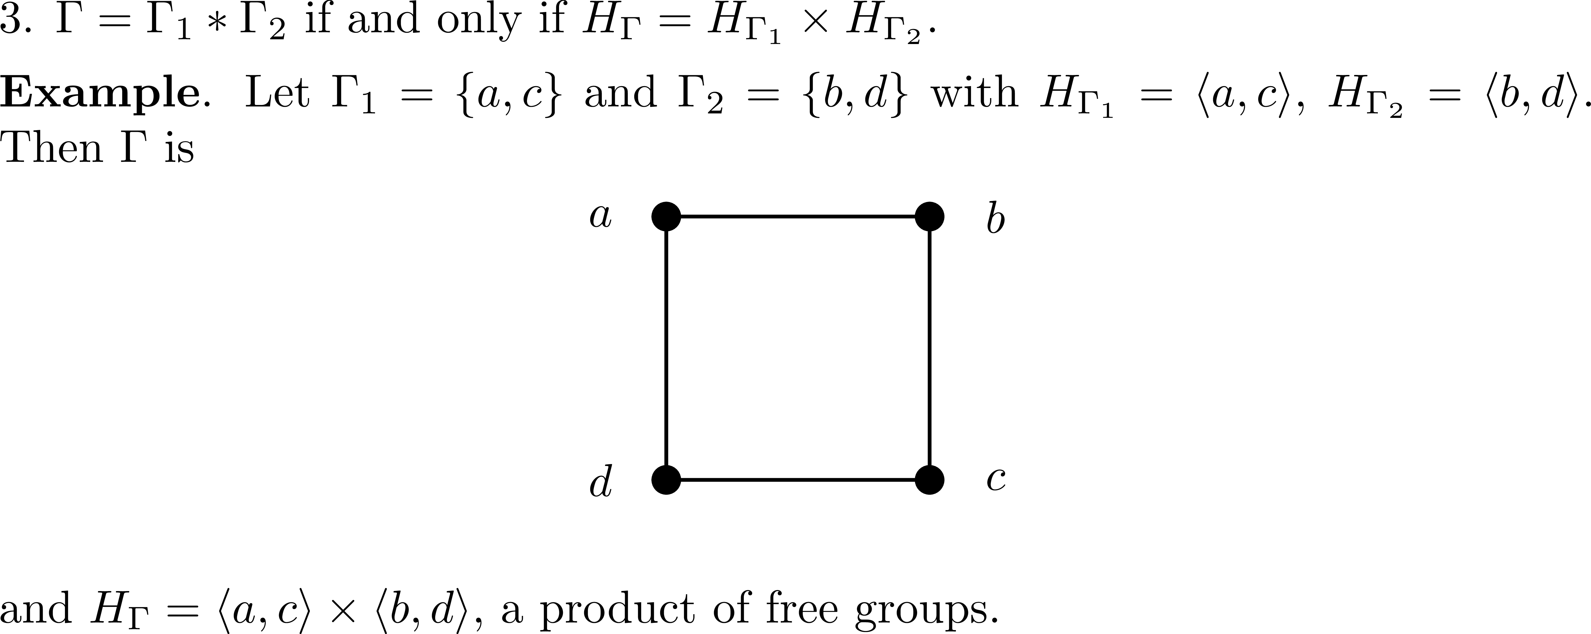
Properties of RAA Groups

Slide 15
Topological Complexities of RAA Groups

Slide 17
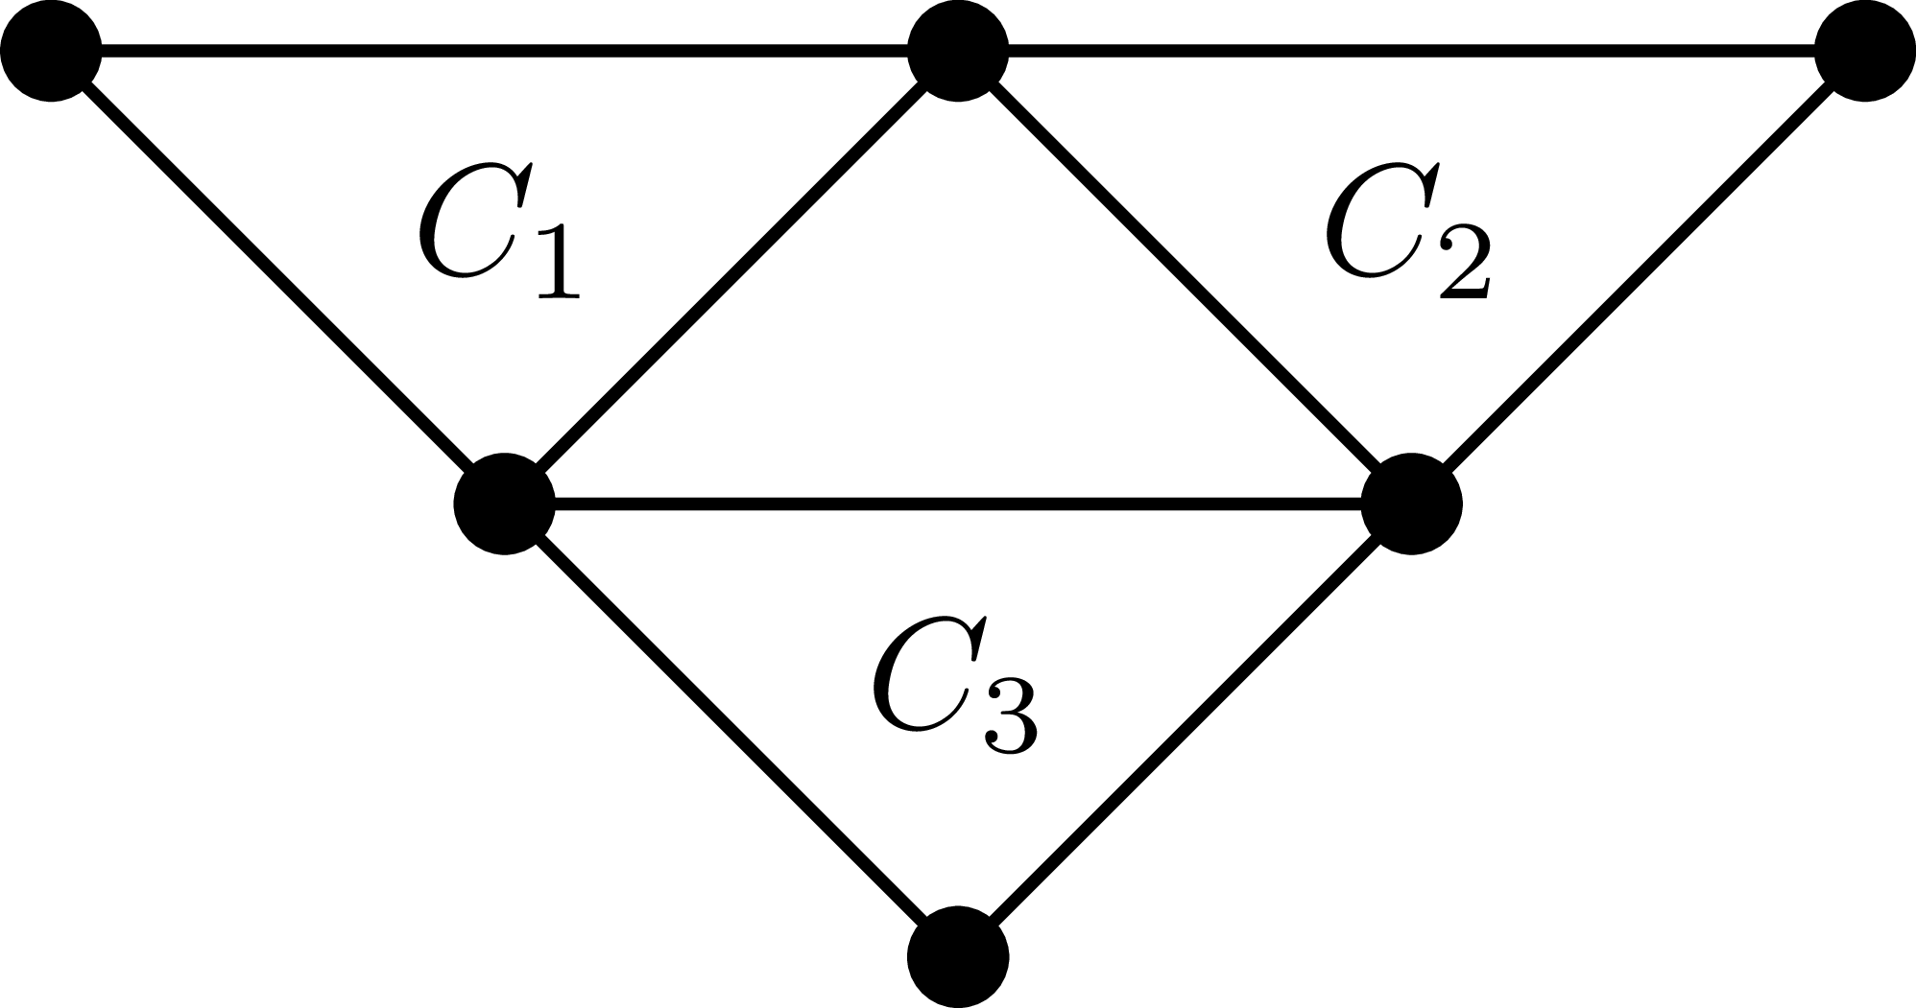

Slide 20
More Uses for RAA Groups

Slide 22
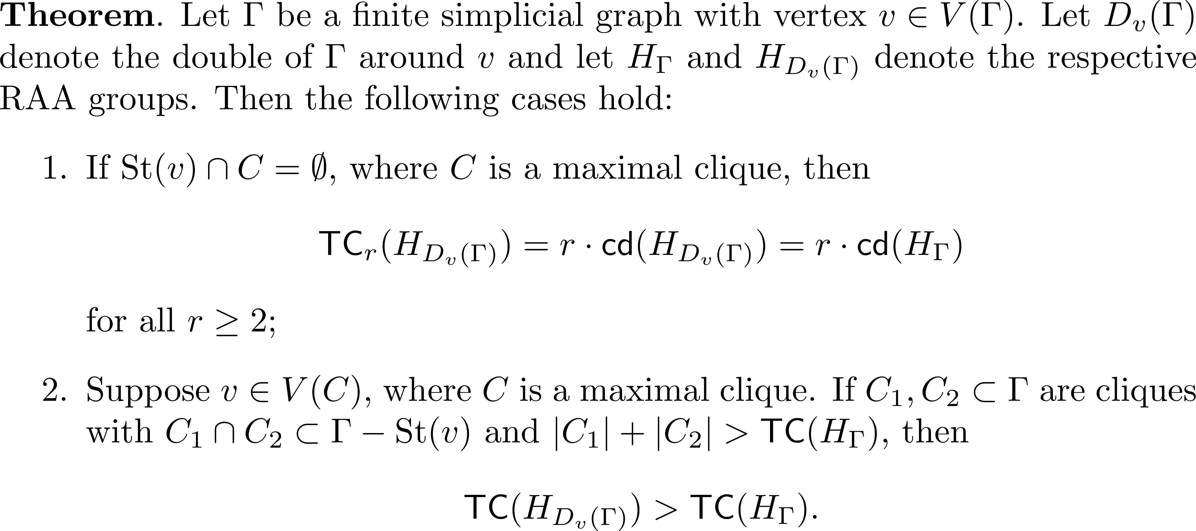

Slide 23
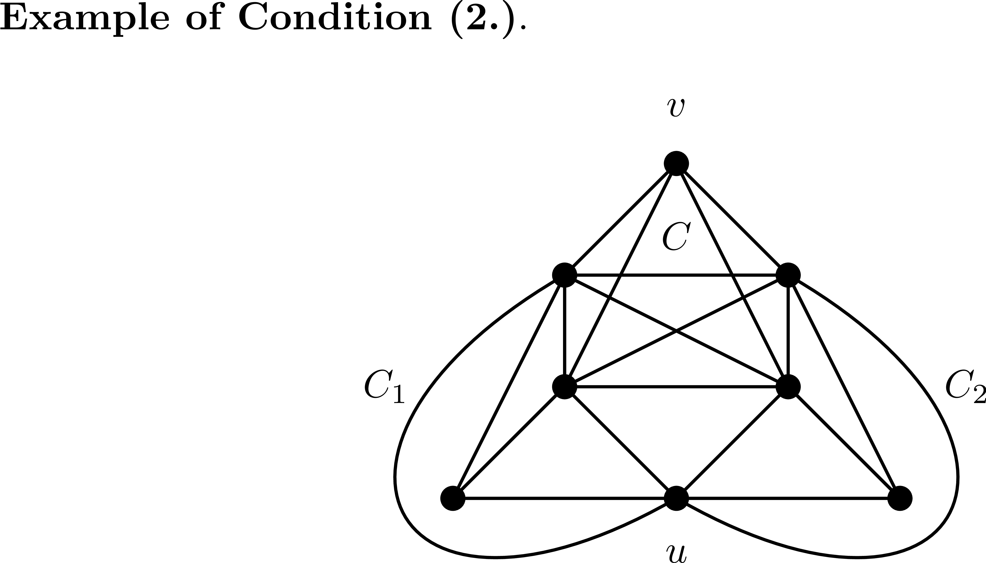

Slide 24
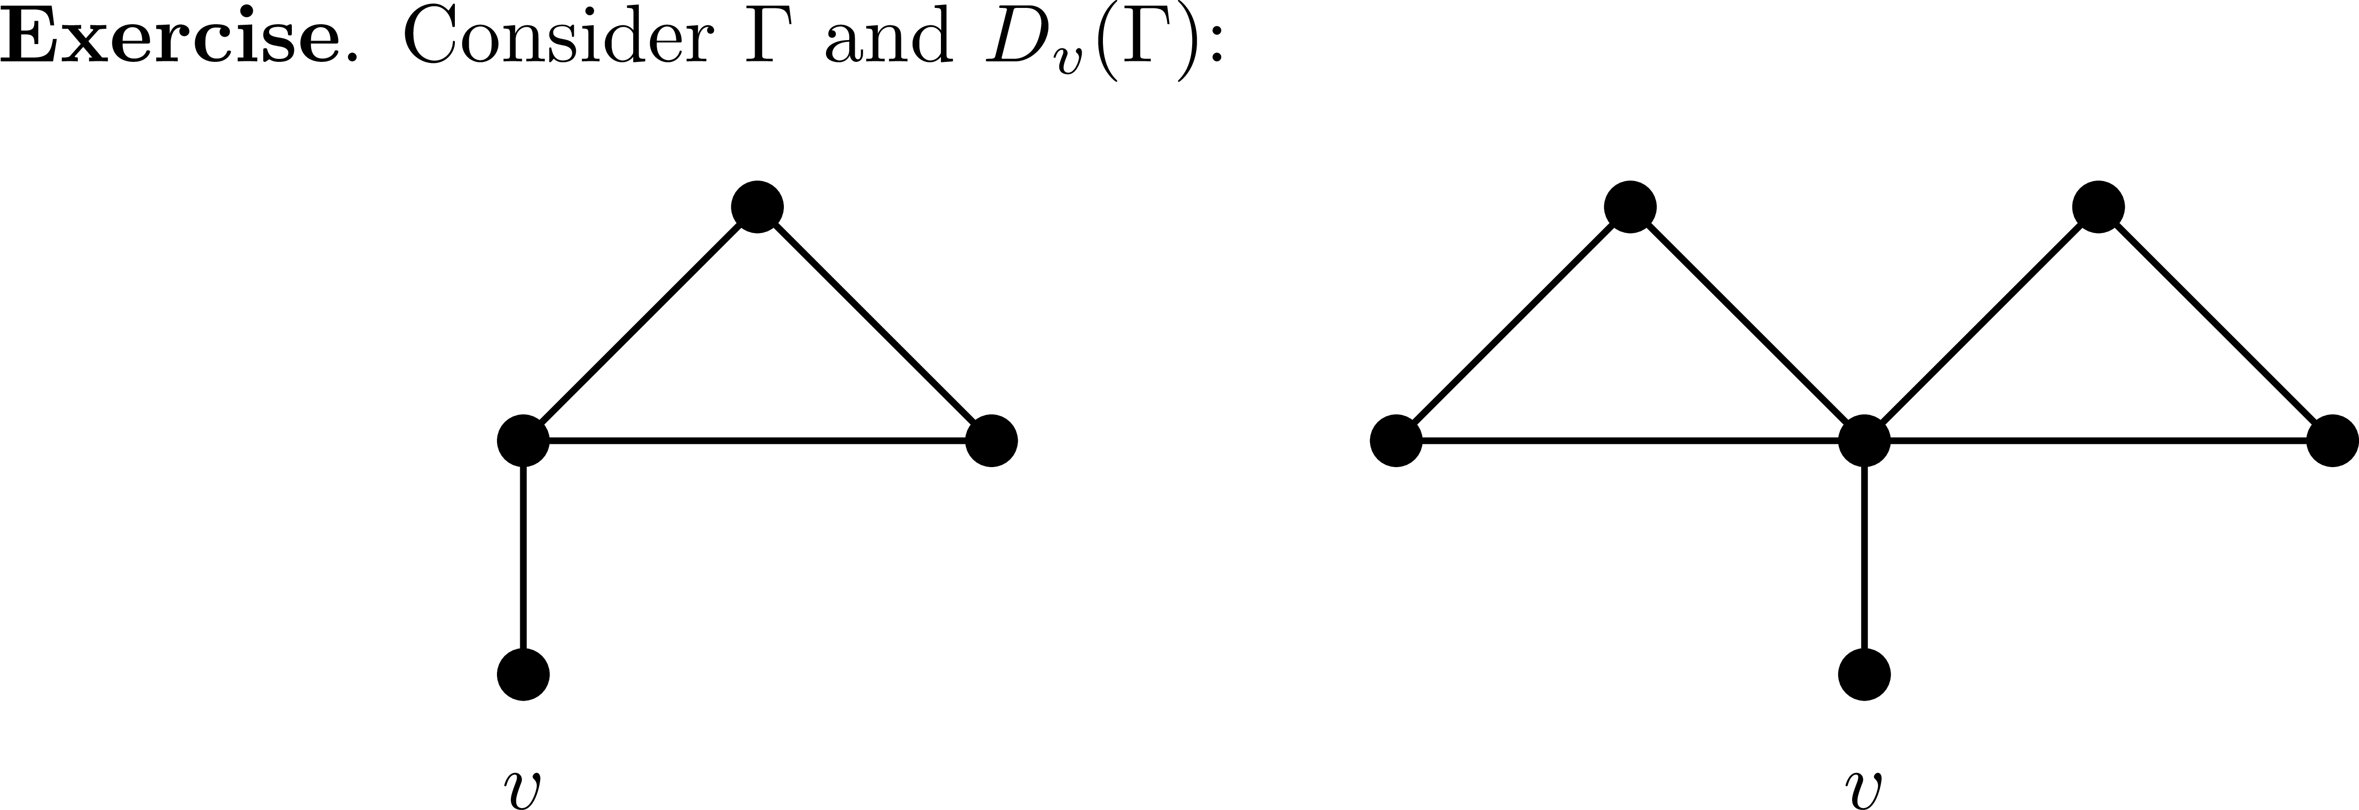

Slide 25
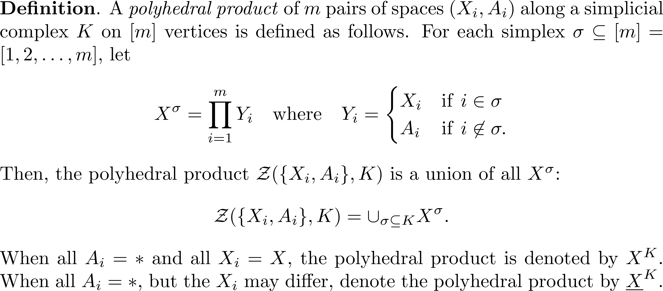
Further Consequences of LS-Logarithmicity

Slide 26
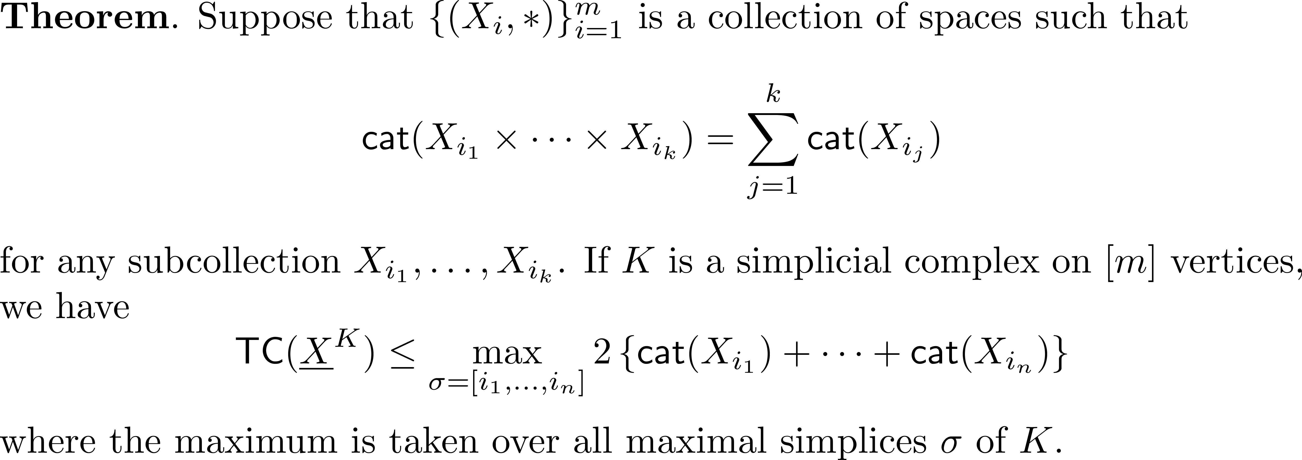

Slide 27
