Slide 1
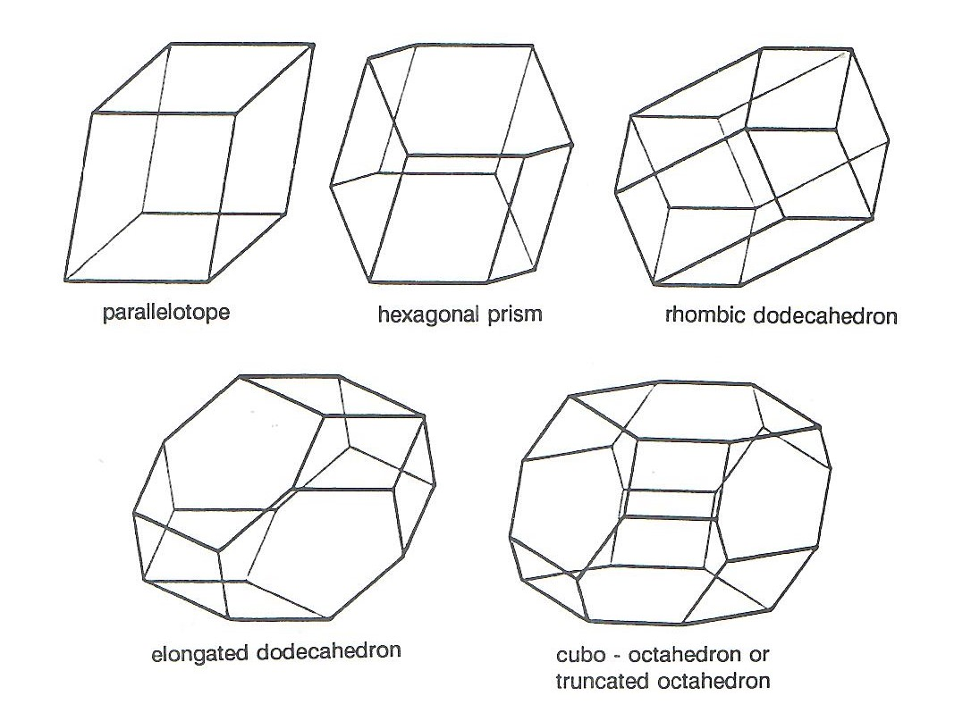
Characterization of
Three-Dimensional Multiple Tiles
Chuanming Zong
Tianjin University
Joint works with
Mei Han, Kirati Sriamorn and Qi Yang

Slide 2
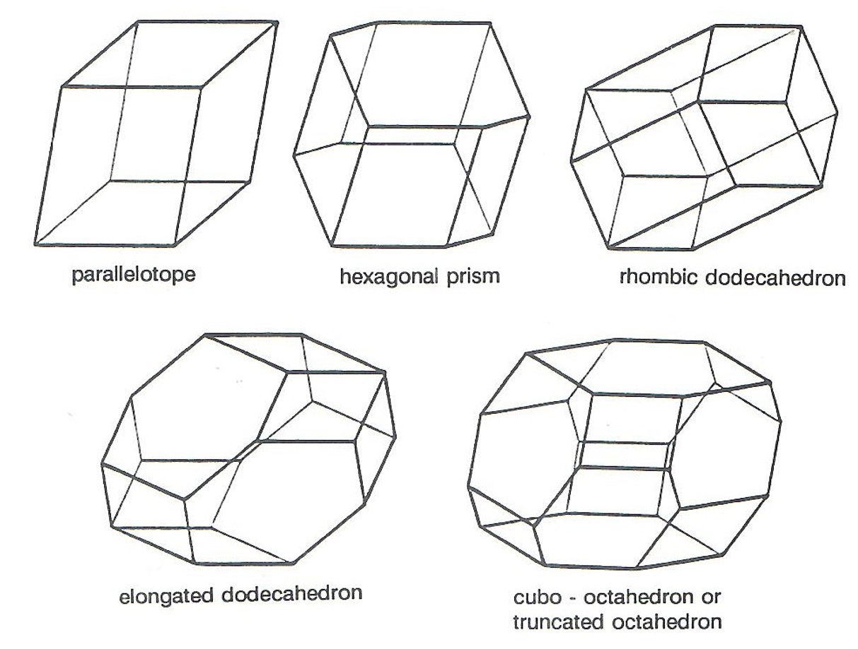
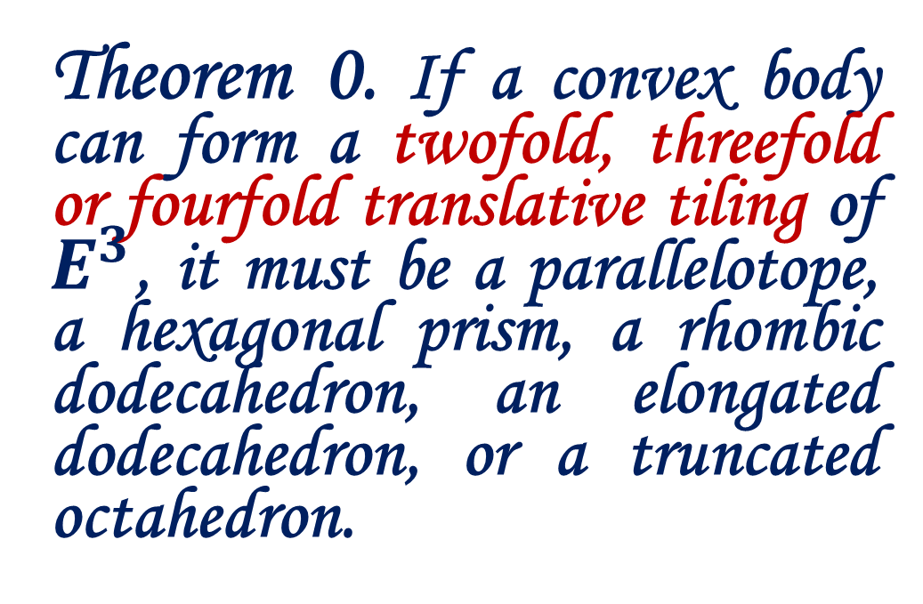
Recently, Mei Han, Kirati Sriamorn, Qi Yang and Chuanming Zong proved the following theorem.
Theorem 0. If a convex body can form a twofold, threefold or fourfold translative tiling of $E^{3}$, it must be a parallelotope, a hexagonal prism, a rhombic dodecahedron, an elongated dodecahedron, or a truncated octahedron.

Slide 3
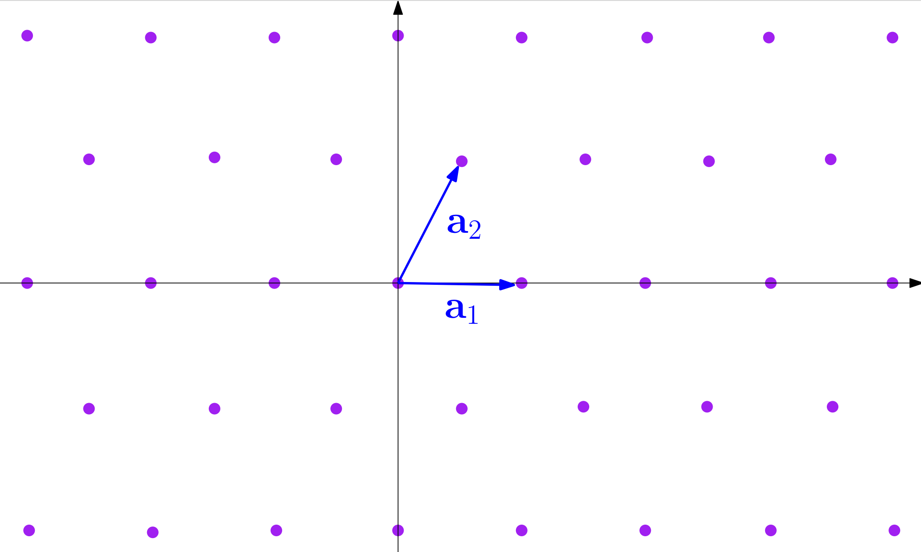
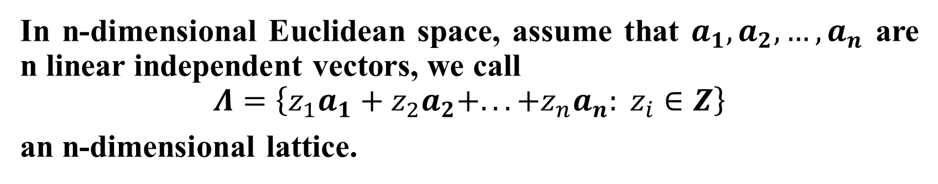
1、Fedorov’s Discovery
In n-dimensional Euclidean space, assume that $a_{1},a_{2},…,a_{n}$ are n linear independent vectors, we call
$$Λ=\left\{z_{1}a_{1}+z_{2}a_{2}+...+z_{n}a_{n}: z_{i}∈Z\right\}$$
an n-dimensional lattice.

Slide 4
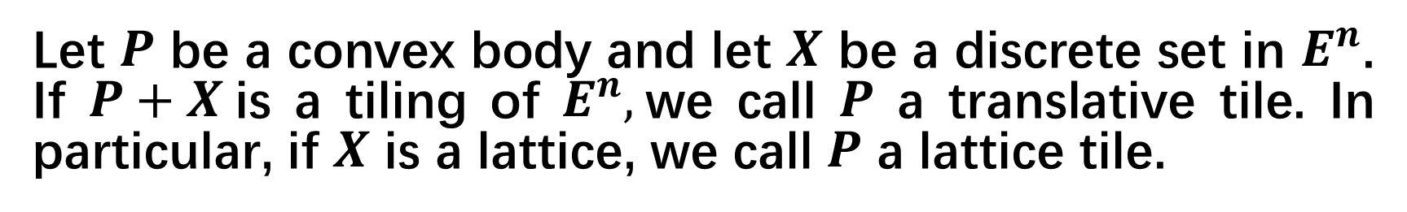
Let $P$ be a convex body and let $X$ be a discrete set in $E^{n}$. If $P+X$is a tiling of $E^{n},$we call $P$ a translative tile. In particular, if $X$ is a lattice, we call $P$ a lattice tile.
In 1885, E. Fedorov characterized all three-dimensional lattice tiles.
Theorem 1. A three-dimensional lattice tile must be a parallelotope, a hexagonal prism, a rhombic dodecahedron, an elongated dodecahedron, or a truncated octahedron.

Slide 5
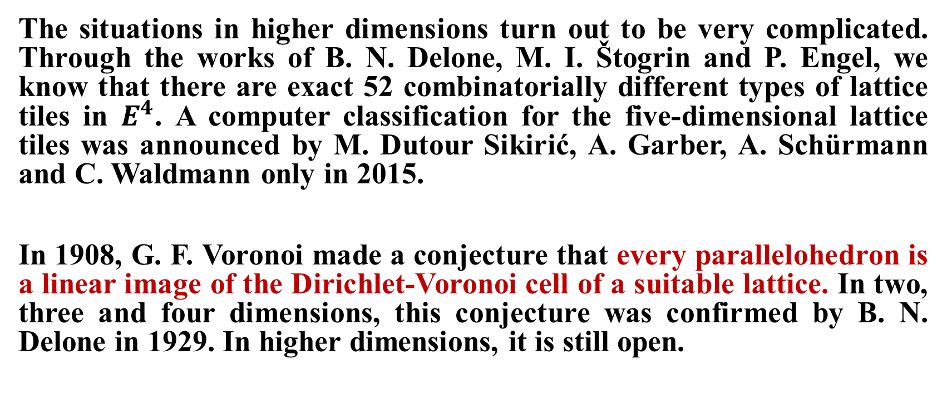
The situations in higher dimensions turn out to be very complicated. Through the works of B. N. Delone, M. I. Štogrin and P. Engel, we know that there are exact 52 combinatorially different types of lattice tiles in $E^{4}$. A computer classification for the five-dimensional lattice tiles was announced by M. Dutour Sikirić, A. Garber, A. Schürmann and C. Waldmann only in 2015.
In 1908, G. F. Voronoi made a conjecture that every parallelohedron is a linear image of the Dirichlet-Voronoi cell of a suitable lattice. In two, three and four dimensions, this conjecture was confirmed by B. N. Delone in 1929. In higher dimensions, it is still open.

Slide 6
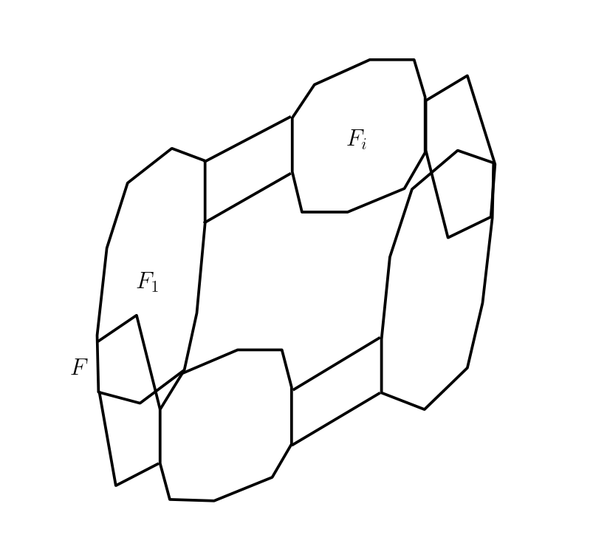
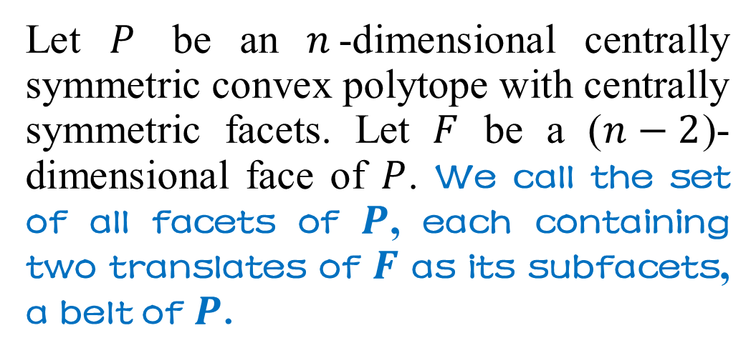
2、From Minkowski to McMullen
In 1897, H. Minkowski proved that a translative tile must be a centrally symmetric convex polytope.
Let $P$ be an $n$-dimensional centrally symmetric convex polytope with centrally symmetric facets. Let $F$ be a ($n−2$)-dimensional face of $P$. We call the set of all facets of $P$, each containing two translates of $F$ as its subfacets, a belt of $P$.

Slide 7
国家天元数学东南中心
Through the works of H. Minkowski, G. M. Voronoï, B. A. Venkov, A. D. Alexsandrov and P. McMullen, we have the following fundamental result.
Theorem 2. Let P be an n-dimensional convex body. The following three statements are equivalent to each other:
P is a translative tile;
P is a centrally symmetric polytope with centrally symmetric facets such that each belt contains four or six facets;
P is a lattice tile.

Slide 8
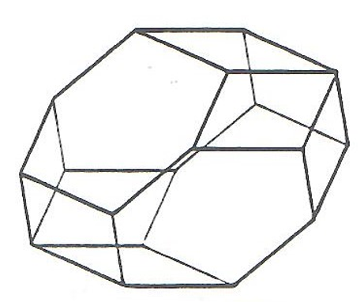
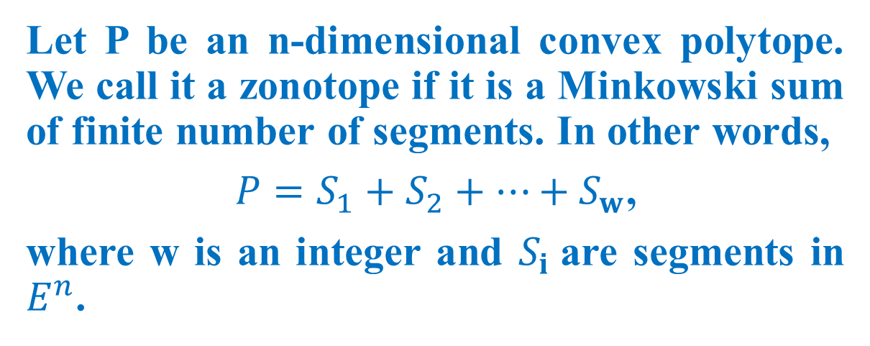
3、Zonotopes
Let P be an n-dimensional convex polytope. We call it a zonotope if it is a Minkowski sum of finite number of segments. In other words,
$P=S_{1}+S_{2}+⋯+S_{w}$,
where w is an integer and $S_{i}$are segments in $E^{n}$.
Clearly, zonotopes are centrally symmetric. In fact, every face of a zonotope is centrally symmetric.

Slide 9
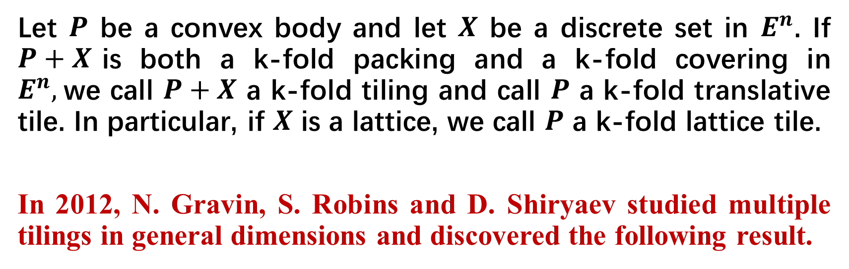
国家天元数学东南中心
Let $P$ be a convex body and let $X$ be a discrete set in $E^{n}$. If $P+X$is both a k-fold packing and a k-fold covering in $E^{n},$we call $P+X$ a k-fold tiling and call $P$ a k-fold translative tile. In particular, if $X$ is a lattice, we call $P$ a k-fold lattice tile.
In 2012, N. Gravin, S. Robins and D. Shiryaev studied multiple tilings in general dimensions and discovered the following result.
Theorem 3. An n-dimensional k-fold translative tile is a centrally symmetric polytope with centrally symmetric facets. In particular, every three-dimensional k-fold translative tile is a zonotope.

Slide 10
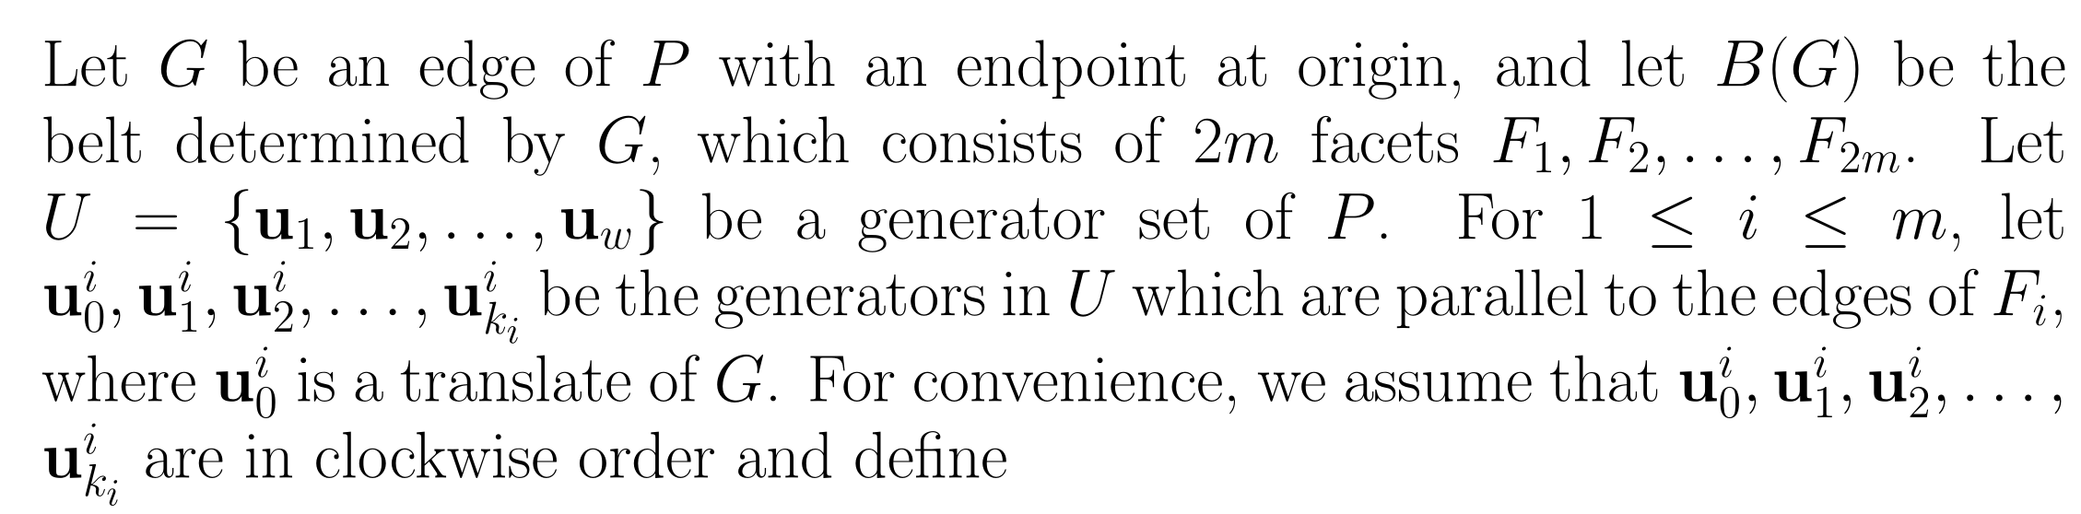
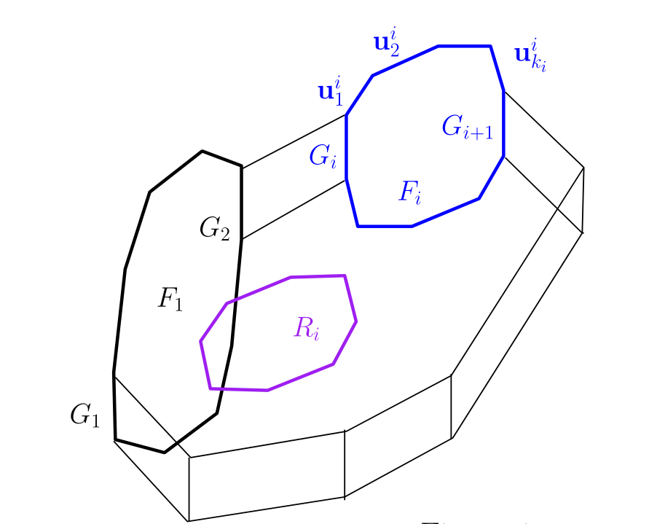
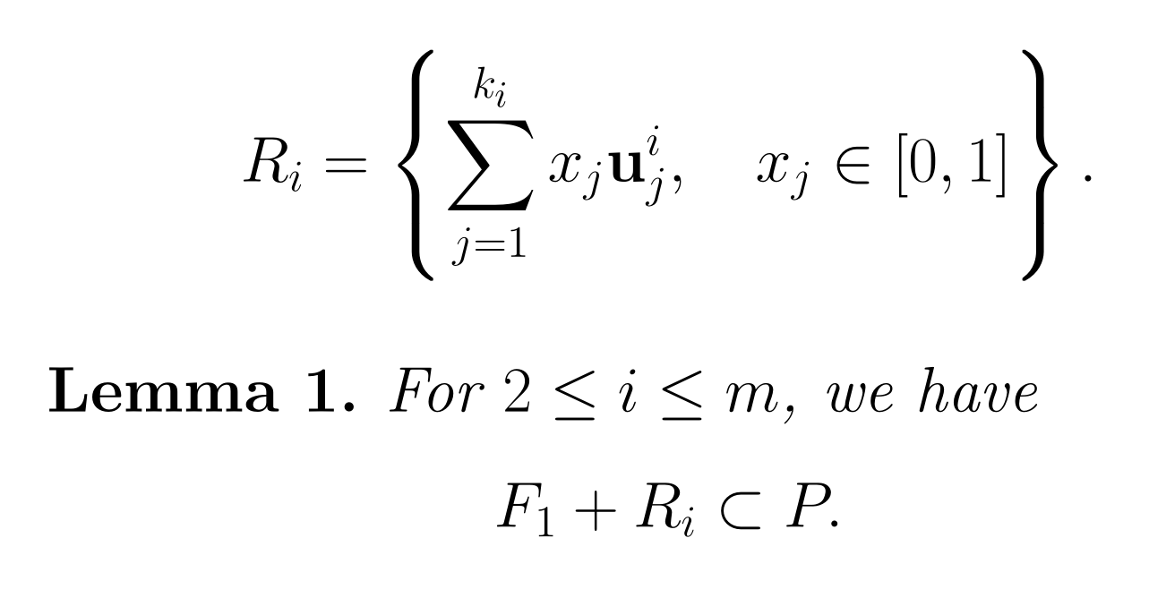

Slide 11
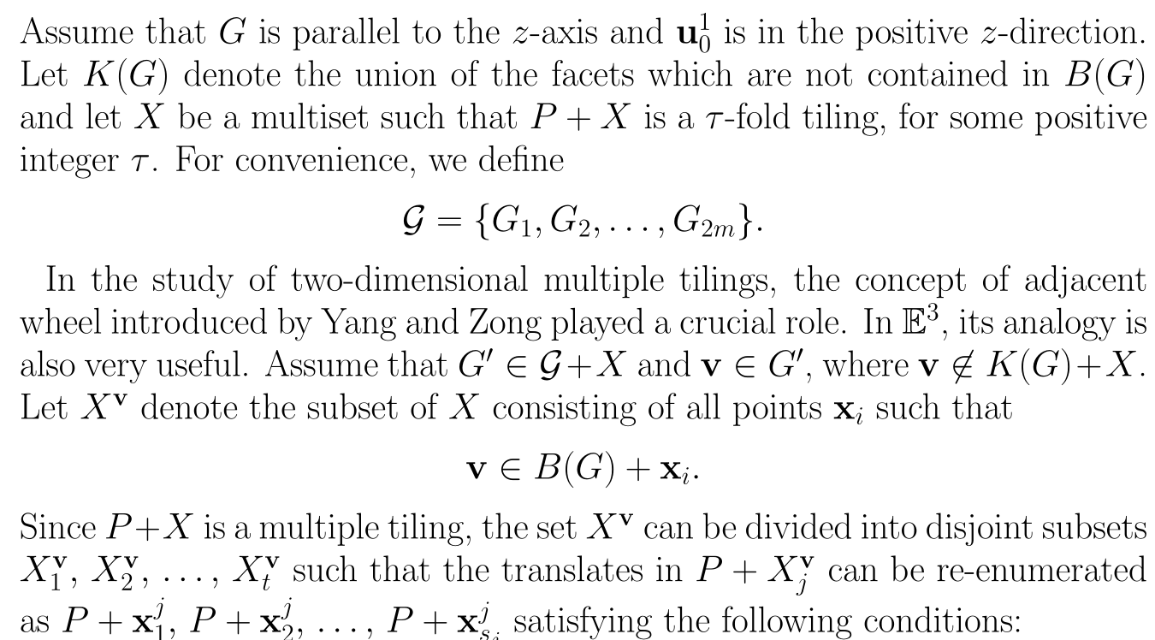
4、Adjacent Wheels

Slide 12
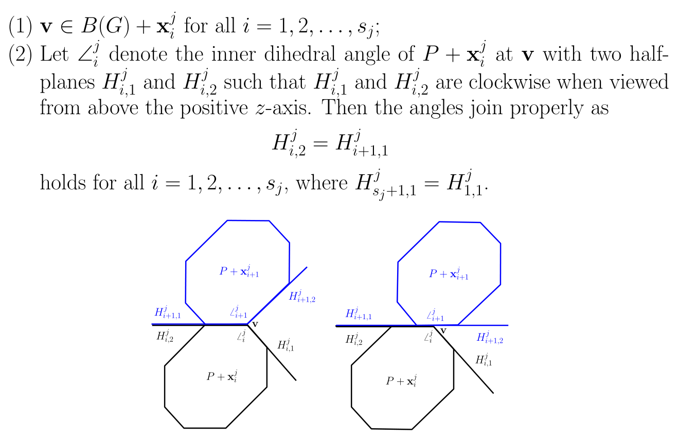

Slide 13
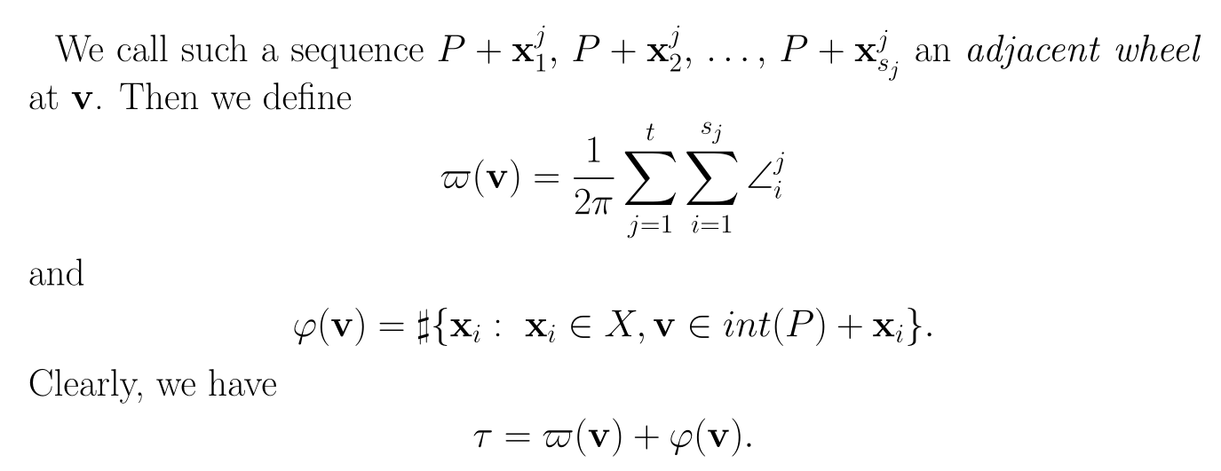

Slide 14
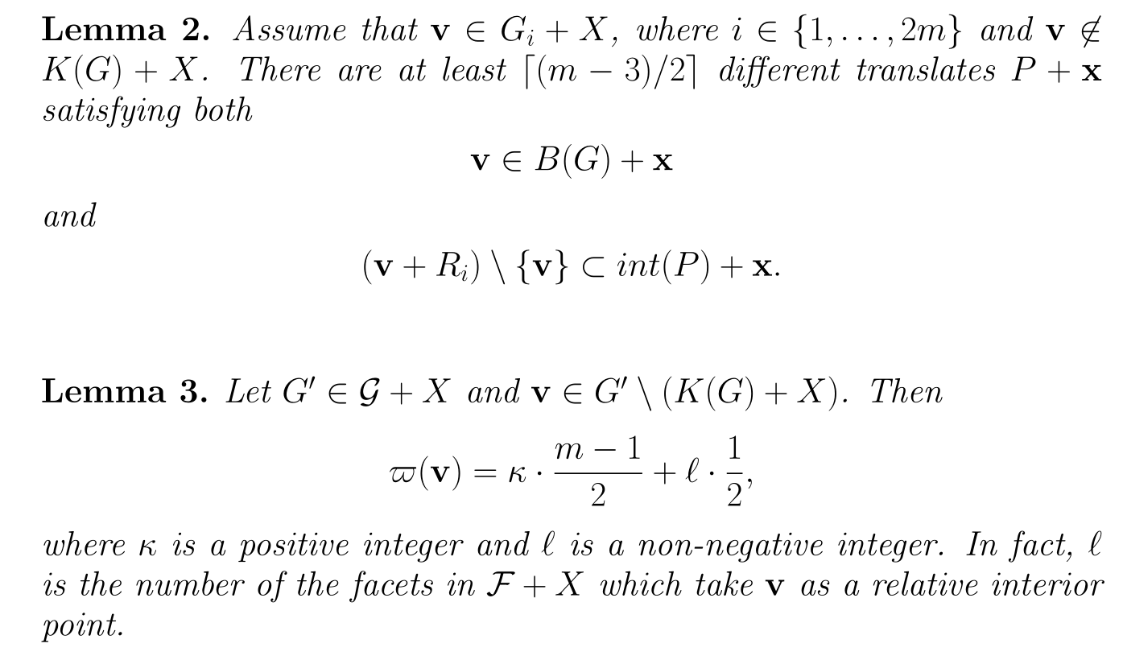

Slide 15
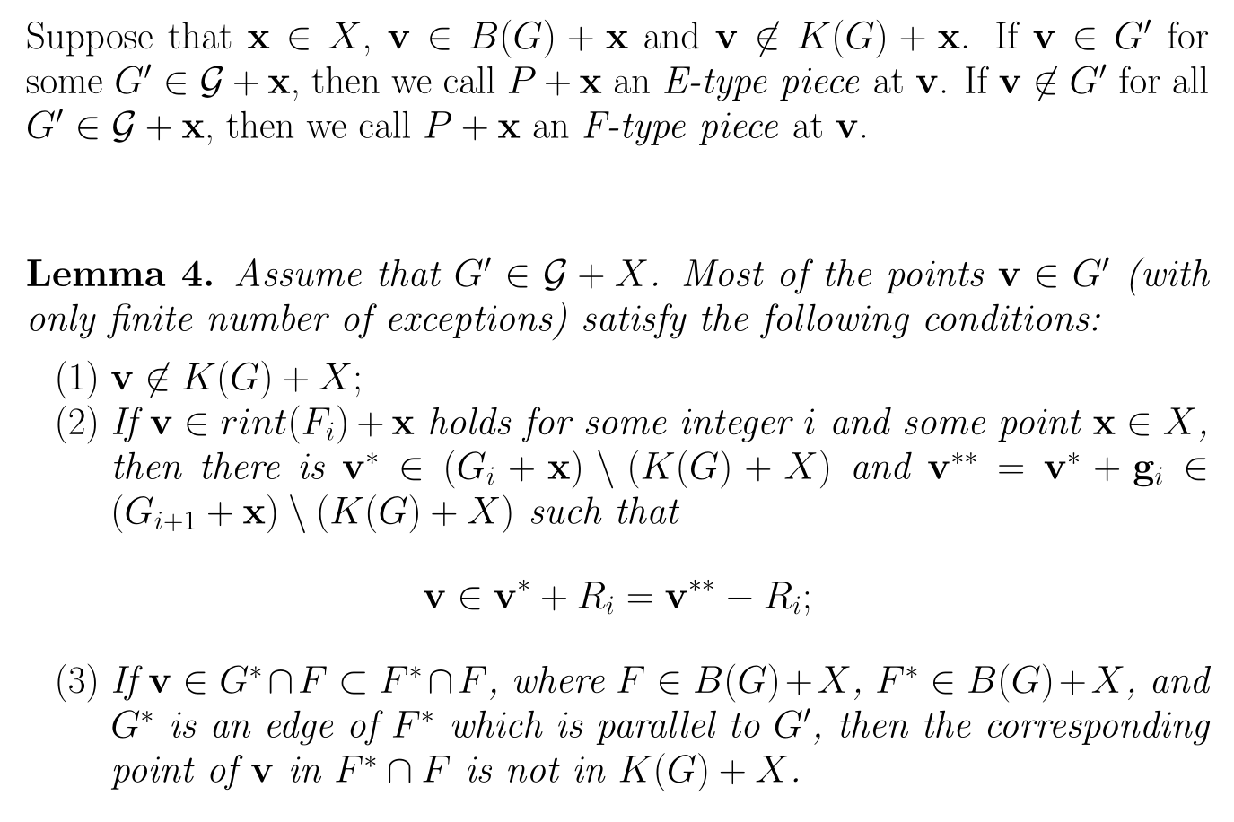

Slide 16
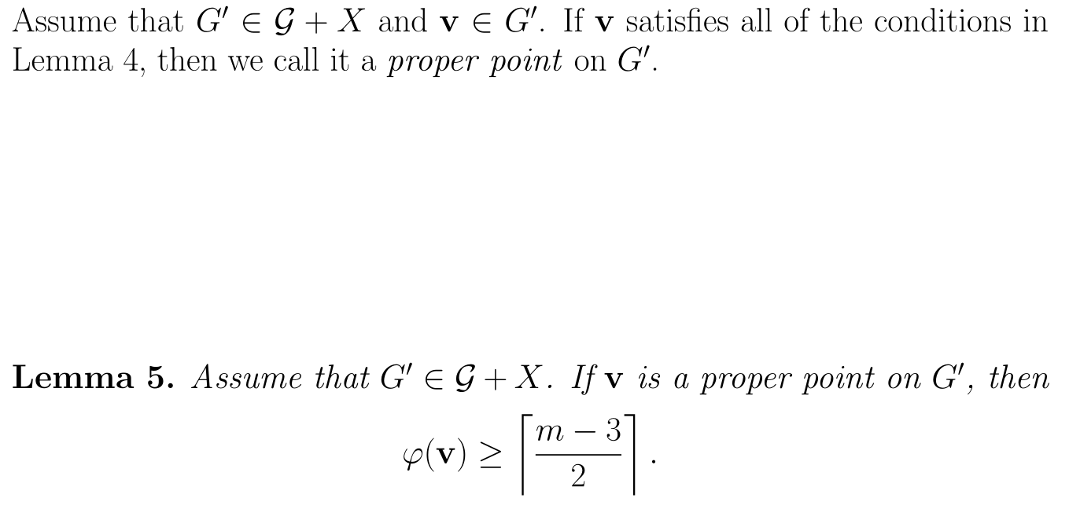

Slide 17
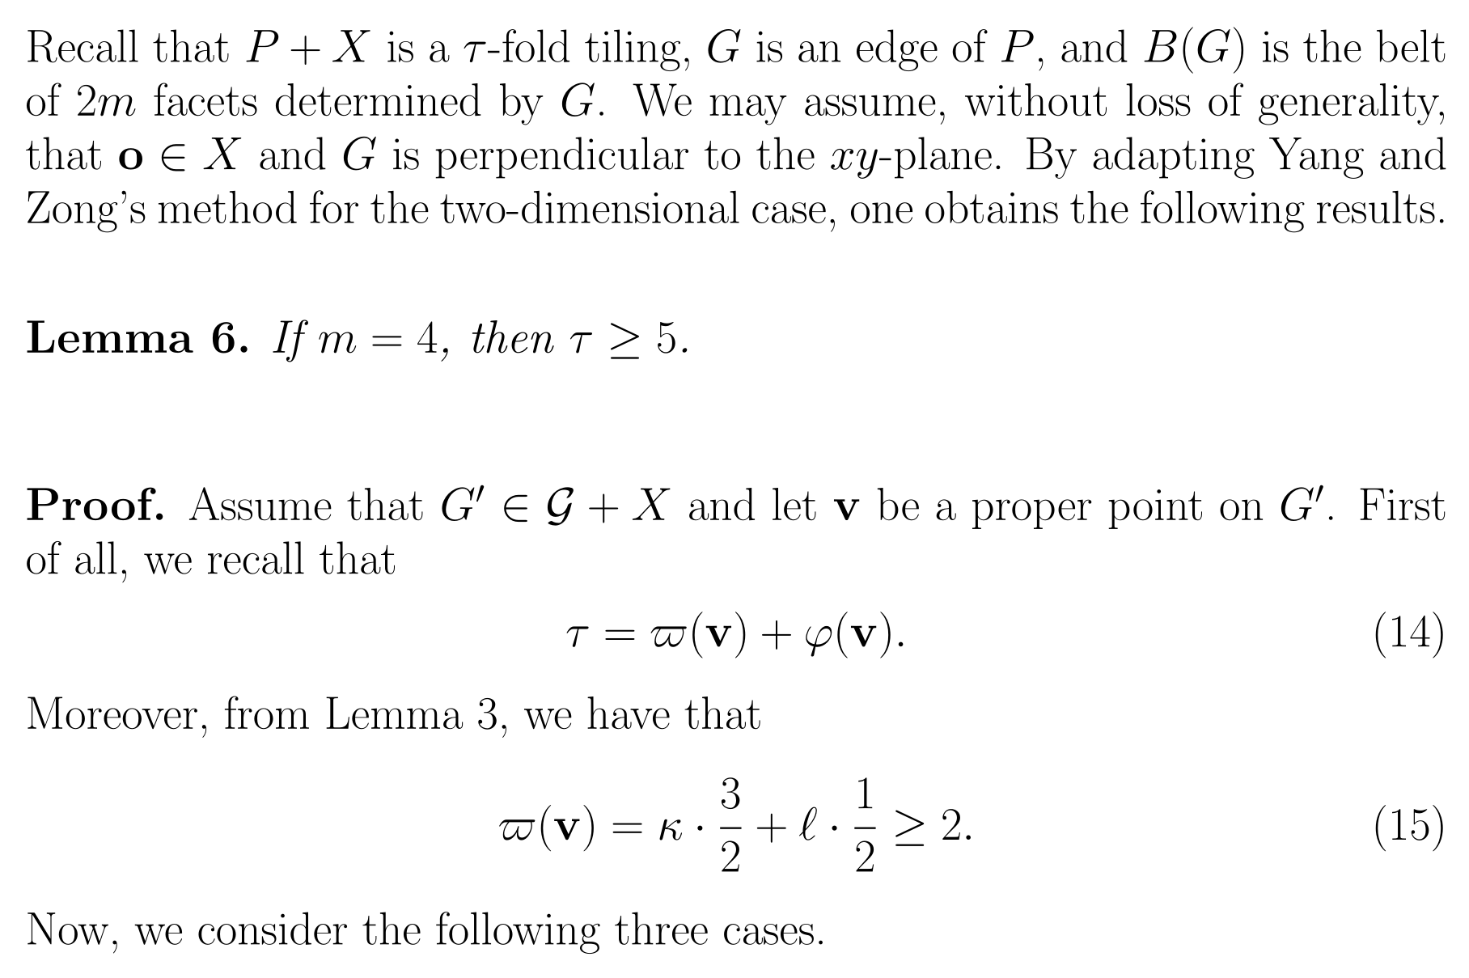
5、Proofs of the Main Results

Slide 18
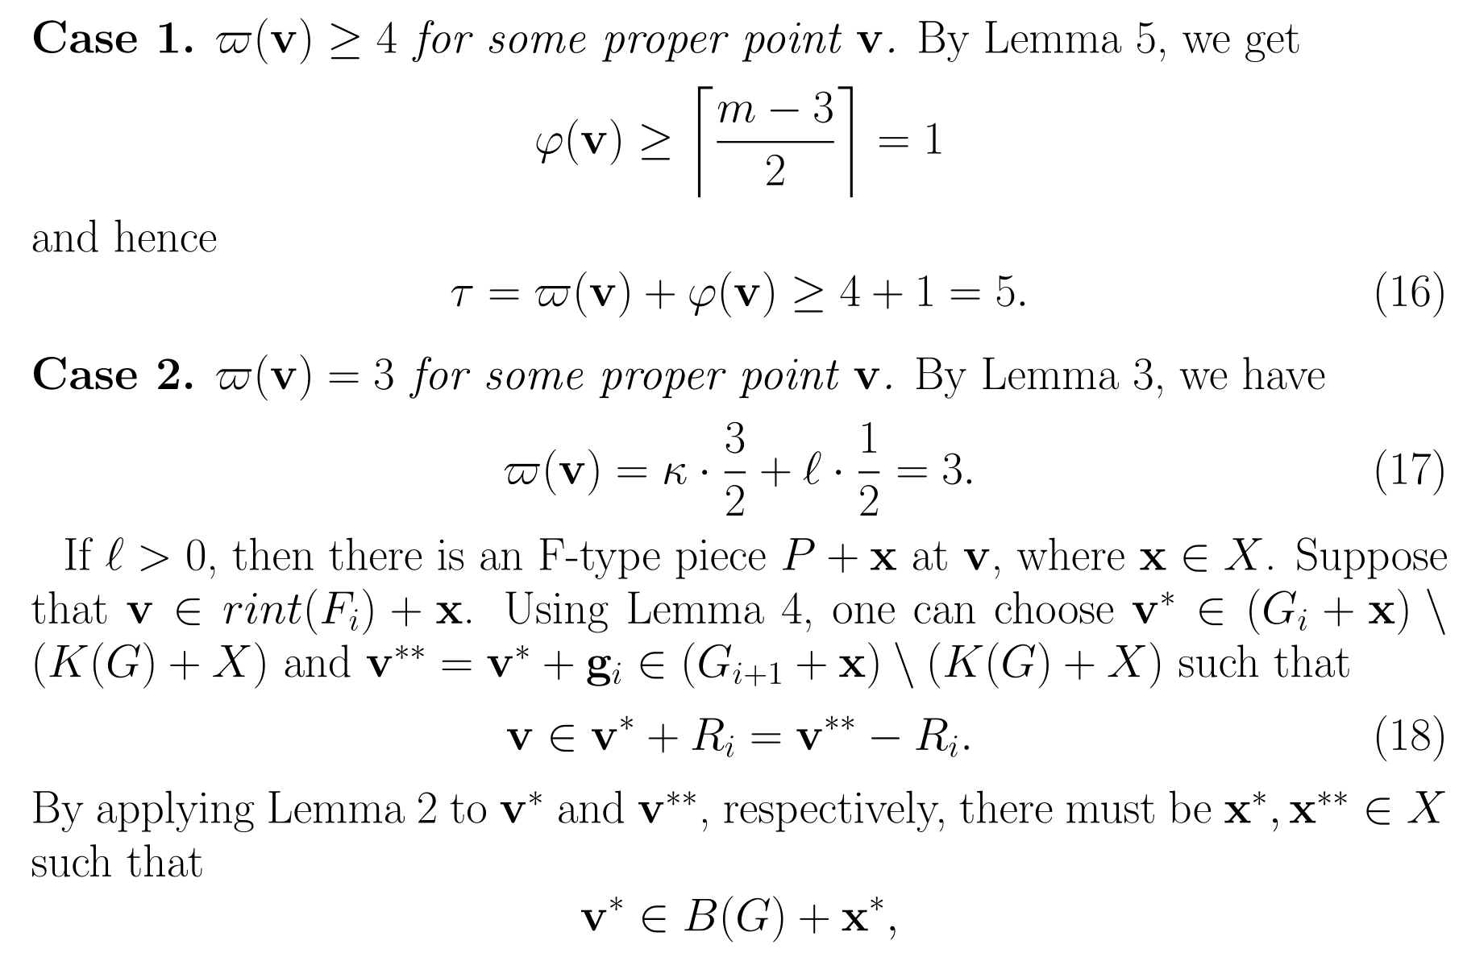

Slide 19
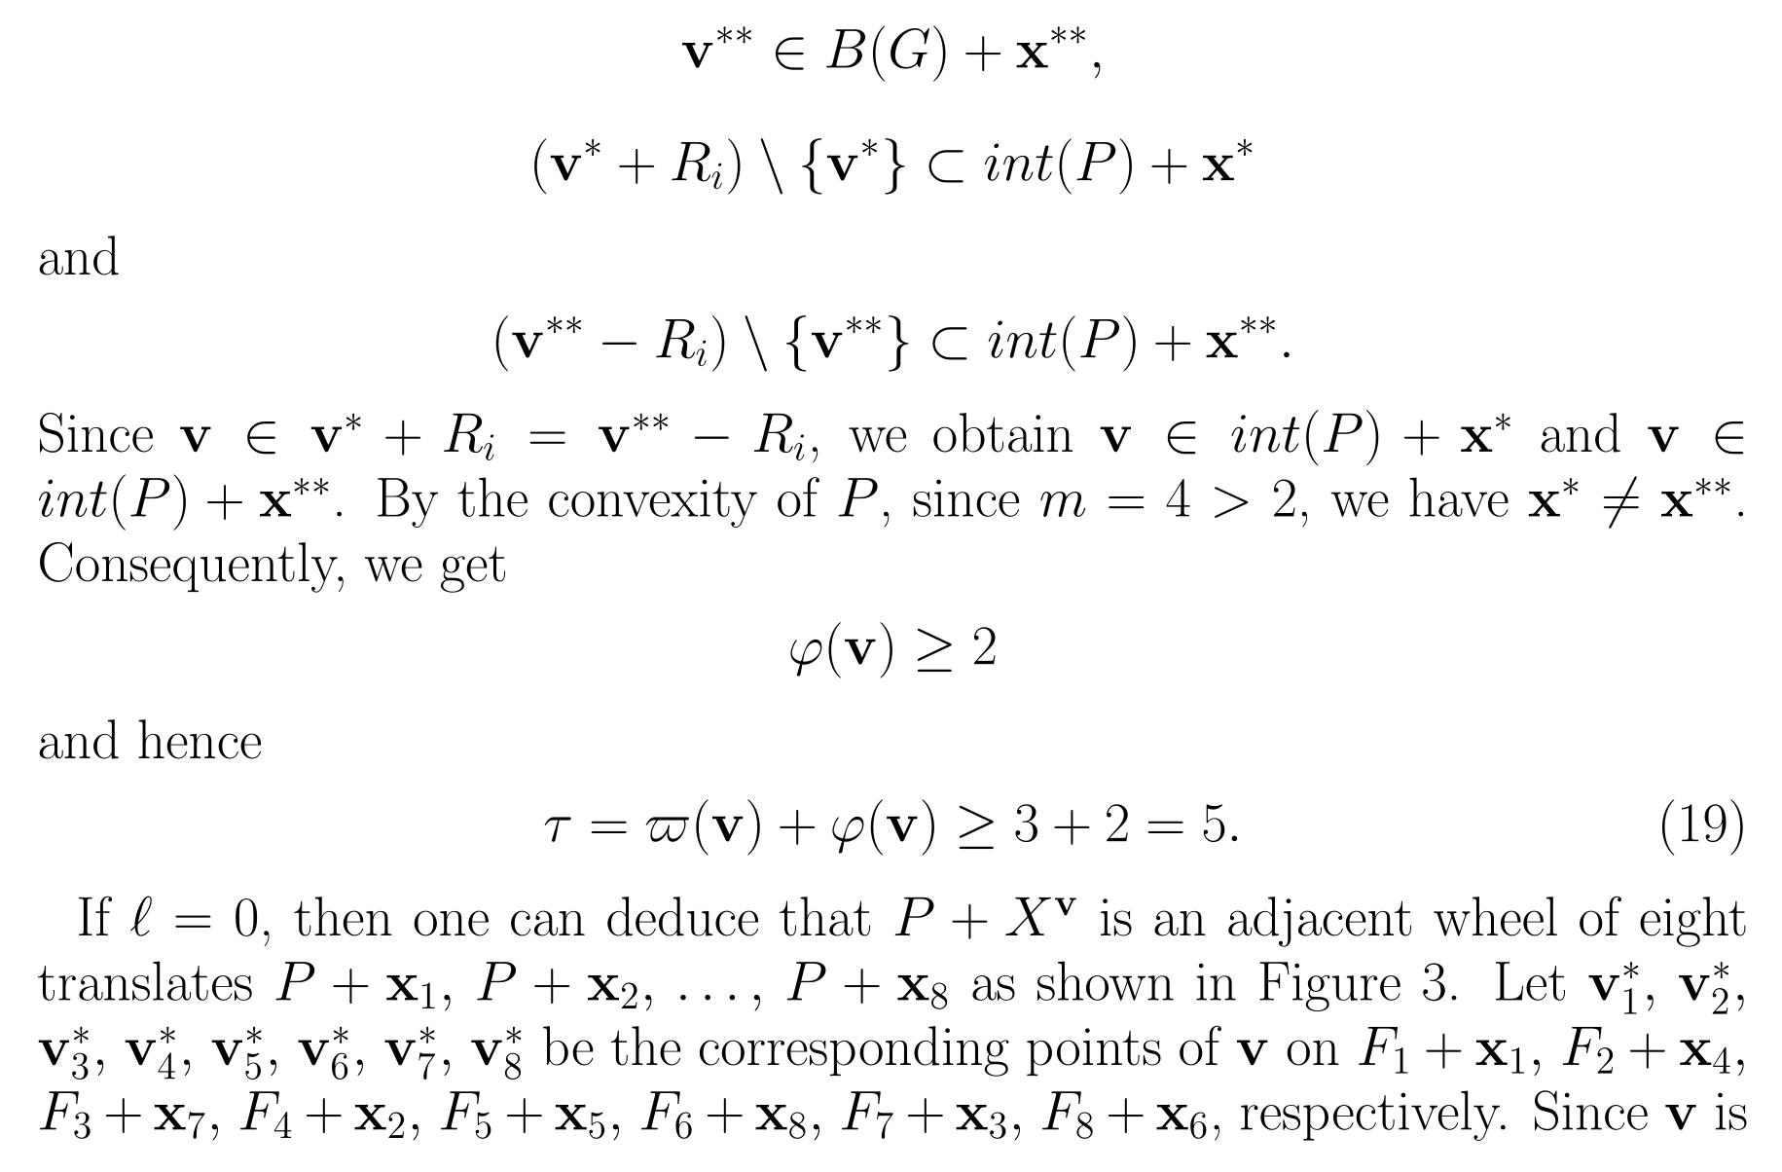

Slide 20
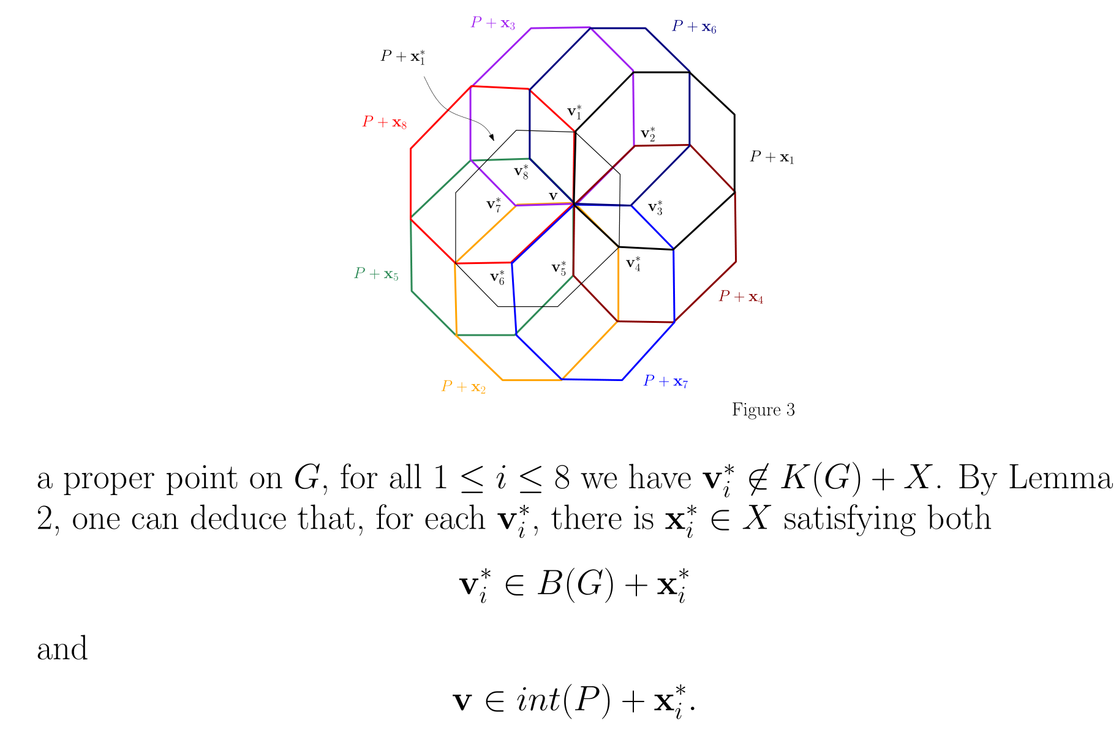

Slide 21
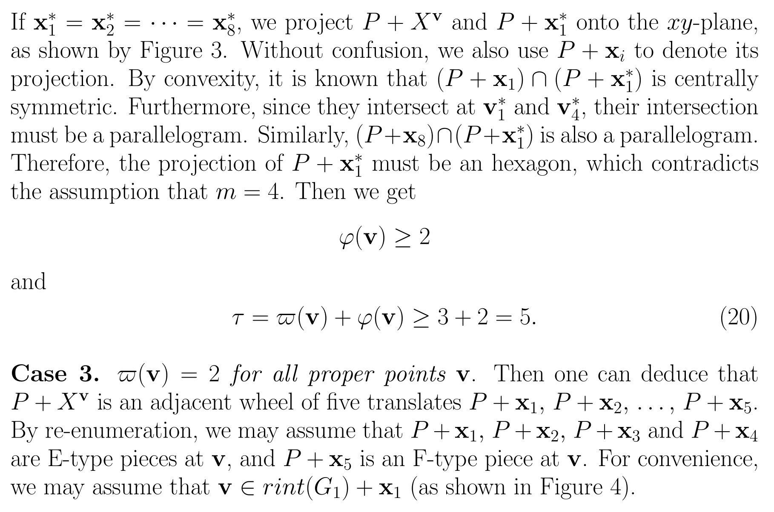

Slide 22
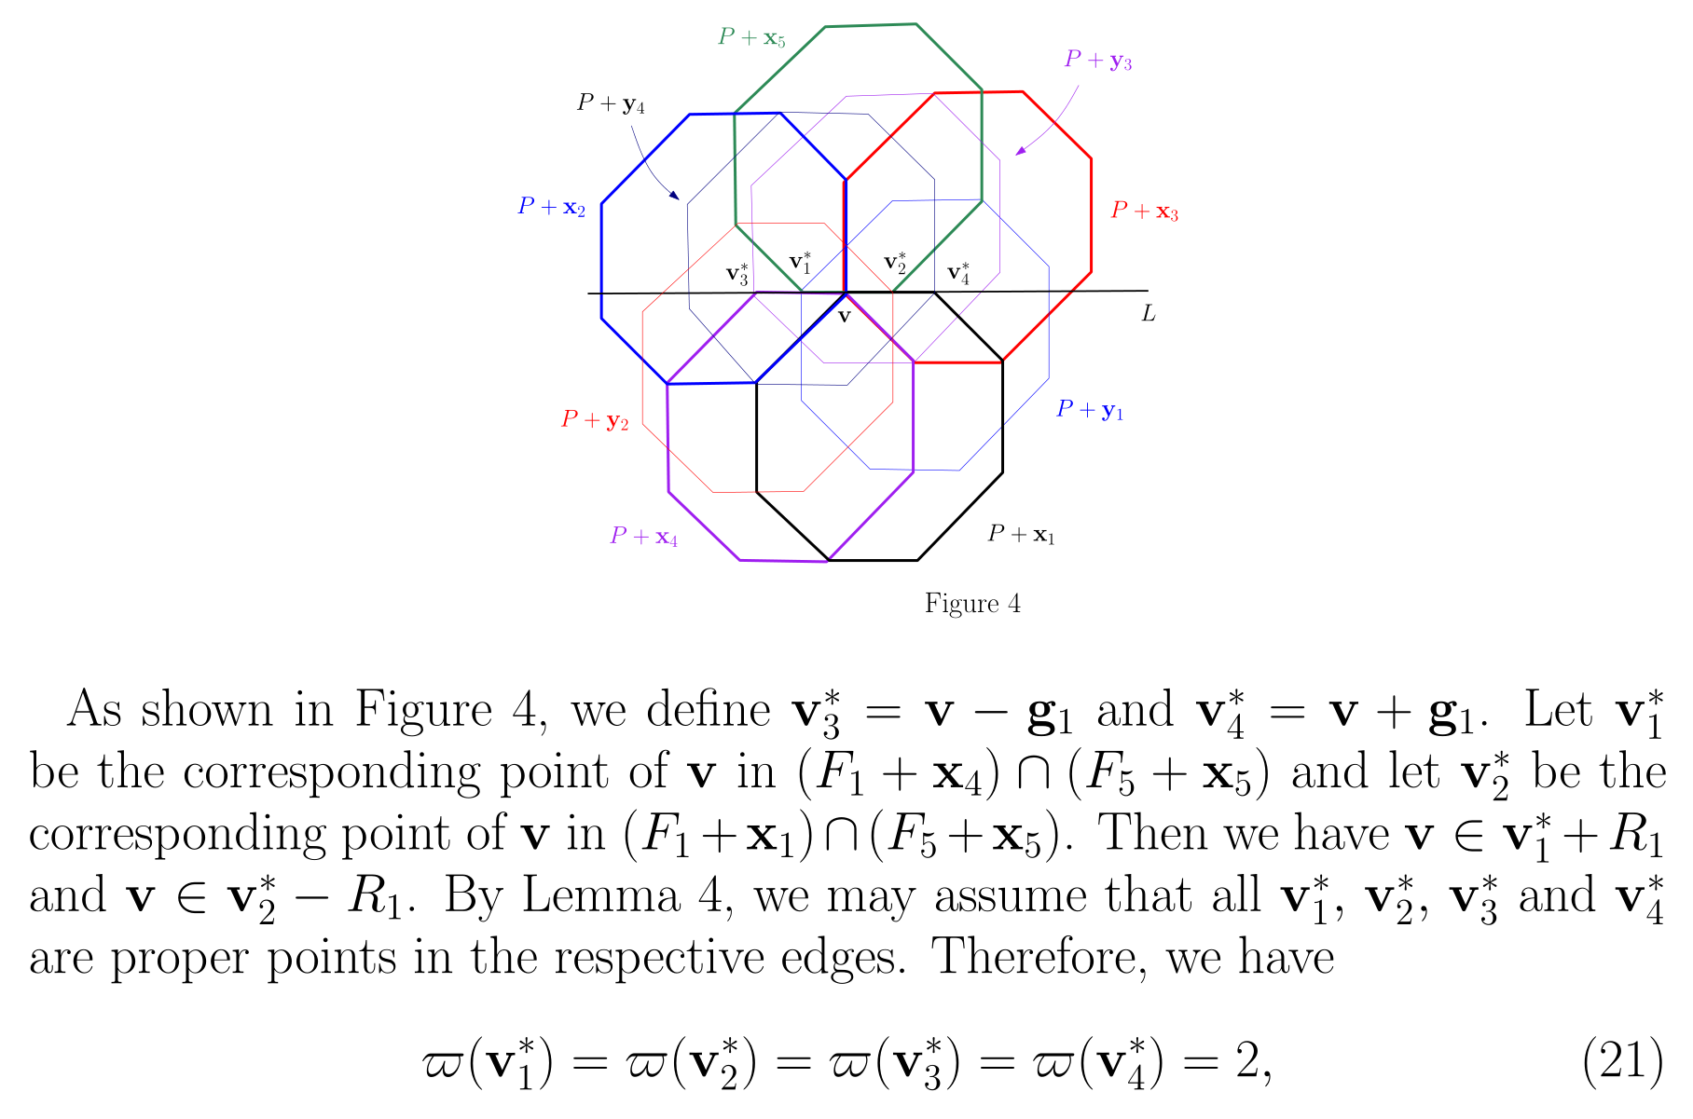

Slide 23
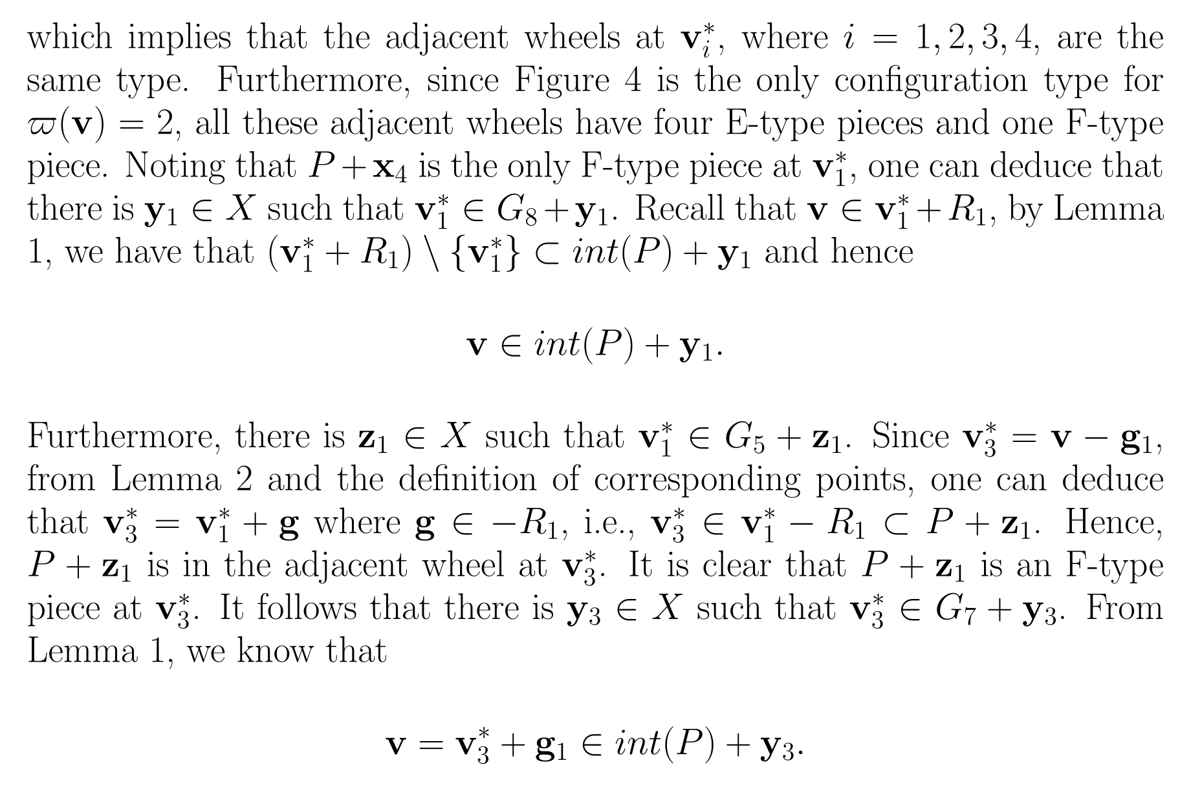

Slide 24
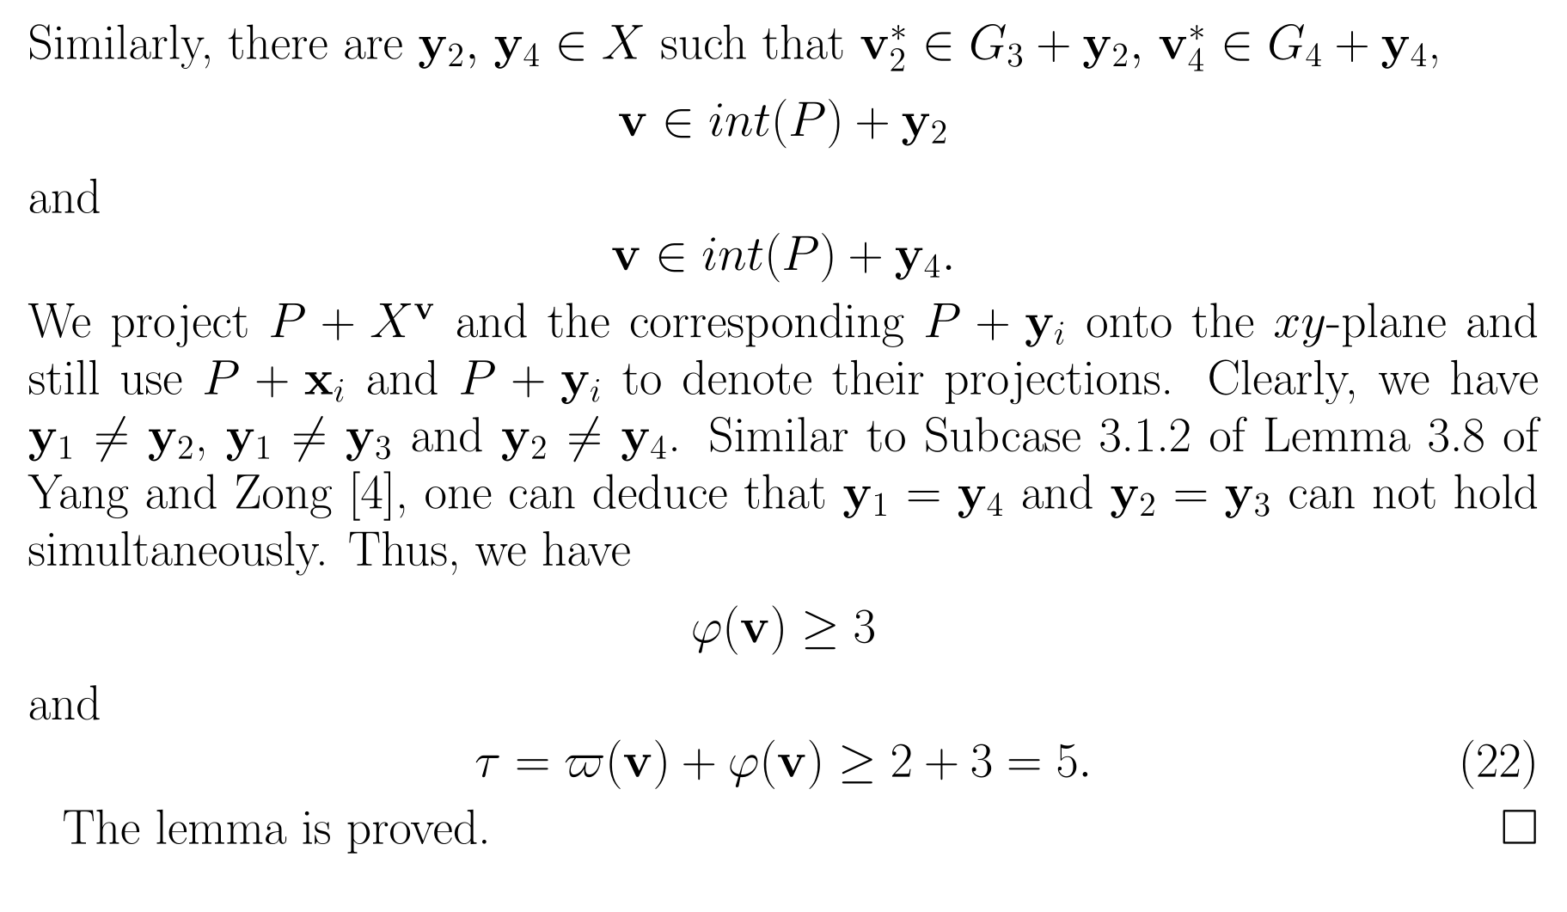

Slide 25
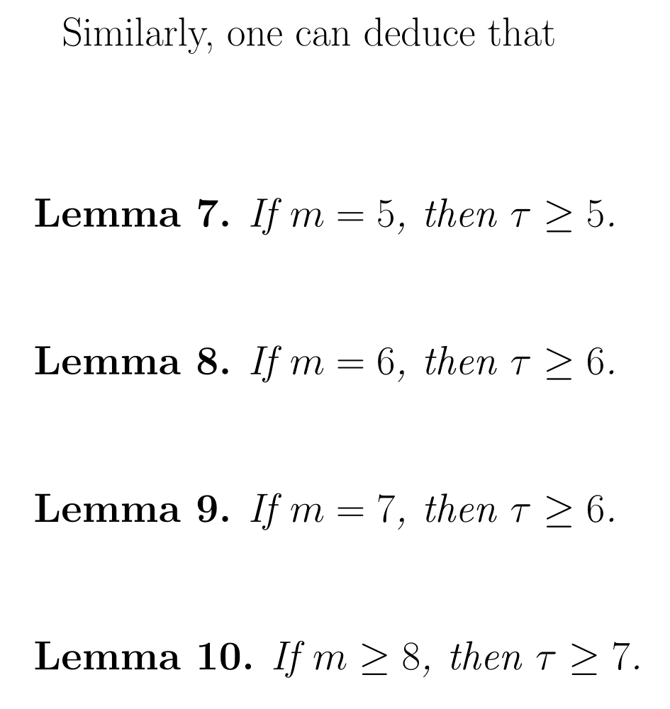
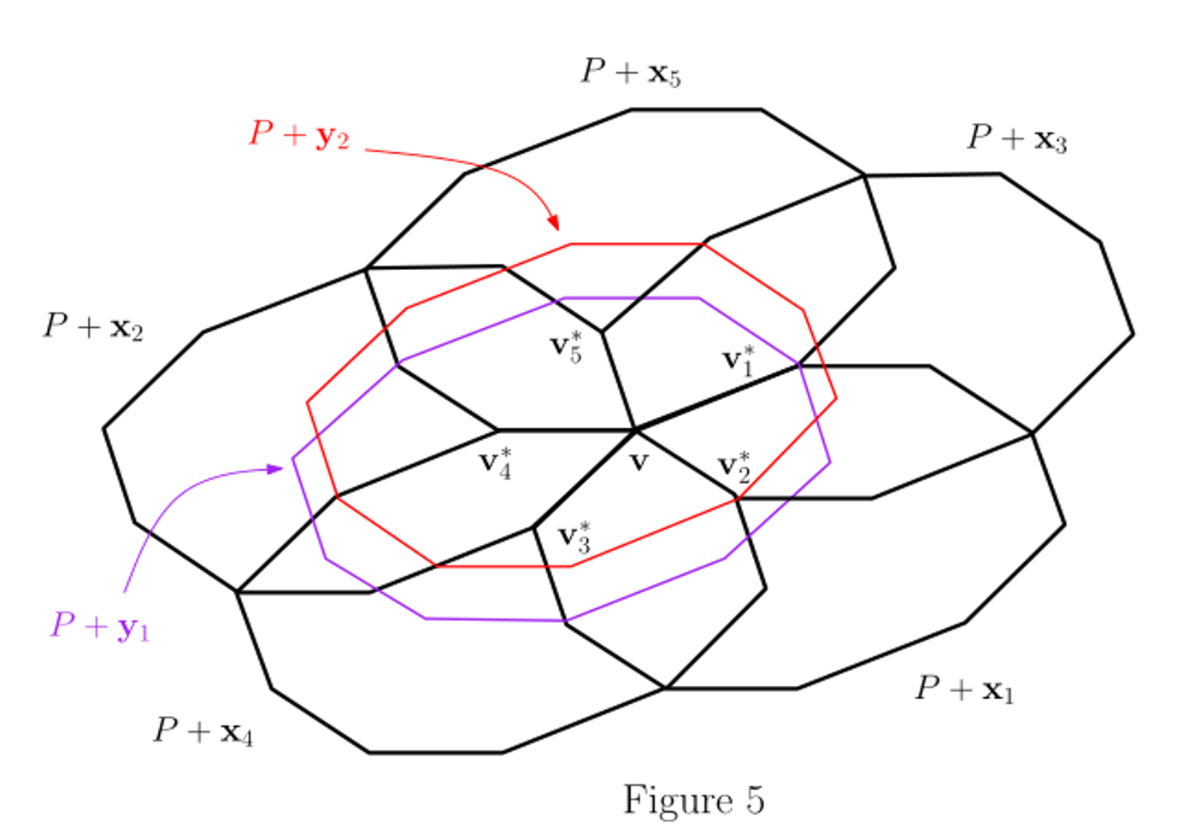
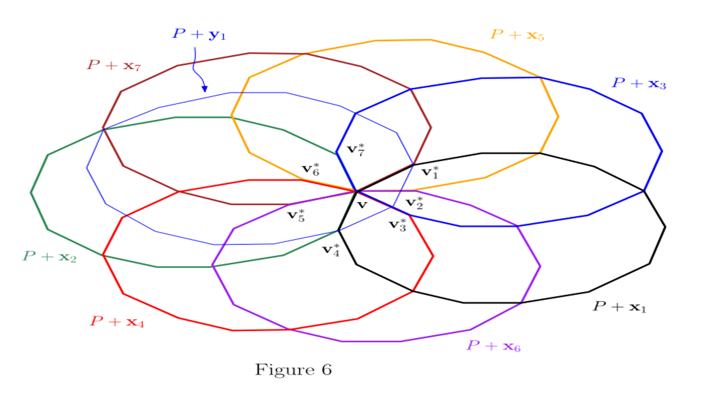

Slide 26
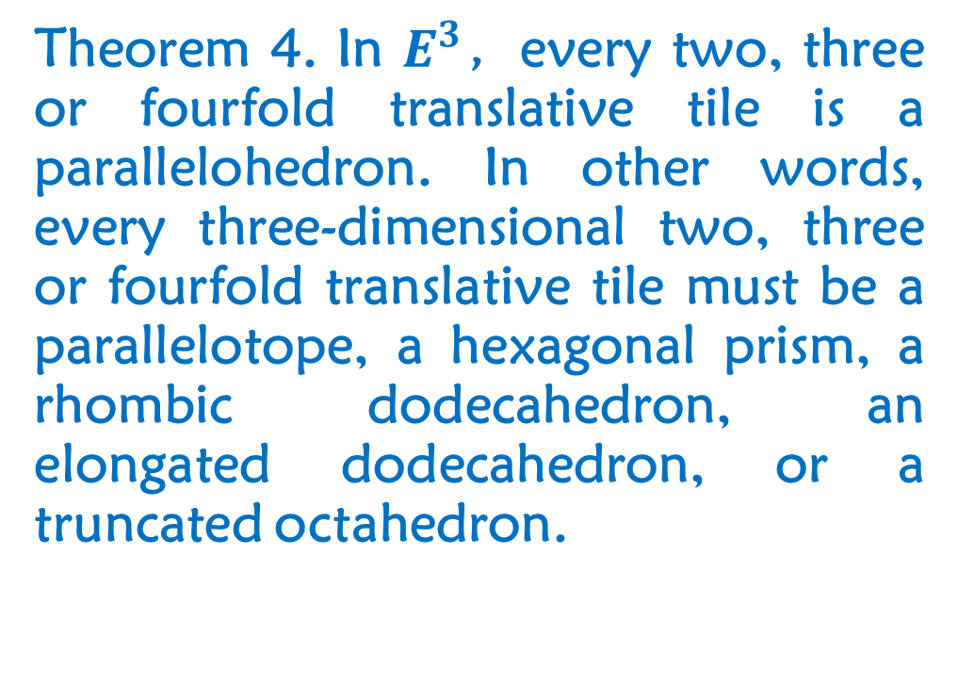
Based on previous theorems and lemmas, we have obtained the following theorems.
Theorem 4. In $E^{3}$，every two, three or fourfold translative tile is a parallelohedron. In other words, every three-dimensional two, three or fourfold translative tile must be a parallelotope, a hexagonal prism, a rhombic dodecahedron, an elongated dodecahedron, or a truncated octahedron.

Slide 27
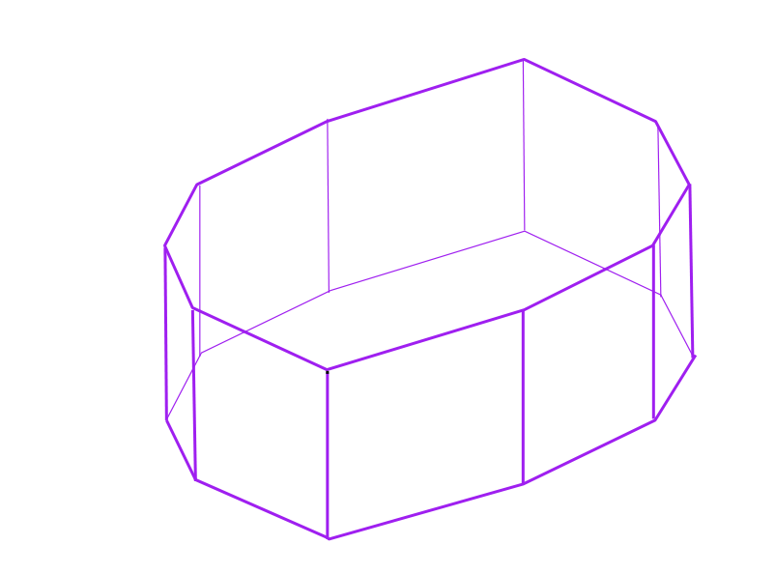
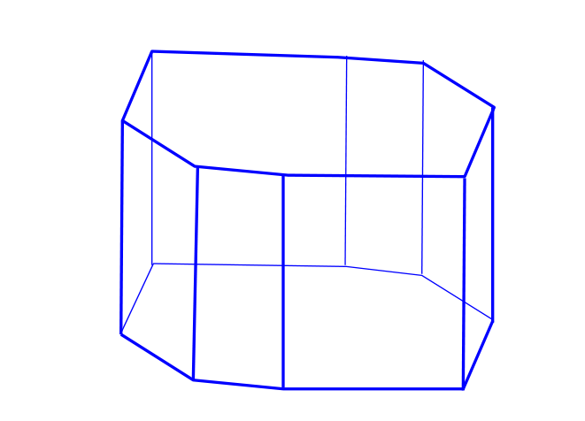
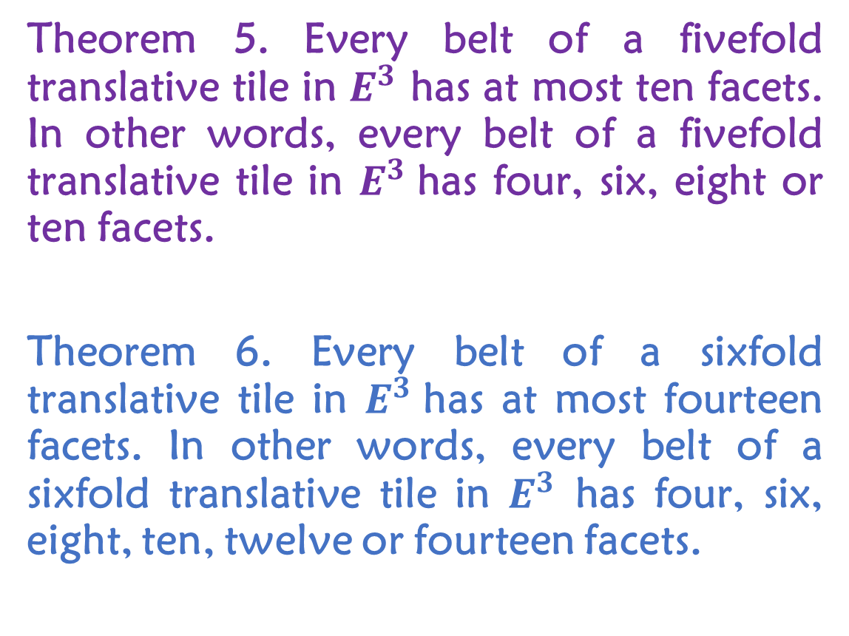
Theorem 5. Every belt of a fivefold translative tile in $E^{3}$ has at most ten facets. In other words, every belt of a fivefold translative tile in $E^{3}$has four, six, eight or ten facets.
Theorem 6. Every belt of a sixfold translative tile in $E^{3}$has at most fourteen facets. In other words, every belt of a sixfold translative tile in $E^{3}$ has four, six, eight, ten, twelve or fourteen facets.

Slide 28
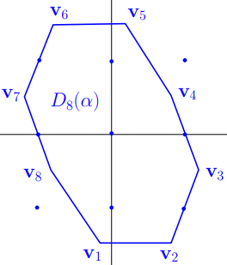
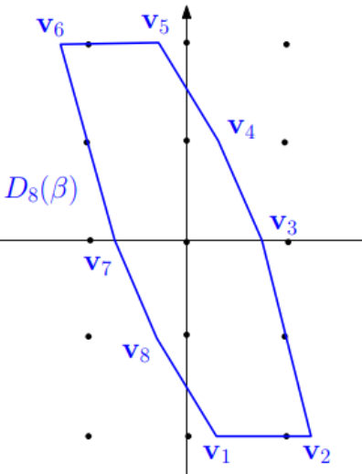
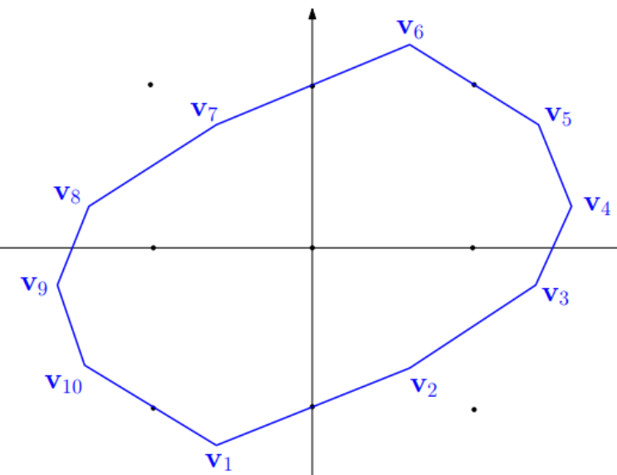
Problem 1. Characterize all the three-dimensional fivefold lattice tiles.
Problem 2. Characterize all the three-dimensional fivefold translative tiles.
Remark. All the two-dimensional fivefold translative tiles have been characterized by Yang and Zong [4].

Slide 29
References:
M. Han, K. Sriamorn, Q. Yang and C. Zong, The twofold translative tiles in three-dimensional space, arXiv:2106.15388.
M. Han, K. Sriamorn, Q. Yang and C. Zong, The three and fourfold translative tiles in three-dimensional space, arXiv:2109.07116.
Q. Yang and C. Zong, Multiple lattice tiling in Euclidean spaces, Canadian Math. Bull. 62 (2019), 923-929.
Q. Yang and C. Zong, Characterization of the two-dimensional fivefold translative tiles, Bull. Soc. Math. France 149 (2021), 119-153.
C. Zong, Can you pave the plane with identical tiles? Notices Amer. Math. Soc. 67 (2020), 635-646.
C. Zong, Characterization of the two-dimensional five- and sixfold lattice tiles, arXiv:1712.01122, arXiv:1904.06911.

