Slide 1
Network Autoregression for Incomplete Matrix-Valued Time Series Joint work with Feifei Wang, Renmin University of China, Zeng Li, Southern University of Science and Technology Yanyuan Ma, The Pennsylvania State University

Slide 2
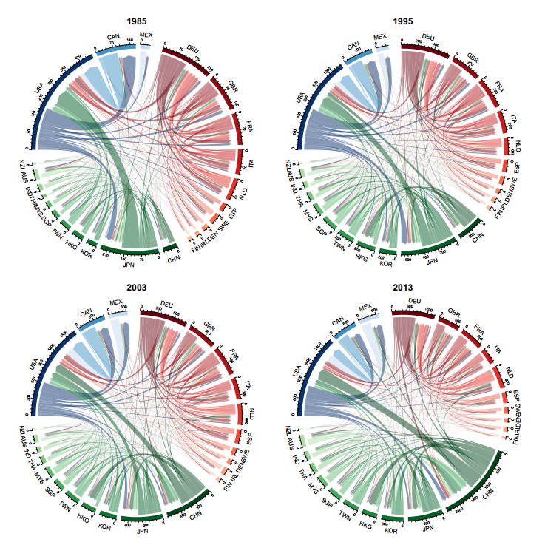
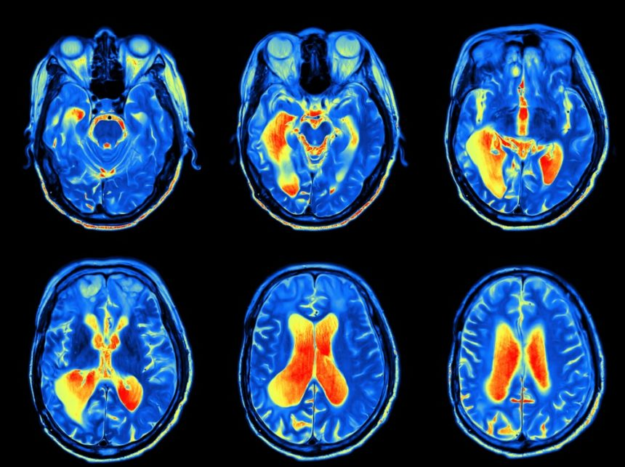
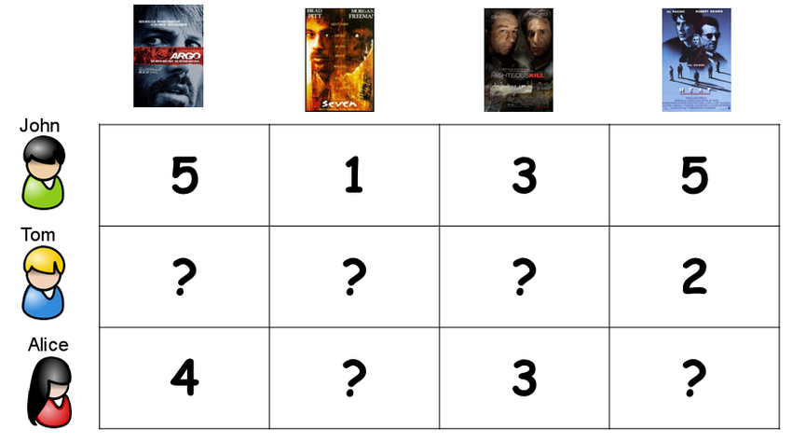
Matrix data
Image data
(fMRI data)
Trading volumes
(Chen and Chen, 2019)
User scoring system
(Mao et. al, 2019)
Our focus: Matrix time series data + Data missing

Slide 3
Literature review
Dynamics→Matrix time series modeling
Matrix factor models (Wang et al.,2019; Chen and Fan, 2021, Yu et al., 2021)
Matrix autoregression model (Chen et al., 2021; Wang et al., 2021)
Missing → Matrix completion
Multiple missing mechanisms (Koltchinskii et al., 2011; Cai et al., 2016; Mao et al., 2019)
Matrix data
Row subjects
$$X_{t}=RF_{t}C^{′}+E_{t}$$
Vectorization
Partially observed
Column subjects
Low rank

Slide 4
Summary
Matrix autoregression →
Need to estimate high dimensional matrices A and B if m and n are large
Reduce parameter dimension →
Use network relationships for row and column subjects respectively (Zhu et al., 2017)
Data Missing→
Need to estimate the unknown parameters and low rank structure simultaneously
Estimate the autoregression coefficients & low rank structure in presence of data missing

Slide 5
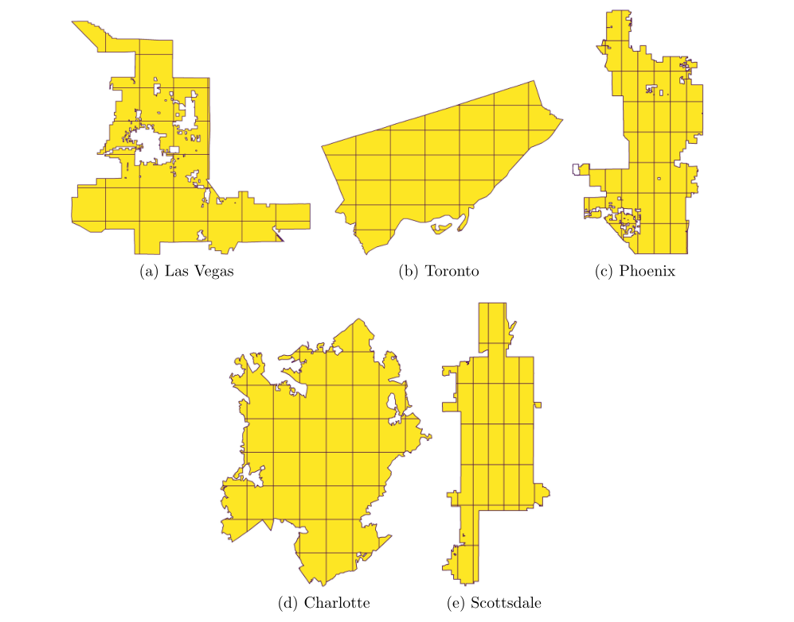
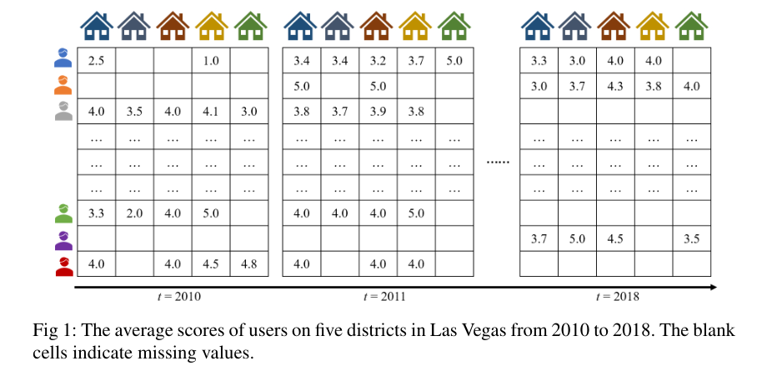
Network relationships
$$？$$
Network relationship:
User network
Location network
Data missingness
Users
Restaurants

Slide 6
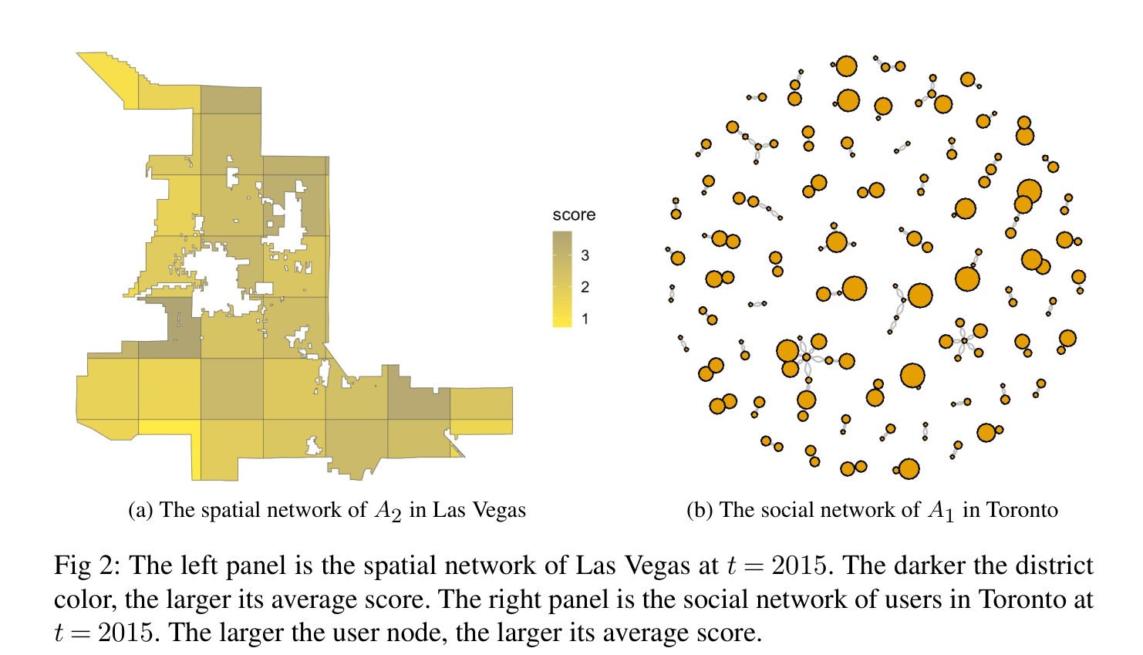
Spatial and network effects in Yelp dataset
$$\overline{Y}∈R^{269×49}$$
SVD
Rank = 12

Slide 7
Matrix network autoregression model (MNAR)
Response: $Y_{t}=\left(Y_{ijt}\right)∈R^{N_{1}×N_{2}}$
Missingness
e.g. the average rating of the i’th user to the j’th spatial region
Adjacency matrix: $A_{1}=(a_{1ij})$(User network); $A_{2}=(a_{2ij})$(Location network)
Row-normalized: $W_{1}=(a_{1,ij}/n_{1i})$ & Column-normalized $W_{2}=(a_{2,ij}/n_{2i})$
Row network
Column network
Covariate
Low rank
$$Λ=(λ_{1},⋯,λ_{N_{1}})$$
$$Γ=(γ_{1},⋯,γ_{N_{2}})$$

Slide 8
Model estimation
Full data objective function:
$$=\sum_{i,j,t}{Δ_{ijt}^{2}(θ)}$$
Profile estimation:
${\tilde{Δ}}_{ijt}\left(θ\right)=Δ_{ijt}\left(θ\right)−{\overline{Δ}}_{ij}\left(θ\right)={\tilde{Y}}_{ijt} −λ_{i}W_{1i⋅} {\tilde{Y}}_{⋅j\left(t−1\right),lag}−{\tilde{Y}}_{i⋅\left(t−1\right),lag}W_{2⋅j}γ_{j}$
and we minimize $\sum_{i,j,t}{{\tilde{Δ}}_{ijt}^{2}(θ)}$ to obtain the result.

Slide 9
Model estimation
Under data missing
Step 1: obtain estimates for $Λ$and $Γ$
$${\tilde{Δ}}_{ij}{\left(θ\right)}^{2}$$
$$Z_{ijt }=\frac{Y_{ijt}R_{ijt}}{p_{i}}$$
and we define $\tilde{Q}\left(θ\right)=\sum_{i,j}{{\tilde{Δ}}_{ij}^{c2}(θ)}$. One can verify $E\left({\tilde{Δ}}_{ij}^{c2}\left(θ\right)\right)=E({\tilde{Δ}}_{ij}{\left(θ\right)}^{2})$
We estimate the parameters by

Slide 10
Model estimation
Under data missing
Step 2: obtain estimates for $β$and $B$
Then we have

Slide 11
Estimation algorithm
Step 1: estimate $Λ$and $Γ$ iteratively
Step 2: estimate $β$and $B$
where $τ_{c}\left(Σ\right)=Udiag\left\{\left(σ_{i}−c\right)\right\}V$is a soft-thresholding function (here $Σ=Udiag\left(σ_{1},⋯,σ_{N}\right)V$)

Slide 12
Theoretical properties
Theorem 1
Define $\tilde{θ}={\left({\tilde{λ}}^{⊤}, {\tilde{γ}}^{⊤}\right)}^{⊤}$ and $m=N_{1}+N_{2}$
Convergence rate is related to m, T, and $c_{p}$ (observation probability)
Under certain conditions, for $c_{1}≤ \left\|η\right\|≤{\left\|η\right\|}_{1}≤c_{2}$ we have
$b_{1}$ is the asymptotic bias which can be reduced
where $b_{1}={\tilde{Σ}}_{2}^{−1}(b^{\left(1\right)}−r/(mT))$ and $r=2{\left(ν_{1}λ^{⊤},ν_{2}γ^{⊤ }\right)}^{⊤}.$ Further assume that $max\left(ν_{1},ν_{2}\right)=o(c_{p}^{−1}m{\left(\log\left(m\right)\right)}^{2K})$. Then we have ${\left\|b_{1}\right\|}_{∞}=O(c_{p}^{−1}{\left(logm\right)}^{2K}/T)$.

Slide 13
Theoretical properties
Theorem 2
Under the same conditions as in Theorem 1 and $ν_{3}=o(m)$ and $p=o(min\left(m, c_{p}^{3/2}mT^{1/2}\right))$. Then we have
Theorem 3
Convergence rate is related to:
m, $c_{p}$ and T,
Network dependence ${\left(logm\right)}^{K}$
Bias terms
Assume the same conditions as in Theorem 1. In addition, let $\frac{ν_{4}αΔ_{E,N_{1}N_{2}T}^{−1}}{N_{1}N_{2}}→∞$ and $p≪{m\left(c_{p}T\right)}^{1/2}$, where
Then we have
where $r_{B}$ is the rank of $B$

Slide 14
Bias reduction
Bias estimation:
Debiased estimator: $\hat{θ}=\tilde{θ}−\hat{b_{1}}$
Bias order:
${\left\|b_{2}\right\|}_{∞}={O_{p}(\left\|b_{1}\right\|}_{∞}^{2})$
After r’th debiasing, we have ${\left\|b_{r}\right\|}_{∞}={O_{p}(\left\|b_{1}\right\|}_{∞}^{r})$
Theorem 4
Under certain conditions, we have
where ${\left\|b_{2}\right\|}_{∞}=O(c_{p}^{−2}{\left(logm\right)}^{4K}/T^{2})$.

Slide 15
Including more abundant covariates
Row
Covariates
Column
Covariates
Interactive
Covariates
Main challenges:
Identification conditions √
Estimation procedure √
Estimation properties √

Slide 16
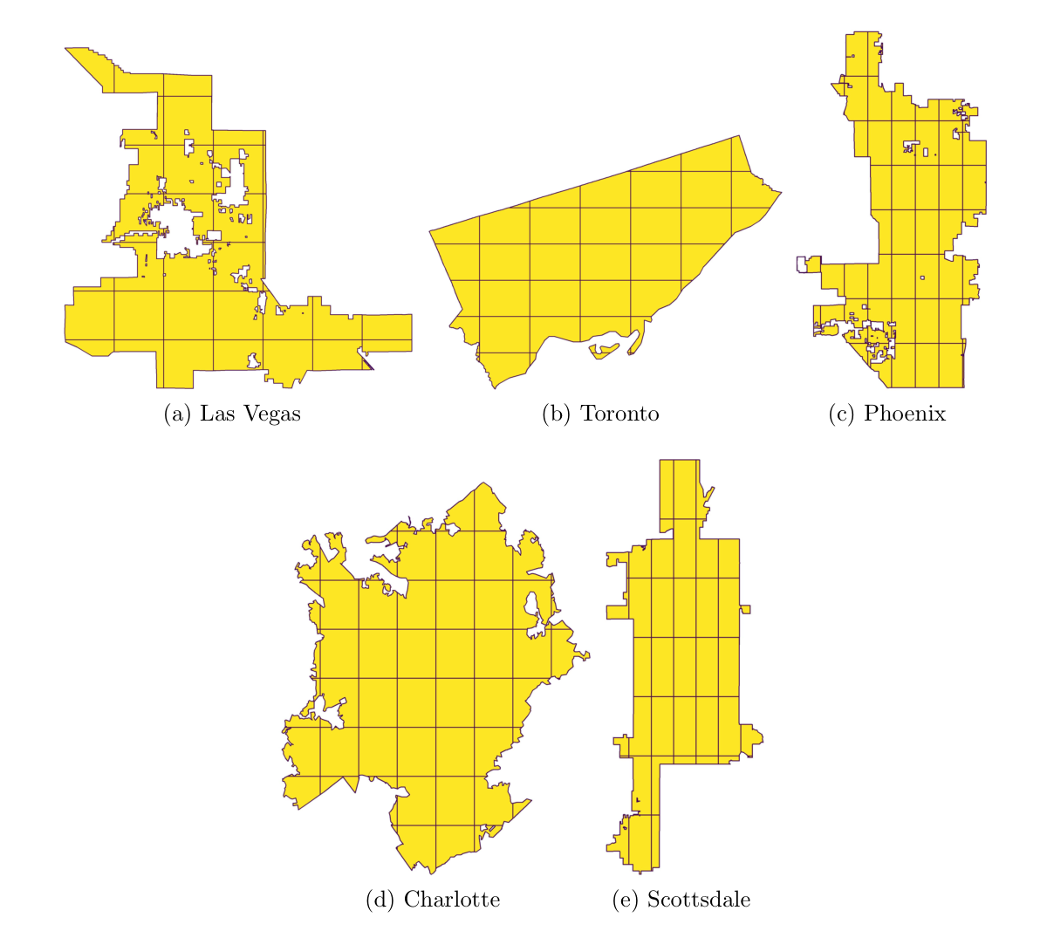
Yelp data analysis
Focus on five cities with most business shops
$Y_{ijt}:$ average score that user i comments on shops in district j during year t.
$R_{ijt}$: whether user i comment on shops in district j

Slide 17
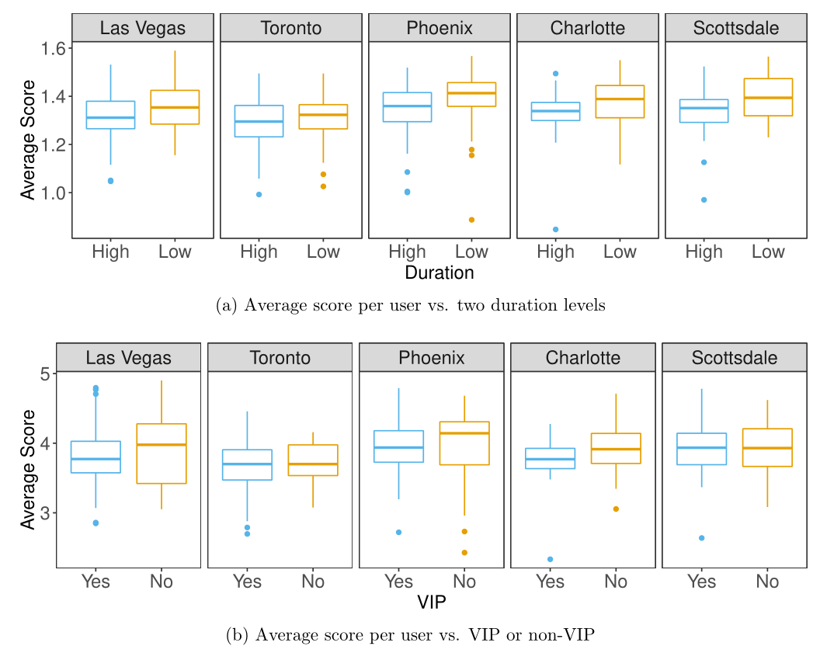
Yelp data analysis
Covariates:
Duration: Number of years from the user’s first registration on Yelp
VIP: whether the user is VIP or not
the cumulated number of “useful”, “cool”, and “funny” comments given by the users.

Slide 18
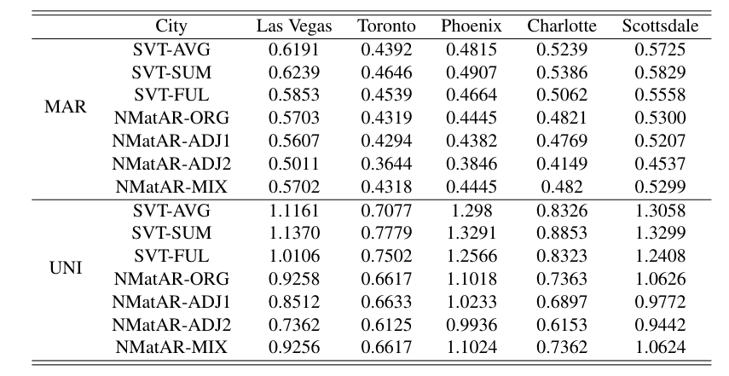
Yelp data analysis
Training data: t = 1,…, T-2; Validation: T-1; Prediction: T
Original
Debiased
SVT-FUL: use SVT for imputation at each time point then use our model.
SVT-MIX: fit the mixed type model.
SVT-SUM:
SVT-AVG: fit a SVT model at each time point and then take average

Slide 19
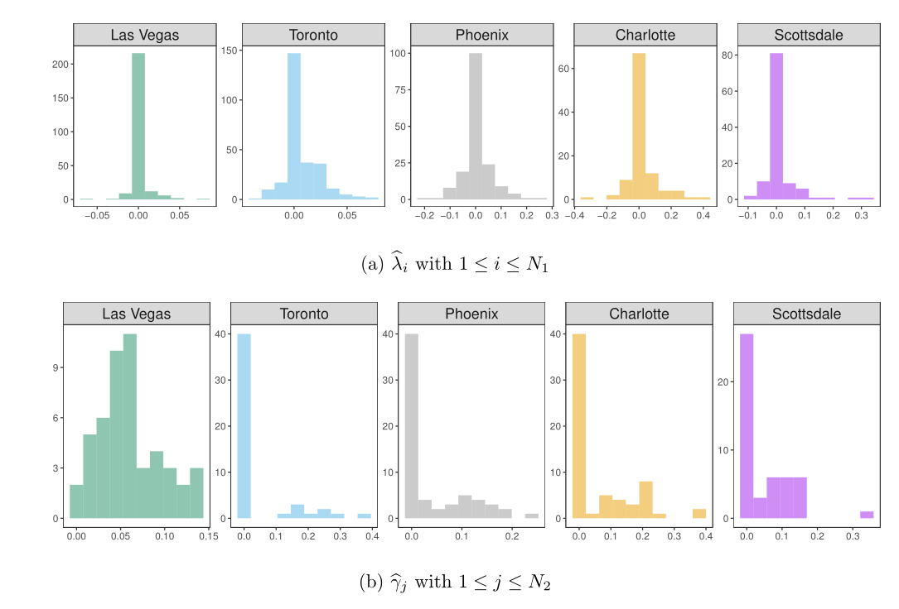
Yelp data analysis

Slide 20
THANKS

Slide 21
Identification Conditions
A cone containing matrices close to B
Local convexity
$=P_{𝕝}^{⊥}$ with no covariate information

Slide 22
Model Estimation
Objective function
Decomposition

Slide 23
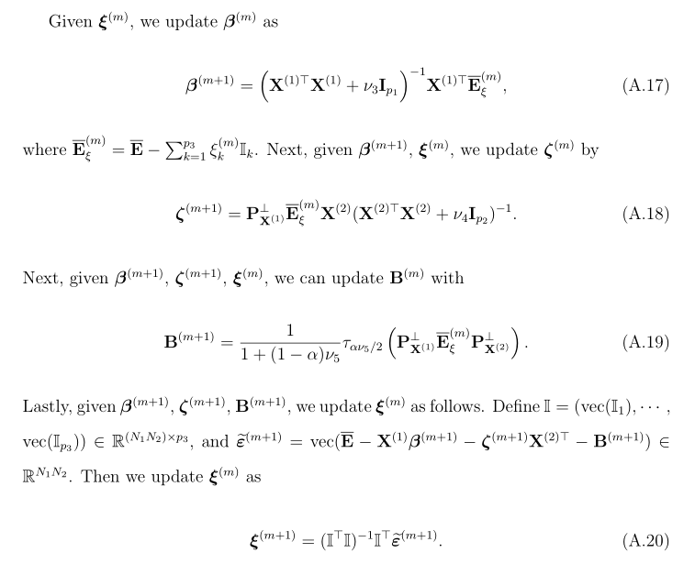
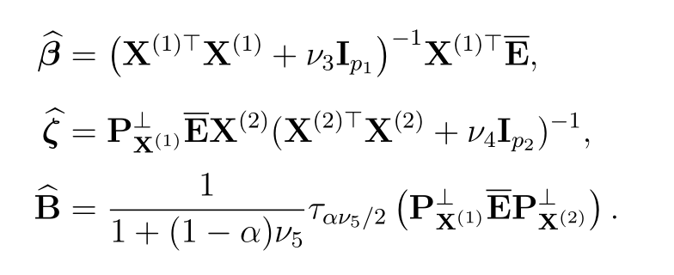
Model Estimation
With interactive covariates →iterated algorithm
Without interactive covariates →Analytical solution

Slide 24
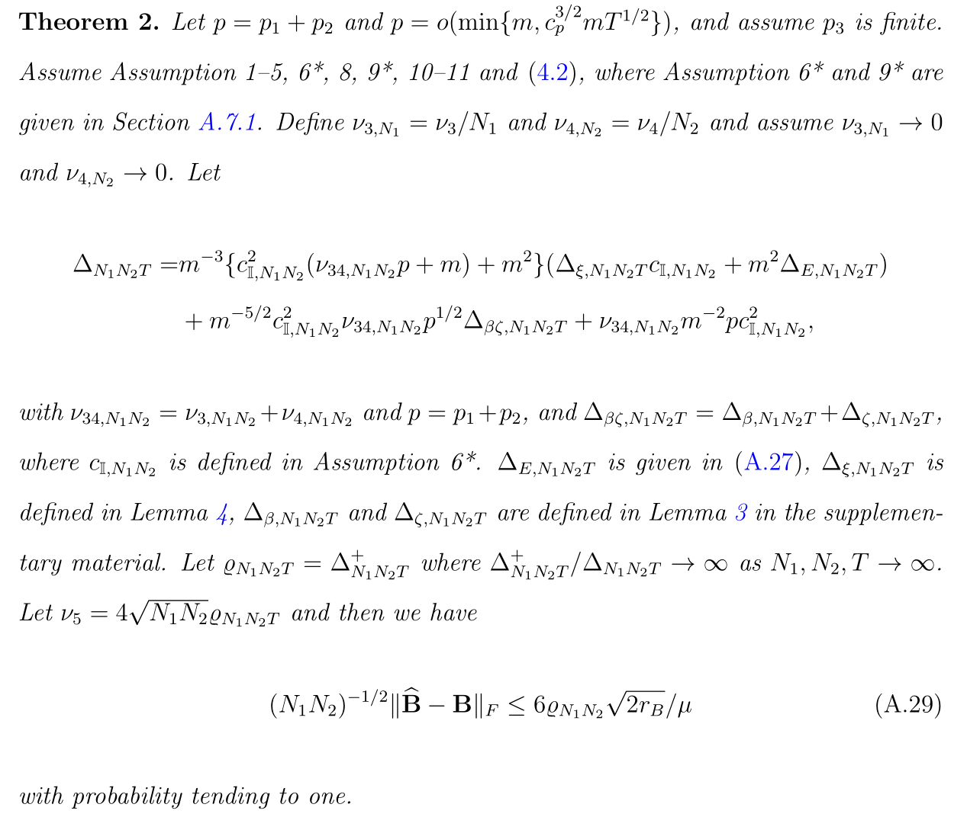
Estimation Properties
Error bound in the first step
Estimation error for $β$ and $ζ$ (profile estimator at true B)
Estimation error for $ξ$ (profile estimator at true B)
Singular value bound for $𝕀_{k}$

Slide 25
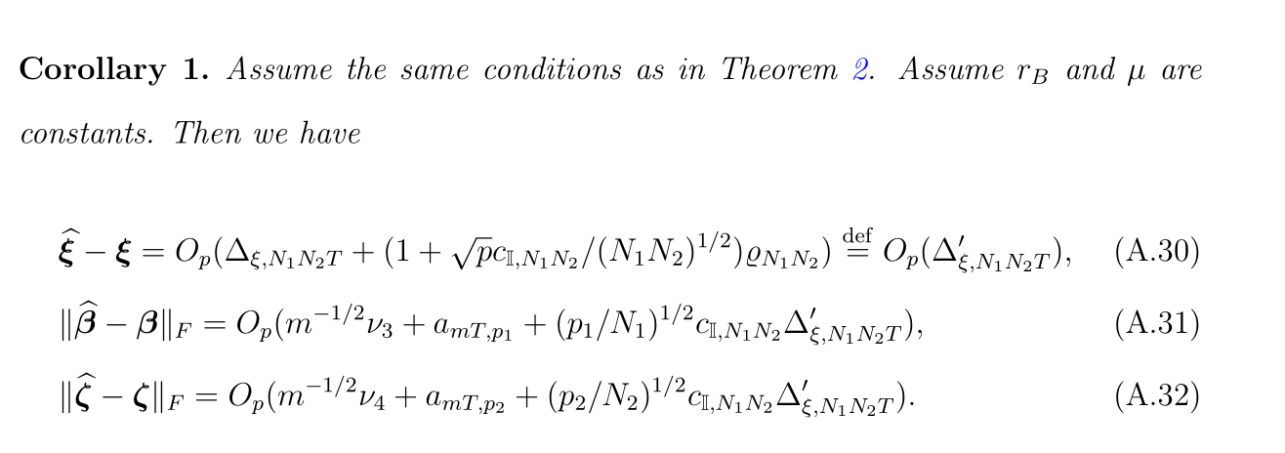
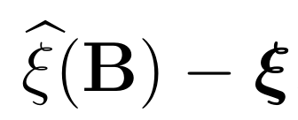
Estimation Properties

Slide 26
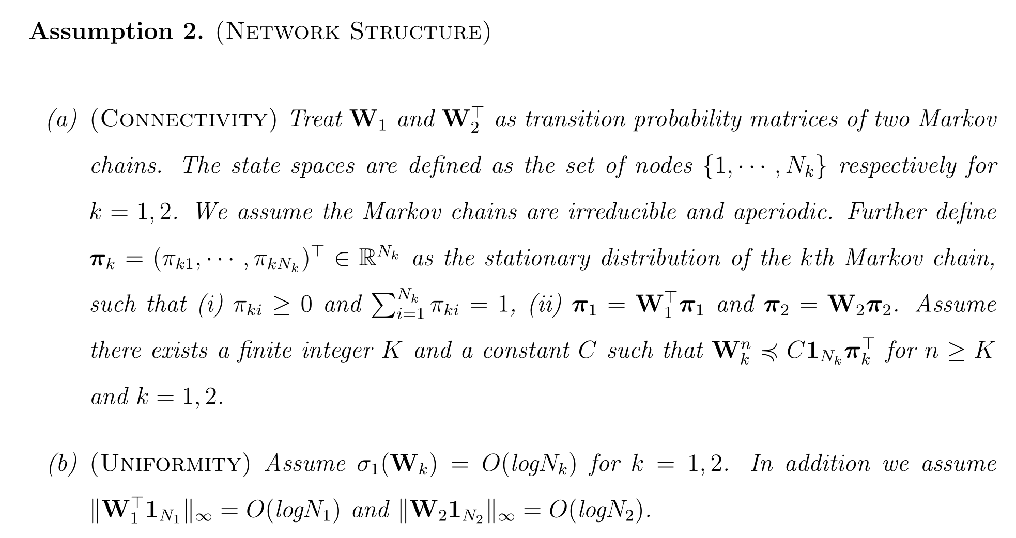
Theoretical properties
Markov chain converges to its stationary distribution
Uniformity for the node’s degrees

Slide 27
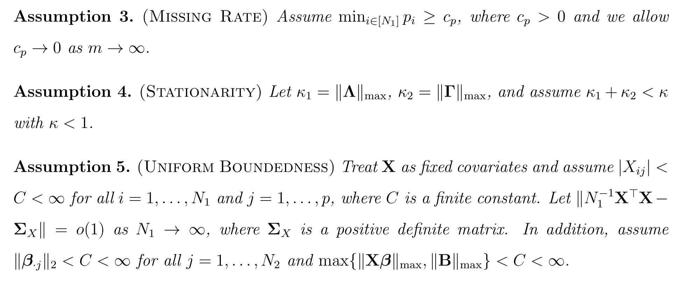
Theoretical properties
Observation rate is allowed to zero
Ensure stationarity

