Slide 1
Applications of the vortex-surface field to flow visualization, modeling and simulation
Vortex Dynamics: the Crossroads of Mathematics, Physics and Applications
IASM-BIRS Workshop, December 4, 2023, Hangzhou, China
Yue Yang
Department of Mechanics and Engineering Science
State Key Laboratory for Turbulence and Complex Systems
College of Engineering, Peking University
Tutorial Review： Y. Yang, S. Xiong, and Z. Lu, Flow, 3, E33, 2023

Slide 2
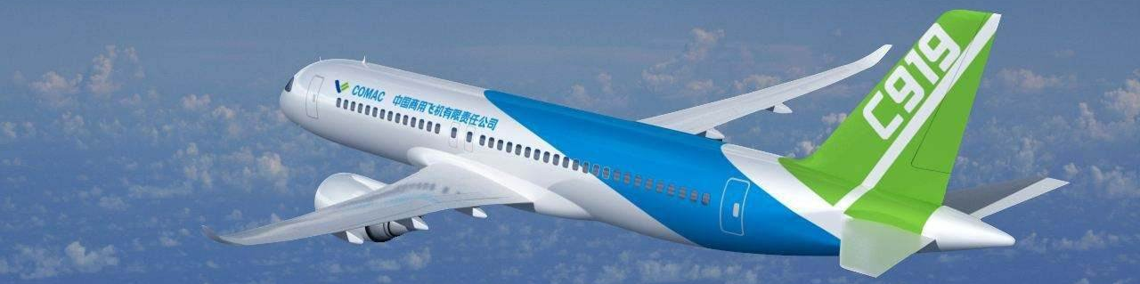
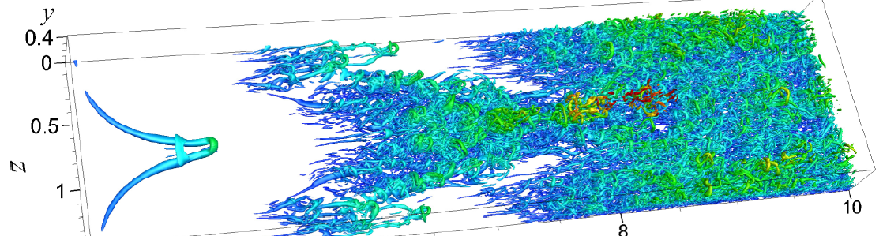
Introduction: coherent structures and vortex dynamics
Coherent structures are emerged in transition and turbulence
It is challenging to track specific structures and quantify their contribution to the variation of aerodynamic forces
(Picture from internet)
Simple
laminar flow
Complex
turbulent flow

Slide 3
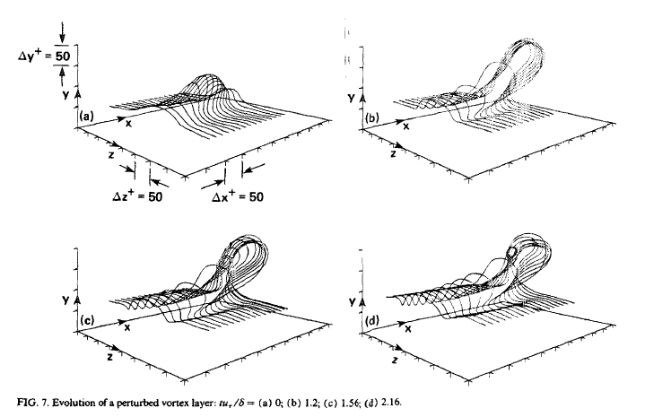
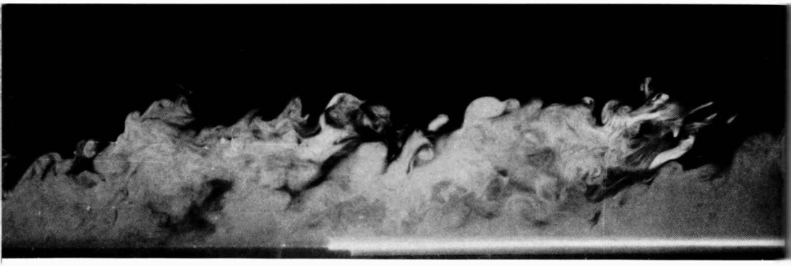
Methods of structure identification
Eulerian-based methods
Lagrangian-based methods
Vortex lines (Moin et al., 1986)
Isosurfaces of the vortex identification criterion
(Zhou et al., 1999)
Passive scalar (Falco, 1977)
Hyperbolic LCS (Green et al., 2007)

Slide 4
Objectives
Issues in current study of coherent structures/vortex dynamics
  No consensus on the vortex identification
  Lack of structure-based predictive models
Objectives of studying the vortex-surface field (VSF)
  Serves as a general flow diagnostic tool
  Inspire Lagrangian-based models and simulation methods
  Tackle the critical issues of vortex dynamics in turbulence and transition

Slide 5


Development of the vortex-surface field (VSF)
Spiral scalar structures in turbulence
(Yang et al., 2010)
Tangled vortex tubes in turbulence
(Xiong and Yang, 2019)

Slide 6
Outline of the VSF study
1. Theory and numerics
2. Flow visualization
3. Flow modeling
4. Flow simulation

Slide 7
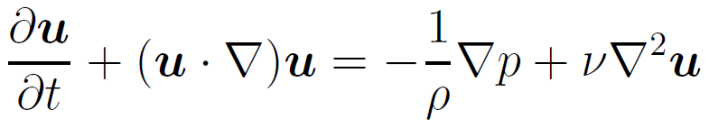
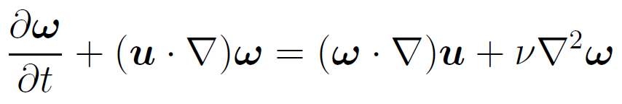
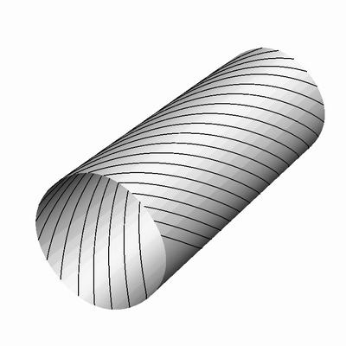
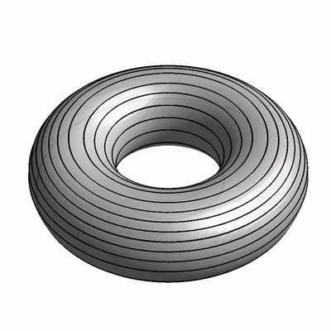
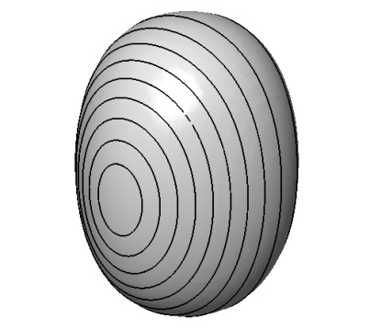
Vorticity and related global structures
Governing equation of fluid motion: Navier-Stokes equations
Vorticity ω = curl(u), and vorticity equation
Vorticity-based global structures (integral lines and surfaces)
Vortex line
Vortex surfaces

Slide 8
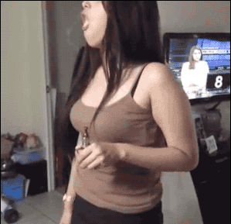
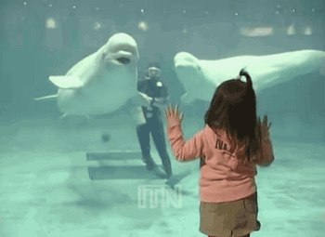
Evolution of a simple vortex ring
Early evolution of a vortex ring is similar to that of a rubber band
Vortex ring is stretched and twisted in a Lagrangian view
(Pictures from internet)

Slide 9
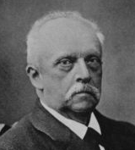
Breakdown of the Helmholtz theorem
Helmholtz theorem: vortex surfaces are material surfaces in inviscid flow
They cannot be exactly tracked in viscous flows
H. von Helmholtz (1821-1894)
Few study on the evolution of complete and smooth vortex surfaces in general three-dimensional flows before the development of VSF
Challenges exist in the initial construction and tracking in viscous flow
  Breakdown of the frozen motion of vortex lines in viscous flow
  How to identify vortex surfaces at different times in viscous flow?
Y. Yang and D. I. Pullin, J. Fluid Mech., 661, 2010； J. Fluid Mech., 685, 2011

Slide 10
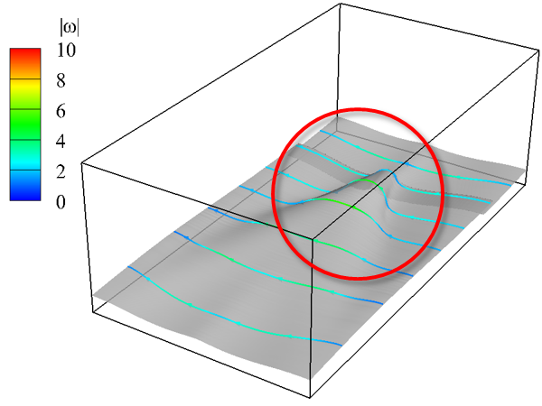
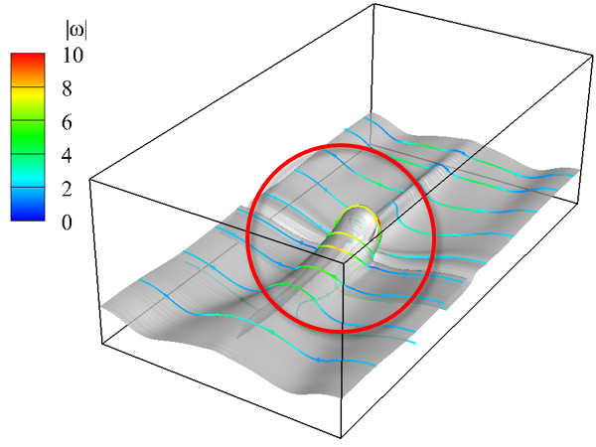
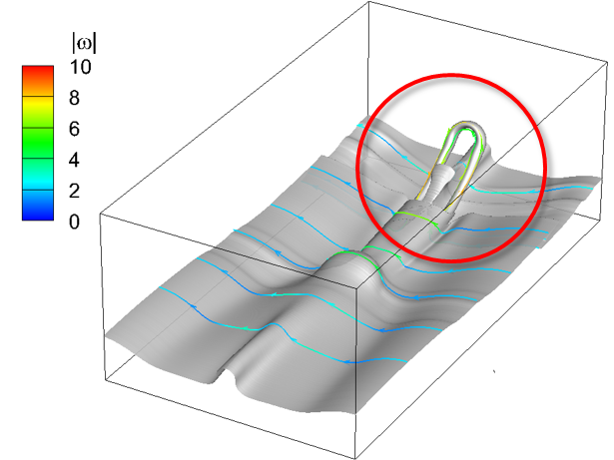
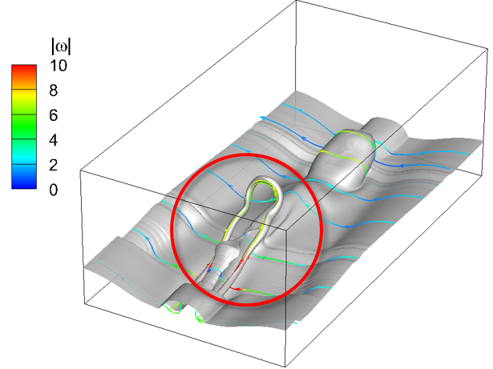
Vortex-surface field (VSF)
VSF is a Lagrangian-based structure identification method
Post-processing tool based on simulation and experimental data
VSF satisfies ω ∙▽φ_{v} = 0; each isosurface is a vortex surface
Has strong time coherence supported by vorticity theorems
Evolution of vortex surfaces in transitional channel flow
Y. Zhao, Y. Yang and S. Chen, J. Fluid Mech., 682, R4, 2016

Slide 11
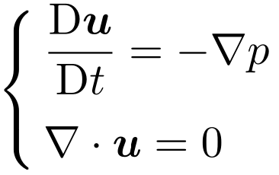
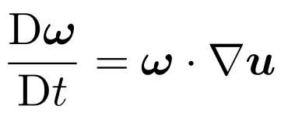
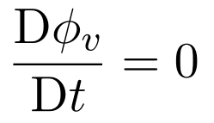
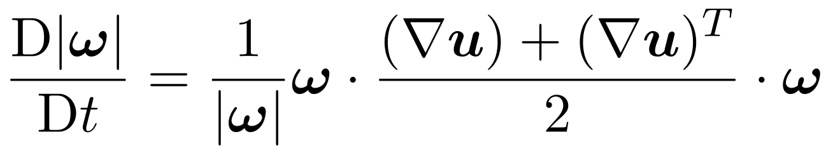
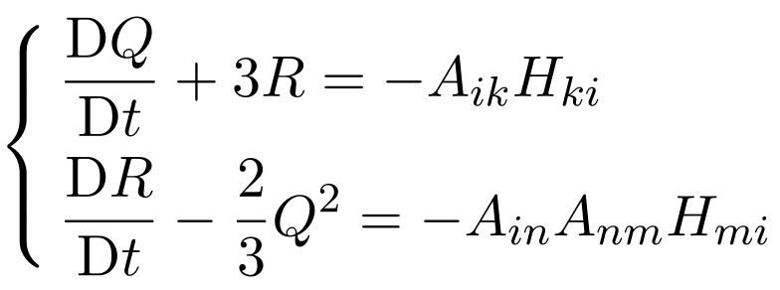
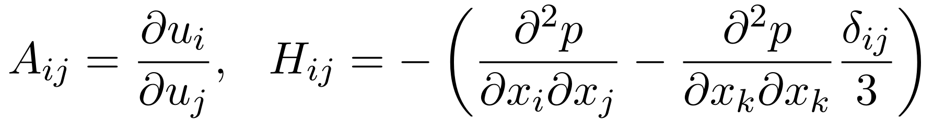
Simplify equation of the quantity for visualization
Velocity
Vorticity
VSF
Vorticity mag.
Q criterion
Complexity of equation
eliminate non-local pressure
conserved Lagrangian
scalar in ideal flows

Slide 12
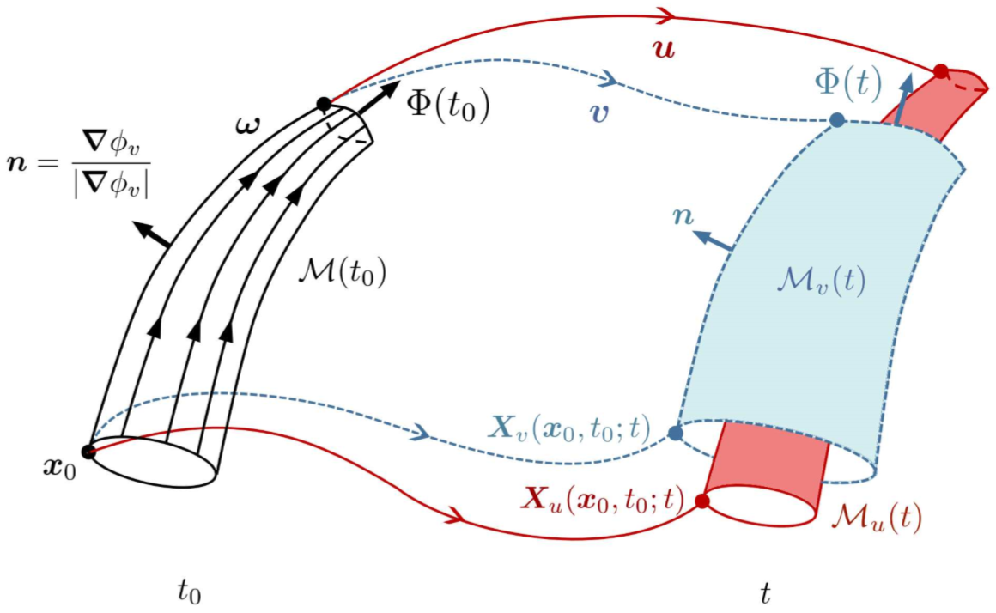
Tracking vortex surfaces in viscous flows
Track vortex surfaces frozen in virtual circulation-preserving velocity in non-ideal flows (e.g., viscous flows)
Extend the vorticity conservation laws to general flows based on vortex surfaces
Physical velocity
Material surface
Virtual velocity
Vortex surface
Initial vortex surface
J. Hao, S. Xiong, and Y. Yang, J. Fluid Mech., 863, 513-544, 2019

Slide 13
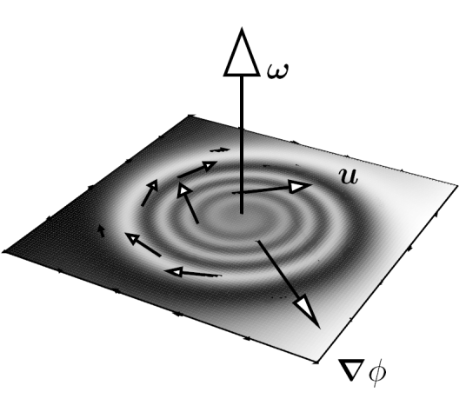
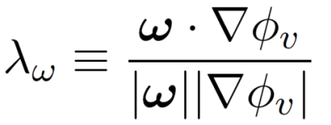
Criterion for constructing VSFs
VSF deviation: deviation between vortex surfaces and isosurfaces of a scalar
Minimize the volume-averaged VSF deviation
Scalar for characterizing vortical structures | Volume-averaged VSF deviation 〈|λ_{ω}|〉∈ [0,1]
Random scalar with a gradient | ≈ 50%
Vortex identification criteria or passive scalar | ≈ 30-40%
Numerical VSF solution | < 5-10%
Exact VSF | 0

Slide 14
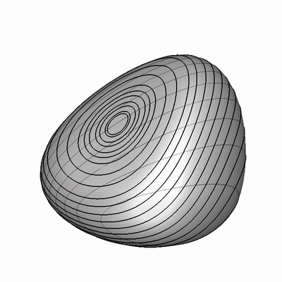
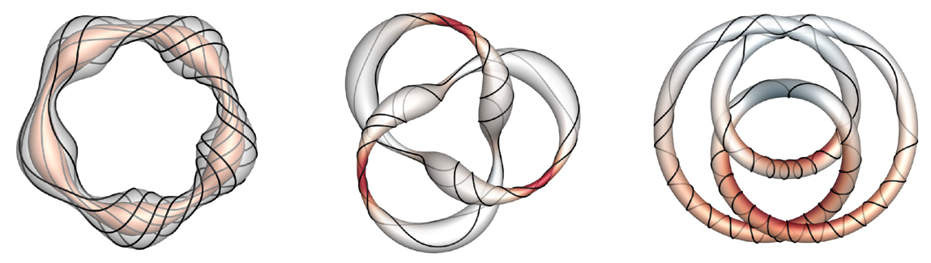
Exact construction of VSFs
Solve global first integrals of the characteristic equation of vorticity
Build a curved coordinate system along vortex axis
Taylor-Green
Kida-Pelz
Vortex ring
ABC (integrable)
Knotted
vortex tubes
P. He and Y. Yang, Phys. Fluids, 28, 2016; S. Xiong and Y. Yang, Phys. Fluids, 31, 2019; W. Shen et al., J. Fluid Mech., 2023

Slide 15
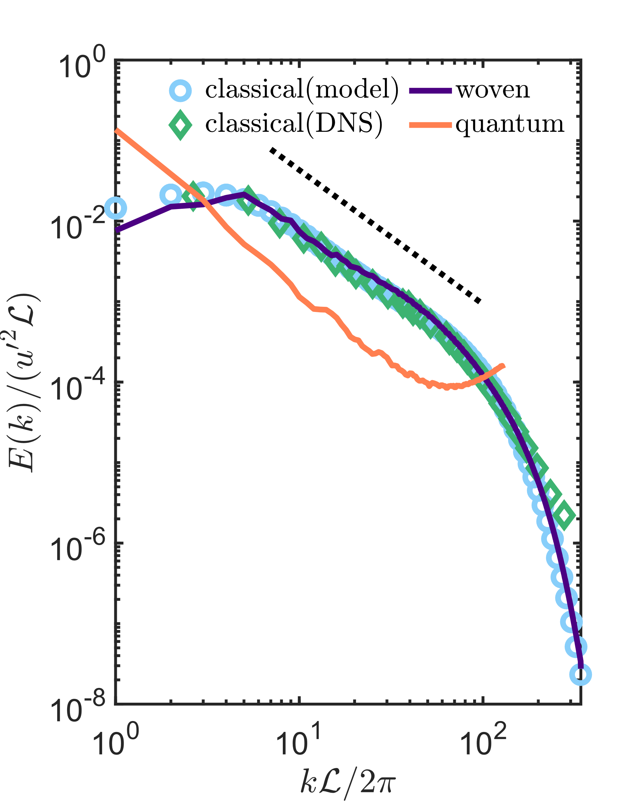
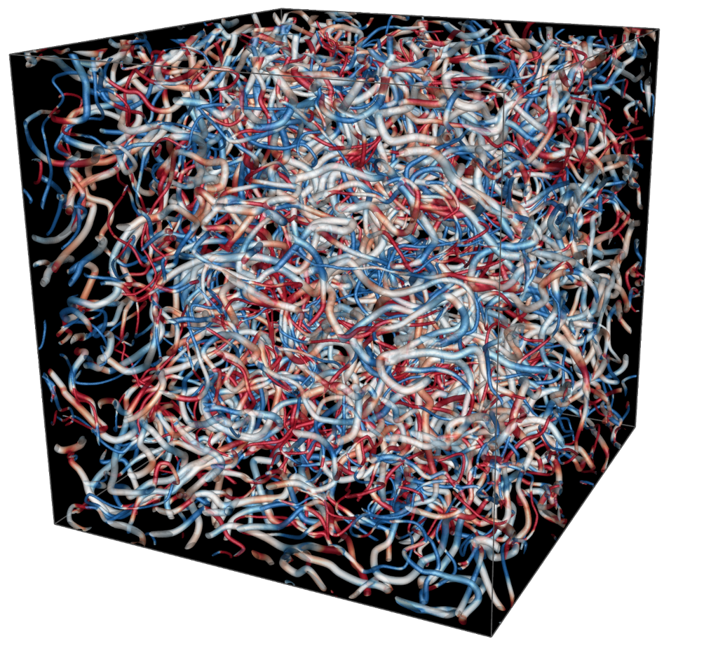
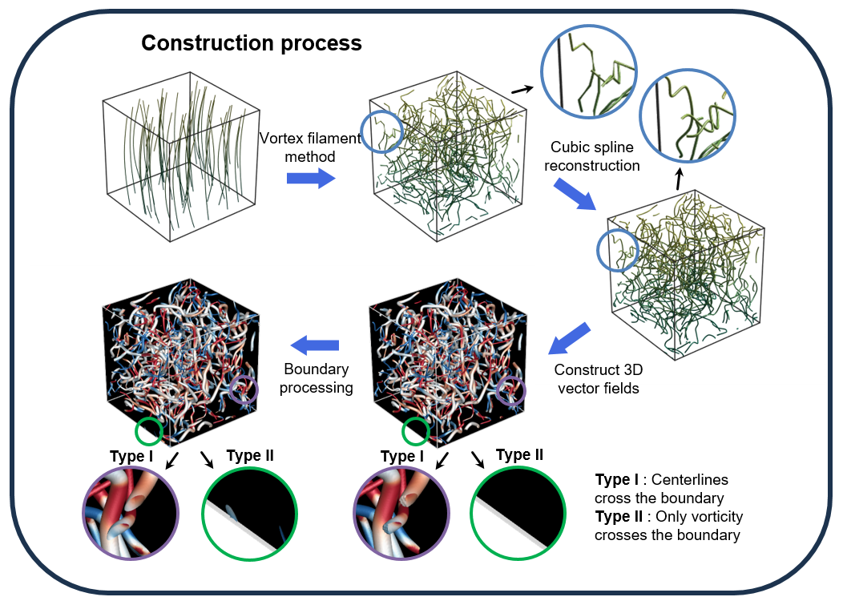
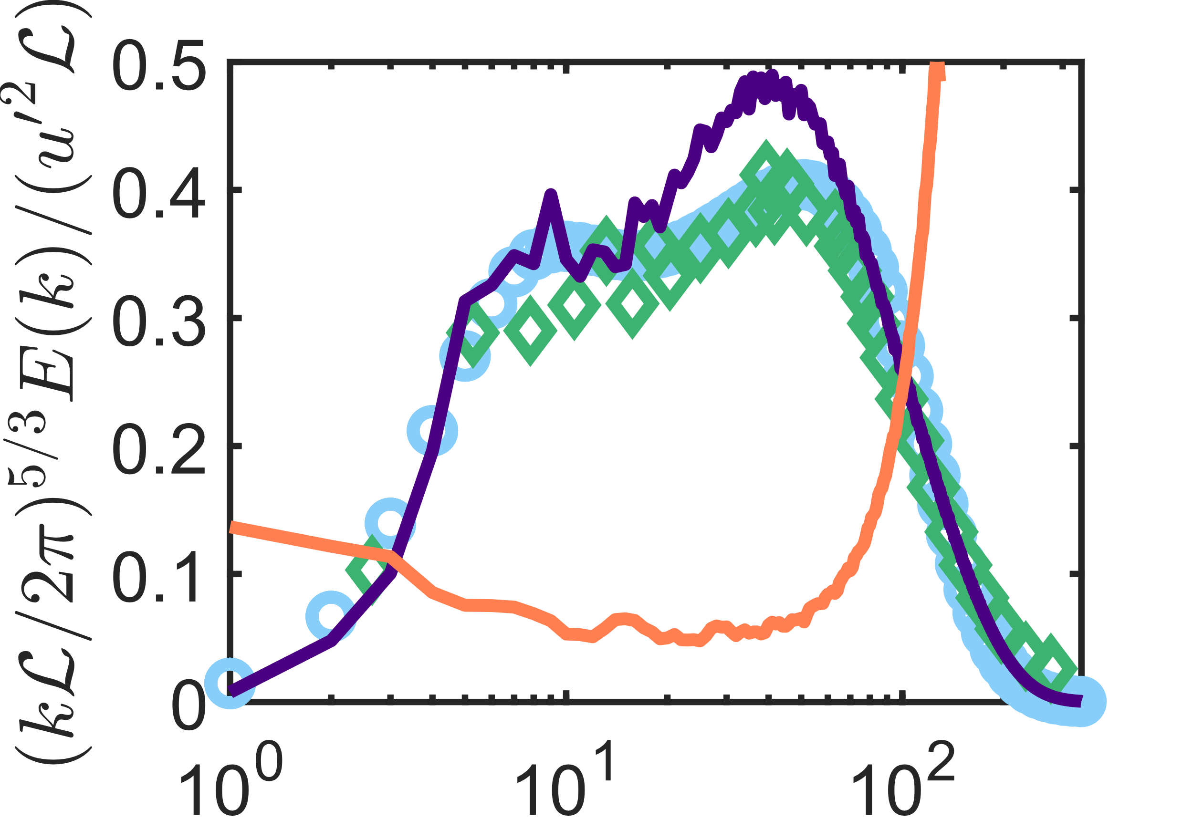
Weaving turbulence
Develop a bottom-up method to construct the vorticity of vortex tubes with arbitrary centerline topology, differential twist, and variable thickness
“Weaving” a turbulent flow field with entangled vortex tubes (VSF isosurfaces)
70
h
2π
-70

Slide 16
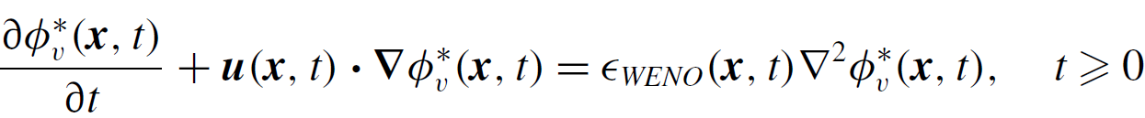

Two-time method for VSF evolution
Prediction step: solve advection equation in time t
Correction step: correct towards VSF in pseudo time τ
5th-WENO and 2nd TVD Runge-Kutta schemes
Implicit numerical viscosity ε_{WENO} for dissipative regularization
Solid curve：VSF solution
Dashed arrow：prediction step
Solid arrow：correction step
Corrector (projection)
Predictor with error from the violation of Helmholtz theorem

Slide 17
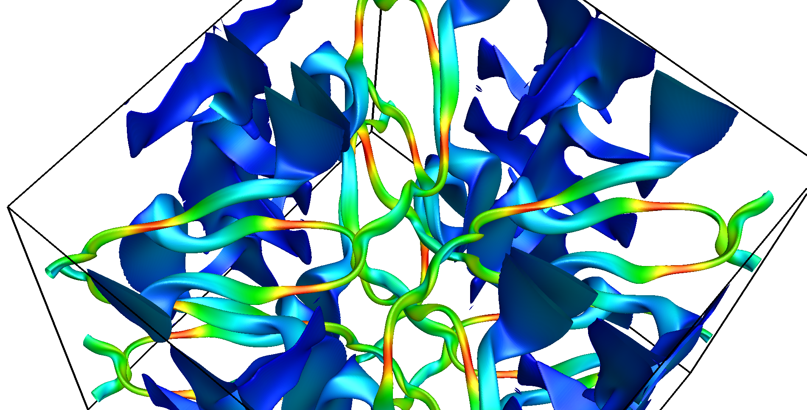
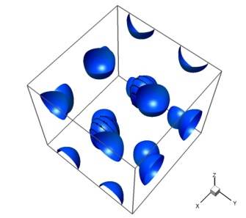
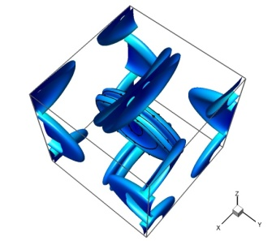
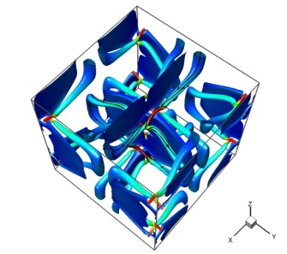
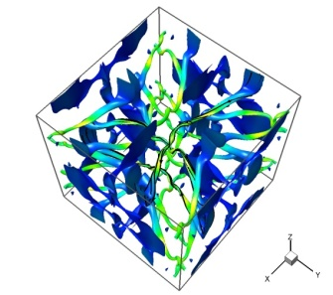
Evolution of vortex surfaces in Taylor-Green flow
From initial large-scale vortex blobs to small-scale, highly-twisted vortex tubes
t = 7.5
time
t = 0
t = 3.0
t = 5.0
t = 7.0
Y. Yang and D. I. Pullin, J. Fluid Mech., 685, 146-164, 2011

Slide 18
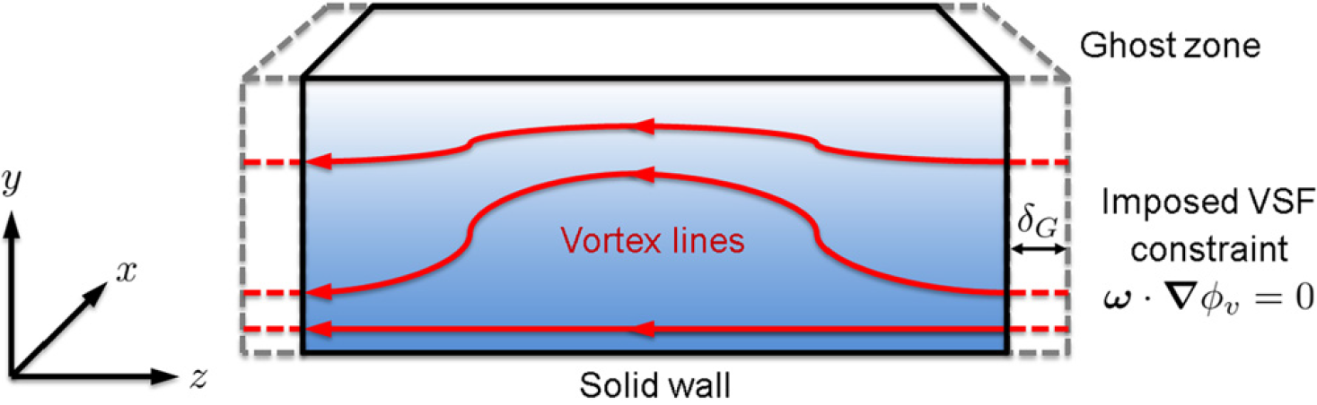
Boundary-constraint method
Calculate VSF from a snapshot of the velocity field
Impose the VSF constraint at the boundary and advect the constraint into the entire domain using the frozen vorticity
Requirement for the vorticity field: most of vortex lines passing through the boundary or symmetric plane, e.g., shear flows
Outflow
Boundary-constraint method for wall-bounded flow
S. Xiong and Y. Yang, J. Comput. Phys., 339, 31-45, 2017

Slide 19
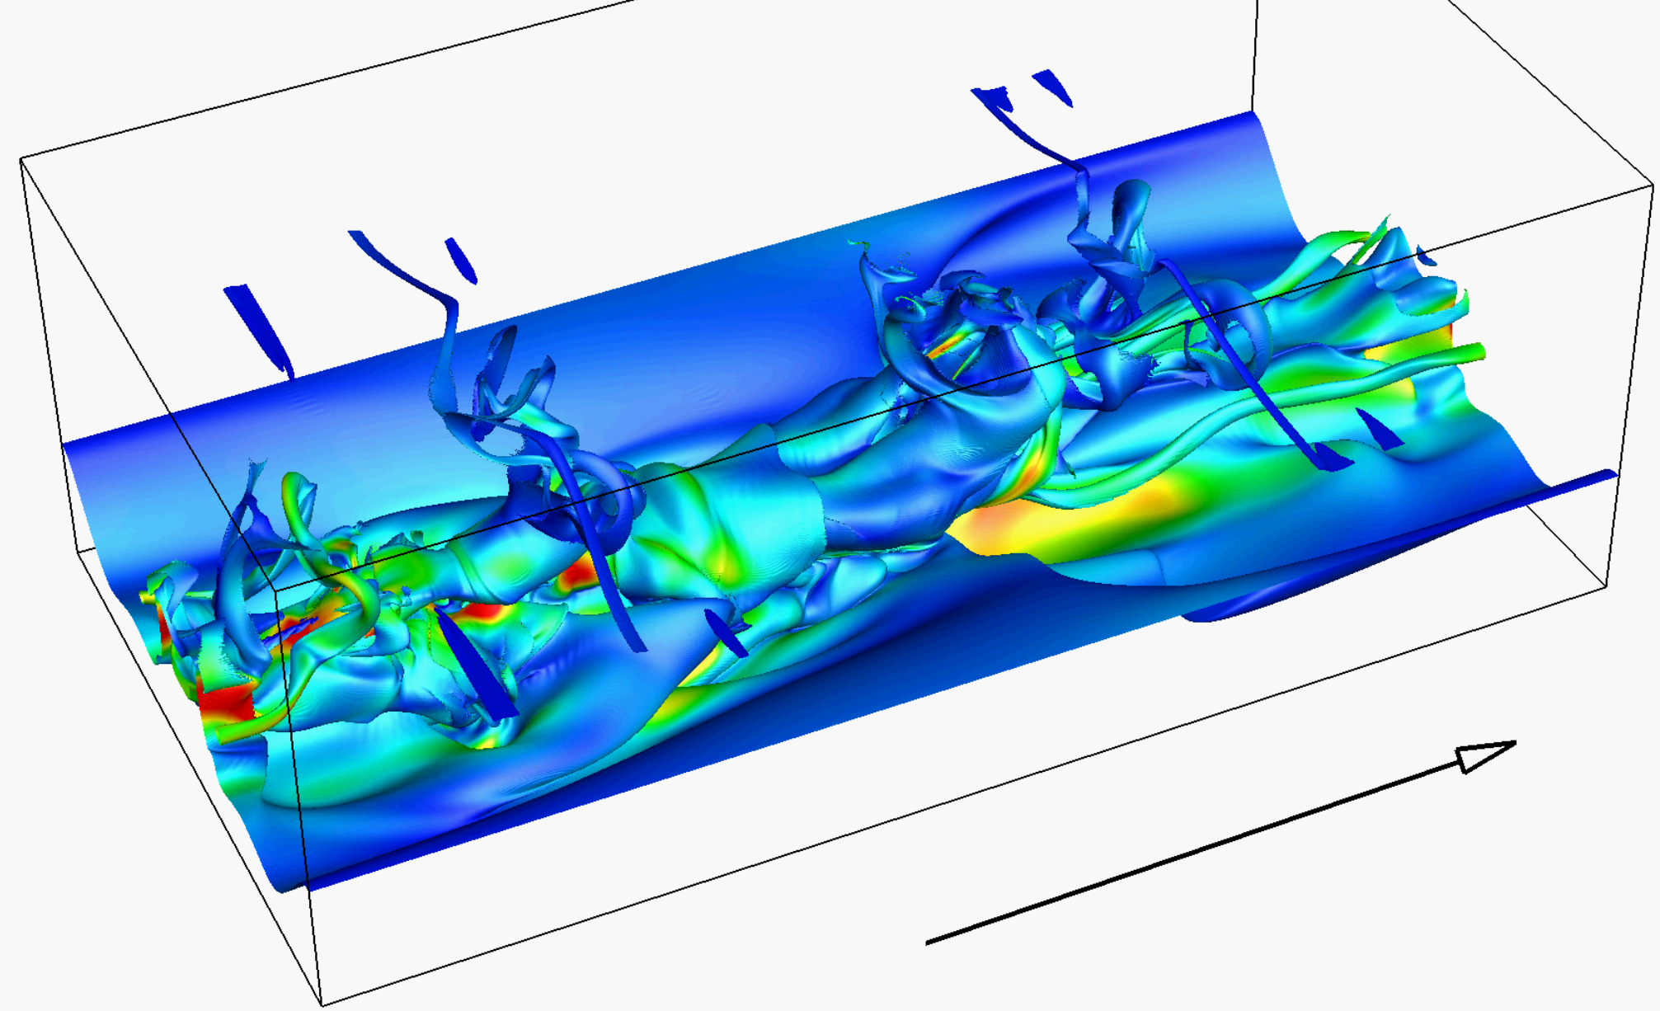
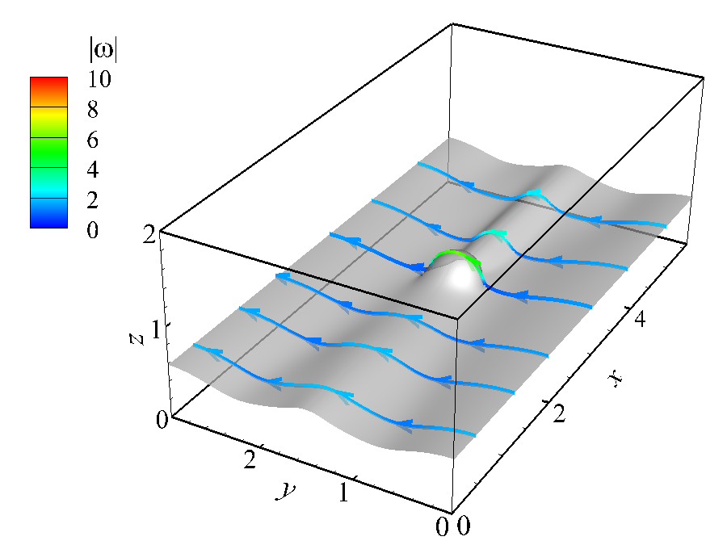
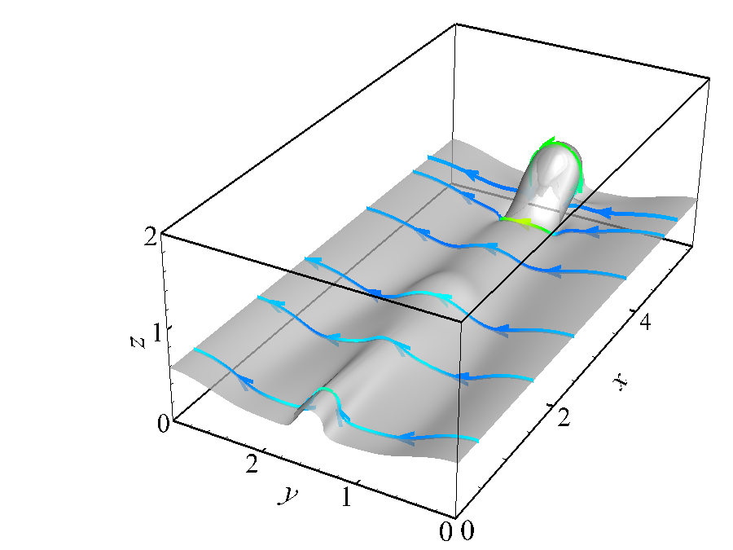
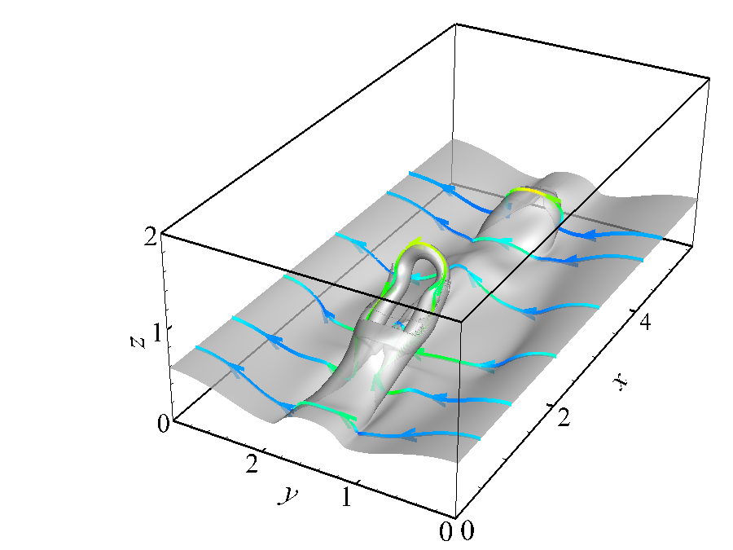
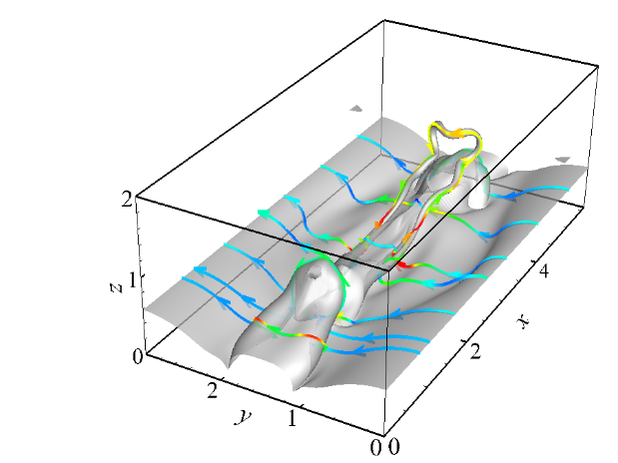
Vortex reconnection in transitional channel flow
Vortex reconnection due to symmetry of boundary conditions
t = 116
time
t = 106
t = 108
t = 110
t = 112
Y. Zhao, Y. Yang and S. Chen, J. Fluid Mech., 682, R4, 2016

Slide 20
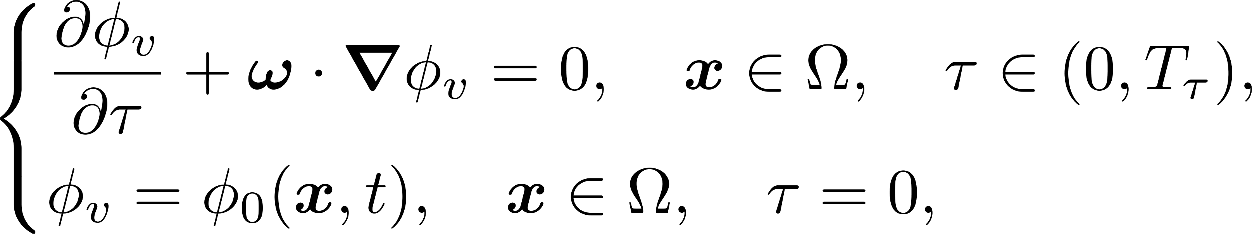


Local optimization
Idea: balancing small VSF deviation for accuracy and small scalar gradient magnitude for smoothness
Procedure of VSF construction
  Solve the pseudo-transport equation driven by frozen vorticity
  Minimize a hybrid constraint in each pseudo-time step
  Normalize the scalar field to the zero mean and unity variance
  Early stage: prefer smoothness; late stage: prefer accuracy
S. Xiong and Y. Yang, J. Fluid Mech., 874, 952-978, 2019

Slide 21
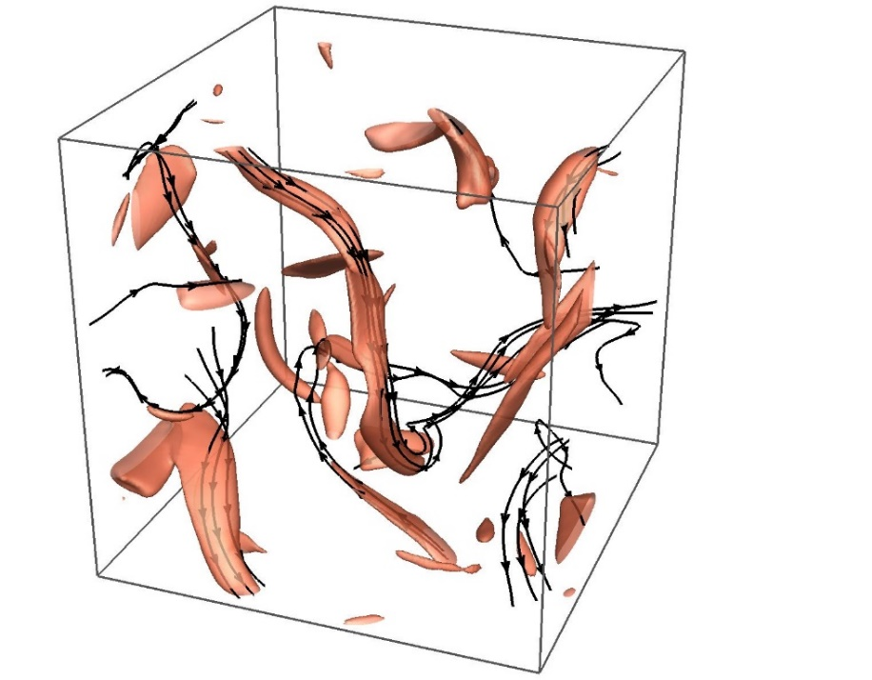
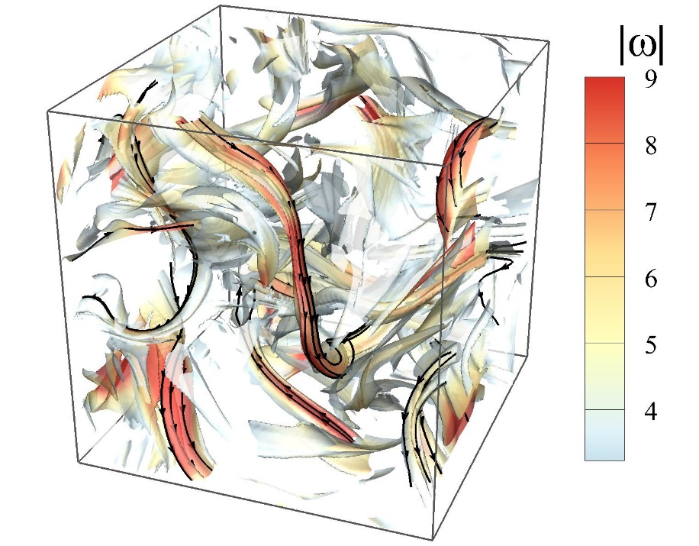
Comparison of vortex identification methods
Isosurface of vorticity magnitude (left)
  Directional information is missing
  Isosurfaces misalign with vorticity, VSF deviation ≈ 30%
Isosurface of VSF color coded by vorticity magnitude (right)
  Capture both magnitude and directional information
  Display real vortex tubes, VSF deviation ≈ 5％
misalignment

Slide 22
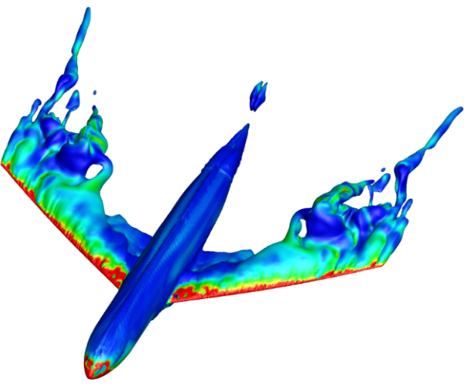
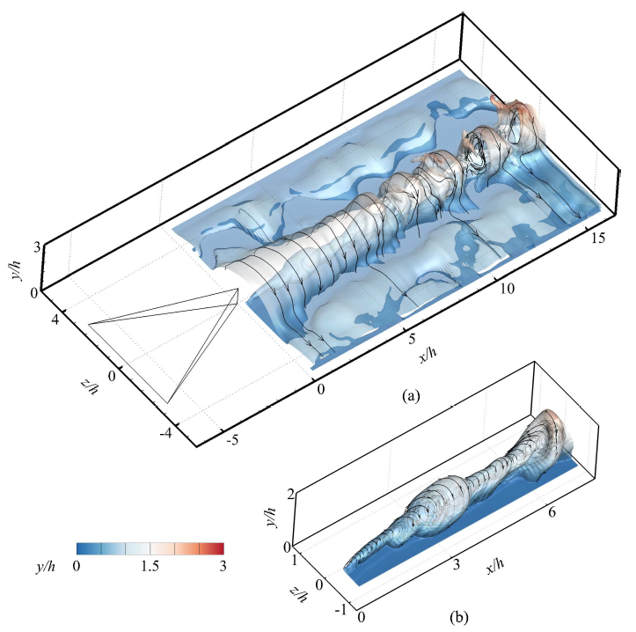
VSF construction in complex flows
Complex domain on unstructured grid with finite volume method and OpenFOAM
Experimental data of Tomo-PIV which can be under-resolved and subject to noise
Flow past a wing-body configuration
Tomo-PIV for the flow past a vortex generator
https://github.com/YYgroup/vsfFOAM Z. Liu and Y. Yang, Exp. Fluids, 64, 120, 2023

Slide 23
Outline of the VSF study
1. Theory and numerics
2. Flow visualization
3. Flow modeling
4. Flow simulation

Slide 24
Case studies based on VSF
Isotropic turbulence：energy cascade
Transition of canonical wall flows
  Boundary layer: formation of hairpin vortex and turbulent spot
  Channel flow: characterization of vortex reconnection
  Pipe flow: interaction of normal and reversed hairpin vortices
Moving-boundary problems
  Flow past a flapping plate: vortex shedding mechanism
Multi-physics coupled flows
  Premixed combustion: flame-vortex interaction
  RM instability: effects of shock wave and baroclinic force
  MHD flow: effects of Lorentz force

Slide 25
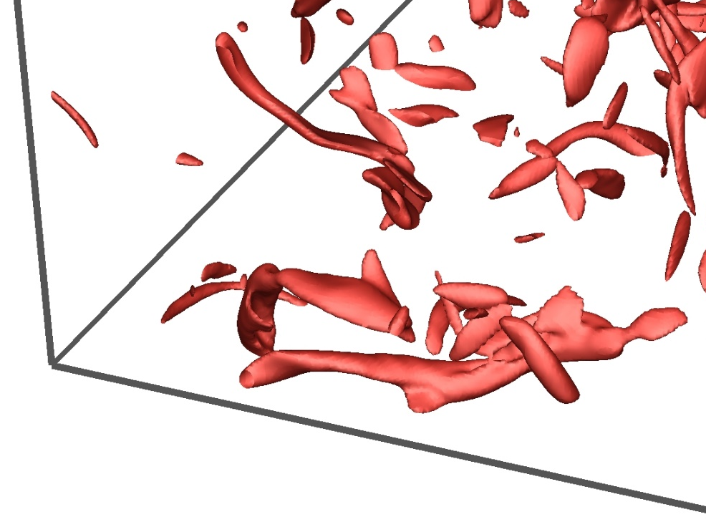
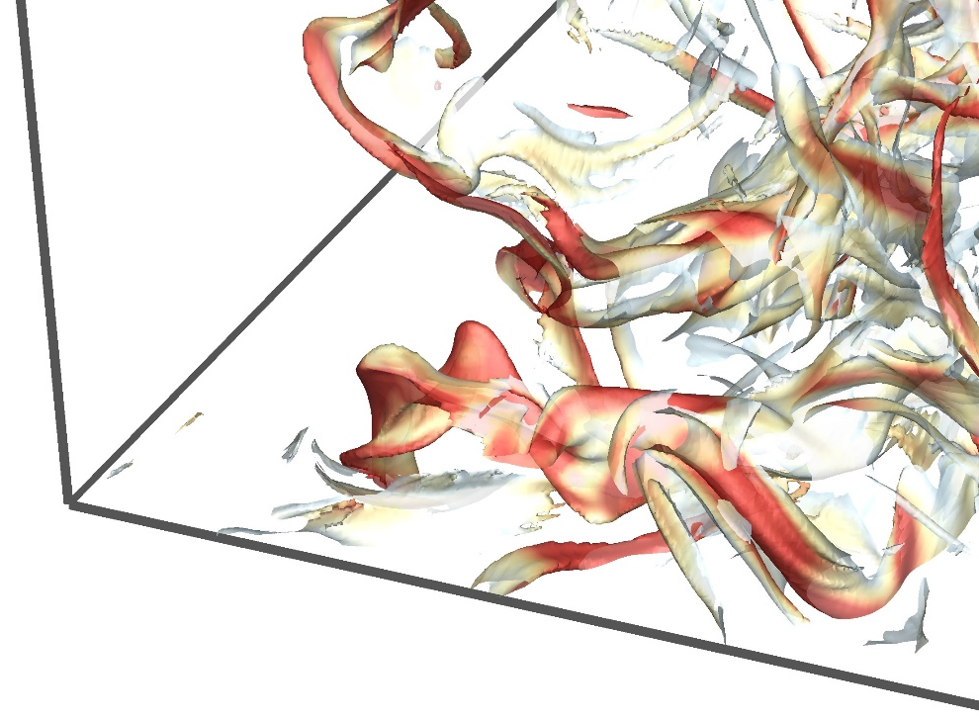
1. Vortex dynamics in isotropic turbulence
Scale cascade sometimes is depicted as the visual ‘breakdown’ of isosurfaces of |ω|, which is elusive in terms of vortex dynamics
Physically reasonable dynamics of vortex lines, surfaces, or tubes in scale cascade should be stretching, twisting, and reconnection
Isosurface of |ω|
Isosurface of VSF
The surfaces with |ω|<|ω|_{max}/5 are cut off for clarity

Slide 26

Effect of the Reynolds number
Re = 400
Re = 800
Re = 1600
Re = 3200
VSF isosurface is distorted
Isosurface of |ω| “breaks down”

Slide 27

Different pictures of energy cascade
S. Xiong and Y. Yang, J. Fluid Mech., 874, 952-978, 2019

Slide 28

2. Structural evolution in boundary-layer transition
  Focus on continuous evolution of vortical structures in a sliding window within a single period of the initial disturbance of TS waves
  Vortex surfaces evolve from initial planar surfaces to convoluted shapes in late transition, along with the growth of wall friction
Sliding window

Slide 29








Streamwise generation of hairpins
φ_{v} = 0.28
φ_{v} = 0.28
φ_{v} = 0.28
φ_{v} = 0.28
x_{c} = 2.49
x_{c} = 2.65
x_{c} = 2.71
x_{c} = 2.82
Q = 50% Q_{max}
Q = 5% Q_{max}
Q = 5% Q_{max}
Q = 2.5% Q_{max}
Scale cascade: triangular bulge → primary hairpin → secondary hairpin → tertiary hairpin (Zhao et al., 2016; Adrian, 2007)
Comparison of vortex-identification methods
Isosurface | Isocontour level | Time coherence | Vortex line alignment
VSF | Fixed | Strong | Perfect
Q-criterion | Varied | Moderate | Significantly misaligned

Slide 30



Generation of turbulent spots
The hairpin train approaches and then passes through nearby streaks, induces the spanwise velocity with alternating signs
Spanwise Kelvin-Helmholtz instability causes sinuous distortion
W4, x_{c} = 2.88
Volumetric rendering
W5, x_{c} = 3.14

Slide 31

Generation of turbulent spots
Spanwise propagation of sinuous distortion leads to mass production of small-scale, skewed hairpins
Y. Zhao et al., Phys. Rev. Fluids, 3, 074701, 2018

Slide 32


Quantification of VSF deformation
We observe the coincidence of the rising wall-friction coefficient C_{f} and volume averaged scalar gradient magnitude
Drag production is highly correlated with the VSF deformation

Slide 33


3. Vortex bursting
Initial vortex ring has differential twist with opposite chirality
Two counter-rotating twist vortex waves collide to burst
bursting!
twist wave propagation
propagation reversed
bursting!
towards 2nd bursting
towards 2nd bursting
Evolution of local twist rates on different vortex surfaces
Evolution of VSF isosurface colored by helicity density
W. Shen et al., J. Fluid Mech., 970, 2023

Slide 34

4. Formation of spikes and bubbles in RM instability
Strong vorticity layer generates after shock wave accelerating perturbed interface, triggering Richtmyer-Meshkov (RM) instability
Effects of the secondary baroclinic vorticity enhance/suppress vortex surface deformation, forming spikes/bubbles
Deceleration
of bubble
Induced velocity
of vortex ring
Acceleration
of spike
Evolution of vortex surfaces in RMI (colored by vorticity magnitude)

Slide 35


Vortex surfaces in multi-mode RMI
Spikes and bubbles evolve independently before vortex reconnection
Vortex reconnection widely occurs and triggers turbulent mixing
reconnection time
Modeling of turbulent mixing width
N. Peng et al., J. Fluid Mech., 911, A56, 2021
N. Peng et al., J. Fluid Mech., 925, A39, 2021
Evolution of vortex surfaces in RMI (colored by vorticity magnitude)

Slide 36

5. Interaction of flame and Taylor-Green vortex
Vortex surfaces merge into bulky structures without rolling-up in burnt region
Vortex surfaces are expanded near flame due to flame-generated dilation
t = 2
unburnt
flame
burnt
t = 4
unburnt
flame
burnt
Characterizing effects of flame on vortex evolution using VSF
H. Zhou et al., Proc. Combust. Inst., 37, 2461-2468, 2019

Slide 37



6. Reconnection of magnetic flux tubes
formation of
plasmoid
reconnection
reconnection
t = 1
t = 2
Visualization (upper) and schematics (bottom) of
tying magnetic knots in plasimoid via reconnection
t = 3
t = 4
Evolution of magnetic surfaces (colored by magnetic helicity density)
J. Hao and Y. Yang, J Fluid Mech., 912, A48, 2021

Slide 38
Outline of the VSF study
1. Theory and numerics
2. Flow visualization
3. Flow modeling
4. Flow simulation

Slide 39
1. Skin-friction coefficient in transition
Skin-friction
Turbulent state
Transition position
Laminar region
Transition region
Turbulent region
x
NPLS imaging in supersonic boundary-layer transition
(L. He et al., Chinese Sci. Bull., 54, 2011)
Transition has strong influence on the skin-friction
Accurate model prediction and measurement of skin-friction in high-speed boundary-layer transition are very challenging

Slide 40



Image-based modeling of skin-friction
Flow data ➝ VSF characterization (vector to scalar) ➝ Flow features ➝ Predictive model
Estimate growth of friction in supersonic transition from inclination angle of small-scale structures in experimental images
α
Obtain image in experiment of boundary layer transition
Calculate inclination angle of small-scale structures after multi-scale decomposition
Estimate friction based on the inclination angle
W. Zheng et al., J. Fluid Mech., 875, 1175-1203, 2019

Slide 41





Image-based modeling of skin-friction
Model equation based on the structural inclination angle α
Reference locations x_{L} and x_{T} are determined from image
Empirical formulae at laminar and turbulent states
Similar to the “intermittency factor”
(Dhawan & Narasimha,1958)
(Anderson, 2010)
(White, 2006)

Slide 42


Model validation
Comparison of skin-friction coefficient from DNS and the image-based model with O(10) viscous length scale
Ma∞=2.25
Ma∞=6

Slide 43


2. Force estimation from far wake
Shedding vortices in the wake of biological locomotion can reveal rich physical information of the moving body
Measurement of forces in far wake is more feasible than the near-wall method due to complex boundary conditions
Force
height, weight…
Footprint
Wake of swimming fish
（Verma et al., PNAS, 2018)

Slide 44













Shedding of vortex surfaces
Periodic shedding of spoon-like vortex surfaces from a flapping plate
The wake consists two sets of discrete vortex surfaces
Tip vortex line
Trailing-edge vortex line
W. Tong et al., J. Fluid Mech., 920, A10, 2021

Slide 45



Impulse theory based on vortex surfaces
Impulse theory (Wu, 2015) in arbitrary finite domain
Choose a vortex surface as integral domain to simplify the impulse theory
For further application, we estimate force in near and far wakes
Total force
Impulse
Lamb vector
Body motion
Normal vorticity
Viscous effect

Slide 46




3. Modeling turbulent mixing in RMI
Model spike and bubble growth rates using the motion of viscous vortex rings
Motion of each vortex ring is modeled by the dual polar coordinates moving with the vortex ring
Schematic for modeling spike/bubble growth in the RMI
Growth rates of spikes and bubbles
N. Peng et al., J. Fluid Mech., 911, 2021; N. Peng et al., J. Fluid Mech., 925, 2021

Slide 47
Outline of the VSF study
1. Theory and numerics
2. Flow visualization
3. Flow modeling
4. Flow simulation

Slide 48


Geometric description of fluid dynamics
Clebsch (1859) describes velocity with zero helicity using multiple VSFs
Spherical Hopf mapping (Kuznetsov & Mikhailov, 1980; Chern et al., 2017)
  A vortex line in R³ is mapped to a point on S²
  A vortex tube in R³ is mapped to a patch on S², patch area = vorticity flux
Hopf mapping
Vortex tube in R³
Patch on S²

Slide 49

Quantization of the velocity field
Two-component wavefunction for velocity (quantization)
Spin vector
  Wavefunction in S³ is transformed to S² by Hopf mapping
  Each spin component is a VSF

Slide 50

Geometric description of vortex tube
wave function
(quaternion)
spin vector
velocity
vorticity
A. Chern et al., ACM Trans. Graph., 2017; R. Tao et al., Phys. Fluids, 2021

Slide 51



Representations of tangled vortex tubes
Vortex lines have complex global topology and simple local geometry (similar to fiber bundle)
Inspire us to develop VSF-based simulation methods
Patch on S² sphere for spin vector
Isosurface of spin-vector component (VSF) in R³
Close-up view:
buddle of vortex lines

Slide 52





Spin Euler equation
Spin Euler equation for ideal flow is based on spin vector rather than velocity
Derive a non-blowup criterion based on Laplacian spin
Lattice of spin vectors
precession of s around m
Evolution of isosurface of s₁ (VSF)
Z. Meng and Y. Yang, J. Fluid Mech. (under review); arXiv:2311.05149

Slide 53

Simulation of free-surface vortex
S. Xiong et al., ACM Trans. Graph., 41, 116, 2022

Slide 54



Quantum computing of fluid dynamics
No effective quantum algorithm for highly nonlinear NS equation
Two-component Schrödinger equation for flow with finite vorticity and dissipation
It has the unitary operator, more suitable than the NSE for quantum computing
Hydrodynamic Schrödinger equation
Corresponding equation for a fluid flow with a special constitutive relation
Tangled vortex tubes for isotropic turbulence in the ISF
Z. Meng and Y. Yang, Phys. Rev. Research, 5, 033182, 2023

Slide 55

Schematic for quantum simulation
Simulation of the Schrödinger flow only involves the wave function
It is equivalent to a Hamiltonian simulation for the motion of a particle
Fluid density and velocity are obtained by measuring the wave function
Schematic of quantum simulation and measurement of the Schrödinger flow

Slide 56


Quantum and hybrid simulations of simple flows
Develop a prediction-correction quantum algorithm to solve the HSE with partial exponential speedup
Use IBM Qiskit with the QASM simulator (virtual quantum computer)
Quantum simulation of
1D steady flow with 6 qubits
Quantum-classical hybrid simulation of
2D Taylor-Green flow with 10 qubits
Z. Meng and Y. Yang, Phys. Rev. Research, 5, 033182, 2023

Slide 57
Summary
VSF: its isosurface is a vortex surface consisting of vortex lines
VSF visualization elucidates key mechanisms in the flows with essential vortex dynamics, such as turbulence and wall flow transition
VSF characterization reveals correlation between geometric statistics and the friction in transition, thrust in bio-propulsion or growth rate in interface instability
VSF inspires novel numerical methods on graphic and quantum processors
Future work: VSF-based diagnostics and simulation of complex flows
Tutorial Review： Y. Yang, S. Xiong, and Z. Lu, Flow, 3, E33, 2023
Notes:
Based on the generalized Helmholtz theorem, the VSF isosurfaces of the same threshold at different times capture the evolution of vortex surfaces

Slide 58
Acknowledgments
Collaborators: Yaomin Zhao, Wenjie Zheng, Hao Zhou, Jiaping You, Jinhua Hao, Naifu Peng, Wenwen Tong, Shanxin Ruan, Likun Gu, Pengyu He, Zhifeng Liu, Zhen Lu, Shiying Xiong (ZJU), Jie Yao (BIT), Fazle Hussain (Texas Tech), and Dale Pullin (Caltech)
This work is supported by NSFC
Thanks!
Email: yyg@pku.edu.cn

