Slide 1
Case-Base Neural Networks: survival analysis with time-varying, higher-order interactions
Jesse Islam
Co-Authors:
Maxime Turgeon
Rob Sladek
Sahir Bhatnagar

Slide 2
What is survival analysis?
Any dataset concerning time to an event.
Time to death.
Time to graduation.
Time to getting a disease.
Dataset consists of individuals who were followed over time.
Study may have a fixed duration or be open ended.
The event is not necessarily experienced until the study is over (“Censored”).
Participants may drop out early for any unrelated reason (“Censored”).
Notes:
Dwell on censoring

Slide 3
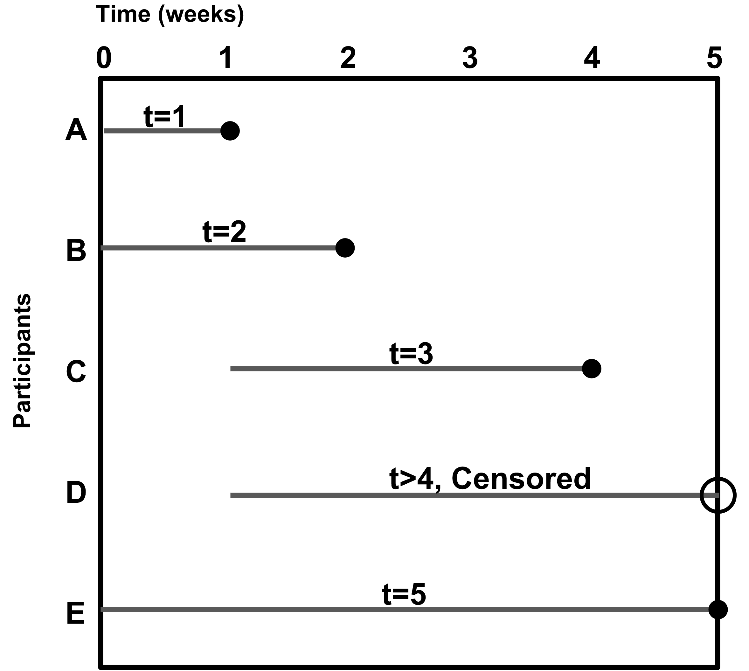
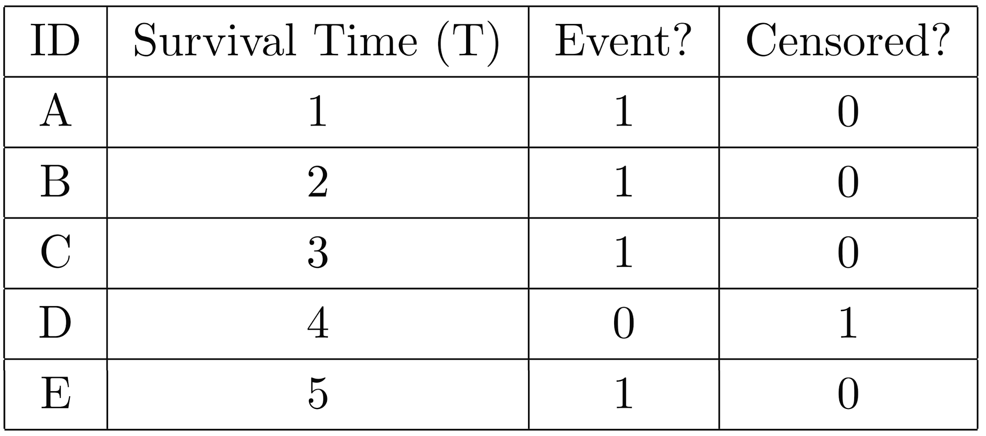
Survival time till assignment completion
Time (weeks)
Participants
Censored: Individual may experience the event of interest after follow-up has ended.
Notes:
How does censoring effect our statistics:
- Can exclude them, but don’t have to

Slide 4
Hazard function:
Instantaneous potential of experiencing an event at time t, given you survived up to time t.
Hazard ratio:
Cox regression: Assumes proportional hazards… Effect of covariates do not vary with time.
h(X,t) : hazard function.
h₀(t) : baseline hazard.
βX : linear predictor
Notes:
Make sure the notation matches the equations
Small x
BASELINE HAZARD DESCT
H0(t)
Example of time varying effects: male female * time
Is a baseline hazard constant with time.
Constant hazard
Non constant hazard
Time varying effects that can make your hazard non constant.
Breast cancer – non-constant hazard but is still proportional.
Time varying effects accelerate hazard.
Time-varying covariates, non-constant hazards.

Slide 5
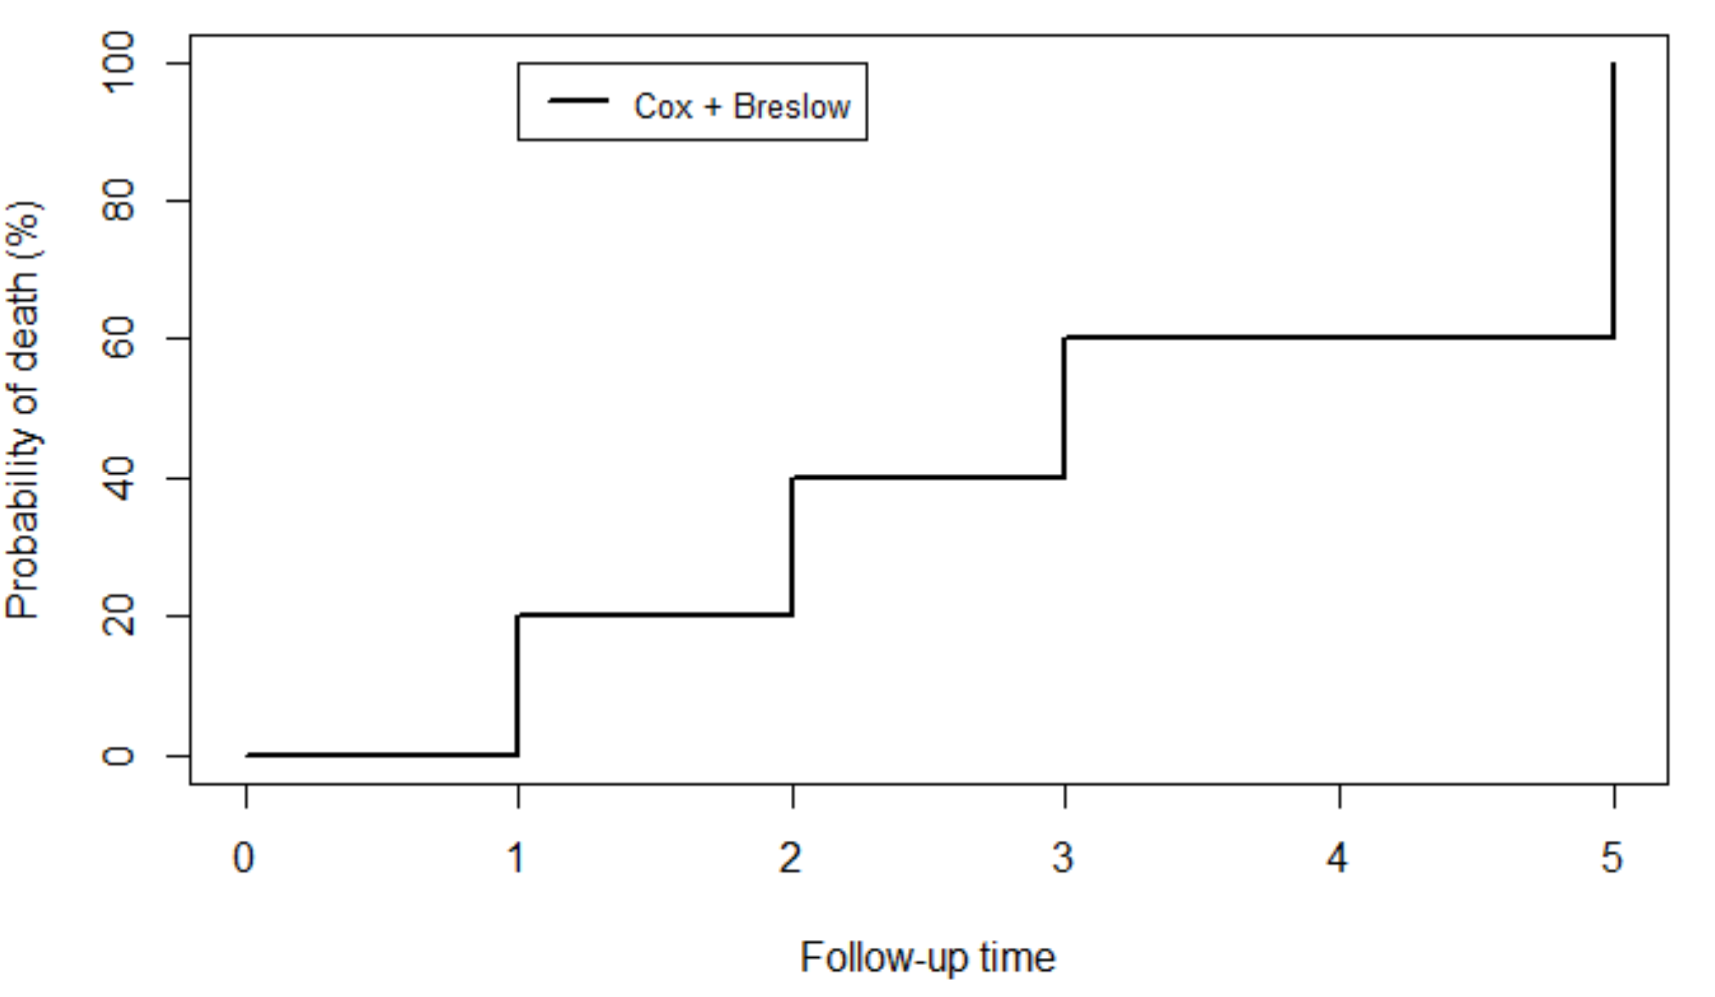
3-week risk?
Time (weeks)
Participants
Notes:
Resize time
Prob of experiencing event, use %
WHY DO WE CARE****
Can I explain why we want a smooth curve better

Slide 6
Case-base sampling with logistic regression

Slide 7
Case-base sampling
Time (weeks)
Time (weeks)
Base: All the person-moments experienced in the study.
Participants
Participants
Notes:
Resize time
Prob of experiencing event, use %
WHY DO WE CARE****
Can I explain why we want a smooth curve better

Slide 8
Case-base sampling
Time (weeks)
Time (weeks)
Base: All the person-moments experienced in the study.
Case series: all the person-moments where an event occurred.
Participants
Participants
Notes:
Resize time
Prob of experiencing event, use %
WHY DO WE CARE****
Can I explain why we want a smooth curve better

Slide 9
Case-base sampling
Time (weeks)
Time (weeks)
Base: All the person-moments experienced in the study.
Case series: all the person-moments where an event occurred.
Base series: sample of the base.
Participants
Participants
Notes:
Resize time
Prob of experiencing event, use %
WHY DO WE CARE****
Can I explain why we want a smooth curve better

Slide 10
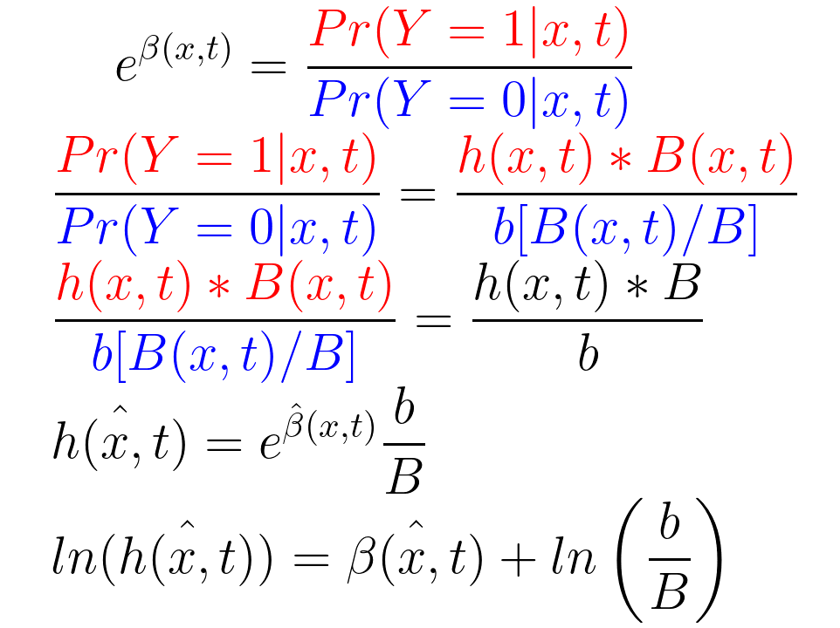
Case-base sampling and logistic regression
Time (weeks)
Participants
b = # Blue
B = # Moments
Notes:
Resize time
Prob of experiencing event, use %
WHY DO WE CARE****
Can I explain why we want a smooth curve better

Slide 11
Case-base sampling and logistic regression
Time (weeks)
…
Participants
b = # (sample of moments)
B = # All moments
To have a flexible baseline hazard:
Notes:
Resize time
Prob of experiencing event, use %
WHY DO WE CARE****
Can I explain why we want a smooth curve better

Slide 12
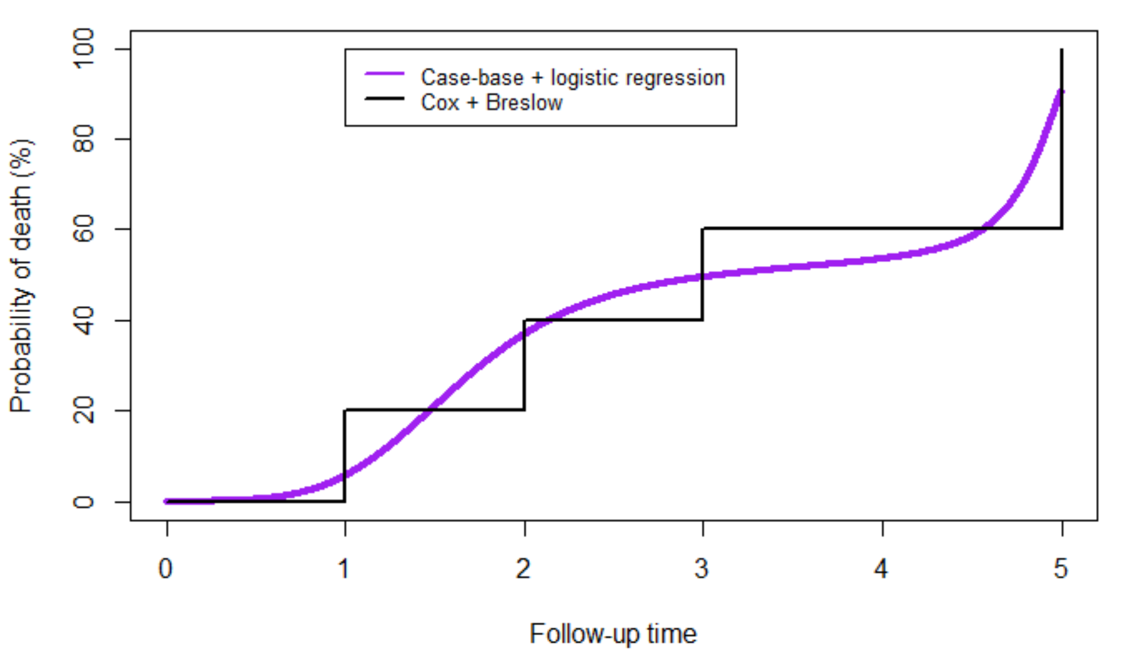
Case-base sampling and logistic regression
Time (weeks)
Participants
Notes:
Resize time
Prob of experiencing event, use %
WHY DO WE CARE****
Can I explain why we want a smooth curve better

Slide 13
Case-base sampling
permits flexible baseline hazard.
h(X,t) : hazard function.
h₀(t) : baseline hazard.
βX : linear predictor
Notes:
Make sure the notation matches the equations
Small x
BASELINE HAZARD DESCT
H0(t)
Example of time varying effects: male female * time
Is a baseline hazard constant with time.
Constant hazard
Non constant hazard
Time varying effects that can make your hazard non constant.
Breast cancer – non-constant hazard but is still proportional.
Time varying effects accelerate hazard.
Time-varying covariates, non-constant hazards.

Slide 14
What about flexibility in covariates?
Case-base sampling
permits flexible baseline hazard.
h(X,t) : hazard function.
h₀(t) : baseline hazard.
βX : linear predictor
Notes:
Make sure the notation matches the equations
Small x
BASELINE HAZARD DESCT
H0(t)
Example of time varying effects: male female * time
Is a baseline hazard constant with time.
Constant hazard
Non constant hazard
Time varying effects that can make your hazard non constant.
Breast cancer – non-constant hazard but is still proportional.
Time varying effects accelerate hazard.
Time-varying covariates, non-constant hazards.

Slide 15
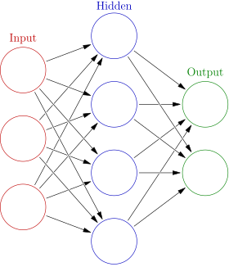
Exhaustive search with regression is hard
Many covariates.
How many contribute?
Interactions?
Non-linearity?
Genotypes, CT scans, etc.
Ideally, the model learns from the data.
Neural networks can be used.
Case-base + NN = CBNN
https://en.wikipedia.org/wiki/Artificial_neural_network
Notes:
What interactions are important?
Infinite many solutions when N<<P Picture of wide dataset*

Slide 16
State of neural network survival analysis
DeepSurv – Cox neural networks.
Cox regression extended using neural networks.
Only uses proportional hazards (PH).
DeepHit – First Hitting Time neural networks.
Inverse Gaussian distribution used as baseline hazard.
Does not let model determine baseline hazard.
DeepSurvivalMachines (DSM) – Mixture model used for baseline hazard.
User specifies a set of distributions to be used as the baseline hazard.
Does not permit time-varying interactions.
Need a parametric method that permits non-PH and flexible baseline hazard.
Notes:
What is survival analysis? How is it done? Problem with Cox? As we get older risks change. This change is not necessarily linear.
Can we learn the actual form?

Slide 17
Proposal
Case-Base Neural Networks (CBNN)
Provides a flexible baseline hazard.
Permits time-varying interactions among covariates.

Slide 18
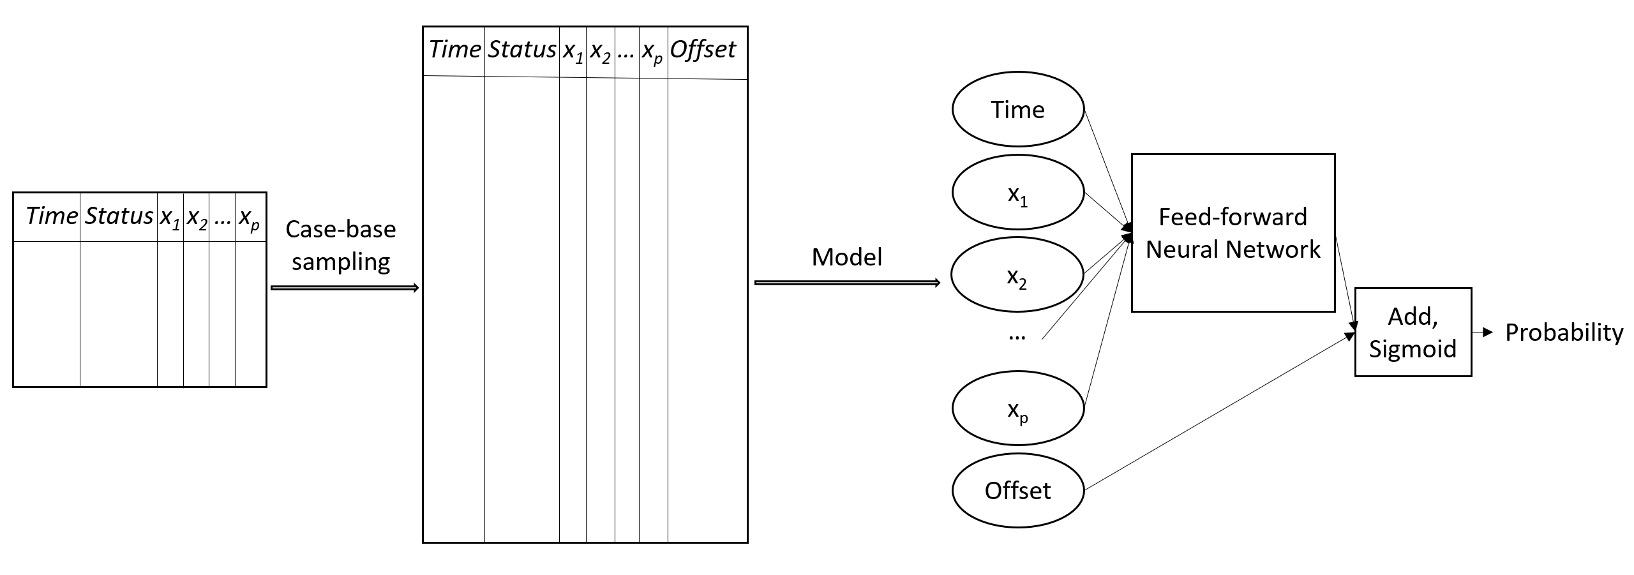
CBNN steps
Case-base sampling.
Neural network model.
Set offset to 0 when predicting on new data.

Slide 19
CBNN to hazard

Slide 20
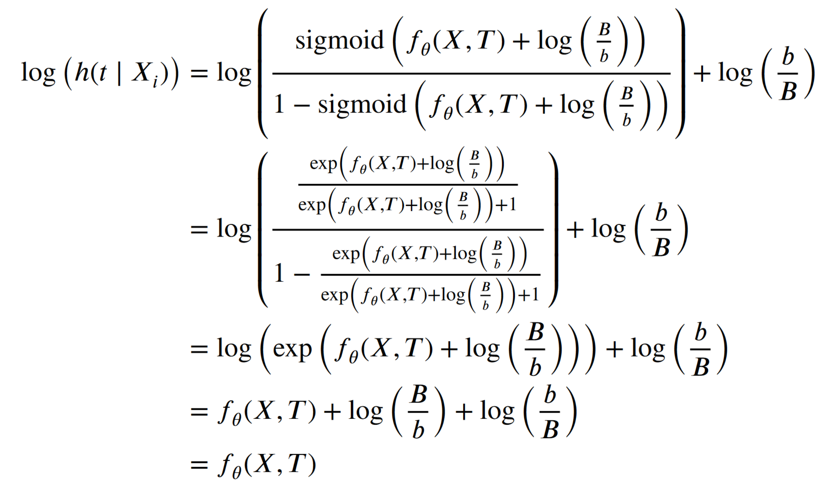
Sigmoid to hazard

Slide 21
Sigmoid to hazard

Slide 22
Sigmoid to hazard

Slide 23
Sigmoid to hazard

Slide 24
Metrics and hyperparameters

Slide 25
Right-censored Brier score
S_{i} <- Survival time of i-th individual.
t <- Survival time of interest.
$\hat{CI}\left(X,t\right)$ <- Cumulative incidence.
$\hat{G}(m)$<- Inverse probability censoring weighting (IPCW) at time m.
$δ$_{i} <- Indicator: 1 = event , 0 = censored.
Graf, E., Schmoor, C., Sauerbrei, W., & Schumacher, M. (1999). Assessment and comparison of prognostic classification schemes for survival data. Statistics in medicine, 18(17‐18), 2529-2545.

Slide 26
Index of Prediction Accuracy
IPA > 0: model performs better than null.
IPA < 0: model performs worse than null.
Kattan, M. W., & Gerds, T. A. (2018). The index of prediction accuracy: an intuitive measure useful for evaluating risk prediction models. Diagnostic and prognostic research, 2(1), 1-7.

Slide 27
Hyperparameters
Epochs = 2000
Batch size = 512
Learning rate = 10e-3
Decay = 10e-7
Hidden layers = {50,50,25,25}
50% dropout after each hidden layer.
60/20/20% train/validation/test.
Stopping condition: minimum change in loss = 10e-7.

Slide 28
Simulation studies

Slide 29
Simulated covariates

Slide 30
Simple simulation
𝛽1 = 𝛽2 = 𝛽3 = 0.1
𝜆 = 1.0

Slide 31
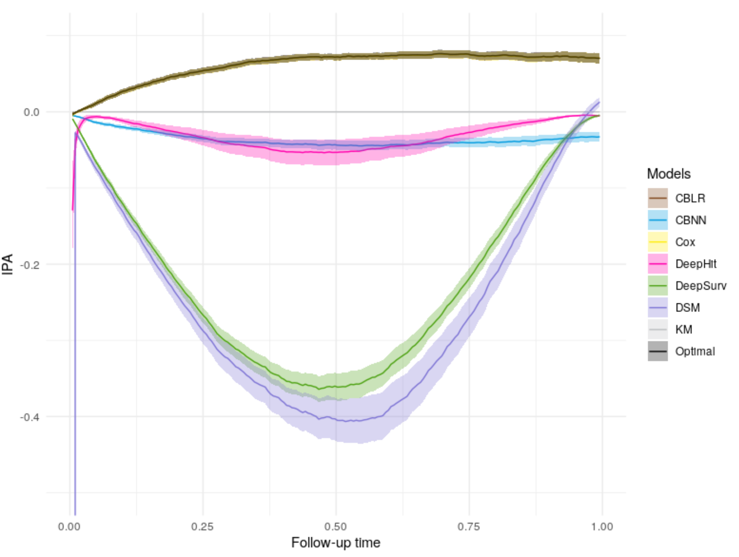
Simple simulation result

Slide 32
Complex simulation
Time-varying interaction
Interactions
𝛽1 = 𝛽2 = 𝛽3 = 1
𝜏1 = 10, 𝜏2 = 2, 𝜏3 = 2
𝛾1 = 3.9, 𝛾2 = 3, 𝛾3 = −0.43, 𝛾4 = 1.33, 𝛾5 = −0.86
Breast cancer dataset from the Flexsurv package.
686 patients with primary node positive breast cancer.
43% die over 7.28 years.
Breast cancer dataset originally used to demonstrate the benefit of flexible baseline hazards.
Crowther MJ, Lambert PC. Simulating biologically plausible complex survival data. Stat Med 2013;32(23):4118-4134.

Slide 33
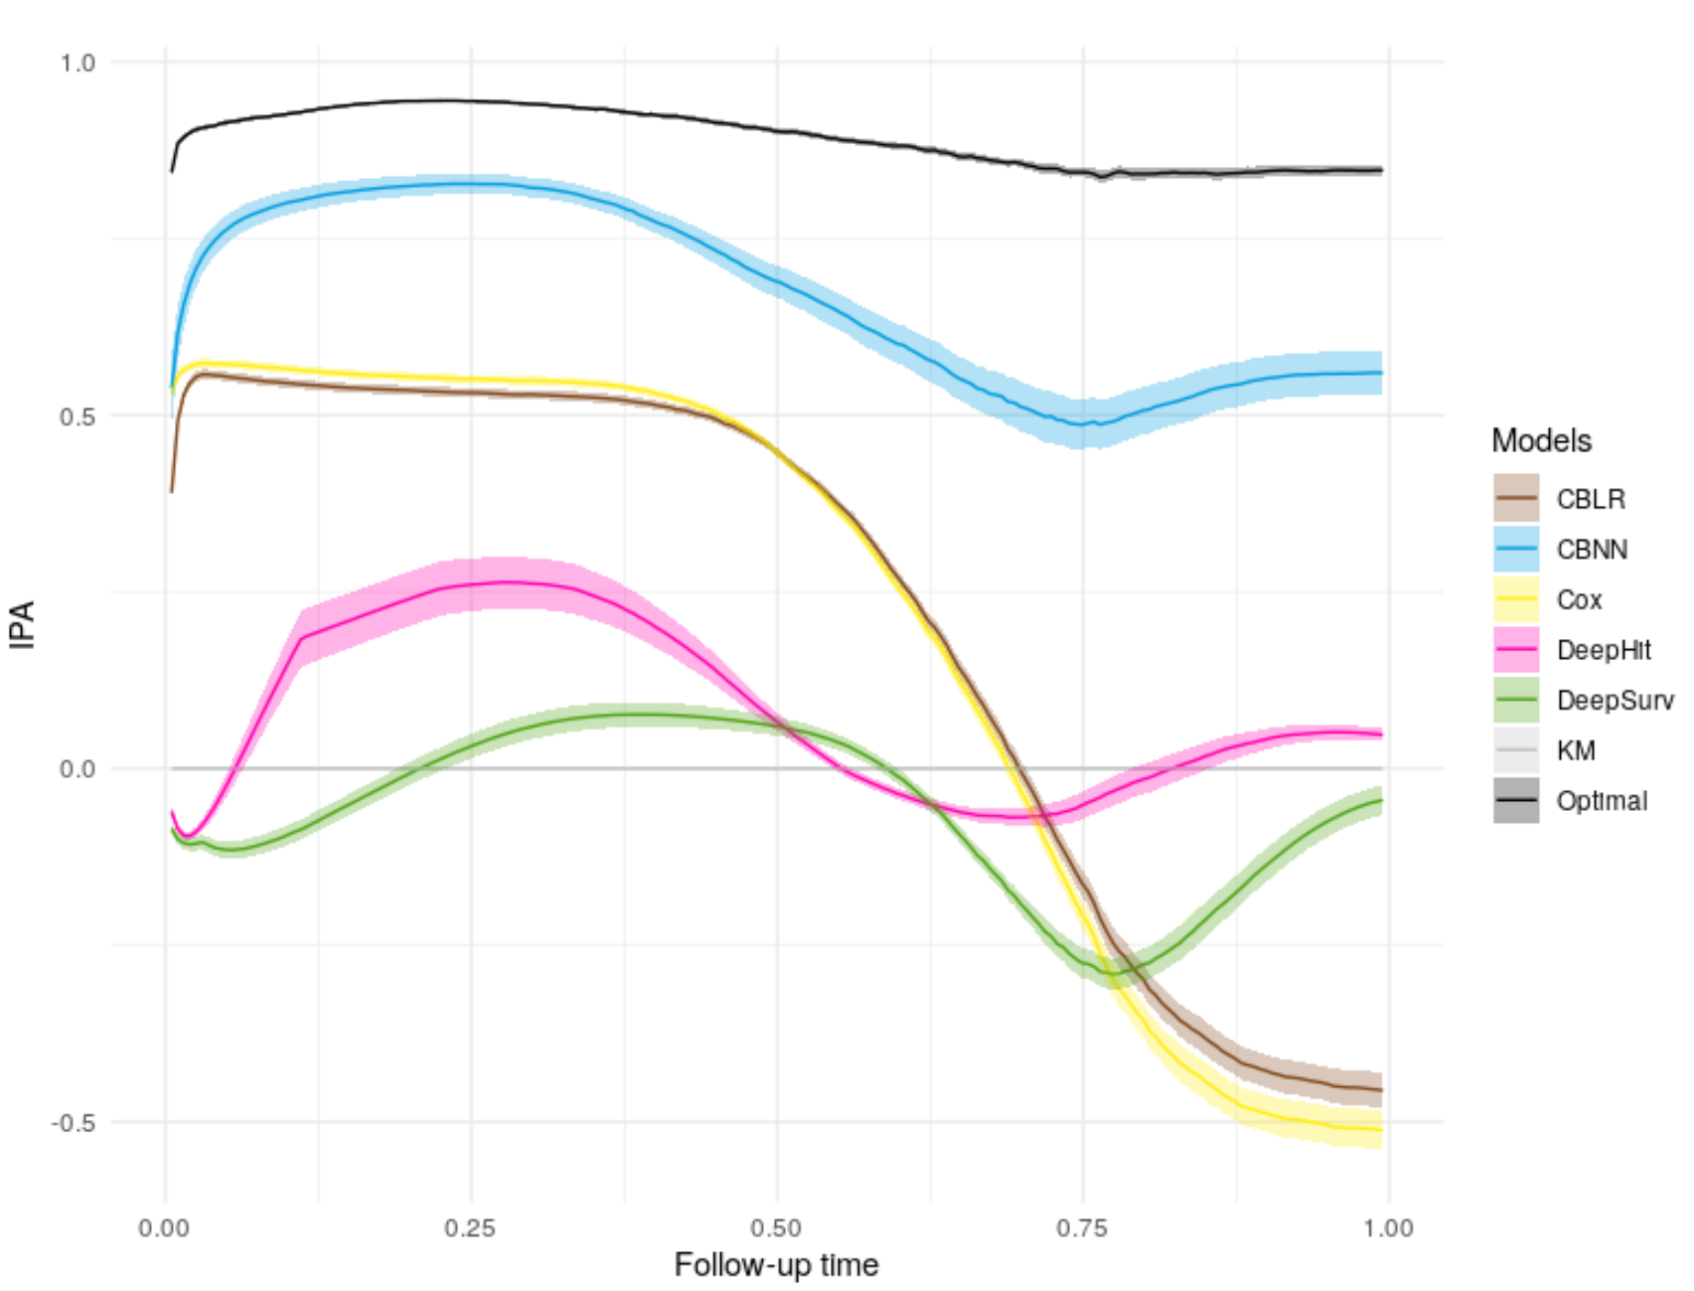
Complex simulation result

Slide 34
Real data studies

Slide 35
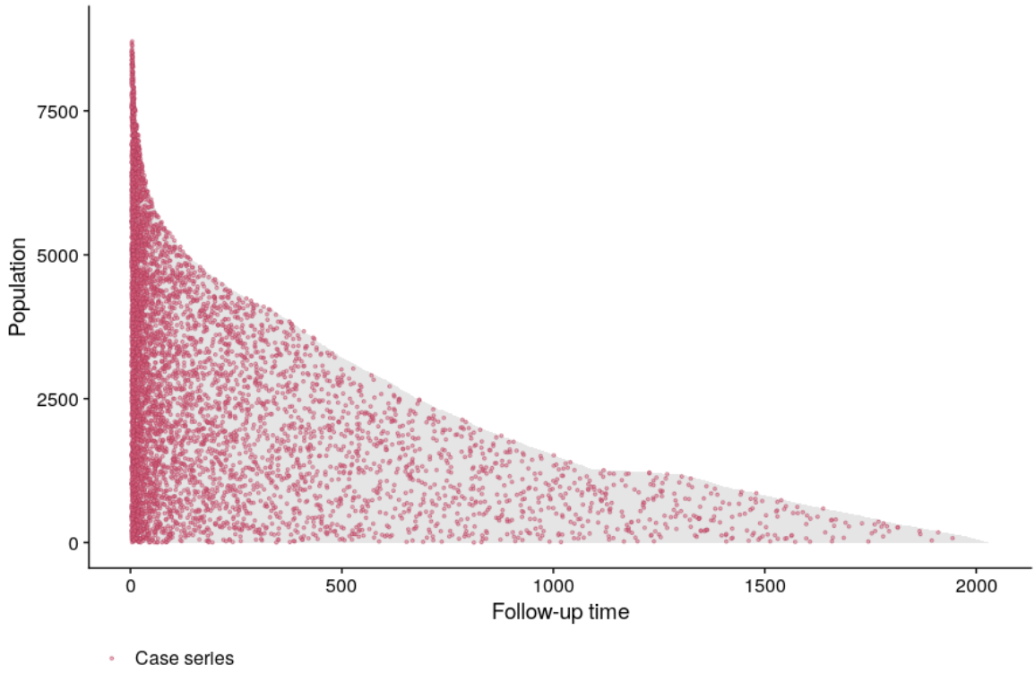
SUPPORT study
Study to Understand Prognoses Preferences Outcomes and Risks of Treatment (SUPPORT) Phase I
8873 hospitalized adults.
Followed up to 5.56 years.
68% incidence (death).
14 covariates (after imputation).
Requires imputation. For comparison with competitors a preprocessed version from DeepSurv is used.
Age, sex, race, number of comorbidities, presence of diabetes/dementia/cancer, blood pressure, heart/respiration rate, temperature, white blood cell count, sodium and creatinine.
Knaus, 1995
Notes:
***IMPUTATION STEPS?

Slide 36
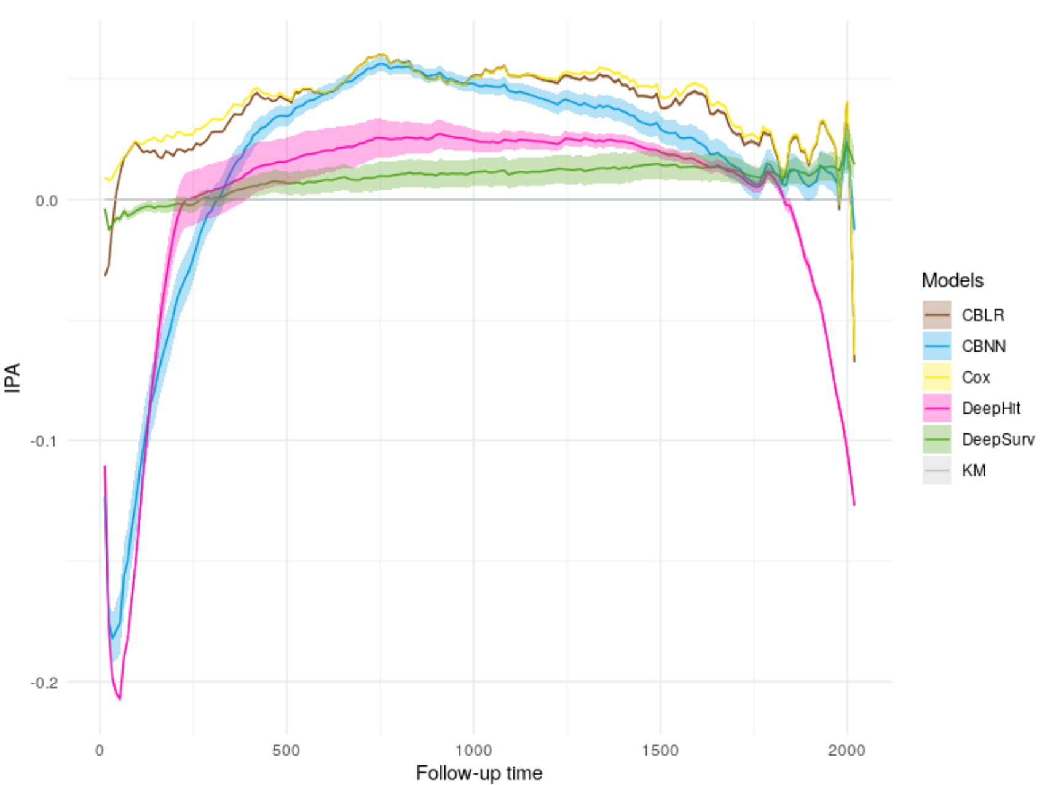
SUPPORT result

Slide 37
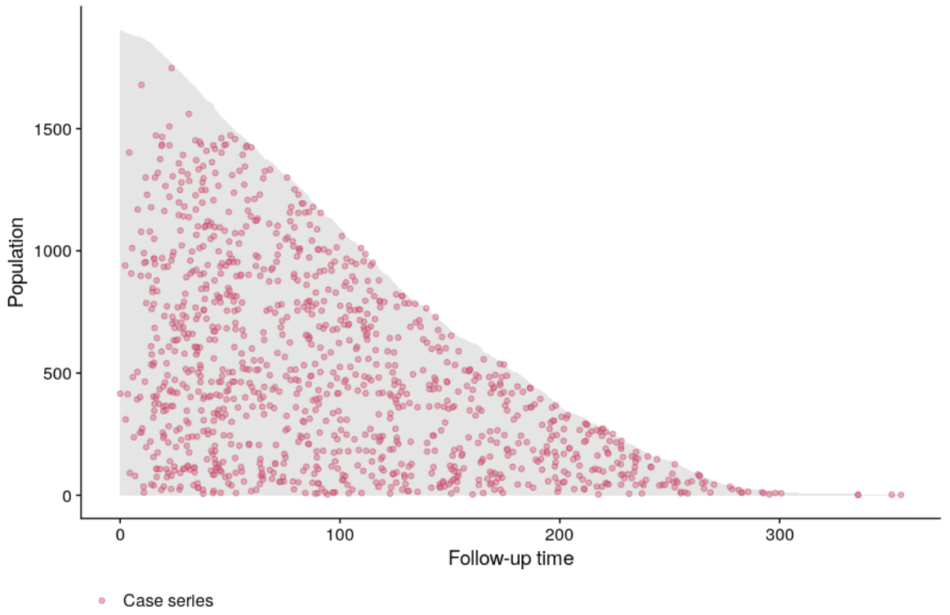
METABRIC study
Molecular Taxonomy of Breast Cancer International Consortium (METABRIC)
1980 individuals:
57.72% die due to breast cancer.
with 30 years of follow-up.
There are 9 covariates in total for this study (from Deepsurv):
4 genes (MKI67, EGFR, PGR, and ERBB2).
5 clinical features:
(hormone treatment/radiotherapy/chemotherapy/ER-positive indicator and age at diagnosis).
Pre-processed version from DeepSurv is used.
Notes:
MKI67: proliferation marker – higher expression in metastatic genes
EGFR: growth factor: causes over-proliferation in tumors if mutated
PGR: progesterone receptor: important for growth. If expression changes can cause abnormal growth
ERBB2: erythroblastic oncogene B – over expressed in breast cancer, lower survival, increased metastasis

Slide 38
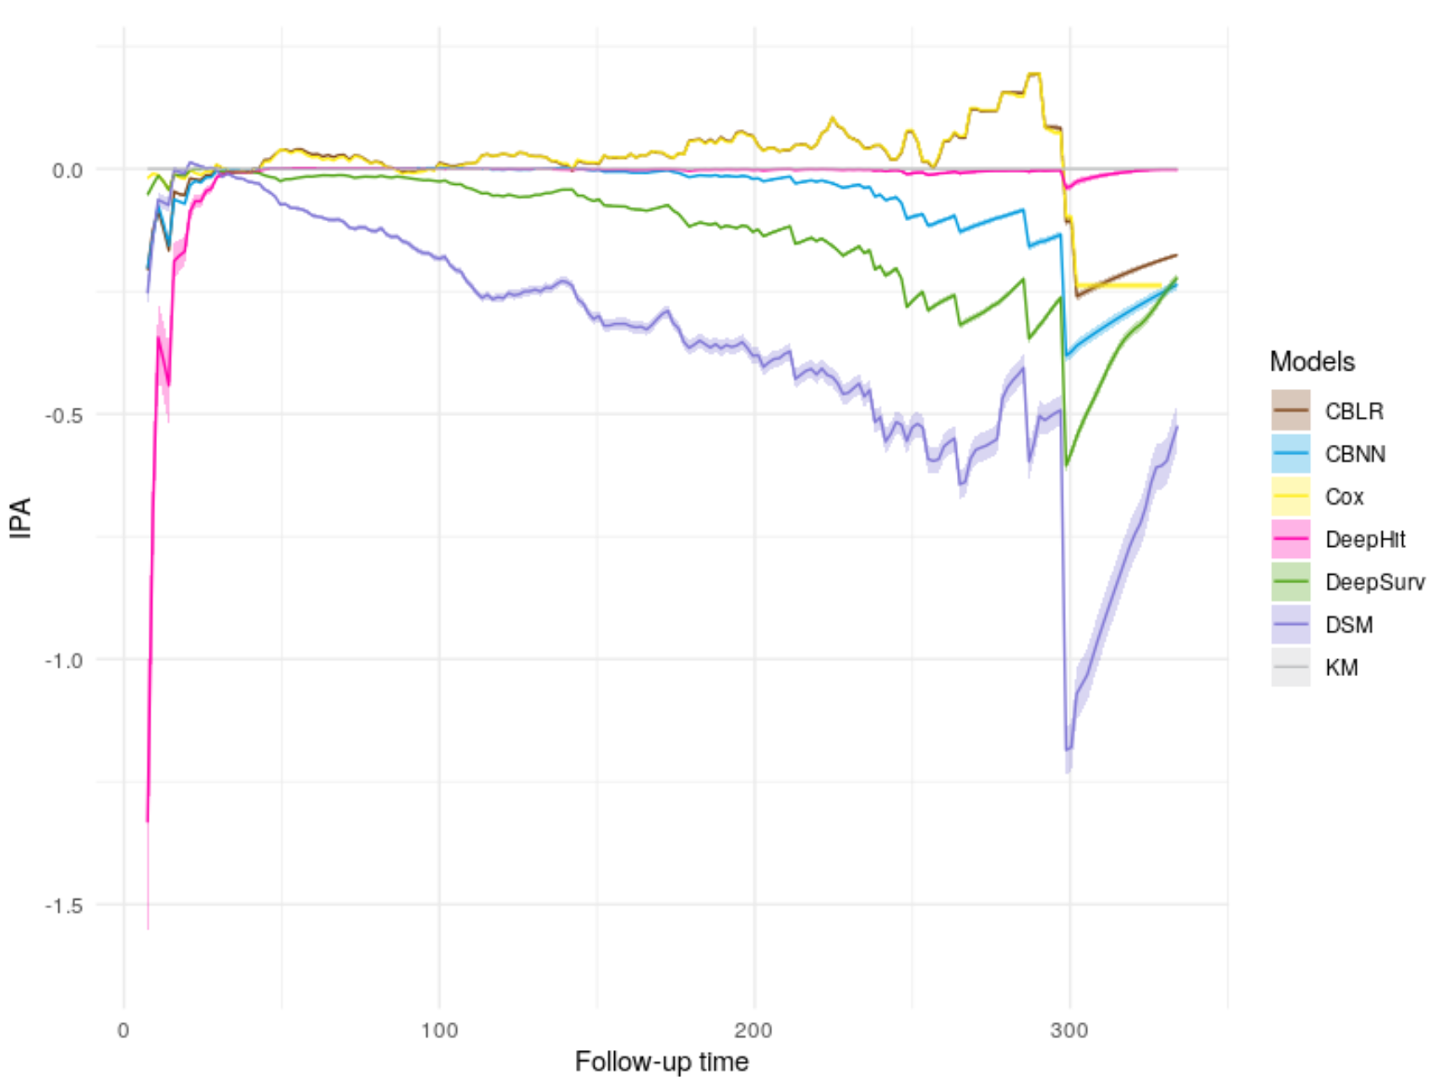
METABRIC result

Slide 39
Conclusion
If time varying interactions and a flexible baseline hazard without user specification are of interest, CBNN Should be strongly considered.
Provides a parametric, flexible baseline hazard.
Permits time-varying effects of covariates.
Applicable to high-dimensional datasets.
https://github.com/Jesse-Islam/cbnn
https://github.com/Jesse-Islam/cbnnManuscript

