Slide 1
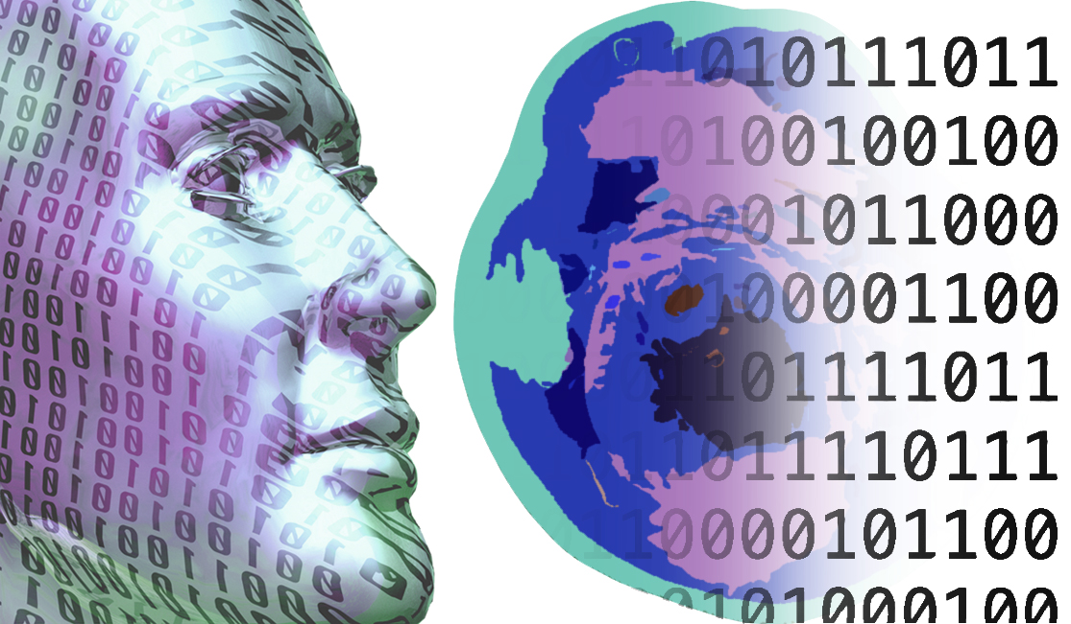
Diffusion Curvature for Estimating Local Curvature In High-Dimensional Data Dami Fasina Applied Math Program Krishnaswamy Lab
Dhananjay Bhaskar
Kincaid Macdonald
Oluwadamilola Fasina
Dawson Thomas
Bastian Reck
Ian Adelstein
Smita Krishnaswamy

Slide 2
Overview
Why do we care about local curvature of high-dim data??
Introduce diffusion geometry framework
Formulation of diffusion-based curvature
Applications

Slide 3
Motivation
High dimensional data is often sampled from a manifold, a key property of the underlying manifold is local curvature
We want to gain novel insights about high-dimensional data via local curvature
Manifold learning and diffusion geometry is a venerable framework for learning underlying manifold using sampled points
Leverage Diffusion-based curvature to define notion of local curvature on point-cloud data

Slide 4
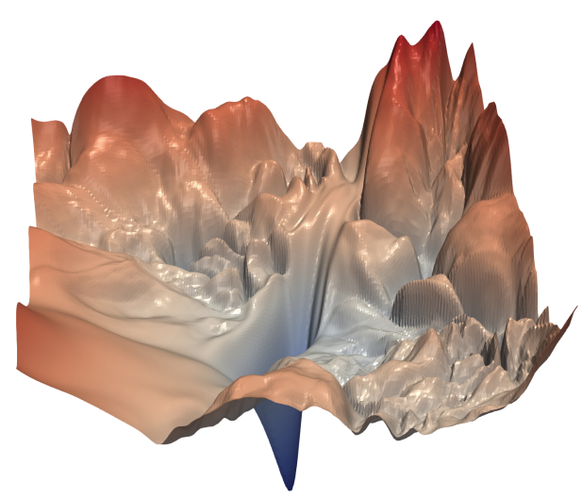
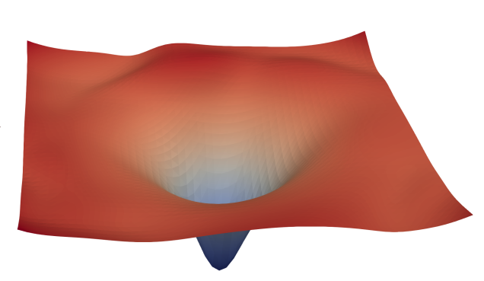
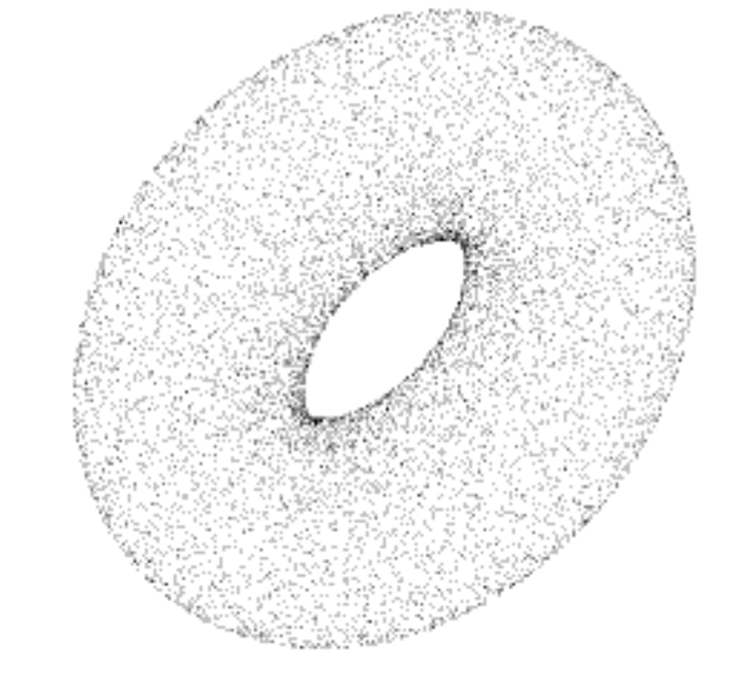
Motivation (Examples)
Local Curvature yields second order information about the Loss Landscape of NN’S
Local Curvature can provide branching information for biomedical point-cloud data

Slide 5
Preliminaries/Background
Diffusion Geometry
Manifold Assumption
Diffusion Maps
Curvature

Slide 6
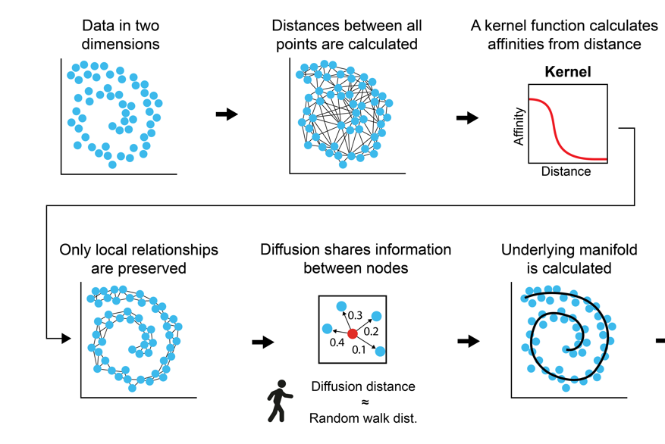
Introduction to diffusion geometry
In the discrete setting, Olivier - Ricci curvature has been used but is limited because it defines curvature based on edges
The notion of edges is nebulous for point-cloud data and thus necessitates diffusion curvature
Diffusion geometry framework traverses' data in a non-linear fashion to extract manifold-intrinsic properties

Slide 7
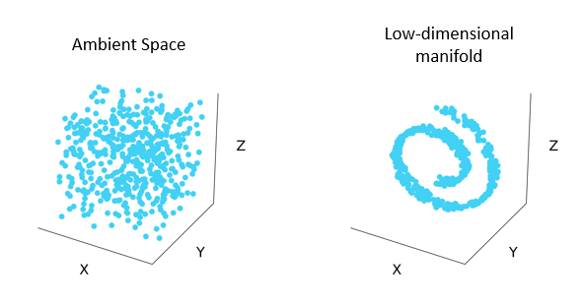
Manifold Assumption
Manifold Assumption: high-dimensional data is sampled from an intrinsic low-dimensional manifold
Given a set of points, $X=\{x_{1},…..,x_{N}\}$ $⊂ R^{n}$
Manifold assumption assumes data points like in Z = ${\{z_{i}\}}_{i=1}^{N}$ $⊂ M^{d}$, where d << n
To learn manifold geometry from point-cloud data, we use the diffusion maps construction

Slide 8
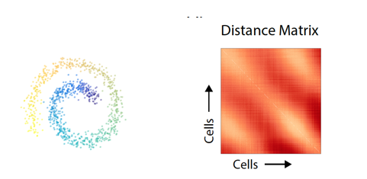
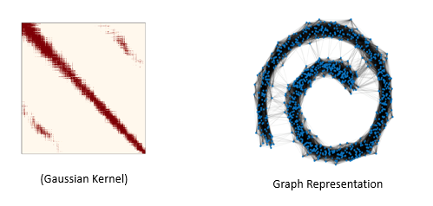
Diffusion Maps
Method introduced by Coifman et al. that traverses' data in a non-linear way to learn manifold
Construct kernel, $K\left(x,y\right)= \frac{G(x,y)}{{∥G(x, .)∥}_{1}^{α}{G(. ,y)}_{1}^{α}}$ ,to compute affinities between points
G(x,y) = $e^{−\frac{{∥x−y∥}^{2}}{σ}}$

Slide 9
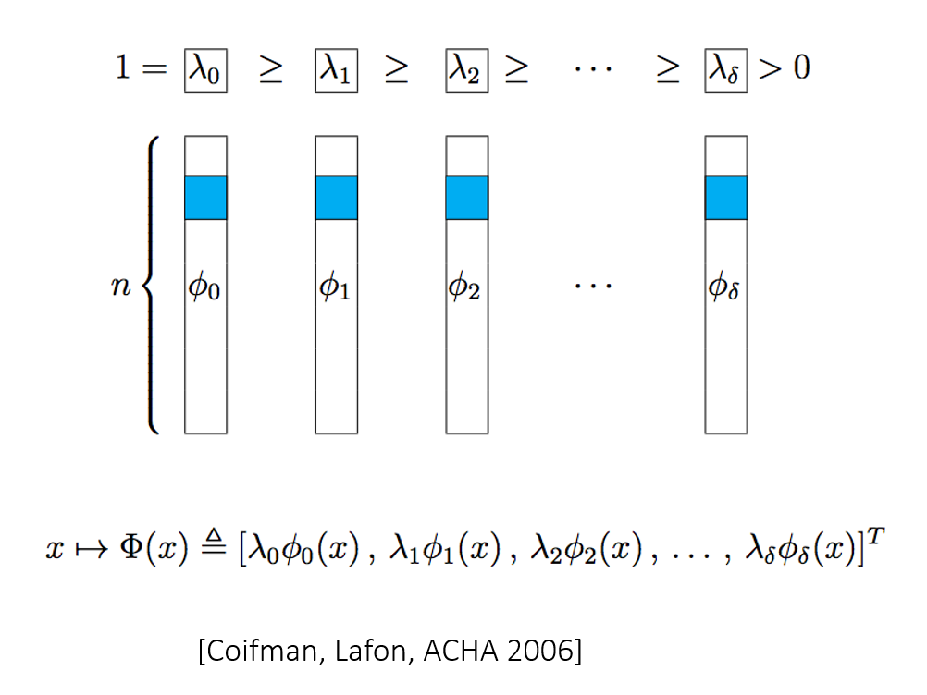
Diffusion Maps
Kernel can be row-normalized to create N X N row-stochastic matrix, $P_{ij}=p\left(x_{i, }x_{j}\right)$ , which describes a Markovian diffusion process
Diffusion map is constructed by eigen decomposing to construct: ${\text{[}\text{(}λ_{1}\text{,}φ_{1}\text{(}x_{1}\text{)}\text{)}\text{ ,…….., }{(λ}_{i}\text{,}φ_{i}\text{(}x_{i}\text{) }\text{)}\text{]}}^{T}$
Euclidean distance = diffusion distance in diffusion map space

Slide 10
Introduction to Curvature (Osculating)

Slide 11
Intro to Curvature (Sticker Phenomenon)

Slide 12
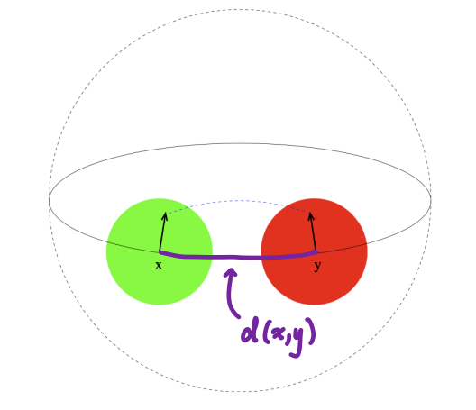
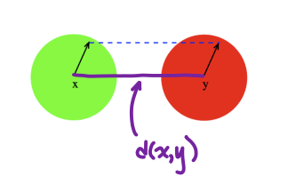
Discrete setting: Olivier-Ricci Curvature
Olivier-Ricci opine that curvature affects transportation cost
Defined edge-wise notion of transportation cost
Olivier-Ricci Curvature: K(x,y) = 1 - $\frac{{W(x,y)}_{1}}{d(x,y)}$
Ollivier, Y. Ricci curvature of Markov chains on metric spaces. J. Funct. Analysis 256, 810–864 0701886v4 (2009)

Slide 13
Methods
Bishop-Gromov
Diffusion Curvature
Main Theorem + Proof

Slide 14
Bishop-Gromov
Sticker Phenomenon (Sphere, Cylinder, Saddle)
K = $\lim_{r⟶∞}{12}\frac{πr^{2}−A(r)}{πr^{4}}$
Bishop-Gromov (Sticker Phenomenon in higher-dimensions)

Slide 15
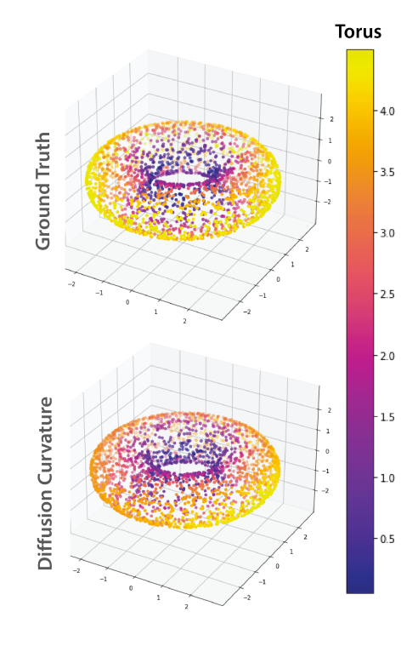
Diffusion Curvature Definition
$$B_{m}\left(x,r\right)=\{y ϵ M:D_{m}\left(x,y\right) ≤r \}$$
$$m_{x}\left(y\right)= P^{t}\left(x,y\right)$$
$$C\left(x\right)= \frac{\sum_{yεB(x,r)}{m_{x}(y)}}{| B\left(x,r\right)|}$$

Slide 16
Main Theorem + Proof
vol ($B_{m}(x,r)$) $≤$vol ($B_{m}(x_{k},r)$) (From Theorem 1)
$|B\left(x,r\right)|$ $≤$|$B(x_{k},r)$|
$$\frac{1}{B(x_{k},r)}≤ \frac{1}{B(x,r)}$$

Slide 17
Results
Toy Test Cases
Single Cell Data
Hessian Estimation of NN

Slide 18
Results – Toy Test Cases

Slide 19
Results – Toy Test Cases

Slide 20
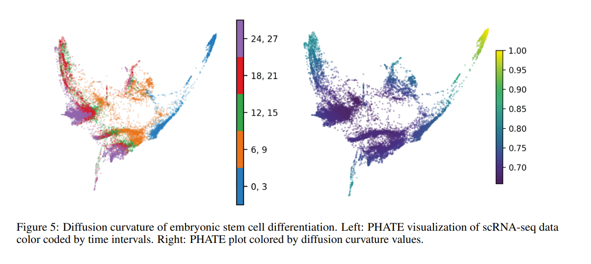
Results – Curvature Estimation for Single-Cell data

Slide 21
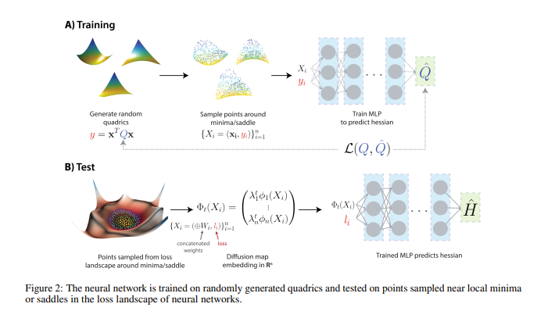
Train/Test Schematic

Slide 22
NN Hessian Estimation Sampling
We sample n points, {$x_{1},x_{2},…,x_{n} | x_{i}εR^{k}$} around the optimum and obtain n loss values, {f($x_{i}$), f($x_{i}$),….., f($x_{n}$)|f:${ R}^{k}→R$}, where k is full-dimensionality of Neural Network
We concatenate the associated loss value, f($x_{i}$)$∈R$ to the vector $x_{i}εR^{k}$ to construct an $R^{n x (k+1)}$matrix.
From this matrix, we then construct a diffusion map ($R^{nxn}$) and pair diffusion axes and their loss values ($φ\left(x_{i}\right),$f($x_{i}$)) as input into a separate NN that estimates the Hessian

Slide 23
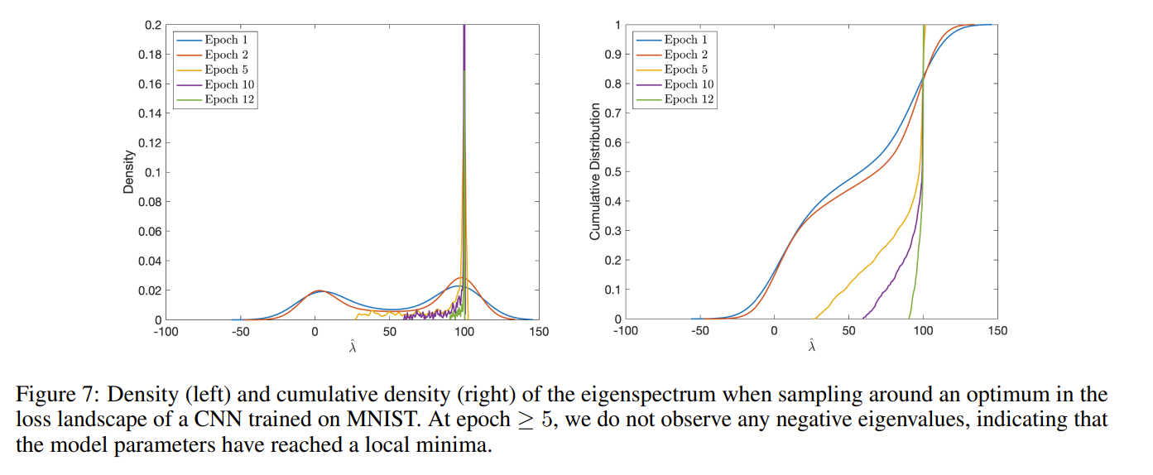
Eigenspectrum of Hessian

Slide 24
Conclusions
Leveraged priors from Diffusion Geometry to create new notion of Diffusion Curvature on point cloud data
Diffusion Curvature can extract meaningful information from high-dimensional data which has nice implications
Limitations: Sampling, Diffusion Curvature has no sign; how to define negative/positive curvature

Slide 25
Future Work
In depth study of applying method for Hessian Estimation of Neural Networks
Further development of theory to extract further insights from high-dimensional biomedical data
What does low-dimensional estimate of high-dimensional system tell us??

Slide 26
Acknowledgements
2206.03977.pdf (arxiv.org) (Diffusion Curvature for Estimating Local Curvature in High-Dimensional Data)
Authors: Dhananjay Bhaskar, Kincaid MacDonald, Oluwadamilola Fasina, Dawson Thomas, Bastian Reck, Ian Adelstein, Smita Krishnaswamy

