Slide 1

Reference Vector Assisted Candidate Search with Aggregated Surrogate for Expnsive Many-objective Optimization Problems
Presented by Christine Shoemaker
This work is in the PHD of Wang Wenyu, which was supervised by Prof. Shoemaker
Department of Industrial Systems Engineering and Management,
National University of Singapore
July 18, 2022

Slide 2
Problem Characteristics
We address the difficult problem of addressing an optimization problem with the following characteristics:
1) It is a “Many” objective problem, meaning that there are more than three objectives and we are looking for Pareto optimal solutions.
2) The objective function is “Multimodal” so it is a “global” optimization problem (with multiple local minima) .
3) the objective function is is expensive to compute (so relatively few function evaluations/iterations can be before stopping the search) so a surrogate is used.
4)Neither derivative information, the number of local minima, nor an analytical expression for the objective function is available

Slide 3


Introduction and Motivation
Integrating $ε$-Dominance with RBF Many-Objective Optimization
Many-Objective Optimization with Aggregated Surrogate
Surrogate-Assisted Multi-Fidelity Multi-Objective Optimization
Conclusions and Future Research
Computationally Expensive MOPs
Surrogate-Assisted Optimization Method
Overview of Research Topics
Computationally Expensive MOPs
Multiple conflicting objectives commonly exist in real-world simulation-based optimization problems and such problems are typically referred to as Multi-objective Optimization Problems (MOPs).
Mathematical Formular of an MOP
$$\min_{x∈𝒟}{f\left(x\right)={\left[f_{1}\left(x\right),f_{2}\left(x\right),…,f_{k}\left(x\right)\right]}^{T}},$$
$$(1.1)$$
$x={\left[x_{1},…,x_{d}\right]}^{T}$ is a $d$-dimensional vector used to denote a point in the decision space.
$𝒟$ denotes the decision space that is bounded by vectors $l$ and $u$, i.e., $𝒟=\{x∈ℝ^{d}|l≤x≤u\}$.
$f={\left[f_{1},…,f_{k}\right]}^{T}$ denotes the vector of $k$ real-valued objectives, and $f_{i}$ is deterministic continuous on $𝒟$.
In the context of computationally expensive MOP, each objective function is assumed to be black-box (i.e., any mathematical characteristics, e.g., convexity and derivatives, is unknown) and computationally expensive (i.e., evaluation of objectives can be computed via complex and time-consuming simulation).

Slide 4
Introduction and Motivation
Integrating $ε$-Dominance with RBF Many-Objective Optimization
Many-Objective Optimization with Aggregated Surrogate
Surrogate-Assisted Multi-Fidelity Multi-Objective Optimization
Conclusions and Future Research
Computationally Expensive MOPs
Surrogate-Assisted Optimization Method
Overview of Research Topics
Solving Computationally Expensive MOPs
Definition 1.1 (Dominance)
Given $k$ objectives in $f={\left[f_{1},…,f_{k}\right]}^{T}$, a point $x_{A}∈𝒟$ is said to dominate another point $x_{B}∈𝒟$ (denoted by $x_{A}≺x_{B}$) if and only if $f_{i}\left(x_{A}\right)≤f_{i}(x_{B})$, for all $1≤i≤k$, and $f_{j}\left(x_{A}\right)<f_{j}(x_{B})$, for some $1≤j≤k$.
Pareto-optimal set is the set of points not dominated by any other points in the whole feasible decision space. The objective vectors in the Pareto-optimal set is called the Pareto-optimal front.
Because the budget is limited to a few hundreds of evaluations, the goal of solving a computationally expensive MOP is to locate a converged and well-spread approximation of the Pareto-optimal front.
Figure 1.1: 2D visualization of Pareto-optimal front.

Slide 5

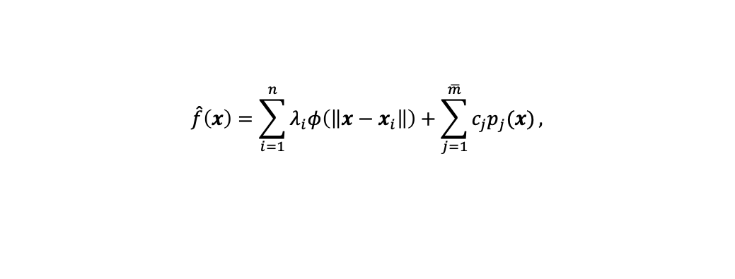
Introduction and Motivation
Integrating $ε$-Dominance with RBF Many-Objective Optimization
Many-Objective Optimization with Aggregated Surrogate
Surrogate-Assisted Multi-Fidelity Multi-Objective Optimization
Conclusions and Future Research
Computationally Expensive MOPs
Surrogate-Assisted Optimization Method
Overview of Research Topics
Surrogate Model
Surrogate Model (also known as response surface model), e.g., Radial Basis Function (RBF) (Powell 1992) and Gaussian Process (GP) (Cressie 1991), can be used to approximate the underlying real-valued function by fitting on finite pairs of function input and output.
Example: augmented RBF model that approximates $f$ with a training set $Q_{n}={\left\{\left(x_{i},f(x_{i})\right)\right\}}_{i=1}^{n}$
$$\hat{f}\left(x\right)=\sum_{i=1}^{n}{λ_{i}φ\left(\left\|x−x_{i}\right\|\right)}+\sum_{j=1}^{\overline{m}}{c_{j}p_{j}(x)},$$
$$(1.2)$$
Figure 1.2: Visualization of RBF that approximates the Ackley function.
Ph.D. Oral Presentation
Notes:
The above augmented RBF has been widely used in deterministic applications because
It converges to the underlying function as the size of $Q_{n}$ goes to infinity, and
It introduces additional modelling flexibility by incorporating condition positive definite type of radial kernels, such as Gaussian, multiquadratic, thin plate, cubic, etc.

Slide 6
Why Use Reference Vectors for Many Objective Optimization?
We proposed GOMORS a few year ago that used a RBF surrogate and other features to enhance the MO algorithm so it was more efficient.
However GOMORS and other surrogate MO algorithms developed later, did struggle if the number of objectives to be optimized became large because each objective had its own surrogate. .
It has been proposed to use reference vectors to decompose objective space and to avoid the issues caused by maintaining many surrogates

Slide 7
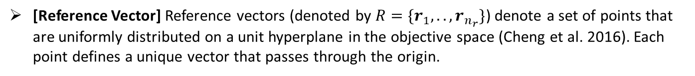

Introduction and Motivation
Integrating $ε$-Dominance with RBF Many-Objective Optimization
Many-Objective Optimization with Aggregated Surrogate
Surrogate-Assisted Multi-Fidelity Multi-Objective Optimization
Conclusions and Future Research
Reference Vectors in Many-Objective Optimization
RECAS Algorithmic Framework
Convergence Analysis Based on Grids
Numerical Experiment Results and Conclusions
Assignments of Points to Reference Vectors
[Reference Vector] Reference vectors (denoted by $R=\{r_{1},..,r_{n_{r}}\}$) denote a set of points that are uniformly distributed on a unit hyperplane in the objective space (Cheng et al. 2016). Each point defines a unique vector that passes through the origin.
[Transformed Objectives] For a point $x$, its objective vector $f(x)$ is first transformed into $\overline{f}\left(x\right)=f\left(x\right)−g_{m}^{min}$, where $g_{m}^{min}$ denotes the ideal objective vector found so far.
[Point Assignment] Point $x$ with transformed objective vector $\overline{f}\left(x\right)$ is assigned to a reference vector $r_{i}$ whose acute angle to $\overline{f}(x)$ is the smallest among all reference vectors.
Figure 3.1: Visualization of a) a set of uniformly distributed reference vectors in the objective space, and b) an example of assigning points to two reference vectors.

Slide 8

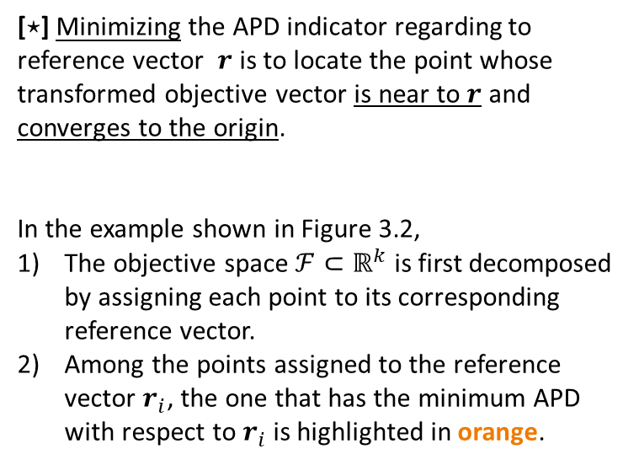
Introduction and Motivation
Integrating $ε$-Dominance with RBF Many-Objective Optimization
Many-Objective Optimization with Aggregated Surrogate
Surrogate-Assisted Multi-Fidelity Multi-Objective Optimization
Conclusions and Future Research
Reference Vectors in Many-Objective Optimization
RECAS Algorithmic Framework
Convergence Analysis Based on Grids
Numerical Experiment Results and Conclusions
Angle-Penalized Distance (APD)
The computation of APD with respect to a reference vector $r$
$Angle Index: APD\left(x,r\right)=\left(1+P\left(θ\right)\right)⋅{\left\|\overline{f}\left(x\right)\right\|}_{2},$A
$$(3.2)$$
where $θ$ is the acute angle between transformed objective vector $\overline{f}(x)$ and reference vector $r$, and $P(θ)$ is a positive penalty function that increases as $θ$ goes up.
[$⋆$] Minimizing the APD indicator regarding to reference vector $r$ is to locate the point whose transformed objective vector is near to $r$ and converges to the origin.
In the example shown in Figure 3.2,
The objective space $ℱ⊂ℝ^{k}$ is first decomposed by assigning each point to its corresponding reference vector.
Among the points assigned to the reference vector $r_{i}$, the one that has the minimum APD with respect to $r_{i}$ is highlighted in orange.
Goal is to mini-mize both Obj 1 and Obj 2
Figure 3.2: Example of selecting points by minimizing APD with respect to each reference vector.

Slide 9
Prior Work on Reference Vectors in
“Many Objective Optimization”
[1]Cheng, R., Jin, Y., Olhofer, M., & Sendhoff, B. (2016). A reference vector guided evolutionary algorithm for many-objective optimization. IEEE Transactions on Evolutionary Computation, 20(5), 773-791.
[2] Chugh, T., Jin, Y., Miettinen, K., Hakanen, J., & Sindhya, K. (2016). A surrogate-assisted reference vector guided evolutionary algorithm for computationally expensive many-objective optimization. IEEE Transactions on Evolutionary Computation, 22(1), 129-142.
[1] The first paper first proposed the concept of reference vectors. It gives details on what are reference vectors and how to use them in multi-objective evolutionary algorithms. But it focuses on non-surrogate-assisted methods only.
[2] The second paper developed a Kriging-assisted (e.g. Gaussian Process surrogate) algorithm that uses the same reference vector idea.
Our algorithm outperforms [2] in the numerical experiments. The algorithm [ 1] does not use a surrogate so the assumption is that it will be slower than a good surrogate method for an expensive objective function. Our algorithm is not an evolutionary algorithm.
Neither of these papers above use the RBF surrogate that we use, nor do they have the same algorithm .

Slide 10
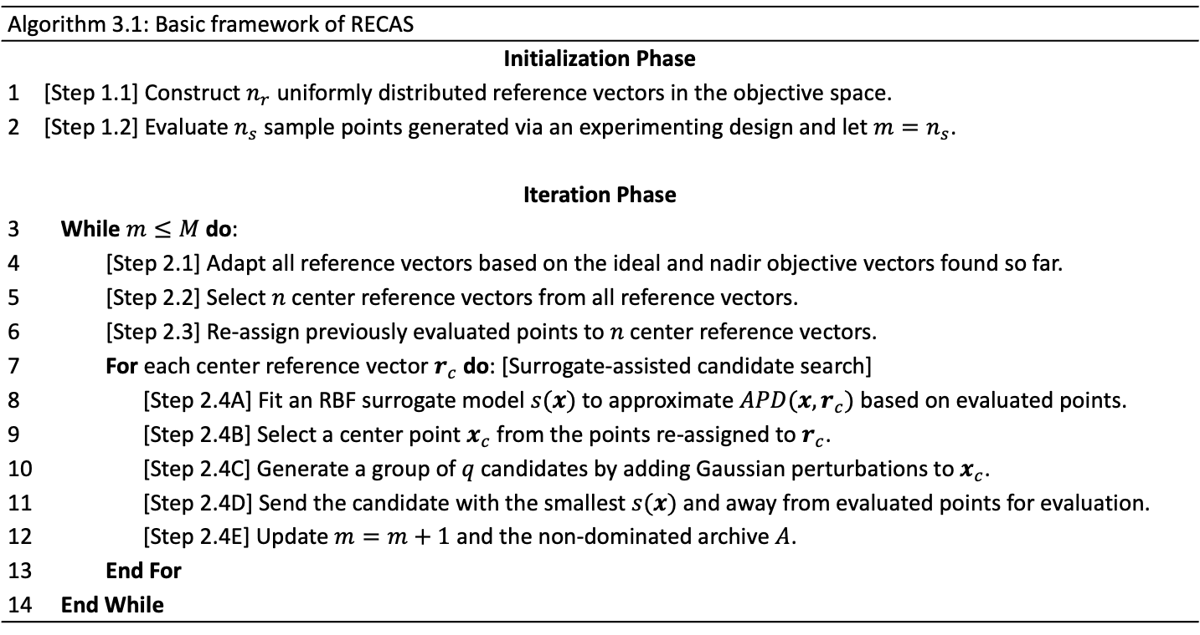
Introduction and Motivation
Integrating $ε$-Dominance with RBF Many-Objective Optimization
Many-Objective Optimization with Aggregated Surrogate
Surrogate-Assisted Multi-Fidelity Multi-Objective Optimization
Conclusions and Future Research
Reference Vectors in Many-Objective Optimization
RECAS Algorithmic Framework
Convergence Analysis Based on Grids
Numerical Experiment Results and Conclusions
Algorithm Description (Framework of RECAS)
Algorithm 3.1: Basic framework of RECAS
Initialization Phase | Generate and evaluate initial sample points.
1 | [Step 1.1] Construct $n_{r}$ uniformly distributed reference vectors in the objective space.
2 | [Step 1.2] Evaluate $n_{s}$ sample points generated via an experimenting design and let $m=n_{s}$.
Iteration Phase | Iteration Phase
3 | While $m≤M$ do: | While $m≤M$ do:
4 |  |  | [Step 2.1] Adapt all reference vectors based on the ideal and nadir objective vectors found so far.
5 |  |  | [Step 2.2] Select $n$ center reference vectors from all reference vectors.
6 |  |  | [Step 2.3] Re-assign previously evaluated points to $n$ center reference vectors.
7 |  |  | For each center reference vector $r_{c}$ do: [Surrogate-assisted candidate search]
8 |  |  |  | [Step 2.4A] Fit an RBF surrogate model $s(x)$ to approximate $APD(x,r_{c})$ based on evaluated points.
9 |  |  |  | [Step 2.4B] Select a center point $x_{c}$ from the points re-assigned to $r_{c}$.
10 |  |  |  | [Step 2.4C] Generate a group of $q$ candidates by adding Gaussian perturbations to$x_{c}$.
11 |  |  |  | [Step 2.4D] Send the candidate with the smallest $s(x)$ and away from evaluated points for evaluation.
12 |  |  |  | [Step 2.4E] Update $m=m+1$ and the non-dominated archive $A$.
13 |  |  | End For
14 | End While | End While
Ph.D. Oral Presentation

Slide 11
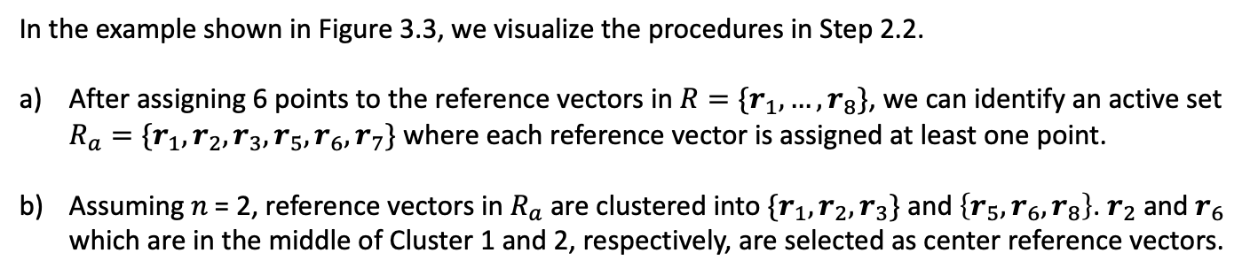
Introduction and Motivation
Integrating $ε$-Dominance with RBF Many-Objective Optimization
Many-Objective Optimization with Aggregated Surrogate
Surrogate-Assisted Multi-Fidelity Multi-Objective Optimization
Conclusions and Future Research
Reference Vectors in Many-Objective Optimization
RECAS Algorithmic Framework
Convergence Analysis Based on Grids
Numerical Experiment Results and Conclusions
Algorithm Description (Clustering)
In the example shown in Figure 3.3, we visualize the procedures in Step 2.2.
After assigning 6 points to the reference vectors in $R=\{r_{1},…,r_{8}\}$, we can identify an active set $R_{a}=\{r_{1},r_{2},r_{3},r_{5},r_{6},r_{7}\}$ where each reference vector is assigned at least one point.
Assuming 𝑛 = 2, reference vectors in $R_{a}$ are clustered into $\{r_{1},r_{2},r_{3}\}$ and $\left\{r_{5},r_{6},r_{8}\right\}$. $r_{2}$ and $r_{6}$ which are in the middle of Cluster 1 and 2, respectively, are selected as center reference vectors.
Figure 3.3: Visualization of a) the identification of active and inactive reference vectors and b) the selection of center reference point in each cluster.
Ph.D. Oral Presentation

Slide 12
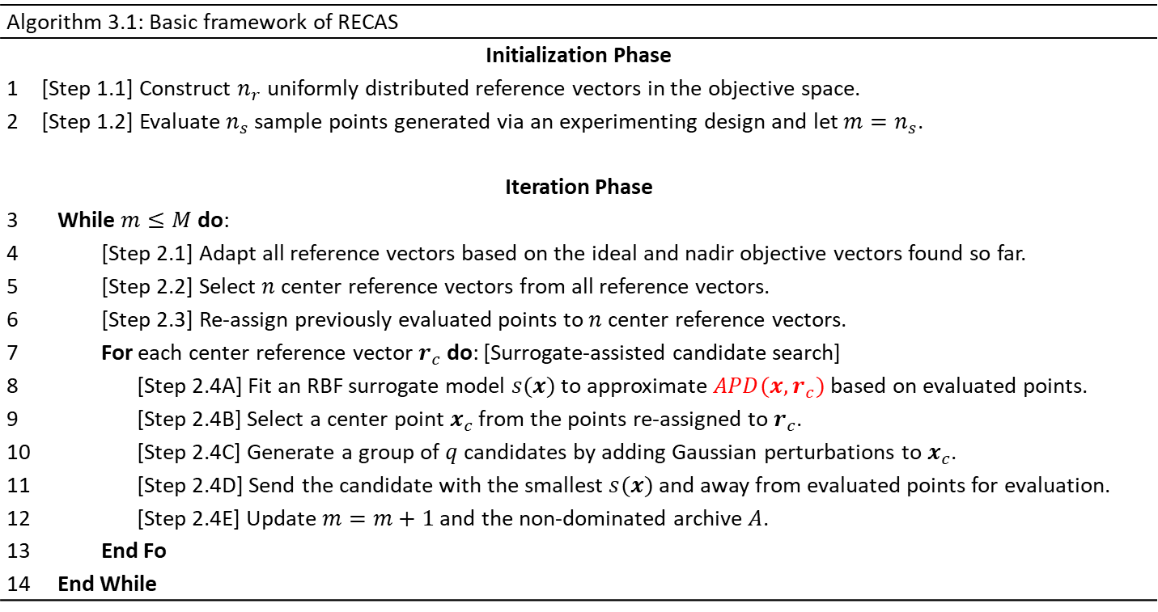
Introduction and Motivation
Integrating $ε$-Dominance with RBF Many-Objective Optimization
Many-Objective Optimization with Aggregated Surrogate
Surrogate-Assisted Multi-Fidelity Multi-Objective Optimization
Conclusions and Future Research
Reference Vectors in Many-Objective Optimization
RECAS Algorithmic Framework
Convergence Analysis Based on Grids
Numerical Experiment Results and Conclusions
Algorithm Description (Framework of RECAS)
Algorithm 3.1: Basic framework of RECAS
Initialization Phase | Generate and evaluate initial sample points.
1 | [Step 1.1] Construct $n_{r}$ uniformly distributed reference vectors in the objective space.
2 | [Step 1.2] Evaluate $n_{s}$ sample points generated via an experimenting design and let $m=n_{s}$.
Iteration Phase | Iteration Phase
3 | While $m≤M$ do: | While $m≤M$ do:
4 |  |  | [Step 2.1] Adapt all reference vectors based on the ideal and nadir objective vectors found so far.
5 |  |  | [Step 2.2] Select $n$ center reference vectors from all reference vectors.
6 |  |  | [Step 2.3] Re-assign previously evaluated points to $n$ center reference vectors.
7 |  |  | For each center reference vector $r_{c}$ do: [Surrogate-assisted candidate search]
8 |  |  |  | [Step 2.4A] Fit an RBF surrogate model $s(x)$ to approximate $APD(x,r_{c})$ based on evaluated points.
9 |  |  |  | [Step 2.4B] Select a center point $x_{c}$ from the points re-assigned to $r_{c}$.
10 |  |  |  | [Step 2.4C] Generate a group of $q$ candidates by adding Gaussian perturbations to$x_{c}$.
11 |  |  |  | [Step 2.4D] Send the candidate with the smallest $s(x)$ and away from evaluated points for evaluation.
12 |  |  |  | [Step 2.4E] Update $m=m+1$ and the non-dominated archive $A$.
13 |  |  | End Fo
14 | End While | End While
Recall: $APD\left(x,r\right)=\left(1+P\left(θ\right)\right)⋅{\left\|\overline{f}\left(x\right)\right\|}_{2},$and a surrogate will be built for this

Slide 13

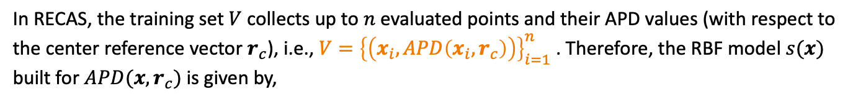
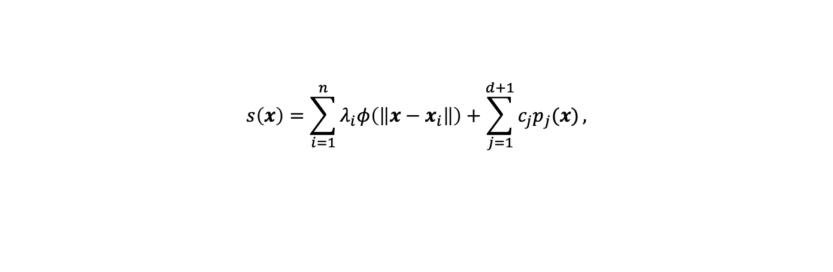

Introduction and Motivation
Integrating $ε$-Dominance with RBF Many-Objective Optimization
Many-Objective Optimization with Aggregated Surrogate
Surrogate-Assisted Multi-Fidelity Multi-Objective Optimization
Conclusions and Future Research
Reference Vectors in Many-Objective Optimization
RECAS Algorithmic Framework
Convergence Analysis Based on Grids
Numerical Experiment Results and Conclusions
Algorithm Description (Fitting Aggregated Surrogate Model)
In RECAS, the training set $V$ collects up to $n$ evaluated points and their APD values (with respect to the center reference vector $r_{c}$), i.e., $V={\left\{\left(x_{i},APD\left(x_{i},r_{c}\right)\right)\right\}}_{i=1}^{n}$ . Therefore, the RBF model $s(x)$ built for $APD(x,r_{c})$ is given by,
$$s\left(x\right)=\sum_{i=1}^{n}{λ_{i}φ\left(\left\|x−x_{i}\right\|\right)}+\sum_{j=1}^{d+1}{c_{j}p_{j}(x)},$$
$$(3.3)$$
where radial kernel function $φ\left(r\right)=r^{3}$, and tail function $p(x)={\left[1,x_{1}…,x_{d}\right]}^{T}$. The coefficients in $λ=[λ_{1},…,λ_{n}]$ and $c={\left[c_{1},…,c_{\overline{m}}\right]}^{T}$ can be uniquely determined by the following linear system,
$$\left[\begin{matrix}Φ & P \\ P^{T} & 0_{\overline{m}×\overline{m}}\end{matrix}\right]\left[\begin{matrix}λ \\ c\end{matrix}\right]=\left[\begin{matrix}A \\ 0_{\overline{m}}\end{matrix}\right],$$
$$(3.4)$$
where matrix $Φ∈ℝ^{n×n}$ with ${\left[Φ\right]}_{i,j}=φ(\left\|x_{i}−x_{j}\right\|)$, matrix $P∈ℝ^{n×\overline{m}}$ with ${\left[P\right]}_{i,j}=p_{j}(x_{i})$, and column vector $A={\left[APD(x_{1},r_{c}),…,APD(x_{n},r_{c}) \right]}^{T}$.

Slide 14
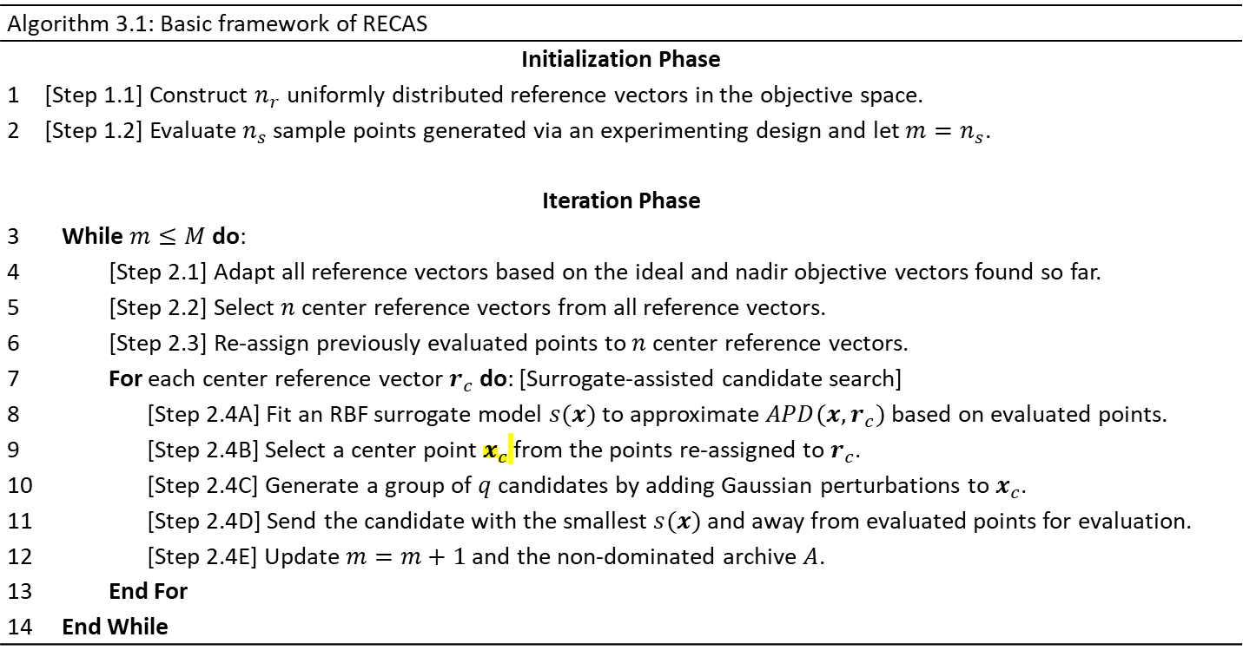
Introduction and Motivation
Integrating $ε$-Dominance with RBF Many-Objective Optimization
Many-Objective Optimization with Aggregated Surrogate
Surrogate-Assisted Multi-Fidelity Multi-Objective Optimization
Conclusions and Future Research
Reference Vectors in Many-Objective Optimization
RECAS Algorithmic Framework
Convergence Analysis Based on Grids
Numerical Experiment Results and Conclusions
Algorithm Description (Framework of RECAS)
Algorithm 3.1: Basic framework of RECAS
Initialization Phase | Generate and evaluate initial sample points.
1 | [Step 1.1] Construct $n_{r}$ uniformly distributed reference vectors in the objective space.
2 | [Step 1.2] Evaluate $n_{s}$ sample points generated via an experimenting design and let $m=n_{s}$.
Iteration Phase | Iteration Phase
3 | While $m≤M$ do: | While $m≤M$ do:
4 |  |  | [Step 2.1] Adapt all reference vectors based on the ideal and nadir objective vectors found so far.
5 |  |  | [Step 2.2] Select $n$ center reference vectors from all reference vectors.
6 |  |  | [Step 2.3] Re-assign previously evaluated points to $n$ center reference vectors.
7 |  |  | For each center reference vector $r_{c}$ do: [Surrogate-assisted candidate search]
8 |  |  |  | [Step 2.4A] Fit an RBF surrogate model $s(x)$ to approximate $APD(x,r_{c})$ based on evaluated points.
9 |  |  |  | [Step 2.4B] Select a center point $x_{c}$ from the points re-assigned to $r_{c}$.
10 |  |  |  | [Step 2.4C] Generate a group of $q$ candidates by adding Gaussian perturbations to$x_{c}$.
11 |  |  |  | [Step 2.4D] Send the candidate with the smallest $s(x)$ and away from evaluated points for evaluation.
12 |  |  |  | [Step 2.4E] Update $m=m+1$ and the non-dominated archive $A$.
13 |  |  | End For
14 | End While | End While

Slide 15

Introduction and Motivation
Integrating $ε$-Dominance with RBF Many-Objective Optimization
Many-Objective Optimization with Aggregated Surrogate
Surrogate-Assisted Multi-Fidelity Multi-Objective Optimization
Conclusions and Future Research
Reference Vectors in Many-Objective Optimization
RECAS Algorithmic Framework
Convergence Analysis Based on Grids
Numerical Experiment Results and Conclusions
Algorithm Description (Surrogate-Assisted Candidate Search)
[Step 2.4B Center Point Selection] Among the set ($V^{i}$) of points re-assigned to the center reference vector $r_{c}^{i}$, a center point $x_{c}^{i}$is determined by,
$$x_{c}^{i}=argmin_{x∈V^{i}}APD\left(x,r_{c}^{i}\right).$$
$$(3.5)$$
[Step 2.4C Candidate Generation] Each candidate point (${\overline{x}}^{i}$) is generated by adding a random Gaussian perturbation to the center point $x_{c}^{i}$, i.e., ${\overline{x}}^{i}∼𝒩(x_{c}^{i},σ^{2}I^{d})$.
Figure 3.4: Visualization of a) selecting center points and b) generating candidate points.
Ph.D. Oral Presentation

Slide 16
Introduction and Motivation
Integrating $ε$-Dominance with RBF Many-Objective Optimization
Many-Objective Optimization with Aggregated Surrogate
Surrogate-Assisted Multi-Fidelity Multi-Objective Optimization
Conclusions and Future Research
Reference Vectors in Many-Objective Optimization
RECAS Algorithmic Framework
Convergence Analysis Based on Grids
Numerical Experiment Results and Conclusions
Algorithm Description (Framework of RECAS)
Algorithm 3.1: Basic framework of RECAS
Initialization Phase | Generate and evaluate initial sample points.
1 | [Step 1.1] Construct $n_{r}$ uniformly distributed reference vectors in the objective space.
2 | [Step 1.2] Evaluate $n_{s}$ sample points generated via an experimenting design and let $m=n_{s}$.
Iteration Phase | Iteration Phase
3 | While $m≤M$ do: | While $m≤M$ do:
4 |  |  | [Step 2.1] Adapt all reference vectors based on the ideal and nadir objective vectors found so far.
5 |  |  | [Step 2.2] Select $n$ center reference vectors from all reference vectors.
6 |  |  | [Step 2.3] Re-assign previously evaluated points to $n$ center reference vectors.
7 |  |  | For each center reference vector $r_{c}$ do: [Surrogate-assisted candidate search]
8 |  |  |  | [Step 2.4A] Fit an RBF surrogate model $s(x)$ to approximate $APD(x,r_{c})$ based on evaluated points.
9 |  |  |  | [Step 2.4B] Select a center point $x_{c}$ from the points re-assigned to $r_{c}$.
10 |  |  |  | [Step 2.4C] Generate a group of $q$ candidates by adding Gaussian perturbations to$x_{c}$.
11 |  |  |  | [Step 2.4D] Send the candidate with the smallest $s(x)$ and away from evaluated points for evaluation.
12 |  |  |  | [Step 2.4E] Update $m=m+1$ and the non-dominated archive $A$.
13 |  |  | End For
14 | End While | End While

Slide 17
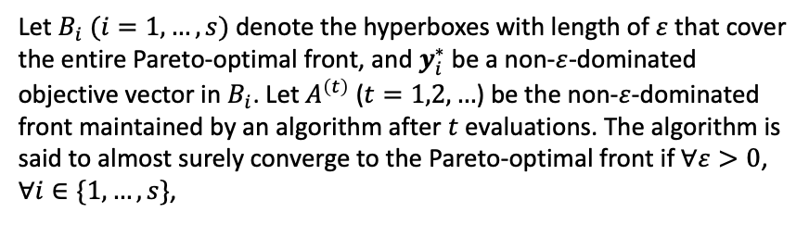





Introduction and Motivation
Integrating $ε$-Dominance with RBF Many-Objective Optimization
Many-Objective Optimization with Aggregated Surrogate
Surrogate-Assisted Multi-Fidelity Multi-Objective Optimization
Conclusions and Future Research
Reference Vectors in Many-Objective Optimization
RECAS Algorithmic Framework
Convergence Analysis Based on Grids
Numerical Experiment Results and Conclusions
Convergence Analysis Based on Grids
Definition 3.1 ($ε$-Neighborhood)
Given $ε>0$, the $ε$-neighborhood of $y∈ℝ^{k}$ is defined as,
$$N_{ε}\left(y\right)=\left\{z∈ℝ^{k} | {\left\|z−y\right\|}_{∞}<ε\right\}.$$
$$(3.6)$$
Definition 3.2 (Almost sure convergence of multi-objective algorithm based on grids) (Zhou and He, 2007)
Let $B_{i} (i=1,…,s)$ denote the hyperboxes with length of $ε$ that cover the entire Pareto-optimal front, and $y_{i}^{∗}$be a non-$ε$-dominated objective vector in $B_{i}$. Let $A^{\left(t\right)}$ ($t=1,2,…$) be the non-$ε$-dominated front maintained by an algorithm after $t$ evaluations. The algorithm is said to almost surely converge to the Pareto-optimal front if $∀ε>0$, $∀i∈\{1,…,s\}$,
$$\lim_{τ→+∞}{P\left(A^{\left(t\right)}∩N_{ε}\left(y_{i}^{∗}\right)≠∅,∀t≥τ\right)=1.}$$
$$(3.7)$$
Figure 3.5(b): $ε$-dominance-based hypercubes $B_{i}$ and the representative objective vector $y_{i}^{∗}$ in it.
Theorem 1 (Almost Sure Convergence of RECAS Based on Grids)
Given that the decision space $𝒟$ is a compact set in $ℝ^{d}$ and all real-valued objective functions in $f={\left[f_{1},…,f_{k}\right]}^{T}$ are deterministic and continuous on $𝒟$, the proposed algorithm RECAS with non-$ε$-dominated archive maintained on grids converges almost surely to the Pareto-optimal front.
Ph.D. Oral Presentation

Slide 18
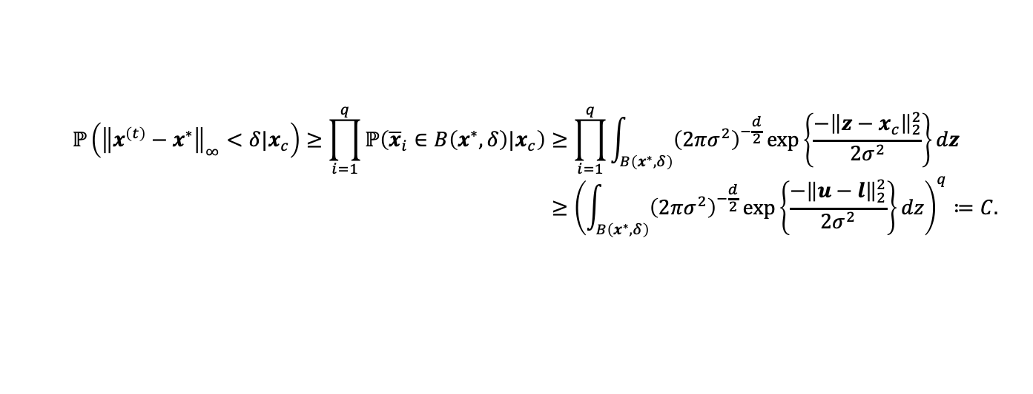


Introduction and Motivation
Integrating $ε$-Dominance with RBF Many-Objective Optimization
Many-Objective Optimization with Aggregated Surrogate
Surrogate-Assisted Multi-Fidelity Multi-Objective Optimization
Conclusions and Future Research
Reference Vectors in Many-Objective Optimization
RECAS Algorithmic Framework
Convergence Analysis Based on Grids
Numerical Experiment Results and Conclusions
Convergence Analysis Based on Grids
Theorem 1 (Almost Sure Convergence of RECAS)
Given that the decision space $𝒟$ is a compact set in $ℝ^{d}$ and all objective functions in $f={\left[f_{1},…,f_{k}\right]}^{T}$ are continuous on $𝒟$, the proposed algorithm RECAS with non-dominated archive maintained on grids converges almost surely to the Pareto-optimal front.
Main proof steps: Given a representative Pareto-optimal objective vector $y^{∗}=f(x^{∗})$. Let $x^{\left(t\right)}$ be the $t$-th point selected for evaluation and $A^{\left(t\right)}$ be the non-dominated archive maintained by RECAS after $t$ evaluations. There exists a $δ>0$ such that,
$$(3.8)$$
$$ℙ\left(A^{\left(t\right)}∩N_{ε}\left(y^{∗}\right)≠∅\right)≥ℙ\left({\left\|f\left(x^{\left(t\right)}\right)−f\left(x^{∗}\right)\right\|}_{∞}<ε\right)≥ℙ\left({\left\|x^{\left(t\right)}−x^{∗}\right\|}_{∞}<δ\right).$$
Let $B\left(x^{∗},δ\right)=\left\{x∈𝒟\right|{\left\|x−x^{∗}\right\|}_{∞}<δ\}$. Note that $x^{\left(t\right)}$ is deterministically selected from a group of candidates ${\left\{{\overline{x}}_{i}\right\}}_{i=1}^{q}$ and each candidate is generated by adding a Gaussian perturbation to a center $x_{c}$. Hence,
$$ℙ\left({\left\|x^{\left(t\right)}−x^{∗}\right\|}_{∞}<δ|x_{c}\right)≥\prod_{i=1}^{q}{ℙ\left({\overline{x}}_{i}∈B\left(x^{∗},δ\right)|x_{c}\right)}≥\prod_{i=1}^{q}{\int_{B\left(x^{∗},δ\right)}{{\left(2πσ^{2}\right)}^{−\frac{d}{2}}\exp\left\{\frac{−{\left\|z−x_{c}\right\|}_{2}^{2}}{2σ^{2}}\right\}dz}} \\ ≥{\left(\int_{B\left(x^{∗},δ\right)}{{\left(2πσ^{2}\right)}^{−\frac{d}{2}}\exp\left\{\frac{−{\left\|u−l\right\|}_{2}^{2}}{2σ^{2}}\right\}dz}\right)}^{q}≔C.$$
$$(3.9)$$
The above result indicates that the probability of having the $t$-th selected point $x^{\left(t\right)}$ in the neighborhood of a Pareto-optimal point $x^{∗}$ is always greater than a positive constant $C$.
Ph.D. Oral Presentation

Slide 19
Introduction and Motivation
Integrating $ε$-Dominance with RBF Many-Objective Optimization
Many-Objective Optimization with Aggregated Surrogate
Surrogate-Assisted Multi-Fidelity Multi-Objective Optimization
Conclusions and Future Research
Reference Vectors in Many-Objective Optimization
RECAS Algorithmic Framework
Convergence Analysis Based on Grids
Numerical Experiment Results and Conclusions
Numerical Results on DTLZ6
DTLZ6 test problem examines the ability of an algorithm to maintain both convergence and diversity since its Pareto-optima front is a degenerated curve that only covers a small subspace even in the high-dimensional objective space.
It can be observed from Figure 3.6 that 1) only RECAS can locate points whose objective vectors are on the Pareto-optimal front, and 2) even the worst front found by RECAS is better than the best fronts found by the other four algorithms.
Best Results are from RECAS
Figure 3.6: The best and worst non-dominated fronts found by each algorithm among 20 independent trials on bi-objective DTLZ6 problem with 10 decision variables.
Ph.D. Oral Presentation

Slide 20
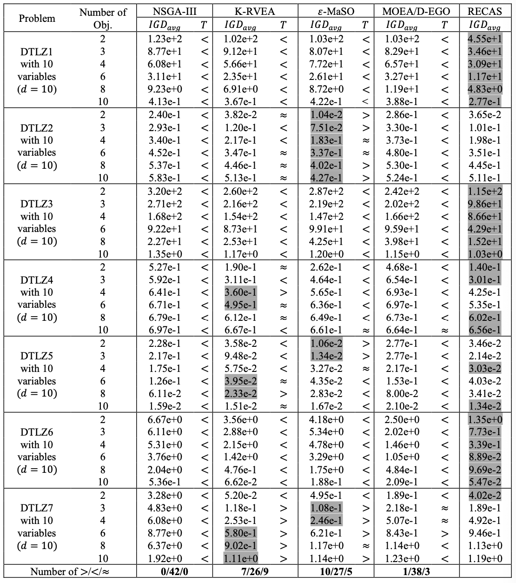
Introduction and Motivation
Integrating $ε$-Dominance with RBF Many-Objective Optimization
Many-Objective Optimization with Aggregated Surrogate
Surrogate-Assisted Multi-Fidelity Multi-Objective Optimization
Conclusions and Future Research
Reference Vectors in Many-Objective Optimization
RECAS Algorithmic Framework
Convergence Analysis Based on Grids
Numerical Experiment Results and Conclusions
Numerical Results on DTLZ Test Suite ($d=10$)
Among 20 trials, the average IGD value obtained by each algorithm after 600 function evaluations. On each problem, the best result is highlighted in gray.
The data profile plots the proportion of problems solved by an algorithm against the number of function evaluations. Highest curves are best so our REGAS is best

Slide 21
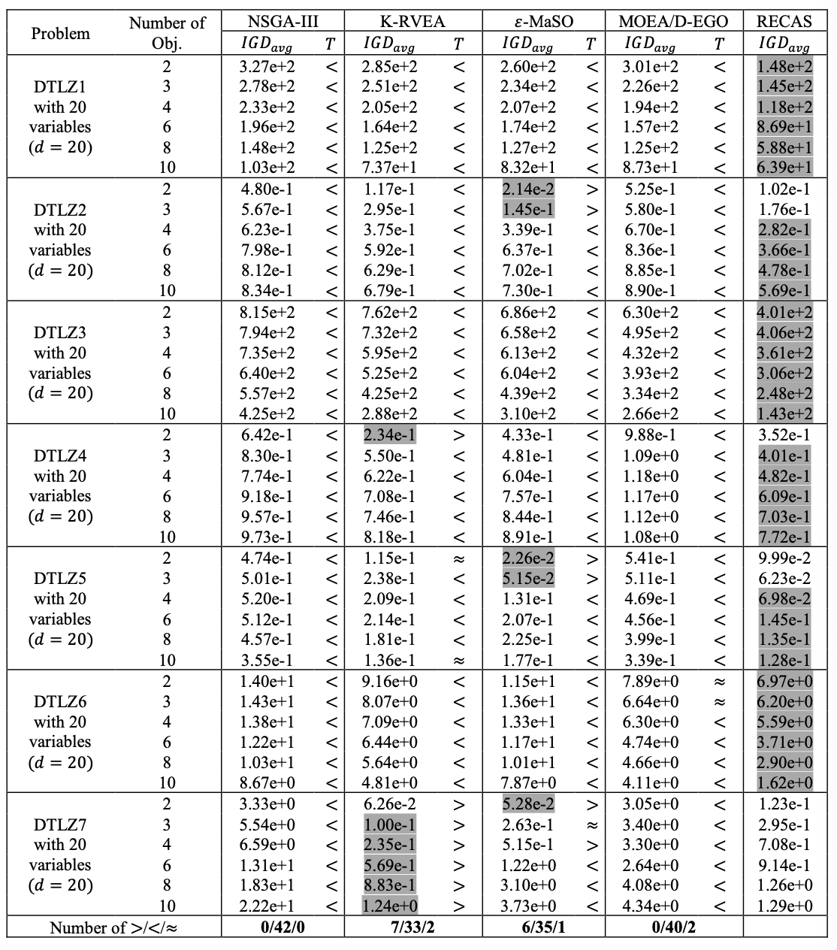
Introduction and Motivation
Integrating $ε$-Dominance with RBF Many-Objective Optimization
Many-Objective Optimization with Aggregated Surrogate
Surrogate-Assisted Multi-Fidelity Multi-Objective Optimization
Conclusions and Future Research
Reference Vectors in Many-Objective Optimization
RECAS Algorithmic Framework
Convergence Analysis Based on Grids
Numerical Experiment Results and Conclusions
Numerical Results on DTLZ Test Suite ($d=20$) RECAS is best.
Among 20 trials, the average IGD value obtained by each algorithm after 600 function evaluations. On each problem, the best result is highlighted in gray.
The data profile plots the proportion of problems solved by an algorithm against the number of function evaluations. High is best
Best

Slide 22
Conclusion
The new algorithm REGAS improves on previous algorithms by combining the use of reference Vectors in combination with a new algorithm that employs a Radial Basis Surrogate.
One of the benefits of the new approach is that there is no need for a surrogate for each of the “many” objective problems.
When this paper is published, the code will be made available in python (probably in Github).

