Slide 1
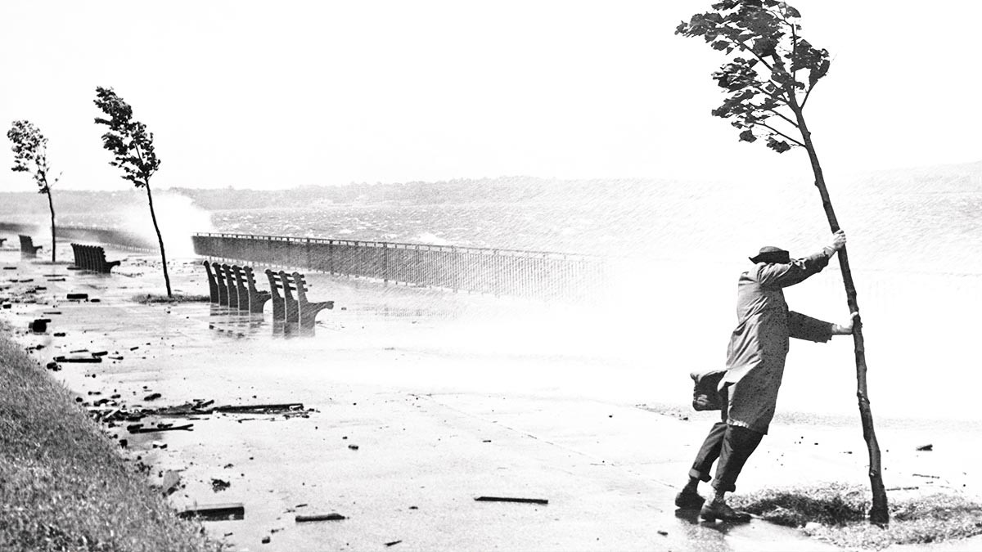
Using science to advance
climate resilience
Paul Kovacs
pkovacs@iclr.org

Slide 2
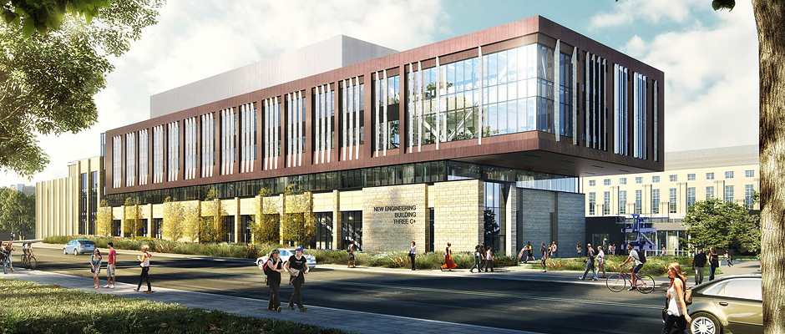
Institute for Catastrophic Loss Reduction
2
1
Canada’s leading disaster research institute
science to reduce losses from climate-related risks and earthquakes
funding from 120 insurance companies and governments / based at Western University
new, proactive mandate to champion implementation of findings
ICLR Office at Western

Slide 3
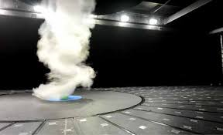
October 18, please join us for a celebration
3

Slide 4
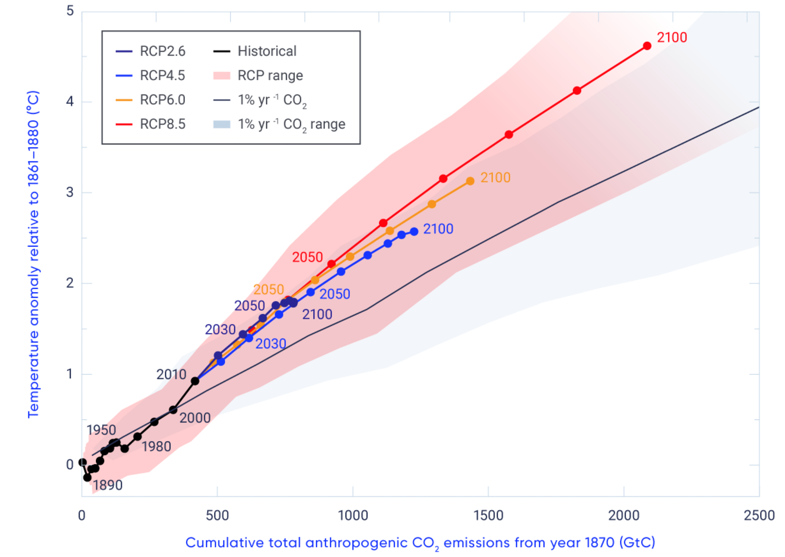
Emissions and temperature continue to grow
4

Slide 5
Risk of physical damage continues to grow
9
5
Estimated annual direct physical damage in Canada, billions of dollars, adjusted for inflation
$15 b
10
5
0
1980
1990
2000
2010
2020
2030
Source: Institute for Catastrophic Loss Reduction

Slide 6
Climate risk and opportunity – The business issue
6
Reframing of the issue in 2015 – climate change becomes climate risks
transition risks – how will we transition to law-carbon future
physical risks – how will we stop the increase in damage to buildings/infrastructure
Industry-led Task Force

Slide 7
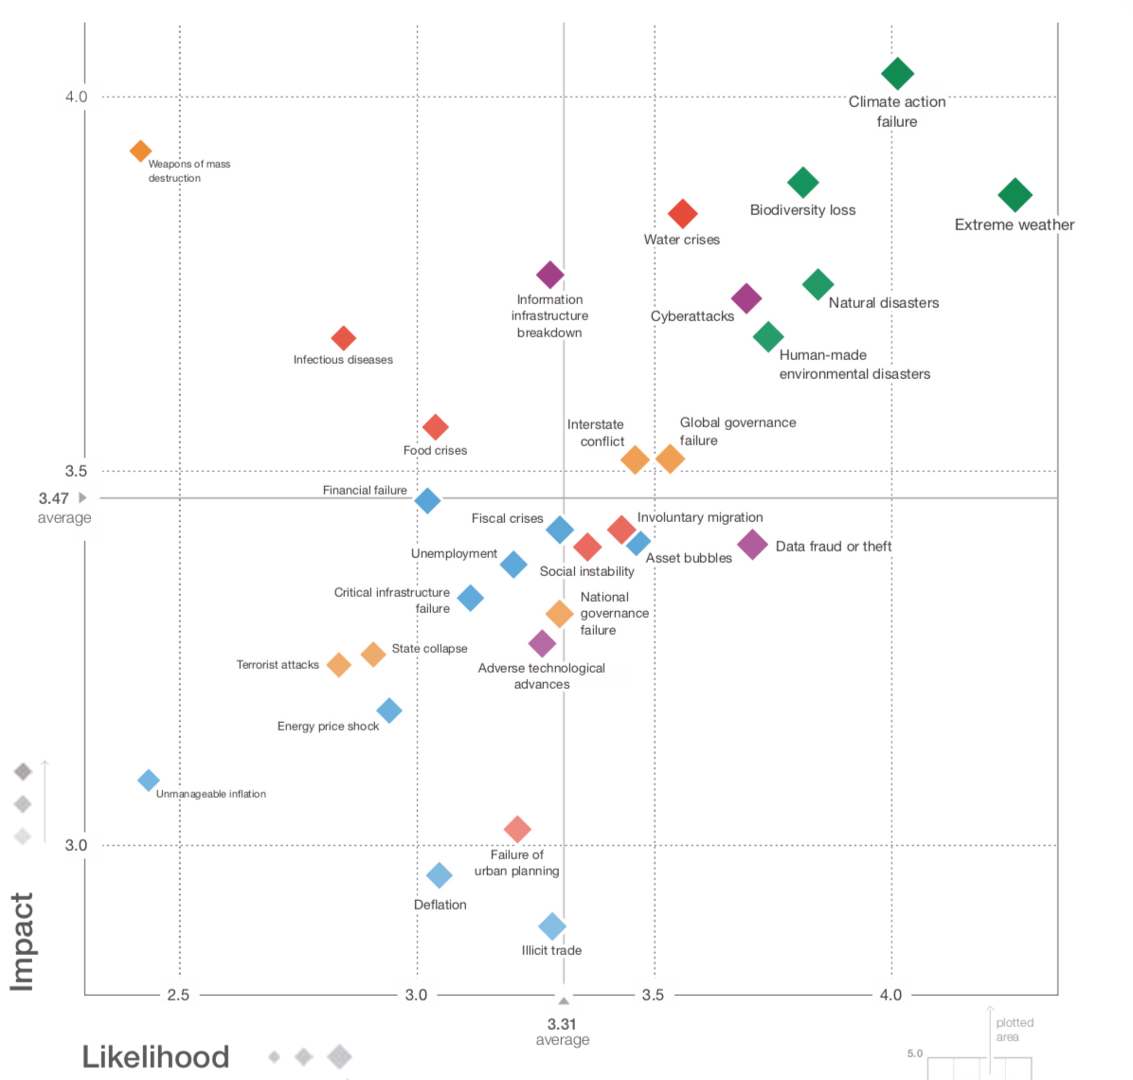
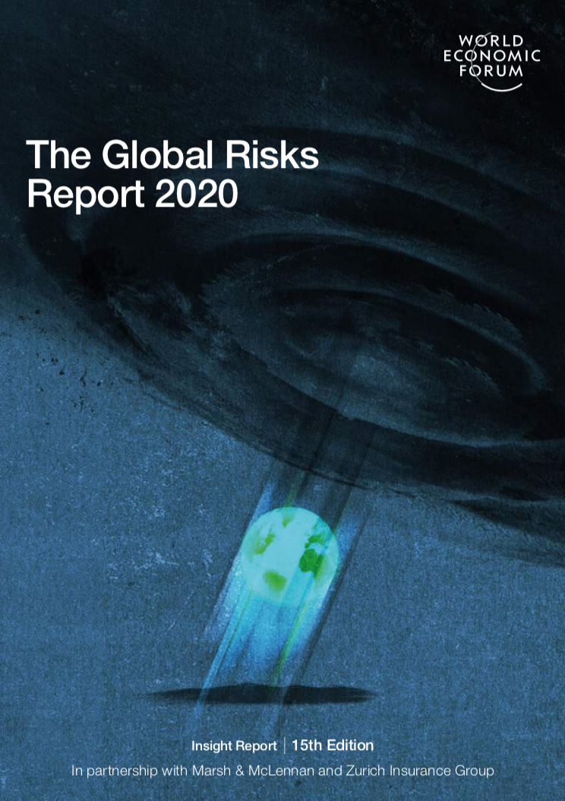
Top risks – climate action failure and extreme weather
7
Global Risks Landscape 2020
World Economic Forum
- survey of global leaders
- 30 top risks over next decade
- impact vs likelihood

Slide 8
Risk of failure to achieve emissions reduction goals
8
8
Historic global green house gas emissions and future emissions scenarios
80
60
40
20
0
-20
1900
1940
1980
2020
2060
2100
Source: Intergovernmental Panel on Climate Change, Global Warming of 1.5°Report

Slide 9
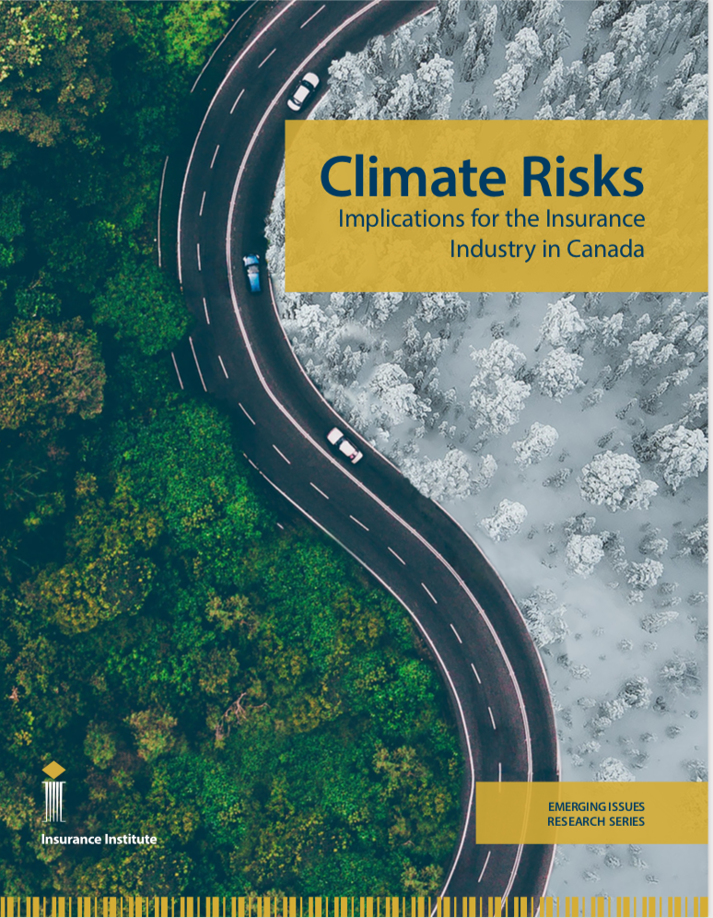
Climate risks - Canadian insurance payments
9
Insurance claims paid, 1983 - 2018, millions of dollars, adjusted for inflation
Log scale
$5,000 m
2030
2,500
2020
2010
500
2000
250
Increasing losses because
- more people / assets at risk
- aging public infrastructure
- large climate-related events
1990
1980
50
25
Source: Institute for Catastrophic Loss Reduction

Slide 10
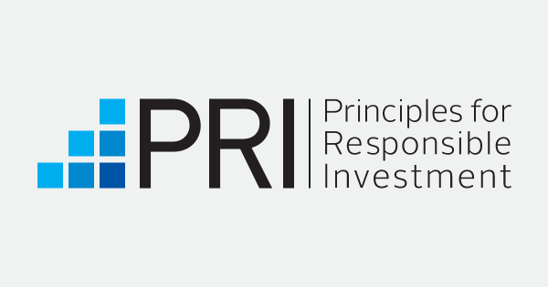
Investment risks and opportunity
10
More volatile values from some investments
manage climate risks by assessing disclosure by others
UN Principles for Responsible Investment
UN Principles for Sustainable Insurance
TFCD investment disclosure guidelines
invest in resilience projects

Slide 11
Climate-related litigation is increasing
8
11
7
Number of new cases world-wide (most are in the United States)
100
50
0
1985
1990
1995
2000
2005
2010
2015
2020
Source: Sabin Center for Climate Change Law

Slide 12
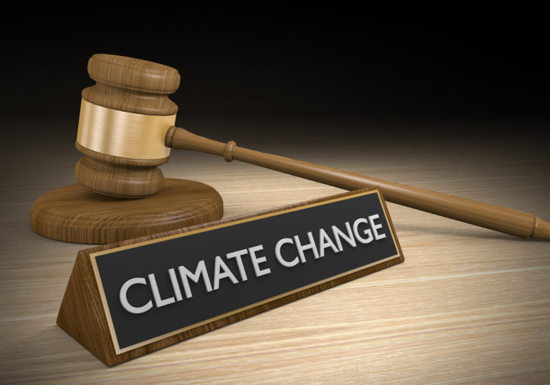
Liability risks and opportunities
12
More legal action confronting emitters and governments
learned from unintended coverage for tobacco and asbestos
many years focused on ensuring coverage clarity
actions target ‘carbon majors’ (70% of emissions by 100 companies)
liability of directors
professional liability

Slide 13
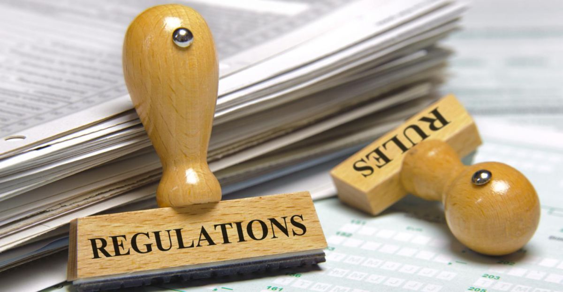
Regulatory risks and opportunities
13
Evolving supervision of insurance
expect and welcome increased climate-related solvency supervision
more scenario tests / sensitivity tests / investment disclosure
possibly requirements for disclosure of climate risks (TCFD)
oppose interference in setting rates
rate regulation harms policyholders

Slide 14
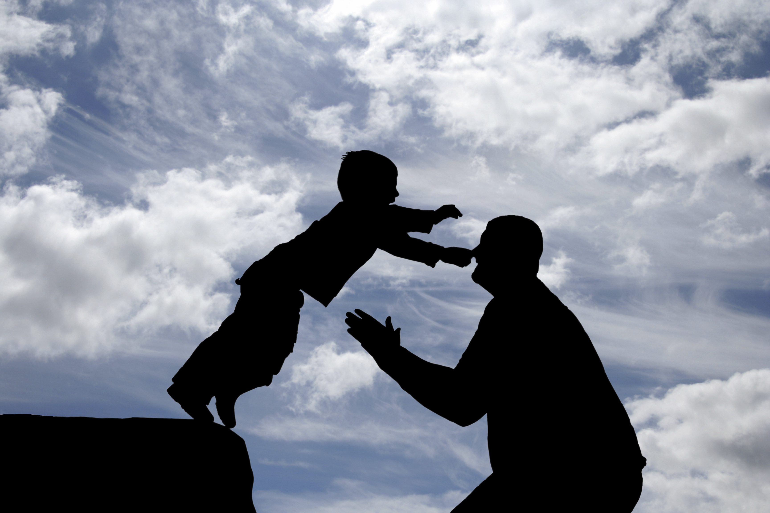
Reputational risks and opportunities
14
Building consumer trust
climate risks are increasing defining insurance for consumers / gov’t
some Canadian insurers are world leaders in managing climate risk
but most insurers / brokers do not disclose emissions / investments
underwriting practices appear complex
insurance is based on trust

Slide 15
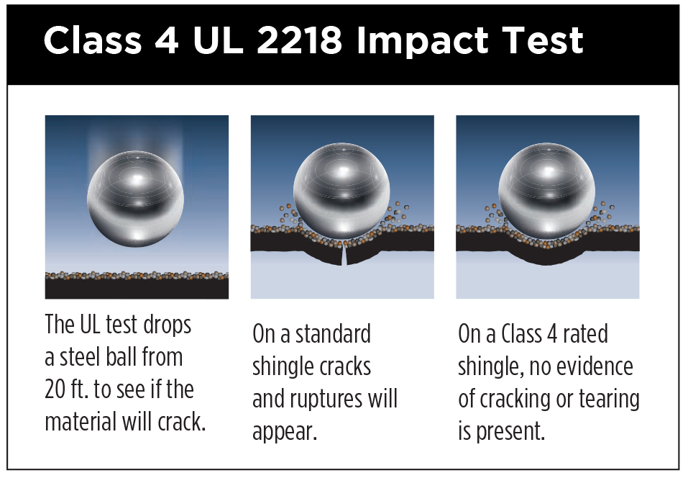
1 Protect existing homes
15
83,000 residential claims paid a year for water damage, wildfire, hail, or severe wind
most losses are preventable with proven and affordable protective investments
homes need backwater valve, fire resistant siding, impact resistant roofs, hurricane clips, …
i) ICLR supports Climate Proof Canada, FireSmart,
HailSmart, Northern Tornadoes Project
ii) ICLR Showcase Homes program
iii) ICLR brochures and videos

Slide 16
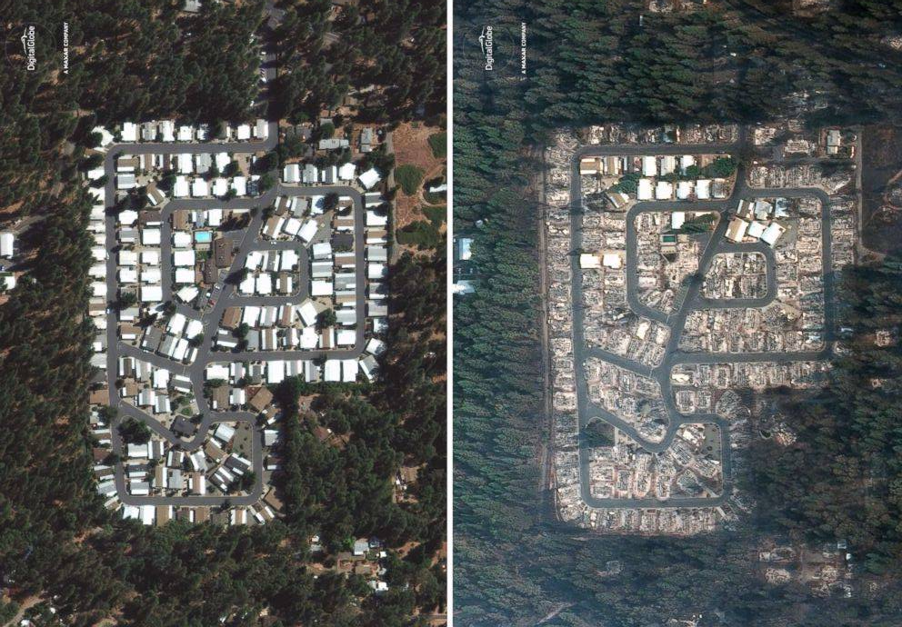
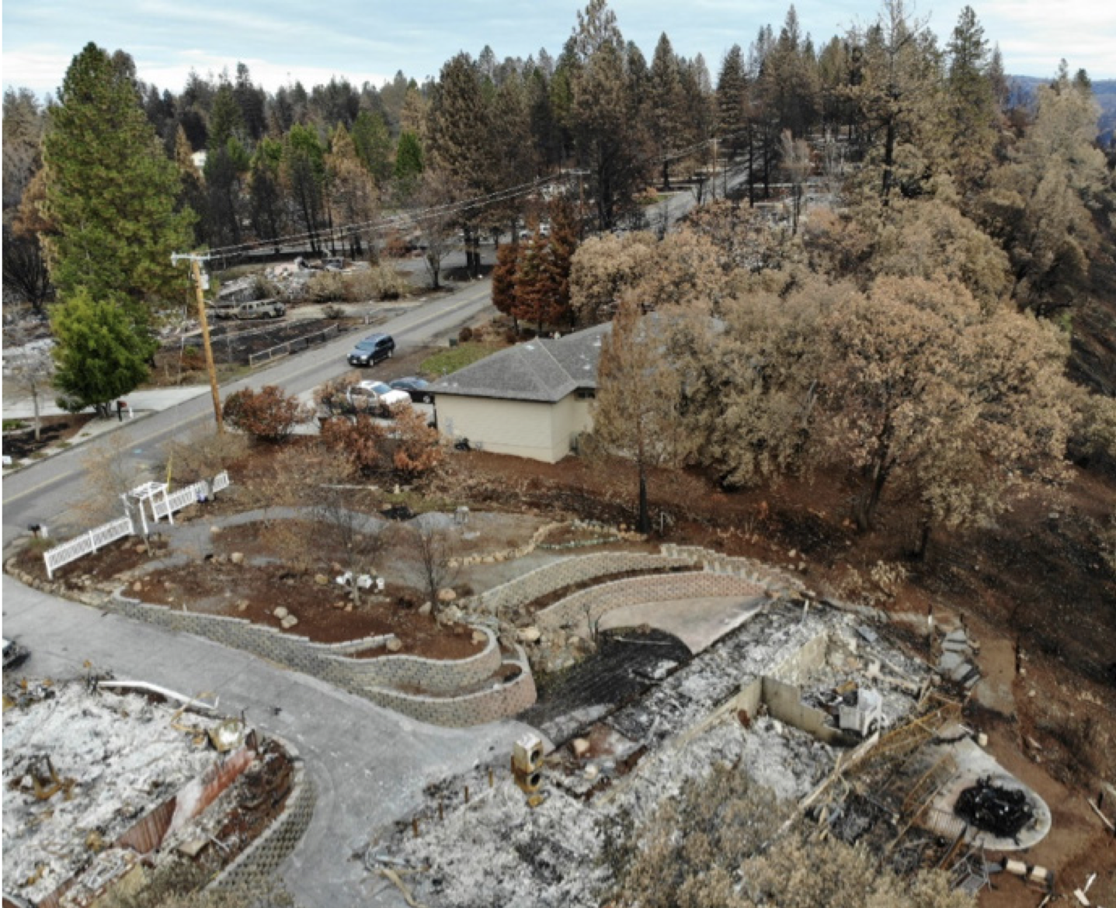
Destruction of Paradise, California
16

Slide 17
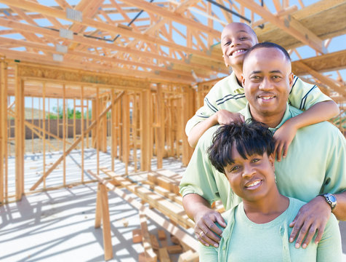
2 Protect new buildings/infrastructure
17
90,000 new homes built each year and tens of billions spent on public infrastructure
most future loss and damage are preventable with proven protective actions
small increase in initial cost offset by benefits more than 6 fold greater than cost
i) ICLR advice for basement flood, wildfire, hail, severe wind
ii) work with builders / may propose reform in building codes
iii) ICLR’s PIEVC Protocol assesses the vulnerability of public infrastructure to climate change
New home construction

Slide 18
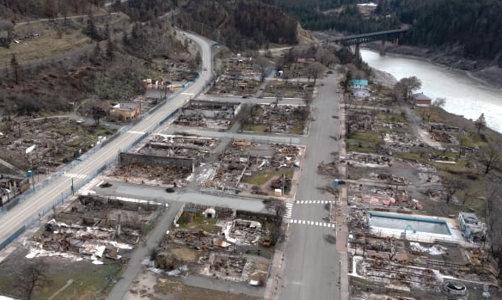
3 Build back better
18
Most adaptation is reactive – communities/insurers may build back better after a loss
ICLR Cities Adapt – Celebrating Local Leadership – 100 case studies of success
ICLR Insurers Rebuild Stronger Homes program supports action by member insurers
ICLR Resilience in Recovery program early success in Calgary, Barrie, and Lytton
i) increase community awareness of protection
ii) damaged homes rebuilt with increased resilience
iii) resilience requirements for future construction
Lytton wildfire 2021

Slide 19
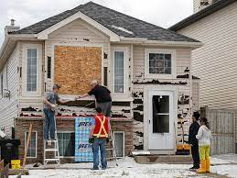
Calgary
19
Unprecedented $1.2 b in insurance claims paid to repair hail damage in 2020
ICLR/IBC partner with Calgary to increase community awareness (ICLR HailSmart)
Calgary $5m rebate program / $3,000 to claimants that install an impact resilient roof
Calgary/ICLR lobby for change in the building code
ICLR Resilience in Recovery award winner
significant and lasting improvement in resilience
Calgary hailstorm 2020

Slide 20
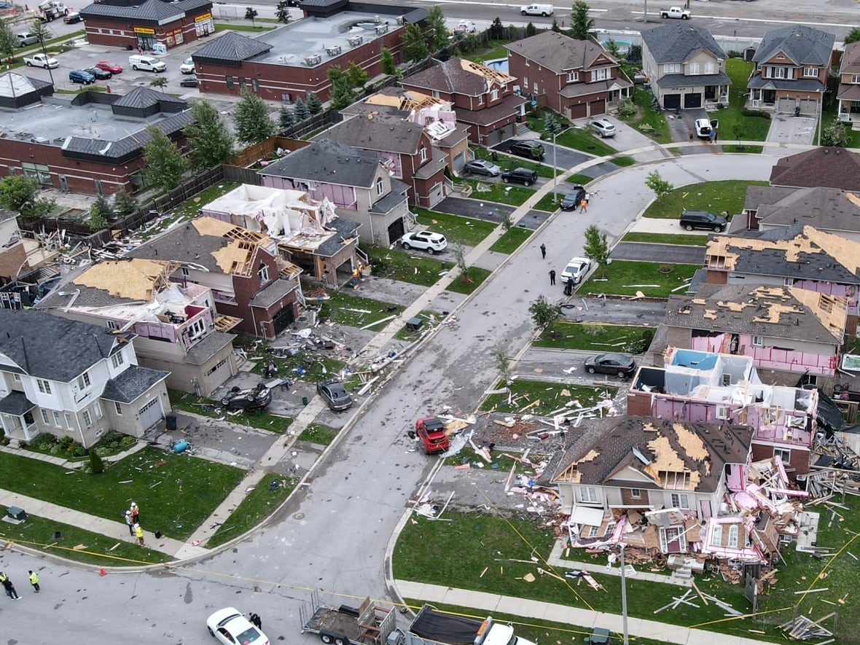
Barrie
20
Many homes in a newer neighbourhood made uninhabitable by an EF2 tornado
Barrie tornado protection awareness program using ICLR materials
ICLR support for Barrie submission requesting change in the provincial building code
a few homes rebuilt with tornado protection proposed by ICLR
Barrie considered but did not introduce incentives
better awareness but no changes in construction practices
Barrie tornado 2021

Slide 21
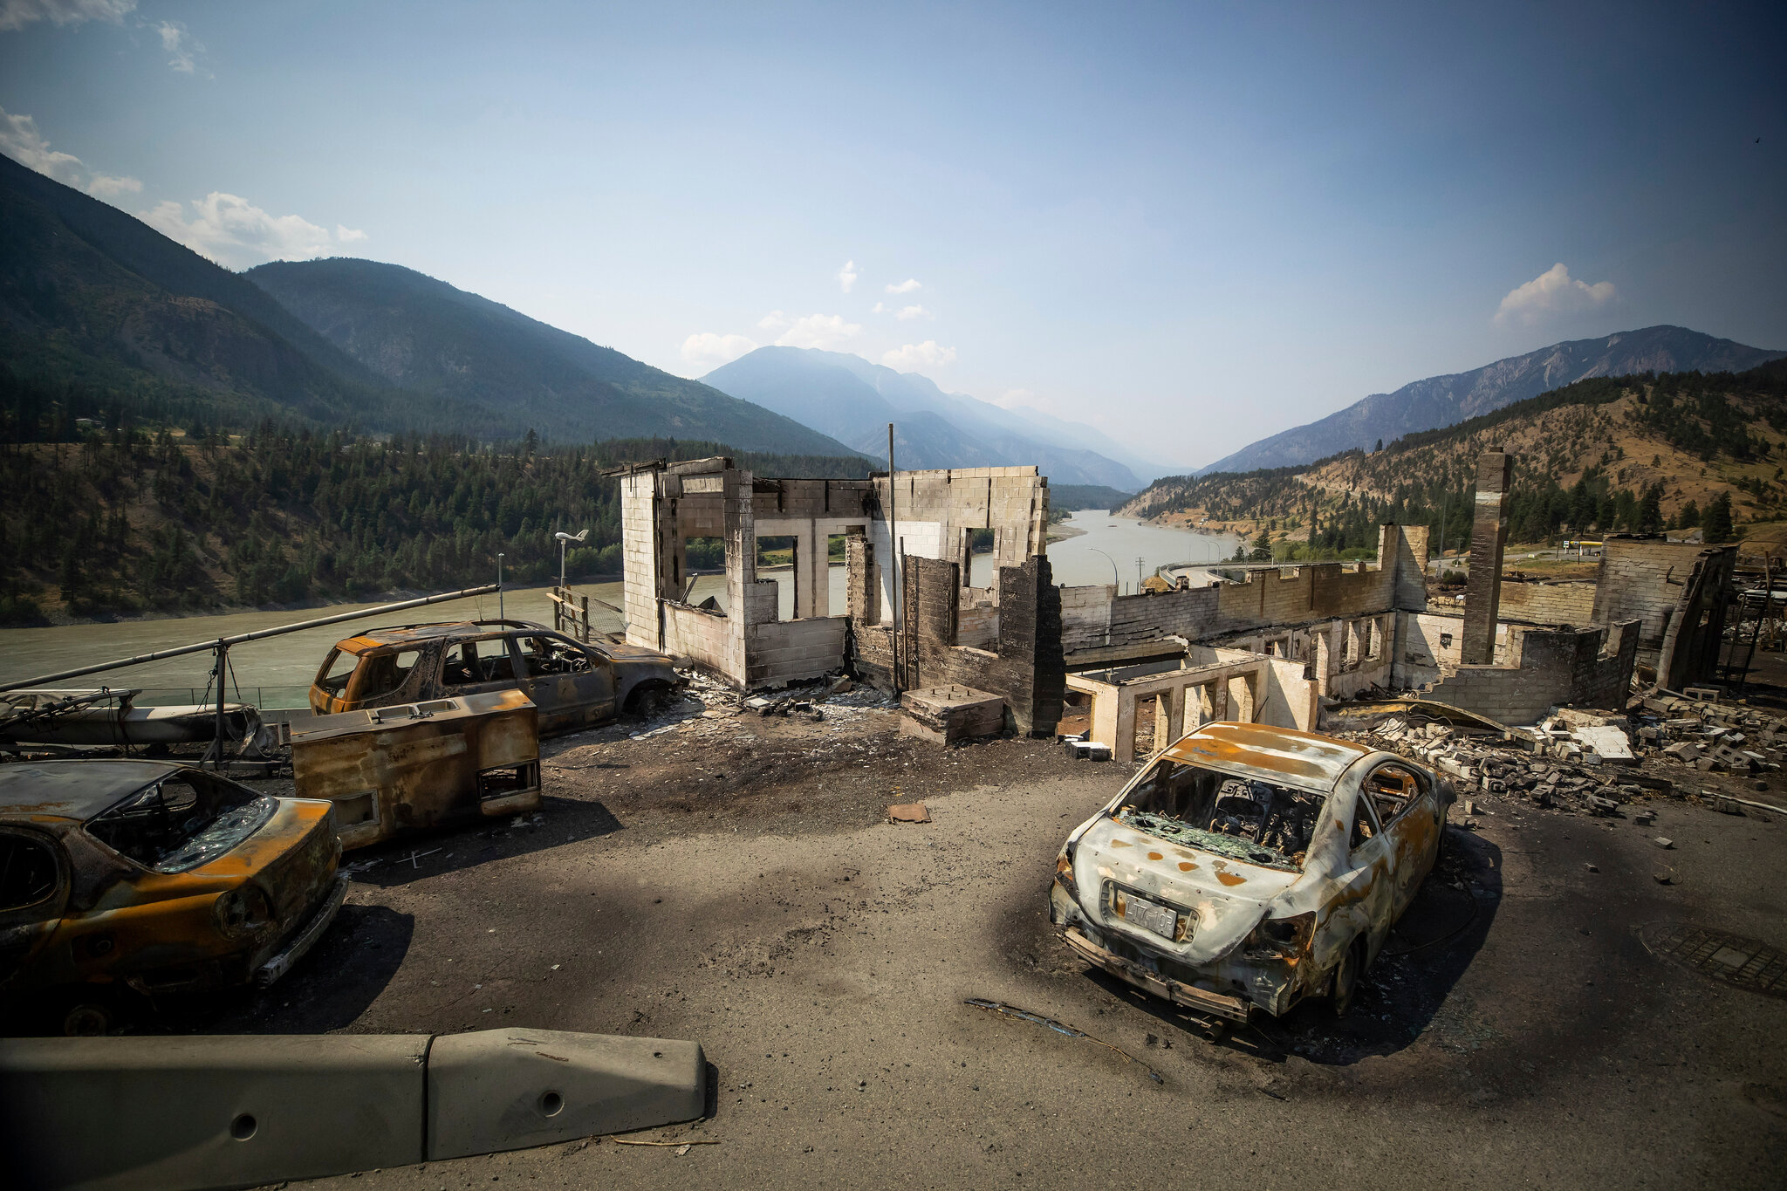
Lytton
21
On a path to become Canada’s best protected community for wildfire
wildfire building bylaw would require fire resistant roof, cladding, deck, fence for all homes
beyond structures with implementation of updated community wildfire protection program
insurance leadership to rebuild with wildfire protection previously absent
Lytton can be a model for other communities at risk
embrace FireSmart / require fire resistant construction
transformative change is possible
Lytton wildfire 2021

Slide 22
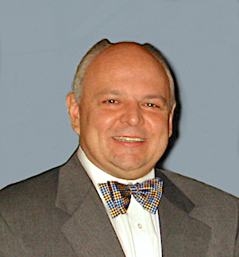
Climate resilience solutions
22
Proven, affordable solutions have been identified for most climate related losses
you are invited to join the celebration on October 18
business focus on transition risk and the risk of physical damage
ICLR focus on existing buildings, new construction, and recovery
Paul Kovacs, Executive Director, ICLR
pkovacs@iclr.org

