Slide 1
Evaluating Renewable Energy and Electricity Prices Using a Polynomial Process Model
BIRS Workshop on Climate Scenarios and Financial Risk
Leonard Olien
PhD Student, University of Calgary
July 3 – 8, 2022

Slide 2
The Six Priorities
CanREA has identified 6 priority areas for action on energy storage:
PRIORITY 1: EDUCATION
Increase familiarity with energy storage and the application of its many services.
PRIORITY 2: REGULATION
Review and inform regulatory frameworks.
PRIORITY 3: MARKETS
Expand market structures and valuation models.
PRIORITY 4: GRID OPTIMIZATION
Advance a modern paradigm for grid reliability that uses energy storage to optimize grid utilization.
PRIORITY 5: COMMUNITIES
Promote energy storage in off-grid, Indigenous and remote communities, who can benefit from increased access to decarbonization technologies.
PRIORITY 6: SUSTAINABILITY
Advance sustainable development and end-of-life practices for energy-storage technologies.
For each of these priorities, we identify the challenge to be overcome, identify key solutions, and recommend specific actions.

Slide 3
Polynomial Process
Key Behaviours: mean reversion and price spikes
Components:
Underlying Factor(s) follow a mean reverting diffusion process(es)
Price is an increasing polynomial function of the underlying factor(s)
Nice result: Forward price is also a polynomial function
Source: Tony Ware, “Polynomial Processes for Power Prices”, Applied Mathematical Finance, 26.5 (2020, pp 453-474

Slide 4
Areas of Research
As a Reduced Form Model
Can we associate different parameter values with changes in generation fleet, especially more wind, solar and storage?
Polynomial Model
How do we calibrate with hourly prices?
Market Assessment Tool
Can we identify levels of wind/solar penetration that lead to market failure?
Merit Order Model
As a Structural Model
Polynomial map represents the energy market merit order
Underlying factor represents net demand
How do we estimate model parameters from historical merit order and price data?

Slide 5
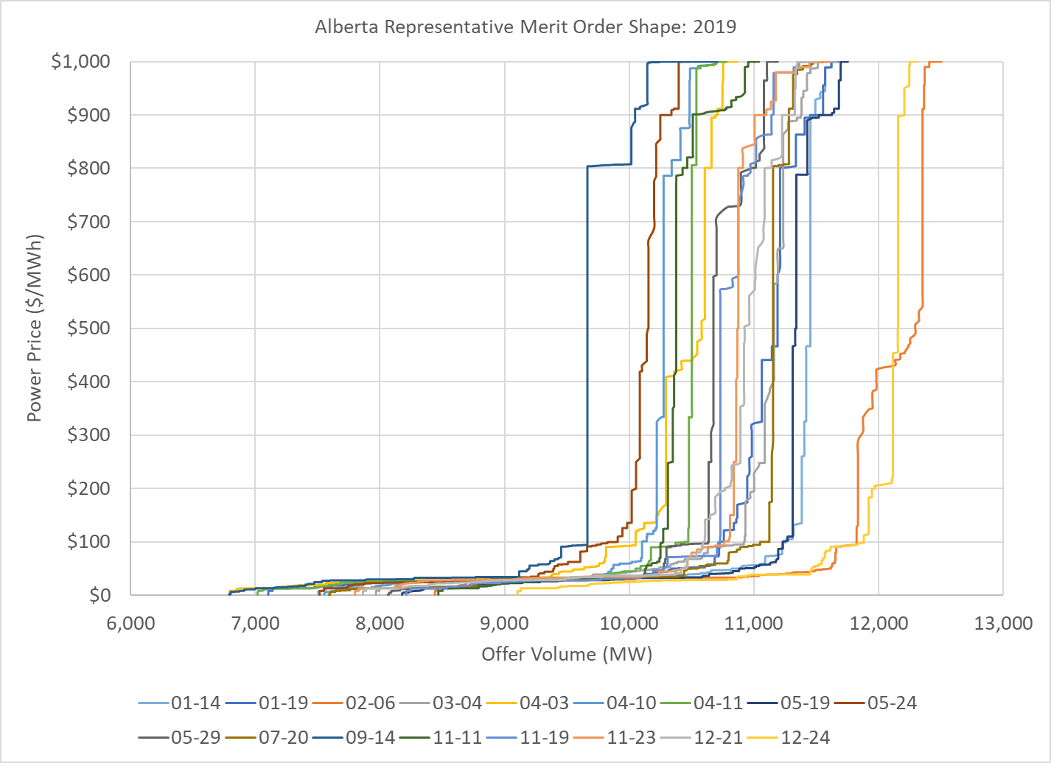
Merit Order Model
Partition price range into N price
Offer Volume is a function of price:
Reduced Form Model
Create “counterfactural” electricity price time series for model calibration
Structural Model
$N−1$ points will determine the polynomial of degree N-2.
Simplifies model calibration

Slide 6
Thank you.
Leonard Olien
leonard.olien@ucalgary.ca
www.linkedin.com/in/leonard-olien

