Slide 1
Models, management interventions, and wildfires in a changing climate
BIRS 22w5201 | July 5, 2022 | Presented by: Neal McLoughlin

Slide 2
20-Year Wildfire Statistic | 1961 to 1980 | 1981 to 2000 | 2001 to 2020
Total number of fires | 47,498 | 48,465 | 33,346
Total area burned (ha) | 1,714,383 | 1,287,717 | 4,699,845
90th percentile fire size (ha) | 4.0 | 3.0 | 6.3
Maximum fire size (ha) | 110,334 | 182,725 | 521,012
Number of fires greater than or equal to 1,000 ha | 241 | 161 | 407
Percentage of fires accounting for 98% of total area burned | 5.3 | 5.8 | 2.0

Slide 3
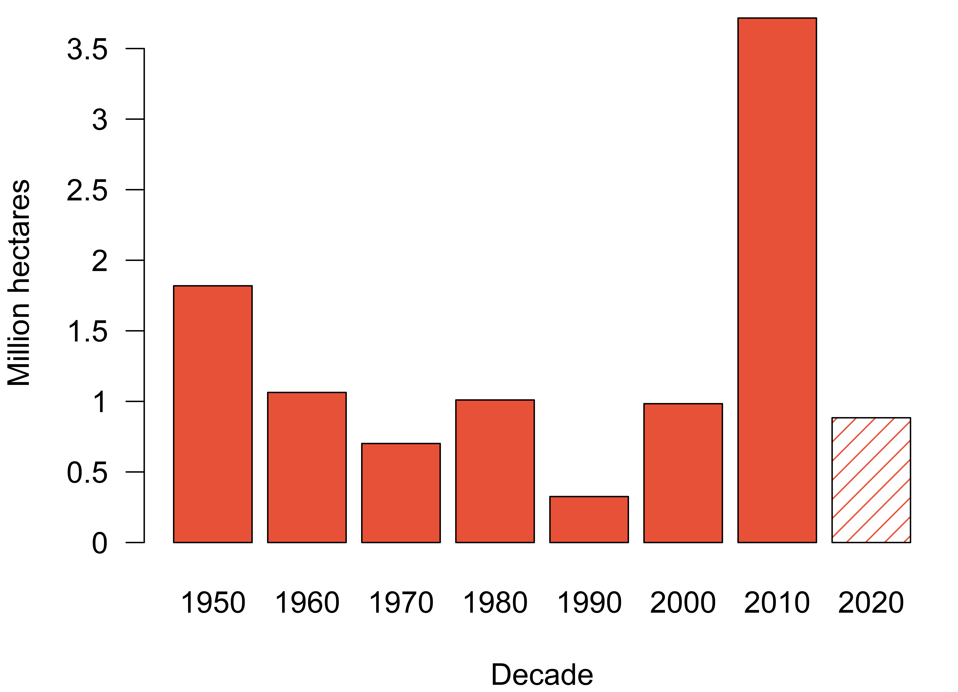
Area burned by decade.
Only two years are accounted for in the 2020 decade, but area burned has already met or exceeded 5 of the 7 previous decades.

Slide 4
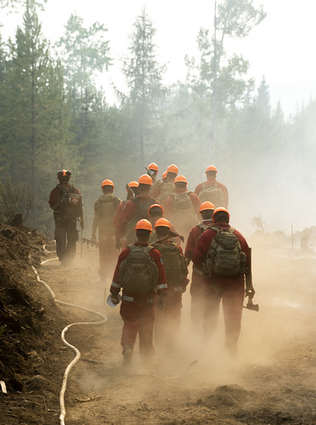
Provincial Wildfire Statistics (Apr 1 to Sep 30, 2021)
Total number of fires | 1,610
Lightning-caused | 60%
Human-caused | 35%
Area burned | 868,203 ha
Fires of note | 67
Evacuation orders | 1981
Evacuation alerts | 304
1-800 wildfire reports | 19,731
Provincial state of emergency | 56 days (July 21 to Sept 14)
Suppression costs | $565 million

Slide 5
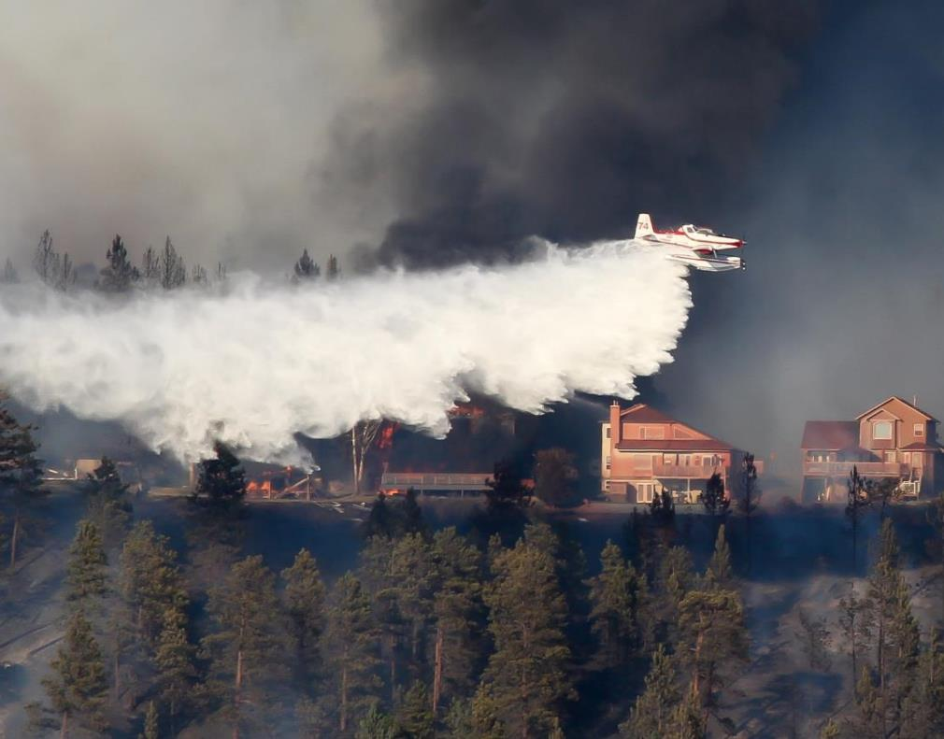
Catastrophic wildfires expected to increase by 50% by 2100.
Consequences of extreme wildfires are wide-ranging, from loss and damage, dangers from smoke inhalation, to costly firefighting response. UNEP report calls on governments to spend 45% of their budget on prevention and preparedness, 34% on response, and 20% on recovery.

Slide 6
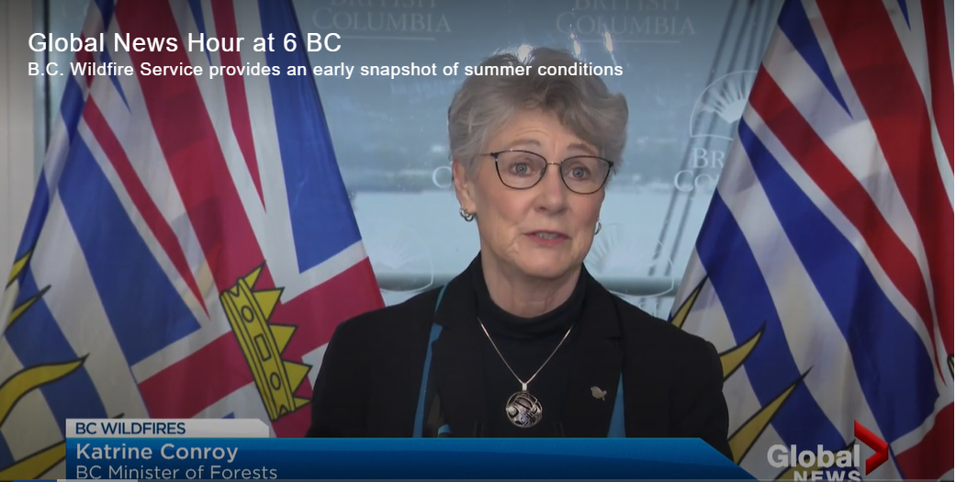
An investment of $359 million of new funding to support wildfire prevention and preparedness announced by B.C.’s Ministry of Forestry Katrine Conroy on June 3, 2022.

Slide 7
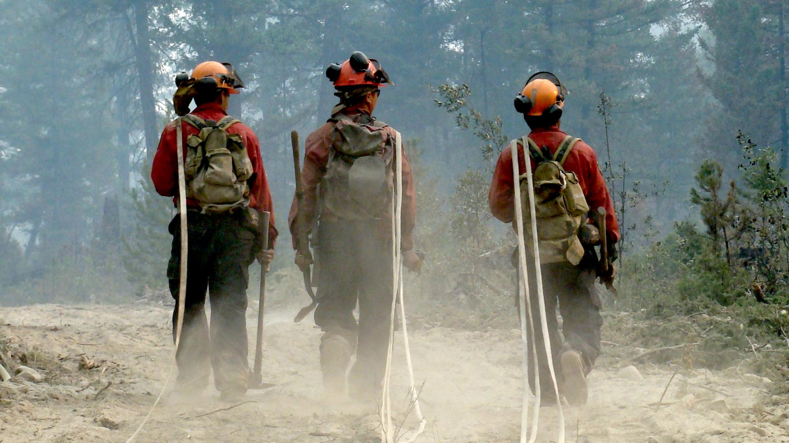
“What’s the point of a prediction if it doesn’t change anything.”
Yuval Noah Harari

Slide 8
Where
What
When
Is the fire now?
Direction is it spreading?
Will it reach me?

Slide 9
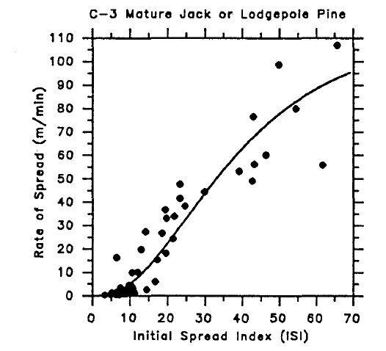
Extreme rates of spread.
The Canadian FBP System provides rate of spread equations for 16 fuel types based on 300 observations from experimental fires, prescribed burns, and large-scale wildfires. 41 experimental, 22 prescribed/wildfire for C-3.

Slide 10
Persistence forecasting.
Assess if weather conditions and fuel types are similar and estimate fire growth based off previous observations.

Slide 11
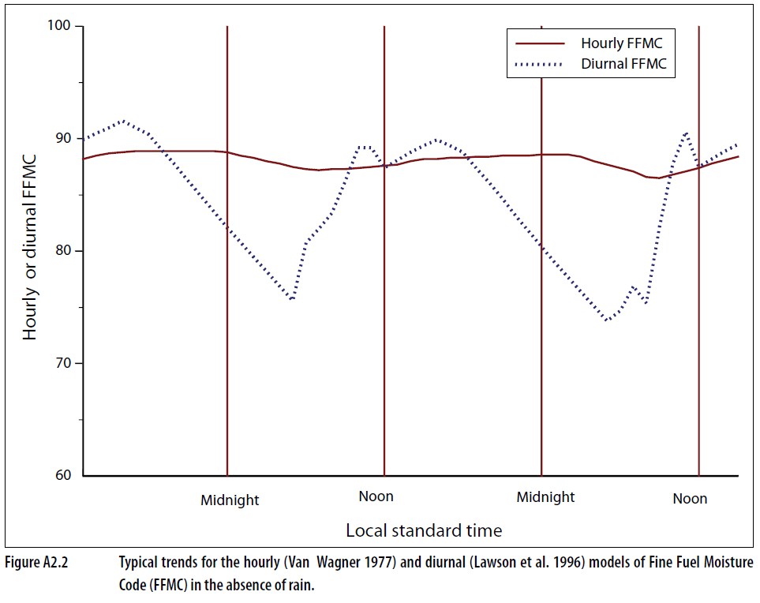
Diurnal moisture and overnight burning.
Overnight down-slope burning was common in 2021. Poor overnight recovery of fuel moisture resulted in “two burn periods” per day.

Slide 12
More fires than resources.
Near-real-time business intelligence required for operational decisions like triaging large fires (67 fires of note). Model automation to support assessments of expected fire growth in the next 5 days.

Slide 13
National fire activity.
Anticipated fire occurrence, initial attack success, and growth of sustained action fires over the next two weeks are needed to inform national and international resource demand and resource sharing decisions.

Slide 14
With respect models, management interventions, and wildfires in a changing climate what opportunities do YOU see for making progress on financial risk?

Slide 15
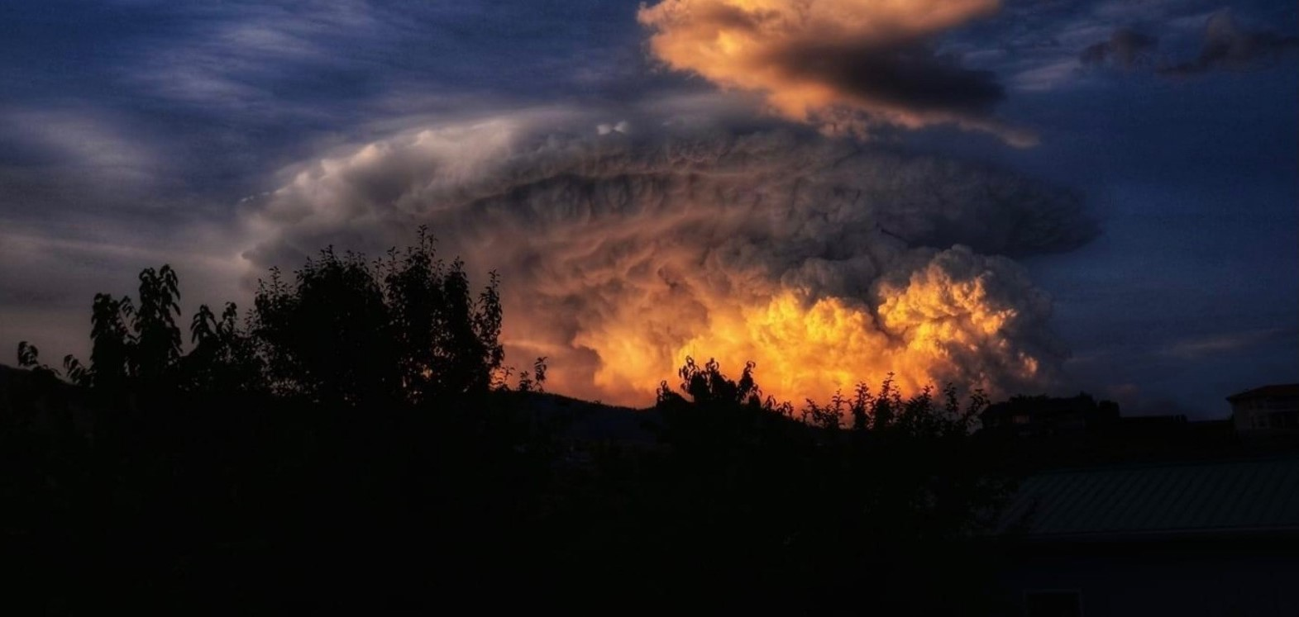

Slide 16
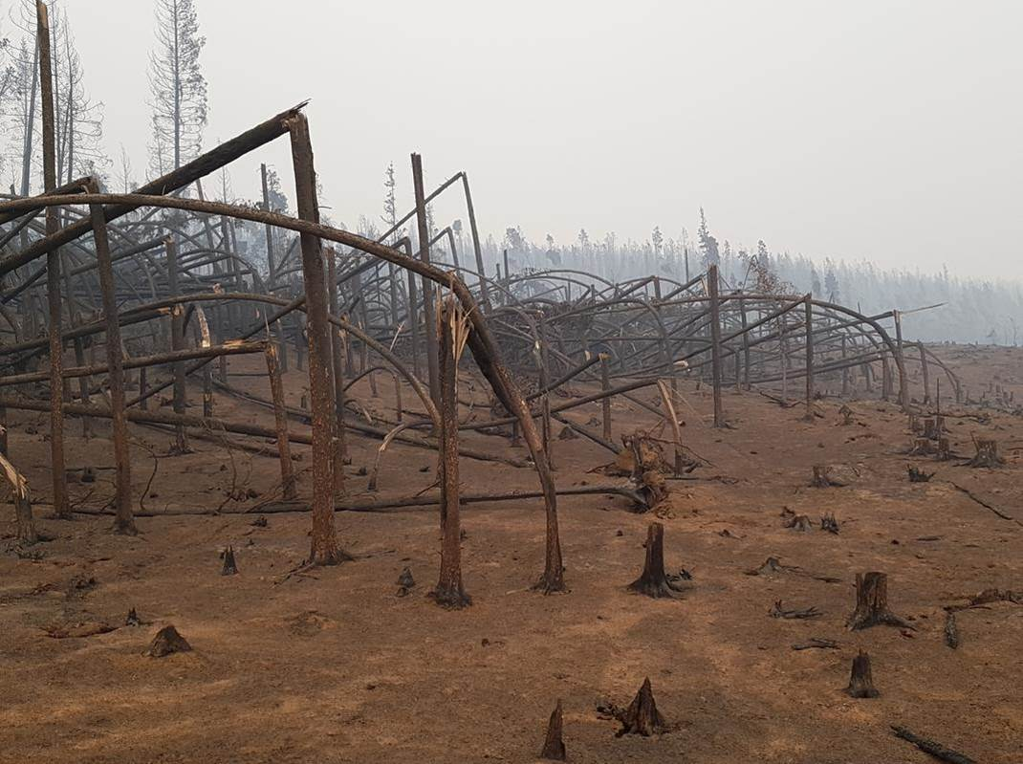

Slide 17
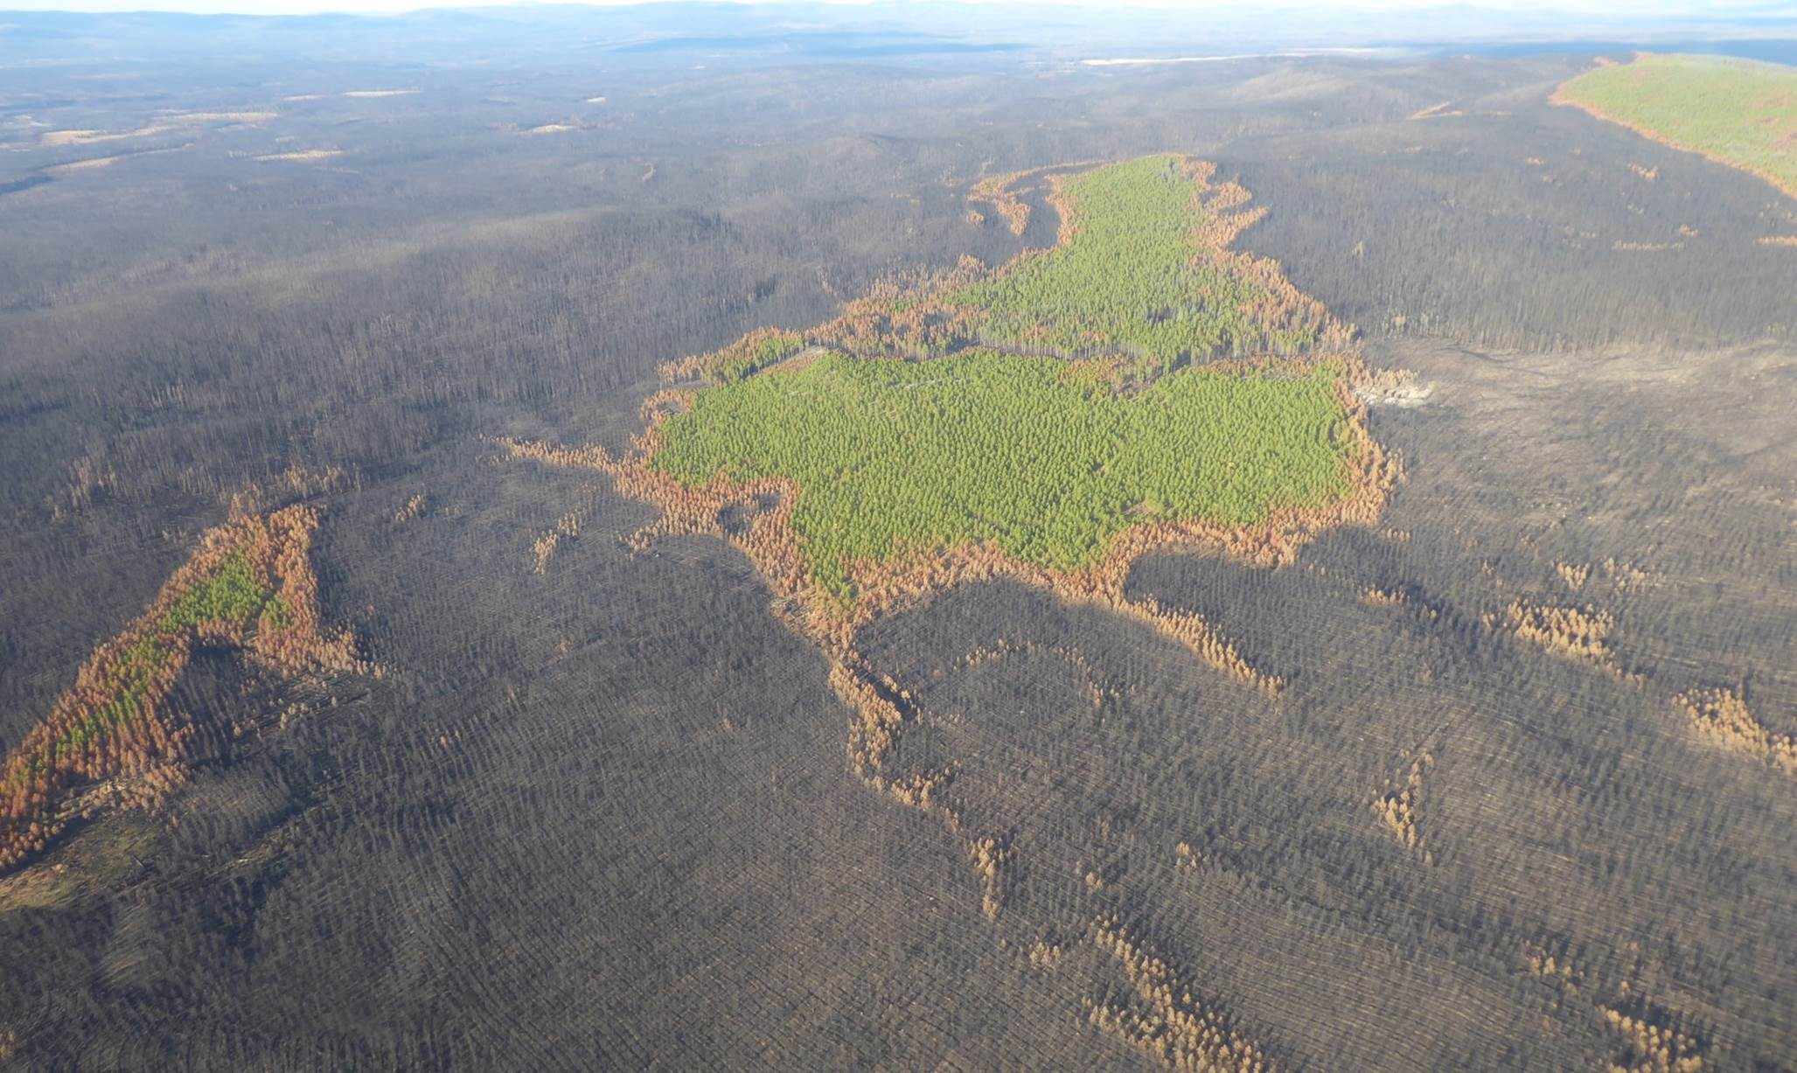

Slide 18
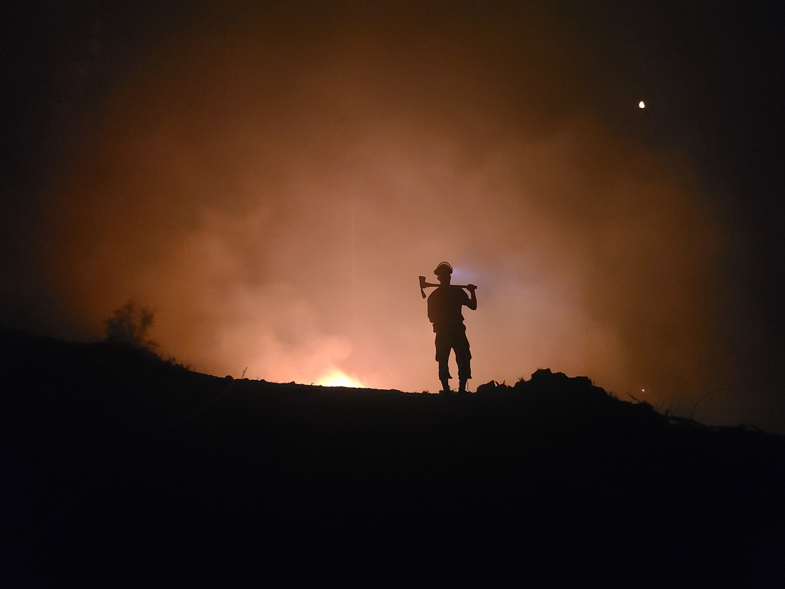

Slide 19
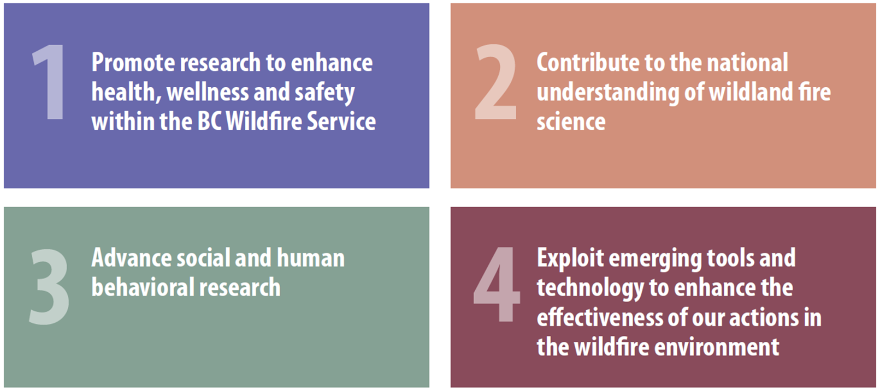
Research and Innovation
Strategic Roadmap 2022-2025

Slide 20
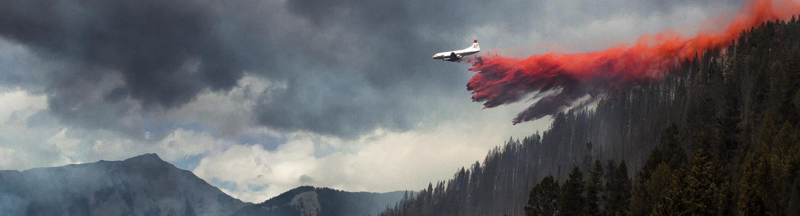
Reduce smoke inhalation and particulate exposure, and shift to total worker health
Increase understanding of wildfire economics and evaluate return on investment of risk mitigation strategies.
Design landscapes that enable the replacement of undesirable fire with prescribed fire and cultural burning.

Slide 21


