Slide 1

Flag Algebras
Alexander A. Razborov
University of Chicago
BIRS, October 3, 2011
TexPoint fonts used in EMF.
Read the TexPoint manual before you delete this box.: AAAAA

Slide 2
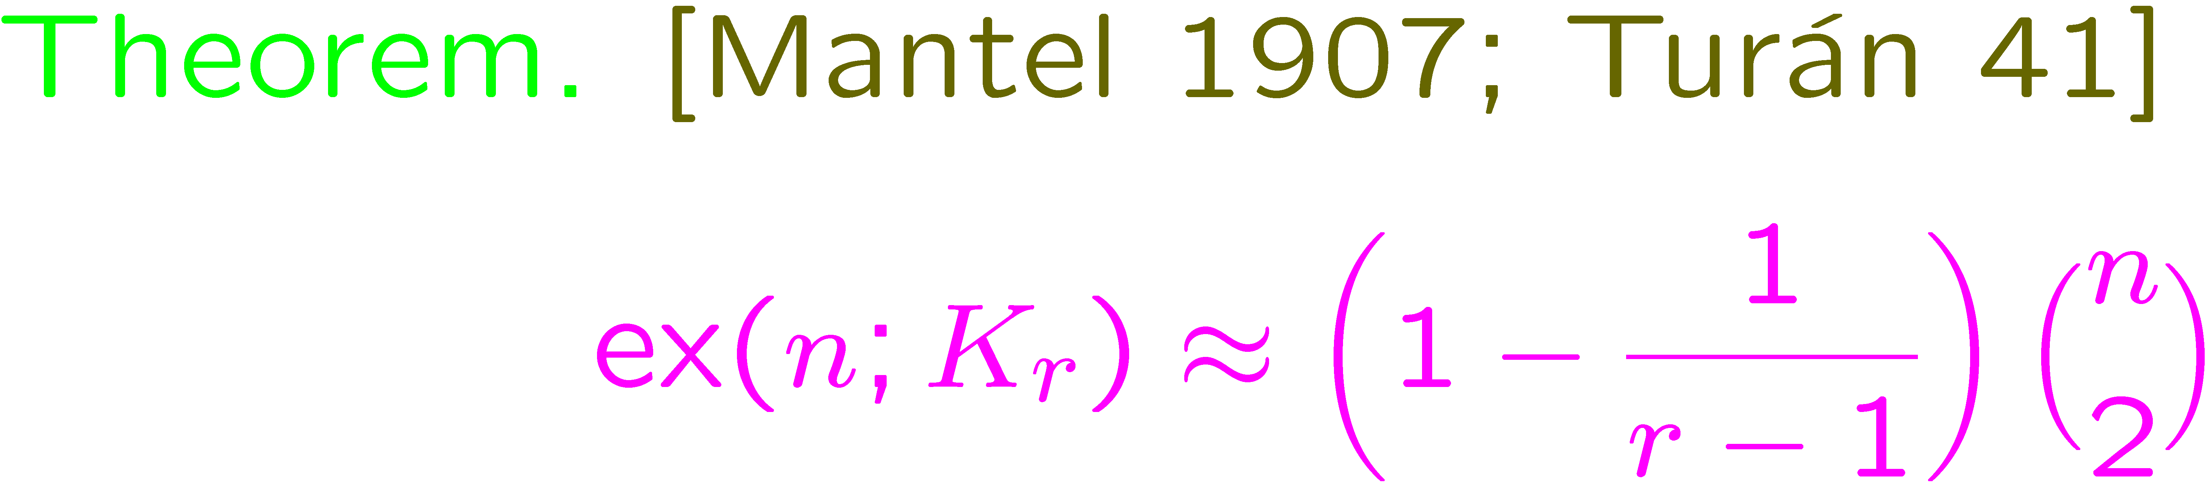
Asympotic extremal combinatorics
(aka Turán densities)
Problem # 1

Slide 3
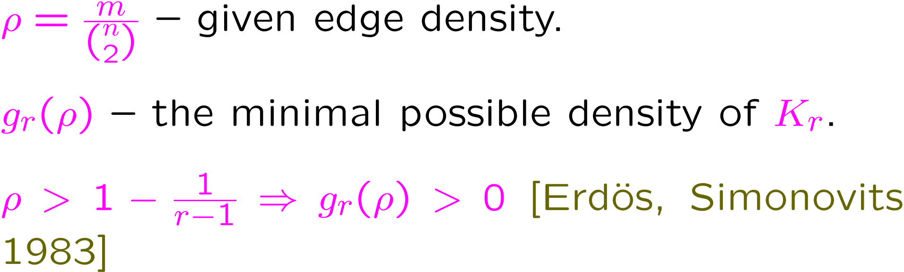
Problem # 2
But how many copies are guaranteed to exist (again, asympotically)?

Slide 4
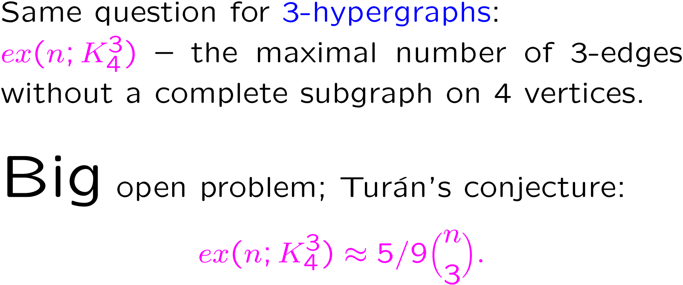
Problem # 3

Slide 5
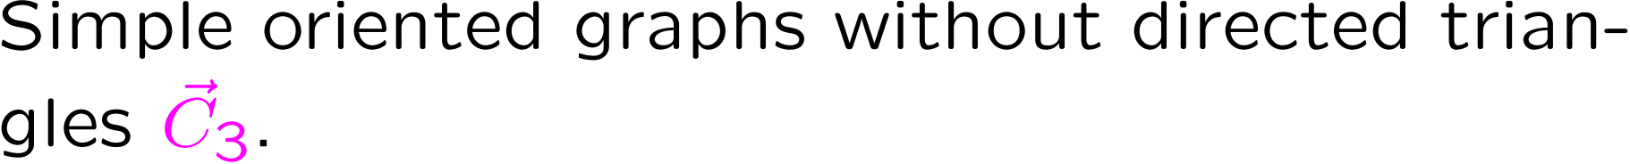
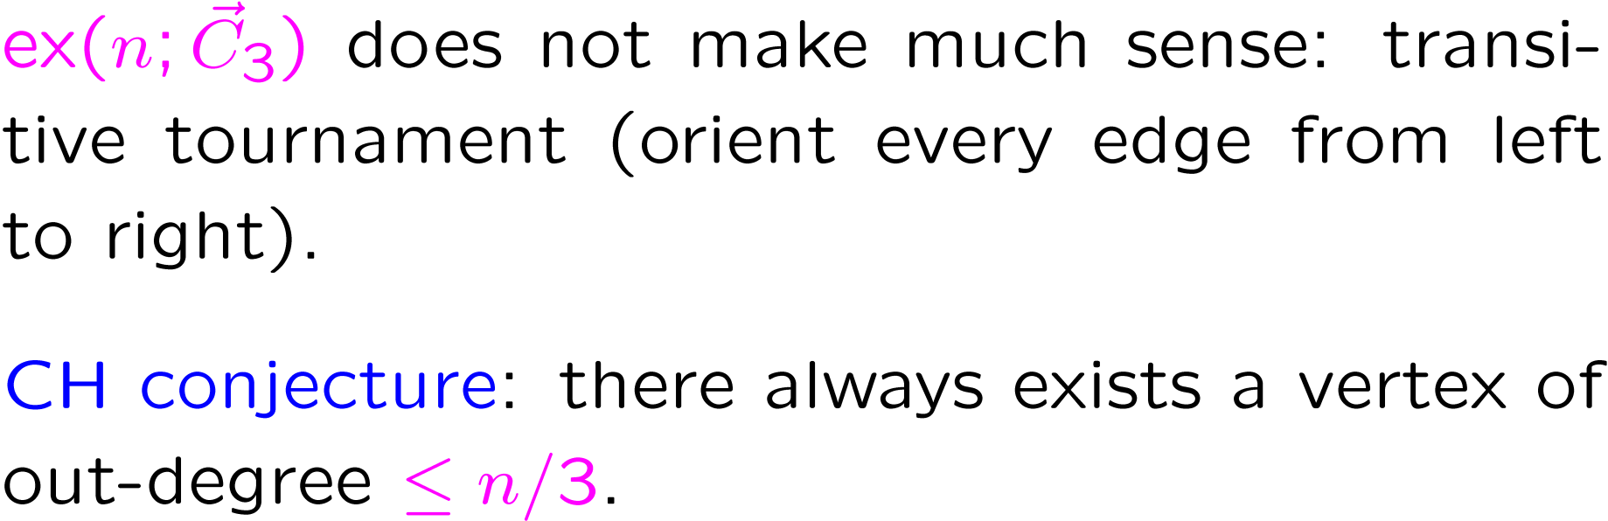
Problem # 4
Cacceta-Haggkvist conjecture

Slide 6
High (= advanced) mathematics is good
Low-order terms are really annoying (we do not
resort to the definition of the limit or a derivative anytime we do analysis).
Highly personal!
The structure looks very much like the structure existing everywhere in mathematics. Utilization of deep foundational results + potential use of concrete calculations performed elsewhere.
Common denominator for many different techniques existing within the area. Very convenient to program:
MAPLE, CSDP, SDPA know nothing about extremal combinatorics, but a lot about algebra and analysis.

Slide 7
Related research
Lagrangians: [Motzkin Straus 65; Frankl Rödl 83;
Frankl Füredi 89]
Early work: [Chung Graham Wilson 89; Bondy 97]
Our theory is closely related to the theory of graph homomorphisms (aka graph limits) by Lovász et. al (different views of the same class of objects).

Slide 8
Some differencies
Single-purposed (so far): heavily oriented toward problems in asymptotic extremal combinatorics.
We work with arbitrary universal first-order theories in predicate logic (digraphs, hypergraphs etc.)...
We mostly concentrate on syntax; semantics
is primarily used for motivations and intuition.

Slide 9
Set-up, or some bits of logic
T is a universal theory in a language without constants of function symbols.
Examples. Graphs, graphs without induced copies of H for a fixed H, 3-hypergraphs (possibly also with forbidden substructures), digraphs… you name it.
M,N two models: M is viewed as a fixed template, whereas the size of N grows to infinity. p(M,N) is the probability (aka density) that |M| randomly chosen vertices in N induce a sub-model isomorphic to M.
Asymptotic extremal combinatorics: what can we say about relations between p(M₁,N), p(M₂,N),…, p(M_{h},N) for given templates M₁,…, M_{h}?

Slide 10
Definition. A type σ is a model on the ground set {1,2…,k} for some k called the size of σ.
Combinatorialist: a totally labeled (di)graph.
Definition. A flag F of type σ is a pair (M,θ), where θ is an induced embedding of σ into M.
Combinatorialist: a partially labeled (di)graph.

Slide 11
M
σ
1
θ
2
…
k

Slide 12
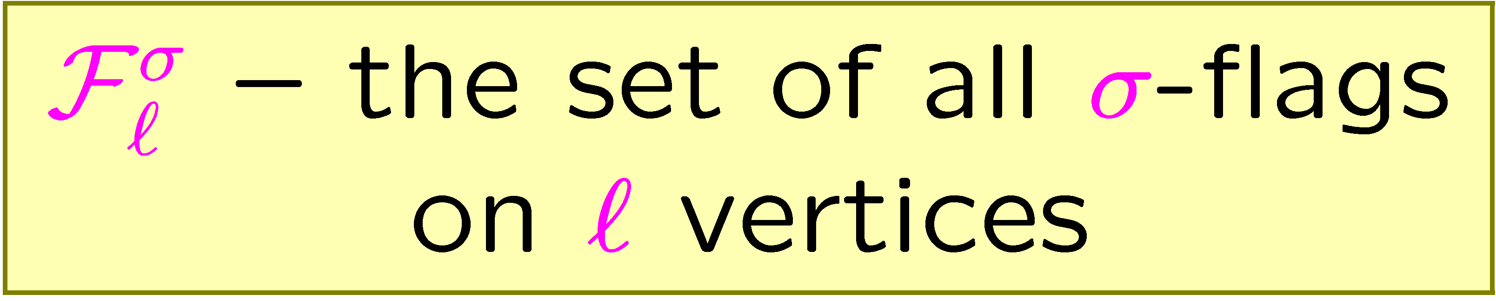

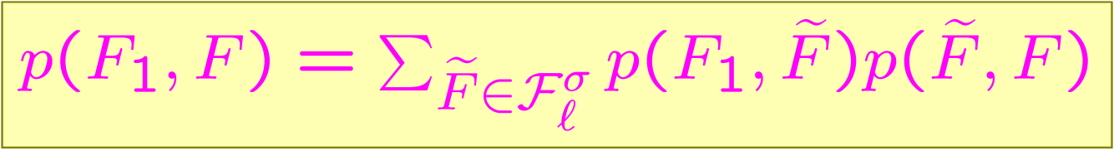
F
p(F₁, F) – the probability that randomly chosen sub-flag of F is isomorphic to F₁
F₁
σ

Slide 13
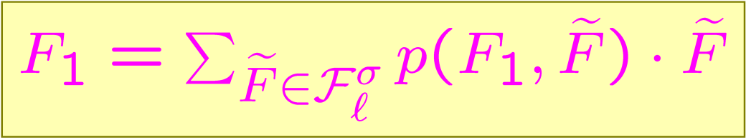

F
Ground set
F₁
σ

Slide 14
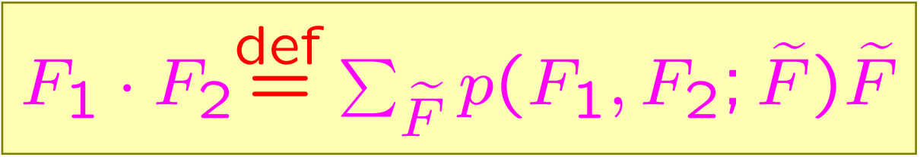
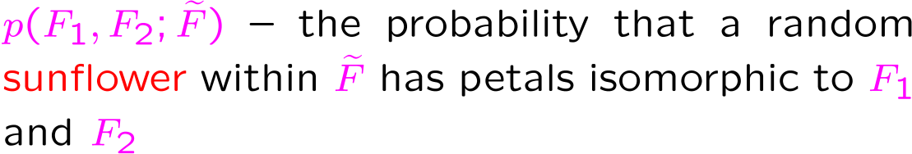
Multiplication
F
F₁
F₂
σ

Slide 15
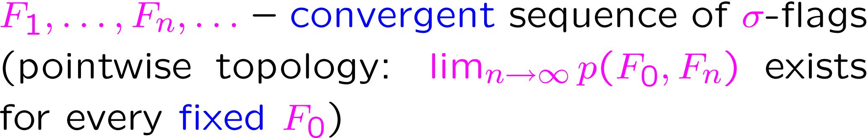
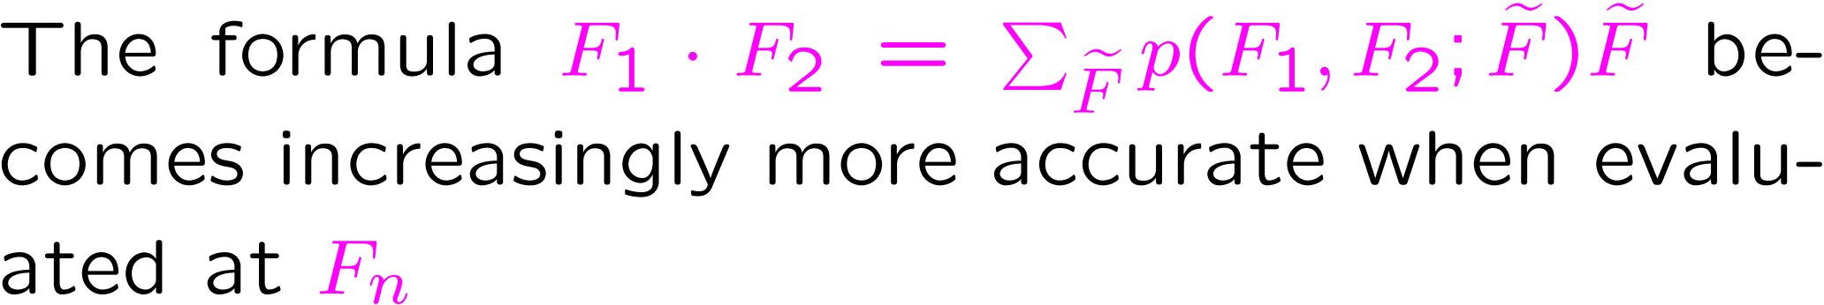
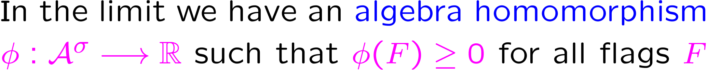

“Semantics” that works

Slide 16
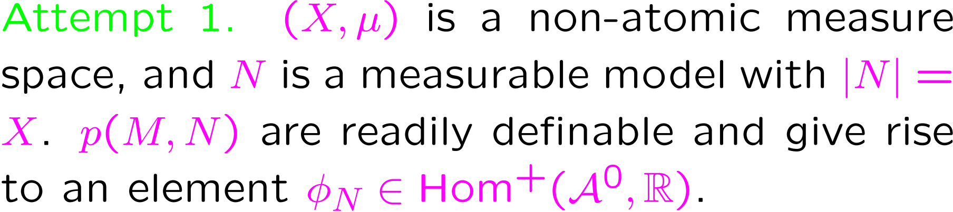
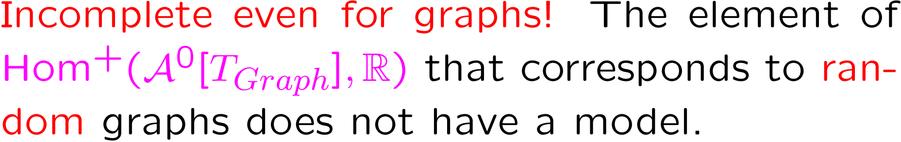
Model-theoretical semantics
(problems with completeness theorem…)

Slide 17
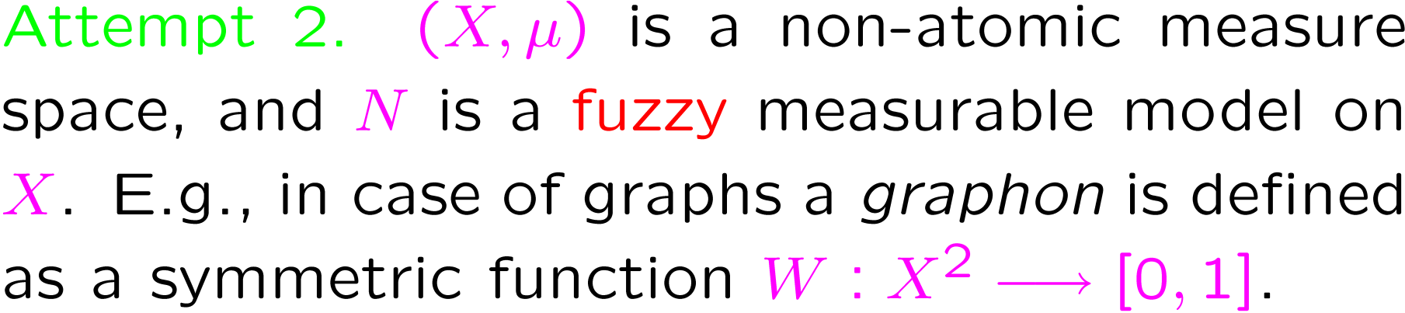
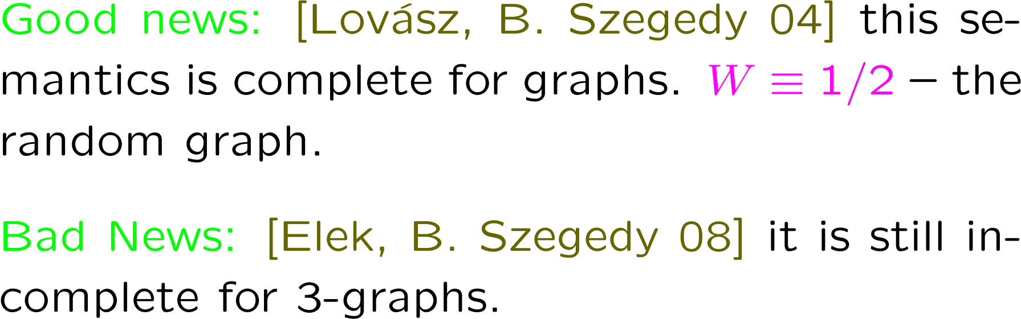

Slide 18
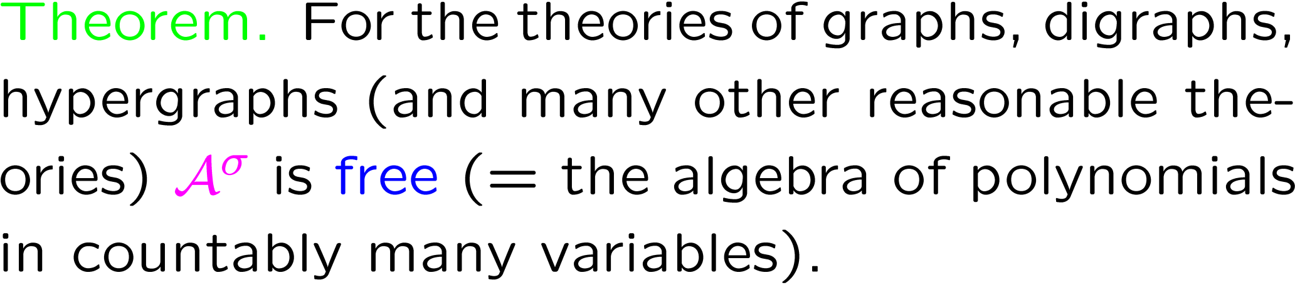
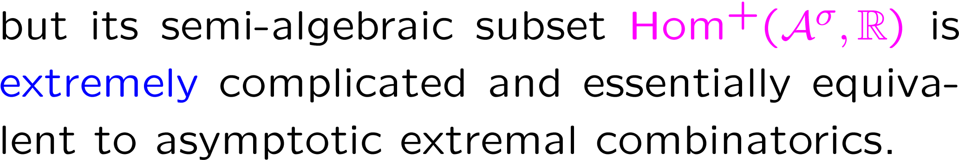
Structure

Slide 19
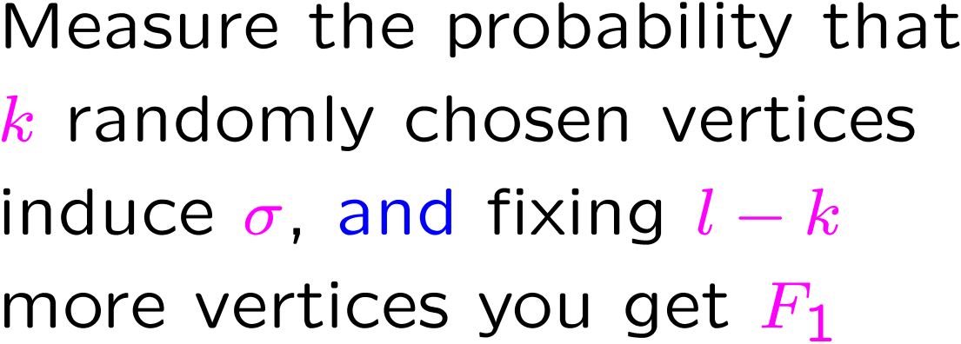
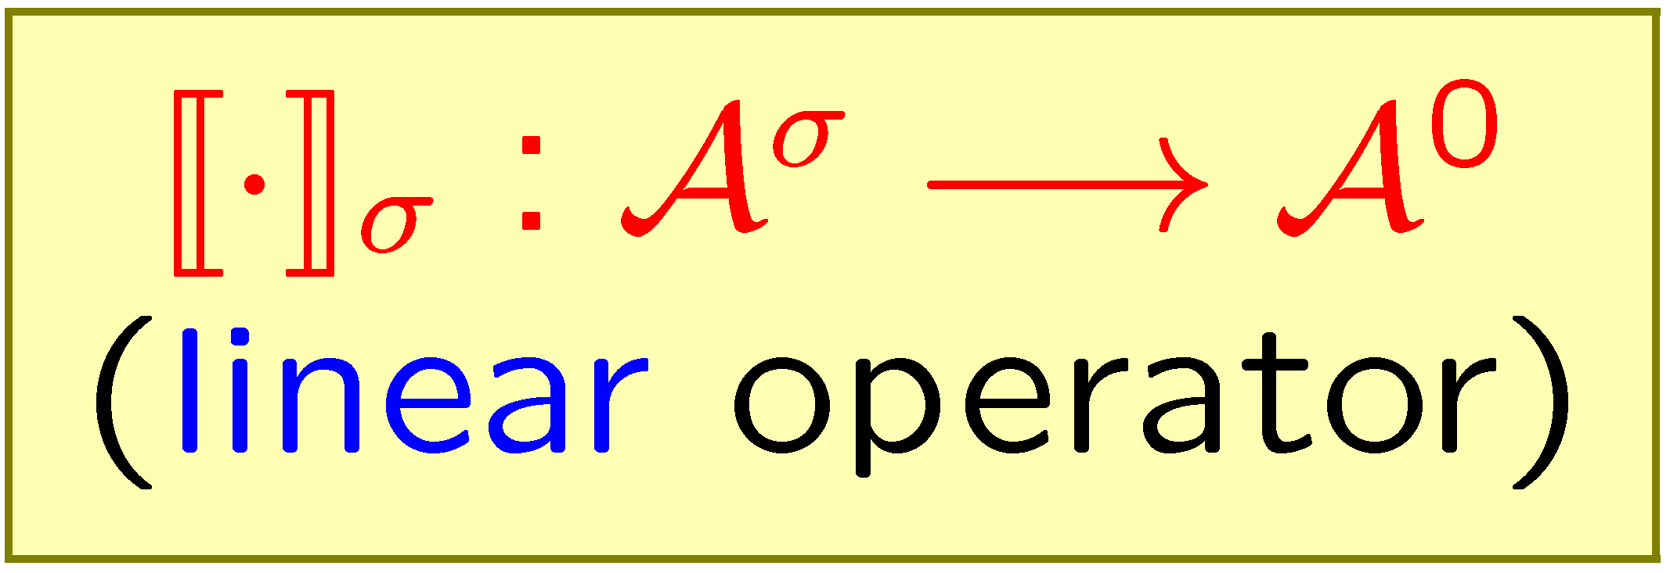
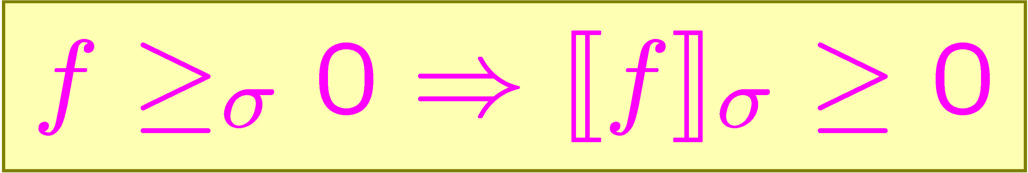
Averaging
F
F₁
F₁
σ
σ
F₁
σ
Relative version

Slide 20
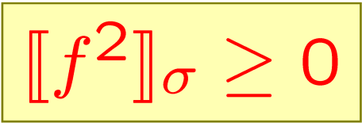
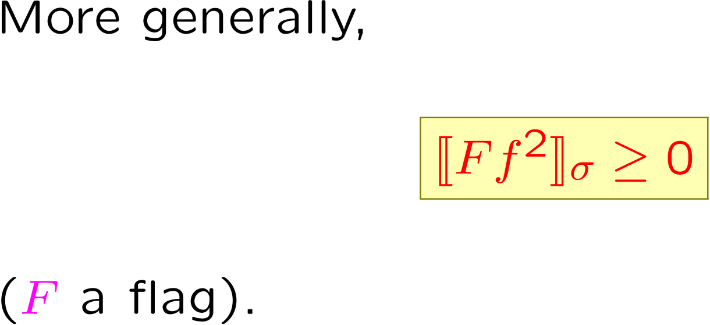
Cauchy-Schwarz
(or our best claim to Proof Complexity)

Slide 21
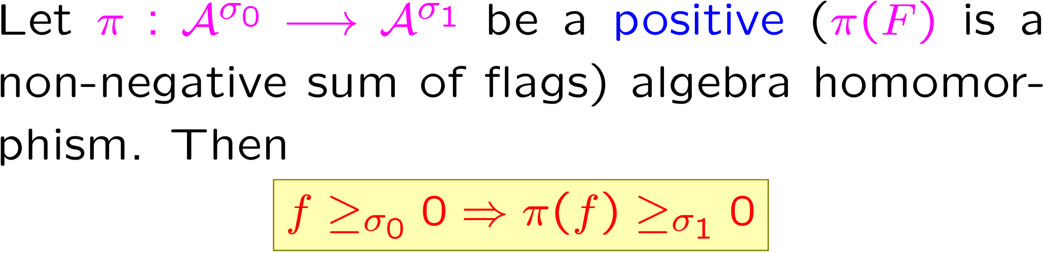
Upward operators (π-operators)
Nature is full of such homomorphisms, and we have a very general construction (based on the logical notion of interpretation) covering most of them.

Slide 22
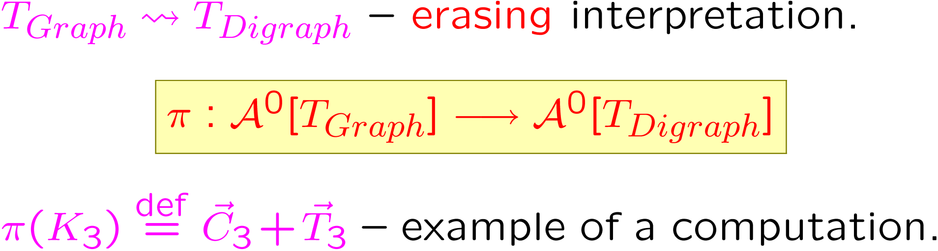
Examples

Slide 23
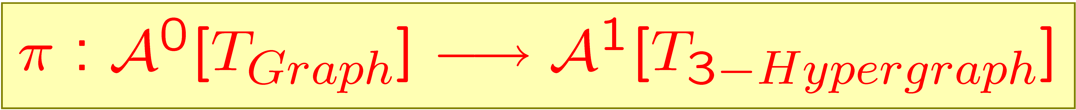
Link homomorphism

Slide 24
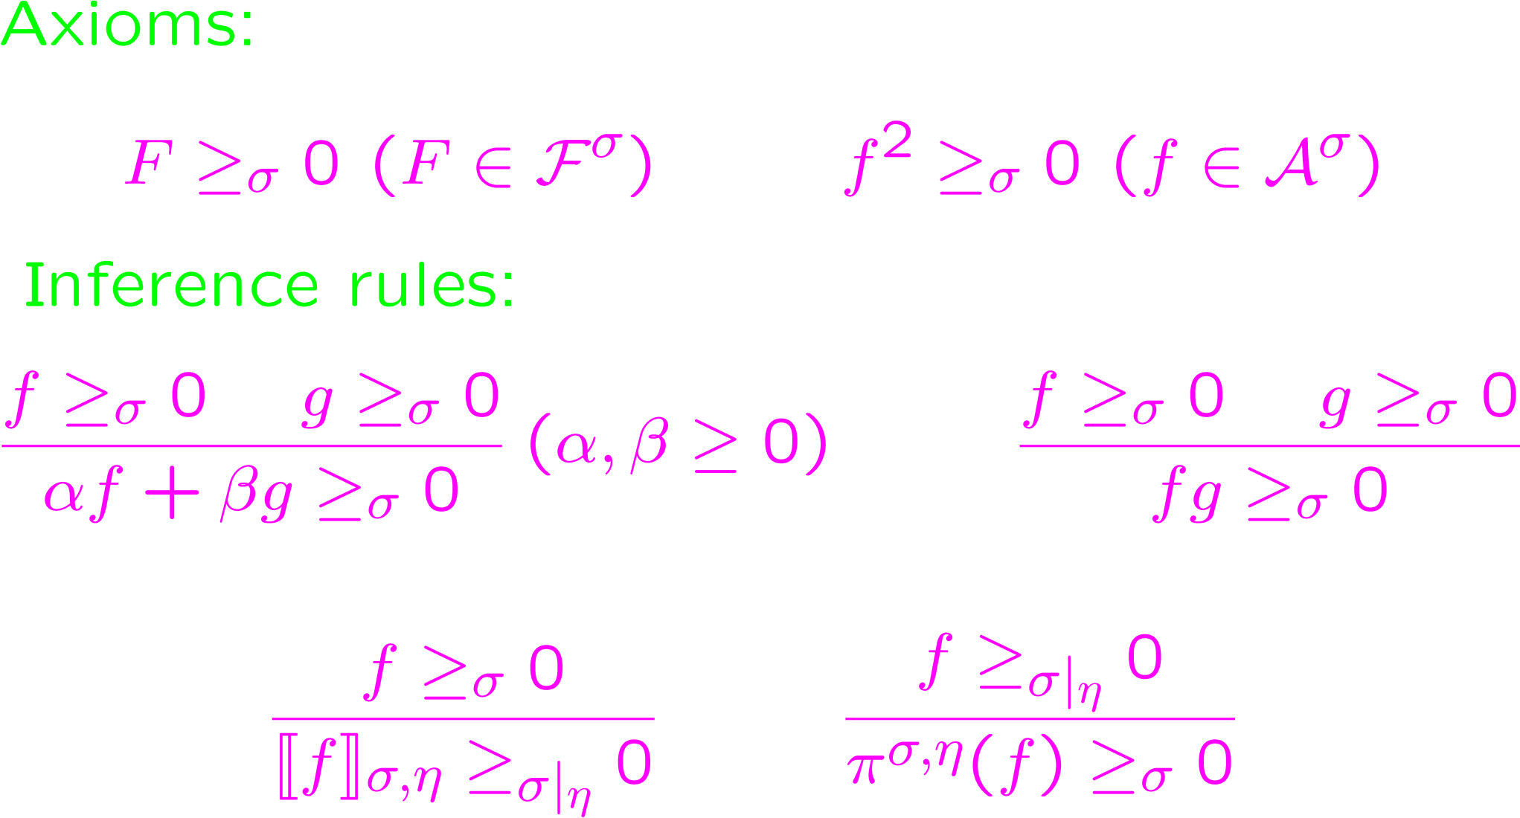
Cauchy-Schwarz calculus

Slide 25
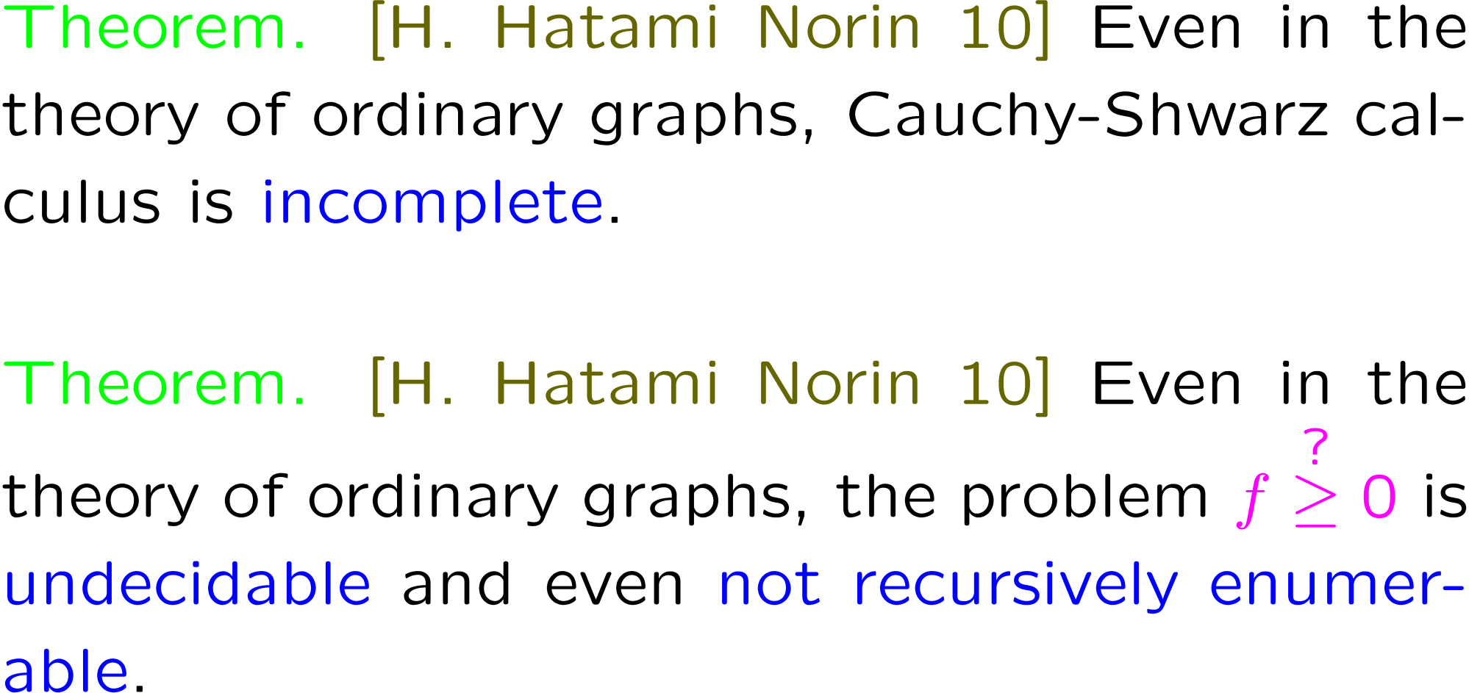

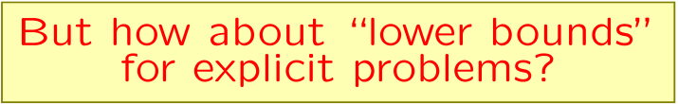

Slide 26
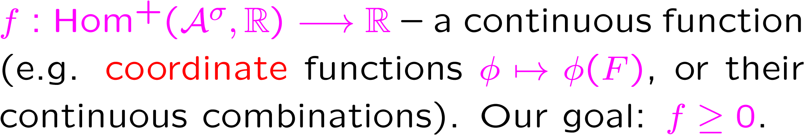
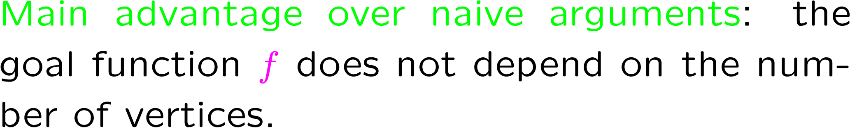
Extremal homomorphisms

Slide 27
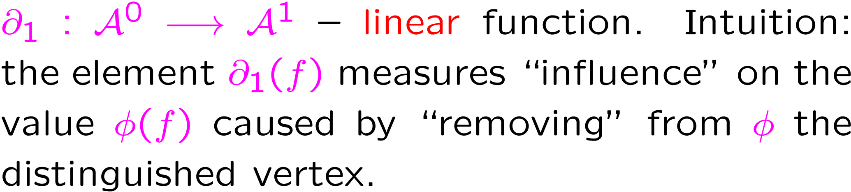
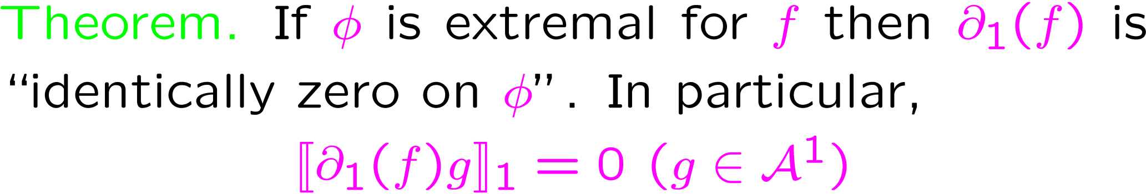
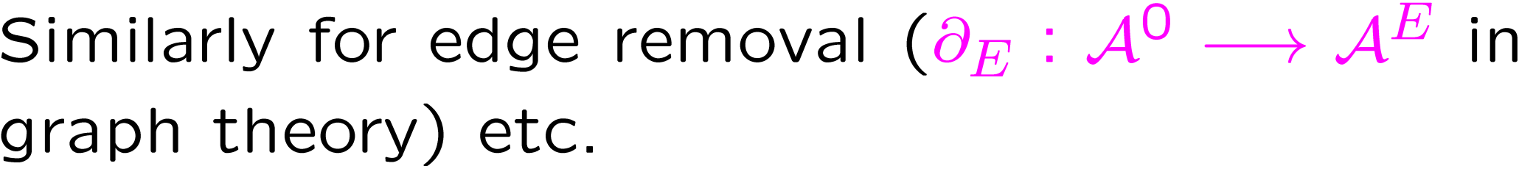
Differential operators
N (=φ)
M
M
v

Slide 28
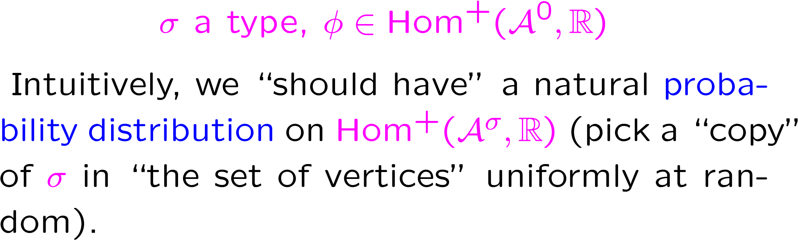
Ensembles of random homomorphisms

Slide 29
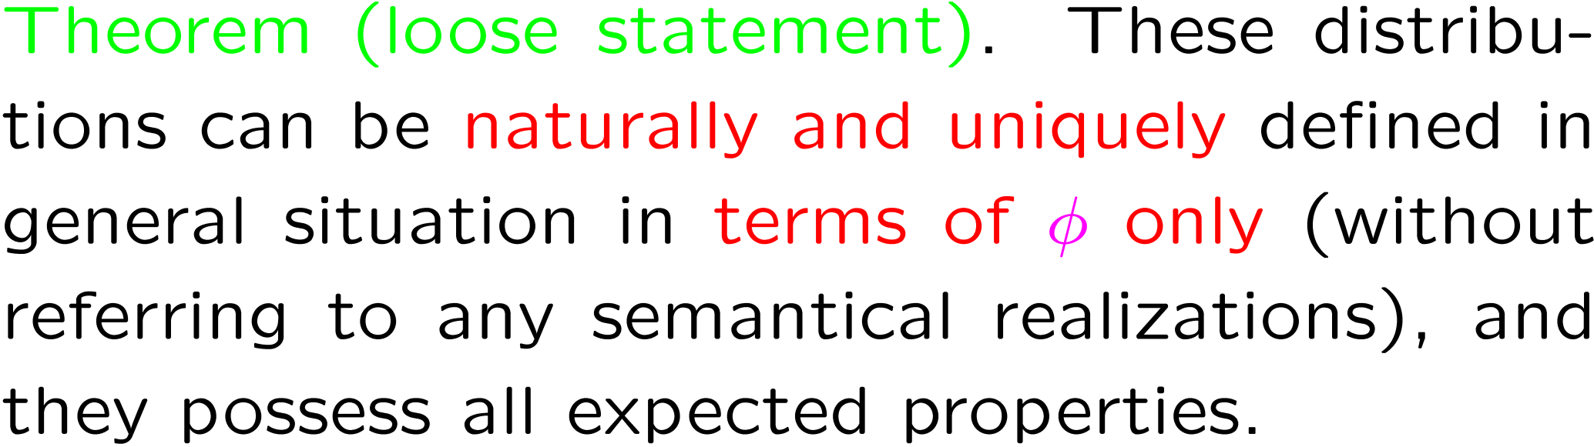

Slide 30
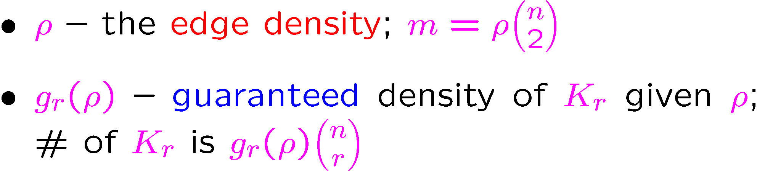
Applications: triangle density
(problem # 2 on our list)
Partial results: Goodman [59]; Bollobás [75]; Lovász, Simonovits [83]; Fisher [89]
We completely solve this for triangles (r=3)

Slide 31
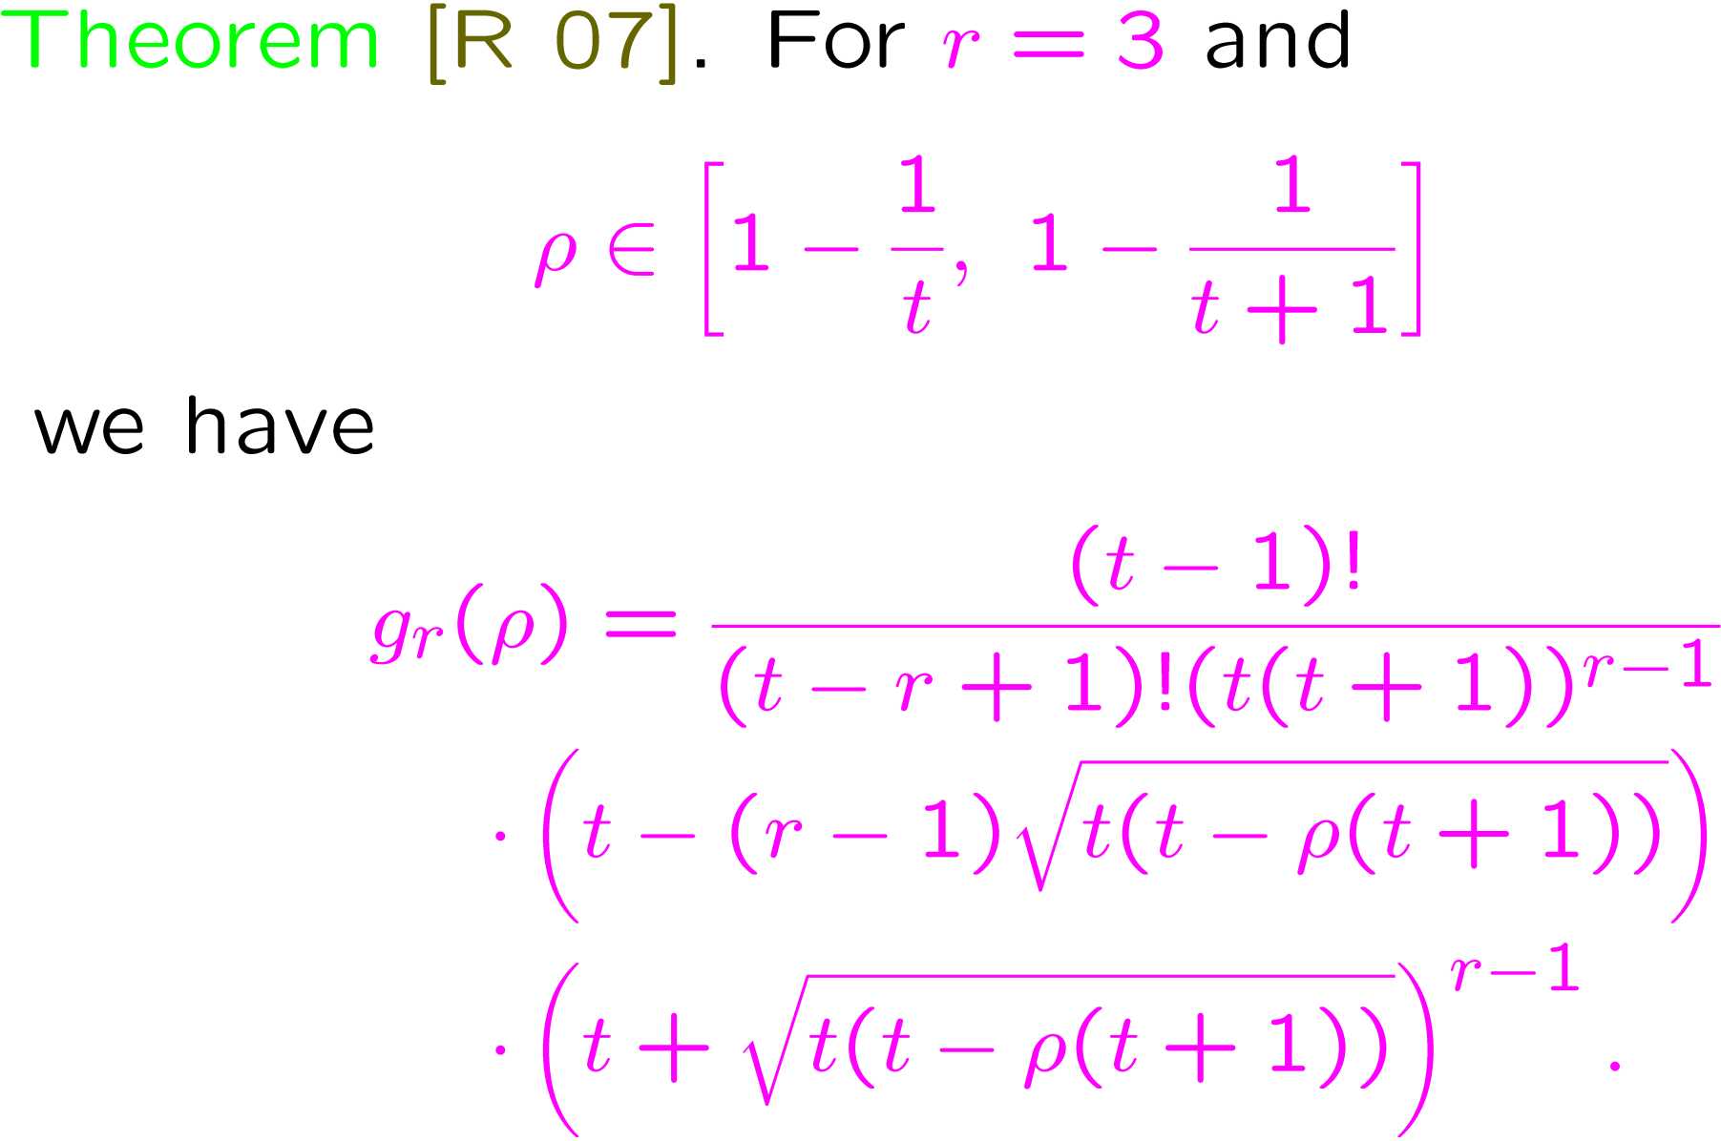

Slide 32
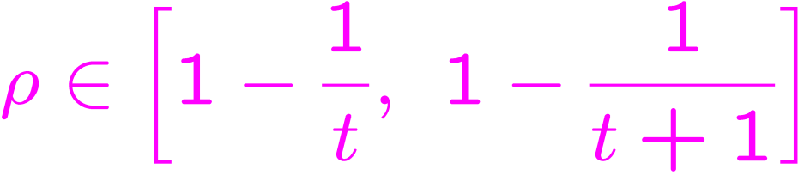
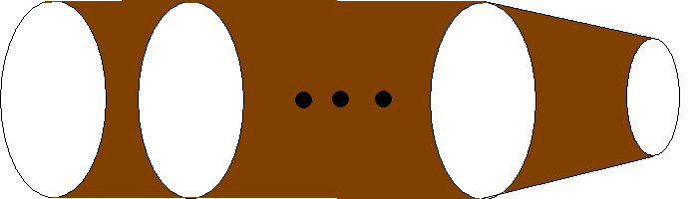
Upper bound

Slide 33

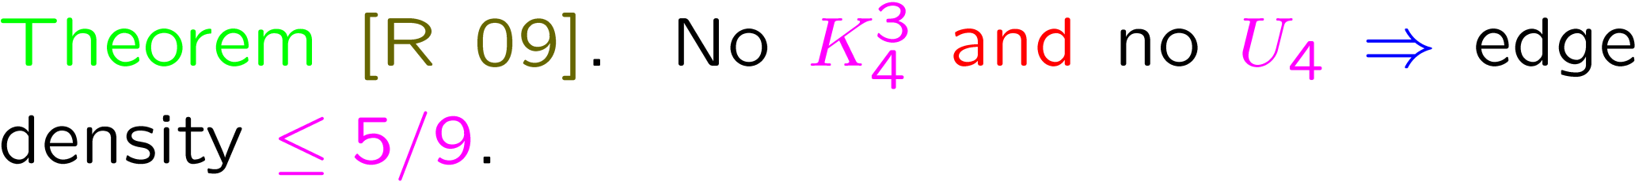
Problem # 3 (Turán for hypergraphs)

Slide 34
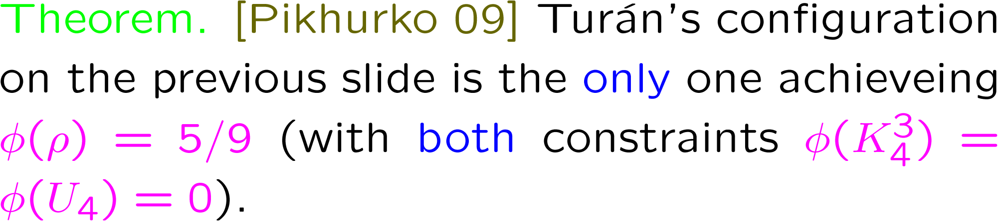
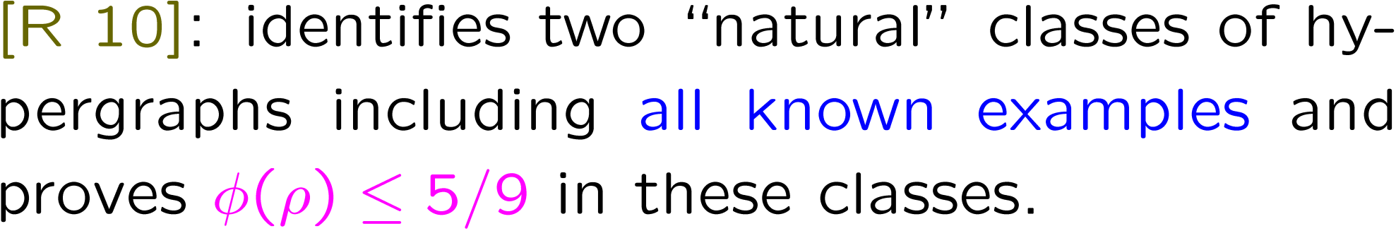

Slide 35
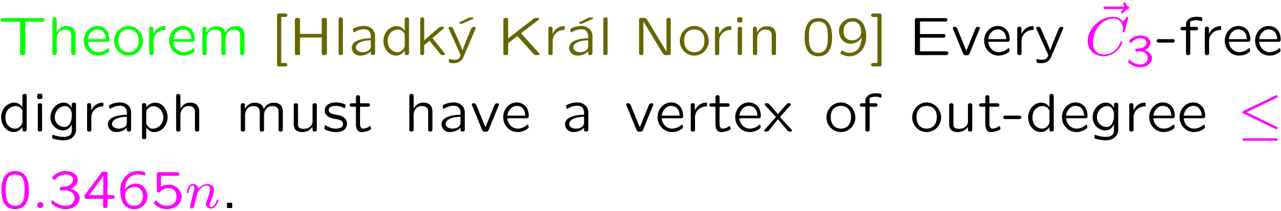
Problem # 4 (Cacceta--Haggkvist conjecture)

Slide 36
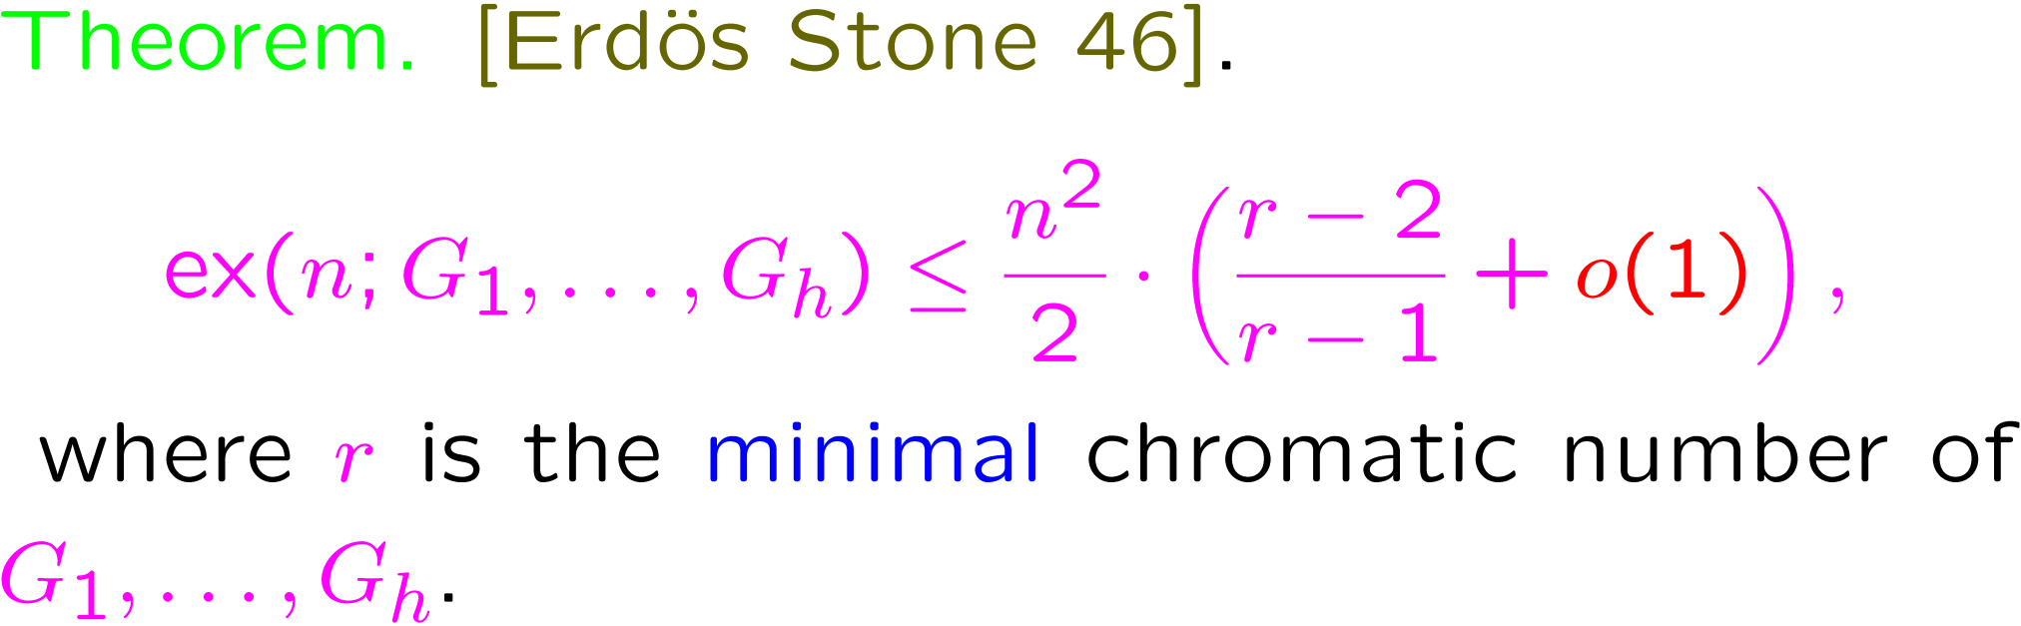
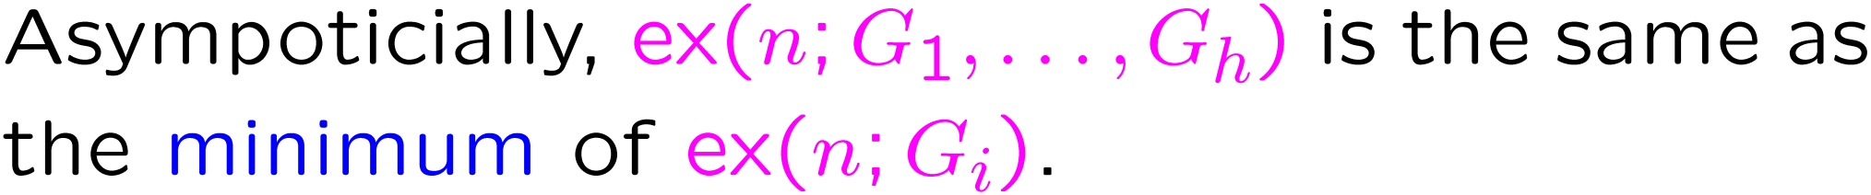
Other Hypergraph Problems: (non)principal families

Slide 37
Examples: [Balogh 90; Mubayi Pikhurko 08]
[R 09]: the pair {G₃, C₅} is non-principal; G₃ is the prism and C₅ is the pentagon.
Hypergraph Jumps
[BaberTalbot 10] Hypergraphs do jump.
Flagmatic software (for 3-graphs)
by Emil R. Vaughan http://www.maths.qmul.ac.uk/~ev/flagmatic/

Slide 38
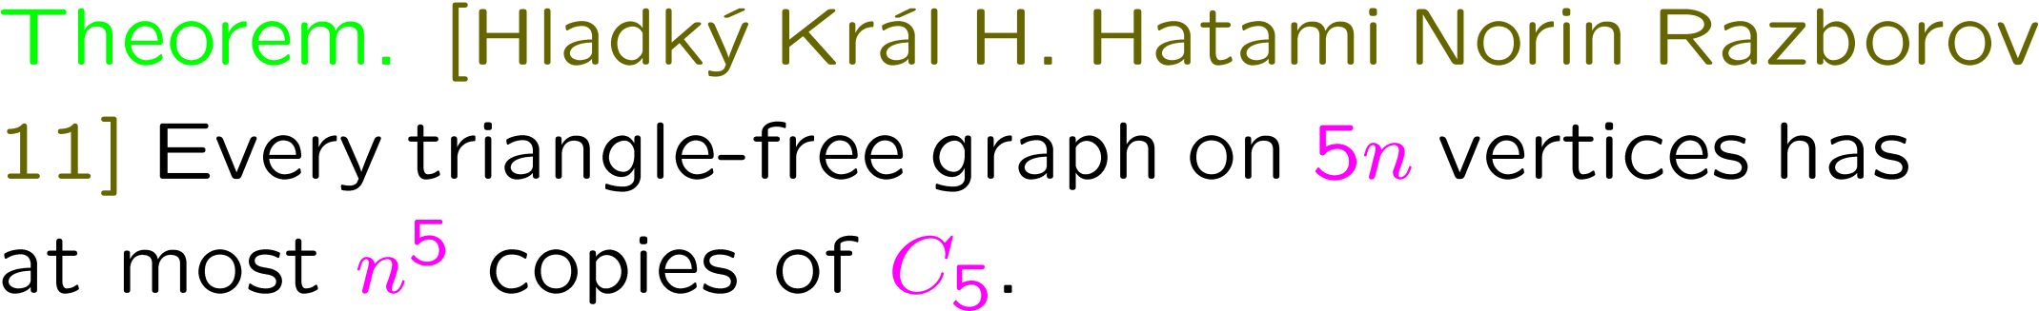
Erdös’s Pentagon Problem
[Hladký Král H. Hatami Norin Razborov 11]
[Erdös 84]: triangle-free graphs need not be bipartite. But how exactly far from being bipartite can they be? One measure proposed by Erdös: the number of C₅, cycles of length 5.

Slide 39
Inherently analytical and algebraic methods
lead to exact results in extremal combinatorics about finite objects.
Definition. A graph H is common if the number of its copies in G and the number of its copies in the complement of G is (asymptotically) minimized by the random graph.
[Erdös 62; Burr Rosta 80; Erdös Simonovits 84; Sidorenko 89 91 93 96; Thomason 89; Jagger
Štovícek Thomason 96]: some graphs are common,
but most are not.

Slide 40
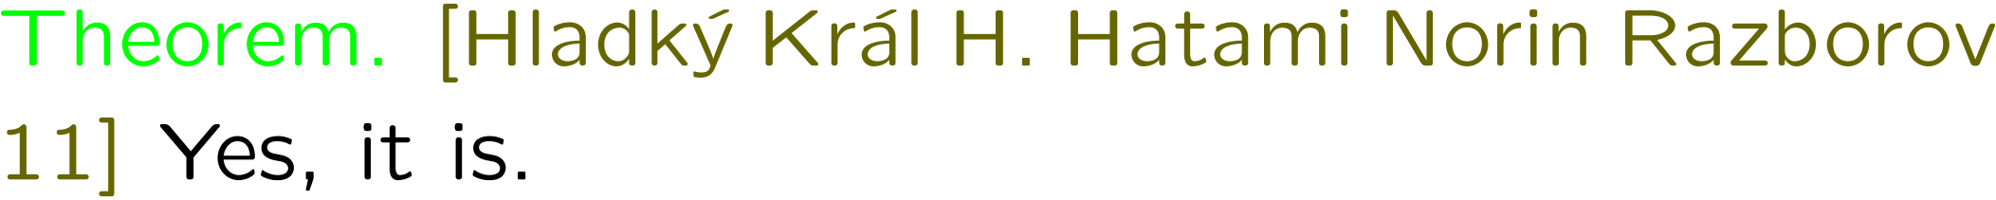
Question. [Jagger Štovícek Thomason 96]: is W₅ common?
W₅

Slide 41
Conclusion
Mathematically structured approaches (like the one presented here) is certainly no guarantee to solve your favorite extremal problem…
but you are just better equipped with them.
More connections to graph limits and other things?

Slide 42
Thank you

