Slide 1
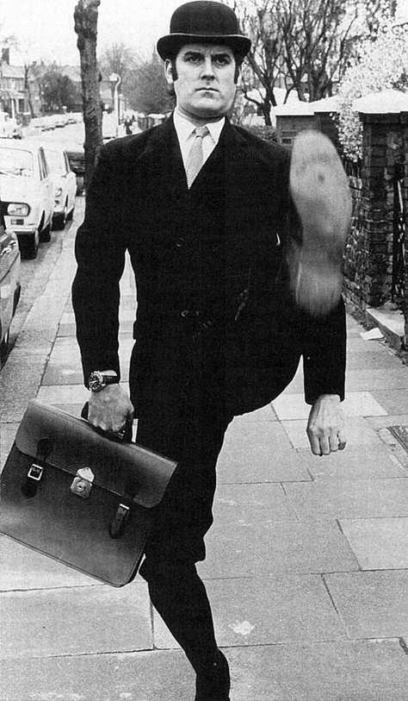
And now for something
completely different.
case-14Oct2011

Slide 2
Models and Capacities of Molecular Communication
Andrew W. Eckford
Department of Computer Science and Engineering, York University
Joint work with:
L. Cui, York University
P. Thomas and R. Snyder, Case Western Reserve University

Slide 3

How do these things talk?

Slide 4
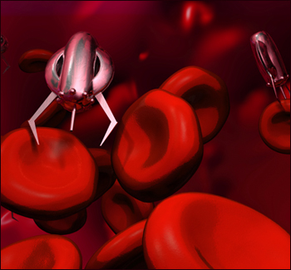
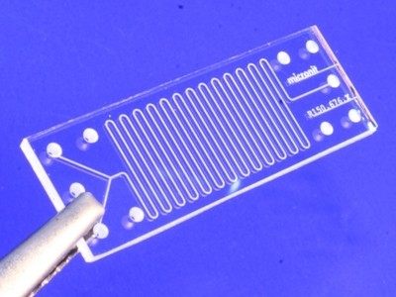
Why do this? … Engineering

Slide 5


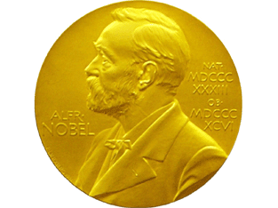
Why do this? … Medicine/Biology
Model and calculate capacity of a molecular communication channel
Show that information theory can predict biological parameters
Show that information theory plays an important role in physiology/medicine

Slide 6
Communication Model
Communications model
Noise
m
Tx
Tx
Rx
Medium
m
m'
1, 2, 3, ..., |M|
m = m'?
M:

Slide 7
Communication Model
Fundamental assumptions
Molecules propagate via Brownian motion
Molecules don’t interact with each other (no reaction, motions are independent)
Molecules don’t disappear or change identity

Slide 8
Say it with Molecules
Identity: Sending 0
Cell 1
Release type A
Cell 2

Slide 9
Say it with Molecules
Identity: Sending 1
Cell 1
Release type B
Cell 2

Slide 10
Say it with Molecules
Identity: Receiving
Cell 1
Measure identity of arrivals
Cell 2

Slide 11
Say it with Molecules
Quantity: Sending 0
Cell 1
Release no molecules
Cell 2

Slide 12
Say it with Molecules
Quantity: Sending 1
Cell 1
Release lots of molecules
Cell 2

Slide 13
Say it with Molecules
Quantity: Receiving
Cell 1
Measure number arriving
Cell 2

Slide 14
Say it with Molecules
Timing: Sending 0
Cell 1
Release a molecule now
Cell 2

Slide 15
Say it with Molecules
Timing: Sending 1
Cell 1
WAIT …
Cell 2

Slide 16
Say it with Molecules
Timing: Sending 1
Cell 1
Release at time T>0
Cell 2

Slide 17
Say it with Molecules
Timing: Receiving
Cell 1
Measure arrival time
Cell 2

Slide 18
Ideal System Model
“All models are wrong,
but some are useful”
-- George Box

Slide 19
Ideal System Model
In an ideal system:

Slide 20
Ideal System Model
In an ideal system:
1) Transmitter and receiver are perfectly synchronized.

Slide 21
Ideal System Model
In an ideal system:
1) Transmitter and receiver are perfectly synchronized.
Transmitter perfectly controls the release times and physical state of transmitted particles.

Slide 22
Ideal System Model
In an ideal system:
1) Transmitter and receiver are perfectly synchronized.
2) Transmitter perfectly controls the release times and physical state of transmitted particles.
3) Receiver perfectly measures the arrival time and physical state of any particle that crosses the boundary.

Slide 23
Ideal System Model
In an ideal system:
1) Transmitter and receiver are perfectly synchronized.
2) Transmitter perfectly controls the release times and physical state of transmitted particles.
3) Receiver perfectly measures the arrival time and physical state of any particle that crosses the boundary.
4) Receiver immediately absorbs (i.e., removes from the system) any particle that crosses the boundary.

Slide 24
Ideal System Model
In an ideal system:
1) Transmitter and receiver are perfectly synchronized.
2) Transmitter perfectly controls the release times and physical state of transmitted particles.
3) Receiver perfectly measures the arrival time and physical state of any particle that crosses the boundary.
4) Receiver immediately absorbs (i.e., removes from the system) any particle that crosses the boundary.
Everything is perfect

Slide 25
Ideal System Model
Two-dimensional Brownian motion
Tx
Rx
0
d

Slide 26
Ideal System Model
Two-dimensional Brownian motion
Tx
Rx
0
d

Slide 27
Ideal System Model
Two-dimensional Brownian motion
Tx
Rx
0
d
Uncertainty in propagation is the main source of noise!

Slide 28
Ideal System Model
Theorem.
I(X;Y) is higher under the ideal system model than under any system model that abandons any of these assumptions.

Slide 29
Ideal System Model
Theorem.
I(X;Y) is higher under the ideal system model than under any system model that abandons any of these assumptions.
Proof.
1, 2, 3: Obvious property of degraded channels.
4: ... a property of Brownian motion.

Slide 30
Ideal System Model
Two-dimensional Brownian motion
Tx
Rx
0
d

Slide 31
Ideal System Model
One-dimensional Brownian motion
Tx
Rx
0
d

Slide 32
Ideal System Model
Two-dimensional Brownian motion
Tx
Rx
0
d

Slide 33
Ideal System Model
Two-dimensional Brownian motion
Tx
Rx
0
d

Slide 34
Ideal System Model
Two-dimensional Brownian motion
Tx
Rx
0
d
First hitting time is the only property of
Brownian motion that we use.

Slide 35
Input-output relationship
Additive Noise: y = x + n
n = First arrival time
f_{N}(n) = First arrival time PDF
f_{N}(y-x) = Arrival at time y given release at time x

Slide 36
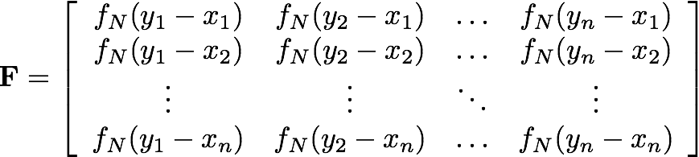
Input-output relationship

Slide 37

Input-output relationship
Bapat-Beg theorem

Slide 38
Delay Selector Channel
Transmit: 1 0 1 1 0 1 0 0 1 0

Slide 39
Delay Selector Channel
Transmit: 1 0 1 1 0 1 0 0 1 0
Delay: 1

Slide 40
Delay Selector Channel
Transmit: 1 0 1 1 0 1 0 0 1 0
Delay: 1
Receive: 0 1 0 0 0 0 0 0 0 0

Slide 41
Delay Selector Channel
Transmit: 1 0 1 1 0 1 0 0 1 0
Delay: 1
Receive: 0 1 0 0 1 0 0 0 0 0

Slide 42
Delay Selector Channel
Transmit: 1 0 1 1 0 1 0 0 1 0
Delay: 1
Receive: 0 1 0 0 2 0 0 0 0 0

Slide 43
Delay Selector Channel
Transmit: 1 0 1 1 0 1 0 0 1 0
Delay: 1
Receive: 0 1 0 0 2 0 0 1 0 0

Slide 44
Delay Selector Channel
Transmit: 1 0 1 1 0 1 0 0 1 0
Delay: 1
Receive: 0 1 0 0 2 0 0 1 1 0

Slide 45
Delay Selector Channel
Transmit: 1 0 1 1 0 1 0 0 1 0
Delay:
Receive: 0 1 0 0 2 0 0 1 1 0

Slide 46
Delay Selector Channel
I
Receive: 0 1 0 0 2 0 0 1 1 0

Slide 47
Delay Selector Channel
I
Receive: 0 1 0 0 2 0 0 1 1 0
… Transmit = ?

Slide 48
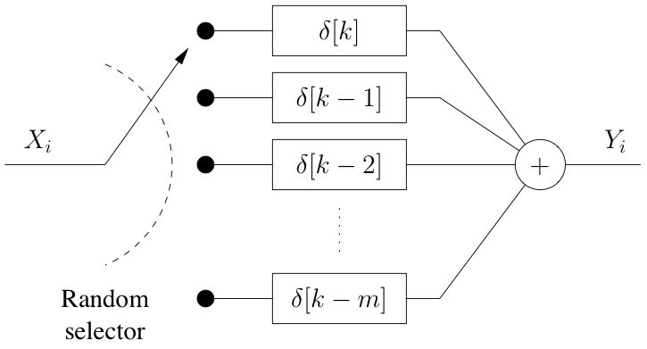
Delay Selector Channel

Slide 49
Delay Selector Channel

Slide 50

Delay Selector Channel

Slide 51
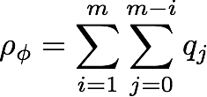
Delay Selector Channel

Slide 52
Delay Selector Channel
[Cui, Eckford, CWIT 2011]

Slide 53
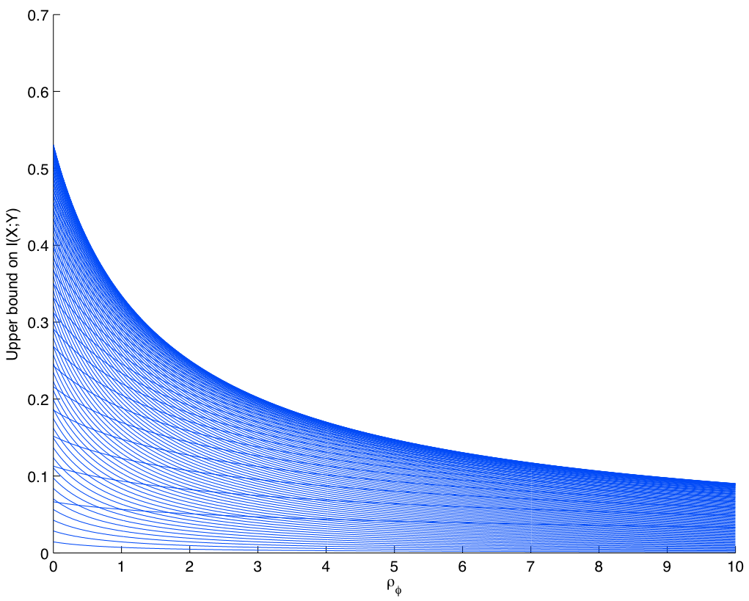

Delay Selector Channel

Slide 54
Delay Selector Channel
Max over p_{x}

Slide 55
Delay Selector Channel

Slide 56
Delay Selector Channel
Let m = 1, q₁ = 0.5:

Slide 57

Delay Selector Channel
Let m = 1, q₁ = 0.5:

Slide 58
Delay Selector Channel
Let m = 1, q₁ = 0.5:

Slide 59
Ligand-receptor channels

Slide 60
Ligand-receptor channels
Y = binding state (B/U)
Cell
X = concentration (H/L)

Slide 61
Ligand-receptor channels
Cell

Slide 62
Ligand-receptor channels
Cell

Slide 63
Ligand-receptor channels
Cell

Slide 64

Ligand-receptor channels

Slide 65
Ligand-receptor channels
Theorem:
If α_{L} = 0, α_{H} = 1, β = 1, capacity is log₂ ϕ = 0.6942.
Proof sketch:
“BB” subsequences are forbidden at the receiver.
Furthermore, the transmitter always knows the binding state.
[Thomas, Snyder, Eckford, ISIT 2012, in prep]

Slide 66
Ligand-receptor channels
Conjecture:
In general, feedback-capacity-achieving input distribution is iid.
[Thomas, Snyder, Eckford, ISIT 2012, in prep]

Slide 67
For more information
http://molecularcommunication.ca

Slide 68
For more information
Acknowledgments
Lu Cui York Univ., Canada
Peter Thomas, Robin Snyder Case Western Reserve Univ., USA
Research funding from NSERC
Contact
Email: aeckford@yorku.ca
Web: http://www.andreweckford.com/
Twitter: @andreweckford

