Slide 1
Theoretical Impacts of Habitat Fragmentation and Generalist Predation on Predator-Prey Cycles
Kelsey Vitense
“Current Challenges for Mathematical Modelling of Cyclic Populations” Workshop at BIRS
11/12/13

Slide 2
Outline:
  Motivation
  Models
  Results
  Next steps

Slide 3
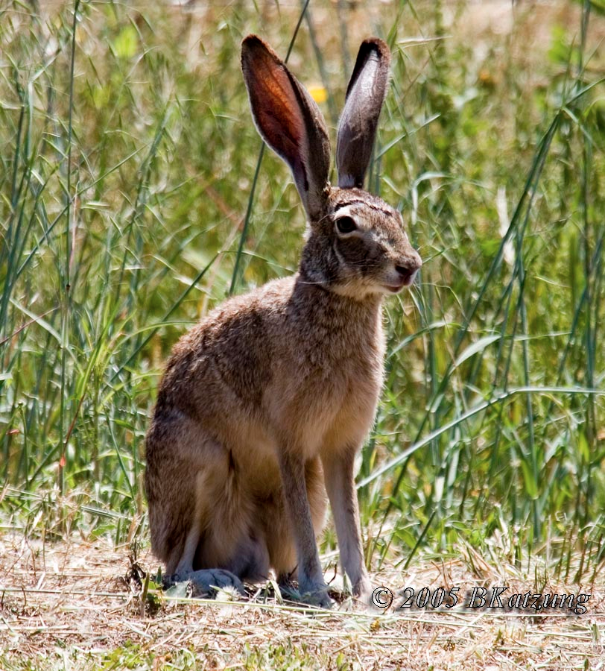
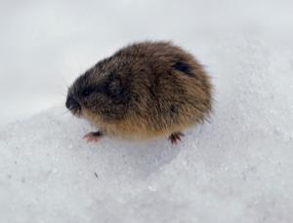
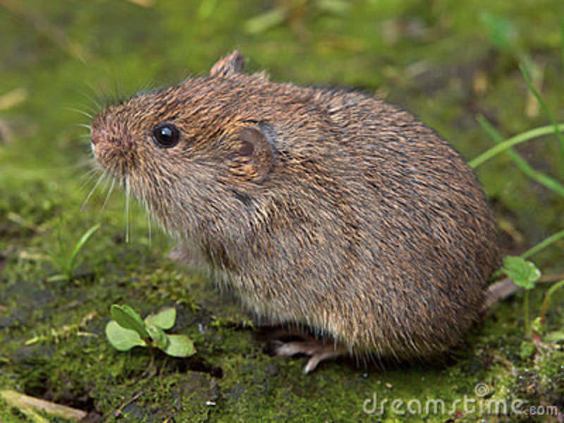
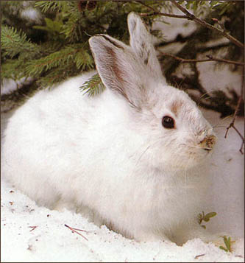
Many cyclic mammalian species undergo dramatic fluctuations in abundance in north but exhibit damped dynamics in south
Proposed Explanations:
Habitat fragmentation or patchiness
Generalist predation
Availability of alternative prey
Black-tailed Jack Rabbit
Brown Lemming
Meadow Vole
Snowshoe Hare
Notes:
As we know, many cyclic herbivores and their predators undergo dramatic fluctuations in abundance in their respective northern latitudes, but their cycles are much attenuated in their southern ranges. Some example prey species are shown at the bottom of the slide.
These species are all important prey items for many predators and they also consume large amounts of plant material, so it’s important for us to understand what is changing their cycles because this will impact other organisms.
There are a few possible explanations for what might be going on. One – habitats tend to be more fragmented or patchy in the south so there’s less suitable habitat and prey might be getting picked off as they disperse from patches. Second – there tend to be more generalist predators that are numerically stable in the and prey are constantly hammered by the generalists and can’t recover after the cyclic lows. Third – more alternate prey available for predators so even “specialist” predators have other things to eat when prey are scarce.

Slide 4
Many cyclic mammalian species undergo dramatic fluctuations in abundance in north but exhibit damped dynamics in south
Proposed Explanations:
Habitat fragmentation or patchiness
Heavy generalist predation
Availability of alternative prey
What are the relative and combined effects of habitat fragmentation and generalist predation on predator-prey cycles?
Notes:
I’m going to be focusing on the first two explanations. I want to know what their relative effects are on predator-prey cycles and if I can say anything about which has a larger effect. And I also want to look at what their combined effects are since habitat fragmentation often makes it possible for generalists to enter areas that were previously inaccessible to them, so they often come hand-in-hand.

Slide 5
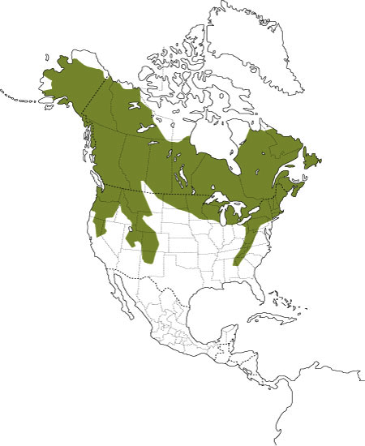
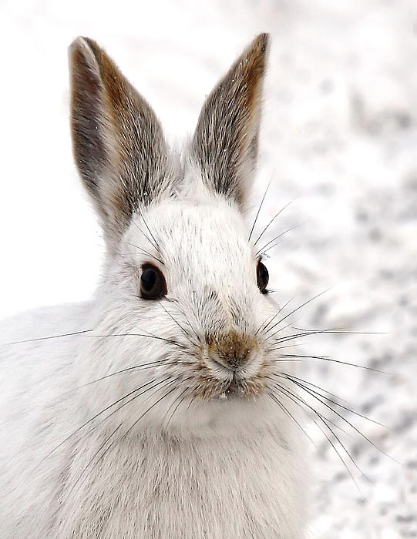
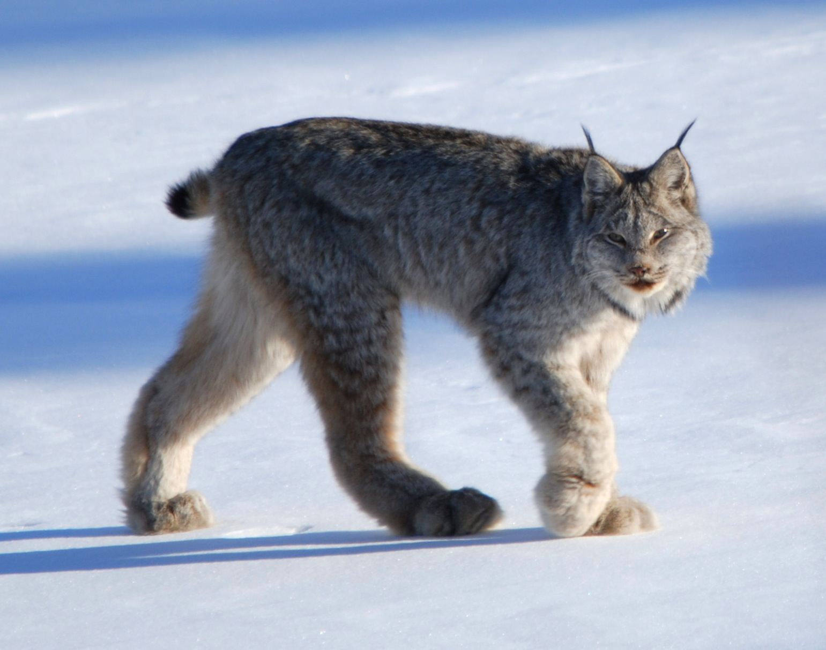
Snowshoe Hare
Canada Lynx
Northern range: Boreal forest of Canada and Alaska
    8-11 year population cycle
    Amplitude = 10-25 fold
    Varies geographically and from period to period
Southern range: Northern US and Great Lakes
    More mountainous and fragmented
    Amplitude = 2-25 fold
    Lower peak densities in South
    Canada Lynx – Listed as threatened in lower 48 states
Notes:
I’m using the snowshoe hare and Canada lynx as a case study since it’s a well-studied system and people have parameterized mechanistic models based on data obtained from field studies. The Canada lynx is also listed as a threatened species in the lower 48 states and is a specialist hare predator, so it’s especially important to their dynamics due to conservation concerns for the lynx.

Slide 6
Approach:
Limited data on southern populations
Use models to do “experiments” to test hypotheses
Start with dynamics similar to north with parameter ranges taken from literature
Perturb system according to parameters expected to be different in southern range
Notes:
Data on southern populations is more limited than in the north, so the approach I’m taking is to use mechanistic models from the north and perturb the system according to environmental parameters and forms of predation that are expected to be different in the south.

Slide 7
Reaction-Diffusion-Advection Models
n = n(x,t) = population density at position x at time t
Notes:
So I’m using reaction-diffusion-advection models so that I can look at how population cycles change in time and in space.
They are PDEs, so n is population density at a specific position x at time t. This equation describes how the density of individuals changes in time through space.

Slide 8
Reaction-Diffusion-Advection Models
n = n(x,t) = population density at position x at time t
D(x) - measure of how quickly individuals spread apart from each other
V(x) - measure of how quickly individuals move together
f(n,x) describes change in population density due to reproduction, natural mortality, etc.
Notes:
So D is the diffusion coefficient and can vary in space… V is the advection piece
So this first term wtih D(x) is the diffusion piece – D is a measure of how fast individuals diffuse through space or spread apart from each other
And the term with V(x) is the advection piece – so V is the velocity of the individuals as a group, so have fast they all move together in a particular direction
And then this function f is the reaction term and describes any change in pop density that isn’t due to movement of individuals, like…

Slide 9
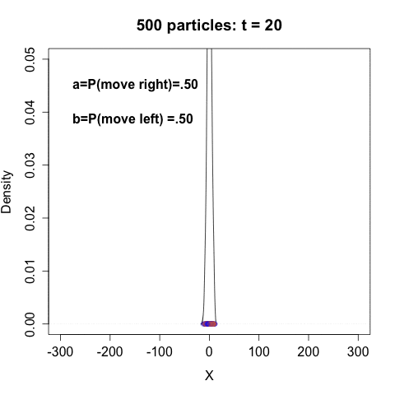
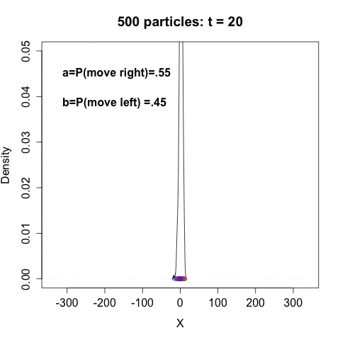


500 particles initially centered at x=0
Each particle moves right with probability a
Each particle moves left with probability b
Symmetric Random Walk
(Diffusion)
Biased Random Walk
(Diffusion-Advection)
Notes:
These equations can be derived as a continuous approximations in time and space for the density curve of a bunch of individuals undergoing a random walk. So I made these movies for a visualization of the movement terms.
On the left, each particle is doing a symmetric random walk, so equal prob of moving left or right, and this is just a diffusion process with particles spreading apart. On the right, the particles have a slight preference to move to the right, so the particles both spread apart from each other and move as a group to the right, and this is a diffusion-advection process. So these equations describe how the density curve changes in time and space.

Slide 10
A system of reaction-diffusion-advection equations can describe predator-prey interactions in space and time:
Prey and predator can have their own movement rates
Reaction terms incorporate the influence of one population on the other and may vary spatially
Strohm and Tyson (2009) used this framework to show that habitat fragmentation reduces cycle amplitude and average densities
Notes:
We can use a system of reaction diffusion advection models to describe predator-prey interactions in space and time.
Preds and prey can have their own movement rates, where the predator should most likely move faster than the prey.
And the reaction terms now account for the influence of one population on the other
So Rebecca and her student Shaun Strohm used this framework to show that hab frag reduces cycle amplitude and average densities for both predator and prey, and so I’m building on this work.

Slide 11
ESTABLISH NORTHERN BASELINE DYNAMICS
Notes:
So the first step is to establish

Slide 12
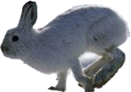
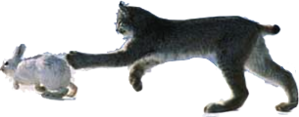
Hare-Lynx (North)
L
X
0
May Reaction Terms
r = hare intrinsic growth rate
k = hare carrying capacity
α = lynx saturation kill rate (hares/lynx/yr)
β = lynx half-saturation constant (hares/ha)
s = lynx intrinsic growth rate
q = minimum hares per lynx (lynx carrying capacity is H/q)
Notes:
-hare and lynx diffusing through a homogeneous habitat along X-axis -
-Neumann boundary conditions for both hare/lynx – no flux across boundaries, dispersal to another area not allowed
-So here’s my equations for the hare and lynx – they both have diffusion terms with no advection, hares diffuse at 75% that of lynx.
-I’m only going to talk about may reaction terms today – I’m also doing R-M model and i’ll be comparing the 2 models
-Hares have logistic growth, r, k
-Lynx also has logistic growth, but carrying cap is H/q, where q is min hare requirement per lynx so dependent on hare density

Slide 13
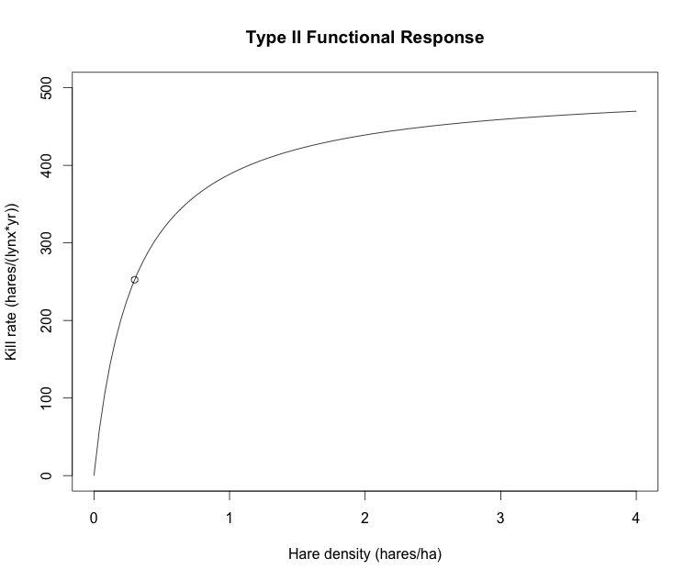
Hare-Lynx (North)
L
X
0
May Reaction Terms
Type II response = Specialist
r = hare intrinsic growth rate
k = hare carrying capacity
α = lynx saturation kill rate (hares/lynx/yr)
β = lynx half-saturation constant (hares/ha)
s = lynx intrinsic growth rate
q = minimum hares per lynx (lynx carrying capacity is H/q)
H
Notes:
And then the functional response for the lynx is type ii which is the type of response commonly used for a specialist predator.
So you have hare density on the x-axis and predation rate on the y-axis.
The lynx responds quickly to changes in hare density and predation rate takes off
Eventually lynx is limited by its ability to process food and it approaches its max kill rate, alpha

Slide 14
Densities in Space through One Cycle
PREY
PREDATOR
Notes:
So these are plots of prey and predator densities in space after they’ve settled into their limit cycle. So each line is pop density through the spatial domain for one year.
For these particular diffusion coefficients, you actually get these double-hump profiles that I wasn’t expecting, but I was actually happy about this at first since some evidence suggests that hares use edges of stands more than the centers. But it’s really by accident.

Slide 15
Densities in Space through One Cycle:
Higher Diffusivities
PREY
PREDATOR
Notes:
If you scale up the diffusion coefficients, the double humps go away and there’s less spatial variation through the patch. So I’m doing these analyses for a few different pairs of diffusion coefficients due to the differences in spatial profiles. But the rest of the plots I’m going to show will be for the lower diffusion coefficients.

Slide 16
PERTURB NORTHERN BASELINE WITH HABITAT FRAGMENTATION
Notes:
So now I’m going to perturb these northern dynamics that I’ve established by fragmenting the spatial domain.

Slide 17
Hare-Lynx with Habitat Fragmentation (South)
L
X
0
B
G
B
G
B
V(x) = spatially varying velocity
  Pulls hares and lynx toward “good” patches
r(x) = spatially varying hare intrinsic growth rate
    Positive in “good” patches
Strohm and Tyson (2009)
Notes:
Now I break up the landscape to make it look more southern
Good patches are in green and bad patches are in red.
And now I’m going to add in velocity terms that are drawing both hares and lynx towards the good patches
So these figures are from Rebecca’s paper – This is V(x). So if the animals are in a “good” patch, they’re happy to stay there and velocity is 0, and if they’re in a bad patch, then they’re drawn to whichever good patch is closest.
Now hare reproduction also varies spatially so they can only reproduce in good patches and the bottom figure is what that function looks like.
So now I start shrinking the size of the good patches while keeping the spatial domain length constant.

Slide 18
Limit Cycles for Different Good Patch Sizes:
1 Good Patch, 1 Bad Patch
Good Patch Size
Notes:
So I only have plots so far for a spatial domain consisting of one good patch and one bad patch, but I will also be doing the same analyses for a 4-patch domain.
But in this figure, I’ve plotted limit cycles for varying sizes of the good patch, and this is the cycle right in the center of the one good patch.
Prey density is on the x-axis and predator density is on the y-axis
Hard to see the legend, but the limit cycle is contracting as good patch size decreases. So the maximum is decreasing for both species, and the minimums actually slightly rise as it contracts to meet up with the maximum and stop the cycle.

Slide 19
CYCLE PROBES VS GOOD PATCH SIZE:
1 Good Patch, 1 Bad Patch
PREY
PREDATOR
Fragmentation
Notes:
And we can see that more clearly with plots of these four cycle probes, which are cycle maximum, minimum, average of max and min, and amplitude.
And this slide is just to show that the prey and predator plots look almost exactly the same so that you believe me.

Slide 20
PREY CYCLE PROBES VS GOOD PATCH SIZE:
1 Good Patch, 1 Bad Patch
Max
Min
Avg
Amp
Fragmentation
Notes:
So we can just look at the prey plots more closely. So we have cycle max, cycle min, average of max and min, and amplitude (difference between max and min rather than their ratio, ratio is 15-fold). And I’m just going to ask you to ignore the gray line and look at the red line. So it takes a little while for the effects to kick in, so the maximum, average density, and prey amplitude don’t significantly decrease until the good patch is about half the domain length. And the minimum rises to stop the cycle.

Slide 21
PERTURB NORTHERN BASELINE WITH GENERALIST PREDATORS
Notes:
So now I want to compare the effects of fragmentation to the effects of heavy generalist predation.

Slide 22
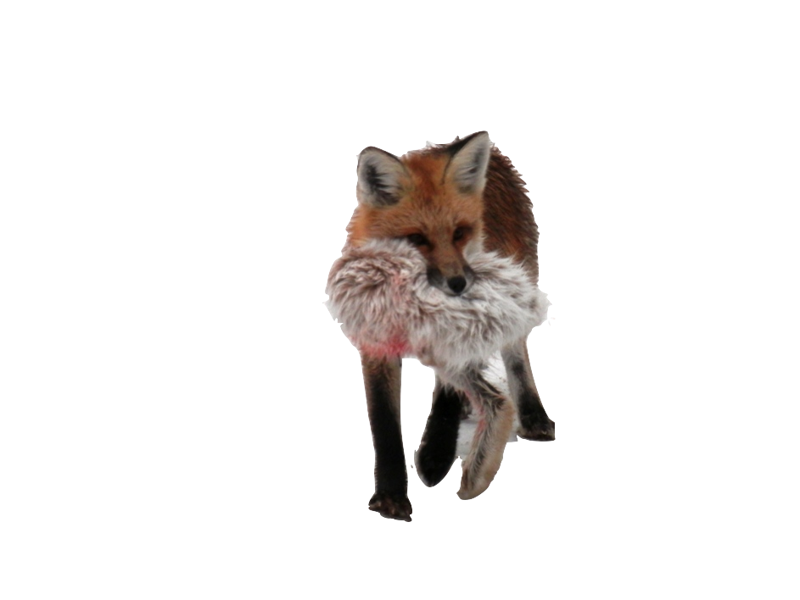
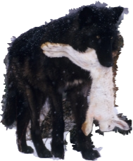
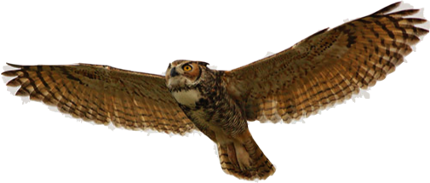
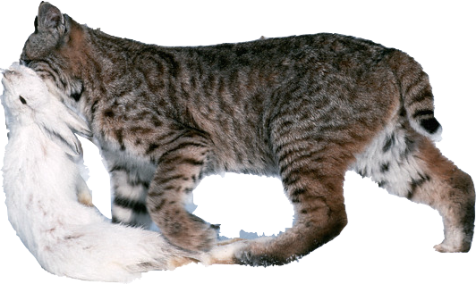
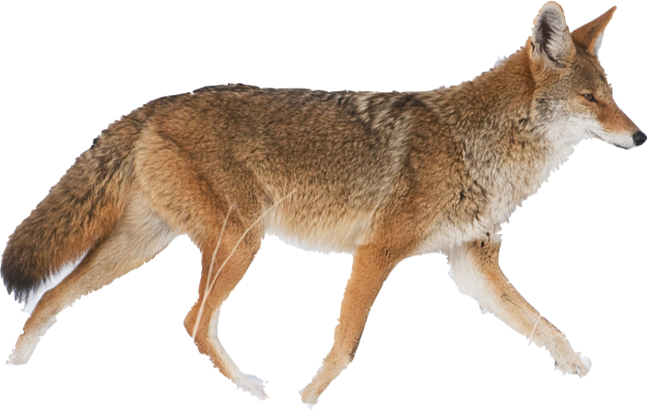
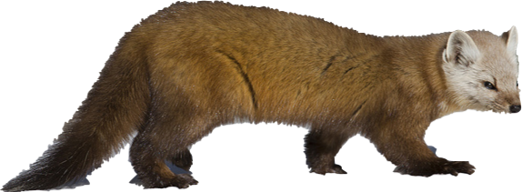
Hare-Lynx with Generalist predation (South)
Aggregate
Generalist
Term
X
0
L
γ = Maximum generalist killing rate (hares/ha/yr)
η = Generalist half-saturation constant (hares/ha)
Notes:
So now I have a homogeneous habitat again and I’ve added a type iii response for generalist predators, which is just one aggregate term.

Slide 23
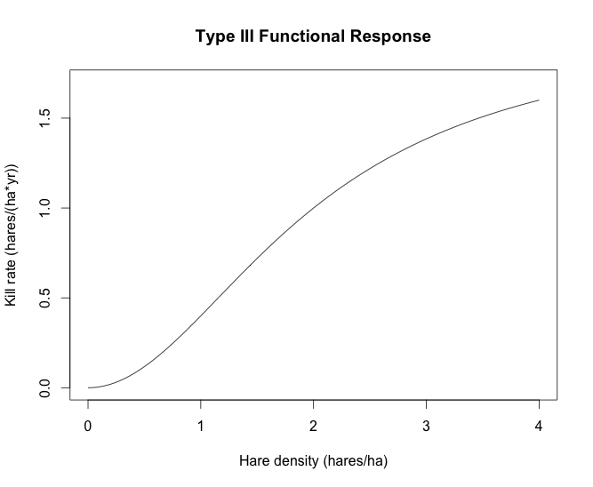
Hare-Lynx with Generalist predation (South)
Aggregate
Generalist
Term
X
0
L
γ = Maximum generalist killing rate (hares/ha/yr)
η = Generalist half-saturation constant (hares/ha)
Type III response = prey switching
Increase γ for higher generalist pressure
H
Notes:
So I’m going to increase gamma which is the max generalist killing rate to see how that affects cycle attributes. And I want to compare those effects to those of fragmentation.

Slide 24
Limit Cycles at Different Levels of Max Generalist Predation:
Single Good Patch
Predation Rate
Oscillations stop around γ=.5 hares/ha/yr.
Estimates from Kluane study put γ between .1-2 hares/ha/yr
Notes:
Here are the limit cycles at different predation rates. Generalist predation has a strong and immediate dampening effect. The oscillations stop at a predation rate of about ..5 hares/ha/year. Estimates from the Kluane study put generalist predation between .1-2, so it really didn’t take much to kill the cycle, and within realistic ranges from northern latitudes.

Slide 25
Cycle Probes Vs. Max Generalist Predation Rate
Prey
Predator
Notes:
And here are the cycle probes now plotted against generalist predation rate. Again, predator dynamics are similar to prey dynamics, so we’ll just look at the prey plots more closely.

Slide 26
Prey Cycle Probes Vs. Max Generalist Predation Rate
Max
Min
Avg
Amp
Notes:
So these are the same four cycle probes as before. Just ignore lines and legend. The maximum has an almost vertical drop as predation increases, and the minimum also sharply rises to meet the max, and then densities decline as a stable spiral point.

Slide 27
PERTURB NORTHERN BASELINE WITH HABITAT FRAGMENTATION AND GENERALIST PREDATORS
Notes:
So now I want to look at the combined effects of fragmentation and generalist predation

Slide 28
Hare-Lynx with Generalist predation and Habitat Fragmentation (South)
X
0
B
G
B
G
B
L
Generalists numerically stable throughout domain
Hare and lynx drawn toward good patches
Simultaneously increase γ and fragmentation
Notes:
So now I’m going to fragment the habitat as before and add in generalist predators that are numerically stable throughout the domain.
So hare and lynx are still drawn toward good patches.
And now I’ll simultaneously increase predation pressure and fragmentation.

Slide 29
PREY Amplitude Contour Plot
Stable
Predation
Fragmentation
Notes:
So here is a contour plot for prey amplitude. And lighter gray is higher amplitude
Can actually compare their relative effects here. So looking at the amplitude plot, generalist predation along the y-axis, so we see how quickly generalists stabilize the dynamics. And fragmentation increases as you move along the x-axis to the left, you can travel along a contour line horizontally without lowering amplitude, so it takes a little longer to kick in..
But the steepest gradient in amplitude occurs once these fragmentation effects have kicked in around
Once effects of fragmentation do kick in, around patch size 10, the steepest gradient in amplitude occurs in this area where you increase predation at smaller and smaller patch size. So I would say they’re combined effects are greater than either effect alone.
FOR CERTAIN RANGES OF GOOD PATCH SIZE (LARGER) GENERALIST PREDATION SAME REGARDLESS OF PATCH SIZE, REALLY NO EFFECT OF PATCH SIZE. BUT SAY BETWEEN 5-10, STEEPEST DESCENT IS ON DIAGONAL OF DECREASING P AND INCREASING G. GENERALISTS HAVE BIG EFFECT REGARDLESS OF PATCH SIZE, BUT EVEN STRONGER EFFECT AT SMALL PATCH SIZE, DEFINITELY EXACERBATED!!! AND DO USUALLY HAVE BOTH OCCURRING AT SAME TIME SO WOULD HAVE VERY STEEP DROP IN AMPLITUDE!!!
INTERESTING THAT IF TAKE VERTICAL SLICES, PREY DIES OFF SLOWER ONCE STOPS OSCILLATING AT SMALLER PATCH SIZE (5-10) COMPARED TO LARGER PATCH SIZE (BUT THIS IS MEASURED IN CENTER OF PATCH AND MAY BE BECAUSE OF WEIRD SHAPE.

Slide 30
NEXT STEP:
PERTURB NORTHERN BASELINE WITH HABITAT FRAGMENTATION AND GENERALIST PREDATORS EXPLOITING HABITAT EDGES
Notes:
So generalist predators tend to exploit edges between habitats by focusing their hunting efforts on edges, so my step next is to incorporate this into the model.

Slide 31
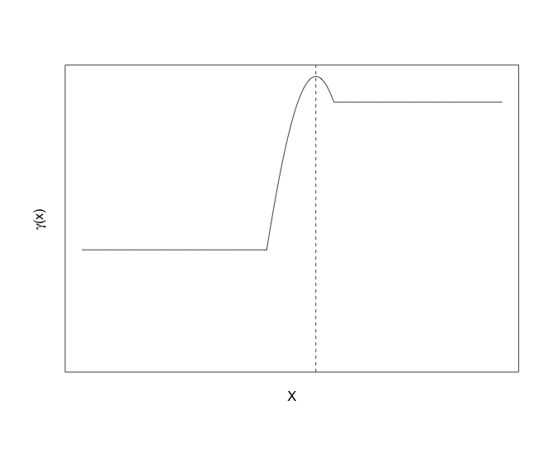
Hare-Lynx with Generalist predation and Habitat Fragmentation (South)
X
0
B
G
B
G
B
L
Maximum generalist killing rate higher on patch boundaries
“Good”
“Bad”
Notes:
So now instead of just increasing gamma, I’ll have the maximum generalist predation rate be higher on patch boundaries. I haven’t entirely decided what this function will look like, but probably something like this graph, where predation is higher in bad patches compared to good patches, and you have a spike on the edges. So that’s yet to be done.

Slide 32
SUMMARY
Generalist predation has stronger, more immediate dampening effect than habitat fragmentation
(for this parameterization of the May model)
Fragmentation and generalist predation both dampened oscillations by reducing cycle maximums and raising minimums
Combined dampening effects of habitat fragmentation and generalist predation are stronger than the relative effects
Notes:
I feel pretty comfortable saying that generalist predation has a stronger, more immediate dampening effect compared to habitat fragmentation, at least for this particular parameterization of the May model.
Both worked to dampen oscillations by lowering max densities and raising minimums. The data suggests that both maximum and minimum densities are lower in the southern range,

Slide 33
Impacts of Results
Shed light on useful data to be collected in future field work
  Generalist predation:
    Rates
    Locations
Habitat Fragmentation:
Proportion of suitable habitat
Patch size
Amount of edge
Abundance estimates of the cyclic species
Long time series in an area likely to be subjected to habitat fragmentation (e.g. clear cuts)
Notes:
I’m hoping that these results will help shed light on what kind of data should be collected in the future for explaining this north-south gradient in amplitude. It would be great to monitor generalist predation levels and locations where they’re focusing their hunting and measures of fragmentation (like proportion of suitable habitat or amount of edge) in a landscape, in addition to abundance estimates of the cyclic species. Ideally you would acquire a long time series in an area that’s likely to become fragmented, say where they’re doing clear cuts, so we can evaluate these hypotheses empirically.

Slide 34
How does a second predator’s level of prey specialization affect dynamics?
Notes:
So I added a couple more slides in because this issue of predators having different levels of specialization has come up a couple times so far. I’ve been thinking about this issue for part of my second chapter. So coyotes for instance are usually thought of as generalist predators but there’s some evidence that they have more of a specialist response to hare density in the north, so I’m also looking at how changing the level of specialization of another predator affects dynamics.

Slide 35
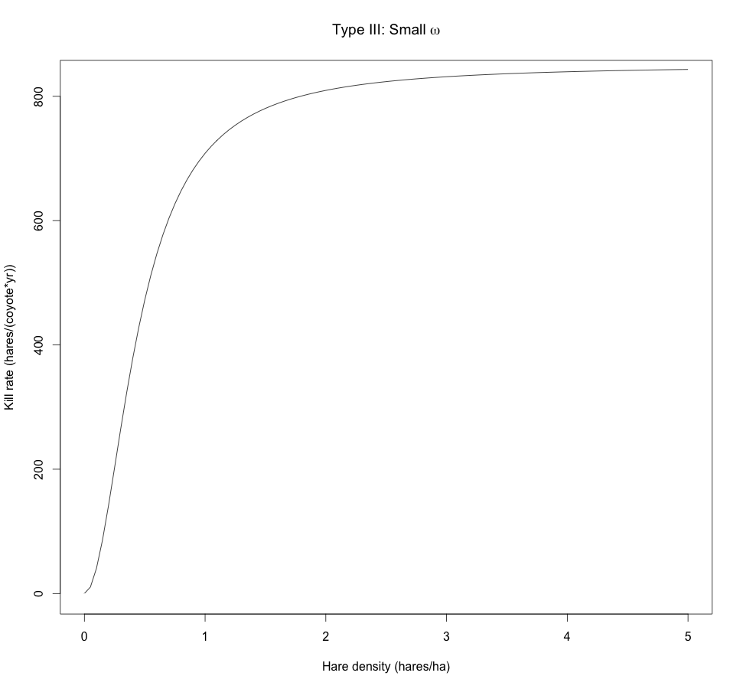
Hare-Lynx with “Specialist” Coyote (North)
μ = coyote saturation kill rate (hares/coyote*yr)
ω = coyote half-saturation constant (hares/ha)
Make coyote look like a specialist with small ω
Notes:
So this isn’t a spatial analysis so these are just ODEs now.
So now I’ve added another equation for the coyote and a type iii functional response in the hare equation but with a small half-saturation constant so that it’s functional response sort of looks specialist.

Slide 36
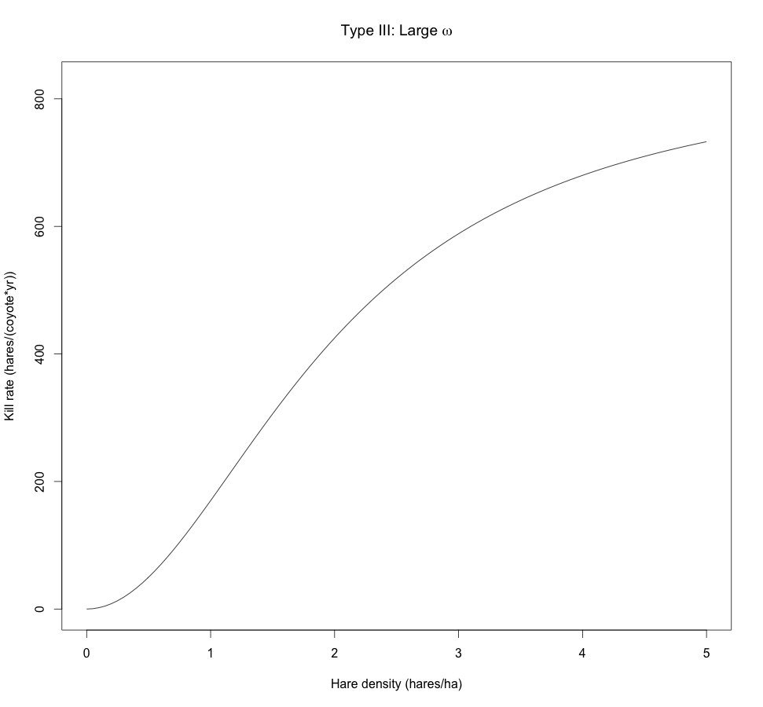
Hare-Lynx with Increasingly Generalist Coyote (South)
Increasing ω = coyote increasingly generalist (more alternate prey available)
Decrease q (min hares needed per coyote) at the same time
Notes:
So now I can increase omega so that the coyote is less responsive to hare density, and I’ll also need to decrease q at the same time (min hares per coyote) so to account for the coyote eating other prey.
So I’m just curious if anyone has any comments on this approach.

Slide 37
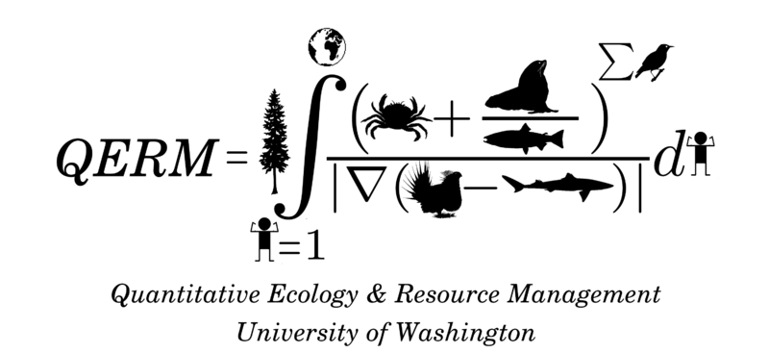
Thanks to NSF for travel funds and BIRS for hosting
Thanks to my committee: Aaron Wirsing, Jim Anderson, Trevor Branch, Rebecca Tyson
UW Center for Quantitative Science for TA support

Slide 38
Limit Cycles for Different Good Patch Sizes:
Higher Diffusivities
Good Patch Size
Notes:
If scale up diffusion rates, don’t get nice pretty steady contraction. Max reduces, increases again, then reduces.

Slide 39
PREY CYCLE PROBES VS GOOD PATCH SIZE:
Higher Diffusivities
Max
Min
Avg
Amp
Fragmentation
Notes:
Stabilizes sooner.
Also advection issue happens at large good patch size. So if animals are moving faster, they are more sensitive to patch size and require larger good patches for it to be beneficial for them to go there.

Slide 40
PREY Contour Plots – Higher Diffusivities
Max
Min
Predation
Avg
Amp
NOT
CYCLING
Fragmentation
Notes:
Cycles for smaller range of predation and patch size

Slide 41
Fragmentation spatial profiles
Lower Diffusivities
Higher Diffusivities
Fragmentation

