Slide 1


Slide 2
Overview
A climate scientist turns to a policy maker and says:
“Our climate model is broken”
“Have you tried tuning it off and turning it back on again?”
The next day , the policy maker comes over and says
“Our government is broken”
“Have you tried tuning it off and turning it back on again?”
Climate science in support of policy making could benefit from something more.
Over the next hour, I am going to suggest that:
  we do not know the space and time scales on which today’s climate simulations are informative for adaptation.
  significant improvement requires re-design, not mere reinterpretation.
  2002 was the time to discuss this in public, but now is better than later.
  the ocean should justify more attention (both obs and cpu).
and
  there is a way forward, which is arguably safer, protects the credibility of science, and yields better policy and decision support. (?and science?)

Slide 3
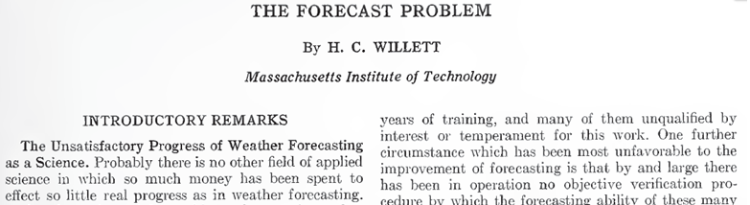
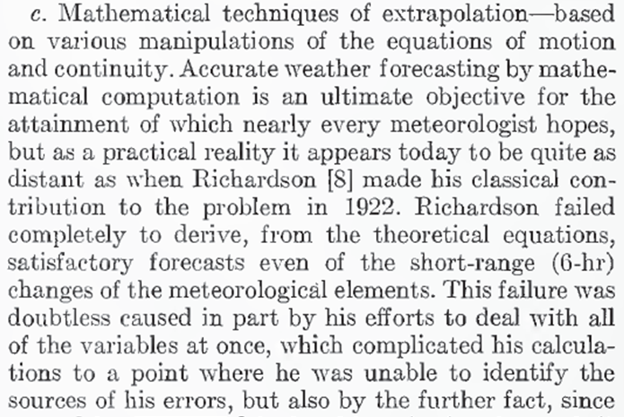
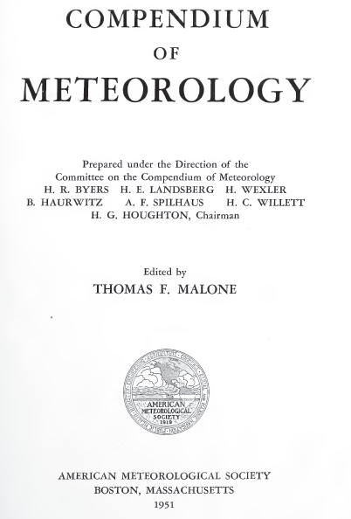
The Forecast Problem: 1951
Science advances to provide actionable information.
It did not take weather forecasting another 30 years!
Failure to clearly distinguish where todays science is not actionable today harms both science and policy.

Slide 4






Types of Uncertainty
Kinds of Probability and
(Re)Designing Climate Simulations from Scratch
Leonard A. Smith
London School of Economics
&
Pembroke College, Oxford
Not Possible without A. Lopez, D.Stainforth, E. Suckling,
E. Thompson, E. Wheatcroft

Slide 5
Aims
Which kind of probabilities shall we consider this week?
Which types of uncertainties shall we consider this week?
Can we remain clear on what is it the probability of we are speaking, exactly?
(How do we get out of model-land to actionable (real world) information?)
Extracting quantitative insight from model large complex models involves discussion of:
Fidelity, Experimental Design, RDU, Prob(Big Surprize),
Distinguishing observables from the model name sakes,
Embracing model inadequacy,
A fundamental challenge to the interpretation of model-based probabilities

Slide 6
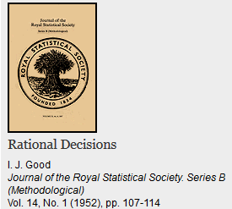
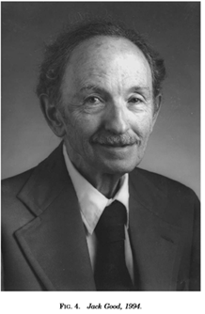
Bayesians, Doogians, and
Physicists
No (few) physicists would argue that probabilities are not conditioned on the information available (something known/believed “now”)
Consider Kelvin’s Gambit:
It seems, therefore, on the whole most probable that the sun has not illuminated the earth for 100,000,000 years, and almost certain that he has not done so for 500,000,000 years. As for the future, we may say, with equal certainty, that inhabitants of the earth can not continue to enjoy the light and heat essential to their life for many million years longer unless sources now unknown to us are prepared in the great storehouse of creation.
On the Age of the Sun’s Heat
Sir William Thomson (Lord Kelvin)
Macmillan's Magazine, vol. 5
(March 5, 1862), pp. 388-393.
“A good Bayesian does better than an non-Bayesian,
but a bad Bayesian gets clobbered.”
Herman Rubin (1970) quoted by I.J. Good:

Slide 7
Types of Probability (Forecasts)
(o) Tautological Probability. A probability P(E|H) the value of which is specified in
the definition of H. (“a fair coin”, H is called “a simple statistical hypothesis”)
(i) Physical Probability: P(x) “True probability” (Laplace’s Demon/Inf Rat Org)
(ii) Psychological Probability: “Personal probability inferred from one’s behaviour.”
(iii) Subjective Probability: P(x|G) probability of x given our information G is true
(Demon’s Apprentice/?semi-finite Rational Org?)
(iv) Logical Probability: “Hypothetical subjective probability when you are perfectly
rational and infinitely large . “Credibility” Russell (1948)
(Infinitely large Rational Org; Laplace Demon ?or Apprentice?)
(v) Dynamic Probability: P_{t}(x| g_{t}<G) when an algorithm encapsulating G has not
yet terminated (finite algorithm, merely still running).
Dynamic in the sense that this probability is expected to change without any
empirical information (by reflection only).
(vi) (Im)Mature Probability: P(x| g<G) when G is known (not) to be encapsulated in g.
Immature in that this probability is expected to change without addition
reflection or additional empirical observation even after the algorithm finishes.
Rational Decisions I. J. Good (1952) Journal of the Royal Statistical Society. Series B (Methodological) Vol. 14, No. 1 , pp. 107-114

Slide 8
Types of Probability (Forecasts)
(o) Tautological Probability. A probability P(E|H) the value of which is specified in
the definition of H. (“a fair coin”, H is called “a simple statistical hypothesis”)
(i) Physical Probability: P(x) “True probability” (Laplace’s Demon/Inf Rat Org)
(ii) Psychological Probability: “Personal probability inferred from one’s behaviour.”
(iii) Subjective Probability: P(x|G) probability of x given our information G is true
(Demon’s Apprentice/?semi-finite Rational Org?)
(iv) Logical Probability: “Hypothetical subjective probability when you are perfectly
rational and infinitely large . “Credibility” Russell (1948)
(Infinitely large Rational Org; Laplace Demon or Apprentice)
(v) Dynamic Probability: Pt(x| g_{t}<G) when an algorithm encapsulating G has not
yet terminated (finite algorithm, merely still running).
Dynamic in the sense that this probability is expected to change without any
empirical information (by reflection only)
(vi) (Im)Mature Probability: P(x| g<G) when G is known (not) to be encapsulated in g.
Immature in that this probability is expected to change without addition
reflection or additional empirical observation even after the algorithm finishes.
.
Rational Decisions I. J. Good (1952) Journal of the Royal Statistical Society. Series B (Methodological) Vol. 14, No. 1 , pp. 107-114

Slide 9
Physical Probability and My Subjective Probability
“Whether or not physical probability actually exists, it is often convenient to speak as if did.” I.J. Good
“Physical probability automatically obeys axioms, subjective probability depends on axioms, and psychological probability neither obeys axioms nor depends very much on them.” I.J. Good p74
My Subjective Probability is then my best attempt to estimate “the” Subjective Probability, just as Laplace saw astronomy related to his Demon.
The thinking of Doogian Bayesians is very close to that of Physicists.

Slide 10
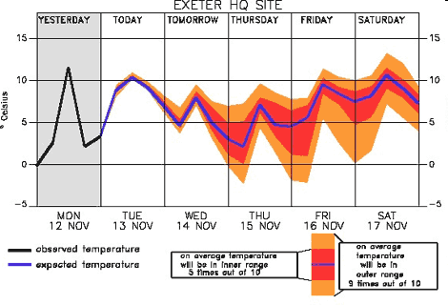
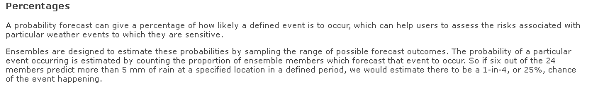
Do weather forecasts provide actionable probabilities?
http://www.metoffice.gov.uk/research/areas/data-assimilation-and-ensembles/ensemble-forecasting/decision-making
Bayesians can do better than this “naïve probability”, but how much better?

Slide 11
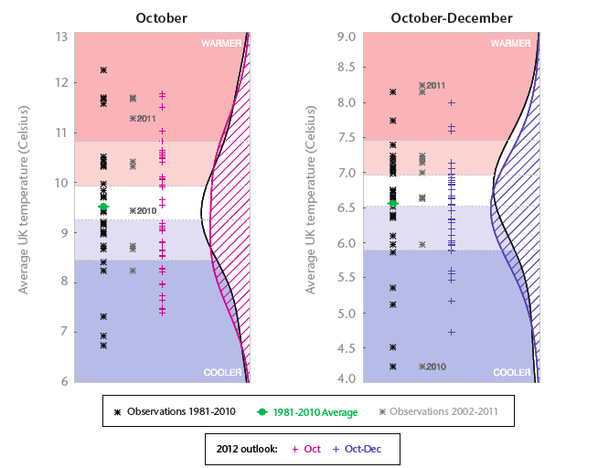
Do seasonal forecasts provide actionable probabilities?
A very nice presentation of information.
Are these actionable probabilities?
Perhaps, Yes!
See: Bröcker, J. and Smith, L. A. (2008) From Ensemble Forecasts to Predictive Distribution Functions Tellus A 60(4): 663.
http://www.metoffice.gov.uk/media/pdf/n/3/A3-plots-temp-OND.pdf

Slide 12
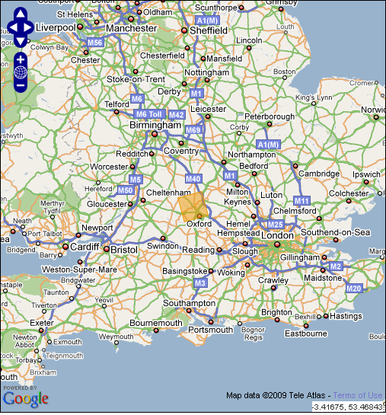
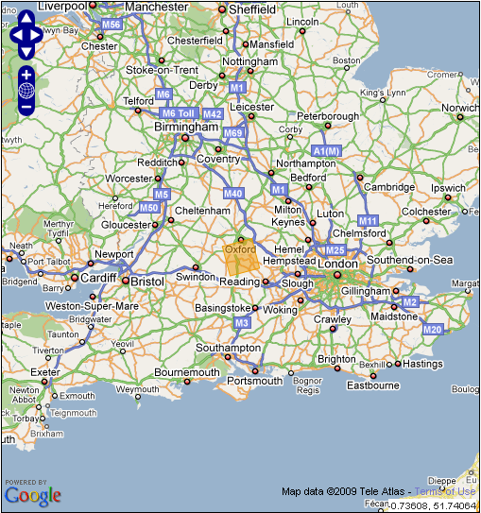

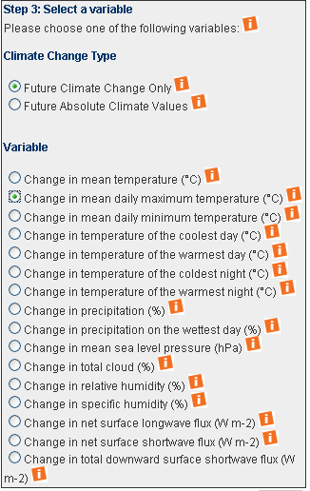
Do UKCP09 PDFs for the stormiest summer day in 2080 Oxford provide actionable probabilities ?
http://www.ukcip.org.uk/

Slide 13

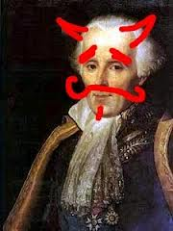
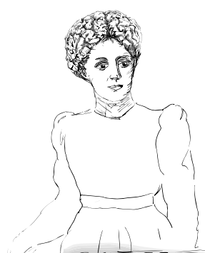


Who could provide actionable probabilities?
Laplace's Demon (1814)
Perfect Equations of Motion (PMS)
Perfect noise-free observations
Unlimited computational power
Demon’s Apprentice (2007)
Perfect Equations of Motion (PMS)
Perfect noise-free observations
Unlimited computational power
Demon’s Novice (2012)
Perfect Equations of Motion (PMS)
Perfect noise-free observations
Unlimited computational power
http://2darts.com/2dtuts/articles/50-terrifying-creatures/

Slide 14



Probability of what exactly?
Do UKCP09 provide actionable probabilities ?
Real World Event:
http://ukclimateprojections.defra.gov.uk/23208 Oct 7,2013
Model Land:
http://ukclimateprojections.defra.gov.uk/21680 Oct 7 2013
“…they are just tying themselves in knots…
The point has been accepted but has not been internalised.”

Slide 15
Definitions
Predictability (working def^{n}): The property of being able to make probabilistic forecasts (in silico or via reflection) with a rational expectation of having more skill than the most naïve rational forecast at hand (say, the climatological distribution).
Alt: Predictability: The possibility of making an “informative forecast” P(x|g)
g: Background Knowledge and information to hand, including μ(x) if it exists.
A naïve forecast in this case is P_{clim}(x|g), our best approximation of μ(x)
G : Ideal (“complete”) background Knowledge (think of Laplace’s Demon)
G: (True if incomplete) background Knowledge (the Demon’s Apprentice)

Slide 16
Definitions
q(x|G): An (ideal) subjective probability of x given (True if limited) information G
Good’s Statistician’s Stooge, Demon’s Apprentice
p(x|g): An accessible (“my”) subjective probability of x given g <= G.
Probability or Predictive Distribution: a positive definite function over observable values that integrates to one. Perhaps from a model.
(see Bröcker, J. and Smith, L. A. (2008)
From Ensemble Forecasts to Predictive Distribution Functions
Tellus A 60(4): 663)
Aim:
“Decision-relevant probability forecast”: one that can be used rationally by decision makers as the probability of x (via the probability calculus, the tools of decision theory, …)
How would the novice know if he were doing badly?

Slide 17

Parameter Estimation Through Ignorance.
H. Du & L. A. Smith Phys Rev E, 2012
An Illustrative example of the Information Deficit
Σ p(x) log₂(p(x)/μ(x))
Σ q(x) log₂(p(x)/μ(x))
Σ q(x) log₂(p(x)/q(x))
where
p(x) a forecast probability
q(x) ideal forecast | information
μ(x) “prior” or natural measure
The Empirical Ignorance reflects the skill of the forecast in practice.
The Implied Ignorance is the skill the forecast claims to have, averaged of forecasts.
The Expected IGN is the expectation of IGN(p(x)) if the outcome was drawn from p(x)
If these first two values differ, then there is an “Information deficit” in the forecast system, which quantifies how overconfident the forecast is.
Information Deficit = Empirical IGN – Implied IGN
Unlike “Potential Predictability” the Information Deficit does not assume that the world becomes like the model: although incomplete, it can sometimes quantify overconfidence.
<Σ q(x) log₂(p(x)/μ(x))>
<Σ p(x) log₂(p(x)/μ(x))>
p(x) a forecast probability
q(x) ideal forecast | information
μ(x) “prior” or natural measure

Slide 18
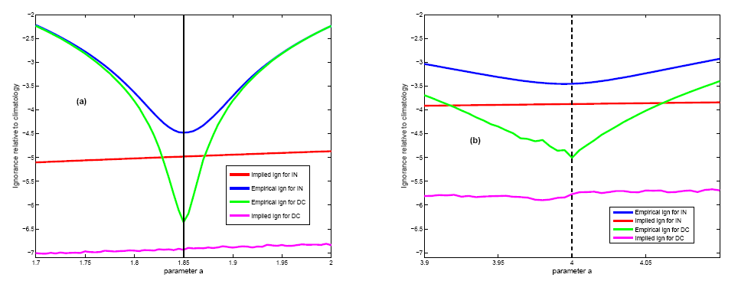
Parameter Estimation: Correct Model Structure
Empirical IGN = ‹–log₂p(x_{obs})›obs Implied IGN = ‹Expected IGN›forecasts
Note that the Implied IGN
is less than the Empirical IGN
even at the correct value of a.
This Information Deficit(s) indicates that the (each) forecast scheme can still be improved.
<Σ p(x) log₂(p(x)/μ(x))>
<Σ q(x) log₂(p(x)/μ(x))>
Perfect Model Structure
All Proper Scores agree
Data Assimilation Method Matters
Target uncertain (but exists)
Implied IGN reveals information deficit
H Du and L A Smith (2012) Parameter estimation using ignorance Physical Review E 86, 016213

Slide 19
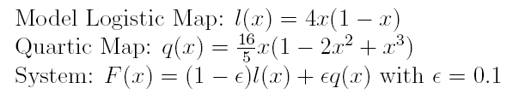
But what is my model is structurally imperfect?
Parameter Estimation: Imperfect Model Structure
Empirical IGN = ‹–log₂p(x_{obs})›obs Implied IGN = ‹Expected IGN›forecasts
Structural Model Error:
H Du and L A Smith (2012) Parameter estimation using ignorance Physical Review E 86, 016213

Slide 20
H Du and L A Smith (2012) Parameter estimation using ignorance Physical Review E 86, 016213
Parameter Estimation: IGN in the Logistic Map Model
Empirical IGN = ‹–log₂p(x_{obs})›obs Implied IGN = ‹Expected IGN›forecasts
Perfect Model Structure
All Proper Scores agree
DA Method Matters
Target uncertain (but exists)
Implied IGN reveals information deficit
Imperfect Model Structure
Score matters
DA Method matters
Lead-time matters
Target indeterminate (none exists)
Implied IGN reveals info deficit

Slide 21
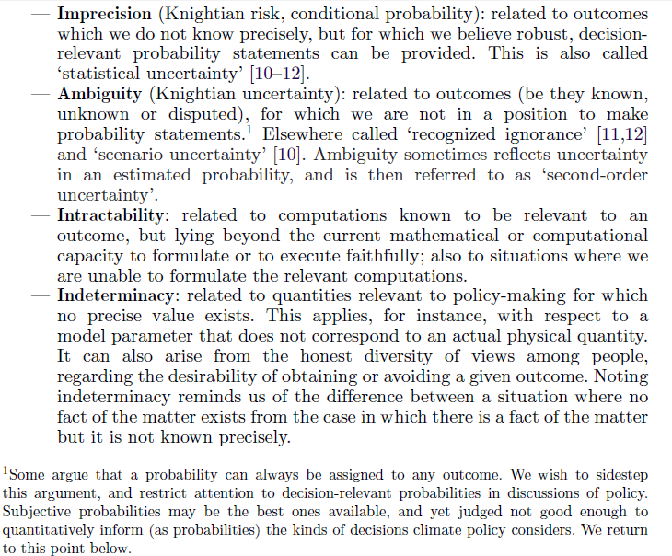
Kinds of Uncertainty
Smith, L.A. and Stern, N. (2011)
Uncertainty in science and its role in climate policy in Phil. Trans. R. Soc. A 369.
Good Probabilities here only
Policy makers deal regularly with these other uncertainties as well.
How well does climate modelling communicate these others?

Slide 22
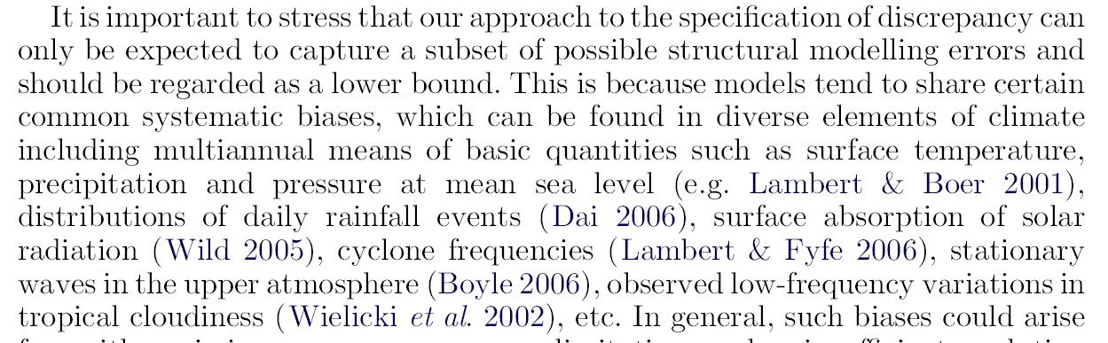
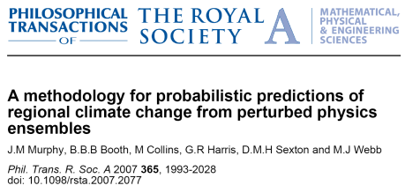
Insight without Quantitative Guidance
The robustness of the result suggests that even model-planets rather different from our best model-earth warm up about the same!
Insight for mitigation is as good as it gets.
These quotes warn against using probabilities in adaptation.
Notes:
22
5-7

Slide 23
Structural uncertainty IS noted in the IPCC AR4:
Admittedly, quantitative statement of the systematic errors are not easily found…

Slide 24
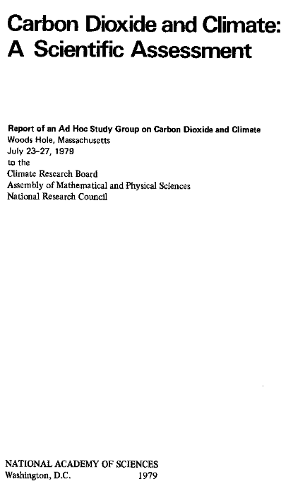

Limitations of (today’s) science were clearer in the past.
The AR5 WG1 document will contain little new actionable information. It reassures us of things long known...
…but the pull for this information is increasing…
1990
In this century: An SPM resembles Highlights Approved by Policy Makers

Slide 25
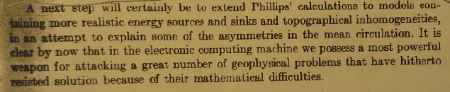
Have we gone so far as seeking valueless numbers?
When you can measure what you are speaking about, and express it in numbers,
you know something about it; but when you cannot express it in numbers,
your knowledge is of a meagre and unsatisfactory kind…
Lord Kelvin (1883)
Lecture on "Electrical Units of Measurement"
(3 May 1883),
Popular Lectures Vol. I, p. 73.
Charney (1956)
This line of argument may have been overplayed, at least in terms of forecasting (perhaps not in terms of understanding).
The provision of immature probabilities to decision makers
risks the credibility of all science-based policy.

Slide 26
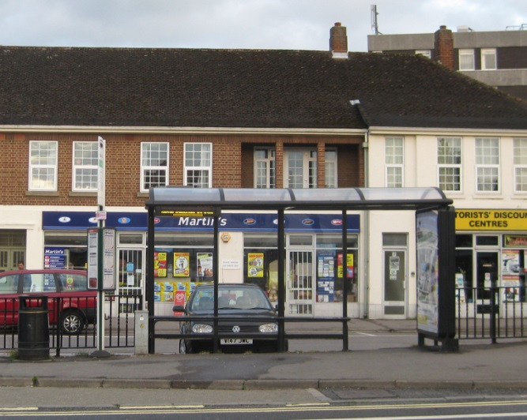
So how do we avoid this:
predictions are wrong
sorry for any inconvenience
July 19,2009

Slide 27
Maths
Policy Based Science
Technology
. Model Land
. Potential Observables (tomorrow’s weather)
. Sturdy Empirical Foundation
Modelling in Model-Land
Mathematics
Here be Dragons
Navier-Stokes Clay Millennium Problem
Science
Modelling for
Actionable Science
Model Building
for an
Asymptotic Tomorrow-model
Policy, Decision Support, Scientific Progress

Slide 28
Maths
. Model Land
. Potential Observables (tomorrow’s weather)
. Sturdy Empirical Foundation
Modelling in Model-Land
Mathematics
Here be Dragons
Science
Modelling for
Actionable Science
Model Building
for an
Asymptotic Tomorrow-model
Policy, Decision Support, Scientific Progress

Slide 29
Maths
Policy Based Science
. Model Land
. Potential Observables (tomorrow’s weather)
. Sturdy Empirical Foundation
Modelling in Model-Land
Mathematics
Here be Dragons
Science
Modelling for
Actionable Science
Model Building
for an
Asymptotic Tomorrow-model
Policy, Decision Support, Scientific Progress

Slide 30
Maths
Technology
. Model Land
. Potential Observables (tomorrow’s weather)
. Sturdy Empirical Foundation
Modelling in Model-Land
Mathematics
Here be Dragons
Science
Modelling for
Actionable Science
Model Building
for an
Asymptotic Tomorrow-model
Policy, Decision Support, Scientific Progress

Slide 31
Maths
Technology
. Model Land
. Potential Observables (tomorrow’s weather)
. Sturdy Empirical Foundation
Modelling in Model-Land
Mathematics
Here be Dragons
Navier-Stokes Clay Millennium Problem
Science
Modelling for
Actionable Science
Model Building
for an
Asymptotic Tomorrow-model
Policy, Decision Support, Scientific Progress

Slide 32
Maths
Technology
. Model Land
. Potential Observables (tomorrow’s weather)
. Sturdy Empirical Foundation
Modelling in Model-Land
Mathematics
Here be Dragons
Science
Modelling for
Actionable Science
Model Building
for an
Asymptotic Tomorrow-model
Policy, Decision Support, Scientific Progress
Can we move climate modelling for decision support this intersection?

Slide 33
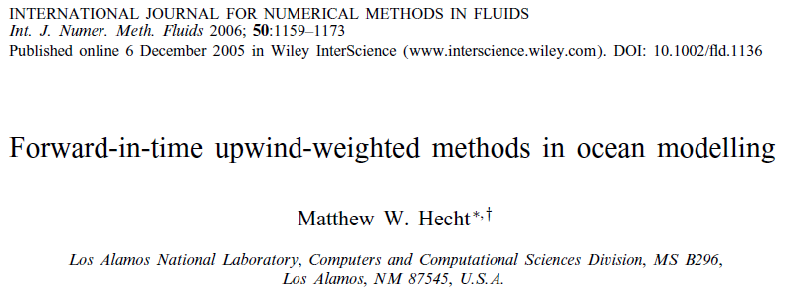
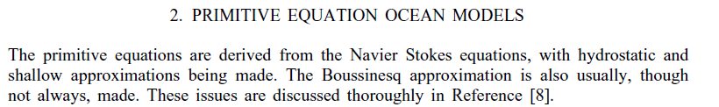
Ocean Modelling
Consider the impact of these approximations in terms of systematic divergence of state space trajectories either from the full equations or from unrealistic ocean drivers of non-ocean climatic processes.
What are the time scales on which the model-ocean loses realism?
What are the time scales on which (perfectly modelled) non-ocean processes driven by this model-ocean lose fidelity and would invalidate model-climate for decision support?
Are these time scales (a) long relative to policy questions on the table? (b) swamped by other model-components behaving badly?
If not then the model ocean is a candidate for the RDU
Can we separate this line of reasoning from the study of the model itself?

Slide 34
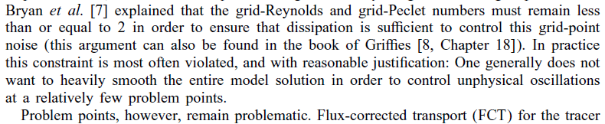
Ocean Modelling
It is in making decisions like this that the policy aims are central to the science.
Or more realistically: when the model output is deployed for policy relevance, it is important that someone recall the impacts of decisions “like this”.

Slide 35
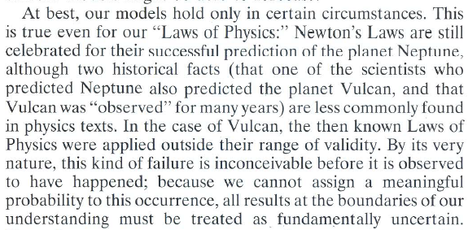
Intuitive examples: Planetary Dynamics
Smith, L.A. (2002) What might we learn from climate forecasts? Proc. National Acad. Sci. USA 4 (99): 2487-2492.

Slide 36
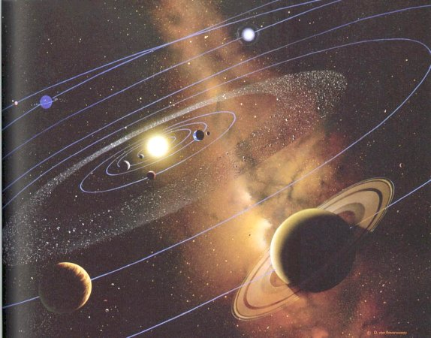
Model Relevance and the Location of the Earth
If our computer model is based on Newton’s Laws, and the Question is the location of the Earth in 10⁸ years….
Monte Carlo sampling of from a prior distribution of initial condition and mass of each major planet will yield a final time distribution one thousand years hence, from which we can form a sensible PDF.
Bayesian Discrepancy terms, based on different integration schemes, compilers and computer hardware may yield valuable information.

Slide 37
Model Relevance and the Location of the Earth
If our computer model is based on Newton’s Laws, and the Question is the location of the Earth in 10⁶ years….
Monte Carlo sampling of from a prior distribution of initial condition and mass of each major planet will yield a final time distribution one thousand years hence, from which we can form a sensible PDF.
Bayesian Discrepancy terms, based on different integration schemes, compilers and computer hardware may yield valuable information.

Slide 38
The Probability of being outside the 99% level?
Our models allow us to draw a balloon in space that captures 99% of the model-earth trajectories.
And our/my subjective probability that our Earth will fall outside that corresponding real-world balloon might rationally be ~1%
The orange balloon corresponds to a probability contour for capturing the Earth.
SUN

Slide 39
Model Relevance and the Location of Mercury
If our computer model is based on Newton’s Laws, and the Question is the location of Mercury….
Then this approach is absurd.
Newton’s Laws are long known to fail for Mercury.
And science could warn us the Newtonian-PDF was misleading long before General Relativity provided an empirically adequate model!
Discrepancy based on different integration schemes, etc, will lead to over-confidence, belief in spurious accuracy and bad decision making!

Slide 40
The Probability of being above the 99% level?
Our model allows us to draw a balloon in space that captures 99% of the model-earth trajectories.
And our subjective probability that the real earth will fall outside that corresponding real-world balloon might be rationally be ~1%
And for Mercury?
Our subjective probability that the real Mercury will fall outside the real-world balloon corresponding to the volume that captures 99% of our model-Mercury trajectories… might be
say, ~90%!
For Mercury, relevant science is more informative than the Newtonian model.
Sit and think, don’t just simulate and count!
SUN

Slide 41

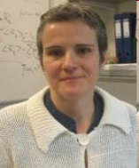

The AR4 acknowledges this shortcoming explicitly
Uncertainty and the IPCC Sixty-Forty Rule
The conditional forecasts (projections) are the grey bars (right); they differ from the ensemble distributions left and centre.
On what space and time scales can decision makers (and economic modellers) have rational confidence in model based probabilities?
The IPCC does not interpret the diversity of ensembles as directly reflecting the probability distribution of future Global Mean Temperature.
41

Slide 42
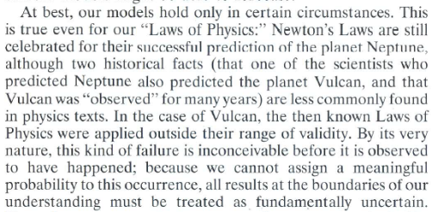
An intuitive example: The Last Solar Eclipse
So for Newton's Laws, the story goes something like this:
Our model does not have sufficient fidelity for Mercury
on time scales of either target question.
This lack of fidelity will surely impact the locations of the other planets,
Estimate of this impact can be obtained via back of the envelope calculation.
For the particular question of the last solar eclipse this appears (say) not to be the
Relevant Dominant Uncertainty:
  Mercury’s violation of Newton’s Laws does not limit us here.
  Focus Resources elsewhere.
  Quantify the (shorter) time-to-(in)fidelity of our models of tidal breaking.
  Do we even need Mercury in the model for the last solar eclipse?!?
For the particular question of the future location of Mercury, this is arguably the RDU:
  Is there a multi-model emulation fix : No
  Is there an empirical fix: ?unlikely on these time scales?
  Obtain (or wait for) resources to code General Relativity.
There is no quantitative decision-relevant info, other than the fact itself.
In the second case, the rational policy approach is risk management, not cost benefit analysis

Slide 43
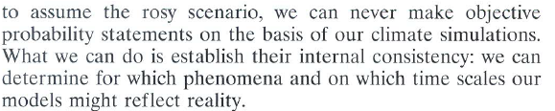
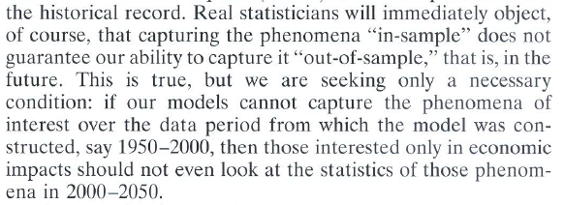
Structural Model Error: Internal Consistency
Smith, L.A. (2002) What might we learn from climate forecasts? Proc. National Acad. Sci. USA 4 (99): 2487-2492.

Slide 44
Shortcomings of State of the Art Models
Missing 2km tall walls of rock!
At what lead times do inadequacies in downstream flow (or precipitation) result in feedbacks with beyond local impacts? alter extremes? &c?
At what lead times is it no longer reasonable to interpret the diversity of climate models as reflecting the uncertainty in the future climate?
We can quantify these limits as it continues to develop methodology to make the dynamics of state-of-the-art models available to decision makers and economists.
Or we can redeploy resources used beyond these limits to better inform policy.
And long term feedbacks (bio-feed backs, albedo, …)
A decision makers needs one and only one thing:
A deadline.
Observed Height – HadCM3 Height

Slide 45
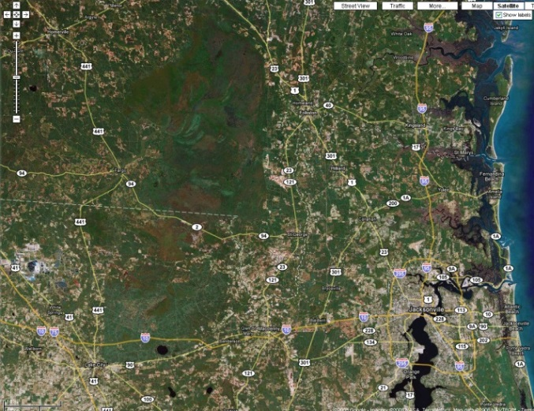
Model-based probability forecasts are incomplete without a quantitative measure of the likelihood of model irrelevance.
Spatial
Scales
If precip over the Amazon (or Okeefenokee) is badly simulated, the biomass will be badly simulated, this missing/extra feedback may lead to model irrelevance… First local, then global.
Timescales for such things may be sound science!
metres
km
1000km
Prob(Big Surprise)
Target
Lead-time
hours weeks years decades centuries
years
weeks
Temporal
Average
Scale
“No presentation of model-based probabilities is complete without an expression of model irrelevance.”
day

Slide 46
X
Relevant Dominant Uncertainty (RDU):
The RDU is the source of uncertainty or error that is the primary limit on the fidelity of our probability forecasts. It could be
- knowledge of natural measure (more obs)
- knowledge of simulation PDF (from the ensemble)
- knowledge of most relevant current model states (DA)
- model fidelity w.r.t reality for a given forecast target (MI)
Communicating Dynamic or Immature Probability forecasts will carry less risk to the credibility science-based decision support when the RDU is discussed and your Probability of a Big Surprise is provided, explicitly.

Slide 47
How Would We (Re)design for Policy?
Start with a decision/policy target question:
What is the target question?
What are the relevant phenomena?
On what time scales do we have high fidelity simulation?
Might these reach the time scales of interest?
What is the Relevant Dominant Uncertainty (RDU)?
What kind of uncertainty limits the fidelity of simulation?
What is the Probability of a Big Surprise?
Is the available simulation sufficiently informative to justify the the resources required to make it?
If yes: Simulate!
If yes: Simulate!
Clear Disclosure: Are Actionable Distributions In-Hand
(or likely to be available soon)
Weather models look more like simplified climate models.

Slide 48
The Constraints on Simulation Modelling for Prediction
What are the challenges we face with interpreting model simulations in different regions of this schematic?
Complex Models
Intractability
Relevant
Irrelevant
Ambiguity
(Knightian Uncertainty)
1000
100
10
1
0.1
0.01
0.001
0.0001
Imprecision
Implied Uncertainty
(Knightian Risk)
Prob(Big Surprise) > 1 in 200
Forecast
Lead time
Run Time Ratio
Inaccessible
Accessible
Technological Constraints
Fidelity Constraints
Knowledge Constraints
Simple Models
LA Smith & N Stern (2011) Uncertainty in science and its role in climate policy Phil. Trans. R. Soc. A (2011), 369, 1-24.

Slide 49
What are you constrained by?
For decision support, the model has to run faster than real time.
The larger the lead time, the fewer ensemble members you can run to examine sensitivity.
Complex Models
We will quantify complexity in terms of a model’s run-time-ratio.
A model with run-time-ratio of 10 will run 10x slower than the system being modelled.
(That is, it will take ten years to simulate one model-year.
Sometimes fine for science, never good for decision makers.)
This impacts ensemble size, maximum lead time considered, and which phenomena to “include” in the model.
1000
100
10
1
0.1
0.01
0.001
0.0001
Forecast
Lead time
Run Time Ratio
Simple Models

Slide 50
What are you constrained by?
this leads to immature probabilities.
Complex models may not fit in current hardware, even if you know what you would build.
And the more complex your model, the fewer “simulation hours” you will have.
Complex Models
1000
100
10
1
0.1
0.01
0.001
0.0001
Forecast
Lead time
Run Time Ratio
Inaccessible
Accessible
Technological Constraints
Simple Models

Slide 51
What are you constrained by?
Requirements for model fidelity sets a lower bound on the complexity with lead time.
Almost always, the model is required to grow more complex at larger lead times.
Complex Models
Relevant
Irrelevant
1000
100
10
1
0.1
0.01
0.001
0.0001
Forecast
Lead time
Run Time Ratio
Inaccessible
Accessible
Technological Constraints
Fidelity Constraints
Simple Models

Slide 52
What are you constrained by?
be expected to
^
Limits of current scientific/economic/mathematical knowledge mean the model may prove inadequate. We will tolerate this as long as the Prob(Big Surprise) < 0.05 (Basel III/Solvency II)
Complex Models
Relevant
Irrelevant
1000
100
10
1
0.1
0.01
0.001
0.0001
Prob(Big Surprise) > 1 in 200
Forecast
Lead time
Run Time Ratio
Inaccessible
Accessible
Technological Constraints
Fidelity Constraints
Knowledge Constraints
Simple Models

Slide 53
What are you constrained by?
The decision you take will depend on how these three curves lie.
Complex Models
Relevant
Irrelevant
1000
100
10
1
0.1
0.01
0.001
0.0001
Prob(Big Surprise) > 1 in 200
Forecast
Lead time
Run Time Ratio
Inaccessible
Accessible
Technological Constraints
Fidelity Constraints
Knowledge Constraints
Simple Models

Slide 54
What are you constrained by?
The decision you take will depend on how these three curves lie.
Complex Models
Relevant
Irrelevant
1000
100
10
1
0.1
0.01
0.001
0.0001
Prob(Big Surprise) > 1 in 200
Forecast
Lead time
Run Time Ratio
Inaccessible
Accessible
Technological Constraints
Fidelity Constraints
Knowledge Constraints
Simple Models

Slide 55
What are you constrained by?
What are the challenges we face with interpreting model simulations in different regions of this schematic?
Complex Models
Intractability
Relevant
Irrelevant
Ambiguity
(Knightian Uncertainty)
1000
100
10
1
0.1
0.01
0.001
0.0001
Prob(Big Surprise) > 1 in 200
Implied Uncertainty
(Knightian Risk)
Forecast
Lead time
Run Time Ratio
Inaccessible
Accessible
Technological Constraints
Fidelity Constraints
Knowledge Constraints
Simple Models

Slide 56
What are you constrained by?
We need to be above the green line, below the red, and to the left of the blue.
So we could make a relevant 100 day simulation and have it a tomorrow.
Complex Models
Relevant
Irrelevant
1000
100
10
1
0.1
0.01
0.001
0.0001
Prob(Big Surprise) > 1 in 200
Forecast
Lead time
Run Time Ratio
x
Inaccessible
Accessible
Technological Constraints
Fidelity Constraints
Knowledge Constraints
Simple Models

Slide 57
What are you constrained by?
But in this case, this “100 day” model is out of our reach.
Of course we can build it anyway, call it “best available” knowing it is both best and irrelevant; and pass it on (saying clearly that Prob(B.S.)~1)
Complex Models
Relevant
Irrelevant
1000
100
10
1
0.1
0.01
0.001
0.0001
Prob(Big Surprise) > 1 in 200
Forecast
Lead time
Run Time Ratio
x
Inaccessible
Accessible
Technological Constraints
Fidelity Constraints
Knowledge Constraints
Simple Models

Slide 58
Decision Support Model (Designed to deliver)
There is some danger in first picking the lead time “required.”
Complex Models
Relevant
Irrelevant
Then finding an accessible level of complexity
1000
100
10
1
0.1
0.01
0.001
0.0001
Prob(Big Surprise) > 1 in 200
x
Forecast
Lead time
Run Time Ratio
Inaccessible
Accessible
The Policy Relevant Frontier is Here
X
And using ensembles to estimate “uncertainty” within an irrelevant model.
Simple Models
Technological Constraints
Fidelity Constraints
Knowledge Constraints

Slide 59
A Resource Allocation Methodology for Forecasting
Thompson (1957) investigated the improvement of US weather forecasting as a resource allocation problem.
How should a given investment be spread between:
better obs, (b) better theory, (c) faster computers?
Today we face additional options along with model complexity per se:
100
10
1
ENS size
OBS Coverage
Value Added
OBS Precision
OBS Coverage (Gaps in Space)
OBS Precision (Noise level)
Ensemble Size
Data Assimilation Complexity
… your favourite here …
DA Scheme(s)
Increasing Real-time Cost

Slide 60
What about “the” case for Multi-models?
The answer depends on the strategy
Optimised single model structure ensemble
100
10
1
Quality Models (each)
Careful e-formation (?each?)
Complementary Dynamical weaknesses (across)
Similar models
Uncoordinated e-formation
Value in Application
Focus on # of models for its own sake
Increasing Real-time Cost
How might structural independence be enhanced? (in space stations?)
Could there ever be a general result?
DTC & NUOPC Ensemble Design Workshop 10 Sept 2012 Leonard Smith

Slide 61
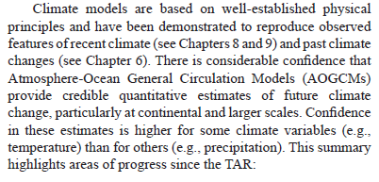
Climate in Practice: In-sample examples.
Page 591

Slide 62
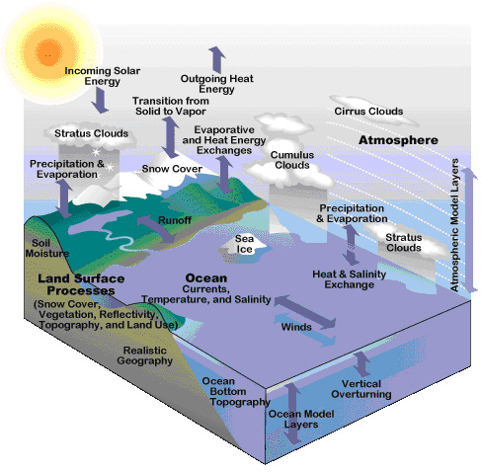
A dangerously schematic schematic
Climate Model Schematic
Climate Model (the squares)
HadCM3 missing elevation
2min x 2min obs – HadCM3
“included” vs
“realisitically simulated”
http://www.windows.ucar.edu/tour/link=/earth/climate/cli_models3.html

Slide 63
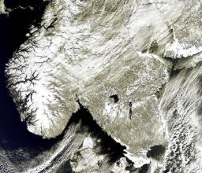
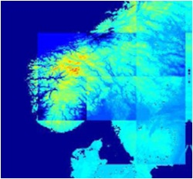


Towards Comprehensive Earth System Models
Past present and future
1975
1985
1992
1997 Present
Atmosphere
Atmosphere
Atmosphere
Atmosphere
Atmosphere
Atmosphere
Land surface
Land surface
Land surface
Land surface
Land surface
Ocean & sea-ice
Ocean & sea-ice
Ocean & sea-ice
Ocean & sea-ice
Sulphate
aerosol
Sulphate
aerosol
Sulphate
aerosol
Stamp Collecting?
Must get one first…
then find a better one.
In 1975 each was known to be potentially important.
Non-sulphate
aerosol
Non-sulphate
aerosol
Carbon cycle
Carbon cycle
Atmospheric
chemistry
Off-line
model
development
Strengthening colours
denote improvements
in models
Sulphur
cycle model
Non-sulphate
aerosols
Ocean & sea-ice
model
Land carbon
cycle model
Carbon
cycle model
Ocean carbon
cycle model
Atmospheric
chemistry
Atmospheric
chemistry
What could be released if we have a maximum 40 year lead time due to model fidelity? 20 year?

Slide 64
Models on Stage: Model Depth and Equidismality
Model depth (relevance of being “based on the laws of physics” to skill) can be explored through comparison with Simple Surrogate models.
That is not to say a model more in accord with the laws of physics will not ultimately provide the ideal forecast, merely that the models in hand today can lay no a priori claim on doing so!
Surrogate models aide in distinguishing equifinality from equidismality.
Models for science based policy should always be benchmarked against simple model never merely against each other!
Smith, L.A. (1992) Identification and prediction of low dimensional dynamics Physica D 58 (1-4): 50-76.

Slide 65
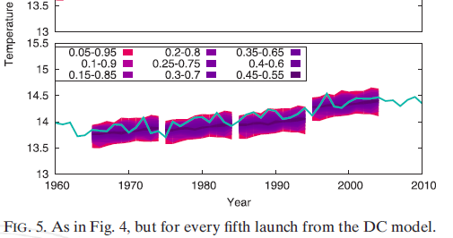
Climate Forecasting by Hand
Take the last hundred twenty nine years of global mean temperature, T_i.
Find the 128 one-year changes by subtracting T_(i-1) from T_i
Add each of these 128 numbers to this years global mean temperature to get a 128 member “ensemble forecast” for next year.
Draw a distribution* over these 128 points and call it a probability forecast for next year.
Repeat for 2 year (direct) forecasts, then 3 years, 4, 5, … 10.
You can do this in a day. By hand:
* true cross-validation throughout

Slide 66
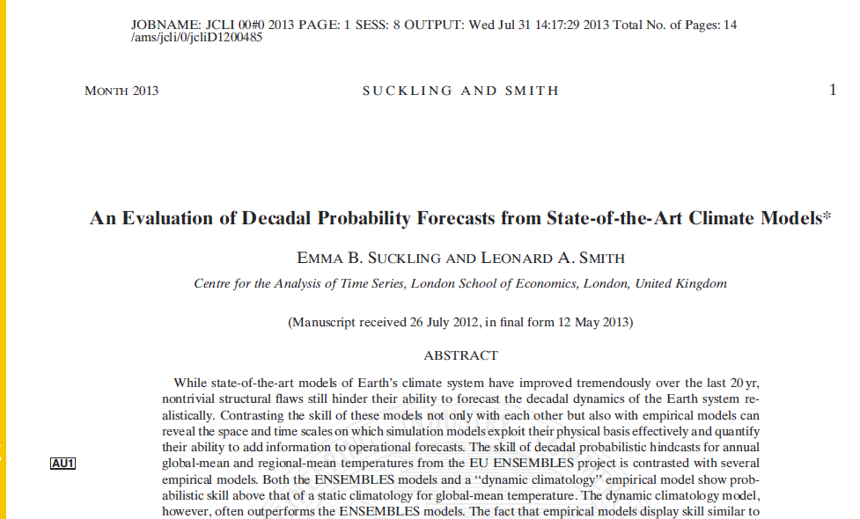

Slide 67
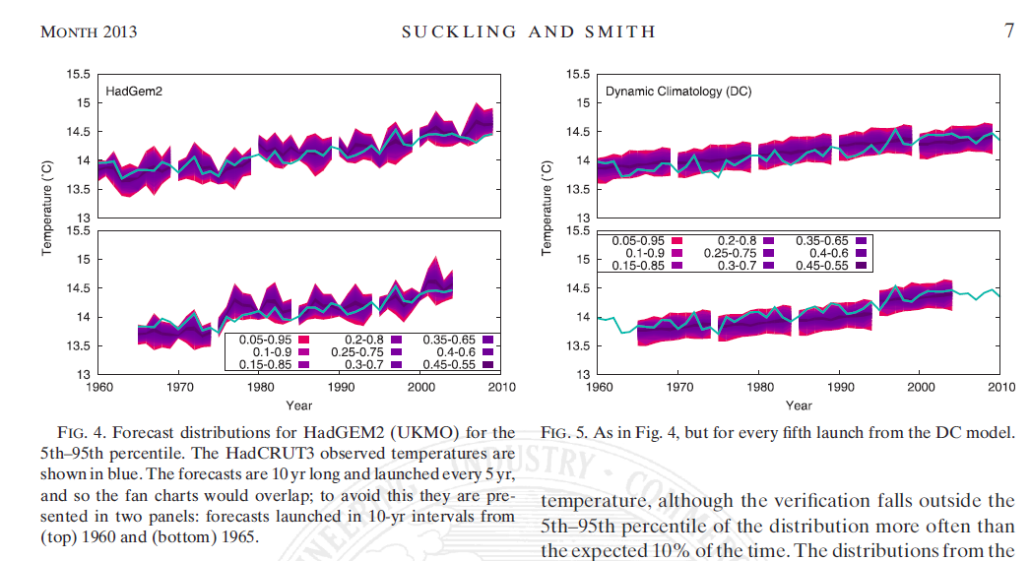

Slide 68
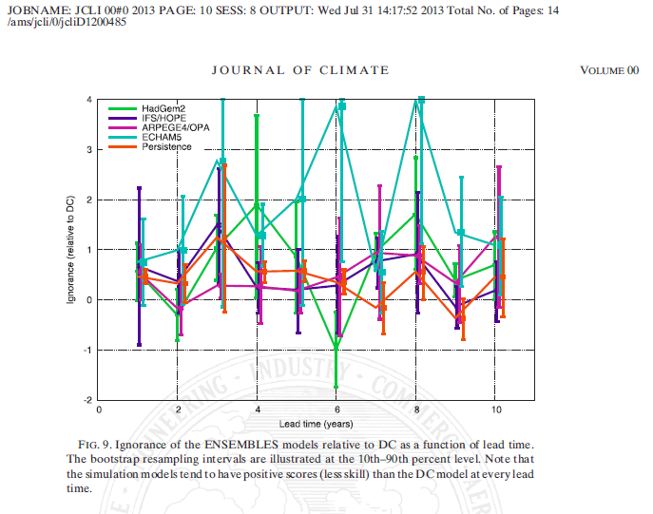

Slide 69
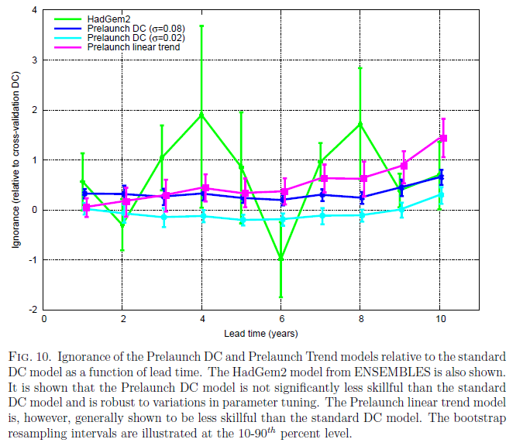
Is this just one over-tuned empirical model?
On decadal time scales, rather simple empirical models produce probability forecasts which systematically outperform state-of-the-art GCMs.
Of course GCMs provide insight into mechanisms and phenomena otherwise inaccessible.
Overselling the fidelity of “physics-based” models puts the credibility of all science-based policy making at risk. Needlessly.
Suckling and Smith (2013) J Climate, in press

Slide 70
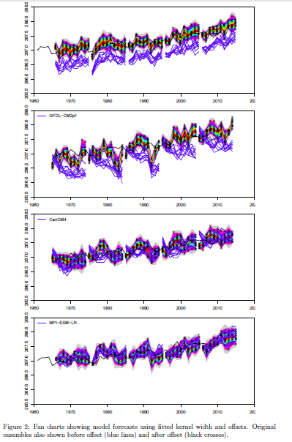

Slide 71
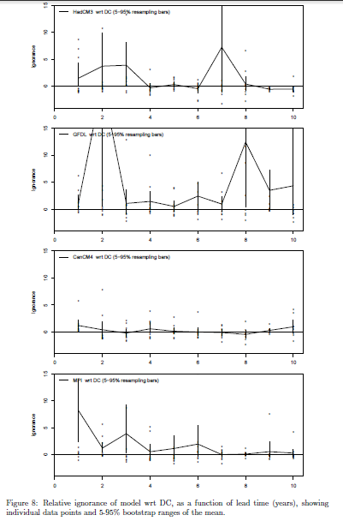
CMIP5
All-Stars

Slide 72
Take home message
On the ten year forecast time scale, empirical models more than hold their own in head-to-head forecast evaluation with simulation models.
On longer time scales, physics-based simulation models will be required to obtain hi-fidelity forecasts.
But that fact is not evidence that today’s physics-based simulation models can provide hi-fidelity forecasts on either decadal or century time scales.
Users might embrace this for better climate services.
But why weren’t these simple straw men models in the AR3?
(None of this challenges the basic physics of global warming, of course.)

Slide 73
This looks a lot like:
From an Oxford Bus Shelter:
X30 N30 predictions are wrong
sorry for any inconvenience

Slide 74
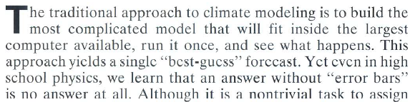
The traditional approach
Smith, L.A. (2002) What might we learn from climate forecasts? Proc. National Acad. Sci. USA 4 (99): 2487-2492.
So what do we find in the AR5?

Slide 75
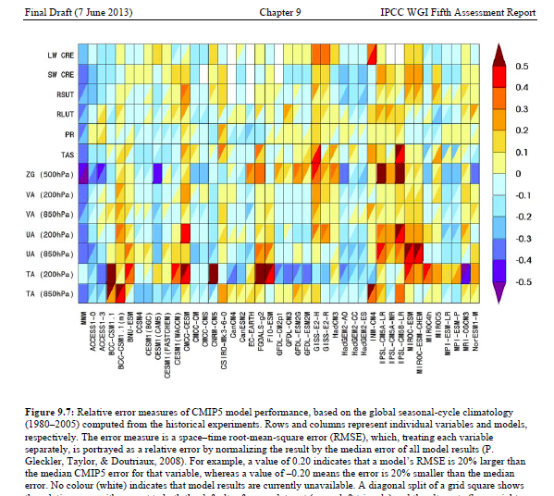
The Danger of Rank Order Beauty Contests

Slide 76
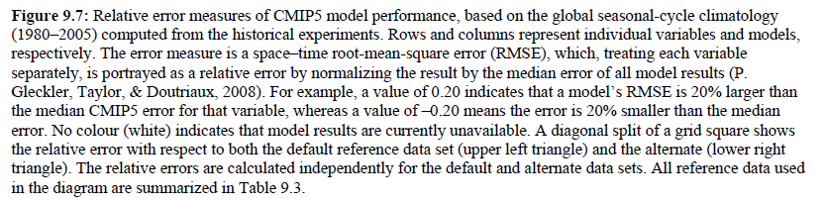
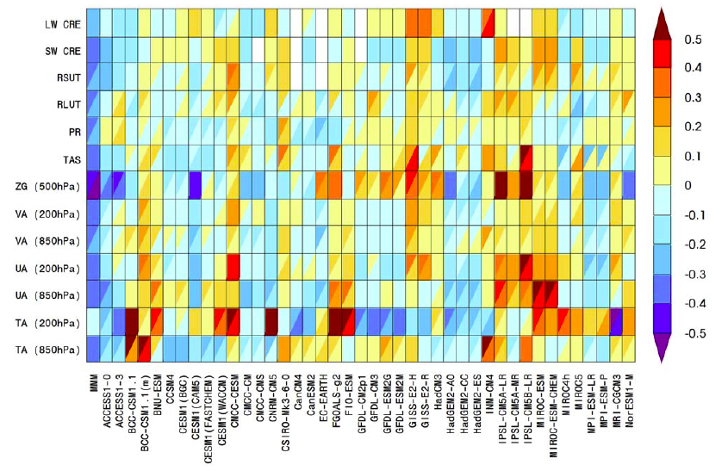
The Danger of Rank Order Beauty Contests
What does this plot on its own actually tell me?

Slide 77
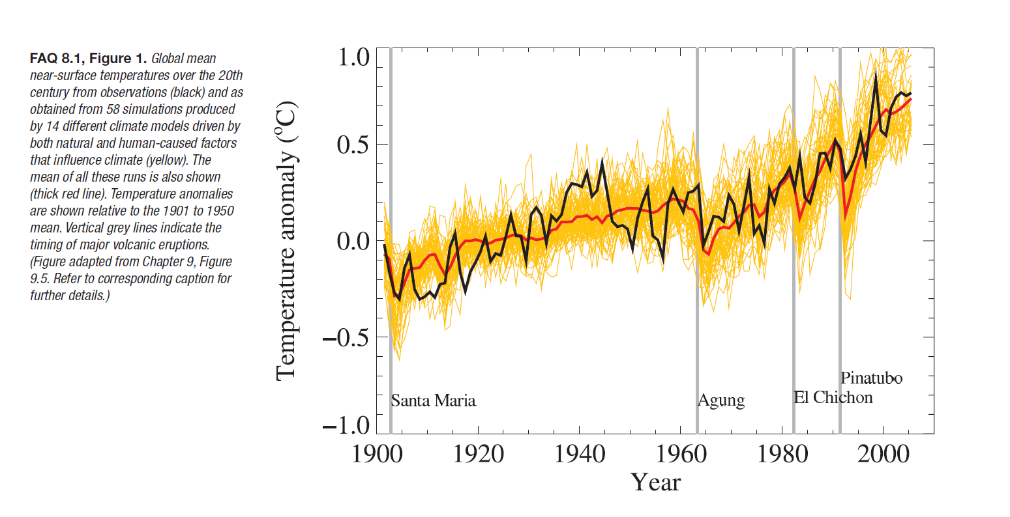
Climate in Practice: In-sample examples.
This graph tends to leave the impression models do rather well.

Slide 78
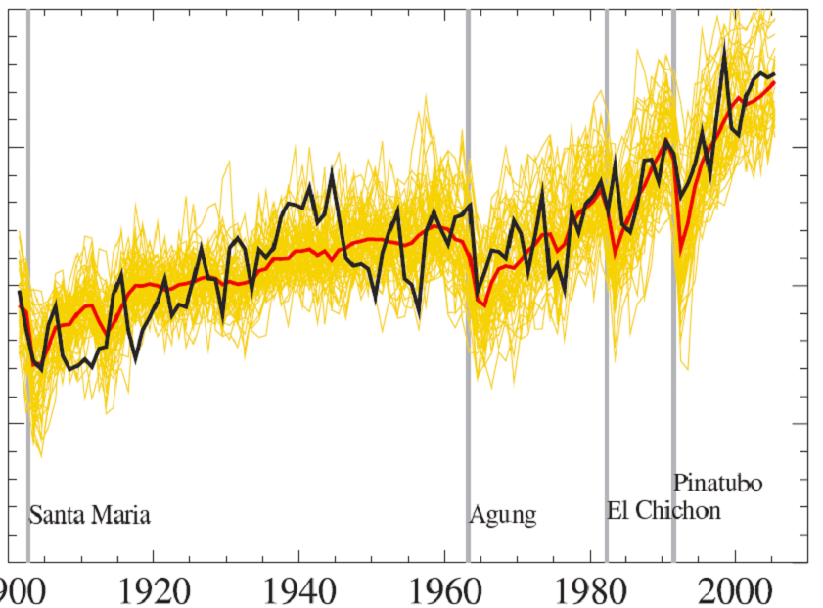
While systematic errors are larger than the observed effect
Anomalies may be fine for mitigation.
They are a nonsense for adaptation.
(and the laws of physics.)
(and biology.)
(Ice melts at zero C, plants die at ….)
Obs
As we refocus from climate-past to the climate-future, how do we cope with such systematic errors, even as we work to reduce them?
Moving to anomaly space requires
Letting go of the “Laws of Physics”.
Note model anomalies are not exchangeable even after 100 years!
AR4 Simulations without 1900-1950 anomaly adjustment
Notes:
15

Slide 79
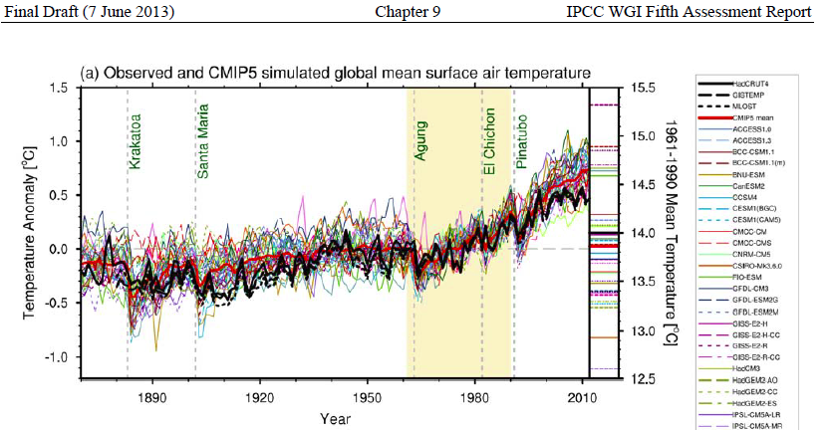
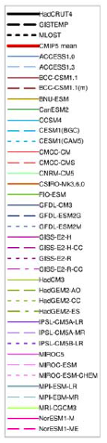
Communication II Anomalies

Slide 80

Anomalies

Slide 81
Anomalies

Slide 82
Anomalies

Slide 83
(Re)Designing Climate Modelling for Policy
The basic idea is simply to consider the limited fidelity of the model before submitting the climate model runs; then redeploy resources due to shorter runs.
And explicitly discussing model inadequacy, big surprises, RDUs, and other central questions with policy makers at the beginning of the simulation process, not the end.
The limitations can be quantified through shadowing experiments, but at the moment reflection on the processes involved suggestion the duration exceeds rational expectations of fidelity (NARCAP divergence).
Pseudo-orbit Data Assimilation can provide information on the structure of model error. (and might prove rather useful in ocean models and reanalysis independently.
It opens up the options of doing time slice and temperature slice experiments with operational weather model resolutions.
In short, following Charney’s triad, with fewer obs but aided by physical insight
Establishing what we can in fact do with fidelity, rather than using any means required to get “an” answer, and then (falsely) calling it “best available”.

Slide 84

Data Data Everywhere, and Not a Bit to Bank On
One is sometimes surrounded by model-based probabilities from models known unlikely to be adequate to inform the questions we must answer.
What is the rational path forward when the “best available” model is believed not to be adequate for purpose?
Estimate the probability that your model probability is misleading?
That is, state the P(Big Surprise)
Or refocus computer experiments in the limited arena where they truly are policy relevant, and state the P(Big Surprise)
0 0 1 1 1 0 1 0 10 00110 0
1 1 0 1 0 10 1 1 1 01 1010 10
0 10 1100 101 1 0 1 10 1 01 1 0
10 1 1 0 1 1 010 100 10001 1 1 1 0 1 1
1 0 1 1 0 1 1 1 0 1 1 10 01 0 0 0
1001 10 1010 1 00 101 1 001 101 10 01 1 1
1002 01 10 1 1 01 0 01 1 010 1 1
1 0 0 10 0 0 1 1 1 1 1 0 1
101 10101 10 1 101 1 1 1 1 001 1 1 01 01 1 0
01 101 1 1 1010 1 01 10 1 0 1 0
01 1010 1 101 1 1 1 1 1 100 1 1 0 01
1 0 0 0 1 1 1 0 1 10101 1
101 000 1 101 10 1 10 101
1 0 1 0 1 0 1 0 1 1
10 0 10 1 10 10 11
1 01 10 11
1
1 0 0 0 0
1 0 0
0 1 0 1 1
1 1 1 0 1 1 0 1
0 1 0
Inspired by Andy Morse (thx andy)
http://4umi.com/coleridge/rime/1

Slide 85
Maths
Technology
. Model Land
. Potential Observables (tomorrow’s weather)
. Sturdy Empirical Foundation
Modelling in Model-Land
Mathematics
Here be Dragons
Science
Modelling for
Actionable Science
Model Building
for an
Asymptotic Tomorrow-model
Policy, Decision Support, Scientific Progress
Can we move climate modelling for decision support this intersection?

Slide 86
Thank you
From an Oxford Bus Shelter:
predictions are wrong
sorry for any inconvenience

Slide 87



www2.lse.ac.uk/CATS/Publications/Leonard Smith Publications.aspx
L A Smith and D A Stainforth (2012) Clarify the limits of climate models in Nature Vol. 489
Du, H. and Smith, L. A. (2012) Parameter estimation using ignorance Physical Review E 86, 016213
Bröcker, J. and Smith, L. A. (2008) From Ensemble Forecasts to Predictive Distribution Functions Tellus A 60(4): 663
D J Rowlands, et al (2012) Broad range of 2050 warming from an observationally constrained large climate model ensemble. Nature Geoscience
K Bevan, W Buytaert & L A Smith (2012) On virtual observatories and modelled realities Hydrol. Process., 26: 1905–1908
Smith, LA and Stern, N (2011) Uncertainty in science and its role in climate policy Phil. Trans. R. Soc. A (2011), 369, 1-24
R Hagedorn and LA Smith (2009) Communicating the value of probabilistic forecasts with weather roulette. MeteoRl App 16 (2): 143
K Judd, CA Reynolds, LA Smith & TE Rosmond (2008) The Geometry of Model Error. J of Atmos Sci 65 (6), 1749-1772. Abstract
DA Stainforth, MR Allen, ER Tredger & LA Smith (2007) Confidence, uncertainty and decision-support relevance in climate predictions, Phil. Trans. R. Soc. A, 365, 2145-2161. Abstract
LA Smith (2006) Predictability past predictability present. Chapter 9 of Predictability of Weather and Climate
(eds T. Palmer and R Hagedorn). Cambridge, UK. Cambridge University Press.
LA Smith, (2002) What Might We Learn from Climate Forecasts? Proc. National Acad. Sci. USA 4 (99): 2487-2492. Abstract
D Orrell, LA Smith, T Palmer & J Barkmeijer (2001) Model Error in Weather Forecasting, Nonlinear Processes in Geophysics 8: 357
LA Smith (2000) 'Disentangling Uncertainty and Error: On the Predictability of Nonlinear Systems' in Nonlinear Dynamics and Statistics, ed. Alistair I Mees, Boston: Birkhauser, 31-64. Abstract
LA Smith, C Ziehmann & K Fraedrich (1999) Uncertainty Dynamics and Predictability in Chaotic Systems, Quart. J. Royal Meteorological Soc. 125: 2855-2886.

Slide 88

END

Slide 89

Fitzroy, 1862

Slide 90


Slide 91

What is a “Big Surprise”?
18
Big Surprises arise when something our simulation models cannot mimic turns out to have important implications for us.
In some cases where we are “leaking probability” when a fraction of our model runs explore conditions which we know they cannot simulate realistically.
(Science can warn of “known unknowns” even when the magnitude remains unknown)
Big Surprises invalidate (not update) model-based probability forecasts,
the g in P(x|g) . “Bayes” is irrelevant outside of probability theory.
How might we better communicate inadequacy as well as imprecision?
Condition explicitly on the euro not collapsing [Bank of England].
Provide subjective estimates of the probability that the model is misinformative in the future [for example, the P(BS)].
Refuse to issue a quantitative forecast, probability or otherwise [UKML].

Slide 92

Measures of Predictability
Lyapunov Time, Doubling Times, Shadowing Times, Decay of Predictability
The distribution of i-shadowing times provides an excellent upper bound on predictability. But they are expensive, perhaps undefined in a forward forecast context, and if the model is perfect they are all infinite!
Smith, L. A. (2000) 'Disentangling Uncertainty and Error: On the Predictability of Nonlinear Systems' in Nonlinear Dynamics and Statistics, ed. Alistair I Mees, Boston: Birkhauser, 31-64
Smith, L. A. (1996) Accountability and Error in Ensemble Forecasting. In 1995 ECMWF Seminar on Predictability. Vol 1, pg 351-368. ECMWF, Reading

Slide 93


X
Is chaos the dominant uncertainty in practice?

Slide 94
From “distance” to climatology to Forecast evaluation:
The IGN relative to climatology only reflects information content when the distribution is a “good forecast”.

Slide 95

Target uncertain (but exists) : Be a Bayesian
Target indeterminate (none exists): Bayes ( & the probability calculus) irrelevant.
P(α | Data, I) = P(Data | α, I) P(α | I) / P(Data | I) ∝ P(Data | α, I) P(α | I)

Slide 96
Target uncertain (but exists) : Be a Bayesian
Target indeterminate (none exists): Bayes ( & the probability calculus) irrelevant.
P(α | Data, I) = P(Data | α, I) P(α | I) / P(Data | I) ∝ P(Data | α, I) P(α | I)
P(α | Data, I) = P(Data | α, I) P(α | I) / P(Data | I) X P(Data | α, I) P(α | I)
= 0

Slide 97


Slide 98
Is it plausible to provide a PDF of hottest or stormiest summer day in 2080’s Oxford???
http://www.ukcip.org.uk/

Slide 99
www2.lse.ac.uk/CATS/Publications/Leonard Smith Publications.aspx
L A Smith and D A Stainforth (2012) Clarify the limits of climate models in Nature Vol. 489
Du, H. and Smith, L. A. (2012) Parameter estimation using ignorance Physical Review E 86, 016213
D J Rowlands, et al (2012) Broad range of 2050 warming from an observationally constrained large climate model ensemble. Nature Geoscience
K Bevan, W Buytaert & L A Smith (2012) On virtual observatories and modelled realities Hydrol. Process., 26: 1905–1908
Broker J and LA Smith (2008) From Ensemble Forecasts to Predictive Distribution Functions Tellus A 60(4): 663
Smith, LA and Stern, N (2011) Uncertainty in science and its role in climate policy Phil. Trans. R. Soc. A (2011), 369, 1-24
R Hagedorn and LA Smith (2009) Communicating the value of probabilistic forecasts with weather roulette. MeteoRl App 16 (2): 143
K Judd, CA Reynolds, LA Smith & TE Rosmond (2008) The Geometry of Model Error. J of Atmos Sci 65 (6), 1749-1772. Abstract
DA Stainforth, MR Allen, ER Tredger & LA Smith (2007) Confidence, uncertainty and decision-support relevance in climate predictions, Phil. Trans. R. Soc. A, 365, 2145-2161. Abstract
LA Smith (2006) Predictability past predictability present. Chapter 9 of Predictability of Weather and Climate (eds T. Palmer and R Hagedorn). Cambridge, UK. Cambridge University Press.
LA Smith (2006) Predictability past predictability present. Chapter 9 of Predictability of Weather and Climate
(eds T. Palmer and R Hagedorn). Cambridge, UK. Cambridge University Press.
LA Smith, (2002) What Might We Learn from Climate Forecasts? Proc. National Acad. Sci. USA 4 (99): 2487-2492. Abstract
D Orrell, LA Smith, T Palmer & J Barkmeijer (2001) Model Error in Weather Forecasting, Nonlinear Processes in Geophysics 8: 357
LA Smith (2000) 'Disentangling Uncertainty and Error: On the Predictability of Nonlinear Systems' in Nonlinear Dynamics and Statistics, ed. Alistair I Mees, Boston: Birkhauser, 31-64. Abstract
LA Smith, C Ziehmann & K Fraedrich (1999) Uncertainty Dynamics and Predictability in Chaotic Systems, Quart. J. Royal Meteorological Soc. 125: 2855-2886.

Slide 100
Maths
Policy Based Science
Technology
. Model Land
. Potential Observables (tomorrow’s weather)
. Sturdy Empirical Foundation
Modelling in Model-Land
Mathematics
Here be Dragons
Navier-Stokes Clay Millennium Problem
Science
Modelling for
Actionable Science
Model Building
for an
Asymptotic Tomorrow-model
Policy, Decision Support, Scientific Progress

Slide 101
Maths
Technology
Modelling in Model-Land
Science
Modelling for
Actionable Science
Model Building
for an
Asymptotic Tomorrow-model
Policy, Decision Support, Scientific Progress

Slide 102
Maths
Policy Based Science
Technology
. Model Land
. Potential Observables (tomorrow’s weather)
. Sturdy Empirical Foundation
Modelling in Model-Land
Here be Dragons
Navier-Stokes Clay Millennium Problem
Science
Modelling for
Actionable Science
Model Building
for an
Asymptotic Tomorrow-model
Policy, Decision Support, Scientific Progress

Slide 103
Improving Predictability
Schematic view of value added for improving initial condition uncertainty.
100
10
1
ENS size
OBS Coverage
M₁ =α₁ P₁ + (1-α₁)P_{clim}
α threshold - - -
OBS Precision
OBS Coverage (Gaps in Space)
OBS Precision (Noise level)
Ensemble Size
Data Assimilation Complexity
… plus your favourite here …
Value Added
DA Scheme(s)
Increasing Real-time Cost
These curves are not independent.
The curves vary with the target.
Development costs start from different legacy baselines
Historically these “optimised” separately (?draw on separate budgets?)
How to measure “value added” in this context?

Slide 104
Examples of Probability Forecasts
Perfect Model Scenario Weather-like Tasks Climate-like Tasks
In these forecasts of a simple “chaotic” circuit, the limitations on predictability come from model inadequacy (structural model error) not from chaos.
This model could not shadow past the point where the ensemble departs from the future trajectory.

Slide 105


How did we get to post code probabilities in 2080s?
(It would be interesting to trace how the idea that climate models could provided quantitative insight came about.)
Mechanisms == Insight
Notes:
5-7

Slide 106
Distinguishing Weather-like and Climate-like tasks
Weather-like forecasting tasks:
model lifetime is long in comparison to the typical forecast lead-time
large archive of truly out-of-sample forecast-outcome pairs
arguably extrapolation in time but interpolation in state space
Here the same model is deployed many times in similar circumstances and one can learn from past mistakes.
Climate-like forecasting tasks:
lead-times of interest are far longer than the lifetime of model
forecast-outcome archive is very small, arguably empty
lead-times of interest are long compared to the career of a researcher.
By the nature of the problem there are no true out-of-sample observations.
Best practice principles of forecasting differ in these two settings.
There is also the Perfect Model Scenario, where known mathematical systems (known if forgotten) play the role of the model and of the target system.

Slide 107
Improving Predictability
Schematic view of value added for improving initial condition uncertainty.
100
10
1
ENS size
OBS Coverage
M₁ =α₁ P₁ + (1-α₁)P_{clim}
α threshold - - -
OBS Precision
OBS Coverage (Gaps in Space)
OBS Precision (Noise level)
Ensemble Size
Data Assimilation Complexity
… plus your favourite here …
Value Added
DA Scheme(s)
Increasing Real-time Cost
These curves are not independent.
The curves vary with the target.
Development costs start from different legacy baselines
Historically these “optimised” separately (?draw on separate budgets?)
How to measure “value added” in this context?

Slide 108
Decision Support Given only Immature Probabilities
Provide Stories in addition to (?rather than?) Numbers
Distinguish Immature Probability from Physical Probability
Balance “Based on the Laws of Physics” with P(BS)
Clearly distinguish statements regarding the probability of the next model run from those on the probability of the true target.
Demonstrate relative skill of empirical surrogate models
(Smith, 1992, 1997; Suckling and Smith 2012)
Identify and discuss the RDU and the timescales for tackling it.

Slide 109

Structural Model Error
Smith, L.A. (2002) What might we learn from climate forecasts? Proc. National Acad. Sci. USA 4 (99): 2487-2492.

Slide 110



Laplace’s Demon, its Apprentice and Good’s ∞ Rational Org
Perfect Model Scenario Weather-like Tasks Climate-like Tasks
Traditional risk management under uncertainty is straightforward in a chaotic system (given a perfect model and large observational archive).
It is only a matter of investment, to extract parameters, probability forecasts that are actionable, &c
These results do not generalise to even the most simple real-world systems best modelled by chaotic models.
Judd, K. and Smith, L. A. (2001) Indistinguishable States I: The Perfect Model Scenario, Physica D 151: 125-141.
Smith (2002) Chaos and Predictability in Encyc Atmos Sci

Slide 111
Measures of Predictability
Lyapunov Time, Doubling Times, Shadowing Times, Decay of Predictability
In this talk, consider the time required before an initial ensemble provides negligible information given the natural measure.
- Σ p(x) log₂(p(x)/μ(x))
If either the ensemble or the model is imperfect, the relevant time is related to
- Σ q(x) log₂(p(x)/μ(x))
And perhaps the most interesting quantity is
- Σ q(x) log₂(p(x)/q(x))
where
p(x) a forecast probability
q(x) ideal forecast | information
μ(x) “prior” or natural measure
we will return to this point.
Smith, L. A. (1996) Accountability and Error in Ensemble Forecasting. In 1995 ECMWF Seminar on Predictability. Vol 1, pg 351-368. ECMWF, Reading
Smith (2002) Chaos and Predictability in Encyc Atmos Sci

Slide 112
The evolution of this probability distribution for the chaotic Lorenz 1963 system tells us all we can know of the future, given what we know now.
It allows prudent quantitative risk management (by brain-dead risk managers)
And sensible resource allocation.
We can manage uncertainty for chaotic systems (given a perfect model).
But how well do we manage uncertainty in the real world? For GDP? Weather? Climate?
Probability Forecasts: Chaos
Do we have a single example of a nontrivial system where anyone has succeeded (and willing to offer odds given their model-based PDFs?)
Smith (2002) Chaos and Predictability in Encyc Atmos Sci

Slide 113

Ocean Modelling

Slide 114

Ocean Modelling

Slide 115
8
Parameters Estimation via Forecasting P(x)
How might we use probability forecasting to estimate parameters?
Form a series of ICE ensembles for a given parameter value
Compute a series of probability forecasts
Select a proper score: -log(p(x)/μ(x)) (IJ Good, 1952)
Compute the score as a function of parameter value.
H Du and L A Smith (2012) Parameter estimation through ignorance Physical Review E 86, 016213

Slide 116
Physical Probability and My Subjective Probability
Whether or not physical probability actually exists, it is often convenient to speak as if did. I.J. Good
Logical Probability/Credibility: “Hypothetical subjective probability when you are perfectly rational and infinitely large. (?requires a perfect model?)
“Logical probabilities are liable to be unknown in practice”
I.J. Good p74
“Whether or not physical probability is regarded as distinct from …., it is often convenient to talk as if it were distinct.”
I.J. Good p66
Physical probability automatically obeys axioms, subjective probability depends on axioms, and psychological probability neither obeys axioms nor depends very much on them.” I.J. Good p74
My Subjective Probability is then my best attempt to estimate “the” Subjective Probability, just as Laplace saw astronomy related to his Demon.
The thinking of Doogian Bayesians is very close to that of Physicists.

Slide 117
Types of probability (after I.J. Good)
Physical Probability: this is the actual probability of the outcome.
P(BS) zero
Subjective Probability : a(n IJ) Good Bayesian Probability
One Laplace's Demon’s Apprentice or a Rational “Org” would strive for.
An accountable ensemble and an actionable probability. P(BS) small
Dynamic (Evolving) Probability: This is a probability that is expect to change without any additional empirical information, as when a chess playing computer is stopped early, or only half of your ensemble has run.
Mature Probability: A mature probability encapsulates all the information implied by your knowledge, more compute power is not expected to make an unexpected different. P(BS) small
If your model is computationally constrained and you would expect a significant change in the PDF given a different model on a bigger machine, then your probability is immature. P(BS) required!

Slide 118
Targets of Probabilistic Forecasting:
- the past : LHR temp on 14 July 1779
the next model run: Climate sensitivity of the next cpdn run to
come home
- the future: LHR temp on 14 July 2013
a Real*8 number: Best available parameter value for a given
forecast target
Our failure to clearly distinguish the probability distribution of temperature-in-the-model, vs temperature as measured on a thermometer causes serious confusion amongst decision makers.
Is uncertainty in a past value of the same type as uncertainty in a future value?
Certainly the approaches to reducing it can be vastly different, as can the elements contributing it.

Slide 119
The Circuit and Ensemble Size
Is chaos the dominant uncertainty in practice?
There is a long standing claim in meteorology that going to ensembles larger than ~16 adds nothing tangible to the accuracy for the forecast.
Consider a house that offers odds based on a 16-member forecast, and a player who Kelly bets based on a larger ensemble…

Slide 120
T
te.

Slide 121
Take home questions (in the paper)
How might we better communicate model diversity given the
possibility that we cannot get probabilities useful as such!
Do we have a single example of a nontrivial system where anyone has succeeded (and willing to bet on their model-based probabilities?)
At what lead times do inadequacies drive (or fail to drive) feedbacks yielding local impacts? extremes? global impacts?
How far to one go with a simulation model (when to stop: in time? space?)
How can we best deal with models behaving badly?
What prevents the provision of Prob(Big Surprise) with lead time?
How can we improve the communication of insights from simulations without falling afoul of forecasting good practice?
How to distinguish the value of improvement from the utility of prediction?
Might the provision of probability be maladaptive?
How might we better communicate the inadequacy as well as imprecision
Is the value of qualitative insight at risk of being discarded in favour of quantitative mis-information?

Slide 122
Forecast Breakdowns, Estrangement & Shadowing
circuit
i) model quality
ii) model depth
Predictability of the Zeroth kind: Shadowing (after the fact)
On time scales the model cannot phi shadow, no operational justification to run it
in terms of decision-relevant probabilistic forecasts.
-> experimental design
ii) model depth (relevance of being “based on the laws of physics” to skill)
Comparison with Simple Surrogate models. (emma)
That is not to say a model more in accord with the laws of physics will not ultimately provide the ideal forecast, merely that the models in hand can lay no claim to doing so!

Slide 123
Aims and Discussion given Mature (Subjective) Probability
Deduce IGN: Additional Information (Obs, DA, N_ens, parameters, Multi-model)
Report Info Deficit,
Report FDE
Identify State Dependent Model skill?
Report Shadowing time Distribution
Determine/Research RDU
?Ikeda Figure?

Slide 124
Communicating the Relevant Dominate Uncertainty
No scientist is admired for failing in the attempt to
solve problems that lie beyond his competence.”
P.D. Medawar
Good science can significantly improve the science in a model without decreasing Prob(BS)
Following Medawar’s advice, scientists typically avoid the intractable parts of a problem, even when uncertainties there dominate the overall uncertainty of the simulation.
Clarifying the uncertainty most relevant to the decision maker, in terms of dominating the uncertainty in the outcome whether, modelled or not, would aid the use of projections in decision support.
Alternatives better than the probability of a big surprise would be welcome.

Slide 125

Proper Scores for formation and evaluation
A score S(p(x), X) is proper if, for any two probability densities p(x) and q(x):
So the expected score will be a minimum when the verification is drawn from the forecast distribution being evaluated.
This does not imply there is a “true” density function, nor that the forecaster is human (and so might “hedge” her forecast).
(How might a parameter estimation algorithm “hedge”?)
J Bröcker, LA Smith (2007) Scoring Probabilistic Forecasts: On the Importance of Being Proper Weather and Forecasting 22 (2), 382-388

Slide 126
Proper Scores for formation and evaluation
IGN = -log(p(X)) Good(1952)
S(p(x), X) = ∫p(z)² dz – 2 p(X) Proper linear score
Ignorance and the proper linear score are proper scores, but the proper linear score is not local.
Within PMS, proper scores agree that the true parameters are “best.”
If the model structure is incorrect, proper scores need not agree on the optimal parameter value.
J Bröcker, LA Smith (2007) Scoring Probabilistic Forecasts: On the Importance of Being Proper Weather and Forecasting 22 (2), 382-388

Slide 127
Local Scores and Distant Scores
IGN = -log(p(X)) Good(1952)
Local Scores: Local scores depend only on the value of p(z) at z = X.
IGN is the only proper local score for continuous variables.
S(p(x), X) = ∫p(z)² dz – 2 p(X)
Distant Scores: The proper linear score is distant in that the score depends on the structure of p(z) far from the outcome x.
All proper polynomial scores are distant: the score includes a term that rewards the forecaster for the shape of the distribution independently of p(x).
J Bröcker, LA Smith (2007) Scoring Probabilistic Forecasts: On the Importance of Being Proper Weather and Forecasting 22 (2), 382-388

Slide 128
Evaluating Probability Forecasts
In practise, the vast majority of simulation based probability forecasts target a(n effectively) continuous variable (the temperature at LHR, wind speed at ORD, wave height at Dover, GDP of Great Britain …)
Approaches to forecast evaluation (also called “verification”) include:
First reducing a PDF to a scalar value, and evaluating that number.
Reducing the target variable to a binary variable via a threshold
Casting to target into terciles, quartiles, … (hereafter few-tiles).
Evaluation of the continuous target or fine-grained proxy.
In forecast evaluation, it is critical to separate the role of the context (scalar, threshold, few-tile, continuous) from the role of the score.
(Each should be justified prior to the analysis.)

Slide 129

Weather in Practice: Demonstrating true skill out-of-sample
Skill, in bits or interest rates, of ensemble forecasting LHR temperatures. Similar results are found in the 3 years after this paper was published.
R Hagedorn and LA Smith (2009) Communicating the value of probabilistic forecasts with weather roulette. Meteorological Applications 16 (2): 143-155.

Slide 130
Take-home Points and Questions
Measures of predictability need to be local, if predictability varies with the state.
It is useful to distinguish mathematical, weather-like and climate-like tasks.
Information content (relative entropy) of the forecast is a good measure of predictability in weather-like tasks.
The information deficit is a useful statistic for understanding the fidelity of probability forecasts.
How would you approach resource allocation to improve operational forecasting?
Real-world probability forecasts consistently fail consistency tests.

Slide 131
Relevant Dominant Uncertainty (RDU):
In Reality (FDE): RDU is chaos
RDU is Model error
RDU is initial distribution
Weather : Blend
Climate: think!
Downside: go bust/over confident over-committed

Slide 132
Resource Allocation
Use the Information Deficit to Improve Ikeda Forecasts
Lastly, we can improve the forecast in a variety of different ways, and use the information deficit to judge which buys the best forecast improvement:
Reducing/Increasing the observational noise
Increasing the ensemble size
Improving the ensemble interpretation scheme
Other…

Slide 133
] Smith, L. A. (2002) What Might We Learn from Climate Forecasts? Proc. National Acad. Sci. USA 4 (99): 2487-2492. Abstract
[45] Orrell, D., Smith, L. A., Palmer, T. and Barkmeijer, J. (2001) Model Error in Weather Forecasting, Nonlinear Processes in Geophysics 8: 357-371. Abstract
[44] Hansen, J. A. and Smith, L. A. (2001) Probabilistic Noise Reduction. Tellus 53 A (5): 585-598. Abstract
[43] Gilmour, I., Smith, L. A. and Buizza, R. (2001) Linear Regime Duration: Is 24 Hours a Long Time in Synoptic Weather Forecasting? J. Atmos. Sci. 58 (22): 3525-3539. Abstract
[42] Judd, K. and Smith, L. A. (2001) Indistinguishable States I: The Perfect Model Scenario, Physica D 151: 125-141. Abstract
[41] McSharry, P. E., Ellepola, J. H., von Hardenberg, J., Smith, L. A., Kenning, D. B. R. and Judd, K. (2002) Spatio-temporal Analysis of Nucleate Pool Boiling: Identification of Nucleation Sites using Non-orthogonal Empirical Functions (NEFs). Int. J. Heat & Mass Transfer 45 (2): 237-253. Abstract
[40] Smith, L. A. (2000) 'Disentangling Uncertainty and Error: On the Predictability of Nonlinear Systems' (PDF) in Nonlinear Dynamics and Statistics, ed. Alistair I Mees, Boston: Birkhauser, 31-64. Abstract
[39] Hansen, J. A. and Smith, L. A. (2000) The role of Operational Constraints in Selecting Supplementary Observations, J. Atmos. Sci., 57 (17): 2859-2871. Abstract
[38] Smith, L. A. (2000) Limits to Predictability in 2000 and 2100, in Proceedings of IEEE 2000 Adaptive Systems for Signal Processing, Communications, and Control Symposium, ed. S. Haykin (IEEE, Piscataway), pg 129-134. (Figure 1). Abstract
[37] Ziehmann, C., Smith, L. A. and Kurths, J. (2000), Localized Lyapunov Exponents and the Prediction of Predictability, Phys. Lett. A, 271 (4): 237-251. Abstract
[36] McSharry, P. and Smith, L. A. (1999) Better nonlinear models from noisy data: Attractors with maximum likelihood, Phys. Rev. Lett 83 (21): 4285-4288. Abstract
[35] Smith, L. A., Ziehmann, C. and Fraedrich, K. (1999) Uncertainty Dynamics and Predictability in Chaotic Systems, Quart. J. Royal Meteorological Soc. 125: 2855-2886. Abstract
[34] Ziehmann, C., Smith, L. A. and Kurths, J. (1999) The Bootstrap and Lyapunov Exponents in Deterministic Chaos, Physica D, 126 (1-2): 49-59. Abstract
[33] McSharry, P. and Smith, L. A. (1998) Just Do It. Reductionism, Modelling and Black-box Forecasting In International Workshop on Advanced Black-Box Techniques for Nonlinear Modeling: Theory and Applications with Time-Series Prediction Competition, Suykens, J. A. K. and Vandewalle, J. (eds.) pp. 106-111, Leuven, K. U. Belgium, Kluwer Academic Publishers. Abstract
[32] Smith, L. A. and Gilmour, I. (1998) Accountability and internal consistency in ensemble formation. In the Proceedings of the ECMWF Workshop on Predictability, 1997. ECMWF, Reading, UK.
[31] Smith, L. A. (1997) The Maintenance of Uncertainty. In Proc International School of Physics "Enrico Fermi", Course CXXXIII, pg 177-246, Societ'a Italiana di Fisica, Bologna, Italy.

Slide 134




In this
http://www.ipcc.ch/publications_and_data/ar4/wg1/en/figure-spm-4.html
http://www.globalchange.gov/images/cir/pdf/20page-highlights-brochure.pdf
Statistical post-processing: These are anomalies, not temperatures.
Parameterization of cloud formation is a bit of a distraction when we are missing two kilometre tall walls of rock…
Notes:
5

Slide 135
Where have we designed operational models?
My subjective view of operational weather (< 10 days), seasonal (< 18 months), and hires Climate (< 80 years) models each fall.
Complex Models
Technological Constraints
Fidelity Constraints
Knowledge Constraints
Relevant
Irrelevant
1000
100
10
1
0.1
0.01
0.001
0.0001
Prob(Big Surprise) > 1 in 200
Forecast
Lead time
Run Time Ratio
x
x
x
x
Inaccessible
Accessible
Prob(B.S.) > 1 in 2
Simple Models

Slide 136
Types of Probability (Forecasts)
(o) Tautological Probability. A probability P(E|H) the value of which is specified in
the definition of H. (“a fair coin”, H is called “a simple statistical hypothesis”)
(i) Physical Probability: P(x) “True probability” (Laplace’s Demon/Inf Rat Org)
(ii) Psychological Probability: “Personal probability inferred from one’s behaviour.”
(iii) Subjective Probability: P(x|G) probability of x given our information G is true
(Demon’s Apprentice/?semi-finite Rational Org?)
(iv) Logical Probability: “Hypothetical subjective probability when you are perfectly
rational and infinitely large . “Credibility” Russell (1948)
(Infinitely large Rational Org; Laplace Demon ?or Apprentice?)
(v) Dynamic Probability: P_{t}(x| g_{t}<G) when an algorithm encapsulating G has not
yet terminated (finite algorithm, merely still running).
Dynamic in the sense that this probability is expected to change without any
empirical information (by reflection only)
(vi) (Im)Mature Probability: P(x| g<G) when G is known (not) to be encapsulated in g.
Immature in that this probability is expected to change without addition
reflection or additional empirical observation even after the algorithm finishes.
Rational Decisions I. J. Good (1952) Journal of the Royal Statistical Society. Series B (Methodological) Vol. 14, No. 1 , pp. 107-114

