Slide 1
Semantics Preserving Transformation: An Impossible Dream?
Arend Rensink, University of Twente BX Position Statement

Slide 2
Graph transformation and modelling
Definition of language syntax
Definition of model transformation
Definition of language semantics
Modelling Language
Grammar
Modelling Language
Transfor-mation
Modelling Language
Semantic domain
Modelling Language
Semantics

Slide 3
Models and software development
Grammar
Grammar
Grammar
Require-ments
Transfor-mation
Design
Transfor- mation
Program
Semantics
Semantics
Semantic domain

Slide 4
Structure of this presentation
Models in Software Engineering
Syntax, semantics, transformation
Behaviour preservation
Observational equivalence
Example
Graph-based syntax and semantics
Triple graph-based model transformation
Questions

Slide 5
Behaviour preservation
Behaviour captured by labelled transition systems
Transitions correspond to visible and invisible atomic steps
Labels specify the observable changes
Semantics as a mapping from modelling language to LTSs
Function $sem_{L}:L→LTS$ for language $L$
Behaviour is preserved when LTSs are equivalent
Many existing notions of equivalence
Prominent: trace equivalence, simulation, bisimilarity
Model transformation as a relation $R⊆L_{1}×L_{2}$
Correctness: $∀(m_{1},m_{2})∈R:sem_{1}(m_{1})≃sem_{2}(m_{2})$
$≃$is the required equivalence

Slide 6
Behaviour preservation needs semantics
Syntax
Syntax
Syntax
Require-ments
Transfor-mation
Design
Transfor- mation
Program
Semantics
Semantics
Semantic domain

Slide 7
Structure of this presentation
Models in Software Engineering
Syntax, semantics, transformation
Behaviour preservation
Observational equivalence
Example
Graph-based syntax and semantics
Triple graph-based model transformation
Questions

Slide 8
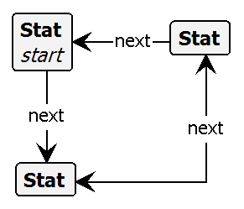
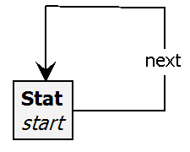
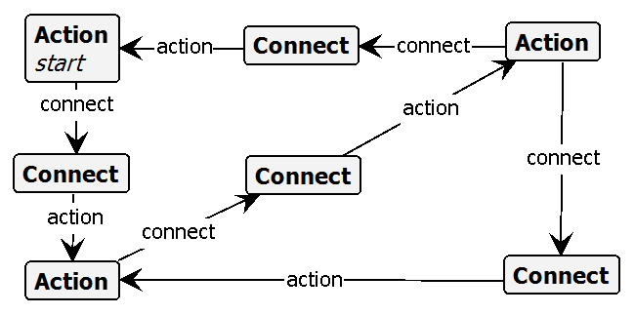
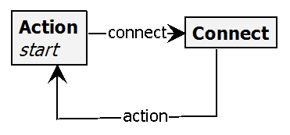
Two laughably simple languages: Syntax
Syntax
Modelling Language
Language A: Featherweight flow graphs
Statements and next-arrows
Language B: Featherweight activity diagrams
Actions and connectors
Type
Instance

Slide 9
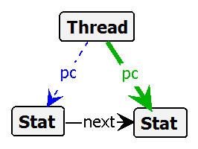
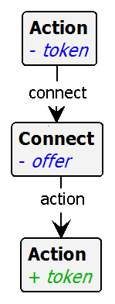
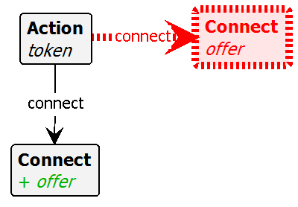
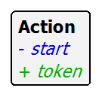
Laughably simple language semantics
Modelling Language
Semantic domain
Semantics
Language A: Thread-based execution
Language B: Token-based execution
start
next
start
next-offer
next-take

Slide 10
Behaviour preservation?
Initial thought: use rule names as transition labels
Does not work: rule names chosen for understandability
Names for comparable activities may differ between languages
For instance: A’s next does not correspond to B’s next-* actions
Refinement: allow relabelling between semantics
Map actions of one language onto that of the other
In LTS: make (sequences of) transitions unobservable or atomic
In this example: two possibilities
Rename one of B’s next-* to next and make the other invisible
Combine next-offer + next-take into single atomic action

Slide 11
Model transformation
Modelling Language
Transfor-mation
Modelling Language
In general, transformation occurs between different languages
In-place (endogenous) or side-by-side (exogenous)
For traceability, exogenous is to be preferred
Triple graph: composition of
Model of language A
Model of language B
Glue graph: connects A-elements with B-elements (tracing)
Triple graph grammar: builds A- and B-models + glue simultaneously
Each triple graph can be projected onto source and target graph
A-model
Glue graph
B-model

Slide 12
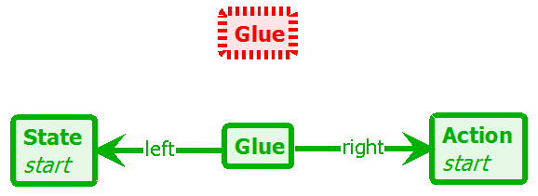
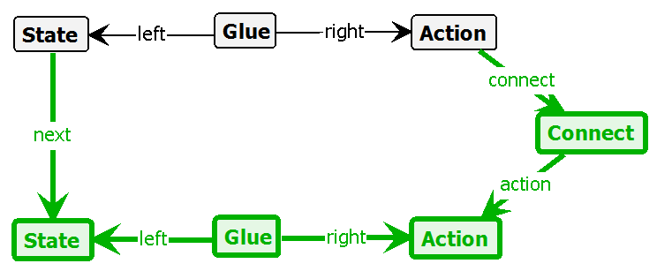
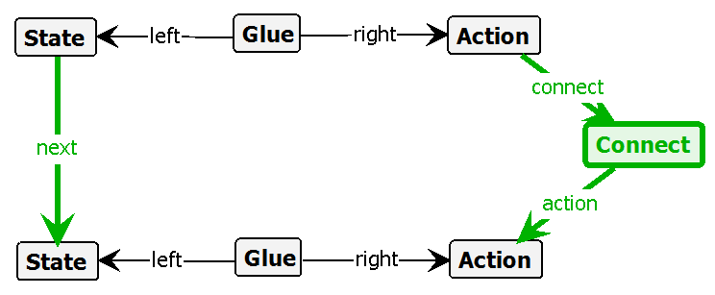
Laughably simple triple graph grammar
A-model
Glue
B-model
AB-init
AB-new-state
AB-new-next

Slide 13
Behaviour preservation!
Semantics
Semantics
Semantic domain
For every combined graph produced by the triple graph grammar …
… if we project to the A- and B-models …
… and compute the corresponding LTS using the semantic rules …
… and apply action relabelling …
… then the LTSs are weakly bisimilar
(Full Semantics Preservation in Model Transformation – A Comparison of Proof Techniques, IFM 2010)
A-graph
Glue graph
B-graph
A-graph
B-graph
$$LTS_{A}$$
$$LTS_{B}$$
$$LTS_{A}^{′}$$
$$≈$$
$$LTS_{B}^{′}$$

Slide 14
Questions
Questions (my answers)
Is semantic preservation an issue?
The topic has hardly been raised here!
If yes: What is your notion of semantics?
Full operational semantics inapplicable? Unachievable?
What are viable proof techniques?
Our Laughably Simple example was hard enough!
Behaviour preservation is a tough proof obligation
Alternative: run-time verification?
Yes
No
No

