Slide 1
ALTERNATIVE
SKEW-SYMMETRIC DISTRIBUTIONS
Chris Jones
THE OPEN UNIVERSITY, U.K.

Slide 2
For most of this talk, I am going to be discussing a variety of families of univariate continuous distributions (on the whole of R) which are unimodal, and which allow variation in skewness and, perhaps, tailweight.
For want of a better name, let us call
these skew-symmetric distributions!
Let g denote the density of a symmetric unimodal
distribution on R; this forms the starting point
from which the various skew-symmetric
distributions in this talk will be generated.

Slide 3
FAMILY 0
Azzalini-Type Skew Symmetric
Define the density of X_{A} to be
where
w(x) + w(-x) = 1
(Wang, Boyer & Genton, 2004, Statist. Sinica)
The most familiar special cases take w(x) = F(αx) to be the cdf of a (scaled) symmetric distribution
(Azzalini, 1985, Scand. J. Statist.)

Slide 4
FAMILY 0
Azzalini-Type
Skew-Symmetric
FAMILY 1
Transformation of
Random Variable
FAMILY 2
Transformation of
Scale
FAMILY 3
Probability Integral
Transformation of
Random Variable
on [0,1]
SUBFAMILY OF
FAMILY 2
Two-Piece Scale

Slide 5
Structure of Remainder of Talk
a brief look at each family of distributions in turn, and their main interconnections;
some comparisons between them;
open problems and challenges: brief thoughts about bi- and multi-variate extensions, including copulas.

Slide 6
FAMILY 1
Transformation of Random Variable
Let W: R → R be an invertible increasing function. If Z ~ g, then define X_{R} = W(Z). The density of the distribution of X_{R} is
where w = W'

Slide 7
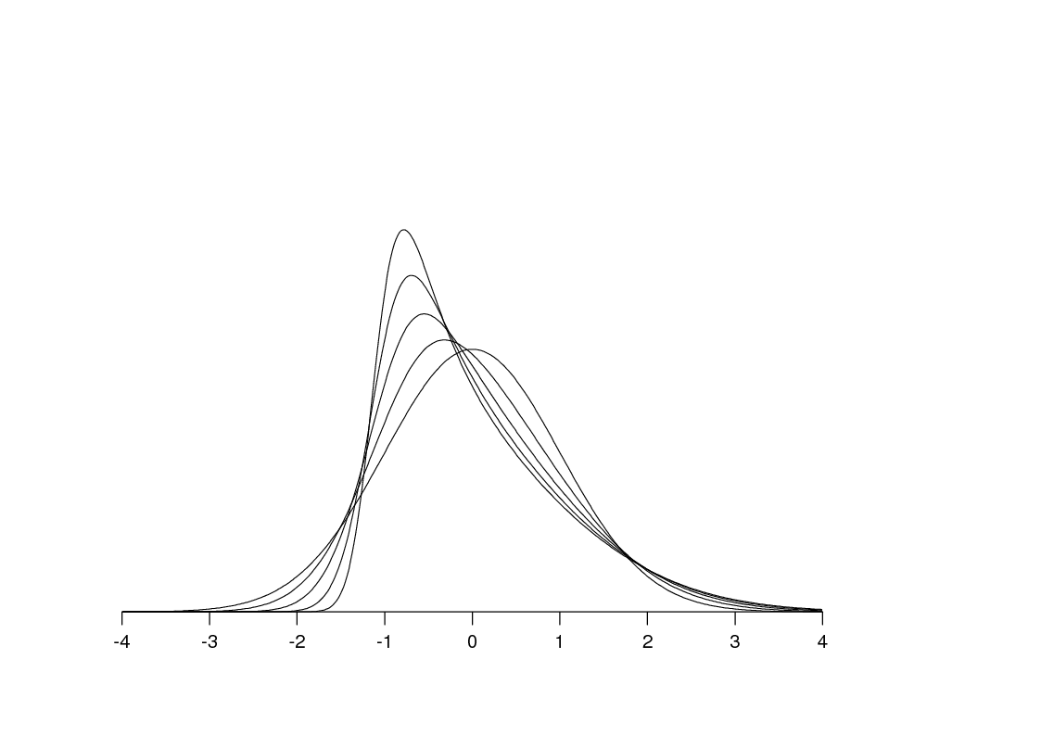
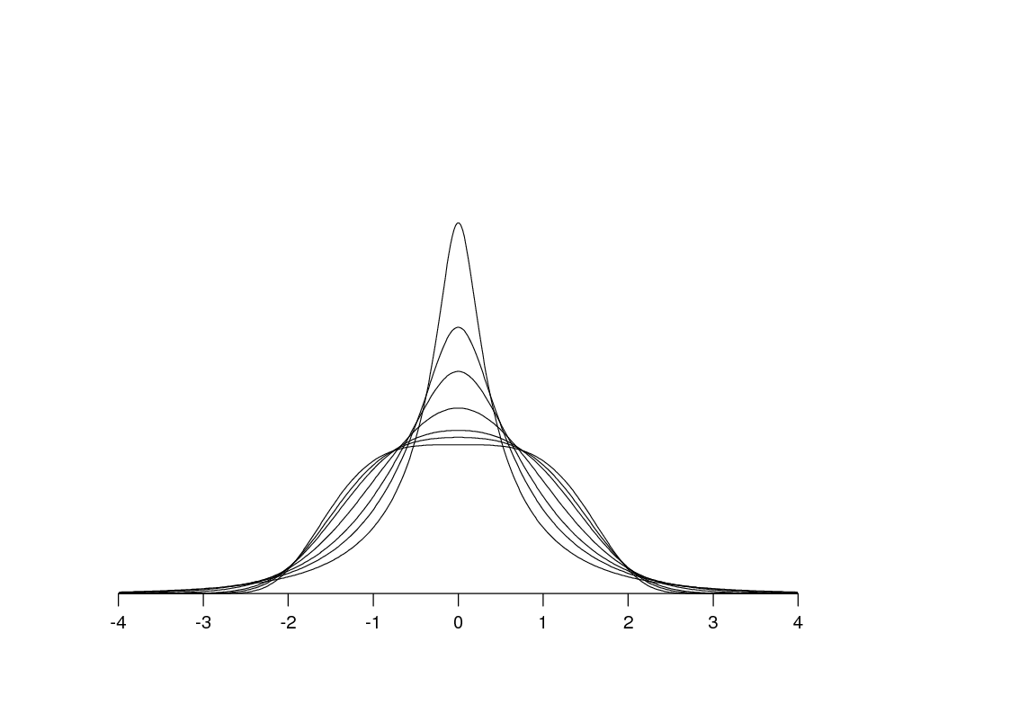
A particular favourite of mine is a flexible and
tractable two-parameter transformation that I call the sinh-arcsinh transformation:
(Jones & Pewsey, 2009, Biometrika)
b=1
a>0 varying
Here, a controls skewness …
a=0
b>0 varying
… and b>0 controls tailweight

Slide 8
FAMILY 2
Transformation of Scale
The density of the distribution of X_{S} is just
… which is a density if
W(x) - W(-x) = x
… which corresponds to w = W' satisfying
w(x) + w(-x) = 1
(Jones, 2013, Statist. Sinica)

Slide 9
FAMILY 1
Transformation of
Random Variable
FAMILY 0
Azzalini-Type
Skew-Symmetric
FAMILY 2
Transformation of
Scale
X_{R} = W(Z)
e.g. X_{A} = UZ
X_{S} = W(X_{A})
where Z ~ g
and U|Z=z is a random sign with
probability w(z) of being a plus

Slide 10
FAMILY 3
Probability Integral Transformation of
Random Variable on (0,1)
Let b be the density of a random variable U on (0,1). Then define X_{U} = G⁻¹(U) where G'=g. The density of the distribution of X_{U} is
cf.

Slide 11
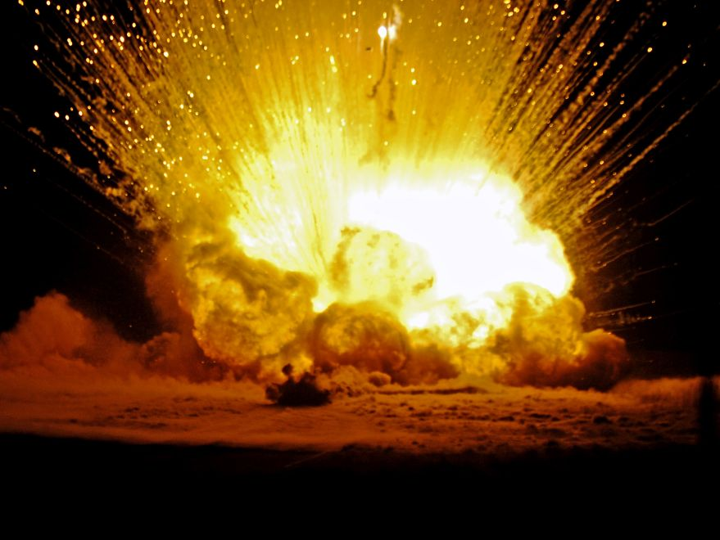
There are three strands of literature in this class:
bespoke construction of b with desirable properties (Ferreira & Steel, 2006, J. Amer. Statist. Assoc.)
choice of popular b: beta-G, Kumaraswamy-G etc (Eugene et al., 2002, Commun. Statist. Theor. Meth., Jones, 2004, Test)
indirect choice of obscure b: b=B' and B is a function of G such that B is also a cdf e.g. B = G/{α+(1-α)G} (Marshall & Olkin, 1997, Biometrika)
and
and

Slide 12

Comparisons I
 | SkewSymm | T of RV | T of S | TwoPiece | B(G)
Unimodal? | usually | often | ✓ | ✓ | often
When unimodal, with explicit mode? | ✗ | ✗ | ✓ | ✓ | ✗
Skewness ordering? | seems well-behaved | ✓ (van Zwet) | ✓ (density asymmetry) | ✓ ✓ (both) | ✗
Straightforward distribution function? | ✗ | ✓ | ✗ | ✓ | usually
Tractable quantile function? | ✗ | ✓ | ✗ | ✓ | usually

Slide 13
Comparisons I
 | SkewSymm | T of RV | T of S | TwoPiece | B(G)
Unimodal? | usually | often | ✓ | ✓ | often
When unimodal, with explicit mode? | ✗ | ✗ | ✓ | ✓ | ✗
Skewness ordering? | seems well-behaved | ✓ (van Zwet) | ✓ (density asymmetry) | ✓ ✓ (both) | ✗
Straightforward distribution function? | ✗ | ✓ | ✗ | ✓ | usually
Tractable quantile function? | ✗ | ✓ | ✗ | ✓ | usually

Slide 14
Comparisons I
 | SkewSymm | T of RV | T of S | TwoPiece | B(G)
Unimodal? | usually | often | ✓ | ✓ | often
When unimodal, with explicit mode? | ✗ | ✗ | ✓ | ✓ | ✗
Skewness ordering? | seems well-behaved | ✓ (van Zwet) | ✓ (density asymmetry) | ✓ ✓ (both) | ✗
Straightforward distribution function? | ✗ | ✓ | ✗ | ✓ | usually
Tractable quantile function? | ✗ | ✓ | ✗ | ✓ | usually

Slide 15

Comparisons I
 | SkewSymm | T of RV | T of S | TwoPiece | B(G)
Unimodal? | usually | often | ✓ | ✓ | often
When unimodal, with explicit mode? | ✗ | ✗ | ✓ | ✓ | ✗
Skewness ordering? | seems well-behaved | ✓ (van Zwet) | ✓ (density asymmetry) | ✓ ✓ (both) | ✗
Straightforward distribution function? | ✗ | ✓ | ✗ | ✓ | usually
Tractable quantile function? | ✗ | ✓ | ✗ | ✓ | usually
Notes:
I’m going to try to make some limited comparisons between families. This is a dubious undertaking because many things aren’t clear cut and there’s plenty of room for disagreement with what I’ve chosen to write down and the “marks” I’ve chosen to give them.
UNIMODAL: case-by-case basis except for ToS and two-piece
EXPLICIT MODE: same two; colour the same means its two sides of the same coin
SKEWNESS: grey is “yes” provided you invent an new way of understanding skewness!
DF & QUANTILE: crosses need numerical integration and inversion (1-d; not necessarily a problem); B(G) usually OK but could be based on nasty B.

Slide 16
Comparisons I
 | SkewSymm | T of RV | T of S | TwoPiece | B(G)
Unimodal? | usually | often | ✓ | ✓ | often
When unimodal, with explicit mode? | ✗ | ✗ | ✓ | ✓ | ✗
Skewness ordering? | seems well-behaved | ✓ (van Zwet) | ✓ (density asymmetry) | ✓ ✓ (both) | ✗
Straightforward distribution function? | ✗ | ✓ | ✗ | ✓ | usually
Tractable quantile function? | ✗ | ✓ | ✗ | ✓ | usually
Notes:
I’m going to try to make some limited comparisons between families. This is a dubious undertaking because many things aren’t clear cut and there’s plenty of room for disagreement with what I’ve chosen to write down and the “marks” I’ve chosen to give them.
UNIMODAL: case-by-case basis except for ToS and two-piece
EXPLICIT MODE: same two; colour the same means its two sides of the same coin
SKEWNESS: grey is “yes” provided you invent an new way of understanding skewness!
DF & QUANTILE: crosses need numerical integration and inversion (1-d; not necessarily a problem); B(G) usually OK but could be based on nasty B.

Slide 17
Comparisons II
 | SkewSymm | T of RV | T of S | TwoPiece | B(G)
Easy random variate generation? | ✓ | ✓ | ✓ | ✓ | usually
Easy ML estimation? | ✓ (“problems” overblown?) | ✓ | ✓ | ✓ | ✓
Nice Fisher information matrix? | ✗ (singularity in one case) | ✓ full FI | ✓ full FI | ✓ (considerable parameter orthogonality) | ✓ full FI
“Physical” motivation? | ✓ | perhaps? | ✗ | perhaps? | some-times
Transferable to circle? | ✗ (non-unimodality) | ✓ | ✓ | ✗ (not by two scales) | equivalent to T of RV?

Slide 18

Comparisons II
 | SkewSymm | T of RV | T of S | TwoPiece | B(G)
Easy random variate generation? | ✓ | ✓ | ✓ | ✓ | usually
Easy ML estimation? | ✓ (“problems” overblown?) | ✓ | ✓ | ✓ | ✓
Nice Fisher information matrix? | ✗ (singularity in one case) | ✓ full FI | ✓ full FI | ✓ (considerable parameter orthogonality) | ✓ full FI
“Physical” motivation? | ✓ | perhaps? | ✗ | perhaps? | some-times
Transferable to circle? | ✗ (non-unimodality) | ✓ | ✓ | ✗ (not by two scales) | equivalent to T of RV?

Slide 19
Comparisons II
 | SkewSymm | T of RV | T of S | TwoPiece | B(G)
Easy random variate generation? | ✓ | ✓ | ✓ | ✓ | usually
Easy ML estimation? | ✓ (“problems” overblown?) | ✓ | ✓ | ✓ | ✓
Nice Fisher information matrix? | ✗ (singularity in one case) | ✓ full FI | ✓ full FI | ✓ (considerable parameter orthogonality) | ✓ full FI
“Physical” motivation? | ✓ | perhaps? | ✗ | perhaps? | some-times
Transferable to circle? | ✗ (non-unimodality) | ✓ | ✓ | ✗ (not by two scales) | equivalent to T of RV?

Slide 20
Comparisons II
 | SkewSymm | T of RV | T of S | TwoPiece | B(G)
Easy random variate generation? | ✓ | ✓ | ✓ | ✓ | usually
Easy ML estimation? | ✓ (“problems” overblown?) | ✓ | ✓ | ✓ | ✓
Nice Fisher information matrix? | ✗ (singularity in one case) | ✓ full FI | ✓ full FI | ✓ (considerable parameter orthogonality) | ✓ full FI
“Physical” motivation? | ✓ | perhaps? | ✗ | perhaps? | some-times
Transferable to circle? | ✗ (non-unimodality) | ✓ | ✓ | ✗ (not by two scales) | equivalent to T of RV?

Slide 21

Comparisons II
 | SkewSymm | T of RV | T of S | TwoPiece | B(G)
Easy random variate generation? | ✓ | ✓ | ✓ | ✓ | usually
Easy ML estimation? | ✓ (“problems” overblown?) | ✓ | ✓ | ✓ | ✓
Nice Fisher information matrix? | ✗ (singularity in one case) | ✓ full FI | ✓ full FI | ✓ (considerable parameter orthogonality) | ✓ full FI
“Physical” motivation? | ✓ | perhaps? | ✗ | perhaps? | some-times
Transferable to circle? | ✗ (non-unimodality) | ✓ | ✓ | ✗ (not by two scales) | equivalent to T of RV?

Slide 22
Miscellaneous Plus Points
T of RV | T of S | B(G)
symmetric members can have kurtosis ordering of van Zwet … | beautiful Khintchine theorem | contains some known specific families
… and, quantile-based kurtosis measures can be independent of skewness | no change to entropy

Slide 23
OPEN problems and challenges: bi- and multi-variate extension
I think it’s more a case of what copulas can do for multivariate extensions of these families rather than what they can do for copulas
“natural” bi- and multi-variate extensions with these families as marginals are often constructed by applying the relevant marginal transformation to a copula (T of RV; often B(G))
T of S and a version of SkewSymm share the same copula
Repeat: I think it’s more a case of what copulas can do for multivariate extensions of these families than what they can do for copulas

Slide 24
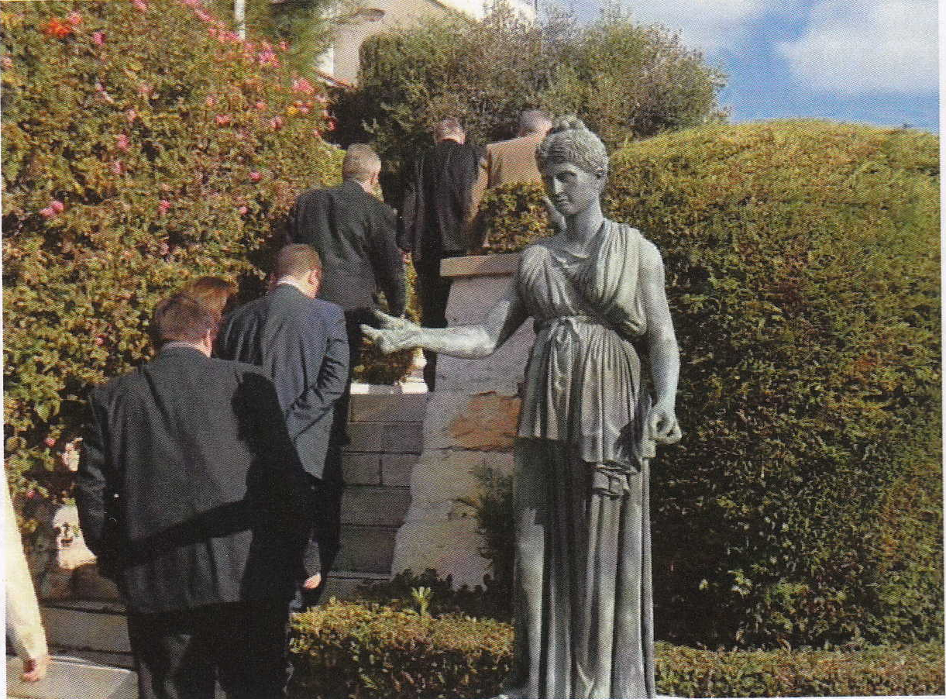
In the ISI News Jan/Feb 2012, they printed a lovely clear picture of the Programme Committee for the 2012 European Conference on Quality in Official Statistics …
… on their way to lunch!

Slide 26
Transformation of Random Variable
1-d:
X_{R} = W(Z) where Z ~ g
This is simply the copula associated with g₂
transformed to f_{R} marginals
2-d:
Let Z₁, Z₂ ~ g₂(z₁,z₂) [with marginals g]
Then set
X_{R,1} = W(Z₁), X_{R,2} = W(Z₂)
to get a bivariate
transformation of r.v. distribution
[with marginals f_{R}]

Slide 27
Azzalini-Type Skew Symmetric 1
X_{A}= Z|Y≤Z where Z ~ g
and Y is independent of Z
with density w'(y)
1-d:
2-d:
For example, let Z₁, Z₂, Y ~ w'(y) g₂(z₁,z₂)
Then set X_{A,1} = Z₁, X_{A,2} = Z₂ conditional on Y < a₁z₁+a₂z₂ to get a bivariate skew symmetric distribution with density 2 w(a₁z₁+a₂z₂) g₂(z₁,z₂)
However, unless w and g₂ are normal, this does not have marginals f_{A}

Slide 28
Azzalini-Type Skew Symmetric 2
Now let Z₁, Z₂, Y₁, Y₂ ~ 4 w'(y₁) w'(y₂) g₂(z₁,z₂)
and restrict g₂ → g₂ to be `sign-symmetric’, that is,
g₂(x,y) = g₂(-x,y) = g₂(x,-y) = g₂(-x,-y).
Then set X_{A,1} = Z₁, X_{A,2} = Z₂ conditional on Y₁ < z₁ and Y₂ < z₂ to get a bivariate skew symmetric distribution with density 4 w(z₁) w(z₂) g₂(z₁,z₂) (Sahu, Dey & Branco, 2003, Canad. J. Statist.)
This does have marginals f_{A}

Slide 29
Transformation of Scale
1-d:
X_{S} = W(X_{A}) where Z ~ f_{A}
2-d:
Let X_{A,1}, X_{A,2} ~ 4 w(x_{A,1}) w(x_{A,2}) g₂(x_{A,1},x_{A,2})
[with marginals f_{A}]
This shares its copula with the second
skew-symmetric construction
Then set
X_{S,1} = W(X_{A,1}), X_{S,2} = W(X_{A,2})
to get a bivariate
transformation of scale distribution
[with marginals f_{S}]

Slide 30
Probability Integral Transformation of
Random Variable on (0,1)
1-d:
X_{U}= G⁻¹(U)
where U ~ b on (0,1)
2-d:
Let U₁, U₂ ~ b₂(z₁,z₂) [with marginals b]
Then set X_{U,1} = G⁻¹(U₁), X_{U,2} = G⁻¹(Z₂) to get a bivariate version [with marginals f_{U}]
Where does b₂ come from? Sometimes there are reasonably “natural” constructs (e.g bivariate beta distributions) …
… but often it comes down
to choosing its copula

