Slide 1
Exploring the Brain Connectivity:
Questions, Challenges and Recent Findings
Ying Guo, PhD
Department of Biostatistics and Bioinformatics
Emory University
Joint work with Phebe Kemmer, Yikai Wang, Jian Kang, DuBois Bowman

Slide 2
fMRI Networking Modeling
“Top-3” network modeling methods based on simulation studies (Smith et al., NeuroImage, 2011)

Slide 3
Questions
Questions we aim to investigate:
Network based on direct connectivity vs. marginal
connectivity?
Sparse network estimation: how does the brain network
change when applying different levels of sparse
regularization?
Whether and how functional connections are related to
structural connections in brain networks.

Slide 4
Brain Functional Connectivity
Marginal connectivity vs. Direct connectivity
Effects of sparse regularization on estimated connectivity

Slide 5
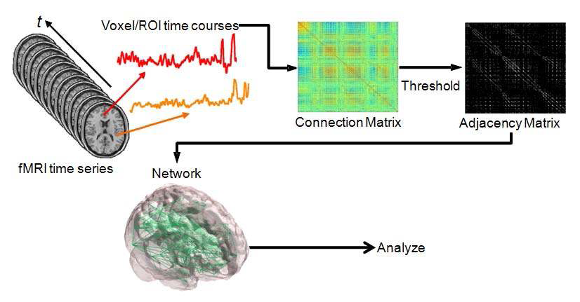
Network construction
Schematic for generating brain networks from fMRI time series data. (Simpson et al., 2013)
Brain Network Representation: M×M matrix ( M: number of nodes).
Σ: covariance matrix for marginal connectivity
Ω: precision matrix for direct connectivity
Steps in brain network construction:
  Defining nodes (brain parcellations)
  Network Estimation: marginal connectivity network vs. direct connectivity network
  Thresholding

Slide 6
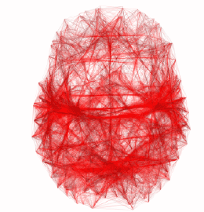
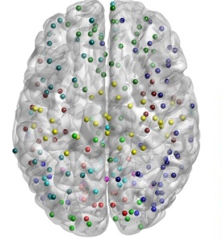
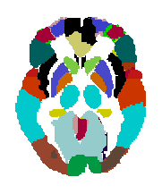
Node Definition
Nodes: individual voxels
computationally challenging
the network tends to be very noisy: high noise level in voxel signals
The network tends to have high between-subject variability
Intermediate node system
Nodes: a coarse parcellation of the brain into large regions
can cause a loss in spatial resolutions in connectivity analysis
high variability in temporal dynamics within the same region
Notes:
The brain is a complex network with macroscopic organization at the level of functional areas and subcortical nuclei, but the number and locations of these entities in humans is largely unknown.
if the nodes of the graph do not accurately represent real items in the system, the graph itself is a distorted model and graph theoretic properties will diverge from the true properties of the system
Standard approaches to forming whole-brain rs-fcMRI graphs often ignore this issue and define nodes as voxels or large parcels from anatomically-based brain atlases. These approaches are not meant to correspond to macroscopic “units” of brain organization,

Slide 7
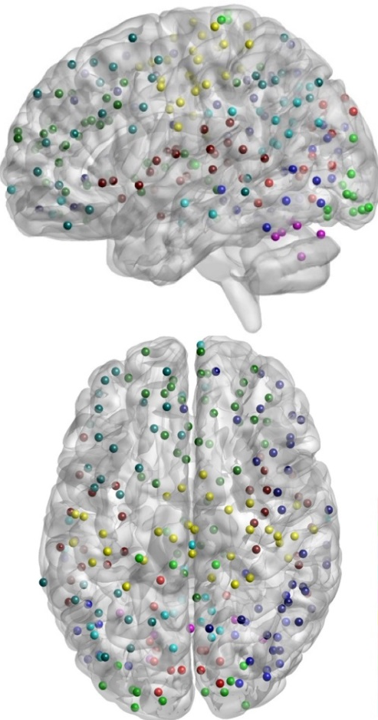
A node system for brain
network
POWER 264-node system (Power et al., Neuron, 2011)
The system include 264 putative areas spanning the cerebral cortex, subcortical structures, and the cerebellum
Each node is a 10mm diameter sphere in MNI space, representing a putative functional area
Centers of the nodes were determined using meta-analytic method+ fc-Mapping (Cohen et al., 2008) of cortical areas based on rs-fcMRI
Advantages:
  the 264-node-based subgraphs are significantly more like functional systems than AAL-based subgraphs.
  provides a good balance between spatial localization and dimension reduction (Fornito et al., 2010; Power et al., 2011)
Notes:
node is a 10mm diameter sphere in MNI space representing a putative functional area.
Functional area: (functional areas possess unique combinations of inputs, outputs, and internal structure, each
functional area is thought to make a distinct contribution to information processing.
Centers of putative areas were identified using two independent methods operating on datasets that were not used in graph analyses (see Methods). The first method was meta-analytic in nature (as in (Dosenbach et al., 2006)), and explored a large fMRI dataset to identify voxels that were reliably and significantly modulated when certain behaviors were demanded (e.g. button-pressing) or certain signal types were found (e.g. error-related activity). The second method extended a recently developed technique of mapping cortical areas using rs-fcMRI to entire cortical sheets (fc-Mapping: (Barnes et al., 2011; Cohen et al., 2008; Nelson et al., 2010a)). The combination of these methods yielded 264 putative areas spanning the cerebral cortex, subcortical structures, and the cerebellum.
Regions of interest (ROIs) were modeled as 10 mm diameter spheres. Graphs were formed using ROIs as nodes (N=264) and ties terminating within 20 mm of a source node center were set to zero to avoid possible shared signal between nearby nodes. This procedure yielded graphs of putative functional areas in which each node represented, to the best of our capabilities, an element of brain organization.
Power, J. D., Cohen, A. L., Nelson, S. M., Wig, G. S., Barnes, K. A., Church, J. A., et al. (2011).
635 Functional network organization of the human brain. Neuron, 72(4), 665-678.
graph theoretic approach (Bullmore and Sporns, 2009; Rubinov and Sporns, 2010).
fc-Mapping uses resting-state functional connectivity MRI (rs-fcMRI) data to identify locations in the cerebral cortex where the whole-brain patterns of functional connectivity change abruptly, consistent with boundaries between cortical areas.

Slide 8
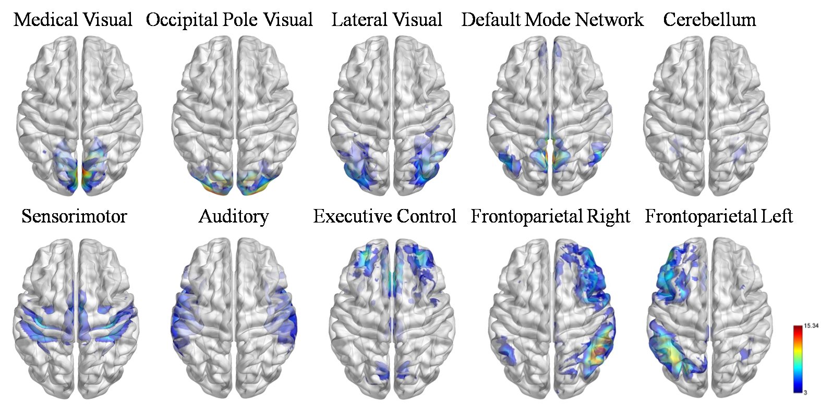
Brain functional systems
The 264 nodes are grouped into 10 functional systems that were consistently identified as rs-networks in larger populations
(Smith et al., 2009).
8
Notes:
8

Slide 9
Network Estimation
Marginal Connectivity: Full correlation
Direct Connectivity: Partial correlation
Methods for estimating Partial correlations in high dimensional case: Ridge regression
(Hoerl and Kennar, 1970); shrinkage estimator (Schäfer J et al., 2005); Graphical
Lasso(Banerjee 2006 ;Friedmann et al., 2008); etc.
Constrained L1-minimization Approach (CLIME) (Cai et al., 2011):
  Theoretical advantage: CLIME precision matrix estimators are shown to converge to the true precision matrix at a faster rate as compared to the traditional L1 regularization methods
  Computational advantage:
    easily implemented by linear programming
    scalable to high dimensional precision matrix with a large number of nodes
A challenge: selecting the tuning parameter. Issues with the existing selection methods:
- not flexible to choose the desired sparsity level (e.g some methods tend to select overly
dense networks);
- computationally expensive.

Slide 10
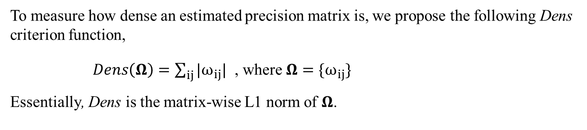
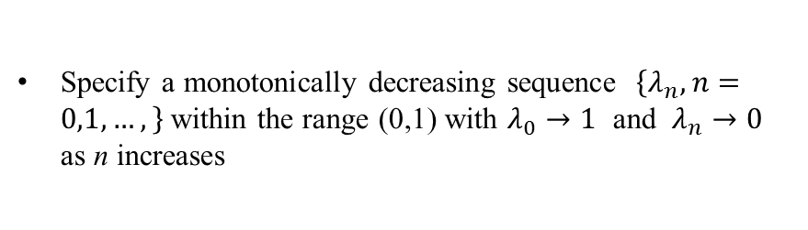
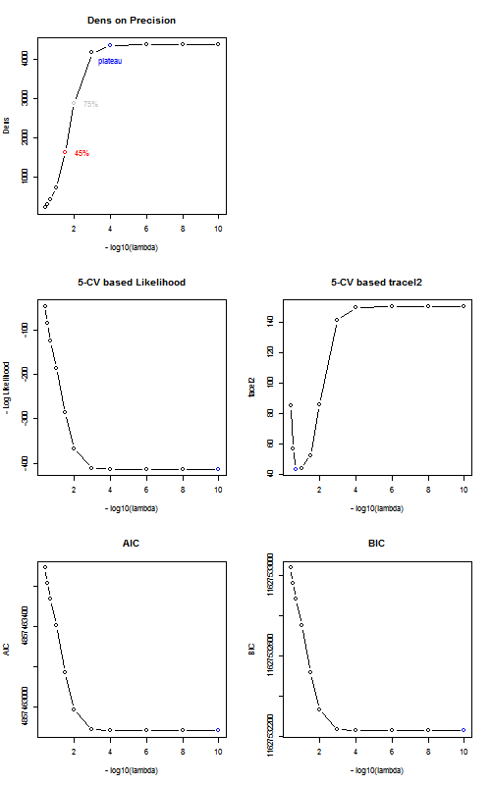
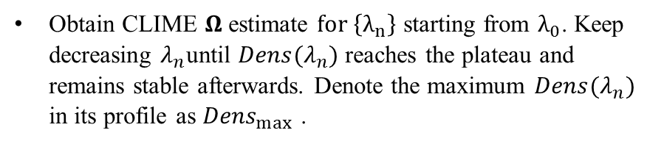
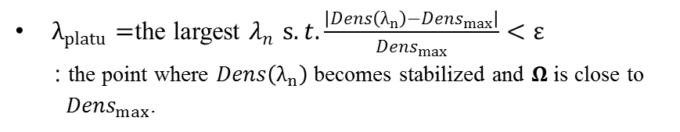
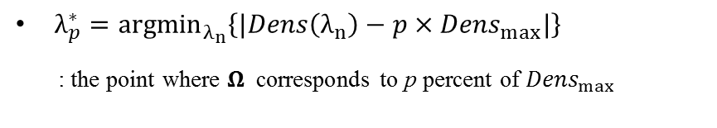
Dens-based tuning parameter selection method

Slide 11
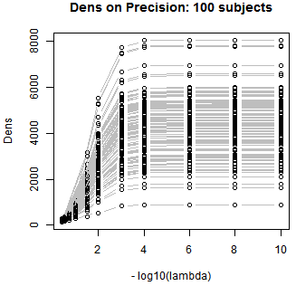
Dens-based tuning parameter selection method
Desirable features of the Dens-based method
Provides a more informative and flexible tool to select the tuning parameter based on the desired sparse level.
Table: Comparison of computation time for tuning
parameter selection methods
it is much faster than the existing selection methods based on cross-validations
Methods | K-CV log like | K-CV TraceL2 | Dens-based
Time (Secs) | 8575.93 | 8257.72 | 0.004
The Dens-based tuning parameter is highly consistent across subjects. Justifies the application of a common tuning parameter across subjects.
Notes:
Justifies applying the same tuning parameter to estimate partial correlation matrices for all subjects.
This greatly facilitates between-subject comparisons and also allows the construction of a group-level partial correlation matrix by combing subject-specific estimates

Slide 12
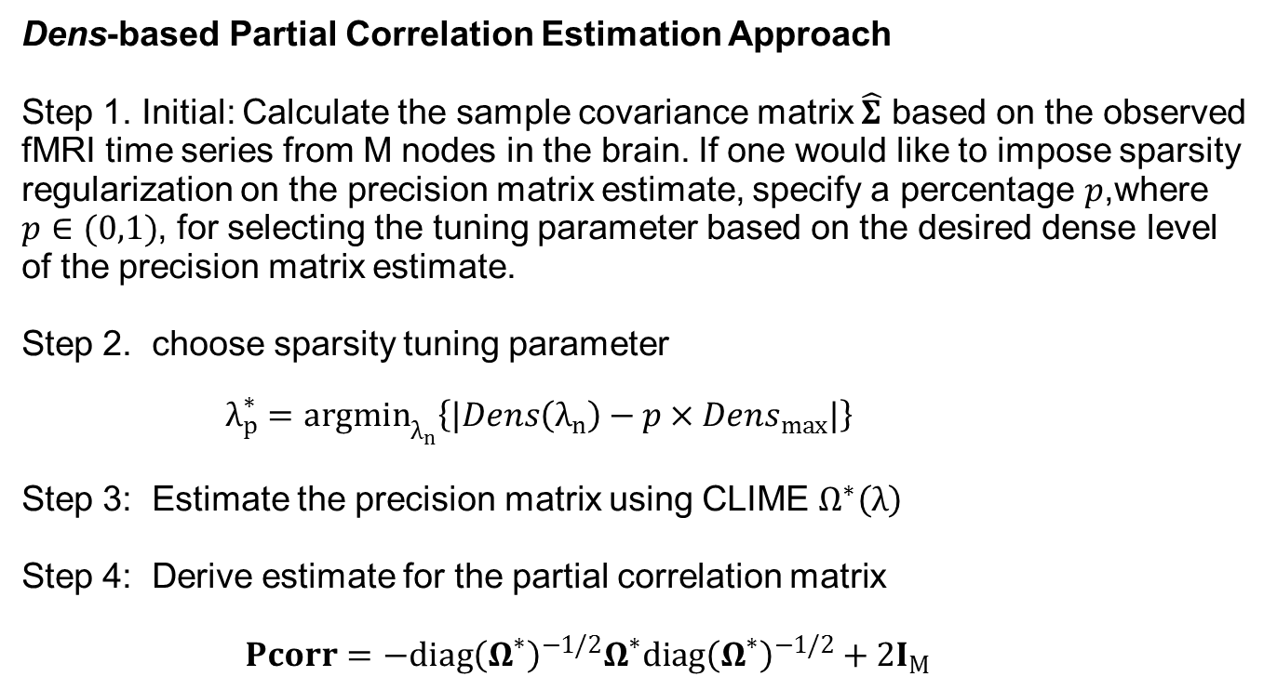
A partial correlation method for whole brain network modeling

Slide 13
Connectivity study using PNC data
Philadelphia Neurodevelopmental Cohort (PNC) Study
The PNC study includes a population-based sample of over 9500 individuals aged between 8-21 years.
A subset of participants (n=1,445) from the PNC received multimodality neuroimaging study which included resting-state fMRI (rs-fMRI). The sample were well-balanced by gender and race.
A major advantage over other large-scale rs-fMRI datasets: all the images were acquired on a single 3T Siemens scanner.
We considered the rs-fMRI from 881 PNC participants released in dbGaP.
Data quality control: removed subjects who had more than 20 volumes with relative displacement > 0.25 mm to avoid images with excessive motion (Satterthwaite et al., 2015). Among the 881 subjects who had rs-fMRI scans, 515 participant passed the quality control and were used in our following analysis.
Among the 515 subjects: 290 Female, Age: Mean(SD)=14.51(3.32)

Slide 14

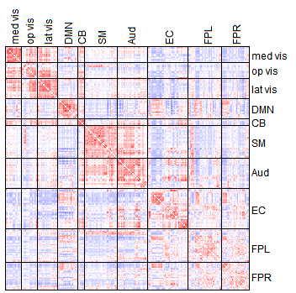
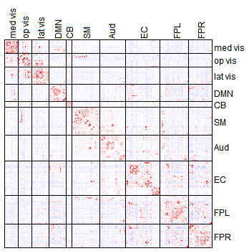
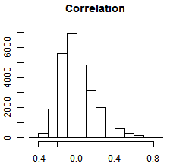
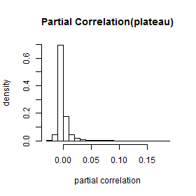
Marginal vs. Direct connectivity
Full Correlation connectivity Partial Correlation connectivity
1
0
-1
0.1
0
-0.1

Slide 15
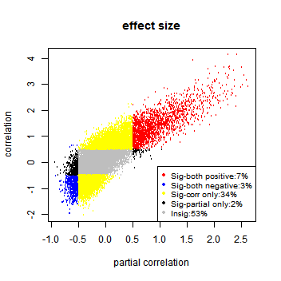
Consistency between correlation and partial correlation

Slide 16
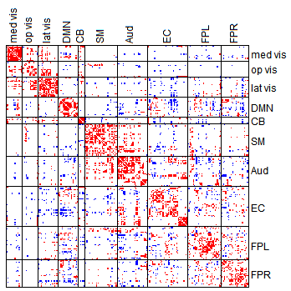
Consistently Significant Edges based on Partial Correlation and Correlation

Slide 17
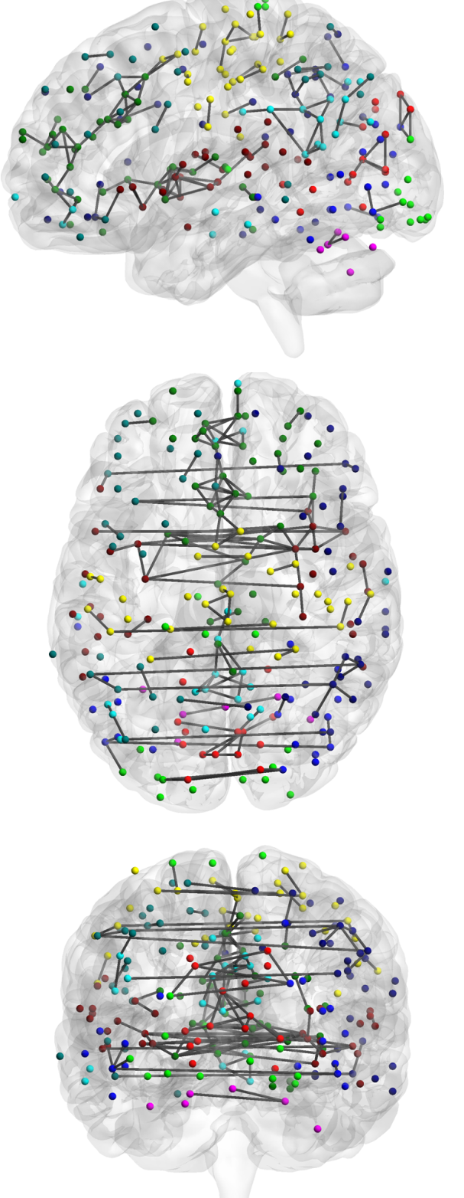
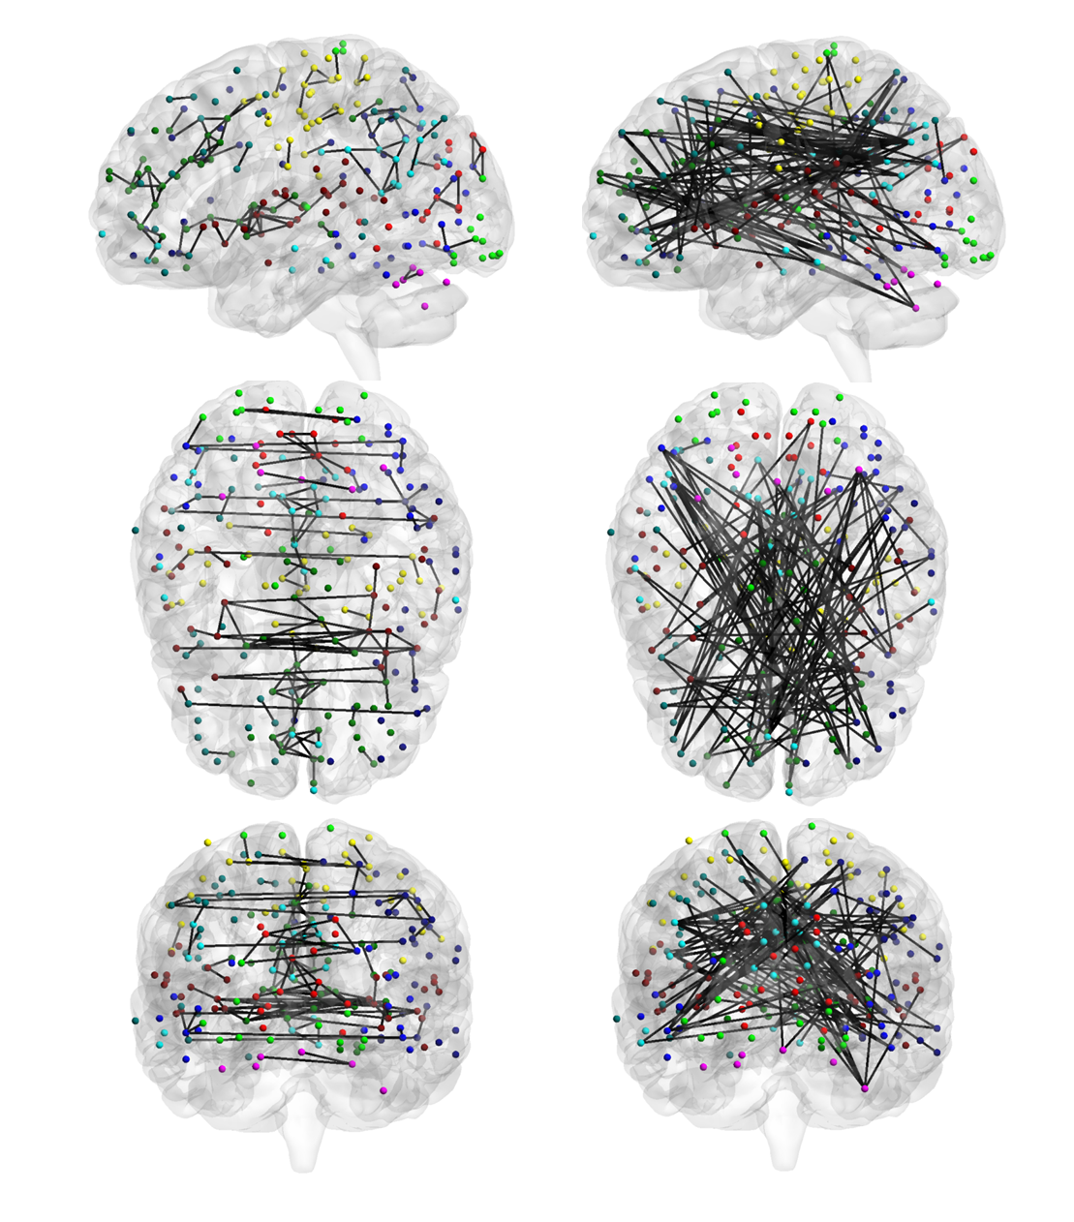
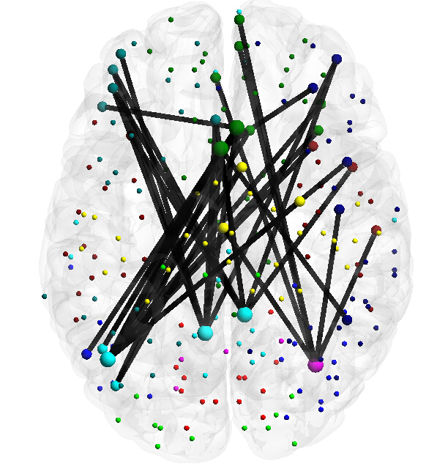
Consistently Significant Edges based on
Partial Correlation and Correlation
Positive
connections
Negative
connections
FPL
EC
DMN
Findings:
The most significant and consistent positive connections are between homologous brain locations in the left and right hemisphere.
The most significant negative connections tend to be long-range connections. Sytems most involved in negative connections: Default mode network (DMN), Executive Control (EC) and Frontoparietal Left (FPL)
Notes:
Executive functions (also known as cognitive control and supervisory attentional system) is an umbrella term for the management (regulation, control) of cognitive processes, including working memory, reasoning, flexibility, and problem solving as well as planning and execution.^{[1][2][3]} The executive system is thought to be heavily involved in handling novel situations outside the domain of some of our 'automatic' psychological processes that could be explained by the reproduction of learned schemas or set behaviors.

Slide 18
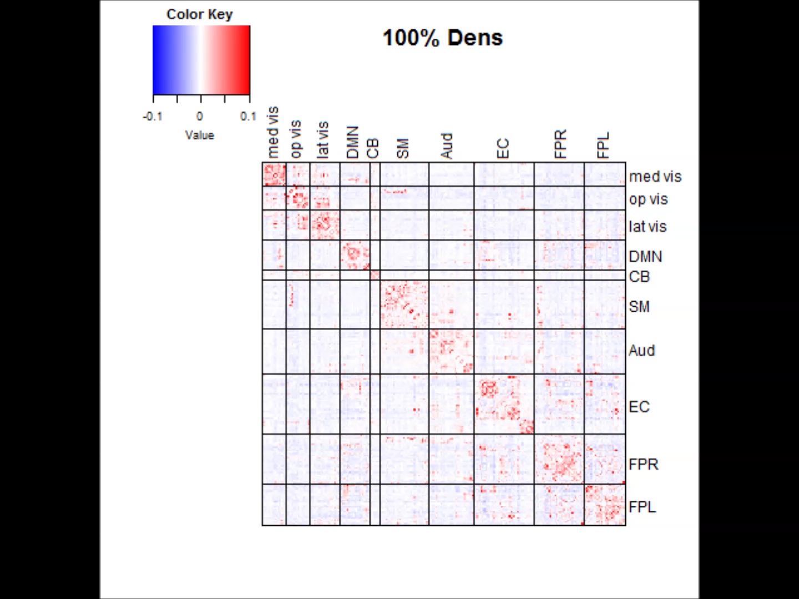
Effects of sparsity control on Direct connectivity
Estimated partial correlation matrices under various Dens levels
Dens level based on existing tuning parameter selection methods:
AIC, BIC and KV-likelihood: the maximum Dens level network: i.e. 100% Dens.
KV-traceL2: tends to choose a sparse network: 28% Dens.

Slide 19
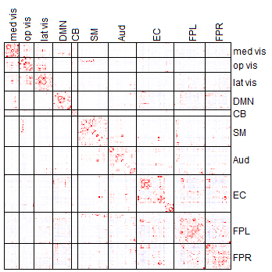
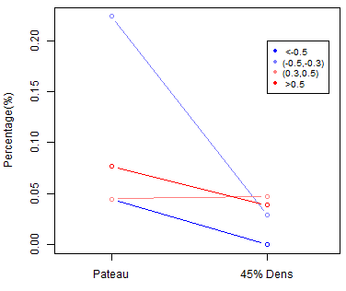
Effects of sparsity control on Direct connectivity
Plateau Dens level
45% Dens level
Findings:
the sparse regularization has more shrinkage effects on negative functional connections than on positive connections
The within-system connections are more likely to be retained under the sparse regularization than between-system connections

Slide 20
Summary for Functional
Connectivity Analysis
Marginal FC and direct FC are more consistent within functional systems than between functional systems. The most consistent and highly significant positive connections are between homologous regions in the left and right hemisphere.
The sparsity regularization has more shrinkage effect on negative connections than positive connections. Positive and negative FC very likely reflect different underlying physiological mechanisms.
Within-functional-system connections are more likely to be retained in sparse networks.
Notes:
Positive FC reflect highly synchronized neural activity in different functional areas.

Slide 21
Functional Connectivity & Structural Connectivity

Slide 22
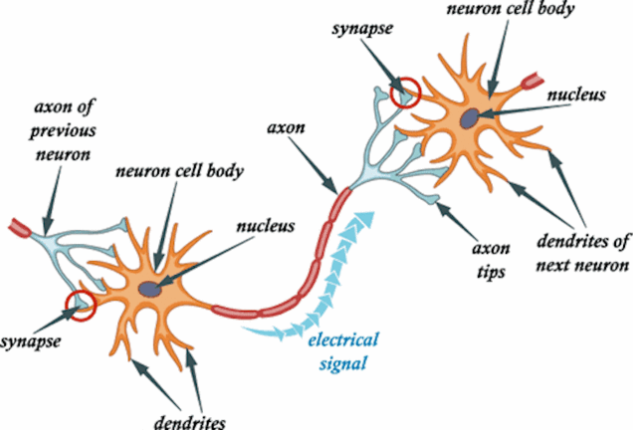
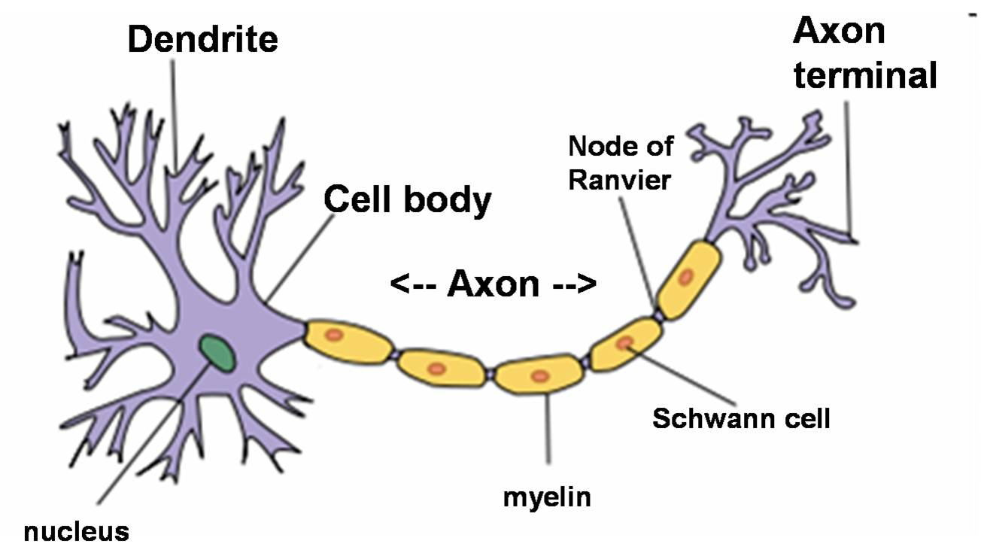
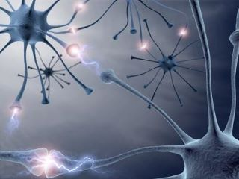
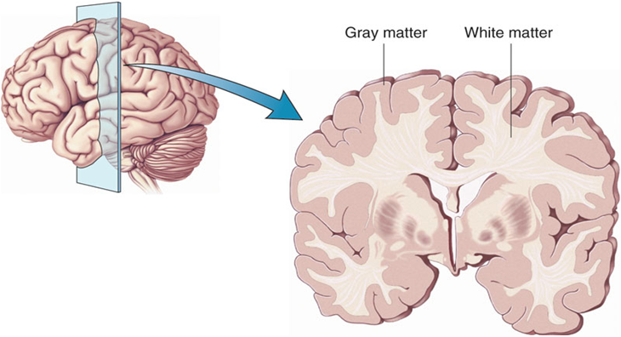
Grey matter and White matter
Figure from pixgood.com
Figure from Brain Harmony Center
Notes:
White matter is composed of bundles of myelinated nerve cell projections (or axons), which connect various grey matter areas (the locations of nerve cell bodies) of the brain to each other, and carry nerve impulses between neurons. White matter is the tissue through which messages pass between different areas of gray matter within the central nervous system.
There are three different kinds of tracts, or bundles of axons, which connect one part of the brain to another and to the spinal cord, within the white matter:
1. Projection tracts extend vertically between higher and lower brain and spinal cord centers, and carry information between the cerebrum and the rest of the body.
2. Commissural tracts cross from one cerebral hemisphere to the other through bridges called commissures. The great majority of commissural tracts pass through the large corpus callosum.
3. Association tracts connect different regions within the same hemisphere of the brain. Long association fibers connect different lobes of a hemisphere to each other whereas short association fibers connect different gyri within a single lobe. Among their roles, association tracts link perceptual and memory centers of the brain.^{[7]}

Slide 23
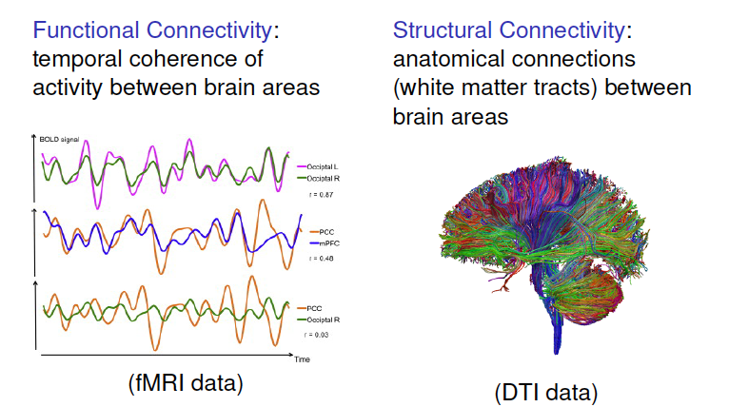
FC and SC
Notes:
White matter is composed of bundles of myelinated nerve cell projections (or axons), which connect various grey matter areas (the locations of nerve cell bodies) of the brain to each other, and carry nerve impulses between neurons.

Slide 24
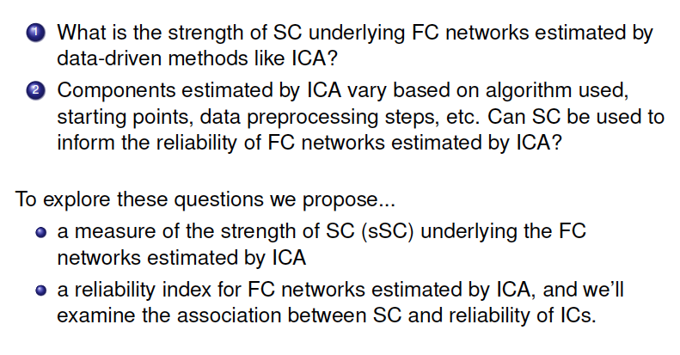
FC and SC

Slide 25
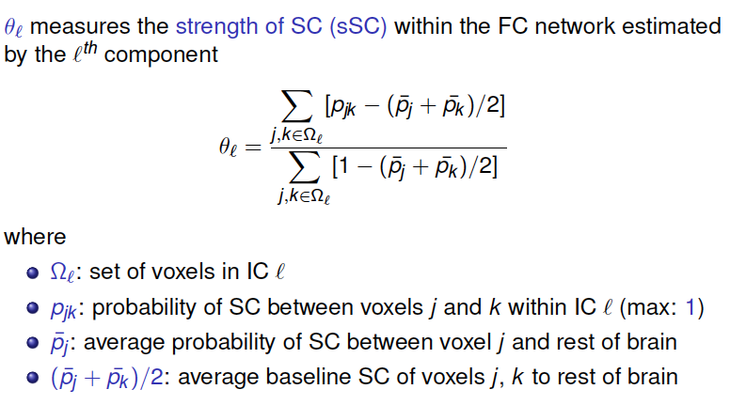
The proposed sSC measure

Slide 26
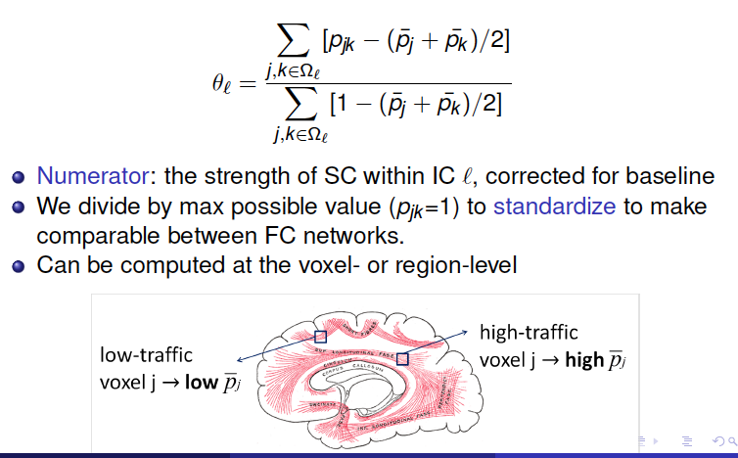
The proposed sSC measure

Slide 27
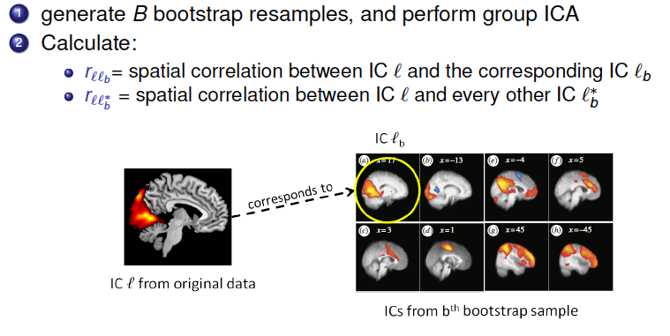
Reliability for FC networks

Slide 28
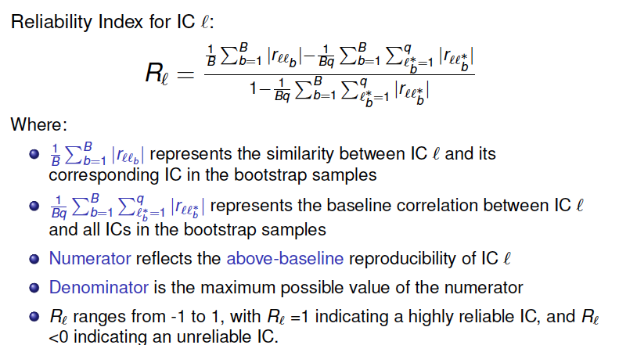
A Reliability Measure

Slide 29
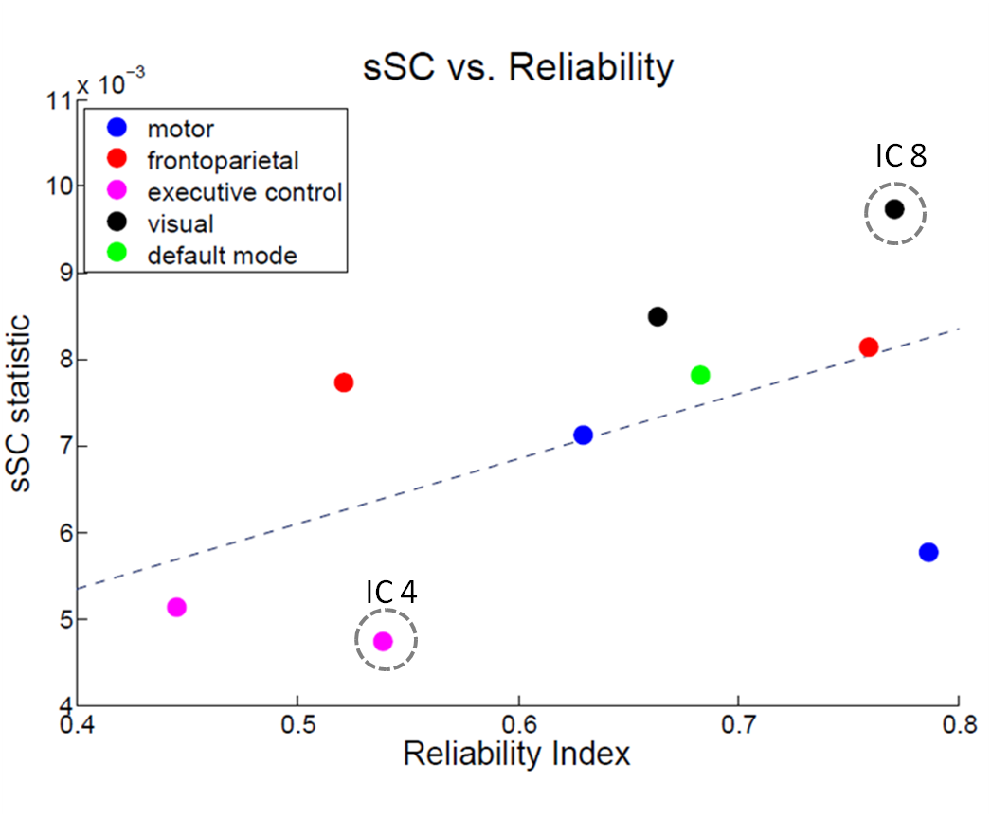
sSC and FC network Reliability
rs-fMRI from 20 control subjects
Results: the strength of SC is related to the reliability of FC networks!

Slide 30
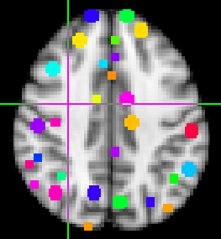
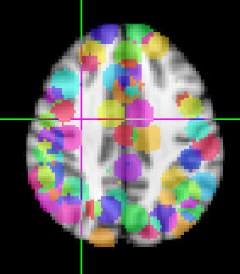



Multimodality Connectivity Study:
Functional & Structural
Functional Connectivity (rs-fMRI)
Structural Connectivity (Diffusion MRI)
Node Specification
Node Specification
Center of the nodes: Power 264 node system
Build a 10mm sphere around the center
Each node contains about 81 voxels in the grey matter
Center of the nodes: Power 264 node system
Build a 20mm sphere around the center
Each node contains 515 voxels (68.4% in the white matter)
FC Estimation and Model
SC Estimation and Model
Extract representative rs-fMRI time series from each node.
Marginal connectivity (full corr) and Direct connectivity (partial corr)
Region-to-region probabilistic tractography, (FSL)
90th percentile voxel connections, symmetry in region pair.

Slide 31
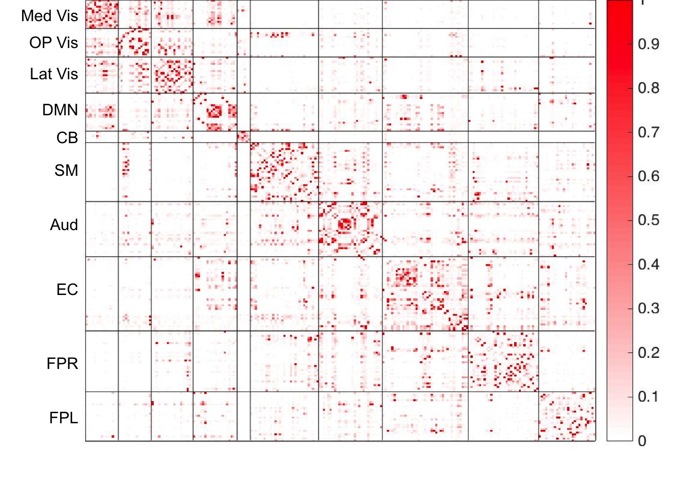
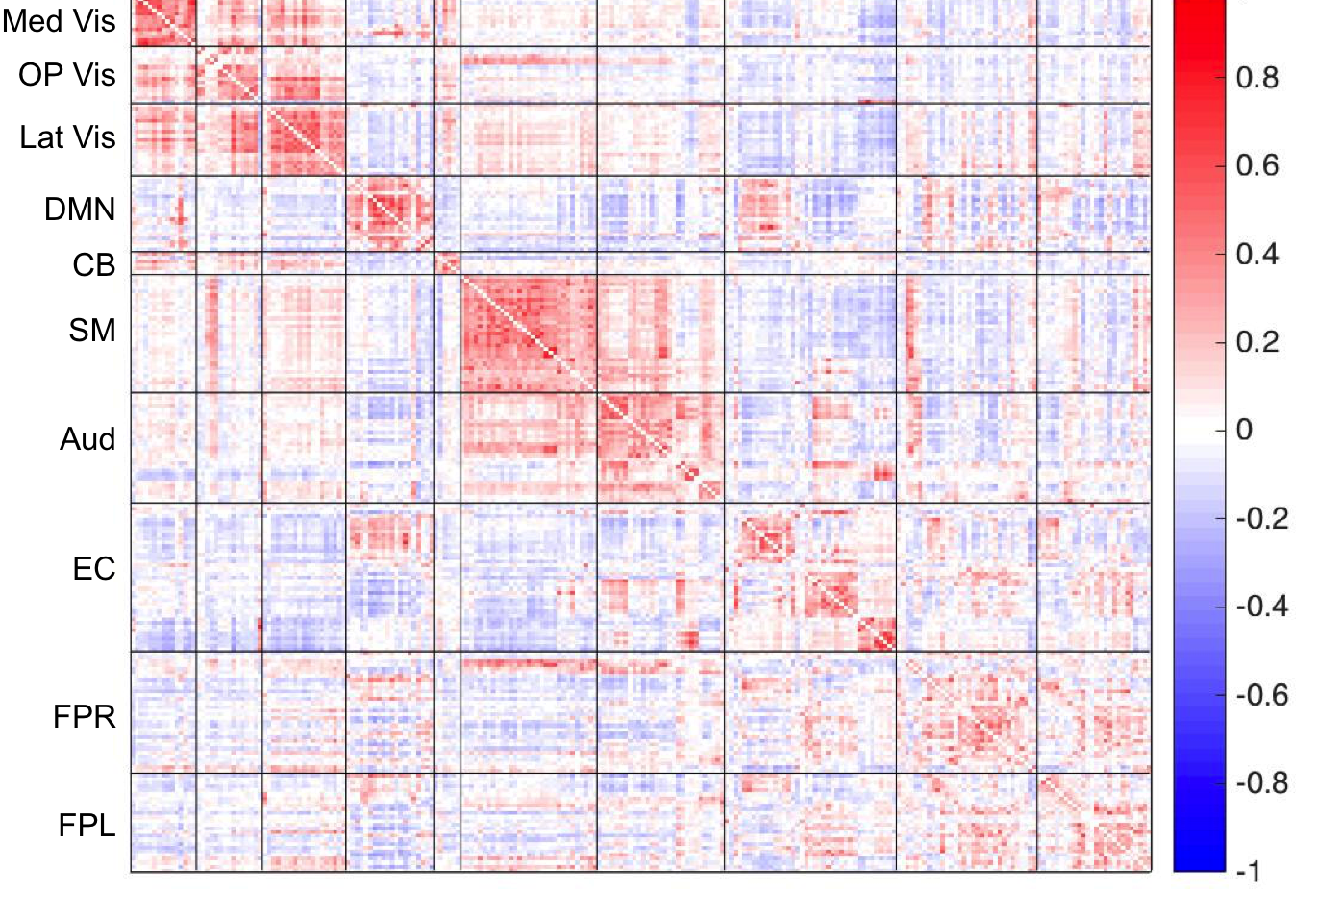
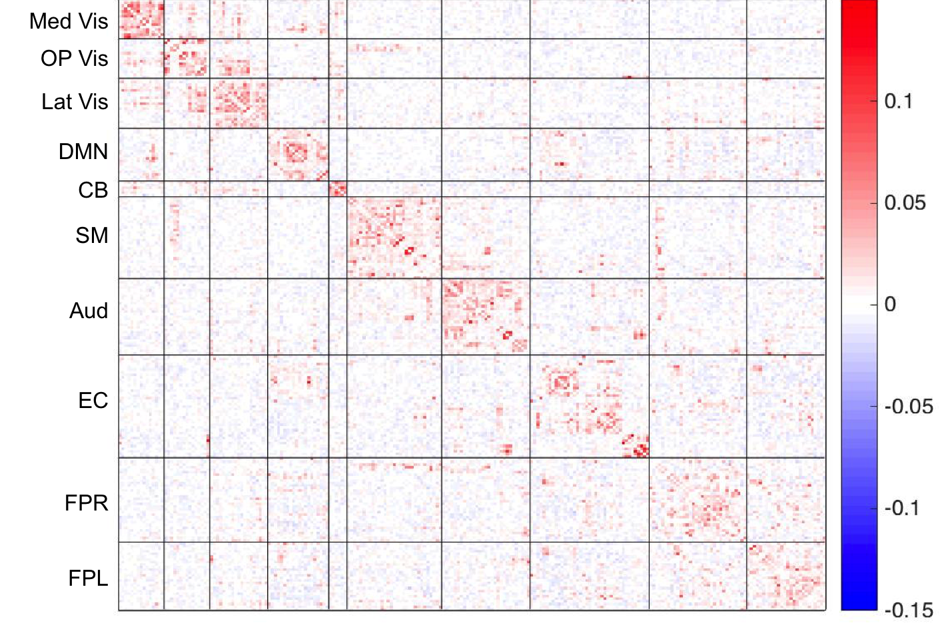
Multimodality Connectivity Study:
Functional & Structural
Structural Connectivity
Marginal FC (full correlation)
r =0.50
Structural Connectivity
Direct FC (partial correlation)
r =0.62

Slide 32
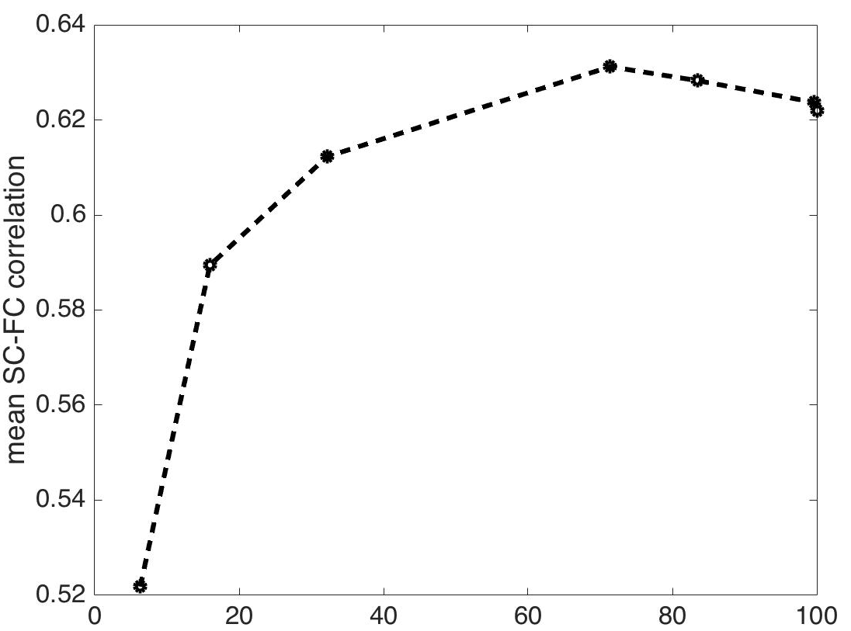
Multimodality Connectivity Study:
Functional & Structural
Figure. Strength of association between SC and direct FC at different Dens levels
Dens level of direct FC

Slide 33
Summary for FC&SC
SC has stronger association with direct FC than with marginal FC. Direct FC is more likely caused by direct structural (white fiber tracts) connections between grey matter functional areas.
Using information from SC, we may be able to distinguish different kinds of functional connections:
- FC caused by direct structural connections (more reproducible, more
likely to be retained in sparse functional networks).
- FC resulting from common connections to hub nodes, membership
in the same functional system and between-system co-activations
Notes:
The BOLD signal is affected by changes in both rCBF and rCBV. The coupling between CBF, CBV and the BOLD signal is complex, nonlinear, spatially inhomogeneous and even layer dependent [48]. The positive phase of the hemodynamic response function in response to stimulus is assumed to be dominated by rCBF changes, while the post stimulus undershoot is assumed to be affected by a delayed rCBV response.
An increase in rCBF presumably results in a decrease in blood deoxy-homoglobin levels, causing an increase in the BOLD signal.; In contrast, an increase in rCBV causes a total increase in deoxy-hemoglobin, resulting in a decrease of the BOLD signal. The balance between rCBF and rCBV could therefore determine the overall resulting BOLD signal.
We hypothesis that if the activity of two groups of neurons in two separate regions is highly synchronized, and if the hemodynamic response of one is rCBF dominated while that of the other is rCBV dominated, the temporal correlation between the BOLD signal in these regions will be negative;
We further hypothesis that if the rCBV and/or the rCBF responses are spatially dependent (for example, synchronized neuronal activity resulting in an increase of rCBV in one
region and a decrease in rCBV in another) one can also expect to find negative correlations with no time lags between such regions.

Slide 34


Acknowledgements
CBIS students:
Phebe B. Kemmer
Yikai Wang
Grants:
NIMH (2R01MH079448-04A1 and 1R01MH105561-01).

Slide 35
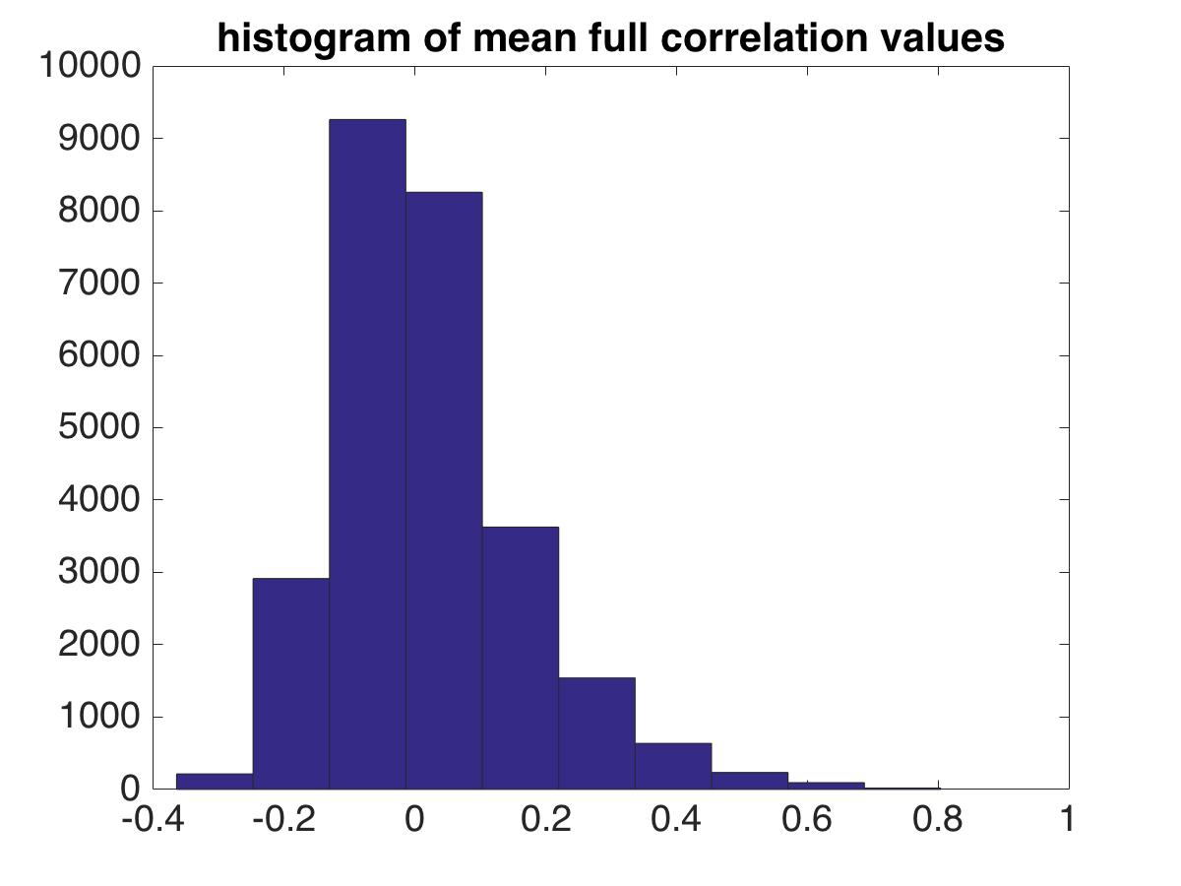
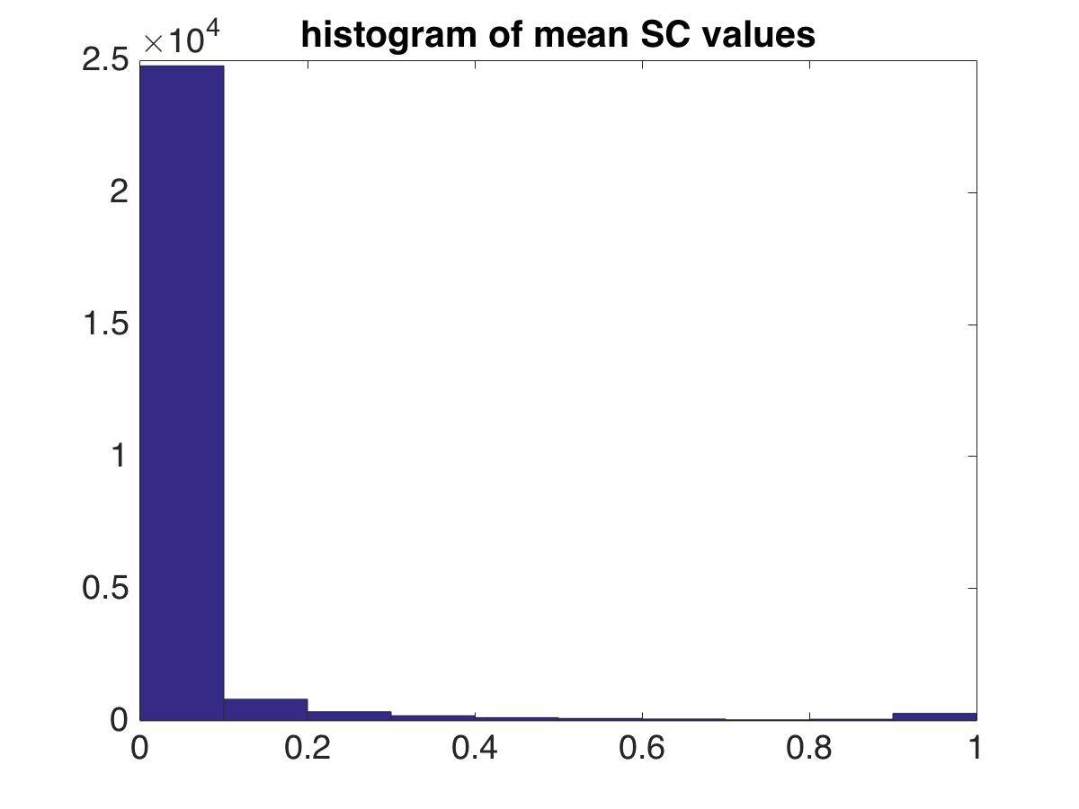
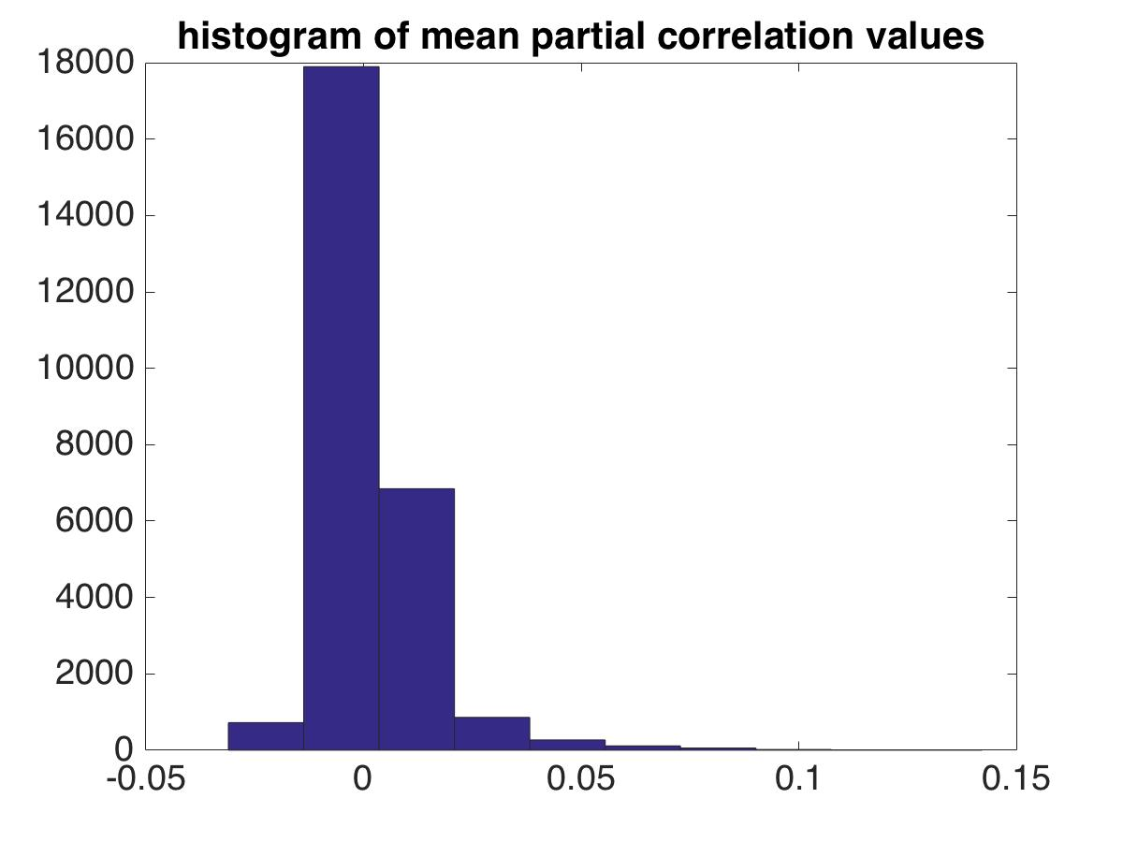
Marginal FC (full corr) and SC
: Positive FC and SC association
edges
: Negative FC and SC association
edges
Direct FC (Partial corr) and SC

