Slide 1


HPRM: Hierarchical Principal Regression Model of Diffusion Tensor Bundle Statistics
Jingwen Zhang¹, Hongtu Zhu^{1,2}, Joseph Ibrahim¹
¹Department of Biostatistics
²Biomedical Research Imaging Center
The University of North Carolina at Chapel Hill

Slide 2
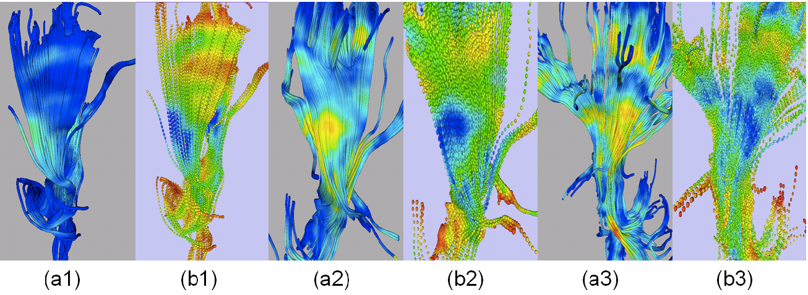
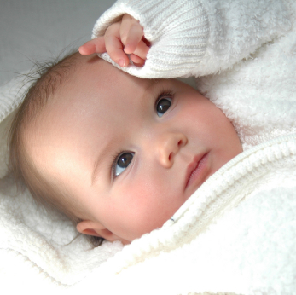
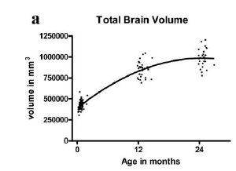
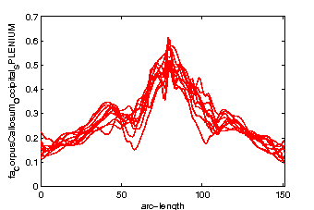
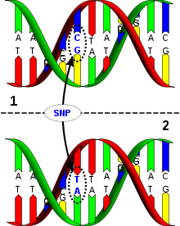
Problem of Interest
Motivation
2 weeks
1 year
2 years
Early Brain Development
Current Efforts
DTI Study
Single Tract Analysis
Multiple Tract Analysis
Point-wise Analysis
Summary Statistics
Result Combine
Inter-correlation and interpretation
Functional spatial feature of imaging data
Notes:
1 motivated by early human brain development
2 young child brain develop fast
3 brain volumn, brain structure
4 Using DTI data, we can study structure change quantitatively
5 For a brain region, extract DTI measure along a selected curve. Genetic factors -> DTI measure
6 In a typical DTI study, Current research focus on
7 Our goal joint, functional data

Slide 3




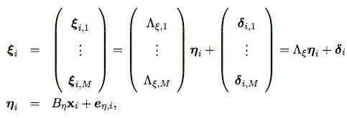

Hierarchical Principal Component Model
Correlation Matrix of 5 fPCs from 44 fiber tract in real data
Weighted Least square (WLS) based on local polynomial kernel (LPK) smoothing
Individual tract analysis
Multivariate Gaussian Process Model
Extract Functional Principal Components*
Multiple tracts analysis
Mean profile
Low
frequency signal
High
frequency noise
Global Factors
PCA based Factor Analysis
Estimation:
Linear Regression Model
Test Statistics:
Summation of Wald/LRT statistics
Tract residual
1st fPC
2nd fPC
3rd fPC
4th fPC
5th fPC
H. Zhu, et al. "FADTTS: functional analysis of diffusion tensor tract statistics." NeuroImage 56.3 (2011): 1412-1425.
Notes:
Propose HPRM
For dti meaurement of fiber tracts,
Project low freq signal, directions
Summarize functional PC scores
To extract effect on different levels
Standard regression

Slide 4




Simulation
General setting
  11 Fiber tract, N=100 simulated subjects
  Effect coefficients estimated from clinical study
Varying coefficient model
Estimated Coefficient
Simulation Data
Simulated Model
  (M1) Both Age and Gender effect for all tracts
  (M2) Age effect and Gender effect for different tracts
  (M3) M2+simulated effect on single tract
Notes:
Conduct simulation
From real data
Generate from varying coefficient model, adding variables such as age and gender, effect to be analyzed

Slide 5


(M1) Both Age and Gender effect for all tract
Model Setting
Effect | Abbrev | Tract
 | CCG CCPB CCTT CCMB CCR ALFT ARFT IFOFL IFOFR UNCL UNCR | CorpusCallosum_GENU CorpusCallosum_Parietal_BODY CorpusCallosum_Temporal_TAPETUM CorpusCallosum_Motor_BODY CorpusCallosum_ROSTRUM Arcuate_Left_FrontoTemporal Arcuate_Right_FrontoTemporal Inferior Fronto Occipital Fasciculus Left Inferior Fronto Occipital Fasciculus Right Left Uncinate Fasciculus Right Uncinate Fasciculus
Notes:
Given by the table,
Changing scale of age effect to evaluate hypothesis

Slide 6
(M1) Both Age and Gender effect for all tract
5 fPcs to include >85% variation
Factor Analysis
Notes:
The trend
First segment steeper slope than following segments

Slide 7


Hypothesis Testing
 | Joint Analysis of Multiple Tracts
 | Global Factor | Tract Residual
c | 1st | CCR | CCG | CCMB | CCPB | CCTT | ALFT | ARFT | IFOFL | IFOFR | UNCL | UNCR
0 | 0.061 | 0.052 | 0.048 | 0.053 | 0.056 | 0.044 | 0.065 | 0.061 | 0.049 | 0.062 | 0.059 | 0.057
0.5 | 0.953 | 0.239 | 0.296 | 0.095 | 0.164 | 0.444 | 0.209 | 0.227 | 0.342 | 0.371 | 0.132 | 0.182
1 | 1 | 0.649 | 0.83 | 0.154 | 0.668 | 0.99 | 0.609 | 0.637 | 0.93 | 0.947 | 0.292 | 0.513
1.5 | 1 | 0.834 | 0.991 | 0.24 | 0.975 | 1 | 0.886 | 0.906 | 0.997 | 1 | 0.458 | 0.806
 | Individual Analysis of Each Tract
0 |  | 0.05 | 0.051 | 0.049 | 0.063 | 0.045 | 0.073 | 0.069 | 0.049 | 0.062 | 0.06 | 0.05
0.5 |  | 0.361 | 0.298 | 0.138 | 0.19 | 0.199 | 0.222 | 0.213 | 0.333 | 0.342 | 0.194 | 0.155
1 |  | 0.946 | 0.862 | 0.372 | 0.614 | 0.699 | 0.661 | 0.66 | 0.912 | 0.915 | 0.548 | 0.501
1.5 |  | 1 | 0.996 | 0.722 | 0.931 | 0.982 | 0.965 | 0.976 | 0.999 | 0.999 | 0.912 | 0.875
Type I error controlled
Global factor is more sensitive than individual tract when shared effect present
Interpretation of Global factor
Notes:
1000 runs
Test age effect
For type I error,
Under alternative hypothesis
Expected result, age effect shared

Slide 8
Mapping-back Age Effect: Mean with 95% Confidence Band
Common Effect
Notes:
For each tract, true effect, mean of estimated effect from indiv
contribution of global factor-> global effect
Global factor has contribution
Common factor

Slide 9
(M2) Age effect and Gender effect for different tracts
Model Setting
Effect | Abbrev | Tract
 | CCG CCPB CCTT CCMB CCR | CorpusCallosum_GENU CorpusCallosum_Parietal_BODY CorpusCallosum_Temporal_TAPETUM CorpusCallosum_Motor_BODY CorpusCallosum_ROSTRUM
 | ALFT ARFT IFOFL IFOFR UNCL UNCR | Arcuate_Left_FrontoTemporal Arcuate_Right_FrontoTemporal Inferior Fronto Occipital Fasciculus Left Inferior Fronto Occipital Fasciculus Right Left Uncinate Fasciculus Right Uncinate Fasciculus
Notes:
Add to different tract
Examine the performance of global factor and tract residual when there is no common effect but subgroup effect

Slide 10
(M2) Age effect and Gender effect for different tracts
5 fPcs to include >85% variation
Factor Analysis
Notes:
Still extract fPC
factor analysis

Slide 11
Hypothesis Testing
 | Joint Analysis of Multiple Tracts
 | Global Factor | Tract Residual
c | 1st & 2nd | CCR | CCG | CCMB | CCPB | CCTT | ALFT | ARFT | IFOFL | IFOFR | UNCL | UNCR
0 | 0.055 | 0.060 | 0.060 | 0.053 | 0.050 | 0.045 | 0.046 | 0.049 | 0.058 | 0.047 | 0.063 | 0.048
0.5 | 0.342 | 0.302 | 0.199 | 0.101 | 0.132 | 0.189 | 0.047 | 0.038 | 0.051 | 0.054 | 0.055 | 0.049
1 | 0.867 | 0.540 | 0.400 | 0.175 | 0.232 | 0.443 | 0.038 | 0.037 | 0.044 | 0.049 | 0.051 | 0.046
1.5 | 0.984 | 0.421 | 0.275 | 0.071 | 0.087 | 0.323 | 0.035 | 0.033 | 0.045 | 0.031 | 0.046 | 0.046
 | Individual Analysis of Each Tract
0 |  | 0.053 | 0.059 | 0.054 | 0.052 | 0.054 | 0.049 | 0.042 | 0.056 | 0.047 | 0.058 | 0.043
0.5 |  | 0.378 | 0.280 | 0.119 | 0.169 | 0.203 | 0.049 | 0.040 | 0.055 | 0.043 | 0.062 | 0.041
1 |  | 0.940 | 0.842 | 0.395 | 0.540 | 0.740 | 0.049 | 0.037 | 0.059 | 0.043 | 0.062 | 0.044
1.5 |  | 0.985 | 0.983 | 0.777 | 0.895 | 0.975 | 0.055 | 0.038 | 0.060 | 0.039 | 0.063 | 0.044
Type I error controlled
Individual tract analysis and tract residual analysis can clearly differentiate between the subgroups with and without effect
Global factor achieves comparable power to tracts with real effect
Notes:
Individual tract with real effect
Age effect not shared but a large group of tracts

Slide 12
Mapping-back Age Effect: Mean with 95% Confidence Band
Subgroup Effect
Notes:
Mapping back, contribution of global factor
This time not common effect shared by all
Extract subgroup

Slide 13


(M3) M2+simulated effect to single tract
Model Setting
Effect | Abbrev | Tract
 | CCG CCPB CCTT CCMB CCR | CorpusCallosum_GENU CorpusCallosum_Parietal_BODY CorpusCallosum_Temporal_TAPETUM CorpusCallosum_Motor_BODY CorpusCallosum_ROSTRUM
 | ALFT ARFT IFOFL IFOFR UNCL | Arcuate_Left_FrontoTemporal Arcuate_Right_FrontoTemporal Inferior Fronto Occipital Fasciculus Left Inferior Fronto Occipital Fasciculus Right Left Uncinate Fasciculus
 | UNCR | Right Uncinate Fasciculus
Notes:
Simulated effect with changing scale

Slide 14
(M3) M2+simulated effect to single tract
5 fPcs to include >85% variation
Factor Analysis

Slide 15

Hypothesis Testing
 | Joint Analysis of Multiple Tracts
c | Global Factor | Tract Residual
 | 1st &2nd | CCR | CCG | CCMB | CCPB | CCTT | ALFT | ARFT | IFOFL | IFOFR | UNCL | UNCR
0 | 0.064 | 0.052 | 0.047 | 0.048 | 0.063 | 0.048 | 0.041 | 0.053 | 0.056 | 0.055 | 0.043 | 0.056
0.5 | 0.064 | 0.052 | 0.046 | 0.049 | 0.064 | 0.047 | 0.046 | 0.055 | 0.056 | 0.05 | 0.043 | 0.289
1 | 0.071 | 0.053 | 0.048 | 0.049 | 0.064 | 0.051 | 0.046 | 0.057 | 0.057 | 0.057 | 0.048 | 0.863
1.5 | 0.112 | 0.051 | 0.046 | 0.049 | 0.06 | 0.048 | 0.057 | 0.056 | 0.058 | 0.059 | 0.052 | 0.978
 | Individual Analysis of Each Tract
0 |  | 0.056 | 0.056 | 0.048 | 0.057 | 0.053 | 0.054 | 0.063 | 0.061 | 0.053 | 0.053 | 0.051
0.5 |  | 0.062 | 0.056 | 0.051 | 0.058 | 0.057 | 0.051 | 0.062 | 0.058 | 0.051 | 0.049 | 0.286
1 |  | 0.059 | 0.055 | 0.052 | 0.063 | 0.054 | 0.051 | 0.056 | 0.056 | 0.053 | 0.047 | 0.877
1.5 |  | 0.055 | 0.053 | 0.051 | 0.06 | 0.054 | 0.049 | 0.062 | 0.06 | 0.056 | 0.049 | 0.978
Type I error controlled
Tract residual analysis achieves similar power to individual tract analysis when detecting single-tract effect
When effect size increase, single-tract effect can be detected by global factor
Notes:
Dev in each tract -> global develop
Globally main variation

Slide 16
Mapping-back Age Effect: Mean with 95% Confidence Band
Tract Specific Effect
Notes:
Barely see global effect
Simu effect -> tract specific effect

Slide 17
GWAS of early brain development
472 twin subjects
  236 DZ pairs, 32 MZ pairs and 260 Singletons
Neonatal MRI (around one month old )
  3T Siemens Allegra head-only scanner or 3T Siemens TIM Trio
  DTIPrep (Quality Control), Slicer^{[1]} (Visual QC, DTI atlas creation, Fiber tract segmentation, Registration)
  FA measure of 44 Fiber Tracts
Genetic markers
  ~ 800k genetic marker
  Imputation with MACH-Admix, template 1000G Phase I v3
  ~ 6 million SNPs and indels with MAF>0.05
Fit ACE model in regression
Covariates^{[2]}
  Gestational age at birth, family income, DTI direction, Scanner Type, 3 genetic PC scores
[1] Fedorov, A., Beichel, R., Kalpathy-Cramer, J., Finet, J., Fillion-Robin, J. C., Pujol, S., ... & Buatti, J. 3D Slicer as an image computing platform for the Quantitative Imaging Network. Magnetic resonance imaging, 30.9 (2012), 1323-1341.
[2] Ahn, M., Zhang, H. H., & Lu, W. “Moment-based method for random effects selection in linear mixed models.” Statistica Sinica, 22.4 (2012), 1539.

Slide 18
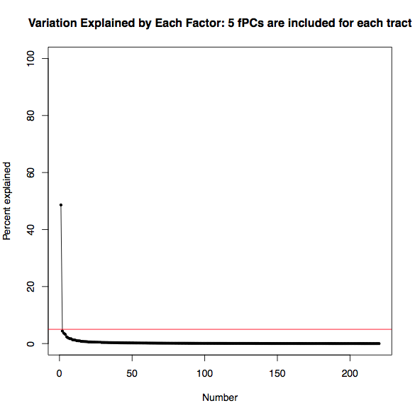
GWAS of early brain development
5 fPcs to include >70% variation
Factor Analysis
Notes:
Loading of global factor on each fPCs weighted by their sd, showing the contribution of fPCs to global factor

Slide 19
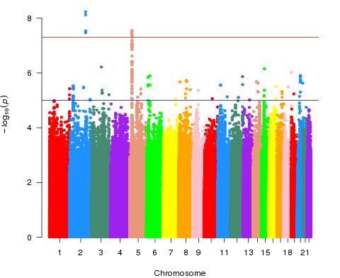
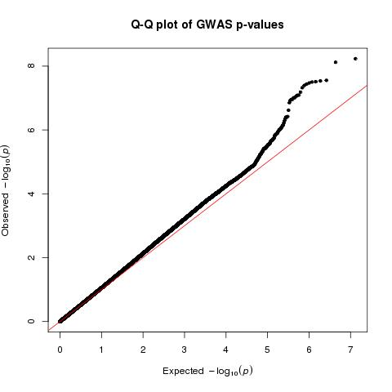
GWAS Result of global factor
ALK gene plays an important role in the development of the brain and exerts its effects on specific neurons in the nervous system
---NCBI Gene Database
Notes:
Cite google/wiki/other picture?

Slide 20
GWAS Result of global factor
Top 20 SNPs and corresponding Gene
rank | snpname | chr | pval | gene | Gene function
1 | rs66556850 | 2 | 5.67E-09 | ALK | Brain development
2 | rs62131138 | 2 | 7.32E-09
3 | rs34328925 | 2 | 2.71E-08
4 | rs34938026 | 2 | 2.81E-08
6 | rs10167952 | 2 | 2.88E-08
5 | rs6878826 | 5 | 2.81E-08
7 | rs6866769 | 5 | 3.23E-08
8 | rs6878602 | 5 | 3.65E-08
9 | rs6883230 | 5 | 4.03E-08
10 | 5:115008755:A_AGT | 5 | 5.55E-08 | LOC102467217
11 | 5:115008760:G_GTG | 5 | 7.61E-08 | TMED7
12 | rs7705506 | 5 | 7.94E-08 | LOC10927100
13 | rs6594898 | 5 | 9.03E-08 | TICAM2 | Progressive Multifocal
14 | 5:115009046:CA_C | 5 | 9.85E-08 |  | Leukoencephalopathy
15 | rs7732489 | 5 | 1.06E-07
16 | rs7712289 | 5 | 1.07E-07
17 | rs6594897 | 5 | 1.20E-07
18 | rs6594896 | 5 | 1.22E-07
19 | rs73116519 | 3 | 7.09E-07
20 | rs72734794 | 15 | 8.66E-07 | UNC13C | infantile epileptic encephalopathy
Notes:
Extracted top 20, find corresp gene. Some related to brain disorder

Slide 21
Summary & Future
We developed a Hierarchical Principal Regression Model (HPRM) on functional data to efficiently conduct joint analysis of multiple diffusion tensor tracts on both global level and individual level
HPRM is successfully applied to genome-wide association study on one-month-old twins to explore important genetic variants related to early human brain development.
Future work
  Theoretical result, asymptotic property of global factor
  Extension to longitudinal study, genetic heritability study, etc
Thank You
Notes:
Interesting finding about important genetic factors related to
Extend to other research

Slide 22
Back Up Slides

Slide 23

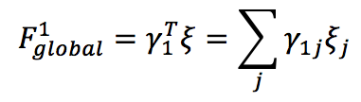
Global Factor in Real Data Analysis
Percent of variation explained by global factor
Weighted Loading
100 80 60 40 20 0 (%)
0 0.02 0.04 0.06 0.08 0.1

