Slide 1

ELASTIC FUNCTIONAL DATA ANALYSIS
ANUJ SRIVASTAVA Department of Statistics Florida State University
More of a “tutorial” than a research talk.

Slide 2
NEUROIMAGING DATA ANALYSIS
  Structural Imaging: deals with the structure of the nervous system
  Data Source: MRI, PET, CT, optical imaging.
  Data Form: Volumes → point clouds, curves, surfaces
  Functional Imaging: measure an aspect of brain function
  Data Source: fMRI
  Data Form: functions indexed by space and time
  Main Message:
  Functional Data Analysis (FDA) is important in many cases.
  Registration is the single biggest issue in handling functional data.
  Need proper mathematical foundation for FDA with registration.

Slide 3
NATURE OF DATA
  Variables of interest are seldom Euclidean vectors
  They are:
  1. High-Dimensional: Functional data is infinite-dimensional
  2. Nonlinear: Elements of nonlinear manifolds
  3. Invariant: Representations needs to be invariant to certain transformations: rigid motion, scale, re-parameterization
  Need to use quotient spaces of manifolds (even worse).
  4. Lack analytical tools: Computational solutions dominate!
  Example: Shape-based model for prediction of Alzheimers disease
  Use a model of the type:
  Shape is often a whole equivalence class.

Slide 4
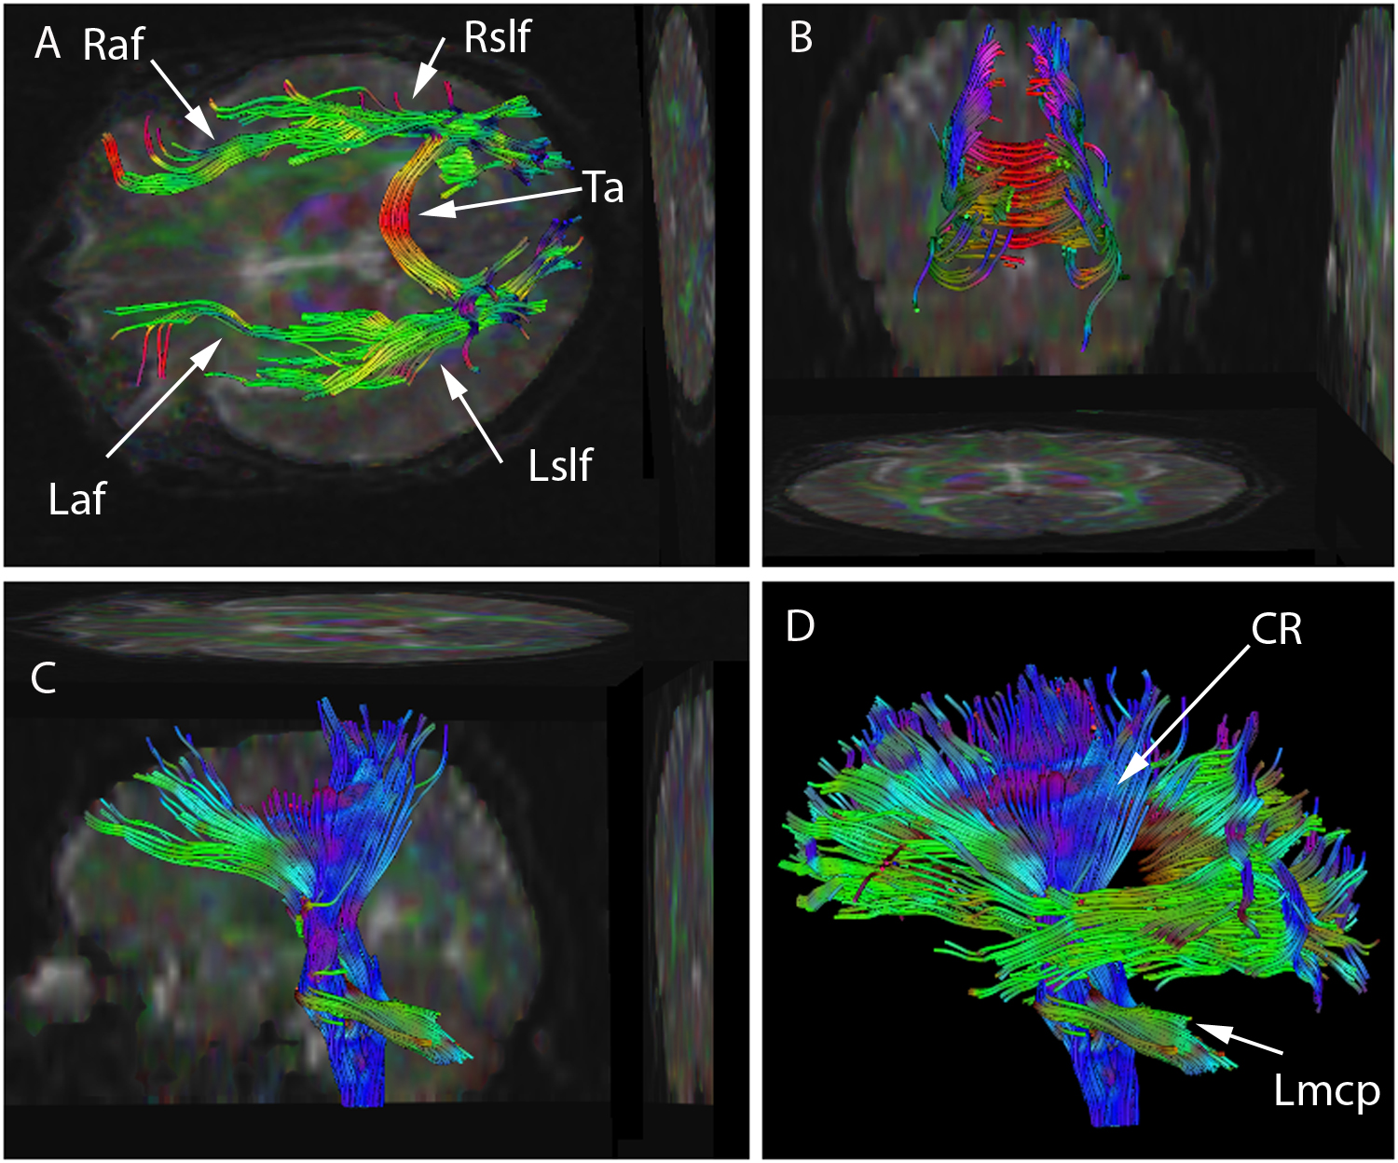
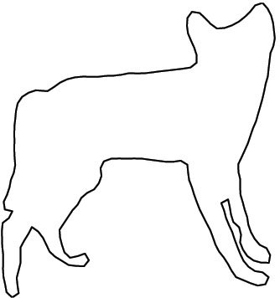
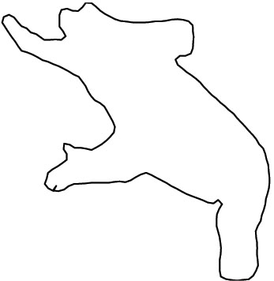
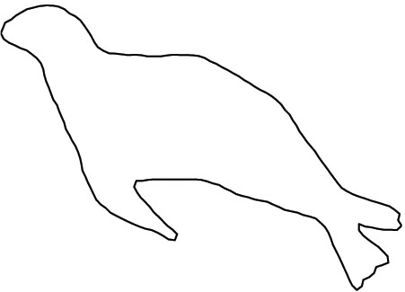
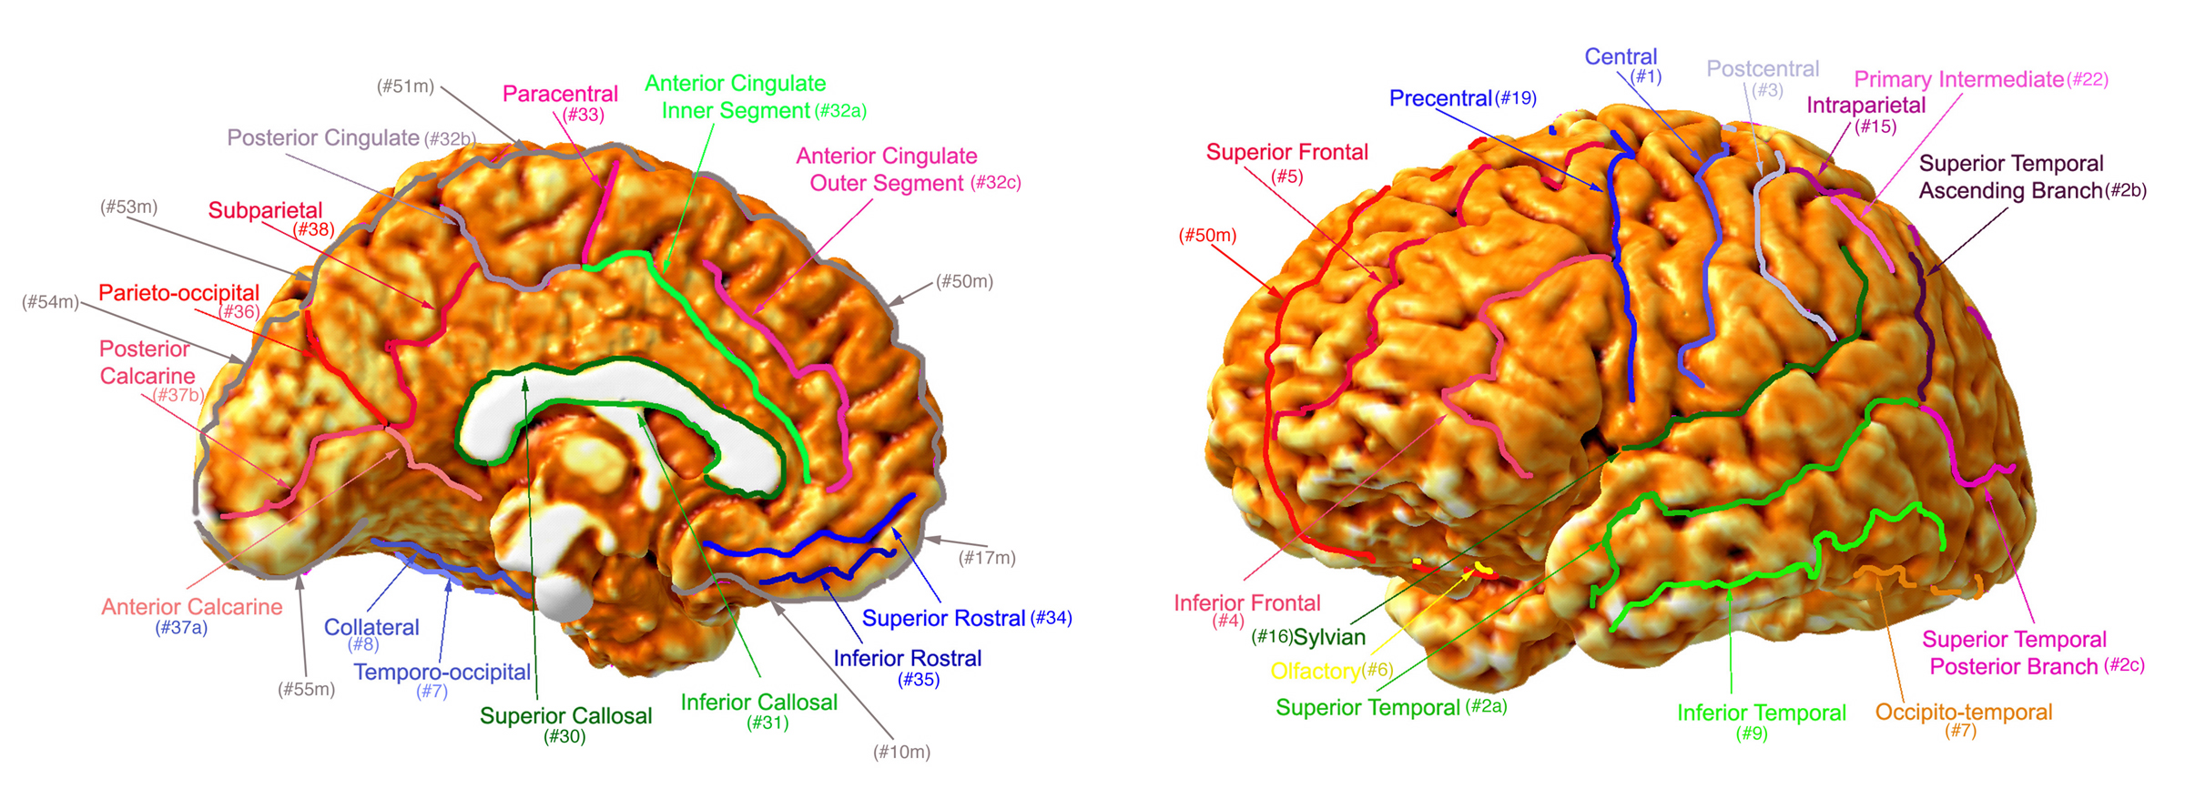
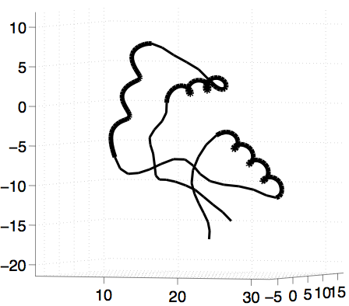
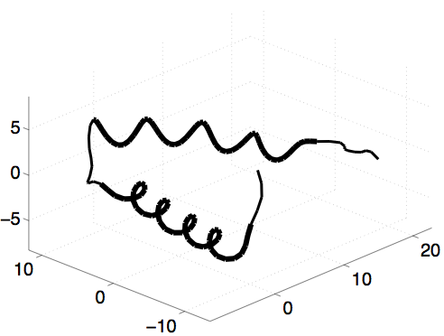
TYPES OF FUNCTIONAL DATA
  Parameterized Curves

Slide 5
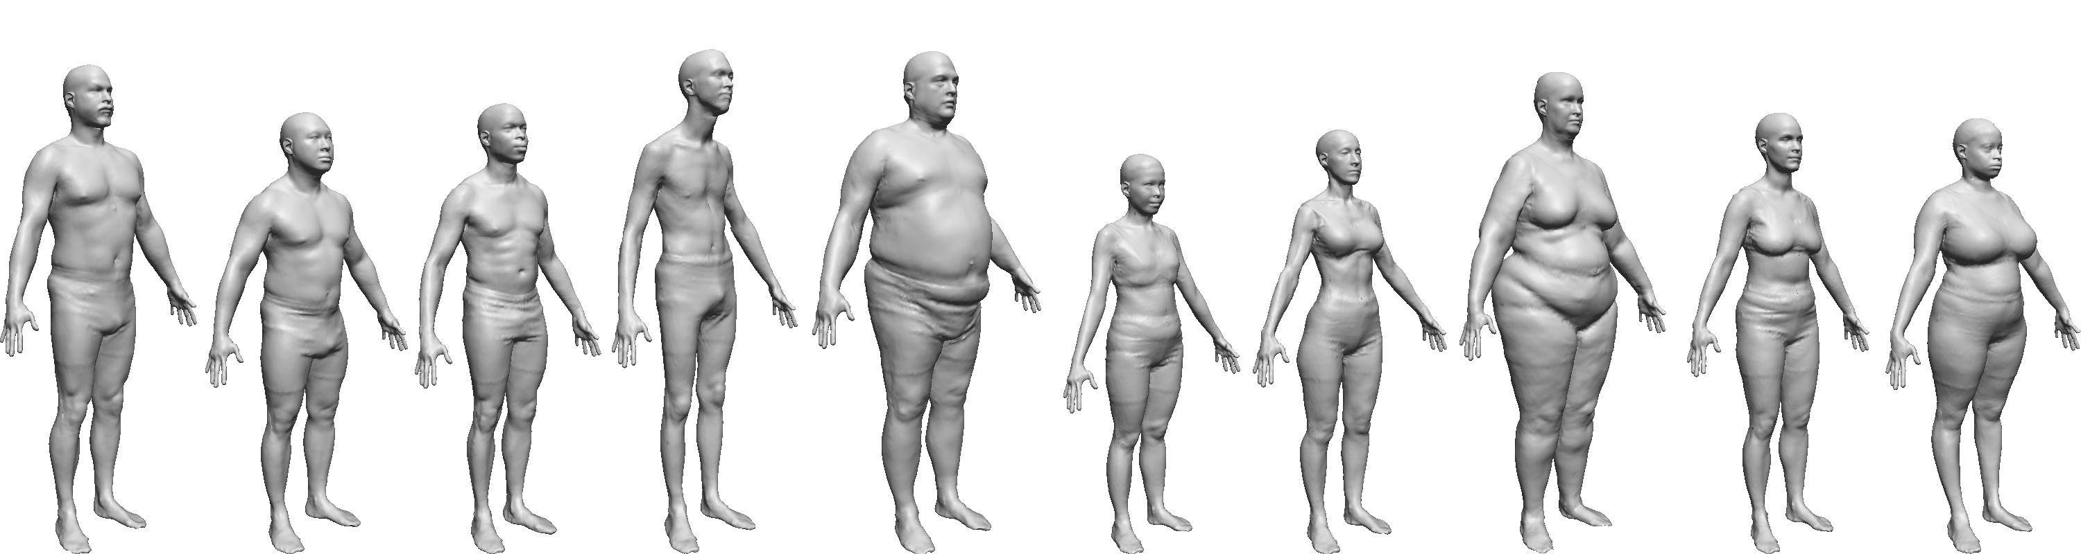
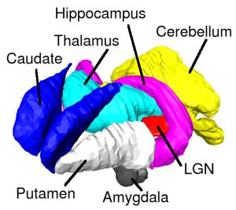
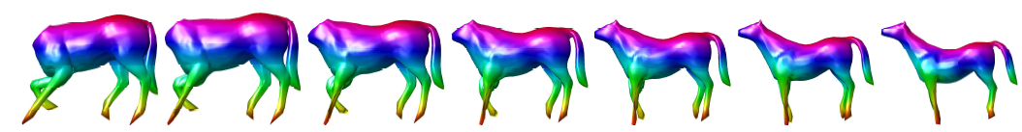
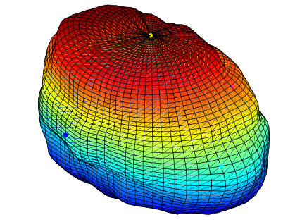
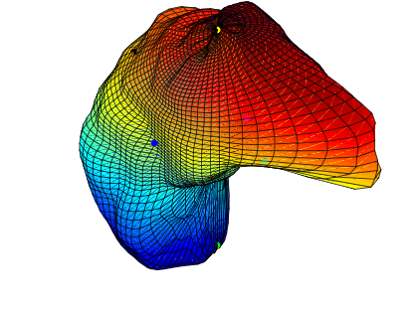
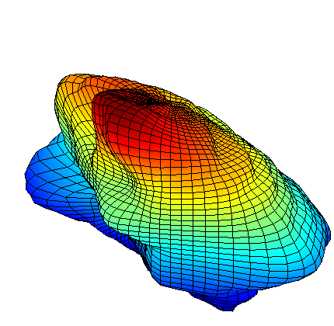
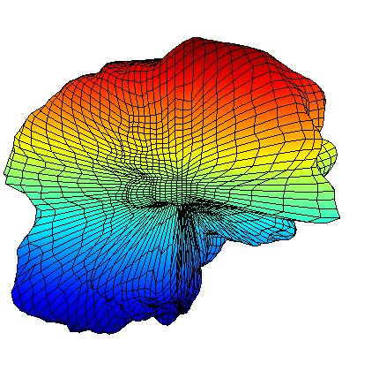
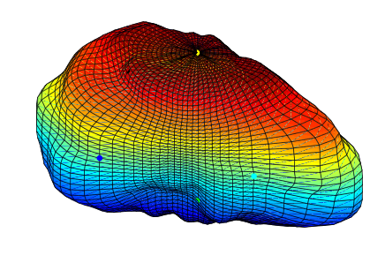
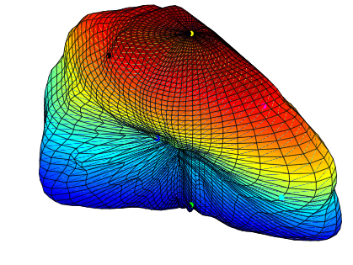
TYPES OF FUNCTIONAL DATA
  Parameterized Surfaces
Thalamus
Caudate
Pallidum
Putamen
Parietal L
Frontal L

Slide 6
TYPES OF FUNCTIONAL DATA
  2D and 3D Images

Slide 7
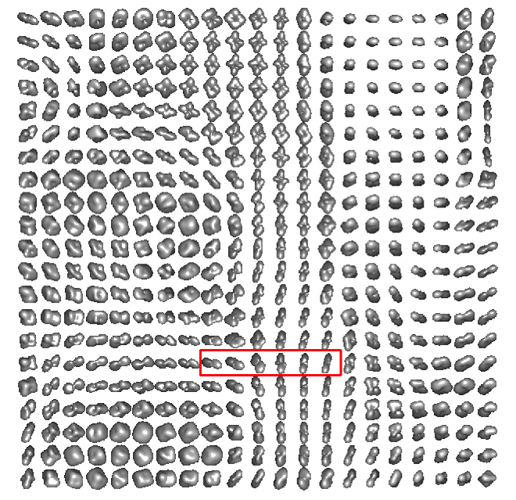
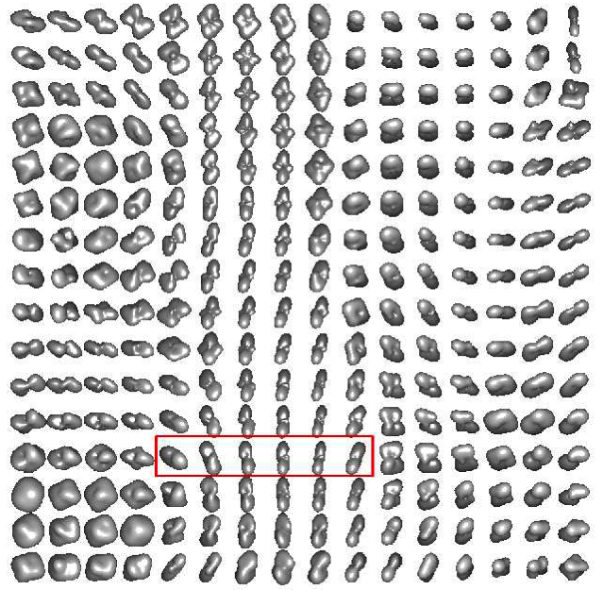
TYPES OF FUNCTIONAL DATA
  ODFs in HARDI Data

Slide 8
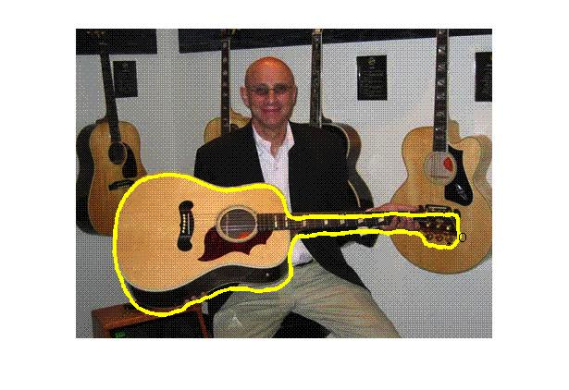
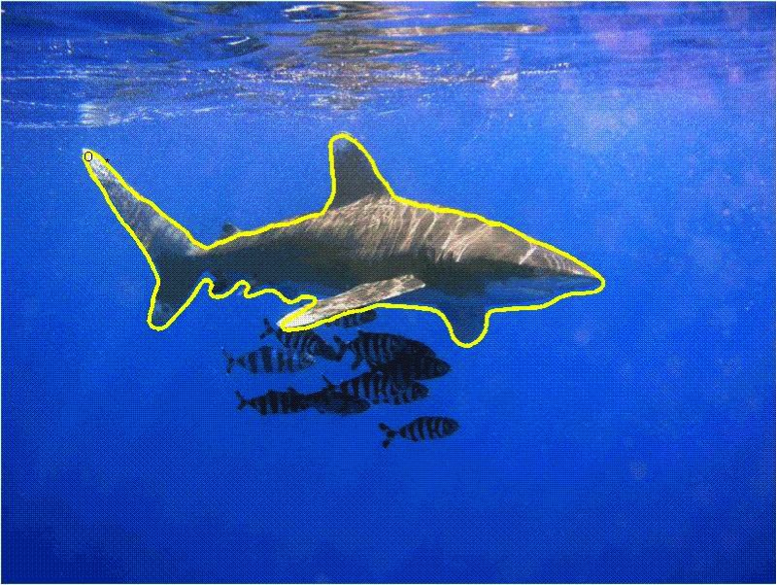
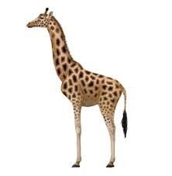
TYPES OF FUNCTIONAL DATA
  Curves and Surfaces with Functions Defined on Them
Textured Surfaces
Colored Curves

Slide 9
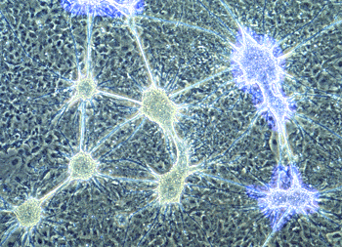
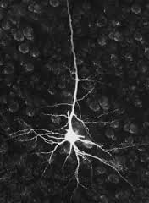
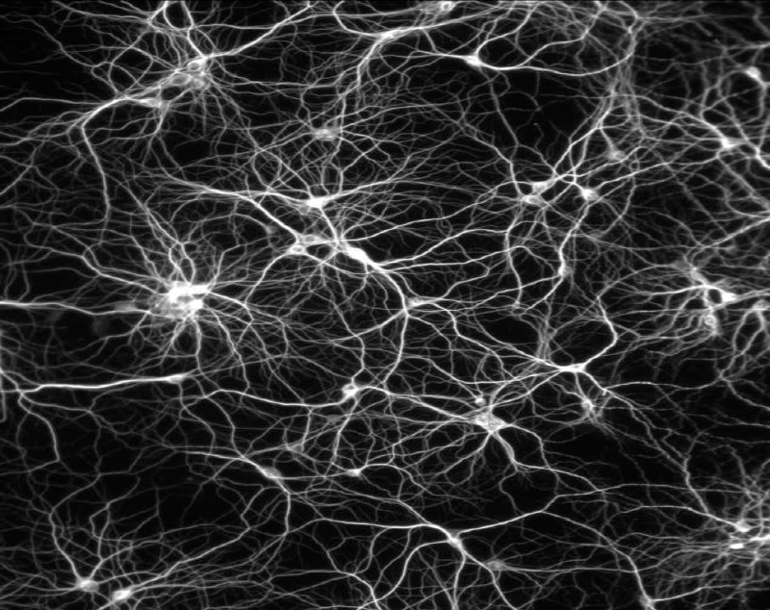
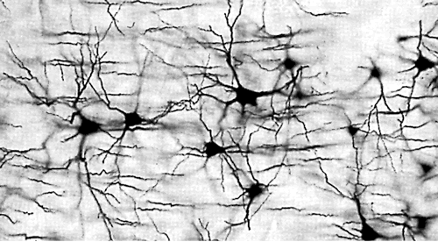
TYPES OF FUNCTIONAL DATA
  Shape Analysis of Neuronal Trees and Networks:
Neuron
Neuronal Networks

Slide 10
COMMON SETUP: M/G STORY
We have a representation space M, and a group of transformations G
Orbits or Equivalence Classes:
Quotient Space: set of orbits
Ideally, we want to perform statistical inferences in the quotient space but we usually know how to do it in M.

Slide 11
QUOTIENT SPACES & SECTIONS
Section: Choose a representative from each equivalence class
One can identify an orthogonal section S with the quotient space M/G
Orthogonal section is very convenient.
Translation and scaling groups have orthogonal sections.
No such orthogonal section exists for rotation or re-parameterization:
→ Objects cannot all be simultaneously pre-registered to each other in a pairwise way….. Need to go back to the equivalence classes.
→ They can all be registered to a template!
Section
Orthogonal Section

Slide 12
PROFOUND IMPLICATION
→ They can all be registered to a template!
→ Problem: Consider Functional Linear Regression

Slide 13
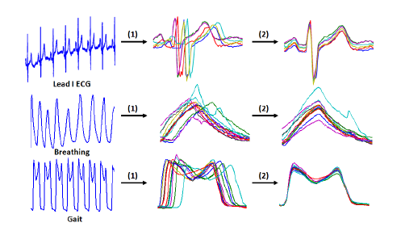
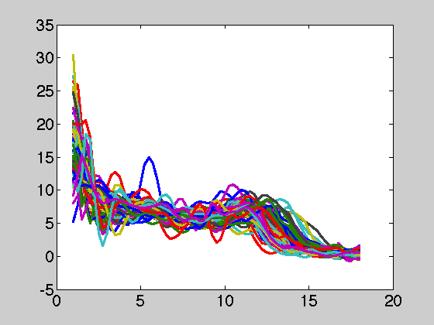
SIMPLER FUNCTIONAL DATA
  Real-valued functions

Slide 14
NATURAL METRIC STRUCTURE FOR FDA
Hilbert Space Structure Under the L² norm:
The L² inner-product:
L² distance between functions:
Mean function under L²: Cross-sectional analysis
How good is this choice for FDA?

Slide 15
FUNCTIONAL DATA WITH PHASE VARIABILITY
Functional data observation
Not all observations are taken at the same time indices
Time indices represent measurement errors themselves
Even if times are synchronized, we want the flexibility to adjust them
in order to align structures.

Slide 16
UNREGISTERED DATA ANALYSIS
Cross-sectional statistics often destroys structures
Original Functions
Cross Sectional Mean
Without registration
Cross Sectional Mean
With registration
Amplitude
Phase

Slide 17
REGISTRATION: PHASE-AMPLITUDE SEPARATION
Amplitude
Phase
Amplitude variability
Phase variability

Slide 18
A COMMON TWO-STEP APPROACH
Registration
Module
Analysis
Module
Registration Using:
(Feature matching, moments,
pair-wise L² optimization, entropy,
mutual-information)
Comparison Using:
(L² distance, feature comparisons
Shape statistics (mean, covariance, etc))
Problem: The two steps are often uncorrelated, using different criteria. Results are sub-optimal.

Slide 19
PROPOSED APPROACH
Joint Shape
Registration and
Analysis
Need to choose a single criterion: Preferably, a distance function
comparison using
invariant metrics
registration over
rotation and parameterization
Advantages:
The registration and comparison steps have identical criterion. This way the solutions are optimal.
The same distance function is used for statistical analysis.

Slide 20
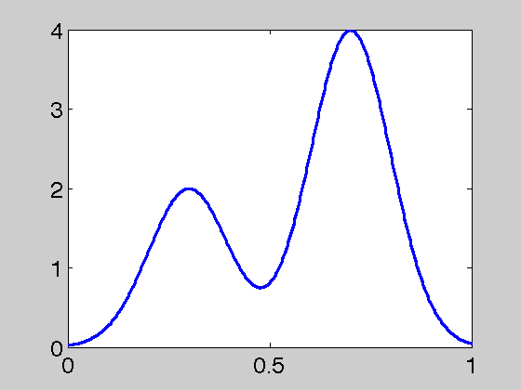
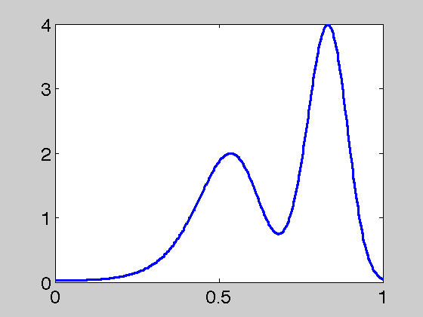
FORMULATING REGISTRATION PROBLEM
The point gets matched with the point
Define a set of registration functions

Slide 21
OBJECTIVE FUNCTION
Given , we have to search for an optimal .
What is a good choice of objective function for registration? L² norm.
This can result in “pinching effect”.

Slide 22
OBJECTIVE FUNCTION
Given , we have to search for an optimal .
What is a good choice of objective function for registration? L² norm.
This can result in “pinching effect”.
Common Solution: Regularize
Problems: solution is not inverse consistent, lack of invariance

Slide 23
NEED FOR ISOMETRY/INVARIANCE
Example:
warping
  The two functions have the same correspondences before and after warping -→ objective function should not change!
  However, the L² norm changes. Thus, it is not a good objective function

Slide 24
ONE SOLUTION: SRVF REPRESENTATION
Define Square Root Velocity Function (SRVF)
-- if is absolutely continuous, then is square-integrable.

Slide 25
ONE SOLUTION: SRVF REPRESENTATION
Define Square Root Velocity Function (SRVF)
-- if is absolutely continuous, then is square-integrable.
If a function is warped to
then its SRVF changes from q to

Slide 26
ONE SOLUTION: SRVF REPRESENTATION
Define Square Root Velocity Function (SRVF)
-- if is absolutely continuous, then is square-integrable.
If a function is warped to
then its SRVF changes from q to
One can go back from SRVF to f up to an additive constant
The space of all SRVFs is

Slide 27
CONNECTION WITH FISHER-RAO METRIC
Under SRVF, F-R metric becomes L² metric.
Fisher-Rao distance on left is same as the L² norm on the right!

Slide 28
SRVF REPRESENTATION SPACE
Why Square Root Velocity Function (SRVF)?
Invariance: for any q₁, q₂, and
  In particular, and hence pinching is not possible
  Resulting registration problem: Given f₁ and f₂, find their SRVFs
  Inverse consistency: if then
  Scale Invariance: Registration is independent of scaling of functions

Slide 29
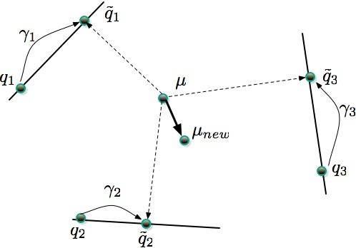
MULTIPLE REGISTRATION
Using the distance function, we can compute the Karcher mean
without a metric, we cannot define the mean
Algorithm for Computing Karcher Mean

Slide 30
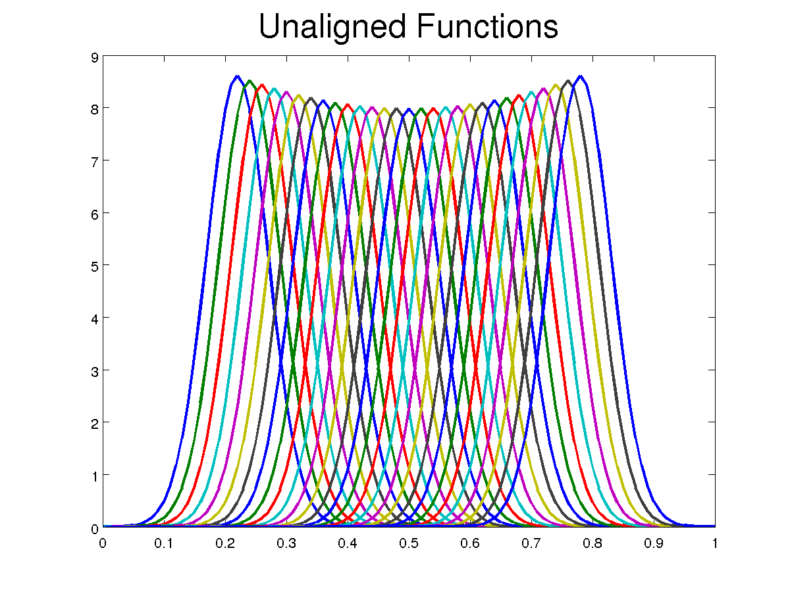
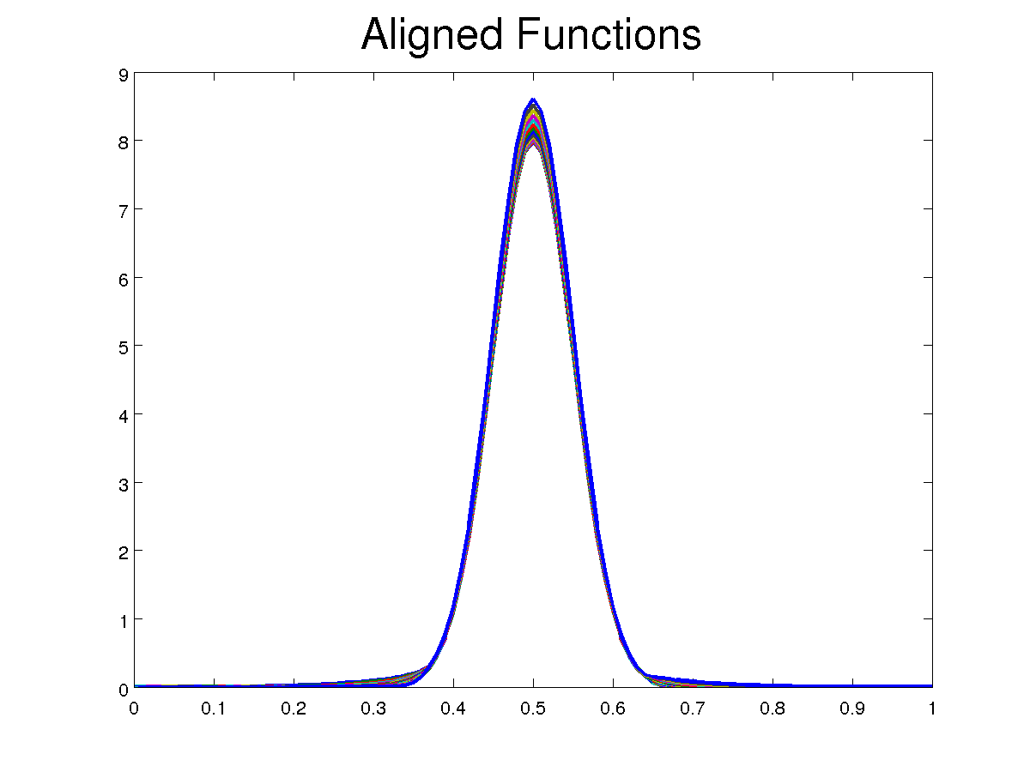
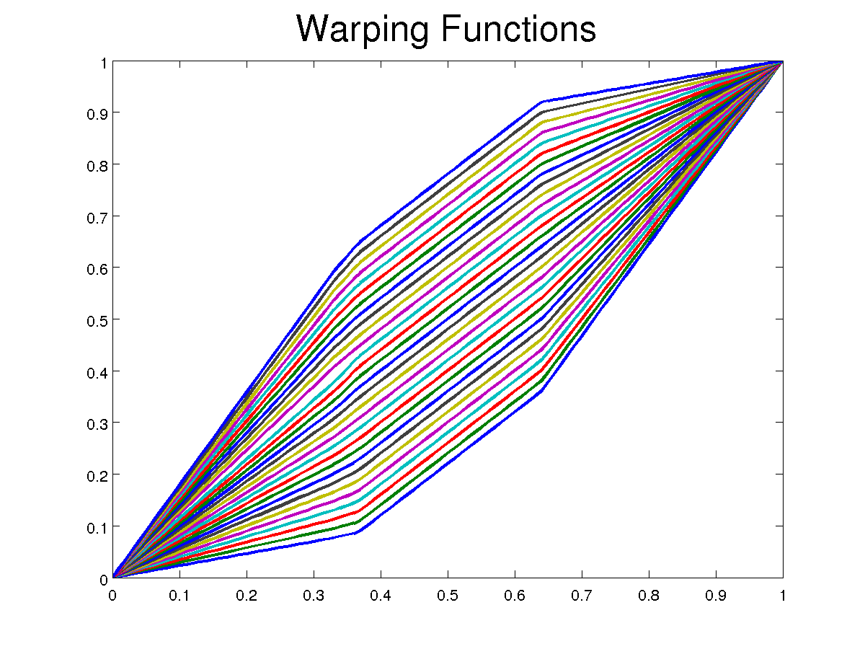
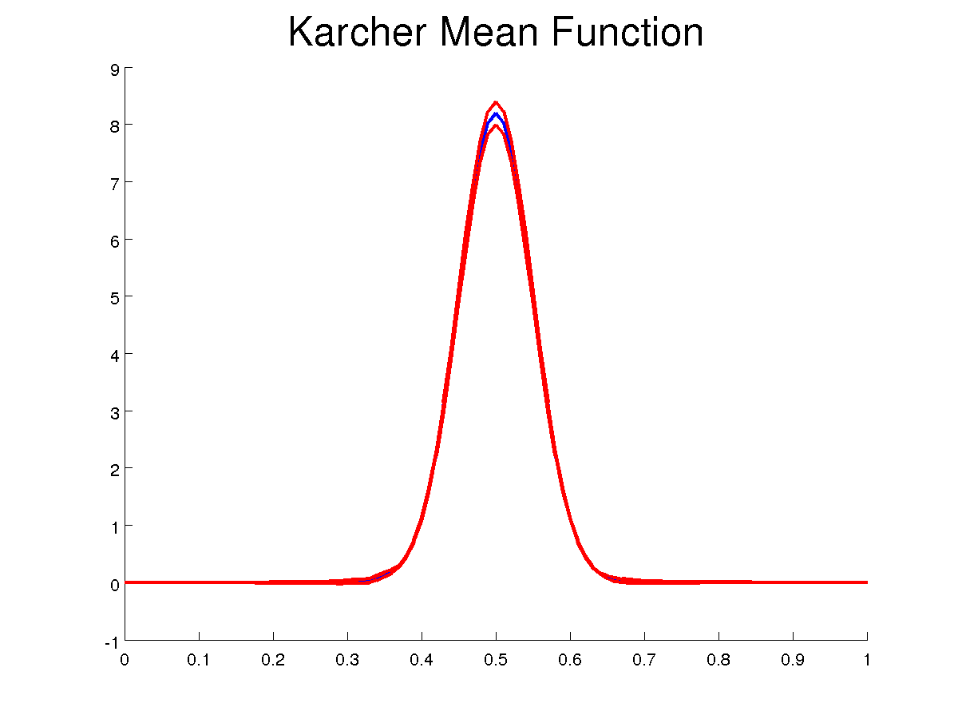
EXAMPLE: SIMULATED DATA
Ensemble Alignment Using Karcher Means:

Slide 31
EXAMPLE: SIMULATED CHROMATOGRAMS

Slide 32
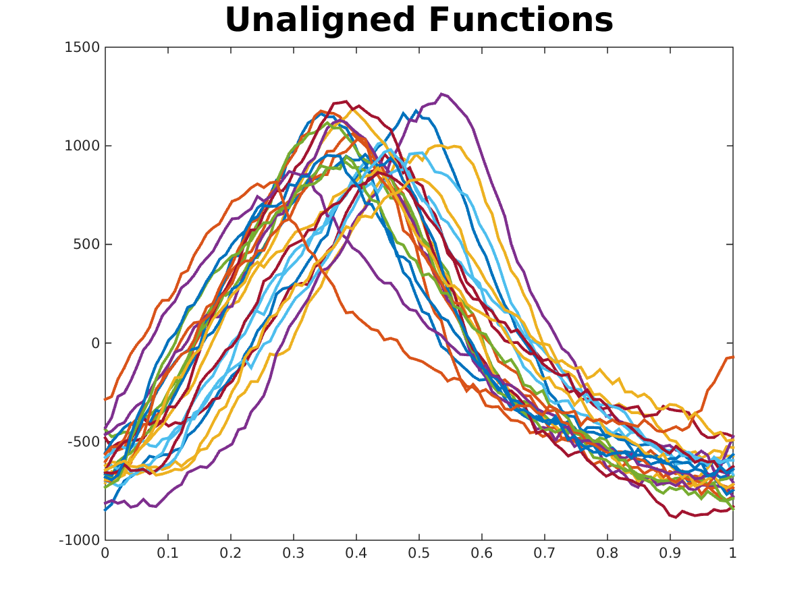
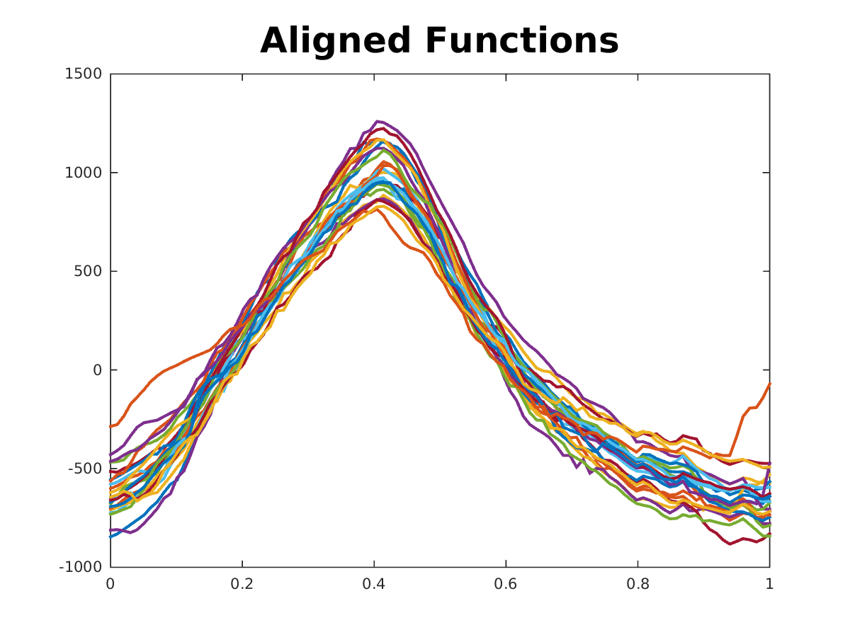
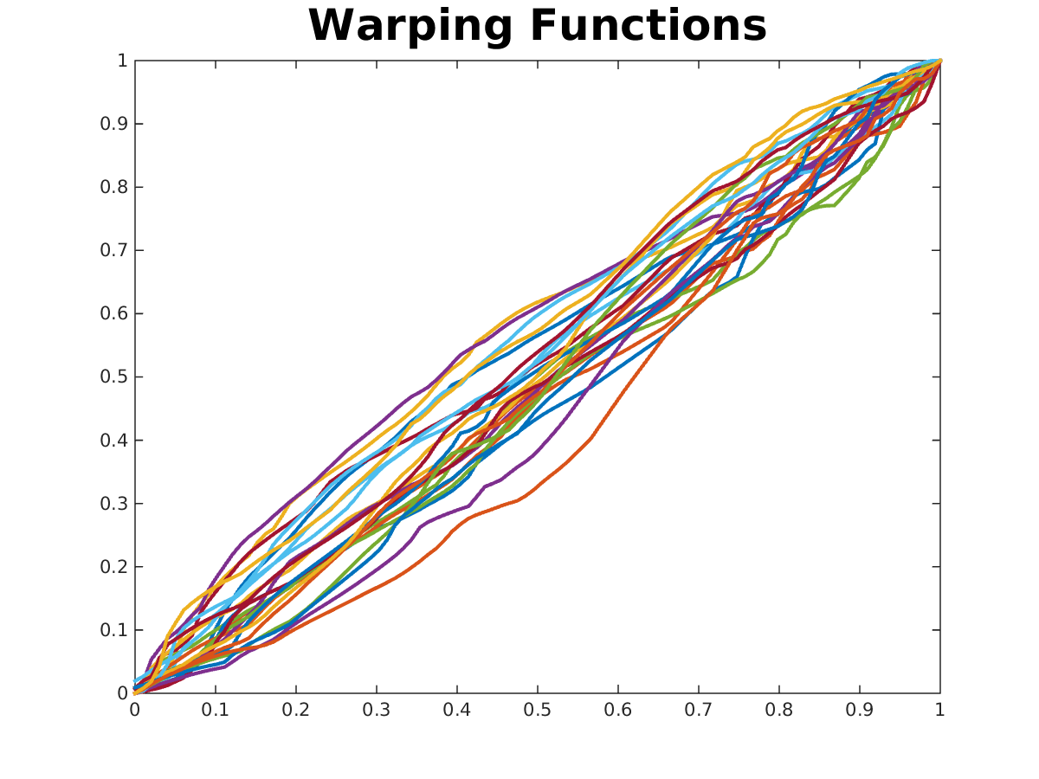
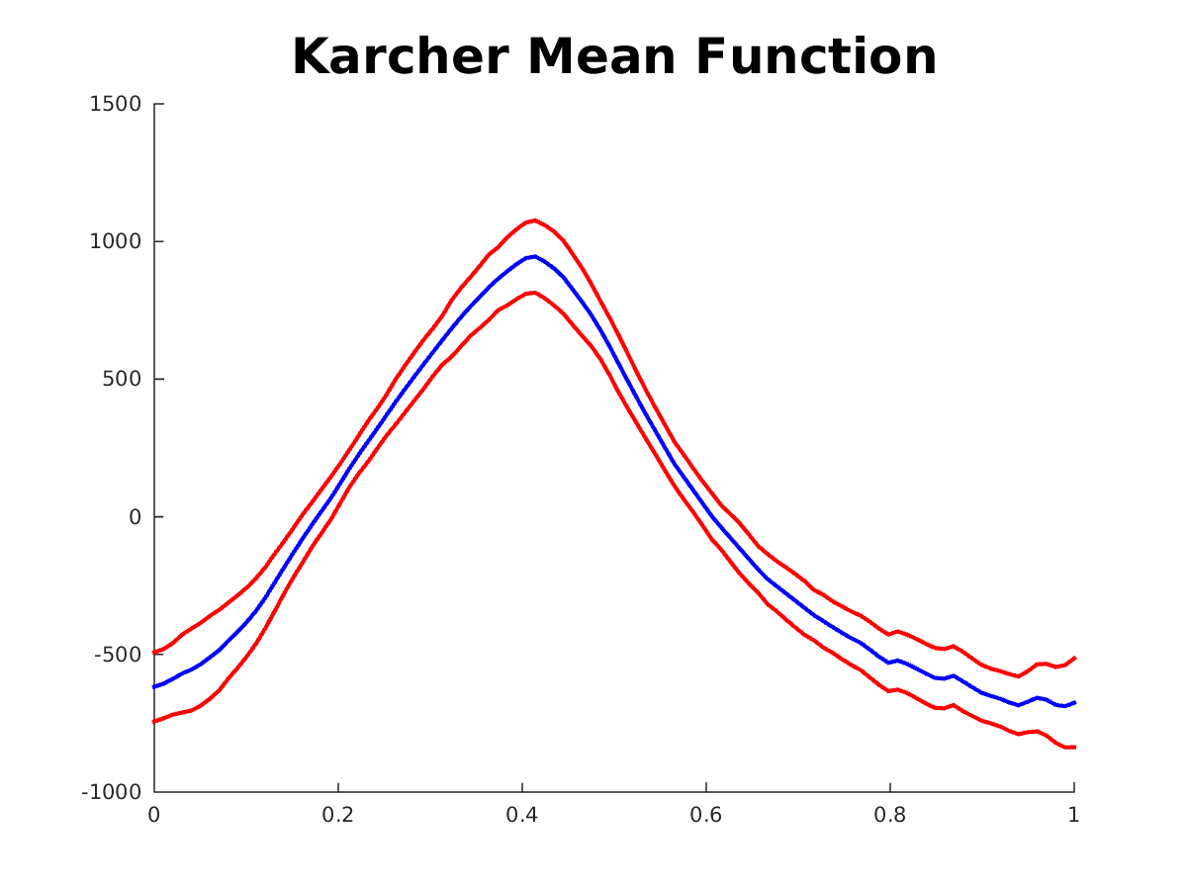
EXAMPLE: RESPIRATION DATA
Ensemble Alignment
Cross sectional mean and standard deviations

Slide 33
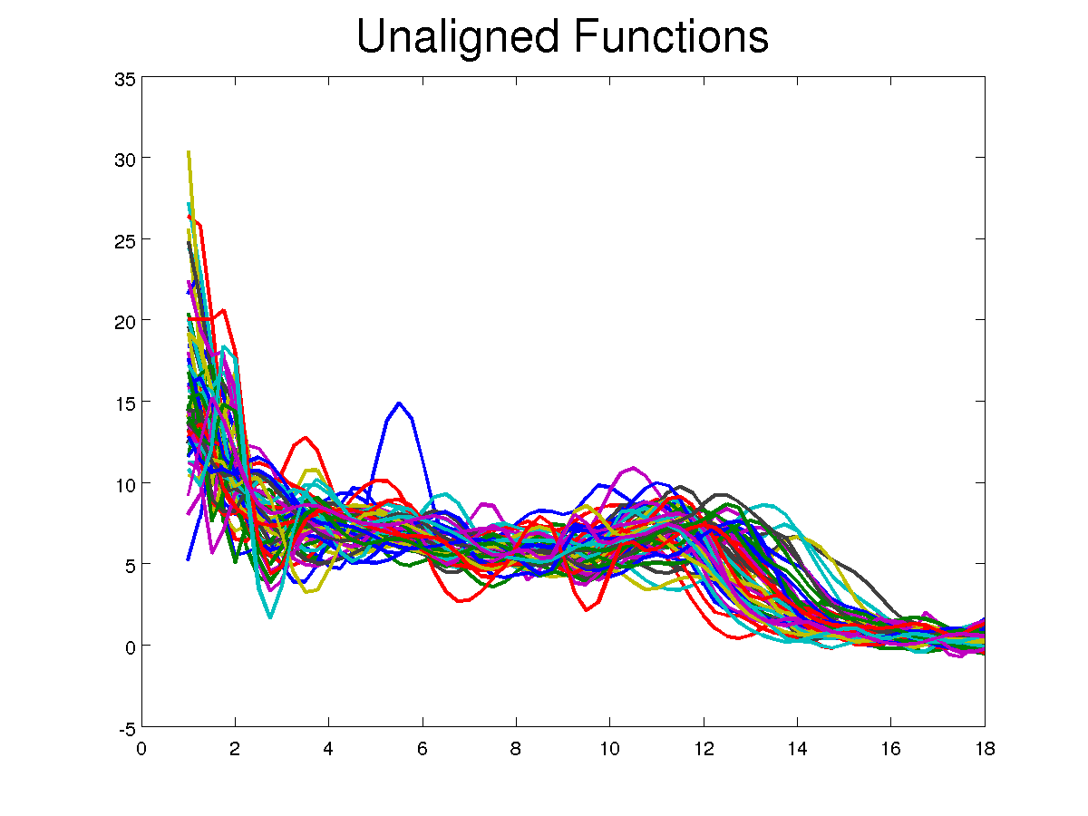
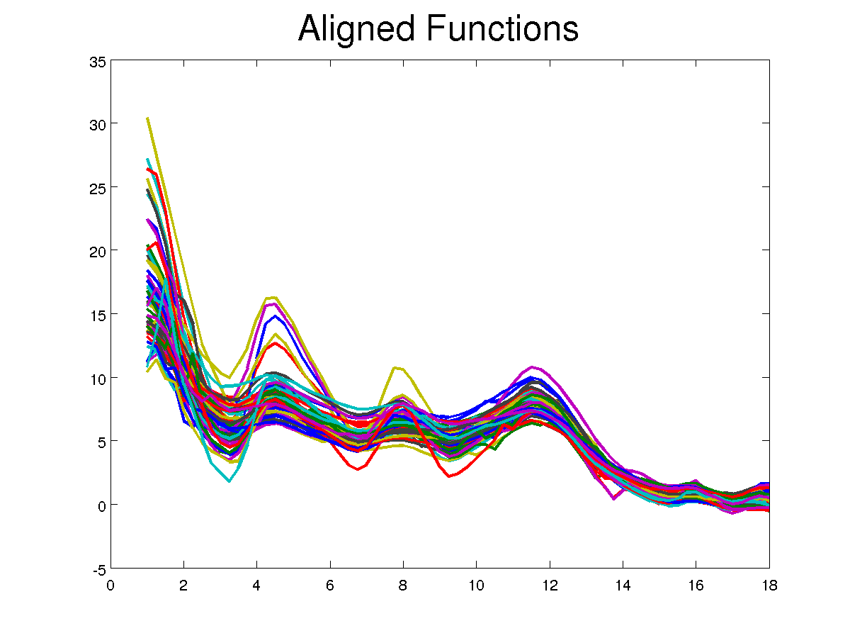
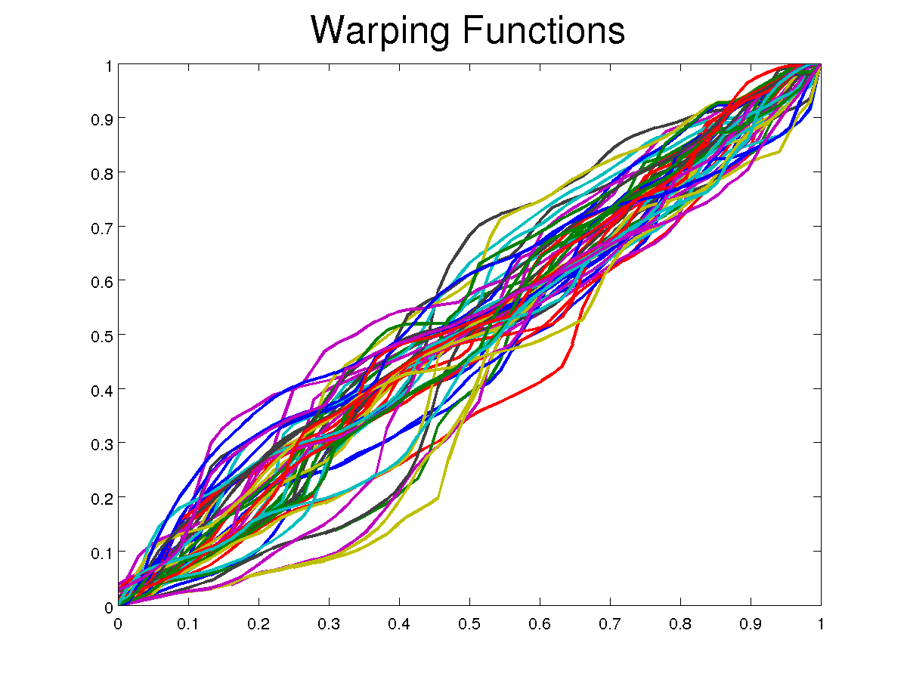
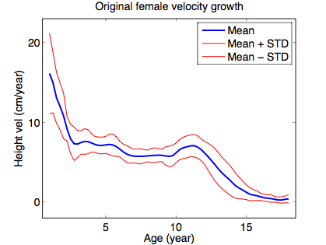
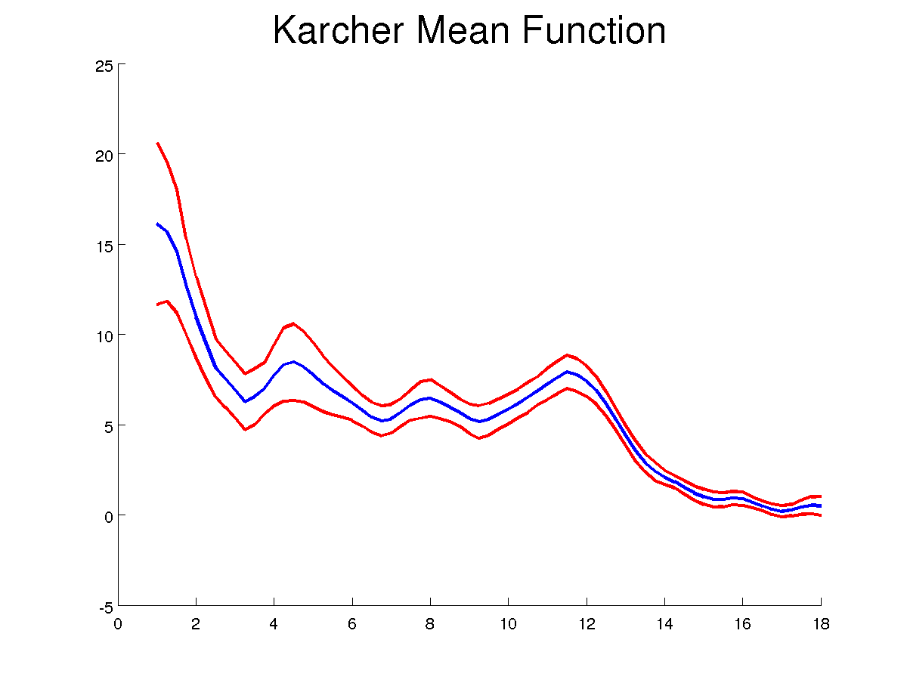
EXAMPLE: BERKELEY GROWTH DATA
Ensemble Alignment Using Karcher Means: Female Data
Cross sectional mean and standard deviations

Slide 34



COMPARISONS WITH OTHER METHODS
Simulated Datasets:
Data
AUTC
PACE
MSE
SMR
MBM
F-R
Mueller
Mueller
Ramsay
Kneip
Gervini
Gasser
James
Ours

Slide 35
SHAPE ANALYSIS OF CURVES
To measure the size of perturbations we need a metric:
Elastic (Riemannian) Metric: for a, b > 0
This metric is invariant to re-parameterizations of curves but is difficult to use in practice.

Slide 36
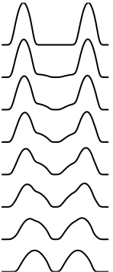
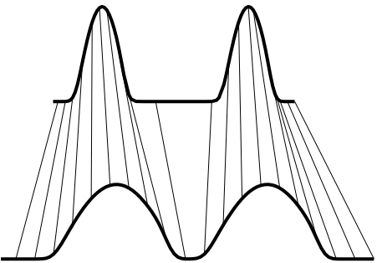
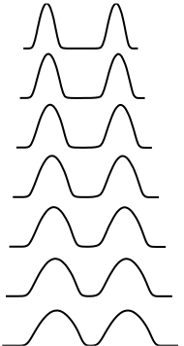
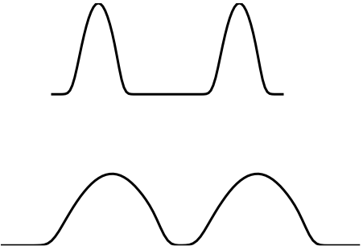
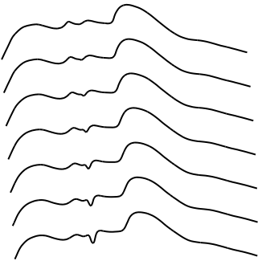
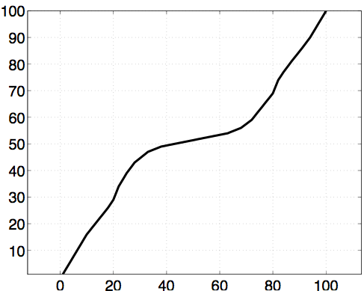
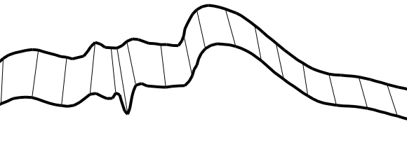


IMPORTANCE OF ELASTIC ANALYSIS
Non-Elastic
Elastic
Elastic
Non-Elastic
Elastic
Non-Elastic
Elastic
It helps to register the points along the curves

Slide 37









STATISTICAL SUMMARIES OF SHAPES
Karcher Mean: Minimized sum of squares
of geodesics distances
Given shapes
Mean Shape

Slide 38





COVARIANCE AND PRINCIPAL MODES
Covariance in tangent space at mean

Slide 39











SHAPE SUMMARY
Registration helps preserve structures
without registration
with registration
Mean Shapes
Without reg
With reg

Slide 40

SHAPE ANALYSIS OF SURFACES

Slide 41


SHAPE ANALYSIS OF SURFACES
1. For a parameterized surface:
where D is a unit sphere
2. Define a novel representation of surface:
Square-root field
Square-root normal field
3. Distance-preserving re-parameterization:

Slide 42


GEODESIC EXAMPLE

Slide 43



MODES OF VARIABILITY/RANDOM SAMPLES

Slide 44

COVARIANCE AND GAUSSIAN CLASSIFICATION

Slide 45




SHAPES OF COLORED CURVES
Shape influence
Color influence

Slide 46



DISCRETELY-LABELED CURVES

Slide 47
JOINT REGISTRATION AND FPCA
FPCA:

Slide 48
JOINT REGISTRATION AND FPCA
FPCA:
Joint FPCA and Alignment:
Iteration:
(i) FCPA for given registration
(ii) Alignment Step:
Issue: Pinching
Solution: Use SRVF representation (or elastic metric)

Slide 49
JOINT REGISTRATION AND FPCA
Change representation space:
Joint Alignment and PCA:
Estimation:

Slide 50
EXAMPLE: COMPARISON
Function Space:
SRVF Space:

Slide 51
EXAMPLE: COMPARISON
Function Space:
SRVF Space:

Slide 52
BRIEF RETURN TO REGRESSION
So far, we have developed foundations for more advanced statistical inferences.
We are looking for models of the type:
Possibilities: FDA
  Parametric: For example, use “linear” regression:
  Nonparametric: For example, a kernel-based approach:
  where is a kernel function.

Slide 53
SUMMARY
  Repeat Message:
  Registration is the single biggest issue in handling functional data.
  Data objects are equivalence classes – not vectors, matrices, tensors, of functions!
  With proper mathematical foundation, one can perform FDA jointly with registration.
  “Good enough” versus a method that solves problems fundamentally.

Slide 54
THANK YOU

Slide 55
TYPES OF FUNCTIONAL DATA
  4. Shape Analysis of Neuronal Trees:
Neuronal Networks
Neuron

Slide 56




TYPES OF FUNCTIONAL DATA
  4. Shape Analysis of Axonal Trees:
Examples from Neuromorpho.org

Slide 57




REGISTRATION OF MAIN BRANCH
Example: Difference is in location of side branches
High elasticity
Low elasticity

