Slide 1
Metrics for Evaluating Functional Neuroimaging
Processing Pipelines.
Stephen C. Strother, Ph.D.
Rotman Research Institute, Baycrest Centre
& Medical Biophysics, University of Toronto
Principal Funding Sources:
CANADA: CIHR, NSERC, Heart & Stroke Foundation,
Ontario Brain Institute
USA: NSF
© S.C. Strother, 2016
Disclosure: Part owner and Chief Scientific Officer
of Predictek, Inc., and ADMdx, LLC., Chicago
(medical image consulting and CRO activities
for drug trials).

Slide 2
Neuroimaging Pipelines
Training
Test
Strother SC. IEEE Eng Med Biol Mag 25(2):27-41, 2006 Churchill NW, et al. PLoS One, 7(2), e31147, 2012
Quality Control (QC)
-display spatial and temporal variance in data
-identify potential motion outlier volumes
Quality Control (QC)
-display spatial and temporal variance in data
-identify potential motion outlier volumes
1. MOT: rigid-body motion correction (AFNI; 3dvolreg)
1. MOT: rigid-body motion correction (AFNI; 3dvolreg)
[OFF/ON]
[OFF/ON]
2. CEN: censoring and interpolation of outliers, based on QC outlier test
2. CEN: censoring and interpolation of outliers, based on QC outlier test
[OFF/ON]
[OFF/ON]
3. RET: physiological correction with RETROICOR (AFNI; 3dretroicor)
[OFF/ON]
3. RET: physiological correction with RETROICOR (AFNI; 3dretroicor)
[OFF/ON]
4. STC: slice-timing correction with Fourier interpolation (AFNI; 3dTshift)
[OFF/ON]
4. STC: slice-timing correction with Fourier interpolation (AFNI; 3dTshift)
[OFF/ON]
5. SMO: spatial smoothing with 3D Gaussian kernel (AFNI; 3dmerge)
FWHM= 4, 8 mm
5. SMO: spatial smoothing with 3D Gaussian kernel (AFNI; 3dmerge)
FWHM= 4, 8 mm
6. MPR: motion parameter regression
[OFF/ON]
6. MPR: motion parameter regression
[OFF/ON]
General Linear Model
regression
7. DET: temporal detrending with Legendre polynomials
ORDER= 0,1,2,3,4,5
General Linear Model
regression
7. DET: temporal detrending with Legendre polynomials
ORDER= 0,1,2,3,4,5
8. TASK: include task design as a GLM covariate
8. TASK: include task design as a GLM covariate
[OFF/ON]
[OFF/ON]
9. GPC1: regression of global signal (GS), using 1st Principal Component
[OFF/ON]
9. GPC1: regression of global signal (GS), using 1st Principal Component
[OFF/ON]
10. PHY+: physiological correction using the PHYCAA+ algorithm **
10. PHY+: physiological correction using the PHYCAA+ algorithm **
[OFF/ON]
[OFF/ON]
11. Data Analysis (on a PCA subspace)
-
11. Data Analysis (on a PCA subspace)
-
Post-Analysis Testing of Pipeline Results
-
Post-Analysis Testing of Pipeline Results
-
Notes:
Problem is one of systematically optmizing the neuroimaigng pipeline or scientific workflow.
Implicit hypothesis: My pipeline choices are either near optimal or don’t matter when using a standard package with defaults.
Focus is on preprocessing + data analysis and their interactions = postprocessing framework for evlauation.
In particular point issues related to (1) experimental design, (2) subject selection, i.e., age + disease, (3) many standard preprocessing steps, (4) analysis choices

Slide 3
Intra-Class Correlation
For , where j = 1,…,J repeats measures for i = 1,…,N subjects
ICC(3,1) = = , with assumed fixed session effect.
Tasks | Emotional Faces |  | Motivational |  | N-Back
ROI | Amygdala-Left | Amydala -Right | Ventral Striatum-L | Ventral Striatum-R | DLPFC-R1 | DLPFC-R2 | Parietal -Left | Parietal -Medial | Parietal -Right
Within-subject (ROI_{mean})
ICC(2,1) | .16 (-.25,.52) | -.02 (-.43,.38) | .51 (.22,.77) | .61 (.30,.80) | .39 (.03,.67) | .13 (-.19,.46) | .39 (.03,.67) | .57 (.24,.78) | .22 (-.10,.53)
ICC(3,1) | .16 (-.25,.51) | -.02 (-.41,.37) | .56 (.22,.78) | .62 (.31,.82) | .44 (.06,.71) | .16 (-.25,51) | .58 (.39,.74) | .66 (.34,.87) | .54 (.31,73)
Shrout P, and Fleiss J, Psychol Bull, 86:420-8, 1979. Plichta M, et al., Neuroimage, 60:1746-58, 2012.
Notes:
M. M. Plichta, et al, and A. Meyer-Lindenberg. Test-retest reliability of evoked bold signals from a cognitive-emotive fmri test battery. Neuroimage, 60(3):1746–58, 2012.
Even more than in cognitive research applications, moving fMRI to the clinic and the drug development process
requires the generation of stable and reliable signal changes. The performance characteristics of the fMRI paradigm
constrain experimental power andmay require different study designs (e.g., crossover vs. parallel groups),
yet fMRI reliability characteristics can be strongly dependent on the nature of the fMRI task. The present study
investigated both within-subject and group-level reliability of a combined three-task fMRI battery targeting
three systems of wide applicability in clinical and cognitive neuroscience: an emotional (face matching), a motivational
(monetary reward anticipation) and a cognitive (n-back working memory) task. A group of 25
young, healthy volunteers were scanned twice on a 3 T MRI scanner with a mean test–retest interval of
14.6 days. FMRI reliability was quantified using the intraclass correlation coefficient (ICC) applied at three different
levels ranging froma global to a localized and fine spatial scale: (1) reliability of group-level activation maps
over the whole brain and within targeted regions of interest (ROIs); (2) within-subject reliability of ROI-mean
amplitudes and (3) within-subject reliability of individual voxels in the target ROIs.
Results showed robust evoked activation of all three tasks in their respective target regions (emotional task=amygdala; motivational
task=ventral striatum; cognitive task=right dorsolateral prefrontal cortex and parietal cortices) with high
effect sizes (ES) of ROI-mean summary values (ES=1.11–1.44 for the faces task, 0.96–1.43 for the reward
task, 0.83–2.58 for the n-back task). Reliability of group level activation was excellent for all three tasks with
ICCs of 0.89–0.98 at the whole brain level and 0.66–0.97 within target ROIs. Within-subject reliability of ROImean
amplitudes across sessions was fair to good for the reward task (ICCs=0.56–0.62) and, dependent on
the particular ROI, also fair-to-good for the n-back task (ICCs=0.44–0.57) but lower for the faces task (ICC=
−0.02–0.16). In conclusion, all three tasks are well suited to between-subject designs, including imaging genetics.
When specific recommendations are followed, the n-back and reward task are also suited for within-subject
designs, including pharmaco-fMRI. The present study provides task-specific fMRI reliability performance
measures that will inform the optimal use, powering and design of fMRI studies using comparable tasks.
Behavioural ICC(2,1) and ICC(3,1) equivalent and generally high: FACES & N-BACK > 0.5; low for REWARD < 0.5

Slide 4
Image Intra-Class Correlation (I2C2)
For , where j = 1,…,J repeat sessions for i = 1,…,I subjects
ICC(3,1) = = , with assumed fixed session effect.
If , where v are 1xV image vectors, and then by analogy with ICC(3,1)
I2C2 = , and ICC(3,1) =
Shou H, et al., Cogn Affect Behav Neurosci, 13:714-24, 2013.
Notes:
M. M. Plichta, et al, and A. Meyer-Lindenberg. Test-retest reliability of evoked bold signals from a cognitive-emotive fmri test battery. Neuroimage, 60(3):1746–58, 2012.
Even more than in cognitive research applications, moving fMRI to the clinic and the drug development process
requires the generation of stable and reliable signal changes. The performance characteristics of the fMRI paradigm
constrain experimental power andmay require different study designs (e.g., crossover vs. parallel groups),
yet fMRI reliability characteristics can be strongly dependent on the nature of the fMRI task. The present study
investigated both within-subject and group-level reliability of a combined three-task fMRI battery targeting
three systems of wide applicability in clinical and cognitive neuroscience: an emotional (face matching), a motivational
(monetary reward anticipation) and a cognitive (n-back working memory) task. A group of 25
young, healthy volunteers were scanned twice on a 3 T MRI scanner with a mean test–retest interval of
14.6 days. FMRI reliability was quantified using the intraclass correlation coefficient (ICC) applied at three different
levels ranging froma global to a localized and fine spatial scale: (1) reliability of group-level activation maps
over the whole brain and within targeted regions of interest (ROIs); (2) within-subject reliability of ROI-mean
amplitudes and (3) within-subject reliability of individual voxels in the target ROIs.
Results showed robust evoked activation of all three tasks in their respective target regions (emotional task=amygdala; motivational
task=ventral striatum; cognitive task=right dorsolateral prefrontal cortex and parietal cortices) with high
effect sizes (ES) of ROI-mean summary values (ES=1.11–1.44 for the faces task, 0.96–1.43 for the reward
task, 0.83–2.58 for the n-back task). Reliability of group level activation was excellent for all three tasks with
ICCs of 0.89–0.98 at the whole brain level and 0.66–0.97 within target ROIs. Within-subject reliability of ROImean
amplitudes across sessions was fair to good for the reward task (ICCs=0.56–0.62) and, dependent on
the particular ROI, also fair-to-good for the n-back task (ICCs=0.44–0.57) but lower for the faces task (ICC=
−0.02–0.16). In conclusion, all three tasks are well suited to between-subject designs, including imaging genetics.
When specific recommendations are followed, the n-back and reward task are also suited for within-subject
designs, including pharmaco-fMRI. The present study provides task-specific fMRI reliability performance
measures that will inform the optimal use, powering and design of fMRI studies using comparable tasks.
Behavioural ICC(2,1) and ICC(3,1) equivalent and generally high: FACES & N-BACK > 0.5; low for REWARD < 0.5

Slide 5
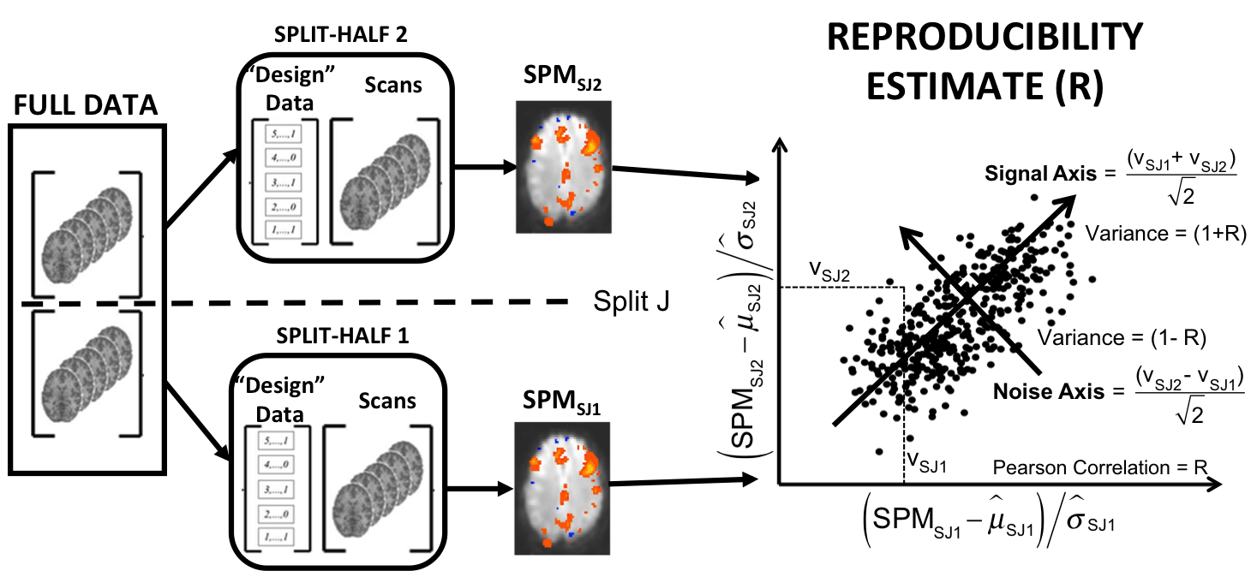
An Image Reproducibility Metric
A necessary but not sufficient criterion for strong scientific inference
Strother, SC, et al., Neuroimage, 15(4), 747-771, 2002
Rasmussen P, et al., Pattern Recognition, vol. 45, pp. 2085-2100, 2012
Meinshausen N, Bühlmann P. J. Royal Stat. Soc: Series B (Statistical Methodology) 72(4):417–473, 2010

Slide 6
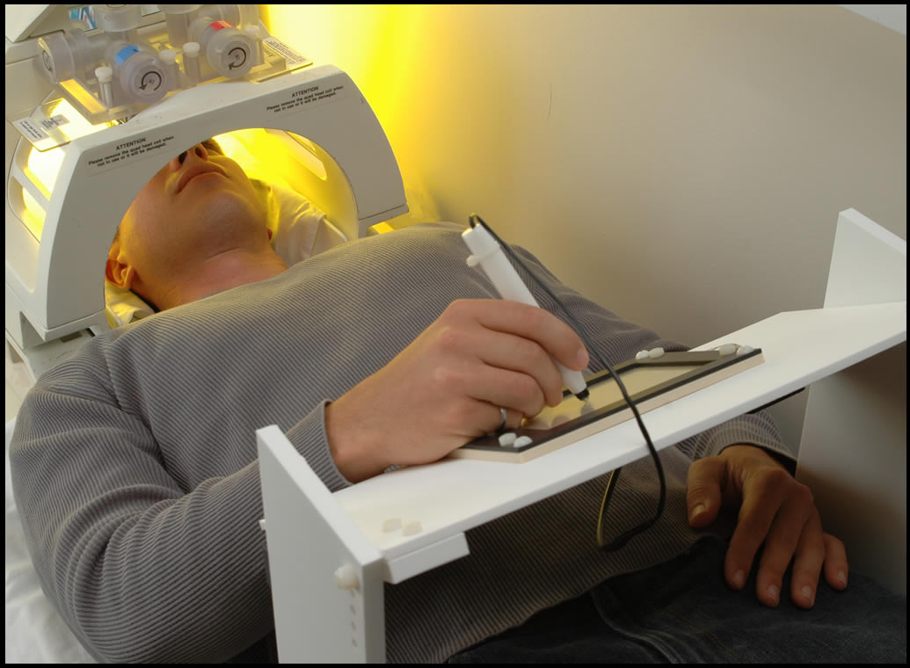
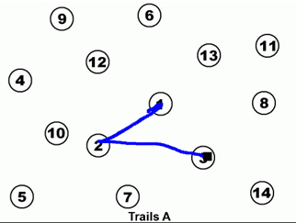
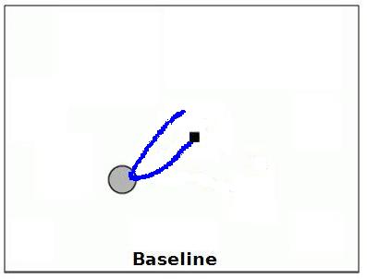
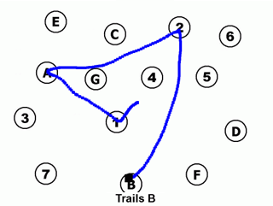
Split-Half Resampling for the
Trail-Making Task
Task A & Task B.
  to compare executive function of set-switching and cognitive flexibility
  Block design task: 25 healthy normal young adults (20-32yrs; 14 female; mean 25 yrs)
  1 Run per Subject
  FDA regularised f(PCA subspace) PER SUBJECT
TASK A
TASK B
TASK A
TASK B
BASELINE
BASELINE
BASELINE
BASELINE
20 s
Split 1: 80s, 40 scans
Split 2: 80s, 40 scans
Tam F, et al. Hum Brain Mapp 32(2):240-8, 2011
Churchill NW, et al., Human Brain Mapping 33(3):609-27, 2012
Notes:
As for why include task B : … (due to increased demand of integrating numbers/letters)
SPLITS ARE ODD CYCLES

Slide 7
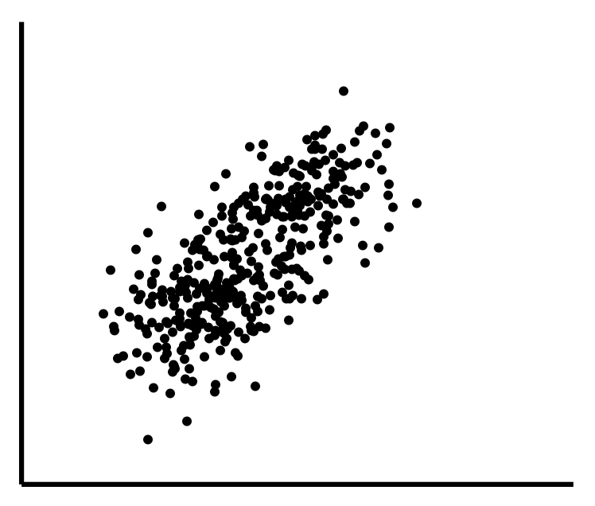


ICC and Image Reproducibility Metrics
R has form of Intra-Class Correlation Coefficient (ICC) for within-subject, test-retest reliability (k=2, n=1)
ICC*(3,1) =
    =
  ICC*(3,1) = R
v_{SJ2}
v_{SJ1}
Global Effect Size
Strother, SC, et al., Neuroimage, 15(4), 747-771, 2002
Raemaekers, M., et al. Neuroimage, 36(3), 532-542, 2007
Raemaekers, M., et al. Neuroimage, 60(1), 717-727, 2012

Slide 8
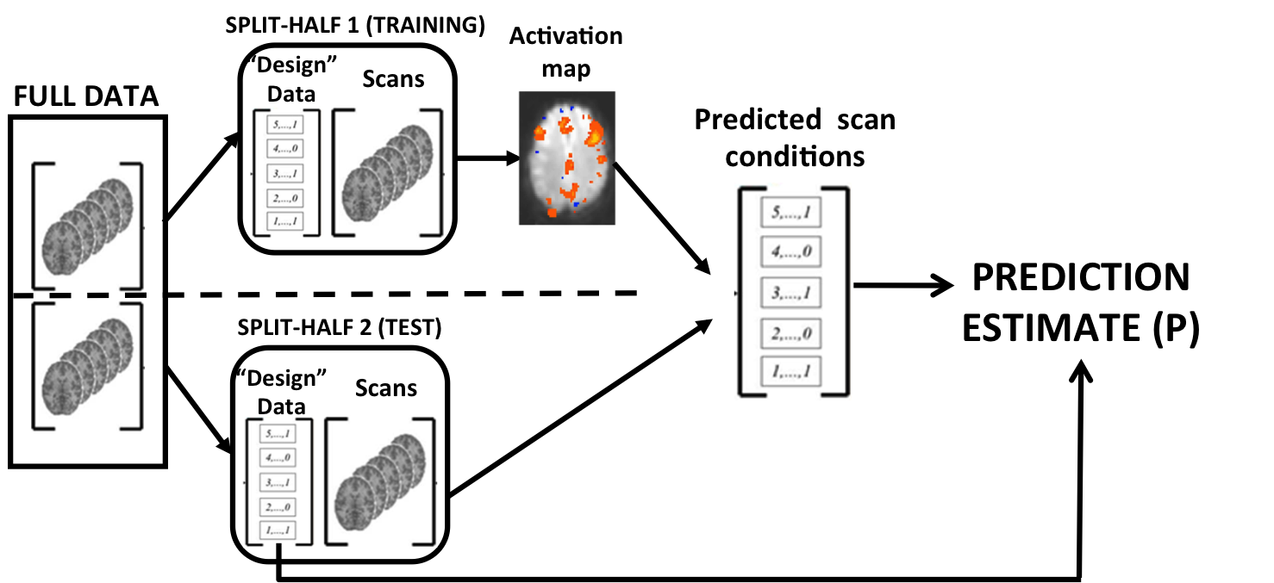
Prediction Metric
Helps to control bias inherent in optimizing R alone.

Slide 9
Measuring Pipeline/Model Performance
Use pseudo-ROC (p vs. r) measures
Define: relative
performance by
distance D from:
reproducibility(r) = 1
prediction (p) = 1
ROC Substitutions
True positives -> Exp. Prediction
False positives -> (1 – gSNR(r))
1.0
D₁
0.75
D₂
Prediction
0.50
ΔD > 0
0.25
Processing pipeline/model 1
Processing pipeline/model 2
0
0.25
0.50
0.75
1.0
Reproducibility

Slide 10
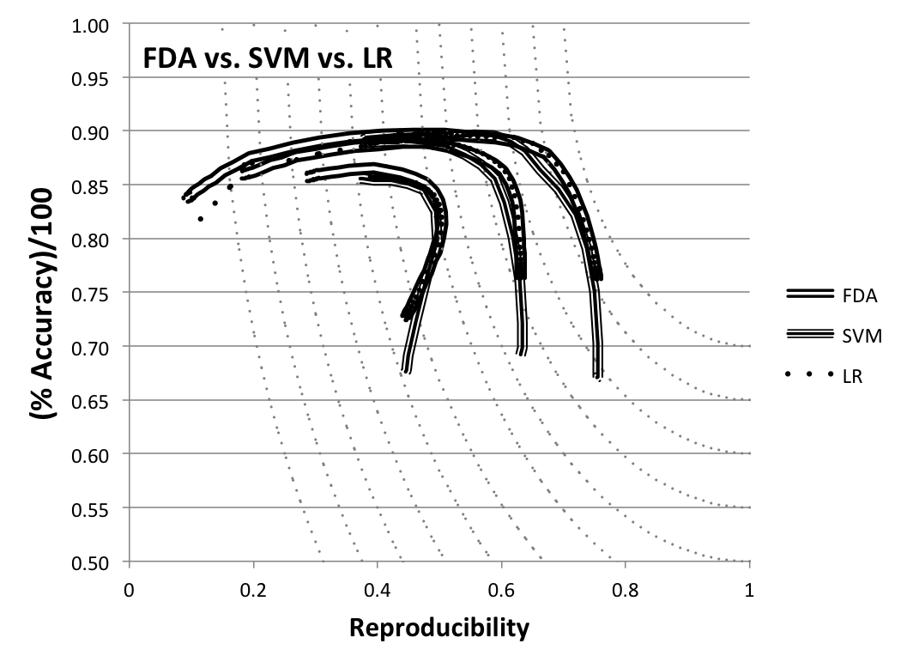
Pseudo-ROC (P, R) Curves:
Preprocessing vs. Models
P_{max}
D_{max}
R_{max}
0mm 3mm 6mm
Haxby et al., Science, 293(5539):2425-30, 2001
Rasmussen P, PhD Thesis, DTU, 2011
Strother S, et al., in Practical Applications of Sparse Modeling,
Rish I, et al., Eds., Boston: MIT Press, pp. 99-121, 2014

Slide 11
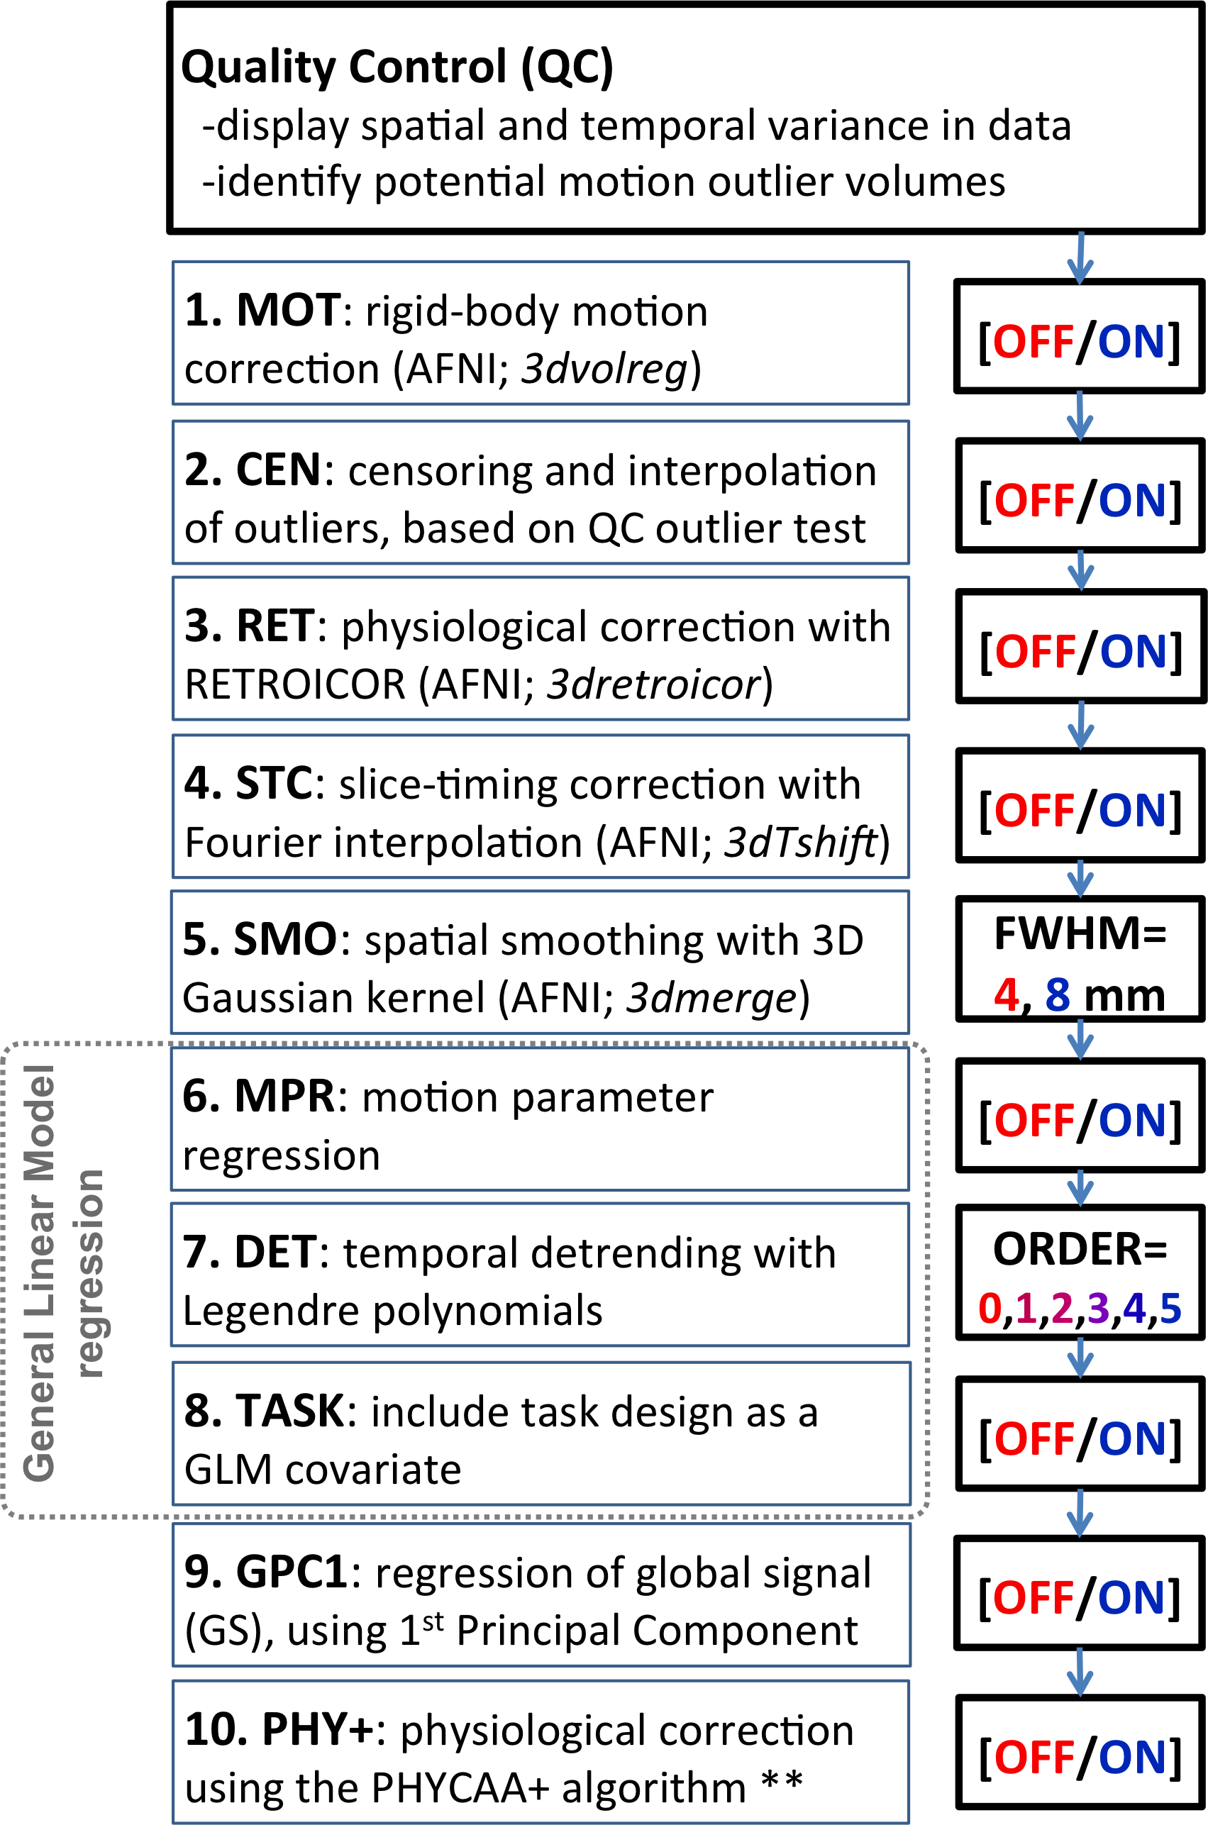
Preprocessing Pipeline Choices
Same Choices for each Subject/Session and Group
Processing Pipeline Steps
Different Choices for each Subject/Session
6 mm
Churchill, NW, et al. Human Brain Mapping, 33(3), 609-627, 2012
Churchill NW, et al. PLoS One, 7(2), e31147, 2012
Churchill NW, et al. PLoS One, 10, e0131520, 2015
Notes:
CON & FIX = Fixed hypothesis to reduce analytic flexibility.
IND = Adaptive hypothesis

Slide 12
Neuroimaging Pipelines
Training
Test
Strother SC. IEEE Eng Med Biol Mag 25(2):27-41, 2006 Churchill NW, et al. PLoS One, 7(2), e31147, 2012
Quality Control (QC)
-display spatial and temporal variance in data
-identify potential motion outlier volumes
Quality Control (QC)
-display spatial and temporal variance in data
-identify potential motion outlier volumes
1. MOT: rigid-body motion correction (AFNI; 3dvolreg)
1. MOT: rigid-body motion correction (AFNI; 3dvolreg)
[OFF/ON]
[OFF/ON]
2. CEN: censoring and interpolation of outliers, based on QC outlier test
2. CEN: censoring and interpolation of outliers, based on QC outlier test
[OFF/ON]
[OFF/ON]
3. RET: physiological correction with RETROICOR (AFNI; 3dretroicor)
[OFF/ON]
3. RET: physiological correction with RETROICOR (AFNI; 3dretroicor)
[OFF/ON]
4. STC: slice-timing correction with Fourier interpolation (AFNI; 3dTshift)
[OFF/ON]
4. STC: slice-timing correction with Fourier interpolation (AFNI; 3dTshift)
[OFF/ON]
5. SMO: spatial smoothing with 3D Gaussian kernel (AFNI; 3dmerge)
FWHM= 4, 8 mm
5. SMO: spatial smoothing with 3D Gaussian kernel (AFNI; 3dmerge)
FWHM= 4, 8 mm
6. MPR: motion parameter regression
[OFF/ON]
6. MPR: motion parameter regression
[OFF/ON]
General Linear Model
regression
7. DET: temporal detrending with Legendre polynomials
ORDER= 0,1,2,3,4,5
General Linear Model
regression
7. DET: temporal detrending with Legendre polynomials
ORDER= 0,1,2,3,4,5
8. TASK: include task design as a GLM covariate
8. TASK: include task design as a GLM covariate
[OFF/ON]
[OFF/ON]
9. GPC1: regression of global signal (GS), using 1st Principal Component
[OFF/ON]
9. GPC1: regression of global signal (GS), using 1st Principal Component
[OFF/ON]
10. PHY+: physiological correction using the PHYCAA+ algorithm **
10. PHY+: physiological correction using the PHYCAA+ algorithm **
[OFF/ON]
[OFF/ON]
11. Data Analysis (on a PCA subspace)
-
11. Data Analysis (on a PCA subspace)
-
Post-Analysis Testing of Pipeline Results
-
Post-Analysis Testing of Pipeline Results
-
Notes:
Problem is one of systematically optmizing the neuroimaigng pipeline or scientific workflow.
Implicit hypothesis: My pipeline choices are either near optimal or don’t matter when using a standard package with defaults.
Focus is on preprocessing + data analysis and their interactions = postprocessing framework for evlauation.
In particular point issues related to (1) experimental design, (2) subject selection, i.e., age + disease, (3) many standard preprocessing steps, (4) analysis choices

Slide 13
Session
Training (P, R)s for Pipeline Choices
*
1.0
Prediction (P)
0.8
0.6
*
Trail Making Test (TMT)
Gaussian Naïve Bayes (GNB)
0 1 2 3 4
Global Signal-to-Noise (gSNR = sqrt(2R/(1-R))
Churchill NW, et al. PLoS One, 10, e0131520, 2015
Notes:
1. Note larger P spread of CONS and FIX compared to D , R and P pipelines.
2. But P metric pipelines show increased gSNR heterogeneity.
3. D metric pipelines maximise average gSNR while reducing prediction heterogeneity

Slide 14
Session Training (P, R)s for Tasks, Pipelines,
Models
Trail Making Test (TMT)
Recognition Task (REC)
Gaussian Naïve Bayes (GNB)
Canonical Variate Analysis (CVA)
Global Signal-to-Noise (gSNR = sqrt(2R/(1-R))
Churchill NW, et al. PLoS One, 10, e0131520, 2015
Notes:
All follow same structure of relative performance across pipelines and metrics
Trailmaking is a weaker intrinsic contrast than Recognition reducing performance of CON and FIX pipelines relative to P and D metrics
Compromise D metric pipelines tend to show reduced heterogeneity relative to CON, FIX and R, and greater gSNR than P metric pipelines.

Slide 15
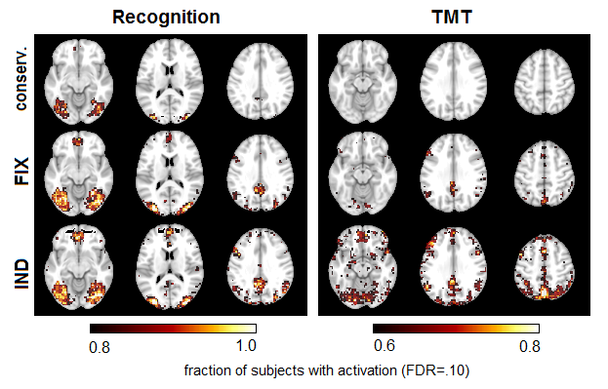
More Reliable Between-Subject SPMs
Example: Single-subject SPMs from multivariate CVA analysis
Churchill NW, et al. PLoS One, 10, e0131520, 2015

Slide 16
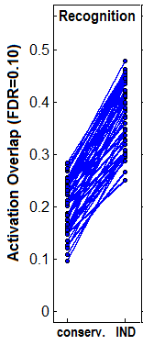
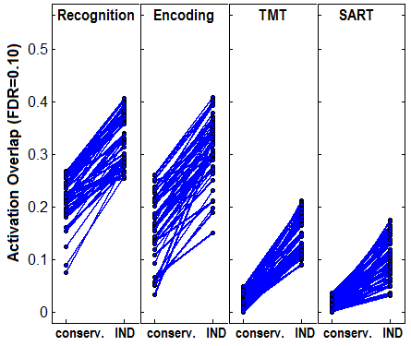
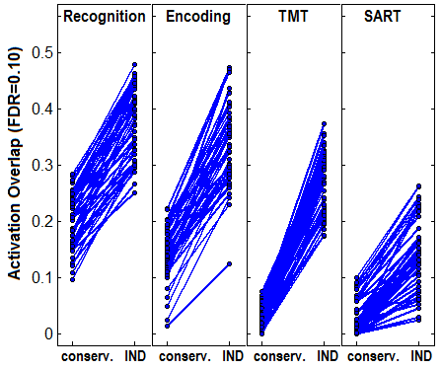
Test 1: Between-Subject Activation Overlap
Univariate GNB (predictive GLM)
Multivariate CVA (Linear Discriminant)
Between-subject reliability: | 1.8x to 9.0x
Churchill NW, et al. PLoS One, 10, e0131520, 2015

Slide 17
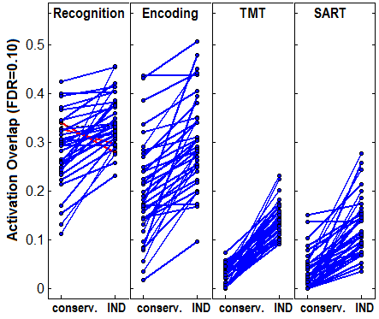
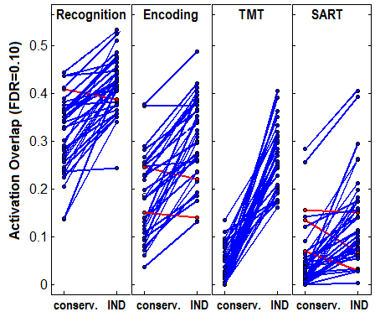
Test 2: Within-Subject Test-Retest Overlap
Univariate GNB (predictive GLM) Multivariate CVA (Linear Discriminant)
Test-retest reliability: | 1.7x to 6.5x
Churchill NW, et al. PLoS One, 10, e0131520, 2015

Slide 18
Conclusions
Using fixed preprocessing choices across subjects/sessions is nonoptimal and produces a conservative result with reduced:
  SNR and detection power
  within-subject test-retest and between-subject spatial pattern reliability
Adapting preprocessing choices on a subject or session basis using crossvalidation resampling can significantly improve pipeline performance
Model tuning is critically important and interacts with preprocessing and other pipeline choices.
Current fixed pipeline processing practices in fMRI lead to an under-powered, excessively noisy neuroimaging literature
  limiting the full potential of meta-analytic methods
All the negative effects of these common pipeline choices are likely to become worse with age and disease

Slide 19
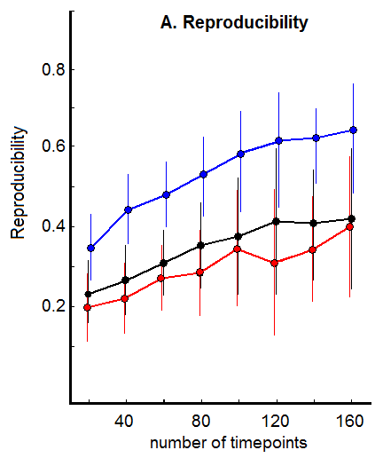
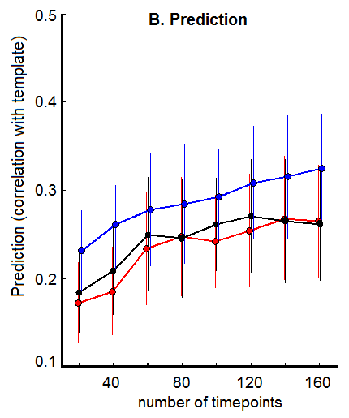
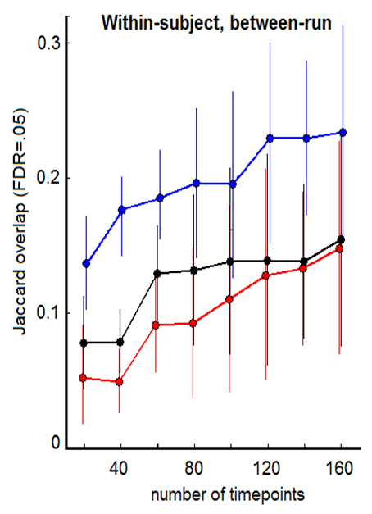
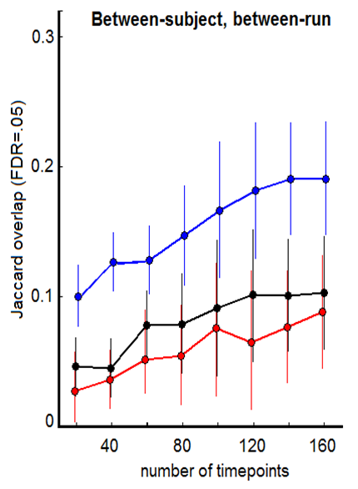

Individually Optimised Pipelines for:
Brain Network Detection in Resting State
A
B
C
D
Nathan Churchill, Afshin-Pour B, Strother SC. Pipeline optimization of resting-state fMRI: improving signal detection and spatial reliability. Poster 3639, Hamburg, Germany, June 2014.

Slide 20
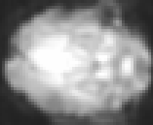
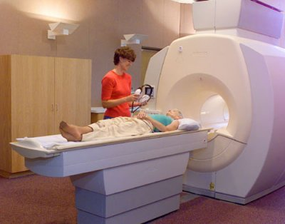
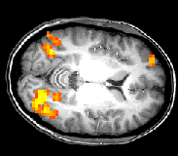
Neuroimaging Workflow
Neuroimaging Experiment
~2s/
brain
••••
~ 5 min
Time
State 1
State 2
VOXEL or Region of interest (ROI)
Experimental Choices
experimental task design
subject selection
age, disease, damage
Data Analysis
METRICS for TESTING
OPTIMIZED outputs
Univariate GNB
Multivariate CVA
Possible Processing Pipeline Steps
6 mm
fMRI
Signal
(Δ%)
Crossvalidation
Statistical Parametric Map (SPM)
METRICS for TRAINING = OPTIMIZING Pipeline Results
Time
➔
Strother SC. IEEE Eng Med Biol Mag 25(2):27-41, 2006
Churchill NW, et al. PLoS One (2015)
Brain State
Quality Control (QC)
-display spatial and temporal variance in data
-identify potential motion outlier volumes
Quality Control (QC)
-display spatial and temporal variance in data
-identify potential motion outlier volumes
1. MOT: rigid-body motion correction (AFNI; 3dvolreg)
1. MOT: rigid-body motion correction (AFNI; 3dvolreg)
[OFF/ON]
[OFF/ON]
2. CEN: censoring and interpolation of outliers, based on QC outlier test
2. CEN: censoring and interpolation of outliers, based on QC outlier test
[OFF/ON]
[OFF/ON]
3. RET: physiological correction with RETROICOR (AFNI; 3dretroicor)
[OFF/ON]
3. RET: physiological correction with RETROICOR (AFNI; 3dretroicor)
[OFF/ON]
4. STC: slice-timing correction with Fourier interpolation (AFNI; 3dTshift)
[OFF/ON]
4. STC: slice-timing correction with Fourier interpolation (AFNI; 3dTshift)
[OFF/ON]
5. SMO: spatial smoothing with 3D Gaussian kernel (AFNI; 3dmerge)
FWHM= 4, 8 mm
5. SMO: spatial smoothing with 3D Gaussian kernel (AFNI; 3dmerge)
FWHM= 4, 8 mm
6. MPR: motion parameter regression
[OFF/ON]
6. MPR: motion parameter regression
[OFF/ON]
General Linear Model
regression
7. DET: temporal detrending with Legendre polynomials
ORDER= 0,1,2,3,4,5
General Linear Model
regression
7. DET: temporal detrending with Legendre polynomials
ORDER= 0,1,2,3,4,5
8. TASK: include task design as a GLM covariate
8. TASK: include task design as a GLM covariate
[OFF/ON]
[OFF/ON]
9. GPC1: regression of global signal (GS), using 1st Principal Component
[OFF/ON]
9. GPC1: regression of global signal (GS), using 1st Principal Component
[OFF/ON]
10. PHY+: physiological correction using the PHYCAA+ algorithm **
10. PHY+: physiological correction using the PHYCAA+ algorithm **
[OFF/ON]
[OFF/ON]
11. Data Analysis (on a PCA subspace)
-
11. Data Analysis (on a PCA subspace)
-
Post-Analysis Testing of Pipeline Results
-
Post-Analysis Testing of Pipeline Results
-
Notes:
Problem is one of systematically optmizing the neuroimaigng pipeline or scientific workflow.
Implicit hypothesis: My pipeline choices are either near optimal or don’t matter when using a standard package with defaults.
Focus is on preprocessing + data analysis and their interactions = postprocessing framework for evlauation.
In particular point issues related to (1) experimental design, (2) subject selection, i.e., age + disease, (3) many standard preprocessing steps, (4) analysis choices

Slide 21
Finger Tapping Data Set
Finger Tapping
10 alternating left then right-hand blocks of 20s paced finger taping at 1 Hz
3T fMRI, Tr=2.5s, 3mm³ voxels
14 young, right-handed subjects
1680 scans x 60k voxels/scan
Cerebellum (CB)
SubCortical (SC)
Sensorymotor
Cortex (SMC)
Right
Left
Secondary Somat-
sensory Cortex (S2)
Supp. Motor
Area (SMA)
Rasmussen PM, et al. Pattern reproducibility, interpretability, and sparsity in classiﬁcation models in neuroimaging. Pattern Recognition 45(6):2085-2100, 2012
Notes:
J. Liu, S. Ji, J. Ye, SLEP: Sparse Learning with Efficient Projections,
Arizona State University, 2009. Software available at
http://www.public.asu.edu/~jye02/Software/SLEP.
C.-C. Chang, C.-J. Lin, LIBSVM: a library for support vector machines,
2001. Software available at http://www.csie.ntu.edu.tw/ cjlin/libsvm.
Z. Zhang, G. Dai, M. I. Jordan, A fexible and efficient algorithm for
regularized fisher discriminant analysis, in: ECML PKDD '09: Proceedings
of the European Conference on Machine Learning and Knowledge
Discovery in Databases, Springer-Verlag, Berlin, Heidelberg, 2009, pp.
632{647.

Slide 22
Finger Tapping: Model*(P,R) Curves f(λ)
FDA
Task coupling (prediction)
Regularisation
Support Vector Machine (SVM)
Logistic Regression (LogReg)
Fisher Discriminant Analysis (FDA)
Rasmussen PM, et al. Pattern reproducibility, interpretability, and sparsity in classiﬁcation models in neuroimaging. Pattern Recognition 45(6):2085-2100, 2012

Slide 23
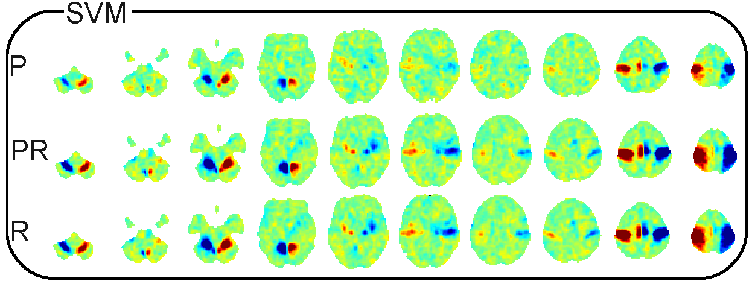
Finger Tapping: (P,R) Curves f(λ)
Task coupling (prediction)
searchlight
Rasmussen PM, et al. Pattern reproducibility, interpretability, and sparsity in classiﬁcation models in neuroimaging. Pattern Recognition 45(6):2085-2100, 2012
Notes:
Suggests hierarchy of response to stimulus causing areas to be missed with optimal prediction.

Slide 24
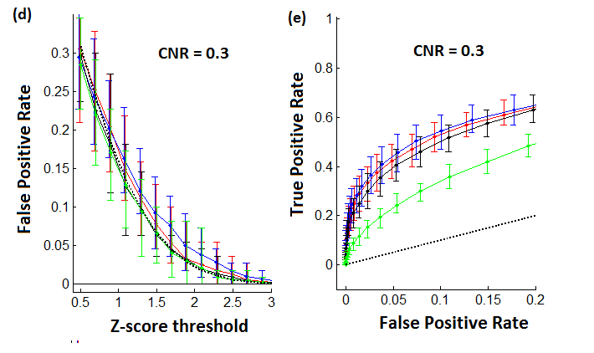
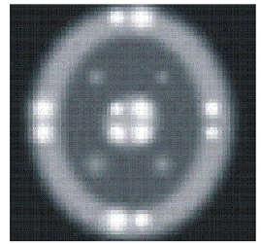
Individual-Subject Pipeline Optimization
Make sure individual pipeline optimization is not fitting to noise
Test in identically-distributed “subject” samples – greatest risk of bias!
Simulation
Churchill NW, et al., PLoS One 7(2):e31147, 2012
Notes:
** take out GLM & label!!

Slide 25
Principles for Studying and Optimizing Processing Pipelines
Simulated data sets, while potentially useful, provide only a rough guide for optimizing processing pipelines, particularly for functional neuroimaging studies.
Seemingly small changes within a processing pipeline may lead to large changes in the output.
New insights into human brain function may be obscured by poor or limited choices in the processing pipeline particularly as a function of age and disease.

Slide 26
Intra-Class Correlation
For , where j = 1,…,J repeats measures for i = 1,…,N subjects
ICC(3,1) = = , with assumed fixed session effect.
Tasks | Emotional Faces |  | Motivational |  | N-Back
ROI | Amygdala-Left | Amydala -Right | Ventral Striatum-L | Ventral Striatum-R | DLPFC-R1 | DLPFC-R2 | Parietal -Left | Parietal -Medial | Parietal -Right
Within-subject (ROI_{mean})
ICC(2,1) | .16 (-.25,.52) | -.02 (-.43,.38) | .51 (.22,.77) | .61 (.30,.80) | .39 (.03,.67) | .13 (-.19,.46) | .39 (.03,.67) | .57 (.24,.78) | .22 (-.10,.53)
ICC(3,1) | .16 (-.25,.51) | -.02 (-.41,.37) | .56 (.22,.78) | .62 (.31,.82) | .44 (.06,.71) | .16 (-.25,51) | .58 (.39,.74) | .66 (.34,.87) | .54 (.31,73)
Between-subject (ROI_{mean})
ICC(2,1) | .62 (.48,.72) | .78 (.72,.83) | .76 (-.04,.93) | .74 (-.06,.92) | .75 (-.06,.93) | .48 (-.01,.82) | .45 (-.09,.76) | .96 (.68,.99) | .45 (-.07,.78)
ICC(3,1) | .66 (.57,.73) | .79 (.74,.83) | .96 (.95,.97) | .92 (.90,.94) | .95 (.94,.95) | .97 (.97,.98) | .77 (.74,.79) | .98 (.98,.99) | .83 (.82,.85)
Shrout P, and Fleiss J, Psychol Bull, 86:420-8, 1979. Plichta M, et al., Neuroimage, 60:1746-58, 2012.
Notes:
M. M. Plichta, et al, and A. Meyer-Lindenberg. Test-retest reliability of evoked bold signals from a cognitive-emotive fmri test battery. Neuroimage, 60(3):1746–58, 2012.
Even more than in cognitive research applications, moving fMRI to the clinic and the drug development process
requires the generation of stable and reliable signal changes. The performance characteristics of the fMRI paradigm
constrain experimental power andmay require different study designs (e.g., crossover vs. parallel groups),
yet fMRI reliability characteristics can be strongly dependent on the nature of the fMRI task. The present study
investigated both within-subject and group-level reliability of a combined three-task fMRI battery targeting
three systems of wide applicability in clinical and cognitive neuroscience: an emotional (face matching), a motivational
(monetary reward anticipation) and a cognitive (n-back working memory) task. A group of 25
young, healthy volunteers were scanned twice on a 3 T MRI scanner with a mean test–retest interval of
14.6 days. FMRI reliability was quantified using the intraclass correlation coefficient (ICC) applied at three different
levels ranging froma global to a localized and fine spatial scale: (1) reliability of group-level activation maps
over the whole brain and within targeted regions of interest (ROIs); (2) within-subject reliability of ROI-mean
amplitudes and (3) within-subject reliability of individual voxels in the target ROIs.
Results showed robust evoked activation of all three tasks in their respective target regions (emotional task=amygdala; motivational
task=ventral striatum; cognitive task=right dorsolateral prefrontal cortex and parietal cortices) with high
effect sizes (ES) of ROI-mean summary values (ES=1.11–1.44 for the faces task, 0.96–1.43 for the reward
task, 0.83–2.58 for the n-back task). Reliability of group level activation was excellent for all three tasks with
ICCs of 0.89–0.98 at the whole brain level and 0.66–0.97 within target ROIs. Within-subject reliability of ROImean
amplitudes across sessions was fair to good for the reward task (ICCs=0.56–0.62) and, dependent on
the particular ROI, also fair-to-good for the n-back task (ICCs=0.44–0.57) but lower for the faces task (ICC=
−0.02–0.16). In conclusion, all three tasks are well suited to between-subject designs, including imaging genetics.
When specific recommendations are followed, the n-back and reward task are also suited for within-subject
designs, including pharmaco-fMRI. The present study provides task-specific fMRI reliability performance
measures that will inform the optimal use, powering and design of fMRI studies using comparable tasks.
Behavioural ICC(2,1) and ICC(3,1) equivalent and generally high: FACES & N-BACK > 0.5; low for REWARD < 0.5

Slide 27
Measuring Pipeline/Model Performance
Use pseudo-ROC (p vs. r) measures
Define: relative
performance by
distance D from:
reproducibility(r) = 1
prediction (p) = 1
ROC Substitutions
True positives -> Exp. Prediction
False positives -> (1 – gSNR(r))
1.0
D₁
0.75
D₂
Prediction
0.50
ΔD > 0
0.25
Processing pipeline/model 1
Processing pipeline/model 2
0
0.25
0.50
0.75
1.0
Reproducibility
Strother SC, et al. Neuroimage 15(4):747-71, 2002
LaConte S, et al. Neuroimage 18(1):10-27, 2003
Shaw ME, et al. Neuroimage 19(3):988-1001, 2003

Slide 28
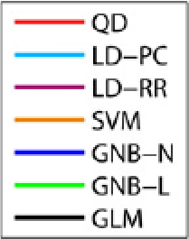
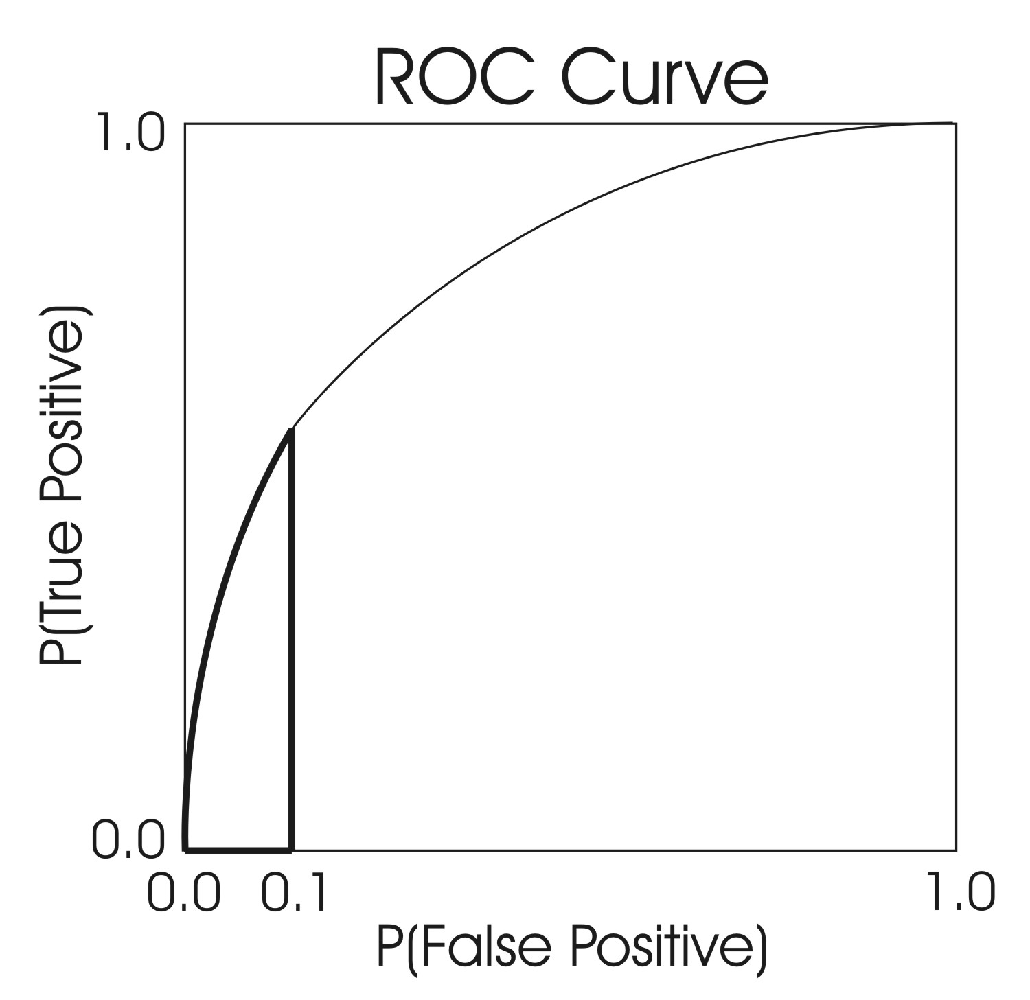
ROC and Reproducibility
Model Key
Reproducibility
Simulations
Real Data
Lukic M, et al. Artif Intell Med, 25:69-88, 2002
Yourganov G, et al., Neuroimage, 96:117-32, 2014.
Notes:
Fig. 4. Performance of the pool of six classifiers on simulated data sets, measured by partial area under the ROC curve corresponding to false positive frequency from 0 to 0.1. The three
columns correspond to three levels of mean signal magnitude M, and the three sub-columns correspond to three levels of spatial correlation ρ. Relative temporal variance of the active
signal (V) is plotted on the x-axis. ROC curves are measured at the centers of each of the 16 active loci. Colored lines show, for each classifier, the mean partial ROC area across the 16
loci, and the error bars show the corresponding standard deviation. Dashed black lines indicate the partial ROC area for random guessing.
Fig. 5. Performance of the pool of classifiers on the dataset from the aging study, based on metrics of classification accuracy (top) and spatial map reproducibility (bottom). Left and right
columns correspond to subjects in the young and the older age groups, respectively. Results are shown for 4 binary task contrasts, ordered fromstrong to weakwithin each panel. The tasks are: reaction task (RT), delayed matching (DM), perceptual matching (PM), and fixation (FIX).

Slide 29
Outline
Neuroimaging processing pipeline optimization
Possible optimization metrics
Preprocessing pipelines for fixed and adaptive pipeline optimization
For multiple tasks with univariate and multivariate analysis models:
  Optimized training results for preprocessing pipeline choices
  Independent test results
Conclusions

