Slide 1


Increased applicability and engagement through interactive web applications
Melanie Harsch
Wikimedia Commons.
Notes:
Thank you for the opportunity to present today. I greatly appreciate the opportunity to provide this talk remotely. I want to thank Juliette for that great presentation and starting the morning off with a discussion of modeling species range shifts in response to climate change.

Slide 2
Outline
Climate change
Moving-habitat models (MHM)
Online MHM simulation models
  Demonstration
  Why developed
  How developed
Notes:
I am going to continue with this theme, discussing briefly the motivation behind modeling species response to climate change. I will then give a brief background on moving-habitat models. Both Joy and Austin will be talking about MHM models in greater detail later in this session. I will then show a simulation model that is available online. The idea is that these are great tools for engaging with a broader audience, teaching the next generation, and, of course, broader impacts. So I will show you the model, talk about why it was developed, and then how it was developed.

Slide 3
Expect species to track shifting climatically suitable habitat
Climatically suitable habitat
mortality
invasion
Temperature gradient
Notes:
In the series of talks this morning, we’re talking about the impacts of climate change on species and how do we predict and manage the impacts of climate change. Species persist in their climatically suitable habitat. This is the grey area on this figure. The climatically suitable habitat is, in part, determined by temperature (CLICK). With climate change, this climatically suitable habitat will shift along an elevational or latitudinal gradient. (CLICK). What we expect to see is that as temperature warms, species distributions will shift due to mortality at lower regions and invasion at the upper limits into areas that are now climatically suitable. This is of course, the best case scenario.

Slide 4
Not all species can or will track shifting climatically suitable habitat
Climatically suitable habitat
mortality
invasion
Climatically suitable habitat
mortality
No invasion
Notes:
In reality, however, it is not that simple. (CLICK) Dispersal ability, life-history traits, and biotic interactions, to name a few factors, all impact how species will respond to climate change. This makes it hard to predict and manage the impacts of climate change on species.

Slide 5
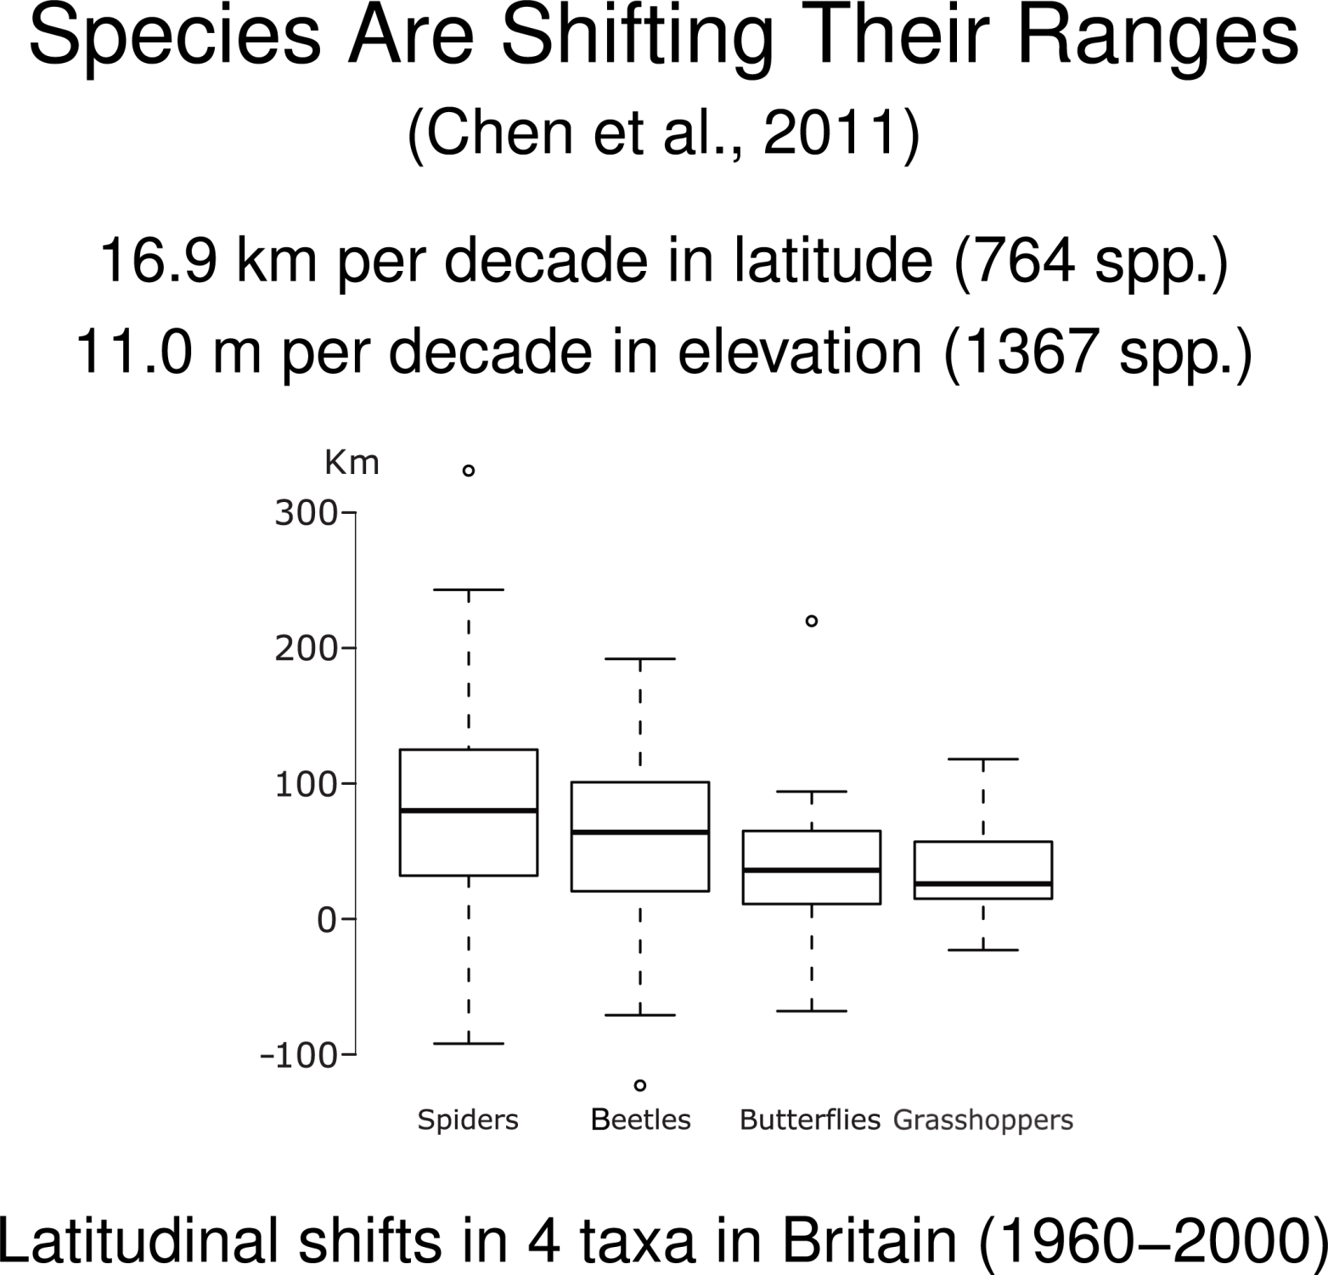
Notes:
To date, the majority of studies on species range shifts, including this excellent one by Chen et al., focus on quantifying observed responses over the past several decades. As you will see with these box-and-whisker plots, there is a huge variation in species responses. Studies such as this one, although useful, don’t get at understanding why there is so much variation in species responses, why not all species are tracking shifts in their climatically suitable habitat. To understand the variation in responses, we need to consider species ability to track climate change, such as dispersal ability, and we also need to consider the velocity of climate change, which will vary spatially. I will now introduce one solution, moving-habitat models.

Slide 6
Moving-Habitat Models
(Integrodifference Equations)
-L/2
L/2
L/2+ct
Kot et al. 1996 Ecology
Zhou and Kot 2011. Theoretical Ecology
Notes:
Moving-habitat models (MHM) track the density of a population over a spatial domain at discrete time steps using the integrodifference equation (CLICK)
L is the climatically suitable one-dimensional habitat over which a species occurs (CLICK)
The habitat moves by a fixed increment of c in each time step. The parameter c represents the speed of movement of suitable climatic conditions.
The function n_{t}(x) tracks the population density at time t at every location along the one-dimensional habitat (L).
(CLICK) Between each time step, as mentioned, the habitat (L) moves, due to climate change, by the fixed increment c
(CLICK) The population grows according to the specified growth function == f [nt (x)]
(CLICK) And propagules disperse according to the specified dispersal kernel k(x-y)
At the end of the dispersal stage, the contribution from all sources y is tallied up by the integral in equation (1). Propagules that land outside the habitat are tallied

Slide 7
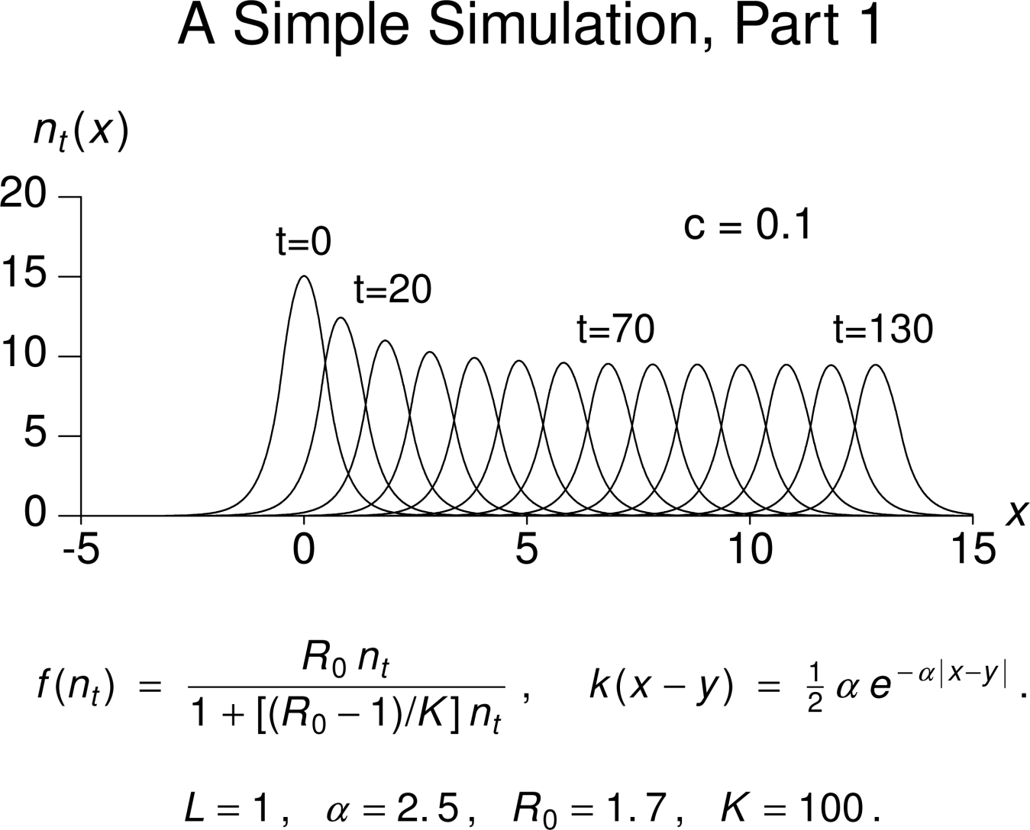
Notes:
Joy Zhou presents a simple simulation of the model in her 2011 Theoretical Ecology paper. The parameters for this simple simulation are defined at the bottom of the screen. Here, c is 0.1. The y-axis is the population density and the x-axis is the spatial gradient. Each line is the population distribution at the specified time step. You will see that the population persists after 130 timesteps.

Slide 8
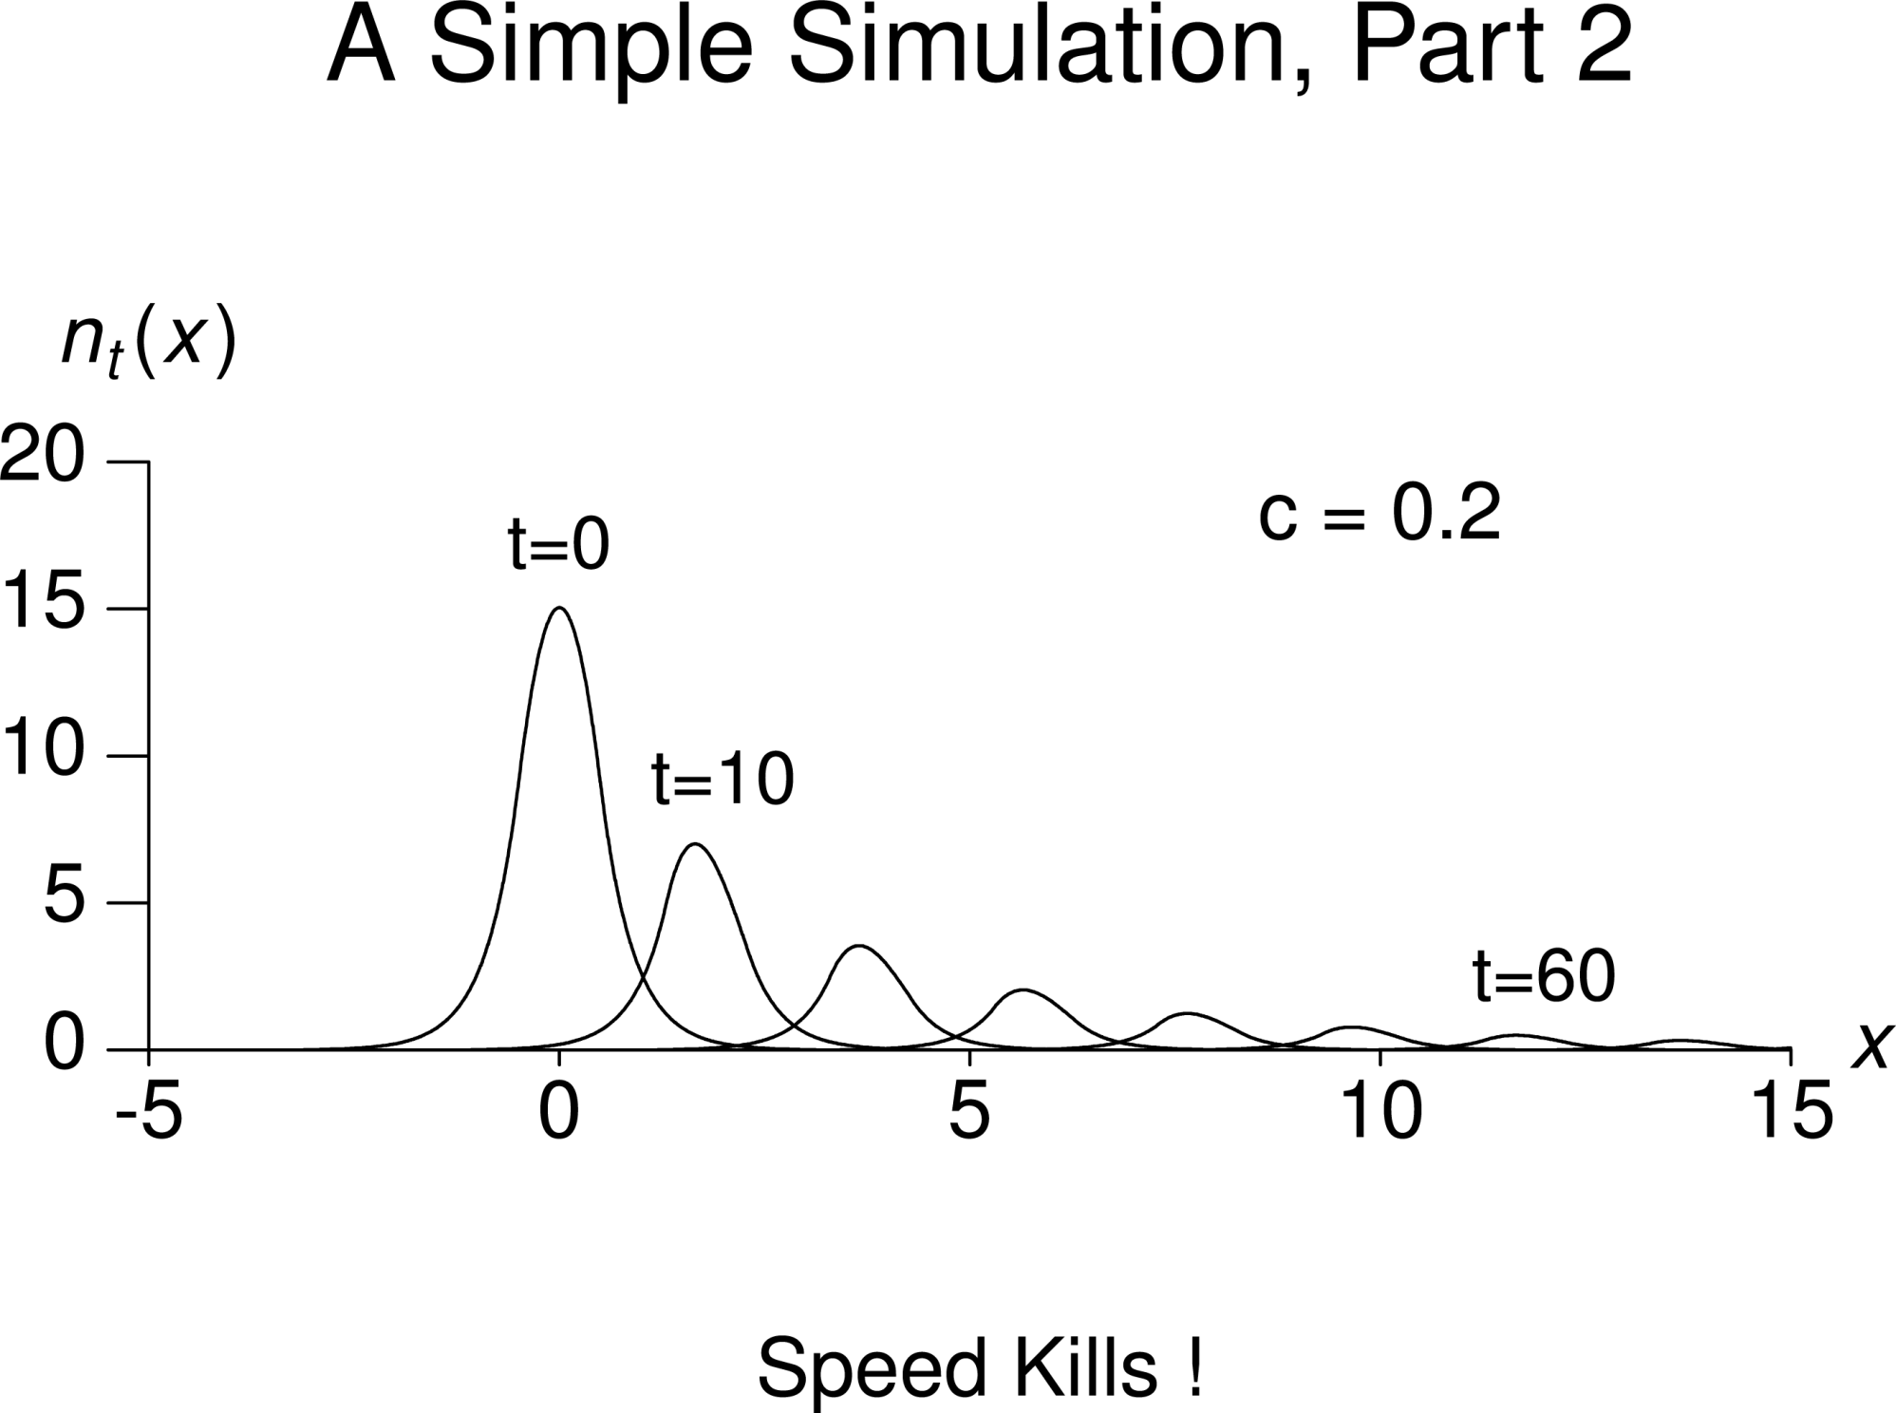
Notes:
If however, we double c to 0.2, we see that the population dies off after 60 time steps. In other words, species cannot infinitely keep track with increased velocities of climate change.

Slide 9
Moving-habitat model
Stage-structured
Two-Dimensional models
Harsch et al. 2014
The American Naturalist
Phillips & Kot 2015
Bulletin of Mathematical Biology
https://movinghabitatmodel.shinyapps.io/BasicModel ( Adds stochasticity)
https://movinghabitatmodel.shinyapps.io/rangesize/ (Change in range size)
https://movinghabitatmodel.shinyapps.io/AlleeEffects/ (Allee effects)
https://movinghabitatmodel.shinyapps.io/BioticInteractions/ (competition, predation, facilitation)
https://movinghabitatmodel.shinyapps.io/InfectionModel/ (Infectious agent)
Notes:
From this simple moving habitat model, a number of advances have been made including adding stage-structure and adding two dimensions (which Austin will talk about later). In a paper in review at the Journal of Ecology we have also developed five simulation models that are available online. These simulation build upon the basic model by adding stochasticity, allowing c to differ between lower and upper limits of L, adding Allee effects, incorporating biotic interactions, including competition, predation, and facilitation, and finally we have also including a Susceptible-Infection MHM.

Slide 10
Why develop online simulation models?
https://movinghabitatmodel.shinyapps.io/BasicModel ( Adds stochasticity)
https://movinghabitatmodel.shinyapps.io/rangesize/ (Change in range size)
https://movinghabitatmodel.shinyapps.io/AlleeEffects/ (Allee effects)
https://movinghabitatmodel.shinyapps.io/BioticInteractions/ (competition, predation, facilitation)
https://movinghabitatmodel.shinyapps.io/InfectionModel/ (Infectious agent)
1. Engage a broader audience
2. Tool for research and management
Education
Notes:
We developed these models for a number of reasons.
(CLICK) First, to engage a broader audience. There are many ecologists who have interests in these models but don’t know how to develop them.
(CLICK) Second, as a tool for research and management. These models are a great tool for developing new hypotheses that can then be tested experimentally.
(CLICK) Third, for education. These models provide an opportunity to explore the impacts of climate change, gain an appreciation for the impacts, and understand why management is important.
(CLICK) Finally, developing the models is a form of broader impacts.
I am not going to show the simulation model for the basic model.

Slide 11
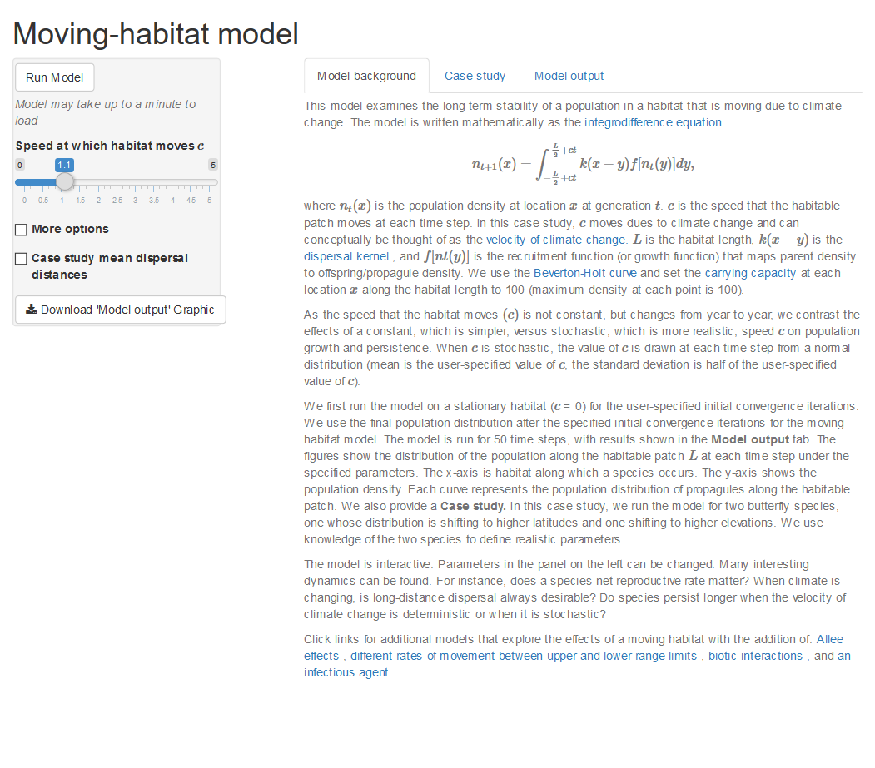
Notes:
This is the landing page of the simple moving habitat model I showed earlier. On this landing page, you will see a description of the IDE including an explanation of parameters. Blue words are hyperlinked to journal articles or other webpages where readers can get more information. This is the first tab that you see. The second tab is the case study…

Slide 12
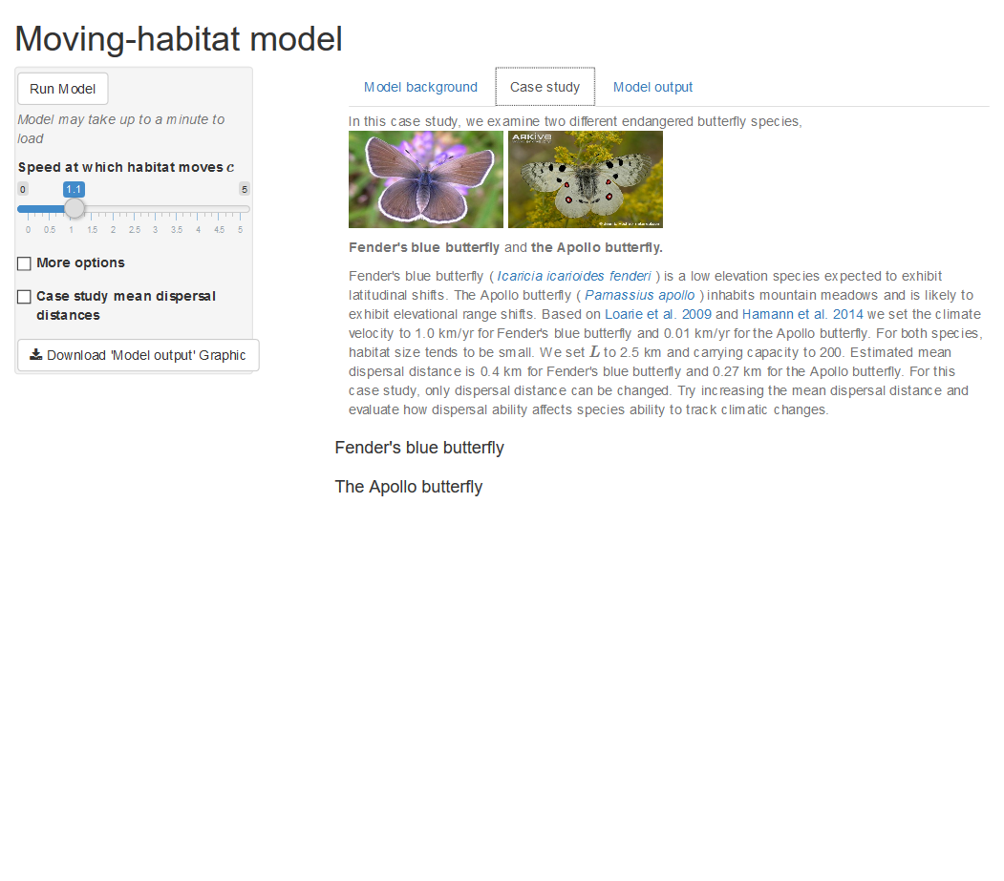
Notes:
The idea behind having a case study is that users can get a sense for these models using real species.
Here we show results for two butterfly species which differ in where they occur and their mean dispersal distances. Fenders blue butterfly is a low elevation species expected to exhibit latitudinal shifts. The Apollo butterfly, however, inhabits mountain meadows and is likely to exhibit elevational range shifts. The dispersal kernel and mean dispersal distance along with the habitat length are fixed to values in the literature.

Slide 13
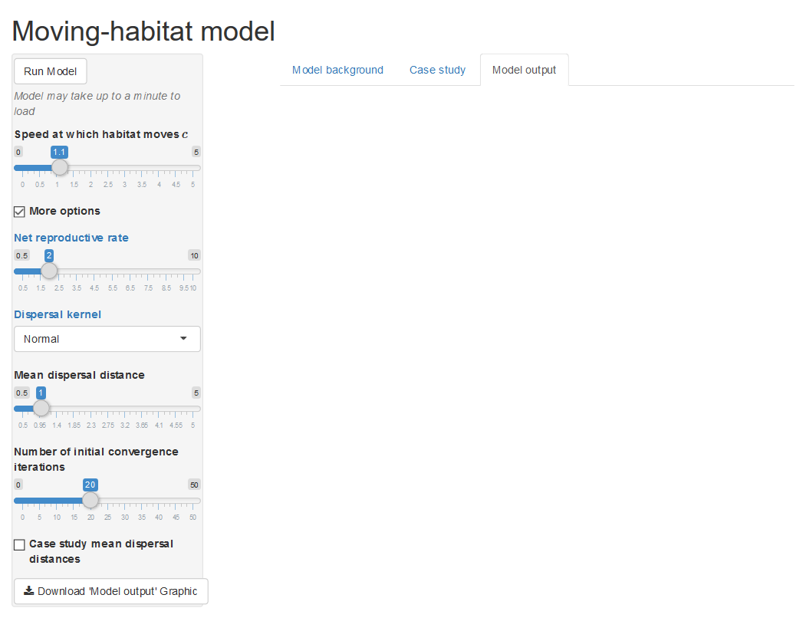
Notes:
The final tab is the Model output tab. In this tab, results are not linked to a specific species and users have a lot more options on the parameters they want to change. On the left hand of the screen you have seen this greyed out rectangle. This is where the user can make changes. The user can modify the value of c, the net reproductive rate, the type of dispersal kernel (gaussian, laplace, cauchy) along with the mean dispersal distance.
Once we set all these, we hit ‘run model’ and the you will a counter at the top right hand corner letting users know how far along in the simulation runs.
Once the simulatin has run, output will be produced

Slide 14
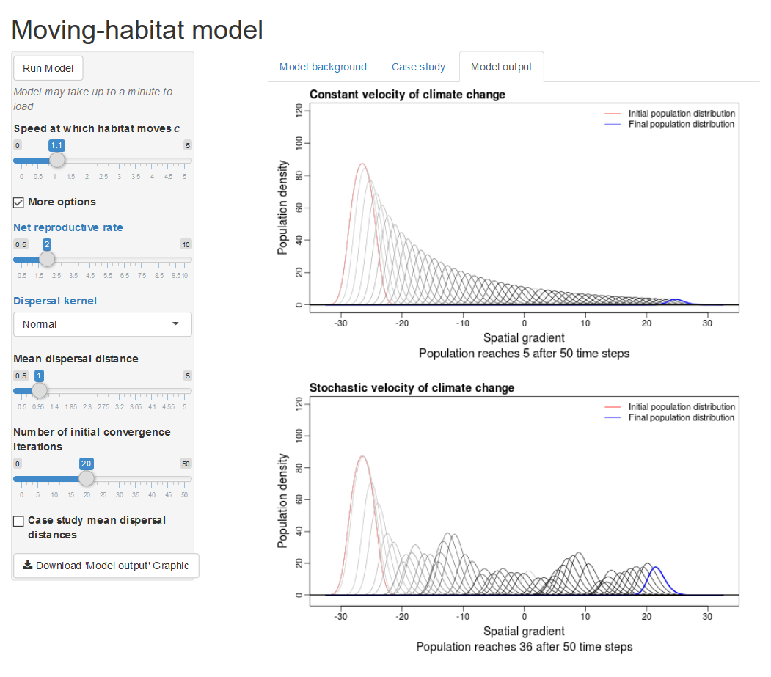
Notes:
Finally, this is the model output. Each figure shows the population density along the spatial gradient where each line is a time step. The red line is the first time step and the blue lines is the final distribution (after 50 time steps). The top figure is where c is constant and the bottom is when c is allowed to vary between timesteps based on a normal distribution where the mean is c and the sd is ½ c.
We can rerun the simulation and you will see that the top graph does not change but the bottom one does.
Another cool thing is that users can download their graphics.

Slide 15
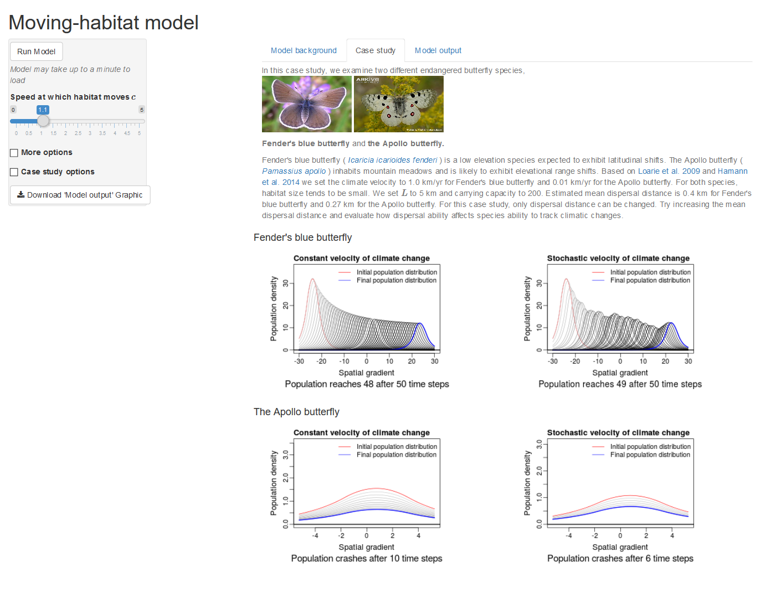
Notes:
We see similar results for the case study. The top set of graphs show fender’s blue butterfly for constant and stochastic velocity of climate change.. The bottom figures are for the Apollo butterfly. You will see that the species will the longer mean dispersal distance persists longer the species with the shorter mean dispersal distance.

Slide 16
Notes:
On our main page, we have links to our other pages we have developed. As I said earlier, there are five different simulation models, each with a specific focus, such as biotic interactions

Slide 17
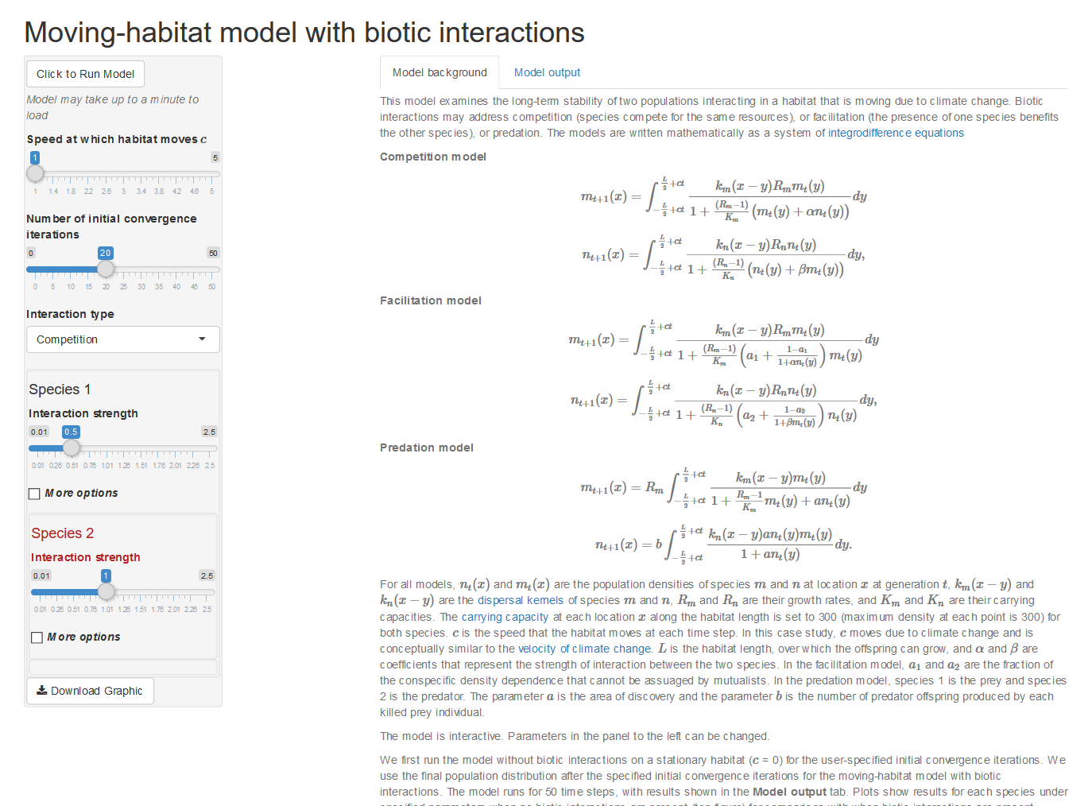
Notes:
So that is just a taste of what we have done. What I find exciting is that what I have shown required no web development skills. These web applications were written entirely in R. I’m going to show you how we did it.

Slide 18
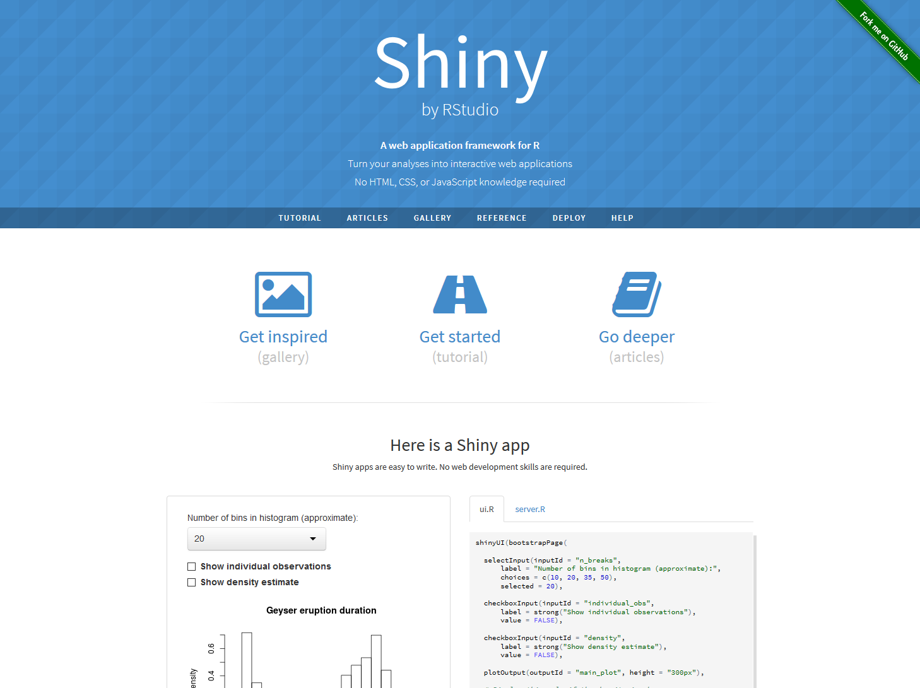
Notes:
We used Shiny, which was developed by Rstudio
Shiny is a package that has the basic codes used to develop web pages wrapped in functions.
•Makes it easy for users familiar to R code but not CSS, HTML, or JAVAscript to develop web pages
•Seamlessly integrate analyses, figures, and tables developed in R code onto the website

Slide 19
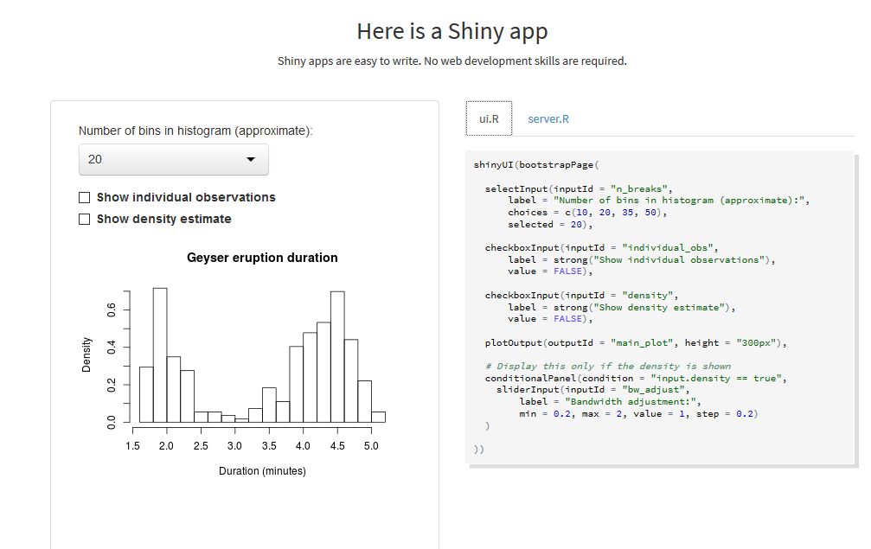
Notes:
Here is an example of a simple shiny app. On the left is the website that would be developed, on the right is the code.
There are two parts to the code, the user-interface definition which is defined in the ui.R file and the server script (the server.R file). The ui.R file defines the appearance of the webpage.
(CLICK) The first three code chunks define the reactive components and their appearance. Here they just appear stacked above the plot output. In my example earlier, they were in a sidebar the left. (CLICK) the next line calls for the output of the plot. The R code defining the data and appearance of the plot are in the server file.

Slide 20
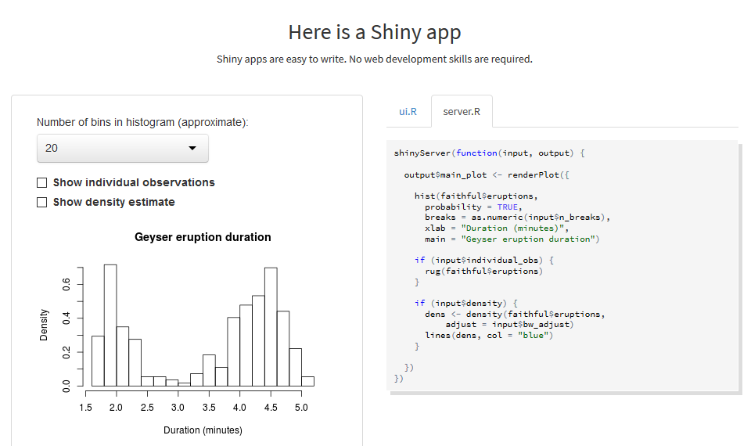
Notes:
In this server file the R code defining the plot is here (CLICK)

Slide 21
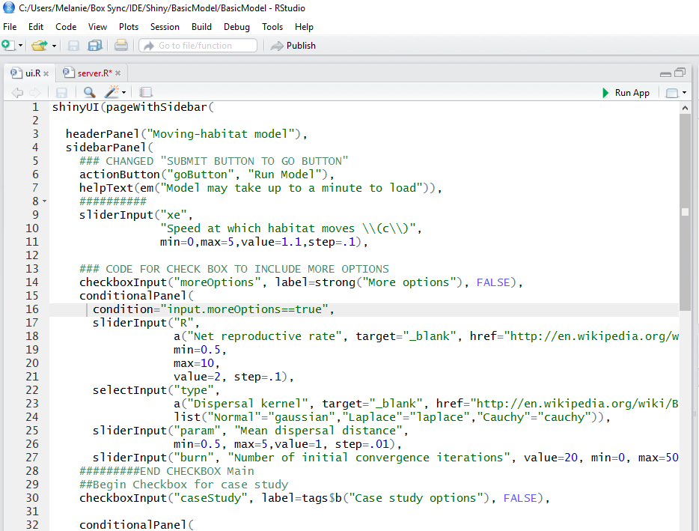
Notes:
As another example, here is a screen shot of the R code for the simulation model I showed earlier.
We uses Rstudio to run Shiny.
You will see our ui.R and our server.R files.
(CLICK)This function specifies the appearance of the page. Specifically, a page with a sidebar for widgets on the left side and the main panel for text or output.
(CLICK) And this is the code specifying which widgets, their appearance, and parameters
(CLICK) And here, we add a title
(CLICK) On the right is a ‘Run App’ button. Click this to run the application. This will run the application on your computer.
(CLICK) After your are happy with the application, click ‘Publish’. The application will then be deployed on the web.

Slide 22
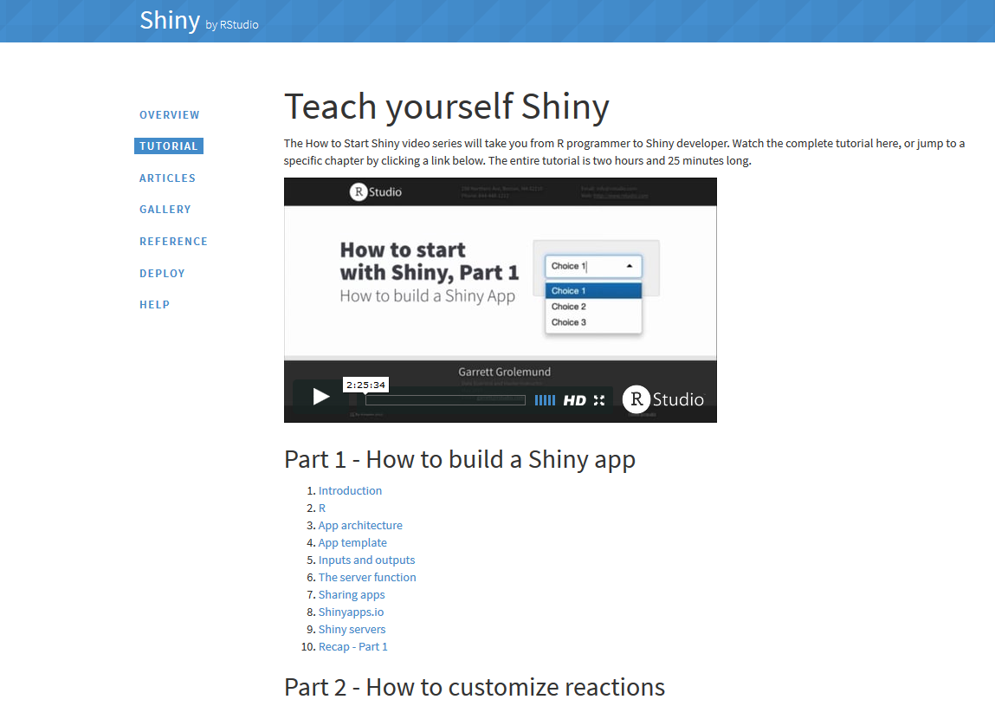
http://shiny.rstudio.com/
Notes:
This overview is simplified and very brief. There are tons of tutorials on the Shiny website (CLICK) to get you started and for guidance on how to build more sophisticated websites.

Slide 23
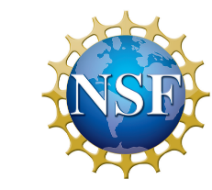
Acknowledgements
Mark Kot
Rosie Leung
Austin Phillips
Scott Rinnan
Ying (Joy) Zhou
Zhou. and Kot. 2011. Theor. Ecol. 4, 13-25
Harsch, Zhou, HilleRisLambers, and Kot. 2014. Am. Nat. 184, 25-37.
Phillips. and Kot. 2015. Bull. Math. Biol. 77, 2125-2159.
http://shiny.rstudio.com/
Model | URL
Basic model | https://movinghabitatmodel.shinyapps.io/BasicModel/
Allee effects | https://movinghabitatmodel.shinyapps.io/AlleeEffects/
Change in range size | https://movinghabitatmodel.shinyapps.io/rangesize/
Biotic interactions: competition/ facilitation/predation | https://movinghabitatmodel.shinyapps.io/BioticInteractions/
Biotic interactions: infectious agent | https://movinghabitatmodel.shinyapps.io/InfectionModel/

