Slide 1
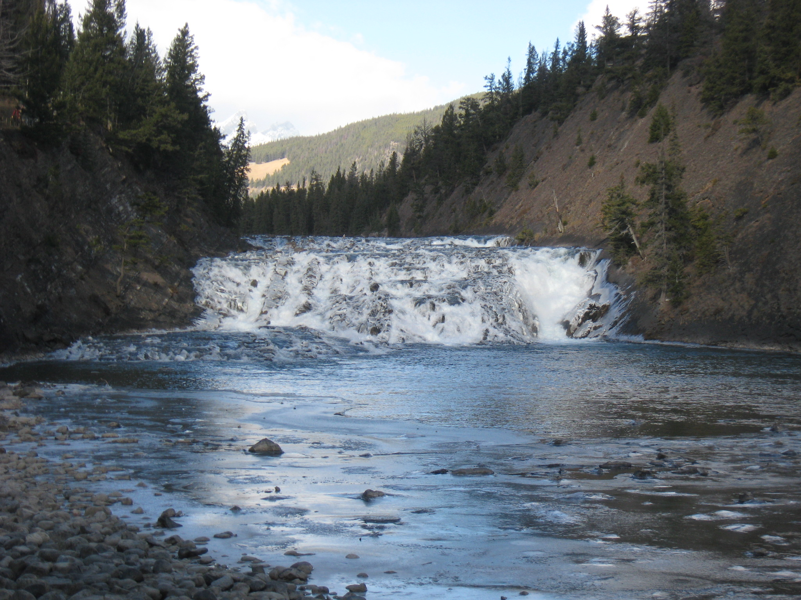


Assessing hydrological and climatological models against observations
Paul Whitfield
University of Saskatchewan

Slide 2
the law of the instrument
Give a small boy a hammer, and he will find that everything he encounters needs pounding.
Abraham Kaplan (1964). The Conduct of Inquiry: Methodology for Behavioral Science. San Francisco: Chandler Publishing Co. p. 28

Slide 3
Background
Models of all types used without sufficient assessment
Process and Empirical Models
    Hydrological
    Climatological
    Downscaling
Reliance on only a few metrics
    RMSE/RME
    NSE
    Pearson Correlation Coefficient

Slide 4
Background
Heavy reliance on models in change studies
Tweak hydrological models against metrics
Equifinality
Common Measures
    Population statistics
    Temporal structure
    Extremes

Slide 5
Why is this a problem?
Environmental data is “complicated”
Metrics may lack sufficient sensitivity
and generality
Is the wrong question being asked?
    How good is my model?
    How can I use my model?
    Right answer for right reasons?

Slide 6
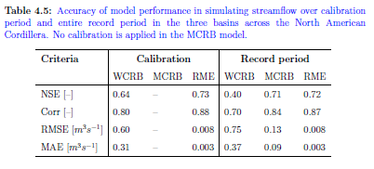
Typical Assessment of Performance
Mean annual discharge is ~0.35

Slide 7
Some examples:
Metrics of sine curves
Gridded data sets
Hydrological models

Slide 8
Metrics
Root mean square error
    RMSE <- sqrt(mean((obs-sim)^2))
Ratio RMSE to Stdev
RMSE <- sqrt(mean((obs-sim)^2))/sd(obs)
Percent Bias
PBIAS <- 100 * [ sum( sim - obs ) / sum( obs ) ]
Volumetric Efficiency
VE <- 1 - ( sum( abs(obs - sim) ) / sum( obs ) )

Slide 9
Metrics
Nash Sutcliffe Efficiency
    NSE <- 1 - ( sum( (obs - sim)^2 ) / sum( (obs - mean(obs))^2 )
Pearson Correlation Coefficient
r_{xy} <- s_{xy} / s_{y *} s_{y}
Dynamic Time Warping
Normalized Warping Distance
distance computed, normalized for path length
Warping Area
area between warping function and diagonal

Slide 10
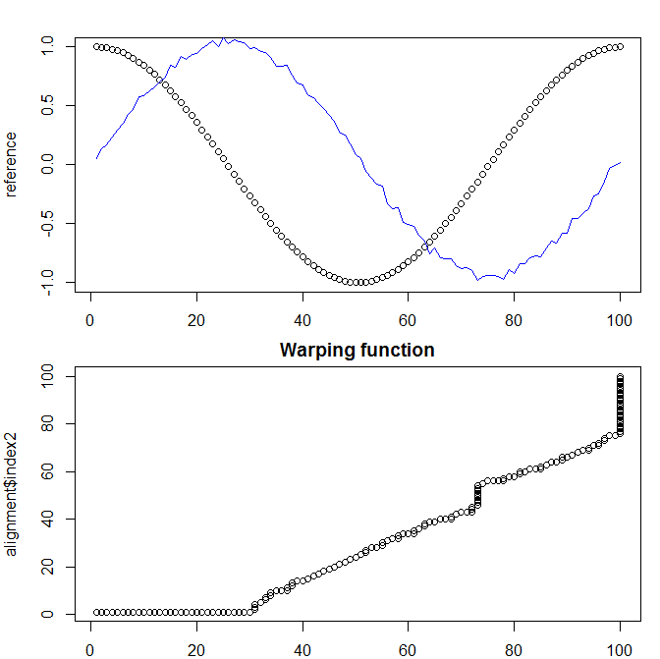
DTW – dynamic time warping
Distance
Area

Slide 11
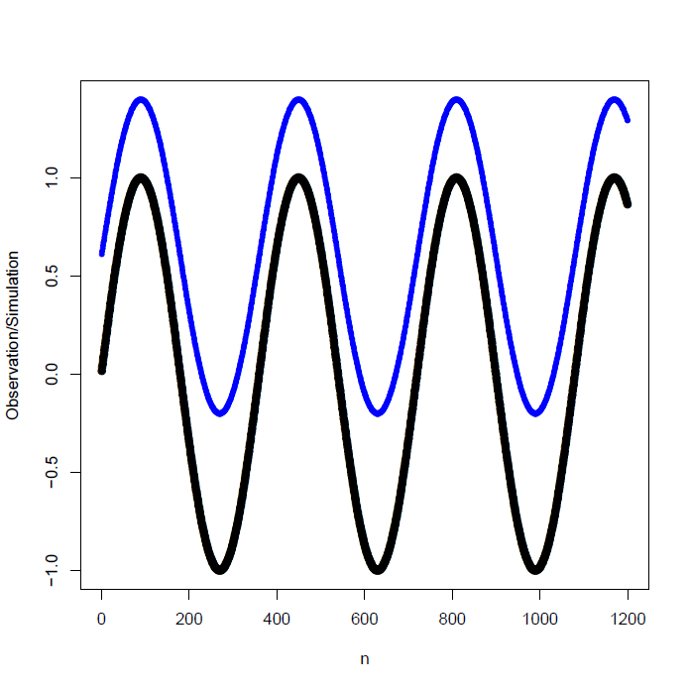
Changing Mean and Variance

Slide 12
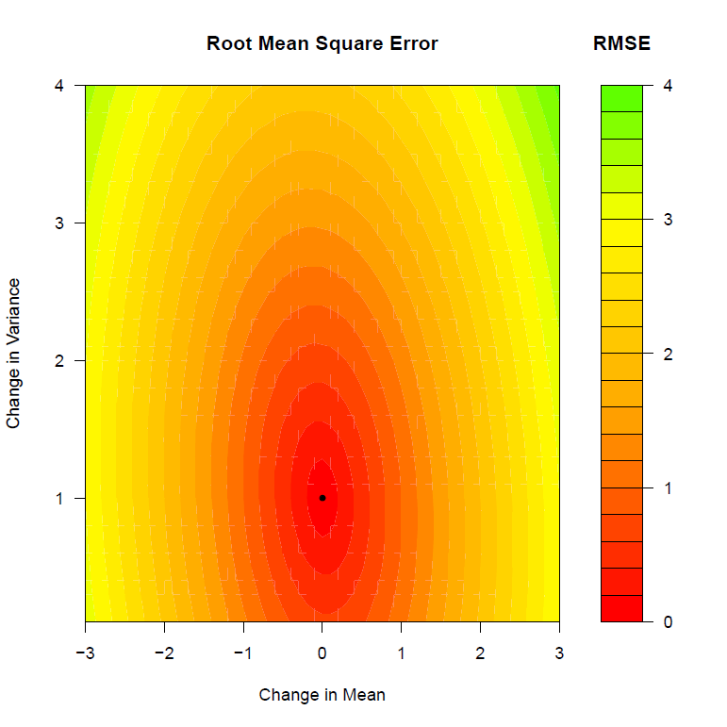
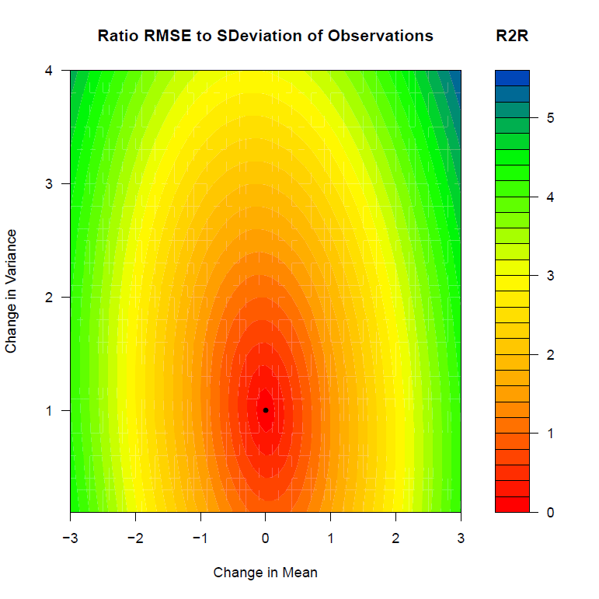
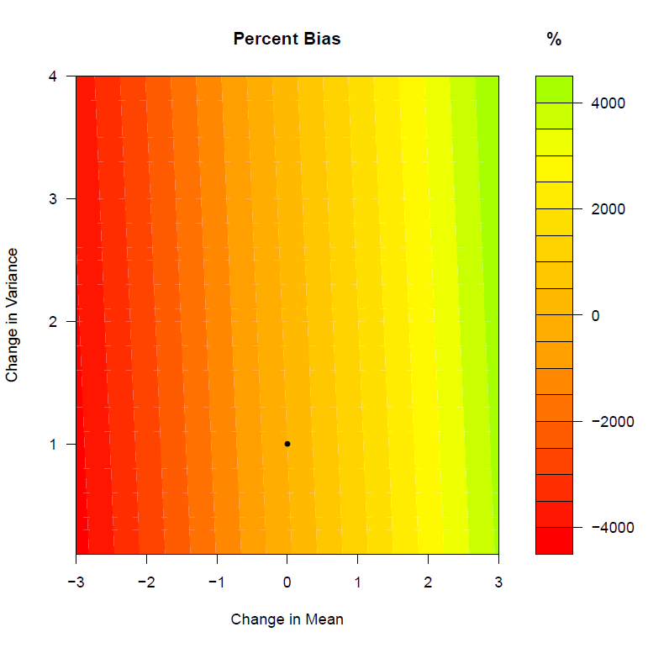
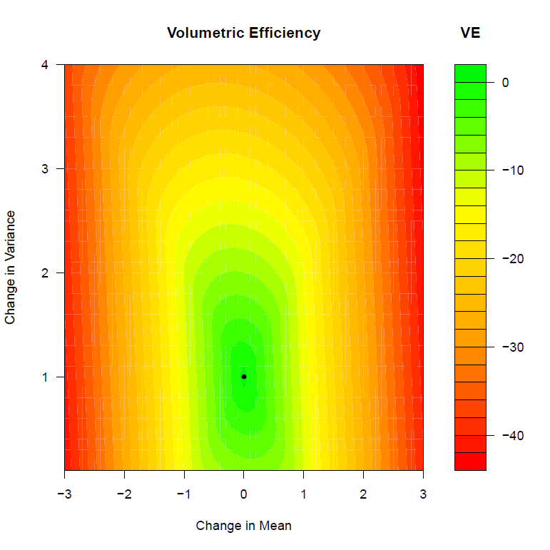

Slide 13
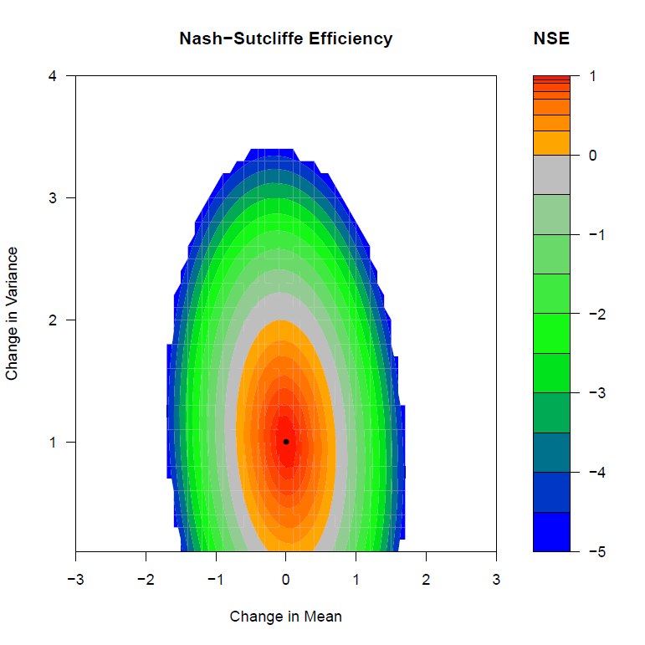
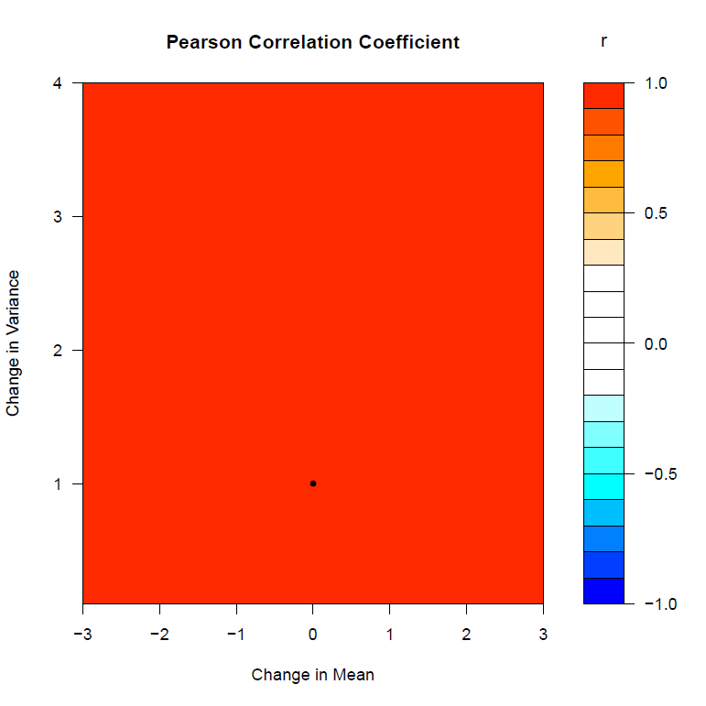
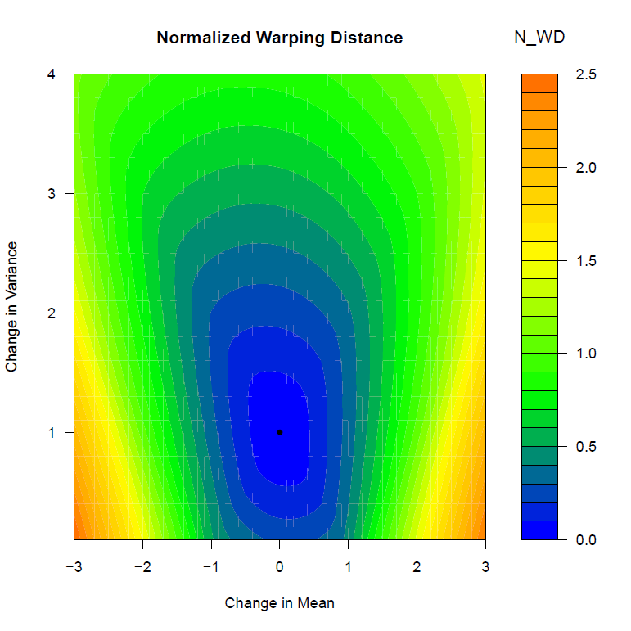
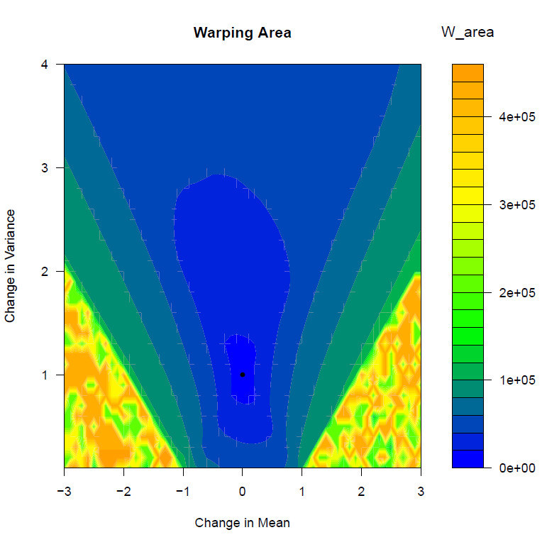

Slide 14
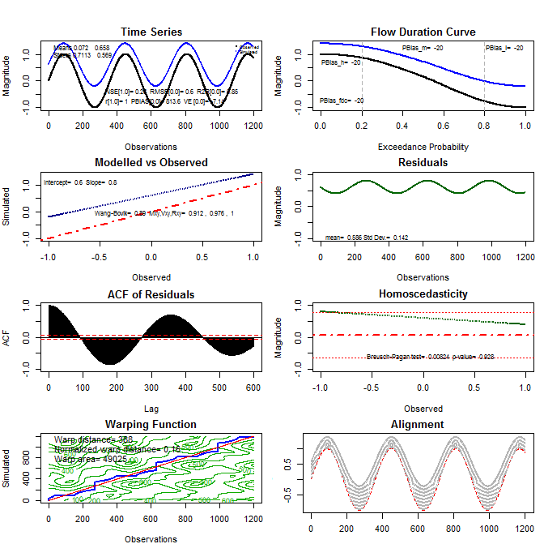

Slide 15
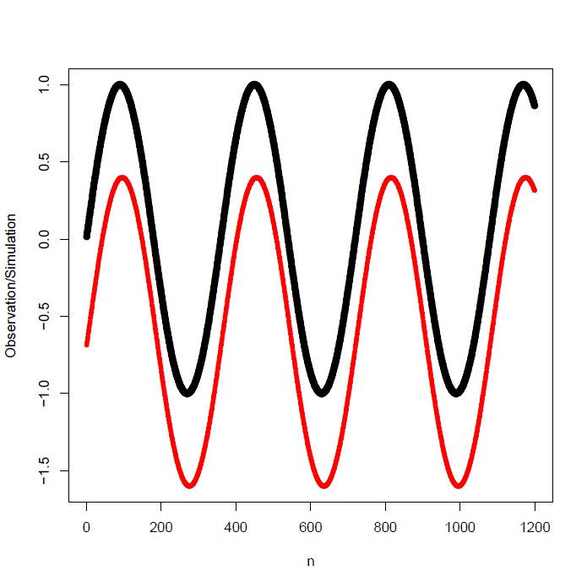
Changing Mean and shifting in time

Slide 16
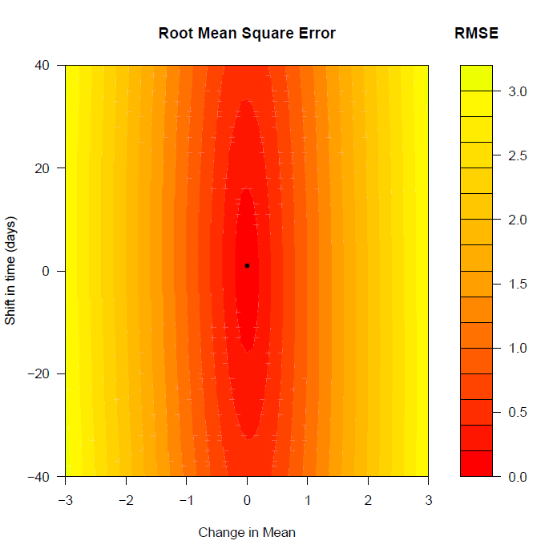
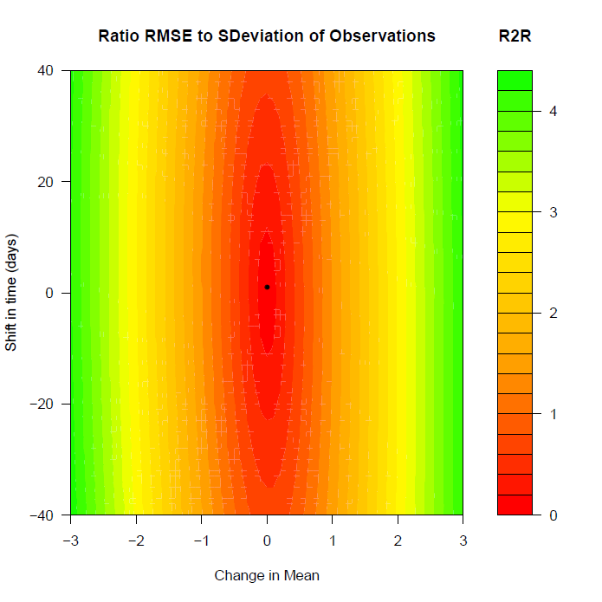
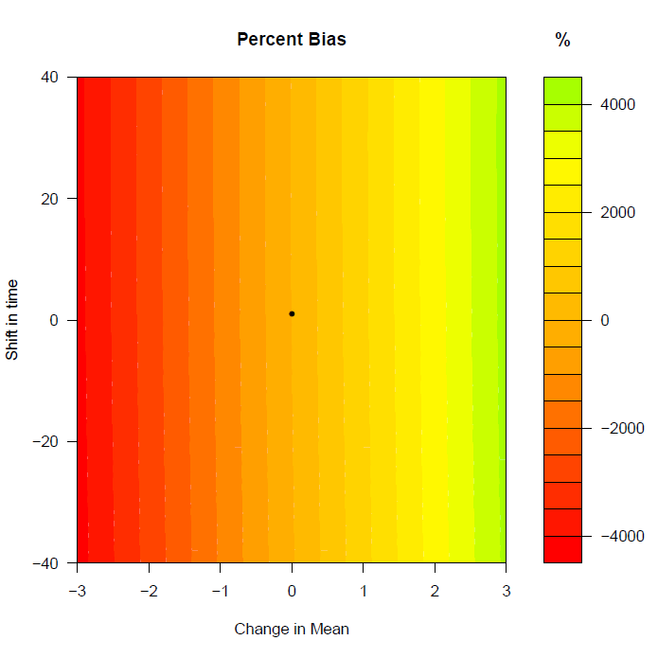

Slide 17
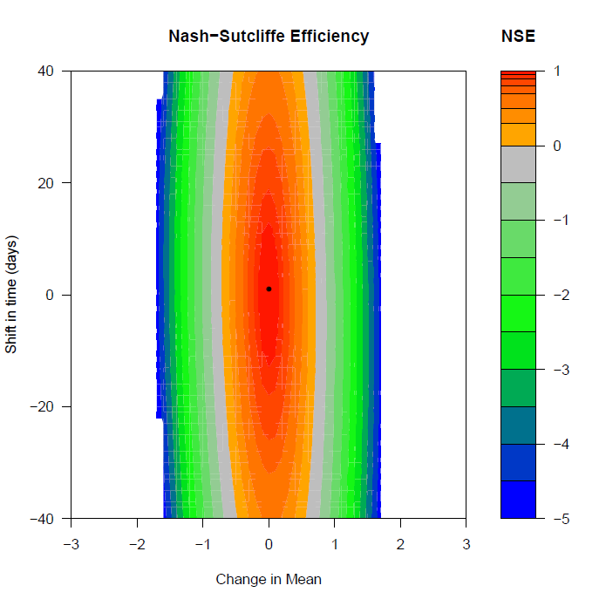
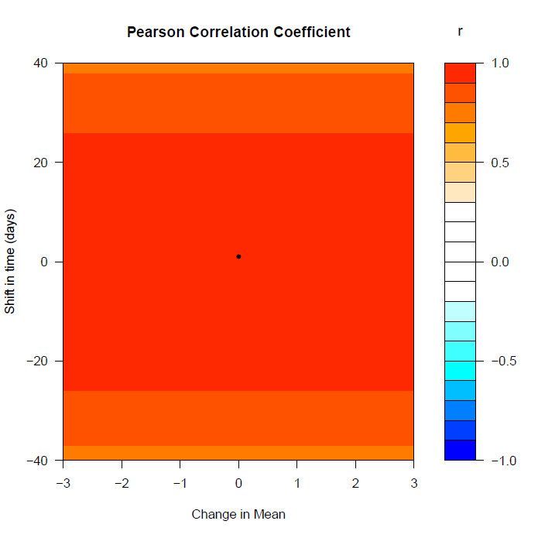
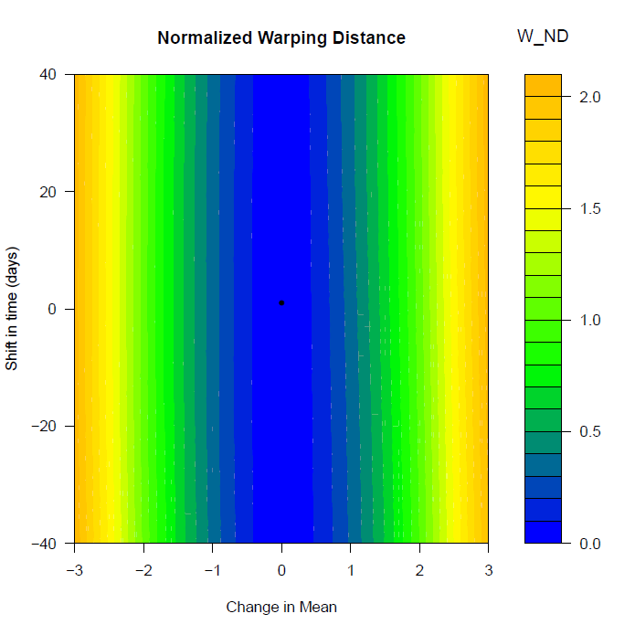
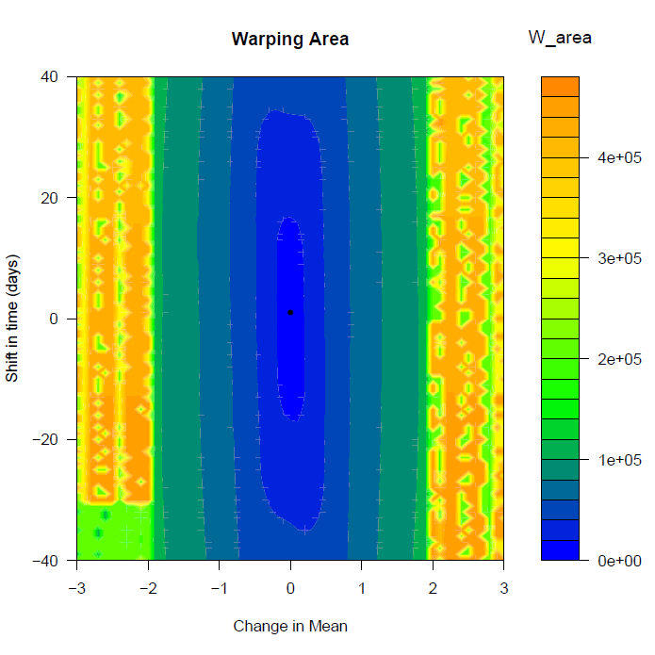

Slide 18
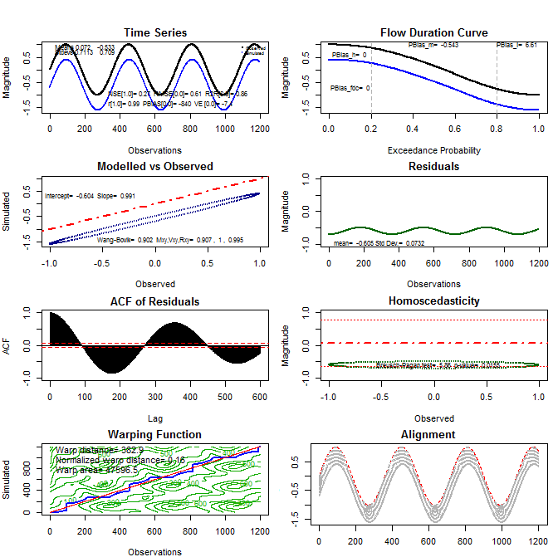

Slide 19
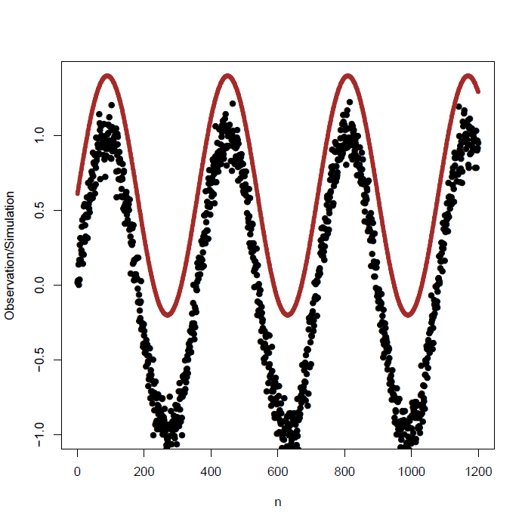
Observations with noise

Slide 20


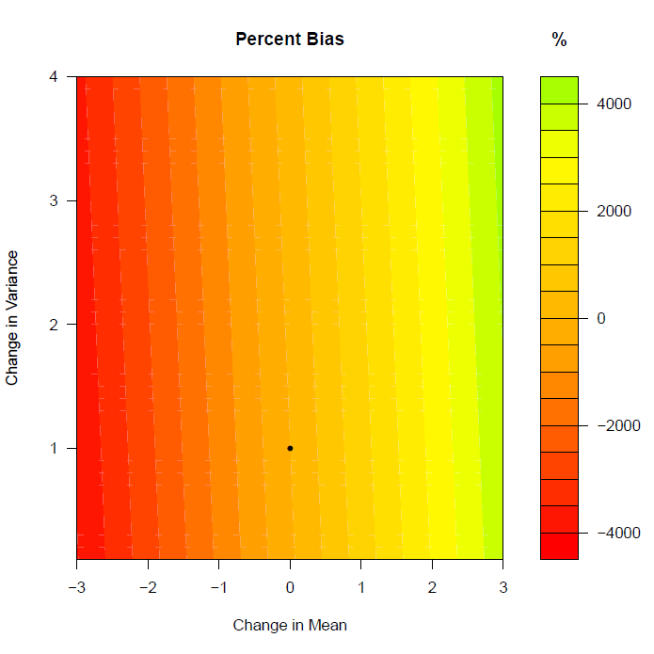
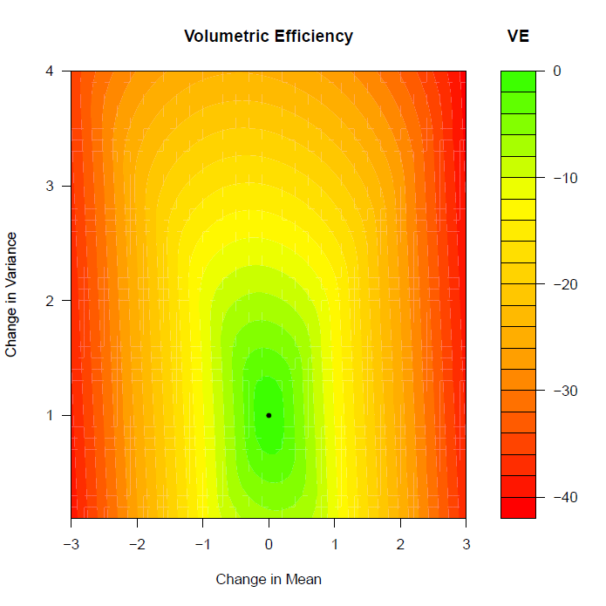

Slide 21
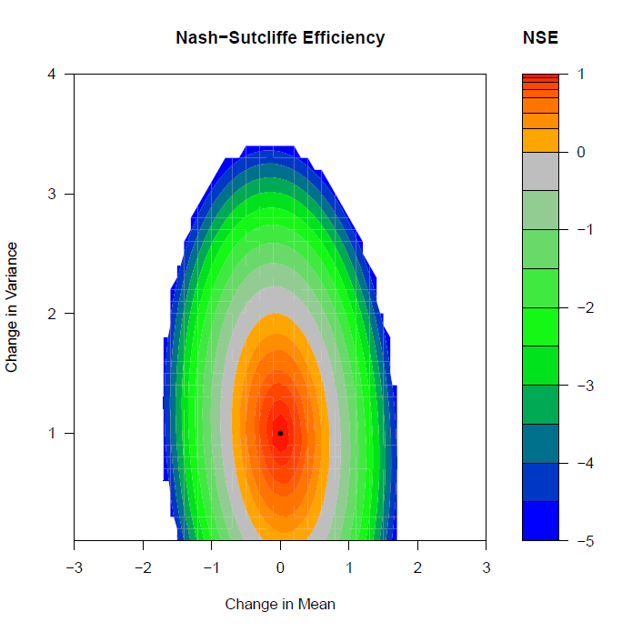
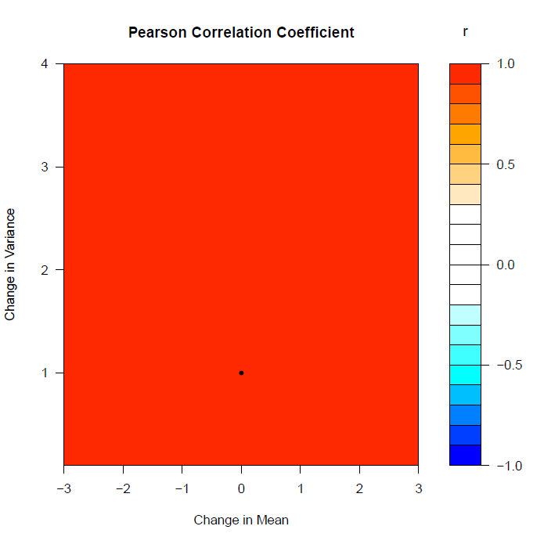
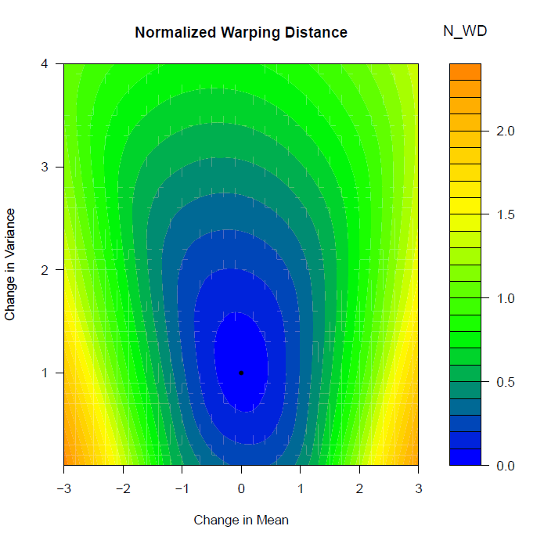
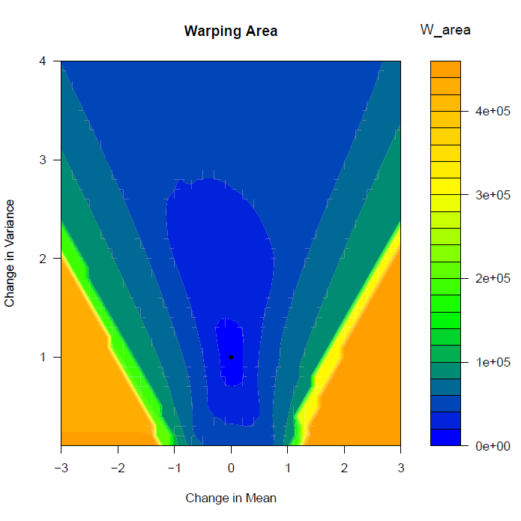

Slide 22
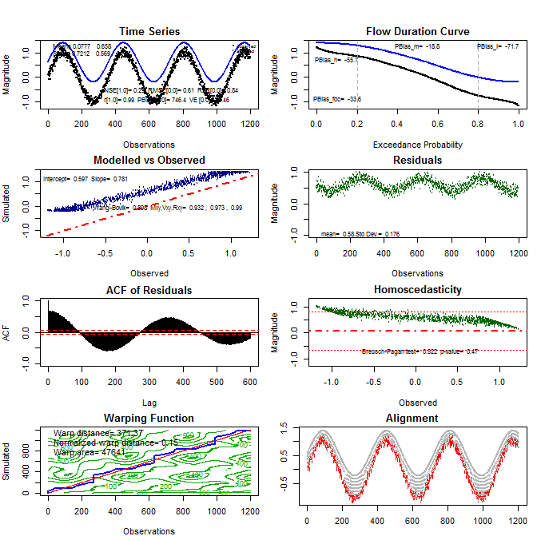

Slide 23
Gridded Climate Data
How well do gridded products resemble observations?
Areas/places without actual observations
How can we be comfortable that these can be substituted for observations?

Slide 24
Gridded Climate Data

Slide 31
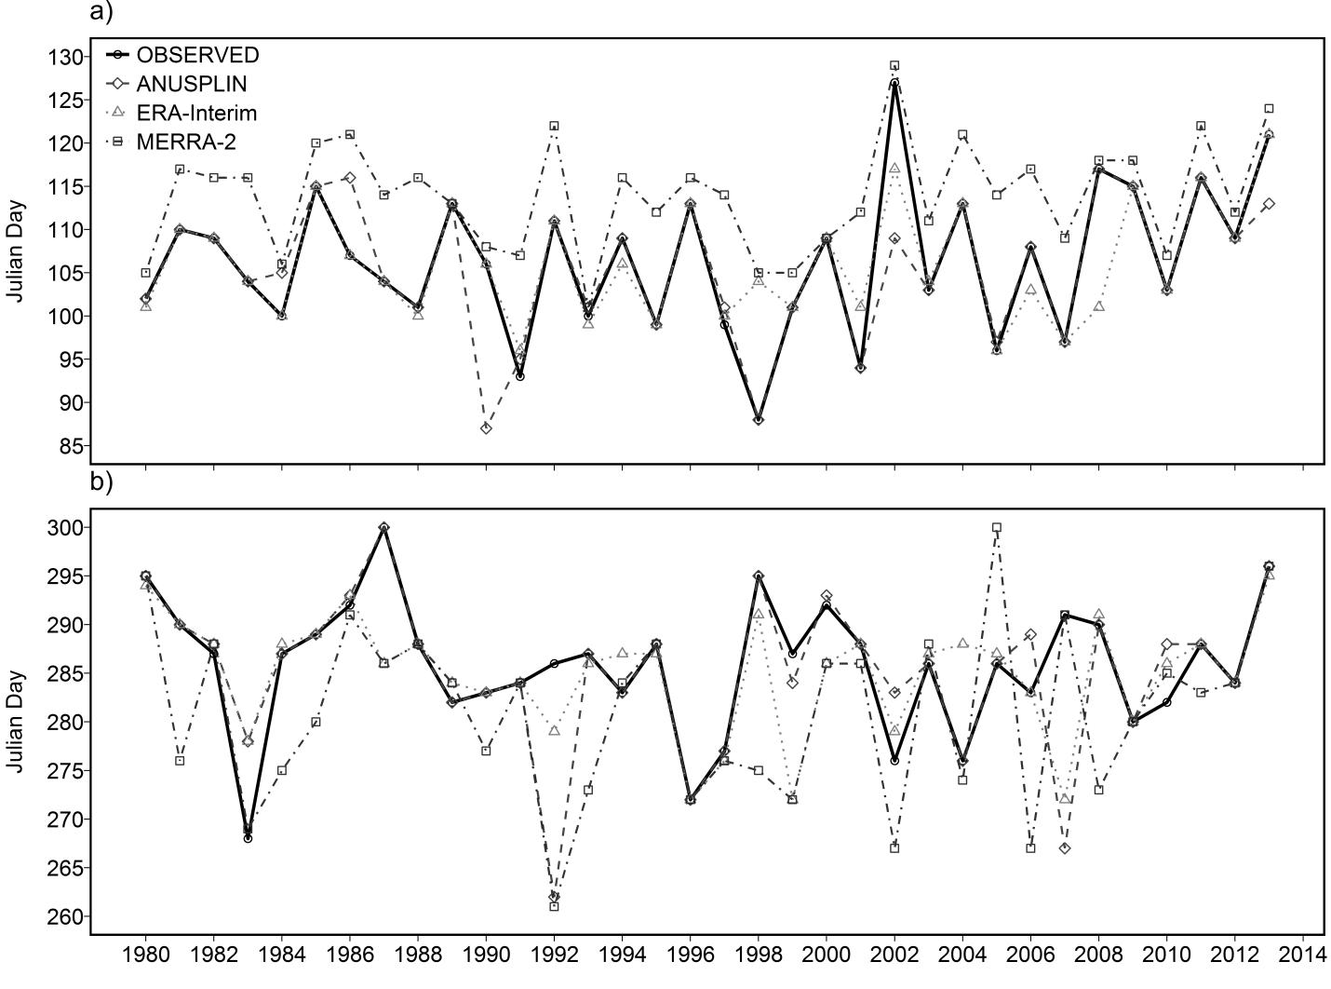

Slide 32
Hydrological Models

Slide 33
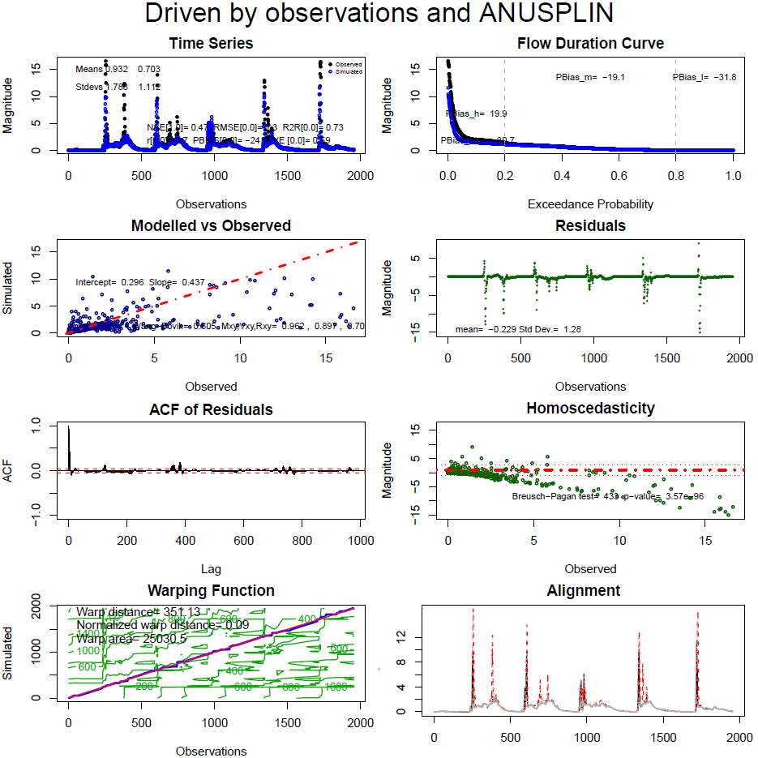

Slide 34
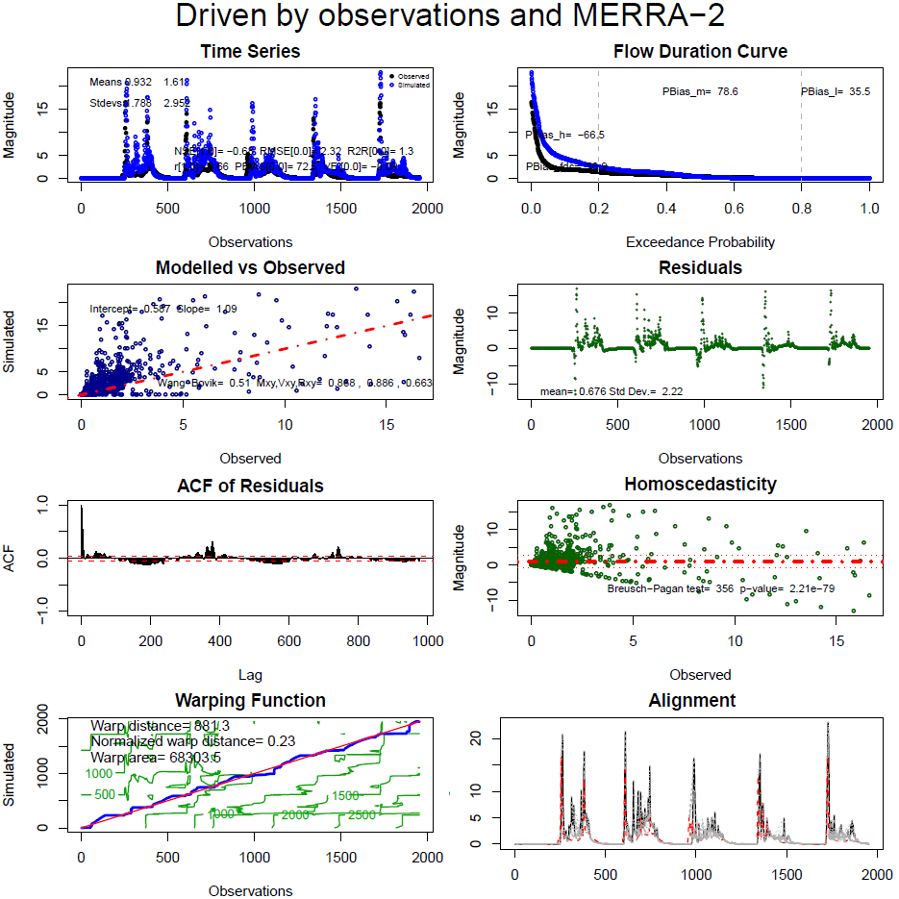

Slide 35
Reduce subjectivity
Correlation and correlation-based metrics weak
Need for absolute error measures
Multiple indicators
Graphical techniques and assessment of metrics
Legates, D. R., & McCabe, G. J. (1999). Evaluating the use of “goodness‐of‐fit” measures in hydrologic and hydroclimatic model validation. Water Resources Research 35(1): 233-241.
Ritter, A., & Muñoz-Carpena, R. (2013). Performance evaluation of hydrological models: Statistical significance for reducing subjectivity in goodness-of-fit assessments. Journal of Hydrology 480: 33-45.

Slide 36
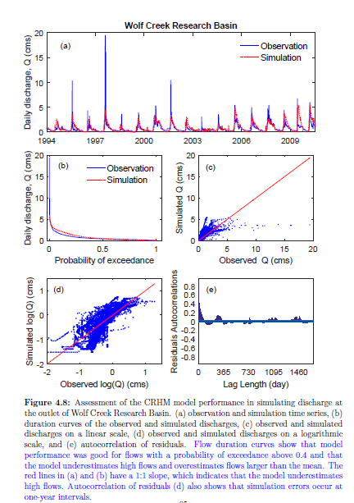
Moving forward
Subjective Assessment
Low flows - Poor
Medium Flows - Good
High Flows - Good
Peak Flows - Poor
Timing - Fair

Slide 37
Need an objective assessment
Multiple metrics
Provide context
Effectively communicate model performance
“Standardize” to make results comparable across studies
Need to connect model use to performance

Slide 38
How does model performance affect use?
Framework for setting context
Absolute or relative
Predictive or instructive or diagnostic
Constrain interpretation using metrics

Slide 39
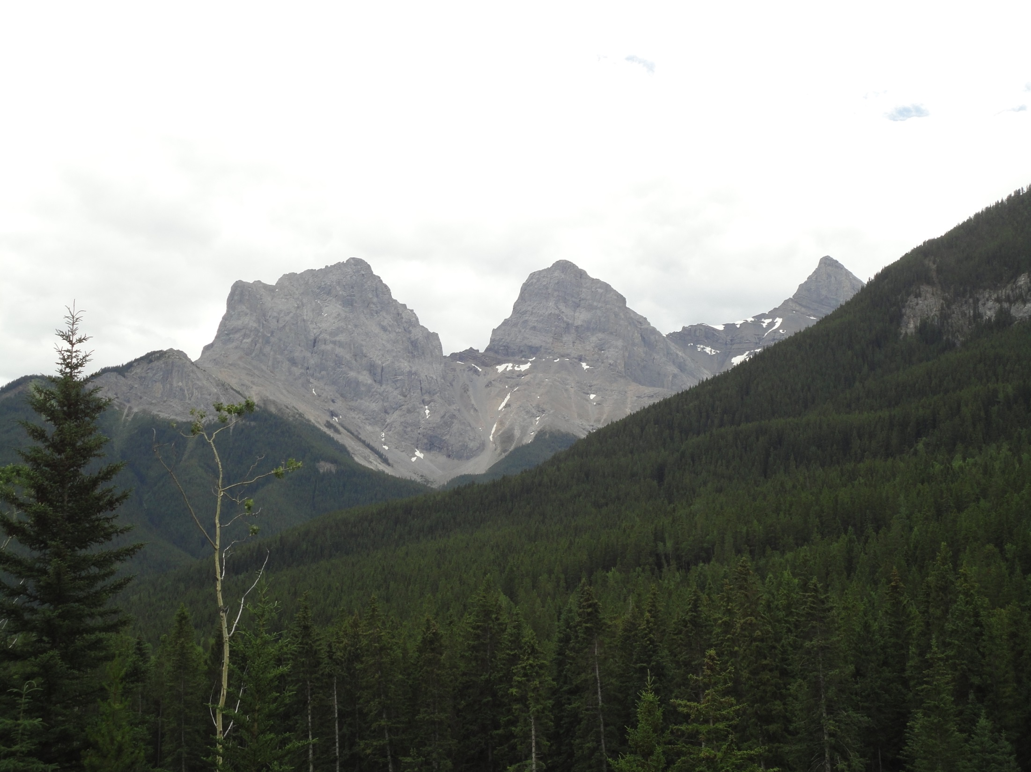
Bhaleka Persaud
Kabir Rasouli
Sebastian Krogh

Slide 42
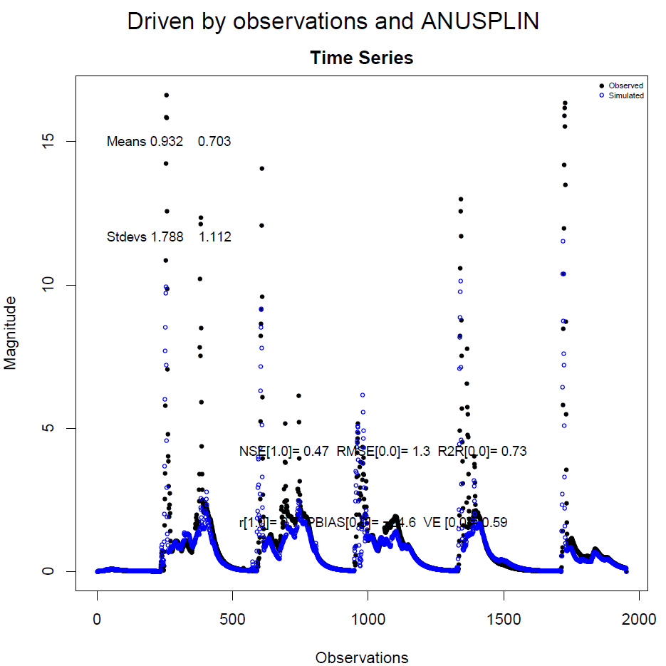

Slide 43
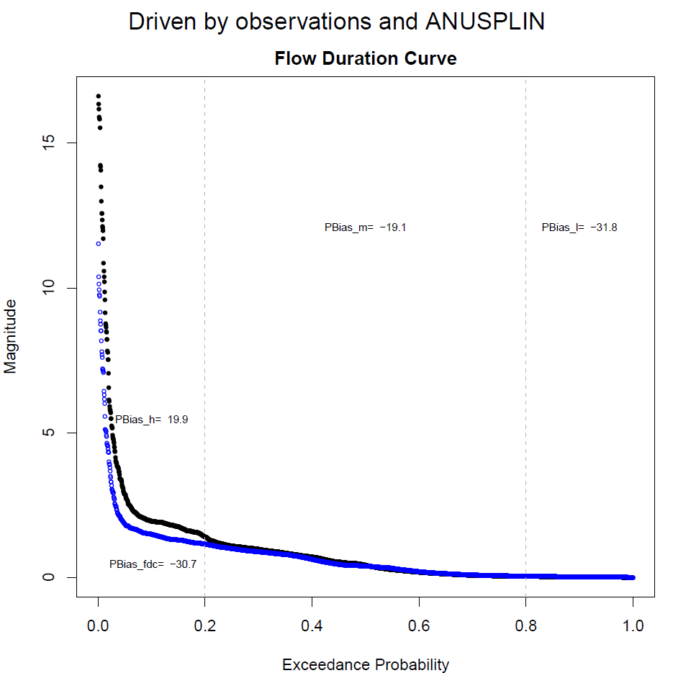

Slide 44
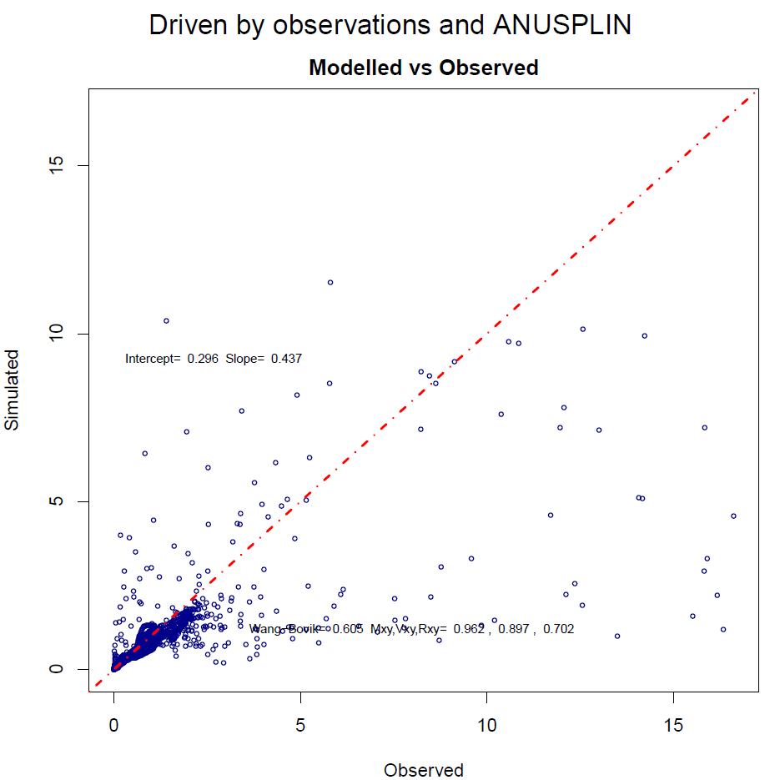

Slide 45
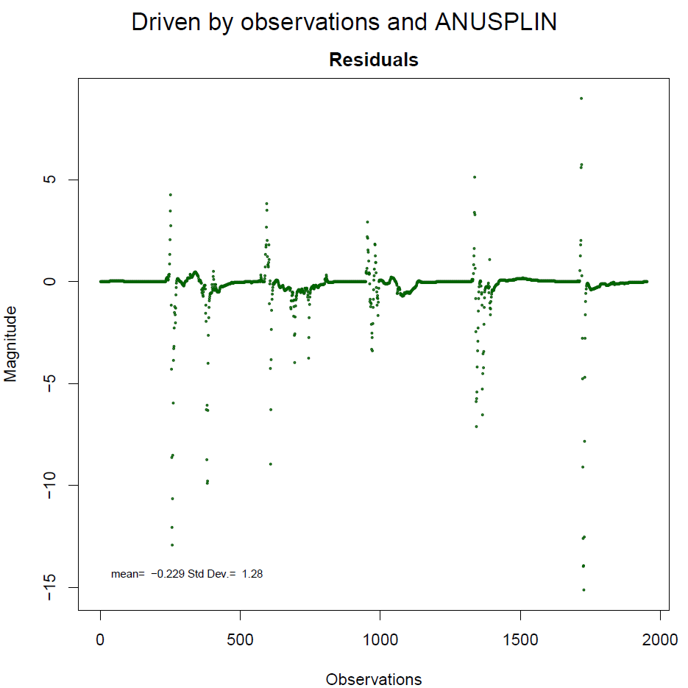

Slide 46
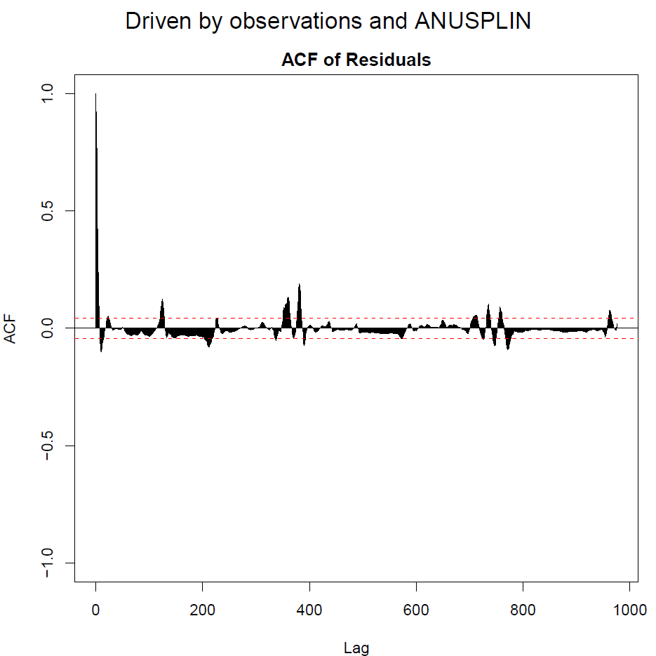

Slide 47
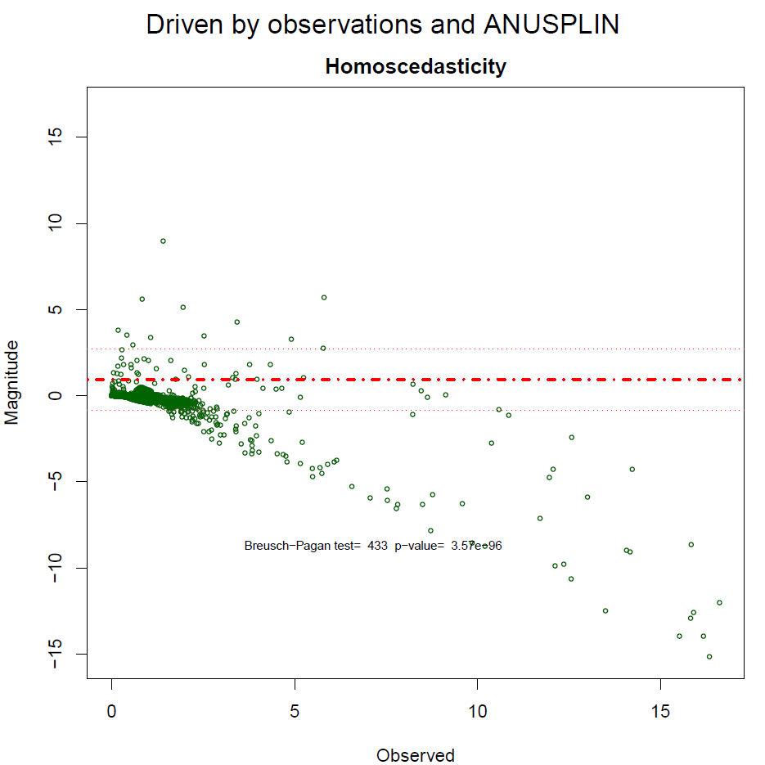

Slide 48
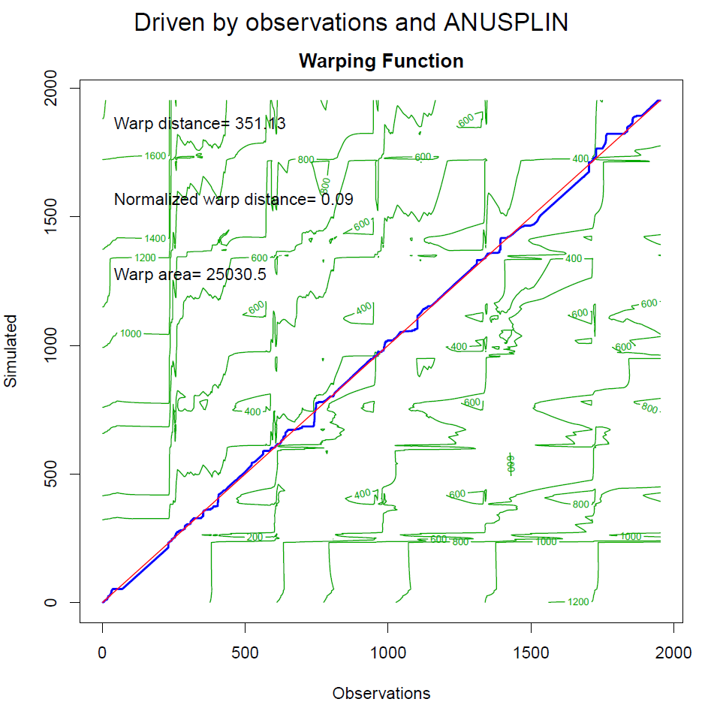

Slide 49
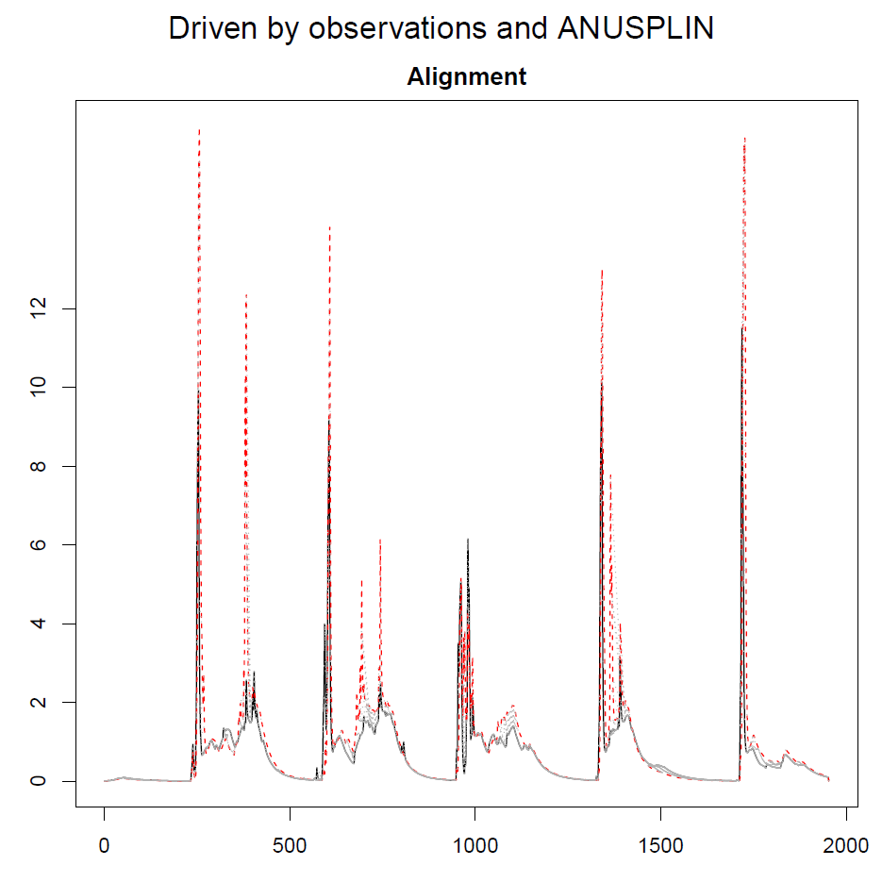

Slide 51
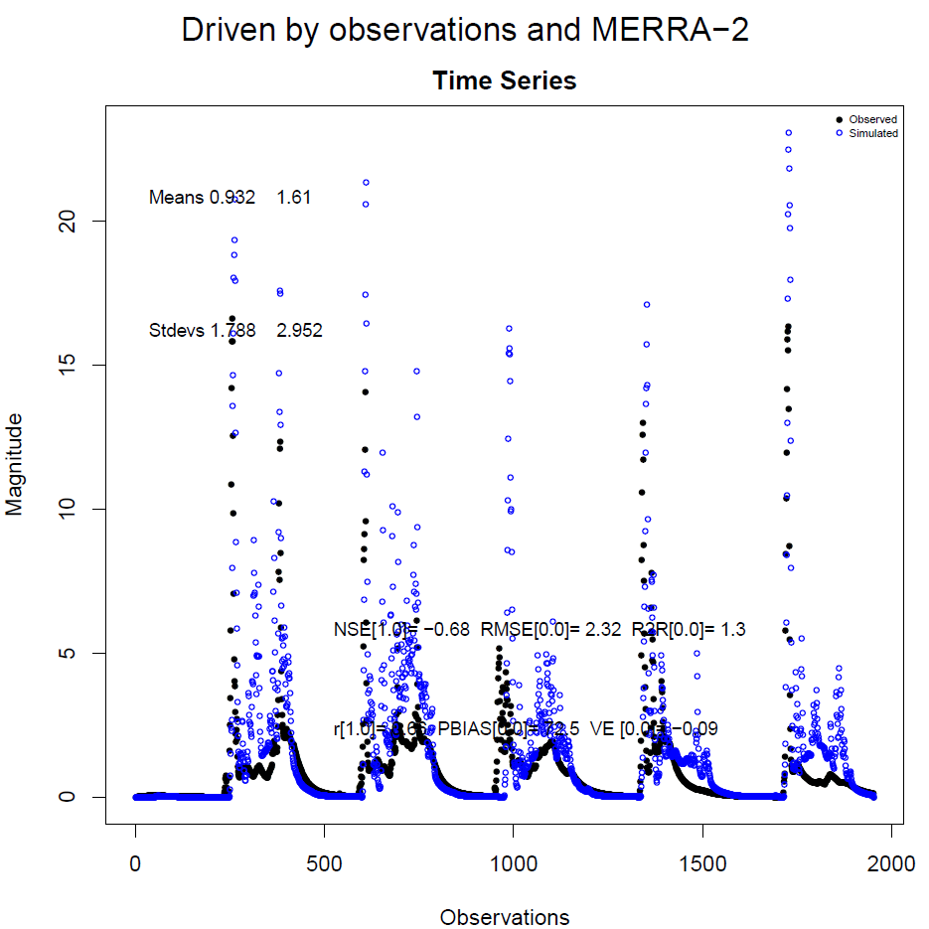

Slide 52
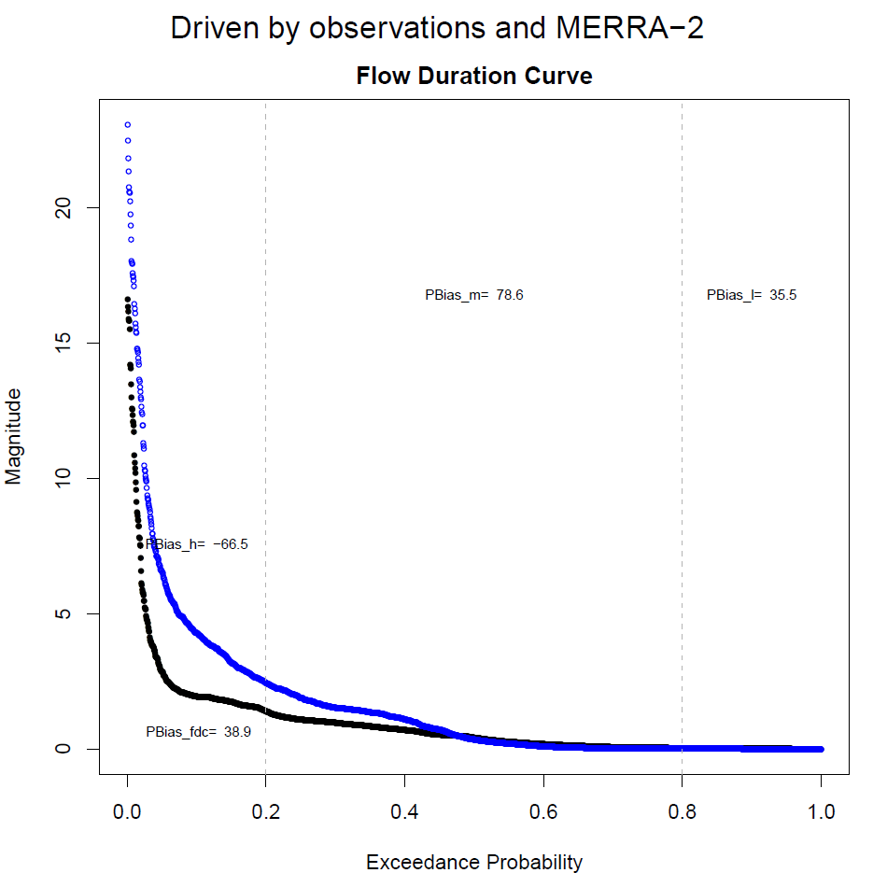

Slide 53
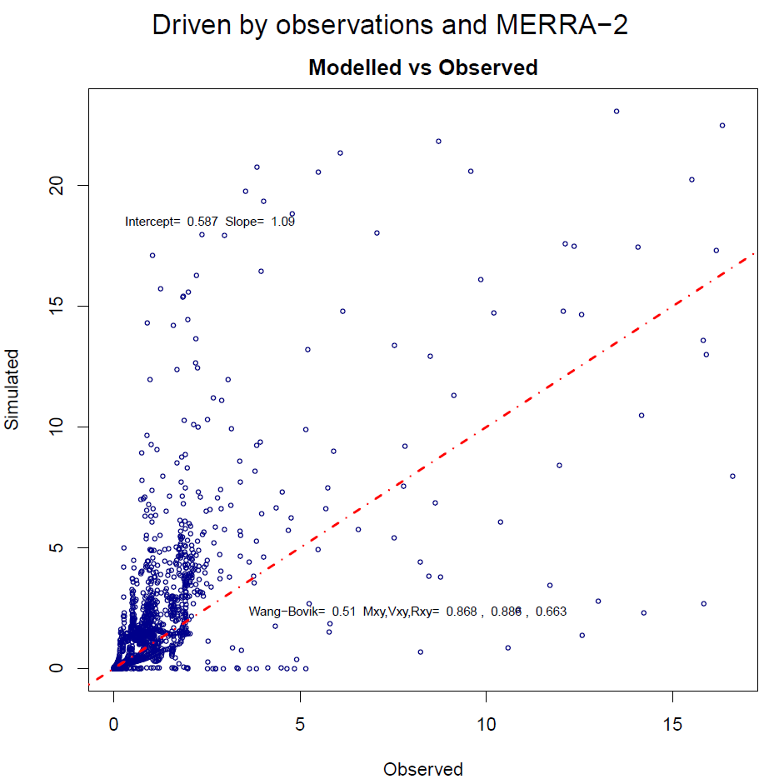

Slide 54
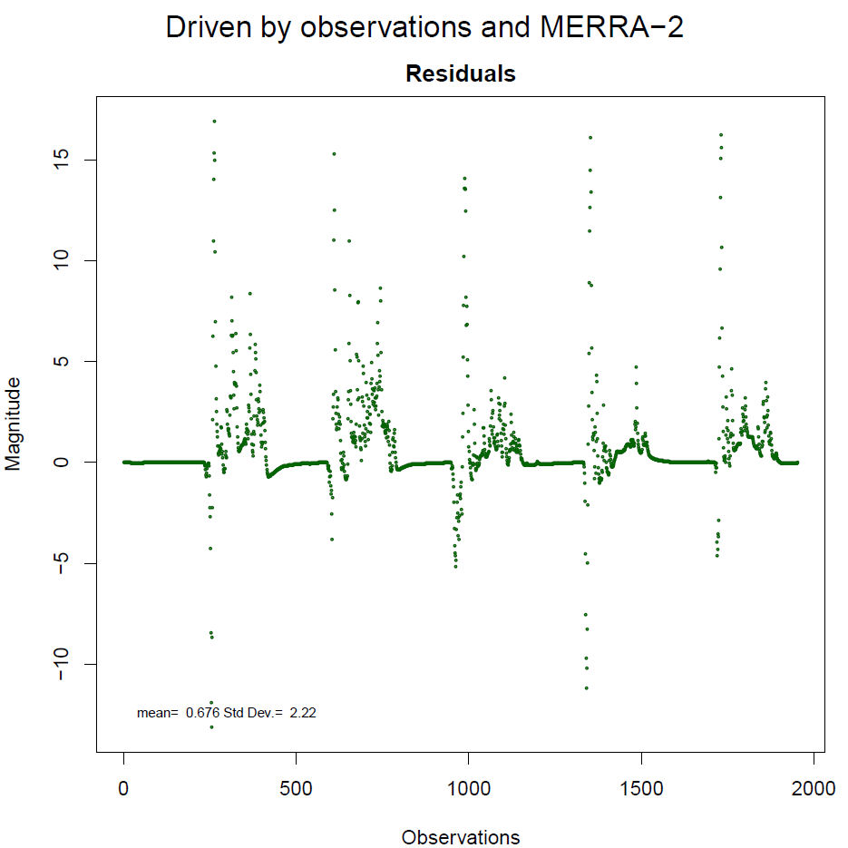

Slide 55
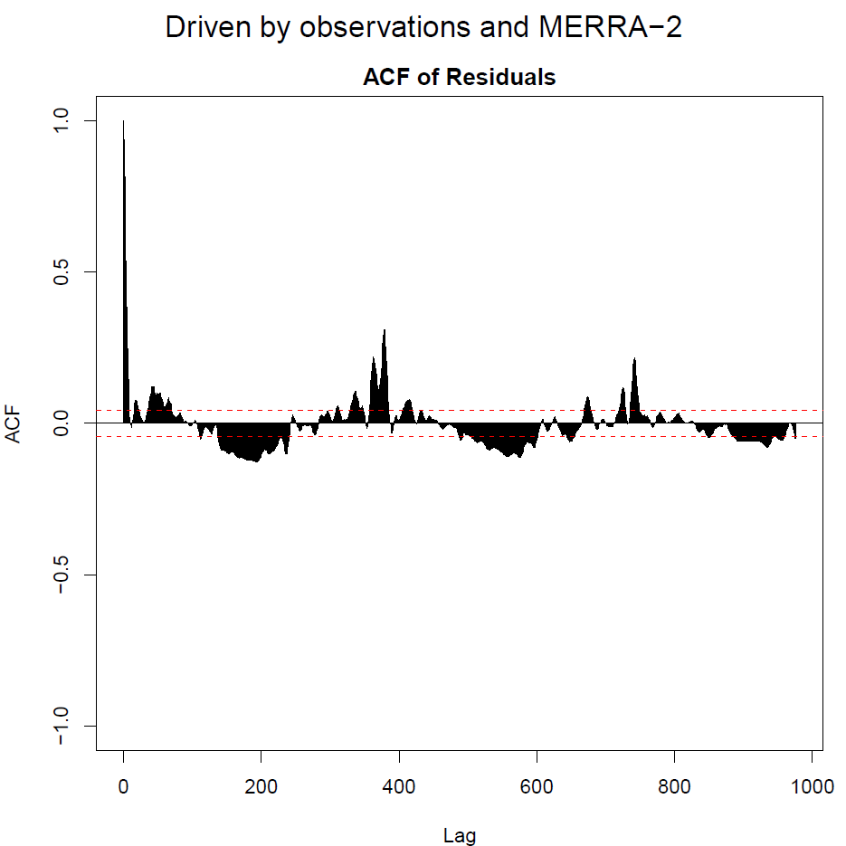

Slide 56
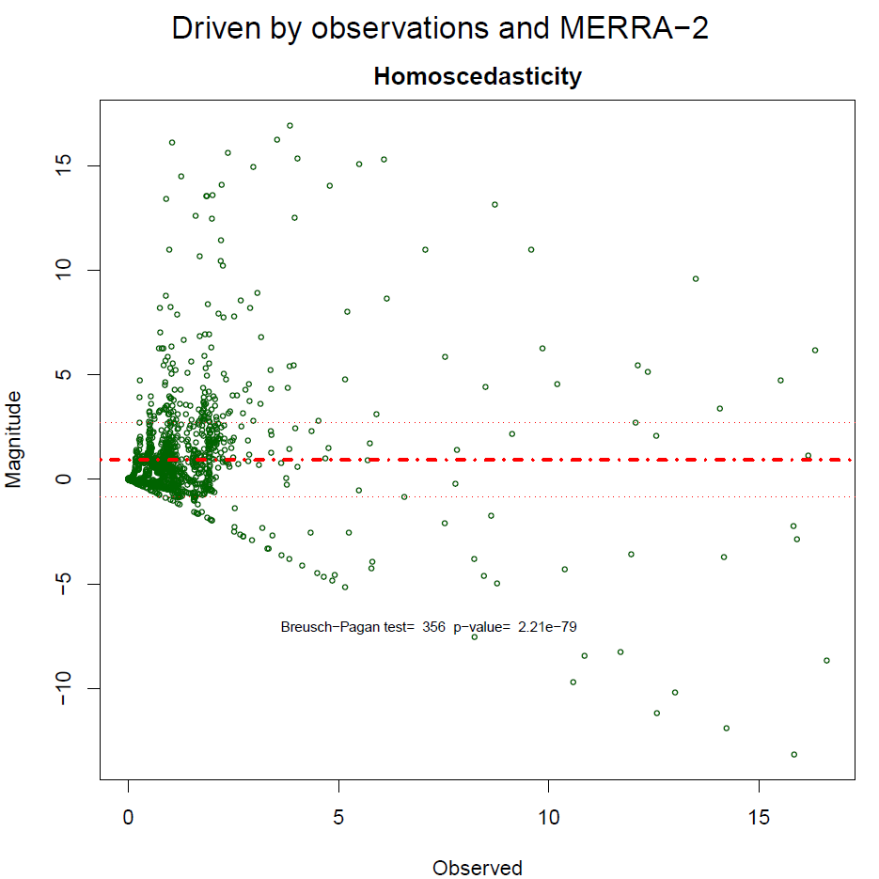

Slide 57
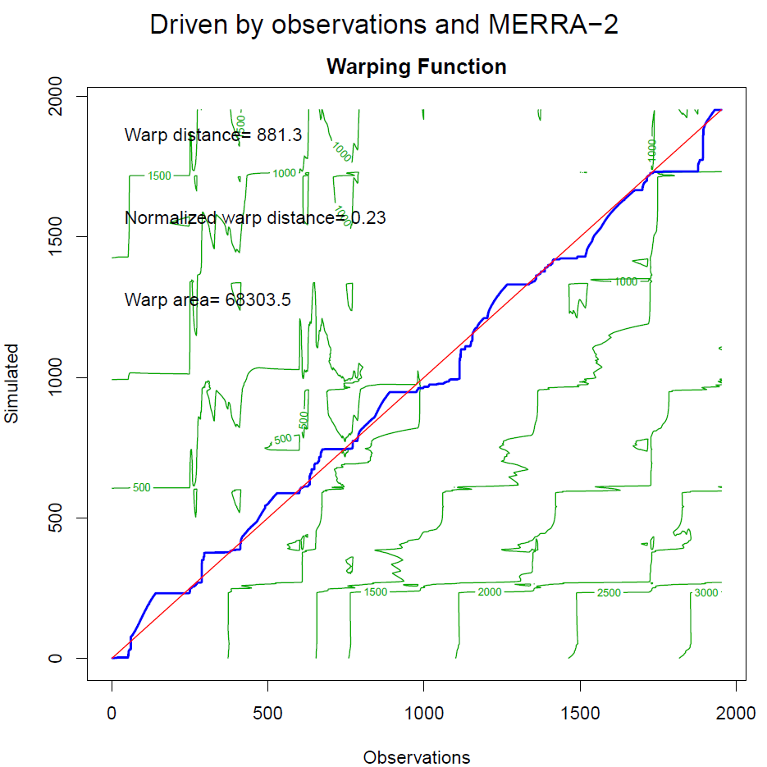

Slide 58


