Slide 1
Design Life Level
quantifying risk in a changing climate
Holger Rootzén
http://www.math.chalmers.se/~rootzen/
Rick Katz
http://www.isse.ucar.edu/staff/katz/
TexPoint fonts used in EMF.
Read the TexPoint manual before you delete this box.: AAAAAAAAA

Slide 2
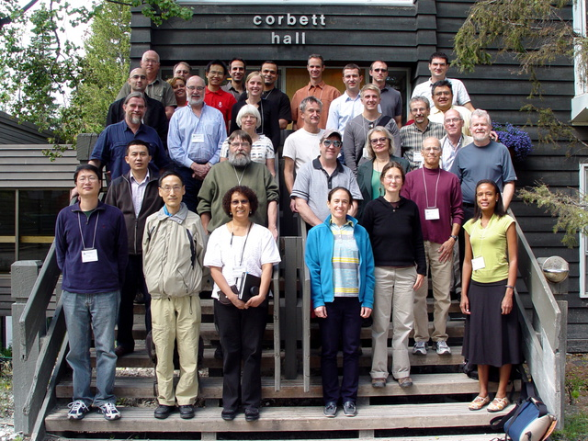
BIRS 2010 workshop

Slide 3
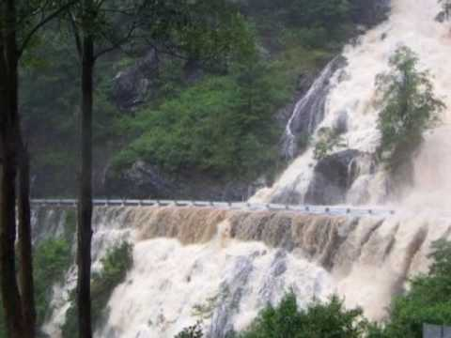
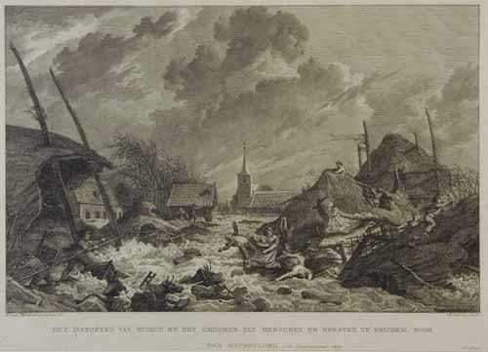
make dam 1.5 m higher
→ costs billions of Euros, popular protests
keep dam as is
→ (perhaps) thousands of deaths

Slide 4
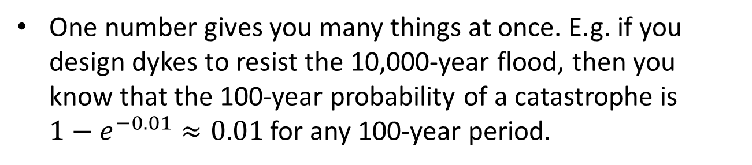
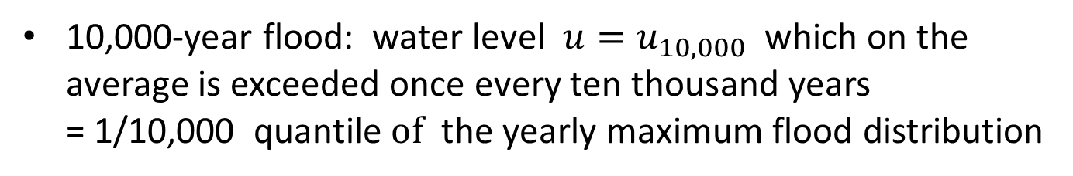

Current stationary practice: return levels
10,000-year flood: water level ${u=u}_{10,000}$ which on the average is exceeded once every ten thousand years
= 1/10,000 quantile$of$ the yearly maximum flood distribution
In a stationary climate with independent years
$P(10,000{yearmax>u}_{10,000}$) $≈1−e^{−1}$ $≈$ 0.63
One number gives you many things at once. E.g. if you design dykes to resist the 10,000-year flood, then you know that the 100-year probability of a catastrophe is ${1−e}^{−0.01}≈0.01$for any 100-year period.
doesn’t make sense in a changing climate

Slide 5
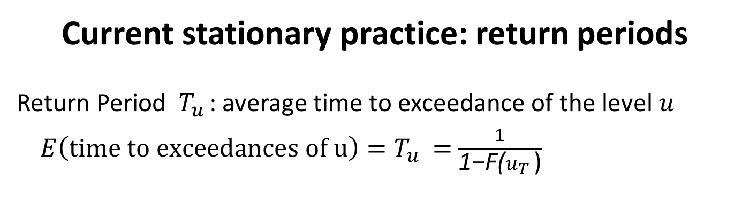
Current stationary practice: return periods
Return Period $T_{u }$: average time to exceedance of the level $u$
$E\left(time to exceedances of u\right)=T_{u }=$ $\frac{1}{\text{1−}\text{F}\text{(}u_{T }\text{)}}$
tempting to use return periods also in non-stationary climate
-- but not a good idea

Slide 6
French dams and Dutch dikes: 10,000 year return levels
10,000 years ago, there were few humans and little civilization on earth. 10,000 year from now, our world will be completely and utterly different in ways we cannot even imagine now.
Common codes: 100 year return levels
From 1913 to 2012 we have passed from a largely non-industrialized world to a post-industrial world. There has been two world wars, the Soviet Union has appeared and vanished, and China is rising to become the major superpower. Also 100 years from now the world will be completely different. But hopefully some major engineering structures will survive 100 years and more.
However interpretations like the following do make sense
The probability that an individual dam will fail next year is 1/10,000. There are (perhaps?) 650 dams in France, so “on the average” 650 x 100/10.000 = 6.5 dams will fail during the next 100 years -- but non-stationarity and dependence makes reality much more complex than this.

Slide 7
New concepts and tools
Basic information for engineering design in a changing climate (whether global or local):
design life period (e.g., the next 50 yrs., say 2018-2067)
risk (e.g., 5% chance) of a hazardous event (typically, in the form of the hydrologic variable exceeding a high level)
Design Life Level (DLL)
Minimax Design Life Level (MDLL)
complemented by
Risk plots
Constant risk plots

Slide 8
The Design Life Level is defined as an upper quantile (e.g. 5%) of the distribution of the maximum value of the hydrological variable (e.g. water level) over the design life period.
The concept Design Life Level is general: it is not tied to any specific method, say statistical or GCM based way to calculate it, and it is equally useful for independent and dependent extremes

Slide 9
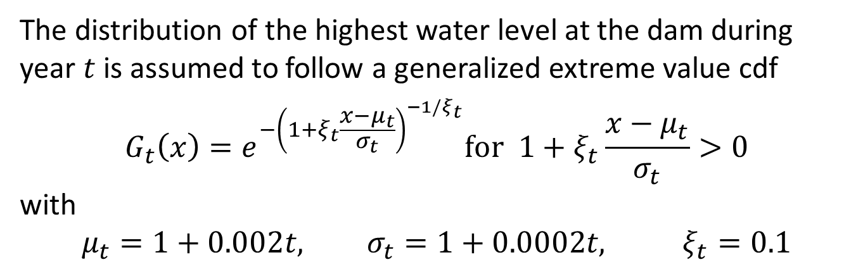
Hypothetical example: flooding of a dam
The distribution of the highest water level at the dam during year $t$ is assumed to follow a generalized extreme value cdf
$$G_{t}\left(x\right)=e^{−{\left(1+ξ_{t}\frac{x−μ_{t}}{σ_{t}}\right)}^{−1/ξ_{t}}}for 1+ξ_{t}\frac{x−μ_{t}}{σ_{t}}>0$$
with
$$μ_{t}=1+0.002t, σ_{t}=1+0.0002t, ξ_{t}=0.1$$
0.2% increase in mean per year – could e.g. be caused by an increase in mean water level
0.2% increase in scale per year – could e.g. be caused by climate becoming more variable

Slide 10
Results for hypothetical example
Design Life Prob. Design Life Level Return Level
(2015 climate)
2015-2064 0.05 11.5 10.9
2015-2064 0.01 15.2 14.4
2065-2114 0.05 12.6 10.9
2065-2114 0.01 16.6 14.4
Return levels are for T = 975 and T = 4975, respectively.
e.g. the 5% design life level for 2015-2064 is 11.5
Technical quantification/communication:
“the 2015-2064 5 % highest water level is 11.5 m”
Communication with the public:
”there is a 1 in 20 risk that the biggest flood during 2015-
2064 will be higher than 11.5 m”

Slide 11
Results for hypothetical example, cnt.
Design Life Prob. Design Life Level Return Level EWT EWT
2015 climate trend stopped
2015-2064 0.05 11.5 10.9 251 788
2015-2064 0.01 15.2 14.4 431 3839
2065-2114 0.05 12.6 10.9 262 1008
2065-2114 0.01 16.6 14.4 453 5002
EWT is expected waiting time until first exceedance of the design life level
Expected waiting times make sense also in a non-stationary climate – but they are dramatically changed if one changes assumptions about what happens after the design life period

Slide 12
Complementary concepts
The p% Minimax Design Life Level is the level for which the maximal probability of exceedance in any one of the years in the design life period is at most p%
Technical quantification/communication:
“the 2015-2064 0.1% bounded yearly risk highest water
level is 12.0 m”
Communication with the public:
”the risk that there will be a bigger flood than 12.0 m is less
than 1 in 1000 for each year in the time period 2015-2064”

Slide 13
The Risk Plot fixes a level and shows how the risk of exceeding this level varies for the different years in the design life period
The Constant Risk Plot fixes a probability and for each year in the design life period displays the level which is exceeded with this probability

Slide 14
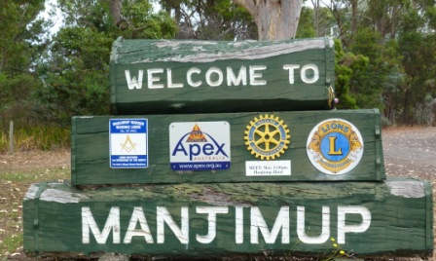
100
80
60
40
the 2011–2060 5% largest daily winter rainfall in Manjimup is 121 mm
1940
1960
1980
2000
Yearly maximum daily rainfall
0.1
100
0.05
60
20
0
2011
2035
2060
2011
2035
2060
The 121 mm-s risk plot
The 0.1% constant risk plot

Slide 15

0
-10
-20
the 2021–2060 10 % highest minimum winter temperature in Fort Collins is 24 degrees
-30
1970
1990
2010
Yearly minimum temperature
1.5
20
1
0.5
10
0
0
2021
2060
2100
2021
2060
2100
The 24 degree risk plot
The 0.1% constant risk plot

Slide 16
Uncertainties
Statistical uncertainties: confidence/prediction intervals
Model uncertainties: model comparison, e.g. via maximum likelihood
Trend uncertainties: difficult, sensitivity studies
GCM uncertainties: choice of spatial resolution; differential equation models; future changes in human activity; extremes not well caught by models
In design phase plan for later modification to make the construction more resistant, if need should arise.
Plan for regular adjustment of rules for managing the construction.
Plan for regular updating of risk measures as experience and knowledge increases.

Slide 17
Rootzen, H. and R. W.Katz (2013). Design Life Level: Quantifying risk in a changing climate. Water Resourses Res., 49,
Since then (examples):
Lins, H.F., Cohn, T.A., (2011). Stationarity: wanted dead or alive? J. Am. Water Resourses Assoc. 47, 969 475-480.
Yan,L., Xiong, L., Guo, S., Xu, C., Xia, J., and Du, T. (2017). Comparison of four nonstationary hydrologic design methods for changing environment.
DLL
ENE = Equivalent Number of Exceedances
ER = Equivalent Reliability
ADLL=Average Design Life Level
EWRI Task Committee: Stochastic Methods for Analyzing Nonstationary Extreme Hydrologic Events

Slide 18
Conclusions
To handle and communicate risks in a changing climate one should specify both a period of time and a probability of failure
If one is not aiming at design but just wants to illustrate the extent of changes simpler concepts may sometimes suffice
We recognize that the concept of Design Life Level is a shift from more common standard-based to less common risk-based engineering design. But such a shift may be desirable even under a stationary climate.

Slide 19

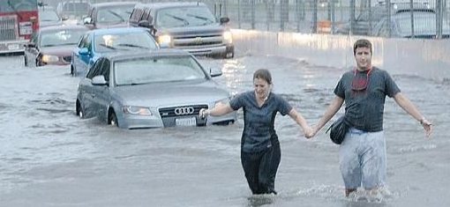
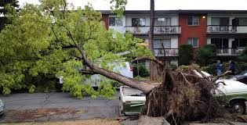

Kuestions – more than answers
Design – risk estimation – regulation – emergency planning – communication for
Each location separately?
River networks?
An entire country?
Small catastrophes – large catastrophes
What dimensions can be handled right now? In future?
Climate change?
Urban flood
Windstorm
Dam breach

Slide 20



