Slide 1
2-crossing-critical graphs as LEGO bricks for inviting kids to graph theory
How can crossing numbers contribute to
more understanding in
a diverse and polarized modern society.

Slide 2
EMOTIONAL STATES
DURING ACTIVITY
Introduction: what do we experience while studying and learning?

Slide 3


Activity and experience
What emotions do we experience while performing activities?
How can acquiring knowledge be an enjoying experience?

Slide 4
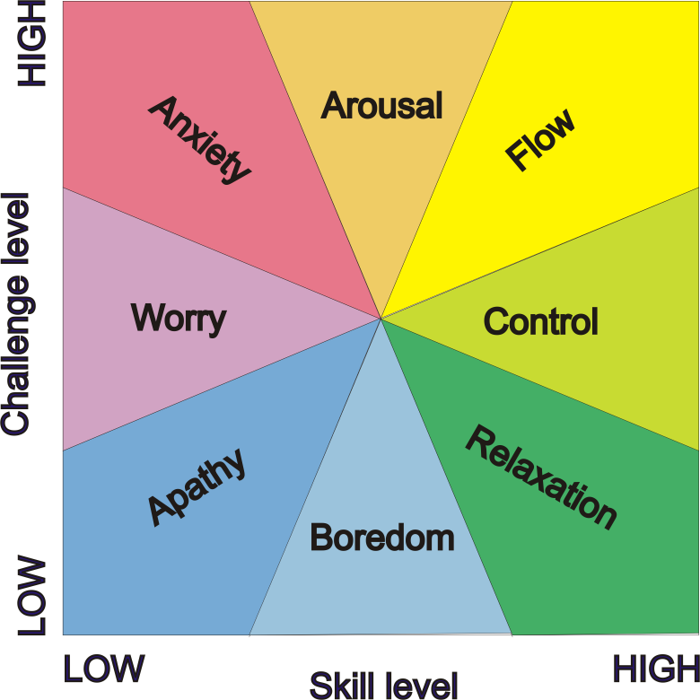
Flow
Emotional states of individuals conducting various activities are classified according to skill level and challenge level they exhibit while performing the activity.
Flow is a state of complete focus,
when both skill level and challenge level
are above individual’s average.

Slide 5
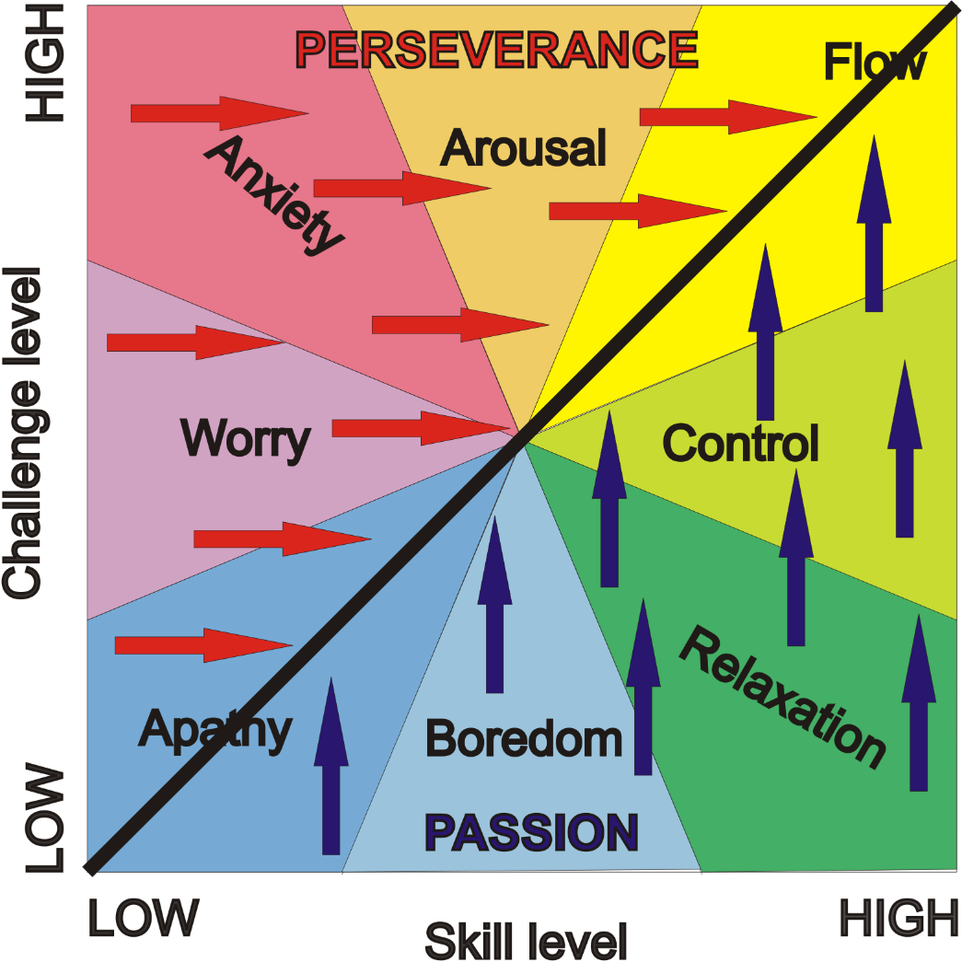
Grit
A tool to achieve flow is grit.
It is a combination of
passion for the activity we
are performing and
perseverance we exhibit
when facing obstacles.

Slide 6
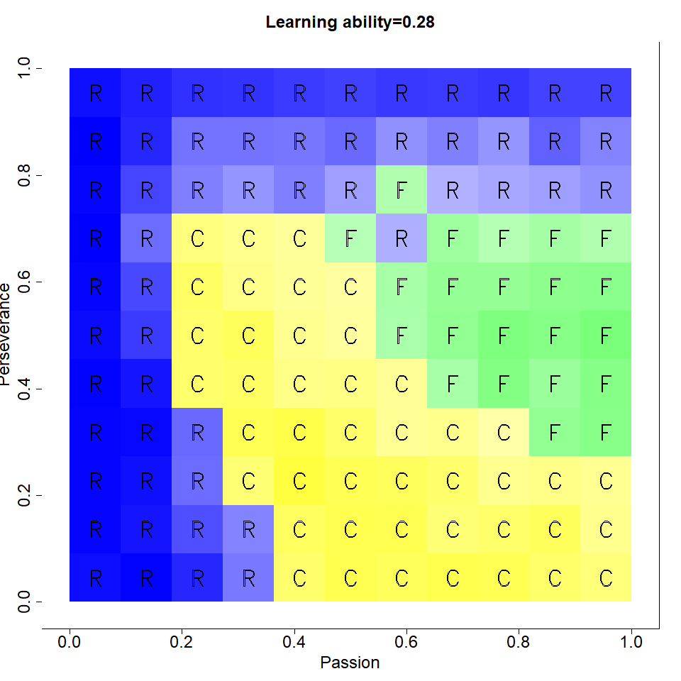
Developing flow in learning
We observed emotional states of a simulated individual
while learning at various specified values of
learning ability, perseverance and passion.
The image displays a section of phase space where
the domain of flow is flanked by
domains of control and relaxation.
Flow is developed through
sufficient levels of
  passion (more is better),
  learning ability (more is better),
  perseverance
(enough, but not too much).

Slide 7
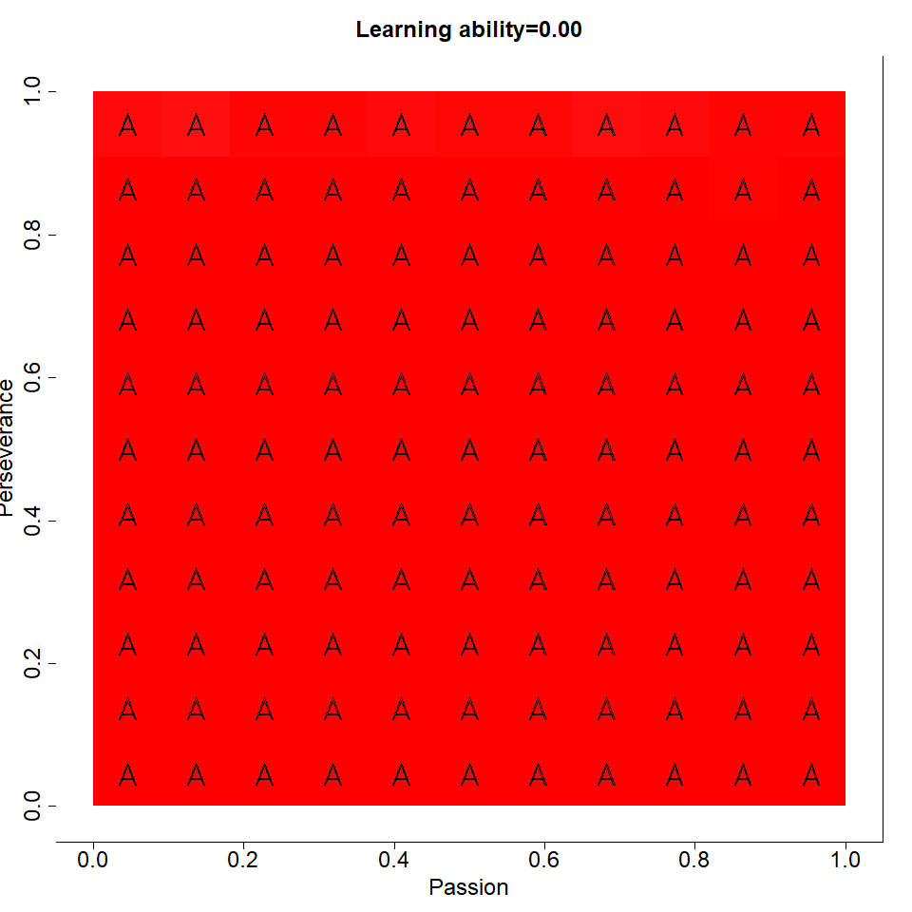

Slide 8
Conditions for flow at work
Conditions on the task:
  Clear goals.
  Immediate feedback.
  Control is not a problem.
Conditions on the environment:
  Deepened concentration.
  Focus is on the present.
Conditions on the person:
  Balance between challenge and skill.
  Perception of time is altered.
  Loss of ego.
  Autotelic experience.

Slide 9
BEGINNER’S INTRODUCTION TO
2-CROSSING-CRITICAL GRAPHS
Background of the problem

Slide 10
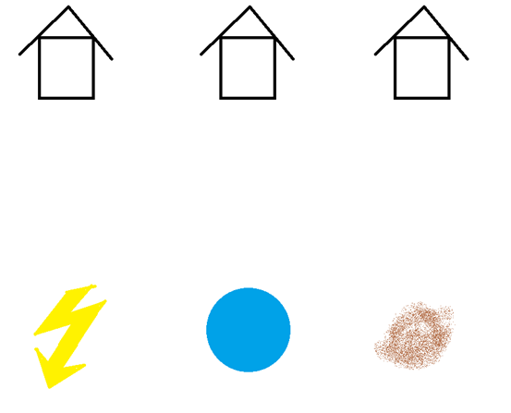
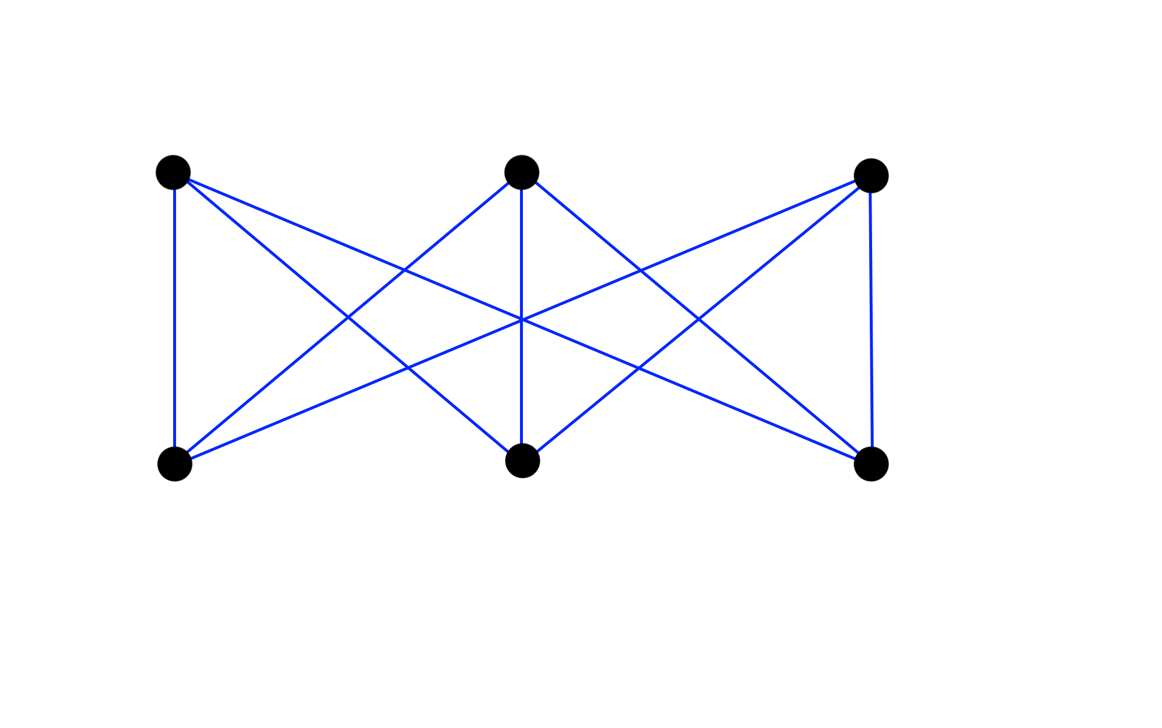
Crossing number, drawings:
Three houses, three commodities

Slide 11
No planar solutions:
Kuratowski theorem
Graph
Planar graph
Complete (bipartite) graphs
Subdivision
Kuratowski theorem:
Improve understanding: Euler formula for the plane.
Graphs are not planar.

Slide 12
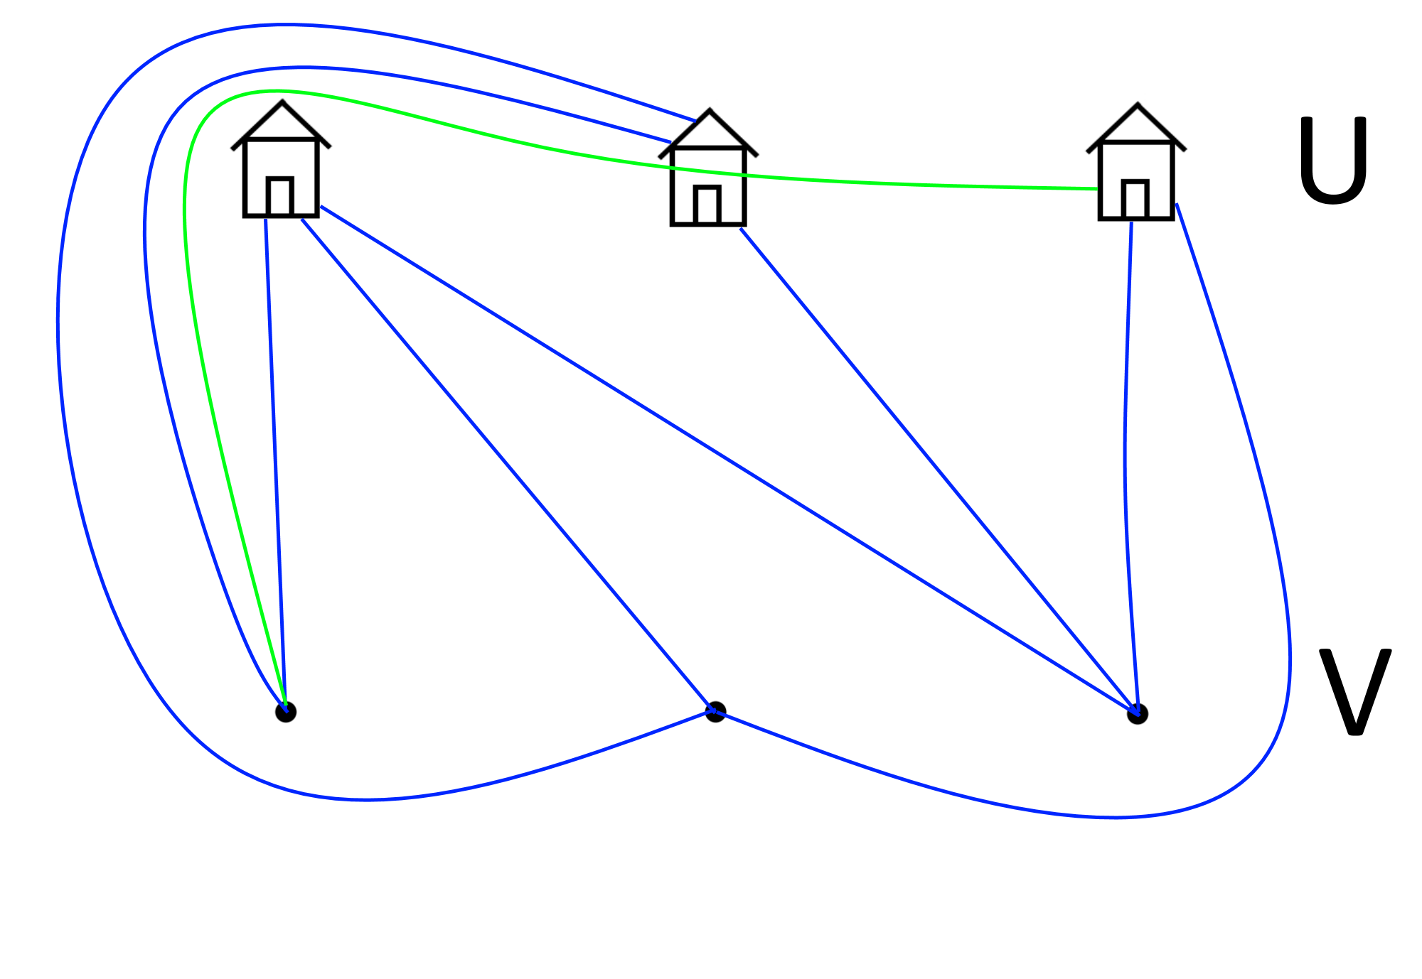
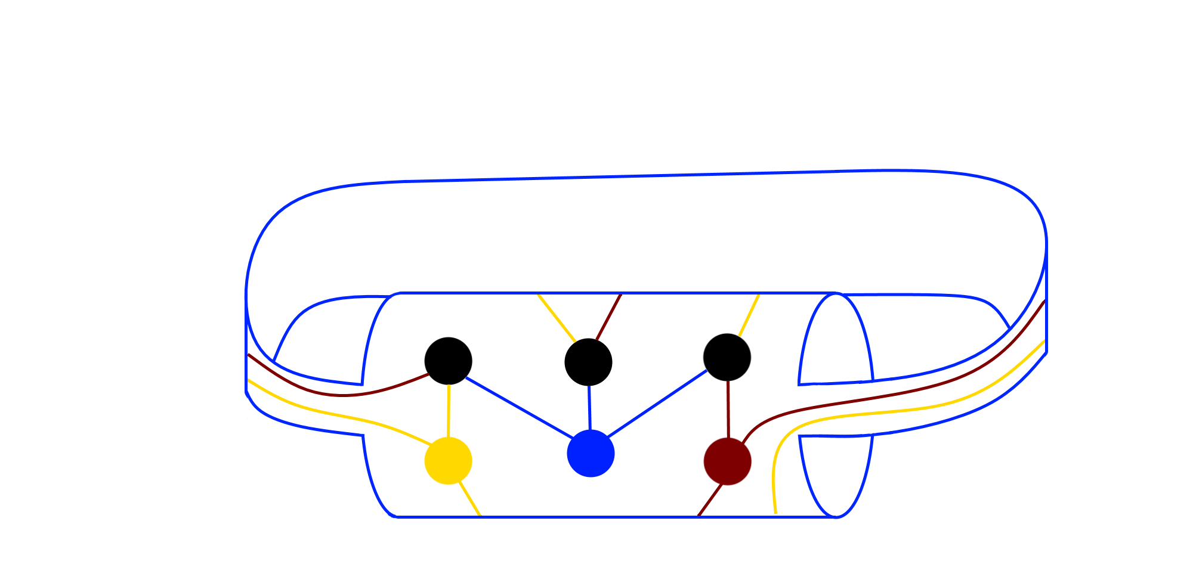
Out-of-the-box solutions
Houses are not dimensionless points, right?
Are tunnels allowed?

Slide 13
k-crossing-critical graphs and Kuratowski theorem
are crossing-critical graphs: any edge you remove, they become planar; ie. their crossing number drops.
Kuratowski: are the only two 3-connected 1-crossing-critical graphs.
Širáň, 1983: For any k>=2, there are infinitely many 3-connected k-crossing-critical graphs.
Kochol, 1984: For any k>=2, there are infinitely many 3-connected k-crossing-critical simple graphs.
Salazar, 2003: For any r in [4,6), for infinitely many k, there exists an infinite family of k-crossing-critical graphs with average degree r. If such a family exists for some k, then r in (3,6).
Pinontoan, Richter, 2003: For any r in [3.5,6), for infinitely many k, there exists an infinite family of k-crossing-critical graphs with average degree r.
Bokal, 2010: For any r in (3,6), for any sufficiently large k, there exists an infinite family of k-crossing-critical graphs with average degree r and crossing number k.

Slide 14
k-crossing-critical graphs, structure
Richter, Thomassen, 1993: If G is a k-crossing-critical graph, then its crossing number is at most (5/2) k +16.
Pinontoan, Richter, 2003: For any r in [3.5,6), for infinitely many k, there exists an infinite family of k-crossing-critical graphs with average degree r.
Hlineny, 2003: k-crossing-critical graphs have bounded path-width.
Hlineny, 2008: k-crossing-critical graphs can have many veritces of even degrees up to 2k-2.
Dvorak, Mohar, 2010: k-crossing-critical graphs can have a vertex of arbitrarily large degree.
Bokal, Bračič, Hlineny, 2018: For any set D of integers containing 3,4, for any rational r in (3,6), and for any sufficiently large k, there exists an infinite family of k-crossing critical graphs with average degree r such that only degrees in D appear arbitrarily often.
Dvorak, Hlineny, Mohar, 2018: large k-crossing-critical graphs are composed of either a crossed band, a twisted band, or a twisted fan, and can be reduced to a small base graph.

Slide 15
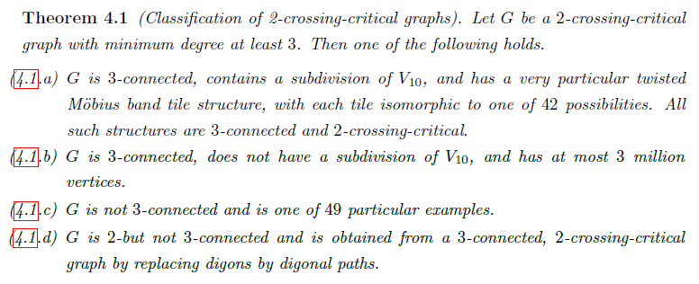
2-crossing-critical graphs:
the next step beyond Kuratowski thm.
Bokal, D., Oporowski, B., Richter, R. B., & Salazar, G. (2016).
Characterizing 2-crossing-critical graphs. Advances in Applied Mathematics, 74, 23-208.

Slide 16

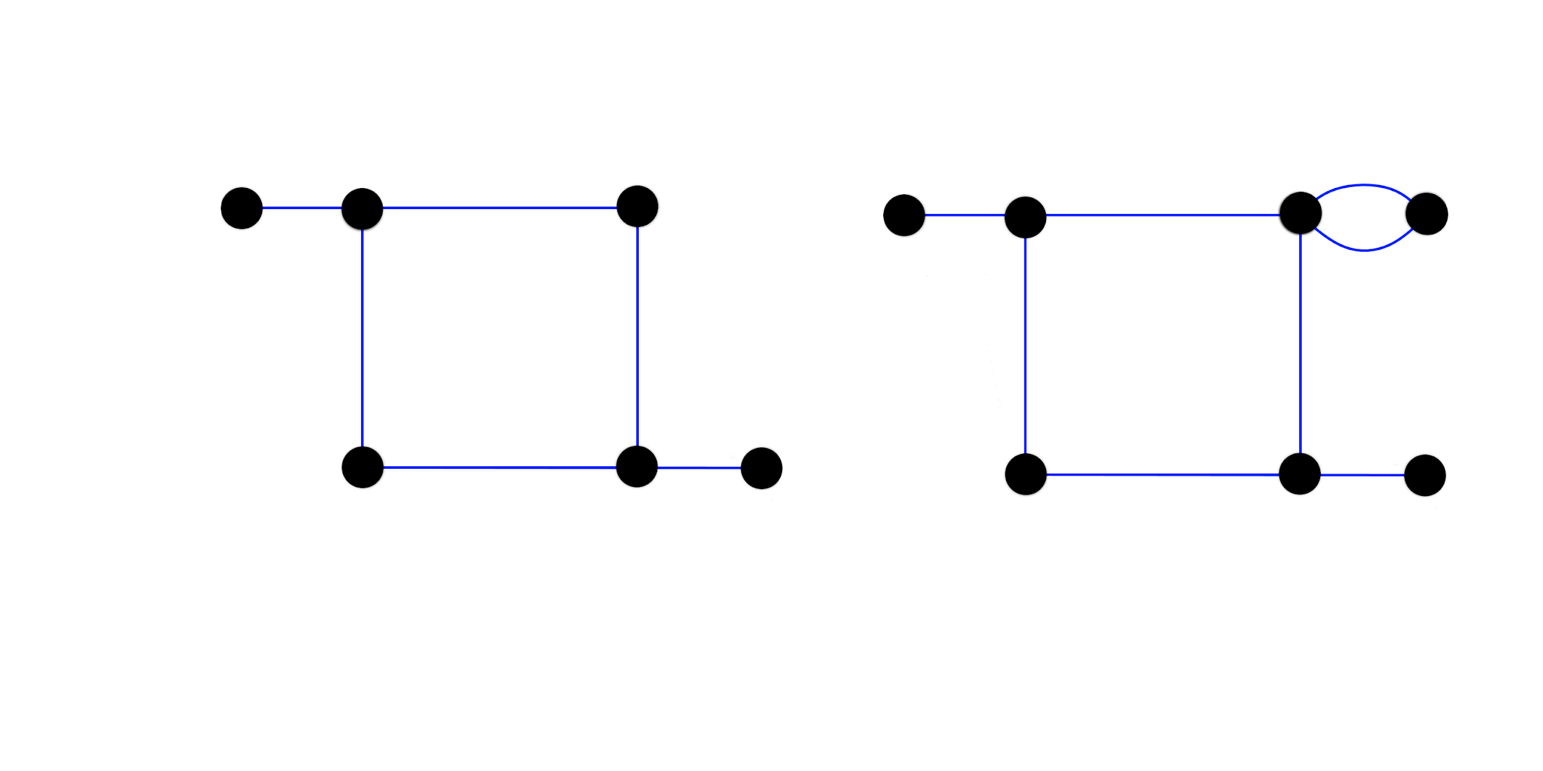
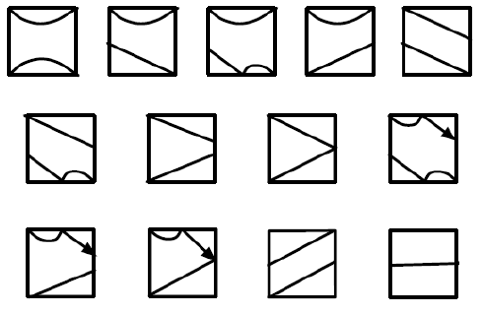


Large 2-crossing-critical graphs

Slide 17
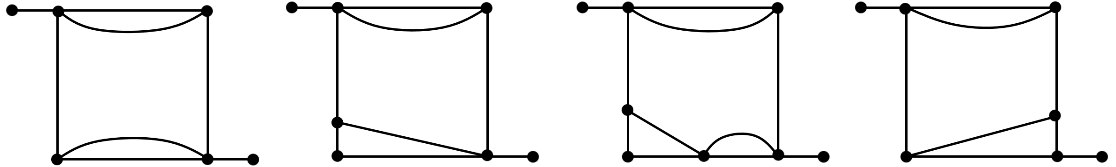
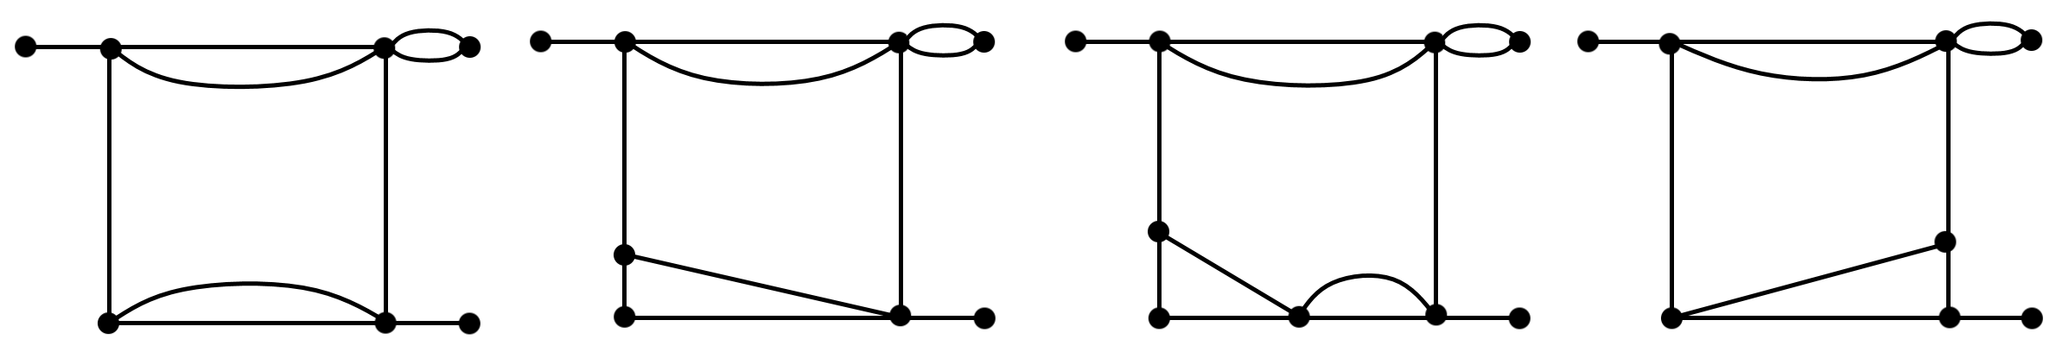
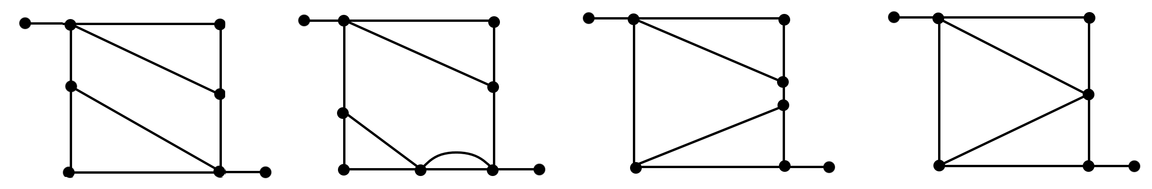
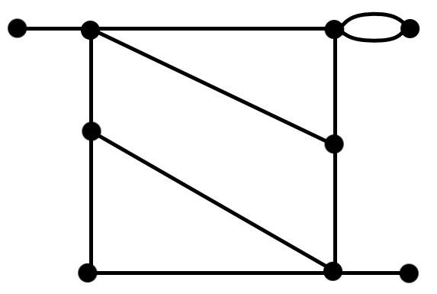
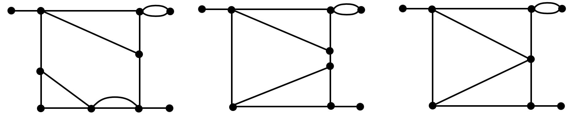
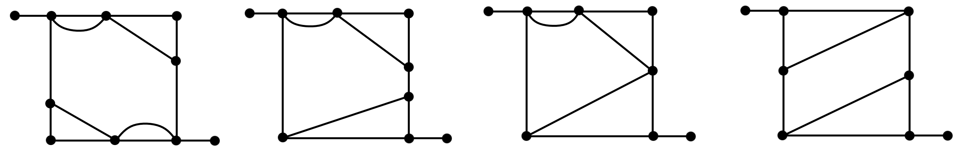
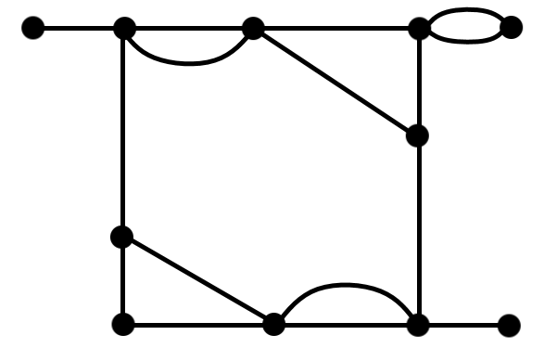
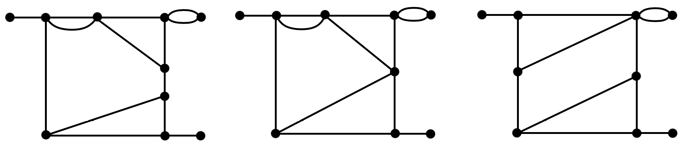
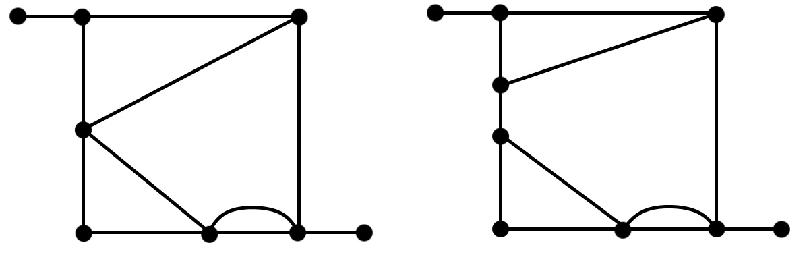
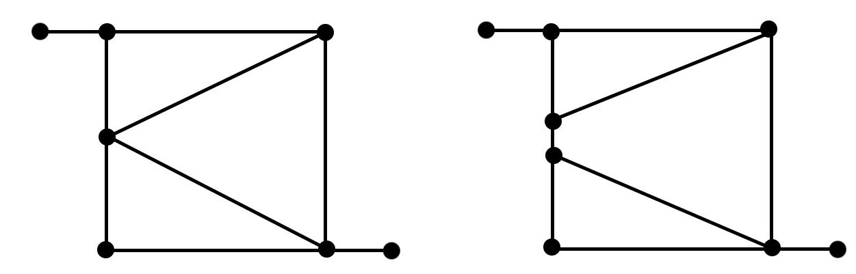
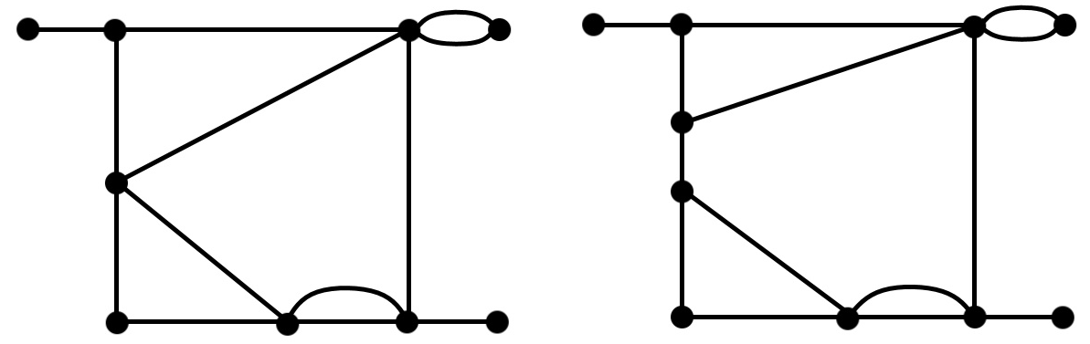
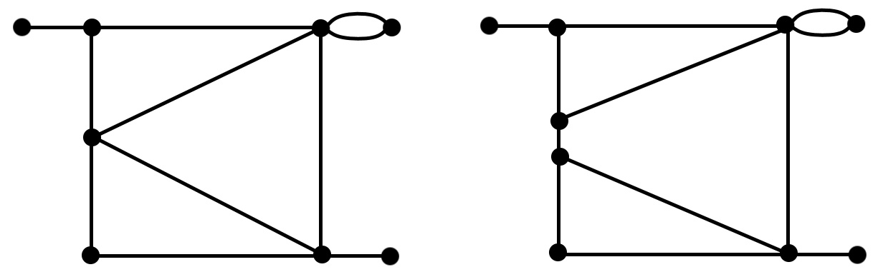
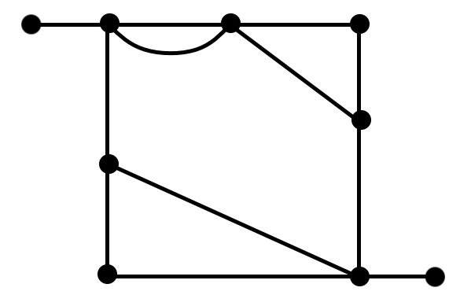
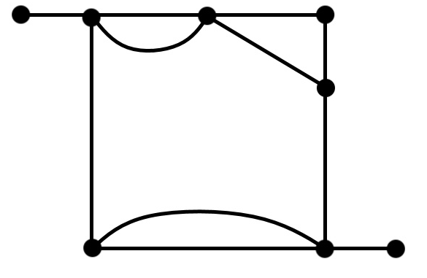
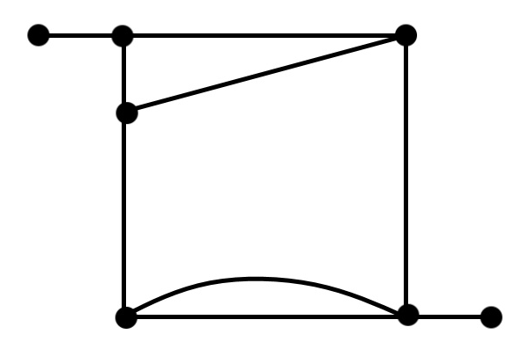
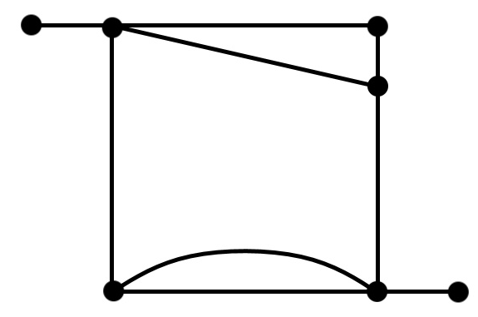
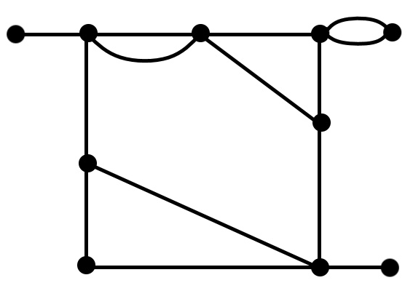
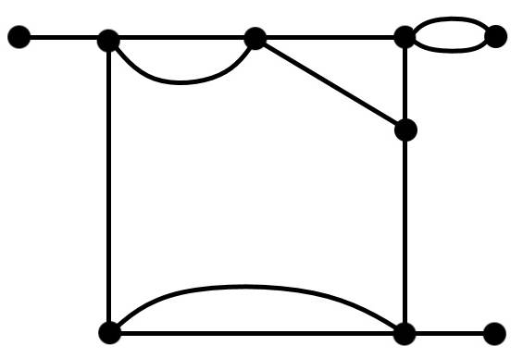
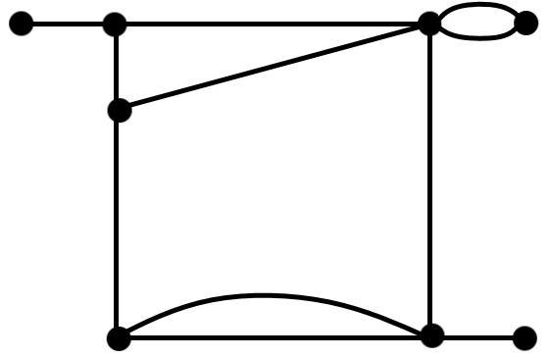
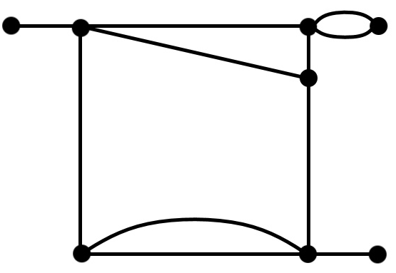
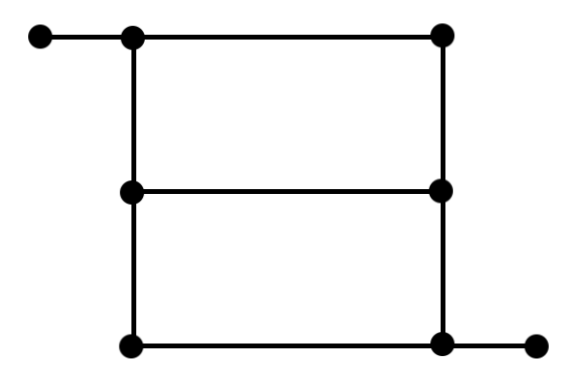
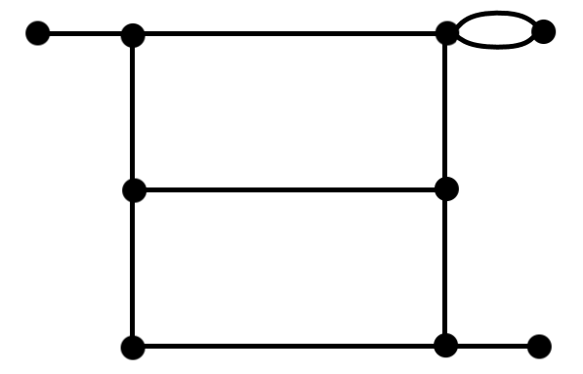
All the 42 tiles

Slide 18
RELEVANCE OF 2 CROSSING CRITICAL GRAPHS FOR BEGINNERS
A forbidden question: why?

Slide 19
An analogy between society
and k-crossing-critical graphs
Bounded resource: crossings, edges.
are the only 3-connected graphs with minimal number of edges that are 1-crossing critical
(proof on 6 pages).
There are infinitely many 3-connected 2-crossing-critical graphs, but they are either small, or rigidly structured
(185 pages).
Total characterization of 3-crossing-critical graphs is
beyond comprehension.
But structurally, all k-crossing-critical graphs are understood.

Slide 20
An analogy between society
and k-crossing-critical graphs
Traditionally:
  Bounded resource: manpower, survival.
  Hunters, gatherers: small, finite societies.
  Ancient civilizations: A better usage of the resources,
  but authoritarian, slave-driven.
Modern civilization:
  abundance of ancient resources,
  but incomprehensible, lacking unifying narrative.
  Limited resources of modern society:
  time, attention, empathy, understanding.
  What kind of society does that lead to?
  Publishing: rule of data, structure of contributions.

Slide 21
Back to mathemathics
Three houses puzzle may attract attention and bring joy to learning discrete math.
How far is it from the frontiers of human knowledge?
The path from one to two-critical graphs seems short.
With structural theorem it seems walkable.
Applying the structural theorem, one can answer interesting, unanswered, yet solvable questions.

Slide 22
Three formulations of a corollary
Let G be a 2-crossing-critical graph containing a
V₁₀ subdivision. Then G is Hamiltonian.
There exists an integer N, such that every 3-connected 2-crossing-critical graph with more than N vertices is Hamiltonian.
Let G be a 2-crossing-critical graph containing a V₁₀ subdivision and consisting of k tiles. There are functions 0<l(k)<u(k), such that G the number of different Hamiltonian cycles of G is between l(k) and u(k).
Note: “large” is required due to Petersen Graph.

Slide 23
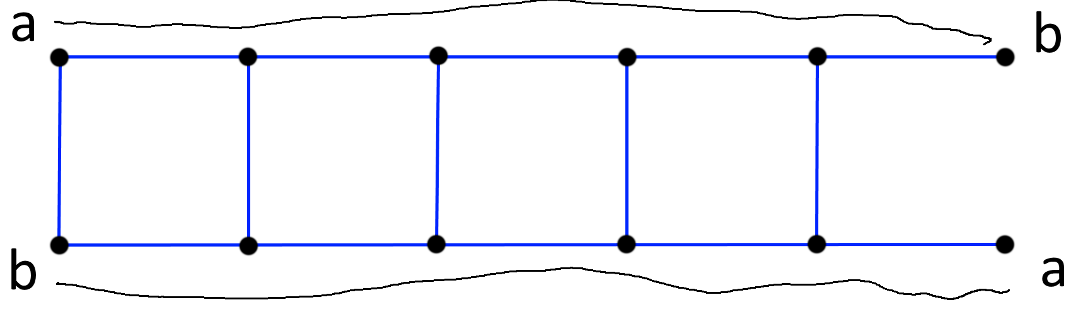
A simple proof

Slide 24
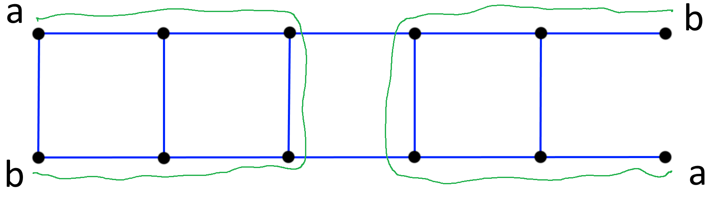
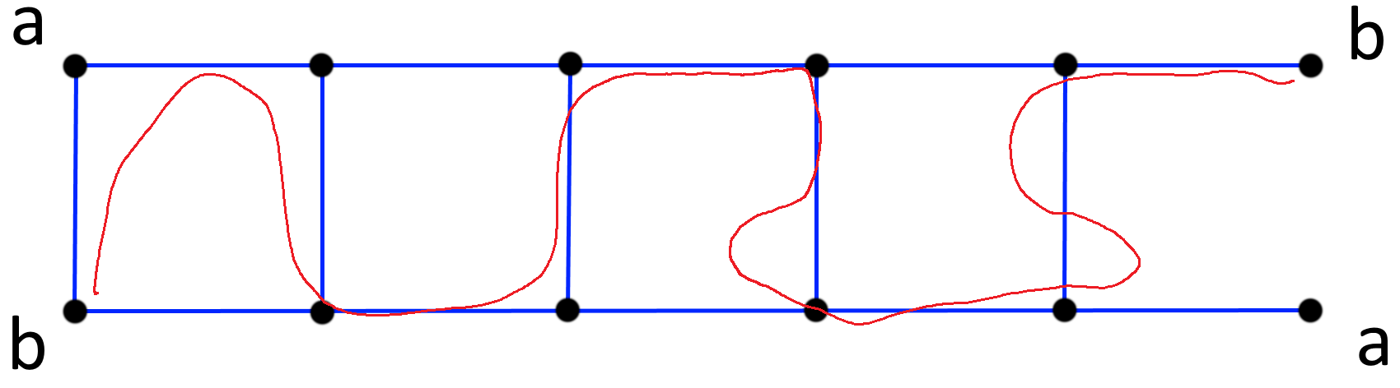
A simple proof

Slide 25
CONCLUSION
What can we take home from the talk?

Slide 26
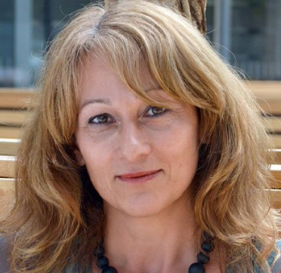
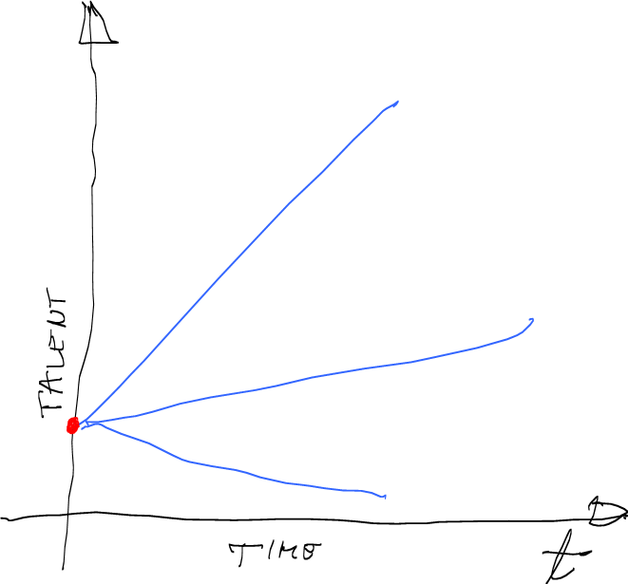
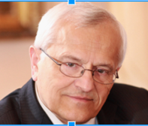
Why?
Professors shall be motivated through
the talent they provide for the society.
Katrien Maes,
League of European Research Universities
Talent defines the potential. Flow defines its derivative.
Love for understanding leads to grit.
The ethical imperative is to live a fulfilling life
with others and for others in a just order.
Jože Trontelj,
Slovenian academy of Sciences and Arts
based on Aristotle, Kant, Riceaou

Slide 27
Why?
To find joy in your work, to induce joy in your students.
  Discussions with colleagues: fresh, open exercisces and freedom of challenge help students find joy with the content. Possibly a diploma/masters thesis.
To spice up the game:
solve an exercise no one has solved yet.
  Administrative problems: seminar course,
  coursework as an optional replacement of exams.
Balance the skills and the challenges.
Engage in research questions early.
  Introduction, prerequisite to an Erasmus exchange.
Find joy in discovering and sharing new knowledge.
University in general and math in particular has lots of teachers and researchers.
It is my opinion it could offer more mentors, who understand and induce flow.

Slide 28
How? Psychologically.
By increase of passion, perseverance, and learning ability, the fraction of individuals who reach the state of flow raises.
Certain level of learning ability, passion and perseverance is needed to achieve flow.
Actual observations are intuitively similar to the simulation results, but the model has not been tested empirically.
Mathematical model of psychological observations allows quantitative presentation of qualitative results.
Key observation:
In the model, learning while working can become empowering experience, a comoponent of a quality life.

Slide 29
Who, when?
Students of BSc, MSc, PhD courses in (topological) graph theory, discrete mathematics, (less likely) topology with coursework.
Coursework: ~30 structured short exercisces building up knowledge to understand the (proof of) the theorem.
Spring or fall semester of 2019:
weekly 10 minute skype with mentor (DB).
Final task: analysing behavior of your favourite invariant on 2-crossing-critical graphs.
If the result is complex enough, invite to
Maribor 2020 Crossing Number Workshop.
Measure flow amd analyse the overall experience
for a didactics journal.
Similar approaches to other research and work topics.

Slide 30
Bibliography
Csikszentmihalyi, M. (2013). Flow: The psychology of happiness. Random House.
Duckworth, A. (2016). Grit: The power of passion and perseverance. Simon and Schuster.
D. Bokal, M. Steinbacher (2018): Searching for phases of optimal experience: simulations of emotional states of learning, submitted.
A. Vegi Kalamar, T. Žerak, D. Bokal: Enjoying counting of Hamiltonian Cycles in 2-crossing-critical graphs. In preparation.

Slide 31
Thank you for your attention.
Want to try crossing number academy as a/with a student?
Contact me at d@bokal.net.
Preferably by December 1st, 2019.

Slide 32

License
This work has been published under the license
Creative Commons Attribution 4.0 International
(CC BY 4.0)
https://creativecommons.org/licenses/by/4.0/

