Slide 1
Roles of noise in shaping gene expression dynamics
Jochen Kursawe
Notes:
Hi everyone, thanks for having me here today. Today I am going to talk about my research project with the title blabla

Slide 2
Cell state transitions are a key contributor to embryonic development
Actively dividing
stem/progenitor cell
Neuron
Notes:
State transitions are a widely studied field. Neural progenitor cells turn into neurons during embryogenesis and being able to understand this process to the extent that we may be able to control it may enable a whole range of science-fiction-like solutions for things like spinal cord injury or neurodegenerative diseases

Slide 3
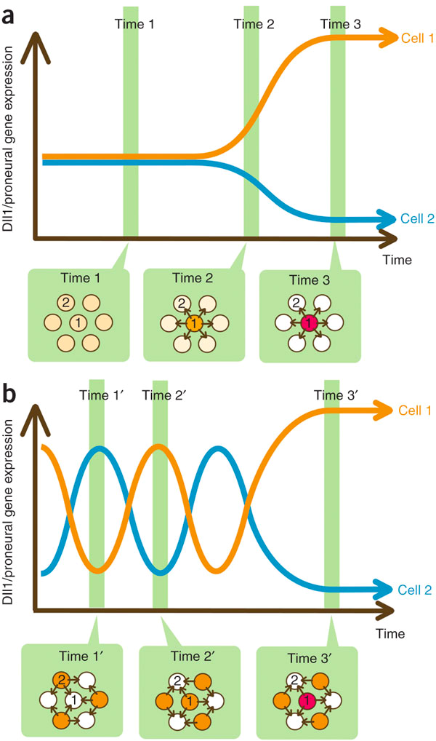
Dynamic changes in gene expression underly novel mechanisms of cell state transitions
Genes are upgregulated
or downregulated
over time as cells
change their fate
Classical view
Genes oscillate and
change in dynamics
drive transitions
New, dynamic view
Proposed and reviewed by Kageyama et al Nature Neuroscience, 2008
Notes:
When we think of cell state transitions we tend to think of genes that are on or off. We are now beginning to understand that the dynamics of gene expression may be equally important. The idea is that gene expression dynamics increases the amount of information that one gene can encode.

Slide 4
Embryonic neural differentiation is controlled by a gene oscillator acting as a timer
Bonev et al, (2012), Cell Reports
Goodfellow et al., (2014) Nature Comm
Phillips et al., (2017) eLIFE
Notes:
On example of how dynamic gene expression can influence cell fate is this example that has been described by the papalopululab. Expression of a gene called hes1 oscillates. The oscillations lead to a stepwise accumulation of miR-9, which initiates differentiation when it exceeds a threshold

Slide 5
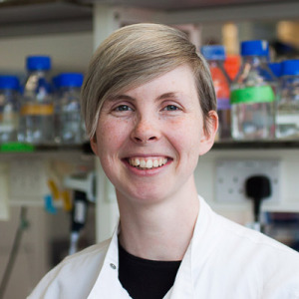
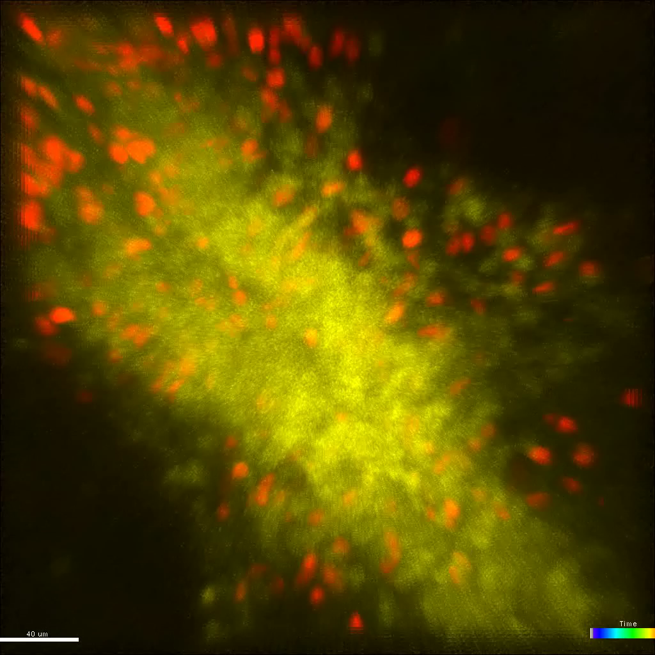

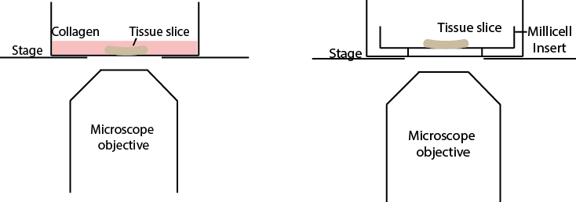
Live imaging of Hes5 dynamics in spinal cord neural progenitors enables analysis of oscillations in a tissue context
Dorsal
Hes5 dynamics
Cerys Manning
Venus-Hes5
Mosaic H2B-mCherry
Dissect live embryos
and slice using vibratome
Ventral
E10 Mouse Spinal cord live section of Venus-Hes5^{+/-} Sox1CreERT2^{+/-} R26R H2BmCherry loxP^{+/-}
2.5 mg of Tamoxifen administered I.P to pregnant female 18hrs before dissection
Notes:
Building on this work the lab has now moved towards understanding the role of these oscillations in a tissue context and I am showing you here experimental data collected by one of the post-docs in our lab. One of the benefits of my new job is that I hve had the privilege to work with some absolutely brilliant experimentalists and Cerys is certainly one of them. She was able to set up this fascinating experimental system that enables us to observe gene expression dynamics in a tissue context. Slice mouse embryo s pinal cords and then enabling it to remain alive in tissue culture. And with the help of mouse genetics we are able to see gene expression. In this section of the spinal cord the revant gene for differentiation is Hes5, which we see in yellow. Cells so close: Cyerys introduced mosaic nuclear labelling so now we are able to follow individual cells over time and observe their gene expression dynamics. Example traces, quite different behaviours

Slide 6
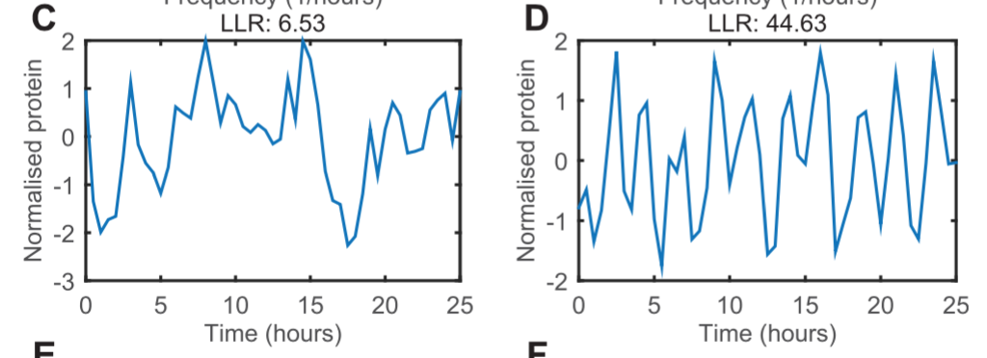
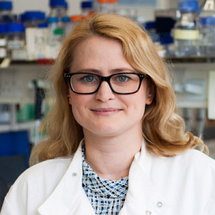

Identification of oscillatory dynamics requires statistical analysis
Tool to analyse periodicity in noisy data using Gaussian Processes. Phillips et al., 2017 Plos Com Biol
Traces of gene expression
Model fitting
Aperiodic fluctuations
Oscillations
Signal SD
Periodicity
of frequency β
Veronica Biga
Model selection by
Log likelihood Ratio (LLR)
$${LLR=LL}_{OUosc}−{LL}_{OU}$$
Notes:
Can we detect oscilations in these? If we look at these traces it’s easy to see shapes in the cloudes if you will and a previous phd student in the papalopululab has actually developed a rigorous statistical test to identify to what extent these traces are oscillatory – based on using gaussian processes with a covariance function that includes a term representing periodicity and one not representing periodicity and then conduciting model selection.

Slide 7
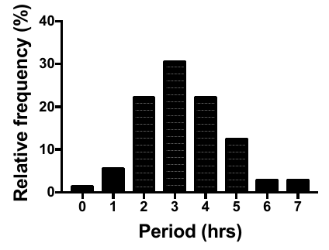
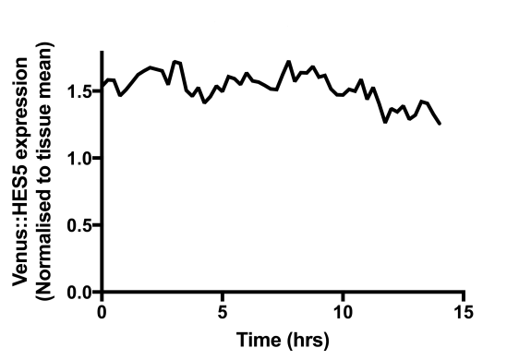
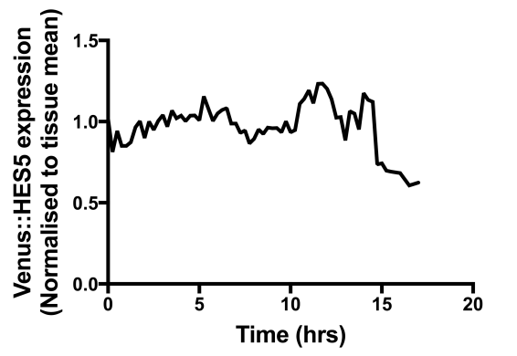
Which cell states show oscillatory HES5 dynamics?
Oscillations are more frequent in differentiating cells; dividing progenitors are noisy
Noise
Progenitors
Differentiating
Differentiating
HES5 high
Declining HES5
Progenitors
HES5 high
Declining HES5
Oscillations may originate from noisy expression
Aperiodic but noisy
“Oscillatory-while-declining” example
Converting

Slide 8
Key modelling questions:
Do we understand the mechanisms governing Hes5 gene expression oscillations?
Can we understand the stochasticity of this system?
Can we identify mechanisms that can explain transitions from aperiodic to oscillatory gene expression?
What predictions can we make from this?

Slide 9
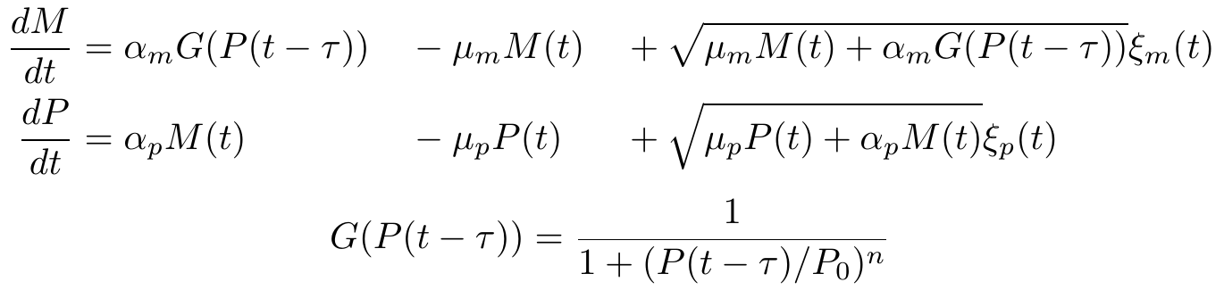
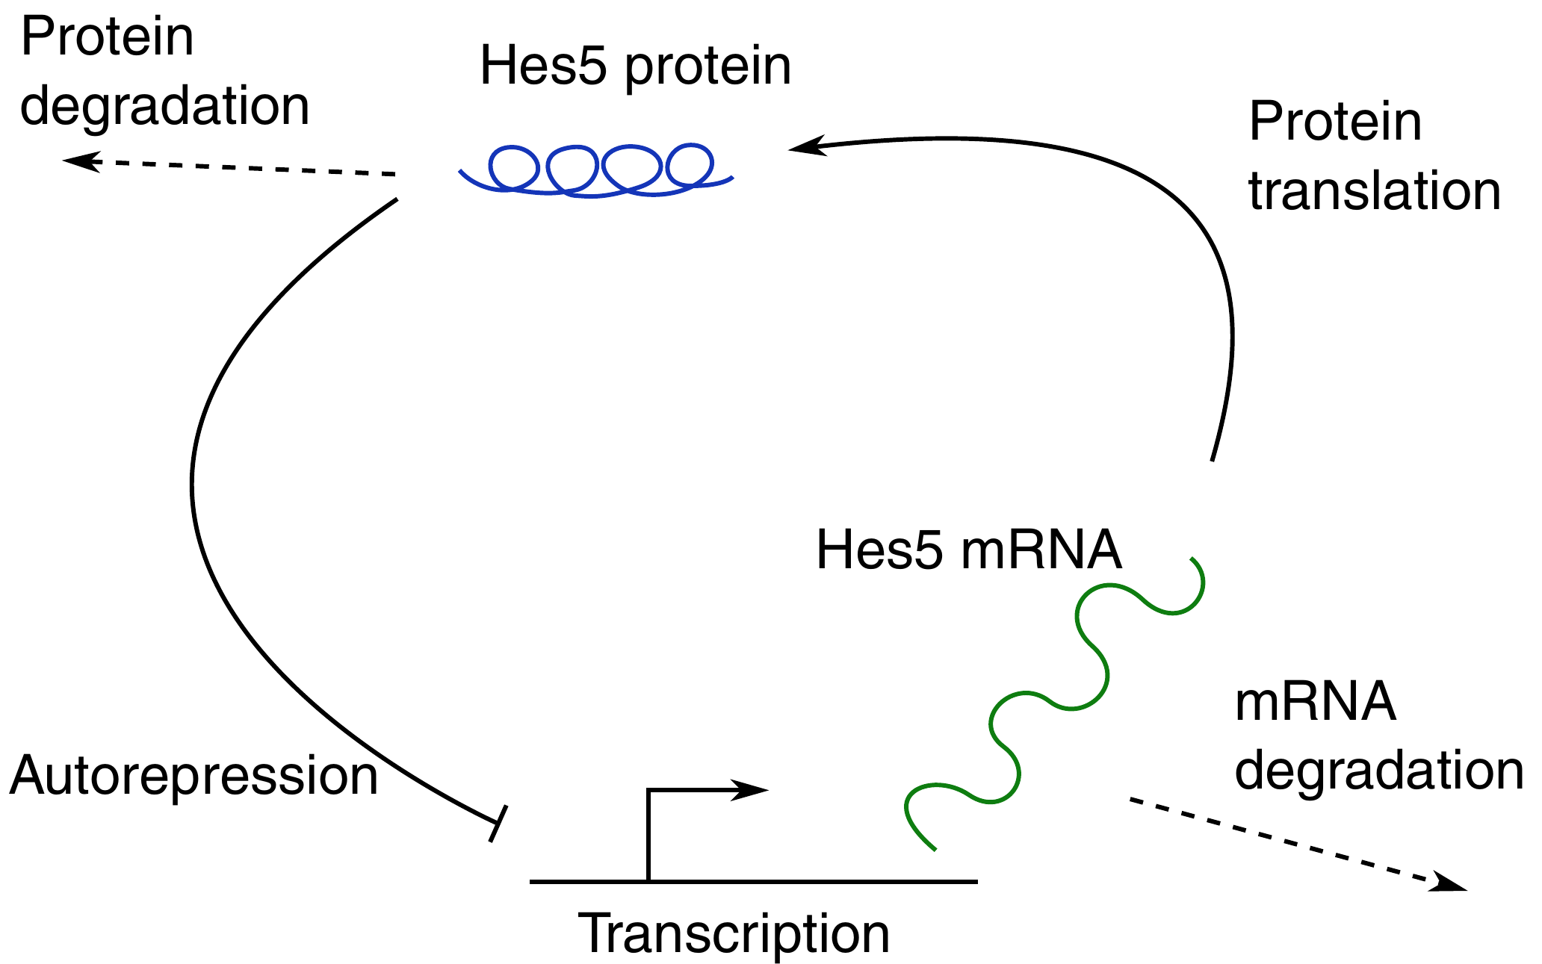
Step one: apply a mathematical model of transcriptional autorepression
Rate of change
Degradation
Production
Noise
[1] N. A. Monk. Curr. Biol. 13(16), 1409–1413. (2003)
[2] T. Brett, T. Galla. J. Chem. Phys. 140(12), 124112. (2014)
Notes:
Apply a model, let me talk you through this, model the dynamic changes in mrna and protein over time. Pool of mrna, pool of protein, this model has originaly been developed by nick monk and in order to be able to describe both aperiodic and oscillatory fluctuations we apply a noise term

Slide 10
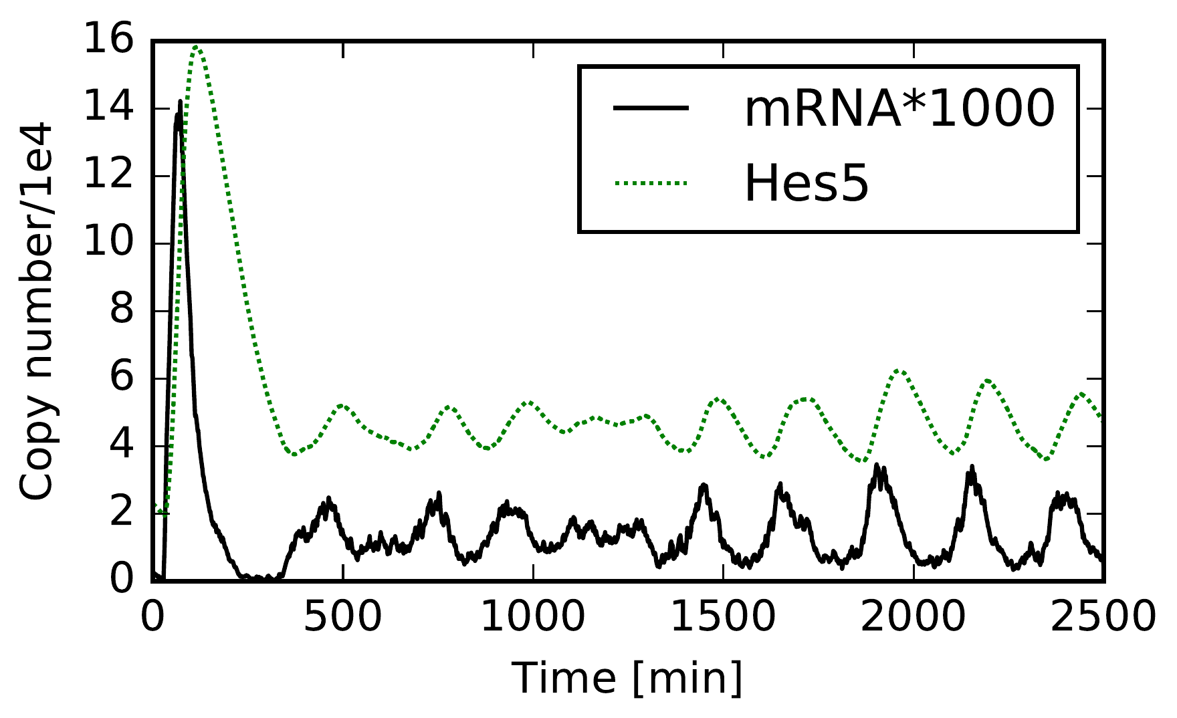
The model generates time traces of Hes5 protein and mRNA expression
Notes:
Example trace, initial behaviour depending on initial condition. We are interested in the long-term behaviour of this system. 1000 min and after that.

Slide 11
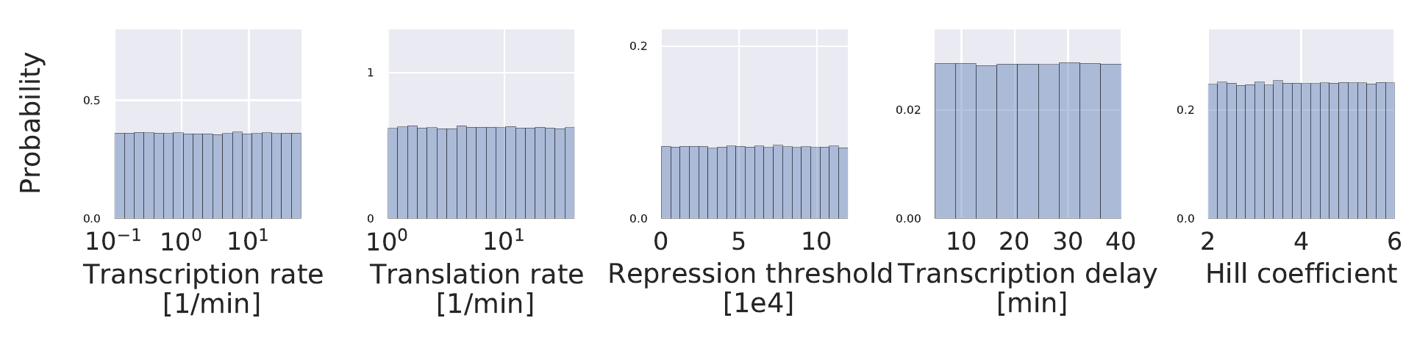
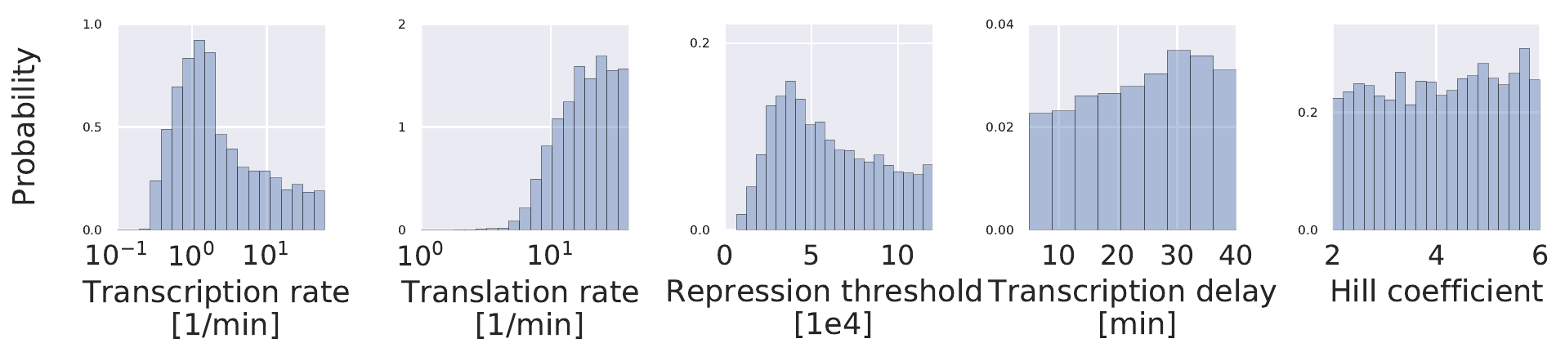
Step two: apply Bayesian inference to parameterise the model
Prior probability p(θ)
Posterior probability p(θ|D) ∝ p(D|θ)p(θ), Summary statistics: mean and standard deviation of Hes5 expression
Notes:
Mayesian inference, priors, rejection sampling: mean and standard deviation of hes5. uncertainty high! Maybe it doesn’t matter?

Slide 12
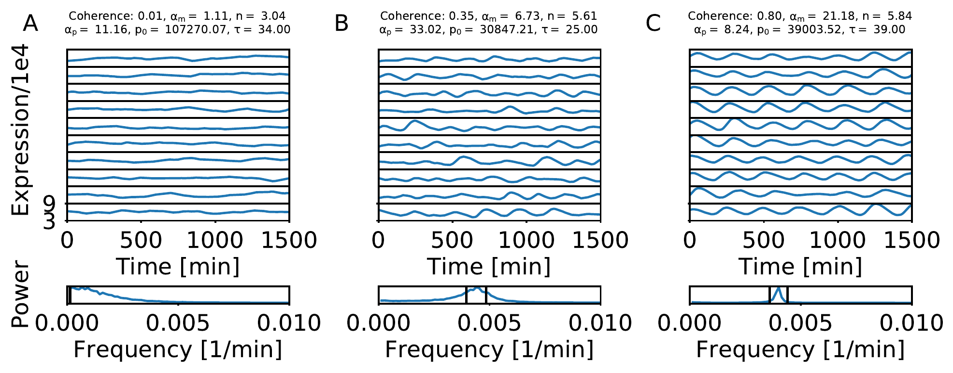
Modelled traces of gene expression can exhibit aperiodic and oscillatory dynamics
Notes:
Some traces oscilate and others don’t, power spectrum can help us understand this!

Slide 13
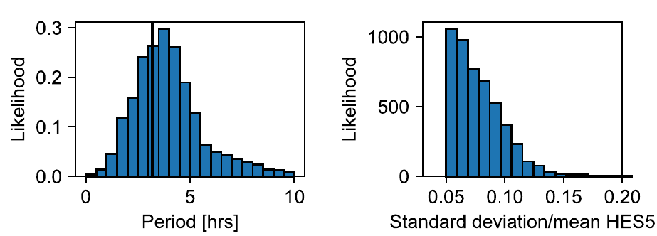
The model correctly predicts the period and amplitude of the oscillations
Notes:
Take all the traces that do oscillate – what’s their period distribution?

Slide 14
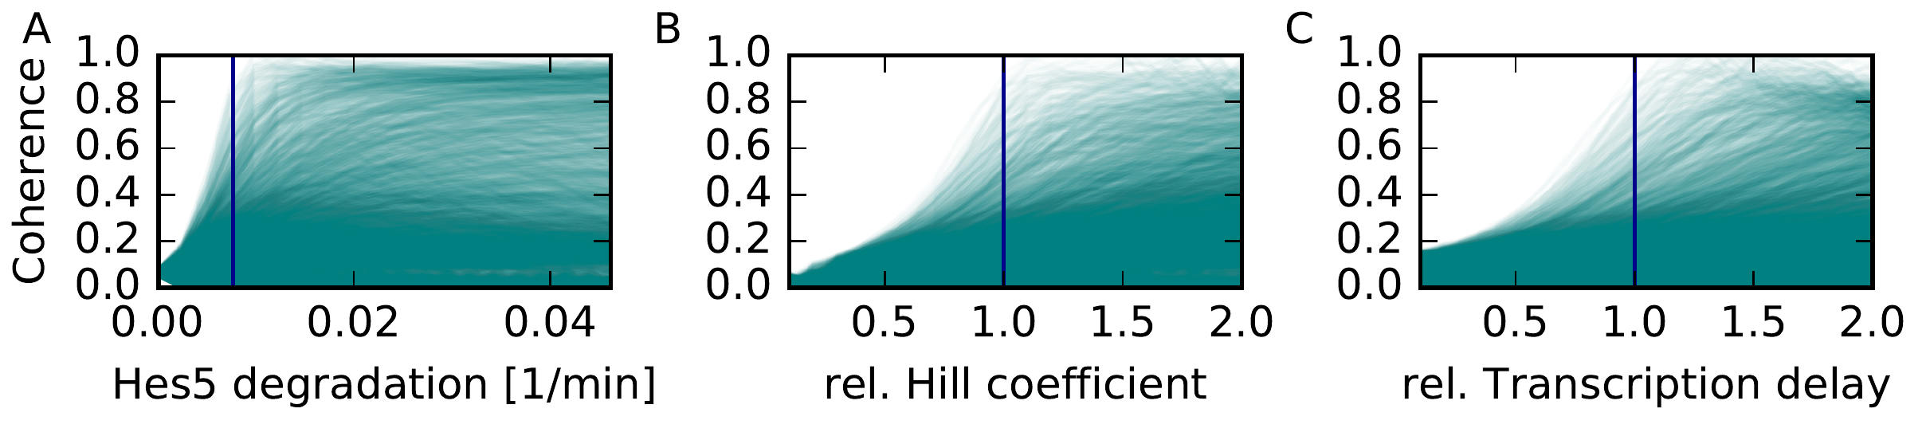
The model is poised at the bifurcation point between aperiodic and oscillatory dynamics
Notes:
Sensitivity analysis -> distribution of response curve. Envelope of these

Slide 15
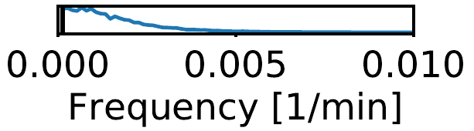
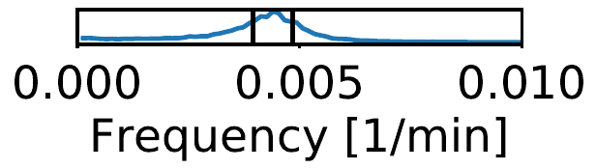
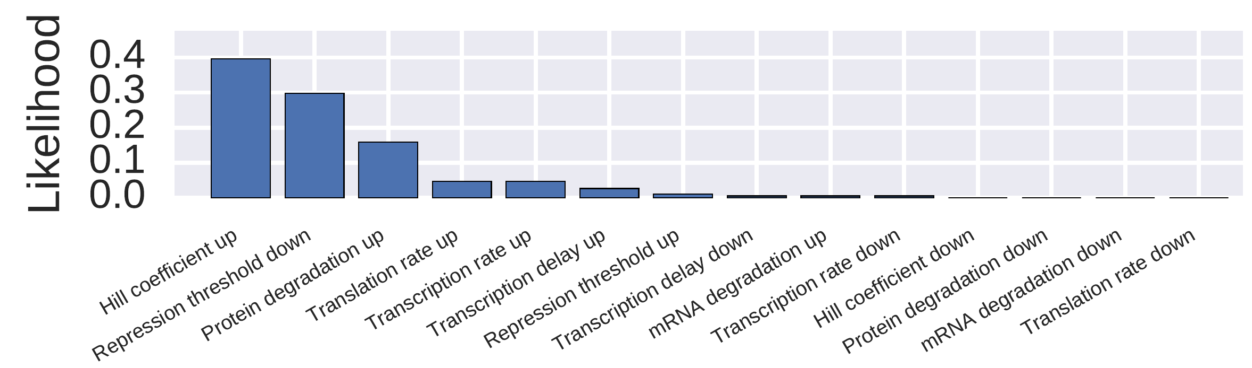
Transitions from aperiodic to oscillatory gene expression can be initiated by changes in individual model parameters
aperiodic
oscillatory
Notes:
Multiple options possible, and some more likely than others.

Slide 16
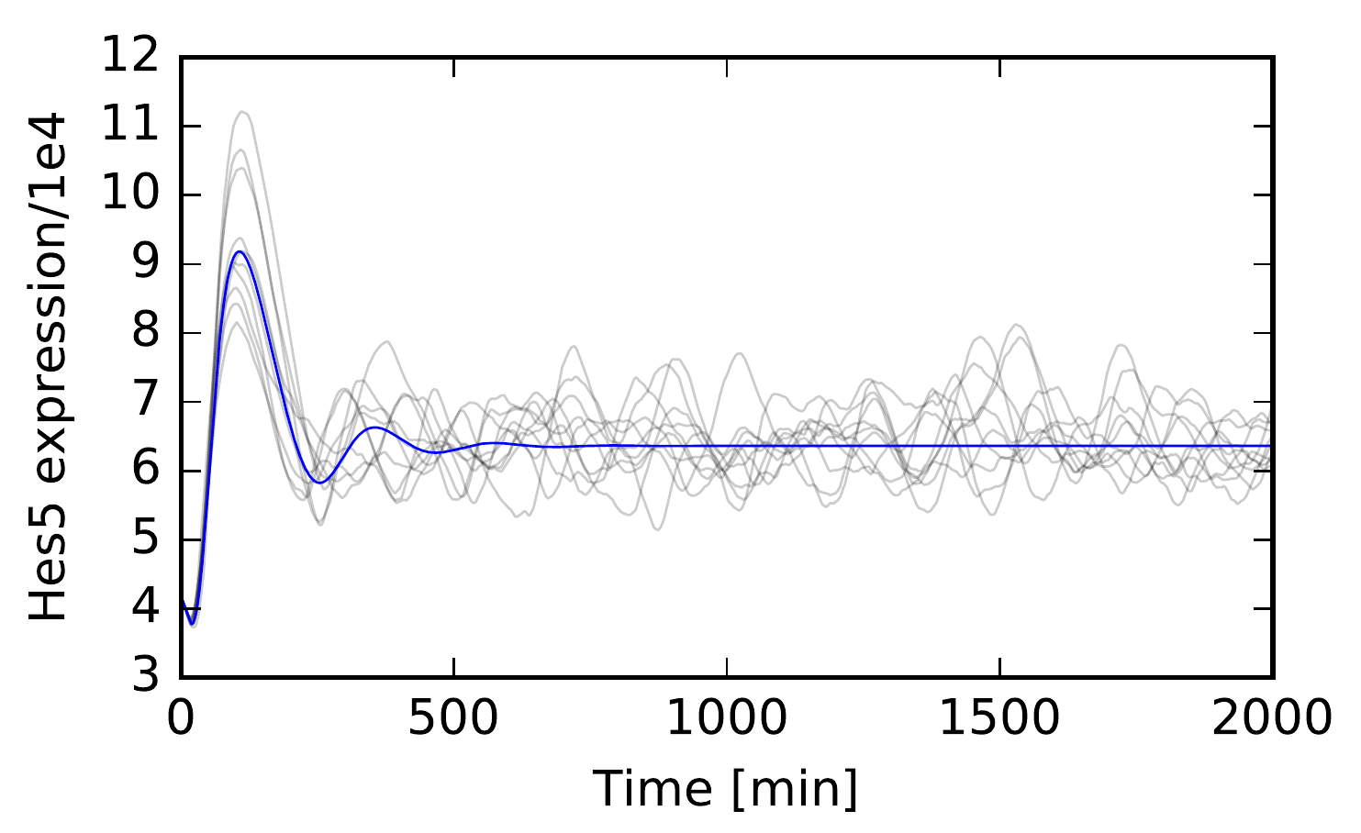
Oscillations are an example of stochastic amplification
Stochastic model
.. vs deterministic model
Manning, C. S., Biga, V., Boyd, J., Kursawe, J., Ymisson, B., Spiller, D. G., … Papalopulu, N. (2018). bioRxiv, DOI: 10.1101/373407
Notes:
Interesting aspect: stochastic oscilations: the stochastic sytem oscillates when the deteriministic system doesn’t. I am showing you here: Interestingly, the dde doesn’t break down: it stil correctly describes the mean behavoiour of the system (blue), whereas individual traces of the stochastic system oscillate (grey). Meaning that the dde isn’t wrong in any way, stochastic dynamics are hiden in higher moements.

Slide 17
Conclusions
Hes5 oscillations in spinal cord neural progenitor cells can be described by a model of transcriptional autorepression with delay
The model can be used to make experimentally testable predictions
Bayesian model interpretation enables the systematic evaluation of uncertainty for model parameters and predictions

Slide 18
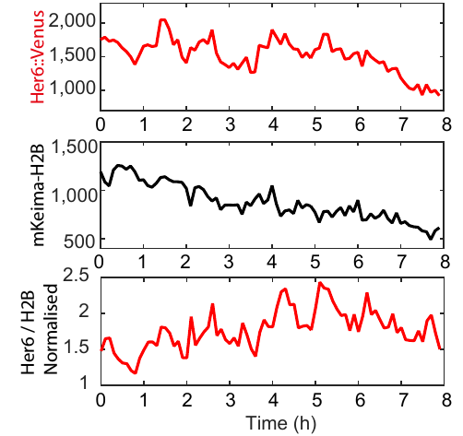
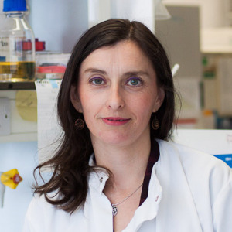
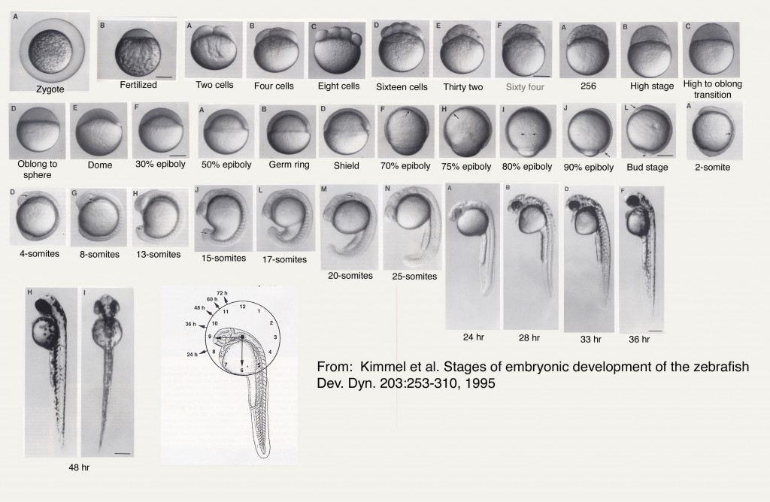
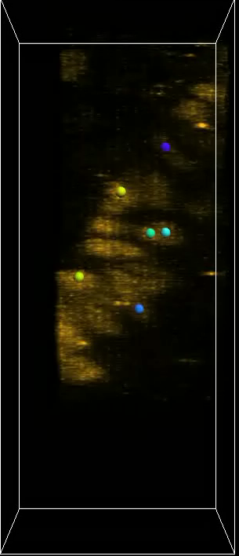
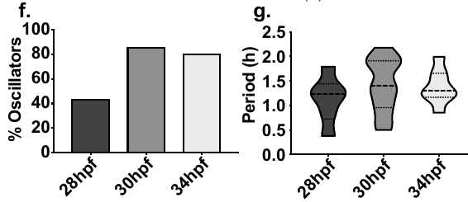
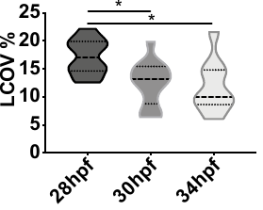
New zebrafish line enables observation of oscillations in vivo
25xW
lens
Ximena Soto
New biorxiv preprint
Soto et al., miR-9 mediated noise optimization of the her6 oscillator is needed for cell state progression in the Zebrafish hindbrain
https://www.biorxiv.org/content/10.1101/608604v1

Slide 19
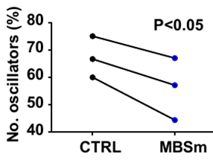
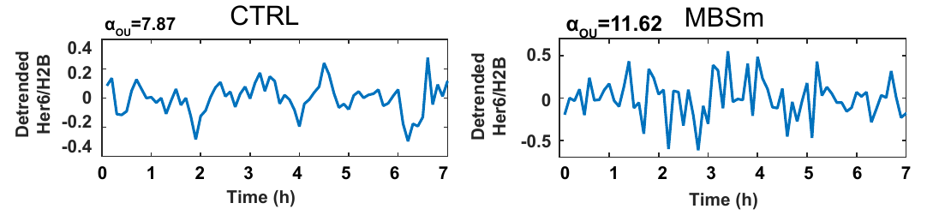
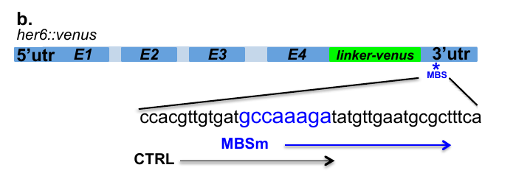
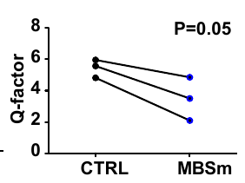

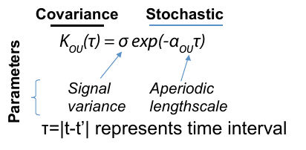
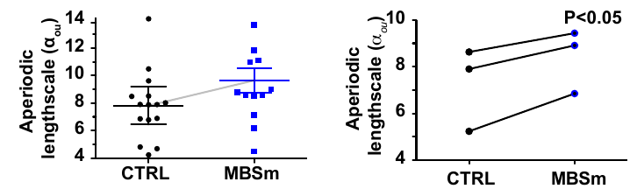
Perturbing microRNA binding enables perturbation of oscillations
Upstream signal
Her6
mir-9

Slide 20
Questions for a mathematical model
Do we understand the emergence of the observed oscillations, and changes in dynamics under the MBS experiment?
  Are the observed changes in dynamics upon
  CTRL->MBS perturbation consistent with simply changing mRNA translation and degradation?
How does noise in emerge in the Her6 oscillator? How does the noise get regulated micro-RNA?

Slide 21
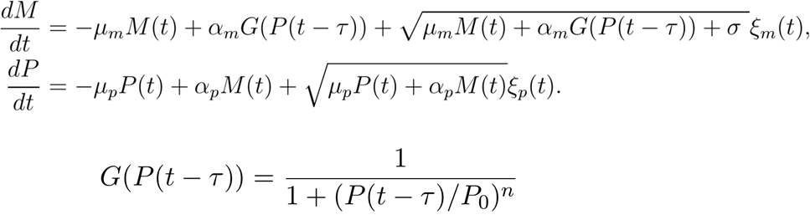
We modify the mathematical model to account for transcriptional noise
The new term, σ, accounts for transcriptional noise due to bursting or upstream signal fluctuations

Slide 22
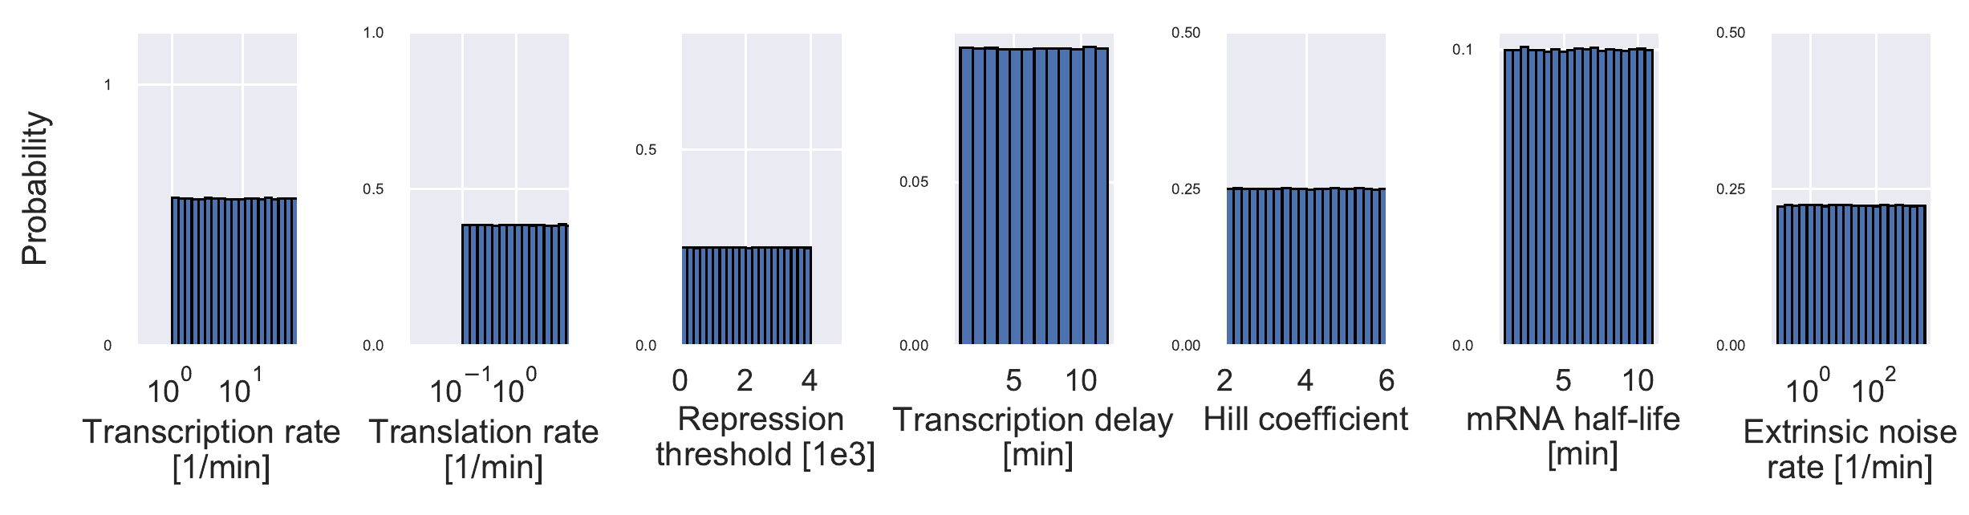
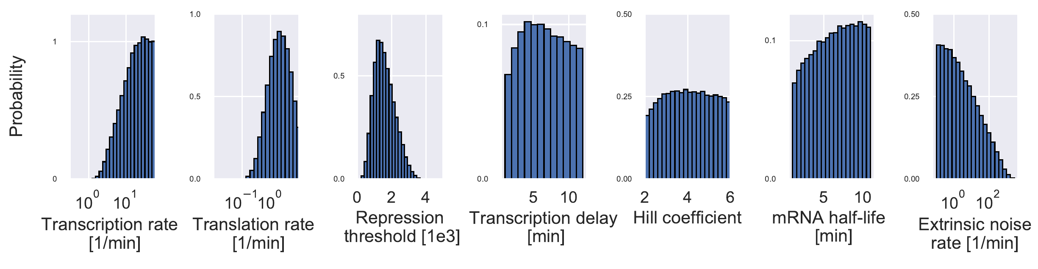
Inference on wildtype oscillations again reveals high parameter uncertainty
Ximena measured a protein half-life of 11 minutes. For the other parameters, we need to make prior assumptions
Knowing that there are 1000-2500 protein molecules per cell, the signal COV is 5-15%, and we see high-quality oscillations with periods below 150 minutes, we obtain posterior distributions

Slide 23
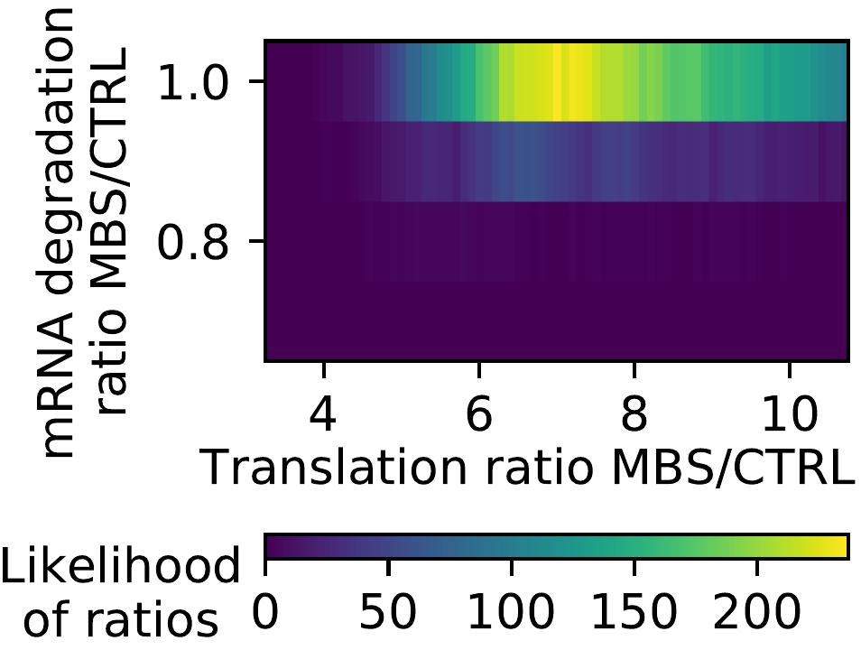
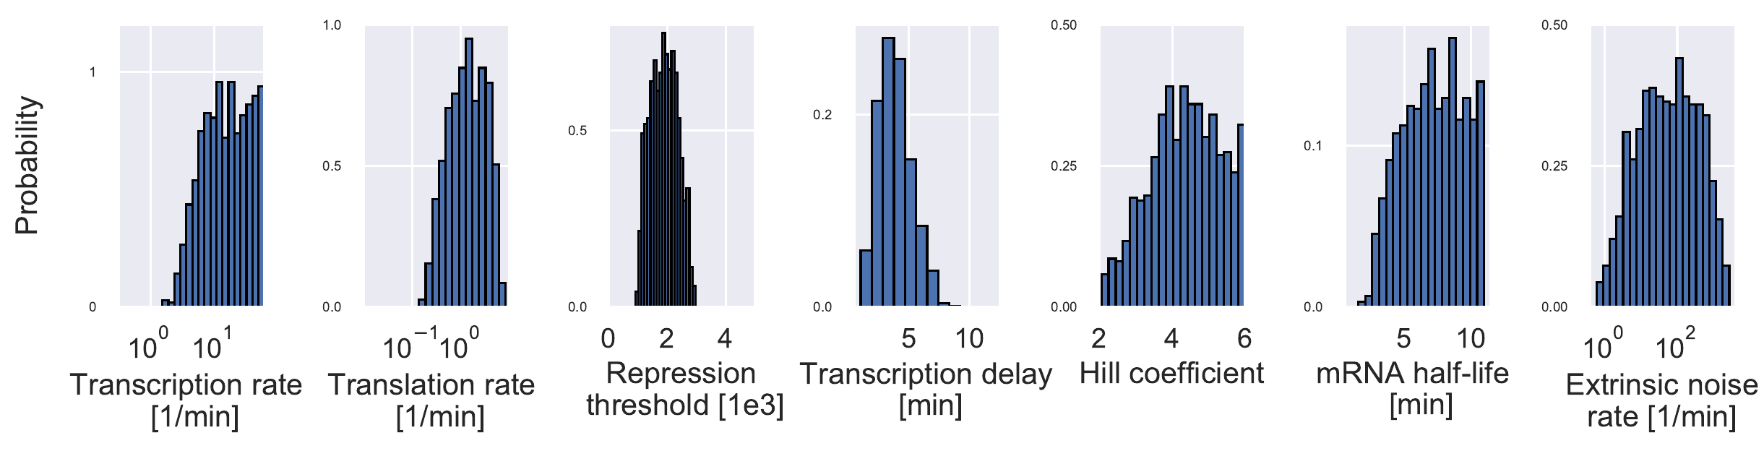
Joint inference on wild-type oscillations and perturbation reduces parameter uncertainty
Joint fitting conditions:
CTRL oscillations as before
MBS translation rate and mRNA degradation rate are changed from CTRL oscillations by unknown amounts
MBS levels are between 1.8 and 2.2 times CTRL levels
MBS oscillation coherence is lower than CTRL
Aperiodic lengthscale in MBS is higher than control by >10%
CTRL scenario posterior distributions:

Slide 24
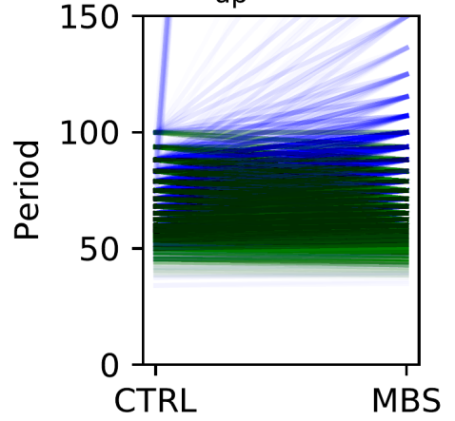
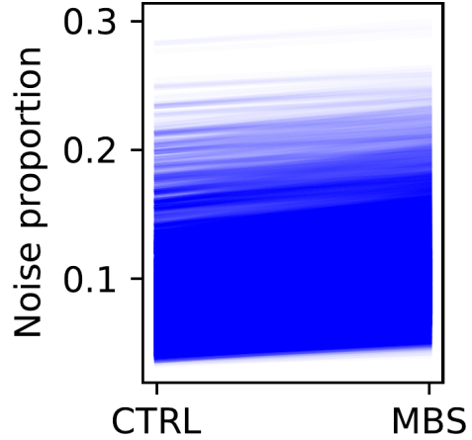
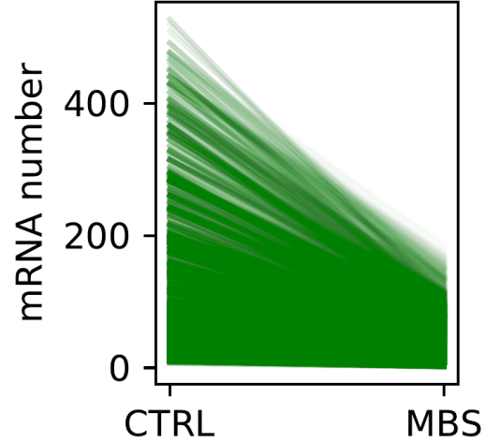
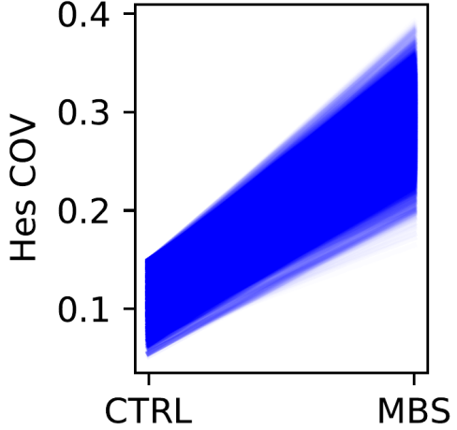
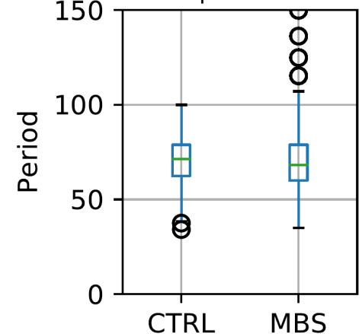
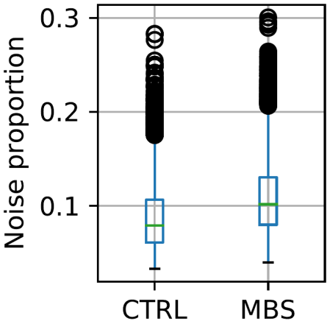
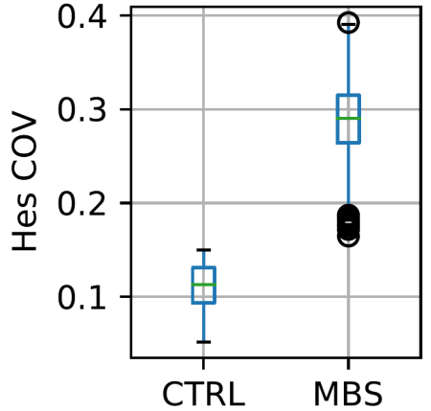
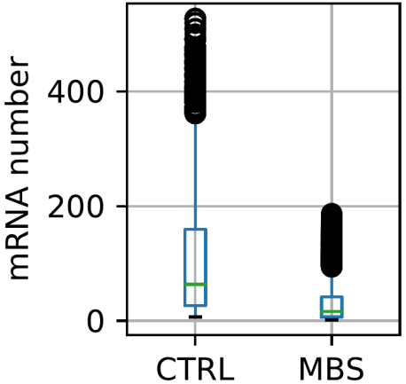
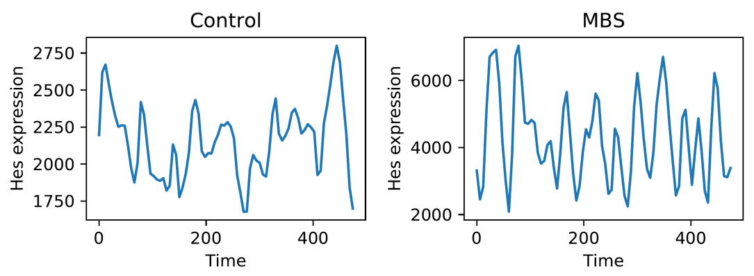
Bayesian posterior predictions inform new experiments

Slide 25
Summary
Mir9 counteracts detrimental effects of transcriptional noise to enable coherent oscillations
Mir9 achieves this by reducing the Her6 translation rate
The model makes multiple experimentally testable predictions:
  Translation rate increases from CTRL->MBS by a factor >=5
  The mRNA degradation rate is similar between CTRL and MBS mutant
  We expect the measured mRNA number in the MBS mutant to be smaller than in CTRL, despite the increase in absolute Her6 levels

Slide 26
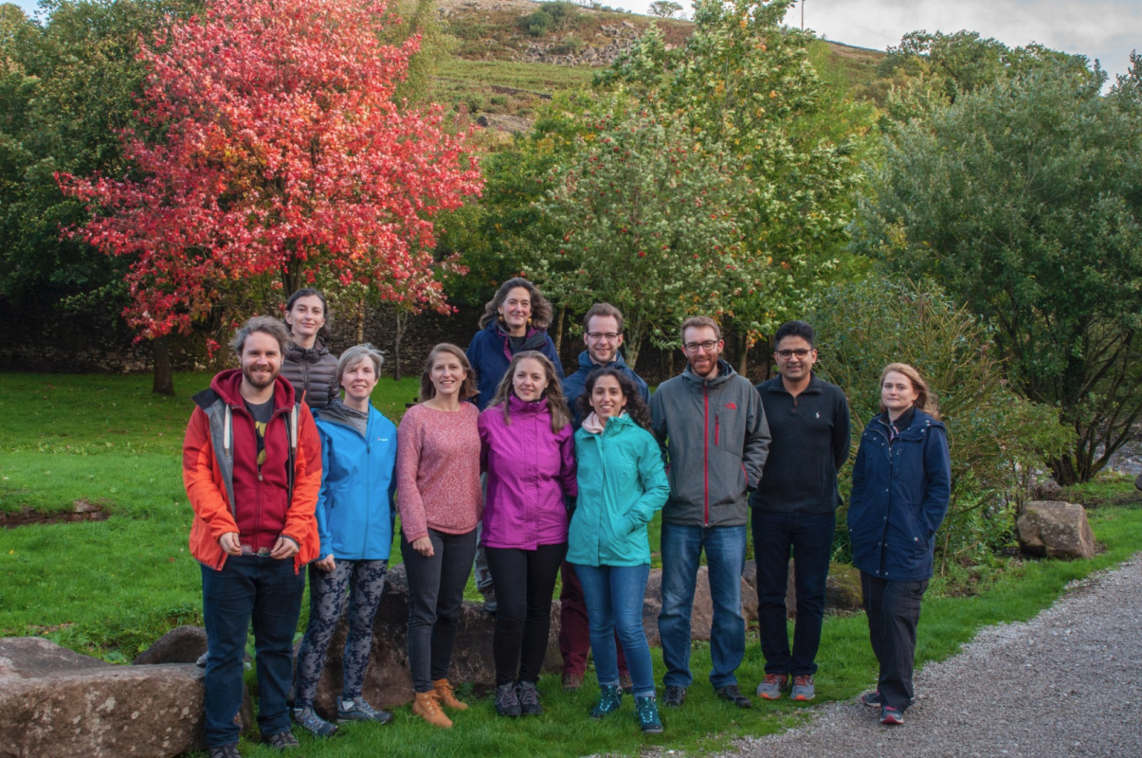

Acknowledgements
Papalopulu lab
Cerys Manning
Veronica Biga
Ximena Soto
Joshua Burton
Elli Marinapoulou
Tom Minchington
Anzy Miller
Nitin Sabherwal
Parnian Doostdar
Nancy Papalopulu

Slide 27
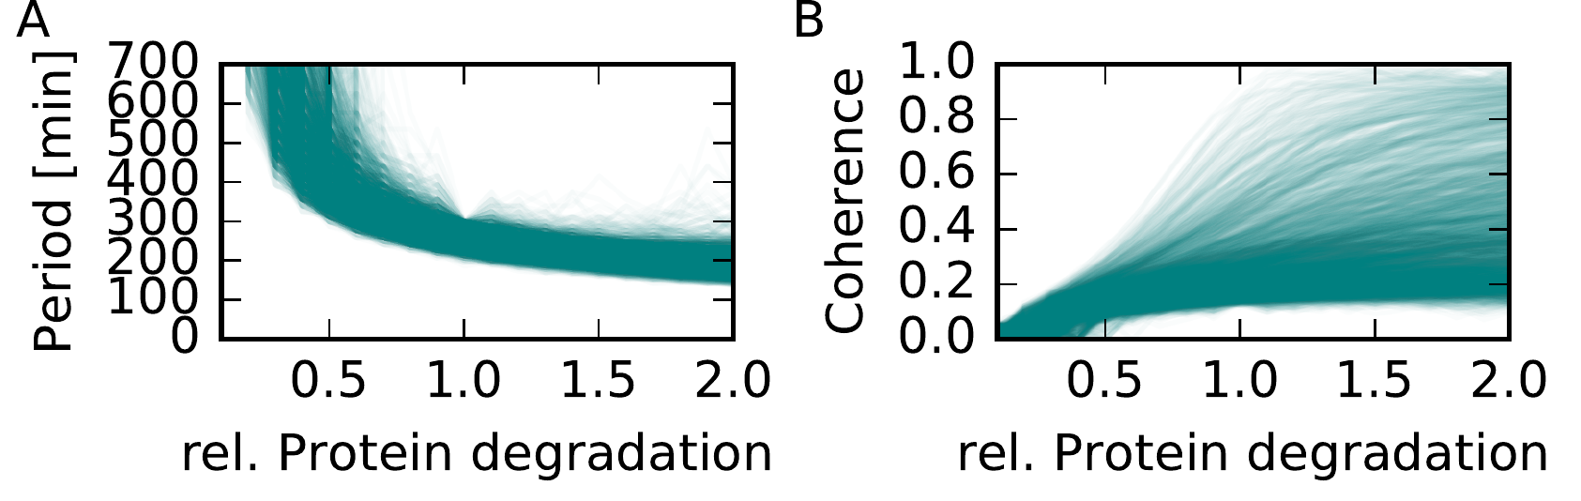
The model predicts that oscillation period can be controlled through changes in the protein degradation rate
Notes:
Tel me something I don’t know

Slide 28
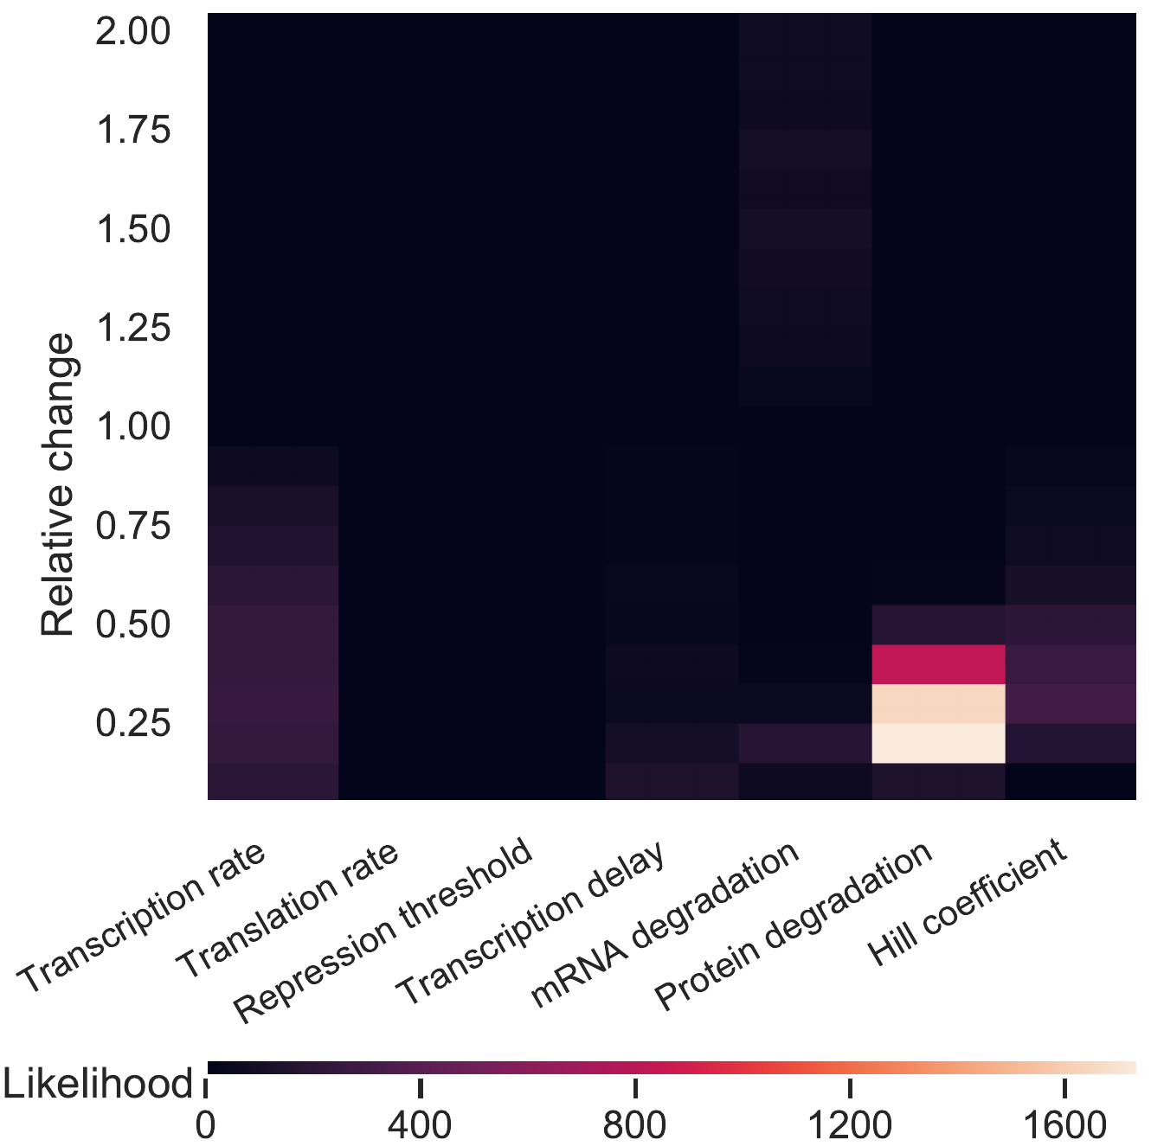
Mathematical modelling is becoming key contributor to experimental design
Example: which parameter changes can explain differences in gene expression dynamics upon changing cell state?
Math modelling helps us decide which experiment to do next.

Slide 29


Her6 single cell dynamic expression
Sp5 Upright. Obj25x4
34hpf
8h movie
Every 6min
Z=16
28°C
25xW
lens
2
1
D
2
6
Period=1.31hr
4
3
6
5
V
Lateral view
D
1
2
6
4
3
Analysed by Veronica Biga with method in Phillips et al., PLOS Comput Biol. 2017
5
V
20μm
750
Intensity mean
2100
Notes:
Colorcoded by intensity
Change size scale

Slide 30


How are changes in gene expression dynamics interpreted downstream?
Ximena Soto
New biorxiv preprint!
Soto et al., miR-9 mediated noise optimization of the her6 oscillator is needed for cell state progression in the Zebrafish hindbrain
https://www.biorxiv.org/content/10.1101/608604v1

Slide 31



Next step: inference on dynamic data
Kalman filters can be used to infer parameters from single traces rather than summary statistics
Joshua Burton

Slide 32
Distinct patterns of Venus-Hes5 dynamics can be identified using hierarchical clustering
Cluster 1
Cluster 2
Cluster 3
Cluster 4
Notes:
In order to make snese of this heterogeneity Cerys applied hierarchical clustering to identify different types of dynamics. What you see here is the dynamics of individual cells visualised. Cells are normalised to be able to compare the shapes rather than absolute levels. Each column one trace of gene expression, time goes downwards

Slide 33

Integrative analysis of live imaging data correlates cell position with cell state
Progenitor
zone
Sox2 - progenitors
Molecular Markers
NeuN - neurons
Mantle
Zone (Neurons)
Venus-Hes5
Cell position
Cell Divisions
Cell movement
Dynamic gene expression
Distance Start point to Finish
point of track
Expression mean of cells in cluster
*
*
*
*Division
*
*
*
*
*
*
*
*
*
*
HES5 high
Declining HES5
Clusters 1 & 2 - dividing progenitors Clusters 3 & 4 - differentiating into neurons

Slide 34

Developmental biology can be described and understood with the help of mathematics
To elucidate the rules governing embryonic development
  Need to understand the interplay of many processes: biophysical constraints, molecular signalling, gene expression dynamics etc.
Aim: closely integrate theoretical tools with experimental data to unravel key phenomena that underly morphogenesis
Notes:
I thought I start by introducing myself a bit. I am a mathematical biologist interested in developmental biology. Mainly because the dynamic increase in complexity and heterogeneity during embryogenesis perfectly lends itself to mathematical analysis and there are many open devbio questions today that may be answered with the help of mathematics and physics.

