Slide 1
A Powerful Two-stage Microbiome-wide Association test Huilin Li Ph.D. Division of Biostatistics Department of Population Health
BIRS 2019 Feb. 4-8
Genomics and Metagenomics workshop
Notes:
First of all, thank you Illuiana, hongzhe and Lei for organizing this amazing workshop at this cystally beautiful Banff. Thanks everyone here for sticking to the last talk. I would think the last is not the least. I wish my talk can addd some fresh take home messages for this workshop.
Thanks for the previous speakers for their excellent introduction, we all know how important is microbiome in the biomedical research. People would like to pindown the causal roles of microbial profile in the health and disease related mechanism. From the previous three talks, we can see to establish the causal role of microbioime, it is necessary to confirm the association between the treatment, intervention and microriome and also between microbiome and outcome. So now let’s step back to the microbiome association test. I promise there is not hard statistical problem here, it is this two-stage concept which we believe form the novelty of our method.

Slide 2
Human Microbiome
The communities of microbes living in and on the various parts of your body
Function of microbial community
Digestive enzyme
Metabolism of food constituents
Protection from pathogens.
Interaction with the immune system
Picture source: Synbiocyc.org
Notes:
Let’s begin with some background. We know the human microbiomes are the communities of microbes living in and on the various parts of our body. The microbes living on our body in nature do not live along. There are massive competing and cooperating. They act as integrated microbial commuity and contribute to our human health in a very important way. Functionally, the human microbial community provide digestive enzyme and metabolism of food constituents to help us digest food. They offer protection against dangerous bacteria and viruses, and keep your immune system responsive to your environment and running smoothly. Maintaining a healthy microbiome is very important.
It is so important, we would like to regard it as a vital organ like our liver or kidneys. If we lost our whole microbiome community, we will quickly die as we lost any vital organ. However, different from the real organ, its developmnt begins not in the embryo but immediately at the moment of birth, continues to develop to the first few years of life by acquiring ever more microbes from the people around you.
______________________
trillions of microbes grow in nearly every part of your body. These bacteria, fungi, viruses, and mites outnumber your human cells by 10 to 1.
They help you digest your food, offer protection against dangerous bacteria and viruses, and keep your immune system responsive to your environment and running smoothly.

Slide 3
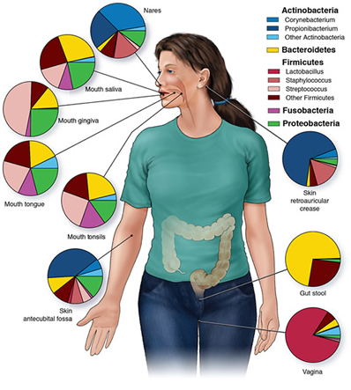
Human Microbiome
Bigger variation than the human genome
Personal; Distinctive microbial profile at different body sites
Microbial state often differs in health and disease
Restore the “out of balance” microbial profile to normal
Cho and Blaser 2012
Picture source: allergiesandyourgut.com
Notes:
When we look at the microbiome data, we observed big variation, much bigger than the variation in hour human genome. In reality,
Microbial communities vary from person to person and from one part of your body to another. Our microbial profile change constantly because of travel, illness, aging, and day-to-day life.
Relavent to human health, our microbiome’s state often differs in health and disease. Thus, understanding a person’s microbial communit wil help doctor to predict the disease and find ways to restore the out of balance microbiome to normal
_______________________________
Maintaining a healthy microbiome is very important: In fact, changes in the microbiome may even contribute to the onset of diabetes, obesity, and other disorders. Because our microbiome’s state often differs in health and disease, researchers predict that understanding a person’s microbial community will help doctors treat patients by working to return their “out of balance” microbiomes to normal again.

Slide 4
Microbiome and Human Disease
Notes:
due to the advent of high-throughput sequencing technologies, recently tons of research have been done to relate the human microbiome with different disease status. From the diabetes, obese, IBD disease. Its interaction with immunology has also been studied in the cancer world.
While with tons of study going on, huge amount of data has been generated. Considering the special structure of the microbiome data, it is challenging in how to analyze the data objectively and efficiently

Slide 5
Experimental Design
Cross Sectional Studies
Finding differences in microbial communities between different human populations
Randomization Trial
Identifying the treatment effect
Longitudinal Studies
Investigating the stability and dynamics of microbial communities
Notes:
Designing an experiment that generates meaningful data is an important first step in the microbiome data. At the first phase of hmp launched in 2007, a great number of cross section microbiome studies has been conducted in order to identify and character human microbial profile. Such like To find differences in microbial
communities between different human populations, such as healthy individuals and those with diseases, or individuals living in different geographic regions.
In those study we found that there are large variation in the microbiome between individuals and the profound influence of lifestyle, diet4, medication5 and physiology, differences between populations may arise from factors other than the disease of interest. Longitudinal studies, especially prospective longitudinal
studies that collect baseline samples before disease onset, can help resolve these issues, although they are more expensive. For ease in downstream statistical
analyses, longitudinal studies should plan the timing of sample collection carefully. Interestingly, community instability rather than the specific taxa present at a single time point can be a strong predictor of disease activity7. For example, individuals with inflammatory bowel disease exhibit greater microbiome fluctuations than control cohorts7.
Interventional studies, including double-​blind randomized control studies, are especially useful for identifying specific effects of a course of treatment on
the microbiome and disease state.

Slide 6
Statistical Analysis
Community level analyses
Taxonomical level analyses
Advanced analysis in longitudinal study
Microbial dynamic modeling
Survival analysis(time-to-event outcome)
Causal/Mediation analysis
Notes:
Such measures provide a broad overview of community structure, but do not investigate specifi c organisms, a

Slide 7
Microbiome-wide Association Study(MWAS)
In microbiome studies, MWAS is a study of a microbiome-wide set of taxa live in different individuals to see if any taxa is associated with a trait.
Trait could be:
Binary outcome — disease status
Continuous outcome-- clinical biomarker(e.g. CD4+, BMI,…)
Survival outcome—time to T1D onset, time to recurrence etc.
Notes:
So mwas, we called is M-WaZi. It is just an analogy to genome-wide association studies. IN MWAS, we study a microbiome-wide set of taxa live in different individuals to see if any taxa is assoicated with a trait.
When we conduct MWAS, one thing which is different from the GWAS is the special data structure of microbiome data.

Slide 8
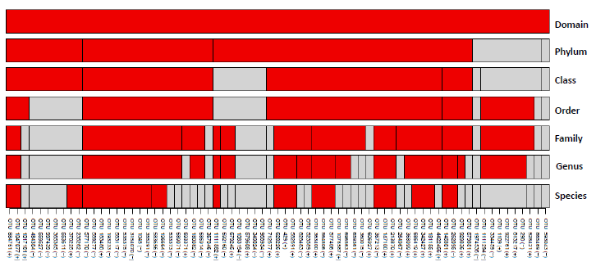
Structure of Microbiome Data
All strains in the domain Bacteria in mammal are hierarchically classified into six major levels
At each lower level, organisms are classified with their most similar cousins based on common features
Notes:
Since our proposed method are utilizing the mircrobial taxonomic structure to improve the efficiency of the microbial association test, it is worth of some time to review the structure of microbiome data. . In the figure, we enumerate the sevel tasonomic ranks vertically from Domain, phylum to species. Each row represents each taxonomic rank. The blocks in each row represent the taxa at that rank. We can see in the domain bacteria in mammal, all the microbes are hierarchicall classifed into six major levels. With phylum being the most general rank and species being the most specific rank. At each lower level, organisms are classified with their most similar cousins based on common features
We know, in the domain bacteria in mammal, all the microbes are hierarchicall classifed into six major levels. In the figure, we enumerate the sevel tasonomic ranks vertically from Domain, phylum to species. The bottom part is for OTU level,each tick on the line respents each OTU and in each row, the taxa are aligned side-by-side. From the figure, you can see each OTU consistently belong to their upper-level taxa. This figure is from a previous paper, there we conducted the microbiome-wide association test at each rank independently. However, in the practice, the research are interested mostly in identifying the signals at the lowest available level, such like species or genus level. While because the large number of taxa at those levels, most of time, at the lowest level, it suffers from the low power with very few discovery.

Slide 9
Taxonomic Classification
Ib. bioninja.com.au
Notes:
Here, further let’s look at the taxonomic classification of the dog to get the sense of what kind of information does the taxonomic structure tells us. From the figure, you can see the dog is classified into the same phylum group as the fish and elephant, at the family level, fox and wolf and dogs are belong to the same group. Obviously the group at the higher rank such like phylum and class are more heterogenous than the group at the lower rank. Bearing this information in our mind, we are ready to look in to our proposed method.

Slide 10
Microbiome Data
There are three components:
Relative abundance table: $Z n×p$
Tree information:
taxonomic tree: group classification
phylogenetic tree distance matrix D$p×p$
Other covariates, trait or outcome X$n×m$
Notes:
Let’s start with some notation definintions. With any down stream microbiome data analysis, we have three compontes of the data.

Slide 11
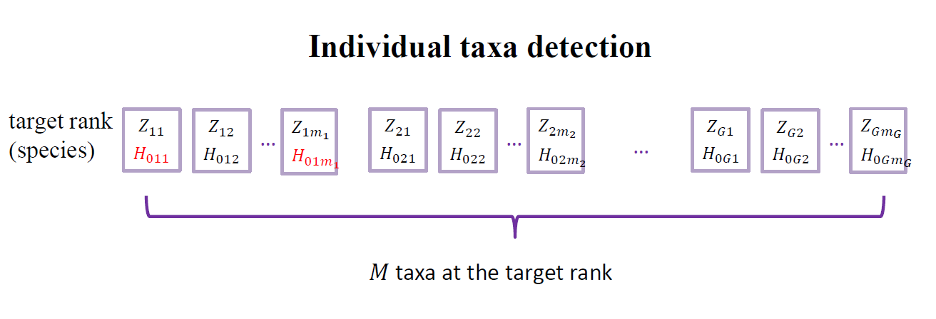
Traditional one-stage method
Test the association for microbes individually and utilize BH procedure afterwards to control the FDR
Problems:
Assume independency of hypotheses
Large number of multiple comparison– very few discovery
Notes:
Before diving into our new method, let’s take a look of the tranditional one-stage method. In this method, people usually go to the lowest available rank directly, say at species rank, then perform the association test one by one than utilize some method such as the benamini-hochberg procedure to control the FDR. There are couple problems for this method: first it assume the independency of the hypotheses. Second, due to the large number of multiple comap…
To improve the efficiency of the microbiome assocation test, we are proposing a two-stage test.

Slide 12
Motivation for a Two-stage Test
The trait-associated taxa tend to be clustered evolutionarily instead of randomly distributed across the community
The known taxonomic structure depicts the microbial evolutionary relationships
A new test which incorporates the prior biological information through the taxonomic tree to alleviate multiplicity issue, thus enhance the statistical power
Notes:
In this new two –stage test, we would like to address the following issues.

Slide 13
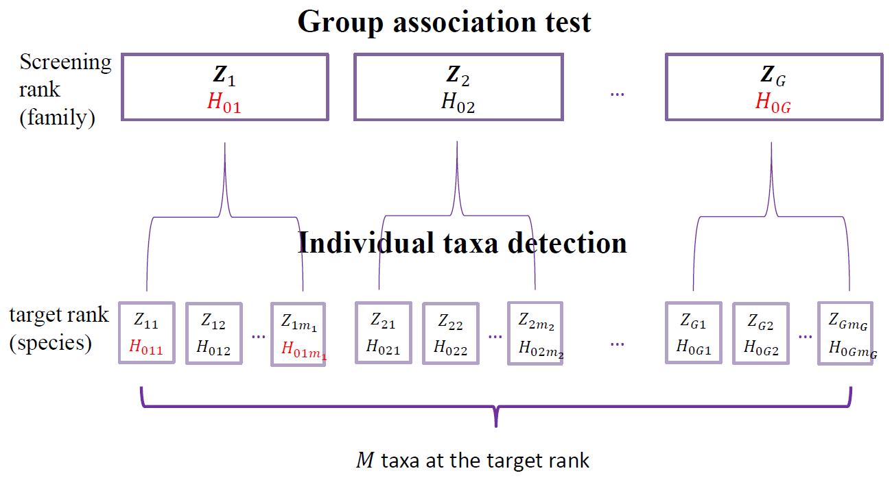
A Two-stage Microbial Association Mapping Framework (massMap)
Notes:
Here is our two-stage microbial association mapping framework (massMap). The goal of our test is efficiently identify the taxa at the target rank, usually the lowest available taxonoimc rank, are associatied with the studied trait. Our test consists of two stages. First, At a preselected higher tasonotmic rank, such like the family rank, we screen the association of taxonomic groups using a powerful microbial group association test which we will discss in details later. The method then proceeds to test the association for each candidate taxon at the target rank within the significant taxonomic groups identified in the first stage.

Slide 14
A Two-stage Microbial Association Mapping Framework (massMap)
Notes:
Here is our two-stage microbial association mapping framework (massMap). The goal of our test is efficiently identify the taxa at the target rank, usually the lowest available taxonoimc rank, are associatied with the studied trait. Our test consists of two stages. First, At a preselected higher tasonotmic rank, such like the family rank, we screen the association of taxonomic groups using a powerful microbial group association test which we will discss in details later. The method then proceeds to test the association for each candidate taxon at the target rank within the significant taxonomic groups identified in the first stage.

Slide 15
A Two-stage Microbial Association Mapping Framework (massMap)
Notes:
Here is our two-stage microbial association mapping framework (massMap). The goal of our test is efficiently identify the taxa at the target rank, usually the lowest available taxonoimc rank, are associatied with the studied trait. Our test consists of two stages. First, At a preselected higher tasonotmic rank, such like the family rank, we screen the association of taxonomic groups using a powerful microbial group association test which we will discss in details later. The method then proceeds to test the association for each candidate taxon at the target rank within the significant taxonomic groups identified in the first stage.

Slide 16
Three Building Components for massMap
A powerful microbial group test to identify the taxonomic groups that contain the associated taxa
OMiAT—Binary and continuous outcomes
OMiSA—Survival outcome
A pre-selected taxonomic rank for screening
An advanced FDR-controlling methodology to resolve the dependency among taxa
Notes:
A highly powerful microbial group test guarantees a higher probability that it only eliminates not-associated microbial taxa and retains true signals to the target rank. The data-driven approach of OMiAT is a microbial group test designed for this purpose and it can efficiently detect microbial groups varying in association patterns.

Slide 17
The Conventional Microbial Association Test
“Genus”
“Species”
Two Steps:
Calculate the relative abundances for the upper level taxa as the aggregates in the lower level lineage
Test the association for microbes one by one at each rank and utilize BH procedure afterwards to control the FDR
We call those methods as the aggregate-based methods.
0.008
0.18
0.05
0.002
0.012
0.15
0.252
0.01
0.22
0.014
0.438
0.03
0.058
0.17
0.214
Notes:
Now, let’s look at how does the conventional method performs the assocition test
Not only has the entire microbial community or individual microorganisms, but also the upper-level taxa in different taxonomic ranks (e.g., phylum, class, order, family, and genus) been highlighted as key microbial biomarkers.
The aggregate-based method: A conventional ecological method, which is based on the aggregates of microbial abundances in lower-level lineages, has been most commonly used.
a conventional ecological method, referenced as the aggregate-based method in this paper, is most commonly used for association testing [8, 9, 21, 22, 23, 24]. The aggregate-based method is based on a univariate analysis, using aggregates of microbial abundances in a lower-level lineage per sample as a single predictor variable
Problem: This approach is inefficient by neglecting detailed information about diverse association patterns from nested microorganisms

Slide 18
The aggregate-based method
Assumption: the associated microorganisms nested in each upper-level taxon are all in the same effect direction.
Problem: This approach is inefficient by neglecting detailed information about diverse association patterns from nested microorganisms
Examples:
LEfSe (Segata et al. 2011)
metagenomeSeq-fit Zig (Paulson et al. 2013)
STAMP (Parks et al, 2014)
Notes:
Such measures provide a broad overview of community structure, but do not investigate specifi c organisms, a

Slide 19
Microbial Group Association Test
$Y_{i}$ and $X_{i}$ denote the binary outcome trait and covariates for subject $i$
$Z_{ig}={\left(Z_{ig1},Z_{ig2},…,Z_{igm_{g}}\right)}^{′} \text{is} \text{the} \text{relative} \text{abundance} \text{of} \text{taxa} \text{in} \text{the} g\text{th} \text{group}$
$Logit\left[P\left(Y_{i}=1\right)\right]= β_{0}+α^{′}X_{i}+β_{g}^{′}Z_{ig}$
$β_{g}={\left(β_{g1},β_{g2},…,β_{gm_{g}}\right)}^{′}$ is the vector of coefficients for taxa from group $g$
$H_{0g}: β_{g1}=β_{g2}=…=β_{gm_{g}}=0$
$v.s. { H}_{1g}: at least one β_{gj}≠0, j=1,…,m_{g}$
Notes:
To replace the aggregated method, we would like to have a powerful test specifically designed for the detection of varying association patterns for a group of taxa and can accommodate multiple covariates

Slide 20
The diverse association patterns
The associated taxa have the same effect direction.
The associated taxa are in mixed effect direction.
The abundant taxa are associated.
The rare taxa are associated.
The phylogenetic tree distance
Notes:
For a powerful microbial group test, we wish it has good performance in capturing different association patterns.
Such measures provide a broad overview of community structure, but do not investigate specifi c organisms, a

Slide 21
Omnibus Microbiome Association Test (OMiAT)
OMiAT: $M_{OMiAT}^{g}=\operatorname{minP}\left\{T_{aSPU}^{g},Q_{OMiRKAT}^{g}\right\}$.
$T_{aSPU}^{g}$ is useful for modulating different association patterns arising from highly imbalanced microbial abundances.
(Pan et al. 2014)
$Q_{OMiRKAT}^{g} is$ advantageous in detecting microbial group associations utilizing phylogenetic tree information, is tailored from the microbiome regression-based kernel association test (MiRKAT)[27],
Features:
A data-driven approach.
Highly robust and powerful.
Notes:
Obviously it is impossible to have a single test which can capture all the possible association pattern. So here our idea is to propose an omnibus microbiome association test, it consists of a series of test, each has superior power to detect on one association pattern. Specfically we are combining twe types of group tests. One is adapted from the kernel based microbial community test Omirkat which take various phylogenetic tree information into consideration, the other type of tests we adapted from SPU test originally proposed for gene- or region-based association testing in in genome-wide association studies
$T_{aSPU}^{g}$ and $Q_{OMiRKAT}^{g}$ are two adaptive test statistics.
originally proposed for gene- or region-based association testing in in genome-wide association studies

Slide 22
Omnibus Microbiome Association Test (OMiAT)
OMiAT: Koh, H. et al. Microbiome. 2017;5:45
Software: OMiAT
https://sites.google.com/site/huilinli09/software
It is a powerful test specifically designed for the detection of varying association patterns at the higher taxonomic rank
It can accommodate multiple covariates
It is a useful screening test
Dr. Hyunwook Koh
Notes:
a powerful test specifically designed for the detection of varying association patterns for a group of taxa and can accommodate multiple covariates

Slide 23
Omnibus Microbiome-based Survival Analysis (OMiSA)
Optimal Microbiome-based Survival Analysis (OMiSA), which includes
Optimal Microbiome-based Survival Analysis using Linear and Non-linear bases of OTUs (OMiSALN),
Optimal Microbiome Regression-based Kernel Association Test for Survival traits (OMiRKAT-S).
Software: OMiSA
https://sites.google.com/site/huilinli09/software
Reference
Koh, H, Livanos, AE, Blaser, MJ, and Li, H.(2018) A highly adaptive microbiome-based survival analysis method. BMC Genomics.
Notes:
Such measures provide a broad overview of community structure, but do not investigate specifi c organisms, a

Slide 24
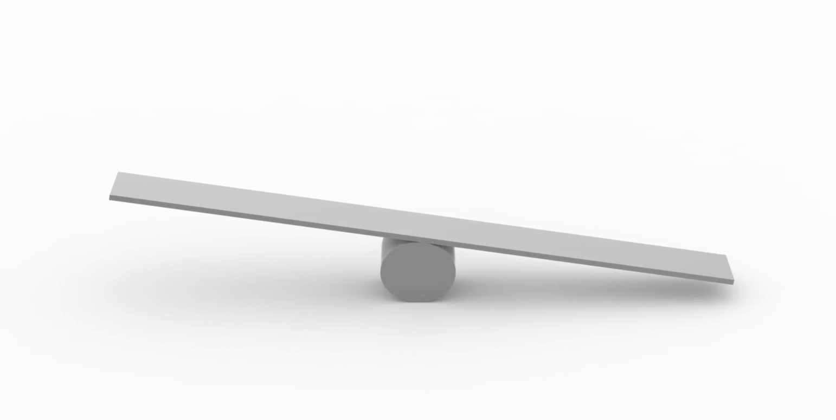
Which rank to perform the screening?
the microbial group test power at screening stage
the multiple comparison penalties at both stages
Notes:
Screening at a higher rank is more powerful with lower multiple comparison penalties at the screening rank. However, the multiple comparison penalty at the target rank is much larger due to a large number of taxa within the discovered associated groups.

Slide 25
Which rank to perform the screening?
the microbial group test power at screening stage
the multiple comparison penalties at both stages
Notes:
Screening at a higher rank is more powerful with lower multiple comparison penalties at the screening rank. However, the multiple comparison penalty at the target rank is much larger due to a large number of taxa within the discovered associated groups.

Slide 26
Which rank to perform the screening?
the microbial group test power at screening stage
the multiple comparison penalties at both stages
A middle taxonomic rank such as order or family is expected to perform best in the proposed two-stage framework.
Notes:
Screening at a higher rank is more powerful with lower multiple comparison penalties at the screening rank. However, the multiple comparison penalty at the target rank is much larger due to a large number of taxa within the discovered associated groups.

Slide 27
Advanced FDR controlling procedures
Two advanced FDR-controlling procedures to accommodate the hierarchically structured hypotheses in massMap.
The hierarchical BH (HBH) procedure (Yekutieli et al. 2006)
The selected subset testing with BH (SST) procedure (Benjamini and Yekutieli 2005)
Notes:
The HBH procedure has merit since it reports many discoveries[21, 22], but it sometimes has higher FDR than the nominal level. In comparison, SST is more conservative than HBH. If tests between two stages are independent, either utilizing an independent source of data or testing unrelated hypotheses, SST procedure can control the FDR at the desired level. Notice that in our setting we ignore the minor correlated noise among tests from two stages to implement SST as researcher did in the microarray

Slide 28
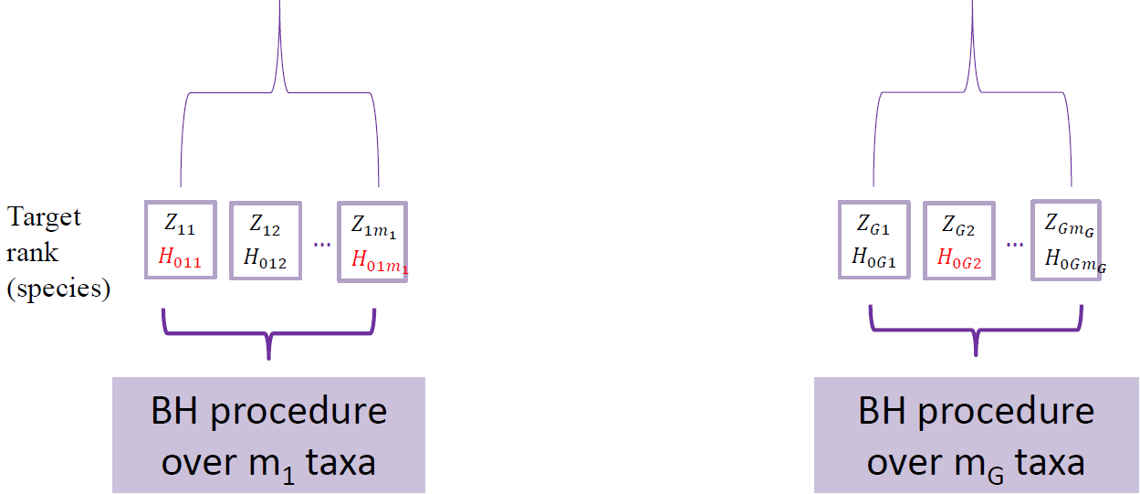
The Hierarchical BH (HBH) procedures
Notes:
The HBH procedure has merit since it reports many discoveries[21, 22], but it sometimes has higher FDR than the nominal level. In comparison, SST is more conservative than HBH. If tests between two stages are independent, either utilizing an independent source of data or testing unrelated hypotheses, SST procedure can control the FDR at the desired level. Notice that in our setting we ignore the minor correlated noise among tests from two stages to implement SST as researcher did in the microarray

Slide 29
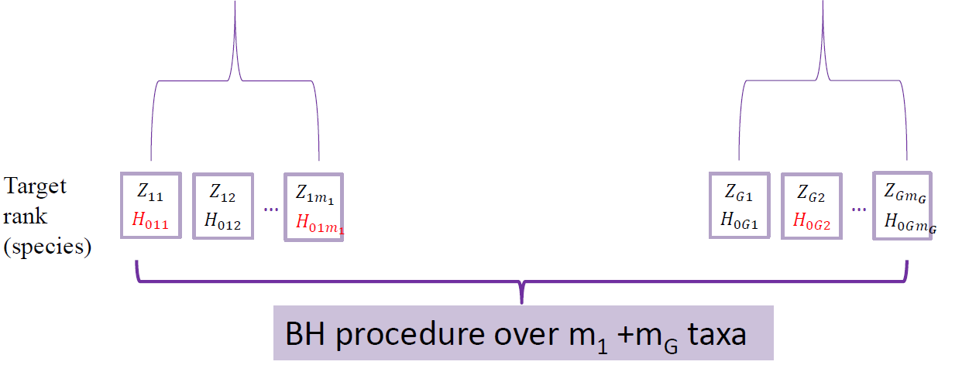
The Selected Subset BH (SST) Procedures
Notes:
The HBH procedure has merit since it reports many discoveries[21, 22], but it sometimes has higher FDR than the nominal level. In comparison, SST is more conservative than HBH. If tests between two stages are independent, either utilizing an independent source of data or testing unrelated hypotheses, SST procedure can control the FDR at the desired level. Notice that in our setting we ignore the minor correlated noise among tests from two stages to implement SST as researcher did in the microarray

Slide 30
Simulations
Simulated OTU counts for 200 subjects from the DM distribution.
Total reads =15,000 for sample.
The dispersion parameter and proportion means. - Estimated from a real microbiome data (AGP data) for 174 OTUs with original taxonomic tree.
Generated binary outcome values.
Partitioned all OTUs into 10 clusters using PAM algorithm.
Randomly set 10% OTUs in 2-3 PAM clusters as the associated OTUs.
$Logit [P\left(Y_{i}=1 | Z_{i}\right)]$ = $\sum_{j∈Λ}{β_{j}scale(Z_{ij})}$
Notes:
where $ε_{i}∼N(0,1)$ is the error term, and $Z_{ij}$ is the OTU abundance for subject $i=1,…, N$. $β=(β_{1},…, β_{j}, …, β_{\left|Λ\right| })′$is a vector of coefficients for the associated OTU. $Λ$ is a set of the indices of truly associated OTU and $|Λ|$ is the number of associated OTU.
structure, but do not investigate specifi c organisms, a

Slide 31
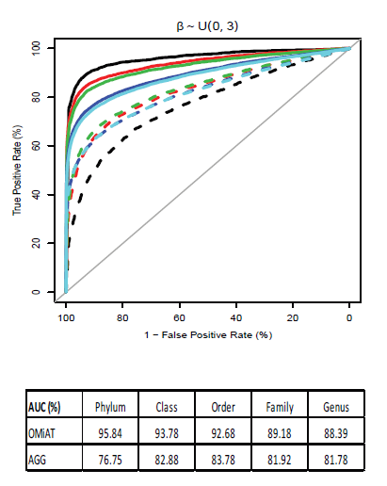
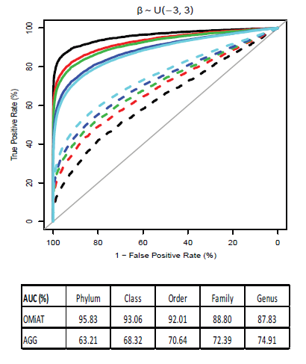
Simulation Results
The screening performance of OMiAT and the aggregated method
Notes:
. We first evaluate the screening performance of OMiAT and the aggregated method using the receiver operating characteristic (ROC) curves and the area under the curves (AUCs) at the phylum, class, order, family and genus ranks, respectively
From the ROC, it is evident that OMiAT’s curves are consistently higher than those from the aggregated method for all ranks under both scenarios (Figure 2A for the same effect direction and Figure 2B for mixed directions). When we look into the AUC, we observe that OMiAT’s performance as a screening test is consistent between two scenarios and its AUC is highest at the phylum rank, and decreases as the taxonomic rank descends. This is explainable since OMiAT is more powerful when the group size is larger and the upper rank (such as phylum) groups consist of more target level taxa than do the lower rank groups. In contrast, the screening performance of the aggregated method is less satisfactory when the associated taxa within the testing group are more in mixed directions (Figure 2B) than in the same direction (Figure 2A), because the aggregation cancels the mixed effect signals. Further, unlike OMiAT, the AUC of the aggregated method increases as the taxonomic rank descends because in theory the aggregated method achieves the highest power when all taxa within the group have the same effect size and direction. As groups become smaller at lower taxonomic ranks, the taxa within the group are more homogeneous, which increases the power of the aggregated method. In summary, through simulations we verified that the aggregated method is not optimal for screening microbial associated groups at the upper rank. As expected, OMiAT exhibits marked performance as screening test statistics in the proposed two-stage framework.

Slide 32
Simulations
For those 17 associated taxa, we considered two scenarios of association.
Under scenario 1, effects of associated taxa have the same sign but varied strength, with small ($β_{j}∼$ Uniform (0, 2)), modest ($β_{j}∼$ Uniform (0, 3)) or large effect sizes ($β_{j}∼$ Uniform (0, 4)).
Under scenario 2, the effect directions were mixed in scenario 2, i.e., $β_{j}∼$ Uniform (-2, 2), Uniform (-3,3), or Uniform(-4, 4).
Notes:
For those 17 associated taxa, we considered two scenarios of association. Under scenario 1, effects of associated taxa have the same sign but varied strength, with small ($β_{j}∼$ Uniform (0, 2)), modest ($β_{j}∼$ Uniform (0, 3)) or large effect sizes ($β_{j}∼$ Uniform (0, 4)). In contrast, the effect directions were mixed in scenario 2, i.e., $β_{j}∼$ Uniform (-2, 2), Uniform (-3,3), or Uniform(-4, 4).

Slide 33
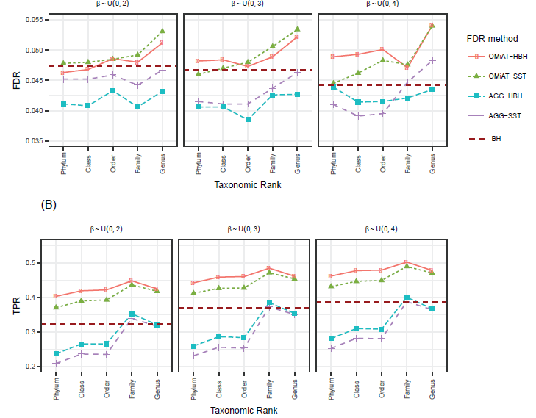
Results: the Empirical FDR and TPR at the Target Rank(Scenario 1)
Notes:
. We first evaluate the screening performance of OMiAT and the aggregated method using the receiver operating characteristic (ROC) curves and the area under the curves (AUCs) at the phylum, class, order, family and genus ranks, respectively
we just focus on comparing the two-stage OMiAT-HBH and OMiAT-SST with the traditional BH method in the following. The proposed two-stage framework using OMiAT as the screening test has substantial power gain against the traditional BH method, no matter which rank is selected as the screening rank (Figures 3B and 4B). Noticeably, both OMiAT-HBH and OMiAT-SST reach the highest power when family rank is selected as the screening rank. This is a result of the balance between the screening test’s power and the multiple comparison penalty at the target

Slide 34
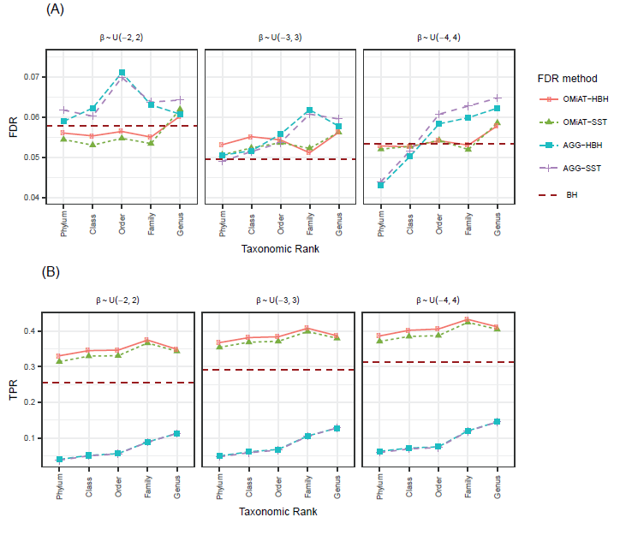
Results: the Empirical FDR and TPR at the Target Rank(Scenario 2)
Notes:
. We first evaluate the screening performance of OMiAT and the aggregated method using the receiver operating characteristic (ROC) curves and the area under the curves (AUCs) at the phylum, class, order, family and genus ranks, respectively

Slide 35
Real Data Analysis -- American Gut Project
The American Gut Project aims to create a comprehensive map of the human microbiome.
7,293 subjects, 456 descriptive variables, 22,891 OTUs
After filtering: 1147 samples & 90 species left for investigation
Two traits of interest:
Antibiotic history (ABH)
Body mass index (BMI)
Covariates: age, gender
Screening rank: family
Notes:
We applied the two-stage framework to real data analyses of the AGP data and a mice study.
The project collected over 400 descriptive variables for 72 hundred individuals.
Plus, gut microbiome data from these individuals are collected and about 23 thousand kinds of OTUs are observed.
After necessary filtering steps : 1147 samples & 90 species left for investigation
As an illustration, we are interested in which gut species are associated with BMI;
And antibiotic histoty.

Slide 36
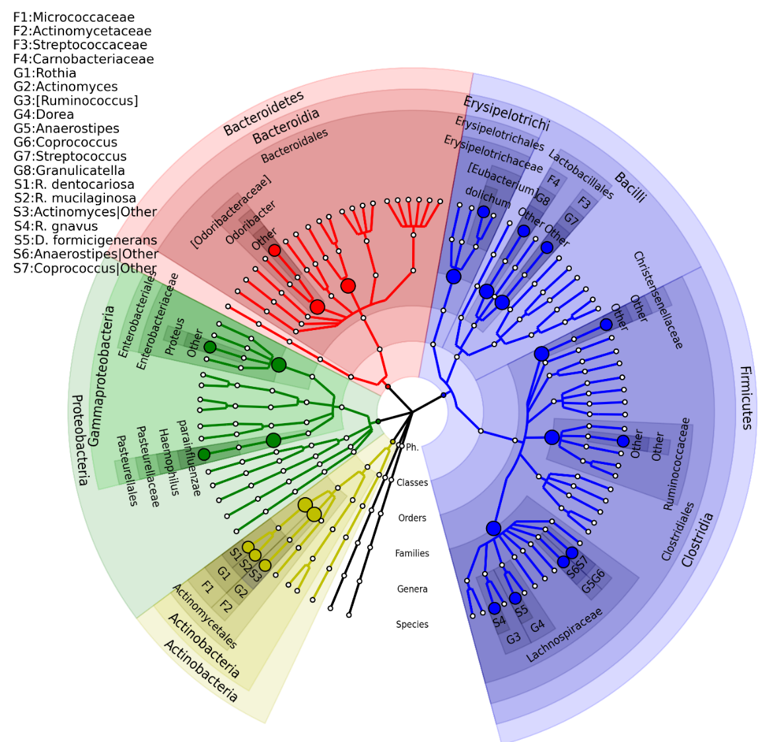
Background | Project 1: massMap | Project 2 | Challenges
AGP—Antibiotic History (ABH)
Highly overlapping results with competing methods
Much smaller adjusted p-values
Clustering association pattern observed – consistent with our assumption
FDR = 0.05
Notes:
The microbial association mapping of antibiotic history (ABH) in American Gut Project subjects (FDR = 0.05).
ABH-associated species with corresponding significant taxonomic groups reported by OMiAT-HBH and OMiAT-SST are highlighted.
OMiAT-HBH, OMiAT-SST, and traditional BH methods each identified 15 ABH-associated species.
the antibiotic effect was sufficiently strong.
However, OMiAT-HBH and OMiAT-SST produced much smaller FDR-adjusted p values than did the traditional BH method, which implies that OMiAT-HBH and OMiAT-SST are more efficient.
There are four ABH associated microbial species clustered in family Lachnospiraceae and two species clustered in family Micrococcaceae. These observations are consistent with the hypothesis that evolutionarily closer taxa usually have similar responses to exposures.

Slide 37
AGP—BMI
OTU ID | Species | Raw p-value | BH | OMiAT-HBH | OMiAT-SST
297635 | [Eubacterium] biforme | 1.90E-04 | 1.70E-02 | 7.60E-04 | 2.50E-03
824876 | Bifidobacterium| Other | 2.70E-03 |  | 5.30E-03 | 1.70E-02
4319938 | Clostridiaceae| Other | 1.00E-02 |  | 2.00E-02 | 3.50E-02
840279 | [Barnesiellaceae]|Other | 1.10E-02 |  | 1.10E-02 | 3.50E-02
4480861 | Catenibacterium| Other | 1.50E-02 |  | 3.10E-02 | 4.00E-02
513664 | Prevotella stercorea | 2.00E-02 |  | 8.00E-02 | 4.30E-02
Number of detected BMI-associated species |  |  | 1 | 6 | 6
Notes:
The associated species identified by OMiAT-HBH/OMiAT-SST are further presented in the taxonomic tree in Figure 6. Compared with the traditional BH and massMap with the aggregated method, OMiAT-HBH and OMiAT-SST discover more taxa and exhibit extra power gain, consistent with the simulations.

Slide 38
Summary
We develop a two-stage microbial association mapping framework -- massMap for binary, continuous and survival outcomes.
MassMap incorporates the highly powerful microbial group test OMiAT/OMiSA for screening and HBH/SST for the control of FDR.
A highly efficient method for microbiome-wide association analyses
Dr. Jiyuan Hu

Slide 39
Acknowledgements
Our group members:
Postdoc:
Dr. Jiyuan Hu
Dr. Chan Wang
Ph.D. student:
Ms. Linchen He
The research is funded by NIH R01 DK110014.
Notes:
I’d like to thank my director, Dr. Huilin Li. Without her insightful guidance, our projects cannot undergo so smoothly.
I’d also like to our research group. Within which We can discuss, share, collaborate with each other.

Slide 40
Acknowledgements
Collaborators:
…
Dr. Martin Blaser and people in his lab
Dr. Zhiheng Pei and people in his lab
Dr. Yu Chen and people in her lab
Dr. Jiyoung Ahn and people in her lab
Notes:
Thanks to our collaborators within NYU. They are productive. And through actively collaborating with them, We have the opportunity to get exposed by the cutting-edge microbiome studies worldwide. And identify cutting-edge microbiome-related statistical questions to work on.
as Biostatistician, we can identify advanced problems.
##He is an established researcher in microbiology and infectious diseases. In 2015, he was selected to be in the TIME 100 Most Influential People in the world

Slide 42
References
Zuur AF, Ieno EN, Walker NJ, Saveliev AA, Smith GM. Mixed Effects Models and Extensions in Ecology with R. New York, NY: Springer Science & Business Media, LLC; 2009.
Martín-Fernández JA, Hron K, Templ M, Filzmoser P, Palarea-Albaladejo J. Model-based replacement of rounded zeros in compositional data: classical and robust approaches. Comput Stat Data Anal 2012;56:2688e704.
Martín-Fernández J, Barceló-Vidal C, Pawlowsky-Glahn V. Dealing with zeros and missing values in compositional data sets using nonparametric imputa-tion. Math Geol 2003;35:253e78.
Aitchison J, Kay JW. Possible solutions of some essential zero problems in compositional data analysis. Compos Data Anal Work Girona 2003; 2003:6.
Zhao, N., Chen, J., Carroll, I.M., Ringel-Kulka, T., Epstein, M.P., Zhou, H., Zhou, J.J., Ringel, Y., Li, H., and Wu, M.C. (2015) Testing in microbiome-profiling studies with MiRKAT, the microbiome regression-based kernel association test. Am. J. Hum. Genet. 96(5): 797-807.
Pan, W., Kim, J., Zhang, Y., Shen, X., and Wei, P. (2014) A powerful and adaptive association test for rare variants. Genetics 197(4): 1081-95.
Cho I, Blaser MJ (2012) The human microbiome: at the interface of health and disease. Nat Rev Genet 13: 260–270. doi: 10.1038/nrg3182.
Li H (2015): Microbiome, Metagenomics and High Dimensional Compositional Data Analysis. Annual Review of Statistics and Its Application, 2:73-94.
Tsilimigras MC, Fodor AA.2016 Compositional data analysis of the microbiome: fundamentals, tools, and challenges. Ann Epidemiol. 2016 May;26(5):330-5.
Tyler AD, Smith MI, Silverberg MS. Analyzing the human microbiome: a "how to" guide for physicians. Am J Gastroenterol. 2014 Jul;109(7):983-93. doi: 10.1038/ajg.2014.73. Review.
Blaser MJ. 2014. Missing Microbes. Henry Holt.
Faust K, Raes J (2012) Microbial interactions: from networks to models. Nature Reviews.
Weiss et al. (2017) Normalization and microbial differential abundance strategies depend upon data characteristics. Microbiome

Slide 43
References
Segata N, Izard J, Waldron L, Gevers D, Miropolsky L, Garrett WS, Huttenhower C: Metagenomic biomarker discovery and explanation. Genome Biol 2011, 12:R60.
Paulson JN, Stine OC, Bravo HC, Pop M: Differential abundance analysis for microbial marker-gene surveys. Nat Methods 2013, 10:1200-1202.
Koh H, Blaser MJ, Li H: A powerful microbiome-based association test and a microbial taxa discovery framework for comprehensive association mapping. Microbiome 2017, 5:45.
Benjamini Y, Hochberg Y: Controlling the false discovery rate: a practical and powerful approach to multiple testing. J R Stat Soc Series B Stat Methodol 1995:289-300.
Yekutieli D: Hierarchical false discovery rate–controlling methodology. J Amer Statistical Assoc 2008, 103:309-316.
Benjamini Y, Yekutieli D: The false discovery rate approach to quantitative trait loci analysis. Genetics 2005, 171:783-789.
Zhang H, DiBaise JK, Zuccolo A, Kudrna D, Braidotti M, Yu Y, Parameswaran P, Crowell MD, Wing R, Rittmann BE: Human gut microbiota in obesity and after gastric bypass. Proc Natl Acad Sci U S A 2009, 106:2365-2370.
Collado MC, Isolauri E, Laitinen K, Salminen S: Distinct composition of gut microbiota during pregnancy in overweight and normal-weight women. Am J Clin Nutr 2008, 88:894-899.

