Slide 1
Rouse Dynamics of Topological Polymers through Gaussian Random Graph Embeddings and
Comparion with Experiments
Tetsuo DEGUCHI
with Erica Uehara, Jason Cantarella^{A} and Clayton Shonkwiler^{B}
Ochanomizu Univ., Univ. of Georgia^{A}, and Colorado State Univ^{B}.
In BIRS workshop 19w5226 ``The Topology of Nucleic Acids: Research at the Interface of Low-Dimensional Topology, Polymer Physics and Molecular Biology”,
Mar. 24 – 29. 2019, BIRS, Banff, Canada

Slide 2
Contents
Part I : Ring and Topological polymers (graph-shaped polymers)
Part II: Gaussian Random Graph Embeddings (cf. Jason’s talk)
Part III : Rouse dynamics of topological polymers
Part IV: Comparison with Experiments and MD simulation of real chains

Slide 3
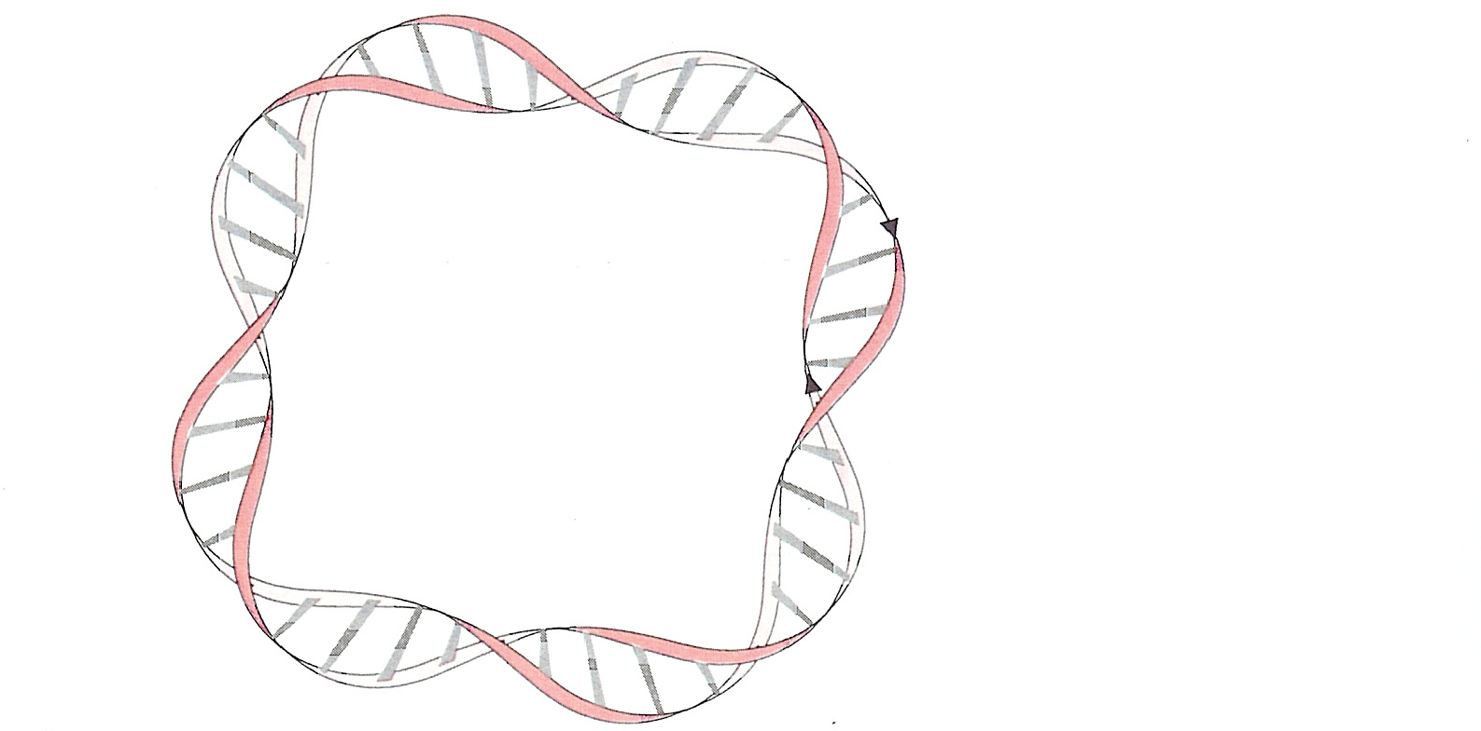
Part 0: Ring Polymers
An example of a Natural ring polymer:
Double stranded circular DNA in plasmids of E. Coli
(A.D. Bates and A. Maxwell, DNA Topology, Oxford Univ. Press, 1993)

Slide 4
Part I: Topological polymers: polymers with complex structure in chemical connectivity and those of complex topology expressed by spatial graphs
・Double-ring polymer
(di-cyclic polymers)
Multiple-ring polymers ※1
※1 M. Fukatsu and M. Kurata,
J. Chem. Phys. 44, 4539 (1966)
・Tadpole (or lasso) polymers ※2
・ Tricyclic Polymers, Triply Fused Tetracyclic Polymers ※3
※2 Y. Tezuka, H. Oike, JACS (2001);
T. Yamamoto, Y. Tezuka, Polym. Chem., 2, 1930 (2011).
※3 N Sugai, H. Heguri, T. Yamamoto, Y. Tezuka, JACS 133 (2011) 19694

Slide 5
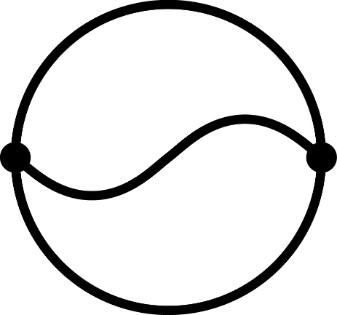


Definition of Topological polymers:
(1) polymers with nontrivial structure in chemical connectivity expressed by graphs and
(2) polymers with nontrivial topology expressed by spatial graphs
Θ-shaped graph (Left, topologically trivial);
complete bipartite K_{3,3} graph:
non-planar spatial graph (Center, Right)
これもK_{3,3}

Slide 6
Task： Fast algorithm for generating an ensemble of conformations of topological polymers with a given graph
→ We want to generate such a set of random walks that gives random conformations of the topological polymer with correct measure.
Topologically constrained random walks (TCRW)
Difficulties：
It seemed that we need N³ time to generate even such random walks simply connecting given two points.

Slide 7
Two approaches:
(1) Quaternion method for generating random polygons
(2) Gaussian random graph embeddings
(1) Quaternion method for generating random polygons:
J. Cantarella, T. D. and C. Shonkwiler,
Commun. Pure Appl. Math. 67, 1658-1699 (2014)
It is a linear time algorithm for generating random walks connecting given two points in 3D
E. Uehara, R. Tanaka, M. Inoue, F. Hirose and T. D.,
Mean-square radius of gyration and hydrodynamic radius for topological polymers evaluated through the quaternionic algorithm,
Reactive and Functional Polymers Vol. 80 (2014) 48-56.
E. Uehara and T. D.,
Mean-square radius of gyration and the hydrodynamic radius for topological polymers expressed with graphs evaluated by the method of quaternions revisited,
React. Funct. Polym. Vol. 133 (2018) 93-102.
(2) Gaussian random graph embeddings (see Jason Cantarella’ s talk) :
J. Cantarella, T. D., C. Shonkwiler, and E. Uehara, in preparation

Slide 8






Part II: Gaussian Random Graph Embeddings
(Topologically Constrained Random Walks (TCRW))
Consider a graph G with $e$ edges ($e_{1}, e_{2}, …, e_{e}$)
and $v$ vertices ($v_{1}, v_{2}, …, v_{v}$)
Theta graph has $v=$ 2 and $e=3$
$R^{e}$: edge space
$R^{v}$: vertex space
$$1$$
$$2$$
$$1$$
$$2$$
$$3$$

Slide 9
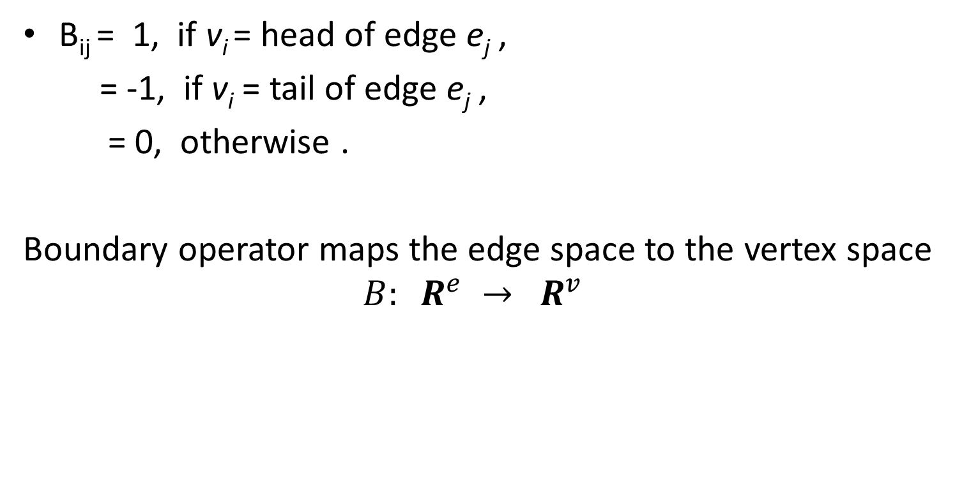
B: boundary operator
(i.e., incidence matrix)
B_{ij} = 1, if v_{i} = head of edge e_{j} ,
= -1, if v_{i} = tail of edge e_{j} ,
= 0, otherwise .
Boundary operator maps the edge space to the vertex space
$$B: R^{e} → R^{v}$$

Slide 10
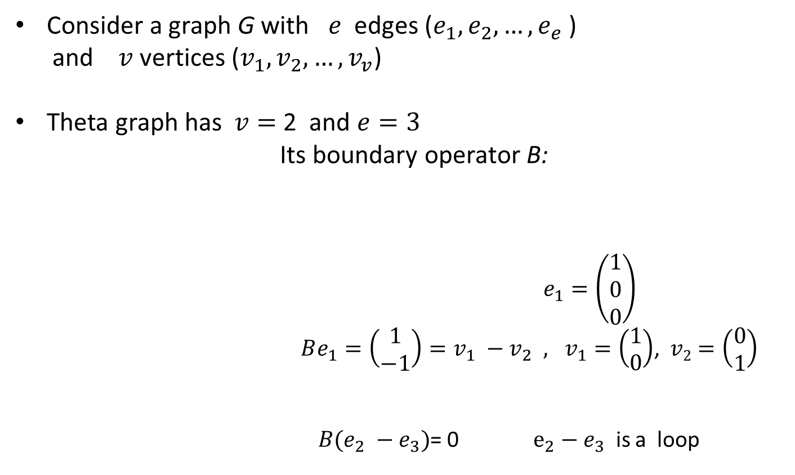
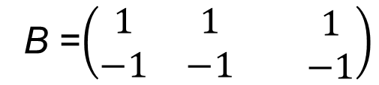
An example: a theta graph
Consider a graph G with $e$ edges ($e_{1}, e_{2}, …, e_{e}$)
and $v$ vertices ($v_{1}, v_{2}, …, v_{v}$)
Theta graph has $v=$ 2 and $e=3$
Its boundary operator B:
$e_{1}=\left(\begin{aligned}1 \\ 0 \\ 0\end{aligned}\right)$
${Be_{1}=\left(\begin{aligned}1 \\ −1\end{aligned}\right)=v_{1} −v_{2} , v}_{1}=\left(\begin{aligned}1 \\ 0\end{aligned}\right)$, $v2=\left(\begin{aligned}0 \\ 1\end{aligned}\right)$
$B(e_{2} −e_{3})$= 0 $e_{2}−e_{3}$ is a loop
$$1$$
B =$\left(\begin{matrix}1 & 1 \\ −1 & −1\end{matrix}\begin{matrix} & 1 \\ & −1\end{matrix}\right)$
$$2$$
$$1$$
$$2$$
$$3$$

Slide 11
Singular value decomposition of matrix B:
B = U S V^{T} where U and V are orthogonal matrices and
S a pseudo diagonal matrix.
U: v x v matrix; V: e x e matrix ; S: v x e matrix;
Moore-Penrose pseudo-inverse of B:
B⁺ = V S⁺ U^{T}
Here S⁺ is pseudo-inverse of S
B⁺B
is projection from edge space to the space of topologically constrained random walks (TCRW), i.e. (ker B)^{perp} , the space orthogonal to ker B
ker B (the kernel of B): the space of constraints such as loops
Lem: (ker B)^{perp} = im(B^{T})

Slide 12
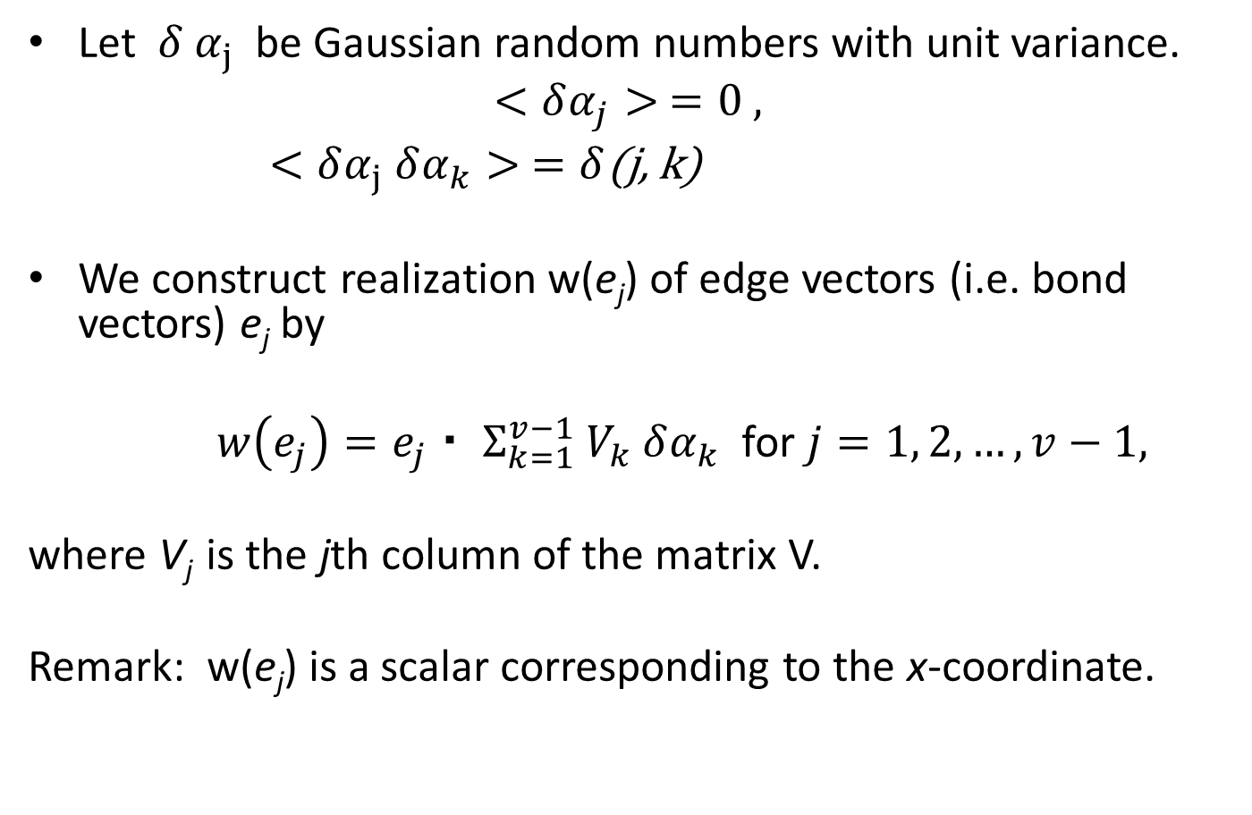
Method for sampling random Gaussian conformations
Let $δ α_{j}$ be Gaussian random numbers with unit variance.
$$<δα_{j}> =0 ,$$
$<δα_{j} δα_{k}> =δ$(j, k)
We construct realization w(e_{j}) of edge vectors (i.e. bond vectors) e_{j} by
$w\left(e_{j}\right)=e_{j} ・ { Σ}_{k=1}^{v−1} V_{k} δα_{k}$ for $j=1, 2, …, v−1,$
where V_{j} is the jth column of the matrix V.
Remark: w(e_{j}) is a scalar corresponding to the x-coordinate.

Slide 13
By making use of projection B⁺ B, the mean square radius of gyration can be calculated exactly. Example: a tri-lasso graph

Slide 14
Summary of Part II
An ensemble of random conformations for topological polymers with any given graph can be generated by Gaussian random graph embeddings in O(N) time
We can evaluate any statistical or dynamical quantities of topological polymers systematically and even analytically by taking the ensemble averages over conformations generated by Gaussian random graph embeddings.

Slide 15
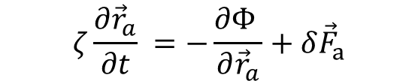
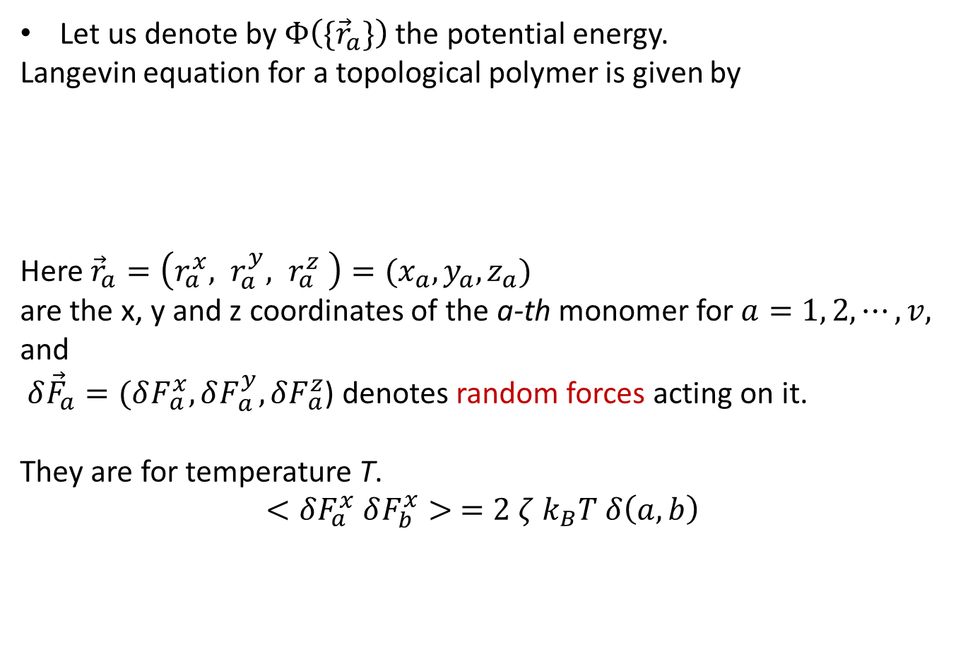
Part III: Rouse dynamics for topological polymers
Let us denote by $Φ\left(\{{\vec{r}}_{a}\}\right)$the potential energy.
Langevin equation for a topological polymer is given by
Here ${\vec{r}}_{a}=\left(r_{a}^{x}, r_{a}^{y}, r_{a}^{z} \right)=(x_{a}, y_{a}, z_{a})$
are the x, y and z coordinates of the a-th monomer for $a=1, 2, ⋯, v,$
and
$δ{\vec{F}}_{a}=(δF_{ a}^{x}, δF_{ a}^{y}, δF_{ a}^{z}$) denotes random forces acting on it.
They are for temperature T.
$$<δF_{a}^{x} δF_{b}^{x}> ={2 ζ k}_{B}T δ\left(a,b\right)$$
$$ζ\frac{∂{\vec{r}}_{a}}{∂t} =−\frac{∂Φ }{∂{\vec{r}}_{a}}+δ{\vec{F}}_{a}$$

Slide 16
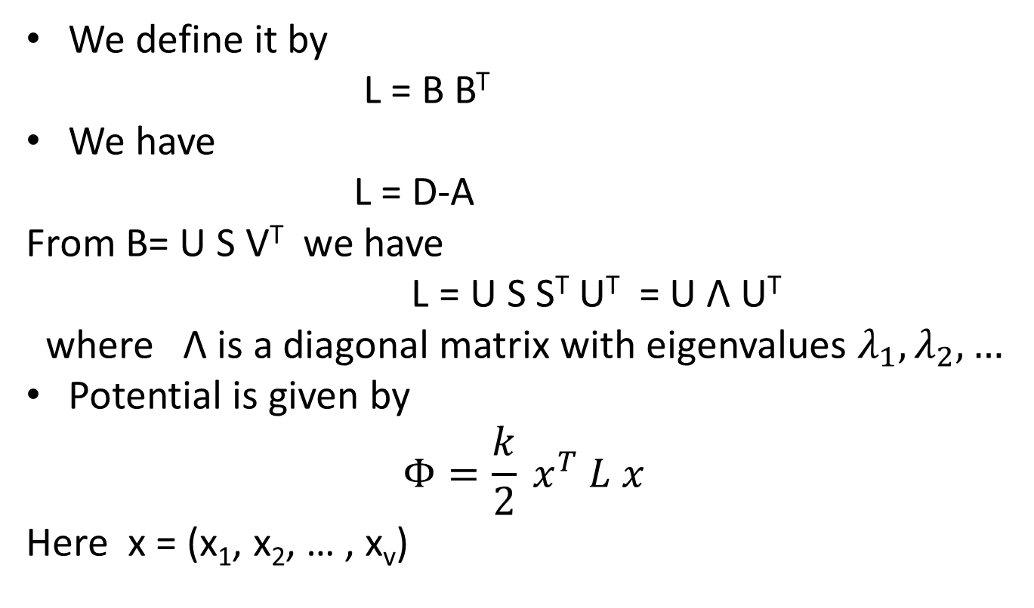
Graph Laplacian L
We define it by
L = B B^{T}
We have
L = D-A
From B= U S V^{T} we have
L = U S S^{T} U^{T} = U Λ U^{T}
where Λ is a diagonal matrix with eigenvalues $λ_{1}, λ_{2}, …$
Potential is given by
$$Φ=\frac{k}{2} x^{T} L x$$
Here x = (x₁, x₂, … , x_{v})

Slide 17
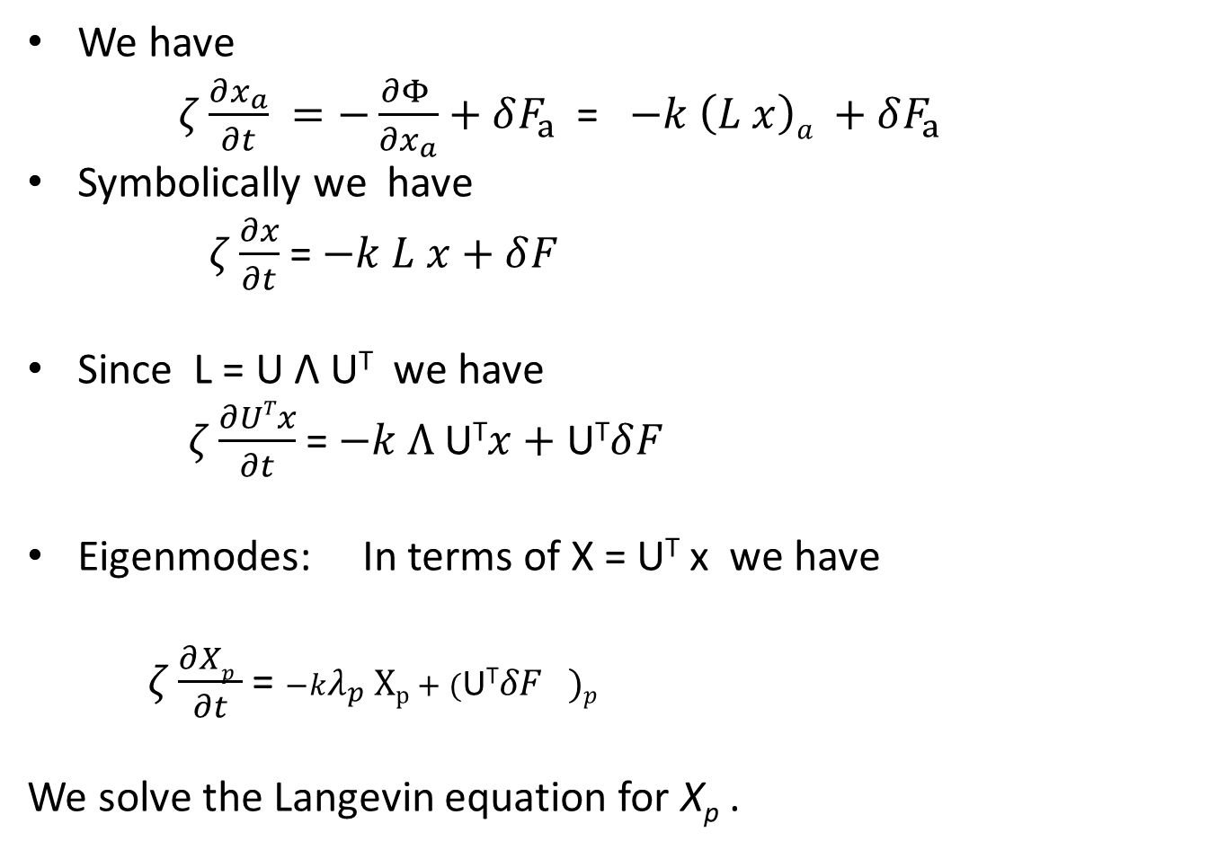
Relaxation modes of the Langevin eq.
We have
$ζ\frac{∂x_{a}}{∂t} =−\frac{∂Φ }{∂x_{a}}+δF_{a}$ = $−k \left(L x\right)a +δF_{a}$
Symbolically we have
$ζ\frac{∂x}{∂t}$= $−k L x+δF_{}$
Since L = U Λ U^{T} we have
$ζ\frac{∂UTx}{∂t}$= $−k Λ \text{U}\text{T}x+\text{U}\text{T}δF_{}$
Eigenmodes: In terms of X = U^{T} x we have
$ζ\frac{∂Xp }{∂t}$= $−kλ_{p} Xp+\text{(}\text{U}\text{T}δF_{})p$
We solve the Langevin equation for X_{p} .

Slide 18
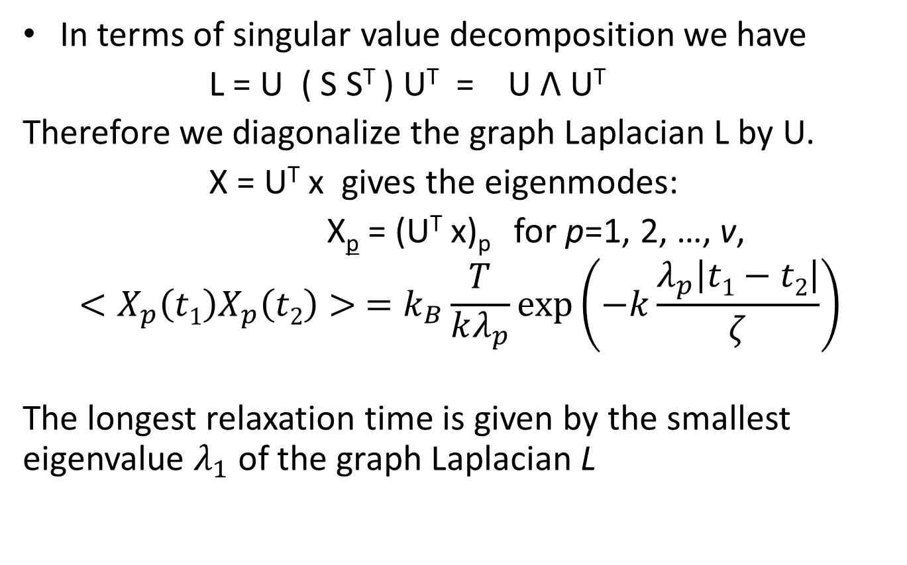
Relaxation of eigenmodes
In terms of singular value decomposition we have
L = U ( S S^{T} ) U^{T} = U Λ U^{T}
Therefore we diagonalize the graph Laplacian L by U.
X = U^{T} x gives the eigenmodes:
X_{p} = (U^{T} x)_{p} for p=1, 2, …, v,
$$<X_{p}\left(t1\right)X_{p}\left(t2\right)> =k_{B}\frac{T}{\begin{aligned}kλ_{p} \\ \end{aligned}}\exp\left(−k\frac{λ_{p}\left|t1−t2\right|}{ζ}\right)$$
The longest relaxation time is given by the smallest eigenvalue $λ_{1}$ of the graph Laplacian L

Slide 19
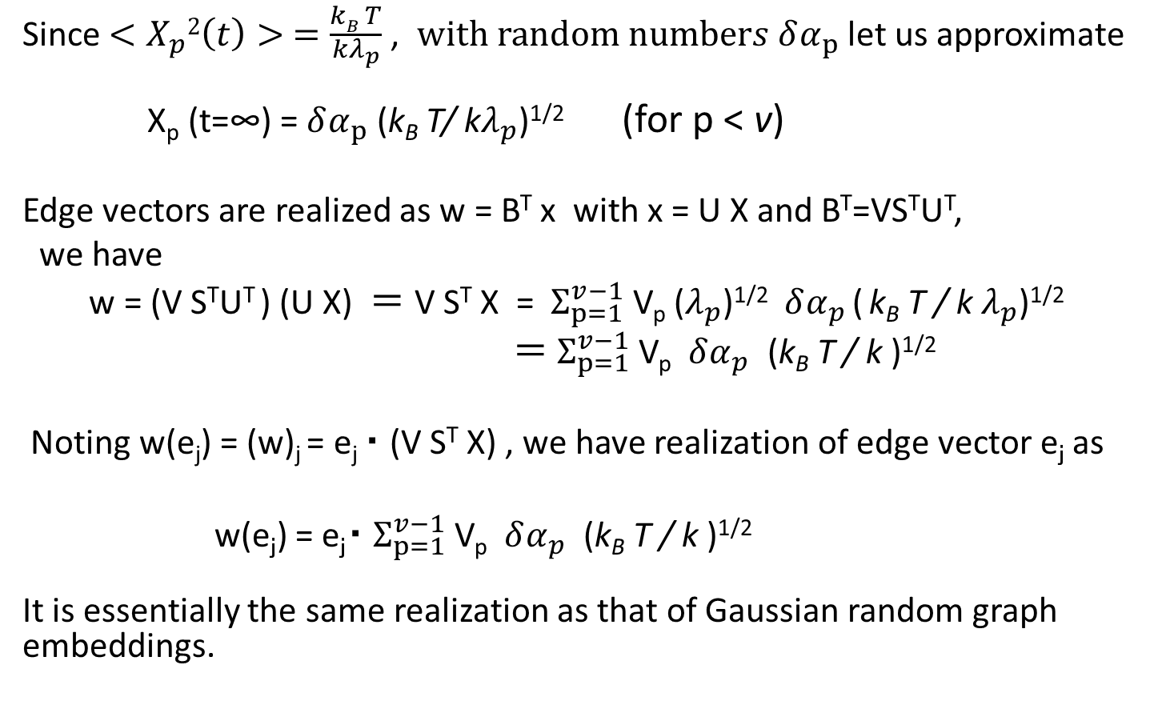
Gaussian random graph embeddings are realized in the Langevin dynamics with temperature T.
Since $<X_{p}2\left(t\right)> =\frac{kB T}{\begin{aligned}kλ_{p} \\ \end{aligned}}$ , $with random numbers δα_{p}$let us approximate
X_{p} (t=∞) = $δα_{p}$ (k_{B} T/ k$λ_{p}$)^{1/2} (for p < v)
Edge vectors are realized as w = B^{T} x with x = U X and B^{T}=VS^{T}U^{T},
we have
w = (V S^{T}U^{T} ) (U X) ＝ V S^{T} X = $Σ_{p=1}^{v−1}$ V_{p} ($λ_{p}$)^{1/2} $δα_{p}$ ( k_{B} T / k $λ_{p}$)^{1/2}
$＝ Σ_{p=1}^{v−1}$ V_{p} $δα_{p}$ (k_{B} T / k )^{1/2}
Noting w(e_{j}) = (w)_{j} = e_{j} ・ (V S^{T} X) , we have realization of edge vector e_{ｊ} as
w(e_{ｊ}) = e_{ｊ}・ $Σ_{p=1}^{v−1}$ V_{p} $δα_{p}$ (k_{B} T / k )^{1/2}
It is essentially the same realization as that of Gaussian random graph embeddings.

Slide 20
Summary of Part III:
Rouse dynamics gives a physical background of the Gaussian random graph embeddings (TCRW)
The x-coordinates of vertices x are given by x = U X
Realization of edge vectors e_{j} are given by
w = B^{T} x
Physical interpretation:
Gaussian random graph embeddings are realized in the time evolution of the Langevin dynamics.
Remark:
We can exactly evaluate static and dynamical properties of TCRW as polymers or networks such as elastic responses analytically through Rouse dynamics.
Ex. Elastic constants are expressed with resistance distances.

Slide 21
Part IV: Comparison with Experiments
Size Exclusion Chromatography (SEC)
Gaussian Random Graph Embeddings
Molecular Dynamics with excluded volume
(TSUBAME supercomputer, Tokyo Institute of Tech.)

Slide 22
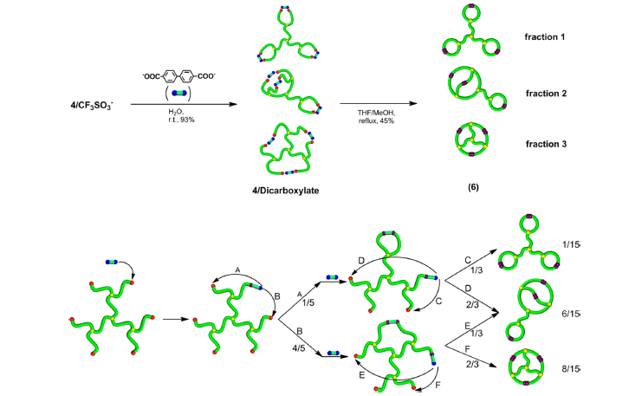
ESA-CF method: Electrostatic Self-Assembly
--> Covaｌent bonding Fixation
T. Suzuki, T. Yamamoto and Y. Tezuka, JACS (2014)

Slide 23
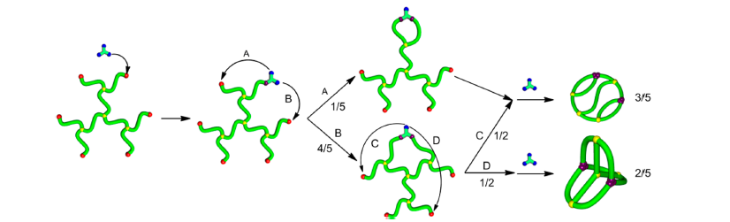
Polymer of a complete bipartite graph K_{3,3}:
T. Suzuki,T. Yamamoto and Y. Tezuka, JACS (2014)

Slide 24
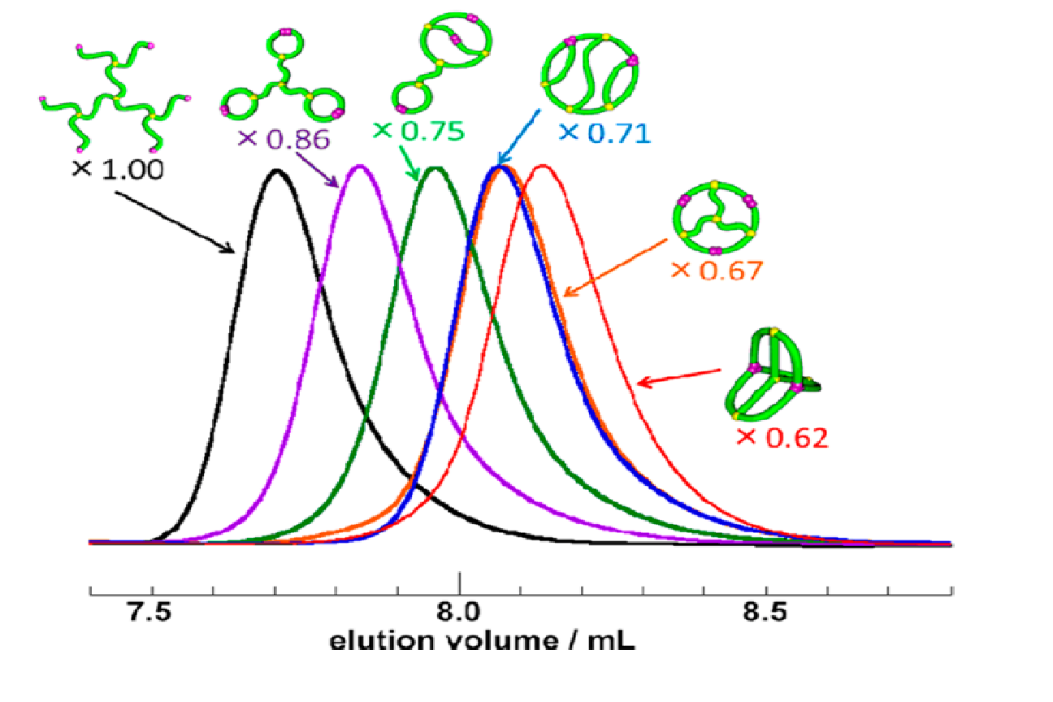
Separation through Size-Exclusion Chromatography:
SEC charts of dicyclic and tricyclic polymers
T. Suzuki, T. Yamamoto and Y. Tezuka, JACS (2014)

Slide 25
Mean-square radius of gyration for topological polymers
segment
: the number of segments
：the position vector
of the th segment
：the position vector
of the center of mass
A model of a polymer chain
The average size of polymers

Slide 26
By the method of Gaussian random graph embeddngs: dendrimer (tree), tri-lasso, theta-lasso graphs

Slide 27
ladder, alpha, K33 graphs

Slide 29
The Gaussian result:
Ideal chain shows
＜R_{g}²＞_{G}＝A(G) N^{ν} , ν = 1.0 for each graph G
The order:
tri-lasso > theta-lasso > ladder > alpha > K33
should be consistent with SEC charts

Slide 30
Molecular dynamics with excluded volume
Mean-square radius of gyration for the Kremer-Grest model:
(TSUBAME computer, Tokyo Institue of Technology)
＜R_{g}²＞_{G}＝A(G) N^{ν} , ν = 1.2 for each graph G
The order among the MSRG is the same as in the SEC charts

Slide 31
Summary of MD simulation
(TSUBAME computer, Tokyo Inst. Tech.)
MD simulation shows
＜R_{g}²＞_{G}＝A(G) N^{ν} , ν = 1.2 for each graph G
The order:
tri-lasso > theta-lasso > ladder > alpha > K33
is consistent with SEC charts

Slide 32
Comparison with Experiment:
Ratio of mean-square radii of gyration
R_{g}²(G)/R_{g}²(tree) with no excluded volume
= 0.88, 0.63, 0.444, 0.436, 0.35
for G=tri-lasso, theta-lasso, ladder, alpha, K33
R_{g}²(G)/R_{g}²(tree) with excluded volume
= 0.96, 0.78, 0.60, 0.58, 0.46
for G=tri-lasso, theta-lasso, ladder, alpha, K33
SEC charts:
0.86, 0.75, 0.71, 0.67, 0.62

Slide 33
Diffusion constants of topological polymers:
(by Kirkwood-Riseman approximation)
T: temperature, η_{s}: viscosity of solution, N: the number of monomers
R_{H} : the hydrodynamical radius defined by
D = k_{B} T/ (6 π η_{s}R_{H} )
Kirkwood-Riseman approximation

Slide 34
Observation: The square of ratios of hydrodynamic radii R_{H} is close to the SEC values
R_{H}(G)/R_{H}(tree)
0.96, 0.89, 0.85, 0.85, 0.79
for G=tri-lasso, theta-lasso, ladder, alpha, K33
(R_{H}(G)/R_{H}(tree))²
0.92, 0.80, 0.71, 0.72, 0.63
for G=tri-lasso, theta-lasso, ladder, alpha, K33
SEC charts:
0.86, 0.75, 0.71, 0.67, 0.62
for G=tri-lasso, theta-lasso, ladder, alpha, K33

Slide 35
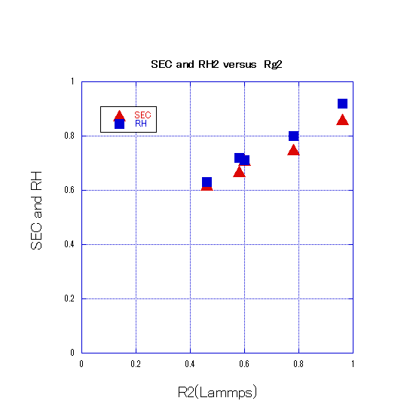
The MD estimates of the square of hydrodynamic radius R_{H} ² for the topological polymers are close to the SEC values.

Slide 36
Summary of Part IV
The order among the estimates of the mean-square radius of gyration for the six topological polymers is consistent with SEC charts
The MD estimates of the square of hydrodynamic radius R_{H} ² for the topological polymers are close to the SEC values.
(real chains with excluded volume)
Estimates of R_{H} ² seems to be related to the SEC values. Is it because they are proportional to the cross sections of the polymers ?

Slide 37
Conclusions
Gaussian random graph embeddings (TCRW) leads to good estimates of the mean-square radius of gyration Rg² for the six topological polymers whose order is consistent with the SEC charts
(ideal chains with no excluded volume)
Rouse dynamics gives physical background to the method of Gaussian random graph embeddings for topological polymers.

Slide 38
This talk is based on collaboration with
Erica Uehara (Ochanomizu Univeristy)
Jason Cantarella (University of Georgia),
Clayton Shonkwiler (Colorado State University)
KAKENHI (Grants-In-Aid) No. 17H06463 with Profs. K. Shimokawa and Y. Tezuka
Acknowledgements:

