Slide 1
Comments on Health Behavior Scores

Slide 2
Background
Many studies look for magic bullets
Red meat meta analysis done at TAMU
  No statisticians experienced with nutritiion
  Non-significant effect, and interpretation that red meat is just fine for you
  Harvard goes berserk
WHI clinical trial emphasizing saturate fat
  last big dietary clinical trial
  P-value 0.07, many, may millions of $$

Slide 3
Background
The only thing that is consistent is the lack of reproducibility in epi studies
It is one at a time
But nutrition is highly multivariate
I think one at a time studies (epi or clinical trials) are just silly
Nutritionists’ idea is to get a score of healthy diets

Slide 4
Background
There are many scoring systems for dietary intakes, with different aims
  Healthy Eating Index (2005, 2010, 2015)
  Alternative Healthy Eating Index
  Dot-Dash scores
  Mediterranean Diet Scores
  World Cancer Research Fund/American Institute for Cancer Research (WCRF/AICR) scores
  .etc

Slide 5
Background
They give consistent results across many studies (the Pooling Project)

Slide 6
Epi and Index Systems
The basic idea of these scores is to create them based on literature research
Emphasize: ONE scoring system, many forms of diets
Once developed, they are then applied to a host of diseases and populations (e.g., men and women, smokers vs nonsmokers, etc.)
Here is the HEI-2005 scoring system

Slide 7
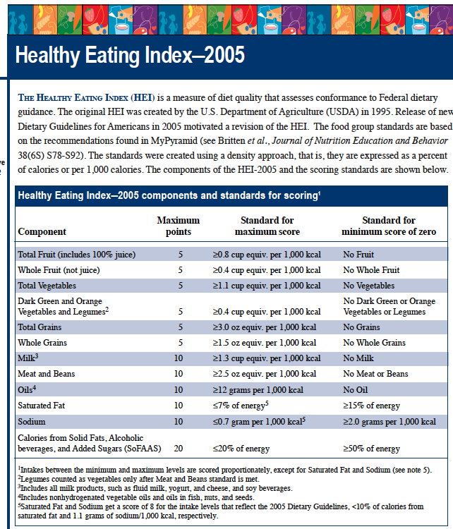
The Healthy Eating Index (HEI) is a measure of diet quality that assesses conformance to Federal dietary guidance. The original HEI was created by the U.S. Department of Agriculture (USDA) in 1995. Release of new Dietary Guidelines for Americans in 2005 motivated a revision of the HEI. The food group standards are based on the recommendations found in My Pyramid (see Britten et al., Journal of Nutrition Education and Behavior 38(6S) S78-S92). The standards were created using a density approach, that is, they are expressed as a percent of calorie or per 1,000 calories. The components of the HEI-2005 and the scoring standards are shown below.
Health Eating Index–2005 component and standards for scoring
Component | Maximum points | Standard for maximum score | Standard for minimum score of zero
Total Fruit (includes 100% juice) | 5 | ≥0.8 cup equiv. per 1,000 kcal | No Fruit
Whole Fruit (not juice) | 5 | ≥0.4 cup equiv. per 1,000 kcal | No Whole Fruit
Total Vegetables | 5 | ≥1.1 cup equiv. per 1,000 kcal | No Vegetables
Dark Green and Orange Vegetables and Legumes | 5 | ≥0.4 cup equiv. per 1,000 kcal | No Dark Green or Orange Vegetables or Legumes
Total Grains | 5 | ≥3.0 oz equiv. per 1,000 kcal | No Grains
Whole Grains | 5 | ≥1.5 oz equiv. per 1,000 kcal | No Whole Grains
Milk | 10 | ≥1.3 cup equiv. per 1,000 kcal | No Milk
Meat and Beans | 10 | ≥2.5 oz equiv. per 1,000 kcal | No Meat or Beans
Oils | 10 | ≥12 grams per 1,000 kcal | No Oil
Saturated Fat | 10 | ≤7% of energy | ≥15% of energy
Sodium | 10 | ≤0.7 gram per 1,000 kcal | ≥2.0 grams per 1,000 kcal
Calories from Solid Fats, Alcoholic beverages, and Added Sugars (SoFAAS) | 20 | ≤20% of energy | ≥50% of energy

Slide 8
Global Index Systems
Crucially, these index systems are to be used across many diseases and mortality outcomes
They are very popular in nutrition because they score the complex nature of dietary intakes
Multiple patterns of intake have much the same risks of various cancers or other chronic diseases
Nutritionists do not think that there is only 1 magic diet (kale ☹)

Slide 9
Global Index Systems
Dietary scoring systems recognize, for example, that there is not a 1-to-1 relationship between cancers and dietary patterns
Different diets can be equally effective at lowering risk
In diet, trying to find the magic combination makes no sense

Slide 10
Global Index Systems
Diet scores are traditionally built on literature review and expert knowledge

Slide 11
Global Index Systems
Two of my statistical papers on diet:
  Ma, et al, JASA, 2007
    Using data to create the scores
    Based on single index models
    Easy in the case that the SIM is linear
  Kravitz and Carroll, STAT, 2020
    Applying some sort of model selection criterion to ask what dietary components actually matter
    Empty calories?

Slide 12
Global Index Systems
Physical Activity scores
Uses AARP data and a physical activity questionnaire (no wearable device data in the study)
Keadle, et al, MSSE 2020
The AARP Study is of people aged 50-75, so not many do a lot of vigorous PA

Slide 13
Global Index Systems
The scores for the best activity sums to 100
At least for mortality, PAQ has a much stronger signal than dietary observations
We used data and a R package called scar (smooth constrained additive regression)
Nonparametric MLE with shape constraints

Slide 14
Global Index Systems
We used scar on the AARP PAQ
The functions are piecewise linear
The R package scam does the same thing, but more smoothly.

Slide 15
Global Index Systems
Maximum scores
  Moderate PA: 30
  Mod-Vig Household: 25
  No television: 15
  Vig: 10
  8 hours sleep: 8
  Non-TV sitting: 5
  Light-intensity household: 4
  Weight training: 3

Slide 16
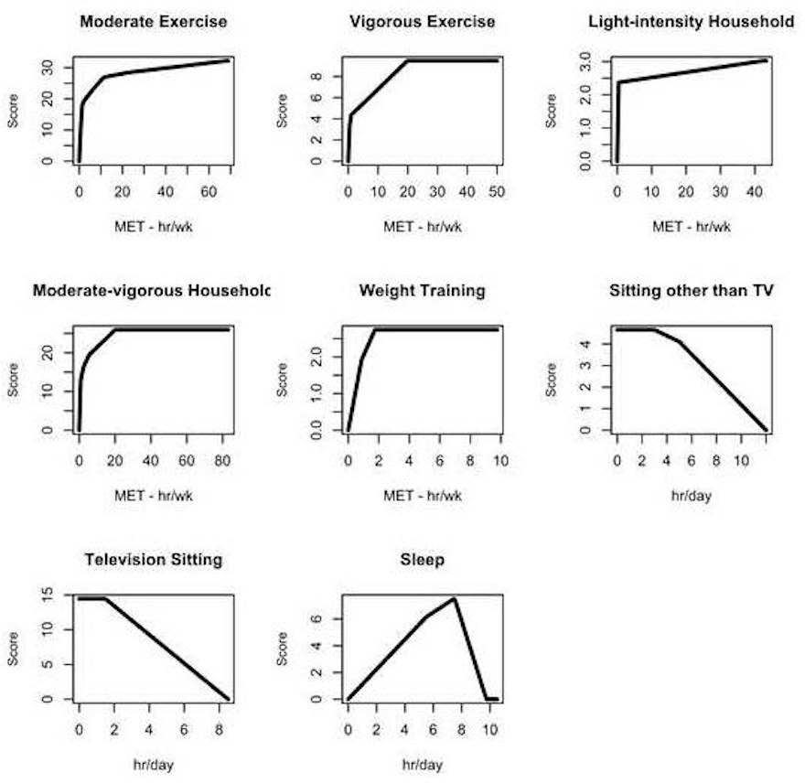
Global Index Systems

Slide 17
Global Index Systems
Clearly AARP is a special study
It only has self-report
I want to do it for accelerometers, across multiple studies
Ciprian and I have started a research project to do so

Slide 18
Under the Hood
The basic idea, for mortality say
You have a collection of variables for PA, sedentary and sleep: call them X
You have demographic and other risk factors that would be in any analysis, Z
You have an outcome, such a mortality, Y
Your have say 2 populations to work with, men and women, k=1,2

Slide 19
Under the Hood
In the simplest format, for k = 1,2, you seek a function S such that
The scoring system is
Crucially, it does not depend on k, the population
It codifies practice: build a score, apply to different populations
Obvious to extend to different diseases

Slide 20
Under the Hood
Model
There are obvious model identification issues, but they are merely technical (I do technical ☺)
There are obvious questions about how to form
Fine, fun challenge, but need to keep it simple

Slide 21
General Idea
The main conceptual issue is to buy into the idea that you want a single scoring system that applies across multiple populations
Nutrition has bought into this in a big way
While they do not express this technically, they know that there is no 1-to-1 function of dietary intakes that best predicts multiple diseases
Jill Reedy and others at NCI

