Slide 1
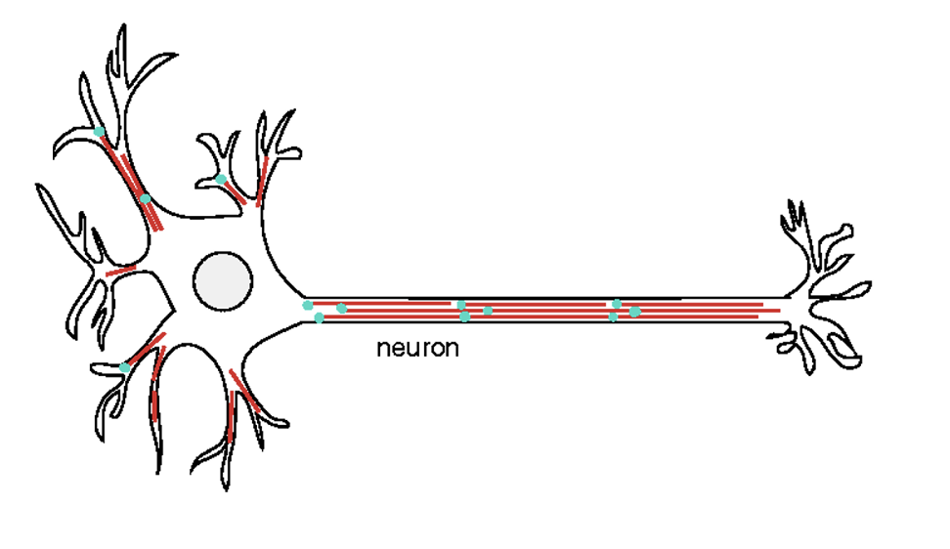
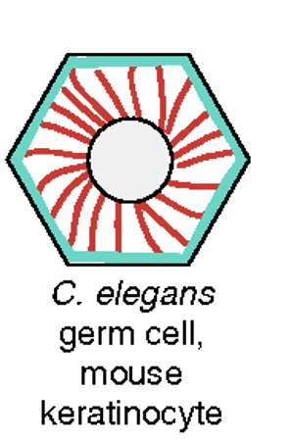
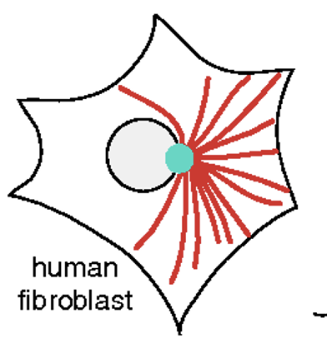
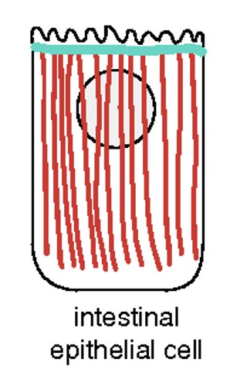
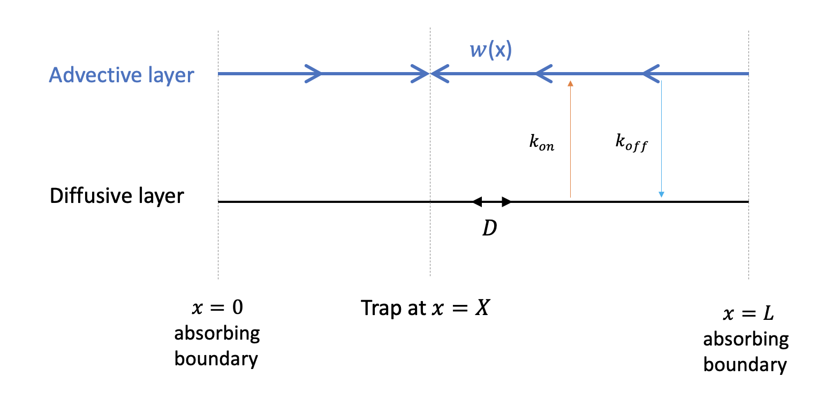
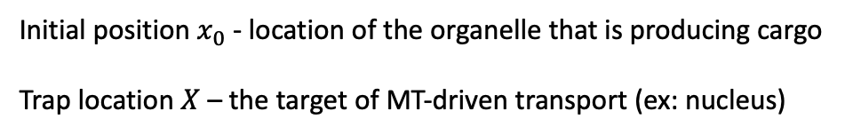
Competing intracellular cargo transport mechanisms result in nontrivial transport time statistics.
Niranjan Surpangala, Brooke Randell, Oleg Kogan, Ajay Gopinathan
Many examples of
microtubule-driven
transport in quasi 1-d
geometries:
One-dimensional model
From Current Opinions in Cell Biology
Initial position $x_{0}$ - location of the organelle that is producing cargo
Trap location $X$ – the target of MT-driven transport (ex: nucleus)
(microtubules)
Want: mean first passage time (MFPT), probability densities, etc.
(cytoplasm or
actin network)

Slide 2
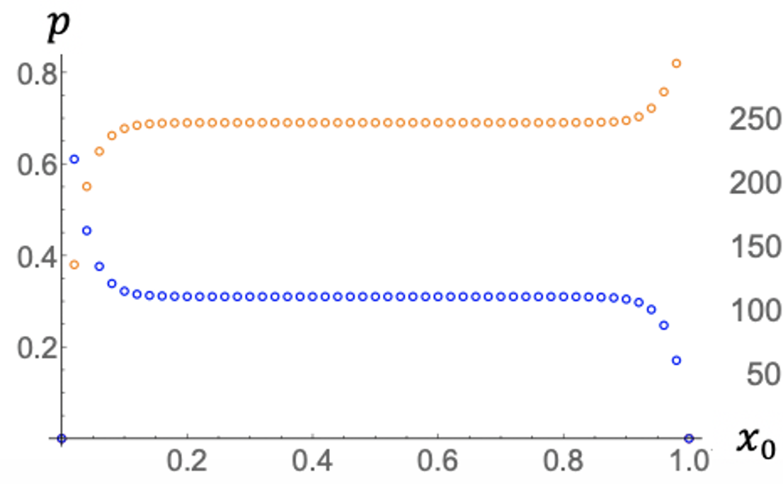
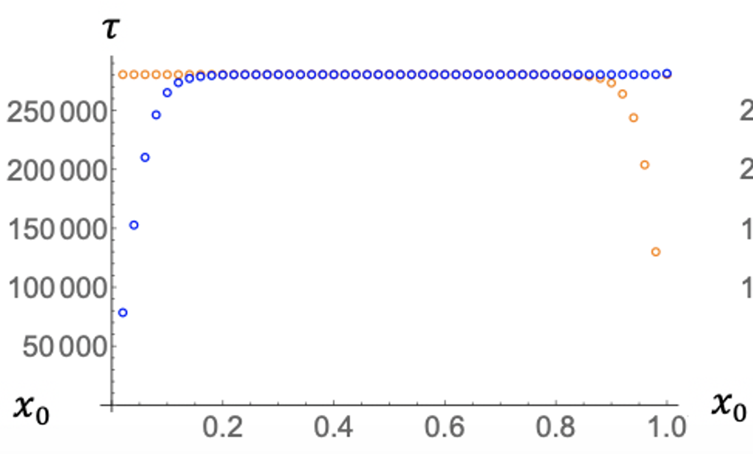
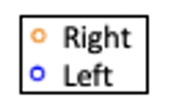
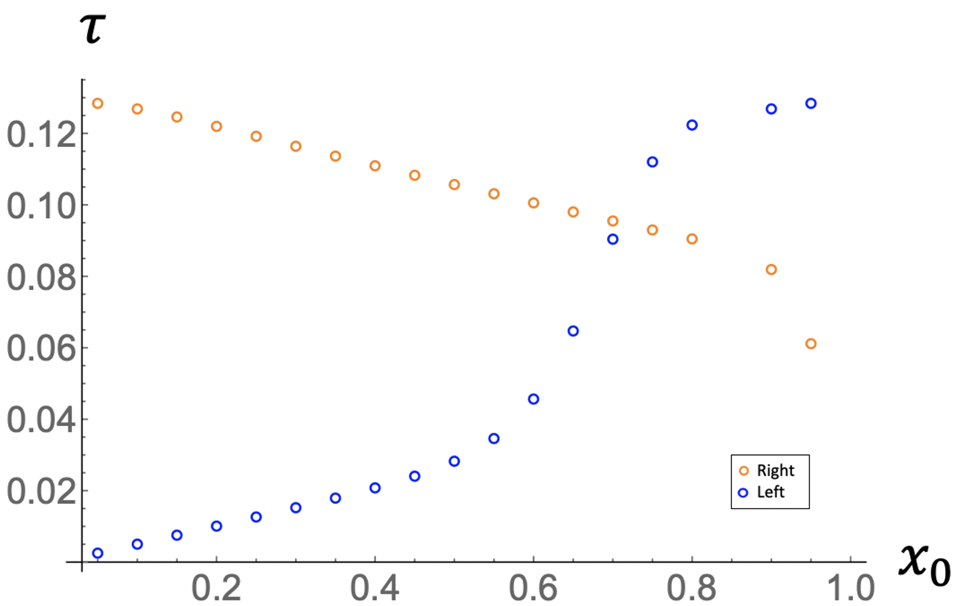
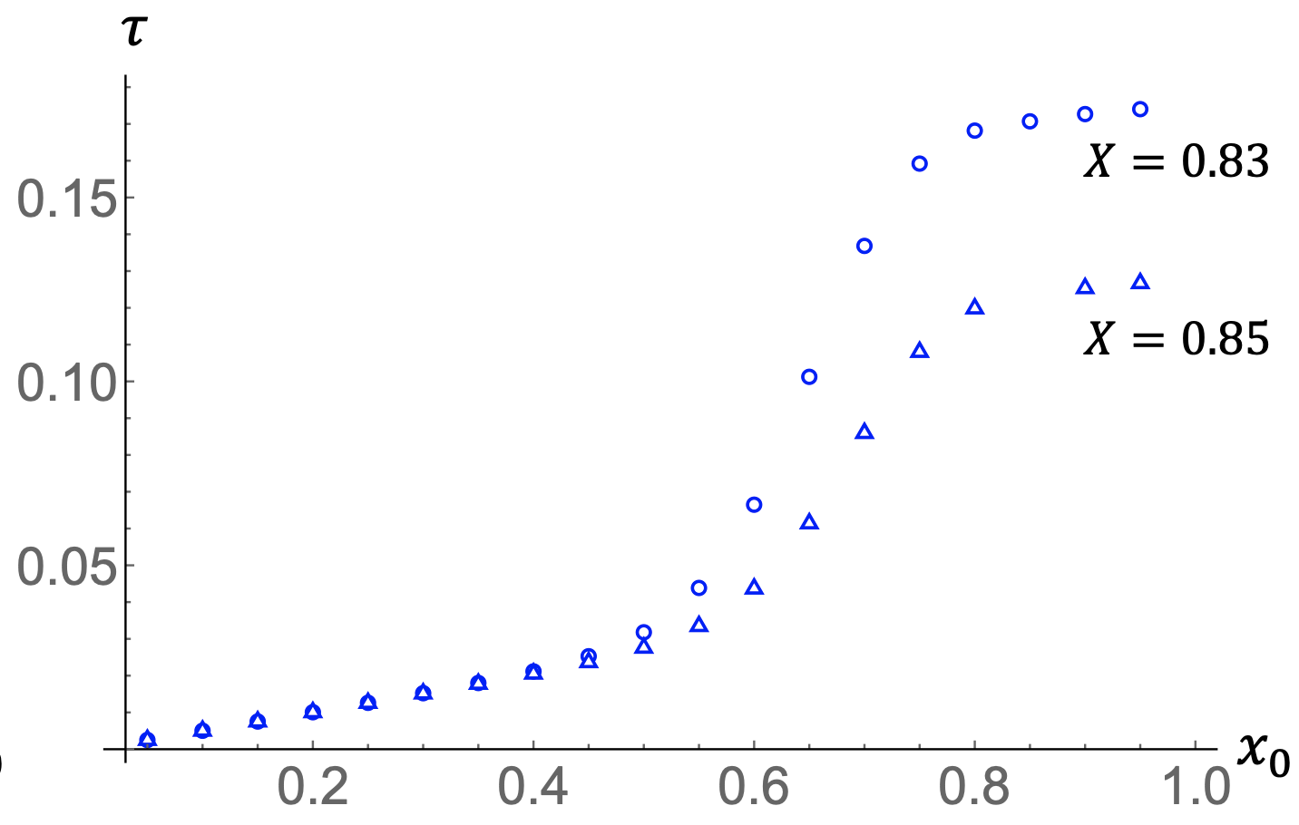
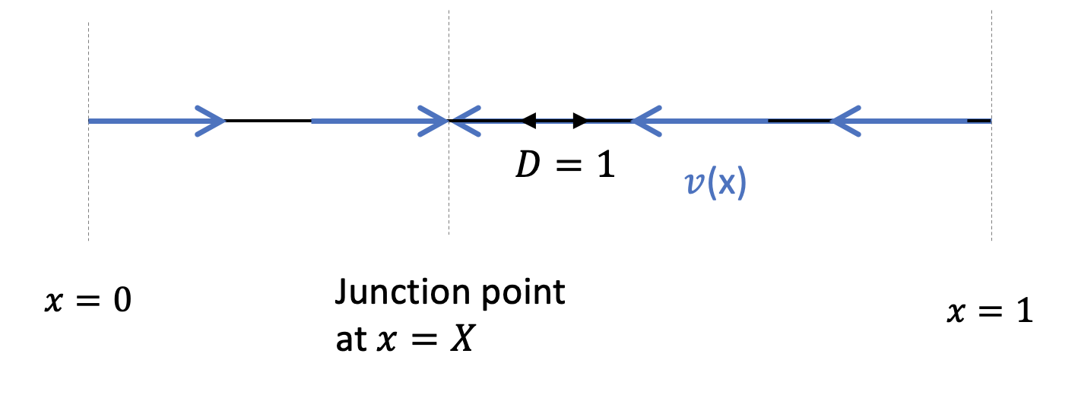


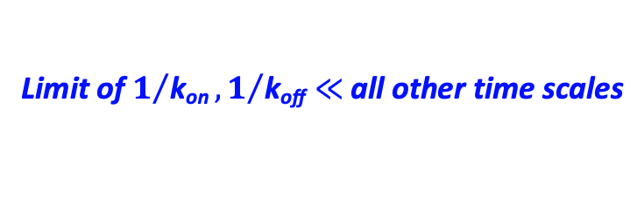


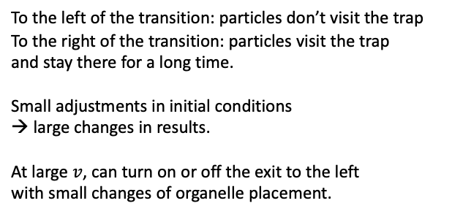

Limit of $1/{\text{k}\text{on}}, 1/{\text{k}\text{off}}≪$all other time scales
Symmetric trap position (X=0.5)
Rare event regime: initial
condition is forgotten
Escape probability
MFPT
$$v=40$$
Asymmetric trap position (X=0.85)
MFPT
MFPT
$$v=20$$
X=0.85
$$v=20$$
To the left of the transition: particles don’t visit the trap
To the right of the transition: particles visit the trap
and stay there for a long time.
Small adjustments in initial conditions
→ large changes in results.
At large $v$, can turn on or off the exit to the left
with small changes of organelle placement.
Small changes in trap positions can
produce significant differences.
$$v=\frac{wL}{D}$$
Trap at $x=X$
Complicated regime with multiple crossovers

Slide 3
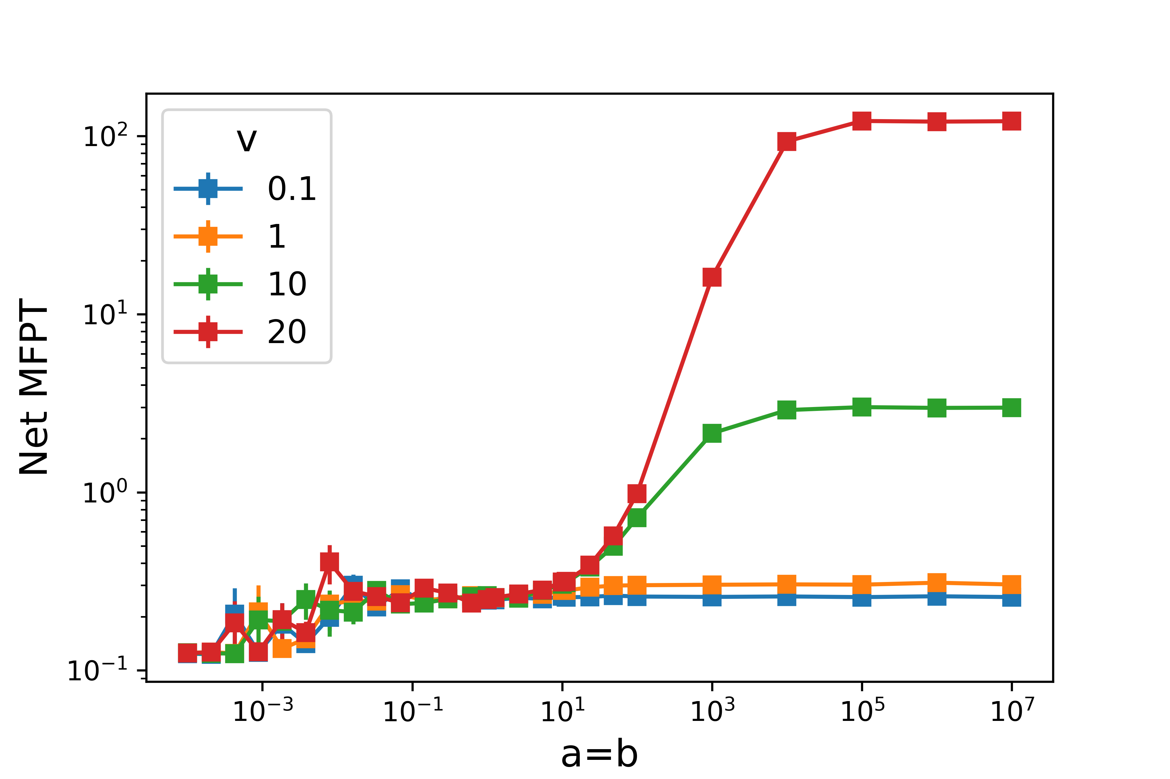
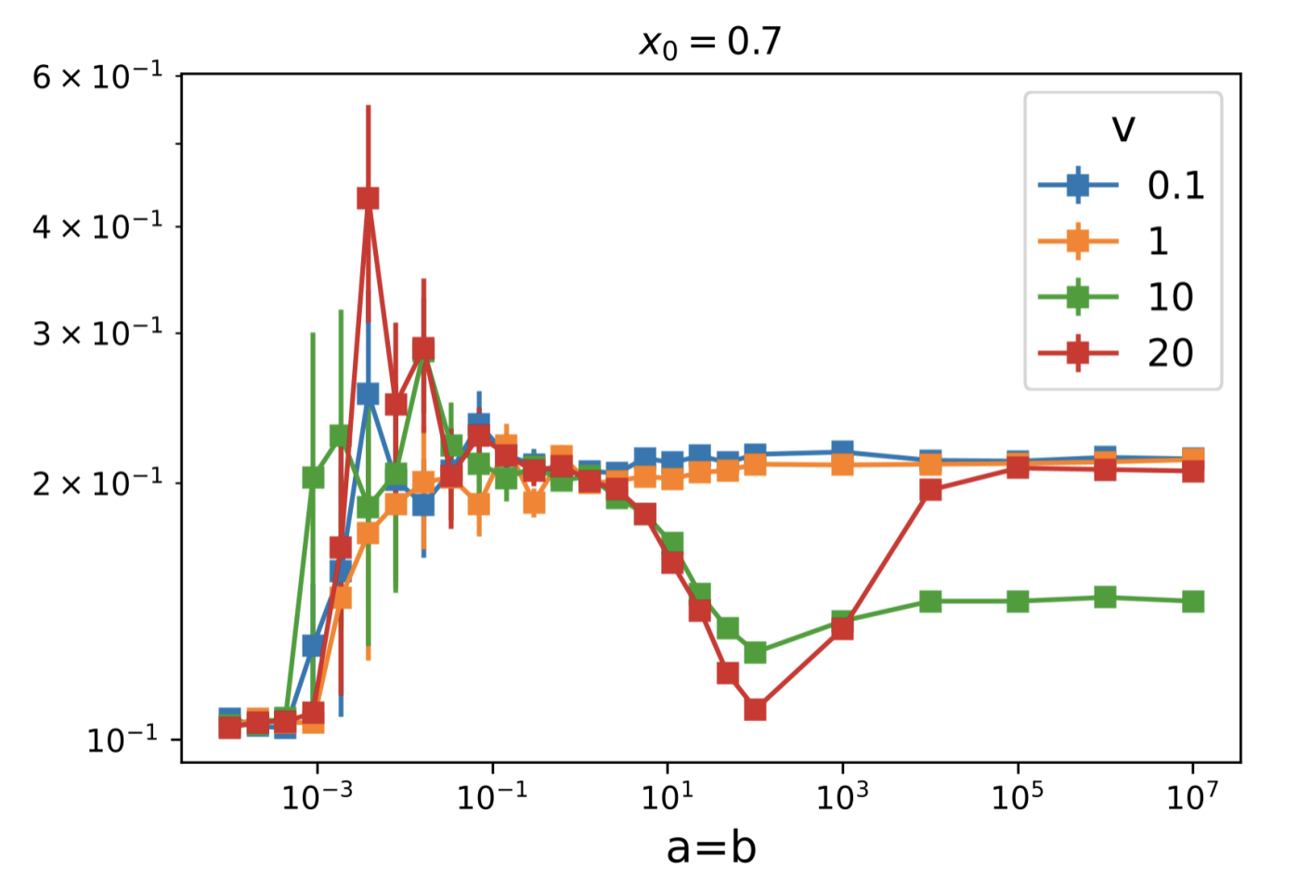
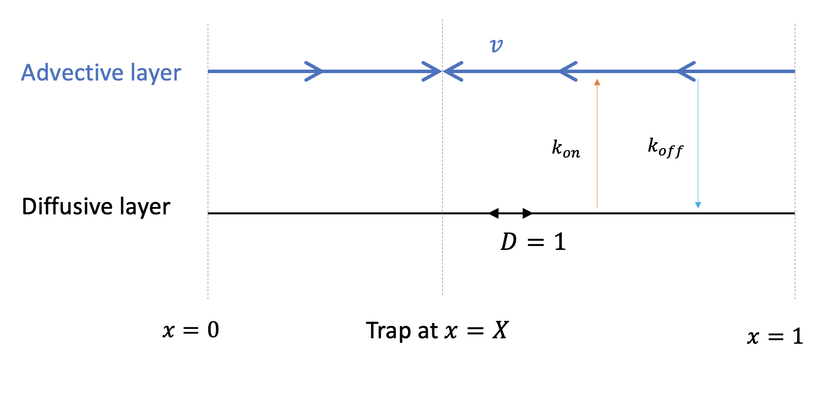

General k_{on}, k_{off} …. complex behavior with multiple regimes
Symmetric trap position (X=0.5)
Asymmetric trap position (X=0.85)
$$v$$
$$v$$
Net MFPT
Net MFPT
dimensionless k_{on}=k_{off}
dimensionless k_{on}=k_{off}
$$v=\frac{wL}{D}$$
Complicated regime with multiple crossovers

