Slide 1
From Playing to Solving Go
Ting Han Wei
Postdoctoral fellow
Department of Computing Science, University of Alberta
Alberta-Montana Combinatorics & Algorithms Days at BIRS
June 5, 2022

Slide 2
Outline
Playing vs solving
How hard is solving anyways?
Why is solving an important problem?
Previous work
Checkers paper
Van der werf papers (up to 5x5, 5x6)
How perfect are NNs at learning exact knowledge?
Solving the GHI problem
What techniques are we using to finally solve 6x6
Reducing depth of search: static safety
Reducing branching factor: decomposition search
Better heuristics: PCN
Guiding the search using an opening: JL/client-worker architecture
Discussions
Putting everything together
Scaling up?
Notes:
TODO: add funders to pg 2

Slide 3
This Research is Funded By
DeepMind
NSERC
CIFAR

Slide 4
Current Project Members
Department of Computing Science, University of Alberta
Martin Müller, Professor
Ryan Hayward, Professor
Ting Han Wei, Postdoctoral fellow
Owen Randall, Master student
Department of Computer Science, National Yang Ming Chiao Tung University
I-Chen Wu, Professor
Ti-rong Wu, Postdoctoral fellow
Chung-ching Shih, PhD student

Slide 6
Playing vs Solving
AlphaGo plays standard Go (19x19) at super-human levels since 2016
Playing: making good decisions at each turn that maximize the chance of winning
Solving: perfect strategy that guarantees best outcome regardless of opponent decisions
Strongly solved: perfect strategy for every legal position
Weakly solved: perfect strategy starting from a specific position
Ultra-weakly solved: the outcome is known, but strategy is not known

Slide 7
How Difficult is Solving Go?
Previous best for Go is 5x6 (2008)
For Go, state space is the number of legal positions
Game tree estimated between $N!$ and $N^{L}$ (positions ^ average game length)
 | State space | Game tree | Status
Checkers | $$5×{10}^{20}$$ | About ${10}^{40}$ | Solved (2007)
Go (5x5) | $$4.1×{10}^{11}$$ | $9.3×{10}^{20}$ to $1.6×{10}^{25}$ | Solved
Go (6x6) | $$6.3×{10}^{16}$$ | $1.3×{10}^{31}$ to $3.7×{10}^{41}$ | Hopefully soon!
Go (19x19) | $$2.1×{10}^{170}$$ | $3.0×{10}^{511}$ to $1.0×{10}^{768}$ | Not in our lifetime?
[1] Erik van der Werf, M.H.M. Winands (2009). Solving Go for Rectangular Boards. ICGA Journal. Vol.32, No. 2, pp. 77-88.
[2] Johnathan Schaeffer et al. (2007). Checkers is Solved. Science.
[3] John Tromp, Gunnar Farneback (2016). Combinatorics of Go.
Notes:
Checkers numbers
State space: checkers is solved
Game-tree: Game over: black to play and draw in checkers (section 3.6)
https://icga.org/icga/journal/contents/Schaeffer07-01-08.pdf
5x6 Go
Solving Go for Rectangular Boards. E.C.D. van der Werf, M.H.M. Winands (2009). ICGA Journal. Vol.32, No. 2, pp. 77-88.
Go legal positions
Combinatorics of Go, John Tromp, Gunnar Farneback, 2016
Game tree for Go sizes
Between two values,
N^L, N is possible moves, L is assumed average length of game (36^25 for 6x6)
N!
Why is 6x6 go smaller? More move histories? Captures?
Cannot use retrograde.

Slide 8
Why is Solving Go Important?
Why is solving Go important, especially when NNs are so powerful?
NNs are not exact
Understanding the gap between perfection and estimation, when NNs are so widely used, can help establish intuition on how much we can rely on NNs
Some applications require exact results
A specific problem that involves many techniques that can be useful in other applications
State space reduction
Scaling up search and data retrieval
Using modern AI tools (NNs) to create better heuristics and guiding the search

Slide 9
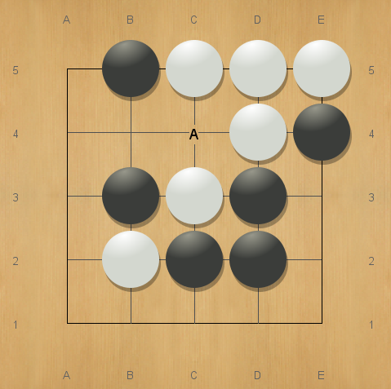
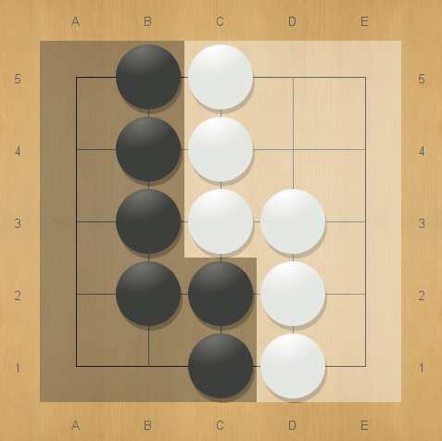
The Wonderful Game of Go
Capturing
Scoring (W+1.5, komi = 0)
Notes:
Capturing

Slide 10
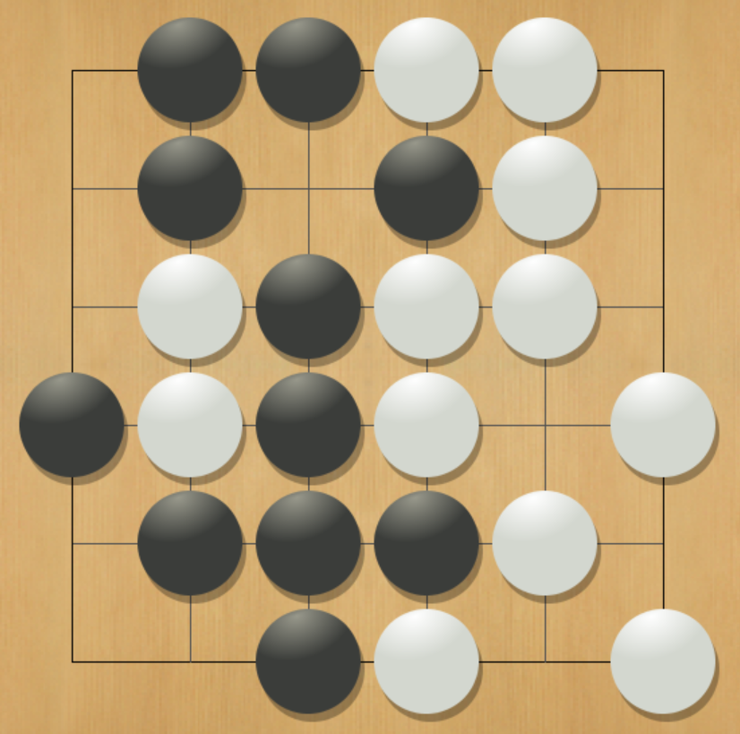
Our Goal: Solving 6x6 Go
What is a solution?
Knowing which player wins
At least one winning move for the winner whenever it is their turn
Verify that the loser loses with every possible response
Experience says outcome is B+4
For komi = 3.5, Black should win
For komi = 4.5, Black should lose

Slide 11
Background and Previous Work

Slide 12
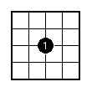
Milestones and Key Concepts
Last published results for Go
5x5: B+25 (published in 2003)
5x6: B+4 (published in 2009)
Checkers was solved in 2007
Dealing with the Graph History Interaction (GHI) problem (2004)
Decomposition search (1999 – ongoing)
Using neural networks to help solve games (2022)
Results by van der Werf, Dec 2002

Slide 13
Go on 5x5 and 5x6 Boards
Main techniques
Iterative deepening Principal Variation Search (PVS)
Hand-crafted heuristic evaluation function
Transposition tables with symmetry
History heuristic
Lots of other enhancements!
5x5
Depth: 23, 603M nodes, 14.3 minutes
5x6
Depth: 27-38, $214×{10}^{9}$ nodes, 4.5 days†
Notes:
For 5x6, they do two searches, one for upper and one for lower bound (komi), value listed here is lower bound; upper bound search was distributed over multiple machines manually.

Slide 14
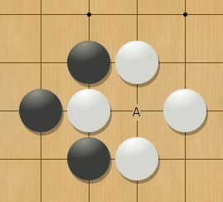
The (Dreaded) Graph History Interaction Problem
Go has cycles!
Rules exist that forbid players from repeating positions
What if winning/losing is dependent on forbidding specific cycles?
Values in transposition tables cannot be trusted
A general way of dealing with GHI is needed (2004)
The Ko rule

Slide 15
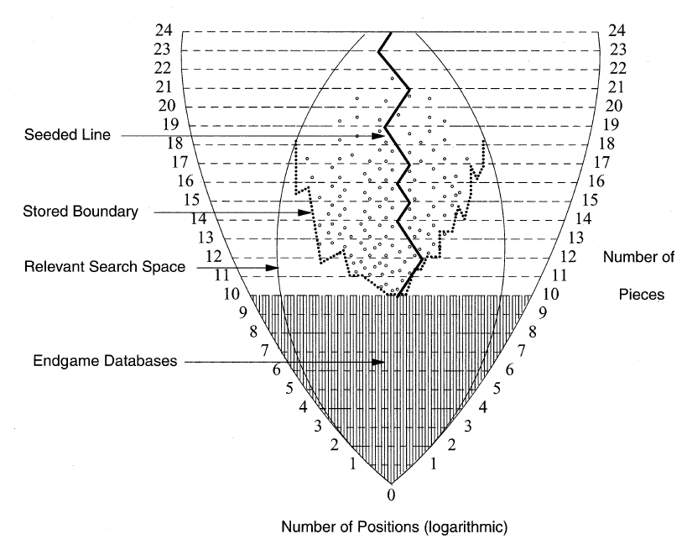
Using the Checkers Solution as a Blueprint
Combines forward search and backward search
Endgame databases cover ${3.9×10}^{13}$ positions
Proof-tree manager
Opening book/seeded line
List of notable positions (jobs)
Proof solver (worker)
Analyzes a specific position
Runs Chinook first (~15s)
Follows up with a depth-first proof number search program (~100s)

Slide 16
The Deep Neural Net’s Emergent Role
AlphaGo/AlphaZero uses deep reinforcement learning cleverly
How far away are NNs from being perfect?
How to use NNs to help solve games?

Slide 17
Current Work

Slide 18
New or Improved Techniques
Reducing depth of search
Static safety, or recognizing life and death
Reducing branching factor
Decomposition search and relevancy zones
Designing better heuristics
The Proof Cost Network (PCN)
Updating the checkers solving framework
Ongoing…
Notes:
Actual stats (ablation studies?) for d and b reduction.

Slide 19
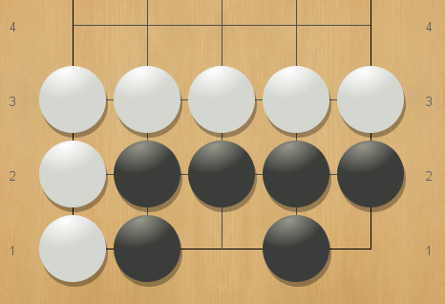
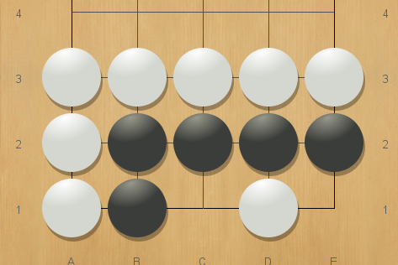
Life and Death in the Game of Go
Signs of life
As dead as it gets
Notes:
TODO in future version: explain Benson safety here.

Slide 20
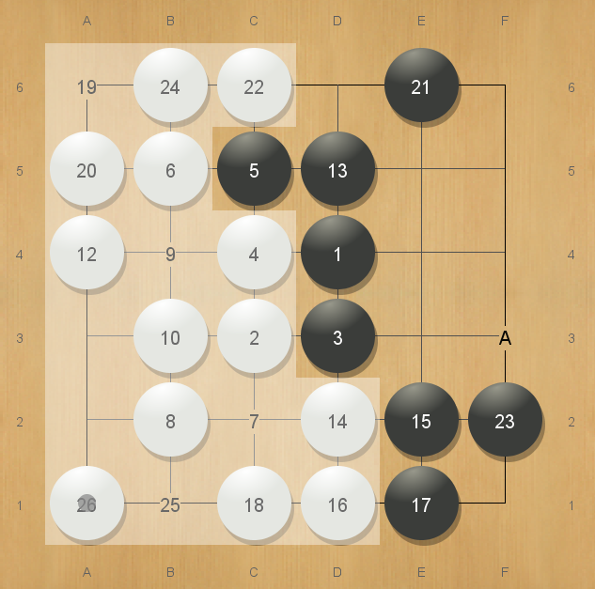
Static Safety
“Static” analyses that calculates life or death
No search
The earlier life is recognized the better
Shallower searches
Determine winner faster
No need to play in opponent’s territory

Slide 21
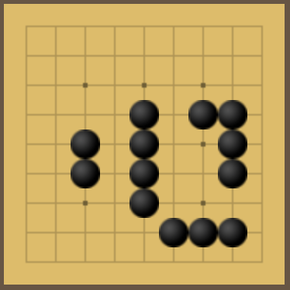
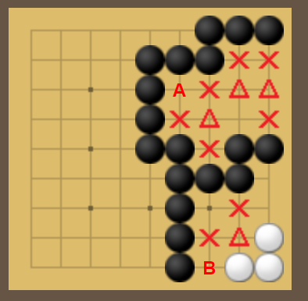
Static Safety with Alternating Play
Try to connect stones to blocks that have two sure liberties
Virtual Connections
Sure Liberty Regions
Notes:
Martin’s PhD thesis

Slide 22
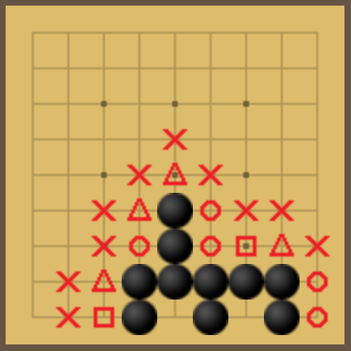
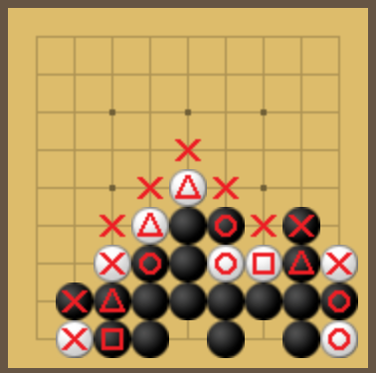
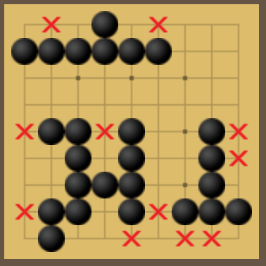
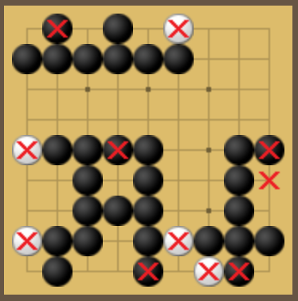
Improved Static Safety
Various tricks
Better pseudo-eye detection
Improved virtual block connections
Computation speed improvements
Extended liberties
Global alternating play

Slide 23
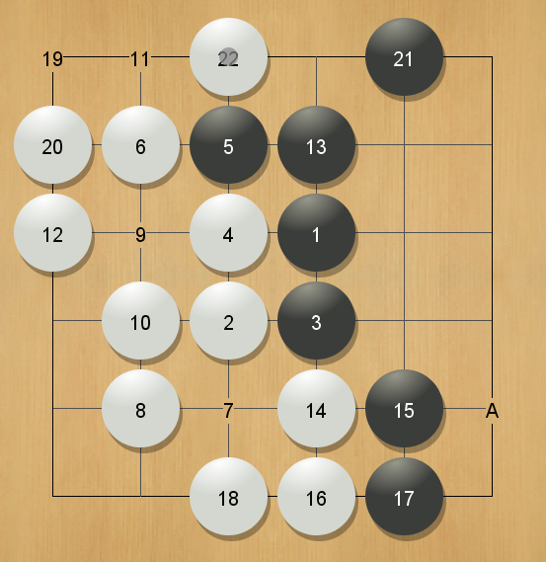
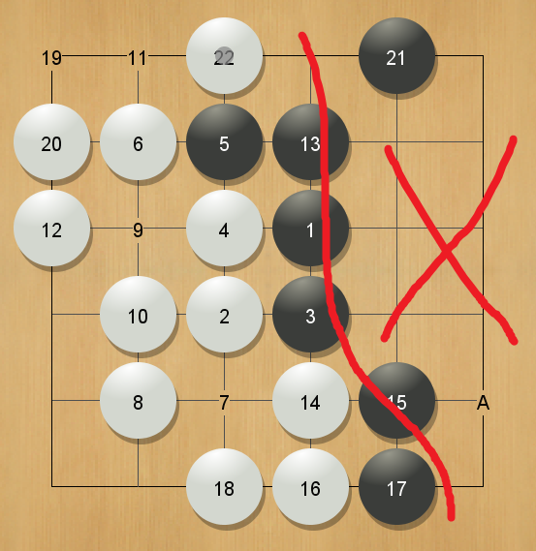
Decomposition Search
Divide and conquer: split board into subgames
Relevancy zones
Ignore parts of the board that do not contribute to result
Similar to null move pruning
Main difficulty: define what is “relevant”, and how to draw the zone automatically
Decomposition is general, but heuristics are often game-specific

Slide 24
Smarter, Machine-Learned Heuristics
What if we used the AlphaZero training pipeline, but for solving?
Proof Cost Network (2022)
Train using self-play, just like in AlphaZero
Set $z$ (the value network training target) to depth of proof, rather than game outcome
The value network now predicts proof difficulty instead of win rate
The policy network can be used for move ordering

Slide 25
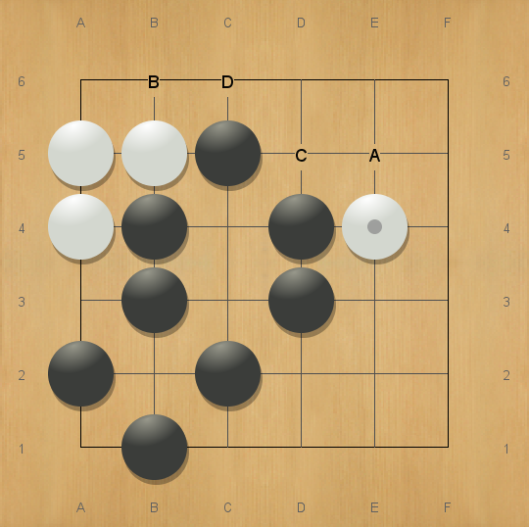
Case Study: Solving Efficiently
A: KataGo (AlphaZero-like program) and human players’ usual choice
A
B
C
D
…
Solution tree without safety
Notes:
The left half of the board is only a few stones away from static safety, but if Black plays very stupidly White can secure some territory on the righthand side. 'A' eliminates this possibility, right? Is this a good verbal description? It's a bit too long; slides should have less (or even minimal text) so I will try to simplify.

Slide 26
Case Study: Solving Efficiently
A: KataGo (AlphaZero-like program) and human players’ usual choice
B: Try to kill white stones and achieve enough territory to win
A
B
C
D
…
Benson
Benson
Benson
Benson
Benson
Solution tree using Benson (unconditional safety)

Slide 27
Case Study: Solving Efficiently
A: KataGo (AlphaZero-like program) and human players’ usual choice
B: Try to kill white stones and achieve enough territory to win
C & D: Try to achieve enough statically safe territory to win
A
B
C
D
…
Safety
Safety
Safety
Safety
Safety
Solution tree using static safety with alternating play

Slide 28
AlphaZero Network
Less efficient move ordering (policy network) and evaluation (value network)
The probability is nearly equally divided between all moves
The values are all close to 1 since Black is close to winning
A
B
C
D
…
Policy network
0.22
0.05
0.05
0.04
0.64
Value network
0.971
0.967
0.967
0.970
Min: 0.956
Max: 0.969
Notes:
What does this use? Benson or static safety?

Slide 29
Proof Cost Network with Benson Safety
Better than AlphaZero, but not the best fit for our solver, which uses static safety to determine game termination
A
B
C
D
…
Policy network
0
0.72
0.11
0.11
0.06
11.49
8.19
9.00
8.21
Min: 9.07
Max: 12.38
Cost network

Slide 30
Proof Cost Network with Static Safety
When integrating static safety into PCN training
PCN now tries to learn a strategy that can achieve safety as soon as possible
Re-train PCN with improved static safety for better results
A
B
C
D
…
Policy network
0.03
0
0.41
0.48
0.08
5.21
5.98
4.25
4.29
Min: 4.87
Max: 8.57
Cost network

Slide 31
Just… One… More… Slide…
Use PCN value output to improve the safety solver?
Supervised learning, predict probability of safety
The PCN’s value training target is “depth of proof”
value output for empty board?
Updating the checkers solving framework
Learn as you solve?

Slide 32
Thank you for your attention!

