Slide 1
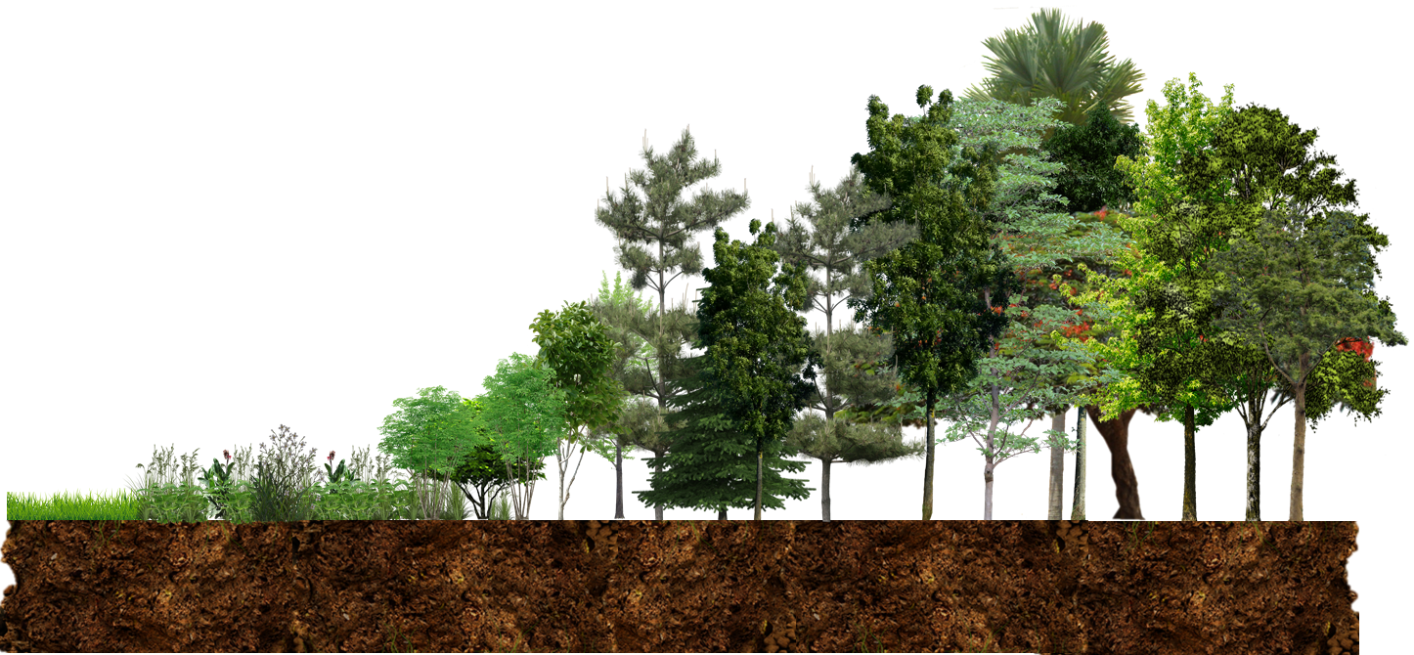

Networked Regeneration of Tropical Forests
Benton Taylor | Harvard University Organismic & Evolutionary Biology

Slide 2
Land Carbon Sink
Land Carbon Source
Pan et al. 2011, Science
Regenerating Tropical Forests Take up 1.64 Pg C yr⁻¹
>40% of global forest carbon capture

Slide 3
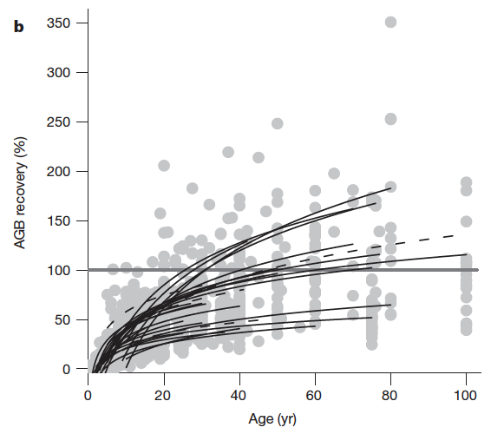
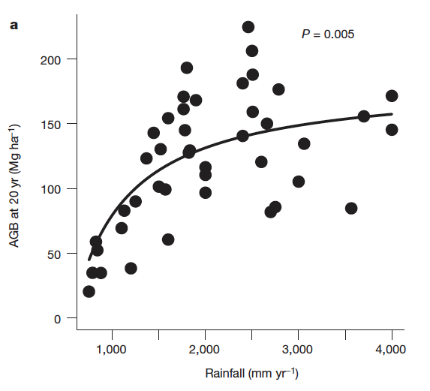
Tropical forests can regenerate quickly
Poorter et al. 2016, Nature

Slide 4
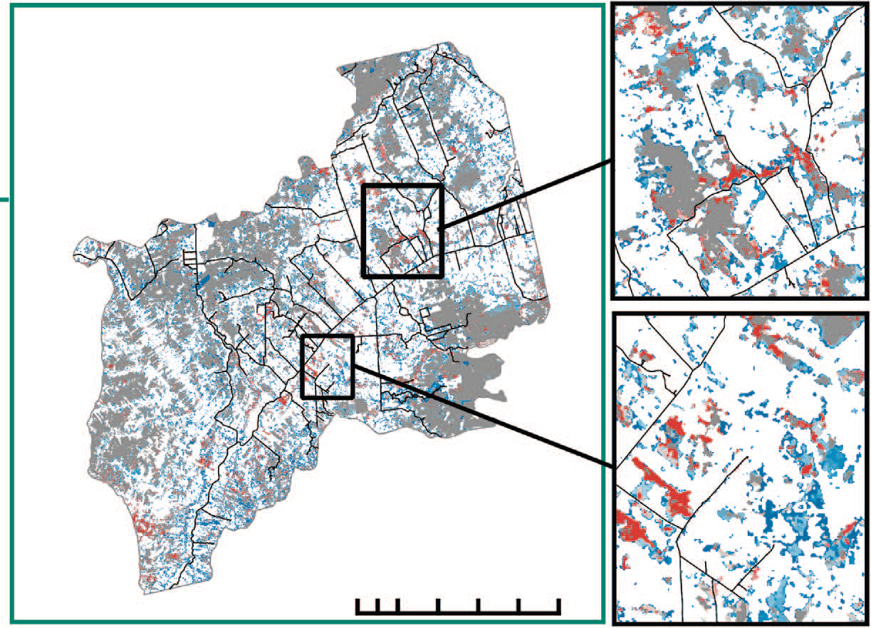
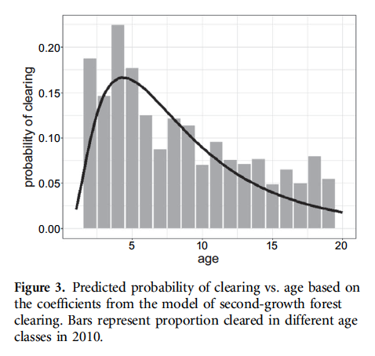
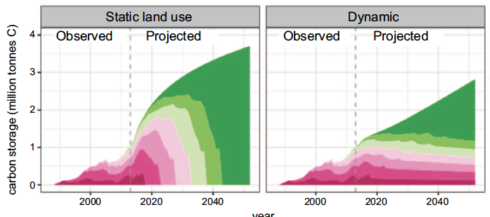
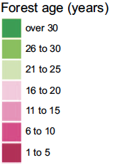
But they often don’t get the chance
Schwartz et al. 2017, Environmental Research Letters

Slide 5
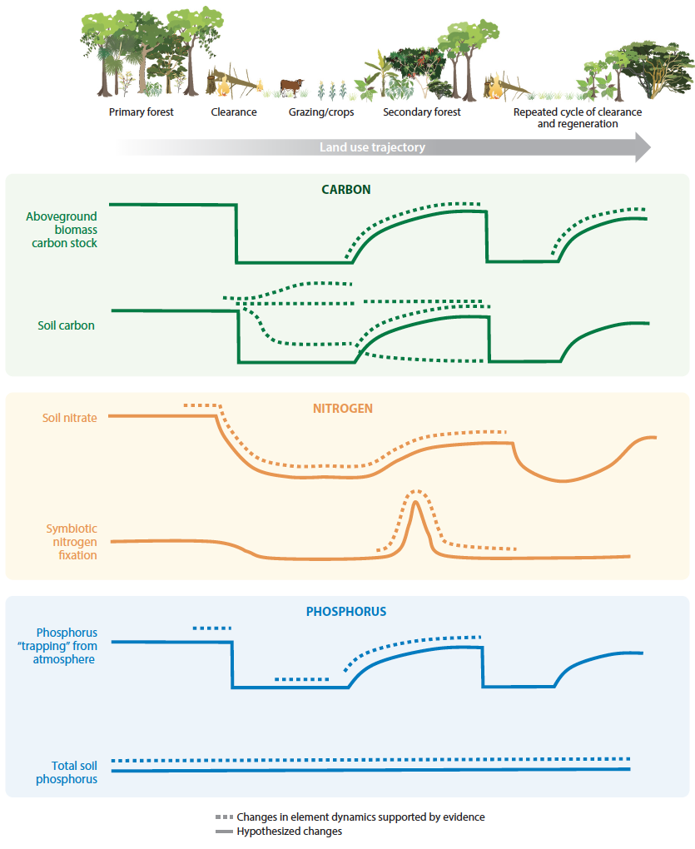
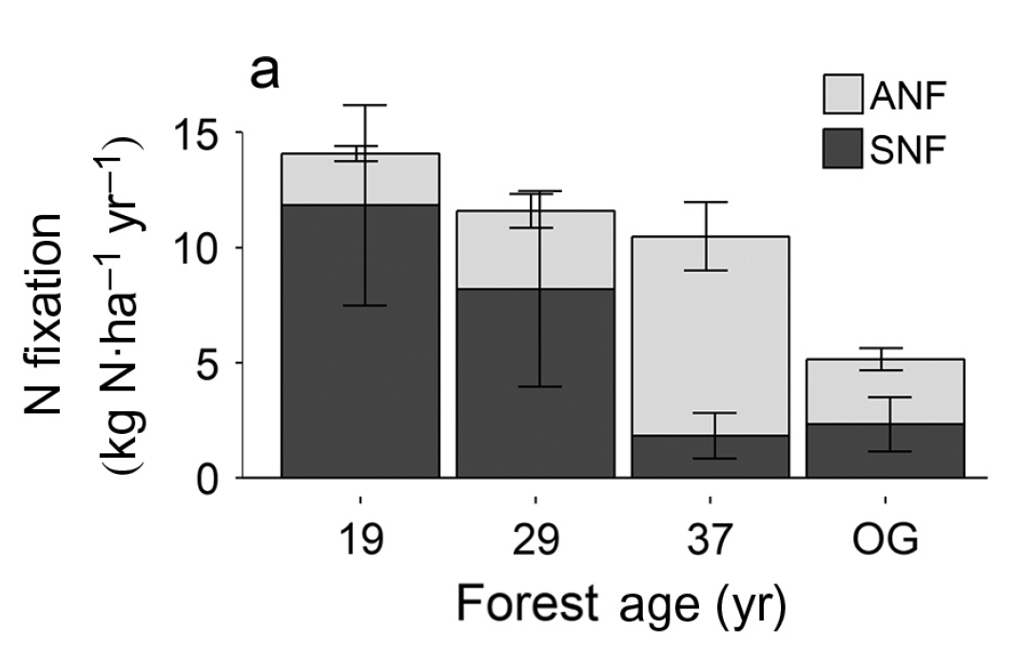
Recovery rates differ by process
Taylor et al. 2019, Ecology
Powers & Marín-Spiotta 2017, AREES

Slide 6
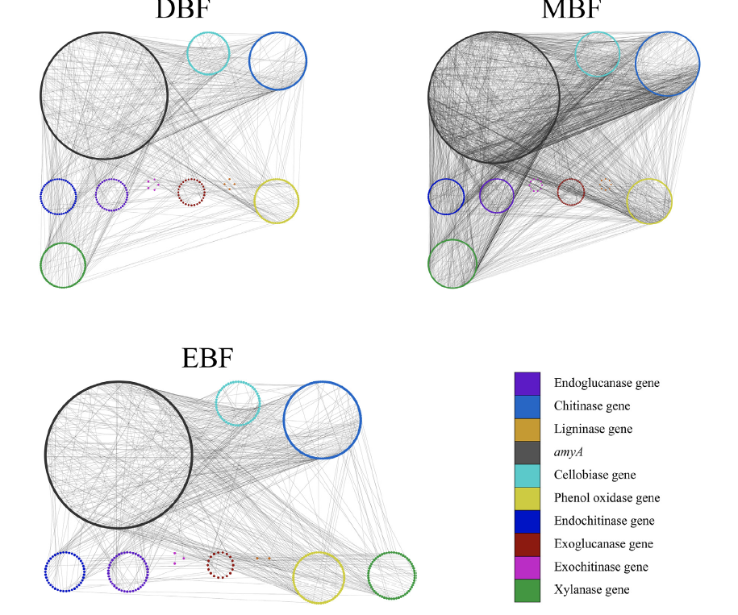
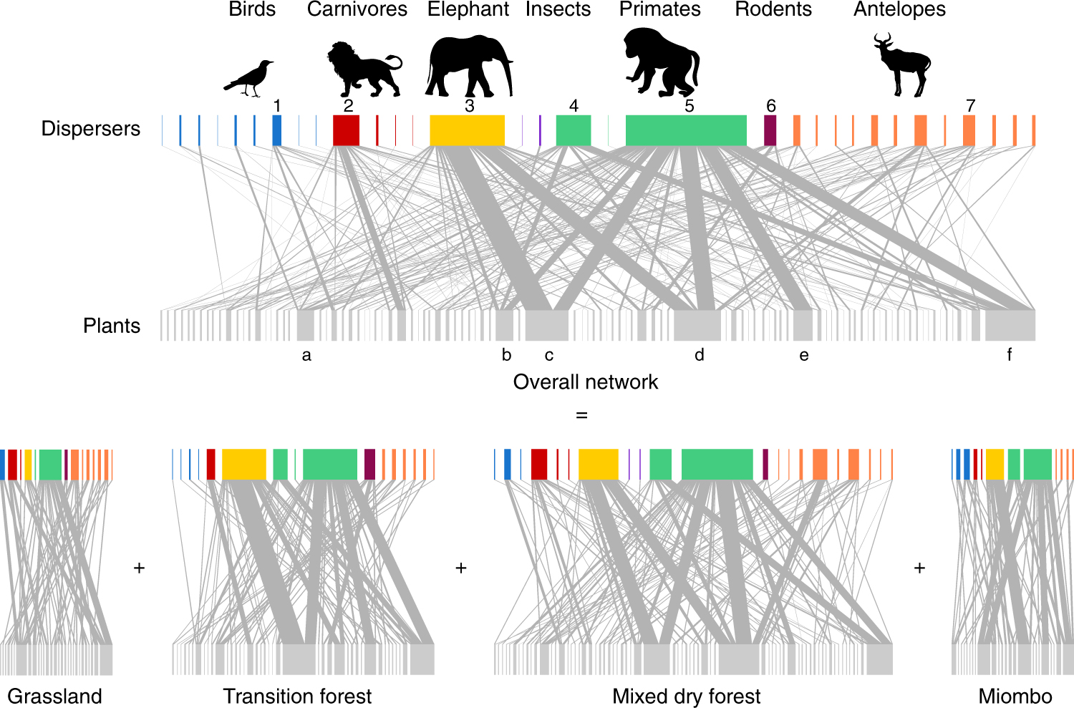
Succession and underlying processes are driven by networks of actors
Microbial Networks
Dispersal Networks
Timóteo et al. 2018, Nature Communications
Cheng et al. 2021, Sci. Tot. Environ.

Slide 7
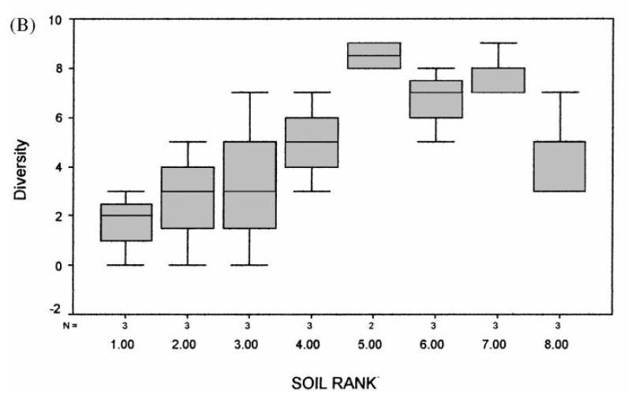
Microbial networks are critical for forest regeneration and vulnerable to perturbation
Mycorrhizal Diversity
Most Degraded
Least Degraded
Batterman et al. 2013, Nature
Carpenter et al. 2001, Forest Ecology & Management
Notes:
Despite the potential importance of this process, there has been relatively little work done on the role that N fixation plays in tropical forest succession. That said, a study out last year shows a striking correlation between the amount of external N required by regenerating forests (as indicated by the red line in the top plot) and rates of nitrogen fixation by N-fixing plants.

Slide 8
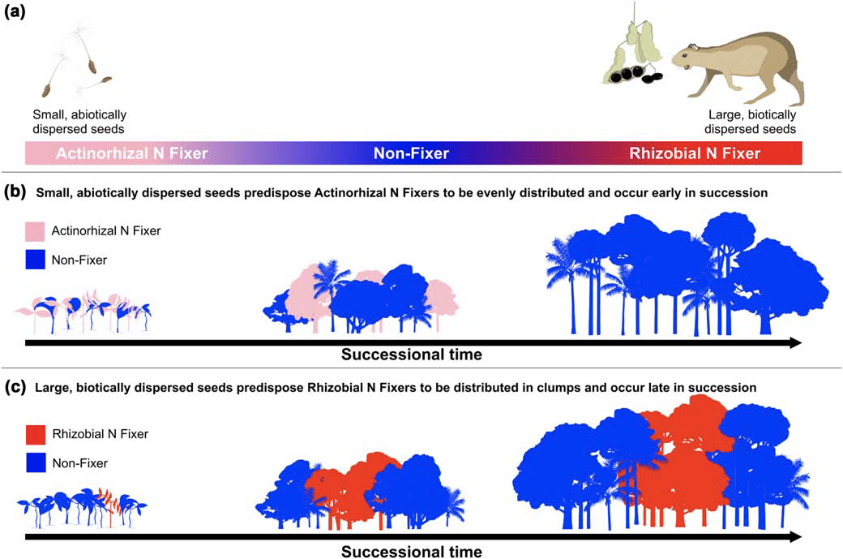
Dispersal Regimes can determine the timing of tree species arrival, which can dictate multiple forest functions
Wilcots, Taylor et al. 2019, Oikos

Slide 9
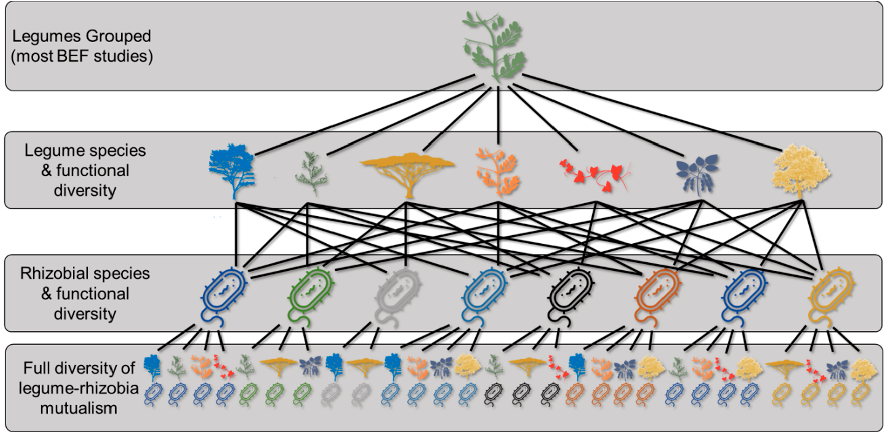
Complex Networks within Functional Groups
Taylor et al. 2020, Diversity

Slide 10
Various aspects of RIT in forest regeneration
Rate-Based Changes
Different Forest States
Hurricane/Cyclone Frequency
Return interval of land clearing
Rate of patch clearing within a region
Forest/Savanna/Grassland
Dominant Mycorrhizal Type
High vs. Low Carbon Storage
  Changes in wood density
  Changes in crown structure
  Changes in tree height

Slide 13
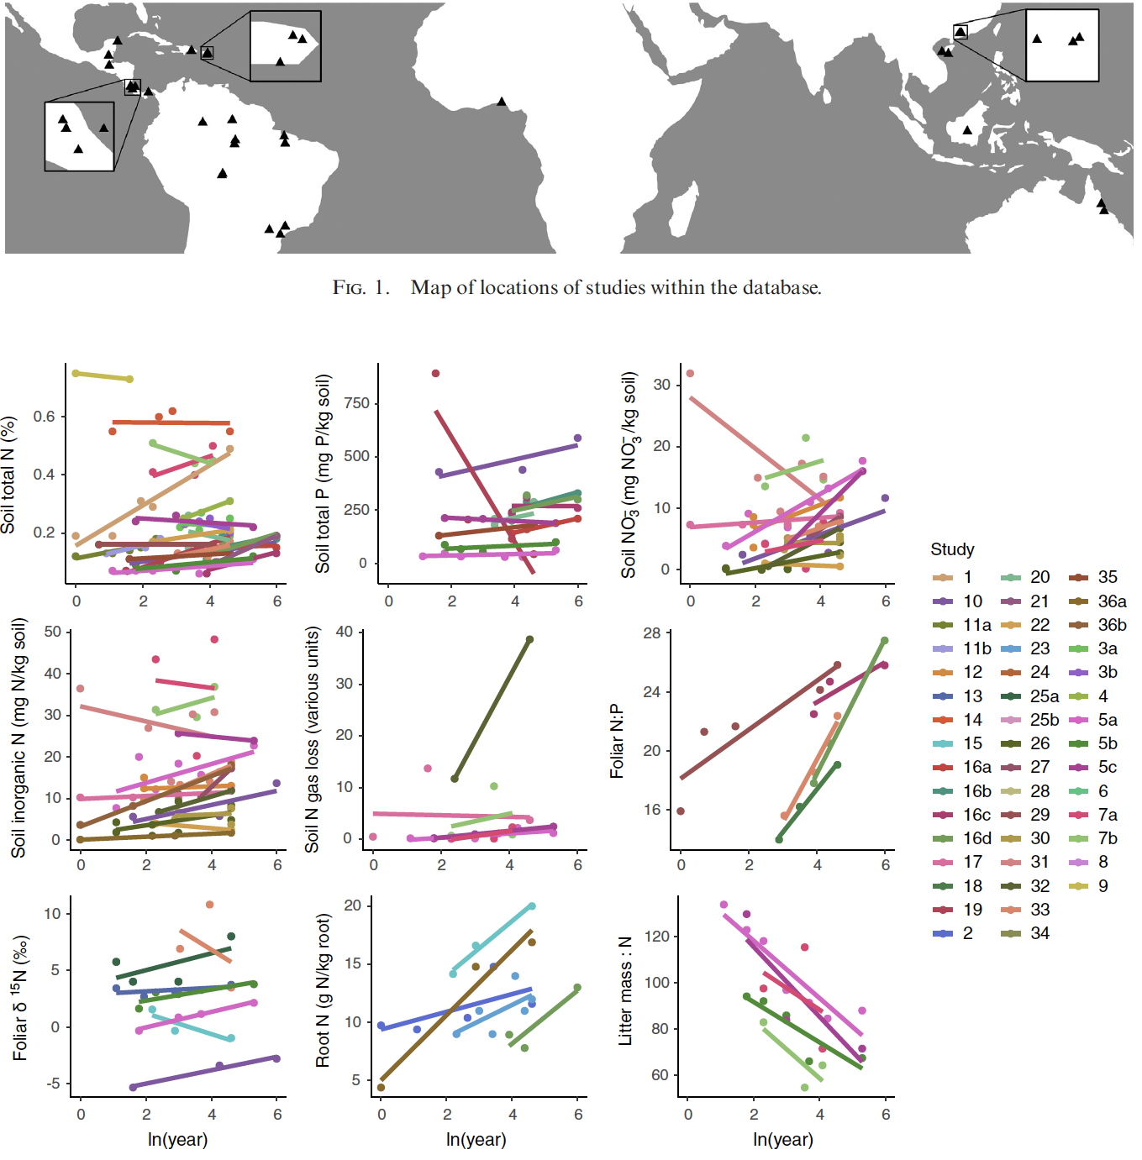
Broad patterns of biogeochemical recuperation in tropical forests
(Sullivan et al. 2019, Ecology)

Slide 14
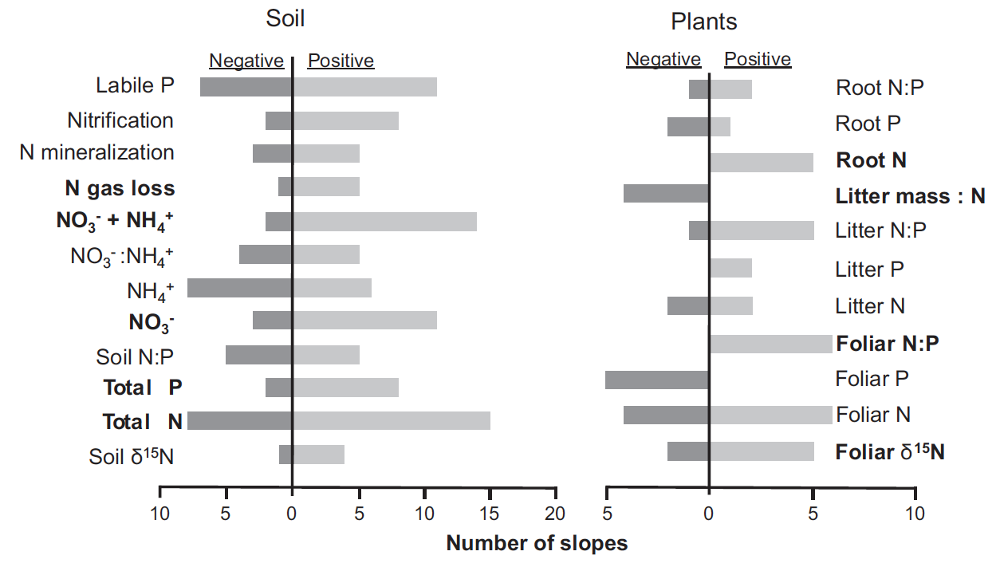
Soil nutrients tend to increase, foliar nutrients tend to decrease during succession
Sullivan et al. 2019, Ecology

