Slide 1
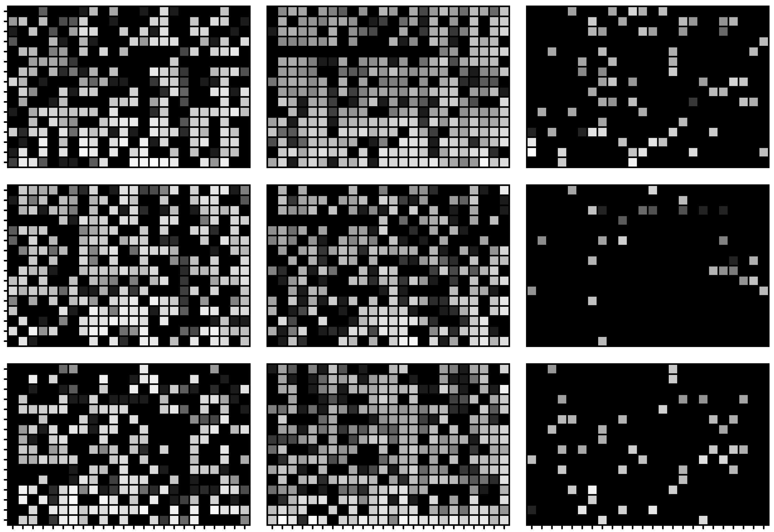
Evolution of a human T follicular helper cell response
Hedda Wardemann
B Cell Immunology, German Cancer Research Center, Heidelberg, Germany

Slide 2
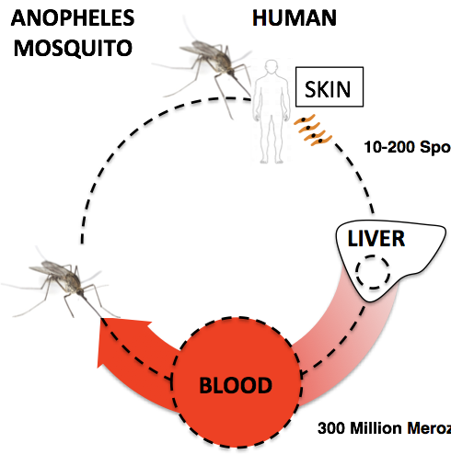

Plasmodium falciparum (Pf) circumsporozoite protein (PfCSP)
anti-PfCSP
Pf sporozoite
DAPI
PfCSP:
Essential for sporozoite development
  in the mosquito
  in the mammalian host
anti-PfCSP vaccine RTS,S AS01:
limited efficacy, short-lived protection
Malaria disease
Notes:
Interested in CSP,

Slide 3
How to design an improved anti-PfCSP vaccine?
Focus the antibody response on most potent epitopes
Avoid antibody responses against non-protective epitopes
Provide strong T cell help (improve quality and durability of the response)
Protective anti-PfCSP antibodies target the central repeat domain and N-terminal junction
N terminus
N-term. junction
Central repeat domain
C terminus
NF54
RI
GPI
B-cell epitopes
T-cell epitopes
RTS,S/AS01
Notes:
Target of malaria vaccine

Slide 4
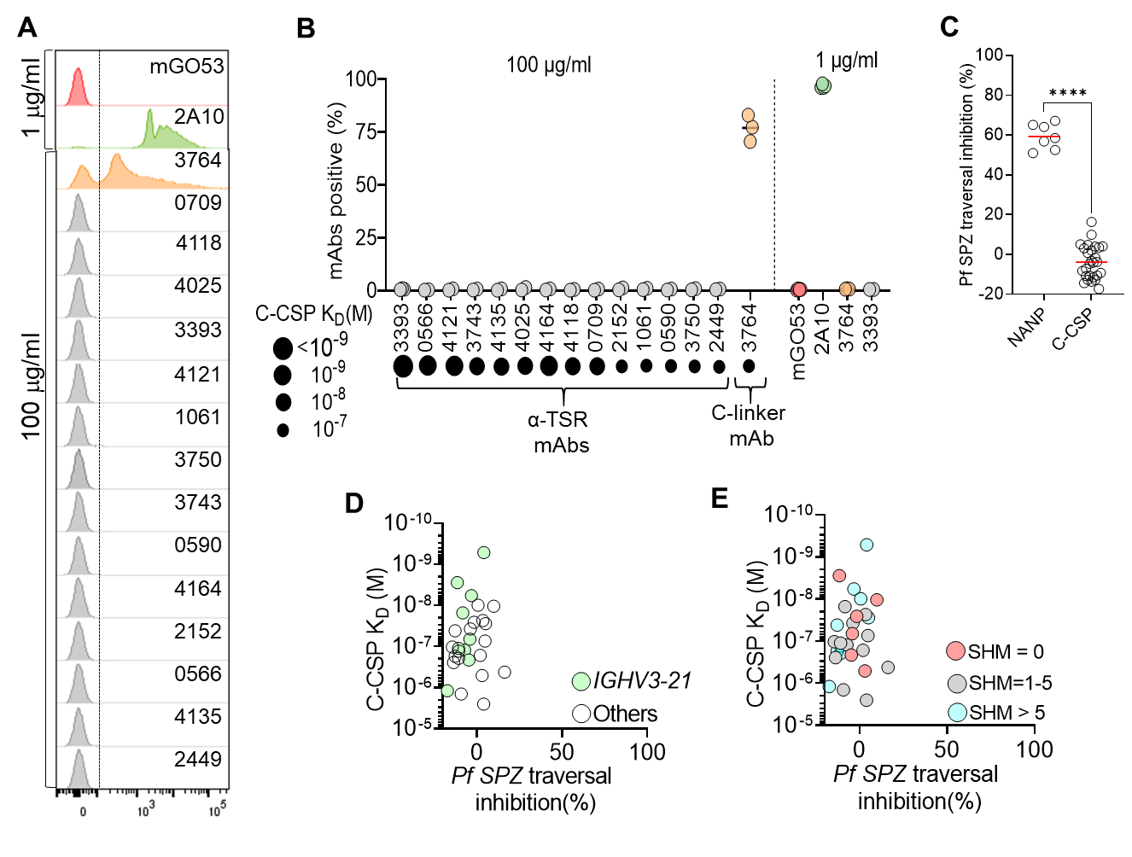
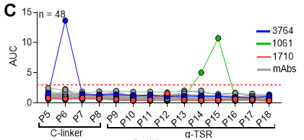
Antibodies against the PfCSP C-terminus are non-protective and target predominantly conformational epitopes
Neg. ctrl. mAb
Anti-repeat mAb
Anti-C-term mAbs
C-terminal peptides
Include linear epitopes for T cell help rather than the whole C-terminal domain to avoid the induction of non-protective antibody responses?
Notes:
Target of malaria vaccine

Slide 5
Study T helper cells in a vaccine trial with high doses of radiation attenuated sporozoites
Ilka Wahl
PBMC sampling time points
Vaccine trial with radiation attenuated sporozoites (PfSPZ; Sanaria); B. Mordmüller, Tübingen
Anna Obraztcova
Wahl et al. bioRxiv preprint doi: https://doi.org/10.1101/2021.09.10.459751, 2021

Slide 6
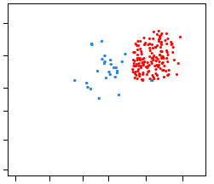
Functional B cell and T cell repertoire analyses through antibody and TCR expression cloning
Barcoded primer matrix
Indexed single-cell
FACS sorting
1
24
2
3
4
5
6
7
8
9
10
11
12
13
14
15
16
17
18
19
20
21
22
23
A
Database &
automated analysis pipeline (sciReptor*)
V(D)J usage
Clonality
SHM, isotype (Ig)
CDR3
B
20
C
F
D
Nested
Ig/TCR gene
RT-PCR
E
F
G
5
H
K
I
J
14
K
N
L
384-well
M
N
*Imkeller et al., BMC Bioinformatics 2016
O
P
Illumina Sequencing
Expression cloning of paired full-length Ig/abTCR genes
Recombinant mAbs
T cell lines
Functional analyses: in vitro (binding, target epitope)
in vivo (protection)
Cell phenotype
Tiller et al., JIM 2008
Busse et al., EJI 2014
Ludwig et al., EJI 2019
Tiller et al., JIM 2009
Murugan et al., EJI 2015
Wahl et al., EJI 2021

Slide 7
Immunization-induced polyclonal circulating T follicular helper (cTfh) cell response
Paired TRB and TRA gene data from > 3000 cells
Wahl et al. bioRxiv preprint doi: https://doi.org/10.1101/2021.09.10.459751, 2021
Wahl et al. EJI 2021

Slide 8
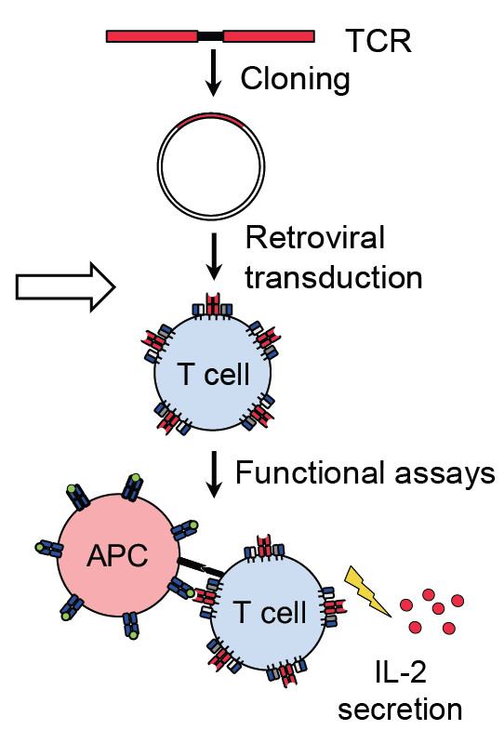
Immunization-induced polyclonal circulating T follicular helper (cTfh) cell response
TCR expression cloning (n=245)
ELISA
APCs: autologous B cell lines
Wahl et al. bioRxiv preprint doi: https://doi.org/10.1101/2021.09.10.459751, 2021
Wahl et al. EJI 2021

Slide 9
Dominant cTfh cell response against the PfCSP C-terminus
N terminus
Junction
Central repeat domain
C terminus
N-CSP peptide pool
C-CSP peptide pool
23% (57/245) CSP-reactive TCRs; 87% (47/57) against C-CSP
Wahl et al. bioRxiv preprint doi: https://doi.org/10.1101/2021.09.10.459751, 2021

Slide 10
Dominant cTfh cell response against aa 311-333 in the PfCSP C-terminus in all individuals
aa 311-333
Wahl et al. bioRxiv preprint doi: https://doi.org/10.1101/2021.09.10.459751, 2021
Notes:
Fine specifcity: stimulation with single peptides; C-CSP reactivity was mostly limited to three overlapping peptides spanning amino acids (aa) 311-333 (PSDKHIKEYLNKIQNSLSTEWSP), overlapping with the known T cell epitopes Th2R and T* . In contrast, aa 291-305 (RNVDENANANSAVKN), represented by a single peptide in the C-terminal linker region, were recognized by only three TCRs from a single donor (D5). Similarly, all N-CSP reactive TCRs from D3 recognized a single peptide spanning aa 105-119 (PNANPNVDPNANPNV), a conserved region in the N-terminal junction containing a known CD4⁺ T cell epitope referred to as T1

Slide 11
Dominant cTfh cell response against aa 311-333 in the PfCSP C-terminus in all individuals
Good et al. 1988
Sinigaglia et al. 1988
Nardin et al. 1989
94% TCRs (44/47) from all donors recognize aa 311-333
Wahl et al. bioRxiv preprint doi: https://doi.org/10.1101/2021.09.10.459751, 2021
Notes:
Fine specifcity: stimulation with single peptides; C-CSP reactivity was mostly limited to three overlapping peptides spanning amino acids (aa) 311-333 (PSDKHIKEYLNKIQNSLSTEWSP), overlapping with the known T cell epitopes Th2R and T* . In contrast, aa 291-305 (RNVDENANANSAVKN), represented by a single peptide in the C-terminal linker region, were recognized by only three TCRs from a single donor (D5). Similarly, all N-CSP reactive TCRs from D3 recognized a single peptide spanning aa 105-119 (PNANPNVDPNANPNV), a conserved region in the N-terminal junction containing a known CD4⁺ T cell epitope referred to as T1

Slide 12
The PfCSP-reactive cTfh cell response evolves slowly with mixed Tfh1 and Tfh2 clones
Wahl et al. bioRxiv preprint doi: https://doi.org/10.1101/2021.09.10.459751, 2021
Notes:
Despite their relative abundance, PfCSP-reactive cT_{FH} cells emerged only after the second immunization, were rarely shared between sampling time points, and were most abundant after the third immunization. The majority of PfCSP-reactive clones showed a cT_{FH}1 phenotype, in agreement with the increase of the overall cT_{FH}1 cell frequency upon immunization

Slide 13
The PfCSP-reactive cTfh cell response evolves slowly with mixed Tfh1 and Tfh2 clones
Wahl et al. bioRxiv preprint doi: https://doi.org/10.1101/2021.09.10.459751, 2021
Notes:
clones were not phenotypically restricted and often included cT_{FH}1 and cT_{FH}2 cells suggesting that cells from the same clone exert different effector functions.

Slide 14
Gene usage and epitope specificity linkage
convergent anti-Th2R/T* TCRs in different donors; HLA?
TCR similarity score: https://github.com/obrzts/BLscore
Wahl et al. bioRxiv preprint doi: https://doi.org/10.1101/2021.09.10.459751, 2021
Notes:
To investigate whether certain TCR properties were associated with binding to different PfCSP epitopes and might explain the bias to aa 311-333 in the cT_{FH} cell response, we analyzed the aa sequence features of all PfCSP-reactive TCRs. In all individuals, Th2R/T*- TCRs utilized a diverse set of TRAV and TRBV segments (Fig. 6A). Compared to non PfCSP-reactive TCRs, TRBV20-1 was overrepresented among Th2R/T*-reactive TCRs in D2 and D5 while TRBV30 was enriched among T1-specific TCRs from D3

Slide 15
Convergent TCRs recognize PfCSP aa 311-333 peptides in the context of HLA-DR molecules
T1 TCRs
C-linker
TCRs
Th2R/T* TCRs
TCR
OLGA (Bioinformatics. 35, 2019)
Wahl et al. bioRxiv preprint doi: https://doi.org/10.1101/2021.09.10.459751, 2021
Notes:
To determine whether the high frequency of anti-Th2R/T* TCRs and sparsity of anti-T1 and anti-C-linker TCRs were linked to presentation on different HLA molecules, we used anti-DP, -DQ or -DR antibodies to block TCR-pMHC binding specifically for each HLA locus. With two exceptions, Th2R/T*-specific TCRs in all donors recognized their target epitope in the context of HLA-DR, while all T1 and C-linker specific TCRs recognized the peptides in the context of HLA-DQ. Th2R/T* TCRs had a higher generation probability compared to the overall TCR repertoire and anti-T1 TCRs.

Slide 16
Preferential recognition of specific pMHC complexes in individual donors
DR
DQ
Preferred over DRB1*07:01P in D2
Preferred over DRB1*07:01P in D3
Wahl et al. bioRxiv preprint doi: https://doi.org/10.1101/2021.09.10.459751, 2021
Notes:
Gene sequencing-based HLA genotyping showed that nearly all donors shared specific HLA alleles with strongest overlap in the HLA-DR locus. We therefore investigated whether Th2R/T*-specific TCRs recognized their target peptides in the context of these shared HLA-DR alleles by stimulating the TCR-transgenic T cells with either autologous or heterologous peptide-pulsed B cells from each individual. , the immunodominant aa 311-333 peptides in the Th2R/T* region are presented predominantly on shared HLA-DR molecules, while TCRs against the T1 and C-linker epitope recognize the peptide in the context of non-shared HLA-DQ molecules. The cT_{FH} cell response in individual donors shows a bias towards preferential recognition of specific pMHC complexes.
NetMHCIIpan-4.0 (26), Sturniolo (27), MixMHC2pred (28) and MHCnuggets

Slide 17
Limited cross-reactivity of aa 311-333 specific TCRs to common PfCSP variants
No cross-reactive
TCRs
Wahl et al. bioRxiv preprint doi: https://doi.org/10.1101/2021.09.10.459751, 2021
Notes:
Since the Th2R/T* region is highly polymorphic, we investigated how the degree of sequence diversity observed in natural Pf populations affects T cell activation by stimulating all TCR clones with autologous B cells that had been pulsed with a peptide covering aa 311-333 of the NF54 vaccine strain or of three representative Pf strains (7G8, K1, Dd2) from different geographic locations. None of the TCRs showed cross-reactivity to 7G8 or K1, which differ from NF54 by five and four aa mismatches, respectively, and only a limited number of TCRs (7/44) recognized the Dd2 peptide (Fig. 7C). All Dd2 cross-reactive TCRs were specific to aa 319-333 in the C-terminal part of the Th2R/T* epitope with only one aa mismatch compared to NF54. Differences in the targeting preferences of peptides in the Th2R/T* region were linked to HLA-DR differences and were similar in donors with shared alleles (D2 and D5, D3 and D4; Fig. 7D), suggesting that HLA genotype restrictions impact the ability to generate NF54-Dd2 cross-reactive TCRs. However, only 7/18 TCRs that responded to the NF54 PfCSP aa 319-333 peptide showed Dd2 cross-reactivity demonstrating that even a single aa mismatch abrogated binding to the pMHC complex for the majority of TCRs (Fig. 7E).

Slide 18
Summary
Repeated sporozoite immunization induces strong highly polyclonal anti-PfCSP cTfh cell responses
Dominated by Th1 cells but clones with shared Th1/Th2 phenotype
Dominant response against the aa 311-333 in the C-terminus (Th2R/T*) presented on HLA-DR
Convergent TCRs recognized target peptides in the context of shared HLA-DR alleles
Individuals show pMHC preferences
Most TCRs do not tolerate natural PfCSP sequence polymorphisms
Wahl et al. bioRxiv preprint doi: https://doi.org/10.1101/2021.09.10.459751, 2021

Slide 19
Implications for vaccine design
Inclusion of aa 311-333 rather than the complete PfCSP C-terminus avoids the induction of non-protective antibody responses against the C-terminus
TCR strain-specificity might be associated with inefficient natural boosting; best T cell epitope?

Slide 20




Acknowledgements
B CELL IMMUNOLOGY, DKFZ
Christian Busse
Christine Niesik
Claudia Winter
Dorien Foster
Ernest Oludada
Hannah v. Dijk
Ilka Wahl
Irene Nailain Nkumama
Joshua Malapit
Julia Gärtner
Julia Ludwig
Rajagopal Murugan
Sandro Hoffmann
Anna Obraztcova
Zhe Li
ALUMNI
Katharina Imkeller, Gianna Triller, Tim Rollenske, Ann-Kathrin Huber, Tizian Decker, Ghulam Mustafa
Gemma Pidelaserra Martí, Silke Schmidt, Caterina Canetta, Julia Puchan, Rebecca Hundsdorfer
COLLABORATORS
J.-P. Julien - Hospital for Sick Children, Toronto, Canada
E.A. Levashina - MPI for Infection Biology, Berlin, Germany
B. Mordmüller - University of Tübingen, Germany
S. Hoffman - Sanaria Inc., Rockeville, USA
T. Höfer - DKFZ, Heidelberg, Germany

