Slide 1

Banff workshop
Dynamics and Data Assimilation, Physiology and Bioinformatics: Mathematics at the Interface of Theory and Clinical Application
Informatics
Biomedical Informatics
discovery and impact
Noémie Elhadad, PhD
George Hripcsak, MD, MS
Biomedical Informatics, Columbia University
Notes:
The national push for electronic health records will make an unprecedented amount of clinical information available for research, with approximately one billion patient visits documented per year in the US. These data may lead to discoveries that improve understanding of biology, aid the diagnosis and treatment of disease, and permit the inclusion of diverse populations and rare diseases. Health record data also bring challenges, with missing and inaccurate data and substantial bias. Some of the bias comes about because the data are generated as part of the health care process. For example blood tests done at night select for patients who are sicker. We employ nonlinear time series methods borrowed from other fields to address the challenges, and we attempt to model and correct for biases due to the health care process. We incorporate mechanistic models to constrain the search space to create accurate predictions despite limited training sets and missing values.

Slide 2
Types of data

Slide 3



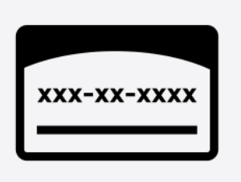

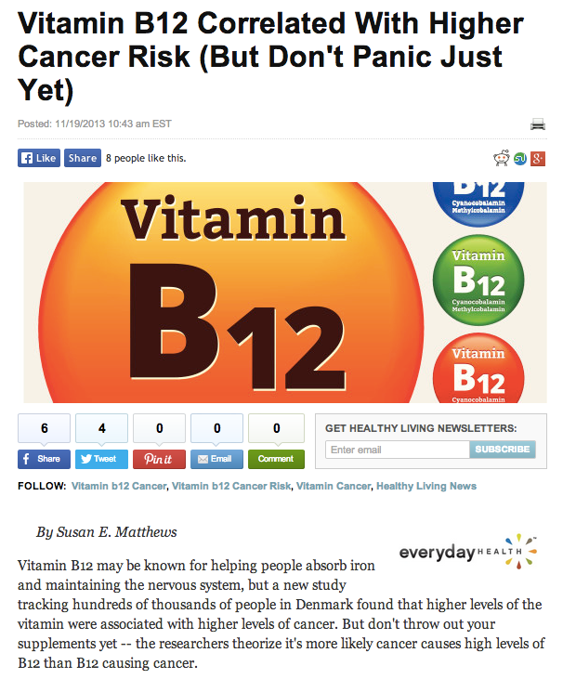

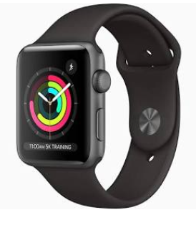


Slide 4




Electronic health record
Interventions
Laboratory Tests
Vital Signs
Diagnostics
EHR
Clinical Notes
Time

Slide 5
Knowledge bases
Terminologies
Ontologies
Enable inter-operability
Enable reasoning

Slide 6
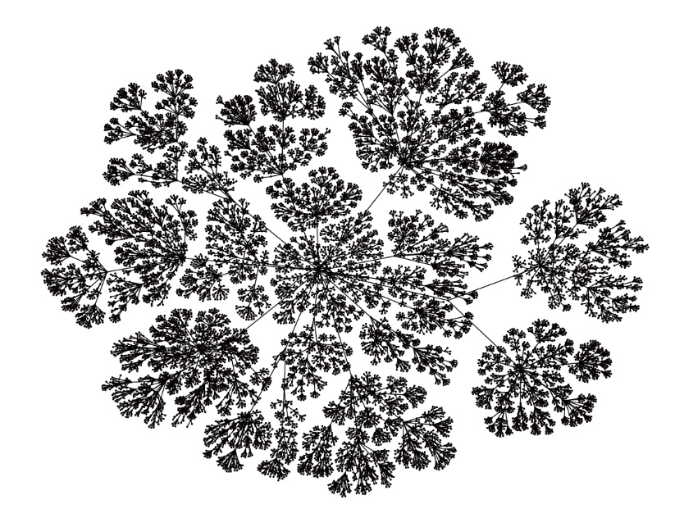
Example: ICD
ICD9 hierarchy
ICD9 Root
Neoplasms
Benign Neoplasms
Lipoma
Lipoma of other skin and subcutaneous tissue

Slide 7
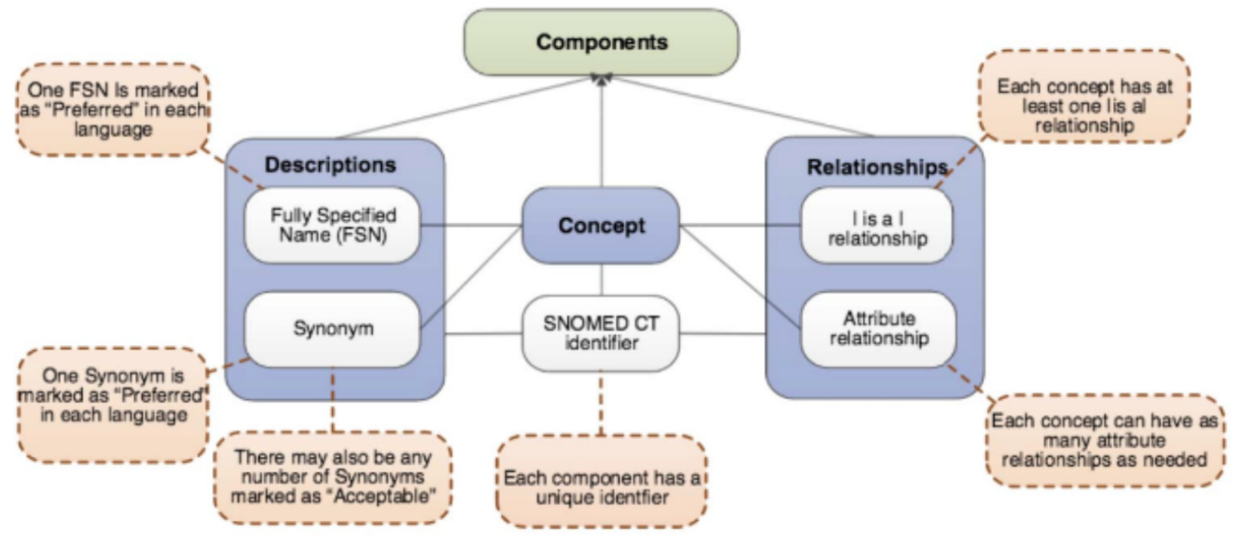
Example: SNOMED-CT (Concepts)

Slide 8
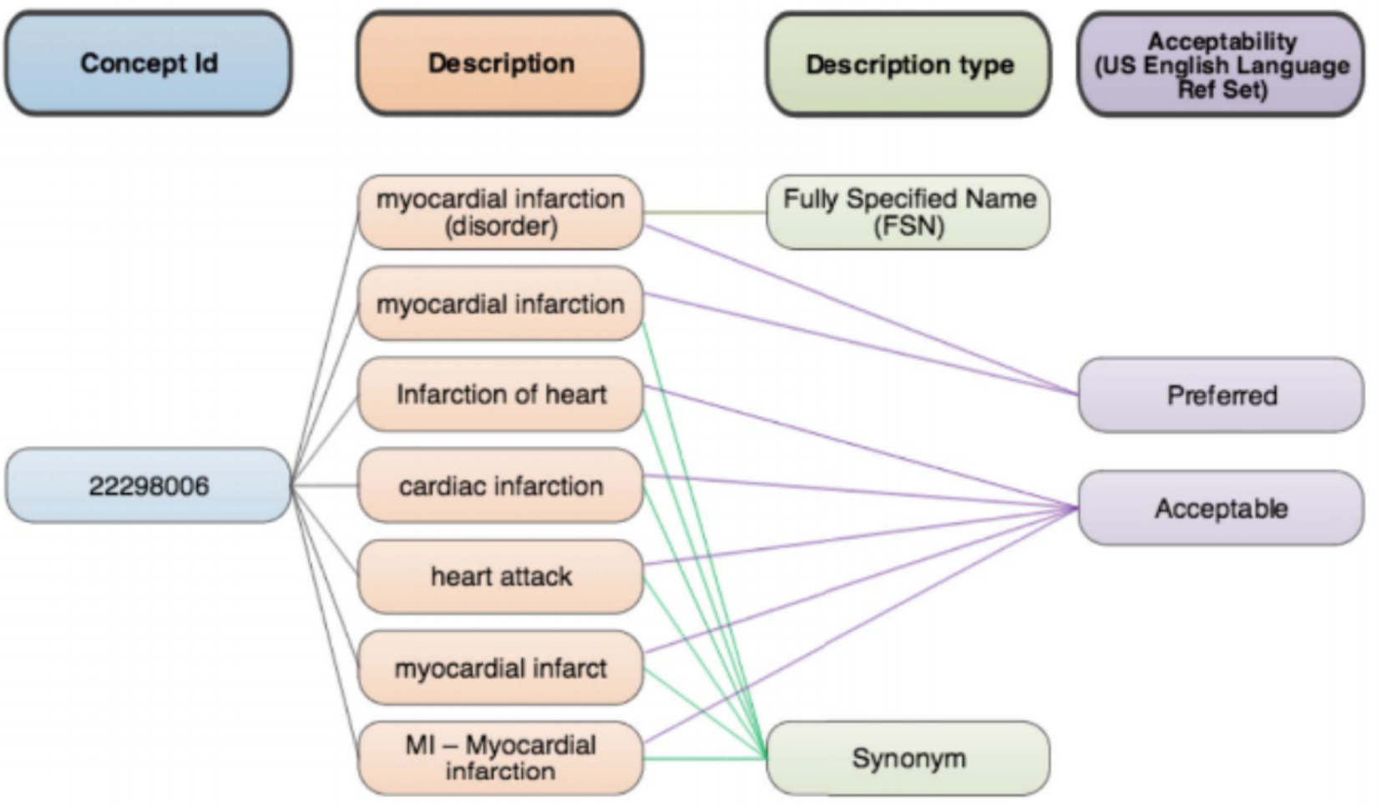
Example: SNOMED-CT Descriptions

Slide 9
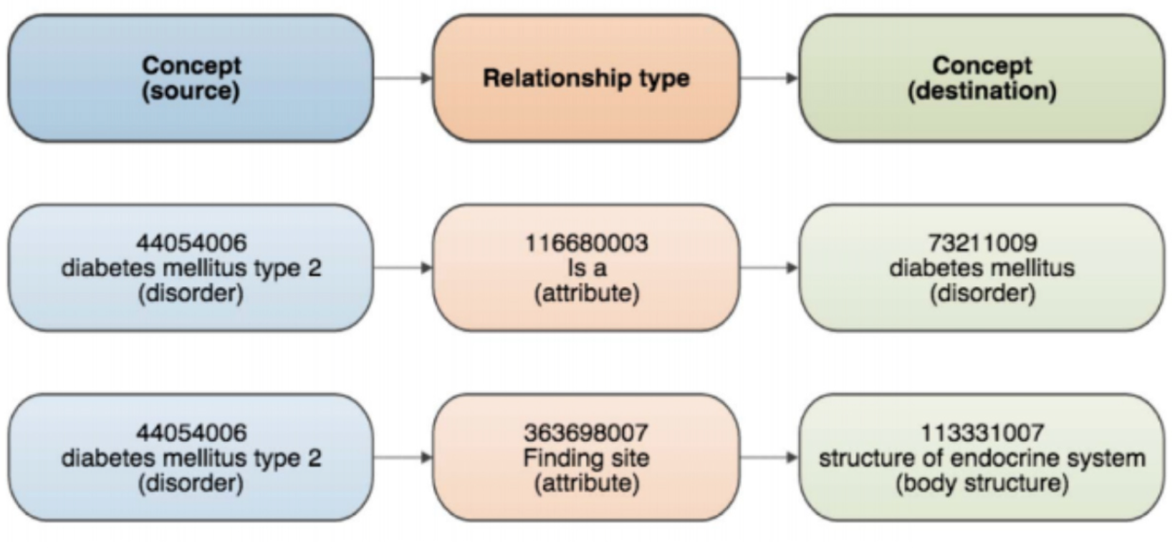
Example: SNOMED-CT
Relations

Slide 10
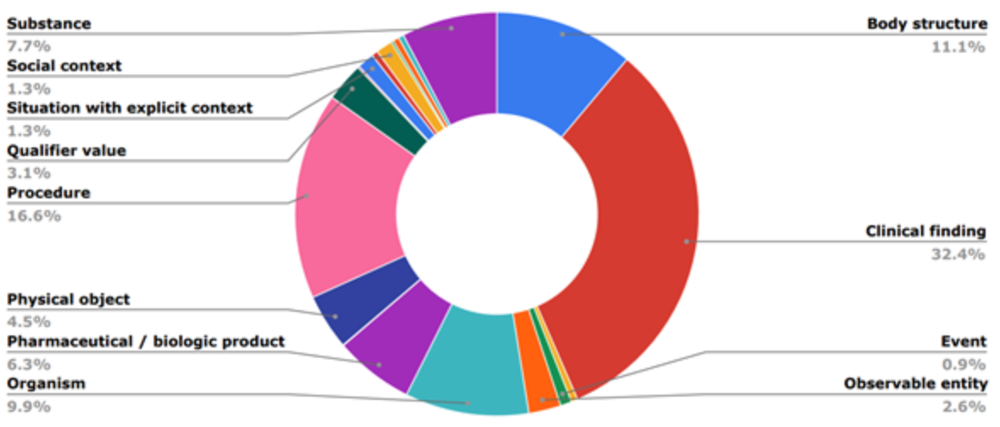
Example: SNOMED-CT

Slide 11
Observational data phenotyping

Slide 12
Good news
Clinicians use the record for patient care
  Human interpretation
Can we deconvolve the truth?
  Need new tools to handle it

Slide 13
EHR-derived phenotype
Clinically relevant feature derived from EHR
  Patient has (a diagnosis of) type II diabetes
  Recent rash and fever
  Drug-induced liver injury
Then use the phenotype in correlation studies, etc.
Raw data
Phenotype
Experiment
Query

Slide 14
EHR-derived phenotype
Want to know if patient has type 2 diabetes
  Don’t just look up the disease in the record
  Yes, look for diagnosis codes
  Diabetes medications
  Glucose suggestive of diabetes
  Special diabetes tests
  Diabetes complications
  Mentions in notes
  Exclusions like type 1 diabetes
Can take months to define and test

Slide 15
Rule-based, learned
Rule-based
  Knowledge engineer and domain expert iterate on a phenotype definition that passes metrics on a manually reviewed gold standard
Supervised ML
  Manually produced training set and supervised learning to create a model
Unsupervised ML
  Data set is subdivided into classes, etc., and the classes are manually assigned labels
Assisted learning
  Silver standard training set plus manual review
  Active learning
  Exploiting ontologies

Slide 16
OHDSI phenotyping pipeline
Phenotype library, literature
Prior work review
PHOEBE
Creating comprehensive concept set representing clinical idea
ATLAS
Creating cohorts of patients that satisfy inclusion and exclusion criteria
Cohort diagnostics
Examining cohorts
PheValuator
Computing phenotype performance metrics
Phenotype library
Storing phenotypes

Slide 17
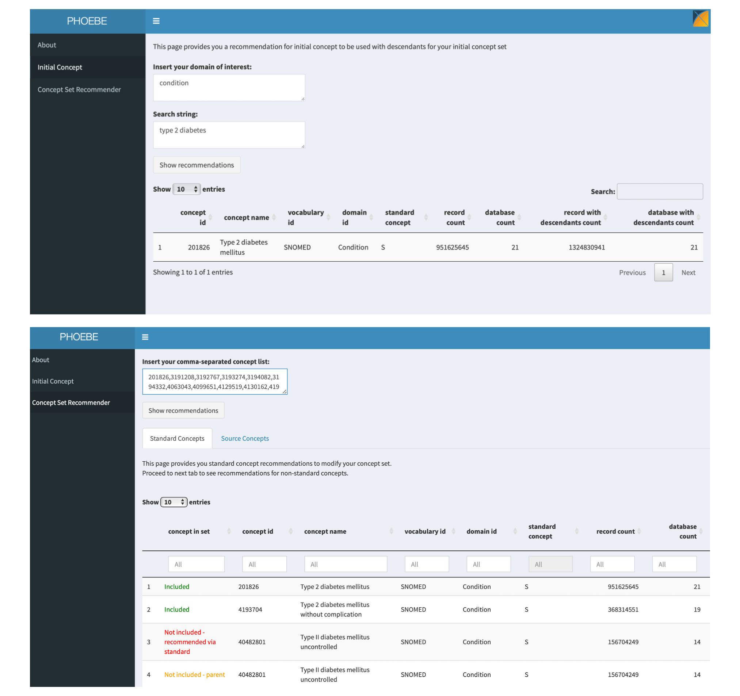
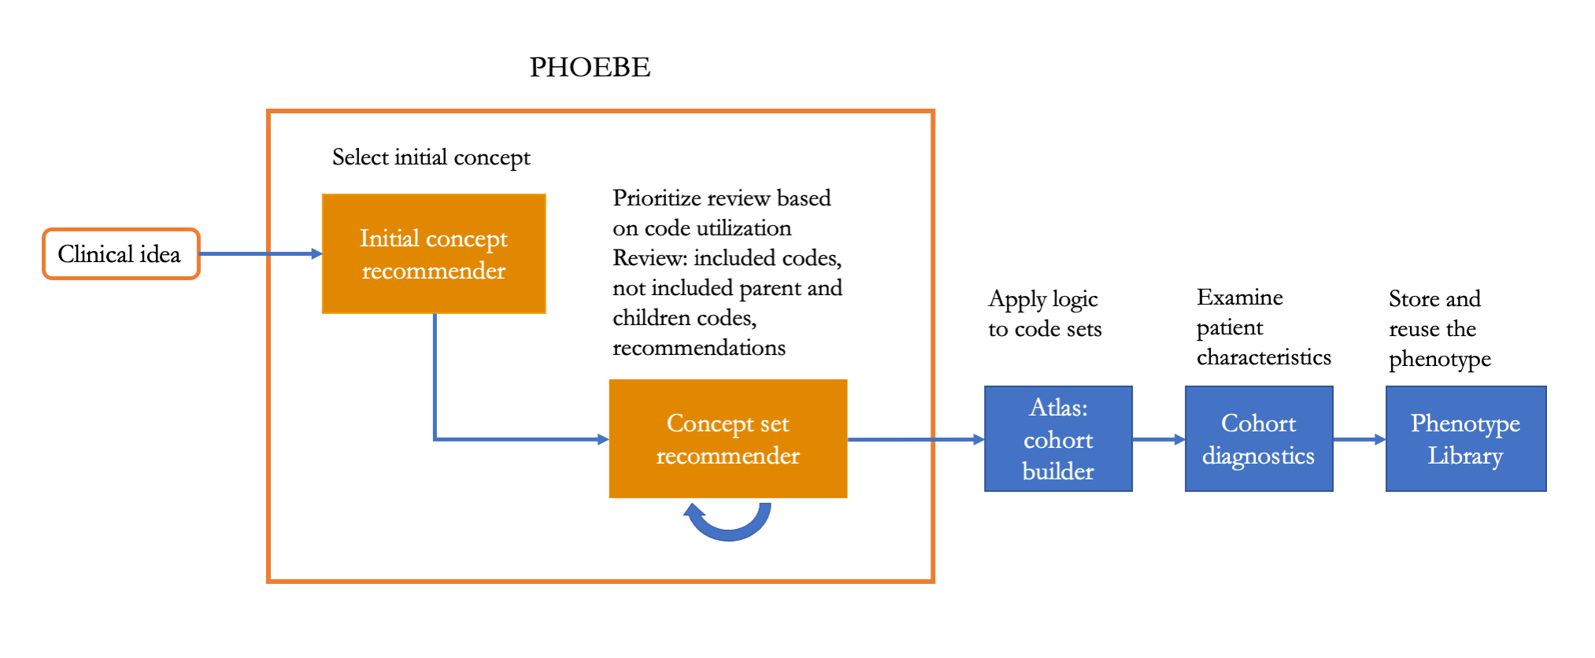
PHOEBE: get the right concepts
Exploit vast data network: rate of every code everywhere
Ostropolets AMIA 2021

Slide 18
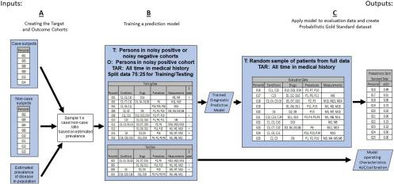
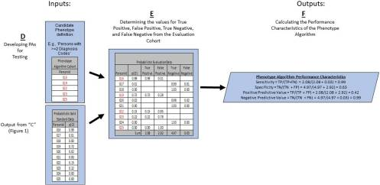
Phevaluator: automate the evaluation
Proxy for manual chart review
Swerdel JBI 2019

Slide 19
Processing EHR

Slide 20
What’s the story of my patient?
Is my patient at risk for …?
How do I manage my day-to-day?
How do I get to a shared decision with my dr?
67 y/o female with PMH of HIV, dilated cardiomyopathy s/p AICD, HTN, DM2, hyperlipidemia, asthma, and morbid obesity; complained of daily vomiting for months;
on 13 medications;
presents to the ED with vomiting.
32 y/o female with endometriosis, IBS, chronic pelvic and hip pain;
on 2 medications;
presents to gyn visit with uncontrolled pelvic pain.
Notes:
On the way to deliver the promise of patient-centered care,

Slide 21
Processing EHR
Natural language processing
Descriptions (e.g., cohort characterization)
Predictions
Prescriptions

Slide 22
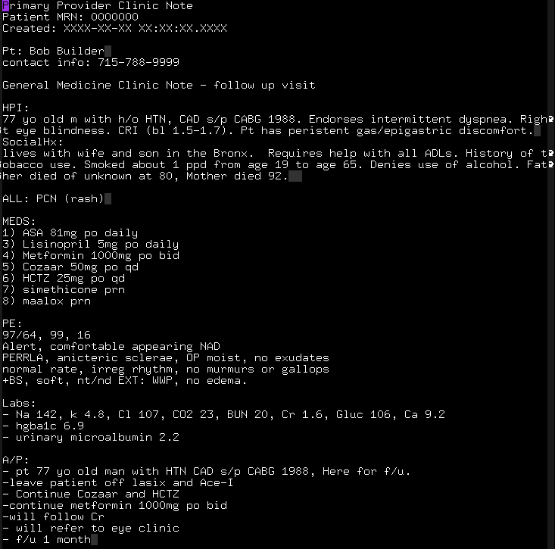
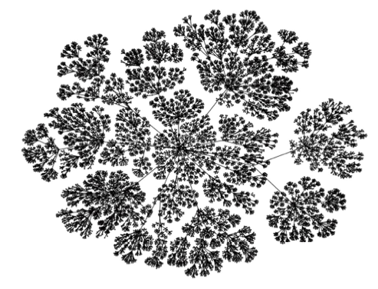
Natural Language Processing
+
401.1 (Hypertension);
428.0 (Congestive heart failure);
369.6 (One eye blindness)
→
Notes:
Mention lengths
More sophisticated approaches that capture the context but can handle length of text

Slide 23
Natural Language Processing
Terminology
Disorder
span: 35-45 (facial rash)
CUI: C0239521
body location: C0015450 (facial; 27-32)
conditional: true (if; 25-26)
negation: false (NULL)
severity: severe (severe; 28-33)
...
Patient should come back if
severe facial rash occurs

Slide 25
Natural Language Processing
Human authored
Automatically generated
The patient reported feeling as her usual self. She denied, dizziness, chest pain or weakness. She stated that she feels well enough to go home at this time and will call her daughter to pick her up. She has an appointment with her MD at the XXXX on x/xx. She had a heart rate in the 40s overnight and will be cautioned to not take her metoprolol today and take her BP tomorrow before taking her medication.
She is currently stable and she feels she is back to her baseline. This is a XXX year old female with a past medical history significant for hypertension , osteoporosis , Hyperlipidemia and known carotid artery disease who presents after a syncopal episode that occurred while she was having a bowel movement. She had a HA and felt that her BP might be high , but did not check it. HYPOTENSION : hold metoprolol 12.5 bid , this should not be restarted until she sees her PMD on x/xx at her regularly scheduled appointment.

Slide 26
Processing EHR
Natural language processing
Descriptions (e.g., cohort characterization)
Predictions
Prescriptions

Slide 27
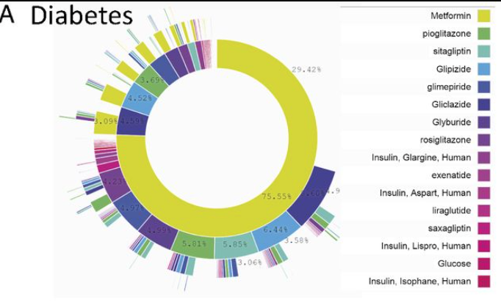
Cohort characterization

Slide 28
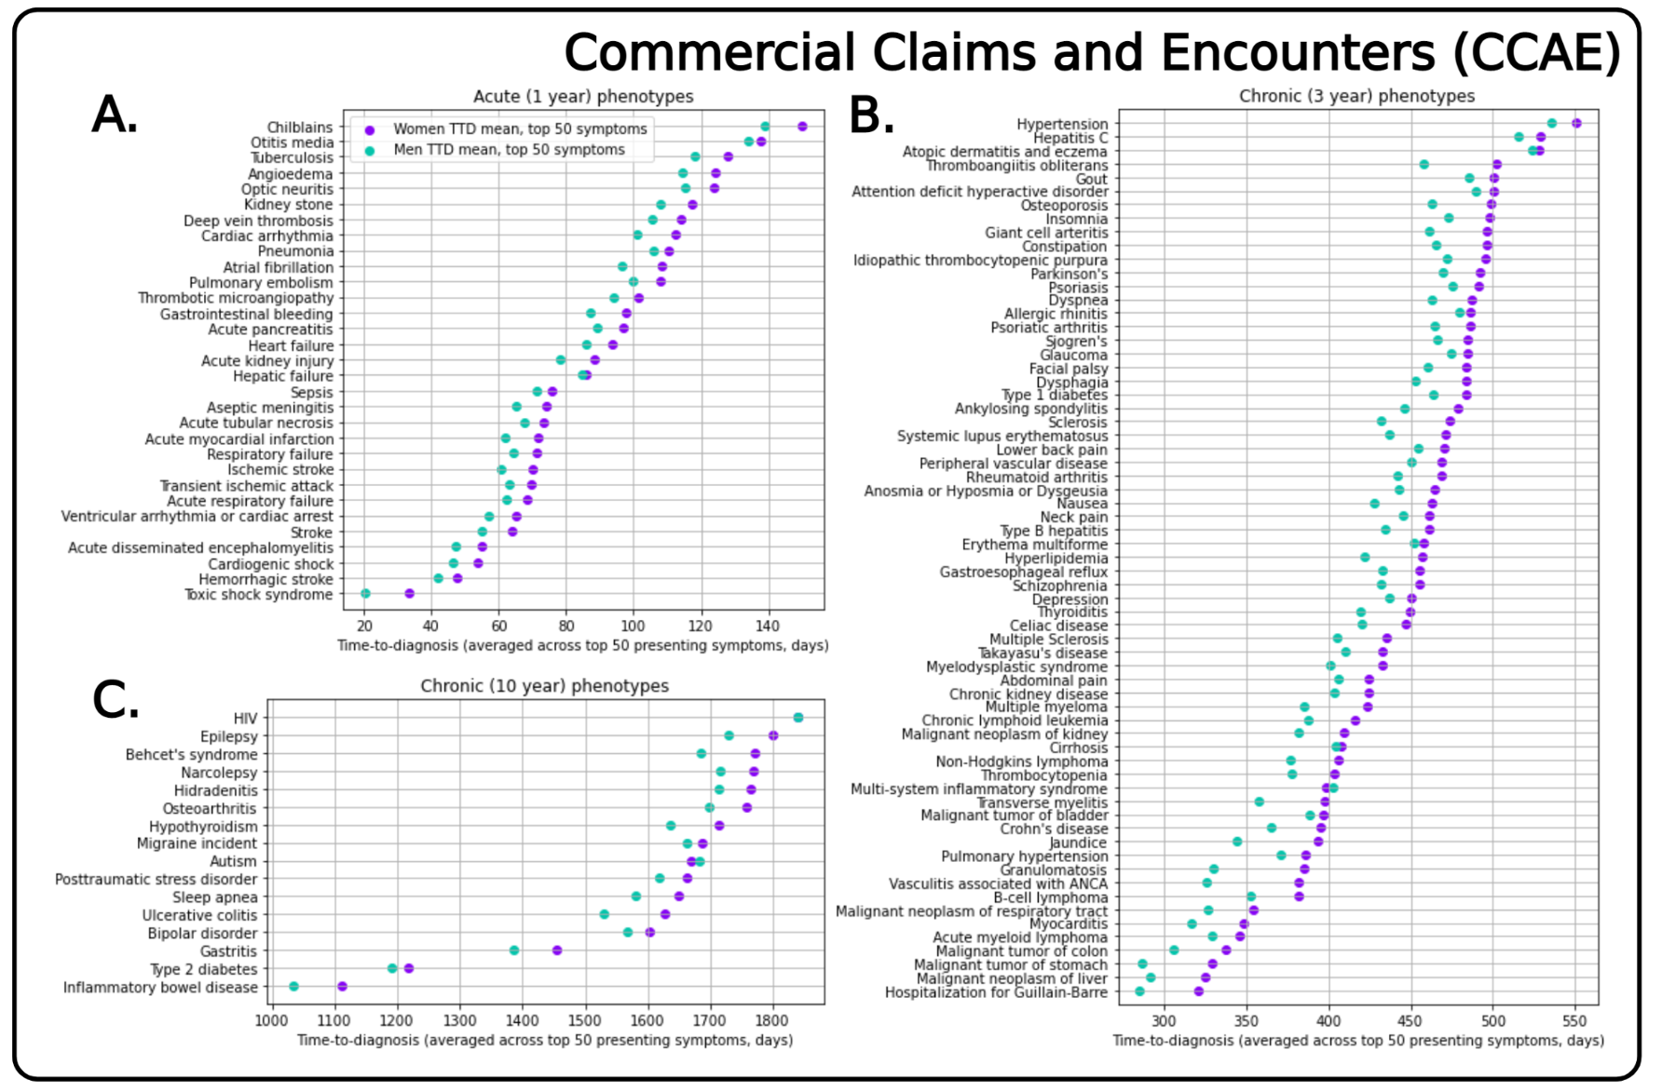
Cohort Characterization

Slide 29
Unsupervised learning

Slide 30
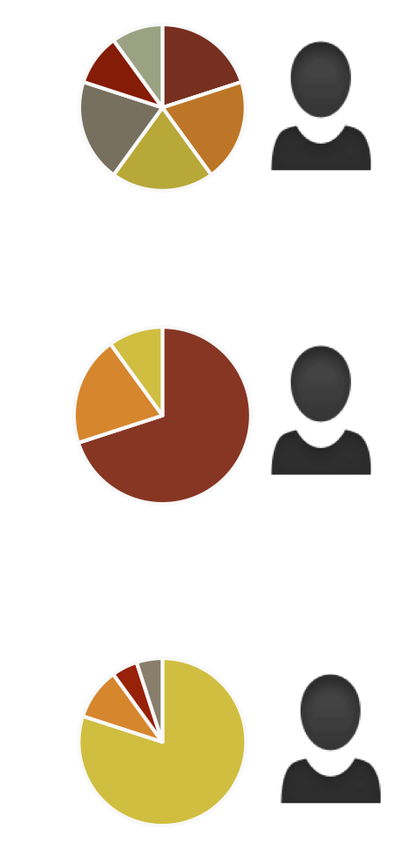
Unsupervised learning
Patient Records
Structured and Unstructured
Learned Probabilistic phenotypes
Inference mechanism
Diabetes Mellitus
Congestive Heart Failure
Depressive Disorder
Joint Disorder
Lupus
Chronic Kidney Disease
Breast Cancer
Colon Cancer
Asthma
Hyperlipidemia
…

Slide 31
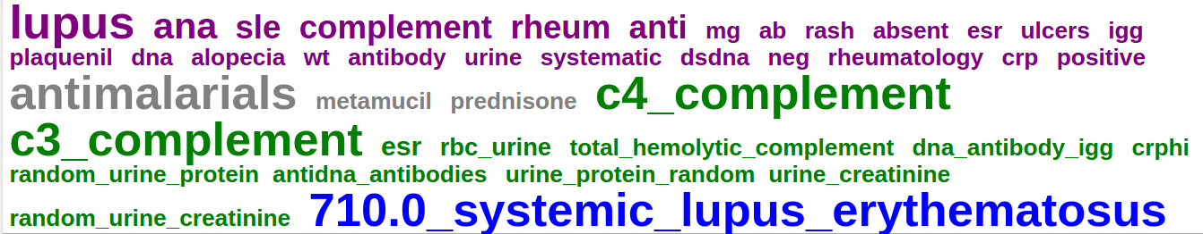
Unsupervised learning
Words from notes written by clinicians
Laboratory Tests Performed
ICD9 codes billed
Medications prescribed

Slide 32
Unsupervised learning

Slide 33
Predictions

Slide 34
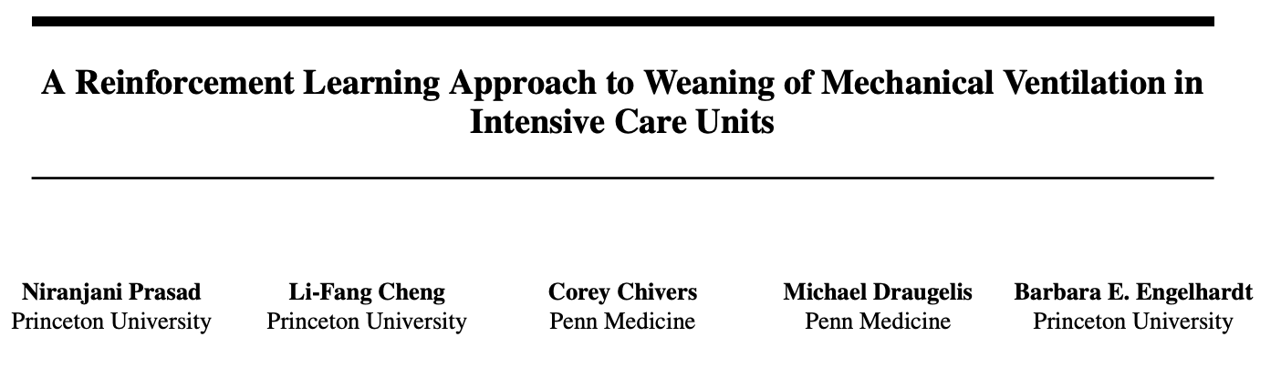
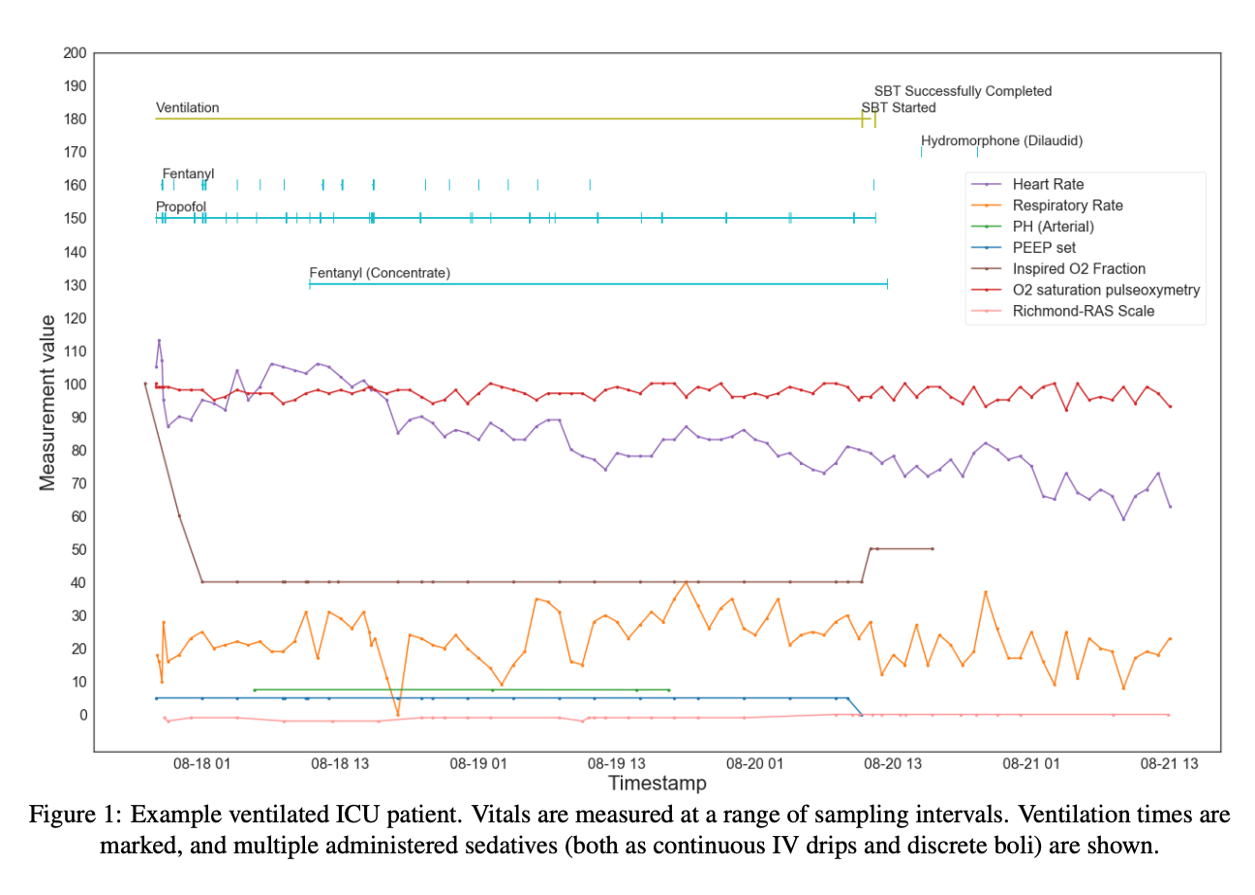
Reinforcement learning

Slide 35
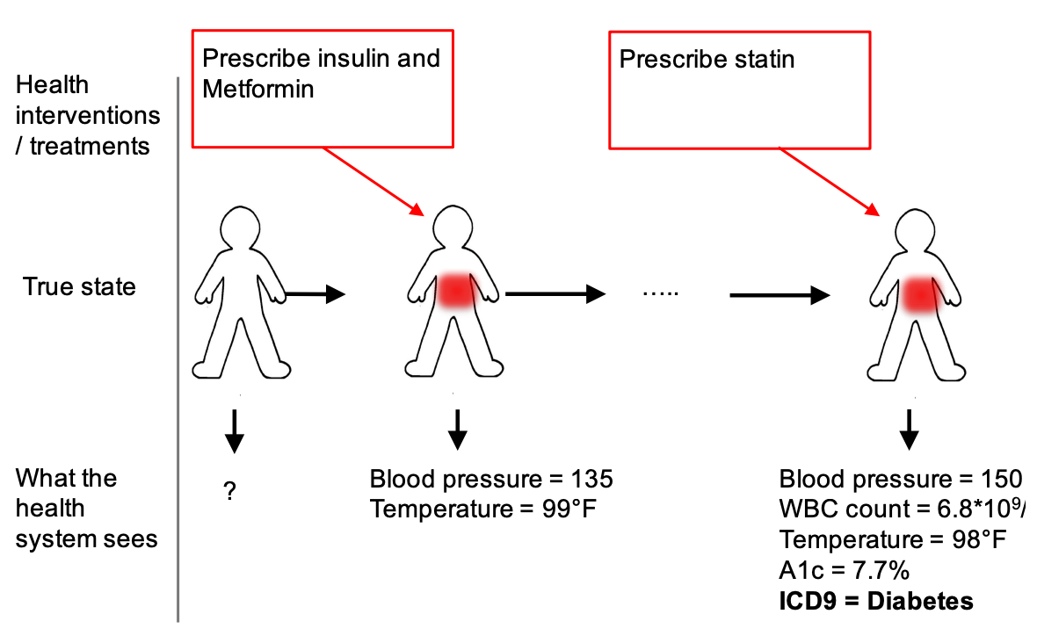
Reinforcement learning
Slide credit: David Sontag

Slide 36
EHR data
Temporal
Heterogeneous
Sparse and incomplete
Noisy and uncertain data
Non-linear relationships amongst observations
Patients are not aligned in time
  Patients enter observations at different stages/health status
  Disease course differ across patients
  Comorbidities with non-linear relationships amongst patients

Slide 37
Thanks!

Slide 38
Banff workshop
Dynamics and Data Assimilation, Physiology and Bioinformatics: Mathematics at the Interface of Theory and Clinical Application
Informatics
Biomedical Informatics
discovery and impact
Noémie Elhadad, PhD
George Hripcsak, MD, MS
Biomedical Informatics, Columbia University
Notes:
The national push for electronic health records will make an unprecedented amount of clinical information available for research, with approximately one billion patient visits documented per year in the US. These data may lead to discoveries that improve understanding of biology, aid the diagnosis and treatment of disease, and permit the inclusion of diverse populations and rare diseases. Health record data also bring challenges, with missing and inaccurate data and substantial bias. Some of the bias comes about because the data are generated as part of the health care process. For example blood tests done at night select for patients who are sicker. We employ nonlinear time series methods borrowed from other fields to address the challenges, and we attempt to model and correct for biases due to the health care process. We incorporate mechanistic models to constrain the search space to create accurate predictions despite limited training sets and missing values.

Slide 39
Day 2!

Slide 40
Observational data biases

Slide 41
US EHR data, per year
1,000,000,000 | visit notes
35,000,000 | admit notes, discharge sum.
46,000,000 | procedure notes
3,000,000,000 | prescriptions
1,000,000,000 | laboratory tests
>50,000,000,000 | facts

Slide 42

Meaning
PERRLA
Pupils equal, round, reactive to light and accommodation

Slide 43
Missing
Data are mostly missing
  Sampled when sick
Implicit information
  Pertinent negatives by attending vs CC3

Slide 44
Noisy
As low as 50% accuracy (Hogan JAMIA 1997)
… 36 year old man … 27 year old woman …

Slide 45
observe & interpret
author
read
Truth
Health status of the patient
Concept
Clinician or patient’s conception
Record
EHR/PHR
Concept
2nd clinician’s conception of the patient (or self, lawyer, compliance, ...)
Error
Error
Implicit
Error
process
Model
Computable representation

Slide 46
Complex
Narrative text holds much of the useful info
  Slight increase of pulmonary vascular congestion with new left pleural effusion, question mild congestive changes
  s/p LURT 1998 c/b 1A rejection 7/07 back on HD

Slide 47
Biased
Environment
Patient state
Therapy
Care team
Objective tests
Electronic health record

Slide 48
18715 cohort
+CXR
+fdg
-recent pneu
-recent visit
1935 cohort
above plus
+DSUM exist
+ICD9 (pneu
not sepsis)
Hripcsak ... Comput Biol Med 2007;37:296-304

Slide 49
Observational data temporal biases and health care process

Slide 50
Lagged linear correlation
lab
positive correlation
concept
negative correlation
lab precedes concept (d)
lab follows concept (d)

Slide 51
Definitional association
Hripcsak ... JAMIA 2011

Slide 52
Timing of cause in disease vs. treatment

Slide 53
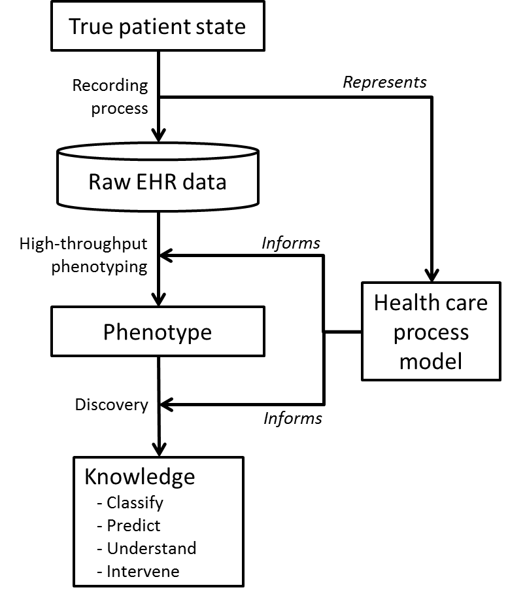
Health care process model
Hripcsak ... JAMIA 2013

Slide 54
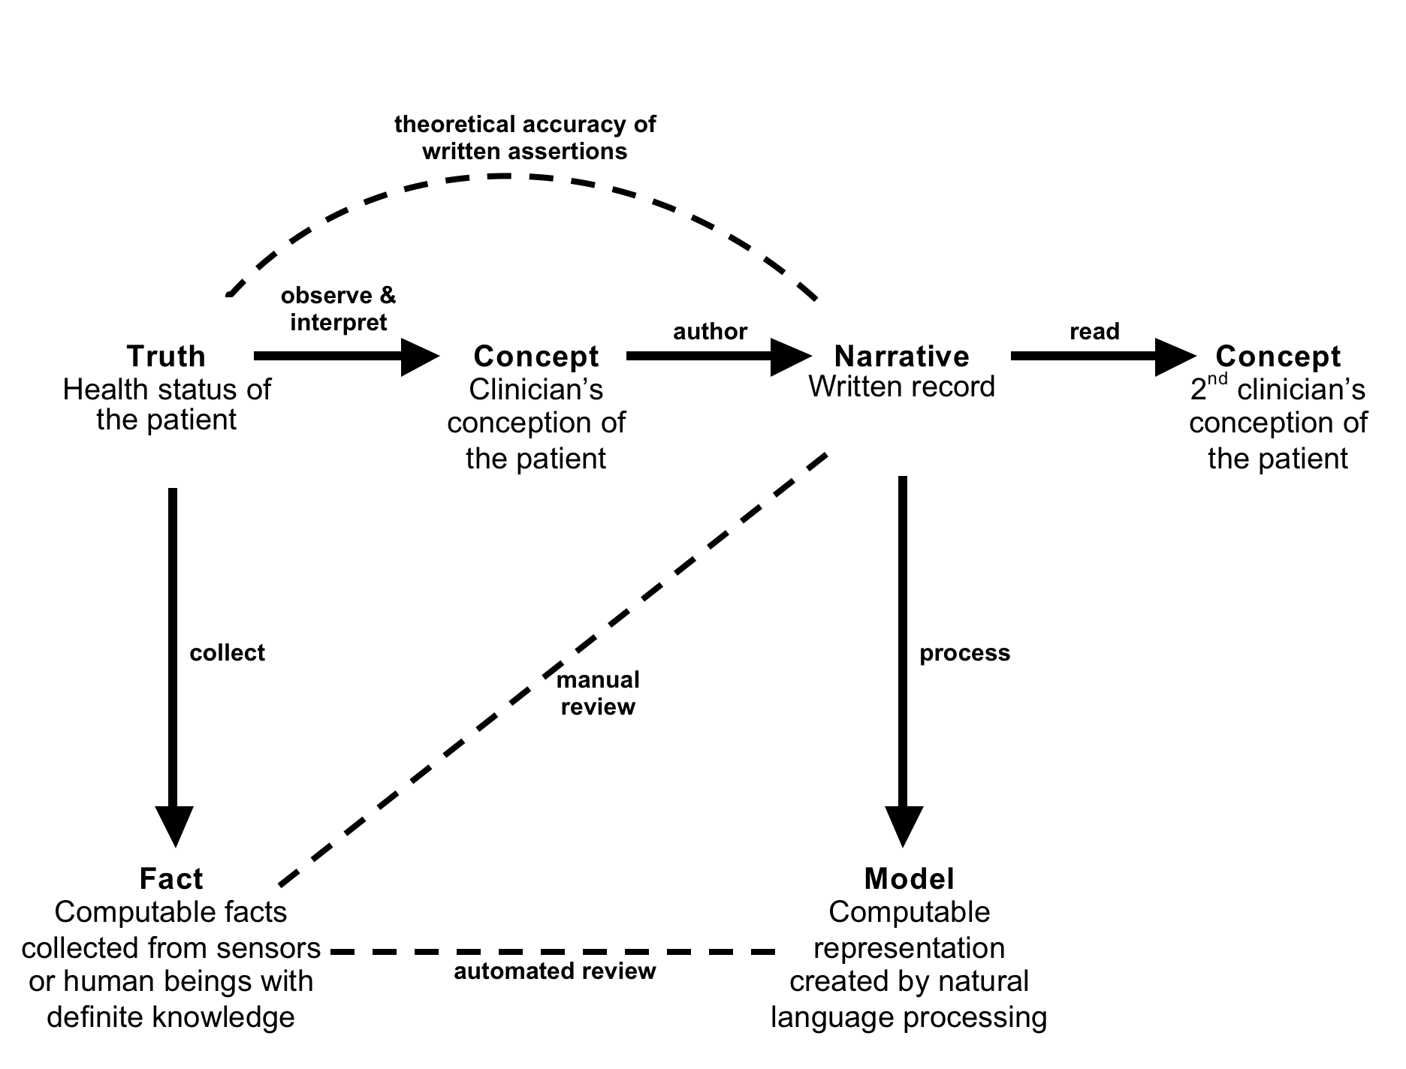
Interpreting time
Hripcsak JAMIA 2009

Slide 55
Stated time
Now

Slide 56
Interpreting time
Variable | Definition | Coefficient | Significance
value | stated numeric value in the temporal assertion (1 to 30 in this sample) | 0.0414 | <0.001
round number | true if value is a multiple of 5 (any unit) or 6 (with months) | –0.0218 | 0.002
ln(duration) | logarithm of stated duration in days, which equals the product of unit and value | 0.150 | 0.023
gt 18 years | true if duration ≥ 18 years, so the event should not be in the database | 0.816 | <0.001
intercept |  | 0.406 | 0.416

Slide 57
Parameterizing Time
Albers, Translational Bioinformatics 2009

Slide 58
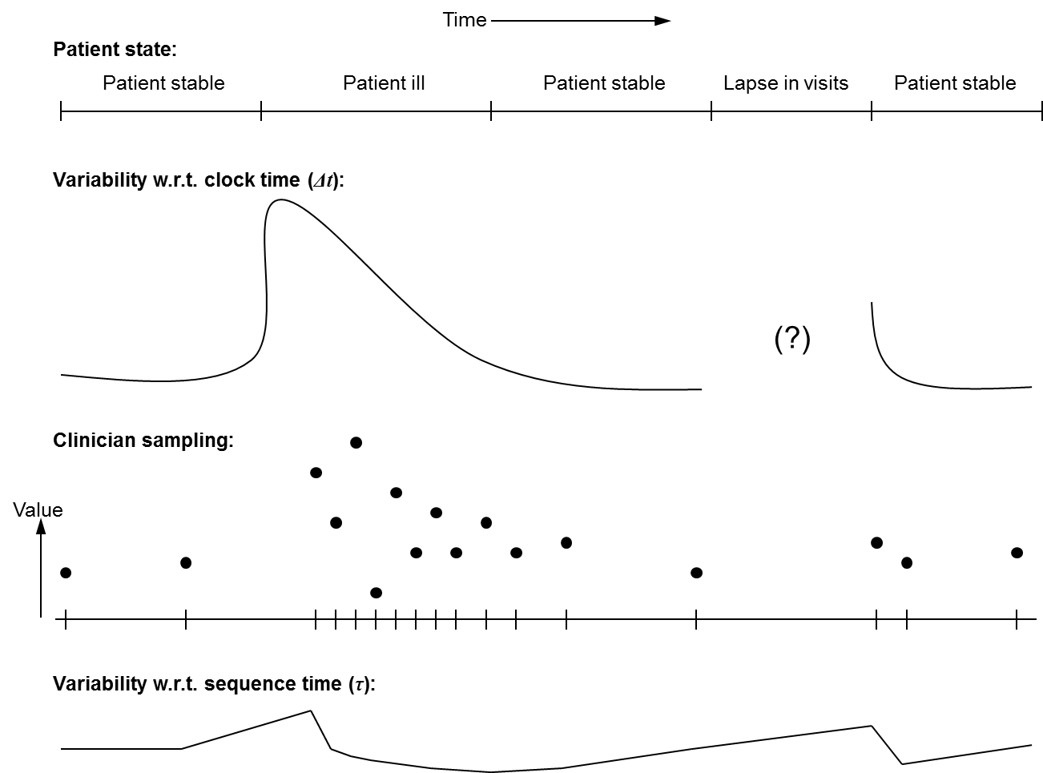
Patient variability and sampling

Slide 59
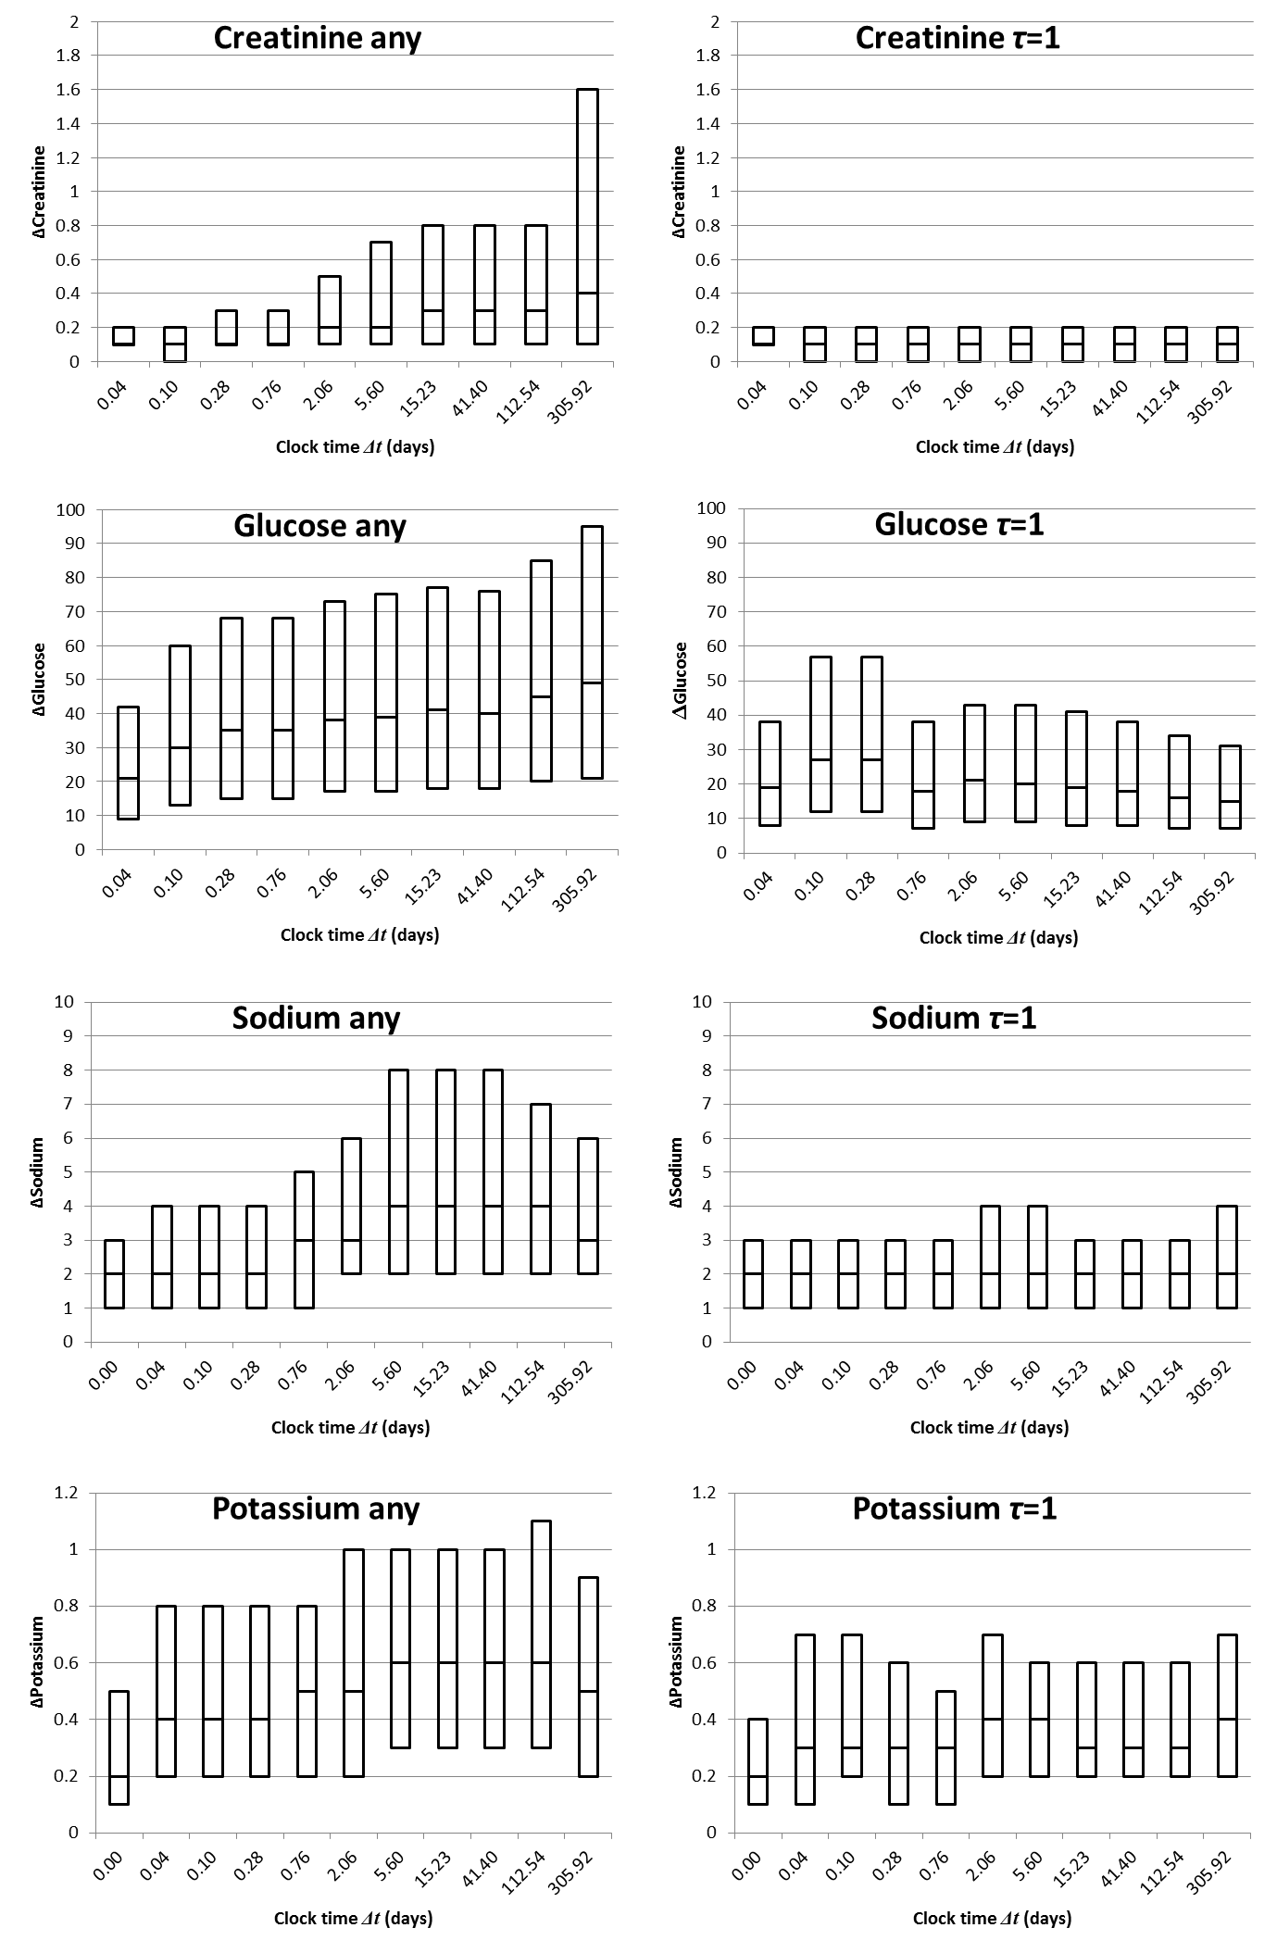
Parameterizing Time
Any
Sequential
1 hour
1 year
1 hour
1 year
Hripcsak, JAMIA 2015

Slide 60
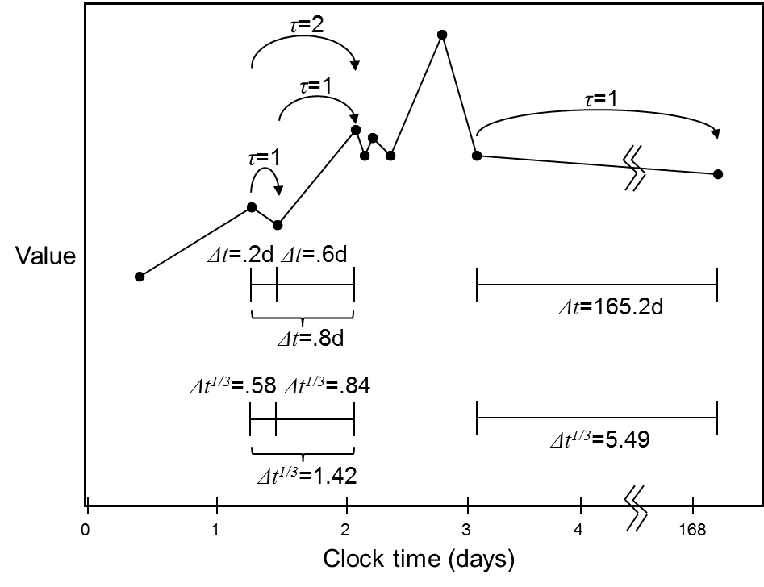
Parameterizing Time
Clock (absolute) time
Sequence time
Warped time
  Lasko PLOS ONE
  2013
Hripcsak, JAMIA 2015

Slide 61
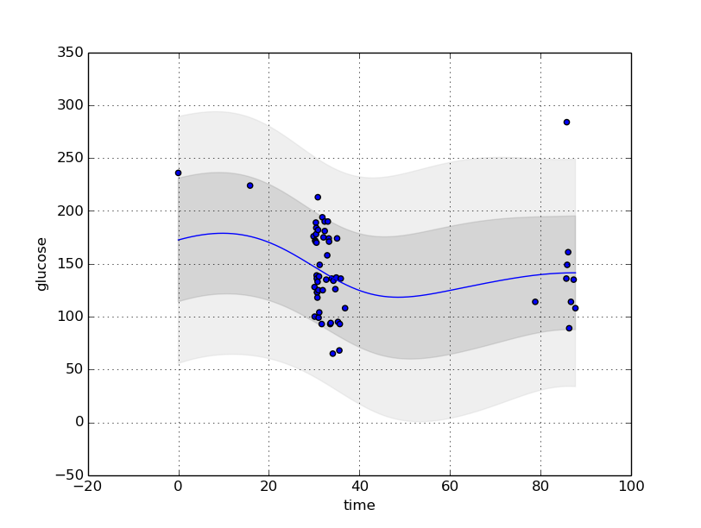
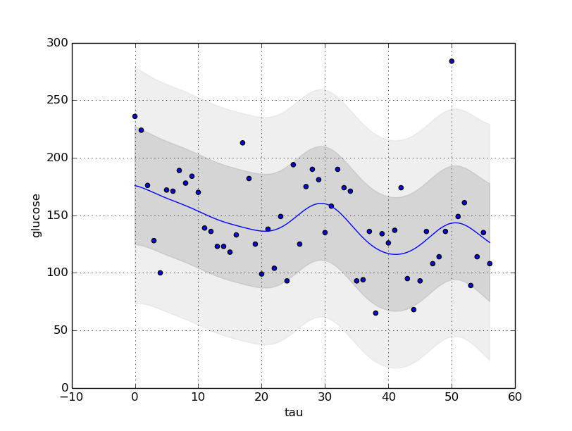
Parameterizing Time
Hripcsak, JAMIA 2015

Slide 62
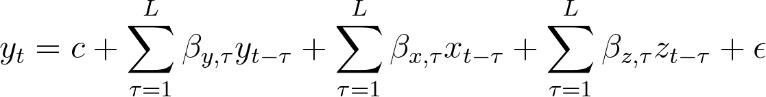
Control for health care process effects
Health care processes inject signals into physiologic processes
Attempt to reduce the effect through techniques like Granger “causation” (lagged linear regression)
y = lab test outcome
x = drug of interest
z = health care process variable

Slide 63
Granger to decipher associations

Slide 64
More barriers to machine learning in healthcare

Slide 65
Transferability
Model learned in one population/institution might not transfer to different population or institution
  Unobserved factors (e.g., social determinants of health, genomics)
  Different care practices
Model learned at one time might not transfer to later

Slide 66
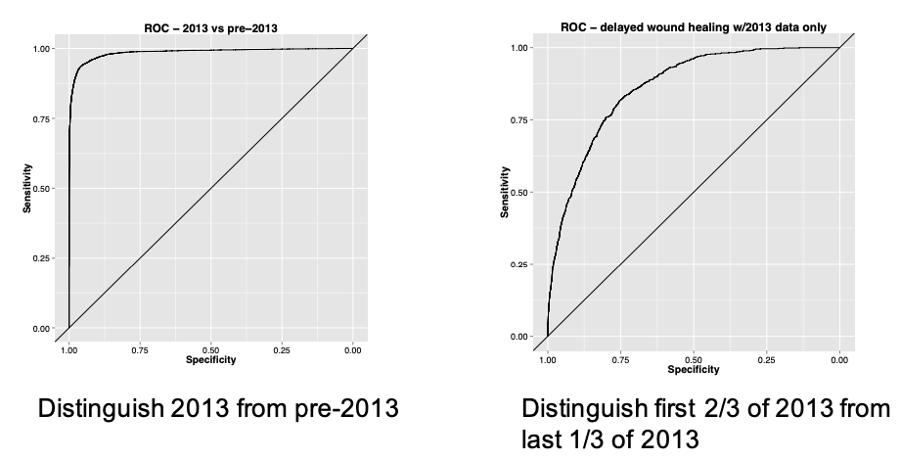
Transferability
Testing for covariate shifts (wound healing)
Slide credit: Ken Jung and David Sontag

Slide 67
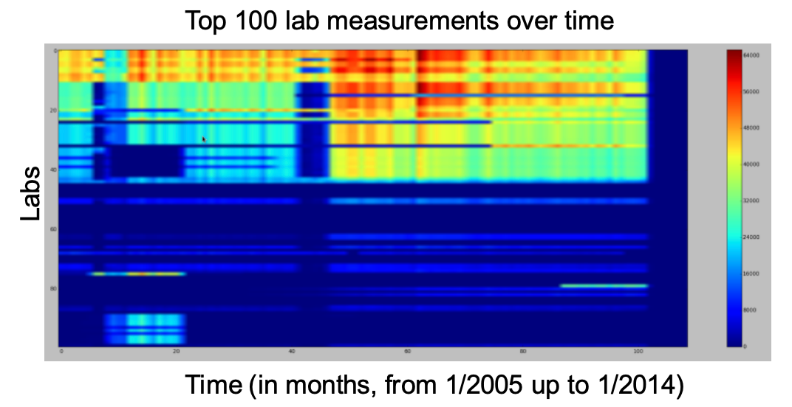
Transferability
Slide credit: David Sontag

Slide 68
Trust
Does the model know when it’s uncertain?
Does the model make same mistakes as human? (e.g., would we be happy delegating decision making authority?)
Are humans comfortable with the model?
Slide credit: Zachary Lipton and David Sontag

Slide 69
Privacy
Access to primary identified data
Ability to re-identify de-identified data
Ability to infer private information from aggregates, especially as the degrees of freedom of the model increase

Slide 70
Ethics
Problem
  There are biases in the data;
  Modeling learns from these biased data;
  Modeling influences decisions and practice;
  Biases are now reinforced
Other problems

Slide 71
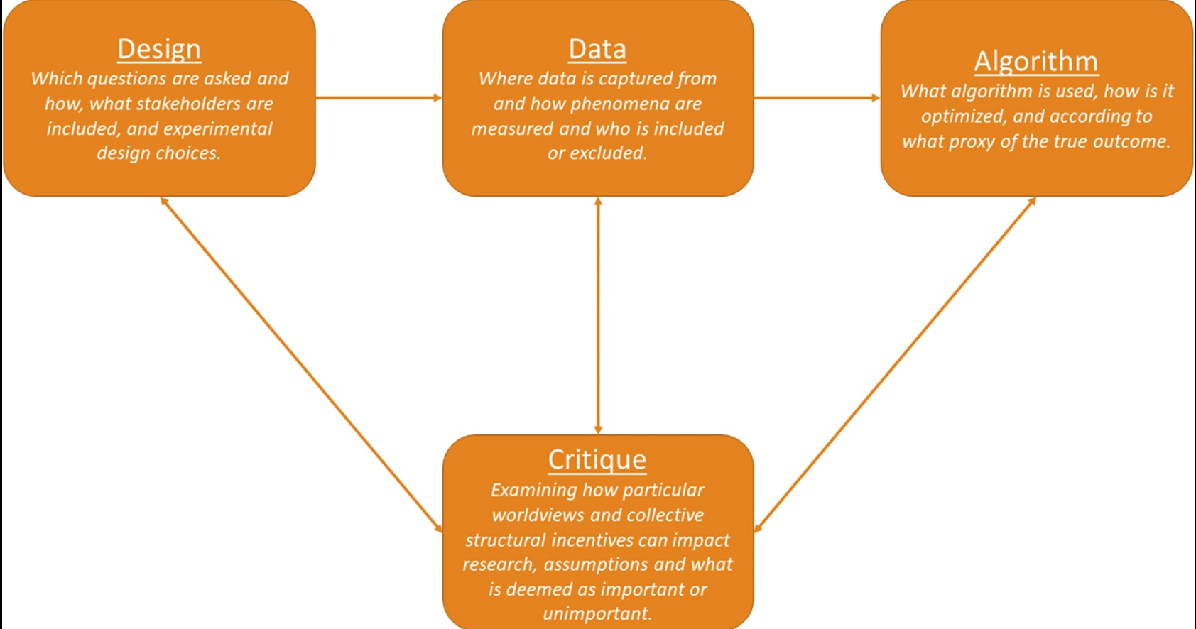
Opportunities for issues

Slide 72
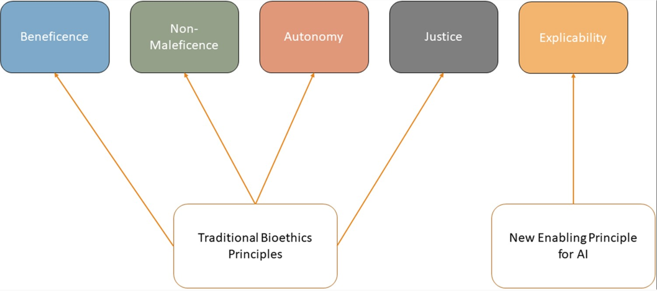
Justice and ethics

Slide 73
Ethics
Data (of patients and of their care) are biased
  How to ensure that diverse patients are represented
  How to identify and mitigate differences in documentation for different groups of patients
Metrics to measure “fairness” or “bias”
Consent (individual; group)
Notes:
Fairness: multiple metrics to operationalize justice concepts, and they are in tension with each other
Consent: transgender status in adolescents
models are learned with waiver of consent
would a teenager be inferred?

Slide 74
Thanks!

