Slide 1

Gene set tests and Cell-Cell Communication in Single-Cell RNA Sequencing Data
Di Wu
Associate Professor, Department of Biostatistics
University of North Carolina, Chapel Hill

Slide 2
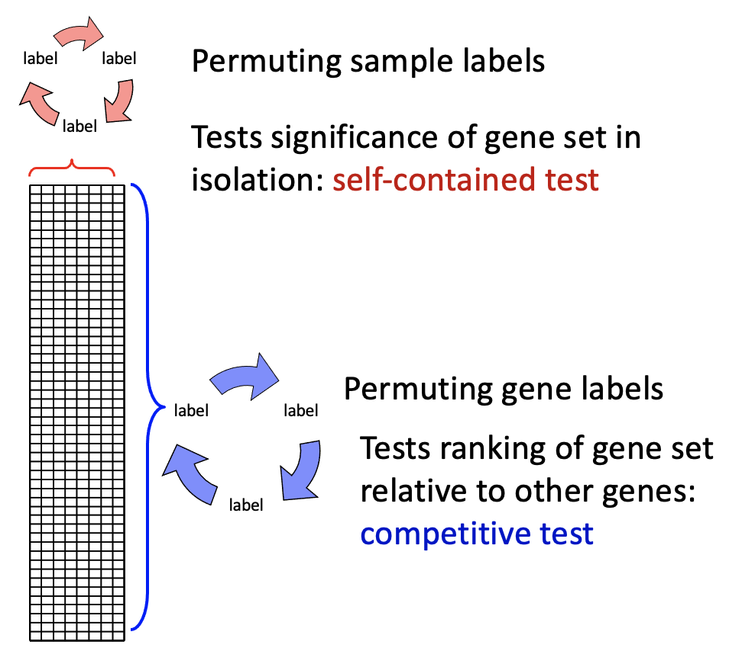
Gene set tests (GST) in bulk RNAseq and scRNAseq
scRNAseq
  Excess zeros
  Large number of cells
  Two types of correlations
Differential Expression (DE) analysis
  To identify genes that are DE between sample groups
Gene set tests based on DE analysis
  Test genes by sets defined a priori (mSigDB), by biological functions or previous gene expression analysis results.
  Advantages include higher power and better interpretation
  Three typical steps:
    Individual test
    Summary statistics in a set
    Inference for P values
Two types of Null Hypotheses
  Permuting genes vs permuting samples
Existing DE based GST in scRNAseq
  GST Module in MAST
  iDEA

Slide 3

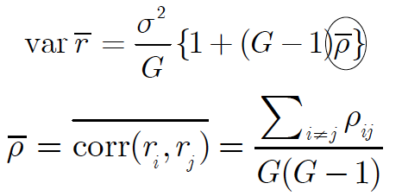
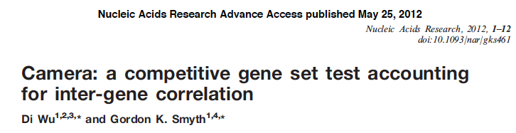
Correlation Adjusted MEan RAnk gene set test (camera)
Variance of mean-rank ( ) of G genes, ranked by moderated e-Bayes t test
is determined only by the average correlation
where
IGC: inter-gene correlation
Also called Gene-wise correlation

Slide 4
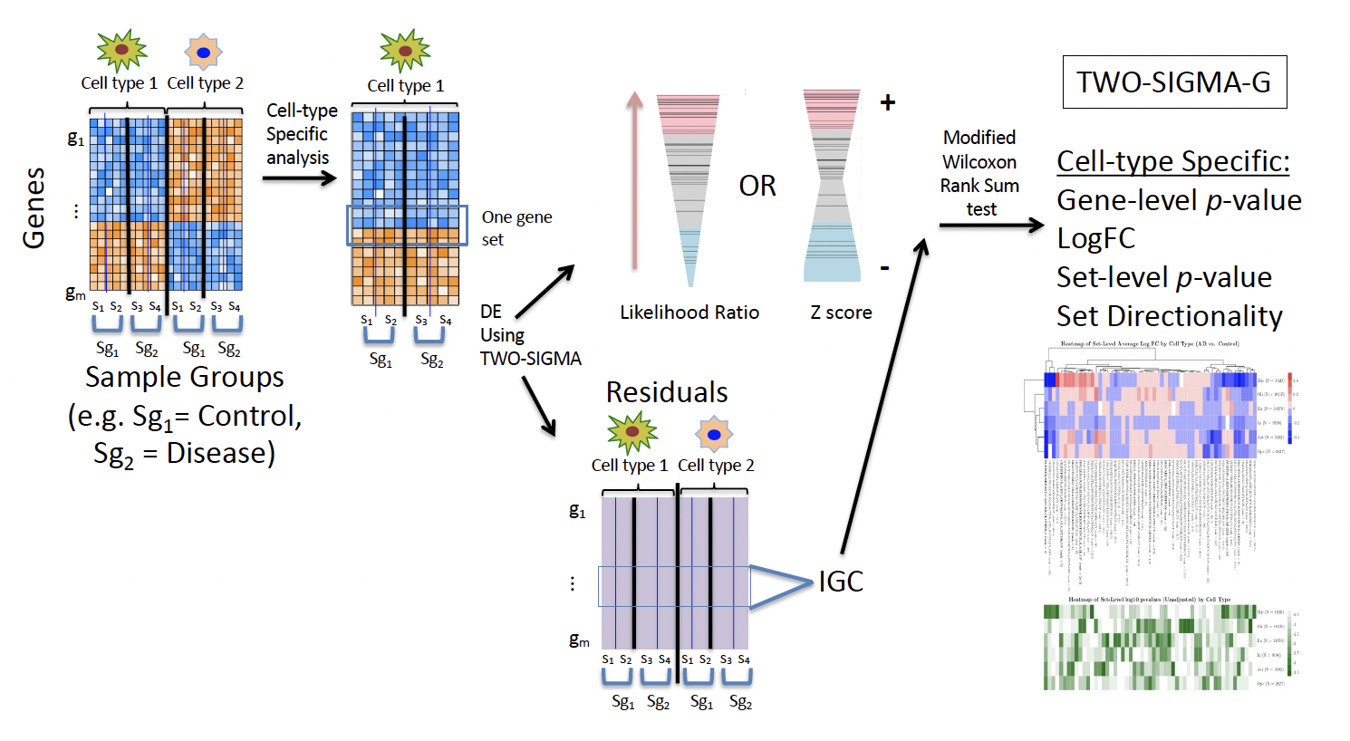


Two-Sigma based competitive gene set test (Two-Sigma-G)

Slide 5
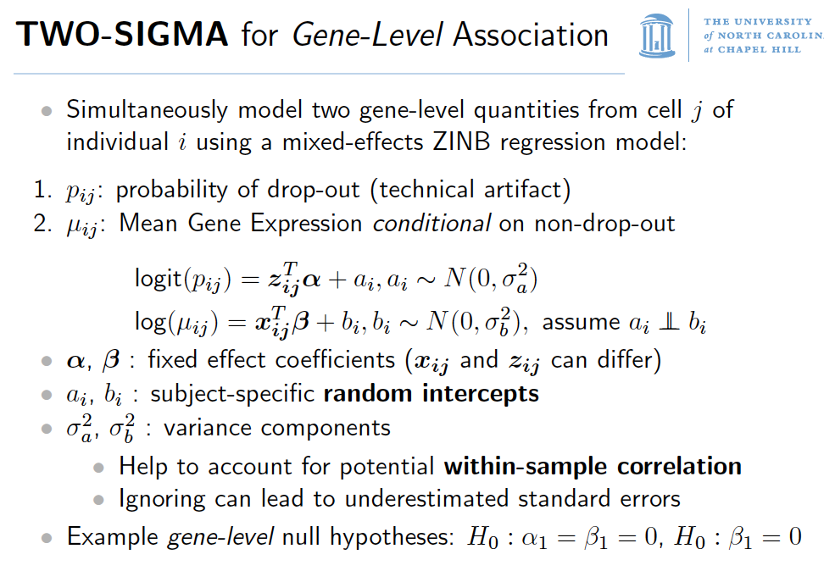
(allows ZINB and NB)
Accommodate within-sample correlation structure; Flexible for complex experimental design
ZINB, zero-inflated negative binomial. NB, negative binomial.

Slide 6
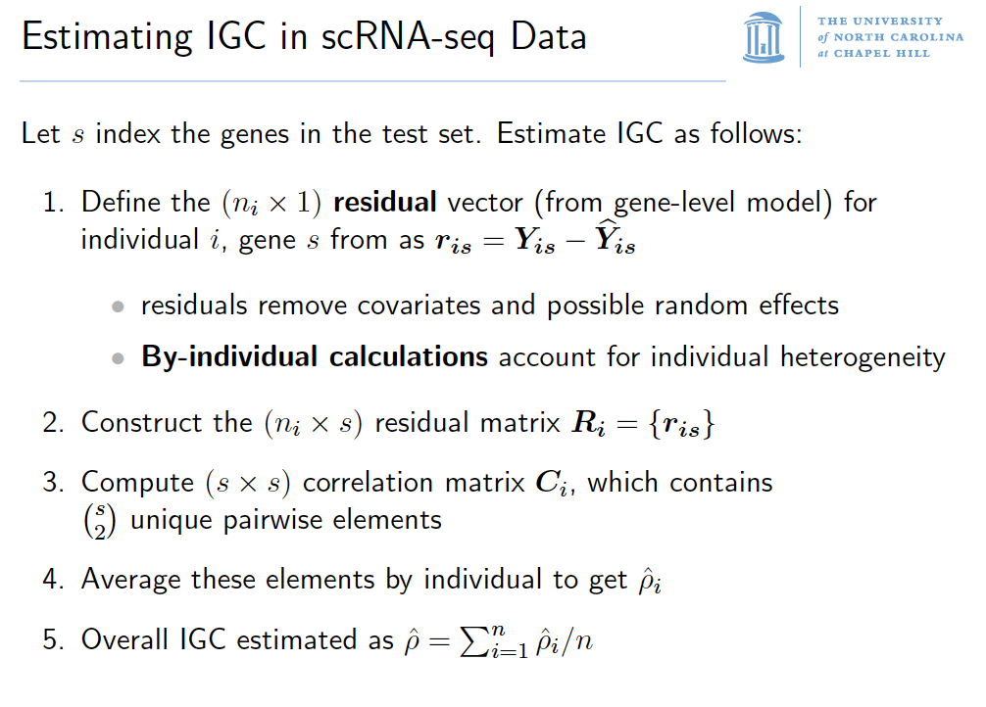

Slide 7
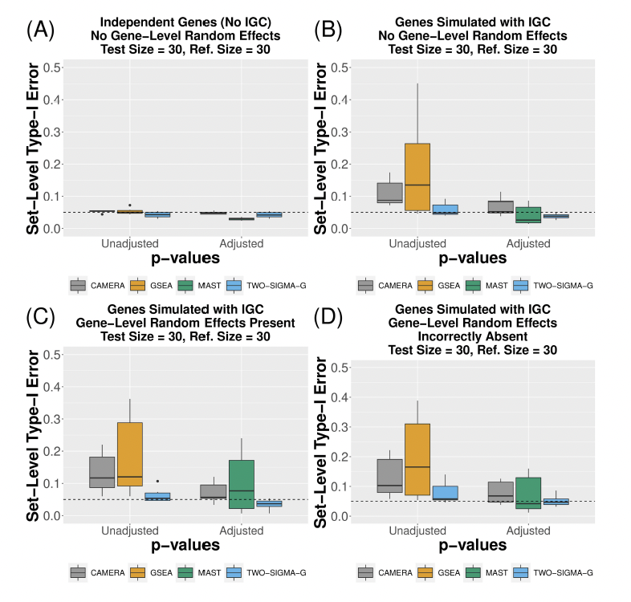
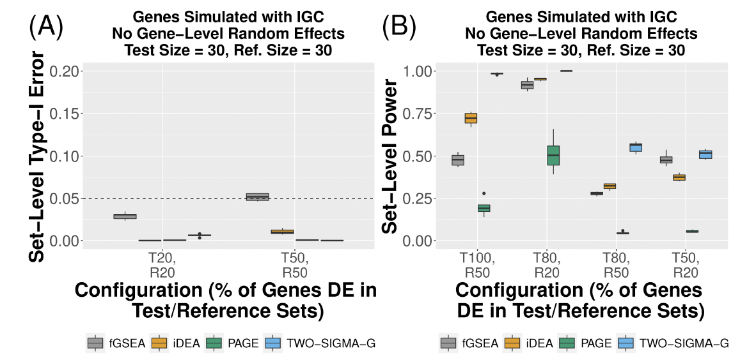
Two-Sigma-G controls Type I Error and has good power
Comparing to
Summary-statistics-based GST methods
iGSEA, iDEA, PAGE
Type-I error performance for CAMERA, GSEA, MAST and TWO-SIGMA-G using a reference set size of 30 genes

Slide 8
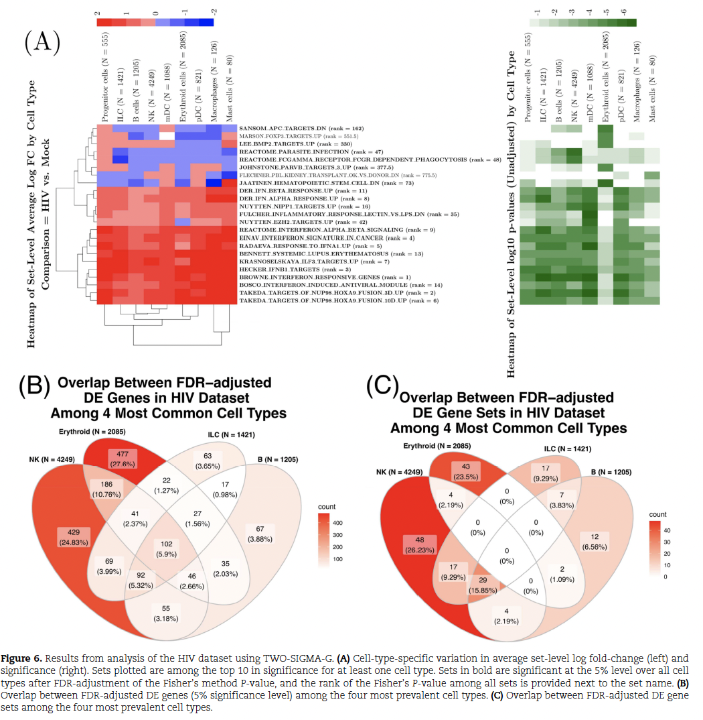
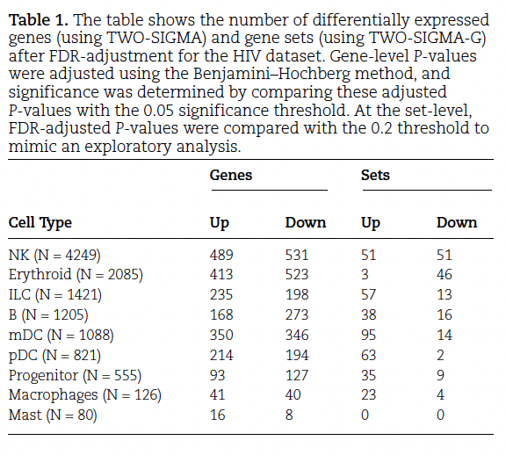
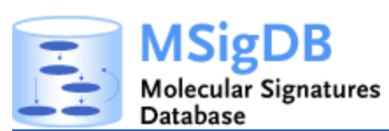
Two-Sigma-G results in
HIV-infected mouse spleen scRNAseq data
10X scRNAseq of humanized mouse spleen
Two sample groups (three reps in each)
Mock
HIV infected
DE (HIV vs Mock)
Enrich Interferon related pathways

Slide 9





Acknowledgement
UNC Chapel Hill, Biostat
Hunyong Cho PhD student, now Amazon
Chuwen Liu PhD student
Prof John Preisser
UNC Chapel Hill, Biostat
Eric Van Buren
PhD student, now Harvard Biostat
Prof Yun Li
UNC Chapel Hill, SOM
Prof Lishan Su
Dr. Liang Chen
Cleveland Clinic Founndation
Prof Ming Hu
https://github.com/edvanburen/twosigma
https://github.com/Hunyong/BZINB
Eric
Hunyong
Chuwen

Slide 10
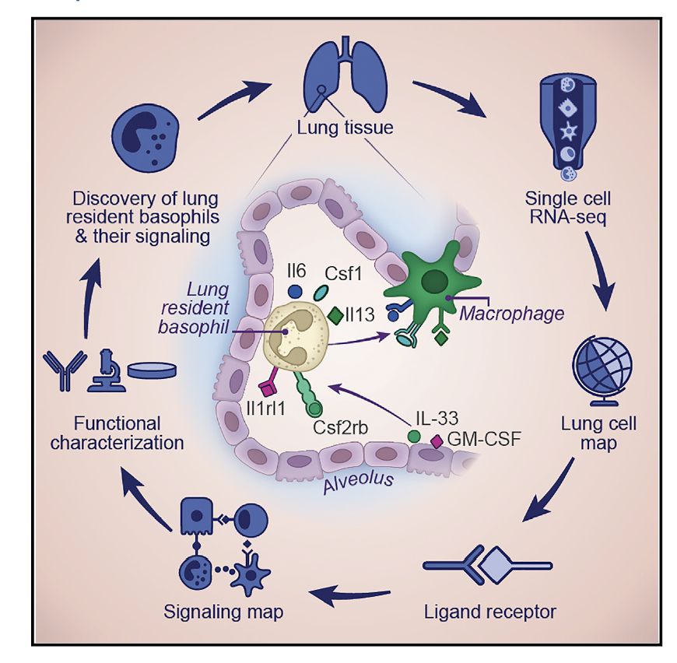

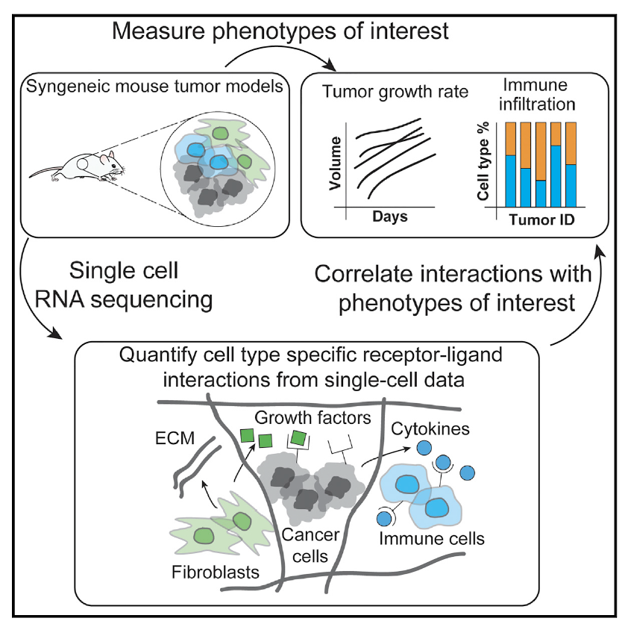

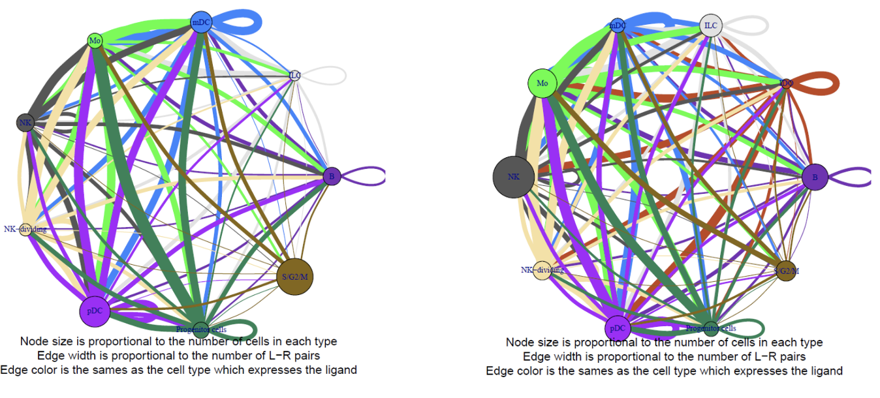


Cell-cell communications (CCC) mediated by intercellular ligand-receptor interactions
  In multicellular organisms, cells synthesize ligands and receptors by expressing the corresponding genes. One type of ligand can specifically bind to its counterpart receptor.
  Important to many biological processes, e.g., development, immune, structure, metabolism, sensory perception.
  ~2,000 ligand-receptor pairs in human. (Ramilowski et al., 2015)

Slide 11
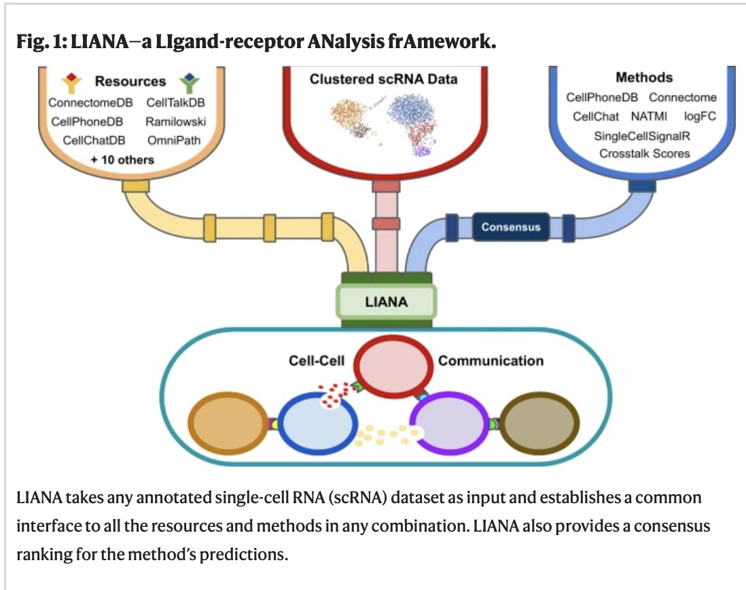

Existing methods to test association between CCC and cell clusters inn scRNAseq

Slide 12
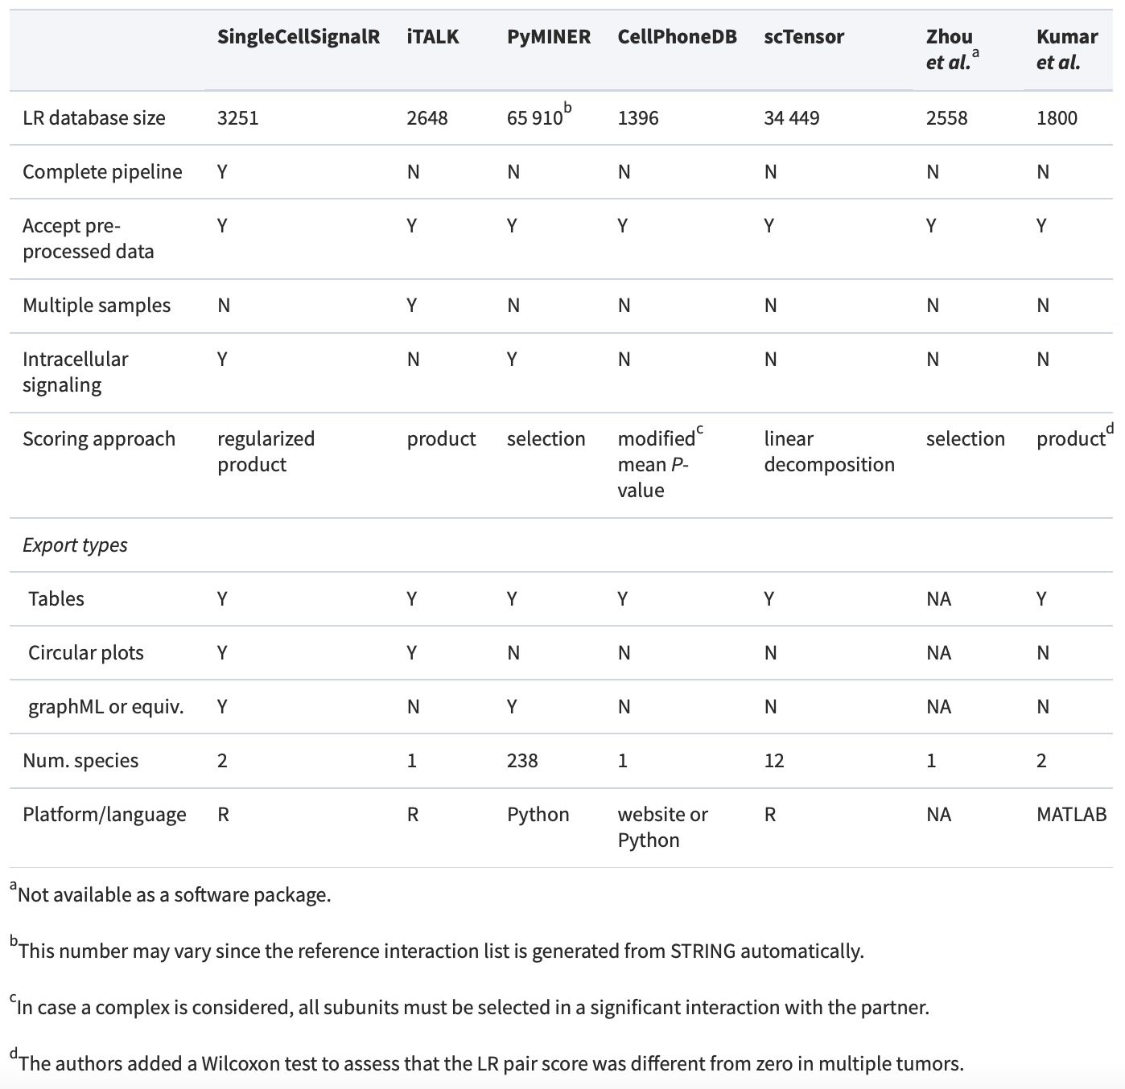


Association with clusters, rank-based methods and non-parametric tests were popular.
Most existing methods detect the enriched cell-cell interactions only within one sample rather than identifying differential cell-cell interactions between sample groups or conditions.
Some tests also have not taken good care of the excess zeros in scRNAseq data.
Notes:
Evidence that L-R also has many zeros.
No comparison of the strength of intercellular ligand-receptor interactions between sample groups, e.g., in Mock and HIV-infected humanized mice to better understand the impact of HIV-infection on the interactions between immune cells.
https://www.nature.com/articles/s41467-022-30755-0

Slide 13
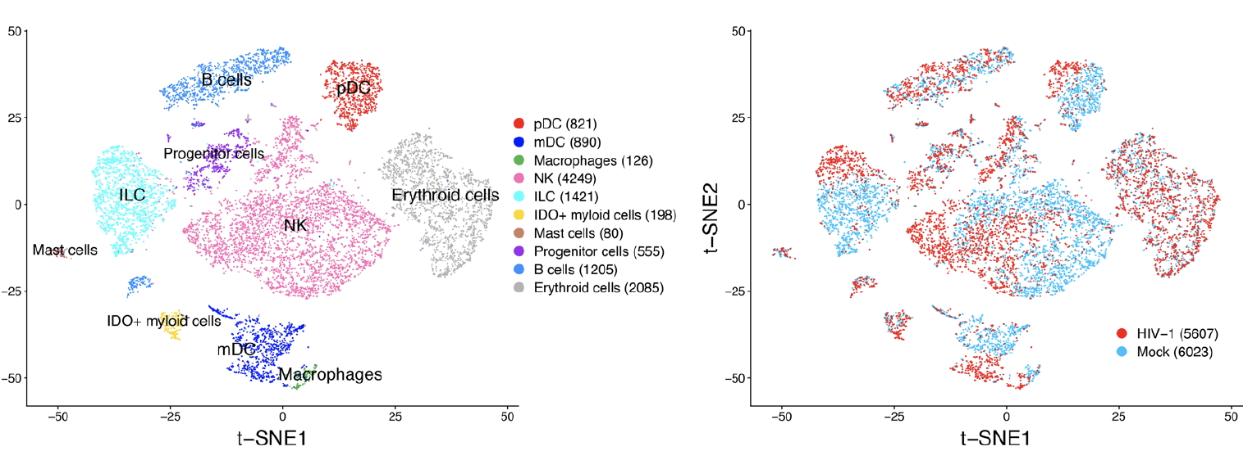

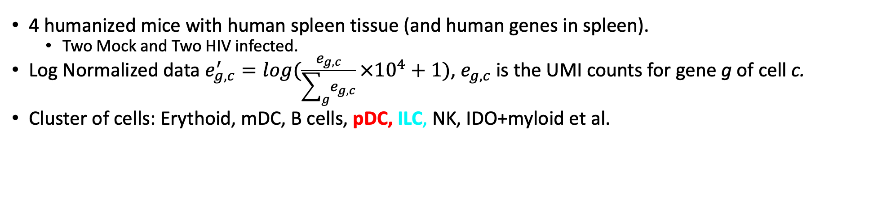
HIV scRANseq data
4 humanized mice with human spleen tissue (and human genes in spleen).
  Two Mock and Two HIV infected.
Log Normalized data $e_{g,c}^{′}=log(\frac{e_{g,c}}{\sum_{g}{e_{g,c}}}×{10}^{4}+1)$, $e_{g,c}$ is the UMI counts for gene g of cell c.
Cluster of cells: Erythoid, mDC, B cells, pDC, ILC, NK, IDO+myloid et al.
Cheng L et al, and Su L. Identification of pathogenic trail-expressing innate immune cells during HIV-1 infection in humanized mice by scRNA-seq. JCI Insight, 5(11), 6 2020.
Dr. Lishan Su

Slide 14
Our proposed DE-CCC
Given a ligand-receptor interaction between two cell types, we model the normalized counts for the ligand gene and the receptor gene in the two corresponding cell types with a two-component generalized linear mixed model respectively.
We test whether a pair of L-R is significantly associated with sample groups, for a pair of cell cluster/ types.
Use two-component model to handle excess zeros
Use random effect model to allow correlation among cells from one sample, so that the variance estimation is more rigorous
Allow comparisons between/among two or more sample groups.
Notes:
? Can accomondate multiple categories? yes
DP CCC

Slide 15
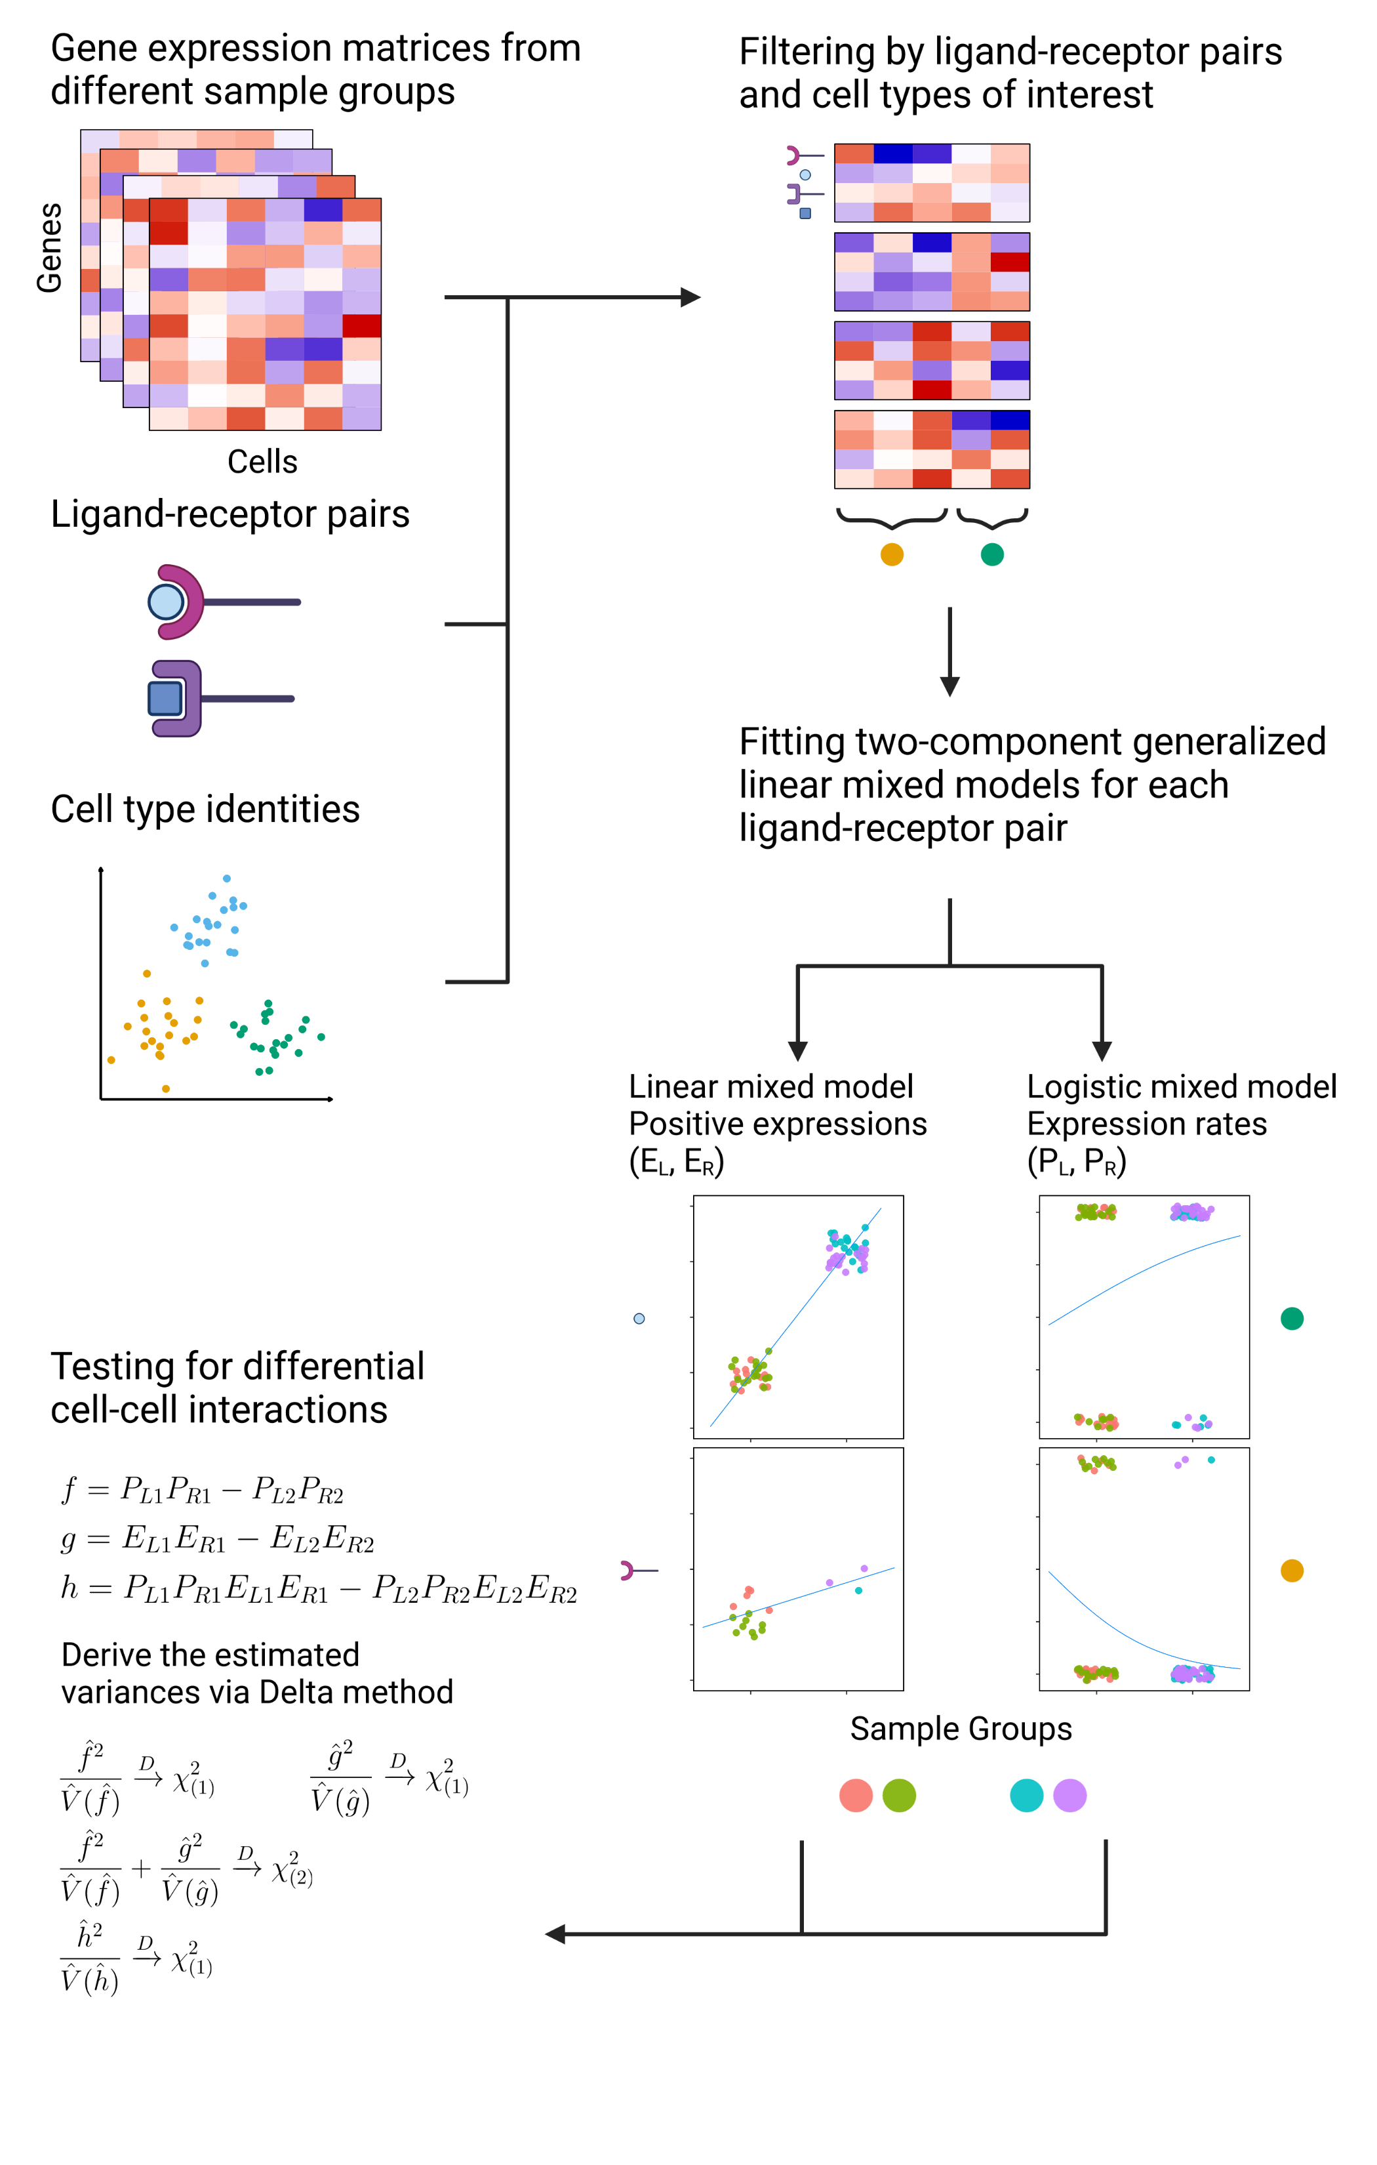
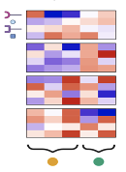

Slide 16
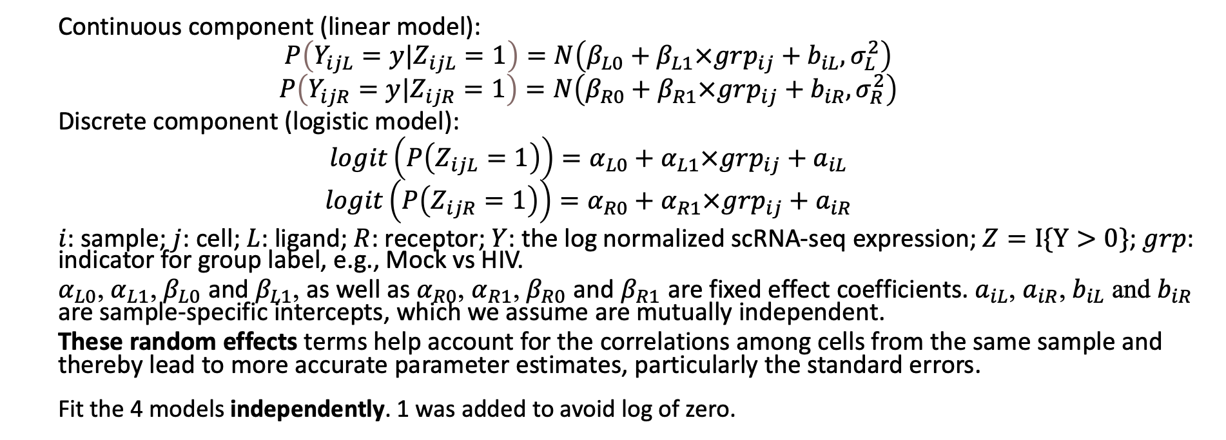
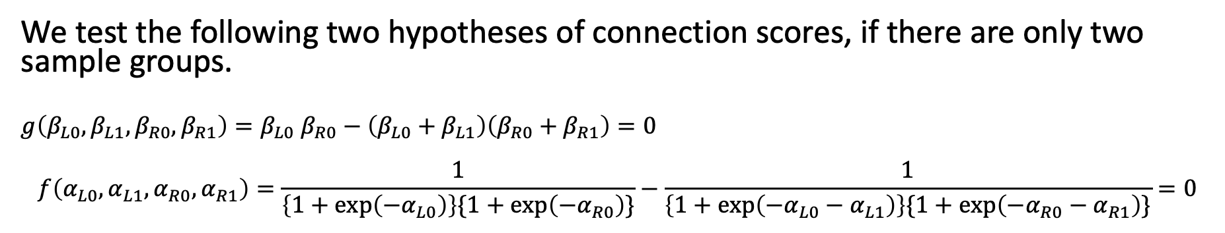
Hurdle model of the scRNAseq data
  Continuous component (linear model):
  $$P\left(Y_{ijL}=y|Z_{ijL}=1\right)=N\left(β_{L0}+β_{L1}×grp_{ij}+b_{iL},σ_{L}^{2}\right)$$
  $$P\left(Y_{ijR}=y|Z_{ijR}=1\right)=N\left(β_{R0}+β_{R1}×grp_{ij}+b_{iR},σ_{R}^{2}\right)$$
  Discrete component (logistic model):
  $$logit\left(P\left(Z_{ijL}=1\right)\right)=α_{L0}+α_{L1}×grp_{ij}+a_{iL}$$
  $$logit\left(P\left(Z_{ijR}=1\right)\right)=α_{R0}+α_{R1}×grp_{ij}+a_{iR}$$
  $i$: sample; $j$: cell; $L$: ligand; $R$: receptor; $Y$: the log normalized scRNA-seq expression; $Z=I\{Y>0\}$; $grp$: indicator for group label, e.g., Mock vs HIV.
  $α_{L0}$, $α_{L1}$, $β_{L0}$ and $β_{L1}$, as well as $α_{R0}$, $α_{R1}$, $β_{R0}$ and $β_{R1}$ are fixed effect coefficients. $a_{iL}$, $a_{iR}$, $b_{iL}$ and $b_{iR}$ are sample-specific intercepts, which we assume are mutually independent.
  These random effects terms help account for the correlations among cells from the same sample and thereby lead to more accurate parameter estimates, particularly the standard errors.
  Fit the 4 models independently. 1 was added to avoid log of zero.
We test the following two hypotheses of connection scores, if there are only two sample groups.
$$g\left(β_{L0},β_{L1},β_{R0},β_{R1}\right)=β_{L0} β_{R0}−\left(β_{L0}+β_{L1}\right)\left(β_{R0}+β_{R1}\right)=0$$
$$f\left(α_{L0},α_{L1},α_{R0},α_{R1}\right)=\frac{1}{\left\{1+exp\left(−α_{L0}\right)\right\}\{1+exp\left(−α_{R0}\right)\}}−\frac{1}{\left\{1+exp\left(−α_{L0}−α_{L1}\right)\right\}\{1+exp\left(−α_{R0}−α_{R1}\right)\}}=0$$
Notes:
We test the difference in the product of positive expressions and in the product of expression rates according to the fitted models. Namely, we evaluate

Slide 17
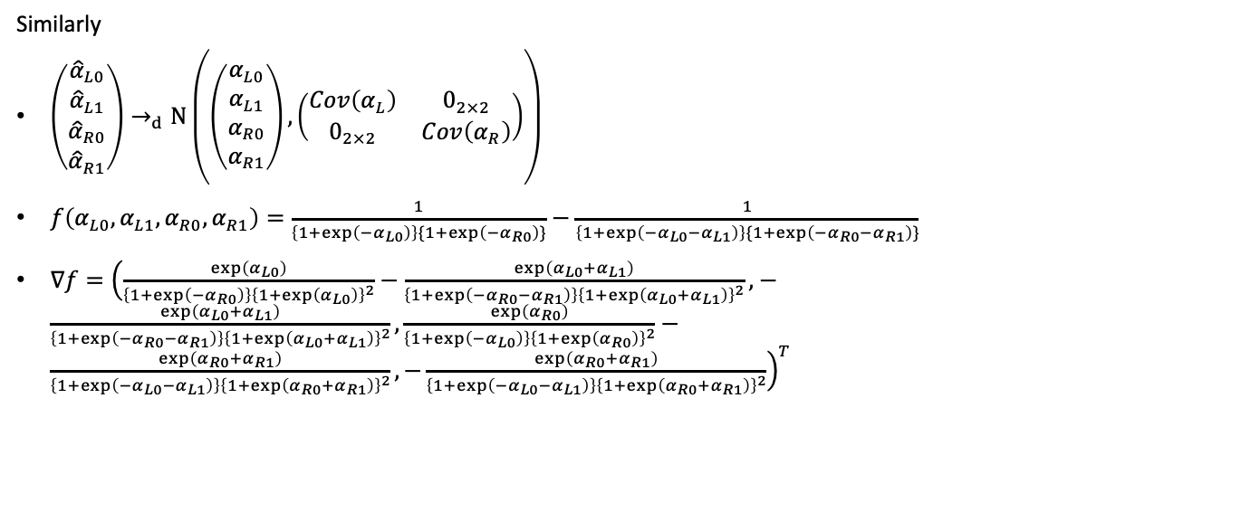
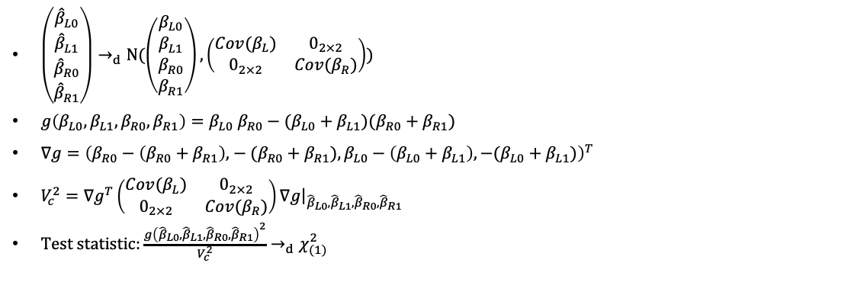

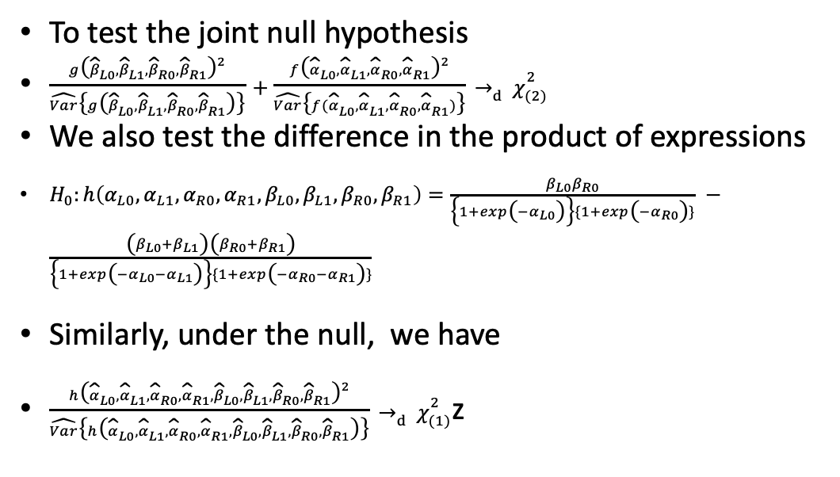
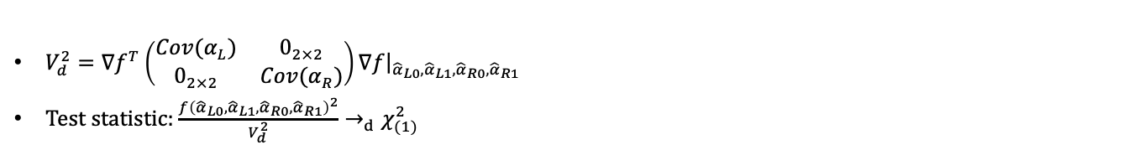
$\left(\begin{aligned}{\hat{β}}_{L0} \\ {\hat{β}}_{L1} \\ {\hat{β}}_{R0} \\ {\hat{β}}_{R1}\end{aligned}\right)→_{d}N(\left(\begin{aligned}β_{L0} \\ β_{L1} \\ β_{R0} \\ β_{R1}\end{aligned}\right),\left(\begin{matrix}Cov(β_{L}) & 0_{2×2} \\ 0_{2×2} & Cov(β_{R})\end{matrix}\right))$
$g\left(β_{L0},β_{L1},β_{R0},β_{R1}\right)=β_{L0} β_{R0}−(β_{L0}+β_{L1})(β_{R0}+β_{R1})$
$∇g={\left(β_{R0}−\left(β_{R0}+β_{R1}\right)\text{,}−(β_{R0}+β_{R1}),β_{L0}−\left(β_{L0}+β_{L1}\right),−(β_{L0}+β_{L1})\right)}^{T}$
$V_{c}^{2}=∇g^{T}\left(\begin{matrix}Cov(β_{L}) & 0_{2×2} \\ 0_{2×2} & Cov(β_{R})\end{matrix}\right)∇g{\left.​\right|}_{{\hat{β}}_{L0},{\hat{β}}_{L1},{\hat{β}}_{R0},{\hat{β}}_{R1}}$
Test statistic: $\frac{g{\left({\hat{β}}_{L0},{\hat{β}}_{L1},{\hat{β}}_{R0},{\hat{β}}_{R1}\right)}^{2}}{V_{c}^{2}}→_{d}χ_{(1)}^{2}$
To test the joint null hypothesis
$\frac{g{\left({\hat{β}}_{L0},{\hat{β}}_{L1},{\hat{β}}_{R0},{\hat{β}}_{R1}\right)}^{2}}{\hat{Var}\left\{g\left({\hat{β}}_{L0},{\hat{β}}_{L1},{\hat{β}}_{R0},{\hat{β}}_{R1}\right)\right\}}+\frac{f{\left({\hat{α}}_{L0},{\hat{α}}_{L1},{\hat{α}}_{R0},{\hat{α}}_{R1}\right)}^{2}}{\hat{Var}\left\{f({\hat{α}}_{L0},{\hat{α}}_{L1},{\hat{α}}_{R0},{\hat{α}}_{R1})\right\}}→_{d}χ_{(2)}^{2}$
We also test the difference in the product of expressions
$H_{0}:h\left(α_{L0},α_{L1},α_{R0},α_{R1},β_{L0},β_{L1},β_{R0},β_{R1}\right)=\frac{β_{L0}β_{R0}}{\left\{1+exp\left(−α_{L0}\right)\right\}\{1+exp\left(−α_{R0}\right)\}}‍−\frac{\left(β_{L0}+β_{L1}\right)\left(β_{R0}+β_{R1}\right)}{\left\{1+exp\left(−α_{L0}−α_{L1}\right)\right\}\{1+exp\left(−α_{R0}−α_{R1}\right)\}}$
Similarly, under the null, we have
$\frac{{h\left({\hat{α}}_{L0},{\hat{α}}_{L1},{\hat{α}}_{R0},{\hat{α}}_{R1},{\hat{β}}_{L0},{\hat{β}}_{L1},{\hat{β}}_{R0},{\hat{β}}_{R1}\right)}^{2}}{\hat{Var}\left\{h\left({\hat{α}}_{L0},{\hat{α}}_{L1},{\hat{α}}_{R0},{\hat{α}}_{R1},{\hat{β}}_{L0},{\hat{β}}_{L1},{\hat{β}}_{R0},{\hat{β}}_{R1}\right)\right\}}→_{d}χ_{(1)}^{2}$z
Similarly
$\left(\begin{aligned}{\hat{α}}_{L0} \\ {\hat{α}}_{L1} \\ {\hat{α}}_{R0} \\ {\hat{α}}_{R1}\end{aligned}\right)→_{d}N\left(\left(\begin{aligned}α_{L0} \\ α_{L1} \\ α_{R0} \\ α_{R1}\end{aligned}\right),\left(\begin{matrix}Cov\left(α_{L}\right) & 0_{2×2} \\ 0_{2×2} & Cov\left(α_{R}\right)\end{matrix}\right)\right)$
$f\left(α_{L0},α_{L1},α_{R0},α_{R1}\right)=\frac{1}{\left\{1+exp\left(−α_{L0}\right)\right\}\{1+exp\left(−α_{R0}\right)\}}−\frac{1}{\left\{1+exp\left(−α_{L0}−α_{L1}\right)\right\}\{1+exp\left(−α_{R0}−α_{R1}\right)\}}$
$∇f={\left(\frac{exp\left(α_{L0}\right)}{\left\{1+exp\left(−α_{R0}\right)\right\}{\left\{1+exp\left(α_{L0}\right)\right\}}^{2}}−\frac{exp\left(α_{L0}+α_{L1}\right)}{\left\{1+exp\left(−α_{R0}−α_{R1}\right)\right\}{\left\{1+exp\left(α_{L0}+α_{L1}\right)\right\}}^{2}}\text{,}−\frac{exp\left(α_{L0}+α_{L1}\right)}{\left\{1+exp\left(−α_{R0}−α_{R1}\right)\right\}{\left\{1+exp\left(α_{L0}+α_{L1}\right)\right\}}^{2}},\frac{exp\left(α_{R0}\right)}{\left\{1+exp\left(−α_{L0}\right)\right\}{\left\{1+exp\left(α_{R0}\right)\right\}}^{2}}−\frac{exp\left(α_{R0}+α_{R1}\right)}{\left\{1+exp\left(−α_{L0}−α_{L1}\right)\right\}{\left\{1+exp\left(α_{R0}+α_{R1}\right)\right\}}^{2}},−\frac{exp\left(α_{R0}+α_{R1}\right)}{\left\{1+exp\left(−α_{L0}−α_{L1}\right)\right\}{\left\{1+exp\left(α_{R0}+α_{R1}\right)\right\}}^{2}}\right)}^{T}$
Multi-group
Under the null, we have
$$\frac{1}{p}{\hat{G}}^{T}{\left(\hat{Σ}\left(\hat{G}\right)\right)}^{−1}\hat{G}→_{d}χ_{\left(p\right)}^{2}$$
$$\frac{1}{p}{\hat{F}}^{T}{\left(\hat{Σ}\left(\hat{F}\right)\right)}^{−1}\hat{F}→_{d}χ_{(p)}^{2}$$
$$\frac{1}{p}{\hat{H}}^{T}{\left(\hat{Σ}\left(\hat{H}\right)\right)}^{−1}\hat{H}→_{d}χ_{(p)}^{2}$$
$V_{d}^{2}=∇f^{T}\left(\begin{matrix}Cov(α_{L}) & 0_{2×2} \\ 0_{2×2} & Cov(α_{R})\end{matrix}\right)∇f{\left.​\right|}_{{\hat{α}}_{L0},{\hat{α}}_{L1},{\hat{α}}_{R0},{\hat{α}}_{R1}}$
Test statistic: $\frac{f{\left({\hat{α}}_{L0},{\hat{α}}_{L1},{\hat{α}}_{R0},{\hat{α}}_{R1}\right)}^{2}}{V_{d}^{2}}→_{d}χ_{(1)}^{2}$

Slide 18
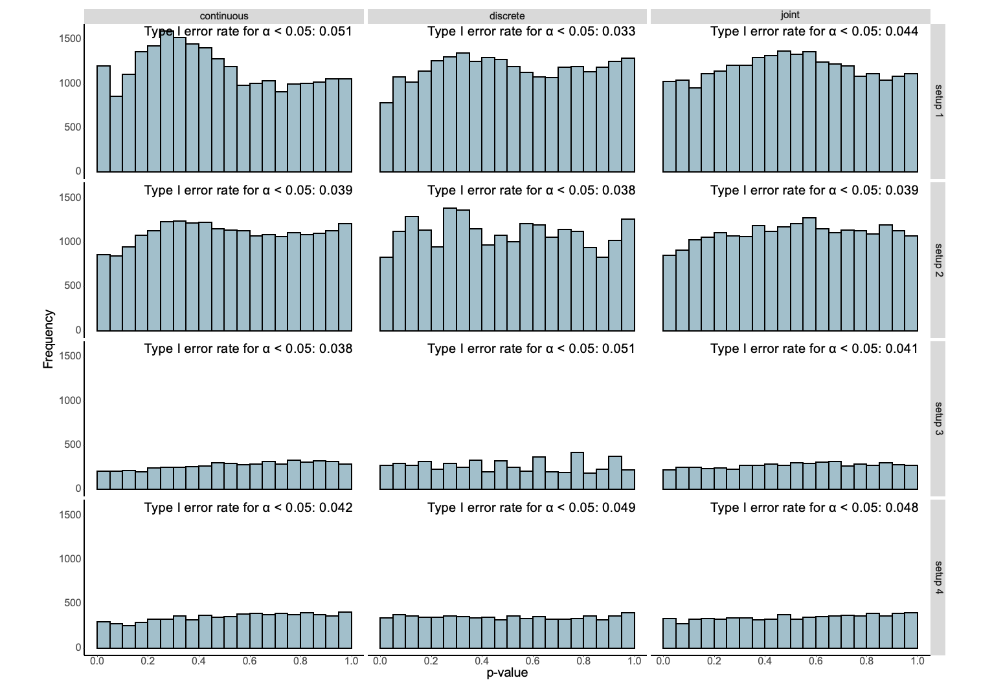
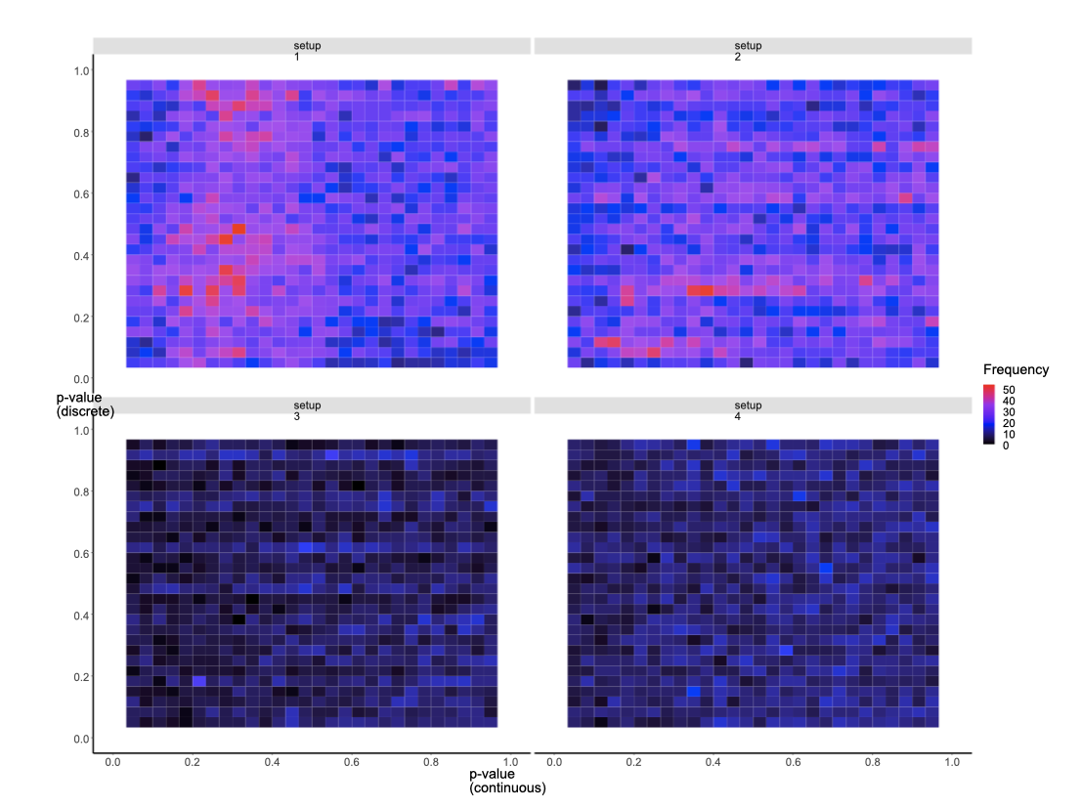
Type I Error is well-controlled (cell permutation based).
S1
S2
S3
S4
P values in continuous component (x-axis)
and discrete component (y-axis), under the Null.
Scenarios | Filter of LRs joint p-val | Min.prop | Number of re-sampling | Sample size | Test
1 | 0.20 | 0.01 | 300 | original | together
2 | 0.20 | 0.01 | 300 | equal split | separately
3 | 0.10 | 0.10 | 300 | equal split | separately
4 | 0.10 | 0.05 | 300 | equal split | together

Slide 19
P values in continuous component (x-axis) and discrete component (y-axis)
in real data
ILC-pDC
pDC-ILC
1.0
0.8
0.6
filter 0
0.4
0.2
0.0
p-value (discrete)
1.0
0.8
0.6
filter 0.01
0.4
0.2
0.0
0.0
0.2
0.4
0.6
0.8
1.0
0.0
0.2
0.4
0.6
0.8
1.0
p-value (continuous)

Slide 20

Numbers of significant L-R pairs
L-R in the database: 1894
Exists in at least one sample:
ILC-pDC: 283
pDC-ILC: 262
Total: 545
filtering threshold 0
“> the threshold in at least one sample”
545
P-val (joint) < 0.05: 86
P-val (continuous) < 0.05: 76
P-val (discrete) < 0.05: 40
filtering threshold 0.01
“> the threshold in at least one sample”
233
P-val (joint) < 0.05: 83
P-val (continuous) < 0.05: 69
P-val (discrete) < 0.05: 40
FDR(joint) < 0.01: 26
FDR(continuous) < 0.01: 14
FDR(discrete) < 0.01: 6
FDR(joint) < 0.01: 15
FDR(continuous) < 0.01: 10
FDR(discrete) < 0.01: 4
Notes:
I take a union instead of intersection when counting the LRs in pDC-ILC and ILC-pDC

Slide 21
Examples of significant L-R interactions
p-value = 0.016 (joint)
p-value = 3e-9 (joint)
p-value = 0.039 effect = 0.68 (continuous)
p-value = 8e-8 effect = -1.16 (continuous)
p-value = 0.044 effect = 0.004 (discrete)
p-value = 0.001 effect = 0.026 (discrete)
ligand:TNFSF10 | pDC
receptor:TNFRSF10A | ILC
ligand:ICAM2 | pDC
receptor:ITGB2 | ILC
HIV
Mock
HIV
Mock
4
3
3
Normalized Expression
Normalized Expression
2
2
1
1
5
6
Sample
7
8
5
6
7
8
Sample
expressed
not expressed
expressed
not expressed
Notes:
Right example goes to different directions…. Our two component method is better

Slide 22
Comparisons between DE-CCC
and CellPhoneDB

Slide 23
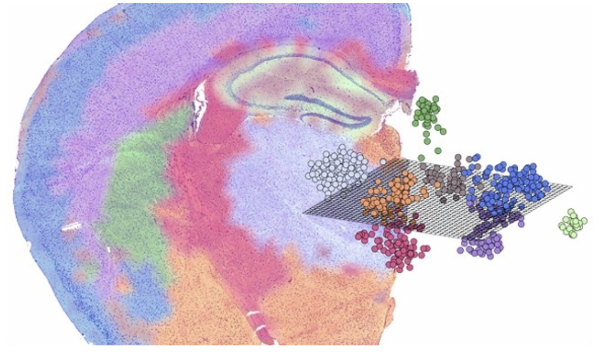

Future directions, CCC in spatial transcriptomics
https://www.science.org/content/webinar/mining-transcriptome-using-spatial-transcriptomics-comprehensive-2d-3d-visualization-all-mrnas-tissue-sections

Slide 24


Acknowledgement
UNC Chapel Hill, Biostat
Chenghao Wang, PhD student
Qisheng Gu, exchange student
Duan Wang, intern student
UNC Chapel Hill, Genetics
Dr. Yuchen Yang, Assistant Professor
UNC Chapel Hill, SOM
Prof Lishan Su
Dr. Liang Chen
University of Queensland, Faculty of Medicine
Dr. Yang Yang
Dr. Di Yu
UNC Chapel Hill, ASoD
Mike Miao
Chenghao Wang
Yuchen Yang
Lishan Su
(dwu@unc.edu)

Slide 25
DP-CCC
p-value = 0.002 (joint)
p-value = 0.018 (joint)
p-value = 5e-4 effect = -0.81 (continuous)
p-value = 0.10 effect = -0.51 (continuous)
p-value = 0.89 effect = -0.005 (discrete)
p-value = 0.021 effect = 0.014 (discrete)
ligand:CD74 | pDC
receptor:MIF | ILC
ligand:HLA-F | ILC
receptor:LILRB1 | pDC
HIV
Mock
HIV
Mock
3.5
5
3.0
4
2.5
Normalized Expression
Normalized Expression
3
2.0
2
1.5
1
1.0
5
6
7
8
5
6
Sample
7
8
Sample
expressed
not expressed
expressed
not expressed
Notes:
Shift in receptor expressions

