Slide 1
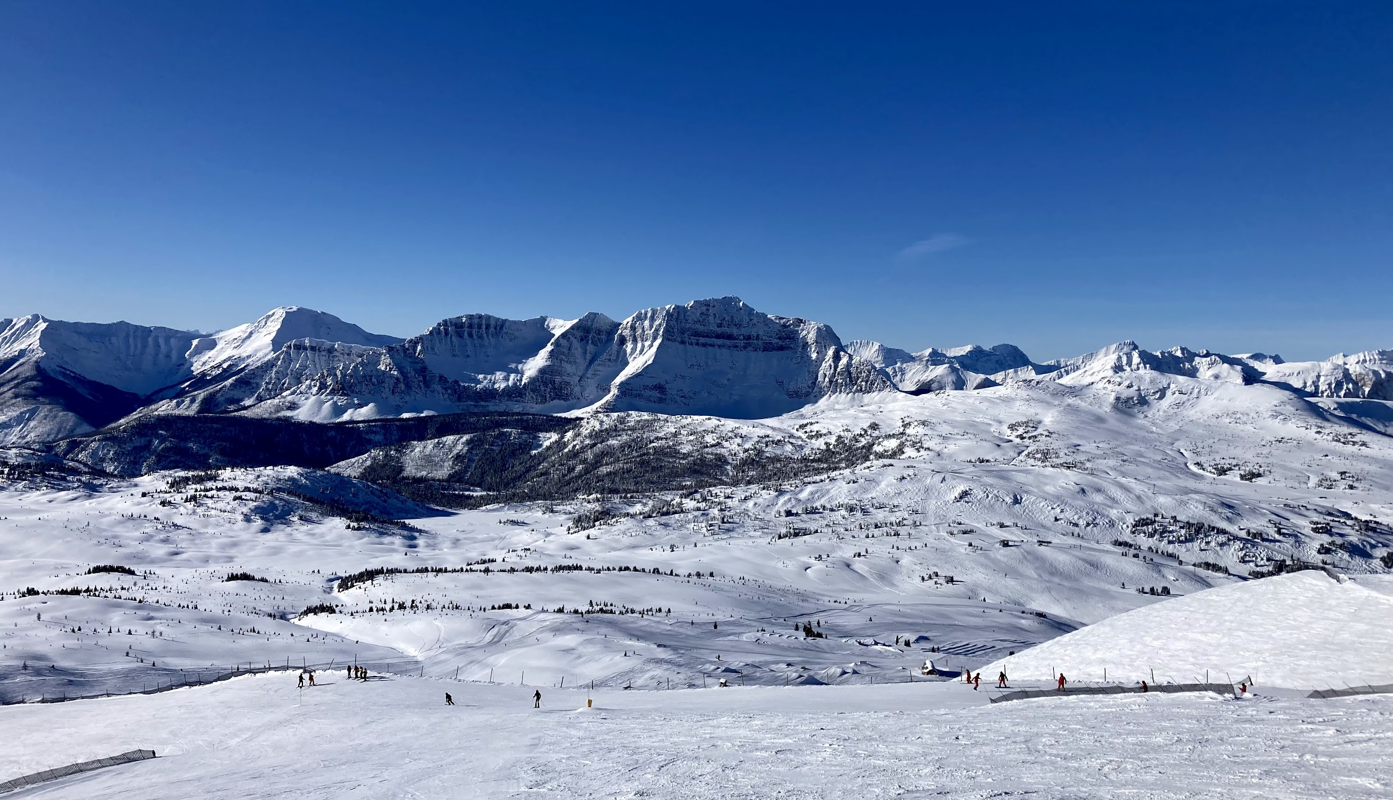
Applications of Hodge Theory on Networks
(BIRS, January 2023)
Details:
Schedule: (available on the workshop website)
MTW: talk and discussion days
Thursday: workshop talks and group activities
Hybrid format:
Shared slack workspace for all members
Zoom links for remote talks
Talks are recorded, and slides can be uploaded
On Site:
Group photo today at 2:00 pm in the TCPL
Short walk to town, shuttles to sight-seeing (ROAM bus)
Enjoy Banff!

