Slide 1
How to stimulate interest in rich mathematics in elementary teachers and their students: some of New Brunswick (French) and international experiences
Viktor Freiman, Université de Moncton
Viktor.freiman@umoncton.ca
BIRS Workshop 23w5150 23-28 July, 2023
Putting Together Resources to Support Current and Future Elementary School Teachers

Slide 2
Overching goal for creating, sharing, implementing, and researching resources
Goal: designing and studying mathematically rich activities for all students to actualize everyone's creative potential.
Main approach: challenging mathematics for all (Freiman, 2006; Barbeau and Taylor, 2009)
French language minority context (New Brunswick): lack of resources for teaching mathematics in French language (Entremont, 2003)

Slide 3
New K-12 math curriculum since 2000
Common framework: actualizing everyone’s learning potential
Mathematical focus (principes didactiques) : gérer et résoudre une situation-problème, raisonner mathématiquement, communiquer mathématiquement, établir des liens
Inter- and transdisciplinary teaching approaches
Use of technology (Internet in all schools since early 2000s; some pilot initiatives, like 1 to 1 laptops for Grade 7 and 8 students (Blain et al, 2007).
Chantier d’apprentissages mathématiques interactifs (CAMI) – renforcer la résolution de problèmes, raisonnement et communication mathématique; collaboration entre les écoles et l’université; expérience pratique pour les futurs enseignants (depuis 2000; Freiman et al, 2005)

Slide 4
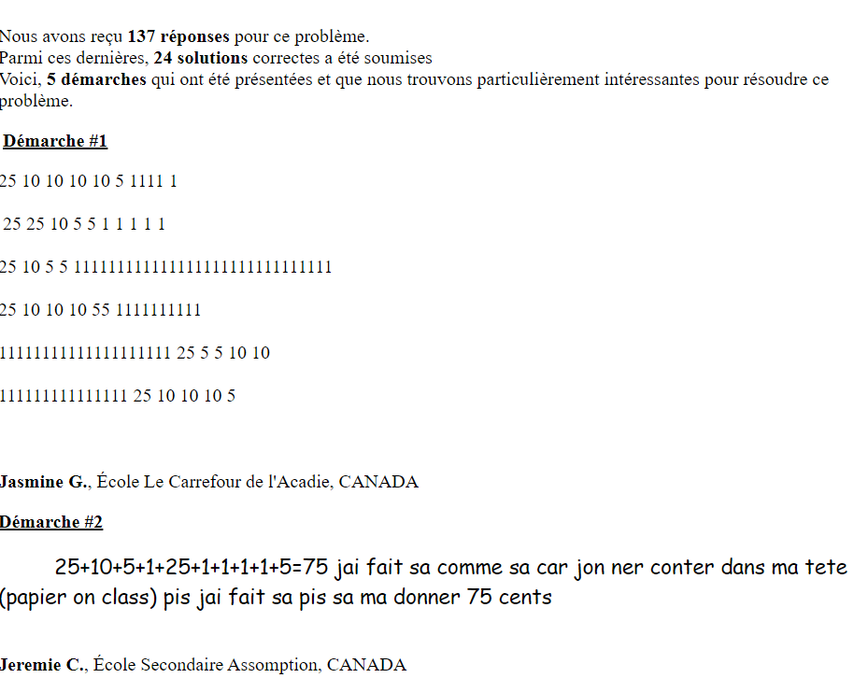
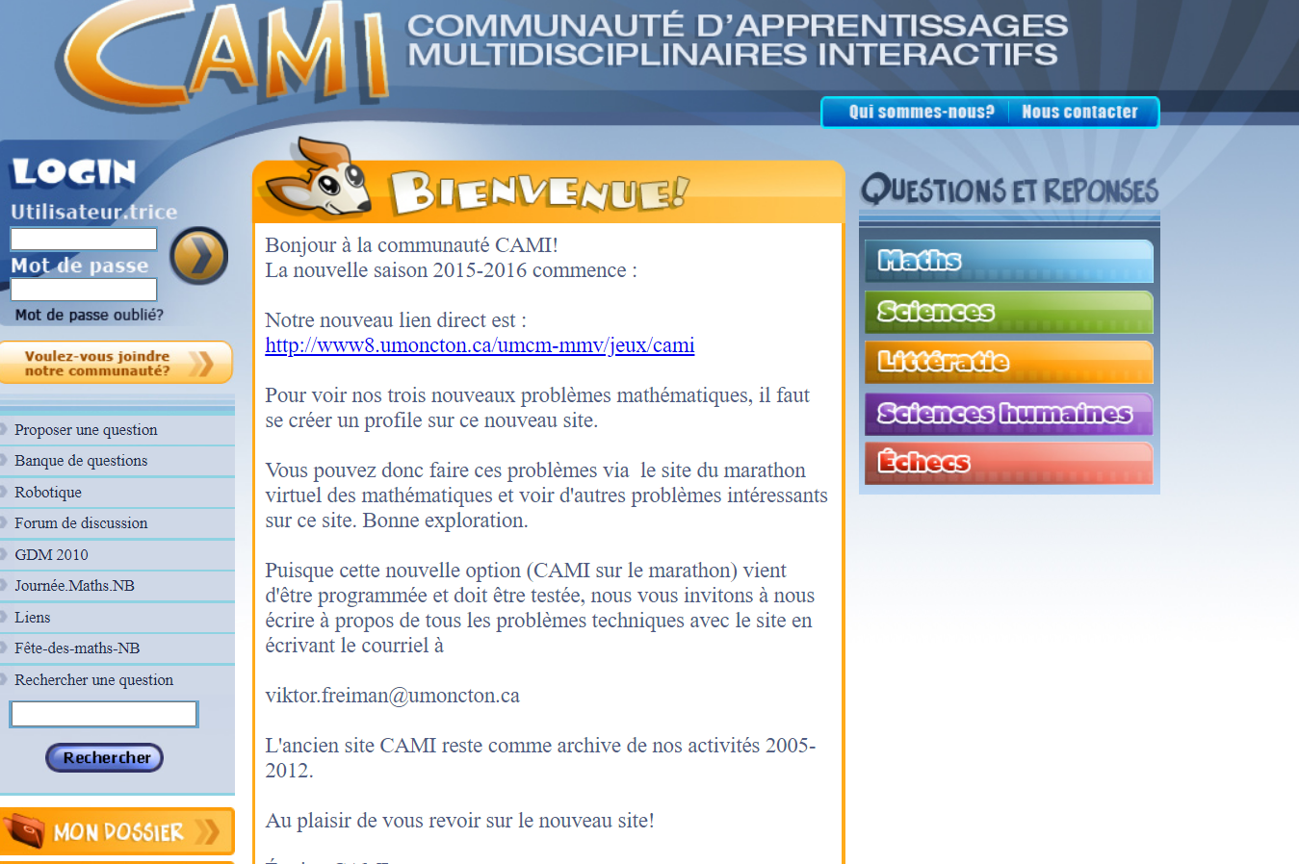
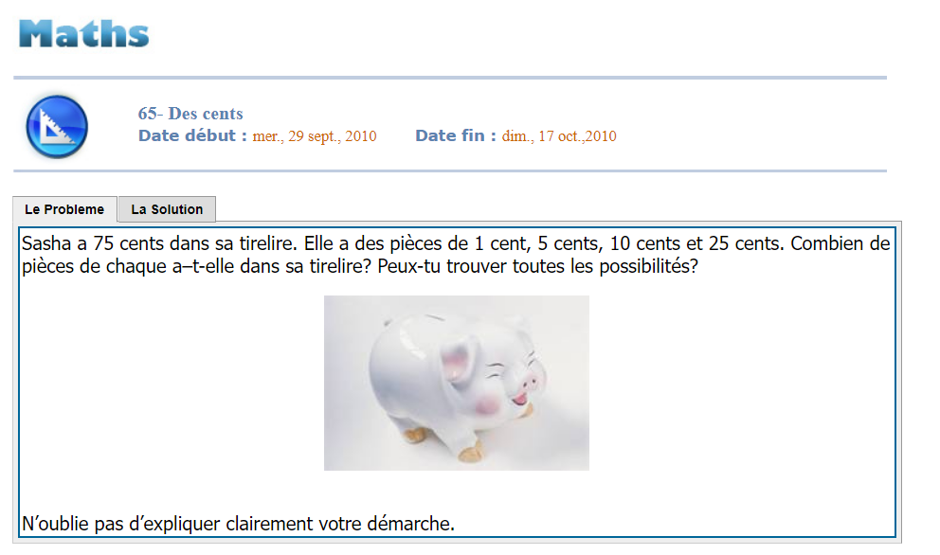
CAMI website: 15 years of evolution
CAMI Workshop (since 2000): Problem of the week model; 4 problems posted weekly, schoolchildren submit the solutions; pre-service teachers analyze them and provide a feed-back
Virtual community CASMI (since 2005): Student’s profile (portfolio); discussion forum; science, chess, and robotics sections (Freiman and Lirette-Pitre, 2009)
From CASMI to CAMI (community; multidisciplinary) adding language and human sciences sections (since 2010); first rounds of virtual mathematics marathon (Freiman and Manuel, 2010; Freiman and Applebaum, 2010); mathematical enrichment and creativity (Freiman, 2009; Manuel, 2018).

Slide 5
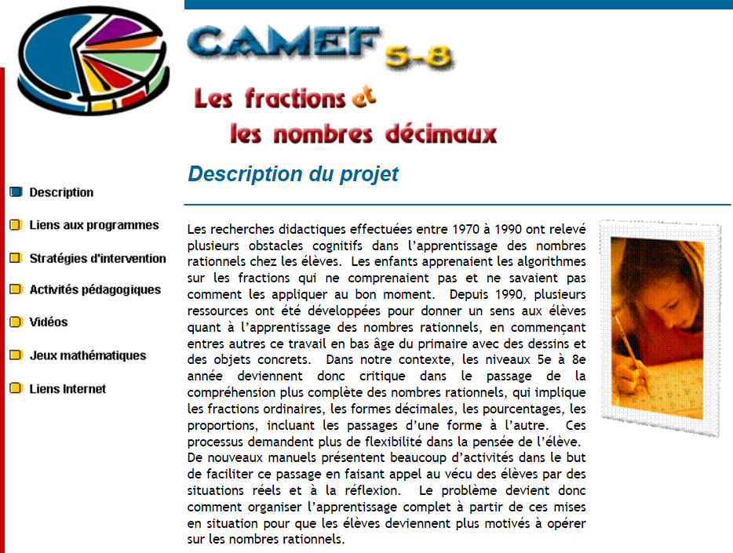
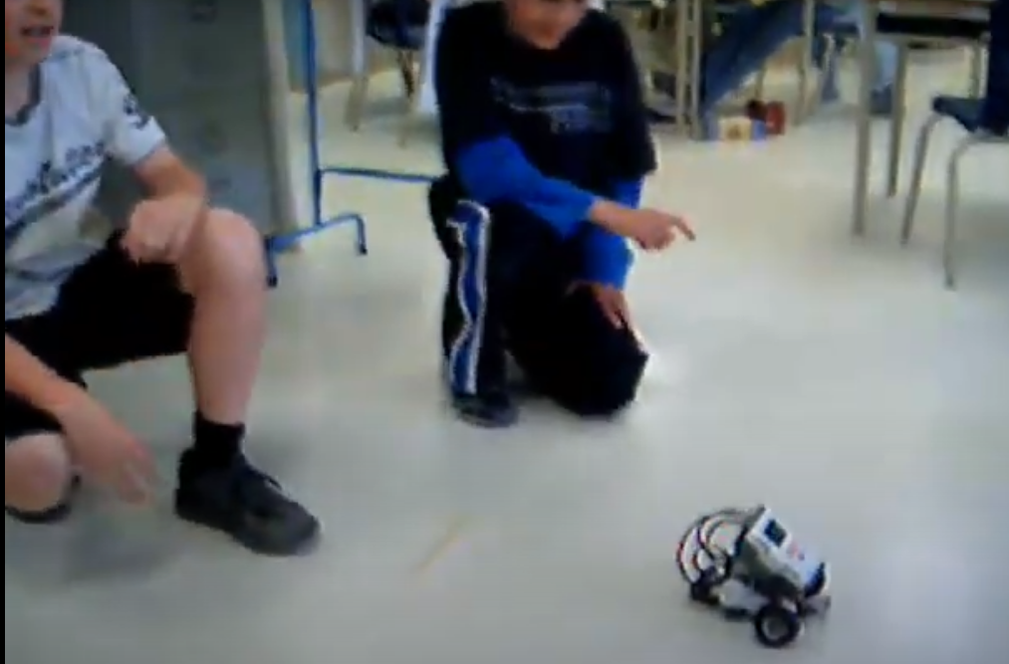
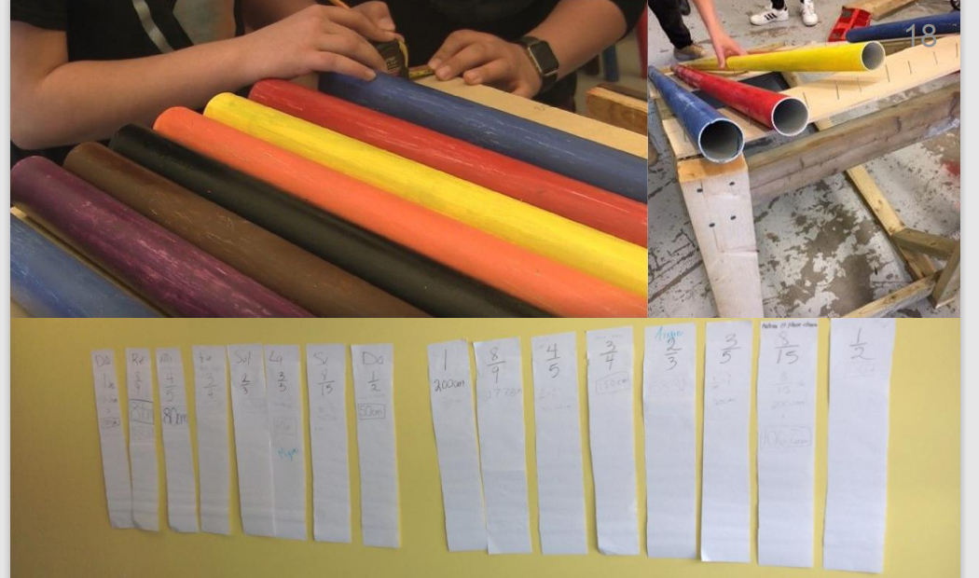
Collaboration with teachers
2004-2006; 1 to 1 laptop initiative: 4 interdisciplinary problem-based scenarios created by UdMoncton research team in collaboration with Grade 7-8 teachers (French, science, math, technology) (Freiman, 2011)
2007-2008; Science and math integration – project-based scenario about fluocompact bulbs (students report about their findings by using school blog, YouTube, and local media (Freiman and Michaud, 2009)
2005-2006; CAMEF scienarios in mathematics (ministry of education and 4 teachers; Grades K-4 – arithmetic and patterns; 5-8 – fractions and decimals).
2008-2009; Robotics-Based learning – RoboMaTIC project (direct funding provided to teachers who want to innovate – learning schenaios (robotics challenges) created and implemented by Grade 5-6 teachers (Blanchard et al, 2010; Savard and Freiman, 2016).
2008-2009; Students supported by teachers and CAMI team created and shared problems for the CAMI website (Freiman and LeBlanc, 2012)
2018-2020; Math-music-technolgy – interdisciplinary projects in three schools (Grades 4 – 8); in-situ creativity (Robichaud and Freiman, 2022). educreative.ca/ws/media-library/248862f3516e4c14b5475277aa2d2421/activites-mathematico-musicales.pdf

Slide 6
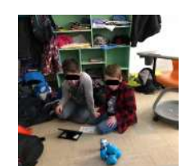
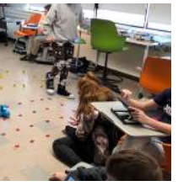
SSHRC-Funded CompeTI.CA partnership network (since 2014)
Several case studies of digital competencies development over the life span (Godin et al, 2020).
Computational thinking (Djambong et al, 2018)
Use of virtual simulators in science (close connection to mathematics) (Djambong, 2018; Djambong, 2023 to come).
New learning spaces & robotics challenges created by the students (Chiasson, 2019; Chiasson and Freiman, 2022)
Makerspaces (collaboration with Brilliant Labs) (Freiman, 2020; LeBlanc et al, 2022; Furlong et al, 2018; Furlong and Léger, 2022): creativity & other 21st century skills; STEM (focus on mathematics) & tinkering as approach to solving problems

Slide 7
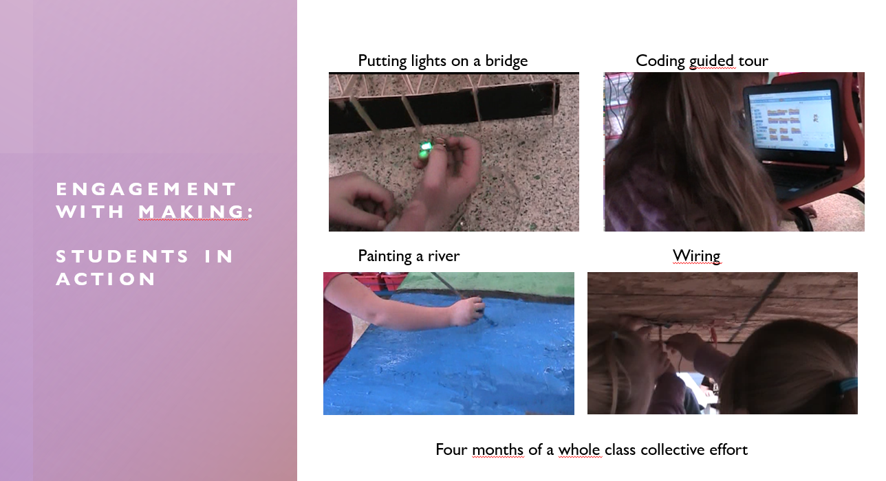
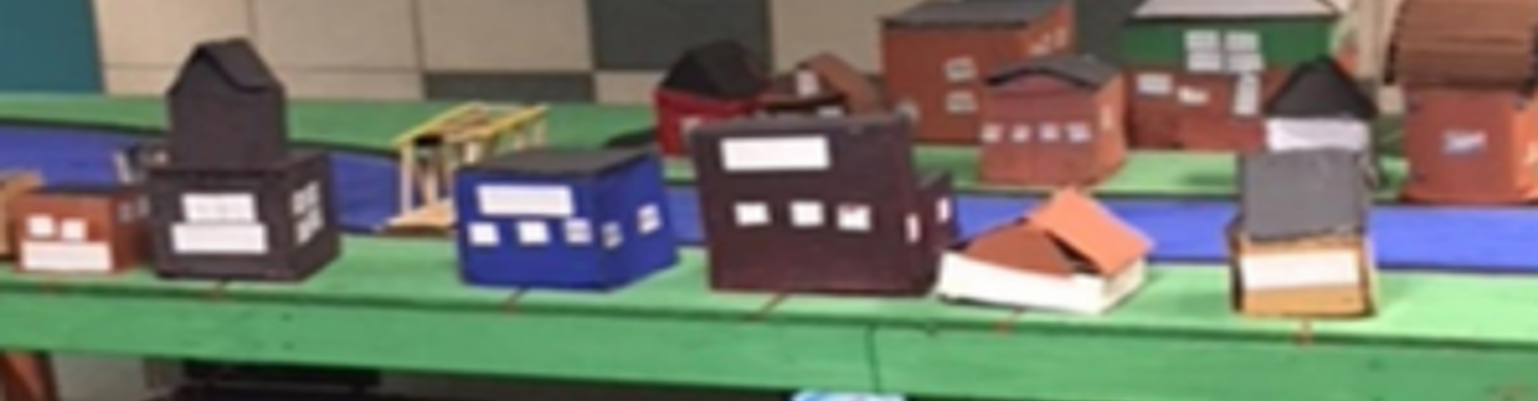
A class of young Grade 3 makers build a village

Slide 8
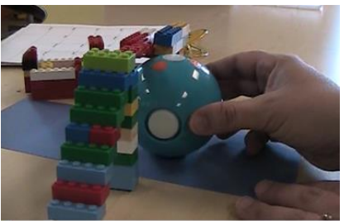
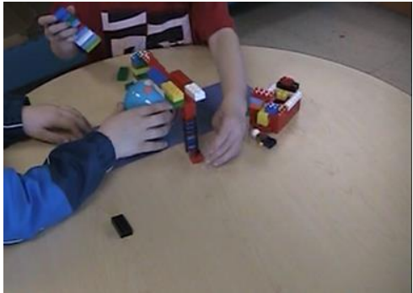
Kindergarten students readjust their bridge to make a bigger boat pass underneath

Slide 9
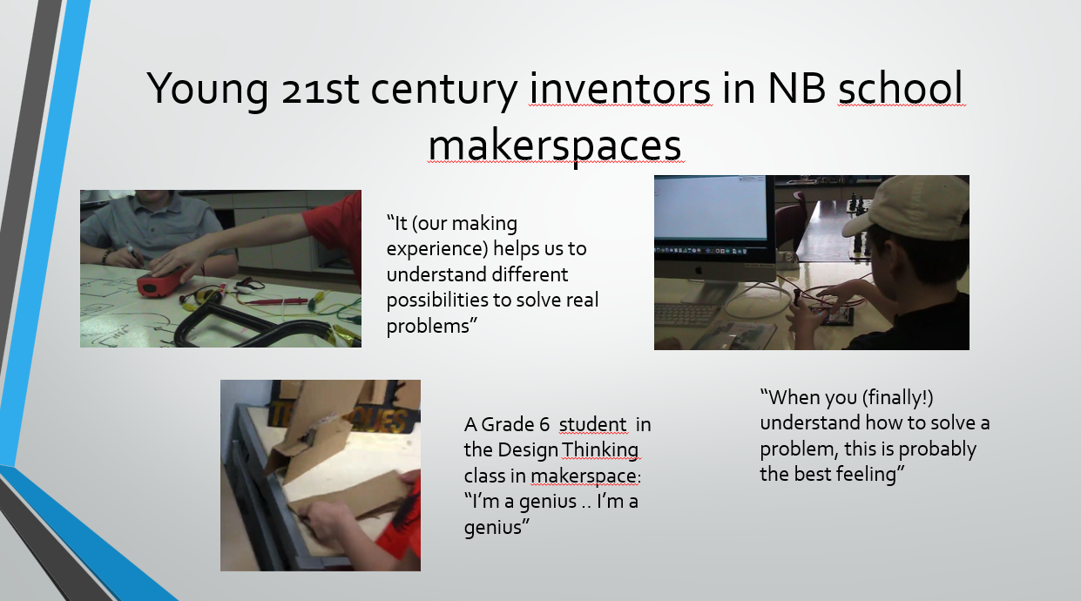
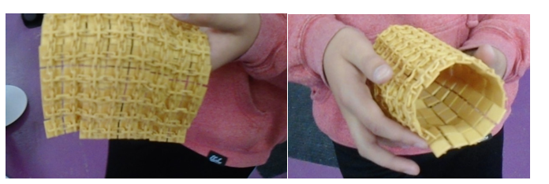
What students say?
“So, it’s 300 chainmail I guess you could say, I designed it so it all prints in one piece” (Grade 8 student)

Slide 10
New/ongoing collaborations
Intr’Appreneurship Project (District scolaire francophone Sud; SSHRC partnership engagement Grant – 2022) (Flexible learning spaces; interdisciplinary teaching; students’ autonomy and initiative; collaboration; Industry4.0 mindset; school transformation into community-innovation centers). (Freiman et al, 2022; Chiasson and Freiman, 2022)
Data science in high school mathematics (collaboration with teachers to create and implement teaching-learning scienarios; supported by CALLISTO and AI (Yaro et al., since 2023).

Slide 11
References
Freiman, V., Vézina, N., & Gandaho, I. (2005). New Brunswick pre-service teachers communicate with schoolchildren about mathematical problems: CAMI project. ZDM, 37, 178-189.
Freiman, V., & Manuel, D. (2015). Relating Students' Perceptions of Interest and Difficulty to the Richness of Mathematical Problems Posted on the CAMI Website. Quadrante, 24(2), 61-84.
Freiman, V., & Applebaum, M. (2011). Online mathematical competition: Using virtual marathon to challenge promising students and to develop their persistence. Canadian Journal of Science, Mathematics and Technology Education, 11(1), 55-66.
Freiman, V., & Applebaum, M. (2014). Engaging elementary students in mathematical reasoning using investigations: example of a bachet game engaging elementary students in mathematical reasoning using investigations: example of a Bachet game. In R. Leikin (Ed.) Proceedings of at the 8th International Conference on Mathematical Creativity and Giftedness, Denver, CO, July, 27–31, 2014.
Freiman, V. (2006). Problems to discover and to boost mathematical talent in early grades: A challenging situations approach. The Mathematics Enthusiast, 3(1), 51-75.
Blanchard, S., Freiman, V., & Lirrete-Pitre, N. (2010). Strategies used by elementary schoolchildren solving robotics-based complex tasks: Innovative potential of technology. Procedia-Social and Behavioral Sciences, 2(2), 2851-2857.
Robichaud, X., Freiman, V., & Lagacé, A. Activer les forces créatives de manière interdisciplinaire (mathématique, musique, technologie). https://educreative.ca/ws/media-library/248862f3516e4c14b5475277aa2d2421/activites-mathematico-musicales.pdf

